Slide 1
Comparison of the effects of e-cigarette vapor and cigarette smoke on indoor air quality
-Dante Staten

Slide 2
Outline
Introduction and my personal background/field of research.
High-Performance Liquid Chromatography (HPLC) utility and background.
Gas-Chromatography Mass Spectronomy (GCMS) utility and background.
Pros and cons of the application of analytical devices.
T. R. McAuley article.
Implications of the article.
Questions.

Slide 3


My background

Slide 4
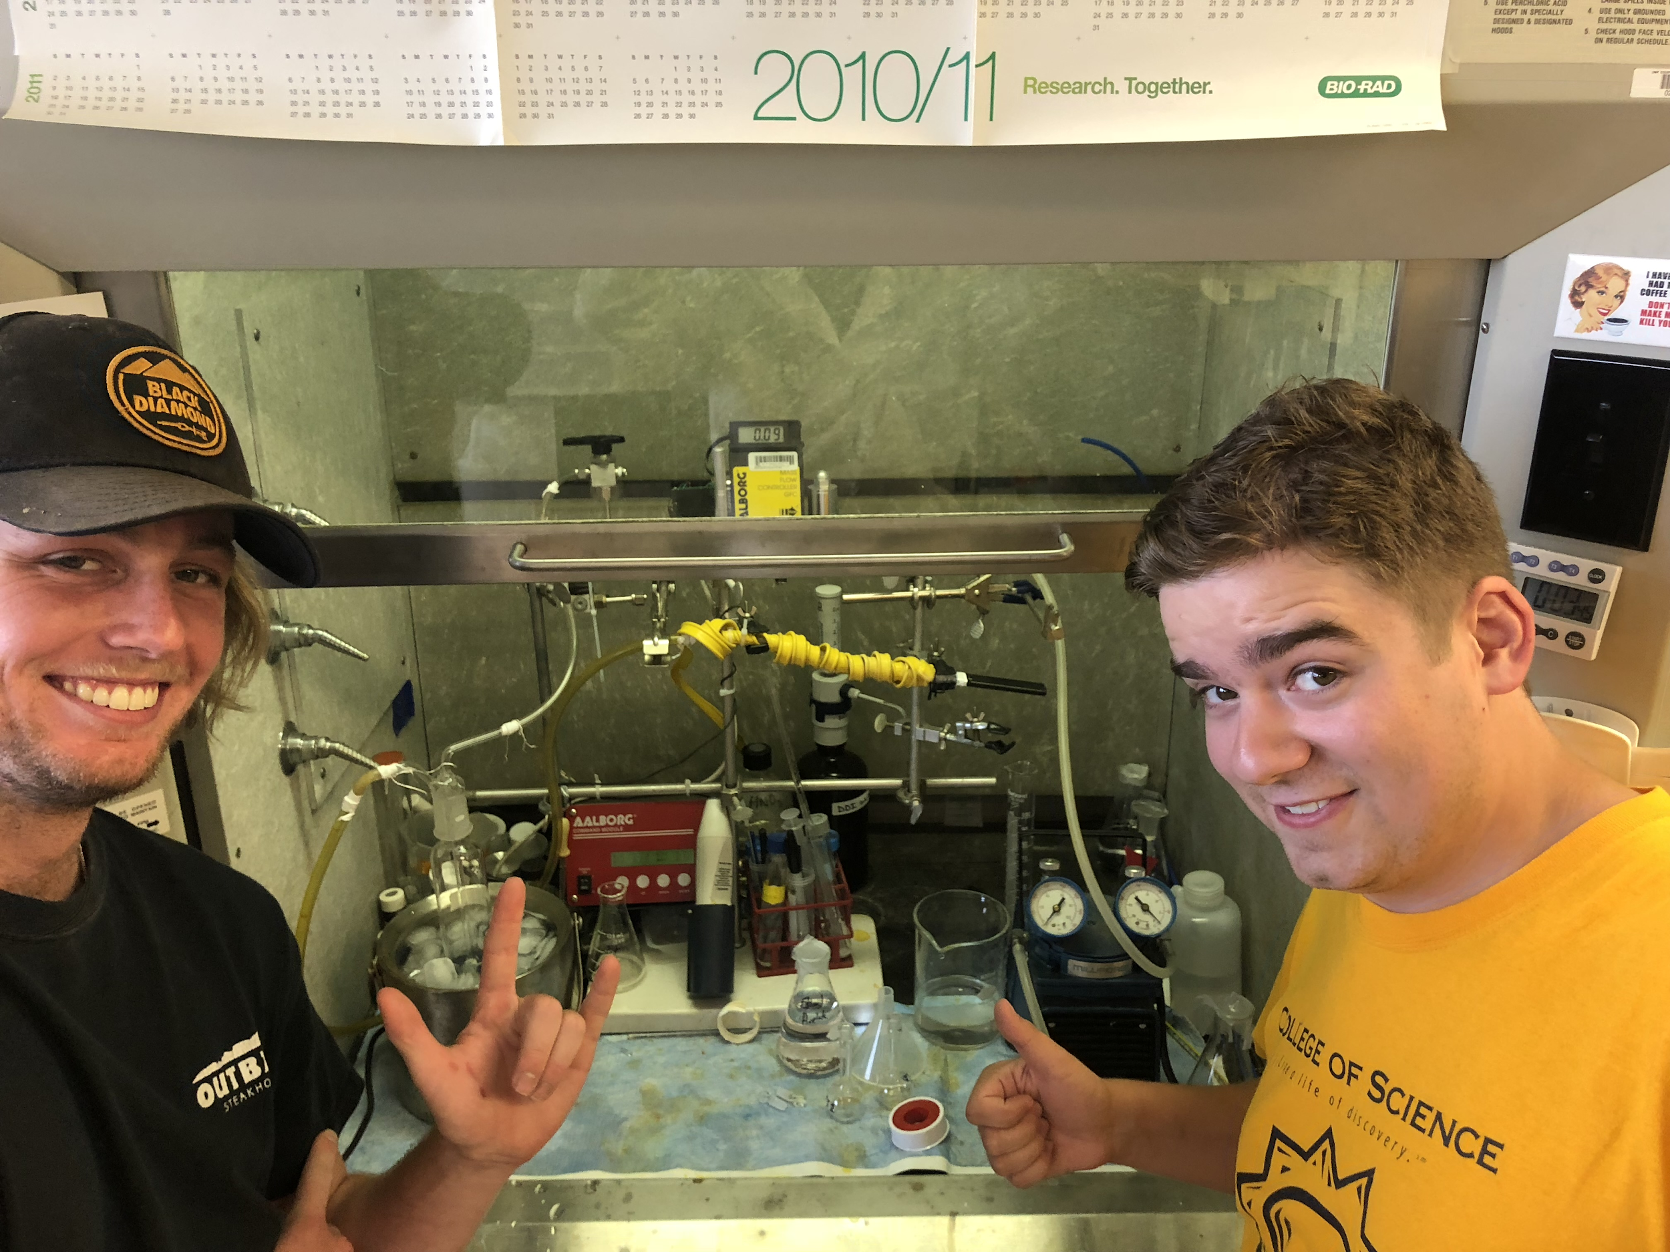
Current Research: Angermann Laboratory
Chemical Contents of electronic-cigarettes post and pre-vaporization.
Liquid extraction of chemicals commonly found within smokeless tobacco product i.e. Snus, snuff, chewing tobacco, and nicotine-salt derived products.
GCMS and HPLC training and use.
Goals: Determine chemical contents of nicotine containing products and their public health implications.

Slide 5
The Utility of GC and HPLC
Some of the golden standards for compound separation, identification, and quantification in many fields of science.
Extremely sensitive instruments enabling users to identify unknowns towards the nanograms.

Slide 6
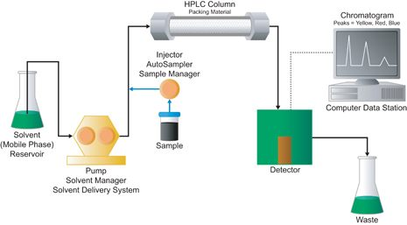
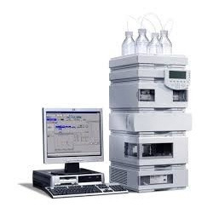
High-Performance Liquid Chromatography

Slide 7
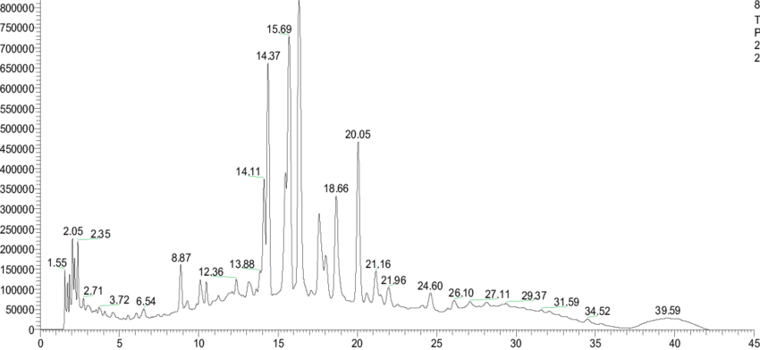

Slide 8
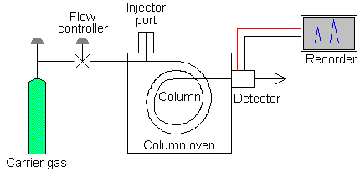
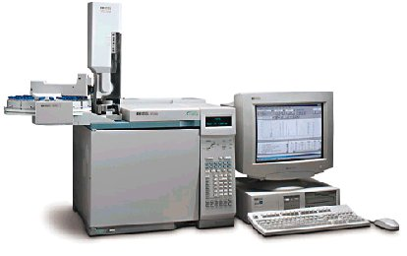
Gas Chromatograph

Slide 9
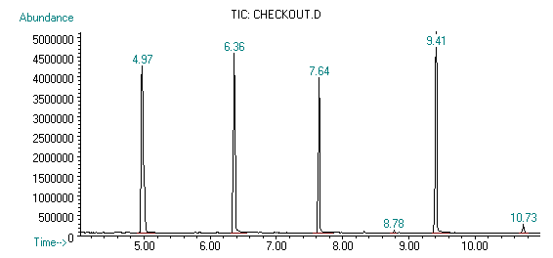

Slide 10
HPLC Pros and Cons
Pros
Separates compounds.
You can analyze non-volatile and volatile-compounds.
Compounds may have low or high molecular weights.
Cons
Compounds must be soluble within the liquid phase.
From my experience people have a lot more trouble learning HPLC over GC, especially in regards to troubleshooting.
Typically there are not libraries within the HPLC system.
Co-Elution. Method development.

Slide 11
GCMS Pros and Cons
Cons
Limited to volatile compounds that are stable at high temperatures. Proteins or many other biological compounds may be impossible to examine. (May derivatize).
Usually these volatile compounds will have low molecular weight.
Compounds with similar molecular weights may have similar retention times. Method development.
Pros
Separates compounds
Identifies compounds based on extracted ions.
Responds better to compounds that can change from matter to the gas phase (volatile).

Slide 12
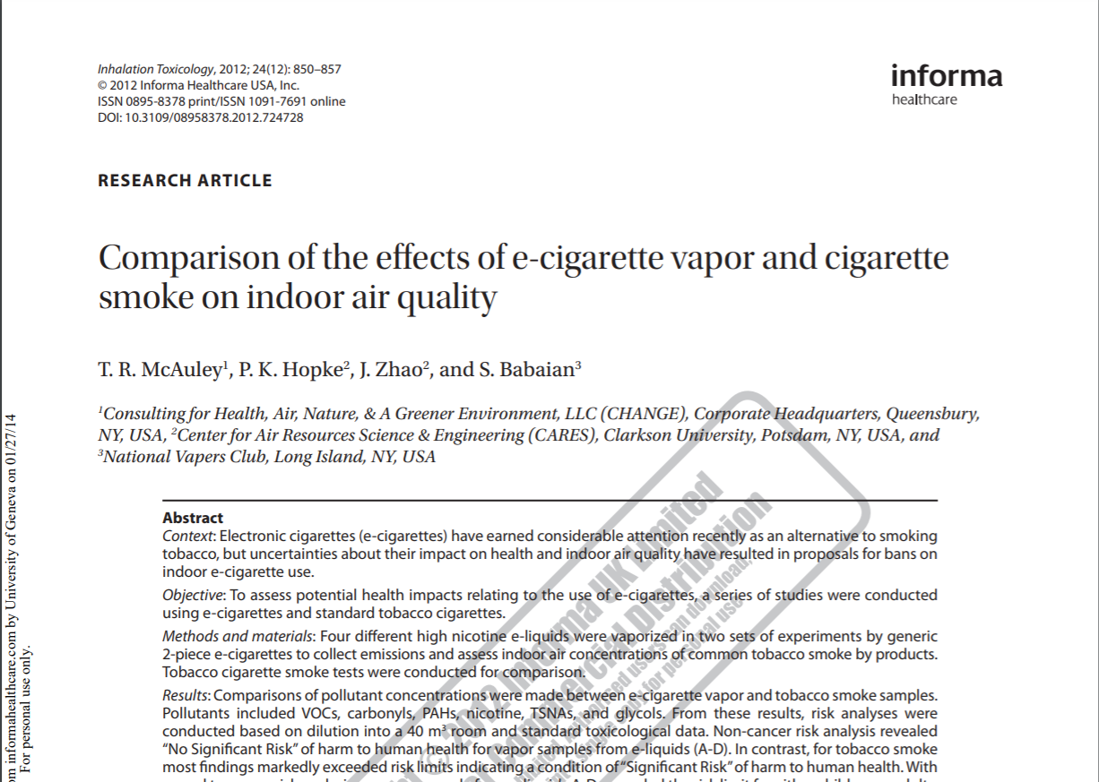

Slide 13
Introduction
A substantial amount of people have converted from tobacco products to electronic cigarette products. However, at the point of this articles publication there was no research done to analyze the effects of vapor on indoor air quality.

Slide 14
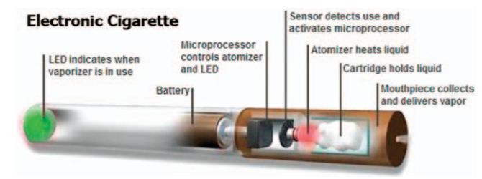

Slide 15
Nicotine
The leading cause of death from cancer in 1999 among both men and women in the United States was lung cancer, there was an estimated death toll of about 158,000 people per year. There are estimates that claim around 90% of male deaths and 80% of female deaths from lung cancer directly result from the use of smoking tobacco.
Alkaloid analysis performed using GC.
Filter: Na2SO4.

Slide 16
Polycyclic Aromatic Hydrocarbons (PAH’s)
Generated from the incomplete combustion of organic materials.
Mutagenic and carcinogenic.
Extraction included: Naphthalene, acenaphthylene, acenaphthene, fluorine, anthracene, henanthrene, fluoranthene, pyrene, benz(a)anthracene, chrysene, retene, benzo(b)fluoranthene benzo(k)fluoranthene, benzo(a)pyrene, indeno(1,2,3-cd)pyrene, dibenz(a, h) anthracene, and benzo(ghi)perylene.
Analysis performed using GC.

Slide 17
Volatile Organic Compounds (VOC’s)
VOC’s analysis performed using GC.
Filter type: Multi Sorbent Tubes.
Typically found in tobacco and fuel products.
Respiratory and immune effects.

Slide 18
Carbonyls
Carbonyls analysis performed using HPLC.
Typically found in fuel (forming carbon dioxide) and tobacco products.
Toxic, many may be carcinogenic.
Filter Type: Quartz Filter.

Slide 19
Tobacco Specific Nitrosamines (TSNA’s)
Formed within tobacco.
Carcinogenic.
Quantified: N′-nitrosoanabasine, N′-nitrosoanatabine, 4-(methylnitrosamino)-1-(3-pyridyl)-1-butanone, and N′-nitrosonornicotine.
Analysis performed using GC.
Filter type: Teflon

Slide 20
Propylene and Diethylene Glycols (PG)
Acutely toxic when inhaled, safe as a food additive.
Common additives in electronic cigarettes and foods.
Filter type: XAD
Analysis performed using GC.

Slide 21
Experimental Design Part 1
Two sets of measurements were made (Phase I) and (Phase II).
Four different E-liquid bottles were used labeled A, B, C, and D.
Each E-liquid was tobacco flavored and of high nicotine concentrations.
Each E-liquid filled three separate cartomizers (1.8ml each) for a total of twelve cartomizers for use.
E-Cig batteries were fully charged and filled.
E-Cigs flavors and cigarettes were ran in triplicate between two phases (excluding one for phase II).
Blanks were used to test off-gassing of polyethylene bag (not evident).

Slide 22
Experimental Design Part 2
A developed smoking device was attached to polyethylene glove bags.
110 liters of commercial air was used as dilution air.
E-cigarettes and electronic cigarettes were attached to the smoking machine to simulate smoking.
Filters and sampling bags were replaced between use.
Smoking machine cleaned with ethanol between use.
Smoking topographies were collected from the federal trade commision (FTC) and electronic-cigarette survey’s.

Slide 23
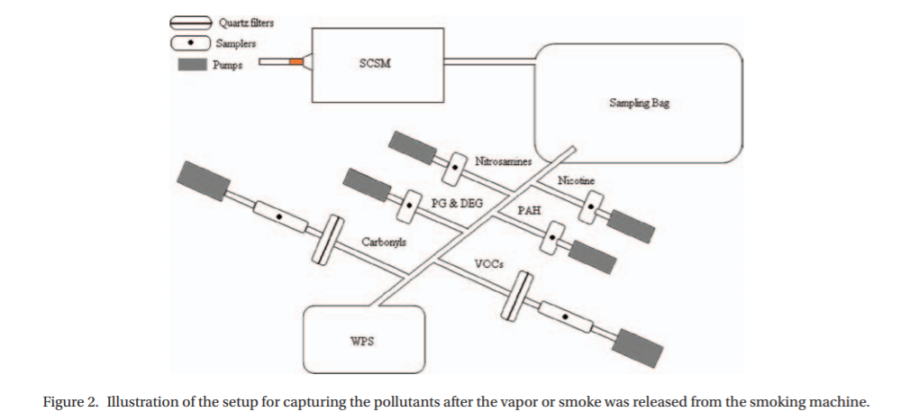
Smoke-Capturing System
Notes:
SCSM - Single Cigarette Smoking Machine
WPS - Wide range particle spectrometer used to measure particle number size distributions.
Filters - contained impreganated DNPH

Slide 24
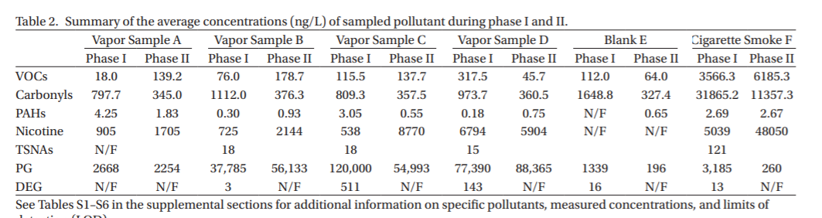
Results

Slide 25
Table 2
VOC’s were below the limit of detection excluding: Ethylbenzene, benzene, toluene, and m/p xylenes (BTEX) which were much higher in tobacco smoke than E-cigs.
Carbonyls concentrations were low in E-cigs with exceptions: acetone, formaldehyde, and acetaldehyde. Much higher in tobacco smoke than cigarettes.
PAHs were below the limit of detection for E-cigs but not in tobacco smoke.
Benzo(a)pyrene was found in the same levels of all samples which was an anomaly.
TSNA’s were lower in E-cigs than tobacco smoke.

Slide 26
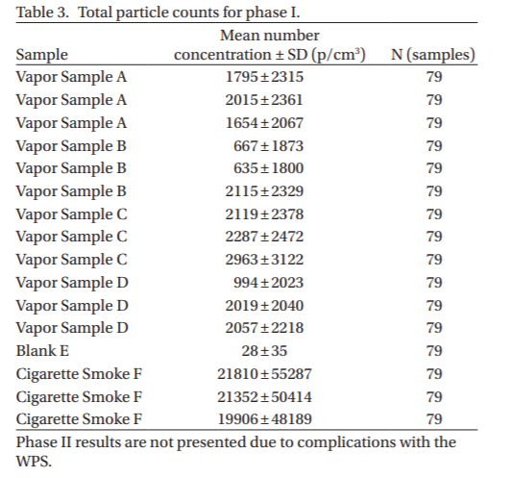

Slide 27
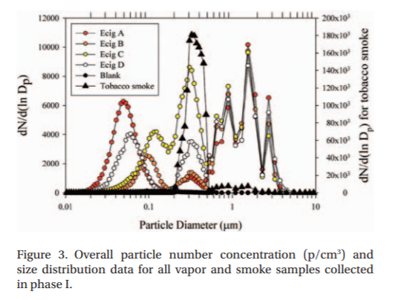
Notes:
-Table three was only done in one phase because of experimental issues with the WPS.
-Electronic cigarette smoke generally does not provide enough matter to affect the indoor environment.
-The lowest measurement for smoking tobacco was an order of magnitude higher than electronic cigarettes.

Slide 28
Toxicological Information and Discussion
-Samples were sent out to toxicological experts to determine the risks for human being from indoor electronic cigarette use who determined “No specific risk” while cigarette smoke was determined to have a significant risk. Cancer risks were not exceeded in electronic cigarettes, they approached risks in cigarettes.
- Particle densities and counts were expected to be higher in cigarettes because of the lack of combustion found in E-cigs.

Slide 29
Implications
Metabolism is not taken into account.
This method was based off of targeted chemicals.
They only used one flavor for e-liquid.
The smoking system was not very understandable.

Slide 30
QUESTIONS!

Slide 31
References
Figure 1 online source: https://www.google.com/url?sa=i&source=images&cd=&cad=rja&uact=8&ved=2ahUKEwi1zNmwn57hAhVDrJ4KHdMYDEIQjRx6BAgBEAU&url=https%3A%2F%2Fen.wikipedia.org%2Fwiki%2FAnchorage%2C_Alaska&psig=AOvVaw2vI2RFglrrdPojdRWe2m4R&ust=1553636026931164
Figure 2 online source: https://www.google.com/url?sa=i&source=images&cd=&cad=rja&uact=8&ved=2ahUKEwjC5YnHn57hAhUEt54KHQiiDoUQjRx6BAgBEAU&url=https%3A%2F%2Ftraveltips.usatoday.com%2Fpacking-list-travel-reno-nv-110413.html&psig=AOvVaw06ty6kTKCl_nqdvYGBXXPf&ust=1553636067819784
Figure 3: Dante’s Iphone
Figure 4 online source: https://www.google.com/url?sa=i&source=images&cd=&cad=rja&uact=8&ved=2ahUKEwjj-qHYn57hAhXJ3J4KHULeCWEQjRx6BAgBEAU&url=https%3A%2F%2Fteaching.shu.ac.uk%2Fhwb%2Fchemistry%2Ftutorials%2Fchrom%2Fgaschrm.htm&psig=AOvVaw01d3BcpWa71W6MJLRaM5tX&ust=1553636113052906
Figure 5 online source: https://www.google.com/url?sa=i&source=images&cd=&cad=rja&uact=8&ved=2ahUKEwiT9vKToJ7hAhUNuJ4KHTl1DbAQjRx6BAgBEAU&url=https%3A%2F%2Fen.wikipedia.org%2Fwiki%2FHigh-performance_liquid_chromatography&psig=AOvVaw1BmDPNwnRPqgGIt1h8htUX&ust=1553636239825743

Slide 32
References Part 2
6) Figure 6 online source: https://bitesizebio.com/wp-content/uploads/2016/04/Figure-1_BSB_FirstArticle.png
7) Figure 7 online source: https://chem.libretexts.org/@api/deki/files/216/tcd.jpg?revision=1&size=bestfit&width=389&height=273
8) Figure 8, 9, 10, 11, 12, and 13: McAuley TR, Hopke PK, Zhao J, Babaian S. 2012. Comparison of the effects of e-cigarette vapor and cigarette smoke on indoor air quality. Inhal Toxicol. doi:10.3109/08958378.2012.724728.

