Slide 1

Tropospheric ozone trends at Mauna Loa Observatory tied to decadal climate variability
Meiyun Lin, Larry W. Horowitz, Samuel J. Oltmans, Arlene M. Fiore and Songmiao Fan
Presented by Adriel Luippold
ATMS 790 Sp. 2019
1/28/19
Notes:
Princeton University and NOAA: National Oceanic and Atmospheric Administration

Slide 2
Outline
Master’s Research Topic
Introduction of Lin et al.
Summary of Findings
Models/Methods
Conclusions

Slide 3
Measurement and Identification of Gaseous Oxidized Hg Using UNRRMAS
Mercury (Hg) is a known toxin to all life
Toxicity depends on the form: elemental, inorganic, organic
Exists in all phases (gas, solid, aqueous)
Gas Phases: elemental, oxidized, particulate bound mercury

Slide 4
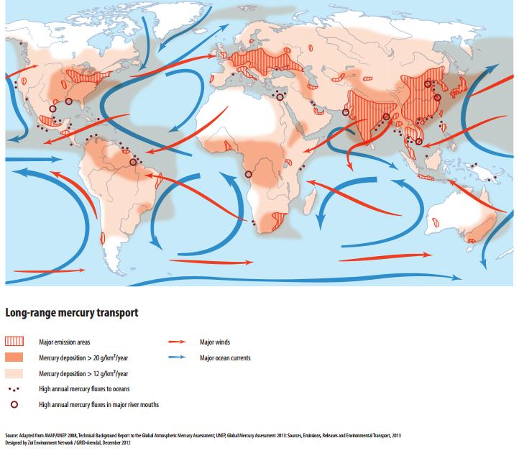
Atmospheric Hg: Transport
Atmospheric mercury is subject to both short-range and long-range transport
Bauer et al. 2014 (AMT)
Notes:
Elemental Hg most stable in Atmos. Lifetime of up to a year in atmos. Oxidized Hg is much more volatile, lifetime on the order of days
https://www.atmos-meas-tech.net/7/4251/2014/

Slide 5
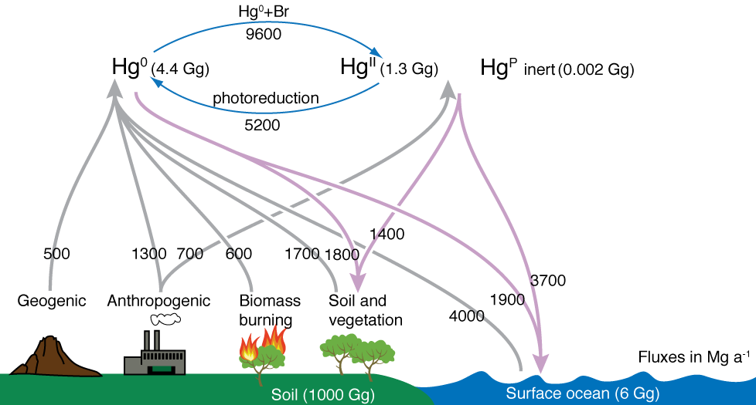
Atmospheric Hg Reactions
Reactions can transform species of Hg. implications for deposition and health effects
O₃
Holmes et al. 2010
Notes:
Direct relationship of concentrations
Interaction supported by thermodynamic and kinetic studies
http://myweb.fsu.edu/cdholmes/pubs/holmes2010.pdf

Slide 6
Measurement of Gaseous Oxidized Mercury
Gaseous Oxidized Mercury is poorly understood
expected to increase with increasing atmospheric oxidants
Main measurement instrument underestimates actual GOM concentration
Gustin Lab group designed a membrane based system

Slide 7
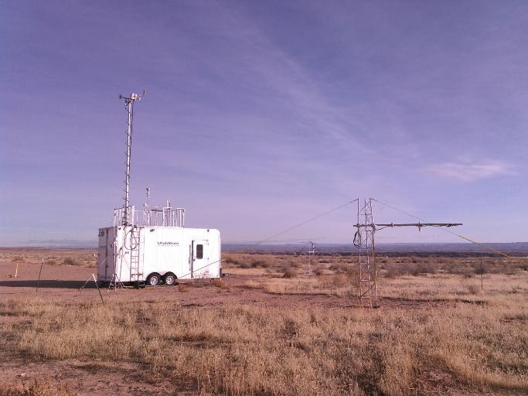
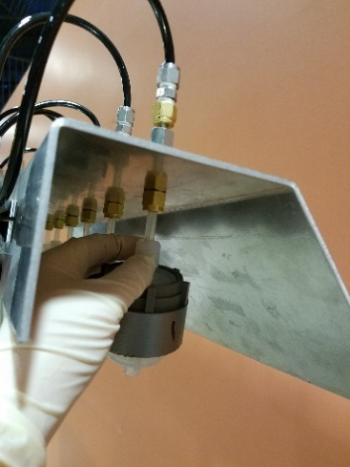
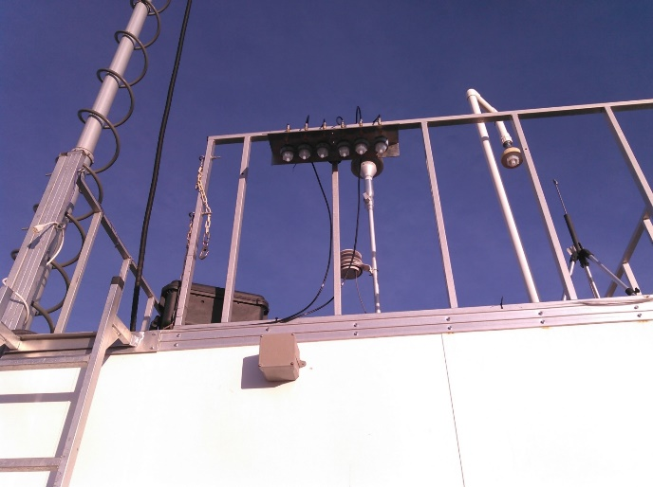
Measurement and Identification of Gaseous Oxidized Hg Using UNRRMAS
University of
Nevada
Reno
Reactive
Mercury
Active
System
Horsepool Monitoring Station, Uintah Basin, Utah
Photos courtesy of Seth Lyman
Notes:
Robust, less expensive, more dependable system for measuring GOM

Slide 8
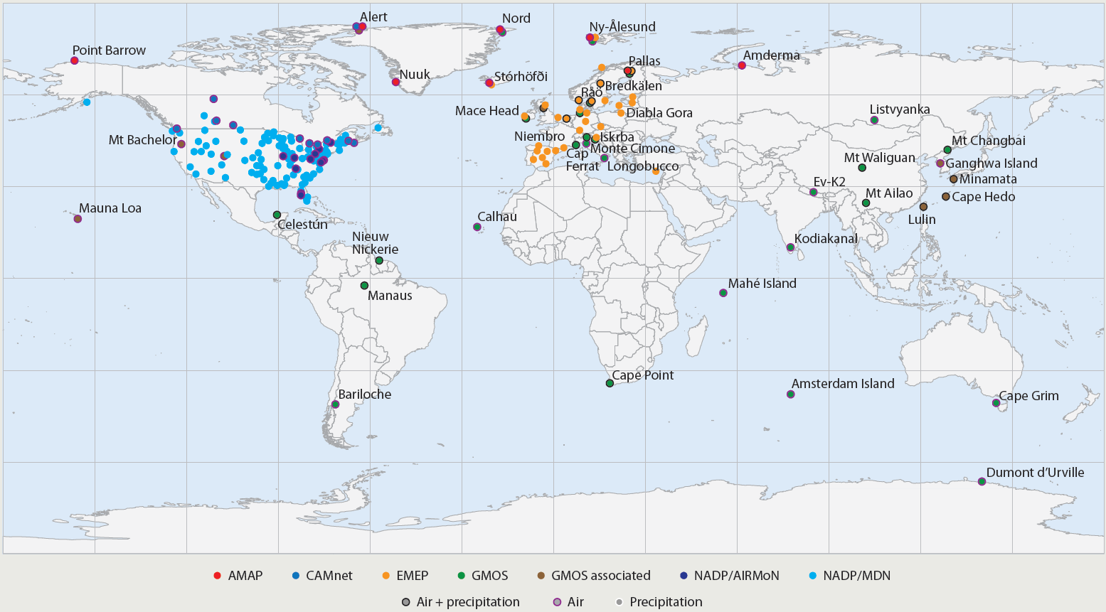
Atmospheric Hg Monitoring
Current Field Sites
UNEP Global Mercury Assessment 2013
Notes:
Deployed at 6 sites: Valley Road Greenhouse at UNR, Utah impacted by fracking, Colorado, Rural Maryland downwind of coal power plants, Svalbard Norway in Arctic Circle to capture AMDE atmospheric depletion event, and Mauna Loa Observatory in HI.
Global effort, but dominantly N. hemisphere (Q: why?)
Discuss pros/cons of networks and current limitations

Slide 9
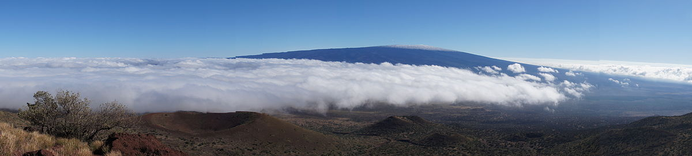
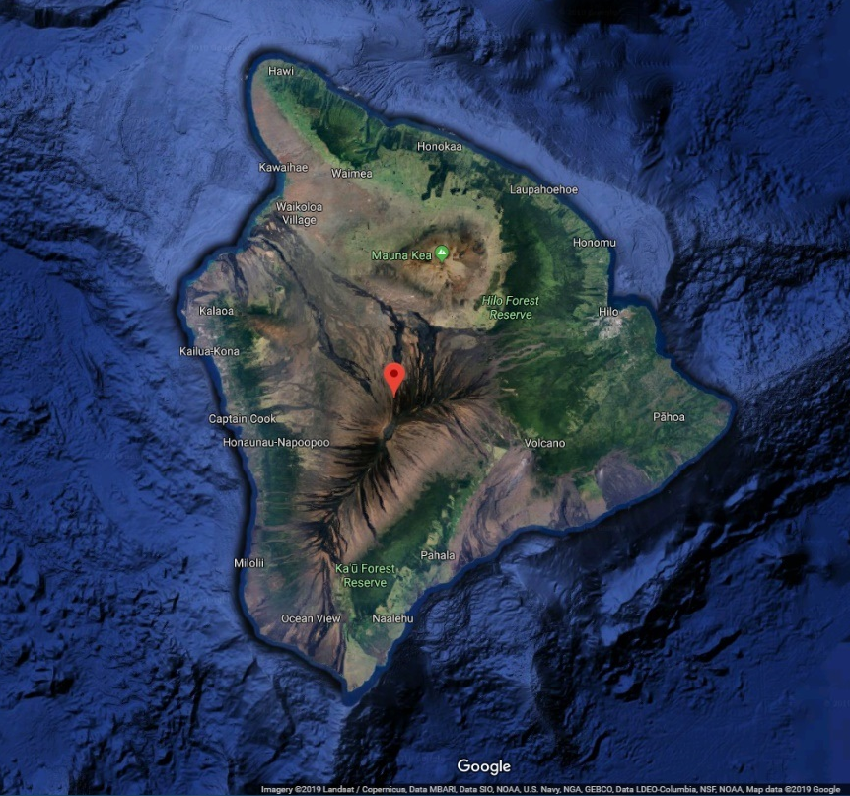
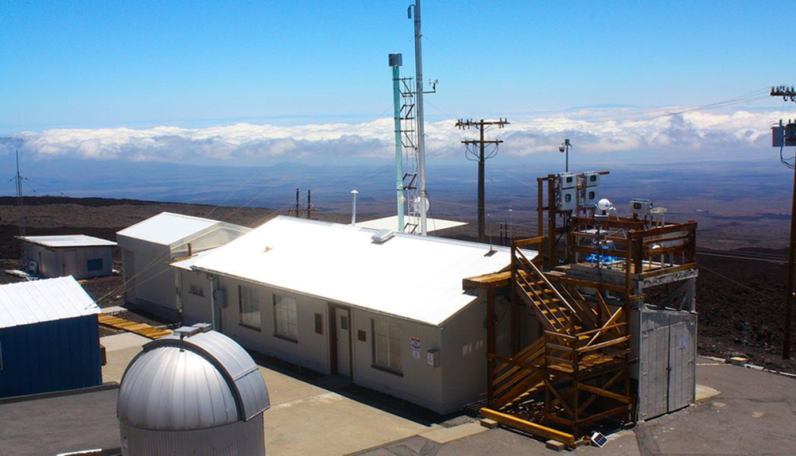
Introduction
Mauna Loa Volcano, 4169 masl
NOAA Mauna Loa Observatory, 3397 masl
By Madereugeneandrew - Own work, CC BY-SA 4.0, https://commons.wikimedia.org/w/index.php?curid=40170089
Notes:
Remote, rural, high elevation allows for tropospheric measurements-since 1973 (now 46 years)
Most famous for the Keeling curve CO2
My interest in the site is that we are collecting GOM on UNRRMAS alongside conventional method of GOM measurement

Slide 10
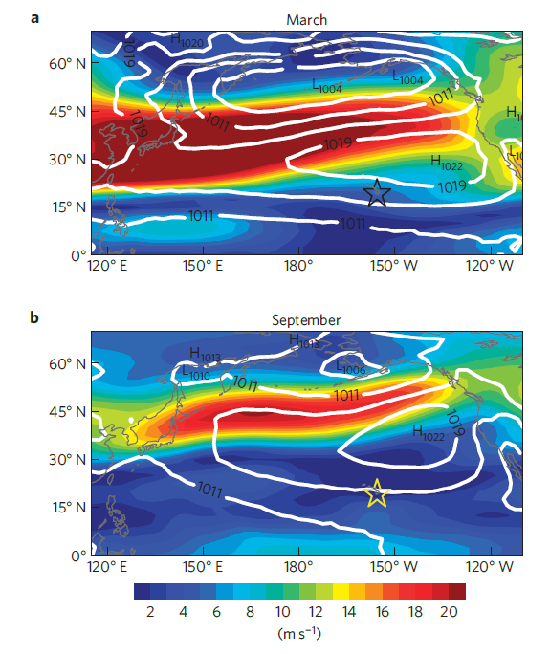
Mean sea level pressure superimposed on wind speed 1980-2012
Fig 2 Lin et al.
Notes:
Mean sea level pressure superimposed on wind speed 1980-2012. Star is MLO

Slide 11
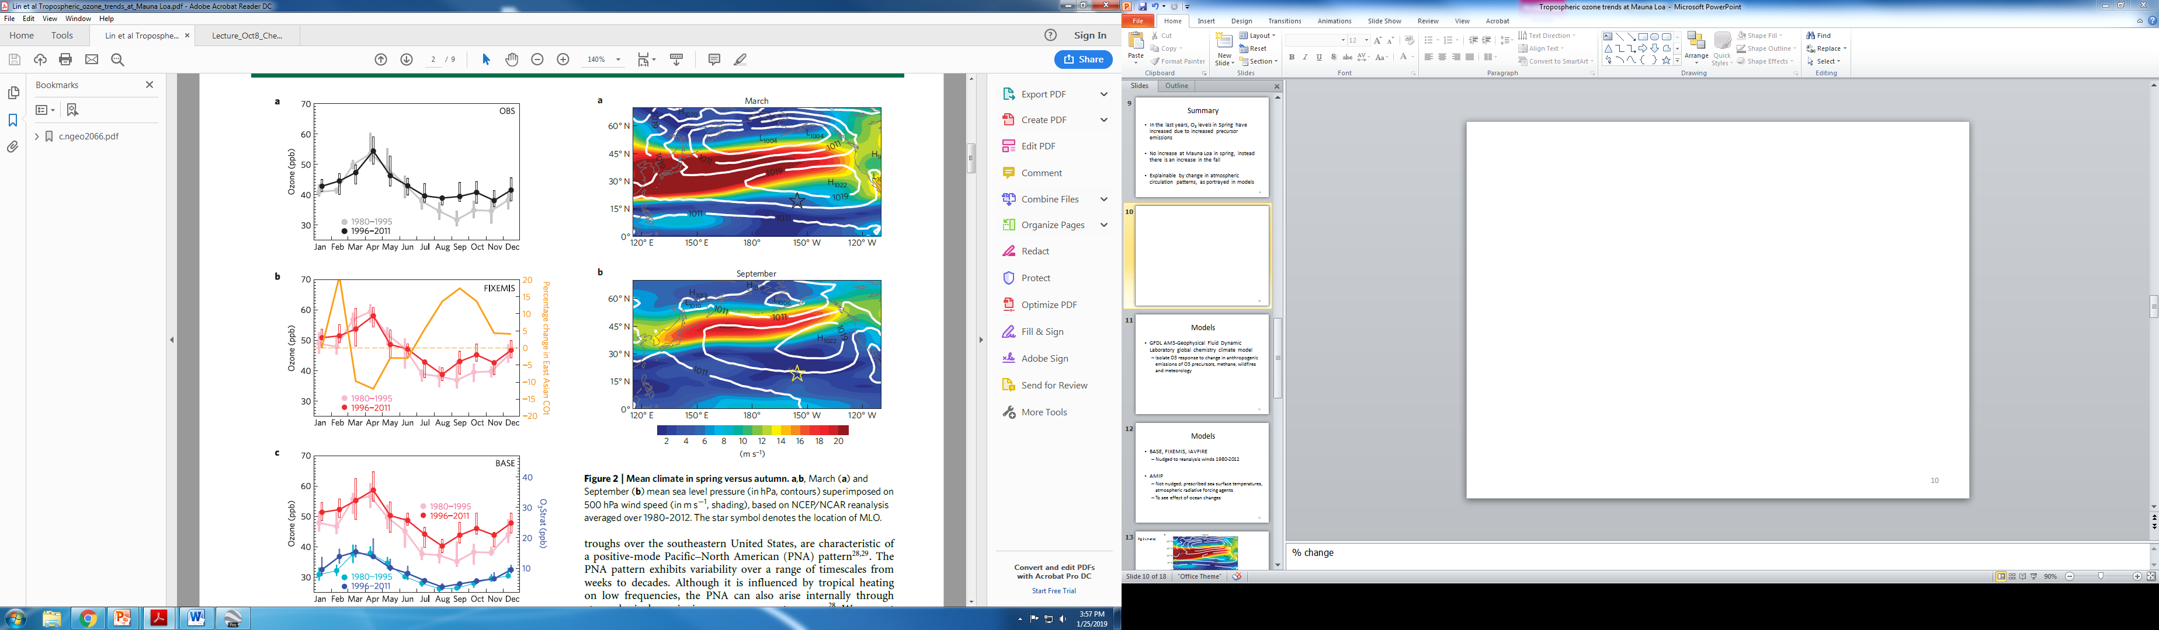
Summary
In the last 20 years, O₃ levels increase in spring at North American sites due to increased precursor emissions (NO_{x} and hydrocarbons) from Eurasia
No spring increase at Mauna Loa in the last 20 years, instead the O₃ levels increase in autumn.
Fig 2 Lin et al.
Notes:
From paper

Slide 12
Summary
Lack of increase in spring, and increase in fall explainable by decade long changes in atmospheric circulation patterns at MLO
Fig 2 Lin et al.
Airflow to MLO weakened in the spring and strengthened in autumn

Slide 13
Models
GFDL AM3-Geophysical Fluid Dynamic Laboratory global chemistry climate model
Isolate O3 response to change in anthropogenic emissions of O3 precursors, methane, wildfires and meteorology
BASE, FIXEMIS, IAVFIRE
Nudged to reanalysis winds 1980-2012
AMIP
Prescribed sea surface temperatures, atmospheric radiative forcing agents to isolate ocean effects
Notes:
Also use tracers to

Slide 14
Decadal Variability in Spring Trends
Pacific Decadal Oscillation strengthened El Niño/Southern Oscillation (ENSO)
An El Niño condition occurs when surface water in the equatorial Pacific becomes warmer than average and east winds blow weaker than normal. The opposite condition is called La Niña. the water is cooler than normal and the east winds are stronger.
Flow of ozone rich air to MLO weakened in spring of 2000’s due to La Nina- like cooling

Slide 15
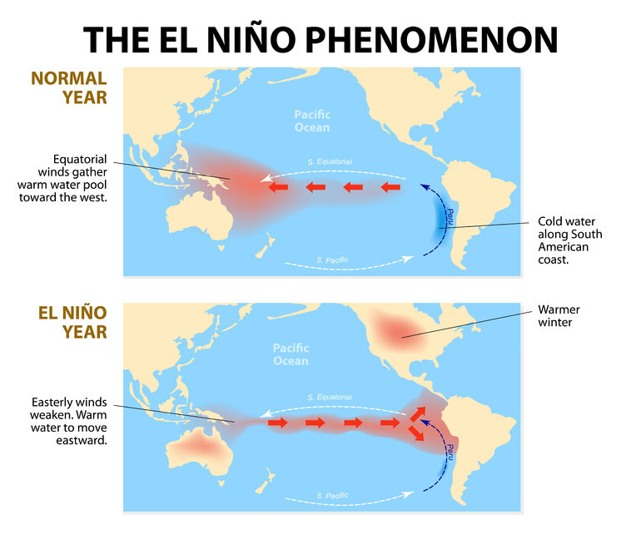
Social Studies for Kids copyright 2002–2019 David White

Slide 16
Decadal Variability in Autumn Trends
Pacific-North American pattern (PNA)
The positive phase of the PNA pattern features above-average heights in the vicinity of Hawaii. positive phase is associated with an enhanced East Asian jet stream and with an eastward shift in the jet exit region toward the western United States.
Positive PNA results in transport of ozone rich air during autumn to MLO
Additional NO_{x} transported as well

Slide 17
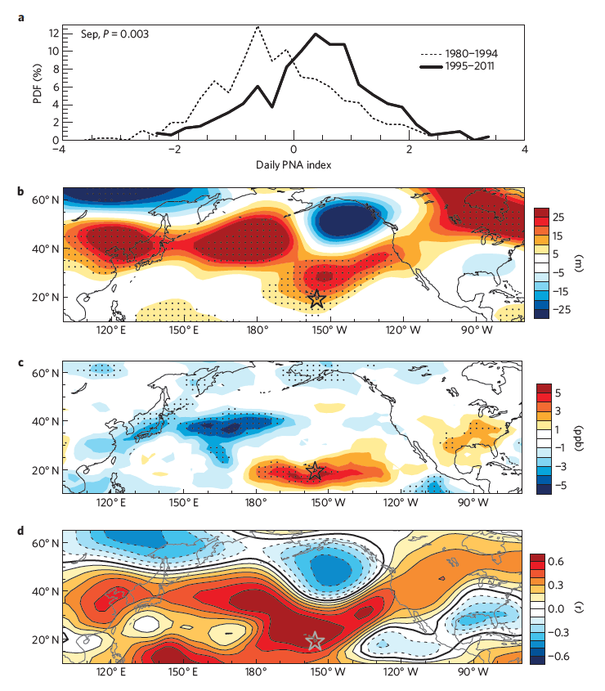
a, Probability distribution of PNA index
b,c, Changes between geopotential heights period means 1995-2011 minus 1980-1994
d, Temporal correlations of September mean MLO ozone with geopotential heights 1980-2011
Fig 6 Lin et al.
Notes:
Stronger transport of Asian pollution to MLO in SEPT tied to shift in PNA patter in 1990’s

Slide 18
Emissions versus Meteorology
COt, carbon monoxide-like tracer shows air flow decrease in spring and increase in fall
Kona storms occasionally transport O₃ from stratosphere to troposphere found insignificant at MLO via ozone tracer
Fig 2 Lin et al.

Slide 19
Summary
Lack of increase in spring, and increase in fall explainable by decade long changes in atmospheric circulation patterns at MLO
Fig 2 Lin et al.

Slide 20
Conclusions
Need to consider changing atmospheric patterns when assessing effect of increased precursor emissions on ozone levels.
Need to consider this effect on gaseous oxidized mercury concentrations at Mauna Loa
Notes:
Climate changes will impact Hg deposition globally

Slide 21
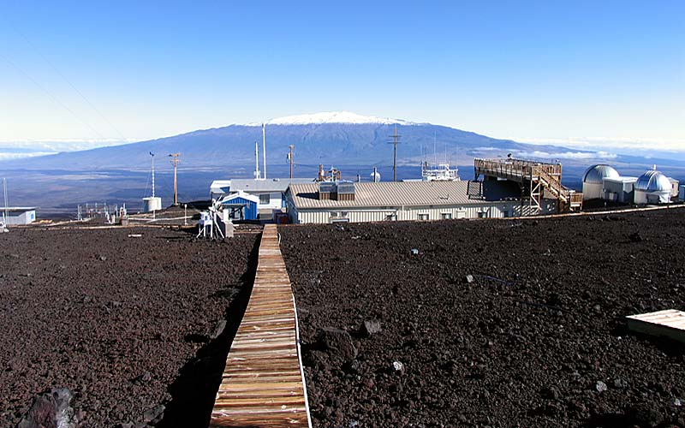
Questions?
NOAA Mauna Loa Observatory, looking towards Mauna Kea volcano (Public Domain, USGS. Date Taken: March 26, 2012)
References can be provided upon request

Slide 22
Extra Slides

Slide 23
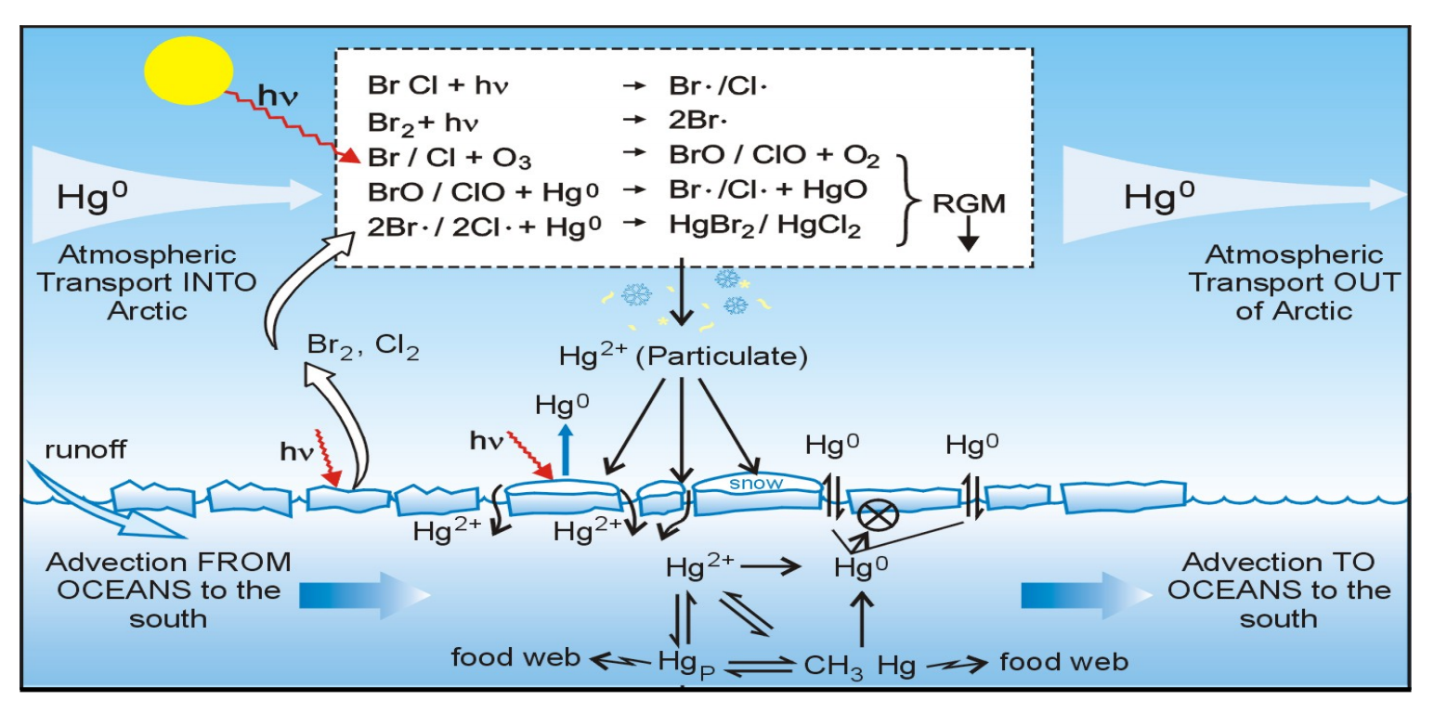
Atm. Hg Depletion Events
Observed in polar regions and during winter inversion events
Extreme decrease in both atmospheric GEM and ozone concentrations after polar sunrise
Result in enhanced deposition during polar spring
Steffen et al. 2008
Notes:
https://www.atmos-chem-phys.net/8/1445/2008/acp-8-1445-2008.pdf

Slide 24
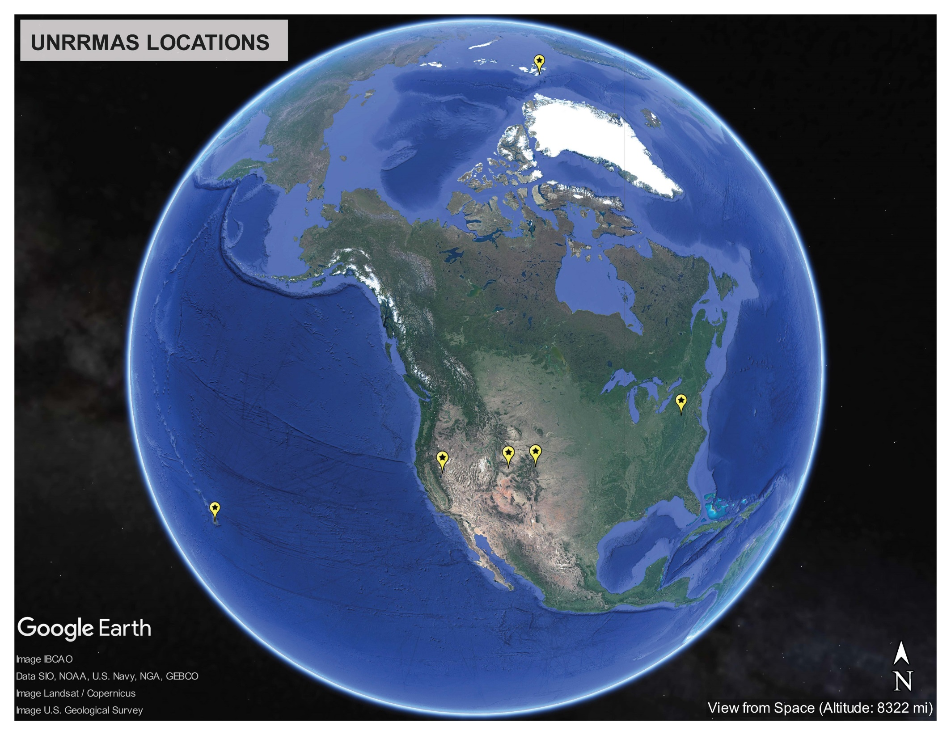
Field Sites
Notes:
Deployed at 6 sites: Valley Road Greenhouse at UNR, Utah impacted by fracking, Colorado, Rural Maryland downwind of coal power plants, Svalbard Norway in Arctic Circle to capture AMDE atmospheric depletion event, and Mauna Loa Observatory in HI.

Slide 25
In Spring, Flow of ozone rich air to MLO weakened in 2000’s due to La Nina- like cooling in Pacific
In autumn, strength of ozone rich air strengthened in the mid 90’s due to positive phase Pacific North American pattern (PNA)

Slide 26
Introduction

