Slide 1
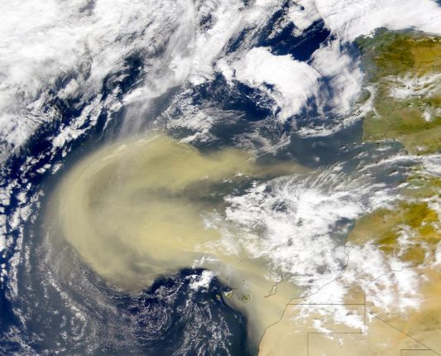
Synoptic and dynamic aspects of an extreme springtime Saharan dust outbreak by Peter Knippertz and Andreas H. Fink
ATMS 790
Graduate Seminar
Presenter: Saroj Dhital
Date: March-12, 2018
Fig : Saharan desert dust blowing from northwest Africa to Atlantic ocean
Source : NASA

Slide 2
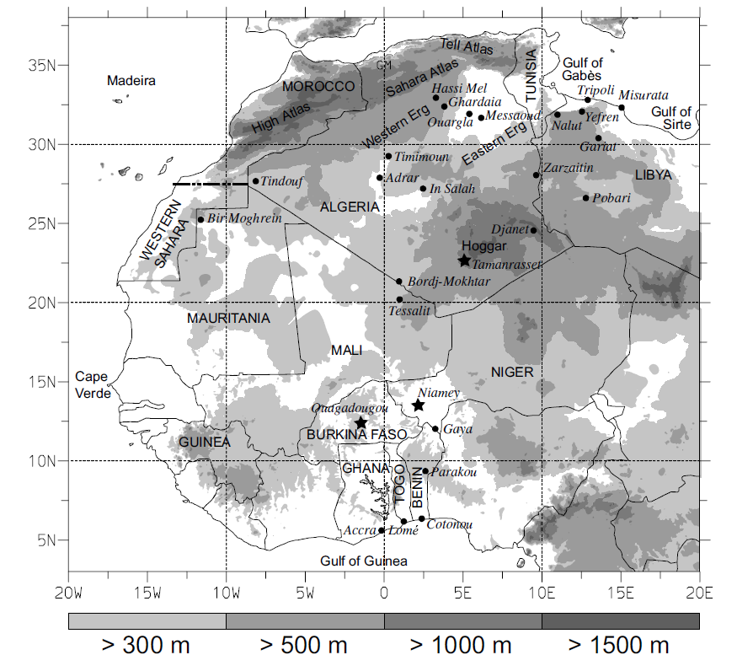
MOTIVATION
Dust storm was observed at 18 UTC 2 March, 2004 over central Algeria.
115 mm rainfall was observed near north-western part of Libya
115 mm = 3* average annual rainfall
Relative humidity (RH) : <10 %
pressure rise : 6mb in 24 hrs
Fig: Grey scale represents the terrain height above mean sea level(m), source: (Peter and Andreas, 2004)

Slide 3
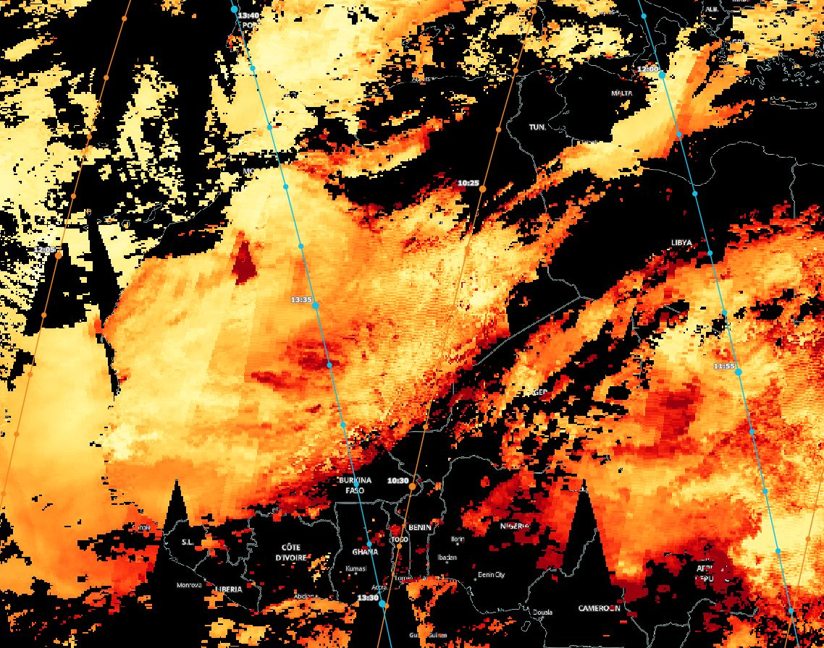
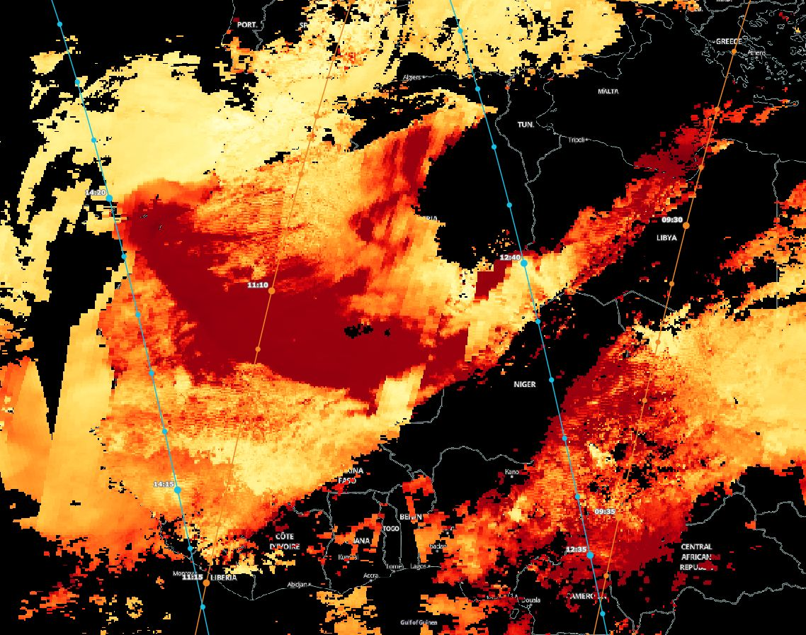
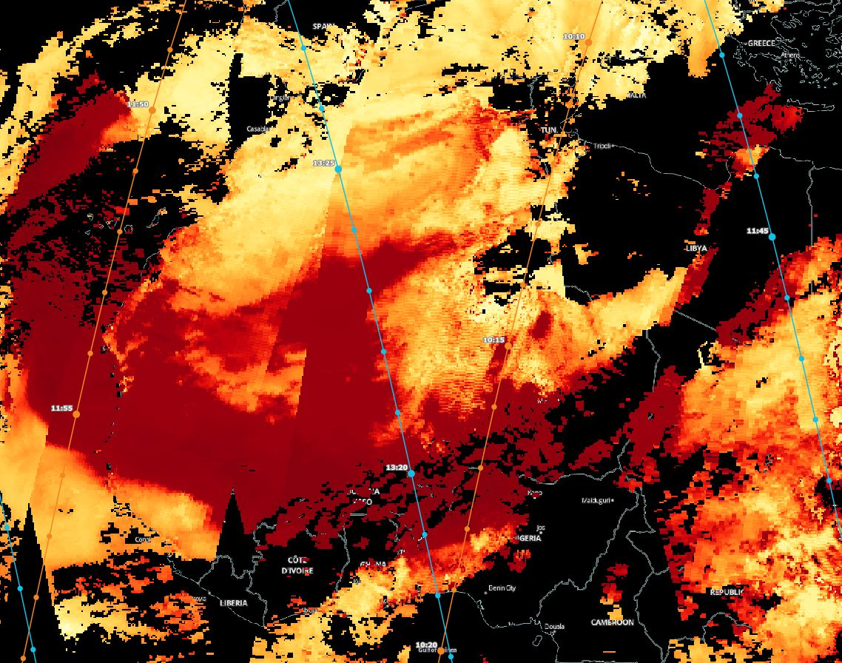
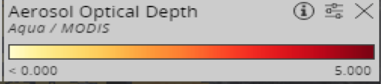
03-04-2004
03-03-2004
03-02-2004
N
W
E
S
Source : NASA Worldview

Slide 4
Outline
Introduction
Sahara dust evolution and it’s transport mechanism
Data and Methods
Results
Vertical structure of the atmosphere
Heat Wave and Harmattan condition
Large- scale upper level flow
Conclusions

Slide 5
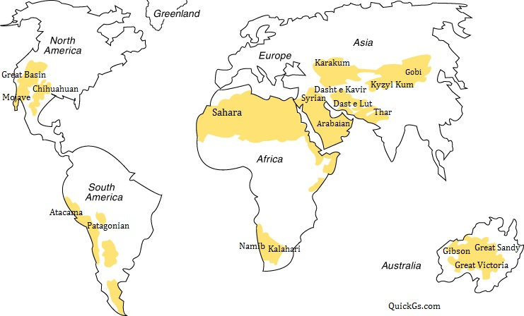
Introduction
Dust: fine particles of matter present in the atmosphere
Sahara desert is the major source of the airborne dust (diameter = <1 - >100 µm )
Location of the dust evolution and its transport changes with seasonal movement of the Inter-tropical Convergence Zone (ITCZ) – belt of low pressure lies near the equator where trade wind converge
Peak of Sahara dust evolution normally during late winter and spring (Swap et al. 1996)
Fig: Main deserts area around the world, source(QuickGS.com)

Slide 6
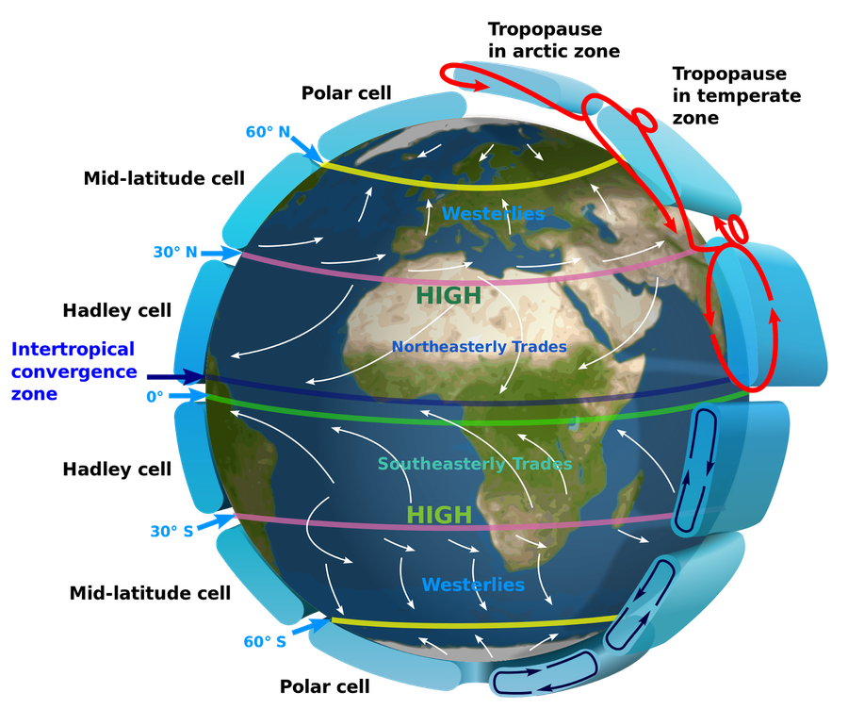
Introduction(contd.)
Cold season: dust transport from Sahara to gulf of Guinea and tropical Atlantic ocean
North Atlantic Oscillation-pressure fluctuation in NAO, and Sahelian (Sahara region between NAO to red sea) rainfall
Airborne dust has major impacts on
Atmospheric radiation budget
Cloud microphysics
Marine bio-chemistry
Human health
Fig: Schematic diagram for global circulation, source: https://en.wikipedia.org/wiki/Atmospheric_circulation

Slide 7
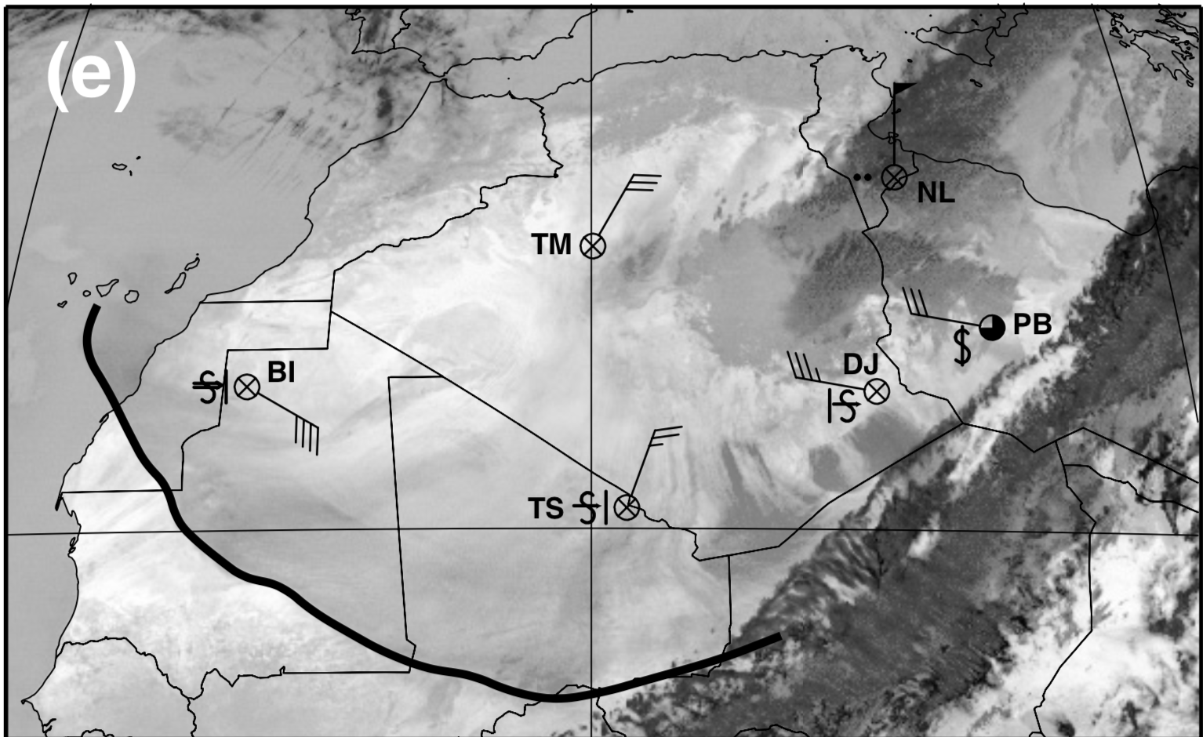
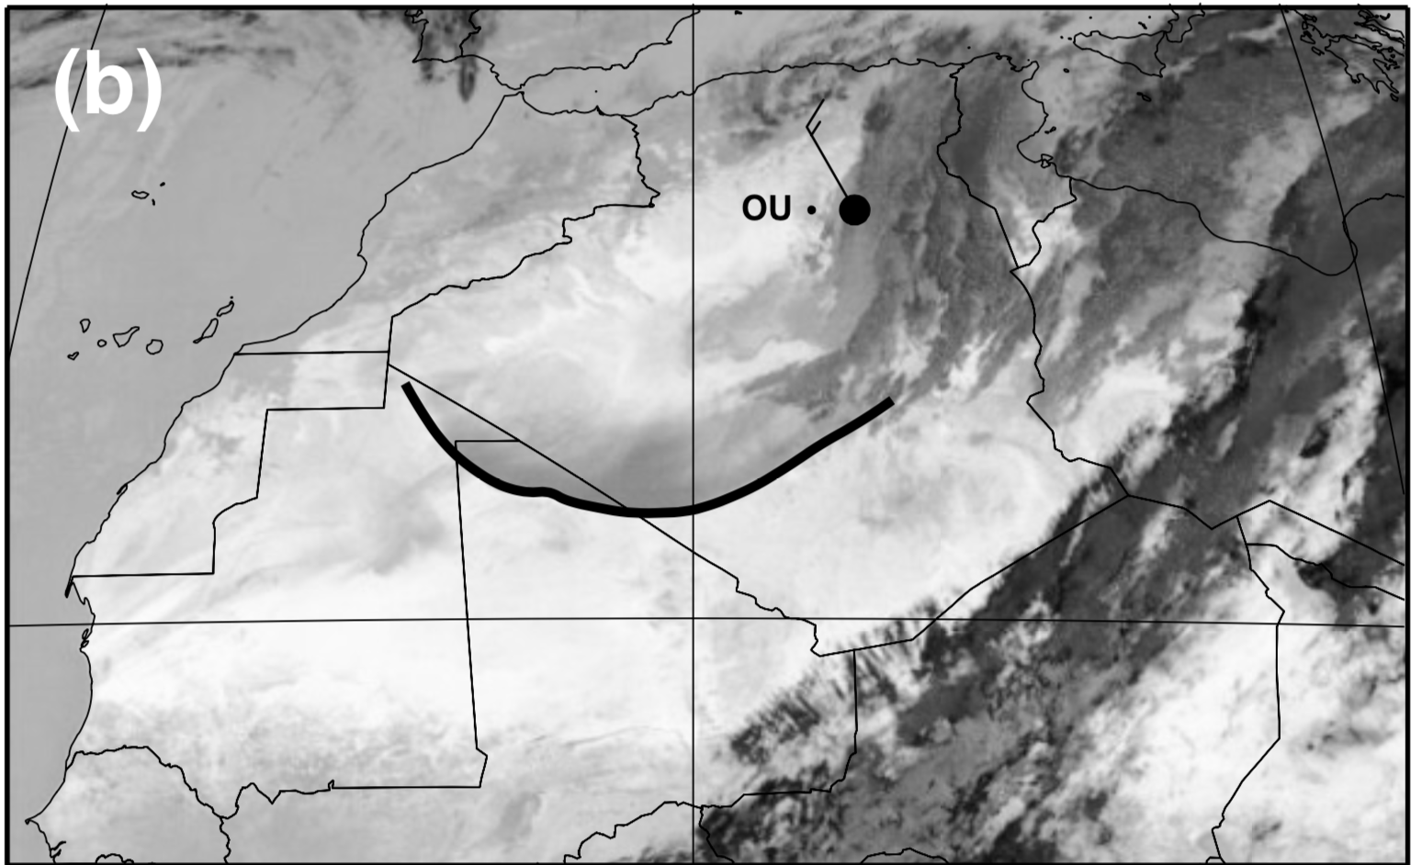
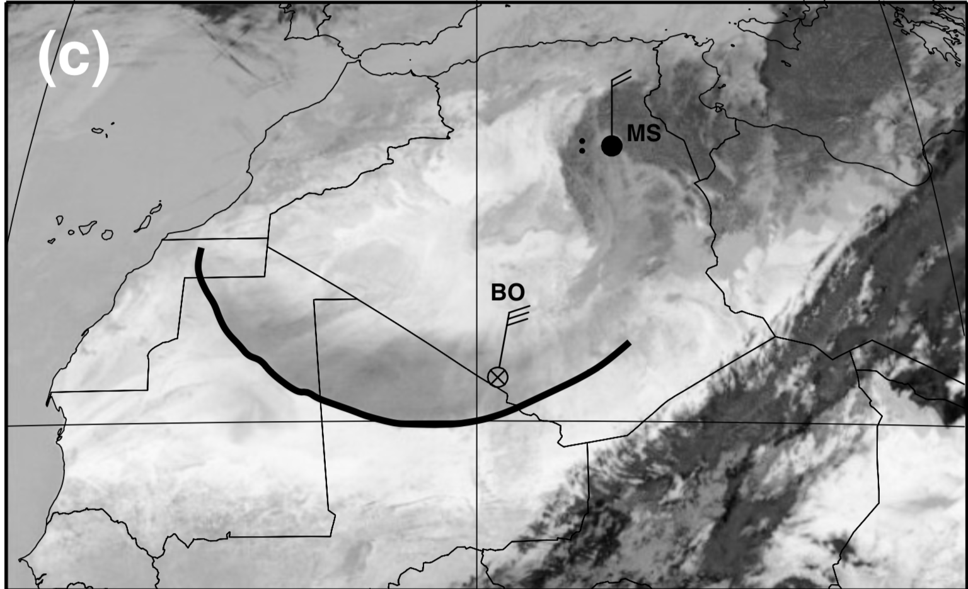
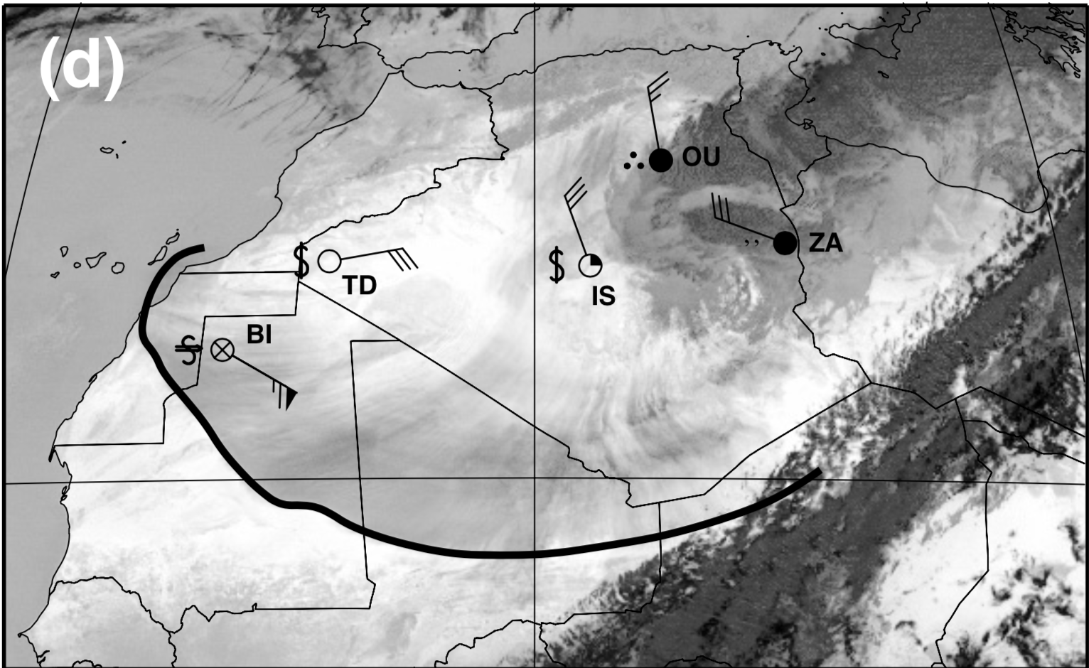
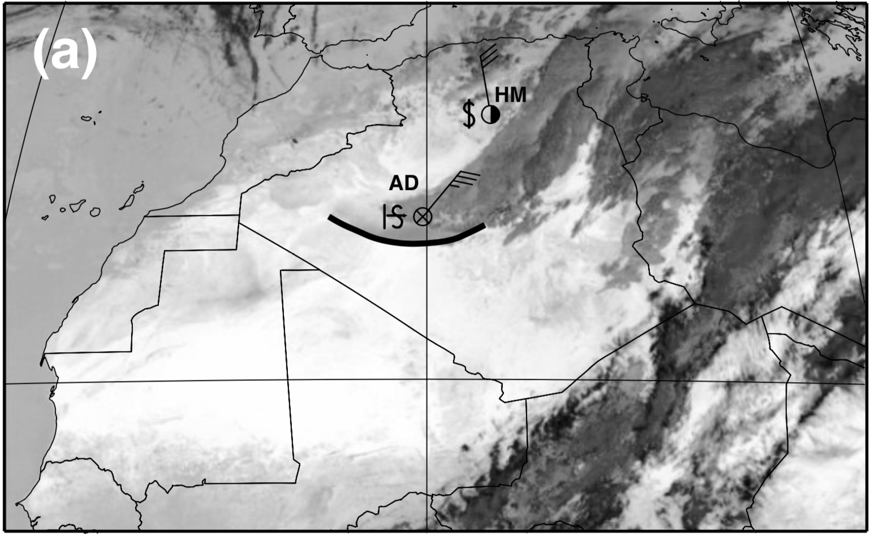
Dust evolution process
Mediterranean sea
18 UTC March 2
12 UTC March 3
06UTC March 3
18 UTC March 3
00 UTC March 3
Sahara Atlas
Tunisia
Atlantic ocean
Morocco
Libya
N
Algeria
Western Sahara
W
E
S
Mauritania
Niger
Mali
source: Peter and Andreas, 2004

Slide 8
Data and Methods
Meteosat images- operated by EUMETSAT
Surface observations from world meteorological organization(WMO) stations and radiosondes data
Hourly METAR observations from major airport
IMPETUS network data
European Centre for Medium-Range Weather Forecasts (ECMWF) reanalysis data

Slide 9
Outline
Introduction
Sahara dust evolution and transport
Data and Methods
Results
Vertical structure of the atmosphere
Heat Wave and Harmattan condition
Large- scale upper level flow – Potential Vorticity(PV) analysis
Conclusions

Slide 10
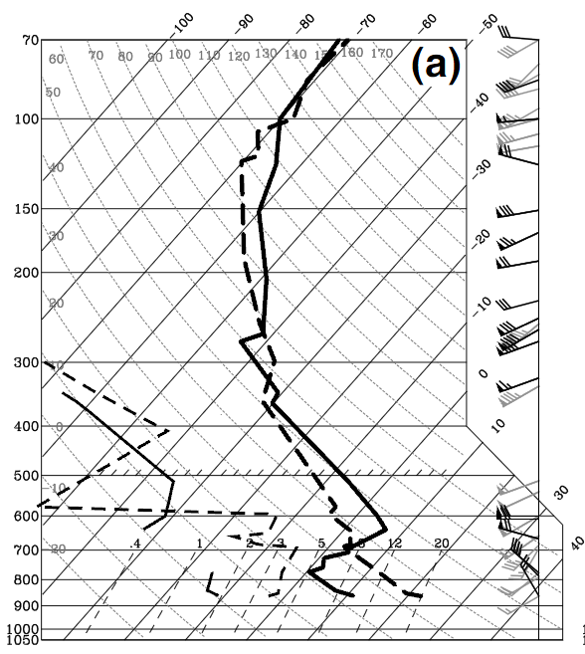
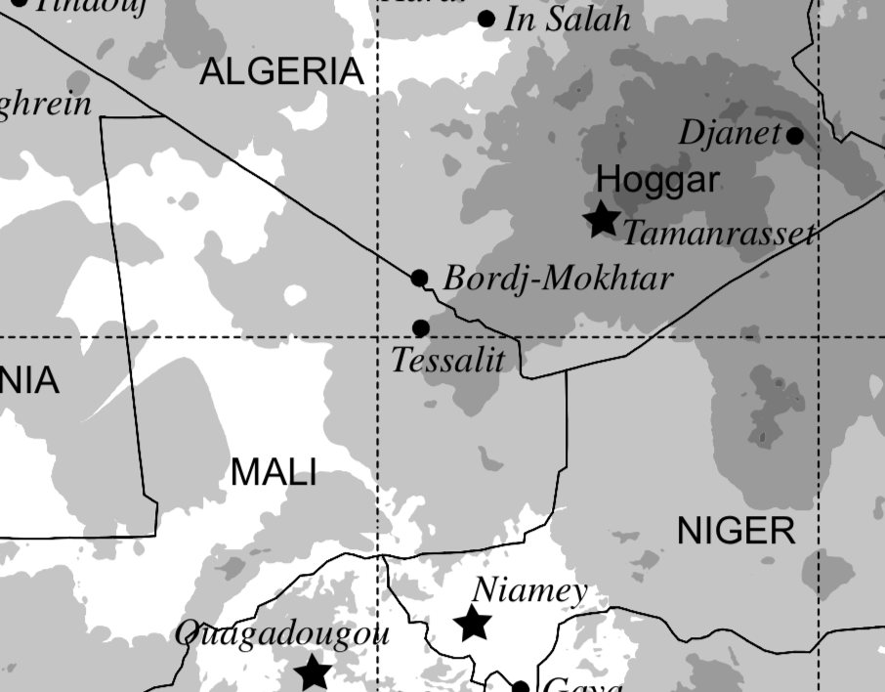
Vertical structure of the atmosphere
Station : Near Hoggar, east of Algeria
Strong Low level cooling below 700hpa and warming above 700hpa
Very dry layer up to mid troposphere
RH : 10% on 18 UTC 3 March
12 UTC March 2
12 UTC March 3
source: Peter and Andreas, 2004

Slide 11
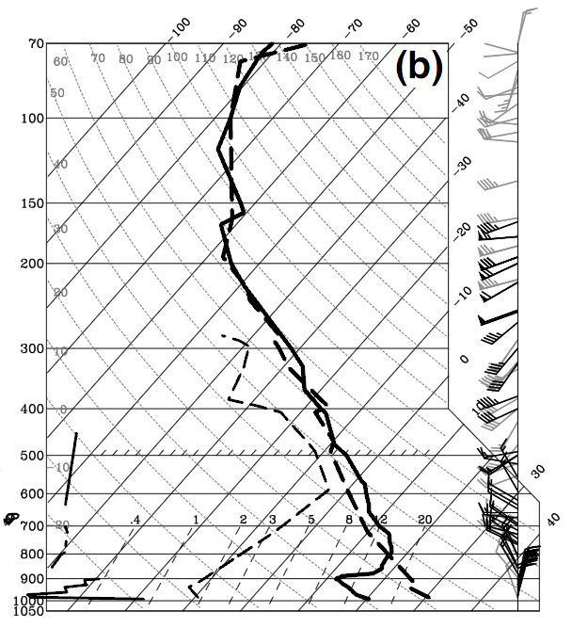
Vertical structure of the atmosphere(contd.)
Station : Niamy-south to the Hoggar mountain
Cold layer up to 800hpa
RH = less than 4% on 12 UTC march 4 between surface and 600 mb
The low level cooling due cold air advection
12 UTC March 3
12 UTC March 4
Extremely dry layer
source: Peter and Andreas, 2004

Slide 12
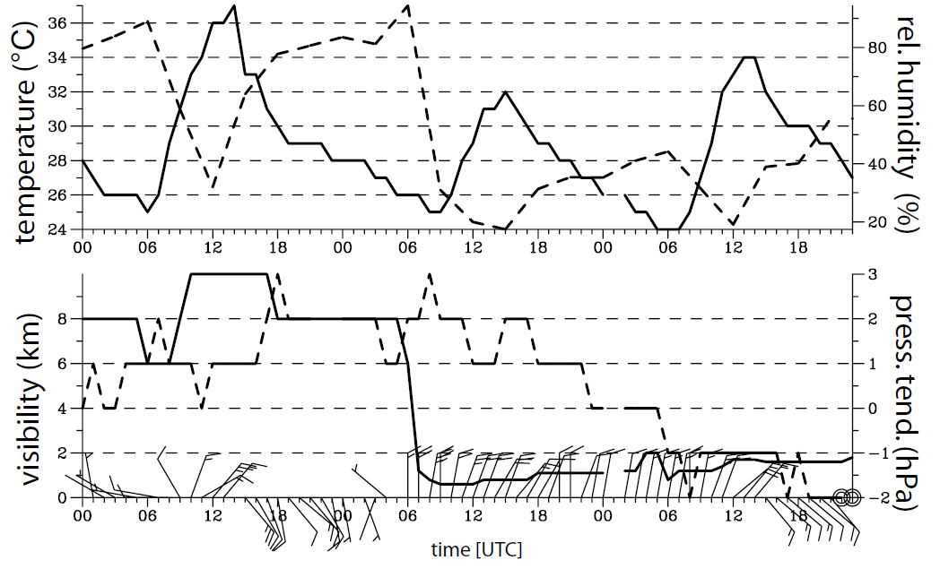
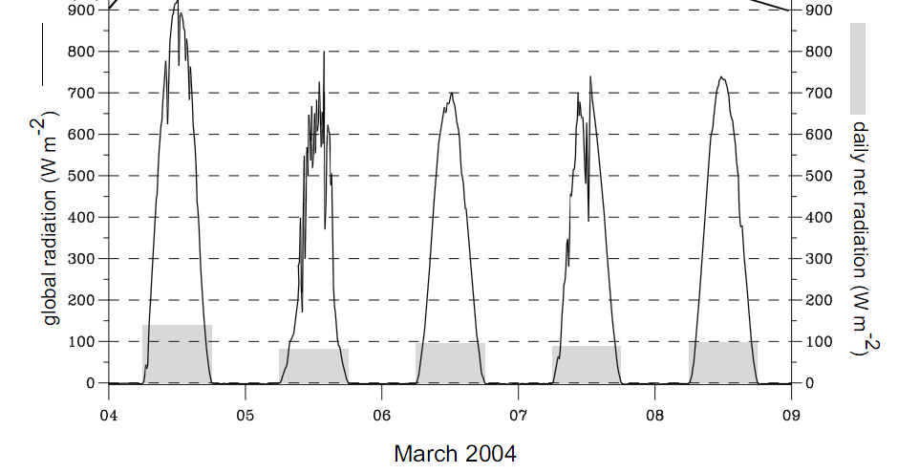
Heat wave and Harmattan condition
Heat wave : period of extremely hot weather
Harmattan episode: season when easterly or northeasterly dry and dusty flow occurs from Sahara to gulf of Guinea
Harmattan : low pressure over gulf of Guinea and sub-tropical high over Sahara
On March 4 at Cotonou (Near Guinea coast)
Max. Temperature : 37.0 °C
Net radiation drop: >30 W·m⁻²
March-4
source: Peter and Andreas, 2004

Slide 13
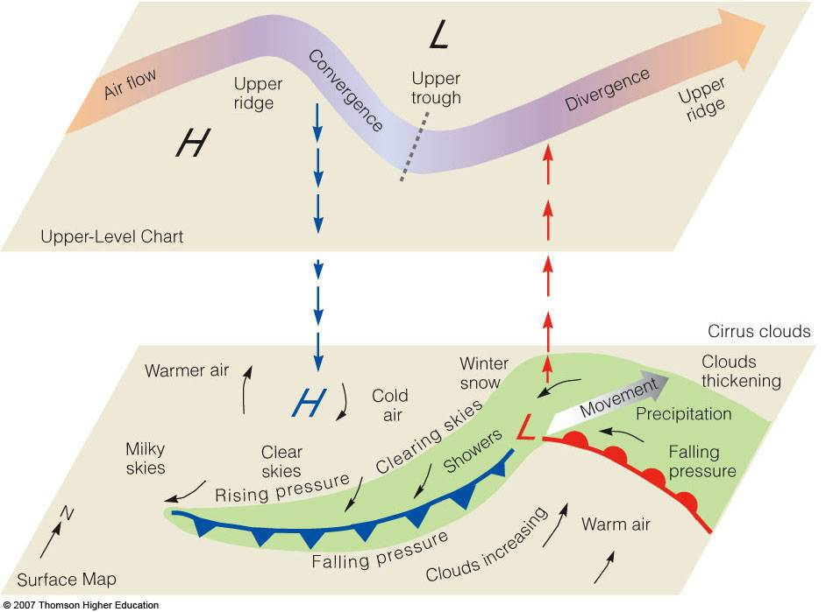
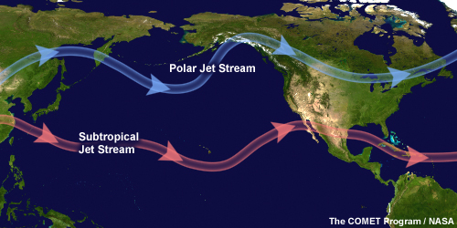
Upper level flow
Jet stream : Narrow band of fast moving air
Jet streak : region of maximum wind speed in
Vorticity : measures the rotation of an air parcel
Potential vorticity (PV) : absolute circulation of the air parcel between two constant temperature surface
Isentropic potential vorticity (IPV) : PV on constant temperature surface
NVA
PVA
PV max

Slide 14
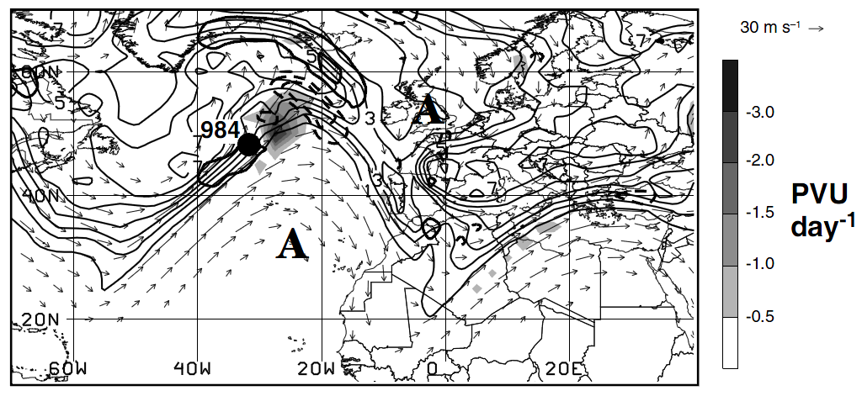
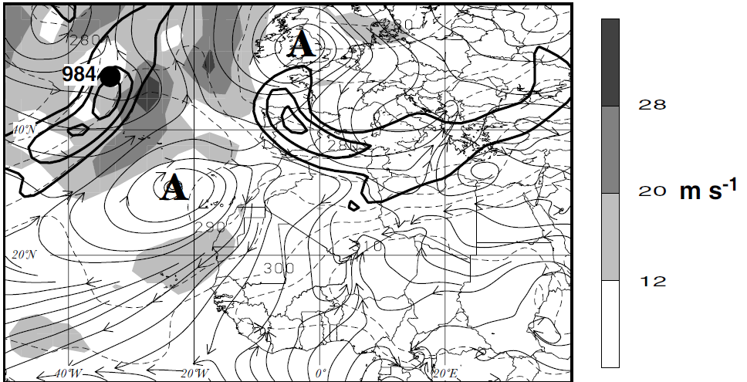
12 UTC March-1, 2004
325 K IPV
A : 925mb anticyclone
925mb streamline and wind speed
source: Peter and Andreas, 2004

Slide 15
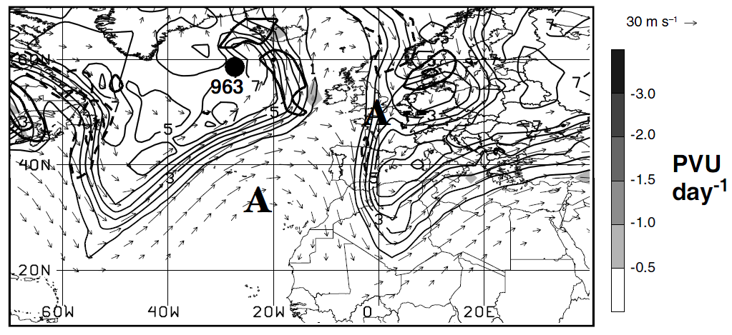
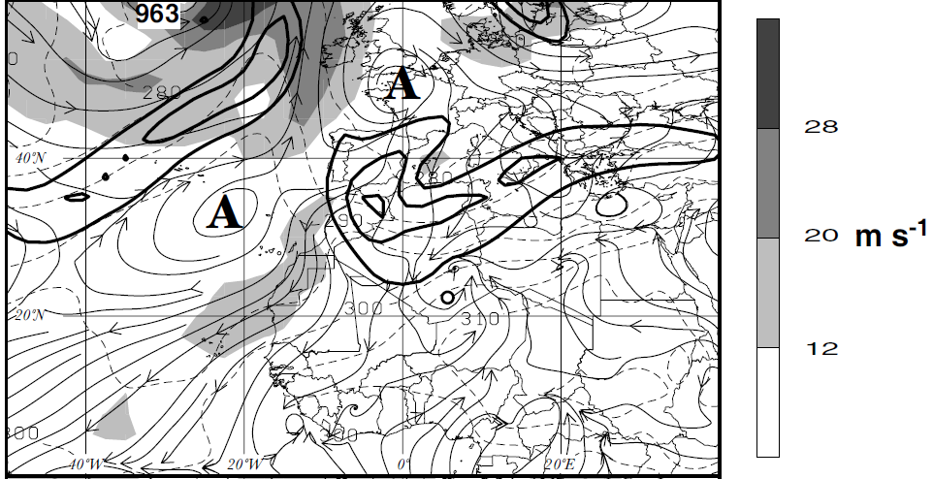
12 UTC March-2
325 K IPV
A : 925mb anticyclone
925mb streamline and wind speed
source: Peter and Andreas, 2004

Slide 16
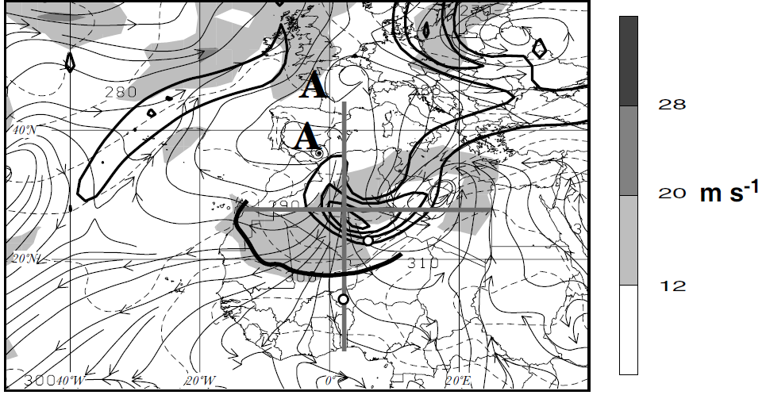
12 UTC March-3
925mb streamline and wind speed
source: Peter and Andreas, 2004

Slide 17
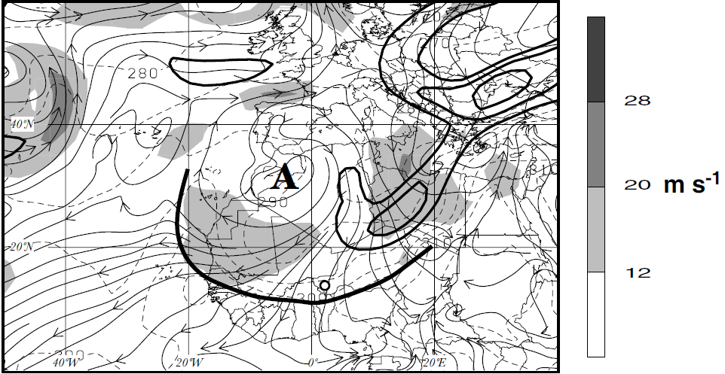
12 UTC March-4
925mb streamline and wind speed
source: Peter and Andreas, 2004

Slide 18
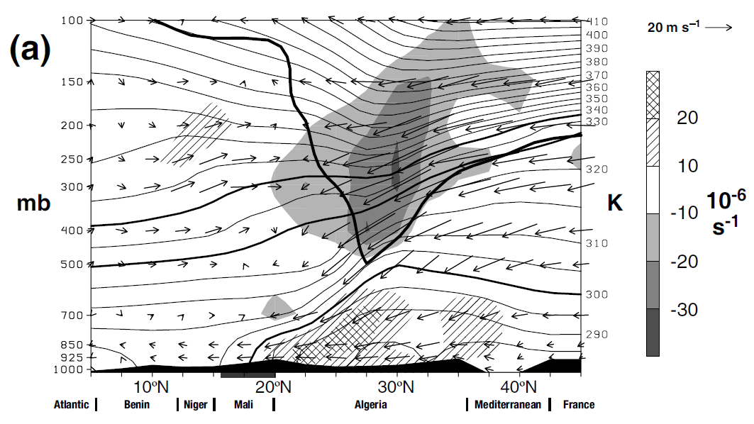
Vertical cross-section (12 UTC March -3)
S-N along 2.5° E
source: Peter and Andreas, 2004

Slide 19
Outline
Introduction
Sahara dust evolution and transport
Data and Methods
Results
Vertical structure of the atmosphere
Heat Wave and Harmattan condition
Large- scale upper level flow – Potential Vorticity(PV) analysis
Conclusions

Slide 20
Conclusions
Amplification of upper level trough results in penetration of cold front over North Africa
Extreme precipitation in Libya is the effect strong positive vorticity advection(PVA) and moist air lifting from Mediterranean sea
West and southward propagation of dust front is because of strong surface wind resulted from strong upper level convergence
The heat low remained at the Guinea coast and ITCZ lies far south from its climatological mean suppressing the west African monsoonal flow
Springtime dust outbreak can lead to the delay in African monsoonal flow

Slide 21
Thank you for your attention!
and
Questions ?

