Slide 1
“A new model for quantifying climate episodes”
ATMS 790
GRADUATE SEMINAR Extreme Weather Events and Climate
Ilaria Vinci

Slide 2
Content
Introduction
Stochastic models
Climatic episodes
Model definition
Bivariate Distribution
BEG
Model application
The Data
Example
“Dust Bowl”
Conclusion
Based on the paper:
Biondi F, Kozubowski TJ, Panorska AK. 2002.
NEW MODEL FOR QUANTIFYING CLIMATE EPISODES.
International Journal of Climatology

Slide 3
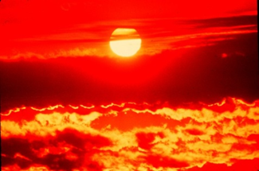
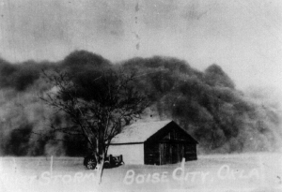
Models, Properties and Examples
“From the tropics to the arctic, climate and weather have powerful direct and indirect impacts on human life. Extremes of heat and cold can cause potentially fatal illnesses, .... Other weather extremes, such as heavy rains, floods, and hurricanes, also have severe impacts on health. Approximately 600 000 deaths occurred worldwide as a result of weather-related natural disasters in the 1990s.”
The WHO, 12 November, 2008

Slide 4
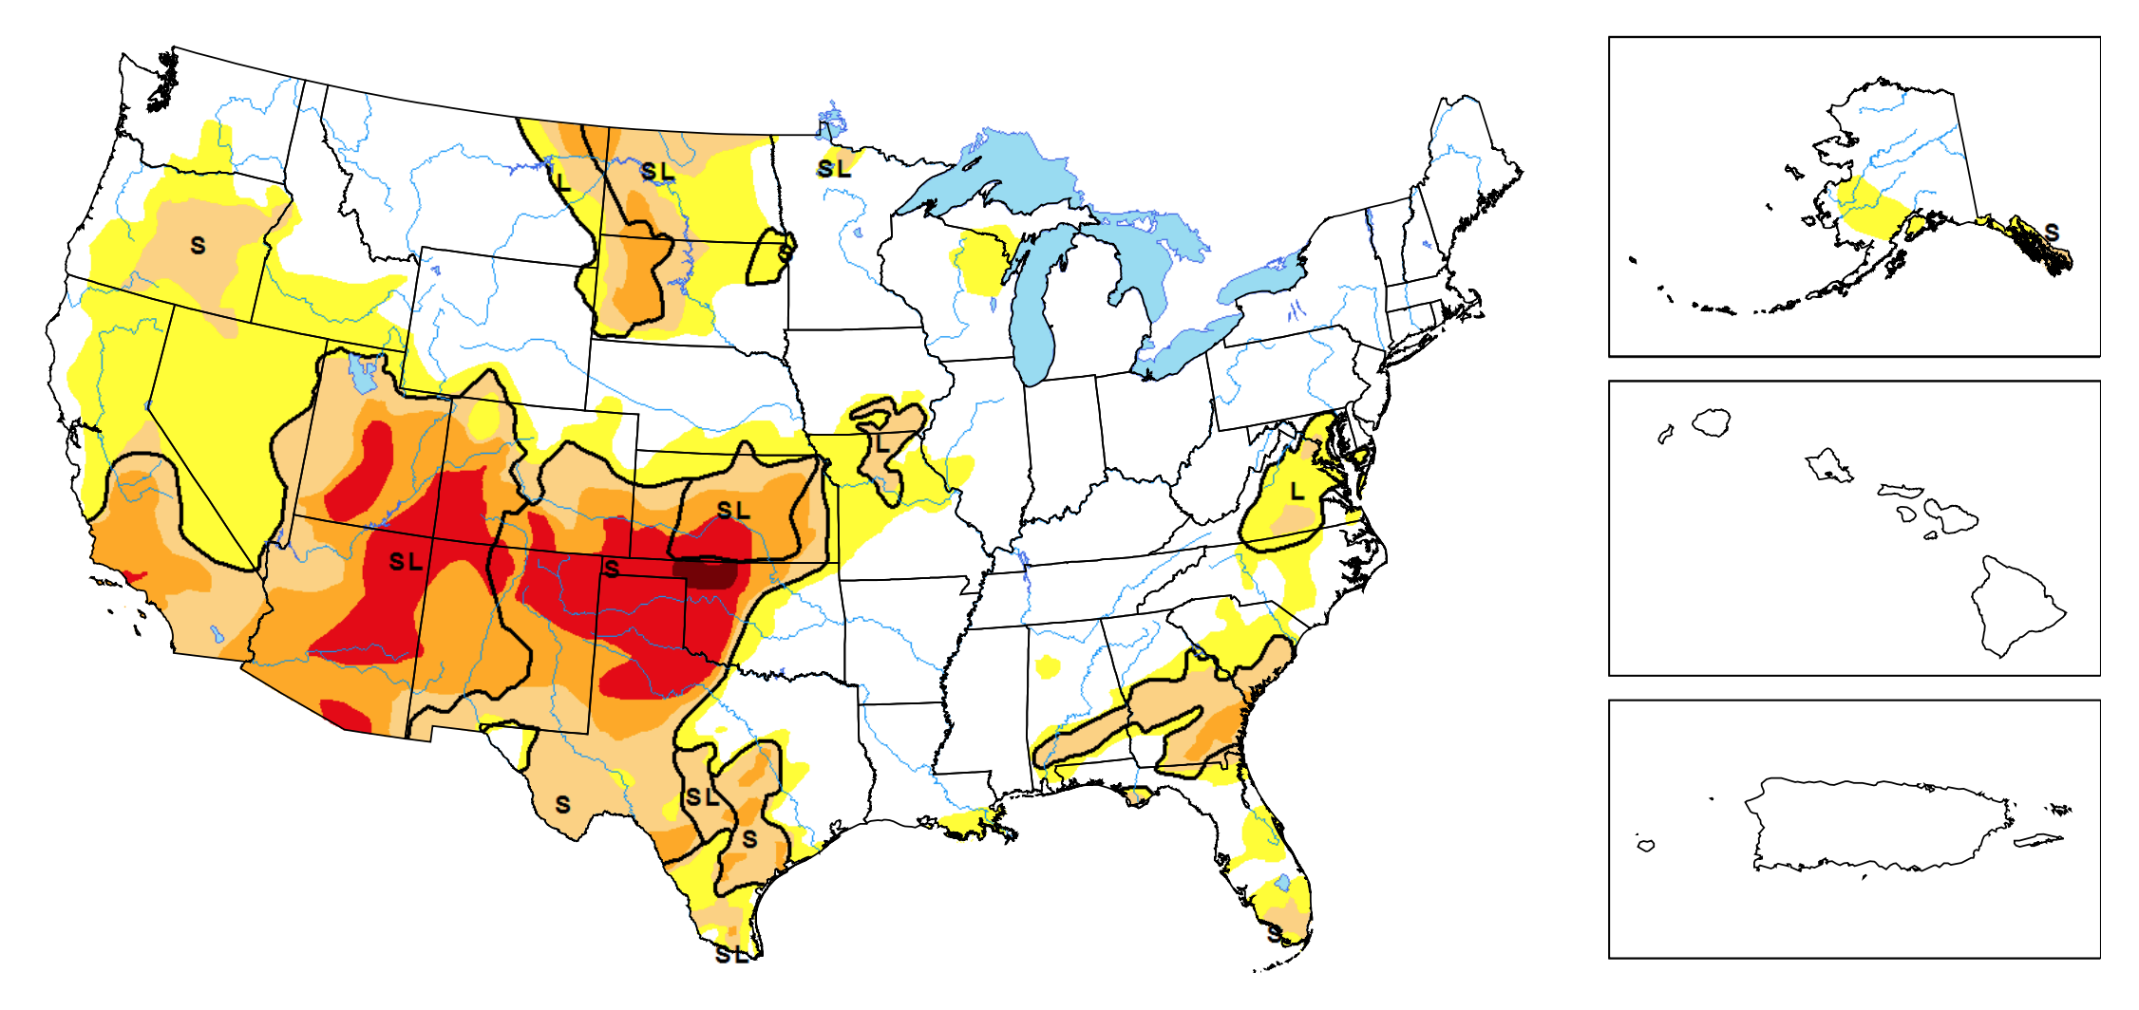
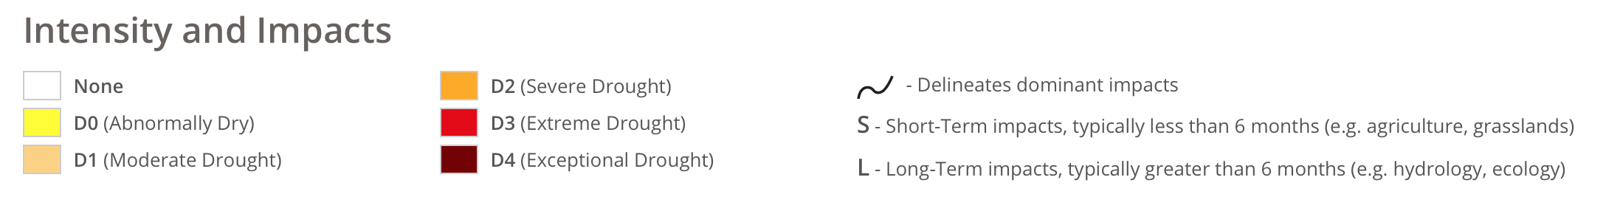
Introduction
United States Drought Monitor

Slide 5
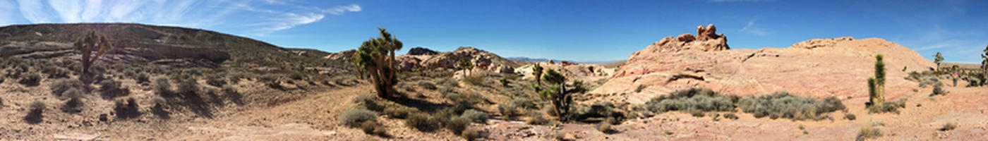
Introduction
The North American Drought Monitor (NADM) is a cooperative effort between drought experts in Canada, Mexico and the United States to monitor drought across the continent on an ongoing basis.
Since 2002, the Climate Monitoring Branch of National Oceanic and Atmospheric Administration (NOAA)’s National Climatic Data Center has begun collaborating with NOAA’s Paleoclimatology section to incorporate pre-instrumental perspectives into the monthly and annual State of the Climate (SoC) Reports.

Slide 6
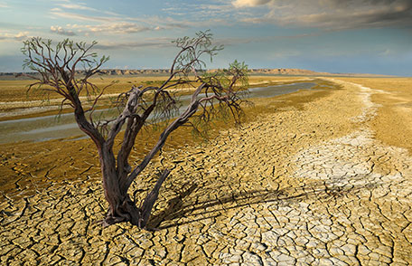
Introduction
Stochastic models:
Compute the likelihood of disastrous phenomena;
Provide numerical tests useful to determine the importance of the episodes.
Important information for:
water resource management
risk assessment
civil engineering projects
insurance industry

Slide 7
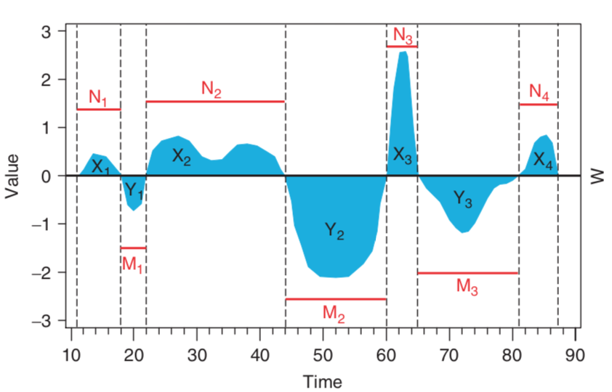
Introduction
Climatic Episodes
Positive events
What are the intuitive or visual
features of a climatological
event?
Threshold for "wet" and "dry" years: e.g. average or median precipitation.
POSITIVE/NEGATIVE EVENT ("wet“/”dry” period) = period with consecutive precipitation exceeding/below threshold.
threshold
Negative events
Figure 1. Time-series plot showing the durations (dashed lines) and magnitude (solid areas) of multi-annual events in a fictitious annual record.

Slide 8
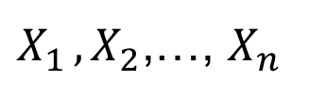
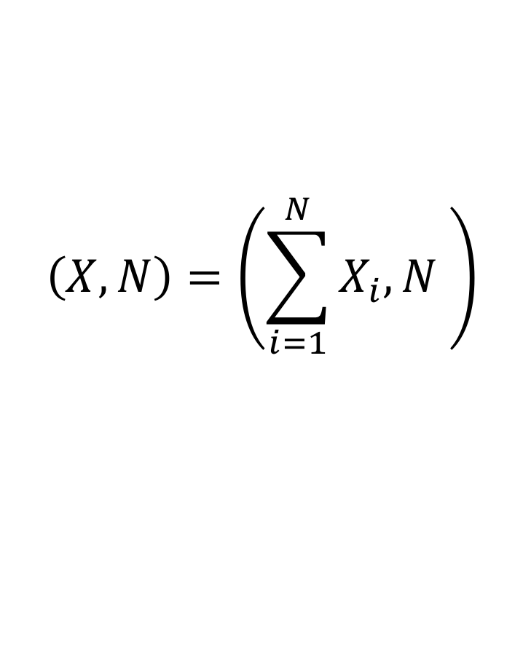

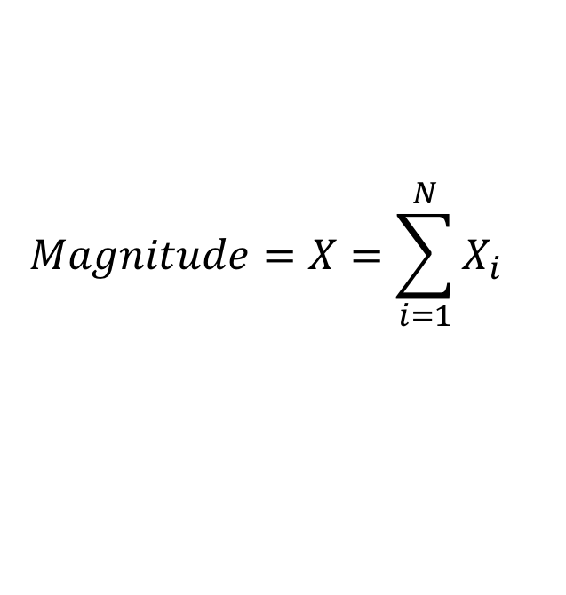
Characteristics/Quantification of Events
Model Definition
Start with a process:
DURATION = the number of years/time periods in one event (random) = N.
MAGNITUDE = area of the shaded region = (random) sum of the series values for one event.
$X_{1 },X_{2}$,…, $X_{n}$
$$Duration=N$$
$$Magnitude=X=\sum_{i=1}^{N}{X_{i}}$$
GOAL: A new stochastic model of bivariate distribution of duration and magnitude of climatic episodes.
$$\left(X,N\right)=\left(\sum_{i=1}^{N}{X_{i},N }\right)$$

Slide 9
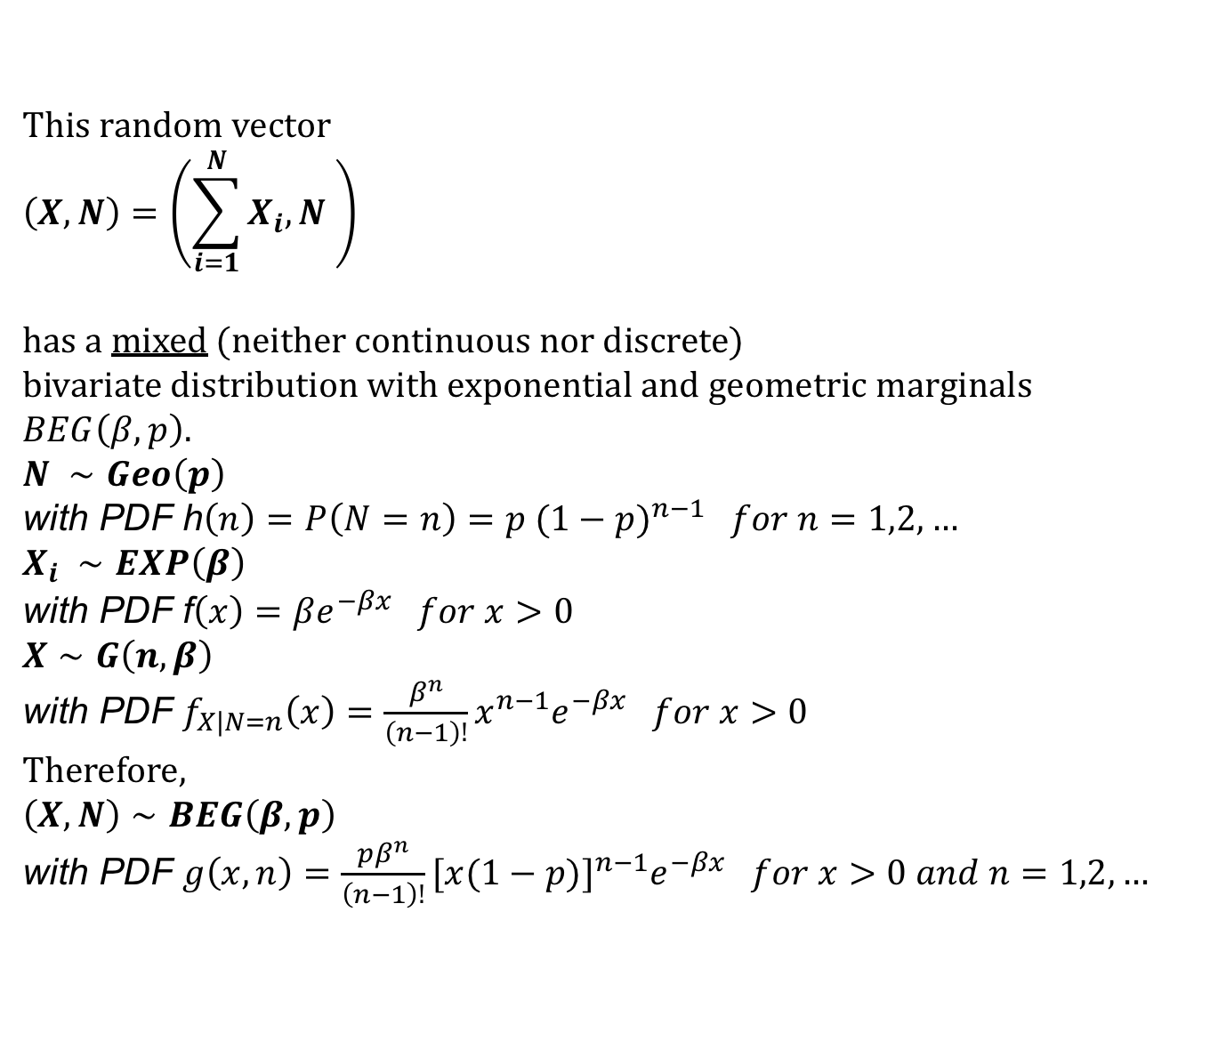
Model Definition
This random vector
$$\left(X,N\right)=\left(\sum_{i=1}^{N}{X_{i},N }\right)$$
has a mixed (neither continuous nor discrete)
bivariate distribution with exponential and geometric marginals $BEG\left(β,p\right)$.
$N ∼Geo\left(p\right)$
with PDF h$\left(n\right)=P\left(N=n\right)=p {(1−p)}^{n−1} for n=1,2,…$
$X_{i} ∼EXP\left(β\right)$
with PDF f$\left(x\right)=βe^{−βx} for x>0$
$X∼G\left(n,β\right)$
with PDF $f_{X|N=n}\left(x\right)=\frac{β^{n}}{\left(n−1\right)!}x^{n−1}e^{−βx} for x>0$
Therefore,
$\left(X,N\right)∼BEG\left(β,p\right)$
with PDF $g\left(x,n\right)=\frac{pβ^{n}}{\left(n−1\right)!}[x{(1−p)]}^{n−1}e^{−βx} for x>0 and n=1,2,…$

Slide 10
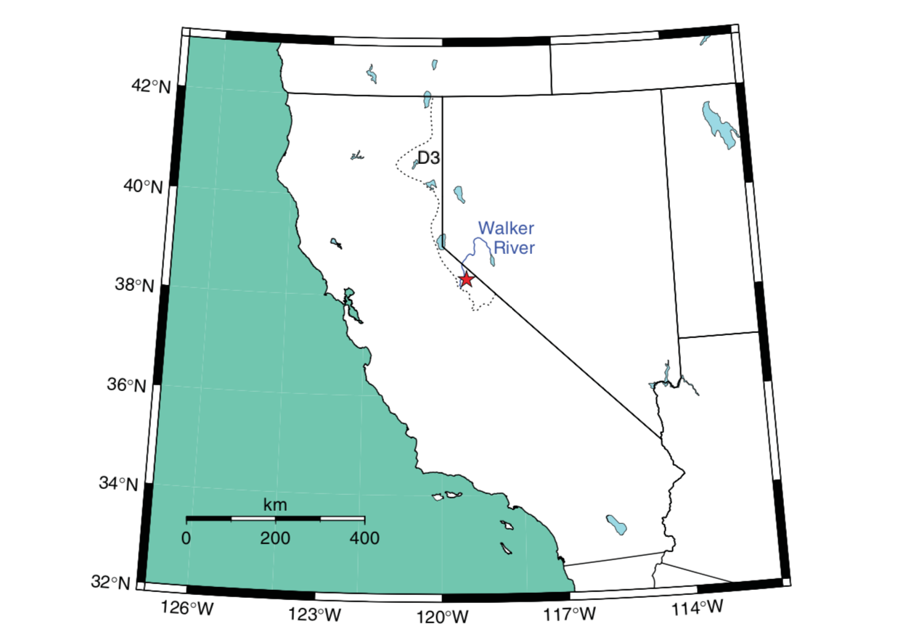
Model Application
The BEG model was applied to a multi-century long dendroclimatic reconstruction of water-year total precipitation.
Tree-ring chronologies from western juniper samples collected in the Walker River basin (boundary between California and Nevada).
Tree ring yielded 2300 annual observations.
Figure 2. Map of the Walker River, the tree-ring collections sites (star), and the boundary of California Climate Division 3 (D3, dotted
line).

Slide 11

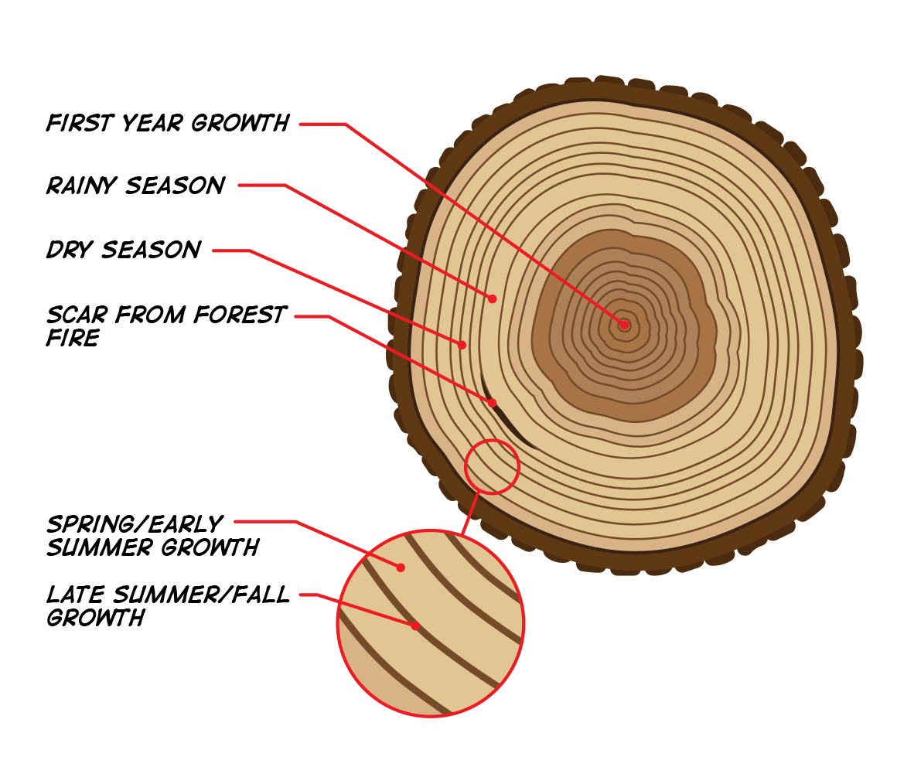
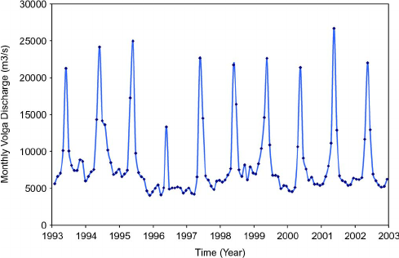
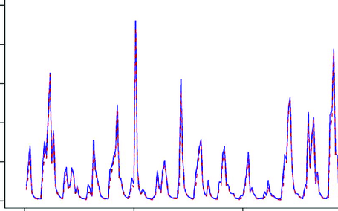
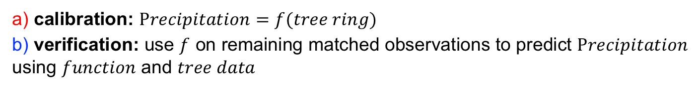
Model Application
Tree-ring data and climatic data are compared over an interval of time called the calibration period.
A statistical growth-environment relationship that can be used to reconstruct the past variations in the environment from past variations in tree-ring growth.
The procedure that estimates the statistical growth-environment relationship is called calibration.
Then using these observations to test the reconstructions for those particular years. This procedure is called “verification”.
a)
b)
a) calibration: $Precipitation=f(tree ring)$
b) verification: use $f$ on remaining matched observations to predict $Precipitation$ using $function$ and $tree data$

Slide 12
Model Application: The Data
Dendroclimatic (western juniper) reconstruction of precipitation from
300 BC to AD 2001 in the Walker River watershed (California/Nevada).
California Climate Division 3.
Figure 3. Tree-ring reconstruction of water-year total precipitation (sdu: standard deviation units). The 1926–36 drought, which corresponds to the ‘Dust Bowl’ period, is indicated by shading below the zero reference level.

Slide 13
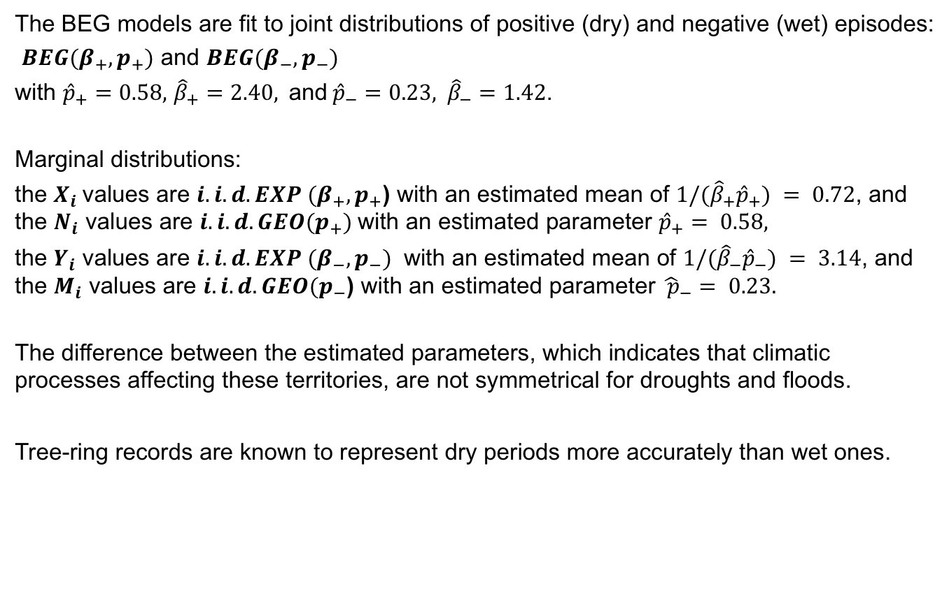
Model Fitting
The BEG models are fit to joint distributions of positive (dry) and negative (wet) episodes:
$BEG(β_{+},p_{+})$ and $BEG(β_{−},p_{−})$
with ${\hat{p}}_{+}=0.58,$ ${\hat{β}}_{+}=2.40,$and${\hat{p}}_{−}=0.23, {\hat{β}}_{−}=1.42$.
Marginal distributions:
the $X_{i}$values are $i.i.d. EXP (β_{+},p_{+}$) with an estimated mean of $1/({\hat{β}}_{+}{\hat{p}}_{+}) = 0.72$, and the $N_{i}$ values are $i.i.d. GEO(p_{+})$with an estimated parameter ${\hat{p}}_{+}= 0.58,$
the $Y_{i}$ values are $i.i.d. EXP (β_{−},p_{−})$ with an estimated mean of $1/({\hat{β}}_{−}{\hat{p}}_{−}) = 3.14$, and the $M_{i}$ values are $i.i.d. GEO(p_{−}$) with an estimated parameter ${\hat{ p}}_{−}= 0.23.$
The difference between the estimated parameters, which indicates that climatic processes affecting these territories, are not symmetrical for droughts and floods.
Tree-ring records are known to represent dry periods more accurately than wet ones.

Slide 14
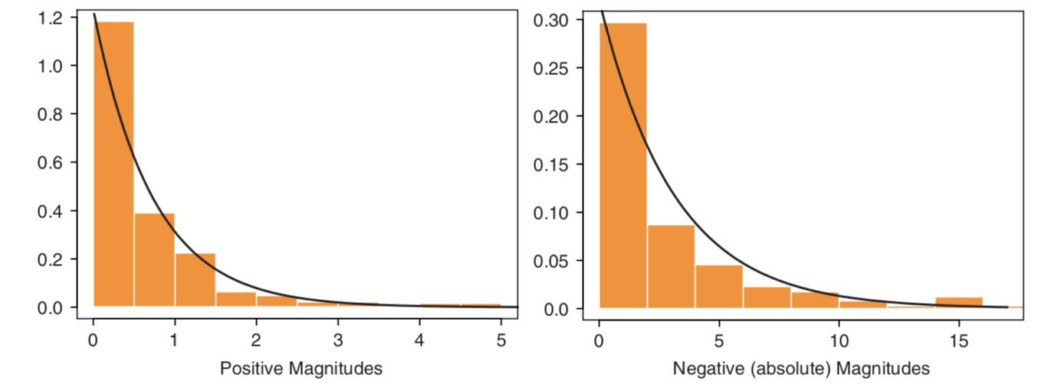
Model Application
Histograms of the $X_{i}$ and $Y_{i}$ values overlaid with the corresponding estimated exponential PDFs.
Figure 6. Probability histogram and fitted exponential distribution for positive and negative magnitudes of reconstructed hydroclimatic episodes.

Slide 15
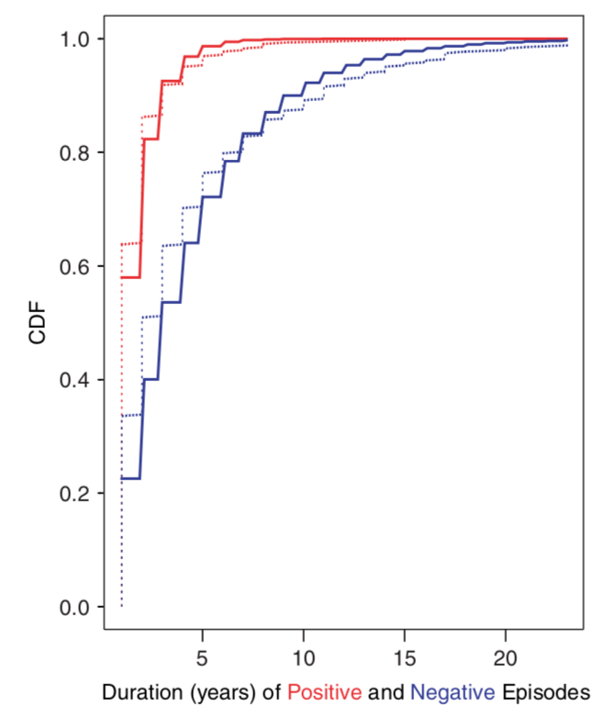
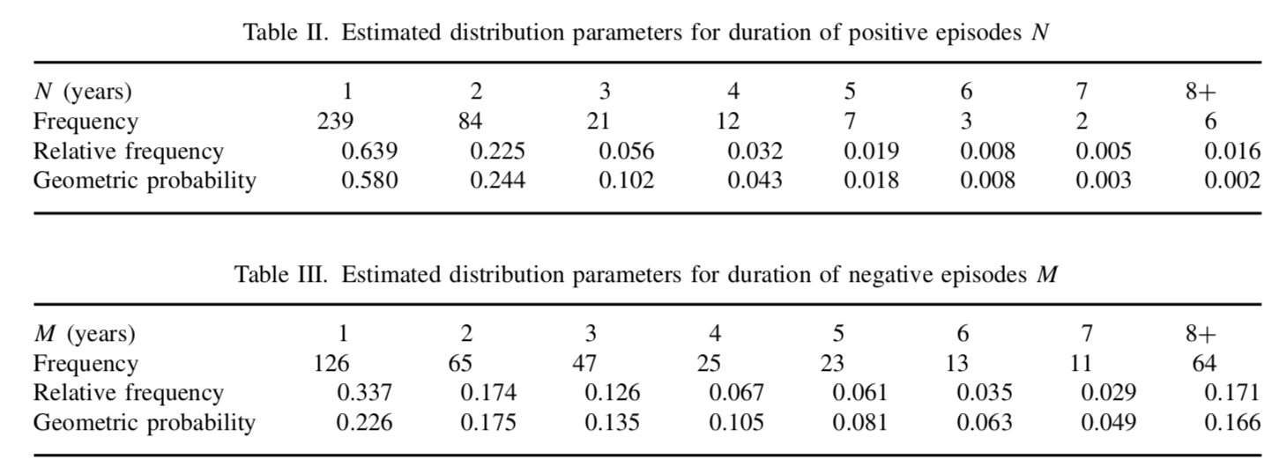
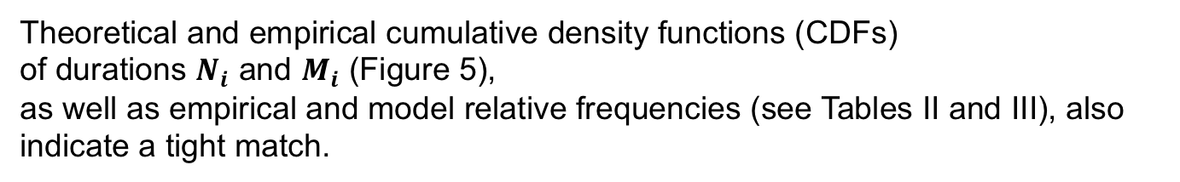
Model Application
Theoretical and empirical cumulative density functions (CDFs)
of durations $N_{i}$ and $M_{i}$ (Figure 5),
as well as empirical and model relative frequencies (see Tables II and III), also indicate a tight match.
Figure 5. Empirical (solid line) and hypothesized (dashed line) geometric cumulative density function (CDF) of duration for positive (red lines) and negative (blue lines) episodes in the reconstructed hydroclimatic record.

Slide 16
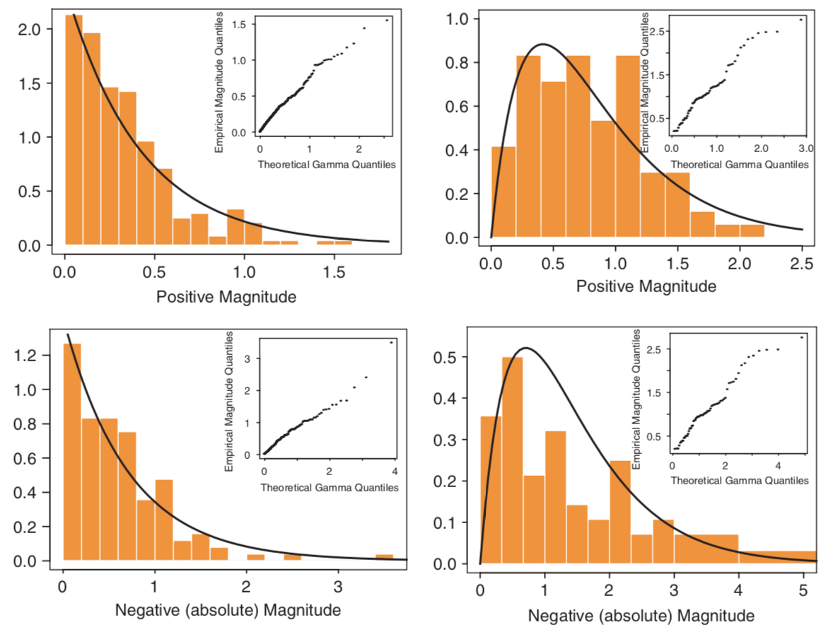
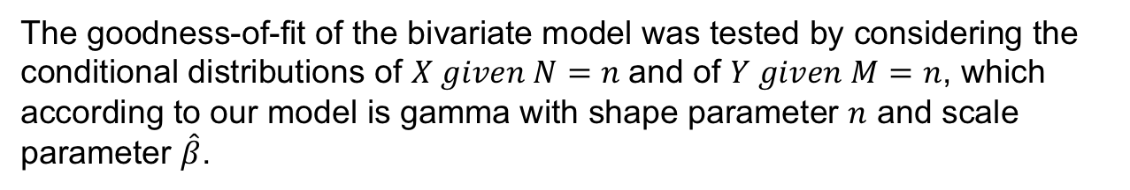
Model Application
The goodness-of-fit of the bivariate model was tested by considering the conditional distributions of $X given N=n$and of $Y given M=n$, which according to our model is gamma with shape parameter $n$ and scale parameter $\hat{β}$.
Figure 6. Conditional distribution
of magnitude given duration n
for positive (upper panels) and
negative (lower panels)
episodes in the water-year
precipitation reconstruction.
The histogram is overlaid with the model gamma density, and a probability plot of the data
vs the theoretical gamma model.
Left panels show results obtained
for n = 1, and right panels show
results obtained for n = 2.

Slide 17
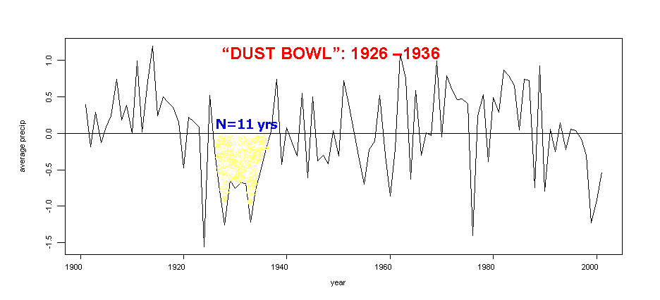
Example: “DUST BOWL”
The great drought of the 1930s, the 'Dust Bowl' impacted millions of people in many
states. It had terrifying effects on the economy and the natural environment.
Magnitude=X=7.76
Maximum=Y= 1.04
Maximum=Y= 1.04
Probability of a drought same or longer duration than the 'Dust Bowl' is 7.7%;
Probability of a drought same or greater magnitude than 'Dust Bowl' is 8.3%;
Conditional probabilities are much higher, i.e. a drought of that magnitude has a 62% chance of lasting for 11 years or longer, and a drought that lasts 11 years has a 46% chance of having an equal or greater magnitude.

Slide 18
Summary
Introduction
Stochastic models
Climatic episodes
Model definition
Bivariate Distribution
BEG
Model application
The Data
Example
“Dust Bowl”

Slide 19
Conclusions
The BEG model allows to compute the likelihood of dry or wet episodes of a given duration and magnitude. We discuss that we have identified a theoretical, stochastic mechanism capable of generating the probability distributions that were empirically found to describe duration/magnitude data in several studies of climatic episodes.
The next step would be to include an additional variable that is commonly used to describe climatic episodes, i.e. the peak value, or absolute maximum, and to model the joint trivariate distribution of duration, magnitude, and peak, as well as the bivariate properties of peak and duration, and of peak and magnitude.

Slide 20
References
Biondi F, Kozubowski TJ, Panorska AK. 2002. NEW MODEL FOR QUANTIFYING CLIMATE EPISODES. International Journal of Climatology
Biondi F, Kozubowski TJ, Panorska AK. 2002. Stochastic modeling of regime shifts. Climate Research 23: 23–30.
Kozubowski TJ, Panorska AK. In press. A mixed bivariate distribution with exponential and geometric marginals. Journal of Statistical Planning and Inference.

Slide 21
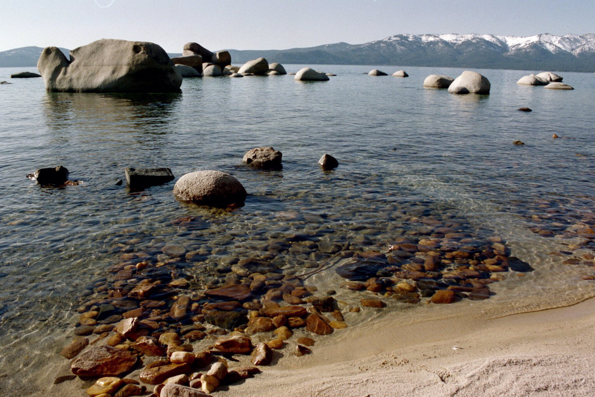
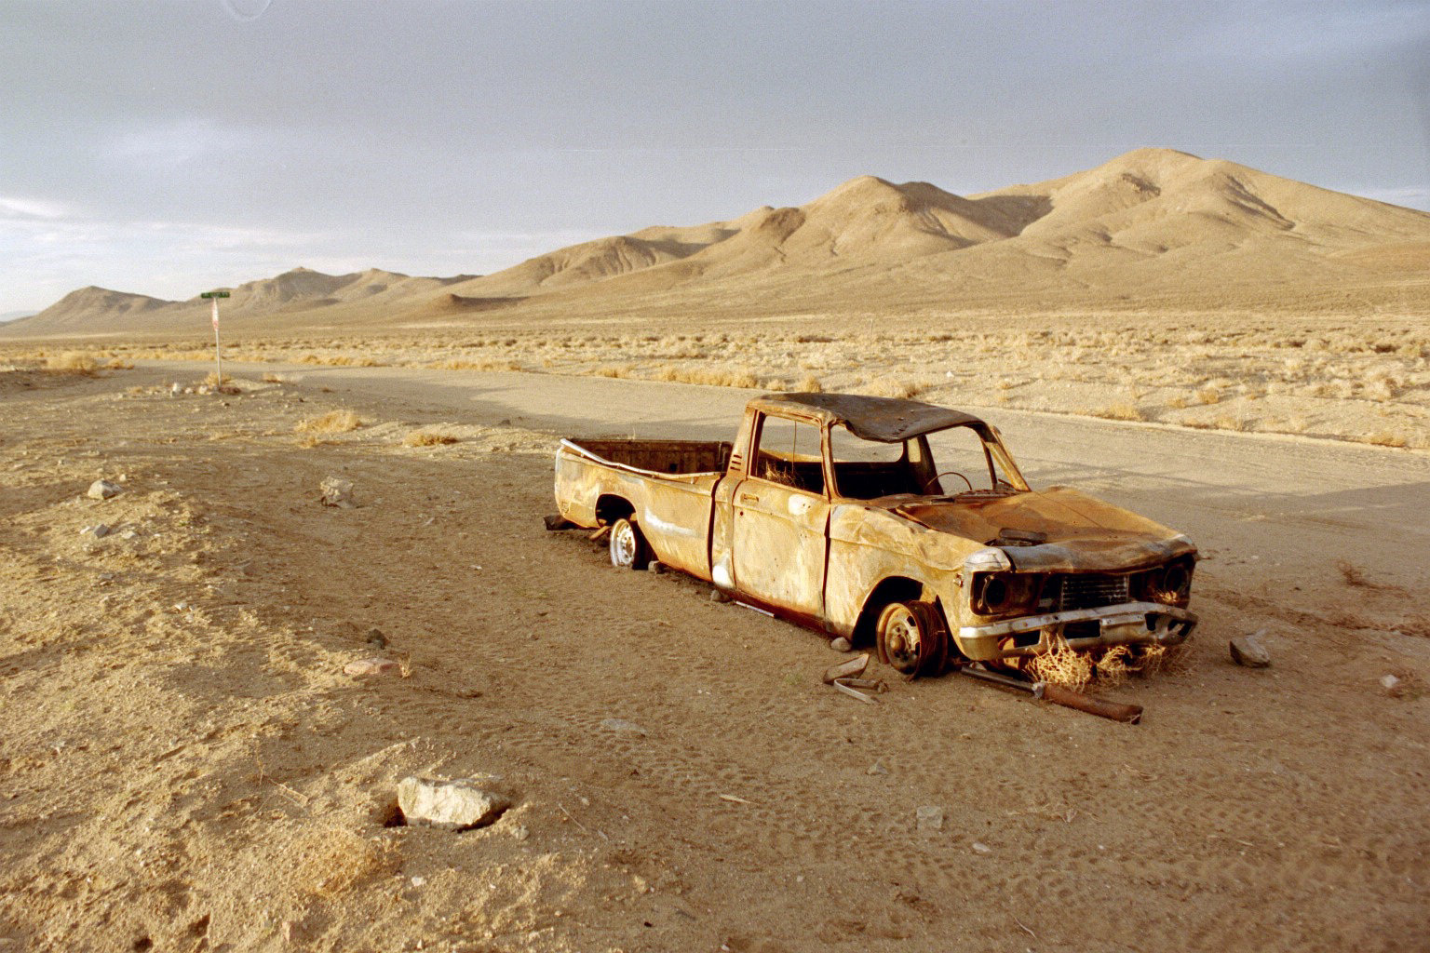
Thanks for your attention.
We have a little water, but …
… we are a very dry state !!!
Questions?

