Slide 1
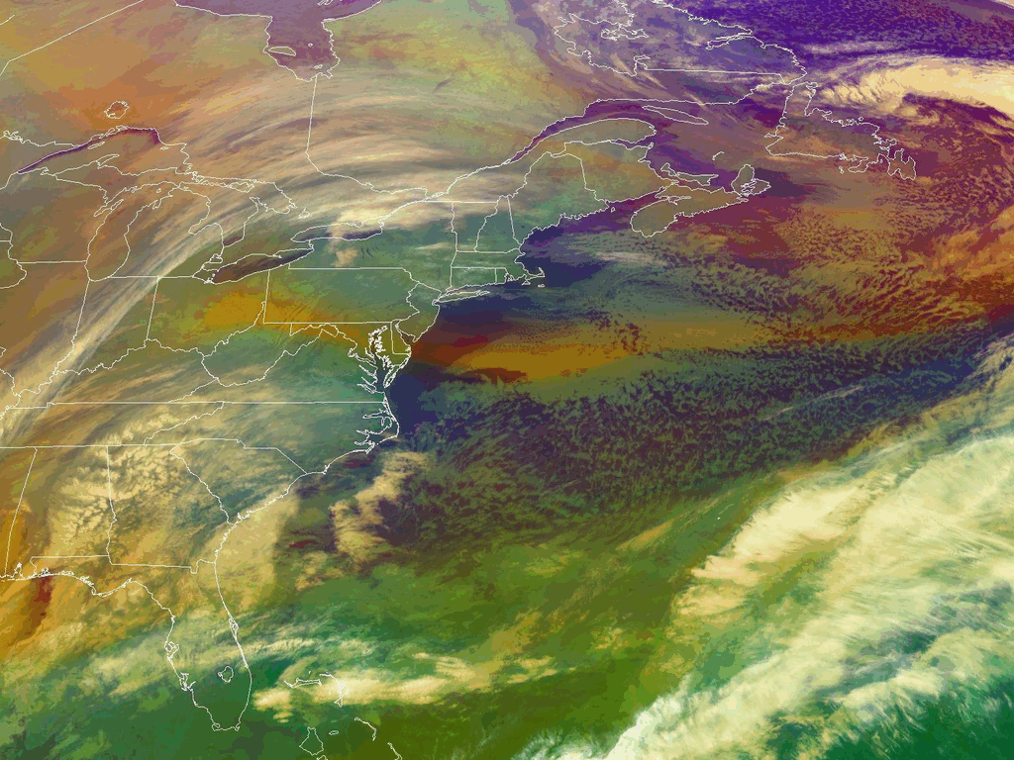
Accelerated increase in the Arctic tropospheric warming events surpassing stratospheric warming events during winter
By Wang et al., 2017, Presented by Josh Walston
January 2018 “Bomb Cyclone” - NOAA/NASA GOES-16 – CSU CIRA RAMMB
ATMS Seminar Spring 2018

Slide 2
Road Map
Key ingredients
Arctic Amplification
Rapid Arctic Warming Events
Arctic Influence on Mid-Latitude Weather
Motivation behind this study
Results
Summarize
ATMS Seminar Spring 2018

Slide 3
Road Map
Key ingredients
Arctic Amplification
Rapid Arctic Warming Events
Arctic Influence on Mid-Latitude Weather
Motivation behind this study
Results
Summarize
ATMS Seminar Spring 2018

Slide 4
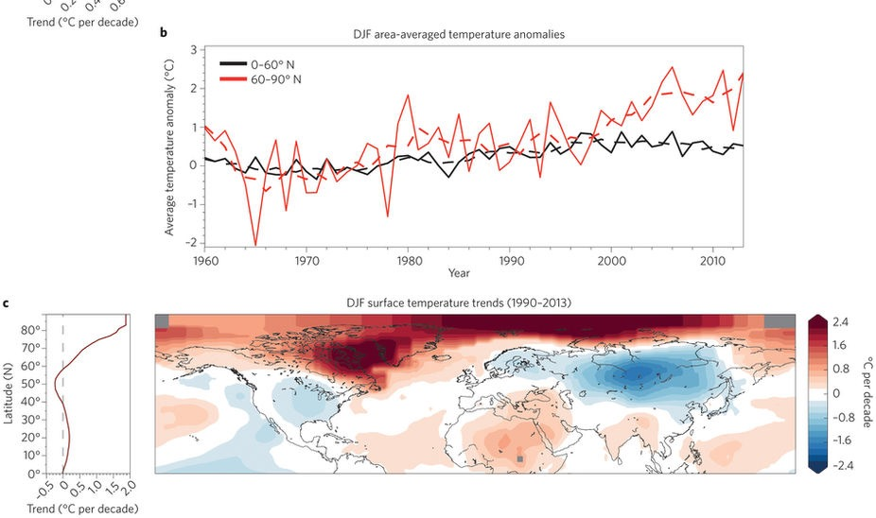
What is Arctic Amplification?
Winter (DJF) Area Averaged Temperature Anomalies
Arctic
Mid-Latitudes
°C
Winter (DJF) Surface Temperature Trends 1990-2013
Cohen et al. 2014
ATMS Seminar Spring 2018
Notes:
Arctic has warmed twice as fast as the global average.

Slide 5
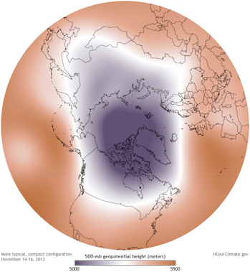
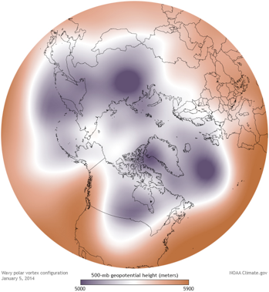
Rapid Arctic Warming Events
“…large, rapid temperature increases in the polar troposphere and stratosphere that disrupt mid-latitude weather patterns and often produce extreme deviations from normal weather conditions.” Cohen et al. 2014; Francis and Skific 2015
2 Types:
Stratospheric Warming Event
Coupled Stratosphere-Troposphere interaction
Rapid Tropospheric Warming Event
Coupled Ocean-Atmosphere interaction
Strong Polar Vortex
Weak Polar Vortex
**Similar…
Both accelerate Arctic warming
Both induce a phase reversal of the Arctic Oscillation (AO)
Both result in atmospheric blocking patterns (i.e, weather extremes)
But they are different…
ATMS Seminar Spring 2018
Notes:
Based on tropospheric-stratospheric interaction.
Atmospheric Blocking patterns cause Tropospheric Rossby waves to amplify
Momentum and energy from troposphere propagates into stratosphere.
This breaks down the strong and decelerates the mean zonal momentum of the polar jet stream and causes stratospheric warming and highly amplified planetary waves.

Slide 6
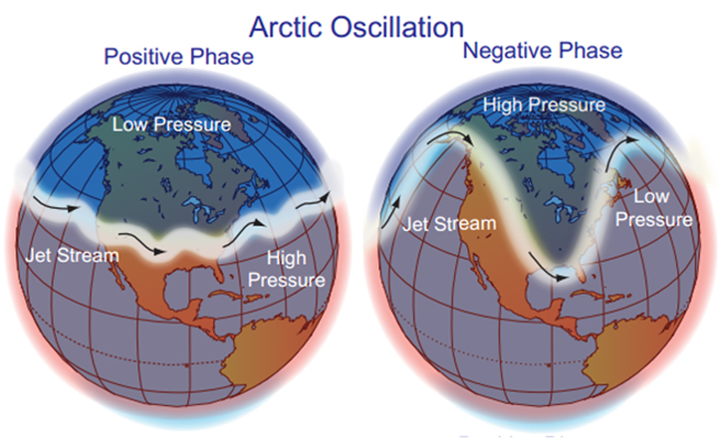
Arctic Oscillation (AO)
Opposing pattern of pressure between the Arctic and the northern mid-latitudes.
+AO: low pressure in Arctic, high pressure in mid-latitudes
-AO: high pressure in the Arctic, low pressure in mid-latitudes
ATMS Seminar Spring 2018

Slide 7
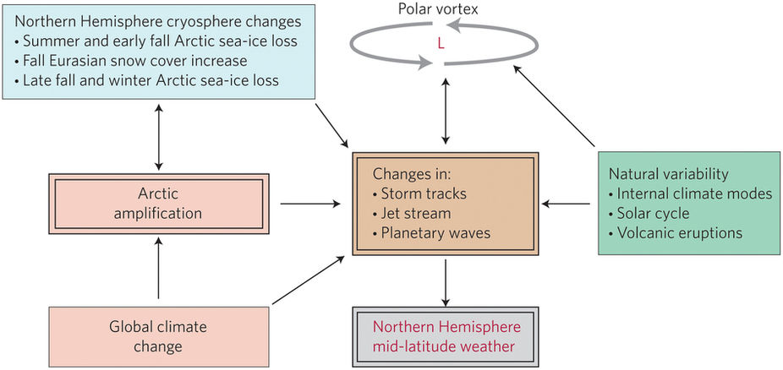
Arctic's Influence on Mid-Latitude Weather
Cohen et al. 2014
ATMS Seminar Spring 2018

Slide 8
Road Map
Key ingredients
Arctic Amplification
Rapid Arctic Warming Events
Arctic Influence on Mid-Latitude Weather
Motivation behind this study
Results
Summarize
ATMS Seminar Spring 2018

Slide 9
What Motivated this Study?
The 2015-16 rapid reversal of AO index caused extreme winter weather in the Northern Hemisphere Mid-Latitudes.
Daily Arctic Oscillation Index at 1000 hPa
4
2
0
-2
-4
2015
2016
11/1
12/1
1/1
2/1
3/1
4/1
ATMS Seminar Spring 2018

Slide 10
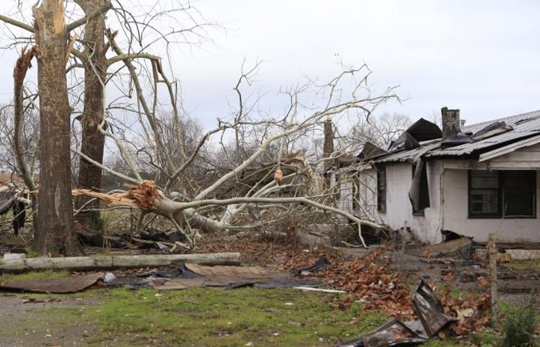
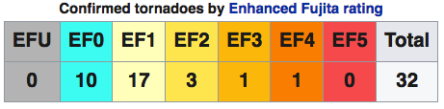
Event 1: 2015-16 Post Christmas Storm Complex
Affected areas: Southwest to Northeast U.S., Mexico and Canada.
Damage: ~ 1.2 billion U.S dollars
Total Fatalities: 59
2015
2016
11/1
12/1
1/1
2/1
3/1
4/1
5/1
ATMS Seminar Spring 2018
Notes:
December 25th-30th , 2015 – N. American Storm Complex
2-3 feet of snow in Mexico and Texas
Ice storm across midwest
Loss of 30,000 cows to storm

Slide 11
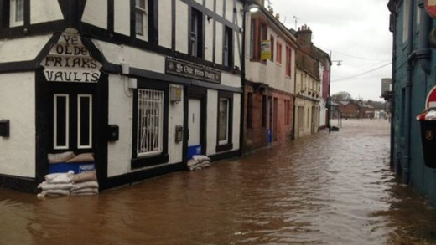
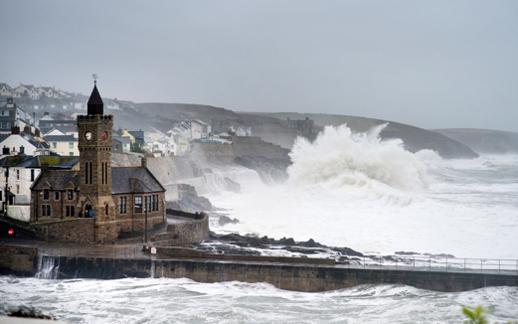
Event 2:
New Years Eve Flooding
Affected areas: Northern Ireland, Scotland and England.
Damage: ~ 7 billion U.S. dollars, ~27,000 power outages.
Total Fatalities: 3
2015
2016
11/1
12/1
1/1
2/1
3/1
4/1
5/1
ATMS Seminar Spring 2018
Notes:
December 28th, 2015 – January 3rd, 2016
Series of storms following an atmospheric river event in western Europe, with the most powerful being storm “Frank.”
Central pressure 928 hPa
70-80 mph wind gusts
Massive storm surge

Slide 12
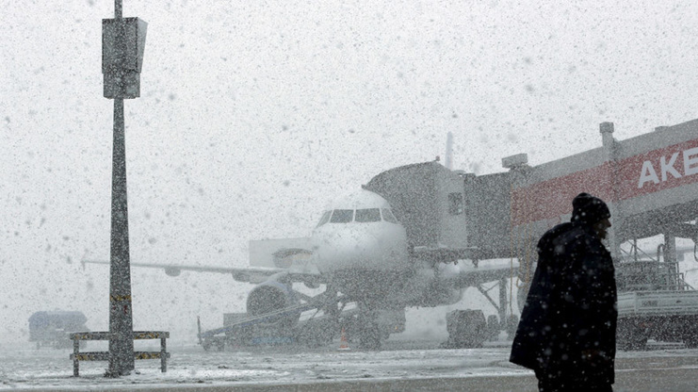
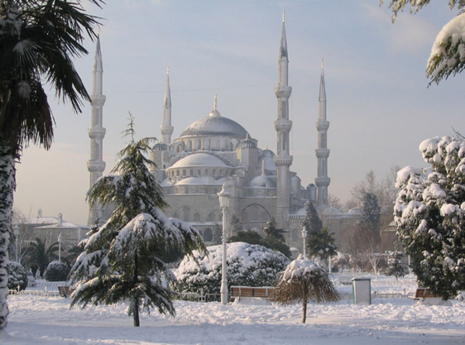
Event 3: Heavy Sea-Effect Snow Across Middle East
Hundred of flights canceled
1-2 feet fell in Istanbul, Turkey
2015
2016
11/1
12/1
1/1
2/1
3/1
4/1
5/1
ATMS Seminar Spring 2018
Notes:
December 31st, 2015

Slide 13
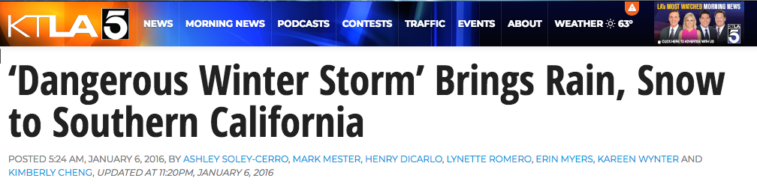

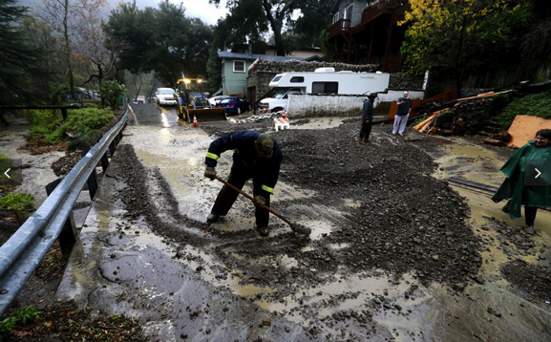
Event 4: Heavy Rain and Snow in Southern California
2015
2016
11/1
12/1
1/1
2/1
3/1
4/1
5/1
ATMS Seminar Spring 2018
Notes:
January 8-10, 2016
7 Fatalities due to poor road conditions.
80-100 mph winds reported, with downed trees and power lines

Slide 14
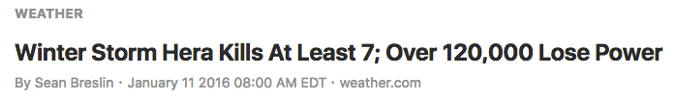
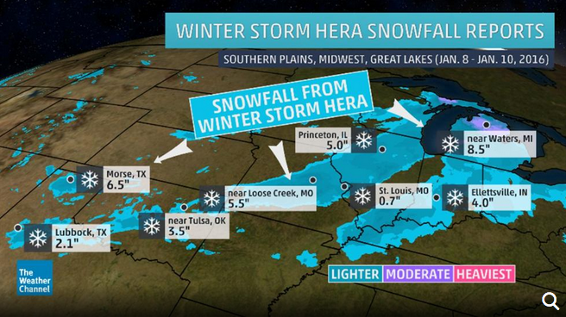
Event 5: Snow Across Midwest and Great Lakes
2015
2016
11/1
12/1
1/1
2/1
3/1
4/1
5/1
ATMS Seminar Spring 2018
Notes:
January 8-10, 2016
7 Fatalities due to poor road conditions.
80-100 mph winds reported, with downed trees and power lines

Slide 15
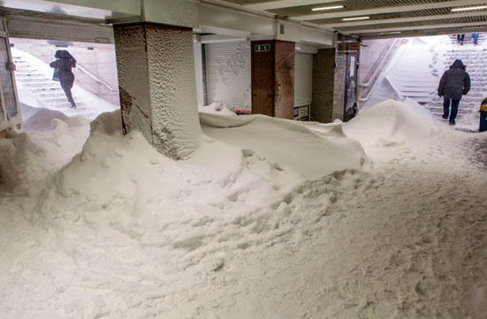
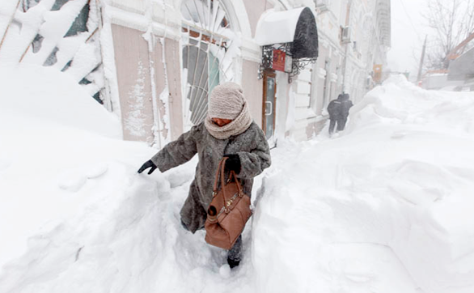
Event 6: Heavy Snowfall Inundates Russian Cities
Several of feet of snow in metro areas halted transportation
2015
2016
11/1
12/1
1/1
2/1
3/1
4/1
5/1
ATMS Seminar Spring 2018
Notes:
mid January 2016.
Winds 30-40 mph, snow drifts exceeded 5 feet in metropolitan areas, complicating transportation.

Slide 16
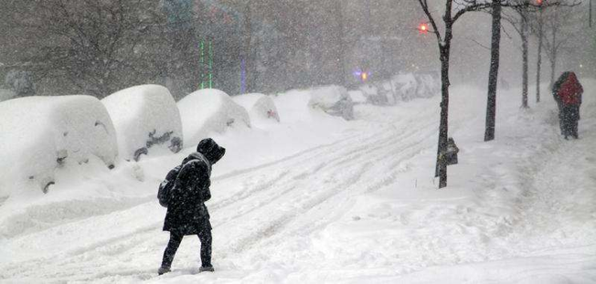
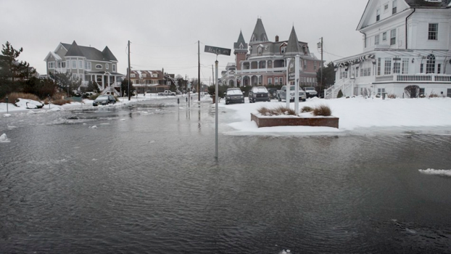
Event 7:
Historic Blizzard Along U.S. East Coast
Affected areas: Mid-Atlantic and Northeast U.S.
Damage: ~ 3 billion U.S. dollars, ~631,000 power outages.
Total Fatalities: 55
2015
2016
11/1
12/1
1/1
2/1
3/1
4/1
5/1
ATMS Seminar Spring 2018
Notes:
January 19th – January 23rd, 2016
6 tornadoes
24-40 inches of snow, with seven different states reporting 30+ inches of snow.
Coastal flooding with some coastal towns under ~9 feet.

Slide 17
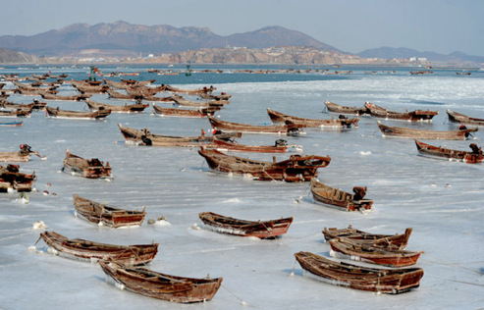
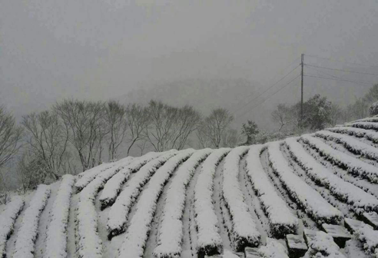
Event 8:
East Asia Cold Surge
Affected areas: East Asia, Southeast Asia, South Asia
Damage: Agricultural losses exceeded 71 million U.S. dollars
Total Fatalities: 85
2015
2016
11/1
12/1
1/1
2/1
3/1
4/1
5/1
ATMS Seminar Spring 2018
Notes:
January 23rd–26th, 2016
Low temperatures ranged from 50 to minus 50 F
Several inches to 56 inches of snow

Slide 18
Comparison of Events with AO Phase Reversal
Daily Arctic Oscillation Index at 1000 hPa
4
2
0
-2
-4
2015
2016
11/1
12/1
1/1
2/1
3/1
4/1
ATMS Seminar Spring 2018

Slide 19
Road Map
Key ingredients
Arctic Amplification
Rapid Arctic Warming Events
Arctic Influence on Mid-Latitude Weather
Motivation behind this study
Results
Summarize
ATMS Seminar Spring 2018

Slide 20
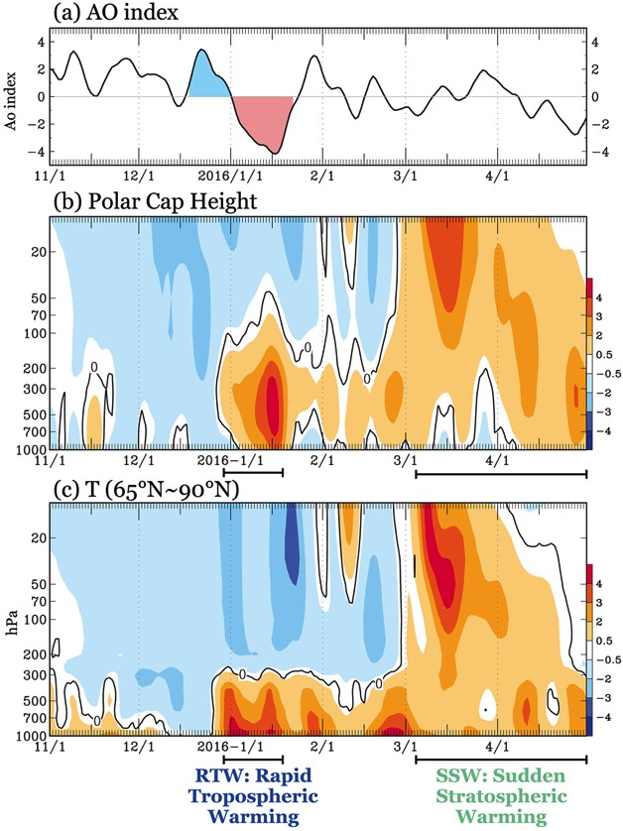
Rapid Tropospheric Warming (RTW) Criteria
Positive Tropospheric Polar Cap Height (PCH) anomalies north of 65° N. Latitude.
PCH anomalies greater than 1.5σ
Stratospheric PCH anomalies remain neutral to negative.
Stratospheric warming must not be present during event, nor 15 days prior to event.
AO reversal must be present.
ATMS Seminar Spring 2018
Notes:
Note: the standard SSW criteria was used to identify events.
50 hPa PCH anomalies greater than 1.5 std
50 PCH anomalies then propagate downward below 200 hPa
Timespan of event is given as the first warming signal in stratosphere to the last warming signal in the troposphere

Slide 21
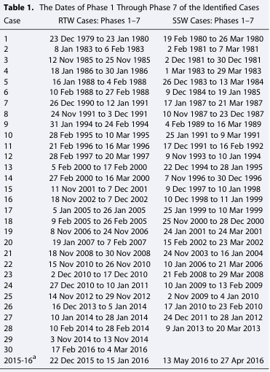
Rapid Tropospheric Warming (RTW) Events
Identified cases from 1979-2016:
30 RTW events
28 SSW events
ATMS Seminar Spring 2018
Notes:
Note: the standard SSW criteria was used to identify events.
50 hPa PCH anomalies greater than 1.5 std
50 PCH anomalies then propagate downward below 200 hPa
Timespan of event is given as the first warming signal in stratosphere to the last warming signal in the troposphere

Slide 22
Composite Analysis: Index of Cycle
Daily Arctic Oscillation Index at 1000 hPa
4
1
2
2
3
0
4
5
-2
6
7
-4
2015
2016
11/1
12/1
1/1
2/1
3/1
4/1
Transition from positive to negative status:
1 representing AO maximum
7 representing AO minimum
ATMS Seminar Spring 2018

Slide 23
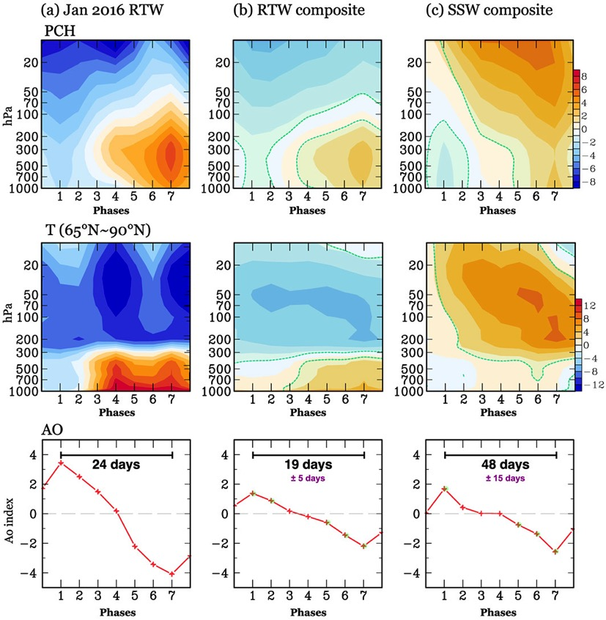
Composite Analysis
Pressure and Temperature anomalies reveal signature RTW (left) and SSW (right) characteristics
AO transition in RTW (left) events are nearly twice as fast compared to SSW (right) events
ATMS Seminar Spring 2018

Slide 24
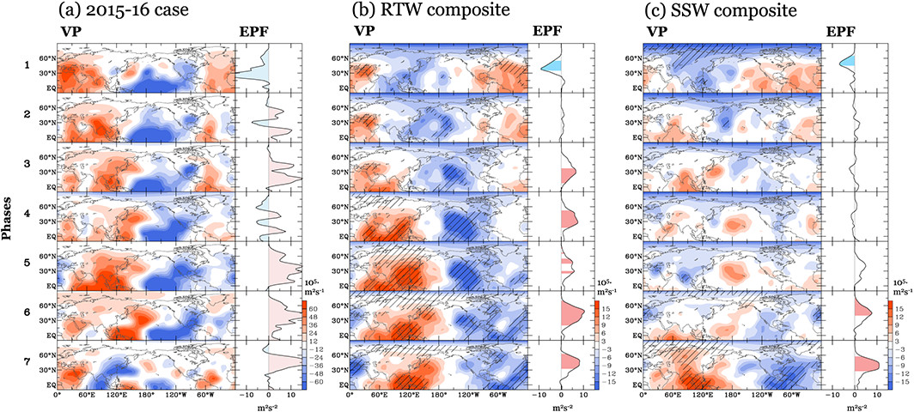
Composite Analysis: Dynamical Aspects
Wave-1 pattern found in RTW composite analysis: 1 ridge, 1 trough.
Positive EP-Flux present in RTW phases 3-7: Tropical influence on heat and
moisture transport into Arctic
ATMS Seminar Spring 2018
Notes:
VP at 200 mb represents divergence aloft, signifying convective outflow from towering cumulonimbus.
Is a proxy for deep convection in the tropics.
EP flux estimate the impact transient eddies have on the mean flow…transport of heat and momentum from tropics to arctic.

Slide 25
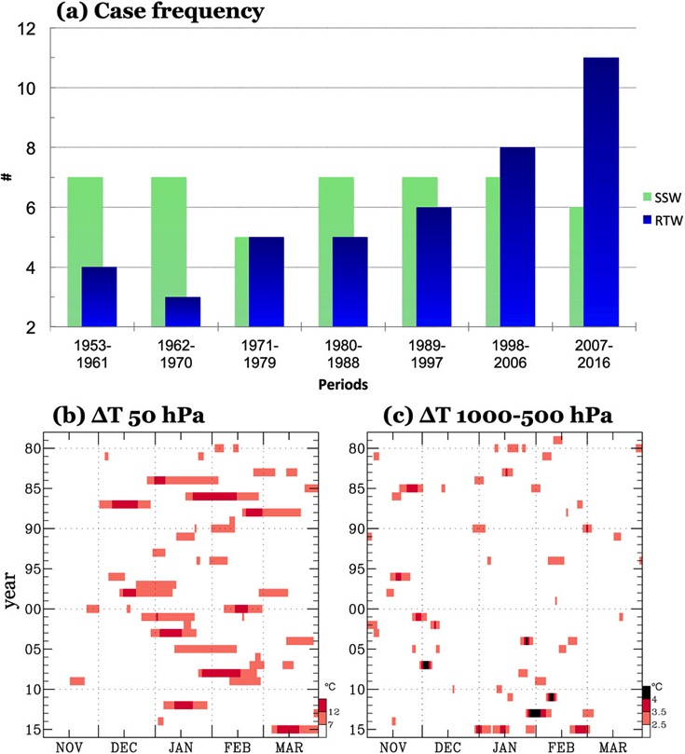
Disparity in Trends
RTW events have been increasing in frequency since the late 1990’s.
Daily occurrence of tropospheric warming has increased since the early 21st century.
ATMS Seminar Spring 2018
Notes:
SSW reveals a flat trend.

Slide 26
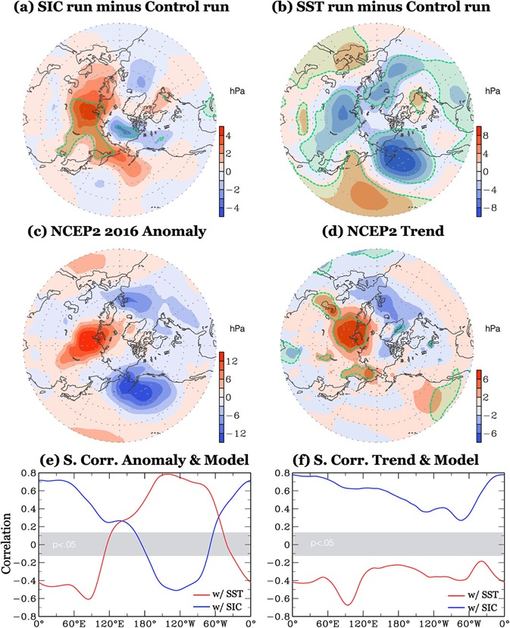
External Forcing: SIC vs. SST
Relative contribution of Sea ice (SIC) vs. Sea Surface Temperatures (SST) on high-latitude circulation:
SIC → constant, climatological SST’s and varying SIC
SST→ constant, climatological SIC and varying SST
Results: opposite patterns in sea level pressure between scenarios.
ATMS Seminar Spring 2018
Notes:
Authors conducted a model experiment to determine the relative effects of sea ice loss and tropical sst’s on RTW’s:
1) SIC → constant climatological SST’s and varying sea ice concentrations
2) SST→

Slide 27
External Forcing: SIC vs. SST
2016 anomaly and observational, long-term trend consistent with the SIC scenario…a pattern driven by Arctic sea ice loss.
SIC scenario is positively correlated with SLP trend and 2016 anomaly.
ATMS Seminar Spring 2018
Notes:
SIC correlation suggests that the strong el nino 2015/2016 was largely offset by sea ice reduction.

Slide 28
Road Map
Key ingredients
Arctic Amplification
Rapid Arctic Warming Events
Arctic Influence on Mid-Latitude Weather
Motivation behind this study
Results
Summarize
ATMS Seminar Spring 2018

Slide 29
Let’s Summarize
Rapid Arctic warming events are:
“…large, rapid temperature increases in the polar troposphere and stratosphere that disrupt mid-latitude weather patterns and often produce extreme deviations from normal weather conditions.” Cohen et al. 2014; Francis and Skific 2015
Take Home Message #1
Sudden Stratospheric Warming (SSW)
Tropospheric-stratospheric interaction
Circulation disrupted by vertically propagating waves
Rapid Tropospheric Warming (RTW)
Confined to the troposphere
Enhanced by intraseasonal Ocean-Atmosphere variation
ATMS Seminar Spring 2018
Notes:
this study, among others, have indicated that the loss of arctic sea ices strongly influences temperatures and circulation over the artic region, in turn, modulates the midlatitude extreme events.

Slide 30
Let’s Summarize
Rapid Arctic warming events are:
“…large, rapid temperature increases in the polar troposphere and stratosphere that disrupt mid-latitude weather patterns and often produce extreme deviations from normal weather conditions.” Cohen et al. 2014; Francis and Skific 2015
Take Home Message #2
RTW events dynamically develop nearly twice as fast, compared to SSW events.
ATMS Seminar Spring 2018
Notes:
this study, among others, have indicated that the loss of arctic sea ices strongly influences temperatures and circulation over the artic region, in turn, modulates the midlatitude extreme events.

Slide 31
Let’s Summarize
Rapid Arctic warming events are:
“…large, rapid temperature increases in the polar troposphere and stratosphere that disrupt mid-latitude weather patterns and often produce extreme deviations from normal weather conditions.” Cohen et al. 2014; Francis and Skific 2015
Take Home Message #3
An accelerated trend in RTW events has been observed since the 1990’s versus a relatively flat trend in SSW events since 1953.
ATMS Seminar Spring 2018
Notes:
this study, among others, have indicated that the loss of arctic sea ices strongly influences temperatures and circulation over the artic region, in turn, modulates the midlatitude extreme events.

Slide 32
Let’s Summarize
Rapid Arctic warming events are:
“…large, rapid temperature increases in the polar troposphere and stratosphere that disrupt mid-latitude weather patterns and often produce extreme deviations from normal weather conditions.” Cohen et al. 2014; Francis and Skific 2015
Take Home Message #4
Modeling experiments indicate reduced Arctic sea ice contributes to the observed increase in the tropospheric warming events, and…
Enhances intraseasonal variations in high-latitude circulation, resulting in extreme winter weather outbreaks accompanying RTW events.
ATMS Seminar Spring 2018
Notes:
this study, among others, have indicated that the loss of arctic sea ices strongly influences temperatures and circulation over the artic region, in turn, modulates the midlatitude extreme events.

Slide 33
Thank you for Listening!
Any questions?
ATMS Seminar Spring 2018
Notes:
this study, among others, have indicated that the loss of arctic sea ices strongly influences temperatures and circulation over the artic region, in turn, modulates the midlatitude extreme events.

Slide 34
Reference list
Cohen, J., J. A. Screen, J. C. Furtado, M. Barlow, D. Whittleston, D. Coumou, J. Francis, K. Dethloff, D. Entekhabi, and J. Overland (2014), Recent Arctic amplification and extreme mid-latitude weather, Nat. Geosci., 7(9), 627–637.
Francis, J. and Skific, N. (2015). Evidence linking rapid Arctic warming to mid-latitude weather patterns, Phil. Trans. R. Soc. DOI: 10.1098/rsta.2014.0170
Gottschalck, Jon. "What Is the MJO, and Why Do We Care." What Is the MJO, and Why Do We Care? | NOAA Climate.gov. N.p., 31 Dec. 2014. Web. 31 Mar. 2018
Overland, J., K. Dethloff, J. A. Francis, R. J. Hall, E. Hanna, S.-J. Kim, J. A. Screen, T. G. Shepherd, and T. Vihma (2016), Nonlinear response of midlatitude weather to the changing Arctic, Nat. Clim. Change, 6(11), 992–999.
L'Heureux, Michelle. “The Madden Julian Oscillation Has Been Active so Far This Winter. Here Is Why It Matters.” The Madden Julian Oscillation Has Been Active so Far This Winter. Here Is Why It Matters. | NOAA Climate.gov, 22 Feb. 2018
Pedatella, N. M., J. L. Chau, H. Schmidt, L. P. Goncharenko, C. Stolle, K. Hocke, V. L. Harvey, B. Funke, and T. A. Siddiqui (2018), How sudden stratospheric warming affects the whole atmosphere, Eos, 99, https://doi.org/10.1029/2018EO092441. Published on 20 March 2018.
Palmeiro, F.M., D. Barriopedro, R. García-Herrera, and N. Calvo, 2015: Comparing Sudden Stratospheric Warming Definitions in Reanalysis Data. J. Climate, 28, 6823–6840, https://doi.org/10.1175/JCLI-D-15-0004.1
Wang, S. -Y. S., Y. -H. Lin, M. -Y. Lee, J. -H. Yoon, J. D. D. Meyer, and P. J. Rash (2017),
Accelerated increase in the Arctic tropospheric warming events surpassing stratospheric warming events during winter, Geophys. Res. Lett., 44, 3806—3815, doi:10.1002/2017GL073012.
ATMS Seminar Spring 2018

Slide 35
Atmospheric Teleconnection Patterns
MJO
ENSO
AO
NAO
PDO
QBO
NAM
PNA
EAJET
WP
TNH
AMO
SAM
Large-scale changes in atmospheric circulation influencing temperature, rainfall, storm tracks, jet stream location and intensity. – Climate Prediction Center NOAA
MJO – Madden Julian Oscillation
ENSO – El Nino Southern Oscillation
AO – Arctic Oscillation
ATMS Seminar Spring 2018
Notes:
Regarded as “natural variability” of the climate system and are a reflection of internal atmospheric dynamics.
More often than not driven by changes tropical SST’s and tropical convection associated with ENSO and MJO.
Typically responsible for simultaneous abnormal wx patterns over vast geographical regions.

Slide 36
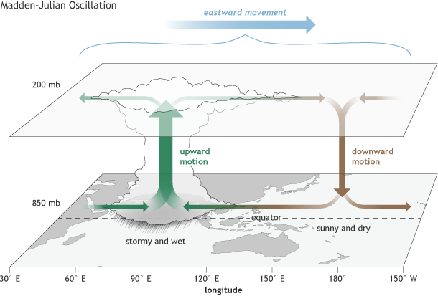
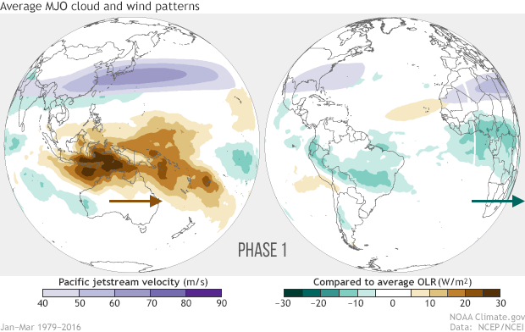
Atmospheric Teleconnection Patterns
Madden Julian Oscillation
NOAA Climate.gov
Eastward moving disturbance of clouds, rainfall, winds, and pressure
Traverses tropics in 30 to 60 days.
Can occur multiple times in a single season (most notable in winter).
ATMS Seminar Spring 2018
Notes:
MJO is confined to the Tropics, it can still push around the global circulation and impact temperature and precipitation over the United States

Slide 37
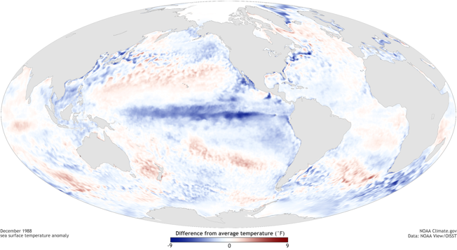
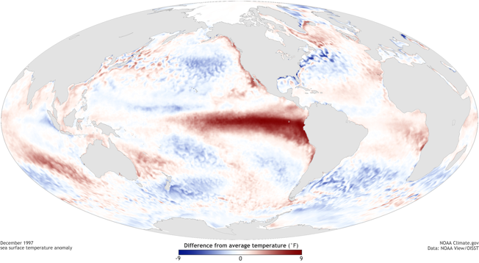
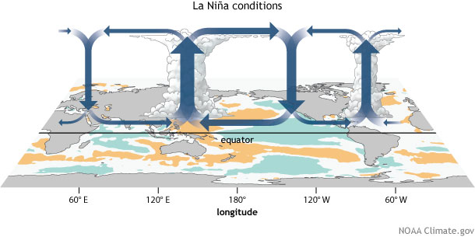
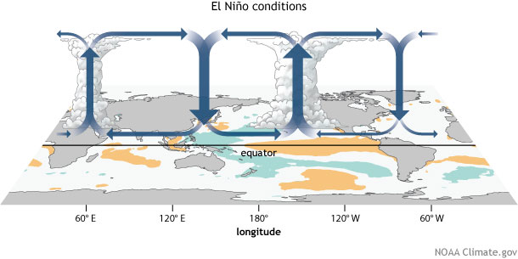
Atmospheric Teleconnection Patterns
EL Nino Southern Oscillation
La Nina
El Nino
NOAA Climate.gov
ATMS Seminar Spring 2018
Notes:
The fluctuations in temperature between the ocean and atmosphere in the east-central Equatorial Pacific

