Slide 1
The Arctic Oscillation and the relation to the extreme summer heat wave of 2010
ATMS790: Graduate Seminar, Yuta Tomii
Reference:Otomi, Y., Tachibana, Y. & Nakamura, T. Clim Dyn (2013) 40: 1939. https://doi.org/10.1007/s00382-012-1386-0

Slide 2
Outline
Motivation
What is Arctic Oscillation?
The Relationship with Jet Streams
Summary of the Paper
Main results of the paper
Conclusion

Slide 3
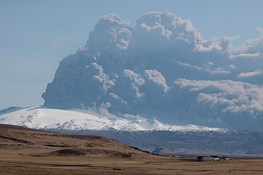

Motivation
1. In summer of 2010, Europe and western Russia experienced record-breaking hot temperatures, attributed to a blocking high pressure over the Europe and Russian region.
2. Northern and eastern part of Japan experienced the highest summer mean temperature in the history.
3. Some researchers predicted the temperature would be below average in summer of 2010: Eyjafjallajökull eruption in Iceland from March to June in 2010 .

Slide 4
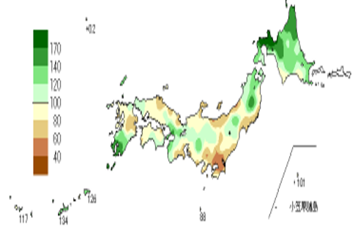
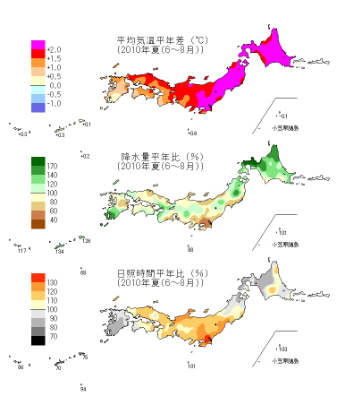


Motivation: heat wave in Japan
Mean precipitation(℃) and temperature (%) deviation(June to August in 2010)
Notes:
This is one example of the climatological data in japan in 2010 summer. As we can see here, most of area in japan experienced hotter summer than climatological mean in 30 years.

Slide 5
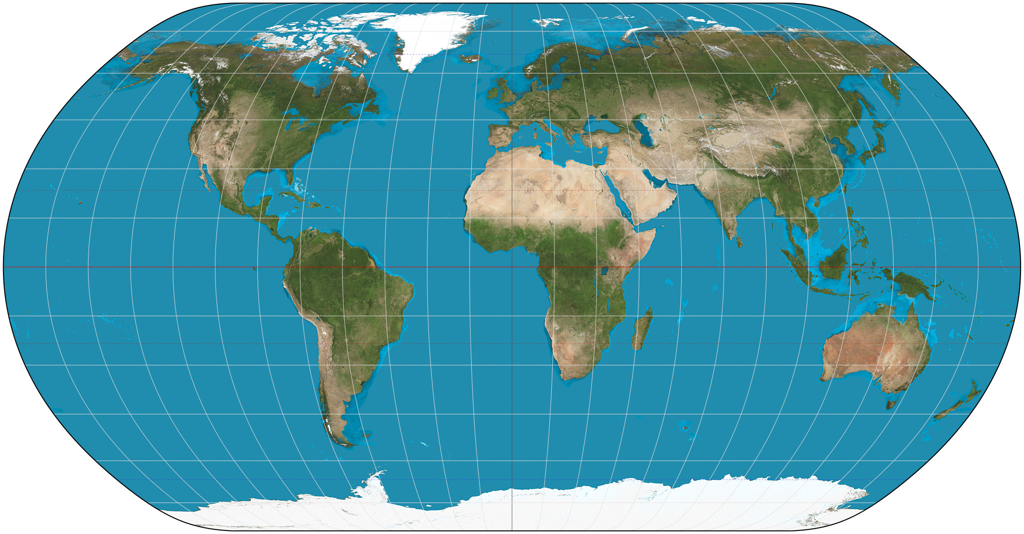
What is the Arctic Oscillation:AO?
Phigh_lat_anomaly
It is a teleconnection: change in systematic pressure difference between high and middle latitudes
Definition: A non-periodic variation in surface atmospheric pressure in the Arctic region coupled with an opposite variation in the middle latitude (and associated with similar variation in the North Atlantic)
Pmid_lat_anomaly

Slide 6
What is the Arctic Oscillation:AO?
AO index: indicator for its state and strength
Positive(+); When P_{mid_lat_anomaly} is positive and
P_{high_lat_anomaly} is negative
2. Negative(-); When P_{high_lat_anomaly} is positive
and P_{mid_lat_anomaly} is negative
Phigh_lat_anomaly
Pmid_lat_anomaly

Slide 7
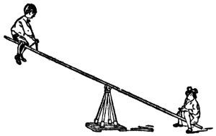
What is the Arctic Oscillation:AO?
AO Positive : When mass of air column at mid-latitude is greater and mass of air column at high latitude is smaller
Mass of Air Column at High Latitude
Mass of Air Column at Middle Latitude

Slide 8
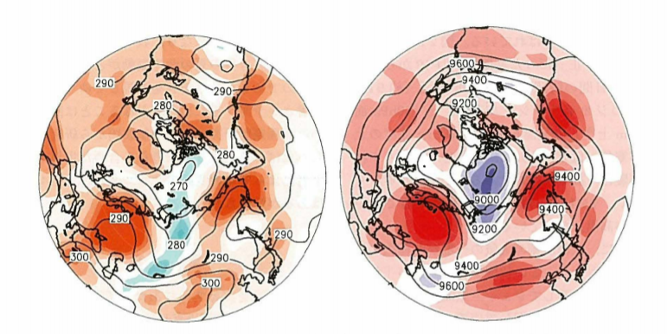
What is the Arctic Oscillation:AO?
low pressure anomaly in the Arctic region and high press anomaly in mid latitude
low and high pressure anomalies are associated with low and high temp anomalies at each location because of compression and expansion.
AO index?
Time-mean temp (850mb)
Time-mean geopotential height (300mb)
Notes:
Geopotential is expressed by the product of gravitational coefficient and actual. Because of the relationship with the hydrostatic equation, the large value means high pressure there.
Explanation of the map. How to look at the map

Slide 9
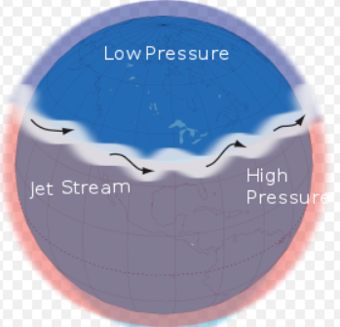
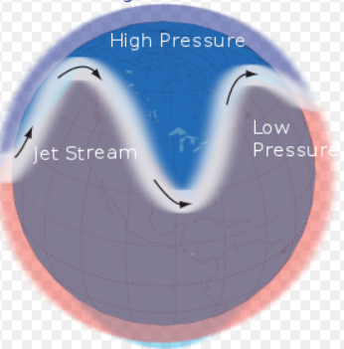
Relationship with Jet Streams
Positive Phase
Negative Phase
Positive phase: warm in the middle latitude
Negative phase: cold in the middle latitude
Notes:
When the AO index is positive, the jet stream will be stronger and flow straightly. On the other hand, when the AO index is negative, the jet stream will be weaker and meander.

Slide 10
Summary of the paper
In 2010, Northern hemisphere: Eastern Europe, and Japan experienced an abnormally hot summer associated with positive AO index.
There was a drastic change in the index from the previous
winter to summer: from negative index to positive index.
The change of the AO index might have been related to the large heat capacity of the Atlantic ocean.

Slide 11
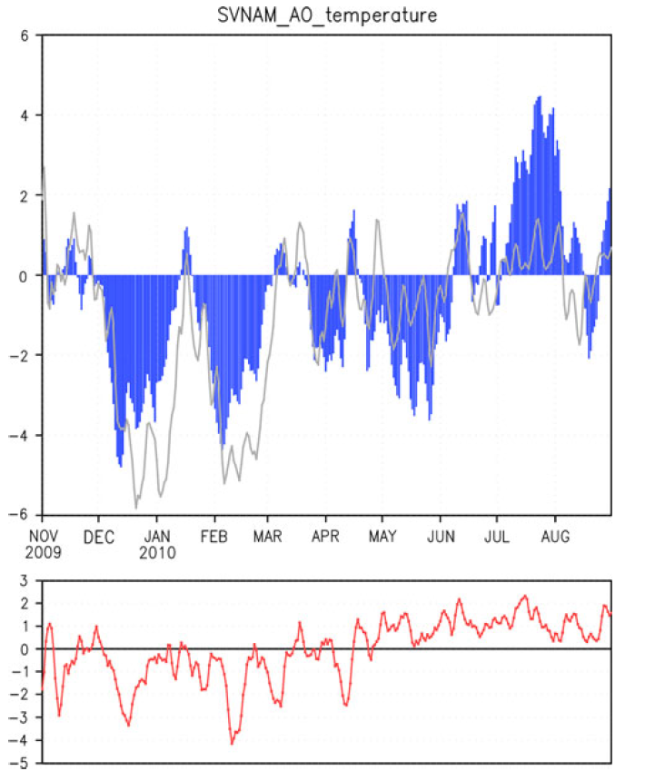
From July to Aug, extremely positive AO index exists: (blue curve).
It coincides with hot days in mid-latitude: (red curve).
Although they do not coincide in spring, the index in summer and winter corresponds well.
Notes:
The top picture shows AO index from Nov 2009 to Aug 2010. The vertical axis is unitless because the indices are normalized.
The bottom picture is temperature anomaly on 925mb at 32.5 degree north latitude.
The hot summer associated with +AO index is due to a blocking anticyclone.
What we should take note here is AO index is a good indicator of abnormal weather and long term forecasting. The grey line in the upper picture is also AO index which was calculated by another method. Empirically, SVNAM method accorded well with the actual temperature change, so all of the AO index used in this paper is derived from SVNAM method.
(Top): Time series of the AO index (blue) as defined by Ogi et al. (2004),who called it SVNAMindex. AO index reported by NOAA/CPC is shown by the
gray line. The vertical axis is dimensionless because the indices are normalized.
(Bottom): Time series of the temperature anomaly (K) at 925 hPa averaged northward of 32.5 N over the Eurasian continent. Anomalies are calculated according to the
daily climatology of 32 years.

Slide 12
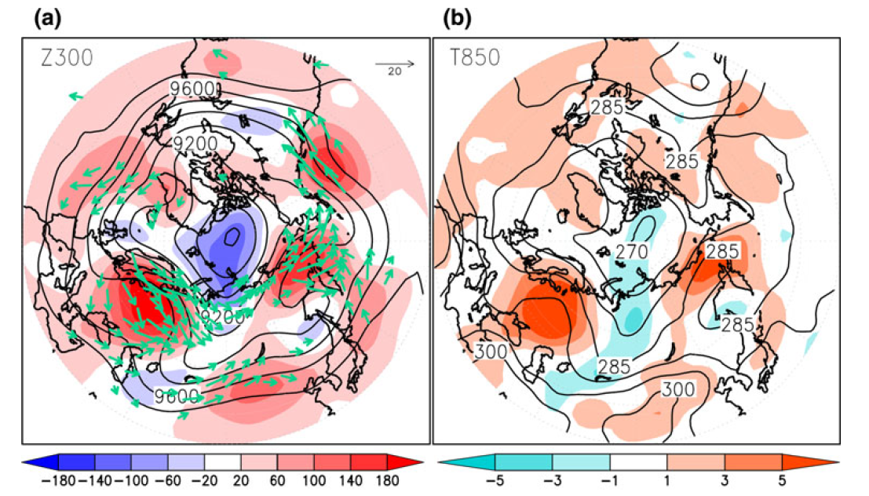
a. Time-mean 300mb layer
b. Time-mean temp on 850mb
In figure a, positive geopotential anomaly is in middle latitude and negative anomaly in the Arctic region
We can see the height contours meandering and suggesting an existence of blocking-high over Europe
In figure b, high temp anomaly is over eastern Europe and Russia and low temp anomaly in the Arctic region and Siberia
Notes:
We have two figures here. This view is from the arctic pole in 2010 summer, so we can see the US here and Europe is here.
In figure a, the contour is time mean geopotential height in the summer on 300mb and the shading is normalized anomaly.
In figure b, the contour shows the time mean temperature on 850mb in the summer, and the shading is normalized temperature anomaly.
In figure a, negative geopotential anomaly can be seen in arctic region. On the other hand, other middle altitude areas are covered by positive geopotential anomaly: high pressure. Blocking high is a stationary high pressure. Because it does not move for a long time, it causes sunny and warm days.
In the figure b, we can see two tremendous high temp anomaly over eastern Europe and eastern Russia. It is corresponding to the high pressure area.
Explanation for the contour and the shading
Labelling each figure
Remove the explanation of the figure2

Slide 13
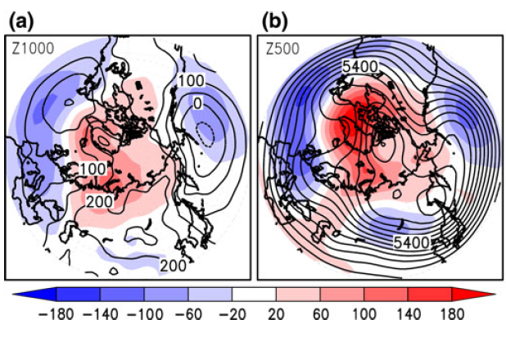
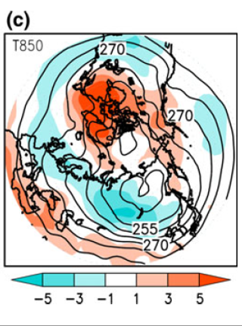
mean 1000mb map
mean 500mb map
In figure a and b, positive geopotential anomaly is in the high latitude (Arctic region ) and negative anomaly in the middle latitude.
In figure c, there is a high temperature anomaly in Northern Atlantic, low anomaly in the middle region and high anomaly in the tropic region.
The pattern corresponds to the typical negative Northern Atlantic Oscillation (NAO), which is called tripolar pattern. The author claims that negative AO index is correlated to the negative NAO index because of the fact.
mean temp on 850mb
Notes:
The three figures are in 2009/2010 winter data. In figure a, the contour is the mean geopotential height on 1000mb and b is same as on 500mb.
The figure c shows the mean temperature of the winter on 850mb map
3. We will go over the tripolar pattern in the next slide

Slide 14
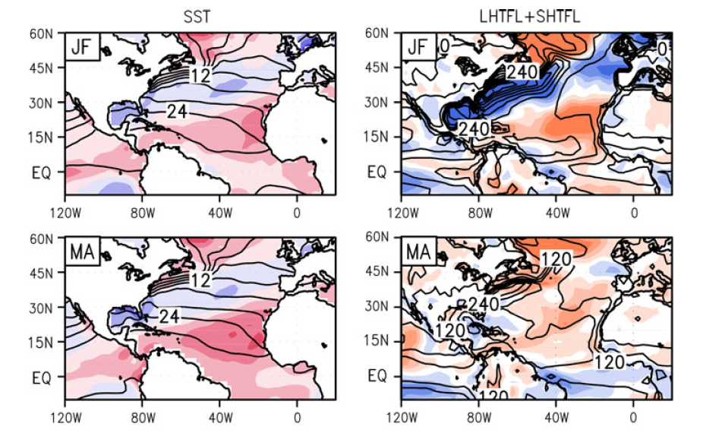
Typical Negative NAO index Structure
We can see the tripolar pattern in SST: warm anomaly in high latitude and tropic, and cold anomaly in middle latitude of Northern Atlantic.
Latent and sensible heat flux
corresponds to the tripolar
pattern.
Notes:
We have 4 figures here. The left column shows the sea surface temperature SST whose unit is cerusius in January, February, march and April. And, the right column shows the latent and sensible heat flux whose unit is watt/m^2. This view is on the Atlantic Ocean, so we can see the US here and Europe here.
The shading shows anomaly. Each contour is time mean of the 2 month. We should pay attention to the sign of the right column anomaly. The flux is positive if the heat goes from ocean to the atmosphere, so orange shade means the ocean is heated by the atmosphere.

Slide 15
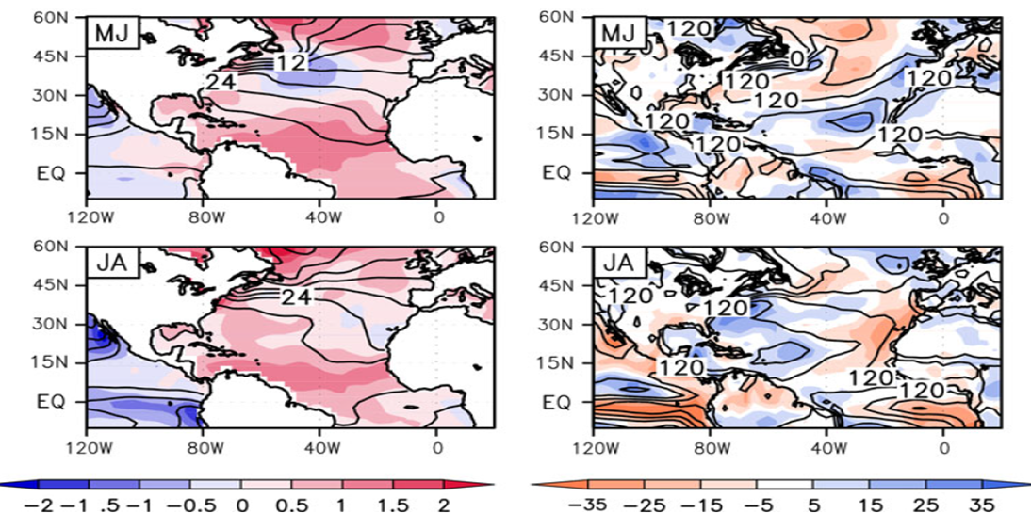
Latent and sensible heat flux deviates from the tripolar pattern from May.
However, the SST anomaly still shows the tripolar pattern. The author claims that this is because of the large heat capacity of the Atlantic Ocean.
Notes:
These 4 figures are the same as the previous slide. But the month is different. Now, we are looking at May to August data.

Slide 16
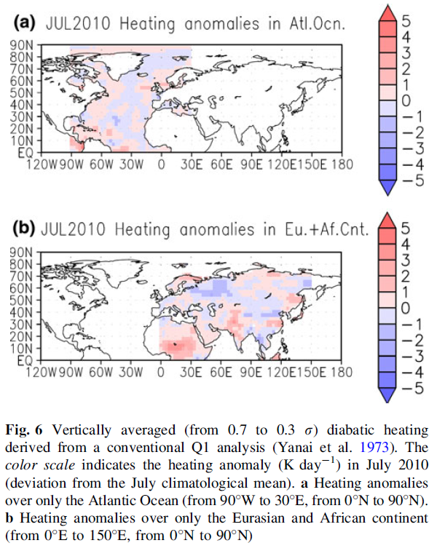
In figure a, diabatic heating anomaly in the Atlantic Ocean is calculated and it corresponds to the SST anomaly in July and August.
The author points out that the Atlantic Ocean heats the atmosphere.
In the same way, the author calculates the heating anomaly in Eurasian and African continent in figure b.
Notes:
These two figures show vertically averaged diabatic heating anomaly in 2010 summer.
Figure a shows diabatic heating anomaly in the Atlantic Ocean whose unit is K/day.

Slide 17
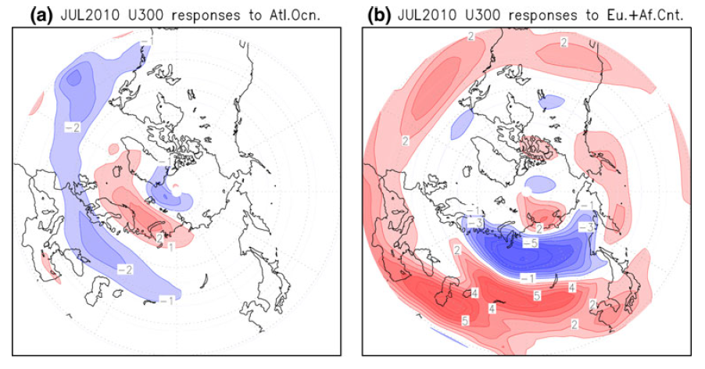
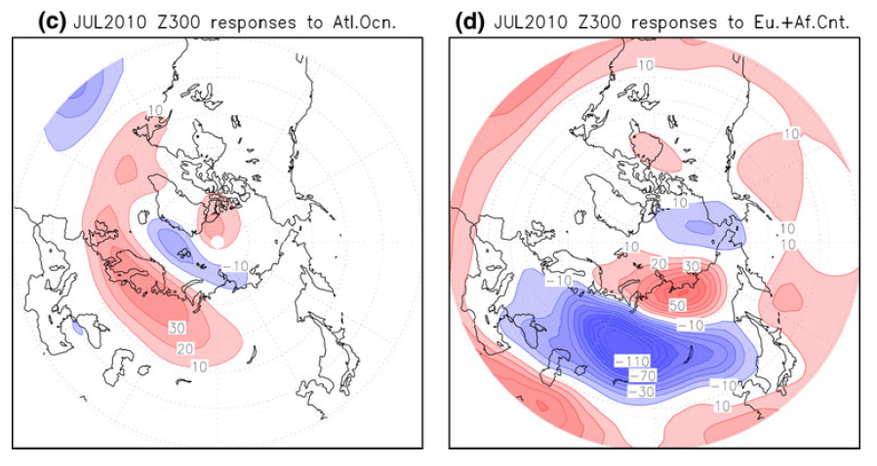
Wind response to the heating anomaly on 300mb in the Atlantic Ocean
Geopotential height response to the diabatic heating anomaly on 300mb
In figure a, the diabatic heating anomaly causes the double jet structure which Ogi et al found is corresponding to the positive AO index.
Figure c shows that the diabatic heating in the Atlantic Ocean causes high pressure over Europe, which resulted in record breaking hot temperature in Europe.

Slide 18
Conclusion
A negative AO (and NAO) index causes warm SST anomalies in high latitude and tropic regions of the Atlantic.
Because of the AO (and NAO) structure, the ocean receives the heat over the high latitude and the tropic regions.
Due to the large heat capacity of the ocean, the warm SST anomaly structure did not change in summer, heating the atmosphere, which can be seen in the diabatic heating map.
As a result, the SST anomaly structure causes high pressure in Europe.
Notes:
AO index time series data: longer time period

Slide 19
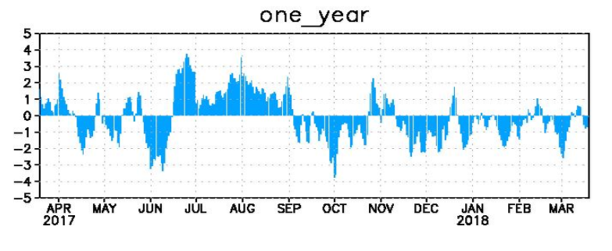
http://www.cpc.ncep.noaa.gov/products/precip/CWlink/daily_ao_index/ao_index.html

