Slide 1
Climate change and health costs of air emissions from biofuels and gasoline
Yang Han
02/26/2017

Slide 2
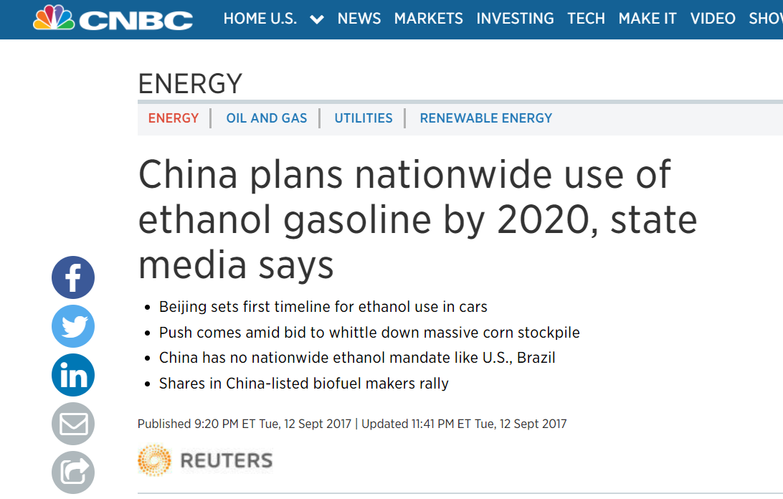
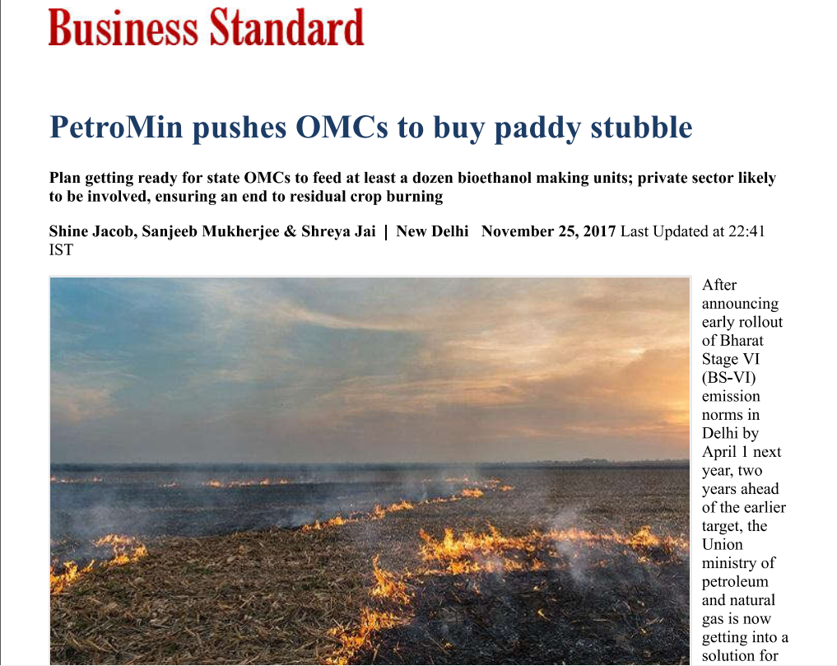
Motivation
Notes:
Last year, both China and India governments eagerly pushed regulations about biofuels.
For India government, The move comes as the government struggles to deal with the problem of environmental issues caused by BB.
Chinese government announced the expansion of their E10 program in all vehicles nationwide by 2020.
Ethanol is known as an environmental friendly fuel because it is produced from biomass and normally has less air pollutant emissions.

Slide 3
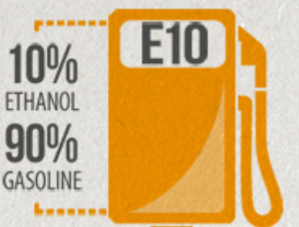
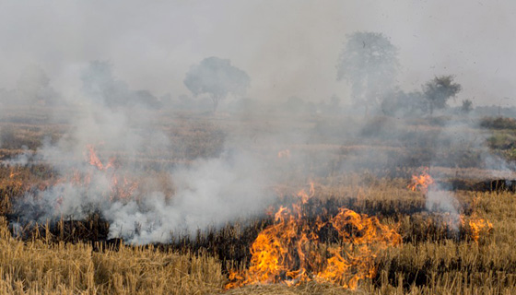
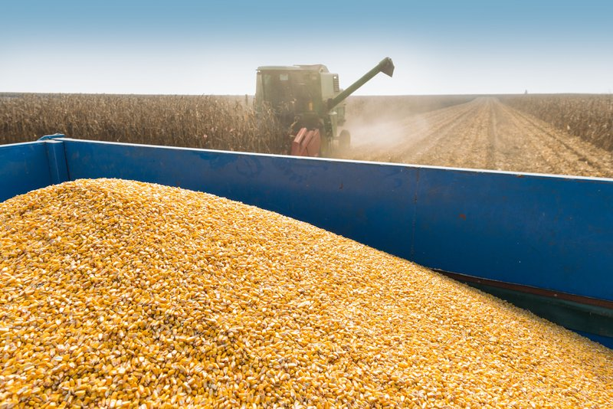
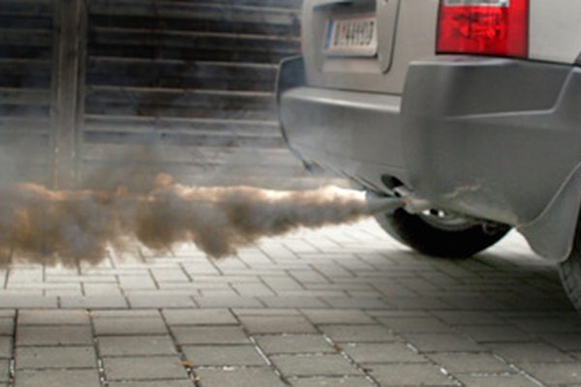
Motivation
Three birds with one stone
Use up damaged stocks
Less air pollutants from vehicles
Less open biomass burning
Notes:
The move in China is 一石三鸟
In China, only corn kernels are reserved in the sockpiles.

Slide 4
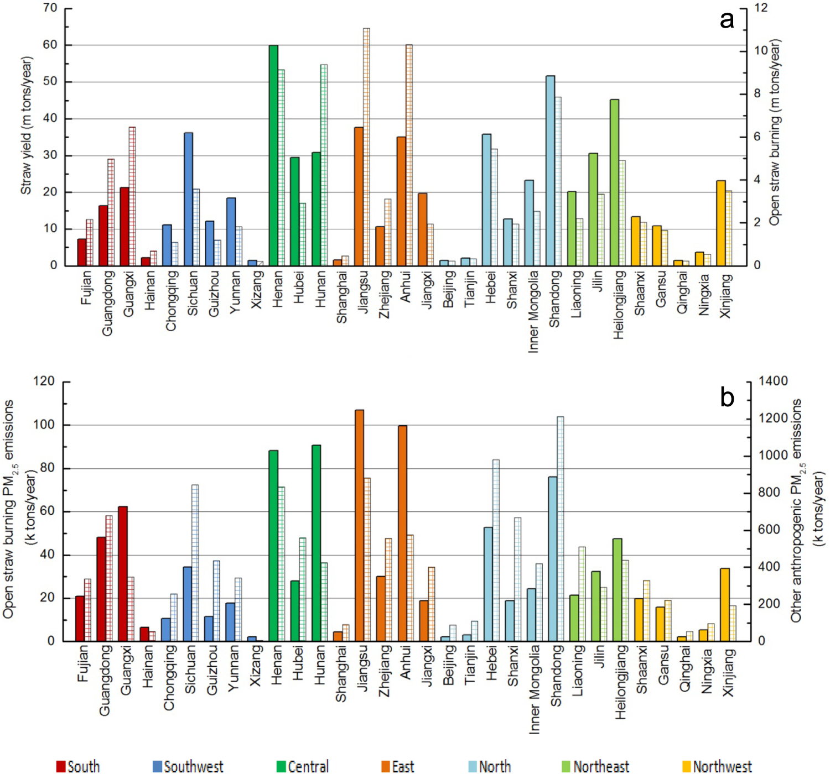
Motivation
Percentage of field residues usages in Northeast China in 2011.
Source: Zhang et al., 2017
PM_{2.5} emissions from straw burning (solid bars) during 1997-2013, and PM_{2.5} emissions from other anthropogenic sources (shadow lines) for 2006.
Source: Zhang et al., 2016
Notes:
30% crop residue were burned directly on the land, another 30% was used for residential cooking.
In this three regions, BB contributes over 10% of total PM2.5 emissions.

Slide 5
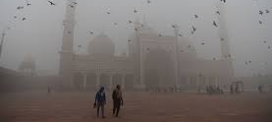
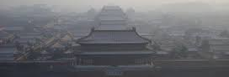
Motivation
Other than energy security and climate change mitigation requirements, pollution abatement is also a motivator for biofuels development for these two developing countries.

Slide 6
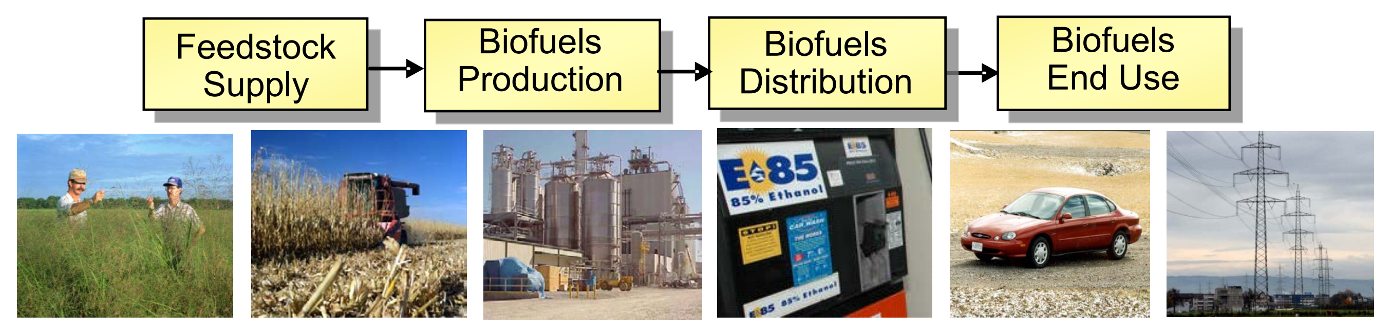
Motivation
Source: Male, 2010
The processes used to grow and collect biomass, including any associated land-use change, can incur additional GHG and PM2.5 emissions.
Notes:
But when I look through the life-cycle of biofuels, I found electricity and fossil fuel energy are used in each process. Not to mention the associated land-use change in the feedstock production phase.

Slide 7
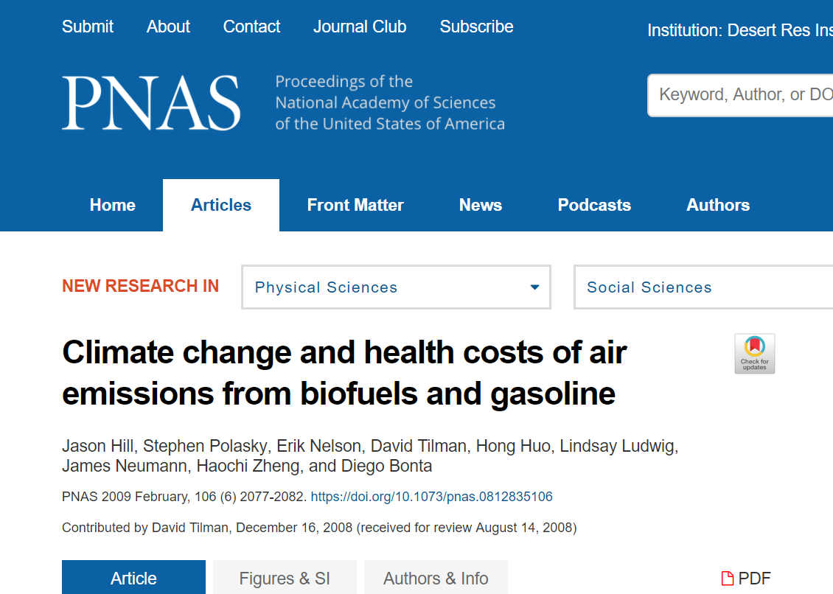
Motivation
Other than “burn through” corn stocks, can we benefit from E10 Ethanol mandate for environmental problems?

Slide 8
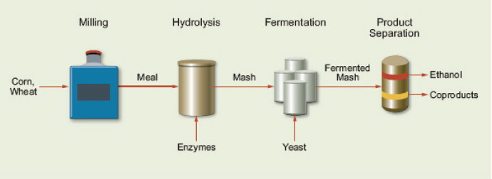
Introduction
Corn ethanol
Dry Distiller’s Grain Soluble
(DDGS)
Processing steps for converting corn grain to ethanol.
Source: Schwietzke et al. (2008).
Notes:
Most corn ethanol today is produced from dry milling process.
In this paper corn ethanol are estimated to be produced through dry milling process yielding 0.405 liter kg-1.

Slide 9
Introduction
Cellulosic
ethanol
Biochemical Conversion
Pretreatment &
Conditioning Distillation
Enzymatic Sugars Fermentation
Hydrolysis
Enzyme By-products
Production Wastes/Residue
DDGS
Lignin
(Electricity
Co-Generation)
Feedstock production
Energy crops
Forest residue
Crop residue
REFINING
Ethanol
Butanol
Olefins
Gasoline
Diesel
Others
Thermochemical Conversion
Upgrading
Fast Liquid Zeolite Cracking
Pyrolysis Bio-oil Hydrogenolysis
Gasification Syngas Fischer Tropsch
Alcohol Synthesis

Slide 10
Introduction
First Generation Biofuels
Ethanol produced via fermentation of sugars (from corn, sugar cane, sorghum, etc.)
Biodiesel produced via transesterification of triglycerides
Second Generation Biofuels
Non-food feedstocks
Advanced processing technology
Or both
Notes:
Because of the imprecise and variable meanings, these terminology are not widely used in the literatures.

Slide 11
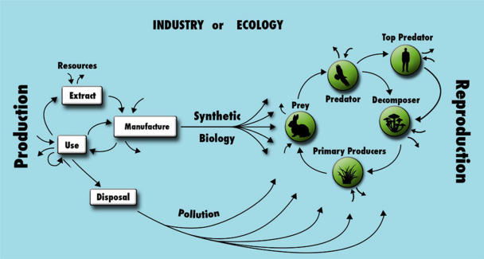
Introduction
Are biofuel “carbon neutral”?
This principle assumes that CO₂ emissions produced during combustion of the fuels are completely offset by the biogenic CO₂ uptake during plant growth.
The boundaries between industry and the environment are blurred.
Information exchange is not designed in the industrial/ecological systems boundary (i.e., genetically modified organisms and engineered nanomaterials).
Source: Seager et al., 2017

Slide 12
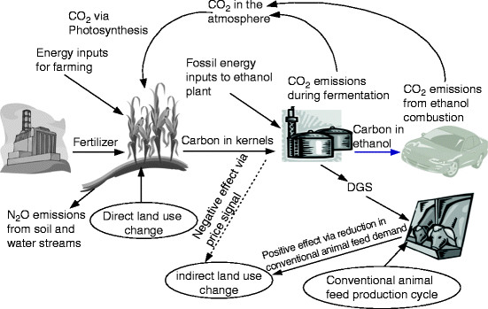
Introduction
Some degree of carbon uptake occurs on lands, regardless of whether they are used for biofuels.
Intensification
--fertilizers and pesticides, and soil degradation
Displacement
--Converting from forest, pastures or Conservation reserve program (CRP) lands to cropland
Expansion
--shifting acreage of soybeans or other crops
Source: Wang, 2010
ILUC, increasing in US biofuels cause new land-use changes in other areas through market-mediated effects.
Notes:
CRP is a voluntary program, administered by US Department of agricultural (USDA), in which contracts are established with agricultural producers and landowners to retire certain croplands and pasture from production for 10-15 years.

Slide 13
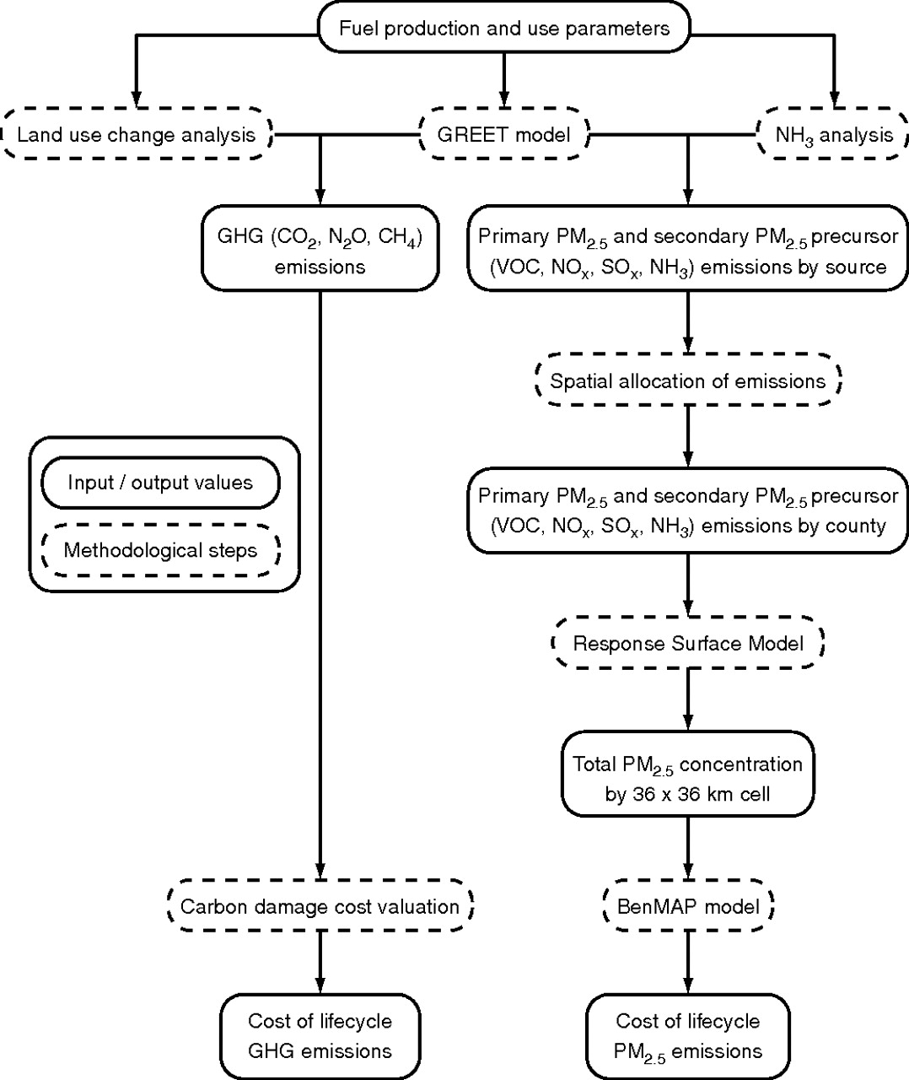
Methods
Assumptions:
All production activity occurred in the U.S. and production of all other goods and services were hold in the economy constant.
Increased emissions estimated from 1 billion gallon expansion in U.S. production and combustion of ethanol or an energy equivalent volume of gasoline.
Flow chart describing methodology for estimating life-cycle GHG and PM_{2.5} costs.
Notes:
This estimation approximately equal to the 2006-2007 increase in U.S. gasoline consumption.
Unlike long-lived GHG emissions, which globally mix in the atmosphere, the formation and health effects of PM2.5 are regional and cannot be accurately determined without considering the spatial patterns of emissions relative to population density.

Slide 14
Methods
GREET model:
The life-cycle emissions were quantified by using the Greenhouse Gases, Regulated Emissions, and Energy Use in Transportation (GREET) model.
GREET models the Greenhouse gas (GHG) and air pollutants emissions from fuel supply chains.
Inputs / Outputs data:
Corn ethanol—current industrial data
Cellulosic ethanol– near-term prediction of pilot plants
Flow chart describing methodology for estimating life-cycle GHG and PM_{2.5} costs.

Slide 15
Methods
NH₃ analysis:
GREET models four groups of air pollutant emissions: NO_{x}, VOCs, Primary PM, and SO_{x}.
A separate analyses was performed to estimate life-cycle NH₃ emissions related to PM_{2.5} formation.
Land-use change:
The additional corn and other biomass needed for biofuel production were grown on CRP lands, in the case of corn stover, was collected from existing cropland.
The expansion of cropland was assumed to occur near currently planned expansion of ethanol facilities.
Flow chart describing methodology for estimating life-cycle GHG and PM_{2.5} costs.

Slide 16
Methods
Cost of GHG emissions:
GHG emissions occur from fuel production and use, fuel combustion, land-use change, and the related upstream processes.
A monetary cost for GHG emissions was estimated to $120 Mg⁻¹C.
Cost of PM_{2.5} emissions:
Primary PM_{2.5}
Secondary PM_{2.5} from 4 precursors (SO_{x}, NO_{x}, NH₃, and VOCs).
The spatial disaggregation is accomplished by using spatial allocation of emissions and Response Surface Model (RSM).
Costs associated with exposure to PM_{2.5} was estimated by EPA’s Environmental Benefits Mapping and Analysis Program model
Flow chart describing methodology for estimating life-cycle GHG and PM_{2.5} costs.
Notes:
Primary PM2.5 from fuel combustion

Slide 17
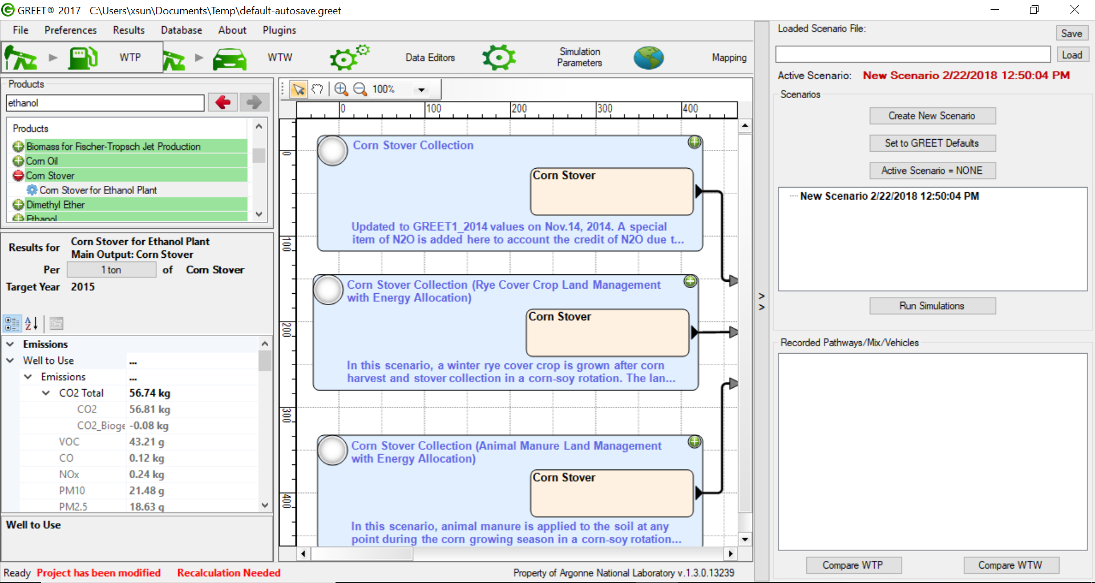
Methods
GREET model

Slide 18
Results
GHG emissions from corn ethanol depended on biorefinery heat source, assumptions about technology, and land-use change.
Producing cellulosic ethanol has lower GHG emissions than corn ethanol or gasoline.
The dedicated biomass (switchgrass and Miscanthus) were grown on former CRP lands with higher biomass yields and lower fertilizer inputs.
Electricity used to produce corn ethanol are purchased from grid whereas excess electricity will be generated and sold to grid in the cellulosic ethanol production process.
Notes:
3 methods (using natural gas, coal, or corn stover for process heat at biorefineries) of producing ethanol from corn grain. For the advanced industry scenario, higher grain yields, lower fertilization and higher conversion efficiency are considered.
4 methods of producing cellulosic ethanol (from corn stover, switchgrass, diverse prairie biomass, or Miscanthus)
Before including the LUC effect, it is shown that corn ethanol produced by using natural gas has lower GHG emissions than gasoline, but this benefit is lost when carbon emissions from converting CRP lands to cropland are include.
If potential advances in production efficiency are assumed, GHG emissions from corn ethanol are lower than gasoline even with LUC included.

Slide 19
Results
For corn-grain ethanol, life-cycle emissions of major air pollutants are higher than for gasoline.
Cellulosic ethanol from either corn stover or dedicated bioenergy crops shows a similar pattern, although SO_{x} life-cycle emissions could be lower than that of gasoline.
Summary of total lifecycle PM_{2.5} related emissions.
Notes:
Vehicle use phase includes tailpipe emissions and evaporative emissions from vehicles and filling stations.
The low SOX is because of cogenerating

Slide 20
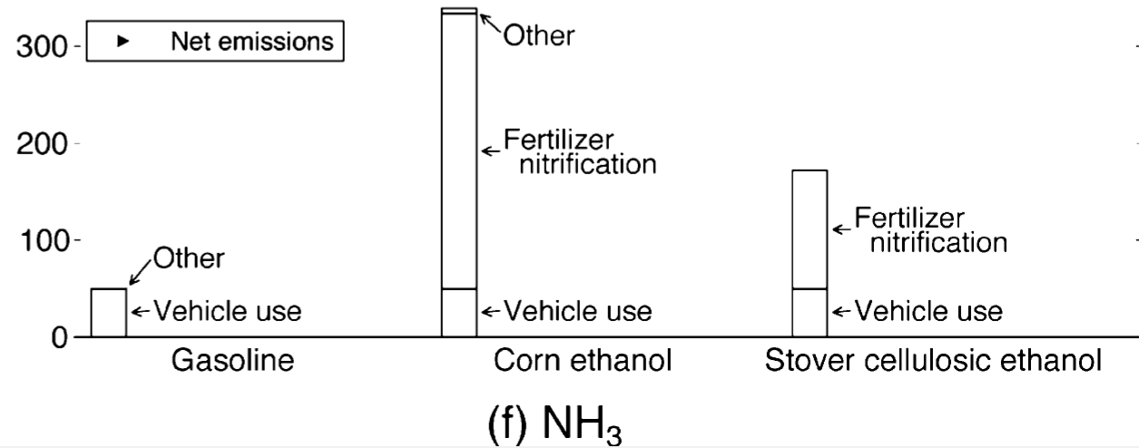
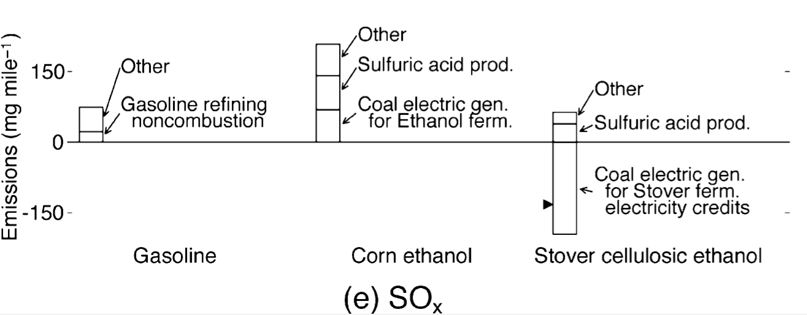
Results
Source: Tessum, et al., 2012
Notes:
Nagtive emissions result from displacement producing the same quantitly of electricity by coal combustion.

Slide 21
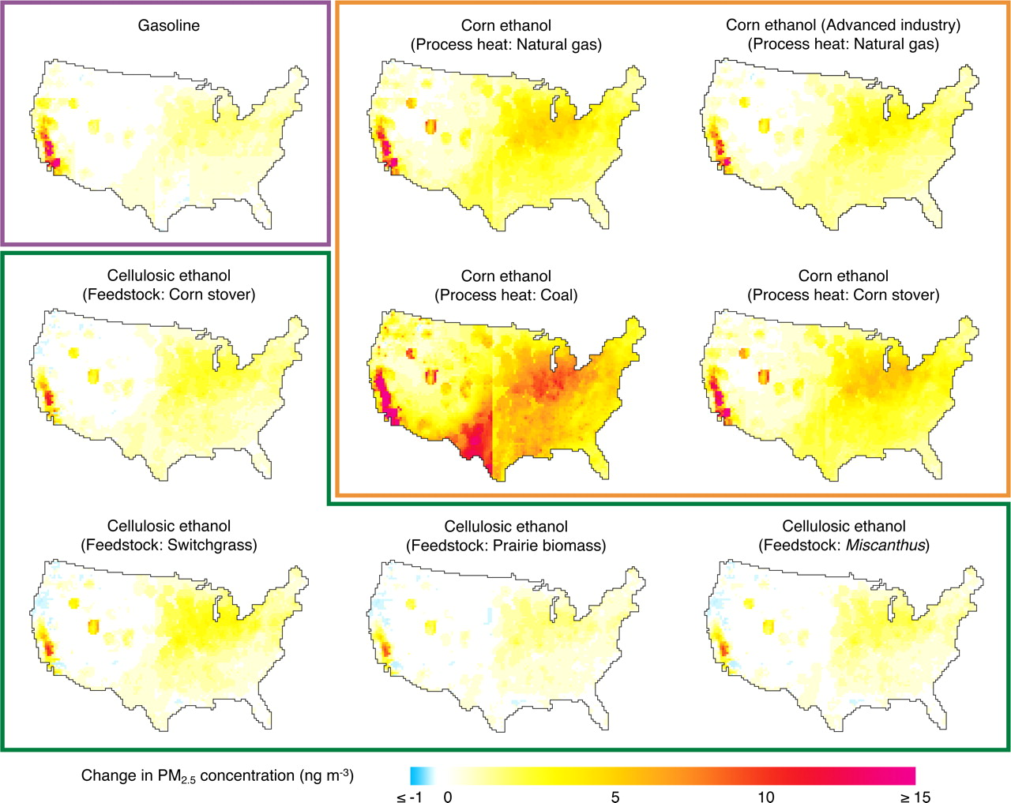
Results
Additional corn production increases PM_{2.5} health impacts in the Midwest Corn Belt and West Coast.
Growing dedicated biomass for Cellulosic ethanol in the same region has lower PM_{2.5} levels.
Change in average annual atmospheric PM2.5 concentration
Notes:
Besides differences in overall magnitudes, the regional impacts of PM2.5 emissions also differ.
Lower SOX emissions
Excess electricity generated and sold to grid

Slide 22
Discussion
Food-based biofuels such as corn-grain ethanol have not been conclusively shown to reduce GHG and PM_{2.5} emissions and might actually increase them.
Biofuels from agricultural and forestry residues are most likely to reduce GHG and PM_{2.5} emissions.
Notes:
Pushing nation-wide E10 use up damaged stocks and the cleaner fuel could help reduce pollution.

Slide 23
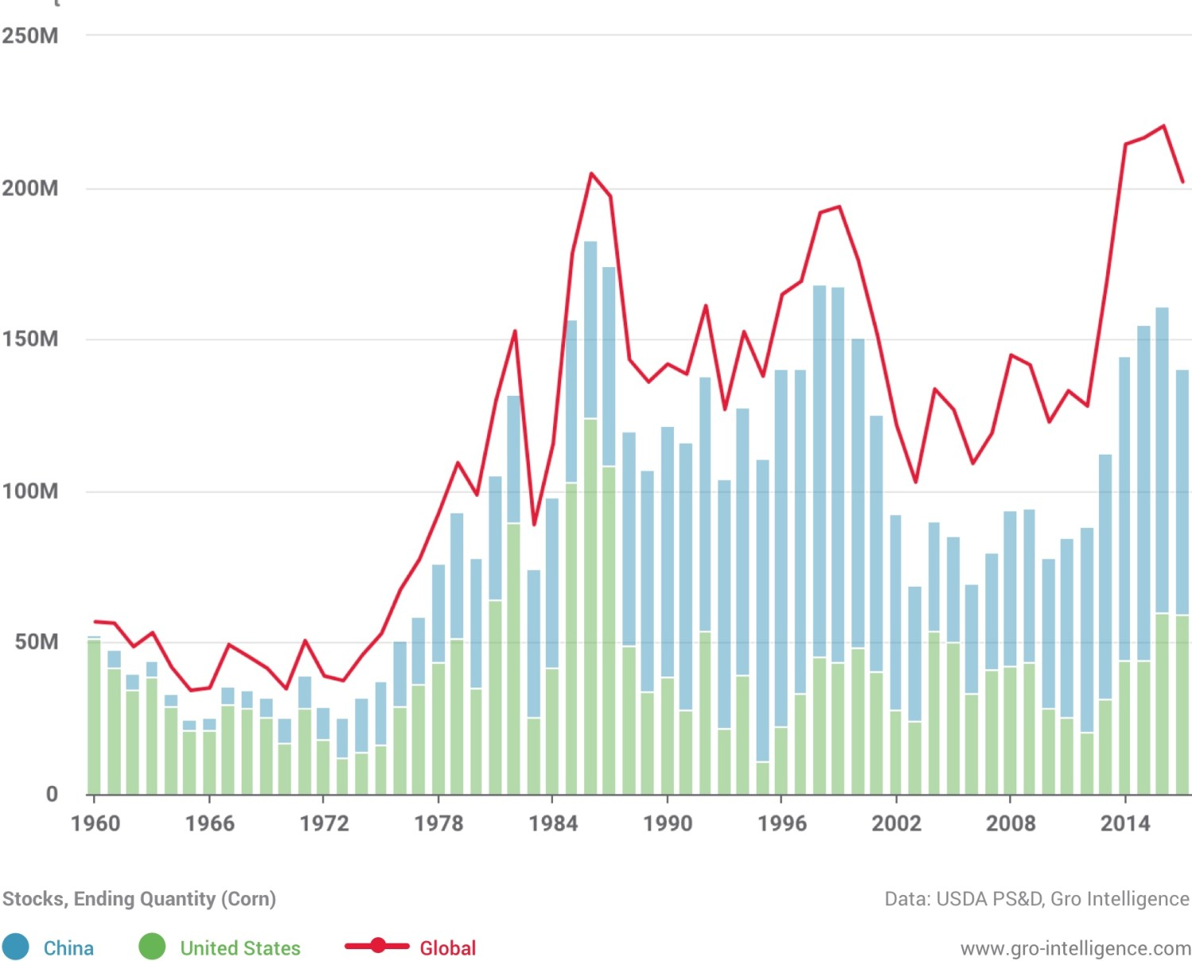
Discussion
China accounts for almost half of the world ending stocks and enough for China’s domestic consumption for a year.
Fuel ethanol is the only solution for the large number of deteriorated corn stocks, which are not suitable for human or animal consumption.
Depending on the size of China’s current stockpile, China have enough corn to meet ethanol demand for two to a little more than six years.
Source: https://gro-intelligence.com/blog/chinese-ethanol-program-corn-stocks
Notes:
Fuel ethanol is the only solution for the large number of deteriorated corn stocks, which are not suitable for human or animal consumption

Slide 24
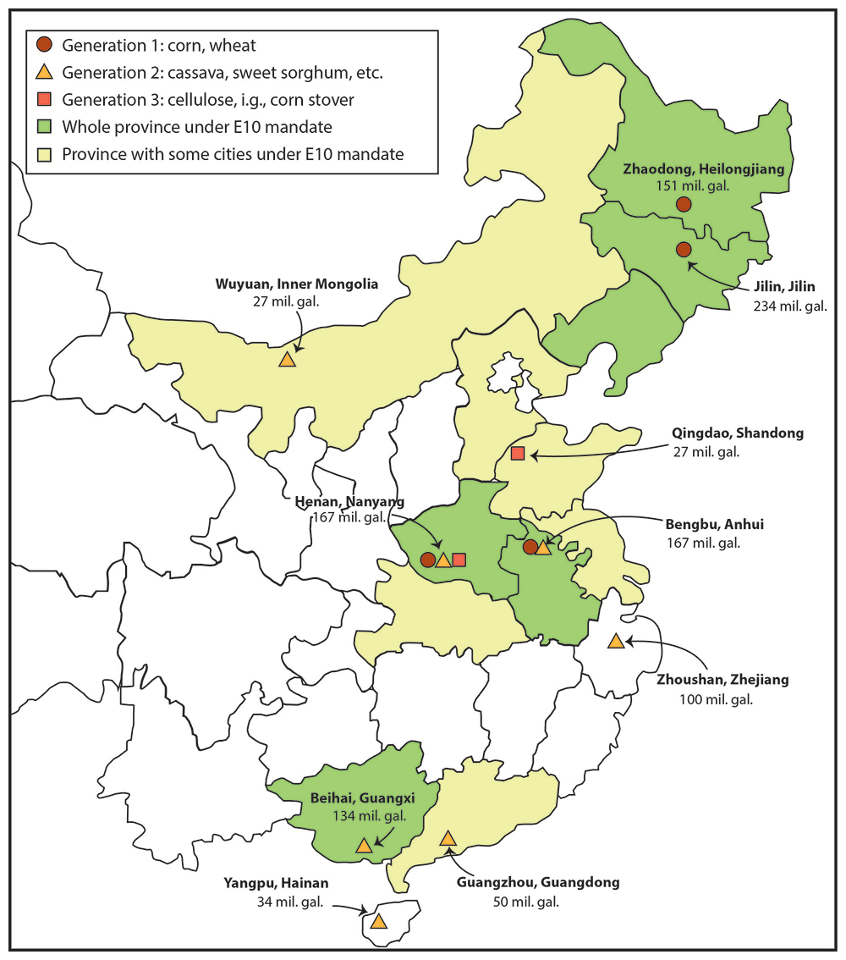
Discussion
The four state-owned corn ethanol producers currently accounts for 64% of total output.
70% of cassava are imported from Southeast Asia.
Cellulosic ethanol production is not expected to reach large scale production until 2025.
Source: Li et al,. 2017
Notes:
Since details of the mandate have not been disclosed, it is not yet clear how China will generate more than four-fold output growth within three years

Slide 25
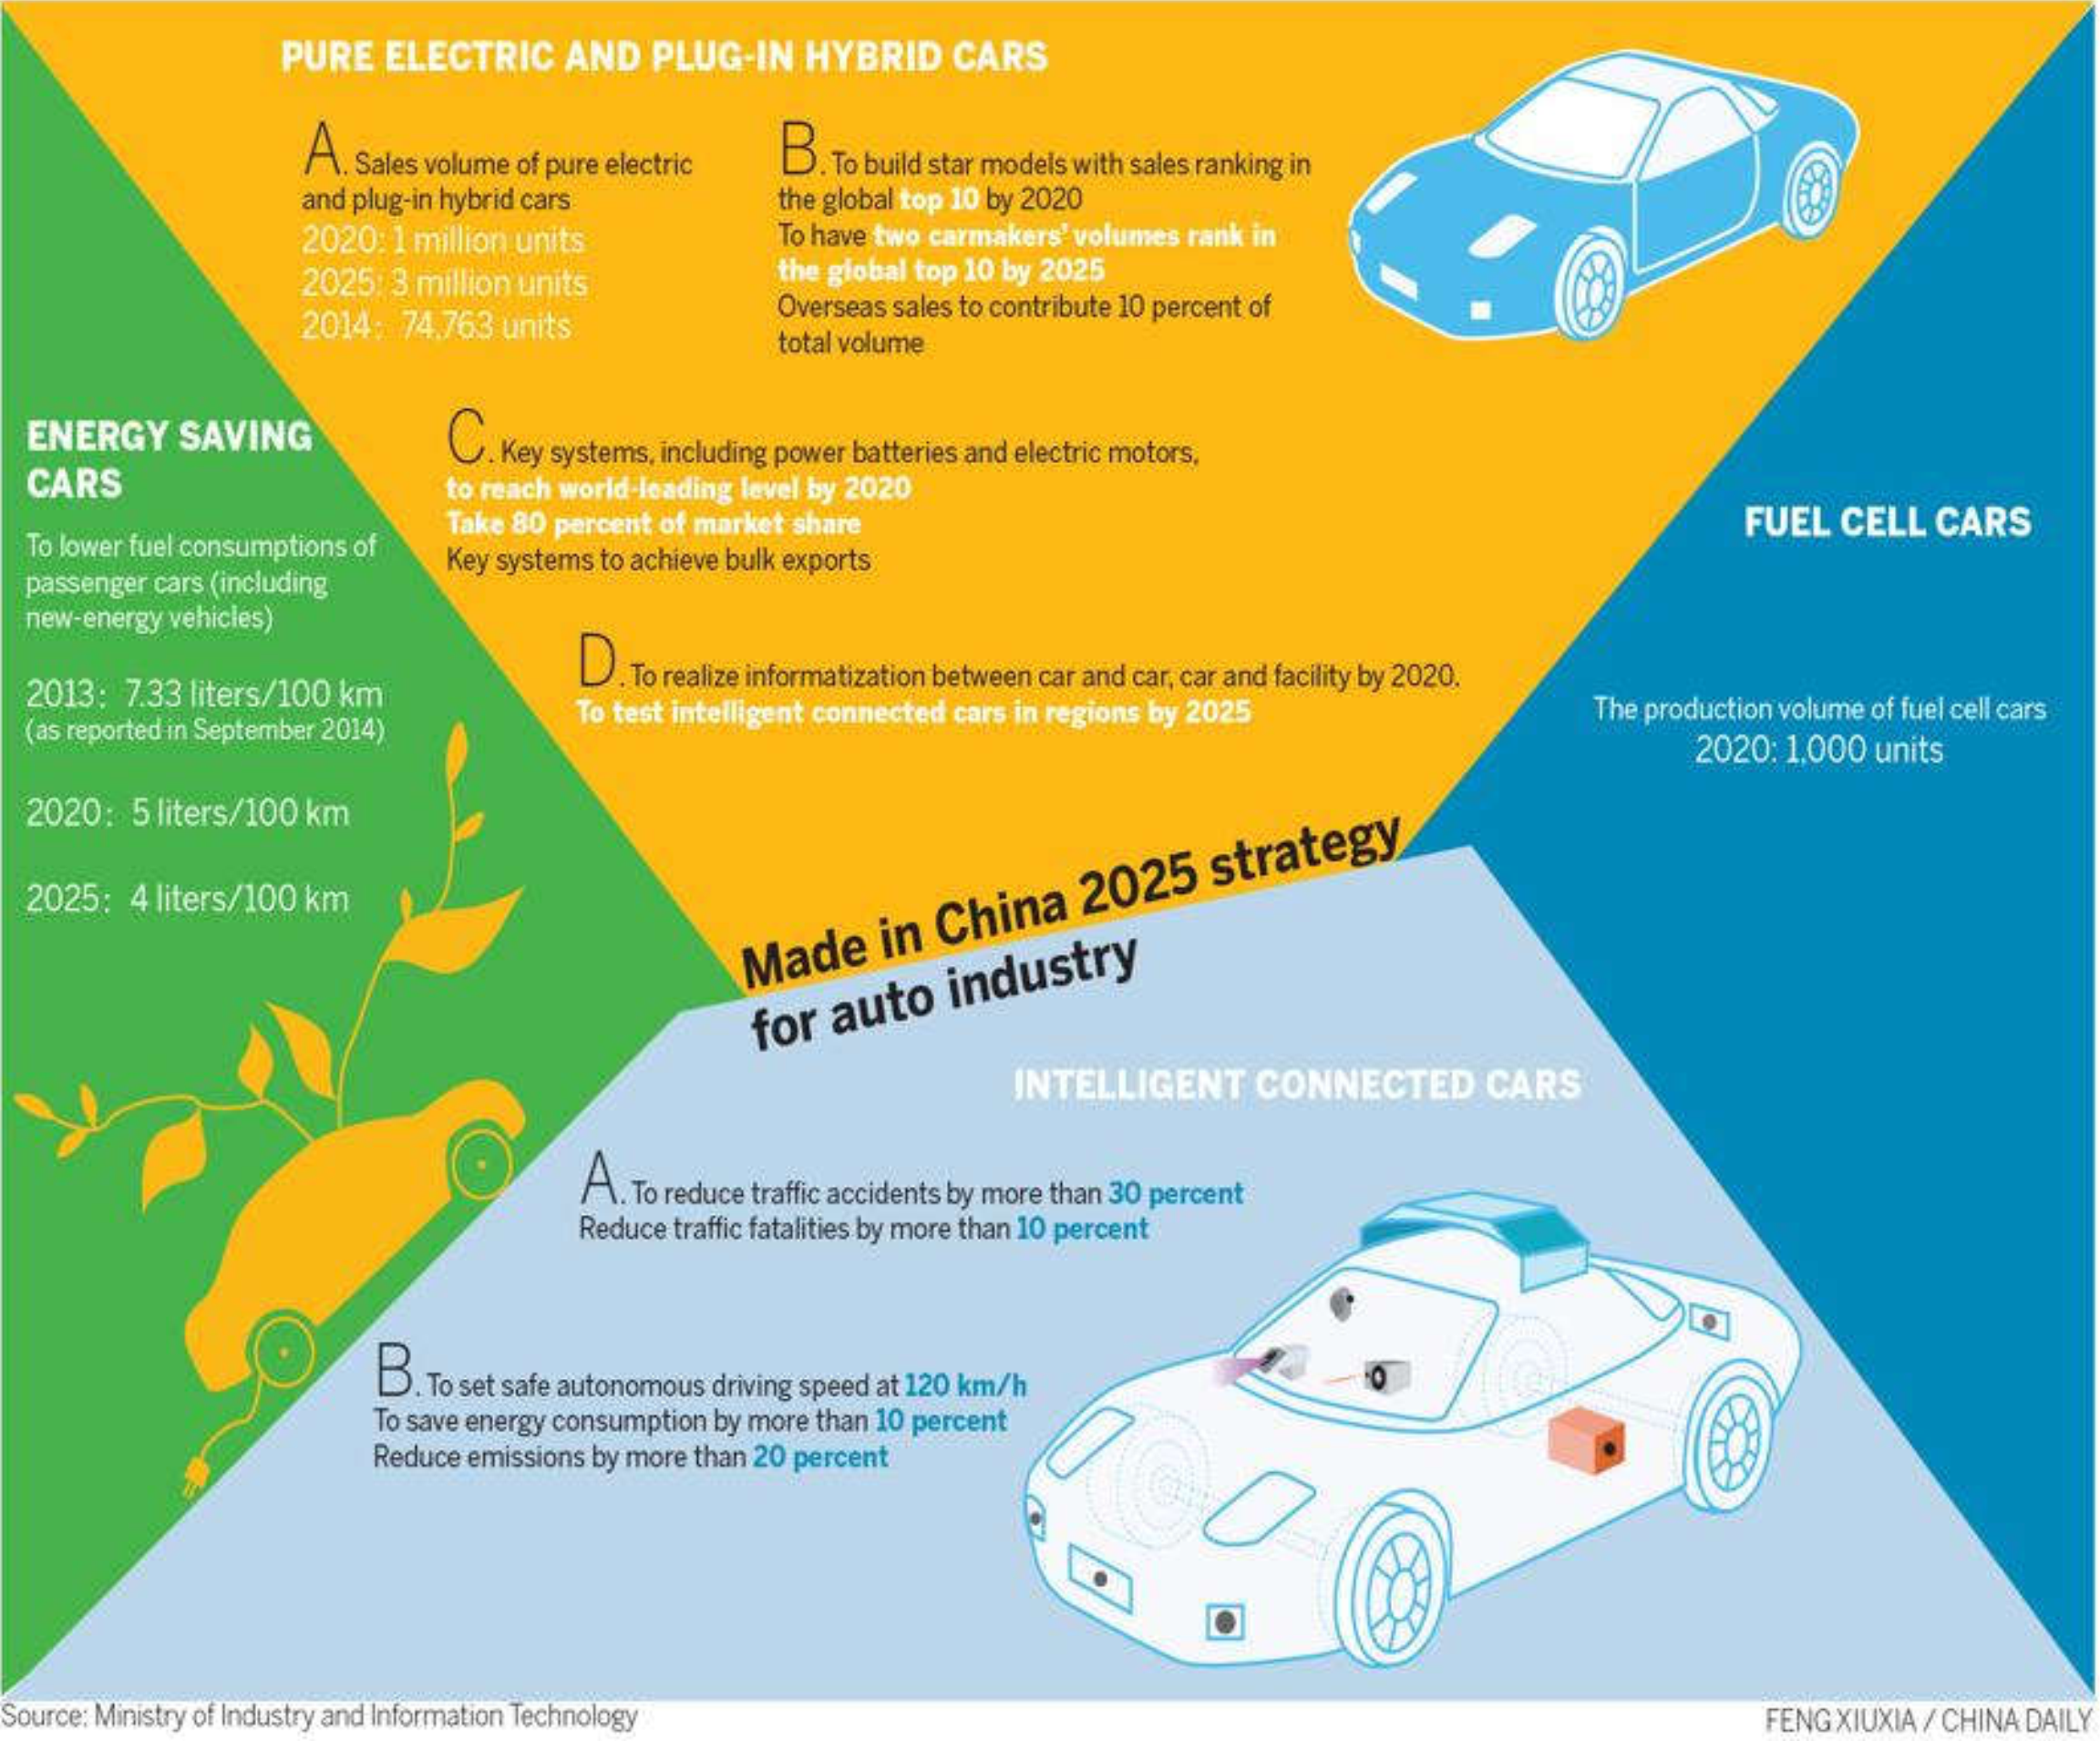
Discussion
Source: Ministry and Information Technology

Slide 26
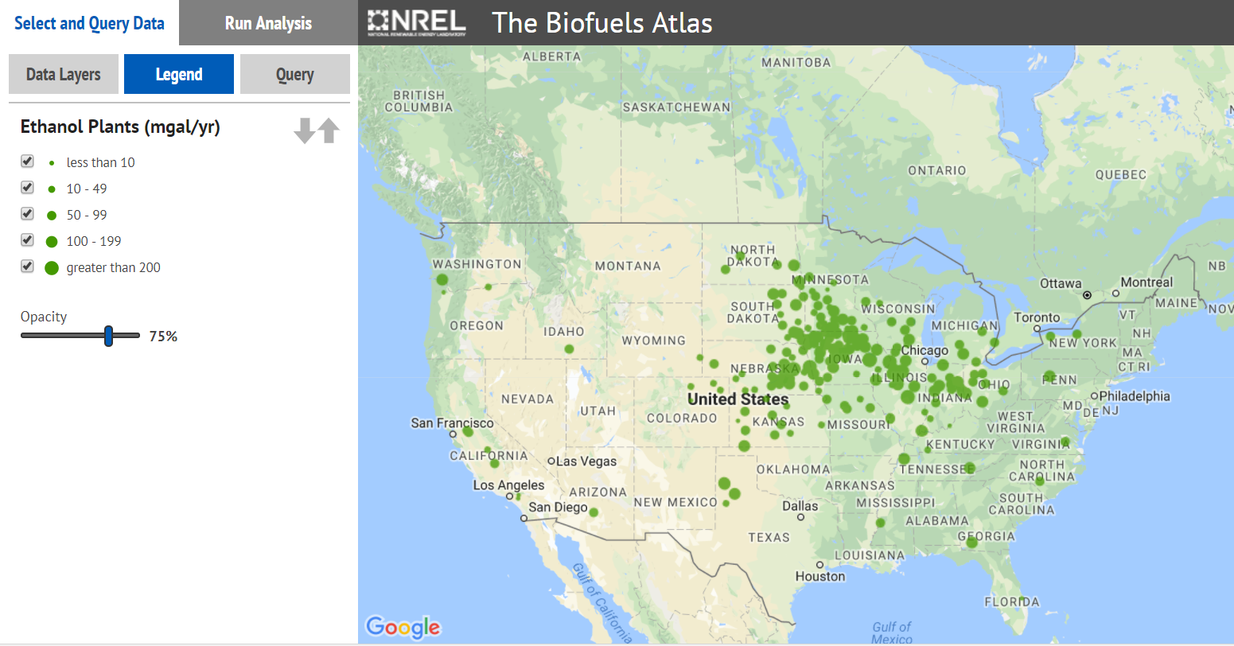
Discussion
There are more than 200 bioethanol plants in U.S..
Source: NREL BioFuels Atlas-http://maps.nrel.gov/biomss)

Slide 27
Discussion
The Chinese ethanol industry is heavily regulated with licensed production operating in a closed market.
Licensed producers (state-owned companies) are only allowed to supply local provincial market or designated cities.
The ethanol price is not determined by agricultural commodity markets, instead it is directly coupled to production cost of gasoline set at 0.911 times the ex-factory price of 90 grade gasoline.
Notes:
With crude oil prices hovering around their lowest levels since 2009, the industry will need heavy subsidies from local and central governments to be economically viable

Slide 28
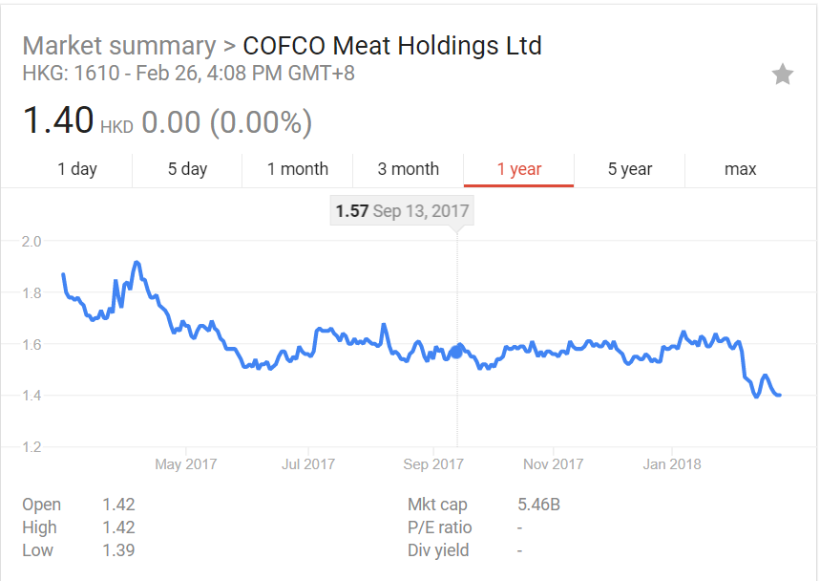
Discussion
China National Cereals, Oils and Foodstuffs Corporation (COFCO), is one of the pioneering companies in Chinese ethanol industry.
By the end of 2013, COFCO accounts for 47% of domestic ethanol production.
The market does not signal the sound policy change.
Source: Google Finance

Slide 29
Conclusion
The Chinese ethanol industry is still at early development stage.
Obstacles feedstock supplements, facility capacity all still lie ahead of the industry.
There is still big gap to the 2020 10 million tonne capacity target.
The second-generation biofuels provides an opportunity for China to diminish its dependency on fossil fuel imports and to fight environmental issues.

Slide 30
References
Zhang, Libo, Yongqiang Liu, and Lu Hao. "Contributions of open crop straw burning emissions to PM_{2.5} concentrations in China." Environmental Research Letters 11.1 (2016): 014014.
Hayes, Dermot J. "China's New E10 Ethanol Mandate and Its Global Implications." (2017).
Hill, Jason, et al. "Climate change and health costs of air emissions from biofuels and gasoline." Proceedings of the National Academy of Sciences 106.6 (2009): 2077-2082.
Wang, M. (2010), Life-Cycle Analysis of Biofuels, in Plant Biotechnology for Sustainable Production of Energy and Co-products, edited by P. N. Mascia, J. Scheffran and J. M. Widholm, pp. 385-408, Springer Berlin Heidelberg, Berlin, Heidelberg.
Jonathan L. Male. “Thermochemical Conversion of Biomass to Advanced Biofuels at the DOE.” (2010)
ZHANG Guo, LU Fei, ZHAO Hong, et al. Residue usage and farmers’ recognition and attitude toward residue retention in China’s croplands[J]. Journal of Aro-Environment Science, 2017, 36(5):981-988 (in Chinese).
Schwietzke, S., M. Ladisch, L. Russo, K. Kwant, T. Mäkinen, B. Kavalov, K. Maniatis, R. Zwart, G. Shahanan, K. Sipila, P. Grabowski, B. Telenius, M. White, and A. Brown. 2008. Gaps in the research of 2nd generation transportation biofuels. IEA Bioenergy T41(2):2008:01.
Tessum, Christopher W., Julian D. Marshall, and Jason D. Hill. "A spatially and temporally explicit life cycle inventory of air pollutants from gasoline and ethanol in the United States." Environmental science & technology 46.20 (2012): 11408-11417.

Slide 31
Thank you for your attention

Slide 32
LUC
Land disturbances to create space for crops or pasture can impact GHG emissions in a variety of ways:
Removal of above and below ground vegetation (roots) release the carbon stored in the vegetation as CO2.
Existing vegetation helps maintain a balance between carbon uptake and emissions from the soil.
An annual uptake of CO2 occurs during growth of vegetation. If vegetation is removed, future CO2 sequestration by the growing biomass is eliminated.

Slide 33
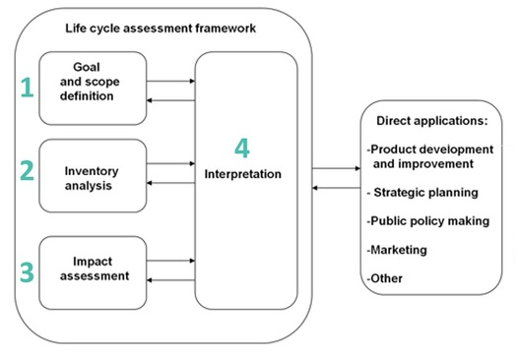
Introduction
Life-cycle assessment
Define the objectives and setting the system boundaries.
Compile inputs and outputs for each process in the life cycle and sums them across the whole system.
Emissions and resources are grouped according to their impact categories and converted to common impact units.
Interpretation of the inventory and impact assessment results.
Source: ISO 14040-2006
Notes:
“compilation and evaluation of the inputs, outputs, and potential environmental impacts of a product system throughout its life cycle”

Slide 34
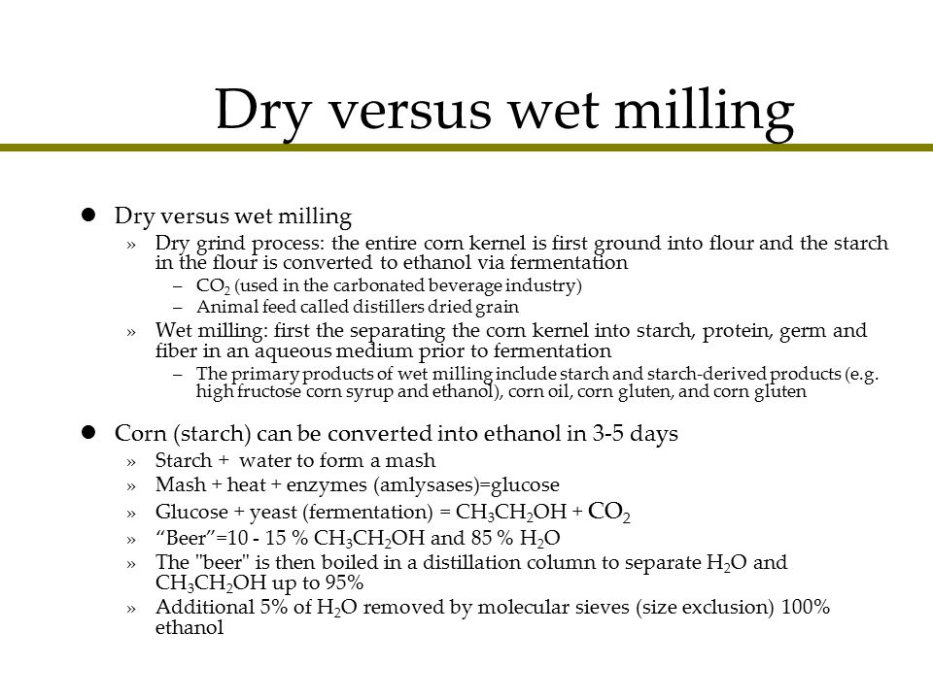

Slide 35
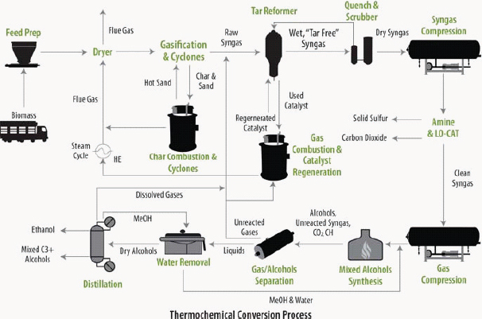
2nd generation biofuel
Schematic diagram of a thermochemical conversion refinery to produce ethanol.
SOURCE: Foust et al. (2009).

Slide 36
National scale

Slide 37
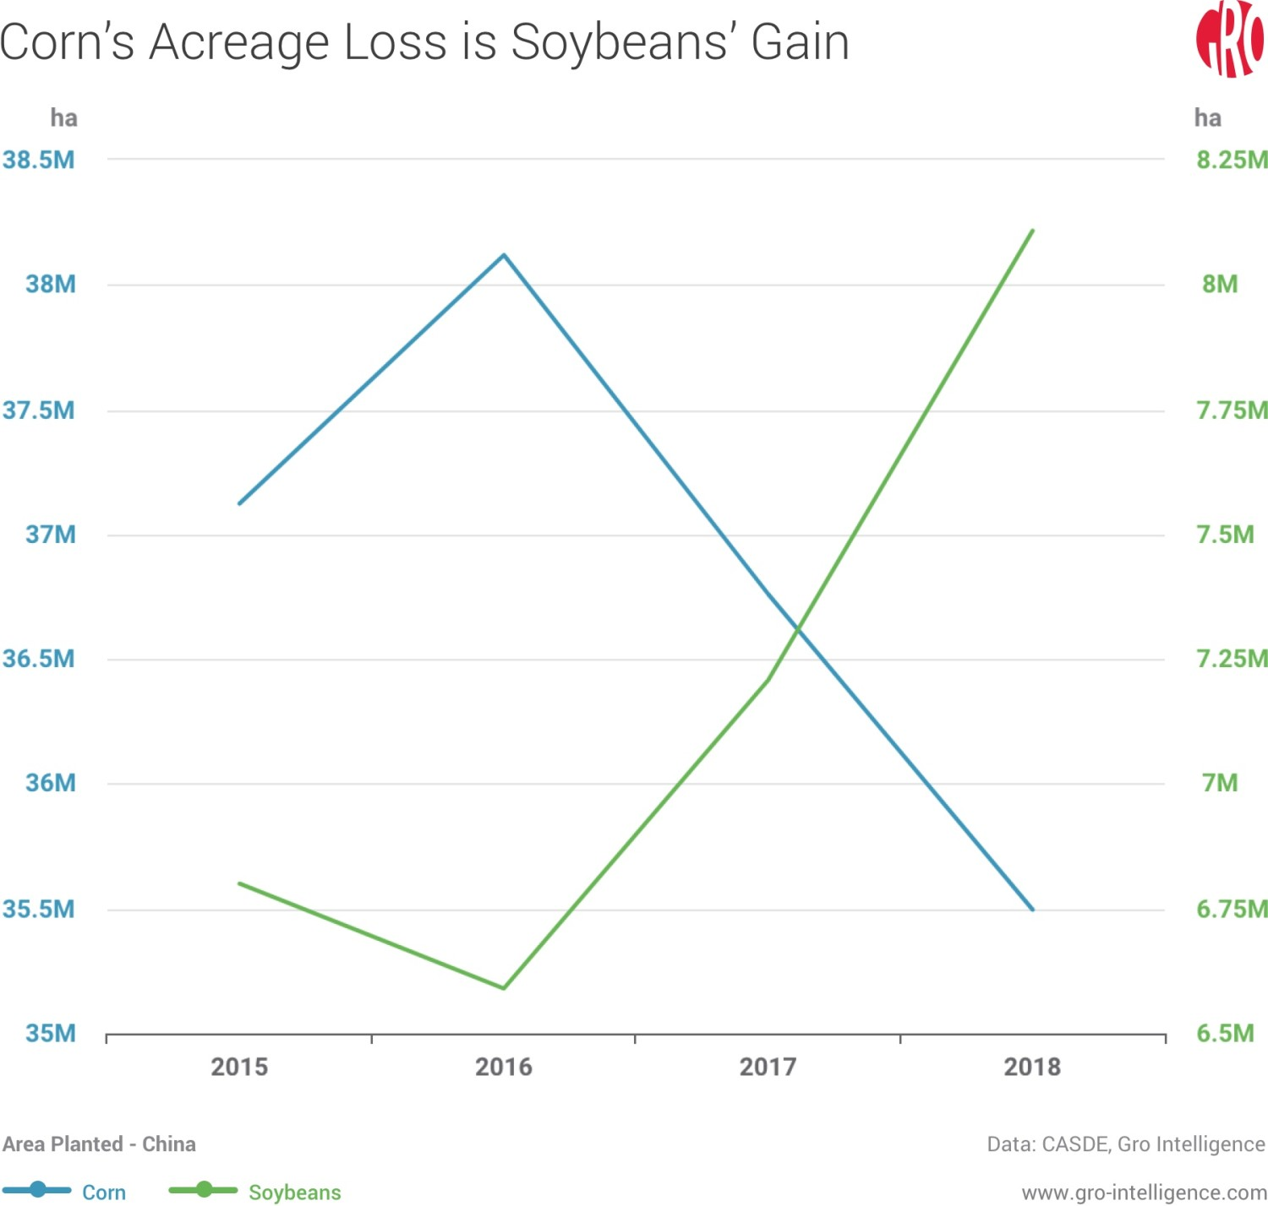

Slide 38
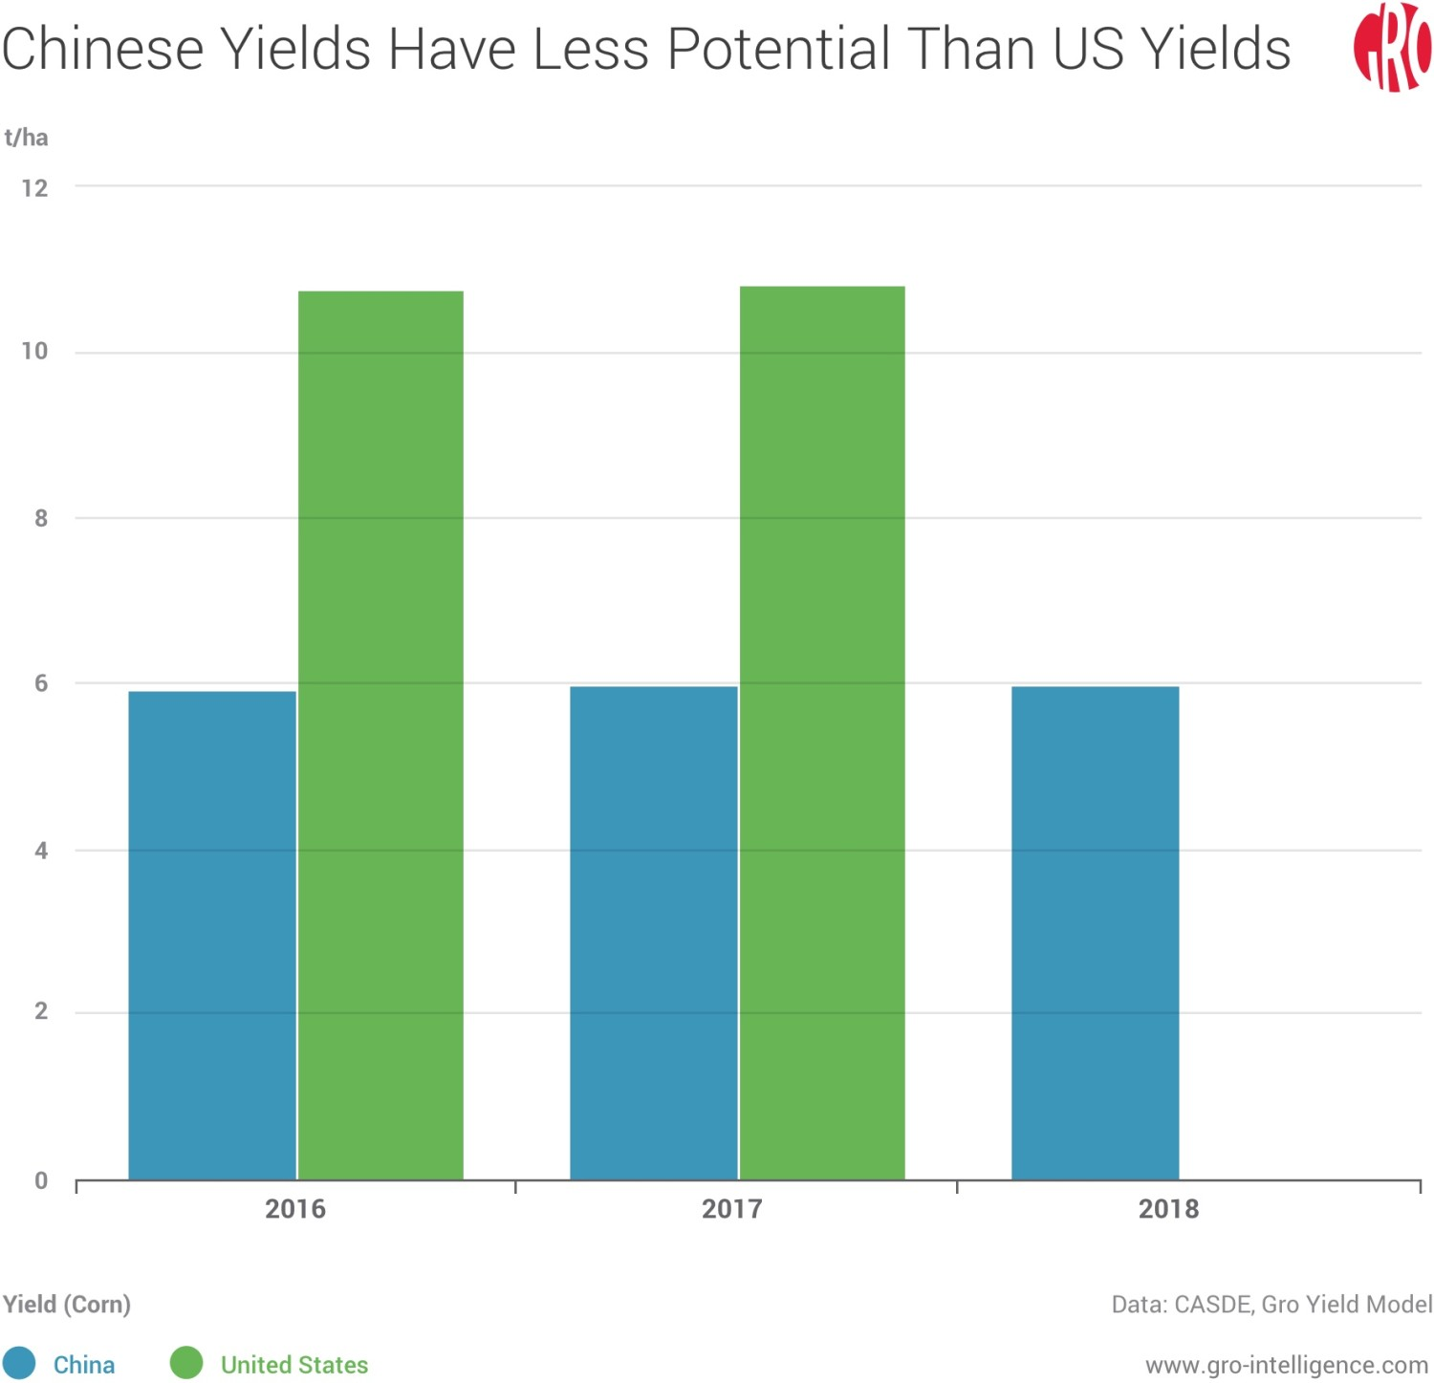

Slide 39
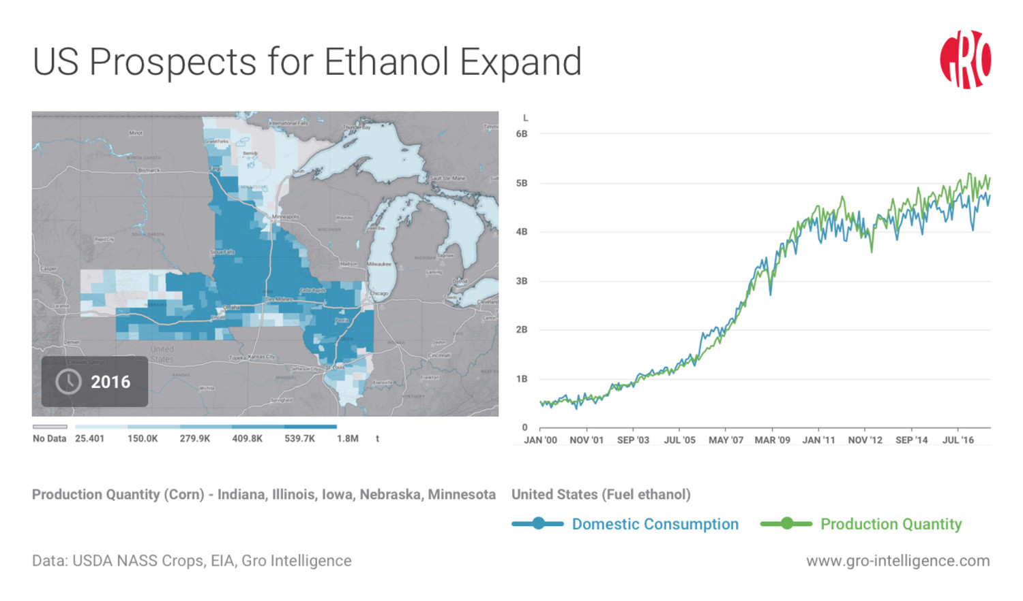

Slide 40
