Slide 1
Soil Moisture–Atmosphere Interactions during the 2003 European Summer Heat Wave
ATMS 790 Course Presentation
Xia Sun
Atmospheric Science Program, Physics Department
01/22/2018

Slide 2
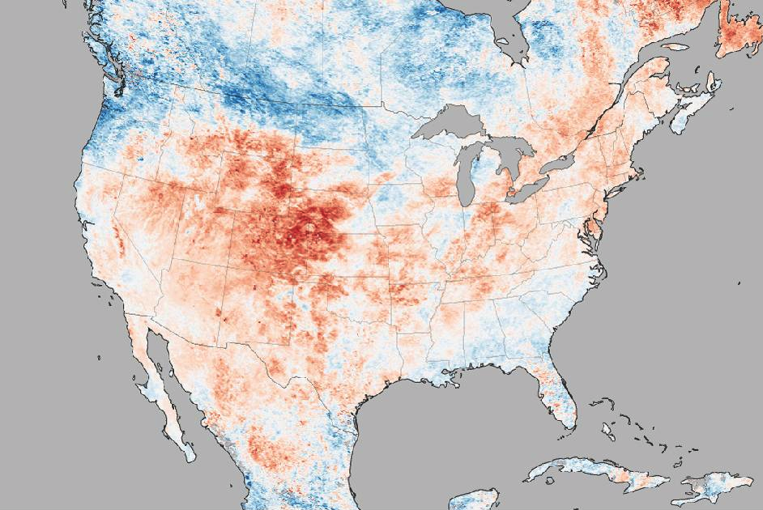

Motivation
Heat Wave
Abnormally hot weather lasting at least 2 days.
Heat anomalies from June 17-24, 2012
Notes:
Abnormally hot and humid weather lasting at least 2 days. It can occur anywhere in the country and cause heat illness or even death.
. The more red an area appears, the more above average the temperatures were during that time. One example of a HOT time was in late June and early July 2012 in the United States. During that time period, more than 8,000 warm temperature records were broken or tied. On July 17, the temperature at Detroit, Michigan Metro Airport climbed to 102 °F (38.9 °C), more than 100

Slide 3


Motivation
Pavement buckled during the heat wave in Chicago, 2012

Slide 4






Motivation
Heat Wave
Notes:
Except for the impacts on infrastructure and human health, heat wave will also incrase power, like more use of air conditioning and water consumption. This power consumption are likely to bring more air pollution and GHGs emissions. Agriculture will suffer a lot since they depended on soil moisture . Related cost will also increase considering these social and environmental impacts.

Slide 5
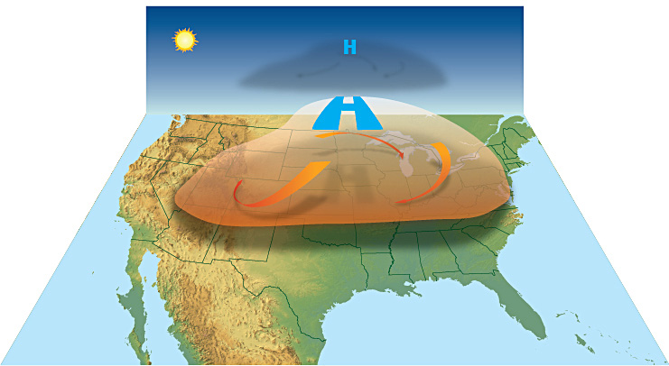
Heat Wave
High-pressure systems can create a 'cap' that traps air in one place as it warms
Notes:
High-pressure systems can create a 'cap' that traps air in one place as it warms. This can lead to a heat wave. High-pressure systems force air downward. This force prevents air near the ground from rising. The sinking air acts like a cap. It traps warm ground air in place. Without rising air, there was no rain, and nothing to prevent the hot air from getting hotter. Heat waves are generally the result of trapped air.

Slide 6
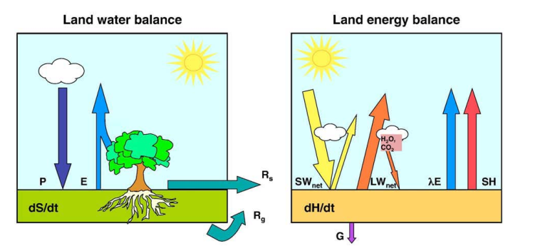


Land-atmosphere Interaction
dS/dt is the change of water content within the given layer
P is the precipitation
E is the evapotranspiration
Rs is the surface runoff,
Rg is the drainage
dH/dt refers to the change of energy within the same layer
Rn is net radiation
λE is the latent heat flux
SH is sensible heat flux
G is ground heat flux
(Seneviratne et al. 2010)
Notes:
Except for the larg-scale conditions, land- surface interactions also play a role. As for the interactions betweem the land and atmosphere, there are two important bablances. The role of soil moisture in the land energy and water balances
Include latent heat of evaporation of water and call it λ (lambda). Include evapo-transpiration rate and call it Ε

Slide 7
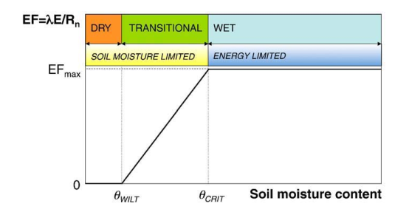
Soil moisture–evapotranspiration coupling
Three regimes
Evaporation Fraction
Definition of soil moisture regimes and corresponding evapotranspiration regimes
(Seneviratne et al. 2010)
Notes:
1. Three evapotranspiration regims; 2 this is the basic conceptual model which is use in different land use models. 3 the transitional areas Only in transitional regions between dry and wet climates are both conditions met
for strong soil moisture–climate coupling: a strong dependency of
evapotranspiration on soil moisture and large mean evapotranspiration

Slide 8
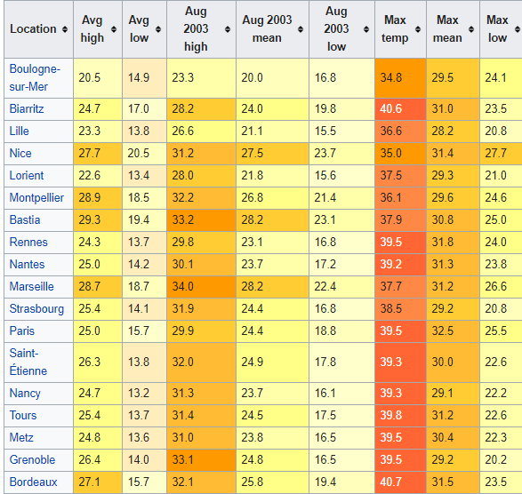
2003 European Summer Heat Wave
Dates | July to August 2003
Areas affected | Mostly Western Europe (France most)
The hottest summer on record since 1954
Notes:
France had no policy in place for such a major heatwave as this, because climate change was viewed as a problem in the distant future

Slide 9
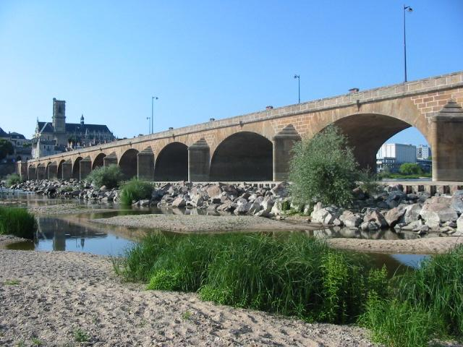
2003 European Summer Heat Wave
Loire river almost dry near Nevers, France

Slide 10
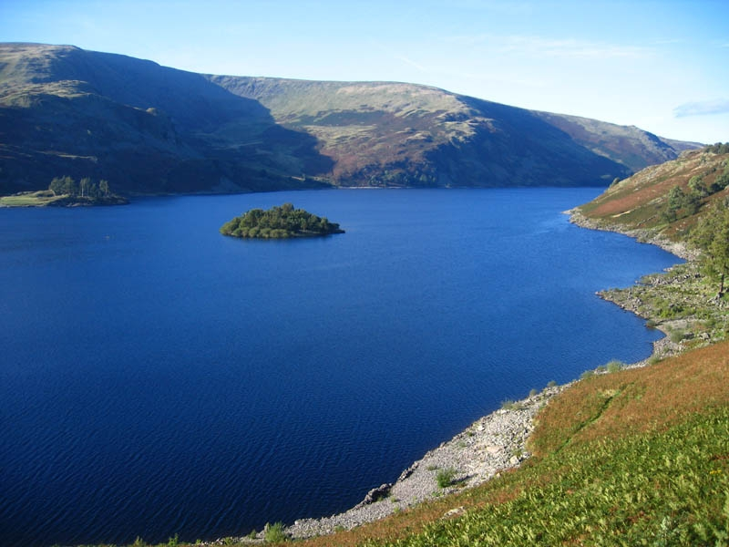
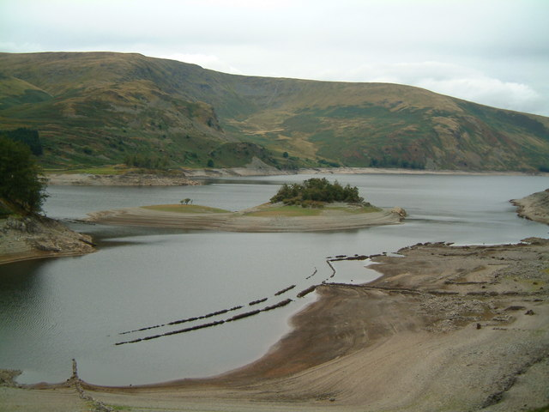
2003 European Summer Heat Wave
Low water level in Haweswater Reservior UK, September 2003

Slide 11
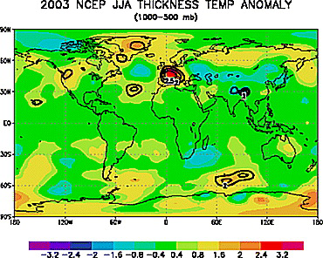
2003 European Summer Heat Wave
More than 3.0SD above the mean of climatology average
1000–500 mb thickness temperature anomaly for June, July, and August 2003 relative to 1979-2003.
Notes:
Areas exceeding 2.0, 2.5, and 3.0 standard deviations from the 1979–2003 mean are contoured in thick lines for anomalies of both sign. The 2003 warm anomaly over Europe was a deep atmospheric phenomenon and exceeded 3.0 SD above the mean for this period. By definition, exceeding 3.0 SD is an extremely unusual event statistically and would be expected in much less than 1% of observations

Slide 12
Model Components
Climate High-Resolution Model (CHRM) version 2.3
Convection scheme
Kessler-type microphysics
Land-surface scheme
Soil thermal model
Radiative transfer model
…
Horizontal resolution: 56 km
Vertical resolution: 20 layers

Slide 13
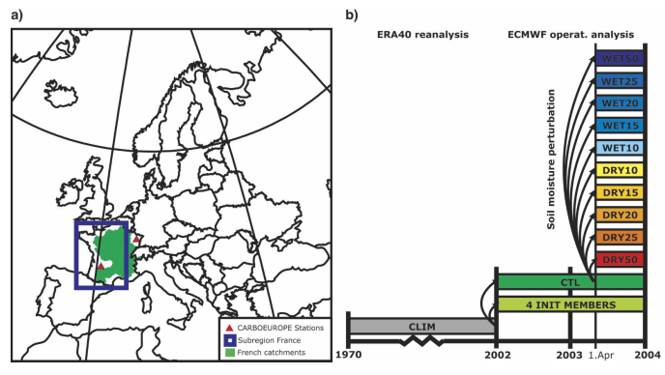
Model Sensitivity Experiments
Climate High-Resolution Model (CHRM) version 2.3
France
Climatology mean: CLIM
Control run: CTL (reference run)
Soil moisture sensitivity experiments: dry and wet 10%, 15%, 20%, 25%, or 50%
Notes:
Regional climate model (RCM) ，Map of the model domain used in all simulations. The land portion within the blue square is used for the analysis of area-averaged soil moisture, temperature, precipitation, and the surface energy budget .On the right is Schematics of the sensitivity experiments.
10 sensitivity simulations with perturbed spring soil moisture conditions (The initialization fields are altered by increasing or decreasing the soil moisture by 10%, 15%, 20%, 25%, or 50% in the total soil depth at every grid box over the model domain.

Slide 14
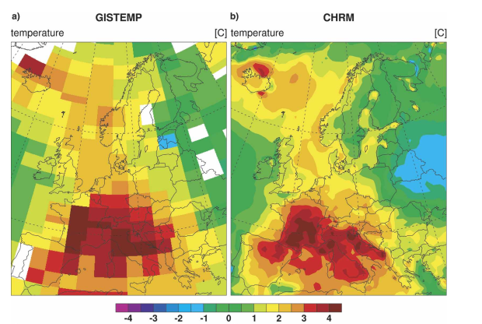
Validation of CTL (control) simulation Temperature
Observation
CTL-CLIM
Warm anomaly
Summer (JJA) 2003 temperature anomaly with respect to the reference period 1970– 2000
Notes:
The overall anomaly patterns compare well, despite a weak underestimation of the spatial extent of the warm anomaly over central Europe.

Slide 15
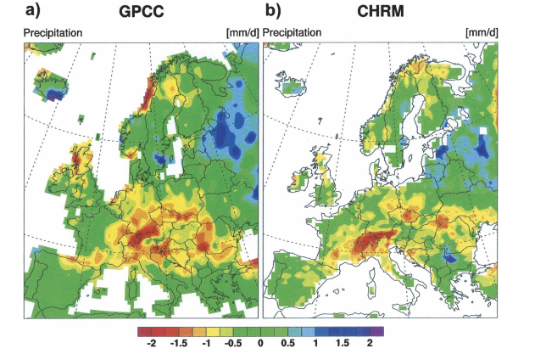
Validation of CTL (control) simulation Precipitation
Observation
CTL-CLIM
Precipitation deficit
Summer (JJA) 2003 precipitation anomaly with respect to the reference period 1970– 2000
Notes:
Strongly reduced summer precipitation over central Europe and and anomalously wet over northeastern europe
validate the model’s representation ofdata [ the pronounced precipitation deficit using GPCC observational

Slide 16
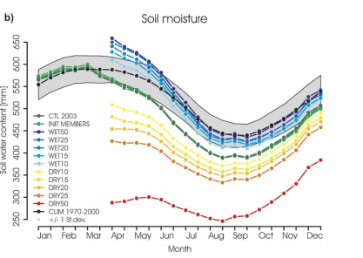
Soil moisture evolution
Higher due to precipitation in summer and autumn of 2012
Wet runs Soil moisture deficit starts in June
CTL Soil moisture deficit starts in Mar
Semimonthly 2003 soil moisture depth averaged over France for sensitivity experiments
Notes:
In early 2003, the simulated soil moisture content (CTL and INIT) is relatively high due to anomalous precipitation amounts in summer and autumn 2002
.e important role of the strong radiative anomalies, the lack of precipitation, and early activation of vegetation, which resulted in a strong desiccation of the soil.
The four inilization scearios are pretty close. This means the different initlizattion time didn’t impact much of the soil moisture.
There is soil moisture deficit anomaly begin on March according to the control run. Even the wet runs have dry anomises starting in Jun, Soil misuture of The control run
Gap between Dry 25 and 50 is high

Slide 17
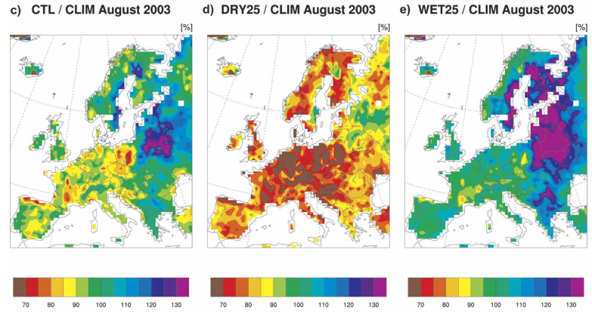
Soil moisture evolution (August)
Aug 2003 soil moisture content in the CTL, DRY25, and WET25 simulations, respectively, divided by the climatological mean (CLIM, 1970–2000) for the corresponding month
Notes:
In August 2003 the soils Fig. in all regions except for northeastern Europe and Scandinavia are anomalously dry in the CTL simulation (Fig. 5c) and very dry over almost the entire domain in DRY25 (Fig. 5d). Even in WET25 ( 5e) and WET50 (not shown), the soil moisture values over parts of western and central Europe drop slightly below the long-term mean.

Slide 18
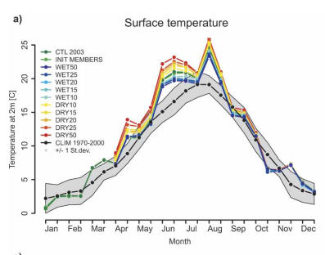
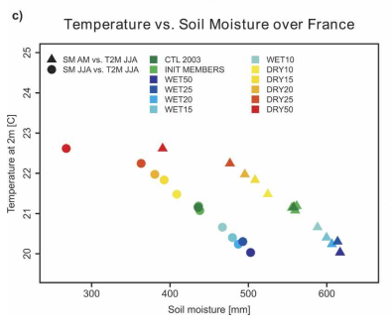
Temperature Response
April-May ▲
June-August
Semimonthly 2003 temperature at 2 m averaged over France
Scatterplot between JJA 2003 surface temperature and soil moisture
Quasi-linearly relation: gradient -0.0015 K mm⁻¹
Notes:
al all perturbed and unperturbed simulations follow the same path in 2003, showing the characteristic warm anomalies in June and the first half of August. The summer temperatures correlate quasi-linearly (gradient 0.015 K mm1) with the absolute soil moisture amount in summer or in the preceding spring (Fig. 6c) Note that the driest simulation (DRY50) is an exception, since the additional warming with respect to the DRY25 simulation is relatively small Due to the extensive perturbation the soil saturation is close to the wilting point in these two simulations. Hence an additional soil moisture reduction does not further affect the latent cooling and surface temperature
the imposed soil moisture anomalies in the DRY and WET simulations decrease continuously over time and approach the CTL in a quasiexponential fashion.

Slide 19
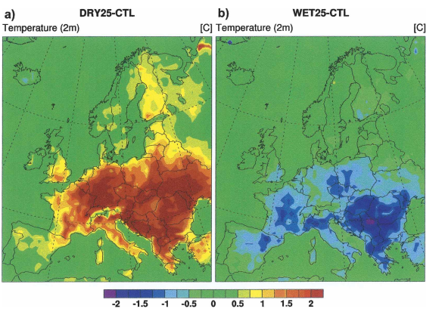
Temperature Response
Low sensitivity in Dry Iberian Peninsula
Summer 2003 temperature anomaly due to spring soil moisture perturbation
Notes:
Summer 2003 temperature anomaly due to spring soil moisture perturbation The reduction of spring soil moisture by 25% results in a strong summer (JJA) warm anomaly of about 2°C .
Over large areas, the spring soil moisture increase in WET25 implies negative temperature departures of around 1.5°C with respect to CTL
egional differences of the response are mainly related to the different sensitivities of the latent heat flux to changes in soil moisture
he sensitivity is low at dry (near wilting point) and at wet (near field capacity) soil moisture contents and strong at the intermediate contents
small temperature response to soil moisture perturbations.

Slide 20
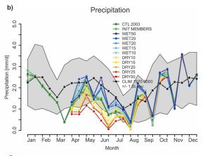
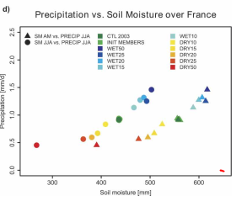
Precipitation Response
Non-linear relation
Semimonthly 2003 precipitation averaged over France
Scatterplot between JJA 2003 precipitation and soil moisture
Dry → limited evaporation → reduced convective activity
Notes:
generally lower spring soil
moisture leads to lower summer precipitation. The precipitation response to the soil moisture perturbation is less continuous than for temperature. In the two driest simulations evaporation is strongly limited, and a further drying has only a minor effect on precipitation. soil moisture–precipitation relationship appears relatively nonlinear, particularly in the DRY simulations
The soil moisture effect on precipitation mainly occurs through a limitation of summer evaporation, which reduces the convective activity

Slide 21
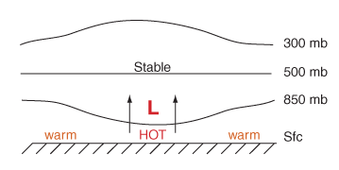
Circulation Response - Geopotential Height
Geopotential Height
the actual height of a pressure surface above mean sea-level
heights are lower in cold air masses, and higher in warm air masses
Surface heat low
Caused by intense surface heating
Notes:
Since cold air is more dense than warm air, it causes pressure surfaces to be lower in colder air masses, while less dense, warmer air allows the pressure surfaces to be higher.

Slide 22
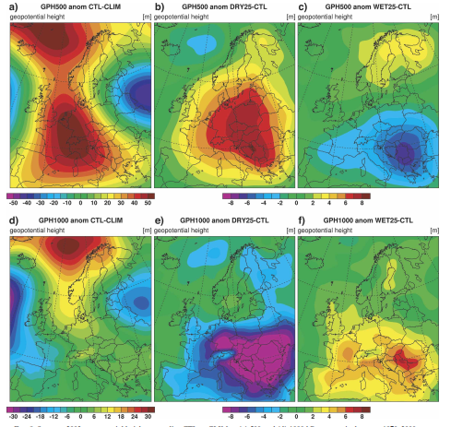
Circulation Response Geopotential height
CTL-CLIM
DRY25-CTL
WET25-CTL
500 hPa
High pressure anomaly and classic wave pattern
1000 hPa
Weak anomaly due to strong surface heating causing surface heat low
Surface heat low
Notes:
Geopotential height approximates the actual height of a pressure surface above mean sea-level.
Impacts surface and upper troposphere
negative anomalies over the eastern North Atlantic and western Russia and pronounced positive anomalies northwest of Scandinavia and central Europe.
500 hPa field has pronounced positive anomalies northwest of Scandinavia and central Europ The analysis of the sensitivity experiment reveals that
soil moisture affects geopotential height from the surface to the upper troposphere.
The geopotential height in the surface and upper-troposphere shows that
These findings suggest that a moderate soil moisture reduction may enhance a positive height anomaly at upper levels and thus make it more persistent.
Both studies found a heat low at the surface and an enhanced positive height anomaly aloft due to substantially reduced soil moisture.
The increased 1000–500-hPa thickness is directly linked to higher tropospheric air temperature and an expanded atmospheric column in this layer. The tropospheric temperature increase due to drought conditions is strongly influenced by the enhanced sensible heat flux (reduced latent cooling).

Slide 23
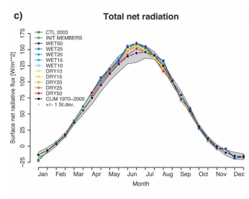
Surface Energy Balance
Net radiation = latent heat flux + sensible heat flux + ground heat flux
Clear skies
Back to climatology mean
This heat wave is not caused by abnormal high net radiation
Notes:
this extremely persistent total net radiation excess during all spring and early summer months strongly contributed to the depletion of soil moisture ； simulated total net radiation returned to climatological mean conditions in late July and during the hottest phase in early August.
This heat wave is not casued by solar radiation, but also the impacts of soil moisture

Slide 24
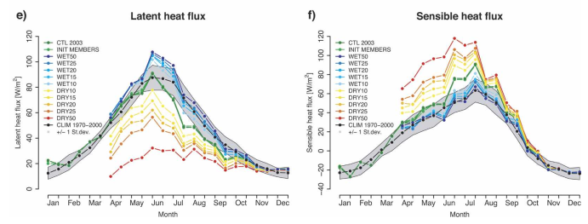
Surface Energy Balance
LH negative anomaly of the control run
Notes:
6), the CTL simulation shows latent heat flux values around the long-term average until mid-June. However, in the following months until October, the lack of
soil moisture led to a dramatic reduction of latent heat
Flu
the latent and sensible heat fluxes are highly sensitive to the soil moisture conditions. A spring soil moisture reduction of 10% (DRY10) produces latent heat flux departures from the CTL simulation of 10 W m2.

Slide 25
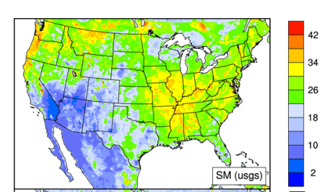
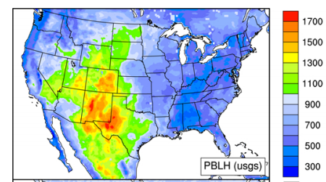
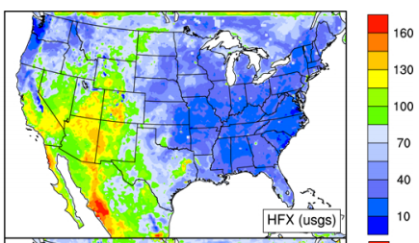
Soil moisture and PBL height (WRF model results, 30 May–3 June 2010)
Soil moisture (%)
PBL height (m)
Sensible heat flux (W m⁻²)
(Z. Tao et al. 2013)

Slide 26
Conclusion
Anomalous atmospheric circulation and the anomalous dry continental-scale soil contribute to the heat wave
Partitioning of net radiation in latent and sensible heat fluxes has strongly contributed to the extreme August temperatures.
Soil moisture perturbations can affect continental-scale circulation

Slide 27
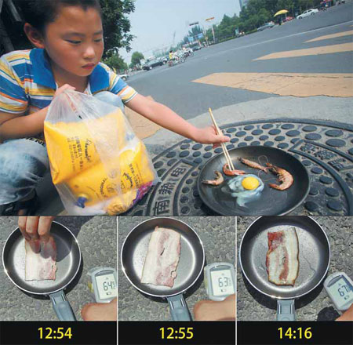

Leisure during Heat Wave
Mahjong

