Slide 1
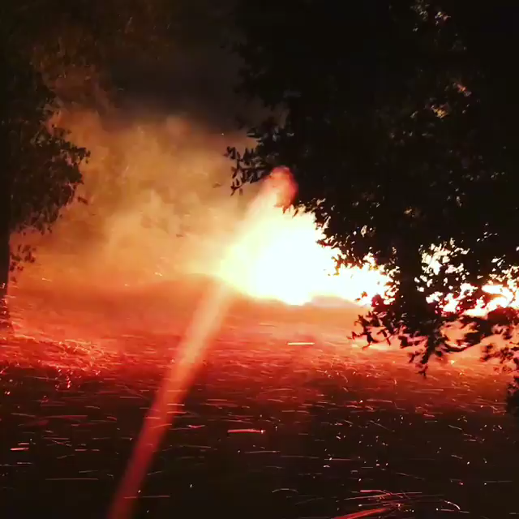
Local and synoptic mechanisms causing Southern California’s Santa Ana Winds
Grzegorz Swistak
Notes:
(I’m going to focus on synoptic mechanisms, why - I will explain myself during the presentation)

Slide 2
OUTLINE
Introduction
Importance
Methods, Implications & Effects
Diablo vs Santa Ana
Example: Background and Pre-existing Conditions
Conclusions & Discussion
“Local and synoptic mechanisms causing Southern California Santa Ana winds” by Mini Hughes and Alex Hall

Slide 3
introduction
What are Santa Ana winds?
Southern California
Fall & winter
Notes:
START WITH THE LEFT THEN RIGHT DIAGRAM. THEN:
In other words, the strong positive high pressure anomaly over the Great Basin causes offshore geostrophic winds (high from the ground, at least 1000m = Coriolis force balancing the PGF, no friction), that are roughly perpendicular to the region’s mountain ranges.
Offshore momentum is then transferred to the surface However, this study finds large variations in the synoptic conditions during the SAW events and that there are many days with SAW and weak synoptic forcing. That leads to the thought that local conditions must play a more significant role.
Also, peak occurrence lands on December, which is 2 months before the climatological peak in synoptic disturbances. That, again, points towards a local mechanism possibly playing an important role

Slide 4
IMPORTANCE
Impact on wildfires
Intensified mixing of the sea surface
Dust introduced into the ocean

Slide 5
METHODS
Synoptic vs Mesoscale
NARR: 32-km resolution North American Regional Reanalysis (NARR)
MM5: 6-km resolution reanalysis
Scatter plot of daily NARR offshore winds vs MM5 offshore wind averaged over the 25 closest grid points from a
12-year simulation.
Notes:
Synoptic – large scale 1000km
Mesoscale – 5km to several hundred.
NARR – to represent synoptic conditions. is an improved, downscaled version of older NCEP Reanalysis. Shows improvement in terms of coarse-scale features, of atmospheric conditions such as pressure and synoptic scale winds. NCEP being National Center for Environmental Information
MM5 – Penn State/NCAR mesoscale model version 5. Climate, much higher resolution data. Identification of events and a local perspective on the dynamics. Allows to represent all major mountain complexes in SoCal.
6km domain is nested within 18km and that likewise nested within a 54km domain.
Plot – location, Thousand Oaks. Offshore surface winds at the exit of the largest gap in SoCal topography, where SAW are historically particularly strong. NARR dramatically underestimate the wind strength during days with strong offshore flow
Beta – buoyancy induced pressure gradient force – katabatic pressure gradient force, calculated using the temperature deficits, average temperature in the layer, slope of topography and gravitational acceleration.

Slide 6
METHODS
MM5 simulation
Correlation between the observed offshore wind component and MM5 winds at the nearest grid point.
Offshore = NE
Days with offshore winds above the desert (at 2km)
Black contour: model terrain Thick black: coastline
>0.7 at 13 locations >0.4 at all but 5 of the 42 locations
Notes:
Effectiveness of this downscaling technique shown by the correlation between observed daily offshore surface winds with MM5 winds
Time period – May 1995 – Dec 2006. Initialized every 3 days and run for 78h (first 6h discarded as spin-up)

Slide 7
METHODS
A Santa Ana index (SAt)
Previous studies used only the large scale pressure conditions
This index does not introduce assumptions about large scale mechanisms. It also aims to provide information about intensity
Based on averaging of the magnitude of offshore wind in strength through the largest gap in the terrain
Diagram (b) shows the magnitude of the SAt for the entire 12-year period – shows strong seasonality (December peaks)
No strong offshore winds April – September
Blue box – area used to compute SAt

Slide 8
METHODS – Synoptic controls (NARR)
Blue box – area used to compute SAt
Notes:
Previous studies suggest that as long as the atmosphere is vertically stably stratified with a Froude number (inertia/gravity) close to one, which occurs on a large proportion of Santa Ana days (SADs) – gravity waves can transfer the upper-level momentum to the surface causing strong gap flows.
Figure a) shows a 700mb GPH (geopotential height) anomaly. Within the blue line – region with days with the SAt index than 5 m/s.
Pattern Is centered off the Oregon coast, which would cause the NE offshore flow

Slide 9
METHODS – Synoptic controls
So does this mean that the Santa Ana winds are caused exclusively by the pressure gradient?

Slide 10
METHODS – Synoptic controls
Blue box – area used to compute SAt
Notes:
Shows zonal and meridional components of the MM5 winds averaged within the area of Mojave desert for each day.
Vector drawn from the middle to the point shows speed and direction - showing the magnitude of the offshore component (away from blue line)
We can see that almost all SADs occur when the desert winds have an offshore component. Assuming those wind as geostrophic – there is a NW to SE high to low pressure anomaly consistent with FIG (a)
EASY VERSION: Calculated the mean Geopotential Height (GPH) anomaly and distinguishing between highest and lowest GPH days ( b & c ) authors show that only slightly more than half the 280 high GPH days have strong offshore surface winds in Southern California.
Therefore, when GPH is unusually high, there is nearly a 50% chance of having weak or no SA winds
Further: half of the SA days (days with SAt [ 5 m s-1) have a GPH anomaly so weak that it is barely visible on a weather map
Authors then calculated the mean mean GPH anomaly over the region with the largest SA composite anomaly (Fig. 5, blue line)
for each winter day and extract the 280 days with a
mean anomaly larger than the SA composite (hereafter these are called high GPH days).
We then segregate the high GPH days by the value of SAt (Fig. 5b, c).
Only slightly more than half the 280 high GPH days have strong offshore surface winds in Southern California (i.e., SAt [ 5 m s-1), whereas the remaining 123 days have very small SAt.
Therefore, when GPH is unusually high, there is nearly a 50% chance of having weak or no SA winds. Further, half of the SA days (days with SAt [ 5 m s-1) have a GPH anomaly so weak as to be barely discernible on a weather map (Fig. 5d).
Composites are just the averages.

Slide 11
Local thermodynamic effects
If synoptic forcing is not the primary driver - which mechanism is dominant?
Desert surface vs temperature gradient
β – katabatic (downslope) PGF
As desert surface gets much colder than atmosphere over the ocean and β increases – the strength of the offshore winds consistently increases
Unless synoptic conditions are unfavorable for the development of Santa Ana winds, strong offshore surface flow often develops due only to katabatic forcing
December is when the climatology of temperature favors development of a strong temperature gradient
Notes:
Local!
Cold air would pool in the desert against the lower Sierras and the coastal topography, hydrostatically increasing the desert-ocean pressure gradient, and causing a negatively buoyant gravity current to pour through mountain gaps at the surface. The negative buoyancy can be written as a pressure gradient force over the sloping terrain, often called the katabatic pressure gradient force (Beta) (Beta is a function of temperature deficits, average temperature, gravitational acceleration as well as the slope of the topography.) Diagram – relationship between the katabatic forcing and the Santa Ana index
B = g * theta’ / theta 0 x sin(alfa)
where g = 9.8 m s-2 is gravitational acceleration, h0 is the temperature deficit of the cold layer, h0 is the average temperature in the cold layer, and a is the slope of the topography. In our calculation of B; we use the average desert surface air temperature for h0 and the average slope of the topography through the largest gap for a (approximately 1 degree, or 1 km drop over 50 km; see Fig. 4a).
Last – Probability of large katabatic forcing is also largest in December

Slide 12
QUESTION!
Will the frequency and intensity of the Santa Ana events decrease or increase?

Slide 13
Effects and implications
Will the frequency and intensity of the Santa Ana events decrease or increase?
- most likely decrease, as:
Half of the variance in SAt is due to local thermodynamic effects and only the other half due to the large scale mechanisms
The temperature of the air over deserts will increase quicker than air over oceans, due to the greenhouse gases
Both of these effects have strong implications for future wildfire frequency in Southern California

Slide 14
How about Diablo Winds?
High pressure system situated over the region East of Sierra Nevada
Winds blow from the central Great Basin toward the Pacific coast – cyclonic flow
Winds forced over the mountain range, descend down the elevated terrain and mountains on the western edge of the basin and into California
A Winds descend, they are compressed and warmed with speeds reaching hurricane levels (>70 mph)
Favorable condition – inversion layer “cap”, causing forced channeling of the winds beneath the "cap."

Slide 15
Northern California wildfires of October 2017
250 wildfires
245,000 acres
Santa Rosa lost 5% of its housing
14,000 homes destroyed or damaged
Over $9 billion in insured losses
44 fatalities, 192 injuries
310,000 customers lost electricity
Source of the main fires: most likely downed power lines & failed electric utilities equipment
Santa Rosa, CA | Oct. 2017

Slide 16
Pre-existing conditions
Five years of record breaking drought
Above normal rainfall Winter 2016/2017
Rapid growth of finer fuels – flammable grass
Strong winds
Keetch-Byram Drought Index, which is a drought index designed specifically for fire potential assessment
Notes:
Stressed trees due to lack of moisture.
Index is based on soil water capacity

Slide 17
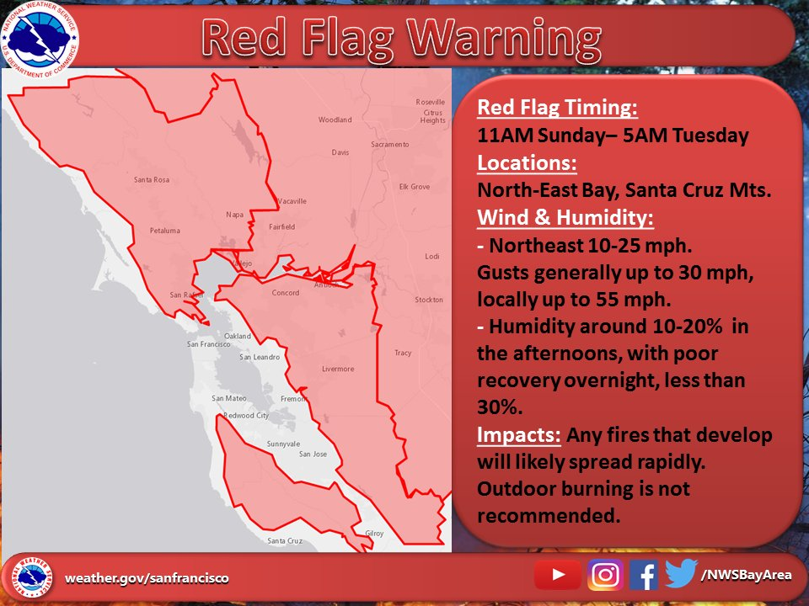
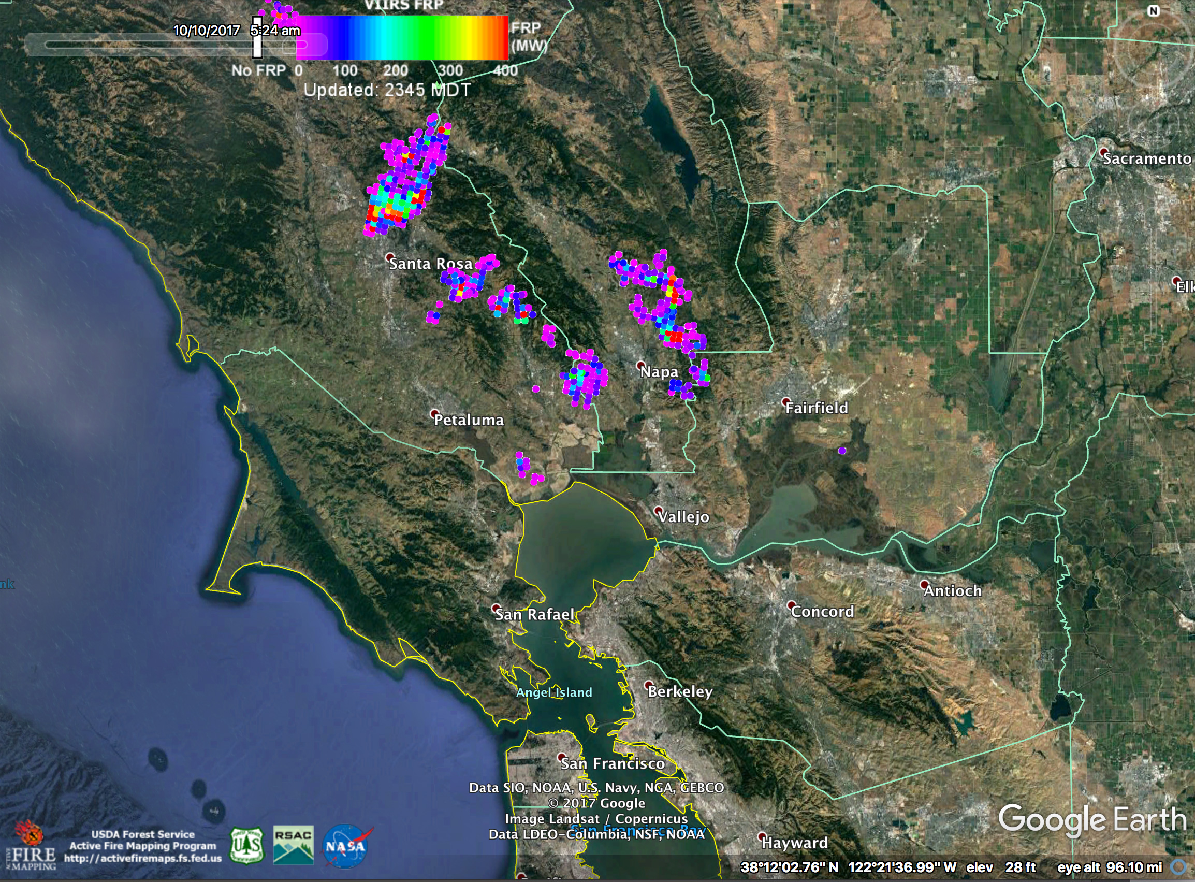
Detection & first day
First Red Flag Warning Issued on October 8th
Measured fire radiative power (fire intensity in MW) for VIIRS (Visible Infrared Imaging Radiometer Suite) fire detections for October 8th – October 10th

Slide 18
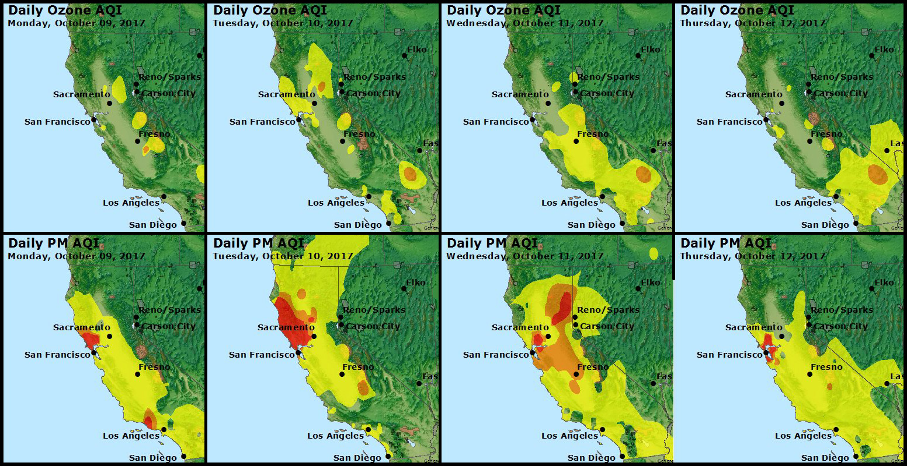
Air Quality
The Copernicus Sentinel-3A satellite image of smoke from wildfires in the US state of California on 9 October 2017.
Impact of wildfires on air quality, including Ozone and Particulate Matter, in Northern California, during October 9th - October 12, 2017.

Slide 19
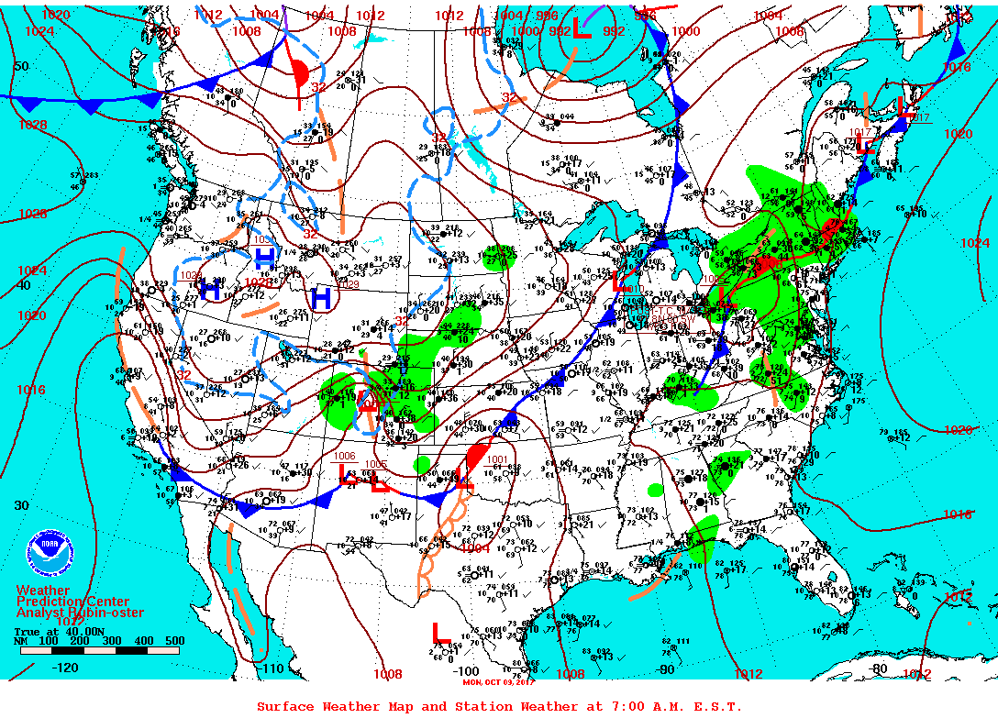
Diablo winds of October 2017
Surface Weather Map for US, for October 9th, 2017

Slide 20

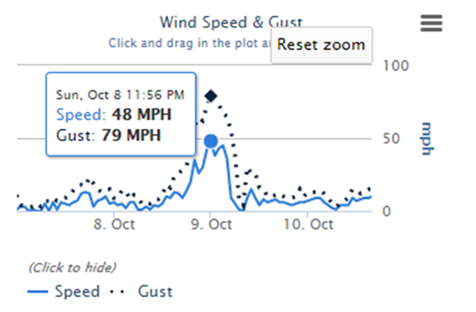
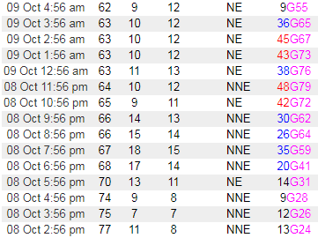
Diablo winds near Santa Rosa
Weather conditions for Hawkeye, CA weather station, located 30 miles north of Santa Rosa, CA. Elevation 2024 ft.

Slide 21
Diablo winds near Santa Rosa
Weather conditions for Hawkeye, CA weather station, located 30 miles north of Santa Rosa, CA. Elevation 2024 ft.

Slide 22
Diablo winds near Santa Rosa
Wind Speed Cross Section graph from the Department of Meteorology and Climate Science at the San Jose State University
Notes:
Coffey Park – Santa Rosa, CA. Mr St. Helena, about 20-25 miles North of Santa Rosa, CA

Slide 23
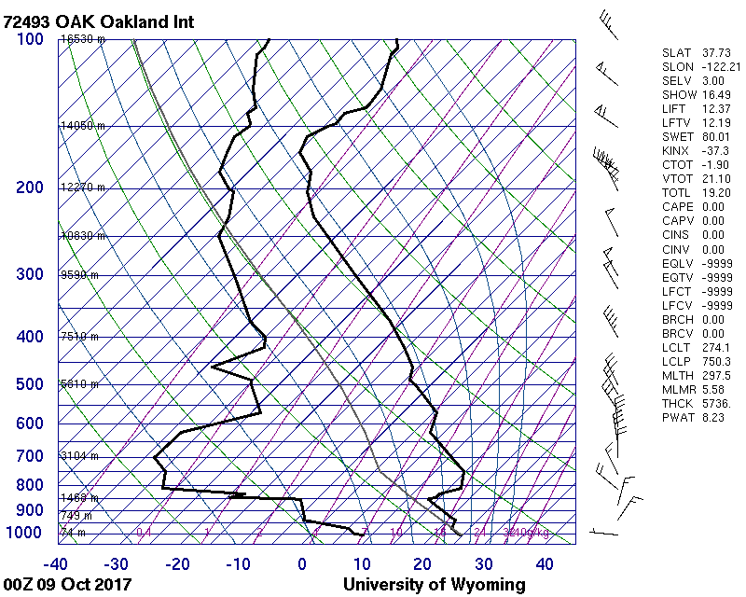
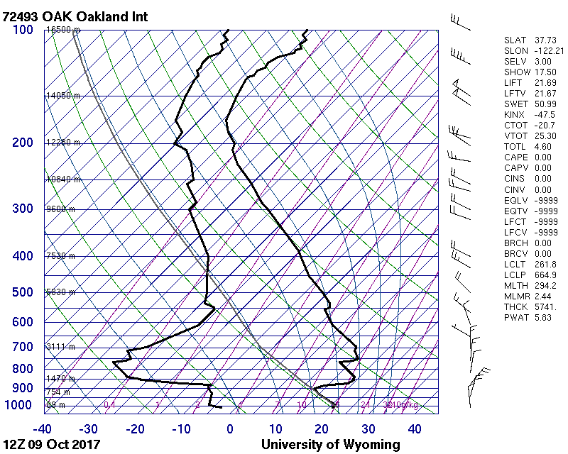
Diablo winds & Inversion Layer
Notes:
Very favorable situation for strong mountain-wave winds is a stable layer at or just above crest level. A stable layer can be noted when temperature is steady with height or increases with height (an inversion).
Also, we can see wind backing / counter clockwise barbs rotation, which in NH means cold air advection and dynamic sinking.

Slide 24
Reanalysis
WRF Model 6-hour Wind Speed and Direction forecast from the Desert Research Institute

Slide 25
Conclusions & DISCUSSION
Diablo and Santa Ana winds are very comparable from a mechanical perspective, at the time of the occurrence
However, comparisons for Diablo and Santa Ana winds suggest a unique model of local forcing mechanisms for Santa Ana winds, related to the temperature gradient
While more recent studies suggest strong impact of local effects in intensifying the Santa Ana wind events, no such studies exist for Diablo Winds
Numerical simulations suggest that terrain forcing during Diablo winds occur at a larger scale (Sierra Nevada), compared to the more local complex boundary layer/terrain wave dynamics involved during Santa Ana winds
Our numerical models are powerful enough to predict such events even few days in advance, which is a good prognosis for the fire seasons to come

Slide 26
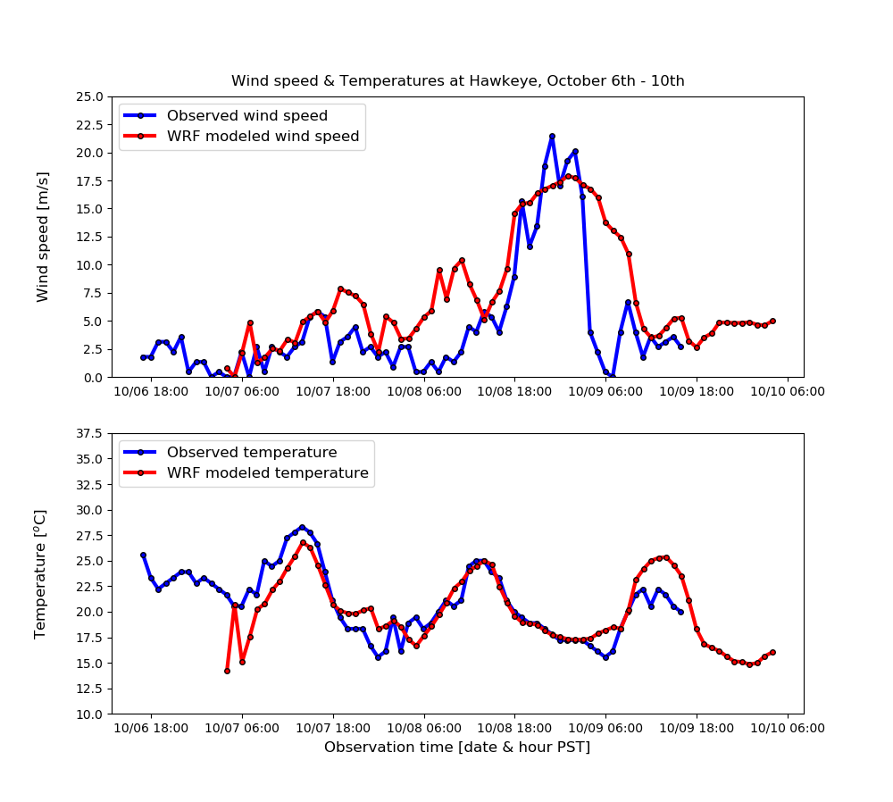
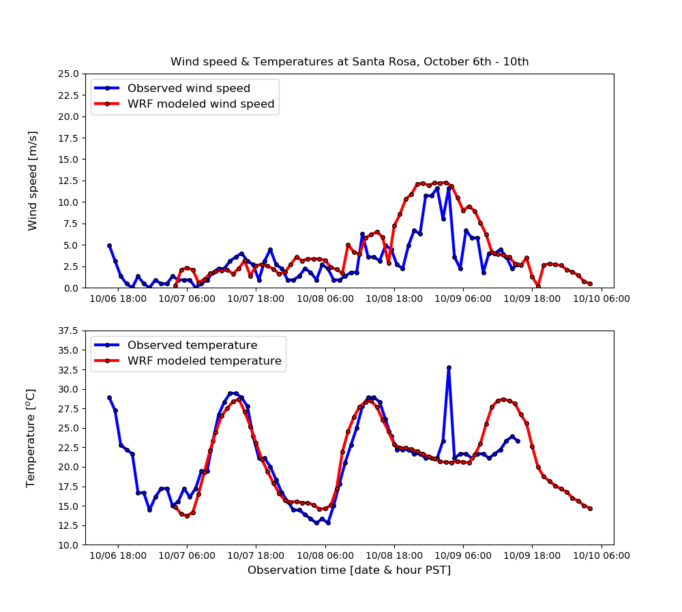
Conclusions & DISCUSSION

Slide 27
Sources
Weather.gov/SanFrancisco
Sonoma County Wildfires by Matthew Mehle
Coursey Graves Winery Instagram video
Before and after pictures from https://www.nytimes.com/interactive/2017/10/10/us/california-fires-maps-photos.html 12/15/2017
Wind Speed Cross Section and Equivalent Potential Temperature graph, obtained from the Department of Meteorology and Climate Science at the San Jose State University
Keetch-Byram Drought Index from the Wildland Fire Assessment System https://www.wfas.net/ 12/06/2017
Hawkeye California Weather Station data https://wrcc.dri.edu/cgi-bin/rawMAIN.pl?caCHAW 12/06/2017
The Science Of 'Diablo Winds' Fanning California Wine Country Fires for Forbes, by Dr. Marshall Shepherd, Dir., Atmospheric Sciences Program/GA Athletic Assoc. Distinguished Professor (Univ of Georgia), Host, Weather Channel's Sunday Talk Show, Weather (Wx) Geeks, 2013 AMS President
Local and synoptic mechanisms causing Southern California Santa Ana winds, by Mimi Hughes and Alex Hall
North Bay Diablo Windstorm Precursor Multiscale Dynamical Environments by Michael L. Kaplan, Benjamin J. Hatchett and Craig M. Smith.

Slide 28
Local and synoptic mechanisms causing Southern California’s Santa Ana Winds Questions?
Grzegorz Swistak

