Slide 1
April 27, 2011 Southeast Tornado Outbreak
Graduate seminar – spring 2018
Sean colgan

Slide 2
Meteorological Overview of the Devasating 27 April 2011 Tornado Outbreak
Knupp, K.R., T.A. Murphy, T.A. Coleman, R.A. Wade, S.A. Mullins, C.J. Schultz, E.V. Schultz, L. Carey, A. Sherrer, E.W. McCaul, B. Carcione, S. Latimer, A. Kula, K. Laws, P.T. Marsh, and K. Klockow, 2014: Meteorological Overview of the Devastating 27 April 2011 Tornado Outbreak. Bull. Amer. Meteor. Soc., 95, 1041–1062,https://doi.org/10.1175/BAMS-D-11-00229.1

Slide 3
Presentation Outline
Motivation
Introduction
Synoptic & Mesoscale
Characteristics
Damage
Statistics
Conclusion

Slide 4
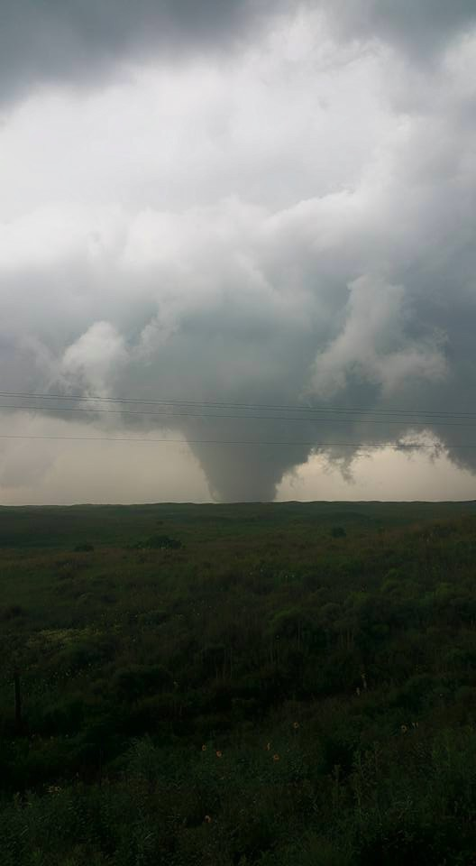
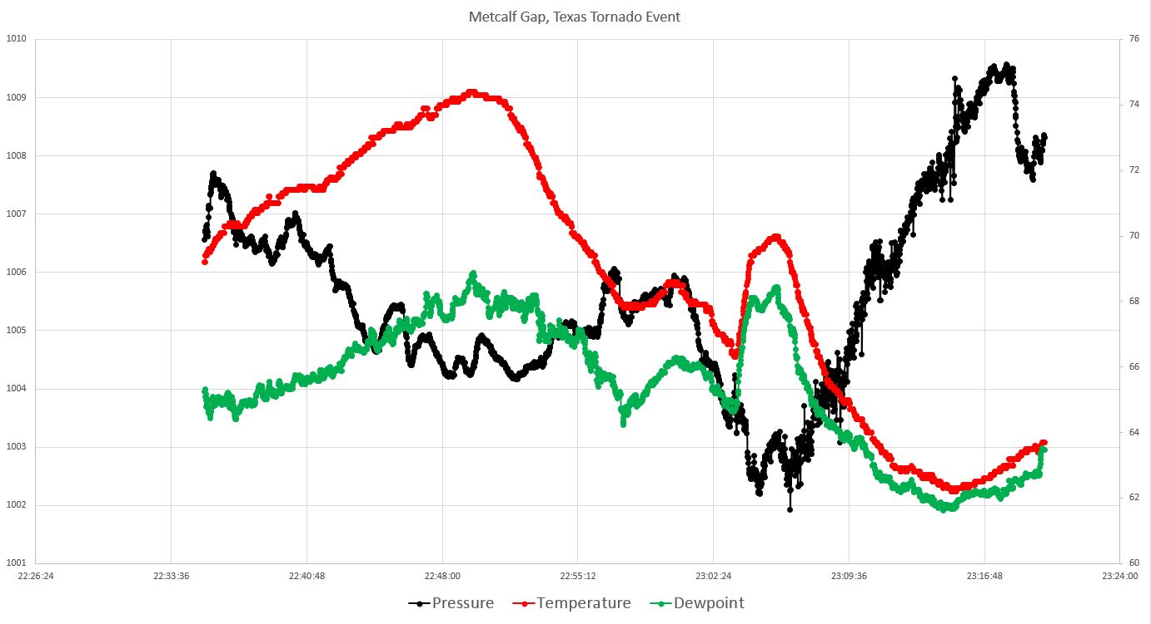
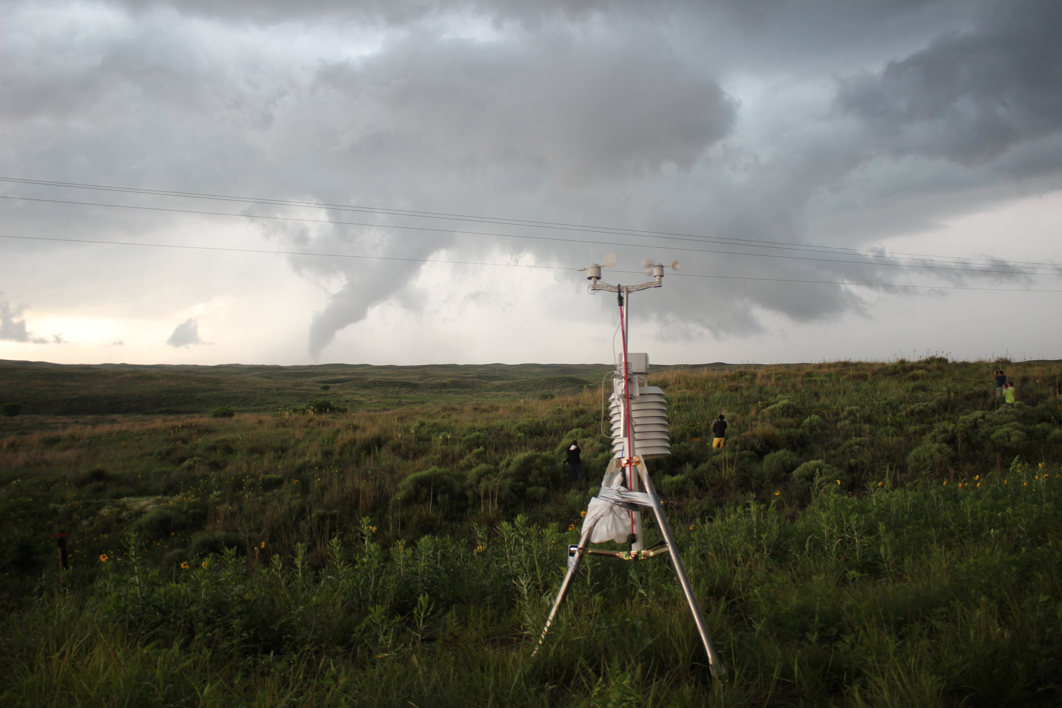
Motivation

Slide 5
Introduction
Record year for spring tornadoes
More extreme than the April 3-4, 1974 ‘Super Outbreak’
May 22
  Joplin, MO tornado (EF5)
758 tornadoes in April alone
  170 from April 14-16 – 45 in AL (record before April 27, 2011)
  350 from April 25-28
  20 year average – 188 tornadoes

Slide 6
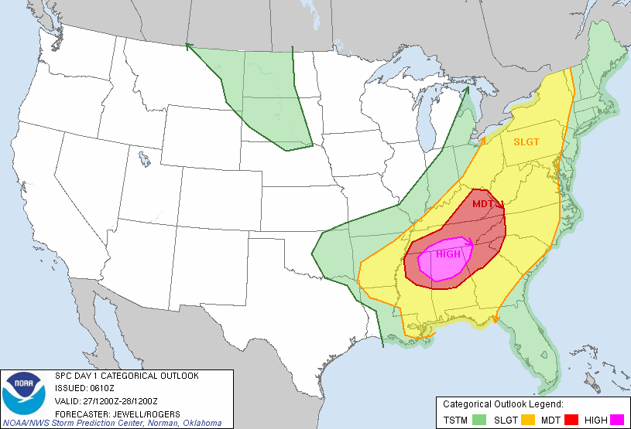
Introduction
Yellow = slight chance
Red = moderate chance
Pink = high chance

Slide 7
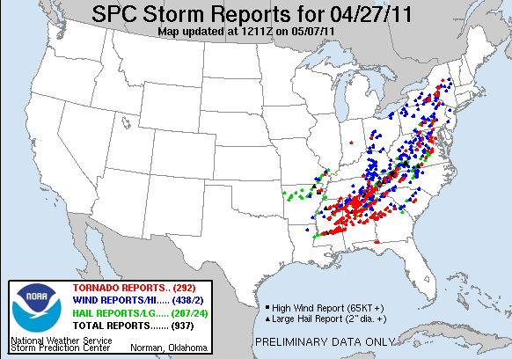
Introduction
Red = tornado reports
Blue = severe wind (>58knots)
Green = hail (>1inch)

Slide 8
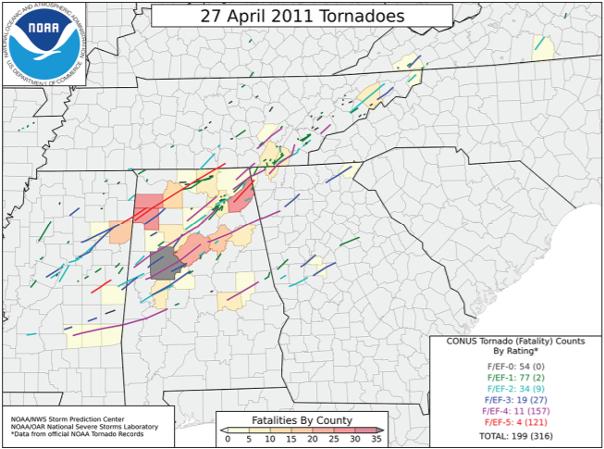
Introduction
199 tornadoes in 24 hours
  April 27, 2011
316 fatalities and over 2700 injuries in 24 hours
Estimated damages of $11B
Multi-day severe weather event
  From Texas to New York

Slide 9
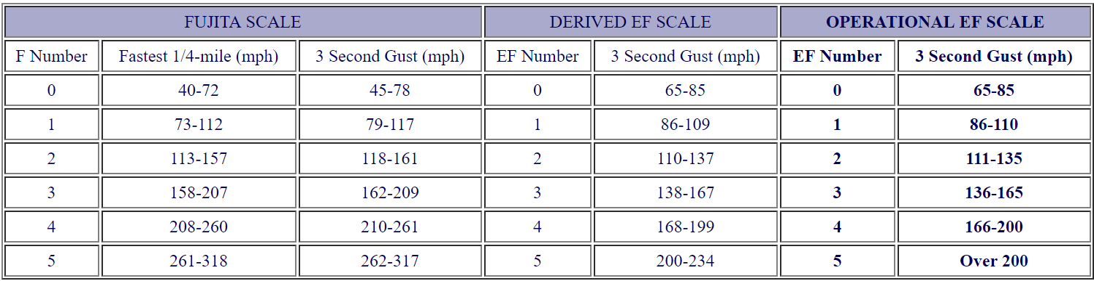
Introduction
http://www.spc.noaa.gov/faq/tornado/EFScale.pdf

Slide 10
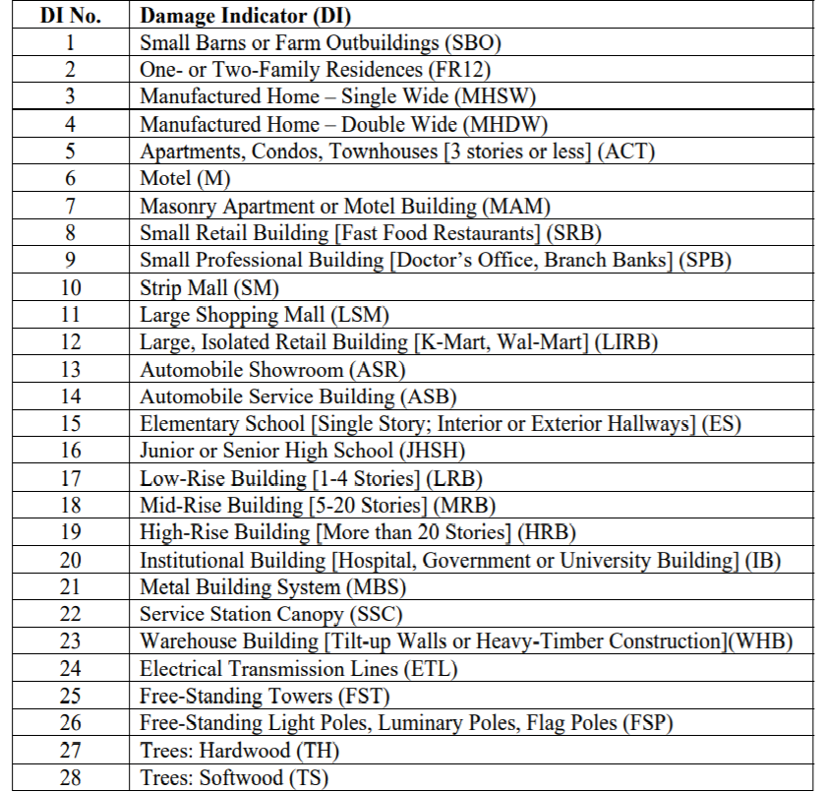
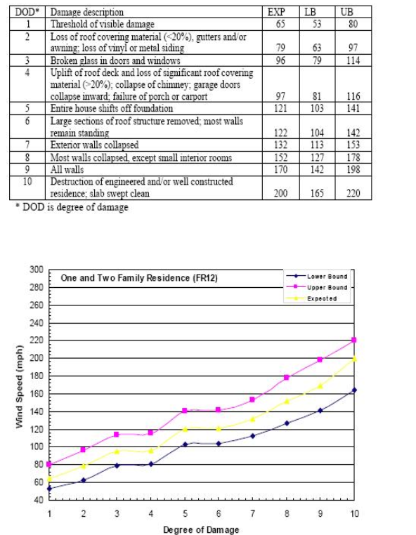
Introduction

Slide 11
Introduction
Synoptic (Low pressure, trough, ridge, etc)
  1000s of kilometers
Mesoscale (Outflow boundary, mountain waves, etc)
  100s of kilometers
Microscale (Tornadoes, dust devils, etc)
  10s of meters
Helicity (Combination of speed shear and directional shear)
  Figure skater

Slide 12
Introduction
MCS
  Mesoscale Convective System
  Larger thunderstorm complex
  Usually produces heavy rain, small hail and gusty winds
Supercell
  Individual storms with rotation updrafts
  Most likely storm type that produces tornadoes
  About ~30% produce tornadoes

Slide 13
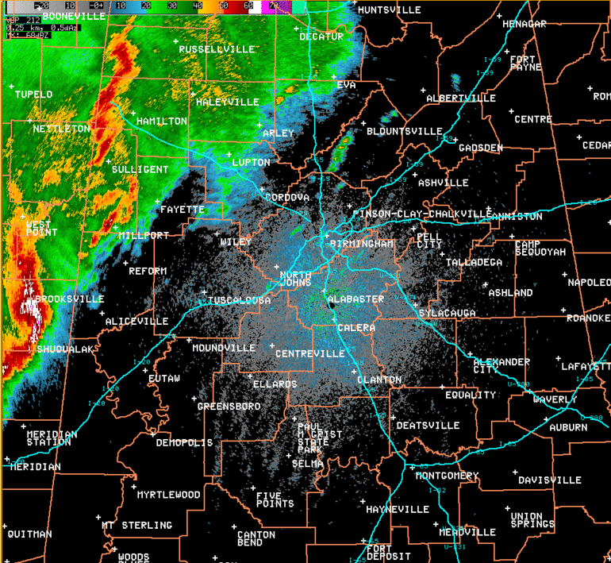
Morning Radar Loop

Slide 14
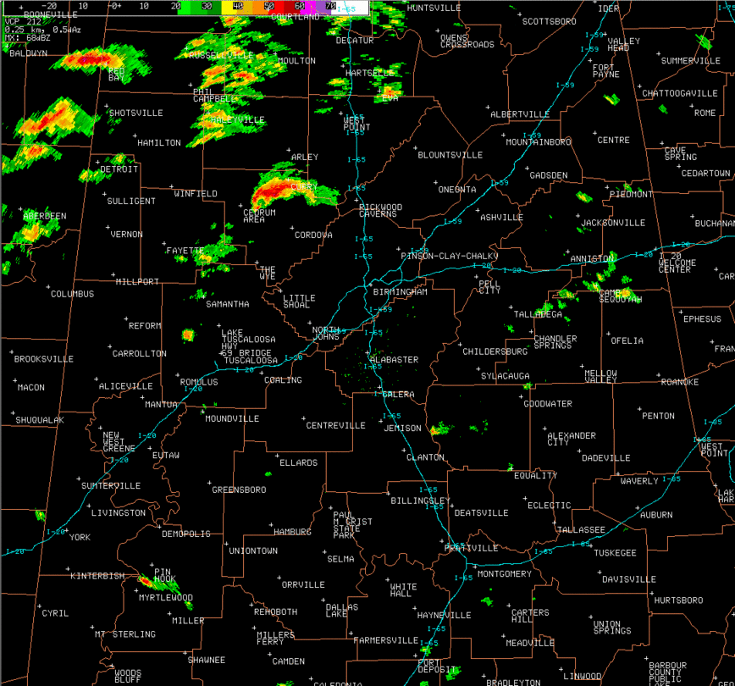
Afternoon Radar Loop

Slide 15

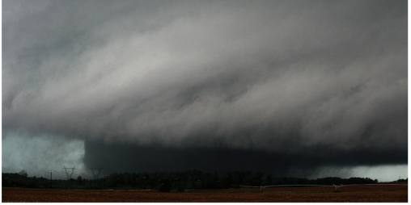
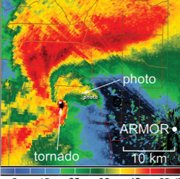
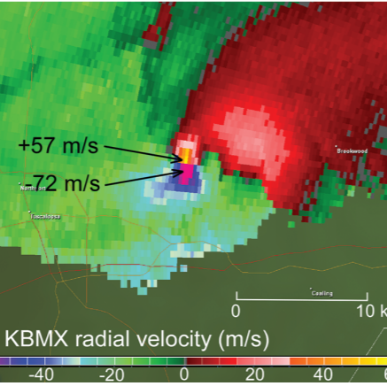
Hackelburg, AL Tornado
Tornado is placed where the hook echo is (supercells)
Red velocity = wind away from radar
Green velocity = wind towards radar
The area where these meet is where rotation occurs

Slide 16
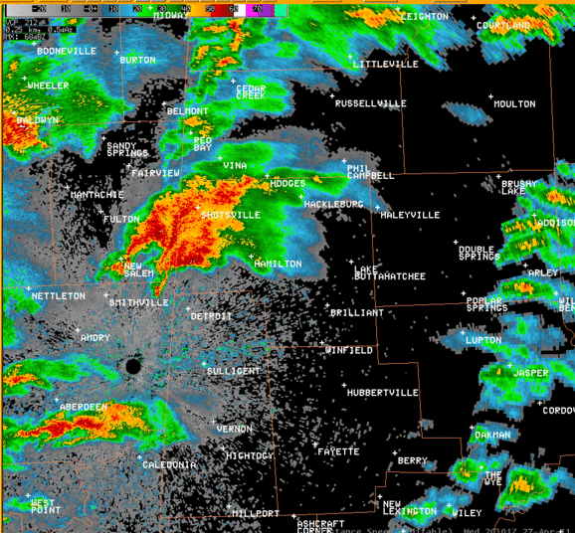
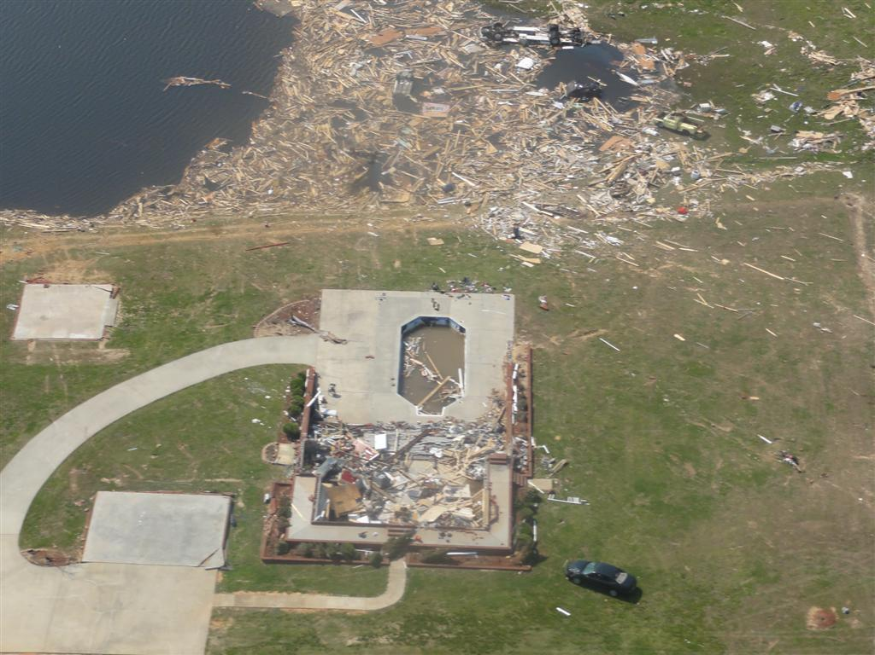
Hackelburg, AL Tornado (EF-5)
Maximum winds ~210mph
Path length ~212km
Tornado width ~2011m
72 fatalities
150 injuries
$1.250B in damages

Slide 17
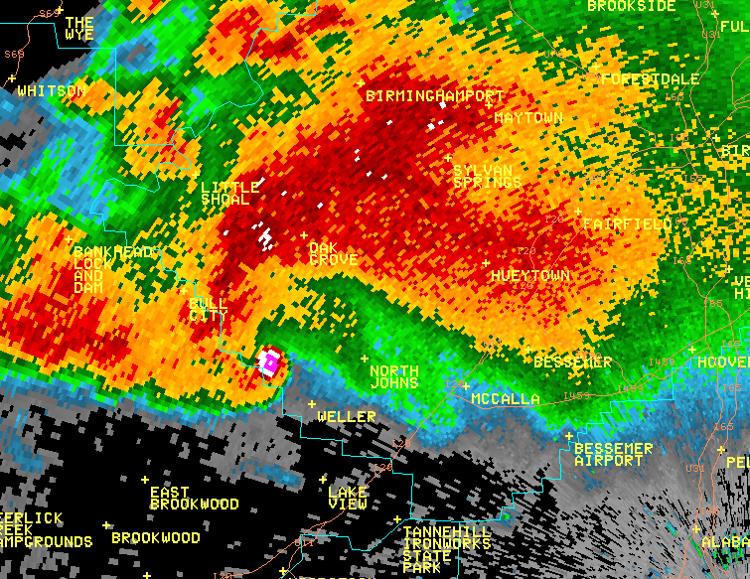
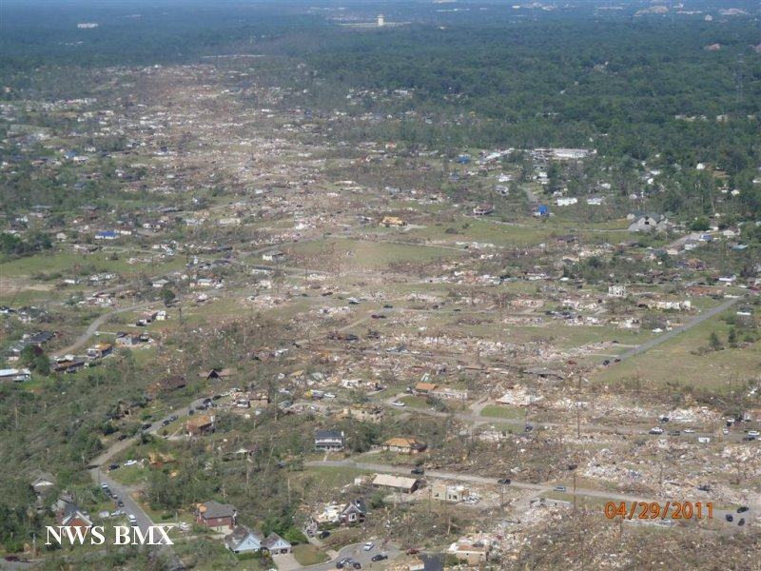
Tuscaloosa/Birmingham, AL Tornado (EF-4)
Maximum winds ~190mph
Path length ~130km
Tornado width ~2377m
64 deaths
1500 injuries
$2.203B in damages

Slide 18
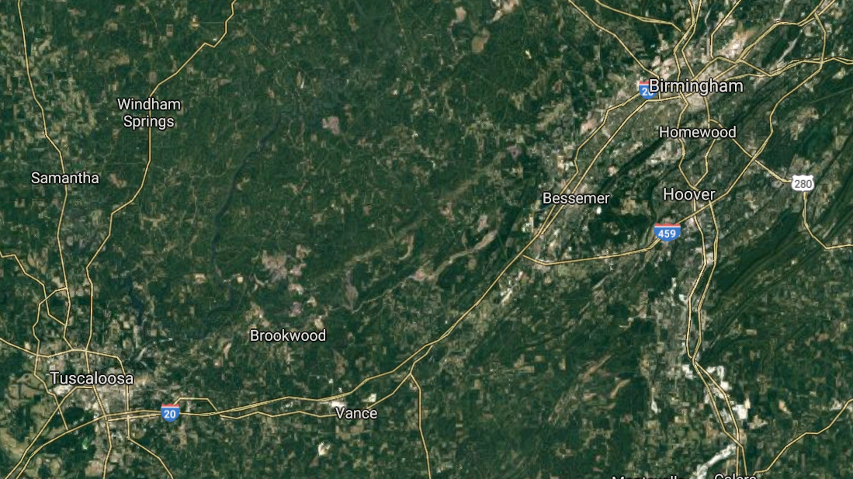
Tuscaloosa/Birmingham Tornado

Slide 19
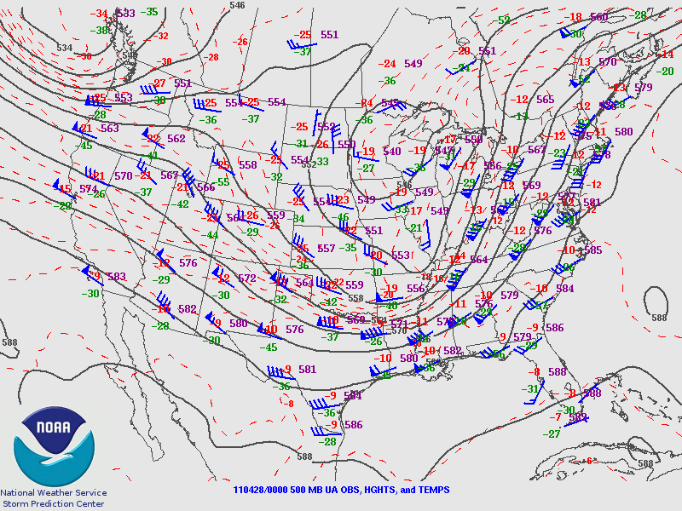
Synoptic & Mesoscale
500mb Analysis (mid-troposphere)
Cold air advecting into the region aloft
Winds from the WSW

Slide 20
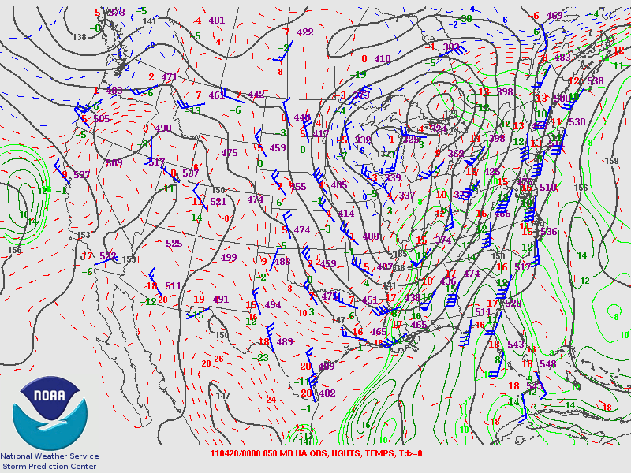
Synoptic & Mesoscale
850mb Analysis (~3000m AGL)
Moisture transport from Gulf of Mexico
Winds from the SW

Slide 21
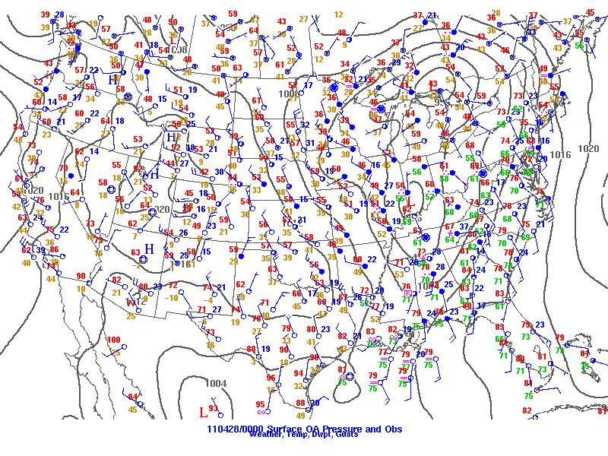
Synoptic & Mesoscale
Surface analysis
Southerly winds
High dewpoint >70F
Temperatures about 75-80F

Slide 22
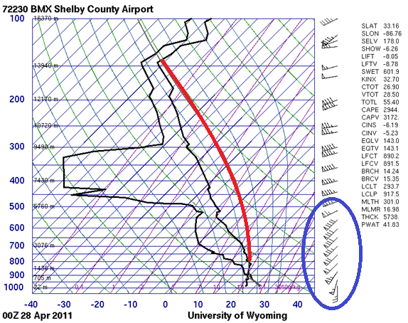
Synoptic & Mesoscale
Skew-T sounding
Birmingham, AL at 8pm EDT
Abundance of instability (CAPE)
Incredible amounts of shear (Helicity)

Slide 23
Synoptic & Mesoscale
MCS – Round 1 (0500-1500 UTC)
  Mesoscale Convective System
MCS – Round 2 (1500-2000 UTC)
  Mesoscale Convective System
Supercell – Round 3 (2000-0500 UTC)
  Storms with strong, tilted and rotating updrafts

Slide 24
Synoptic & Mesoscale
Round 1
  Extreme values of low-level speed shear and directional shear
    Helicity - 500-700m²s⁻² (only need about 250m²s⁻² for supercells/tornadoes)
  Decent instability (1000 j/kg CAPE)
  Moisture from the Gulf of Mexico
  Favorable environment for rotating imbedded storms
  76 tornadoes
  3 fatalities
  Knocked out power to many in MS & AL

Slide 25
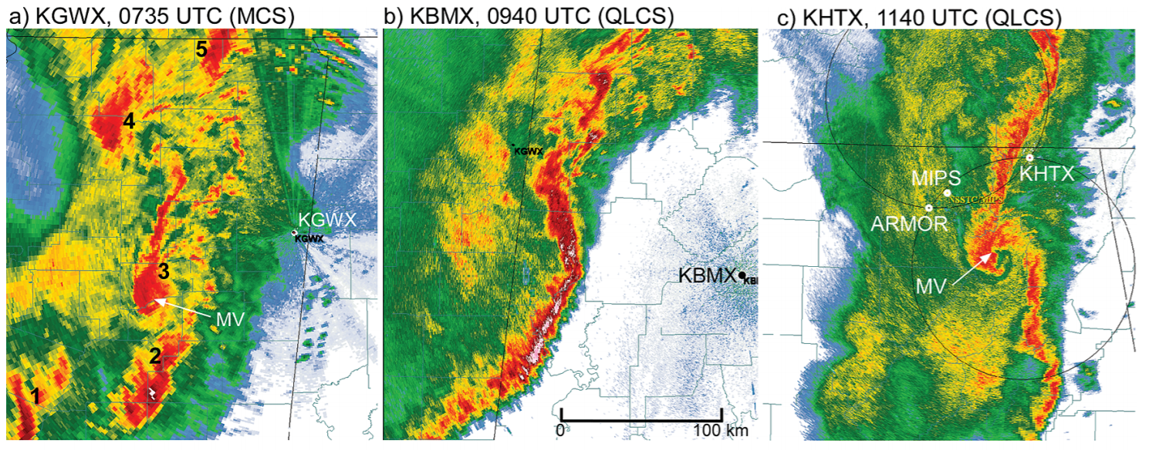
Synoptic & Mesoscale
Round 1 – Mississippi and Alabama

Slide 26
Synoptic & Mesoscale
Round 2 (Midday)
  7 tornadoes
  Tracked through NW Alabama
  Left behind an outflow boundary
    Responsible for the violent tornadoes later in the day
  1 fatality

Slide 27
Synoptic & Mesoscale
Round 3 (1900-0500 UTC)
  Dozens of supercells
  Most conductive environment for supercells and tornadoes ever recorded
  Strong upper-level trough and low pressure at the surface
  Instability reaching 3,000 j/kg over Alabama
  Increasing dewpoint with strong winds transporting moisture
  Helicity values increased to 600-900m²s⁻²
  Outflow boundary from earlier storms allowed for more shear, smaller scale and cannot be captured until hours before event

Slide 28
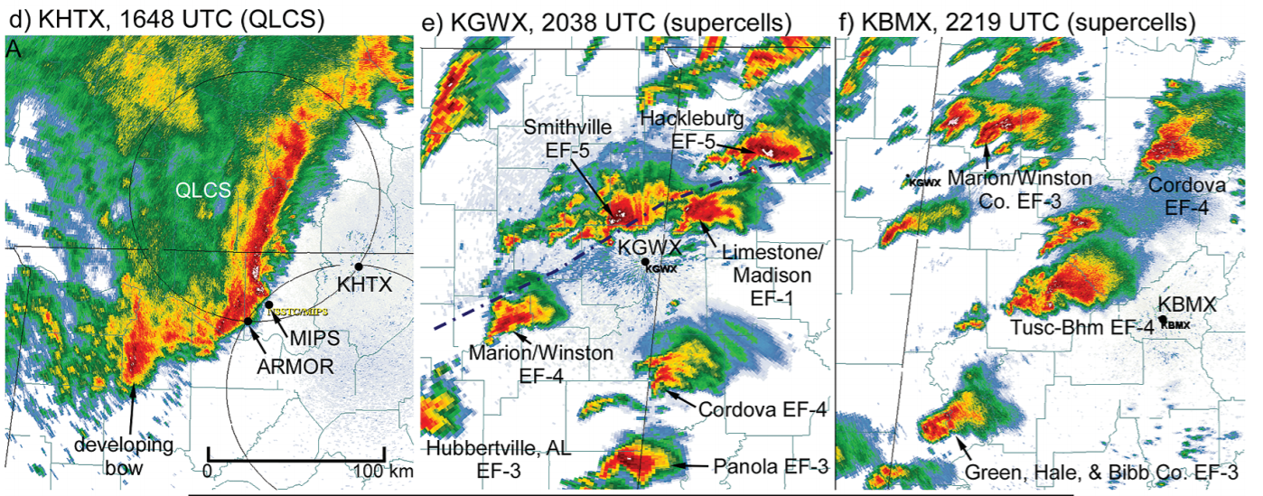
Synoptic & Mesoscale
Round 2 & 3 – Mississippi, Alabama and Tennessee

Slide 29
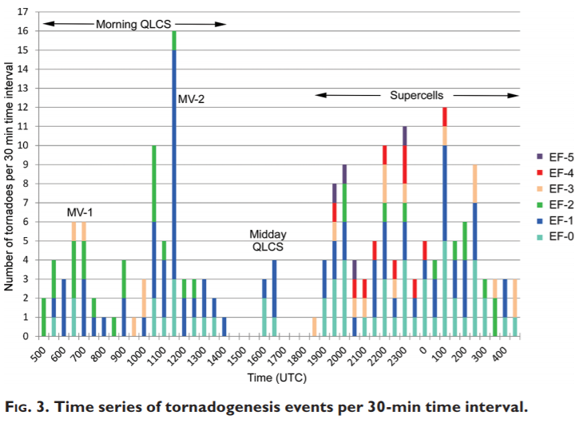
Characteristics
3 distinct rounds of tornadogenesis
Only 6 30minute periods without tornadoes on this day
MV = mesoscale vortex
QLCS
  Quasi-Linear Convective System
MCS includes QLCS

Slide 30
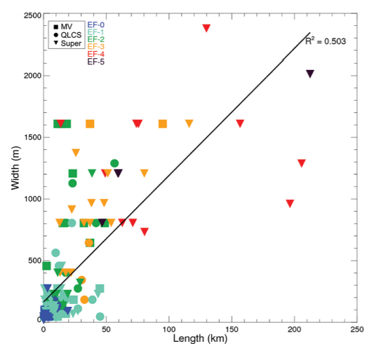
Characteristics
Wide and long tornadoes tended to be supercells
A few tornadoes from the MV (mesoscale vortex) in the morning that did produce wide tornadoes

Slide 31
Characteristics
90% of all supercells on this day produced at least one tornado
3 tornadoes travelled more than 200km
19 EF-3, 11 EF-4, 4 EF-5 tornadoes
How does this compare with April 3-4, 1974 tornado outbreak?
  Less area, but longer lived tornadoes

Slide 32
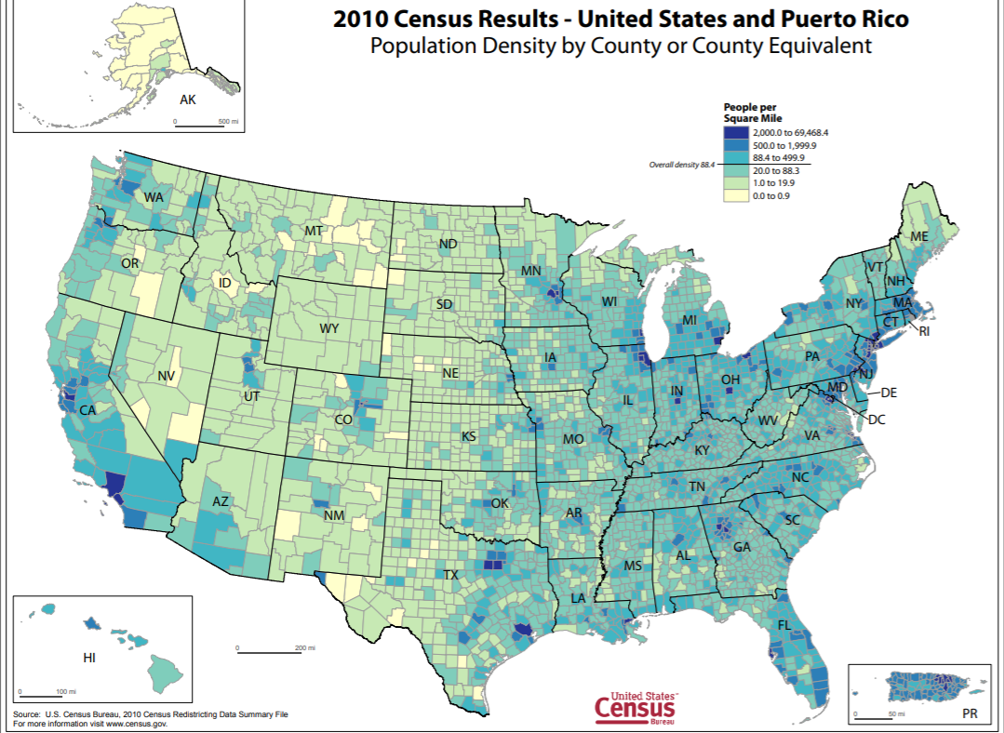
Characteristics
Despite adequate warnings, many deaths occurred
Basements are not common in the Southeast
The Southeast is most populous region (>80 million people)

Slide 33
Damage
Round 1 knocked out power to areas that would be affected later
Businesses and schools closed for the day
Some people did not receive warnings or thought the tornadoes were done due to early morning tornadoes
Early morning tornadoes were impressive alone
Tornado warnings were sufficient, but structures were not

Slide 34
Damage
Many people took shelter, but the tornadoes were too violent
133 deaths in single-family homes and 51 deaths in mobile homes
Most common places people died (in houses)
  Bathroom (7.3%)
  Basement or underground shelter (4%)
  Bedrooms (4%)
  Hallways (4%)

Slide 35
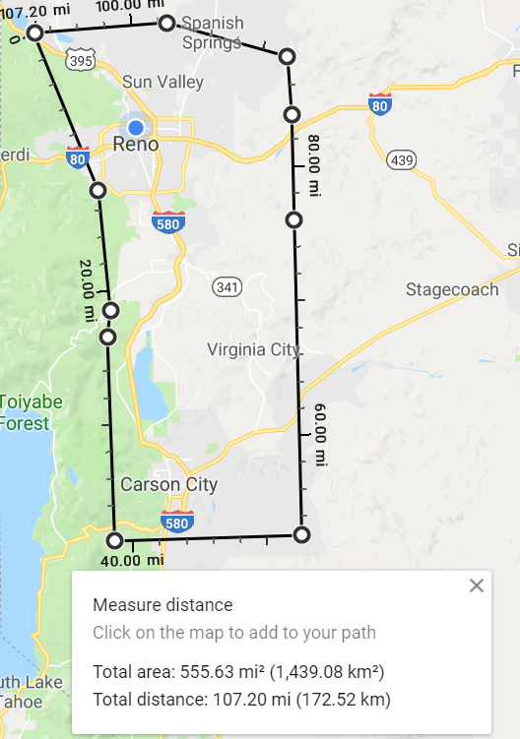
Damage
1.06% of Alabama was affected by tornadoes
  1439km²
  Same area as shown →
10 million cubic yards of debris

Slide 36
Damage
Average lead time was 22 minutes in Alabama
  National Weather Service goal = 15 minutes
  Great lead times
Some people were just complacent, most were not

Slide 37
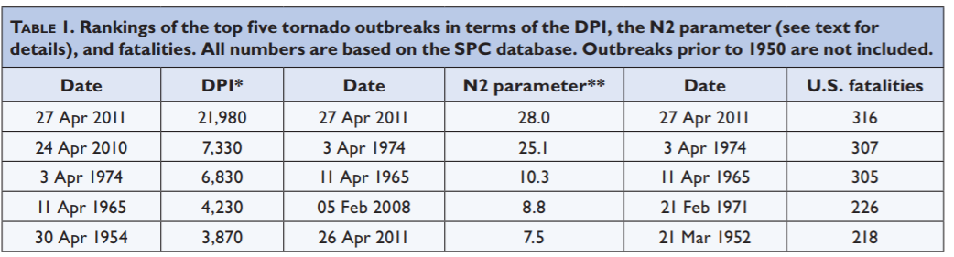
Statistics
DPI – destruction potential index
  The tornado area multiplied by the EF scale
N2 – parameter for characterizing tornadoes
April 27, 2011 & April 3, 1974 are extreme events
Tri-State tornado (March 18, 1925) not included, but >700 deaths

Slide 38
Statistics
No other tornado outbreak can compare, except April 3-4, 1974
One of the costliest natural disasters in US history
Often classified as a ‘once-in-a-generation’ event
The atmosphere was ‘perfect’ for tornadoes on this day

Slide 39
Statistics
199 tornadoes on April 27, 2011
758 tornadoes in April 2011
Previous record for tornadoes in any month was 542 (May 2004)
Previous April tornado record was 267 (April 1974)
5 of the 10 longest tornadoes in recorded history occurred on April 27, 2011

Slide 40
Conclusion
Historic tornado outbreak
Many people died on this day despite the efforts from the National Weather Service
Warnings are getting more efficient
Three distinct rounds of tornadoes

Slide 41
References
Knupp, K.R., T.A. Murphy, T.A. Coleman, R.A. Wade, S.A. Mullins, C.J. Schultz, E.V. Schultz, L. Carey, A. Sherrer, E.W. McCaul, B. Carcione, S. Latimer, A. Kula, K. Laws, P.T. Marsh, and K. Klockow, 2014: Meteorological Overview of the Devastating 27 April 2011 Tornado Outbreak. Bull. Amer. Meteor. Soc., 95, 1041–1062,https://doi.org/10.1175/BAMS-D-11-00229.1
Stewart, Nick. “Field Deployments.” Midwest Weather Center, www.midwestweathercenter.com/field-projects/.
US Department of Commerce, and NOAA. “Historic Outbreak of April 27, 2011.” National Weather Service, NOAA's National Weather Service, 29 Sept. 2016, www.weather.gov/bmx/event_04272011.
Center, Storm Prediction. “NOAA's NWS Storm Prediction Center Forecast Tools.” Beaufort Wind Scale, NOAA's National Weather Service, 1 Jan. 2001, www.spc.noaa.gov/obswx/maps/

Slide 42
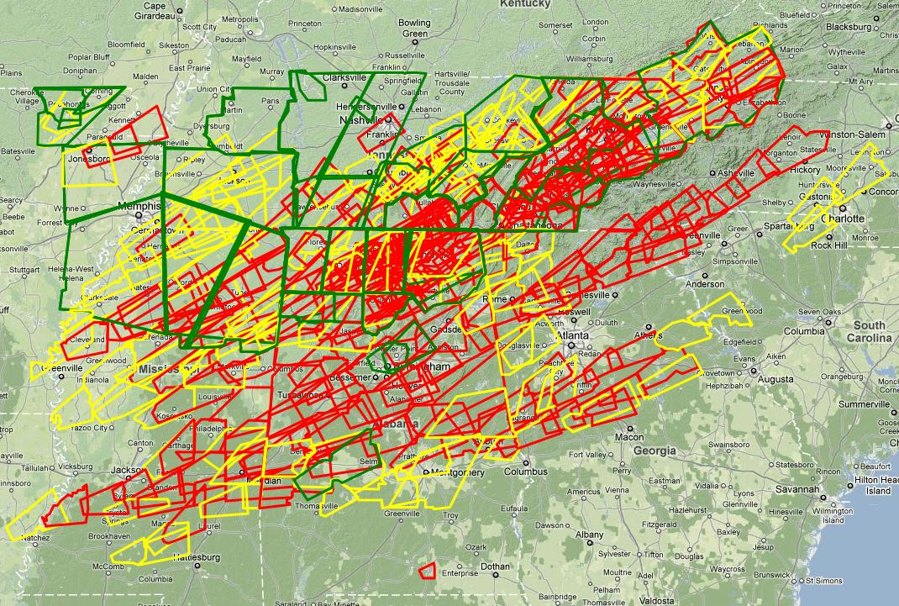

Slide 43
https://www.nsstc.uah.edu/uahsevere/April27/27April_Timeline.pdf
  List of all tornadoes on this day

Slide 44
Wireless Emergency Alerts
  Mobile alerts send to wireless devices if in a warning area
  Late June 2012
POD tornado shelters
Explicit language in tornado warnings
  Began in 2012
  IF YOU ARE IN OR NEAR (TOWN NAME)...SEEK SHELTER IMMEDIATELY!”, and the tag line will read, “TORNADO DAMAGE THREAT...CATASTROPHIC.
  “YOU WILL BE KILLED IF YOU DO NOT TAKE SHELTER”

Slide 45
Homes in the Southeast have become more structurally able to withstand tornadoes
Incentives were given for people who opted for this
Dramatic increase in shelters and building codes

