Slide 1
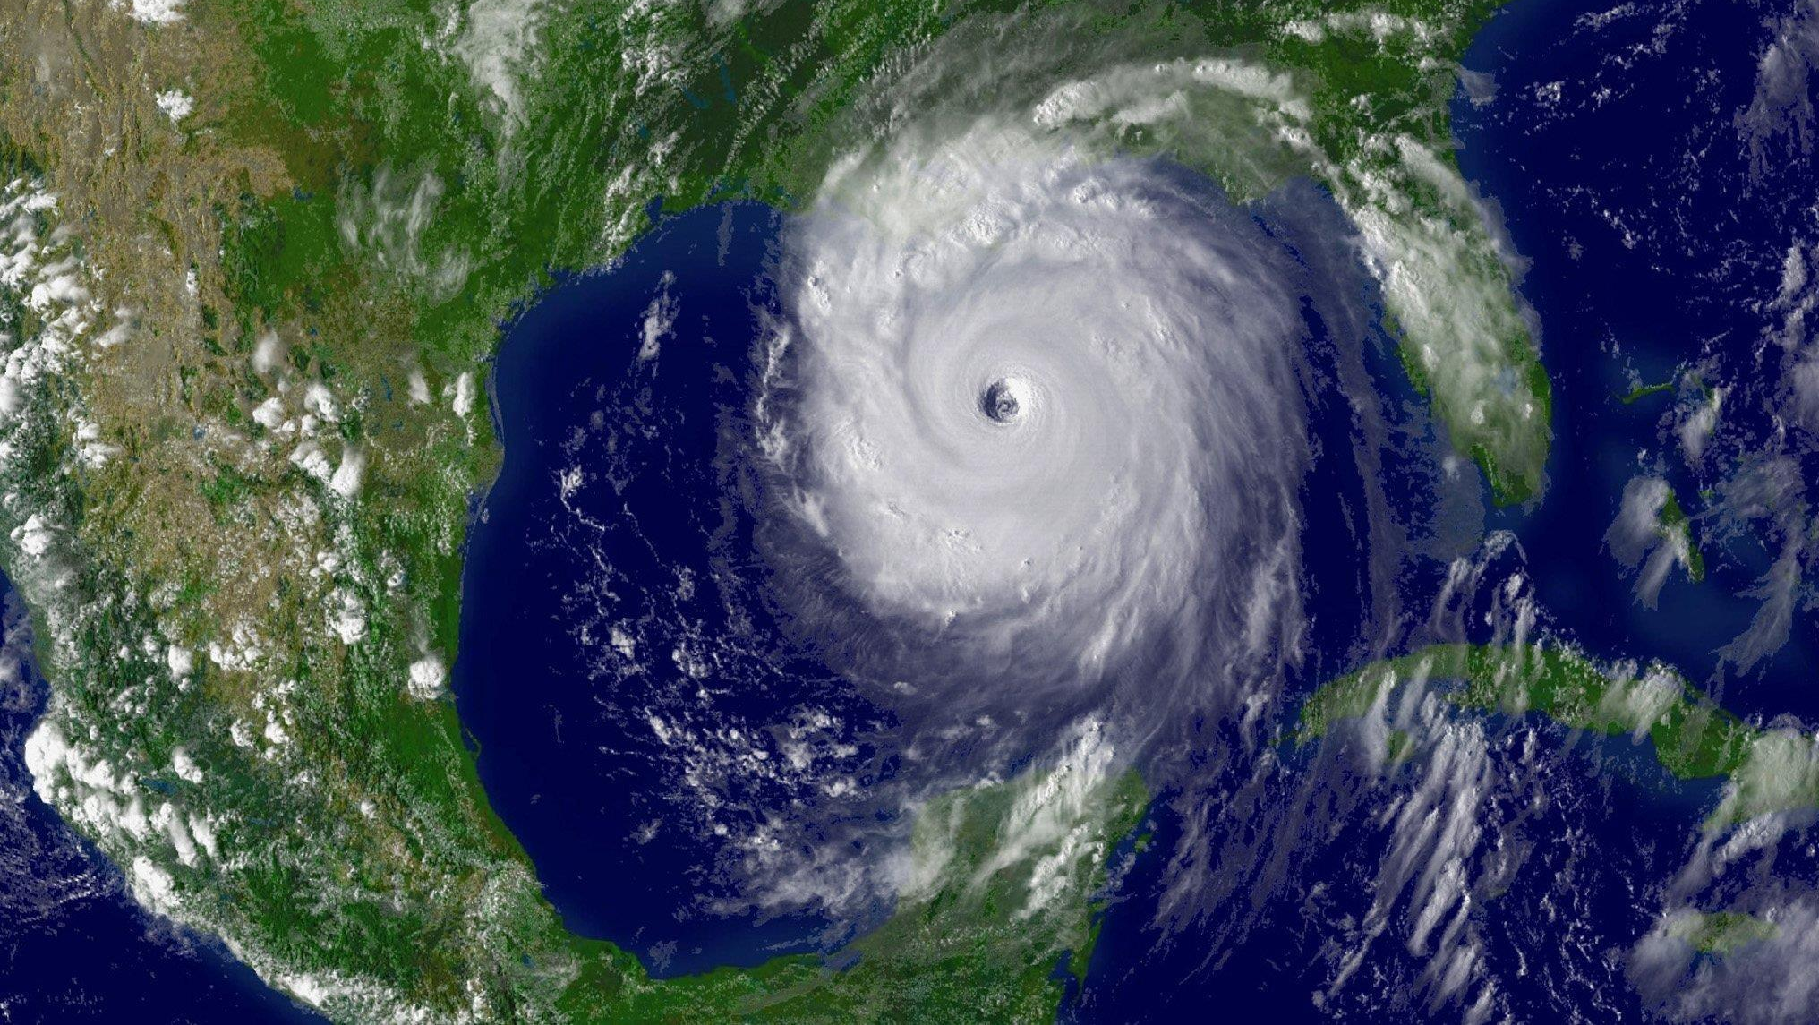
Climate change impacts on extreme events in the United States
By: Erwan Monier, Xiang Gao
Presenter: Ehsan

Slide 2
In this presentation:
Introduction
Basic concepts
Methodology
Results
conclusion

Slide 3
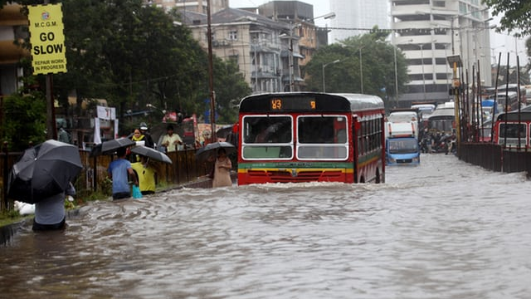
Introduction
Extreme events: an event that is rare within its statistical reference distribution.
examples: heat waves, droughts, severe precipitations …
Impacts of extreme events: direct and indirect
Economy
Large infrastructure and private properties
Severe human losses
Air quality and human health
Terrestrial ecosystems
Agriculture and forestry
Water demand
Energy demand and production

Slide 4
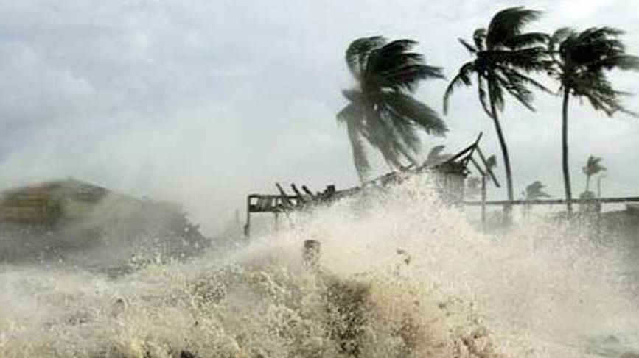
Examples of damages from extreme events
Agriculture: single extreme event, economic damages exceeding $1 billion.
Drought and excessive heat: summer 2012, in the Midwest and Great plains, decreases in yields, loss of $16 billion.
Hurricanes Katrina and Rita: shut down 27 % of oil production in the US.
Hurricane Sandy: inflicted approximately $65 billion in economic losses.
In 1998, Hurricane Mitch resulted in more than 10,000 deaths in Central America due to flooding and landslide.
In 2003, European summer heat wave resulted in more than 70,000 deaths in 16 countries.

Slide 5
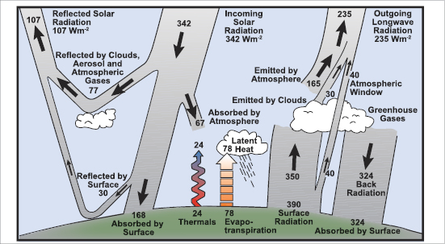
Basic concepts of climate change
Radiative forcing (RF):
The difference between sun energy that is absorbed by the Earth, and energy that is radiated back to space.
Unit= Wm⁻²
RF (Wm⁻²) = E(in) – E(out)
A type of influence that changes Earth climate system, by changing Earth’s radiative equilibrium.
Could have warming or cooling influence

Slide 6
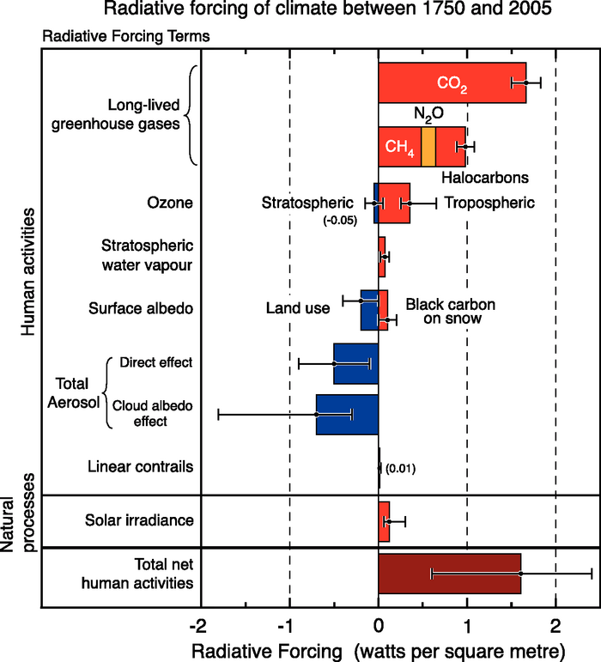
Radiative forcing
Any factor that changes the energy balance of atmosphere causes radiative forcing.
The balance: radiative equilibrium.
Changes in radiative/climate forcing come from three major forcing factors:
Green House Gases
Aerosols
Solar activity

Slide 7
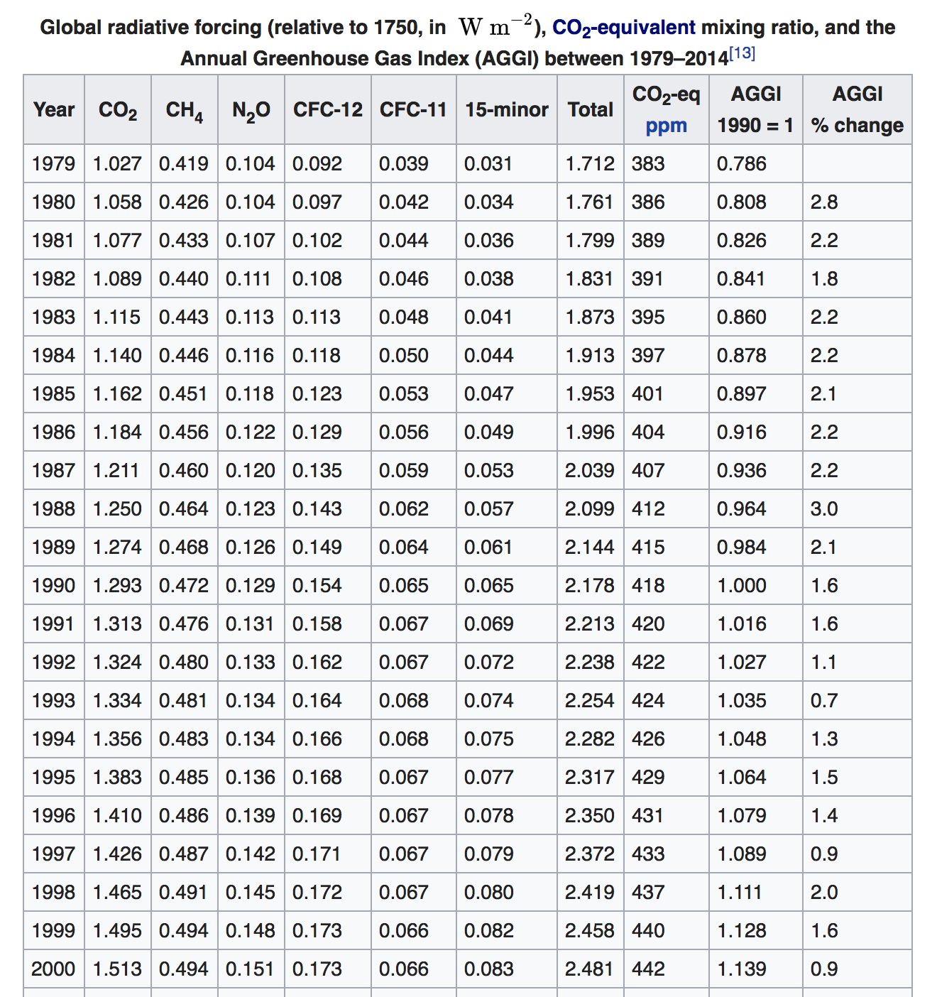
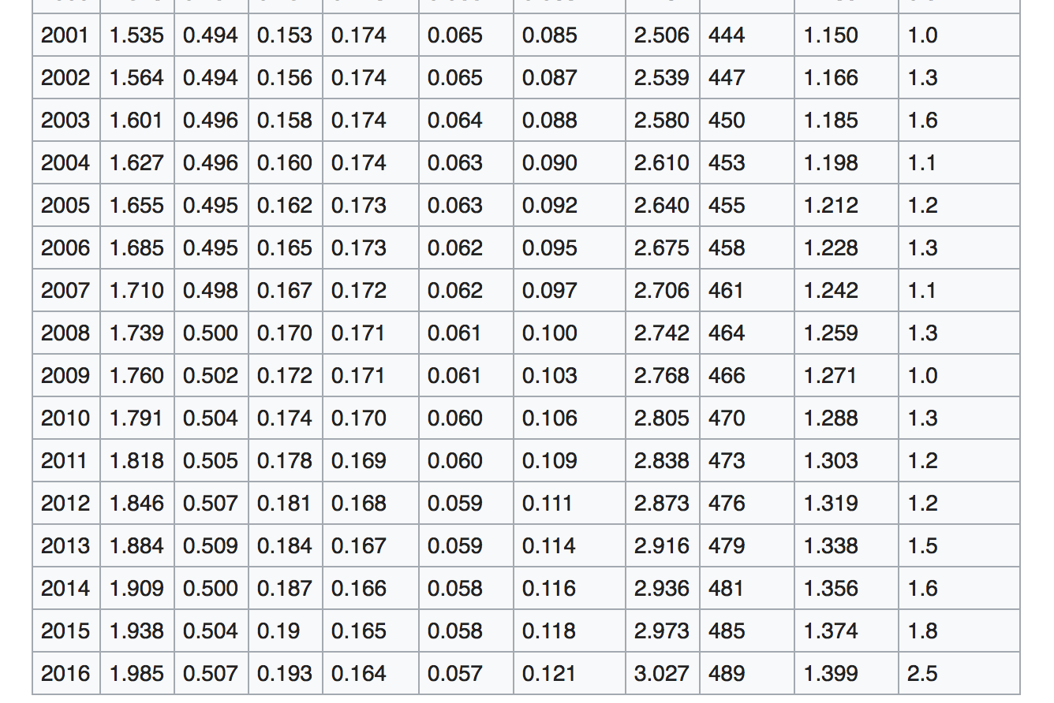
Changes in radiative forcing due to GHGs

Slide 8
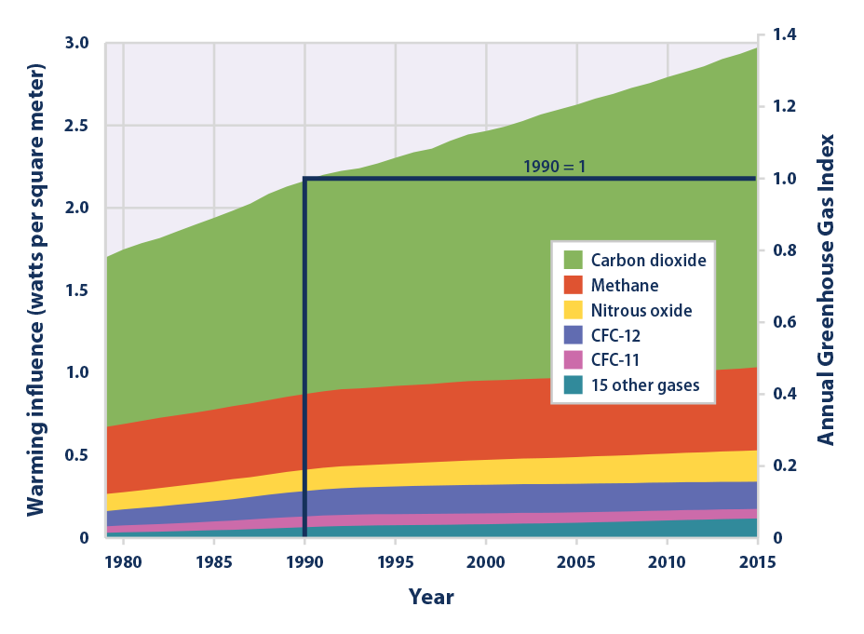
Changes in radiative forcing due to GHGs

Slide 9
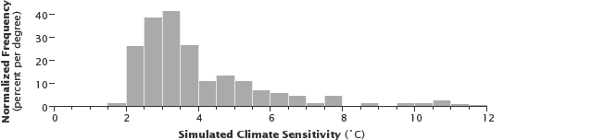
Climate sensitivity
The relationship between CO₂ concentrations and warming.
Climate sensitivity = changes in surface temperature/Radiative Forcing.
Changes in surface temperature due to 1 unit change in Radiative forcing of atmosphere.
Unit = K*/ (Wm⁻²)
Is an emergent property from simulations (not a explicit parameter)
Result of models (due to different physics and parameters)

Slide 10
Methodology
Climate model = Integrated Global System Model–Community Atmosphere Model (IGSM-CAM)
Scenarios:
Reference scenarios = unconstrained emissions after 2012, a total radiative forcing of 10 Wm⁻² by 2100.
stabilization scenario (POL4.5), with a total radiative forcing of 4.5 W/m2 by 2100.
A stringent stabilization scenario (POL3.7), with a total radiative forcing of 3.7 W/m2 by 2100.
Four values of climate sensitivity (CS): 2.0, 3.0, 4.5 and 6.0 ◦C
(CS6.0) = low probability/high risk climate sensitivity
Calculation of extreme events:
Intensity and frequency
Climate parameters:
Extreme minimum temperature (T01)
Extreme maximum temperature (T99)
Extreme precipitation (P99)
Periods: present (1981-2010) , future (2085-2015)

Slide 11
Results
Changes in extreme hot events
Changes in extreme cold events
Changes in extreme precipitation events
Results were compared with:
National Aeronautics and Space Administration (NASA) Modern Era Retrospective- Analysis for Research and Applications (MERRA) reanalysis
NCEP/NCAR Reanalysis

Slide 12
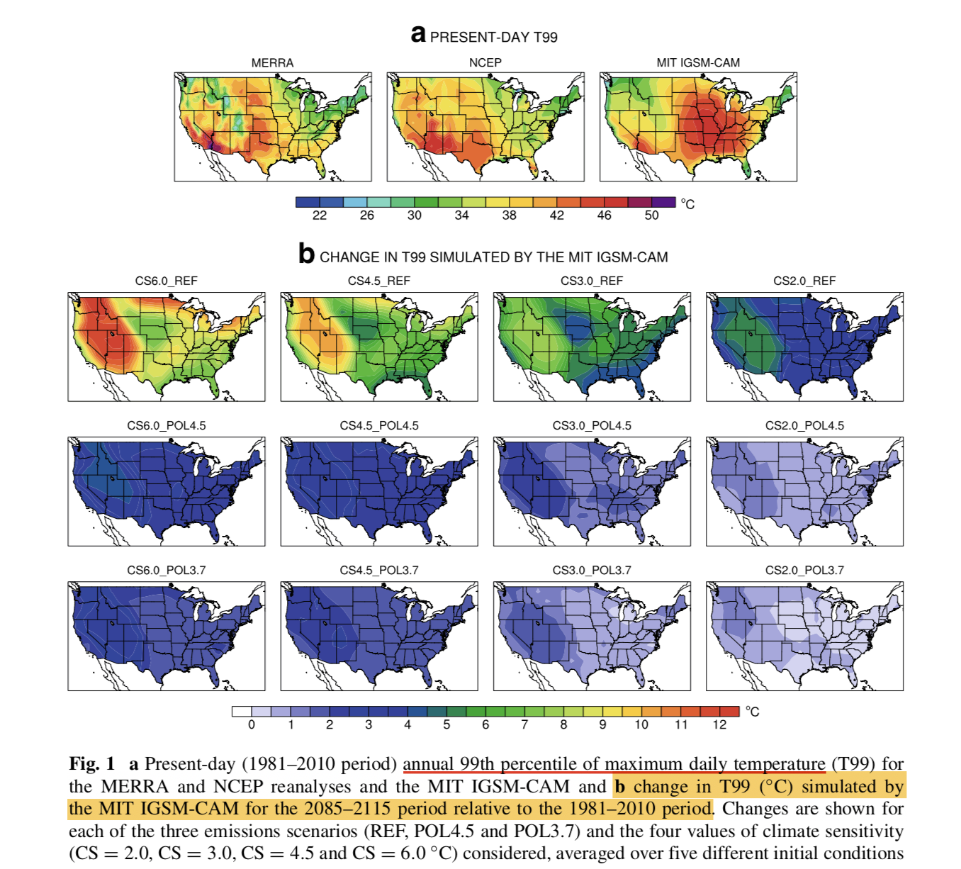
Changes in extreme hot events

Slide 13
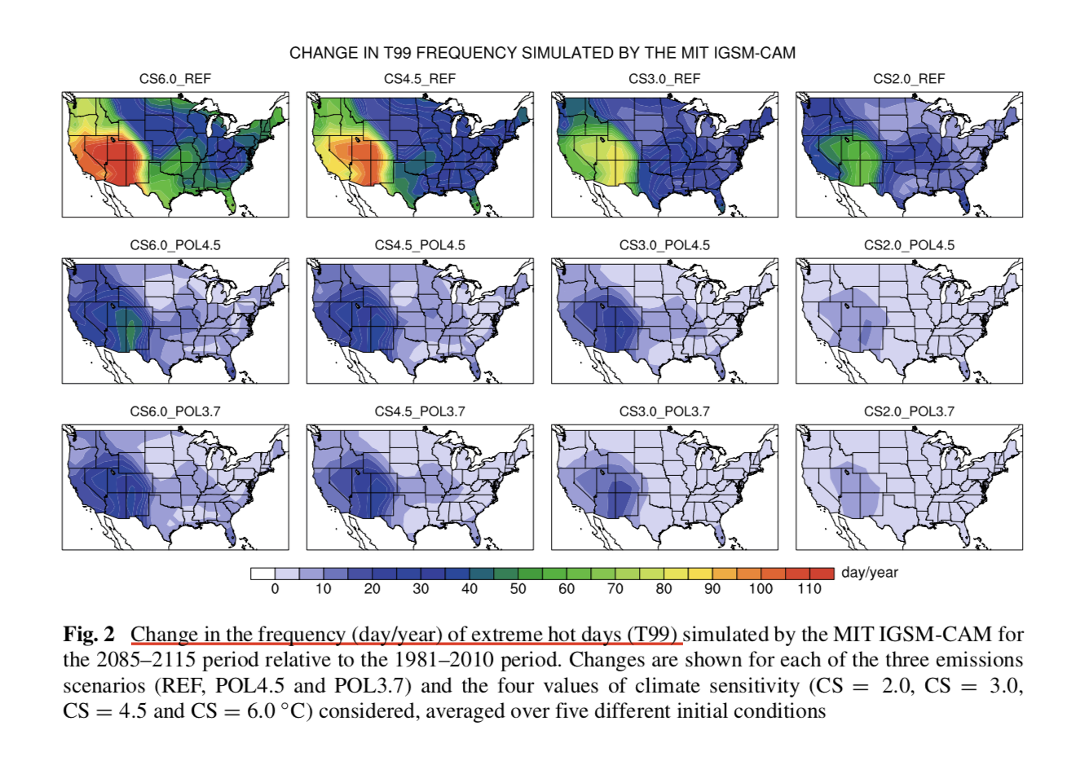
Changes in extreme hot events

Slide 14
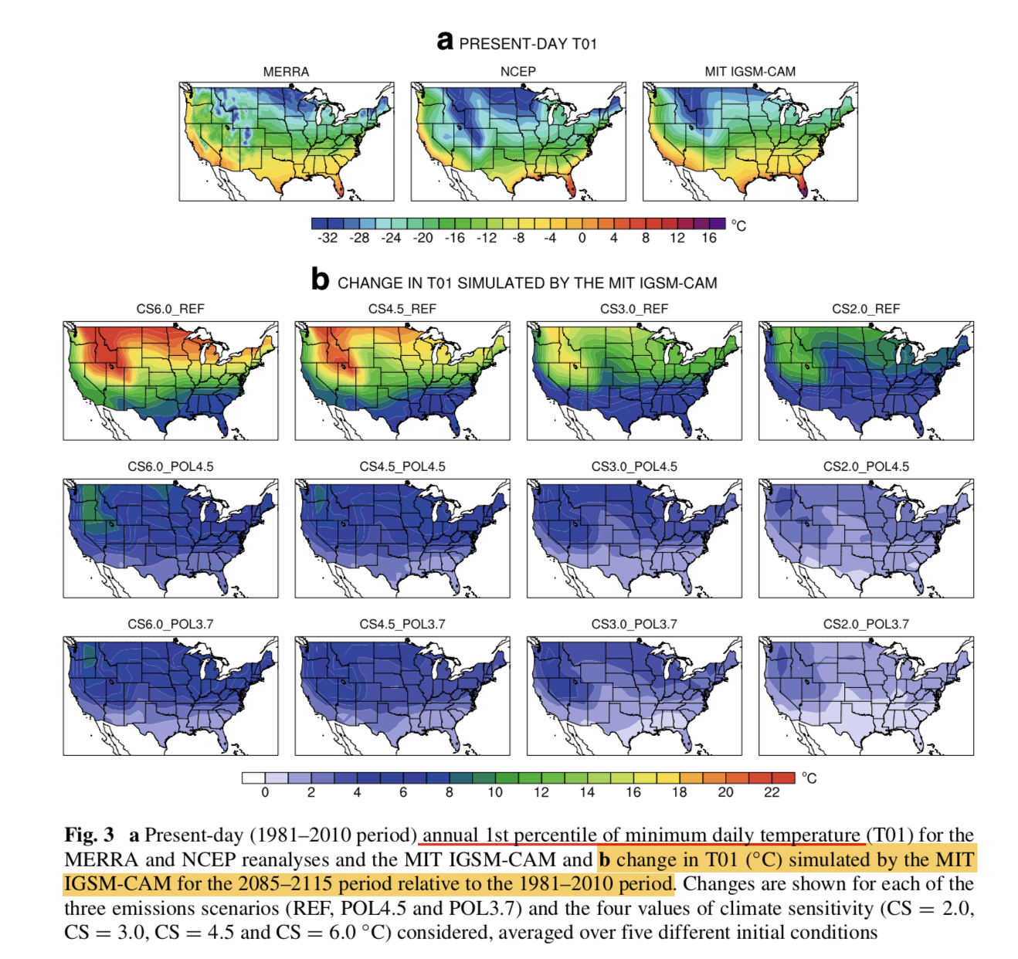
Changes in extreme cold events

Slide 15
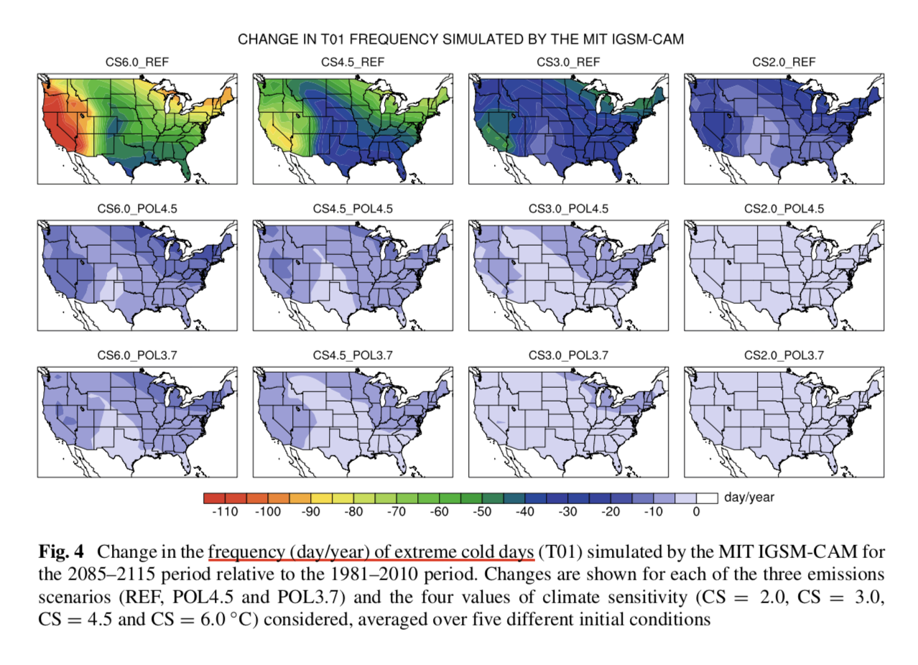
Changes in extreme cold events

Slide 16
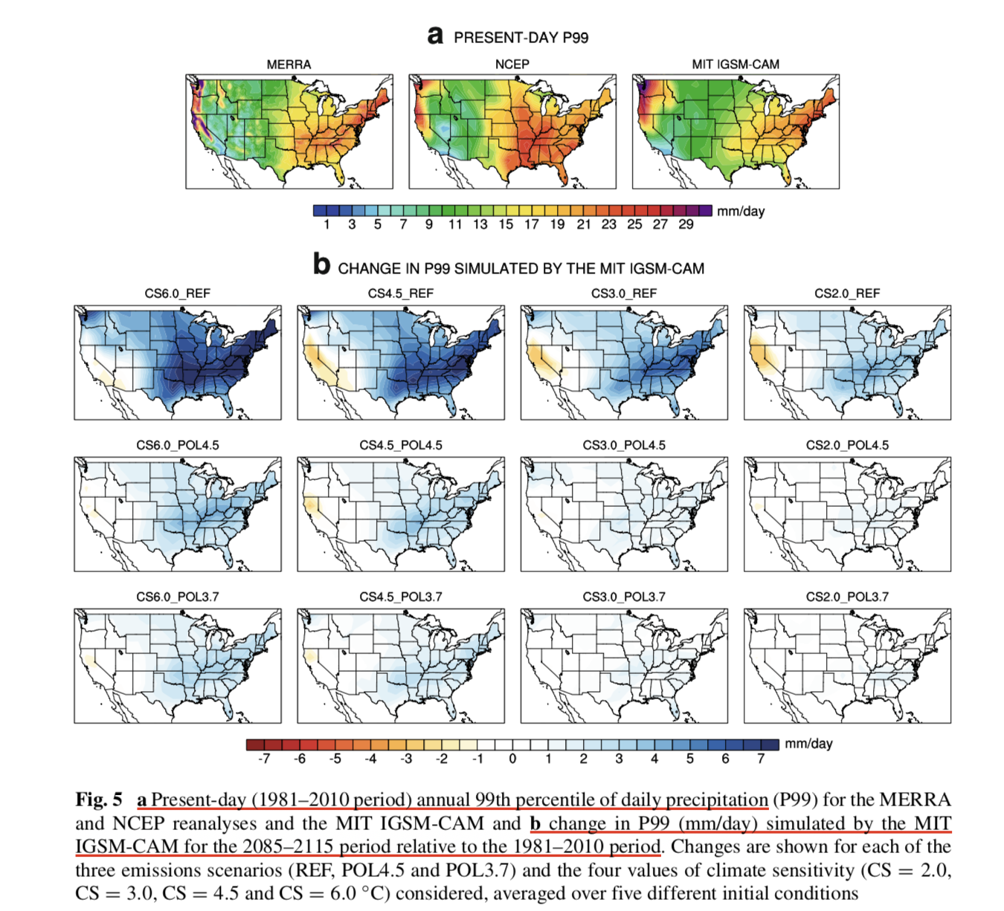
Changes in extreme precipitation events

Slide 17
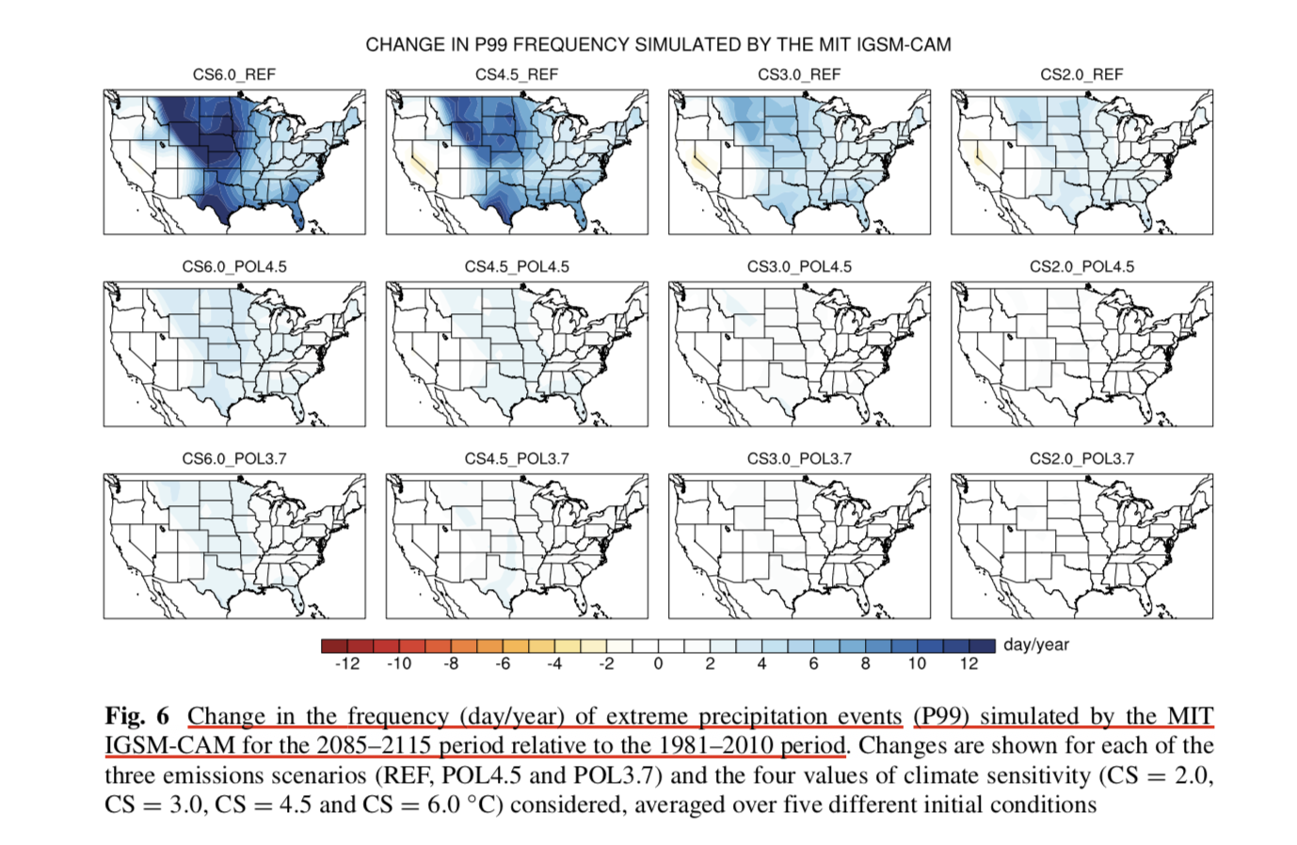
Changes in extreme precipitation events

Slide 18
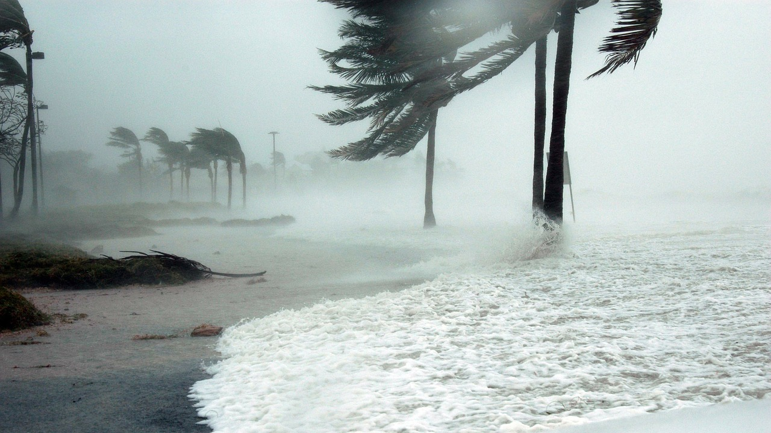
Thank you

