Slide 1
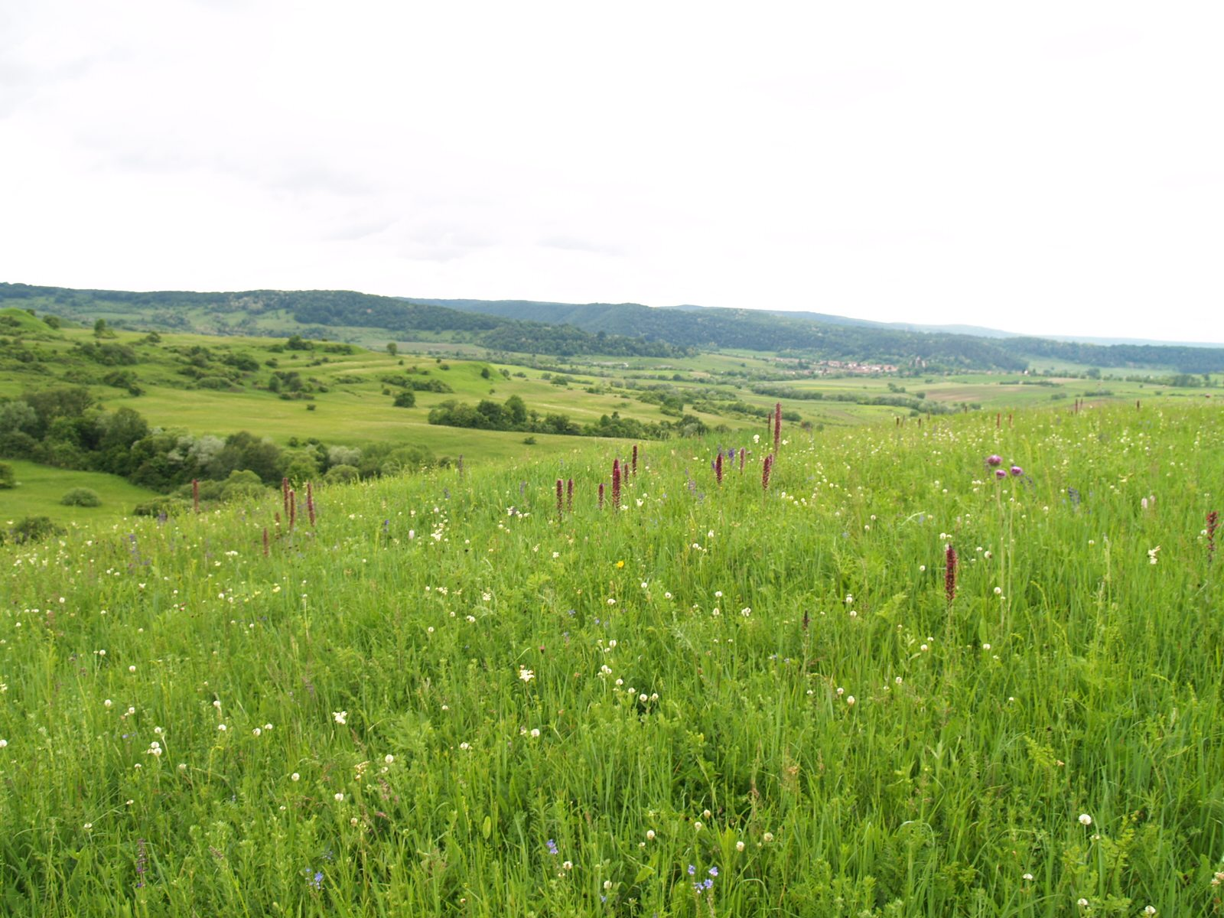
Extreme Weather Events and Plant-Plant Interactions
Danielle Miles
PhD student in Ecology, Evolution, and Conservation Biology
Department of Natural Resources and Environmental Science

Slide 2
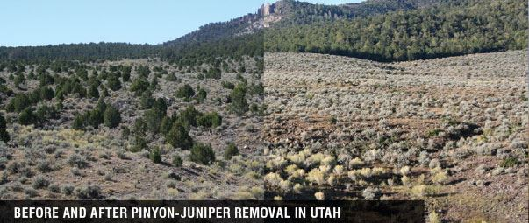
My work

Slide 3
Grant, K., Kreyling, J., Heilmeier, H., Beierkuhnlein, C., & Jentsch, A. (2014). Extreme weather events and plant–plant interactions: shifts between competition and facilitation among grassland species in the face of drought and heavy rainfall. Ecological research, 29(5), 991-1001.

Slide 4
Outline
Plant Responses
Theory
Vocab
Study Questions
Study Methods
Study Conclusions
Future

Slide 5
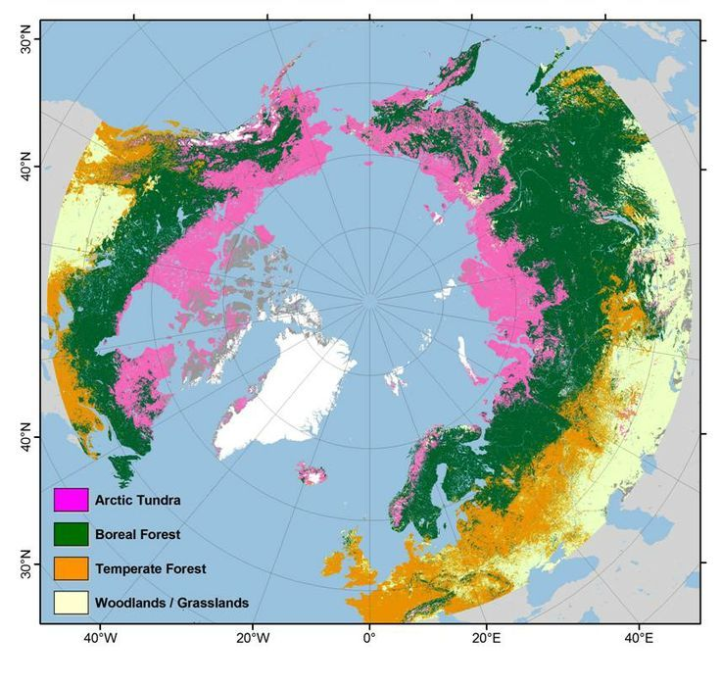
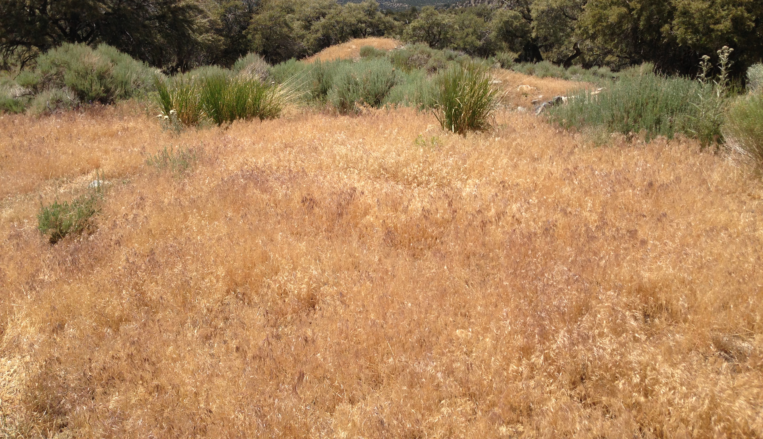
Plant Responses
Boundaries between vegetation types
Rainfall
Soil type
Conditions more suitable for exotic species
Notes:
https://www.bgci.org/policy/climate-change-and-plants/
cheatgrass

Slide 6
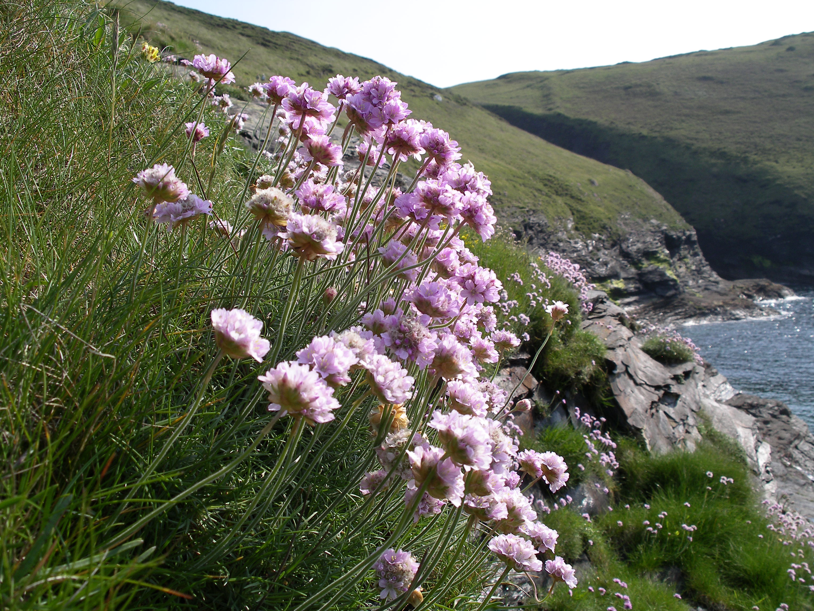
Plant Responses
Plants may not be able to disperse
Grow taller
Leaves narrower, spread out
Selection influences genetic composition
Coastal species which will be 'squeezed’
between human settlements and rising sea levels
Notes:
Plants with long life cycles or slow dispersal

Slide 7
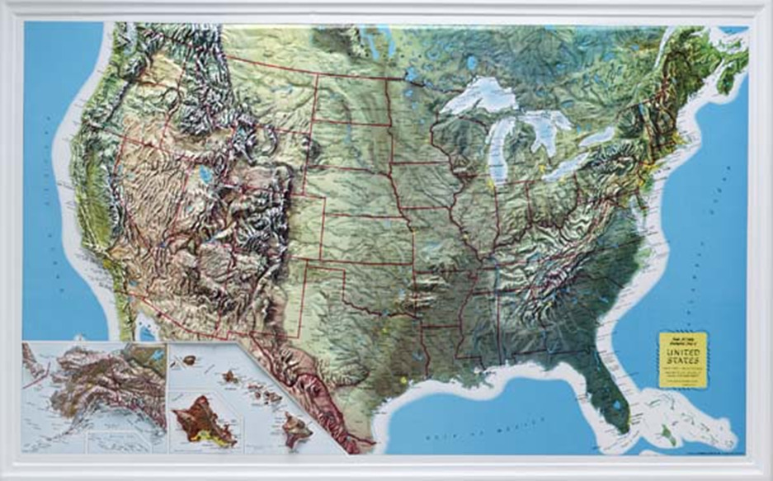

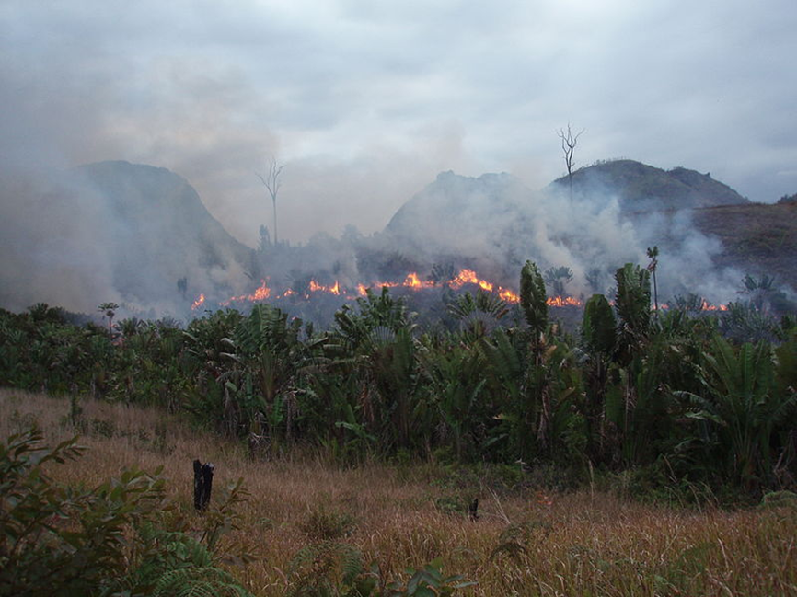
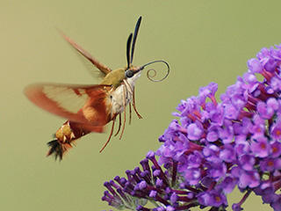
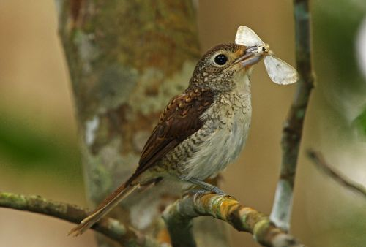
Climate change intensifies habitat threats
Loss in biodiversity hotspots
12% land cover to 1.4% (Brooks et al, 2002)
Temperature intolerance
Species interactions
Limits to habitat ranges
(Zarnetske et al., 2012; Cahill et al, 2012; Thomas et al, 2004)

Slide 8
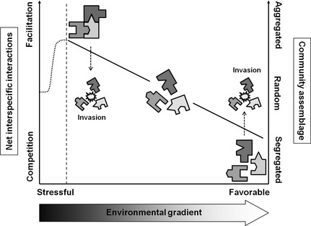
Stress Gradient Hypothesis
As stress increases, mutually supportive interactions become more significant
Negative interactions become less
Longer stress, more shifts
Climate change increases harshness
Driest environments

Slide 9
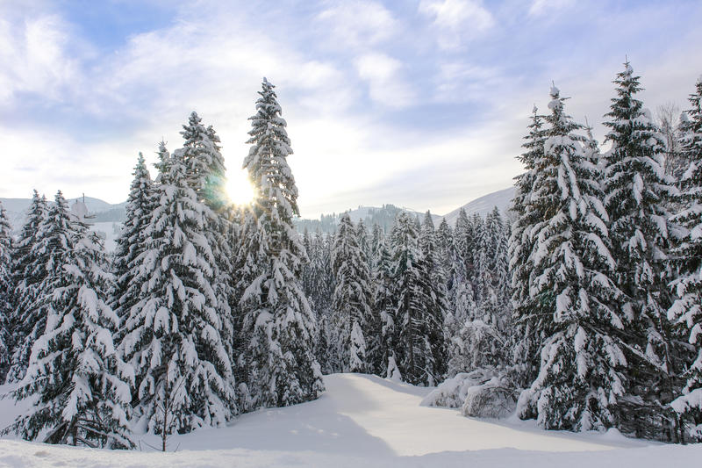
Stress Gradient Hypothesis Example
Positive interactions among alpine plants increase with stress
Callaway et al, 2002
biomass, growth and reproduction of alpine plant species are higher when other plants are nearby

Slide 10
Study goals
Response of plant-plant interactions in extreme weather conditions
Does extreme drought decrease competition intensity amongst grassland species?
Increased facilitation
Do extremely high rainfall events decrease competition amongst grassland species?
Low competition as neighbours struggle
Does the presence of a legume change these interactions?

Slide 11
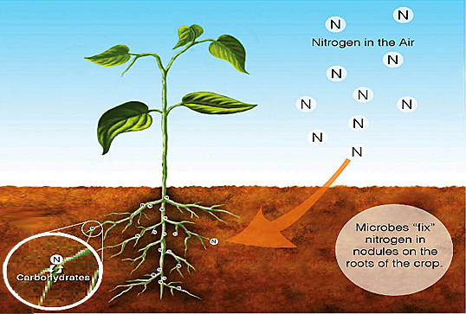
Design
Ecological Botanical Garden, Germany
Manipulated plant community composition
Manipulated levels of precipitation
Notes:
Cover legume idea - nitrogen

Slide 12
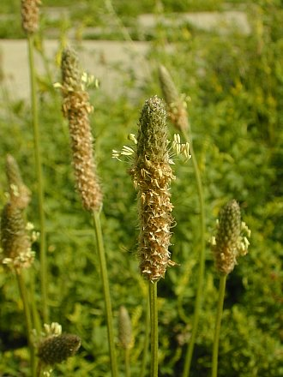
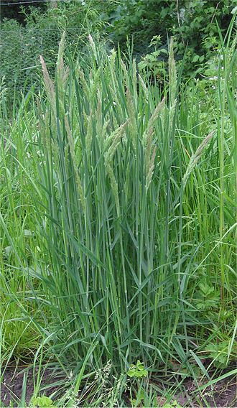
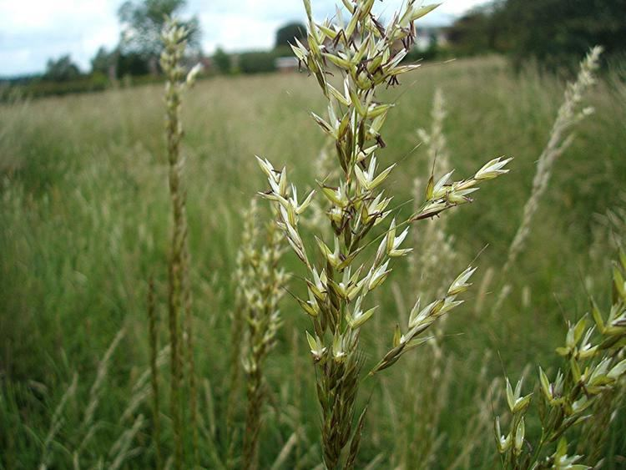
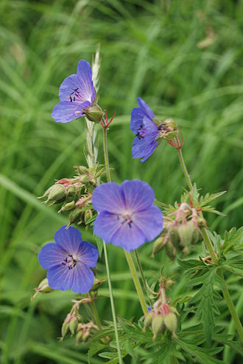
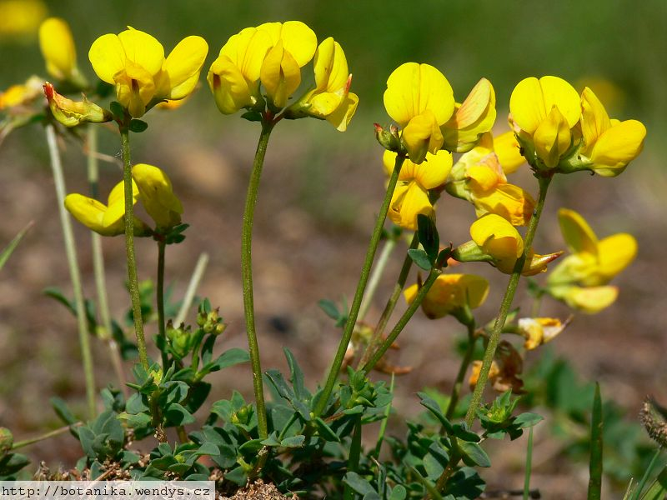
Study Plant Species
Holcus lanatus
velvet grass
Arrhenatherum elatius
Oat grass
Geranium pretense
meadow geranium
Plantago lanceolata
English Plantain
Lotus corniculatus
bird's-foot trefoil

Slide 13
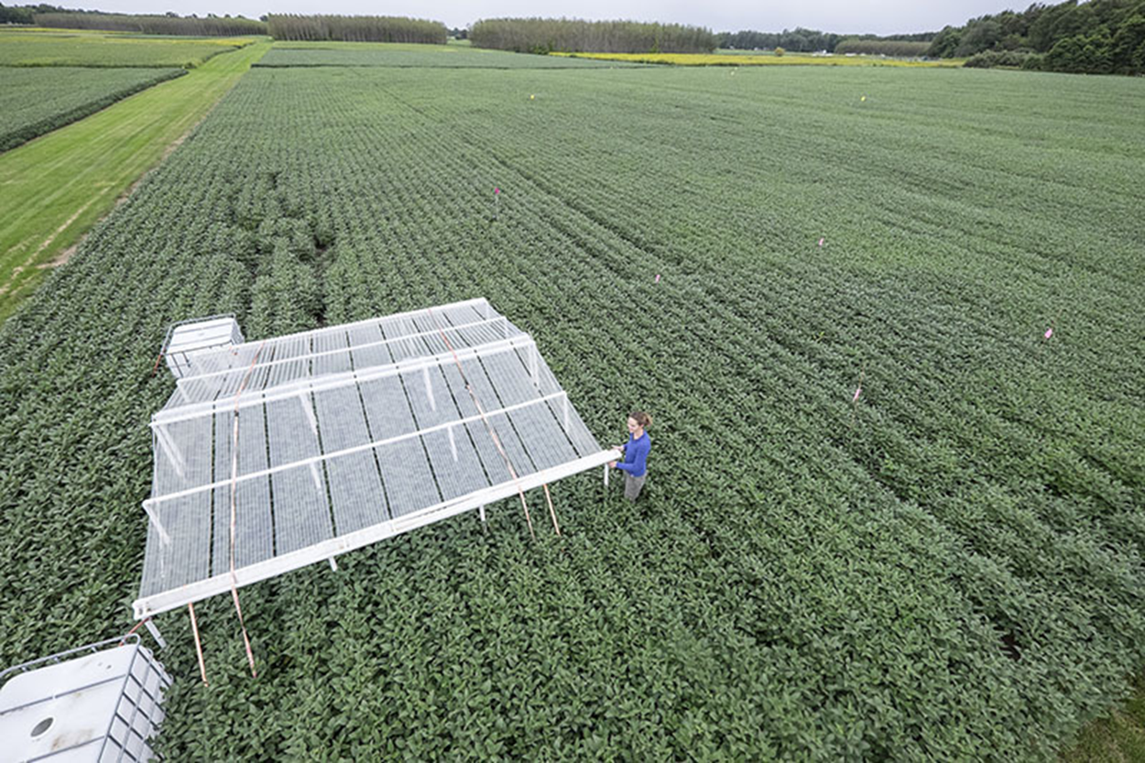
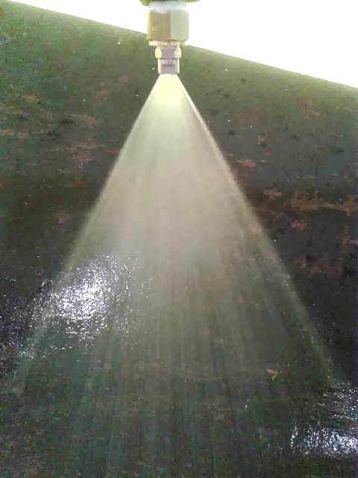

Slide 14
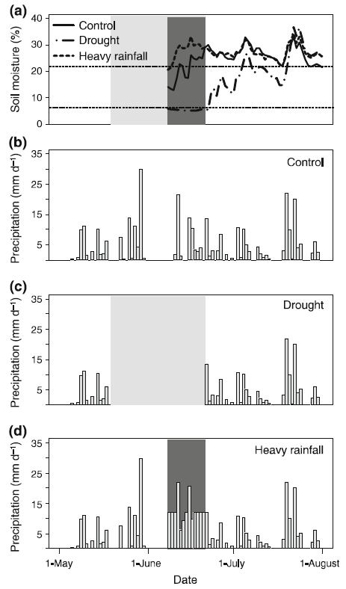
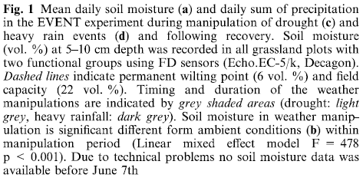
Climatic Events
Growing season
Planted 2 years prior

Slide 15
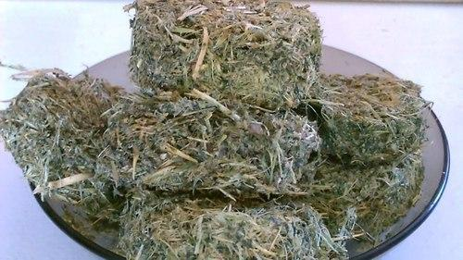
Data Collected
Plants collected 10 days after drought or heavy rainfall
Aboveground biomass dried and weighed

Slide 16
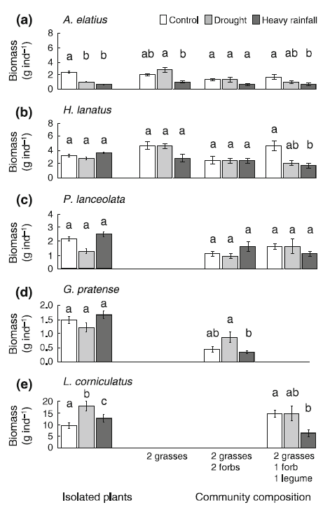
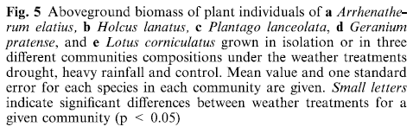
Biomass (growth) changes by condition
Notes:
Take home message

Slide 17

Response parameter: biomass of plant individuals and community biomass
Relative Neighbour Effect (RNE) – the effect of neighbours relative to the plant with the greatest performance
X = yiso if yiso > ymix
Negative numbers indicate facilitation
Positive numbers indicate competition
Notes:
RNE is unitless

Slide 18
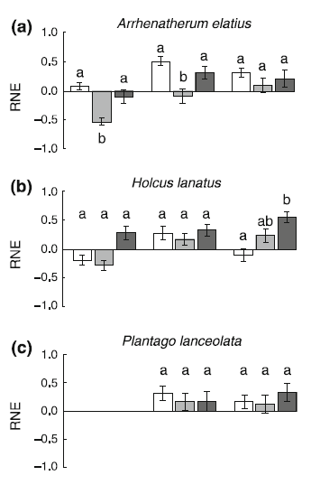
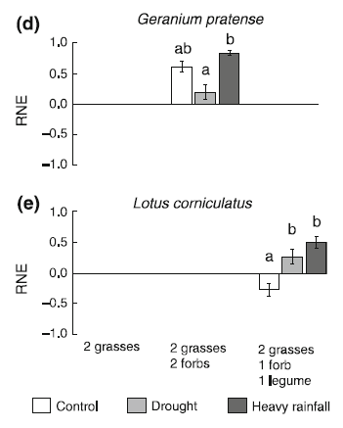
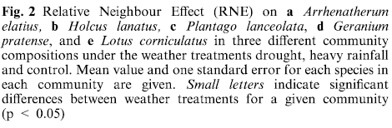

Different species have different responses to these events
Notes:
Add key message to the slide

Slide 19
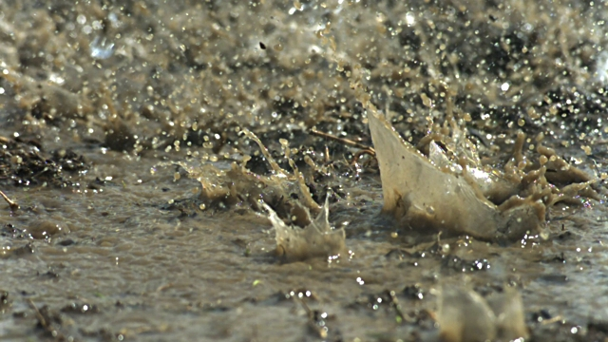
Results
Grass communities increased facilitation under drought
Shade
Lower transpiration
Increased soil water availability
Root growth
Higher competition under heavy rainfall

Slide 20
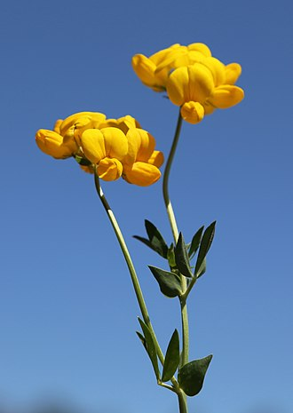
Nitrogen Fixers
Lotus corniculatus
Legumes
Facilitate growth in control ambient conditions
Water logging reduces soil oxygen
Dry top soil layer
Increased nitrogen uptake instead of fixation

Slide 21
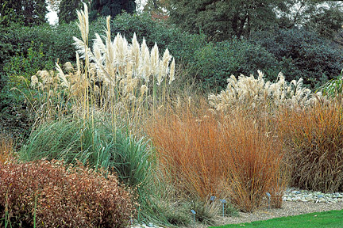
Species Richness
Ecosystem functioning
Biodiversity-ecosystem function hypothesis
(Yachi & Loreau, 1999)
Insurance hypothesis (Naeem & Li, 1997)
Variability in changing environments
(Zhang et al. 2012; Waide et al. 1999)
Productivity (Gross et al, 2014)

Slide 22
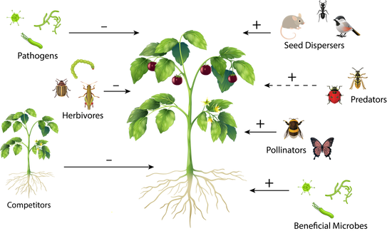
Climate Modelling
Changing strategy is adaptation!
Single extreme events caused shifts in plant-plant interactions
Predicting plant communities shifts under climate change
Notes:
Add take home

Slide 23

Thank you

