Slide 1
Smart adaptation in an era of rising climate risks
Christopher B. Field
McKenna Murray
ATMS 790

Slide 2
What are you willing to pay for?
What are you willing to pay for a cup of coffee?
What are you willing to pay for a new laptop?
What are you willing to pay for water?
What are you willing to pay for home insurance?
Would you be open to paying a climate adaptation tax?

Slide 3
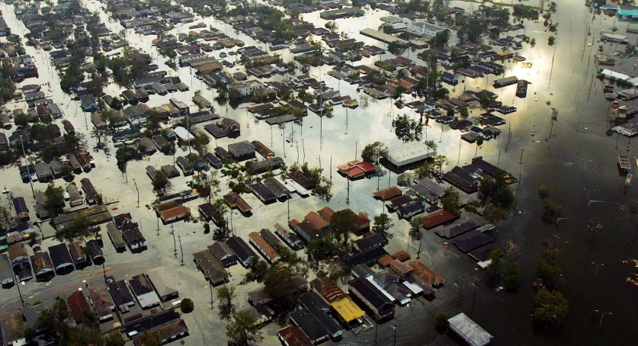
Hurricane Katrina – $163.8 Billion

Slide 4
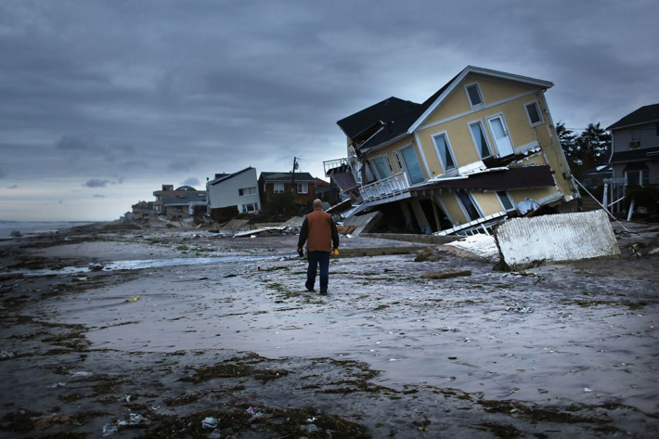
Hurricane Sandy - $71.5 Billion

Slide 5
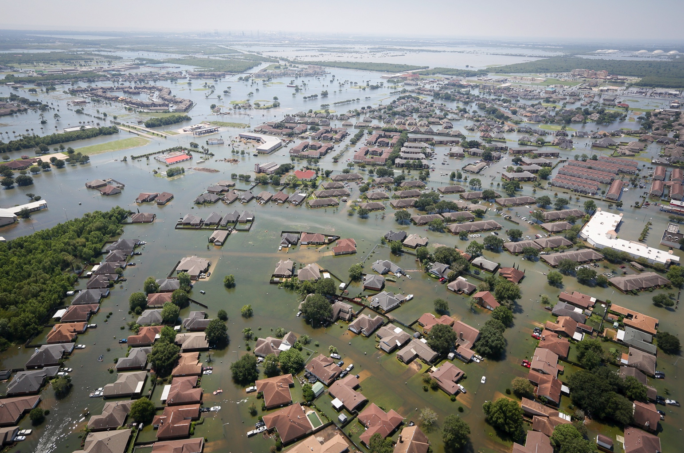
Hurricane Harvey - $126.3 Billion

Slide 6
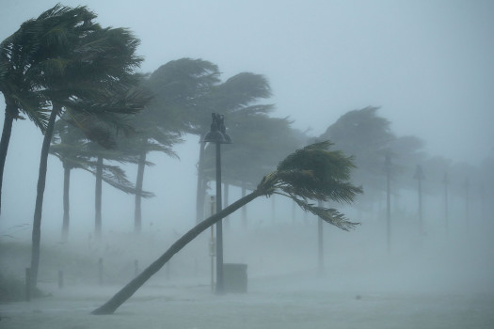
Hurricane Irma - $50.5 Billion

Slide 7
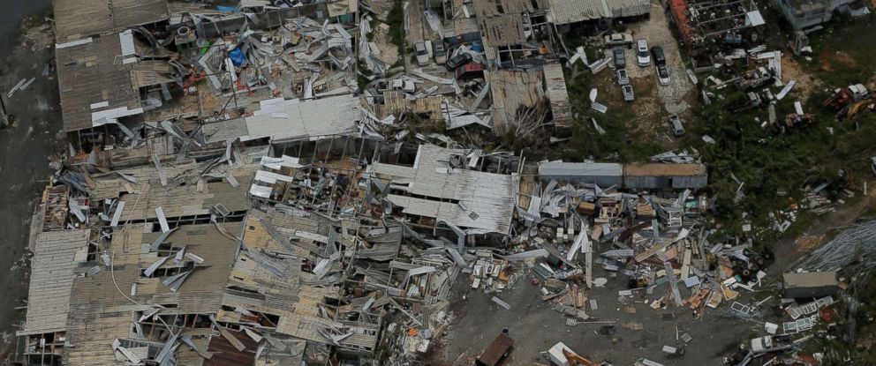
Hurricane Maria - $90.9 Billion

Slide 8
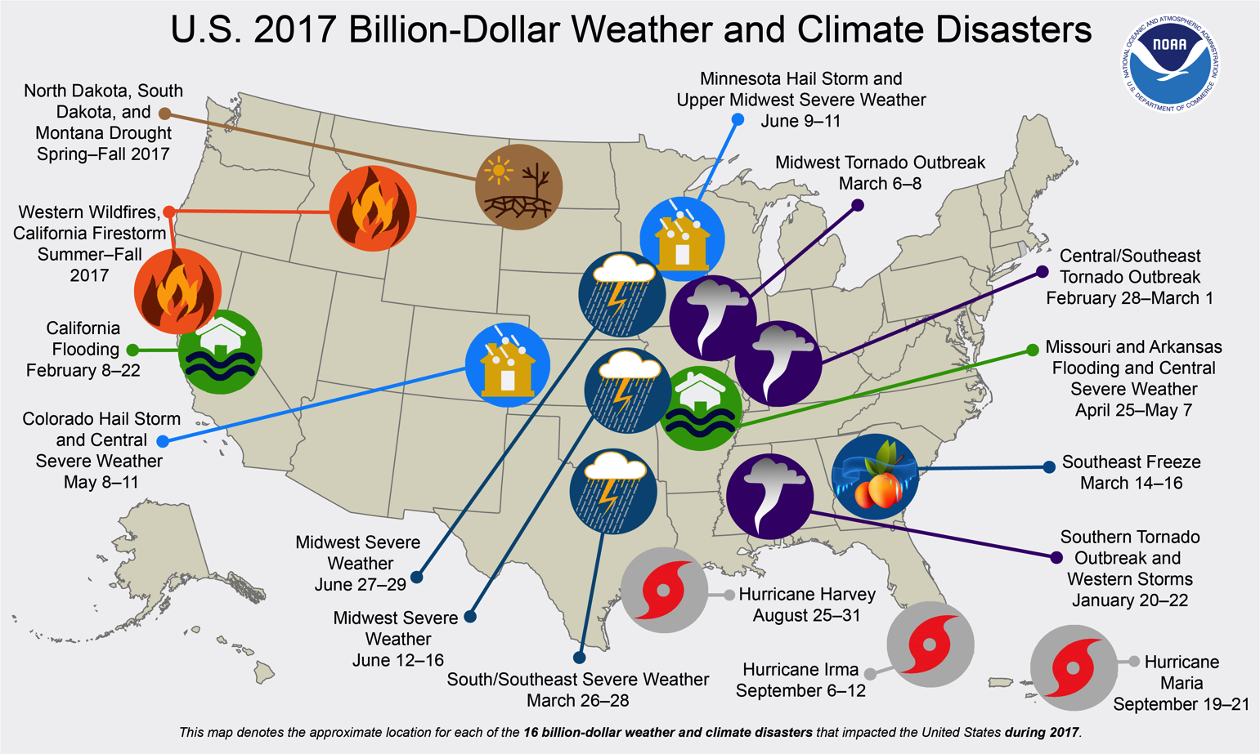

Slide 9
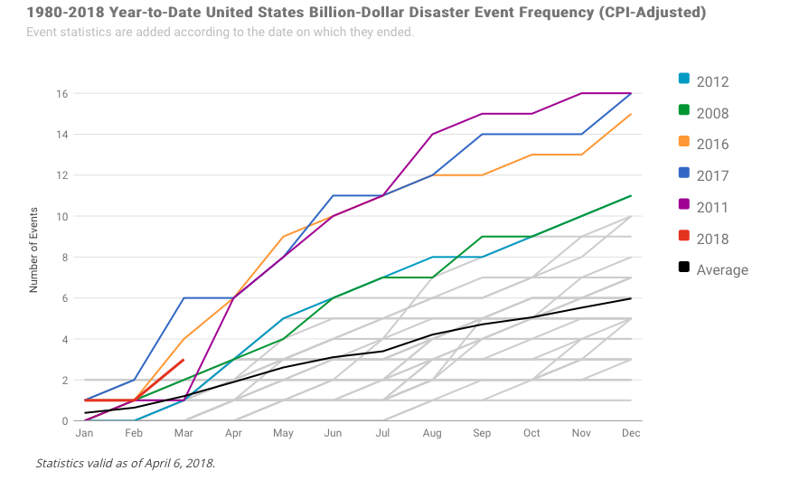

Slide 10
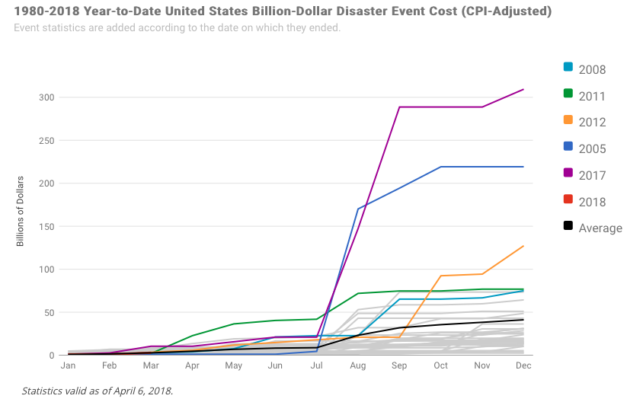

Slide 11
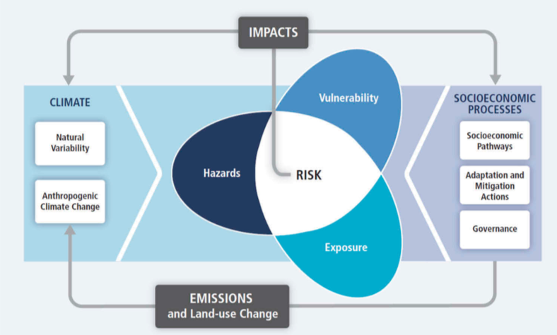
Risk of Disaster Impacts

Slide 12
The Paradox
Disaster losses have increased dramatically in the past 40 years
  300 global events per year in 1980
  900 global events per year in recent years
Disaster losses are heavily impacted by changes in hazard, vulnerability, and exposure
However, globally there is no disaster loss trend after the losses are adjusted for inflation and GDP differences

Slide 13
Financially important climate hazards
Floods and storms are the source of 65% of losses
Temperature, drought, and fire only account for 10%
Humans have a major impact on severity – making economic loss data noisy

Slide 14
Statistical Challenges
Most of the losses come from a few major disasters – which are rare
The small sample size makes it difficult to determine trends

Slide 15
Counteracting Physical Processes
Some impacts from climate change can counteract each other
  Climate change increases the risk for drought, but can cause plants to use water more efficiently
  Hurricane potential intensity should be increasing, but it offset by atmospheric aerosols

Slide 16
Social Processes
Disasters have disproportionate impacts on poorer economies
Better infrastructure and preparedness can lead to fewer damage losses

Slide 17
Potential Solutions
Work on limiting climate change
Look for investments that help adaptation, but also have economic benefits
Add climate projections into adaptation planning
Institutions need to have disaster plans that factor in climate change
Create flexible adaptation plans
Willingness to try and use multiple adaptation strategies

Slide 18
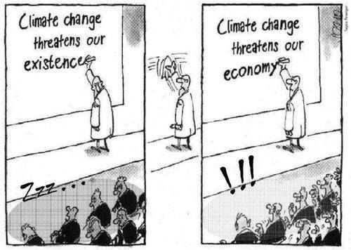
Conclusions
The lack of a trend does mean that climate change is not impacting disaster losses
Climate change is likely to increase disaster losses
Action should be taken to adapt to the changing climate

Slide 19
Sources
Christopher B. Field (2018) Smart adaptation in an era of rising climate risks, Bulletin of the Atomic Scientists, 74:2, 73-80, DOI: 10.1080/00963402.2018.1436806
NOAA National Centers for Environmental Information (NCEI) U.S. Billion-Dollar Weather and Climate Disasters (2018). https://www.ndc.noaa.gov/billions

