Slide 1
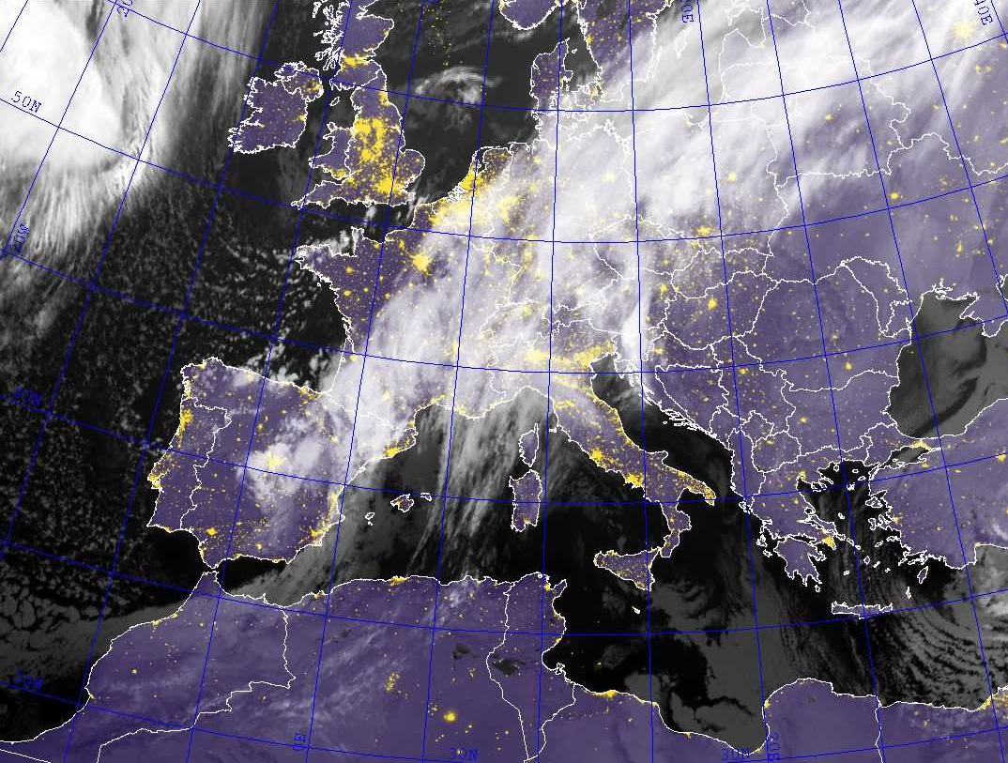
Recent Enhanced
High-Summer North Atlantic
Jet Variability Emerges
From Three-Century Context
V. Trouet, F. Babst, & M. Meko 2018
Amanda Young
Graduate SEMINAR
ATMS 790
1.29.18

Slide 2
Outline
Introduction
Jet Stream Dynamics
Results
Discussion
Methods
Conclusions

Slide 3





Introduction
W of Athens, GR
Nov/2017
Istanbul, TR
Jan/2017
The Climate Age
of FIRE and ICE
Vienna, AT
Jul/2017
Croatia
Jul/2017

Slide 4
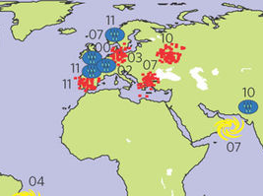
Introduction (cont)
Map showing the regional record extremes.
The numbers refer to the year in the twenty-first century.
Blue symbols - rainfall;
Red symbols - heatwaves/droughts;
Yellow symbols - hurricanes/cyclones;
The position and strength of the Northern Hemisphere polar jet stream are important modulators of mid-latitude weather extremes……
….…..and their societal, ecosystem, and economic impacts.

Slide 5
Introduction (cont)
In Europe, the position of the North Atlantic Jet (NAJ) drives temperature and precipitation extremes
Controls the location of the Atlantic storm track.
Inﬂuences the occurrence and duration of
stationary atmospheric pressure ﬁelds.
(“atmospheric blocking”)

Slide 6
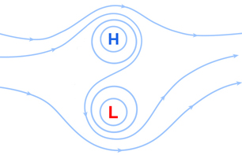
Introduction (cont)
In summer, a southern NAJ regime is associated with a decrease in blocking frequency over the British Isles (BRIT) and northwestern Europe which can result in ﬂoods in these regions.
In the northeastern Mediterranean (NEMED), on the other hand, the southern NAJ phase increases blocking frequency as well as the odds of heatwaves.
High-over-low blocks feature high pressure to the north and low pressure toward the south (sometimes directly south, as in this schematic). (©UCAR, The COMET Program.)
The NAJ is strongest in winter, but also inﬂuences European climate in summer, the season that is most commonly recorded in tree rings as climate proxies.

Slide 7
Introduction (cont)
Such conditions occurred during the summer of 2007.
BRIT experienced the second wettest summer on record since 1912,
Across the NEMED, record-breaking high temperatures were observed that led to excess human mortality and prompted catastrophic wildﬁres.
In contrast, the summer of 1976—when the NAJ was in an anomalously northward position and blocking patterns were reversed—was one of the driest and hottest summers on record in BRIT, but was associated with a NEMED cold extreme.

Slide 8
Introduction (cont)
It was found that extreme weather events—including ﬂoods, heatwaves, and wildﬁres—in BRIT and NEMED over the past 300 years have been linked to August NAJ anomalies.
Two summer temperature-sensitive tree-ring records were combined to reconstruct the interannual variability in the latitudinal position of the August NAJ going back to 1725 CE .
The NAJ reconstruction showed that late twentieth century NAJ positions fall within the range of the preceding centuries, but that a recent increase in the number of NAJ anomalies was unprecedented.
This increase in NAJ variance coincides with enhanced variance in the Paciﬁc Basin and points to an increase in inter-annual meridional jet stream variability since the 1960s.

Slide 9
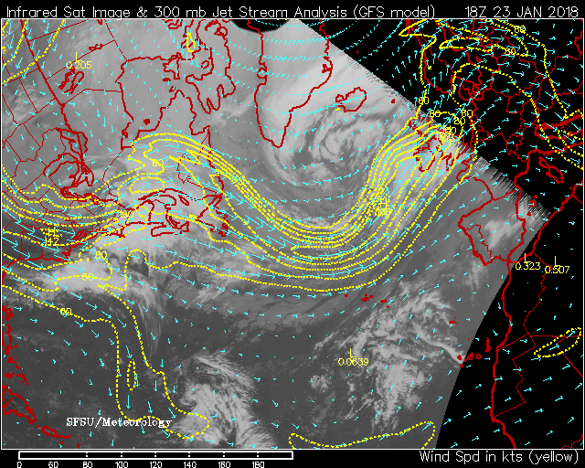
Jet Streams…...a refresher

Slide 10
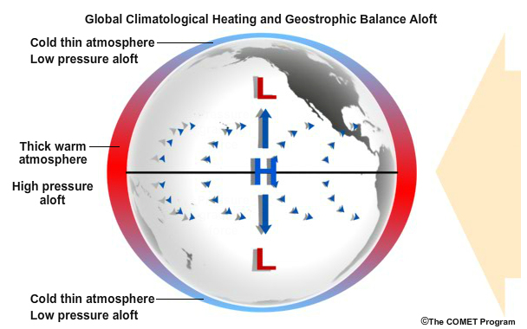
The Jet has to start somewhere
Processes for Jet formation
Global Climatological Heating
Geostrophic Balance Aloft
……or Thermal Wind
The reason the PFJ and STJ flow from west to east in the upper
troposphere at mid-latitudes.

Slide 11
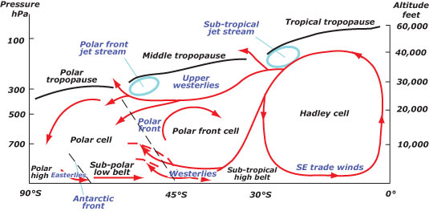
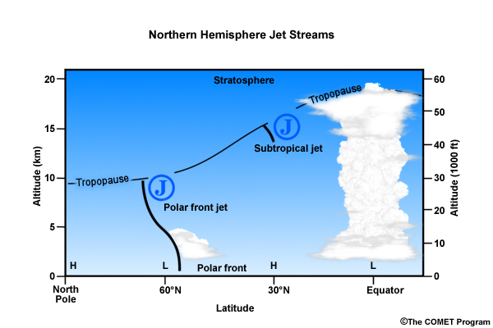
Cross-section of Tropospheric Circulation
The ITCZ is the 'boiler room' of the Hadley tropical cells.
The air in the trade wind belts is forced to rise in the ITCZ
Large quantities of latent heat is released.
(Ferrel Cell)
About half the sensible heat transported within the atmosphere originates in the 0–10°N belt.
Most of this sensible heat is released by condensation in the towering cumulus rising within the ITCZ

Slide 12
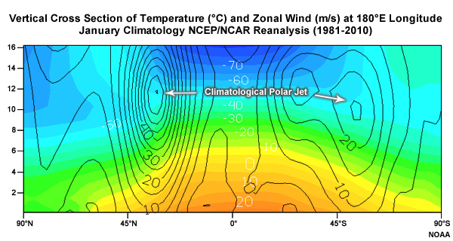
Meridional vertical cross section

Slide 13
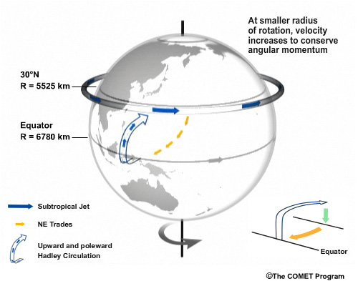
Hadley Cell Air Movement

Slide 14
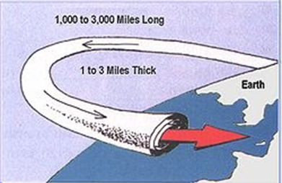
What’s with the Jet?
Narrow band (or river) of very high wind velocities.
(>50kts or >26m/s)
Generally blows from west to east, at an altitude of 20,000 - 50,000 feet (6,100 - 9,144 meters), or about 7 miles (11 kilometers) up.
Storm tracks generally follow the path of the Jet Streams

Slide 15
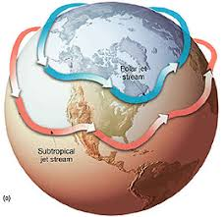
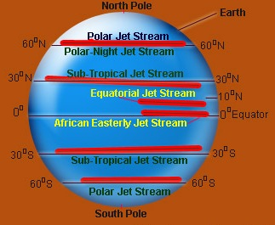
What’s with the Jet…continued?
Very unstable and undulates in 3-5 large waves that migrate around the globe generally from west to east
Two primary types, dependent upon tropospheric region
Subtropical jet (STJ)
Polar Front jet (PFJ)
But wait…also….
Tropical Easterly Jet
Polar-Night jet

Slide 16
Results

Slide 17
Tree-ring-based reconstruction of August NAJ variability
Jet anomalies in the eastern North Atlantic (10–30W) are most inﬂuential for European climate
The region that comprises the Icelandic Low and Azores High
Variability in the position of the summer NAJ is also linked to jet stream variability over Central North America, Europe, and eastern Asia.
Northern (southern) jet anomalies in this region correspond to northern (southern) jet anomalies over northwestern Europe and southeastern Europe and create a summer temperature reversal between BRIT and NEMED.

Slide 18
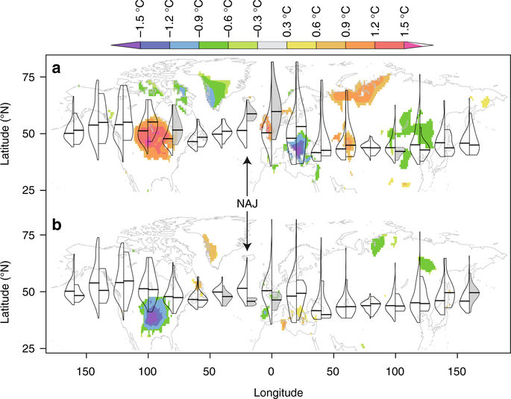
Tree-ring-based reconstruction of August NAJ variability
Left wings of the violins represent the August Northern Hemisphere Jet latitudinal position distribution over the instrumental period (1920–2012) for 20° longitudinal slices.
Right wings represent distribution during anomalous years when the North Atlantic Jet (NAJ; 10–30°W) latitudinal position exceeded 1 stdev northwards (a) or southwards (b).
Gray shading indicates significant differences between the left and right distributions (one-sided Kolmogorov–Smirnov test; p < 0.05).
Background map shows August surface temperature anomalies (°C; CRUTEM3.2160) composited over the anomalous years.

Slide 19
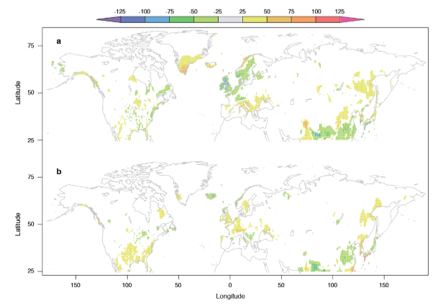
Tree-ring-based reconstruction of August NAJ variability
August precipitation anomalies (mm; CRUTEM3.211; 1920-2012) composited over anomalous years when the North Atlantic Jet (NAJ; 10-30° W) latitudinal position exceeded 1.5 standard deviations.
Northwards
Southwards
Non-significant results have been masked out. Composite maps created in R with color palette adapted from the KNMI Climate Explorer (https://climexp.knmi.nl).

Slide 20
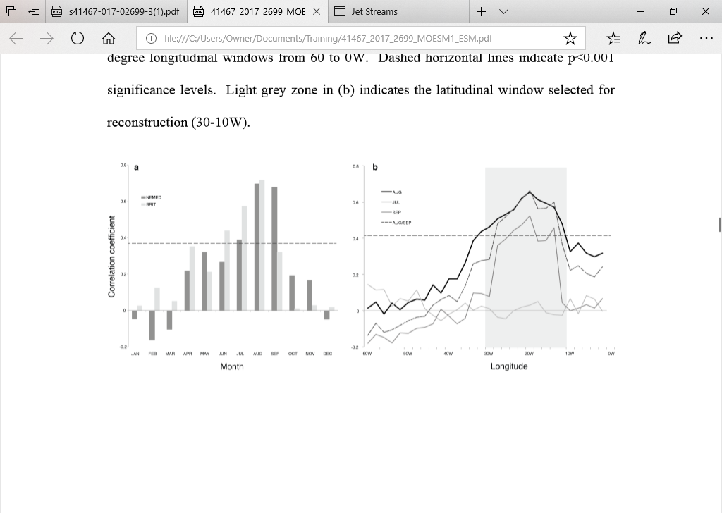
Tree-ring-based reconstruction of August NAJ variability
Maximum latewood density (MXD) records were compiled for both regions that represent interannual variability in regional August average surface temperature.
BRIT – 11 records
NEMED – 24 records
The two well-replicated temperature proxies explain 52% and 44% of the variance in regional August average temperature variation in BRIT and NEMED, respectively, and illustrate the temperature dipole generated by anomalous NAJ positions.

Slide 21
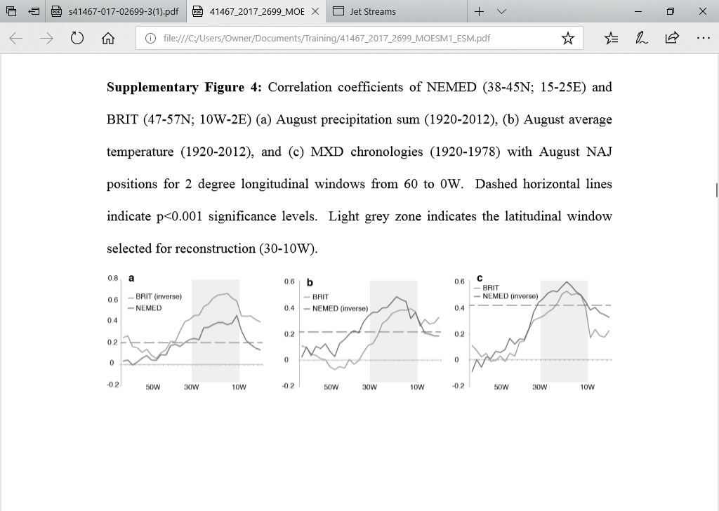
Tree-ring-based reconstruction of August NAJ variability
Correlation coefficients of NEMED (38-45N; 15-25E) and BRIT (47-57N; 10W-2E) with August NAJ positions for 2 degree longitudinal windows from 60W to 0W.
August precipitation sum (1920-2012)
August average temperature (1920-2012)
MXD chronologies (1920-1978)
Dashed horizontal lines indicate p<0.001 significance levels.
Light grey zone indicates the latitudinal window selected for reconstruction (30-10W).

Slide 22
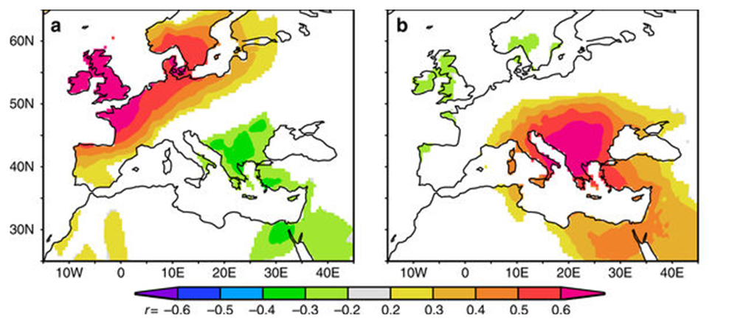
Pearson's correlation maps of tree-ring chronologies
Pearson's correlation maps of BRIT and NEMED tree-ring chronologies.
BRIT
NEMED
Pearson's correlation maps of tree-ring chronologies with gridded 1° CRU TS4.047 August temperature anomaly ﬁelds (1901–1978) over Europe. Correlation coefﬁcients higher than 0.3 are signiﬁcant at the p<0.01 signiﬁcance level.
The temperature reversal (negative correlation) created by August NAJ anomalies is reﬂected in regional tree-ring records

Slide 23
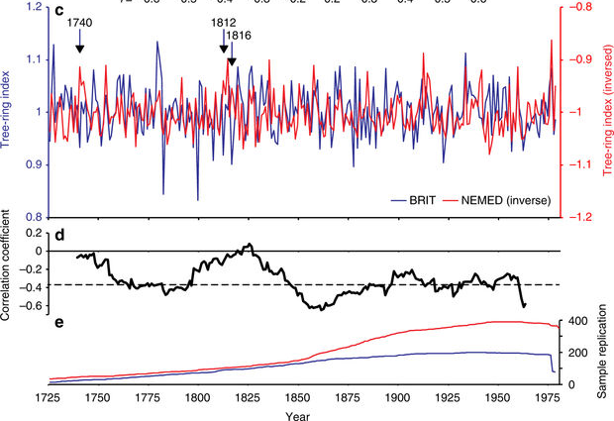
Tree-ring-based reconstruction of August NAJ variability
The BRIT and NEMED tree-ring records correlate signiﬁcantly negatively with each other over their period of overlap (r=−0.29; p<0.01; 1725–1978, Tree Ring Index c)
The negative correlation between the two tree-ring series weakens only in years when volcanic (e.g., Mount Tabora in 1816; r=−0.06) or other forcings (e.g., in 1740, r=−0.05) generate cold summers over the entire European continent (Sample Replication e).
Tree-ring chronologies with gridded 1° CRU TS4.047 August temperature anomaly ﬁelds (1901–1978) over Europe. BRIT and NEMED (inversed) tree-ring chronologies (1725–1978)
BRIT and NEMED (inversed) tree-ring chronologies (1725–1978
Their sample replication over time
Little Ice Age cold period
Mount Tambora volcanic eruptions
(Except for years (1740, 1812, 1816), external forcing created cold conditions throughout Europe.)

Slide 24
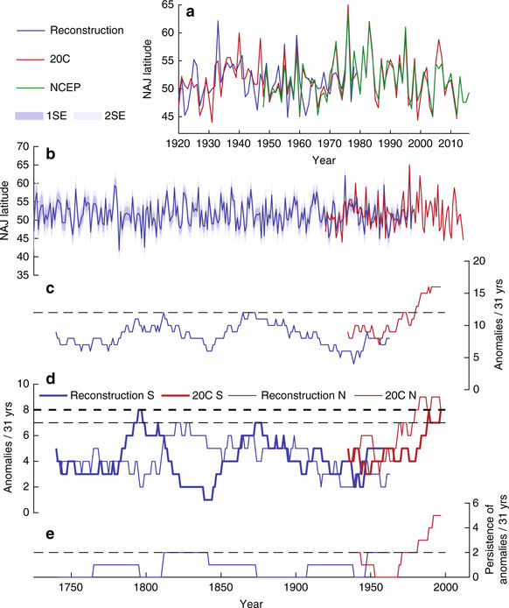
Tree-ring-based reconstruction of August NAJ variability
Summer NAJ reconstruction and variance.
The NCEP/ NCAR reanalysis data (1948–2016) are plotted for comparison.
The full NAJ reconstruction (1725–1978) including combined error estimations is plotted above.

Slide 25
Tree-ring-based reconstruction of August NAJ variability
The BRIT and NEMED MXD chronologies are both signiﬁcantly correlated with August NAJ position and their composite explains close to 40% of the variance in the August NAJ target data set.
Calibration and veriﬁcation trials show that August NAJ position can be skillfully reconstructed back to 1725 based on this combination.
Calibration/veriﬁcation statistics, however, were weaker for the early calibration period (1920–1948) compared to the later period (1949–1978), which is possibly due to inhomogeneities in the earliest period of the twentieth century reanalysis target data set

Slide 26
300 years of high-summer NAJ variability.
The reconstruction shows that late twentieth century NAJ positions fall within the latitudinal NAJ range of the preceding centuries.
With the exception of the summer of 1976, which was the northernmost NAJ position in both the instrumental data and the reconstruction.
The southernmost NAJ position of the target time series (44N in 1931) was exceeded only twice in the late eighteenth century (1782 and 1799).
These two years respectively are the seventh and second wettest Augusts in England and Wales since record keeping began in 1766.
It is worth noting that the NAJ can deviate further northward from its average position (51.6N) than southward and as a result European climate anomalies can be more extreme during northern compared to southern NAJ anomalies

Slide 27
300 years of high-summer NAJ variability (cont)
NAJ variability is often characterized using circulation indices such as the North Atlantic Oscillation (NAO) and the East Atlantic (EA) pattern.
When the NAJ is in an anomalously northerly position, it generates stronger than normal cyclonic conditions to the north (Icelandic Low) and anticyclonic conditions to the south (Azores High), which corresponding to + NAO and - EA phase.
Our August NAJ target correlates signiﬁcantly with summer NAO and EA indices.
The NAJ reconstruction also correlates signiﬁcantly positively with a tree-ring-based summer NAO reconstruction over their full length of overlap.

Slide 28
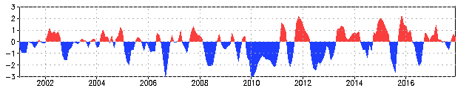
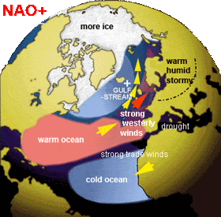
North Atlantic Jet Relation to +NAO
Strong positive phases of the NAO tend to be associated with above-average temperatures in the eastern United States and across northern Europe
Also associated with above-average precipitation over northern Europe and Scandinavia in winter, and below-average precipitation over southern and central Europe.

Slide 29
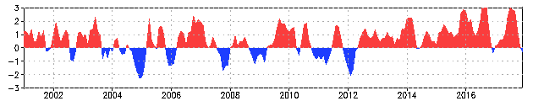
North Atlantic Jet Relation to the -EA Index
The second prominent mode of low-frequency variability over the North Atlantic, and appears as a leading mode in all months.
The EA pattern is structurally similar to the NAO, and consists of a north-south dipole of anomaly centers spanning the North Atlantic from east to west.
The anomaly centers of the EA pattern are displaced southeastward to the approximate nodal lines of the NAO pattern. For this reason, the EA pattern is often interpreted as a southward shifted NAO pattern.

Slide 30
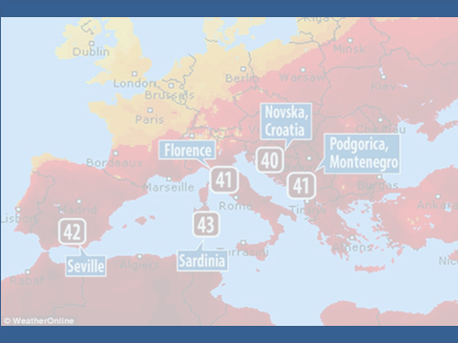
Extreme summer weather
Extreme summer weather events in BRIT, NEMED, and the American Midwest are often associated with northward and southward NAJ deviations.
A comparison of the NAJ reconstruction with independent time series of past BRIT summer weather and NEMED ﬁre occurrence conﬁrms that the position of the NAJ has impacted European extreme weather events since at least 1725 CE.
Heatwaves and droughts in BRIT and the northwestern European Lowlands have consistently been associated with northern NAJ positions, whereas the NAJ showed southward anomalies during periods of marked increases in rainfall (pluvials) and cold summers.

Slide 31
Discussion

Slide 32
Discussion
Enhanced late twentieth century variance has also been detected in climate and ecosystem dynamics in the Central and Northeast Paciﬁc.
Combined results thus suggest a late twentieth century increase in jet stream latitudinal variance in the North Atlantic and the North Paciﬁc Basin, the two basins where interannual jet stream variability is strongest.
CMIP5 projections indicate that such meridional variability will weaken on a daily time scale as mid-latitude jets move to higher latitudes with increasing greenhouse gas emissions.

Slide 33
Discussion (cont)
On interannual time scales, however, increased meridional jet stream variability can reﬂect a wavier, slower jet that is accompanied with blocking systems and thus creates contrasting mid-latitude extreme weather events.
The enhanced NAJ variability further coincides with a prevalence of meridional ﬂow regimes and an infrequency of zonal ﬂow in the North Paciﬁc Basin.
The larger north–south NAJ and NPJ deviations and the more meridional ﬂow are indicative of enhanced jet stream waviness and in recent decades coincide with a modeled and observed increase in conditions that are favorable to the occurrence of quasi-resonant ampliﬁcation (QRA).

Slide 34
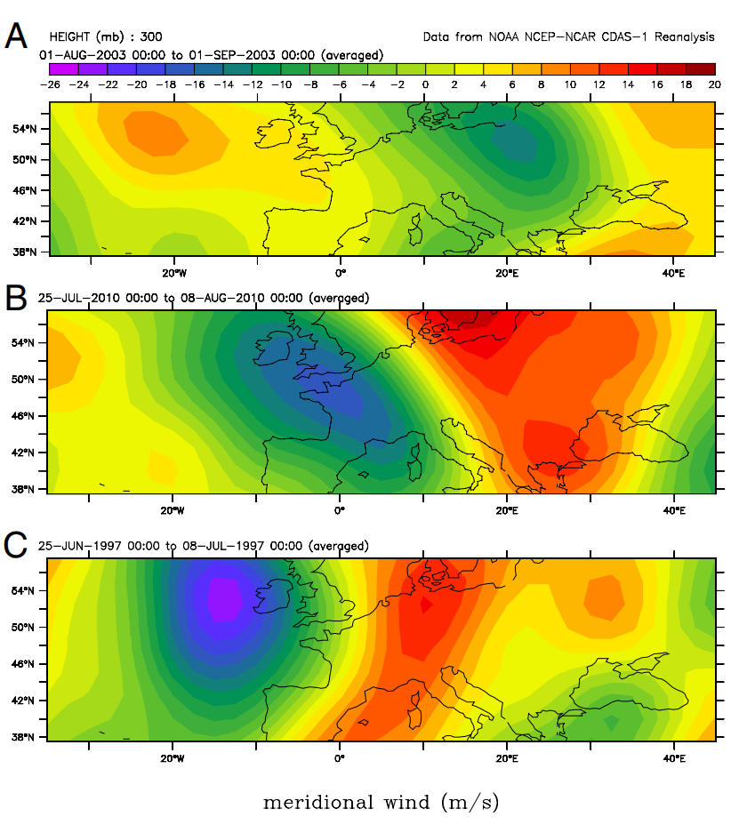
Quasi-Resonant Ampliﬁcation
QRA is the process through which synoptic-scale Rossby waves (with zonal wave numbers 6–8) are trapped within an effective mid-latitude atmospheric waveguide and create persistent extreme mid-latitude summer weather in the Northern Hemisphere.
Maps of the meridional winds (m/s) at 300 hPa over the North Atlantic–European sector during the three recent summer extremes in Europe.
the record European summer heat wave in August 2003
the most devastating phase of the Russian heat wave, July 25 to August 7, 2010
the most destructive episode of the Great European Flood, June 25 to July 7, 1997.
Notes:
a. Weak +NAO block and neg tilt ridge b. strong –NAO strong south-southeast upper flow from Middleeast c. moderate +NAO deep trough moving through western Europe.

Slide 35
Quasi-Resonant Ampliﬁcation (cont)
QRA as well as a more sinuous jet stream can result from a decrease in the equator-to-pole temperature gradient….
…….. and thus from Arctic ampliﬁcation—the disproportionate
warming of the Arctic region compared to the mid-latitudes over the
past three decades.
Both mechanisms have been proposed as potential dynamical pathways linking recent extreme mid-latitude weather events to Arctic warming

Slide 36
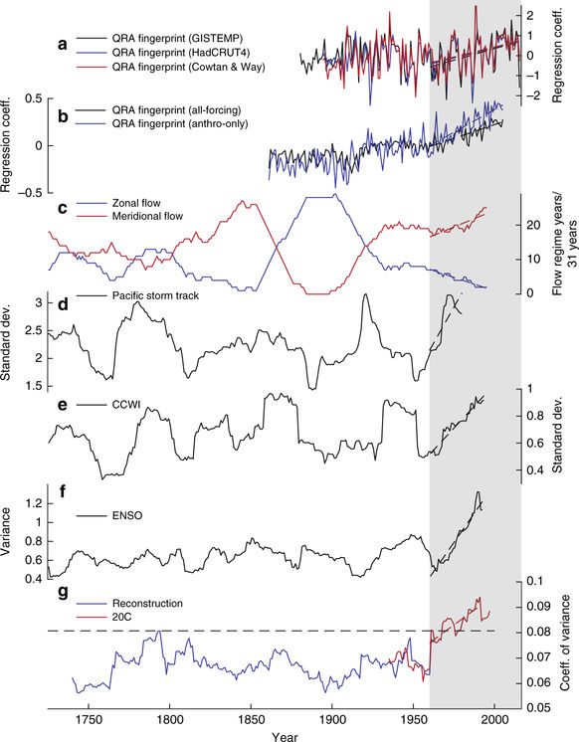
Late twentieth century variance increase in North Atlantic and North Paciﬁc Basin
(a) Observed QRA
Modeled QRA
QRA ﬁngerprint of reconstructed zonal and meridional ﬂow in the North Paciﬁc
(d) Variance in the climate dynamics of the
North and Central Pacific
(e) California Current Winter Index (CCWI)
(f) NIÑO4 SST index31
(g) Represents the highest 31-year values over
the reconstruction period (1725–1978 CE)

Slide 37
Methods

Slide 38
Climate data
Calculated the latitudinal position of the Northern Hemisphere polar jet (NHJ) based on 300hPa scalar wind data (ms−1) averaged for August and derived from the twentieth century reanalysis data set.
Therefore, the time series derived from this data set was restricted to the period 1920–2012, which includes an adequate time frame (1920–1978) for statistically signiﬁcant calibration/veriﬁcation exercises.
August NHJ position for each longitudinal grid cell was deﬁned as the latitude with the greatest average August 300hPa scalar wind speed and NAJ positions were averaged over a subset of longitudes (10–30W) in the eastern North Atlantic.
For the period 2013–2016, the August NAJ position calculations were based on the NCEP/NCAR Reanalysis data set, which includes globally gridded (2.5°x2.5°) monthly pressure values for the period 1948–present.

Slide 39
Climate data (cont)
NAJ position was calculated in the same way as described above for the twentieth century reanalysis data set and the two data sets correlate strongly (r=0.93, p<0.001) over their period of overlap (1948–2012 CE).
The NCEP/NCAR NAJ data were then linearly transformed (also referred to as scaled) to match the mean and standard deviation of the twentieth century reanalysis NAJ data.
Mean and standard deviation for scaling were calculated over the period that was common to the two instrumental data sets and the tree-ring data set (1948–1978 CE).
Pearson's correlation coefﬁcients were further calculated between August NAJ position and the rotated principal component analysis-based indices of summer (June–August) NAO and EA as provided by the NOAA Climate Prediction Center (1950–2012 CE).

Slide 40
Tree-Ring data.
MXD tree-ring data for BRIT and NEMED were selected from the International Tree Ring Data Bank (http://www.ncdc.noaa.gov/paleo/paleo.html).
The NEMED compilation (1675–1980) contains 401 individual MXD series from four tree species at 21 high-elevation sites and explains 44% of the variance in regional August average temperature variation.
For BRIT, a compilation of 213 individual Scots pine MXD series from 11 sites to develop one BRIT master chronology (average inter-series correlation=0.531, mean segment length=147 years) that explains 52% of the variance in regional (47–57N, 10W–2E) August temperature variation.

Slide 41
Reconstruction.
Applied a composite-plus-scale method to reconstruct August NAJ position from the BRIT and NEMED MXD chronologies.
ﬁrst normalized the two chronologies using the mean and standard deviation over their full period of overlap (1725–1978 CE).
then calculated the average of BRIT and negative NEMED for each year.
The resulting BRIT–NEMED composite is strongly and signiﬁcantly positively correlated with August and August–September average NAJ position over longitudes between 10 and 30W.
The August NAJ position was reconstructed by scaling the BRIT–NEMED composite to match the mean and variance of the August NAJ data over the period 1948–1978 CE.

Slide 42
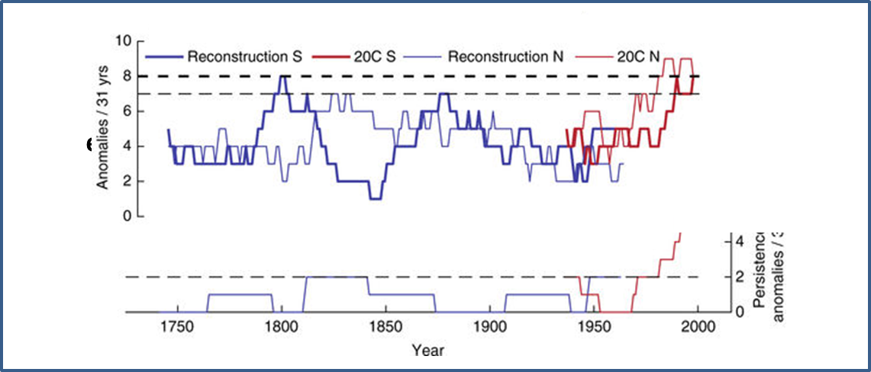
Variance and extreme analysis
Three metrics were used to calculate variability in NAJ variance over time.
Calculated 31-year window running coefﬁcients of variance for the NAJ reconstruction and for 20C reanalysis data .
Also calculated for both time series the running number of extreme NAJ anomalies per 31-year period and the number of occasions per 31-year period when NAJ extremes of the same sign occurred in consecutive years (persistence of extremes).
The running number of extreme NAJ anomalies per 31- year period was
also calculated for
positive and negative
extremes separately.

Slide 43
Conclusions
Northward NAJ anomalies have resulted in heatwaves and droughts in northwestern Europe
Southward anomalies have promoted wildﬁres in southeastern Europe.
Discovered an unprecedented increase in NAJ variance since the 1960s, which co-occurs with enhanced late twentieth century variance in the Central and North Paciﬁc Basin

Slide 44
Conclusions (cont)
Results also suggest increased late twentieth century inter-annual meridional jet stream variability.
Also adds evidence that more sinuous jet stream patterns and quasi-resonant ampliﬁcation act as potential dynamic pathways for Arctic warming, that in turn inﬂuences mid-latitude weather patterns.

Slide 45
Summary
Introduction
Jet Stream Dynamics
Results
Discussion
Methods
Conclusions

Slide 46

QUESTIONS???
QUESTIONS???
QUESTIONS???
QUESTIONS???
QUESTIONS???

Slide 47
References:
Trouet, V., F. Babst, and M. Meko, 2018: Recent enhanced high-summer North Atlantic Jet variability emerges from three-century context. Nature Communications, 9:180, 1-9, https://doi.org/10.1038/s41467-017-02699-3
Woollings, T. and M. Blackburn, 2012: The North Atlantic Jet Stream under Climate Change and Its Relation to the NAO and EA Patterns. J. Climate, 25, 886–902, https://doi.org/10.1175/JCLI-D-11-00087.1
Luo, D. and J. Cha, 2012: The North Atlantic Oscillation and the North Atlantic Jet Variability: Precursors to NAO Regimes and Transitions. J. Atmos. Sci., 69, 3763–3787, https://doi.org/10.1175/JAS-D-12-098.1
Petoukhov, V., Rahmstorf, S., Petri, S., and Schellnhuber, H.J., 2013: Quasiresonant amplification of planetary waves and recent Northern Hemisphere weather extremes. PNAS 2013 April, 110 (14) 5336-5341. https://doi.org/10.1073/pnas.1222000110

