Slide 1
Seminar
2017
Aerosol pollution impact on the precipitation
Yunpeng Shan
Division of Atmospheric Science, DRI
Department of Physics, UNR

Slide 2
Back ground
Further efforts
Classic theories
Current limitations
Case study

Slide 3
Part 1
Background

Slide 4
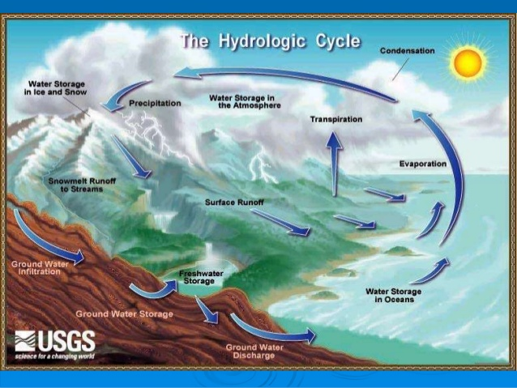
Importance of cloud-precipitation system in Hydrologic Cycle
Cloud-precipitation system is main pathway transporting water from ocean back to continent.
Aerosol pollution impact on precipitation may redistribute water resource on ocean and continent.

Slide 5
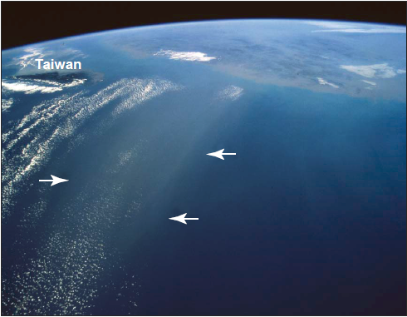
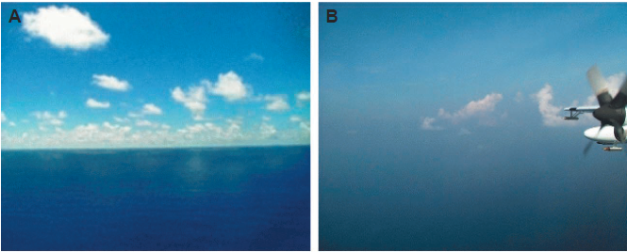
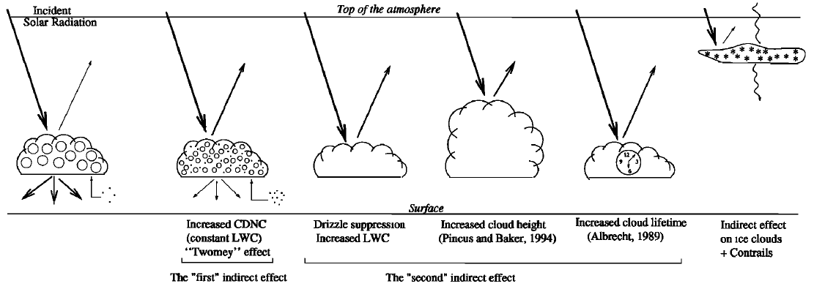
Physical mechanism of aerosol radiation forcing
Semi-direct forcing: Cloud evaporation caused by absorbing aerosols
Direct forcing: Aerosols scatter sun light
T. L. Anderson et, al. 2006, Science
A. S. Ackerman et, al. 2000, Science
First indirect forcing: More aerosols leads to smaller cloud droplets
Second indirect forcing: More aerosols leads to longer cloud life time
J. Haywood et, al. 2000, Rev. Geophys

Slide 6
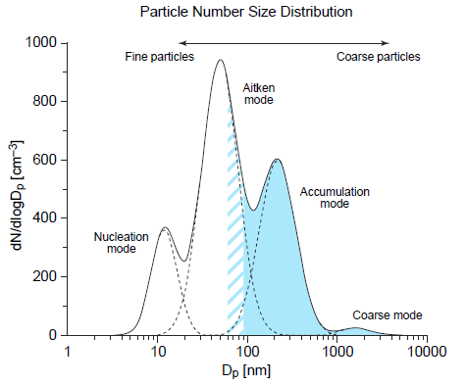
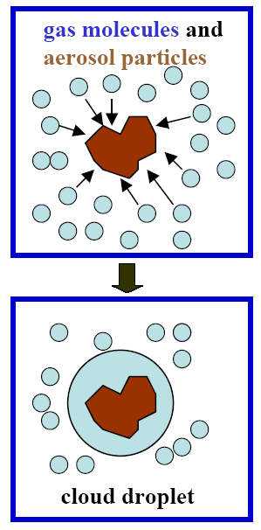
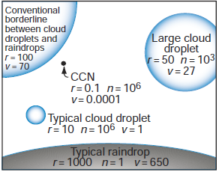
Physical mechanism of aerosol impact on cloud-precipitation system
Cloud Condensation Nucleus(CCNs) and Ice Nucleus (INs) are initialization of cloud droplets/ice crystals.
Collision-coalescence would be the most effective way to produce rainfall.
Aerosol Particle Spectrum
Overwhelming CCN number concentration makes initiated small cloud droplets smaller. Then rainfall production would be suppressed.

Slide 7
Part 2
Classic Theory

Slide 8
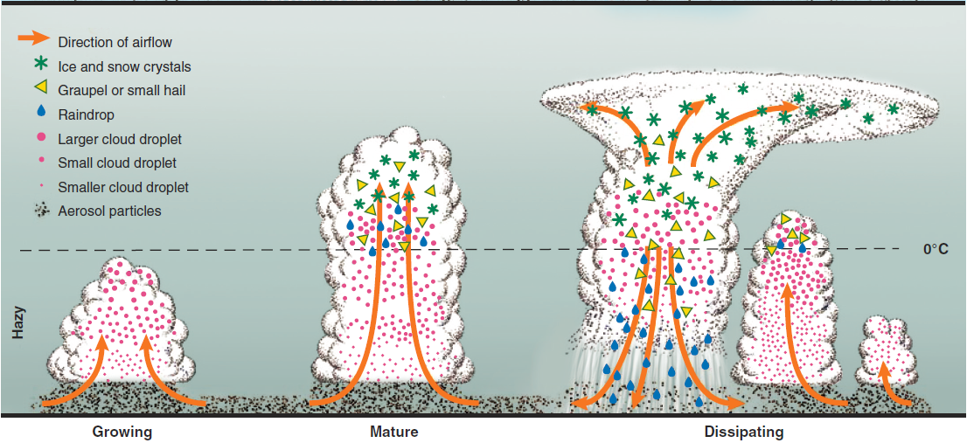
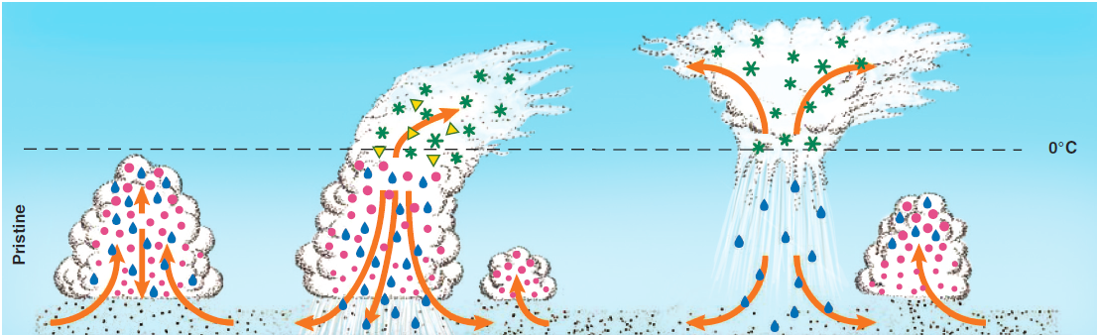
Aerosol-cloud-precipitation conception
Hazy
Aerosols suppress warm cloud rain and enhance cold precipitation
Pristine
Condensed water fall out before freezing. Weak cold cloud body remains
Rosenfeld et, al. (2008)

Slide 9
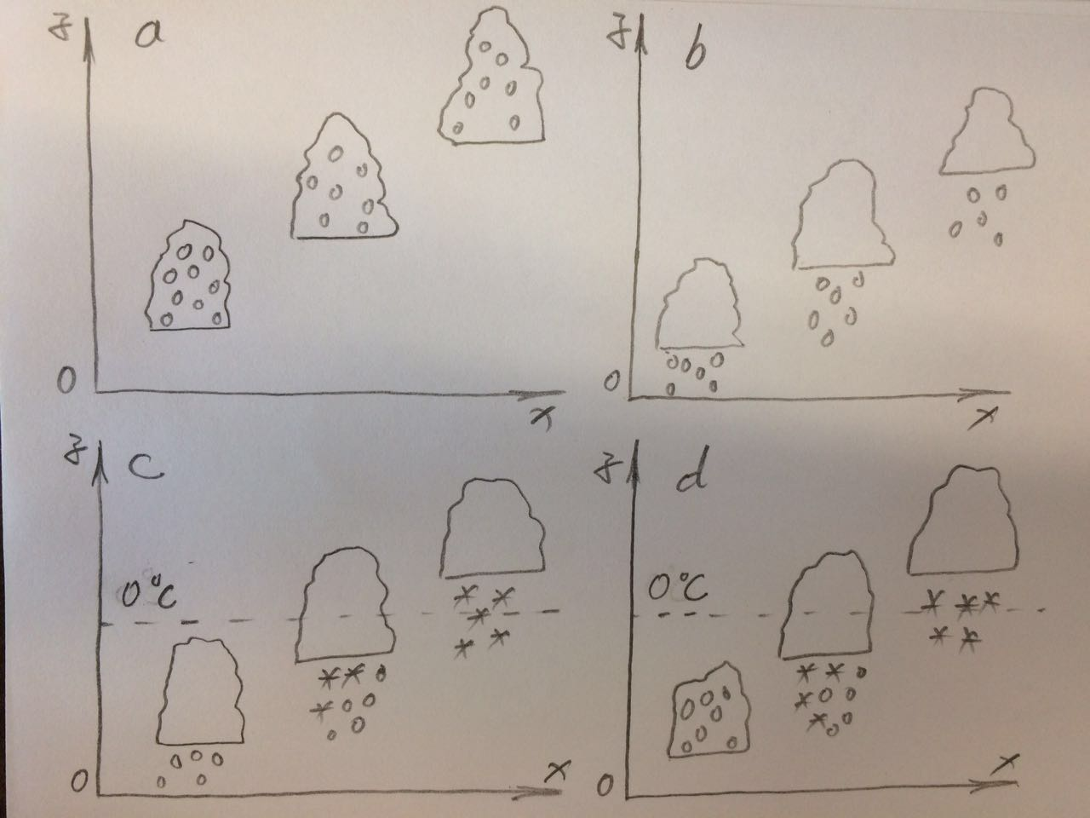
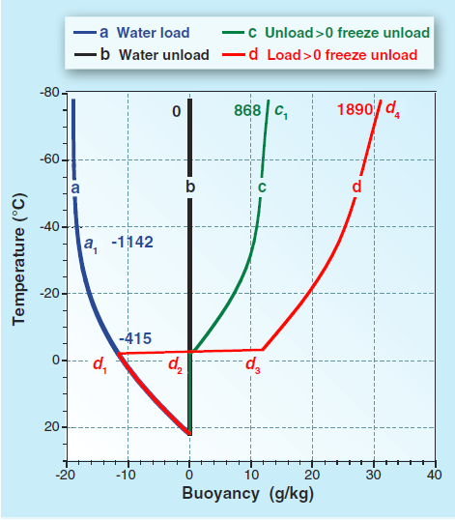
Positive buoyancy contribution (PBC) versus negative buoyancy contribution (NBC)
PBC: qv -> ql
NBC: Rising, no rainfall
PBC: qv -> ql, rainfall
NBC: Rising
PBC: qv -> ql, ql -> qs, rain/snow fall
NBC: Rising
PBC: qv -> ql, ql -> qs(more), rain/snow fall
NBC: Rising
Large mount of freezing latent heat and rainfall contributes to obvious buoyancy increase

Slide 10
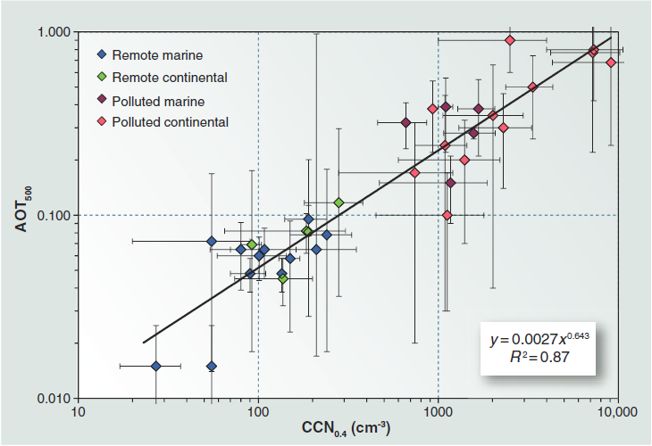
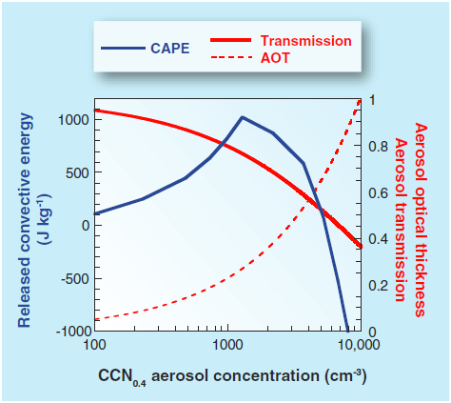
Quantify the impact threshold
AOT(500nm) vs CCN(0.4)
Reliable linear relationship between AOT and CCN concentration
0.25
Clean background
Aerosol pollution (reflected by transmission) -> CCN concentration and CAPE
Impacts of aerosols are always positive
1200 cm⁻³
Polluted background
Convection-enhancing shows a threshold where CCN is about 1200 cm⁻³
Beyond that CAPE would decrease very obviously

Slide 11
Part 3
Case study: direct forcing to dynamics

Slide 12
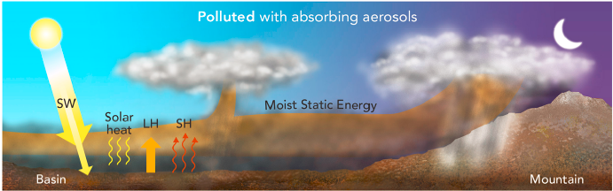
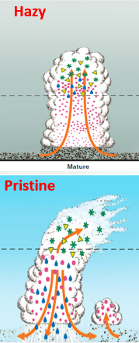
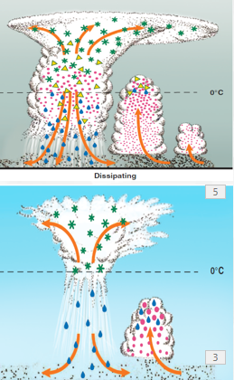
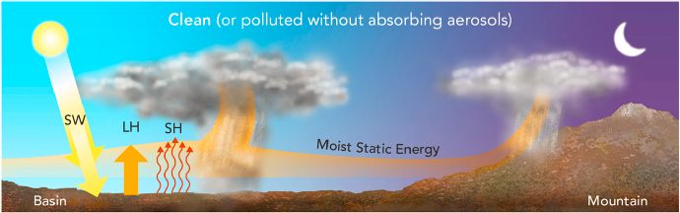
A conception model
BCs absorb SW
Clean/polluted situation allows more/less SW to heat surface
Precipitation in Basin
Aerosols suppress warm cloud convection and precipitation
More remained cloud water is transported to mountain area
Precipitation on Mountain
One more trigger is orographic forcing
Suppressed warm cloud is convert into mixed phase convection and heavy rainfall

Slide 13
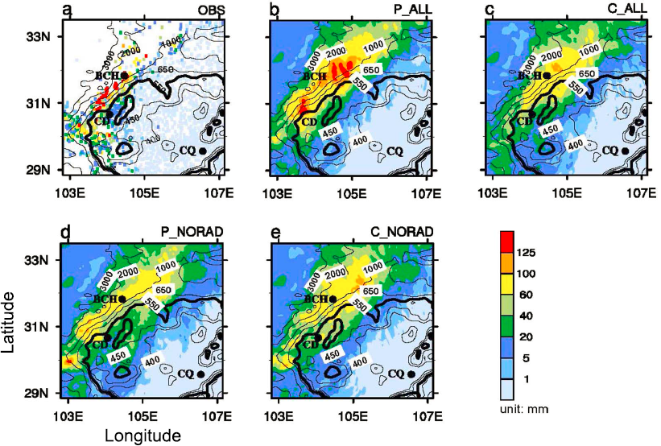
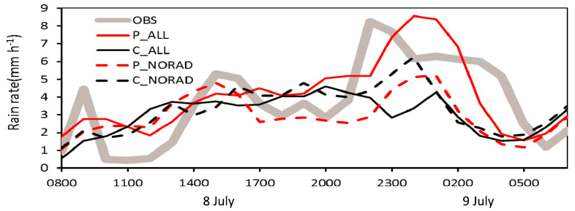
Simulation evaluation
Physical mechanism sensitivity
Polluted case captures real situation
Similarity between P-NORAD and C-All inflates importance of direct forcing
Precipitation in Basin
Modeled rainfall is not good, but reflected tendency
P-all group producs most suppressed rainfall at around noon
Precipitation on Mountain
P-all group captures correct rainfall rate and triggering time
Difference with other groups is caused by sensitive processes

Slide 14
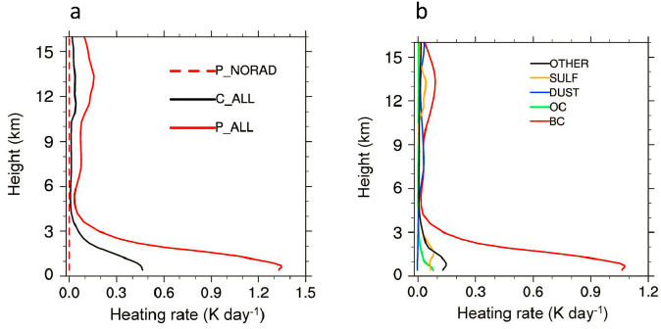
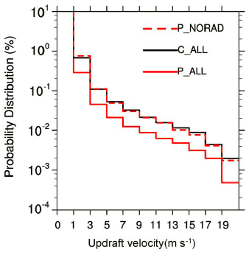
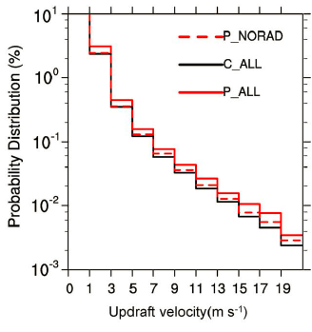
BC absorption impacts vertical velocity
Direct forcing caused by BC
Upwards velocity (basin)
BC aerosols absorb SW radiation and heats boundary layer
BC heating in P-All group is about three folder to C-All group
As a consequence, aerosol pollution would cause lower surface temperature and weak LW radiation from ground
Weak LW radiation limits convection
Little difference between C-All & P-NORAD indicates ignorable indirect effect
Upwards velocity (mountain)
P-All models strongest convection
Direct effects (caused by BCs) make main contribution to difference between P-All and C-All

Slide 15
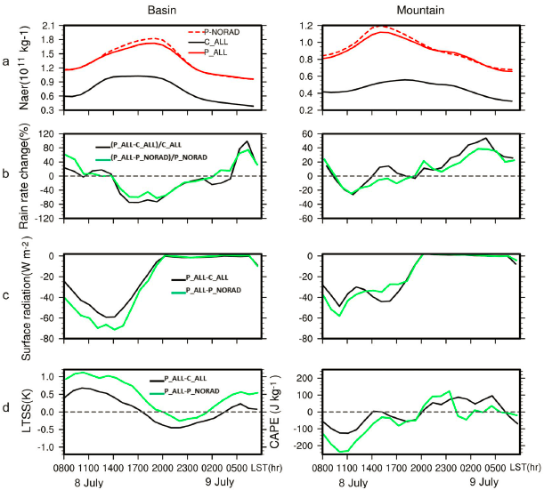
Evidence of direct forcing dominating contribution
Basin Area (Day time)
Aerosols make negative variance of rain rate and surface radiation and positive LTSS (Low Troposphere Static Stability)
Direct forcing dominates, while indirect forcing is somewhat opposite it
Mountain Area (Night time)
Aerosol makes positive contribution to rainfall rate

Slide 16
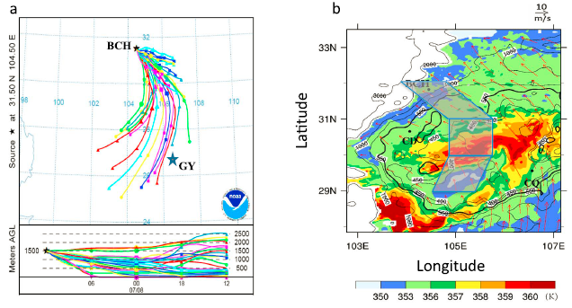
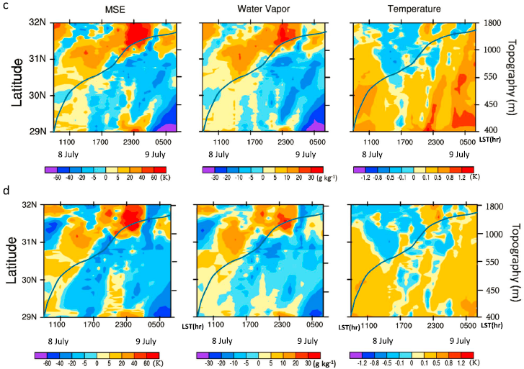
Analysis on air parcel trajectory
P_All – C_All
P_All – P_NORAD
P_All – C_All
Aerosols supplies a good rainfall condition on mountain area
P_All – P_NORAD
Main contribution is caused by direct radiation forcing of BC

Slide 17
Part 4
Model limitations

Slide 18
Comments on the modeling setup
Four unsolved modeling uncertainty resource
Concentration and spatial distribution of GCCN
Turbulence impact on CCN nucleation
Turbulence impact on cloud particle collision
IN activation parameterization
(A. Khain, 2009, ERL)
Existing questions in Jiwen et, al. (2015)
Saturation adjustment/CCN nucleation -> mass/number mixing ratio -> Gamma SDF
Turbulence is neglected in current Morrison Scheme
IN is also neglected (insoluble aerosols could be good INs) -> IN caused phase change would feedback to dynamical situation which is not ignorable! -> A question that if direct radiation forcing is overwhelming to indirect still has uncertainties.
Possible solutions and further effort
Use spectrum recognizing method to explicitly describe particle collisions (involving turbulence impacts)
Four main IN nucleation processes should be parameterized individually.

Slide 19
Part 5
Further Efforts

Slide 20
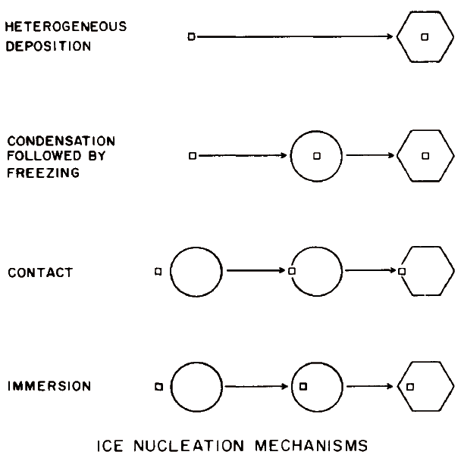
Improvements to IN parameterization
Deposition and Condensation INs
Essence is the collisions between aerosol particles and water vapor molecules
These processes could be measured in the lab easily
Both physical and chemical properties may play a key role in nucleation ability
Contact and Immersion INs
Essence is the collisions between aerosol particles and existing liquid droplets
Physical theory is an effective pathway
Physical properties, such as momentum of aerosol may dominate
(Rogers & Yau, 1989)

Slide 21
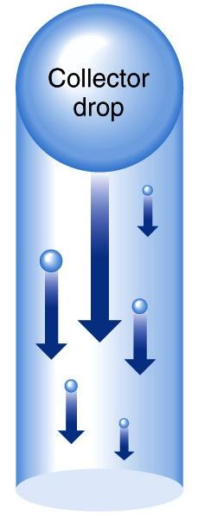
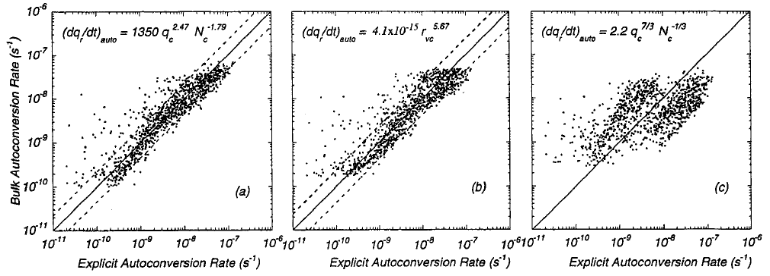
Current accretion & acceleration parameterization
(Marat Khairoutdinov & Yefim Kogan, 2000, MWR)
Mostly simplified version just considers moments of whole cloud droplet spectrum. Reliability is examined in a double-log coordinate. Actually it is too disperse to build up a linear relationship.

Slide 22
Bin version parameterization
Spectra are always recognized (assumption free)
Assume particle spectra follows a size distribution function (SDF)
Current
Moments
N(D)
0
D
Parameter group
Solve the parameters in SDF to calculate source/sink terms
Moment variance tendency for each bins
N(D)
Moment variance tendency
Predicted
Moments
0
D

Slide 23
Questions?
Thank you for your attention

