Slide 1
Increasing Great Lake–Effect Snowfall during the Twentieth Century: A Regional Response to Global Warming?
Burnett et al. (2003)
Lucas Bancroft
ATMS 790
3 April 2017

Slide 2
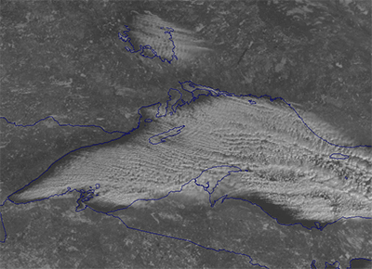
Outline
Introduction
Purpose
Key Topics
Lake-Effect Snow
Oxygen Isotopes in Relation to Lake-effect snow
Data and Results
Future Research
University of Michigan School of Natural Resources & Environment

Slide 3
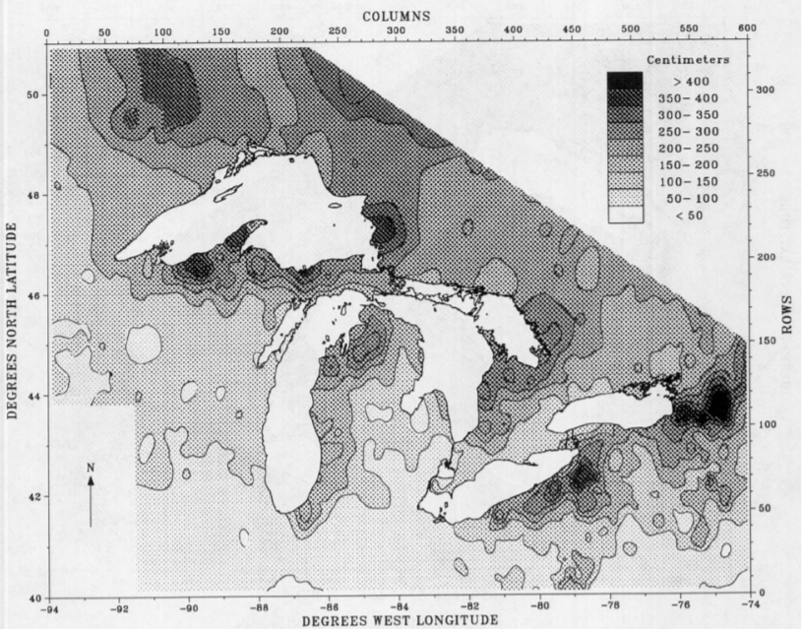
Introduction
Norton and Bolsenga (1993) found significant increases in lake-effect snowfall between 1951 and 1980
Leathers and Ellis (1996) weather patterns associated with lake-effect snowfall became more frequent between 1951 and 1982
Snowfall in Syracuse, NY has increased by 1.9 cm yr⁻¹ since the early 1900s
(Norton 1993)
Notes:
Norton and Bolsenga used data from 1230

Slide 4
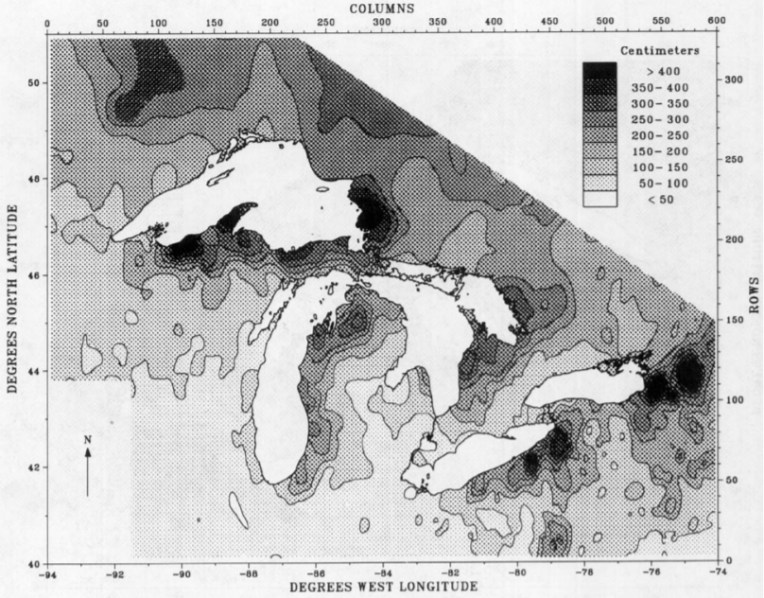
Introduction
Norton and Bolsenga (1993) found significant increases in lake-effect snowfall between 1951 and 1980
Leathers and Ellis (1996) weather patterns associated with lake-effect snowfall became more frequent between 1951 and 1982
Snowfall in Syracuse, NY has increased by 1.9 cm yr⁻¹ since the early 1900s
(Norton 1993)
Notes:
Norton and Bolsenga used data from 1230

Slide 5
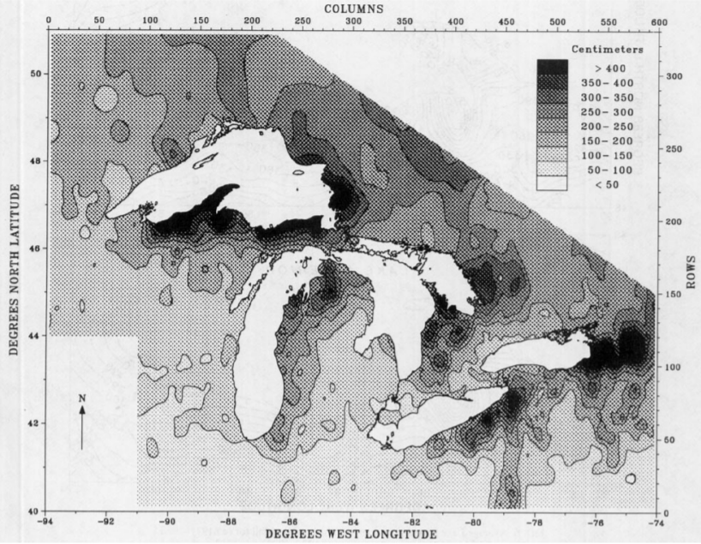
Introduction
Norton and Bolsenga (1993) found significant increases in lake-effect snowfall between 1951 and 1980
Leathers and Ellis (1996) weather patterns associated with lake-effect snowfall became more frequent between 1951 and 1982
Snowfall in Syracuse, NY has increased by 1.9 cm yr⁻¹ since the early 1900s
(Norton 1993)
Notes:
Norton and Bolsenga used data from 1230

Slide 6
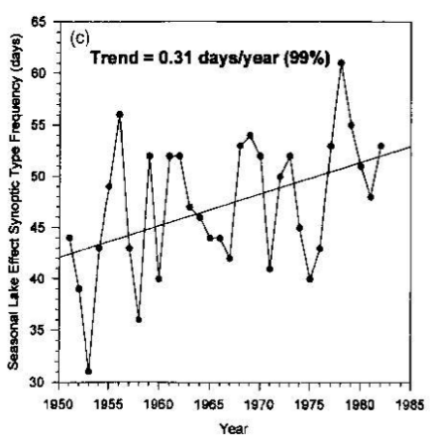
Introduction
Norton and Bolsenga (1993) found significant increases in lake-effect snowfall between 1951 and 1980
Leathers and Ellis (1996) weather patterns associated with lake-effect snowfall became more frequent between 1951 and 1982
Snowfall in Syracuse, NY has increased by 1.9 cm yr⁻¹ since the early 1900s
(Norton 1993)
Notes:
Norton and Bolsenga used data from 1230

Slide 7
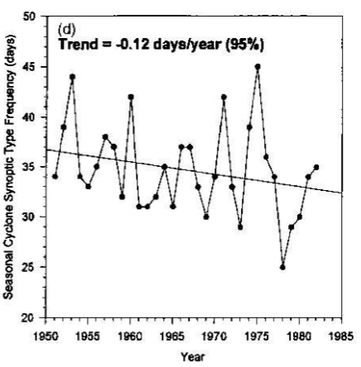
Introduction
Norton and Bolsenga (1993) found significant increases in lake-effect snowfall between 1951 and 1980
Leathers and Ellis (1996) weather patterns associated with lake-effect snowfall became more frequent between 1951 and 1982
Snowfall in Syracuse, NY has increased by 1.9 cm yr⁻¹ since the early 1900s
(Norton 1993)
Notes:
Norton and Bolsenga used data from 1230

Slide 8
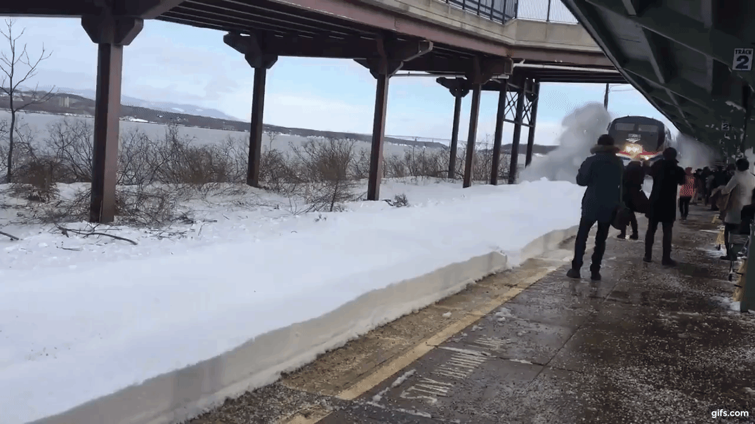
Purpose
Real Purpose
Determine whether other lake-effect sites exhibit increases like those in Syracuse
Determine to what extent lake-effect snowfall is regional in nature
Transportation
Hazard to life and property
Agriculture
Recreation

Slide 9
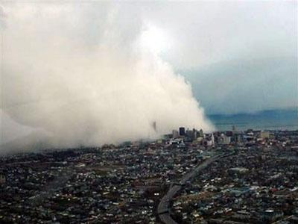
Key Topics
Lake-Effect Snow
Measuring oxygen isotopes in finger lakes in New York
Cayuga, Owasco, Otisco Lakes
Water derived from evaporation from Great Lakes is characterized by low oxygen isotope ratios.
University of Michigan School of Natural Resources & Environment

Slide 10
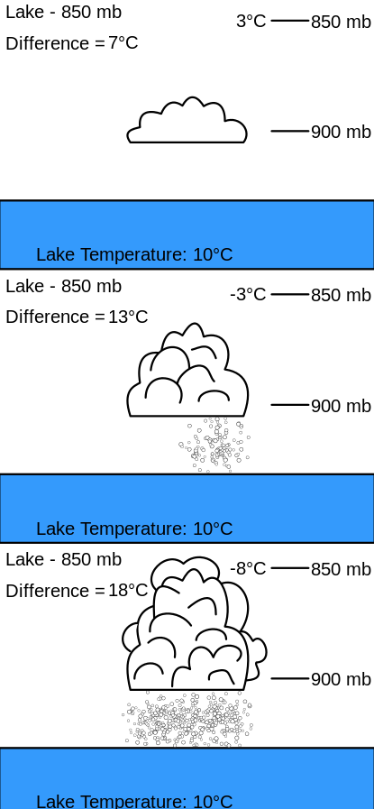
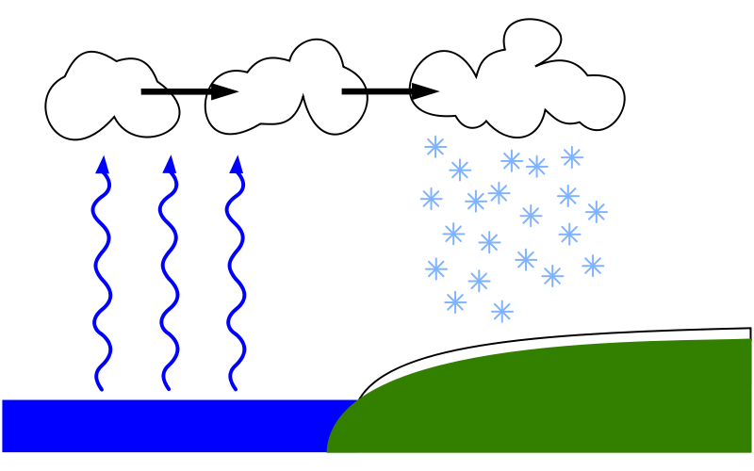
Lake-Effect Snow
Notes:
Other areas lake-effect occurs: Great Salt Lake, Chesapeake and Delaware Bays, Black Sea, Caspian Sea. 2004 Tahoe

Slide 11
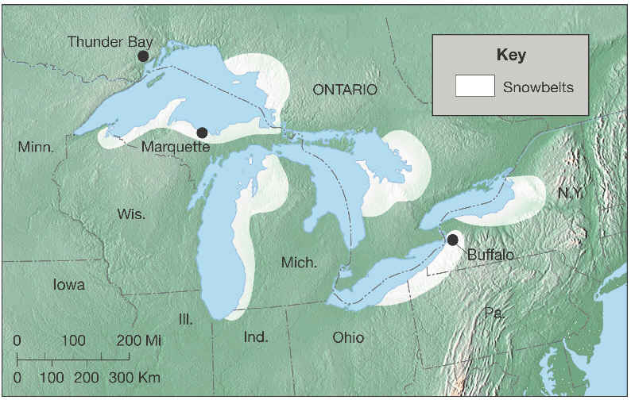
Lake-Effect Snow
University of Michigan School of Natural Resources & Environment
Notes:
Dot for syracuse

Slide 12
Oxygen Isotope Ratio 𝞭¹⁸O
Analysis of 𝞭¹⁸O in ice cores used to track precipitation temperature
Rainwater is ¹⁶O enriched
Preferential evaporation due to light ¹⁶O in seawater
Ocean surfaces in the tropics and subtropics have higher 𝞭¹⁸O due to more evaporation while surfaces in the mid-latitudes have lesser 𝞭¹⁸O due to more precipitation
Water molecules containing ¹⁸O precipitate before those containing ¹⁶O atoms

Slide 13
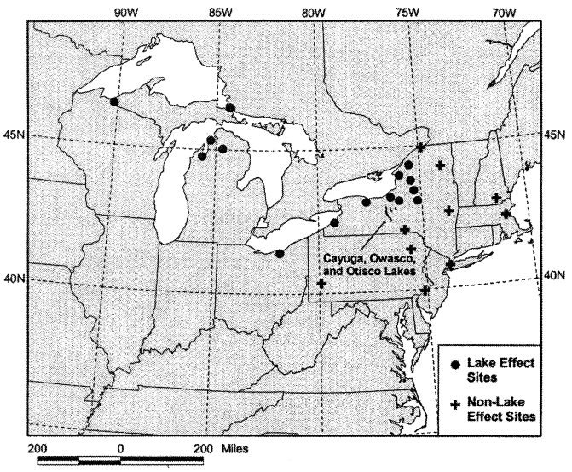
Data: Snowfall, Precipitation, and Mean Air Temperature
Each station’s history was checked for changes in method or location.

Slide 14
Data: Oxygen Isotopes
Box cores were collected from Cayuga, Owasco, and Otisco Lakes
Age of core sediments was found using radiogenic dating of ¹³⁷Cs and ²¹⁰Pb
Cs is a fallout product only occurring since ~1950.
Pb has a half life of 22.26 years so it is useful in dating sediments of age less than 150 years.
Calcite fraction was analyzed for oxygen isotope ratios
Previous studies of NY lake water have isotope values fluctuating mainly with the moisture source and not temperature.
Notes:
From Cs and Pb was found the sedimentation rates and ages
a Kiel III carbonate prep- (CaCO ) 3 aration device directly coupled to a Finnigan MAT 252 stable isotope ratio mass spectrometer. Results are reported in delta notation relative to Vienna-Pee Dee Belemnite (VPDB), which is the international standard for reporting oxygen isotopes.
O isotopes vary with temperature or moisture source. Previous studies
Moisture source variability whu it occurs

Slide 15
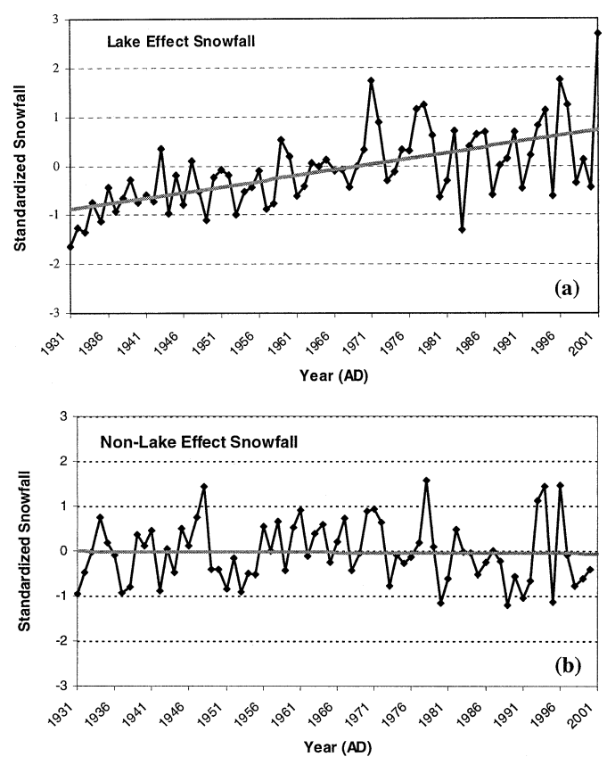
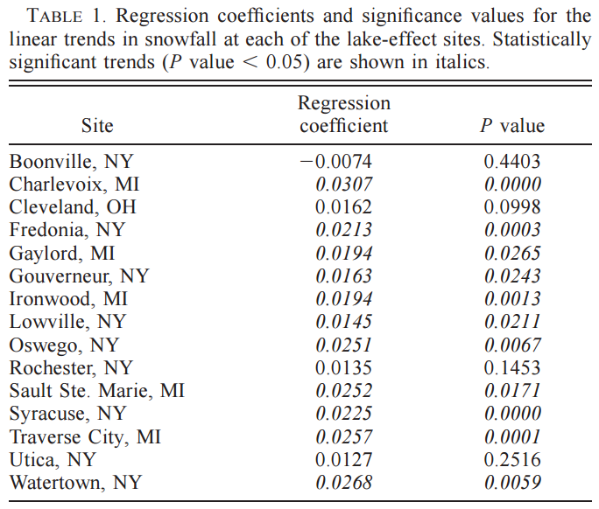
Results: Snowfall
Notes:
Because we do not see an increase in non lake effect areas, increases are not based on processes affecting regional snowfall (normal weather patterns). Increase can be attributed to the lake effect. To avoid errors due to changes in sampling procedure and location over time they looked in archives from the NWS, NE Climate Center

Slide 16
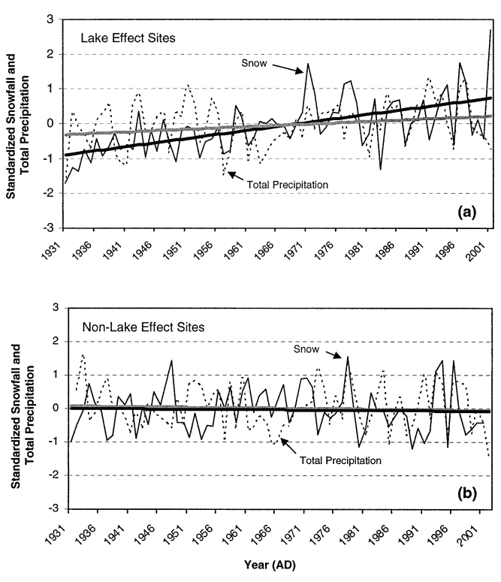
Results: Total Precipitation
Increased snow-liquid contribution ratio in lake-effect sites.
Notes:
Due to steeper snow slope, not only are snowfall and total precip increasing, but the snow-liquid contribution ratio is increasing

Slide 17
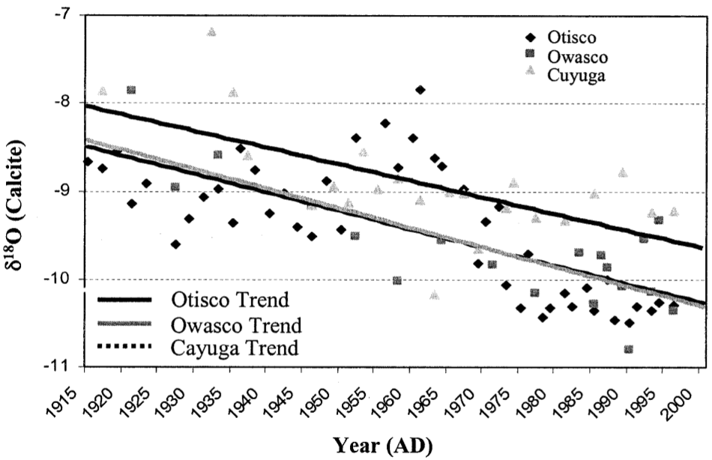
Results: Oxygen Isotope Ratio (from sediments)
Notes:
P values .0000; .0001 and . 0014.
CCN availability or type could be the cause for the increase in snowfall in lake effect areas. However, uncertainty if CCN enhance or suppress snowfall, or how they act differently in lake-effect areas ---> meteorological or lake thermal condition difference between lake and non lake effect areas.

Slide 18
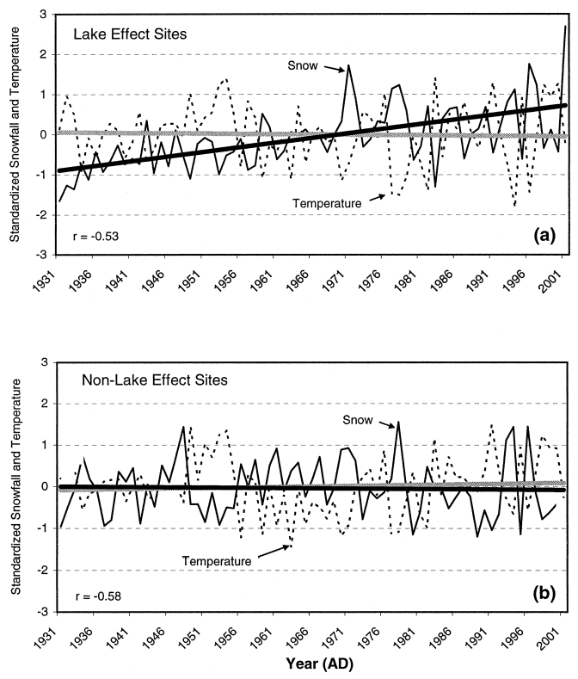
Results: Air Temperature
Norton and Bolsenga (1993) hypothesized that colder air temperatures could cause increased snowfall.
Warmer lake surface temperatures
Notes:
But mean winter temperatures cannot be used as it affects all areas, not just lake effect areas.

Slide 19
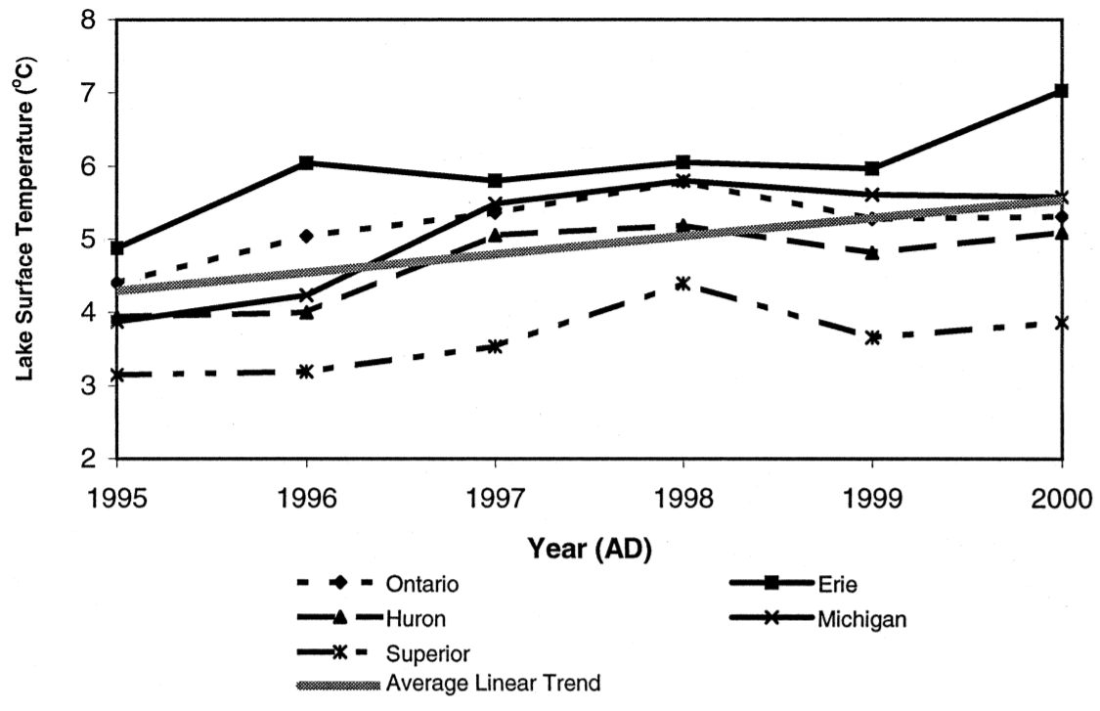
Results: Surface Temperature
NOAA CoastWatch Program has lake (non-ice) surface temperature data since 1995.
Ice season has started later and ended earlier since the 1850s.
Winter air temperatures do not have an upward trend (all other seasons do).
Notes:
Upward trend in other seasons helps heat the water; water heat is lagged and provides for lake effect.

Slide 20
Future Research
How does lake-effect snow vary through all winter months?
The month of greatest snowfall in Syracuse has shifted from February to January.
Focus on whole-lake heat content and ice cover.
How CCN from Great Lakes differ from those from surrounding areas.
Do cloud microphysics play a role?
Notes:
Recent years (during western drought) Great Lakes were colder than normal. Did it affect lake effect.

Slide 21
Sources
Burnett, A. W., Kirby, M. E., Mullins, H. T., & Patterson, W. P. (2003). Increasing Great Lake–effect snowfall during the twentieth century: A regional
response to global warming?. Journal of Climate, 16(21), 3535-3542.
"Lake-effect Snow in the Great Lakes Region." Lake-effect Snow in the Great Lakes Region | GLISA. University of Michigan School of
Natural Resources & Environment, n.d. Web.
Norton, D. C., and S. J. Bolsenga, 1993: Spatiotemporal trends in lake effect and continental snowfall in the Laurentian Great Lakes, 1951–1980. J.
Climate, 6, 1943–1956.

