Slide 1
Warming boots air pollution
Yang Han
05/15/2017

Slide 2
Content
Background
The problem
Motivation
Methods
Results and conclusions
Future work

Slide 3
Background information
Haze events
Time during which atmospheric concentration of fine particles (PM2.5) are high enough to reduce visibility to less than 10 km.
Severe haze events
When concentration exceed 150 µgm⁻³, conditions can be considered severe, surpassing the level of the World Health Organization defines as dangerous to human health.
Severe haze events are epitomized by January 2013 conditions

Slide 4
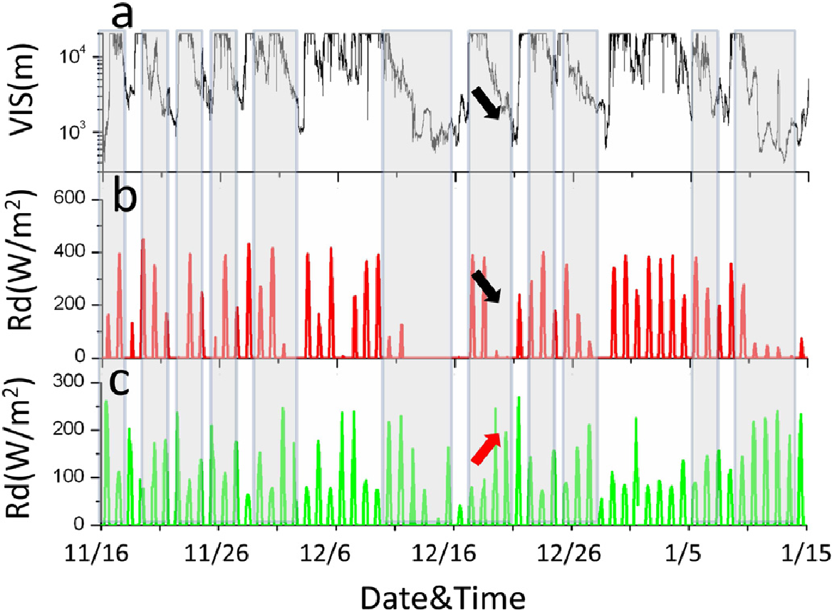
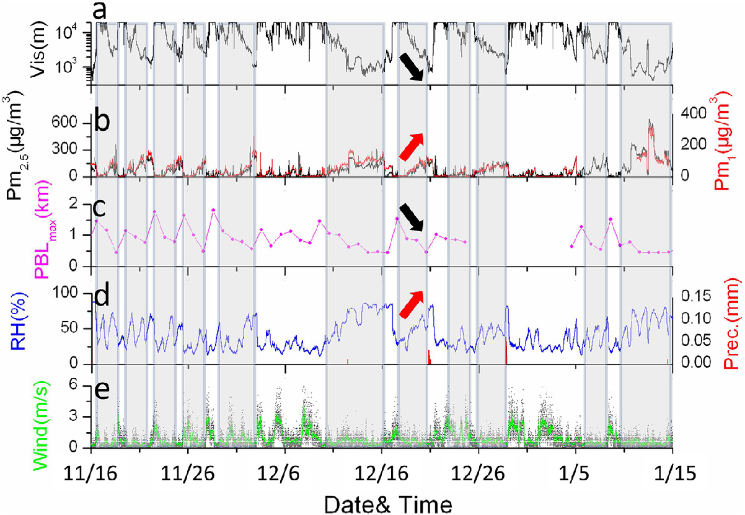
General characteristics of the haze events
Haze days: Vis < 10km in China
wind speed < 1 m/s (average < 5 m/s)
RH is increasing
PBL is low
(Quan et al. 2014)
Background

Slide 5
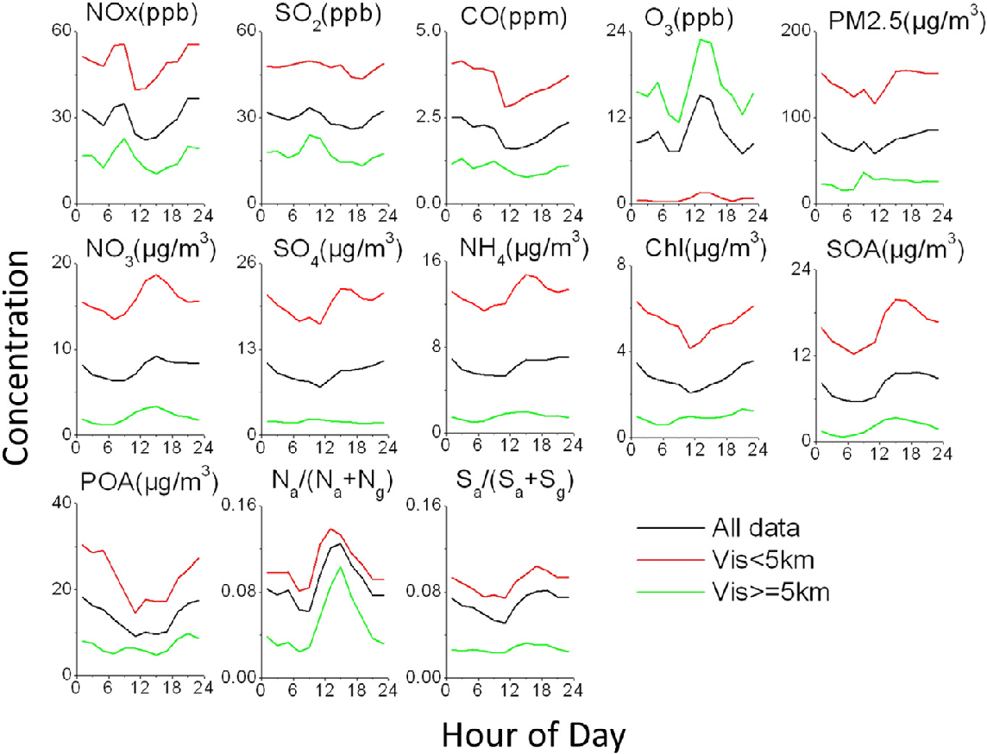
Variations of particles and precursors
Aerosol precursor
Aerosol compounds
(Quan et al. 2014)
Background

Slide 6
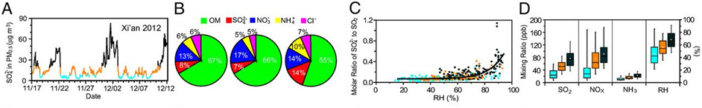
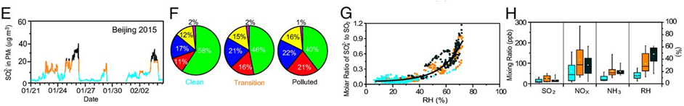
Xi’an city
Beijing city
SO₄²⁻ mass concentration variation with time
five main non refractory PM_{2.5} species
molar ratio of SO₄²⁻ to SO₂
Vs. RH
(Wang et al. 2016)
SO₂ converts to sulfate with high RH and concurrently with elevated SO₂, NO_{x}, and NH₃. And this conversion is responsible for the enhanced sulfate formation.
NO_{x} and NH₃ acts as an oxidant during this conversion.
Effective haze mitigation is achievable by intervening in sulfate formation process with enforced NH₃ and NO₂ control.
Background

Slide 7
The problem
Due to the severity of air pollution, the Chinese government introduced the Air Pollution Prevention and Control Action Plan in 2013.
The plan implemented extreme measures to curb emissions, including controlling current pollutant sources, optimizing industrial structures, accelerating technology transformation, and increasing clean energy supply.

Slide 8
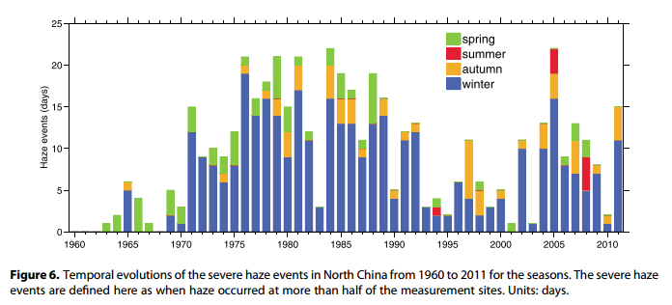
The problem
The statistical results indicate that the majority of severe haze events (74%) occurred during winter time.
In the spring, 61 events occurred and 56 occurred in the autumn.
The fewest events are in boreal summer, only 9 days.
(Chen et al. 2015)

Slide 9
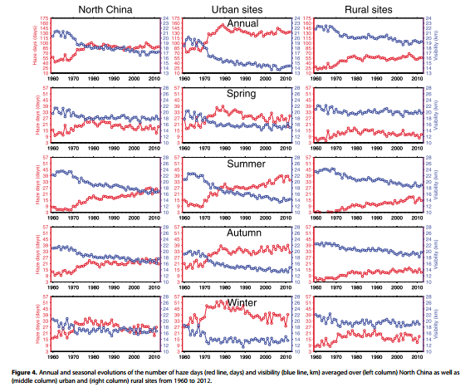
In annual and seasonal scales, haze episode not only occur in winter
(Chen et al. 2015)
The problem

Slide 10
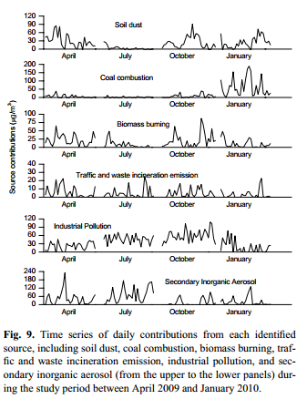
Coal combustion reveals a pronounced wintertime maximum
Biomass burning contributions relatively higher concentrations in spring and autumn and lower concentrations in summer and winter
traffic and waste-burning emissions, the resulting time series do not reveal evident seasonality
Industrial pollution has higher contributions in summer and autumn
SIA has higher contributions in summer and spring
(Zhang et al. 2013)

Slide 11
The problem
The magnitude of particle concentrations is not the sole factor that determines haze days
The increasing haze days in China is inevitably accompanied by the meteorological conditions that are unfavorable to pollutant dispersion.

Slide 12
The problem
The intensity, duration, and spatial coverage of severe haze events have increased. In Beijing, for example, severe haze was present for 12, 18, and 25 days of the 2014–2015, 2015–2016 and 2016–2017 winter seasons, respectively.
Although the mean winter-time concentration of atmospheric pollutants over all of China has decreased by 20% in 2015 compared to 2014 levels, it is believed that 40% of this reduction may be attributed to meteorological conditions.
An increase in anthropogenic pollutants can undoubtedly be connected to enhanced haze events observed across China, particularly in large cities such as Beijing. However, severe haze events are also driven by specific meteorological conditions that encourage stagnant air.
Notes:
The plan implemented extreme measures to curb emissions, including controlling current pollutant sources, optimizing industrial structures, accelerating technology transformation, and increasing clean energy supply.

Slide 13
Motivation
The East Asian winter monsoon, characterized by strong winds from the northwest and outbreaks of cold air over northern China, has dramatically changed (decreased) during the last several decade.
The reduced thermal contrast between middle and high latitudes, which probably caused by global warming, may lead to weak winter monsoon.
By reducing the amount of solar radiation and diminishing the ocean-land contrast, aerosols were found to spin‐down the Asian monsoon circulation and water cycle.
Land and sea pressure differences, regionally averaged meridional winds in the lower troposphere, zonal winds in the higher troposphere, and the strength of the East Asian trough, are various East Asian winter monsoon indices
The East Asian winter monsoon

Slide 14
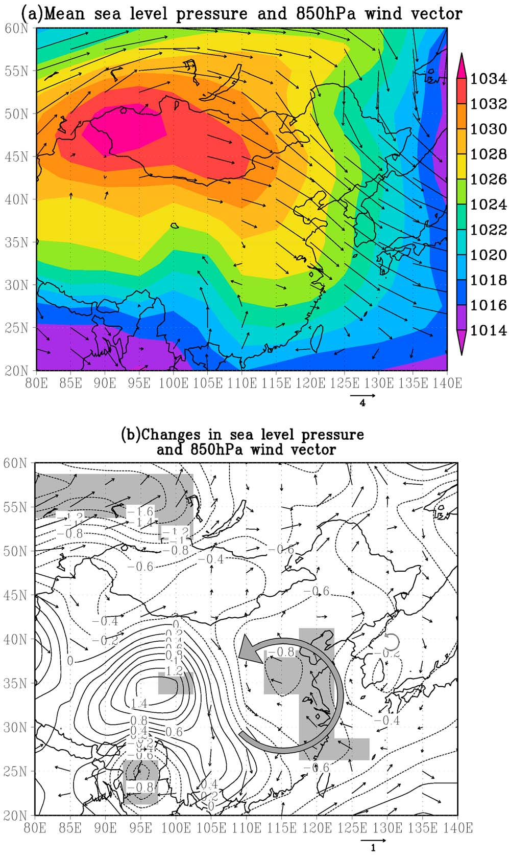
The East Asian winter monsoon
Wintertime sea level pressures (hPa) and 850hPa wind vectors (m/s) from the NCEP reanalysis: (a) mean values from 1976 to 2000, and (b) the difference (1989–2000 minus 1976–1988). Wind vectors over topography higher than 850hPa are masked out. Shaded areas are at the 5% significance level.
(Niu et al. 2010)

Slide 15
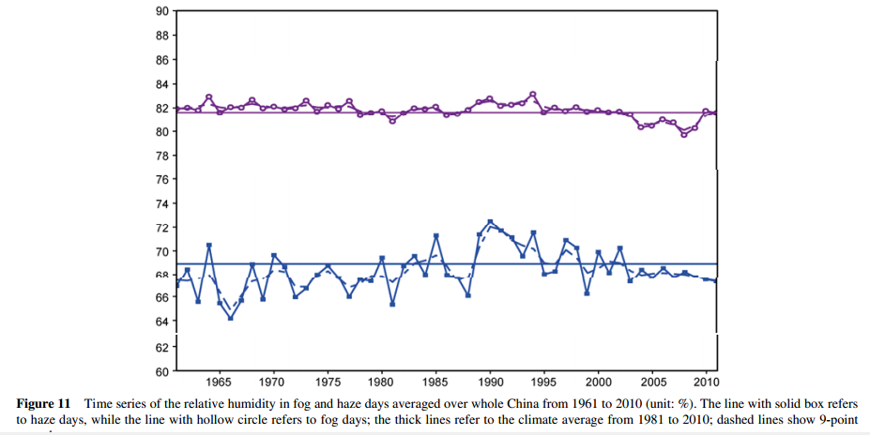
Decreased relative humidity
The surface temperature in China has increased since the 1960s and the specific humidity has been decreasing since then.
Climate warming in China will make the transition from haze into fog harder.
As a result, haze day would last longer or would be more likely to occur.
(Ding, et al. 2014)

Slide 16
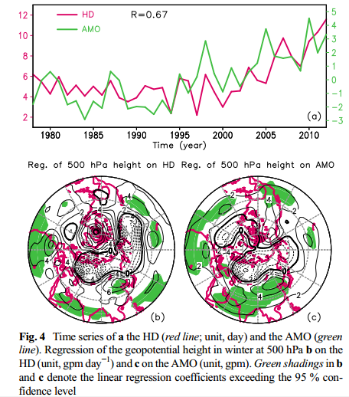
Atlantic Oscillation vs. haze events
The AMO shows similar decadal variations to those in the HD, particularly for the intensive increase after 1995
Negative geopotential height anomalies occur north of 60° N,whereas positive anomalies occur south of 60° N in the Northern Hemisphere
Such a meridional structure of the geopotential height anomalies generally indicates the positive phase of the AO
Overall, positive anomalies of the AO are not conducive for dispersing air pollutants; therefore, more frequent haze events occur in China
Xiao et al. (2014)

Slide 17
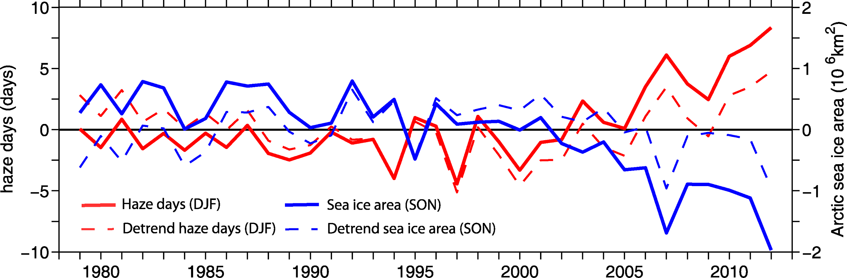
Reduced Arctic Sea ice
From 1979 onwards, particularly from the late 1990s, the WHD index has increased remarkably.
Meanwhile, the autumn (average of September, October, and November) ASI has decreased substantially.
After removing the linear trend, the correlation is still strong (r = –0.67, above 99% confidence level), suggesting year-to-year variability of the WHD is closely associated with autumn ASI variability

Slide 18
Weather conditions conducive to Beijing severe
haze more frequent under climate change
Wenju Cai1,2, Ke Li3,4, Hong Liao5*, Huijun Wang6 and Lixin Wu1
Nature Climate Change. 2017 Apr 1

Slide 19
Method
Data
Daily fields, such as surface winds, mean sea level pressure, and mid-tropospheric winds from the NCEP/NCAR) global reanalysis.
A seven-year observed time series of PM_{2.5} in Beijing (117◦ E, 40◦ N), commencing in 2009, was used in this study, available from the US Embassy (http://www.stateair.net/web/historical/1/1.html )
Linkage between severe haze events and weather conditions
The weather linkage was conducted by correlating the seven years of winter daily PM_{2.5} with similarly arranged time series of anomalies.

Slide 20
Haze weather index (HWI)
We normalized the delta T, V850 and U500 time series by their respective standard deviation, and combined them into one index by summing the three normalized time series. The new index is then normalized by its standard deviation, and is referred to as a HWI.
CMIP5 experiments
To examine how the conducive weather conditions will respond to greenhouse warming, we assessed 15 CMIP5 models, in which daily outputs are available covering historical and future climate.

Slide 21
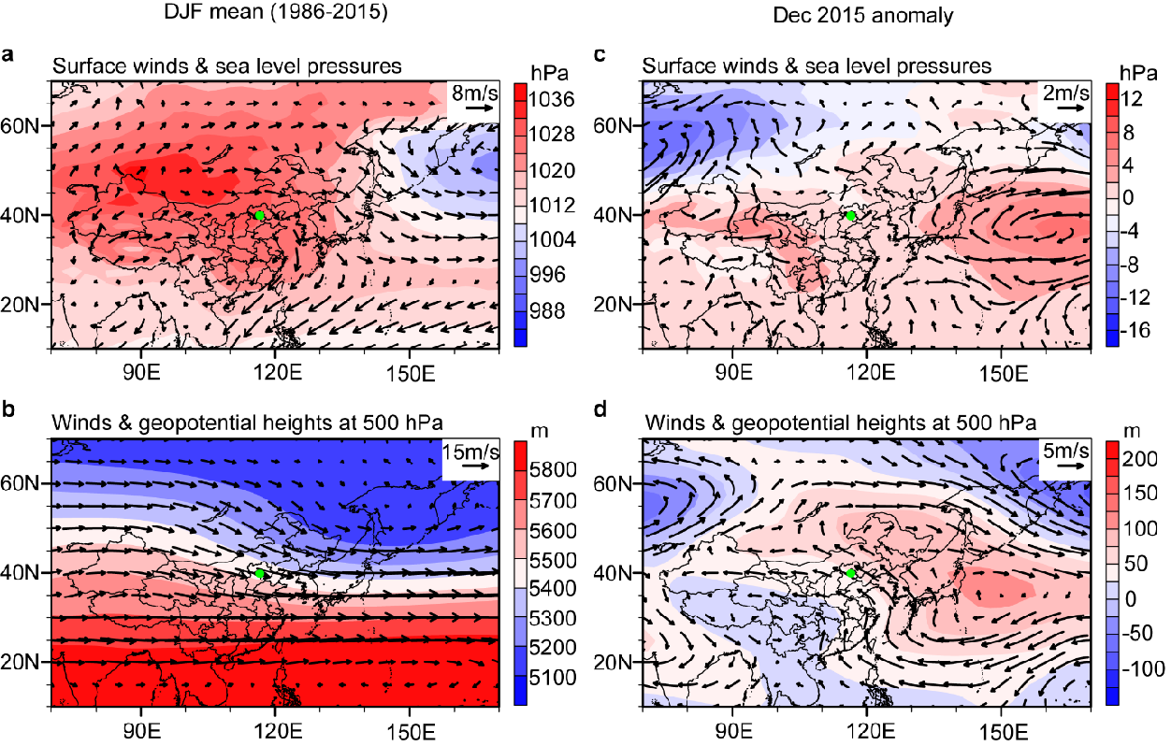
Results and conclusions
Weakened northerly winds
Declined east asian winter monsoon
Decreased relative humidity
Reduced Arctic Sea ice
(Cai et al. 2017)

Slide 22
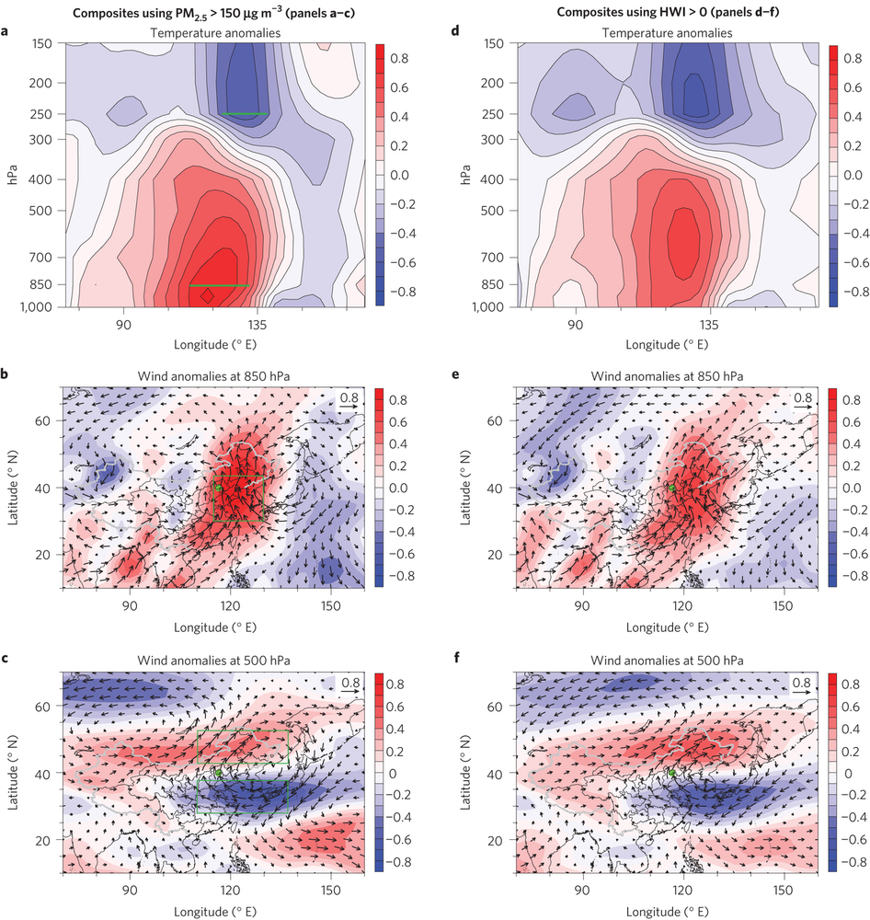
Linkage between PM_{2.5} and weather conditions
Warm anomalies near-surface preventing vertical dispersion of pollutants, accompanied by an anomalous cooling in the upper atmosphere.
This leads to reduced seasonal prevailing surface cold northerlies or increased near-surface southerlies from the south of Beijing, which is conducive to warming and increased moisture, the southerlies are favourable for haze formation and maintenance.
In mid troposphere, the East Asia trough shallows during haze days, and the associated northwesterlies extend to north of Beijing, weakening the cold and dry northwesterly and reducing the wind speed.
(Cai et al. 2017)

Slide 23
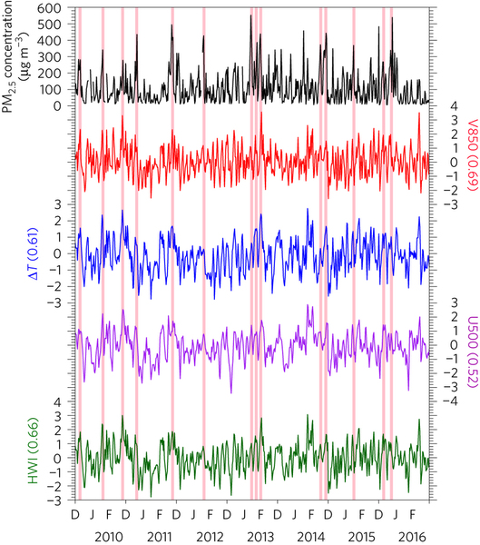
Haze weather index (HWI)
Haze weather index (HWI) that describes whether meteorological conditions (vertical air temperature difference between the lower and upper atmosphere, lower tropospheric wind velocity, and mid-tropospheric zonal flow) are favorable for extreme haze.
The HWI averaged over the severe haze events of January 2013 is 1.02.
(Cai et al. 2017)

Slide 24
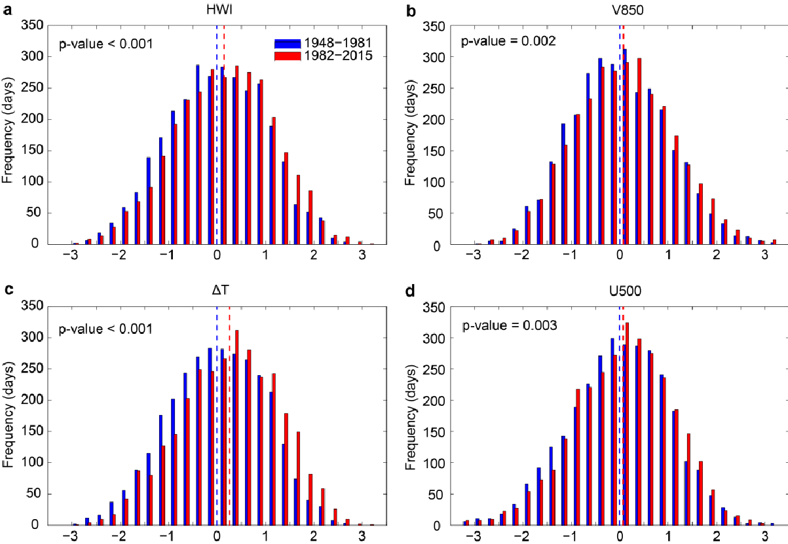
How climate change affects haze events
The frequency of the conducive weather conditions, as measured by the winter HWI, has increased since 1948. From the first half (1948-1981) to the second (1982-2015) half of the 1948/1949- 2015/2016 period, there is an increase of 10% in the mean frequency of HWI>0 occurrences, from 45.5 days to 50.2 days per season.
(Cai et al. 2017)

Slide 25
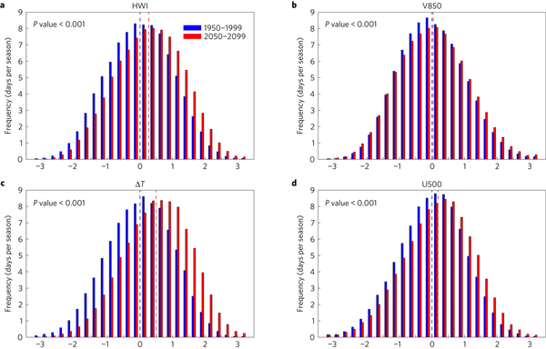
The frequency of all positive HWI events will increase in the future, and that this will be most notable for more extreme conditions; for example, events with a HWI higher than 1 (analogous to January 2013 conditions) will increase by 50% when comparing 1950–1999 with 2050–2099.
Haze events, particularly extremes, are therefore found to occur more frequently in the future.
(Cai et al. 2017)

Slide 26
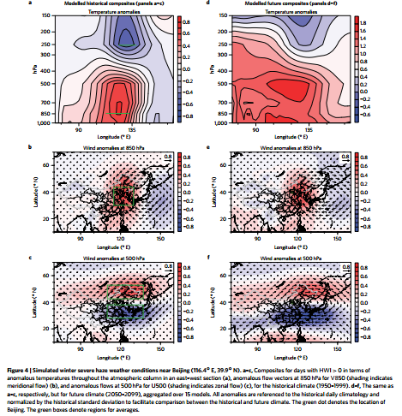
(Cai et al. 2017)

Slide 27
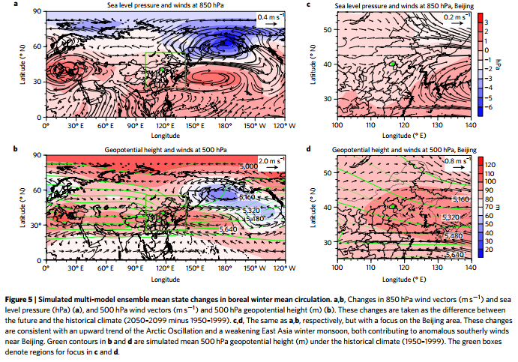
(Cai et al. 2017)

Slide 28
Conclusions
The conditions conducive to severe haze events in Beijing have increased in response to anthropogenic climate change, and will likely continue to do so throughout the twenty-first century.
Climate change over the past several decades is thought to create weather conditions more favourable for triggering haze events in Beijing.
Haze events, particularly extremes, are therefore found to occur more frequently in the future.

Slide 29
Future work
Strategies to improve air quality typically focus on the reduction of emitted pollutants such as particulate matter (PM) and the precursors of tropospheric ozone (O₃). However, changing climate dynamics are also likely to play a role in determining future air quality, but the magnitude and direction of this role is uncertain.

Slide 30
References
Zhang, R. (2017). "Atmospheric science: Warming boosts air pollution." Nature Clim. Change 7(4): 238-239.
Cai, W., et al. (2017). "Weather conditions conducive to Beijing severe haze more frequent under climate change." Nature Clim. Change 7(4): 257-262.
Sun, Jian, et al. "The haze nightmare following the economic boom in china: dilemma and tradeoffs." International journal of environmental research and public health 13.4 (2016): 402.
Quan, Jiannong, et al. "Characteristics of heavy aerosol pollution during the 2012–2013 winter in Beijing, China." Atmospheric Environment 88 (2014): 83-89.
Xiao, Dong, et al. "Plausible influence of Atlantic Ocean SST anomalies on winter haze in China." Theoretical and Applied Climatology 122.1-2 (2015): 249-257.
Zhang, Renjian, et al. "Chemical characterization and source apportionment of PM 2.5 in Beijing: seasonal perspective." Atmospheric Chemistry and Physics 13.14 (2013): 7053-7074.

Slide 31
Hui-Jun, W. A. N. G., C. H. E. N. Huo-Po, and L. I. U. Jiping. "Arctic sea ice decline intensified haze pollution in eastern China." Atmospheric and Oceanic Science Letters 8.1 (2015): 1-9.
Xiao, Dong, et al. "Plausible influence of Atlantic Ocean SST anomalies on winter haze in China." Theoretical and Applied Climatology 122.1-2 (2015): 249-257.
Ding, YiHui, and YanJu Liu. "Analysis of long-term variations of fog and haze in China in recent 50 years and their relations with atmospheric humidity." Science China Earth Sciences 57.1 (2014): 36-46.
Chen, Huopo, and Huijun Wang. "Haze days in North China and the associated atmospheric circulations based on daily visibility data from 1960 to 2012." Journal of Geophysical Research: Atmospheres 120.12 (2015): 5895-5909.
Niu, Feng, et al. "Increase of wintertime fog in China: Potential impacts of weakening of the Eastern Asian monsoon circulation and increasing aerosol loading." Journal of Geophysical Research: Atmospheres 115.D7 (2010).

Slide 32
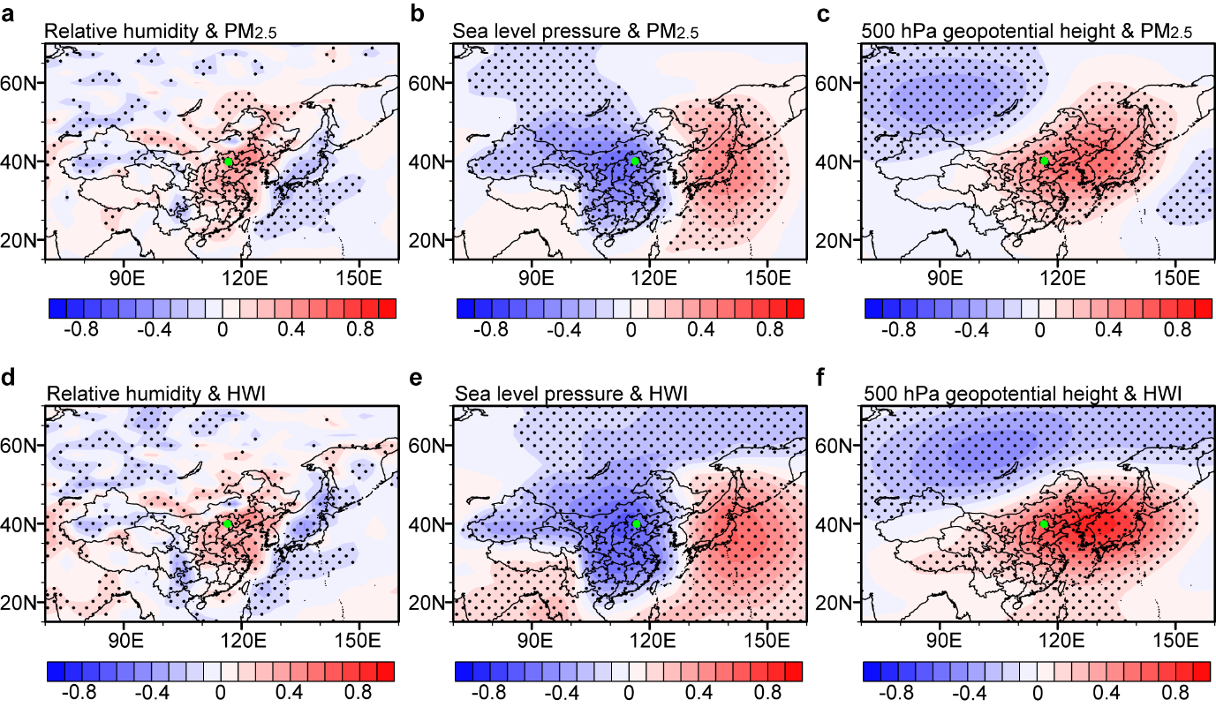

Slide 33
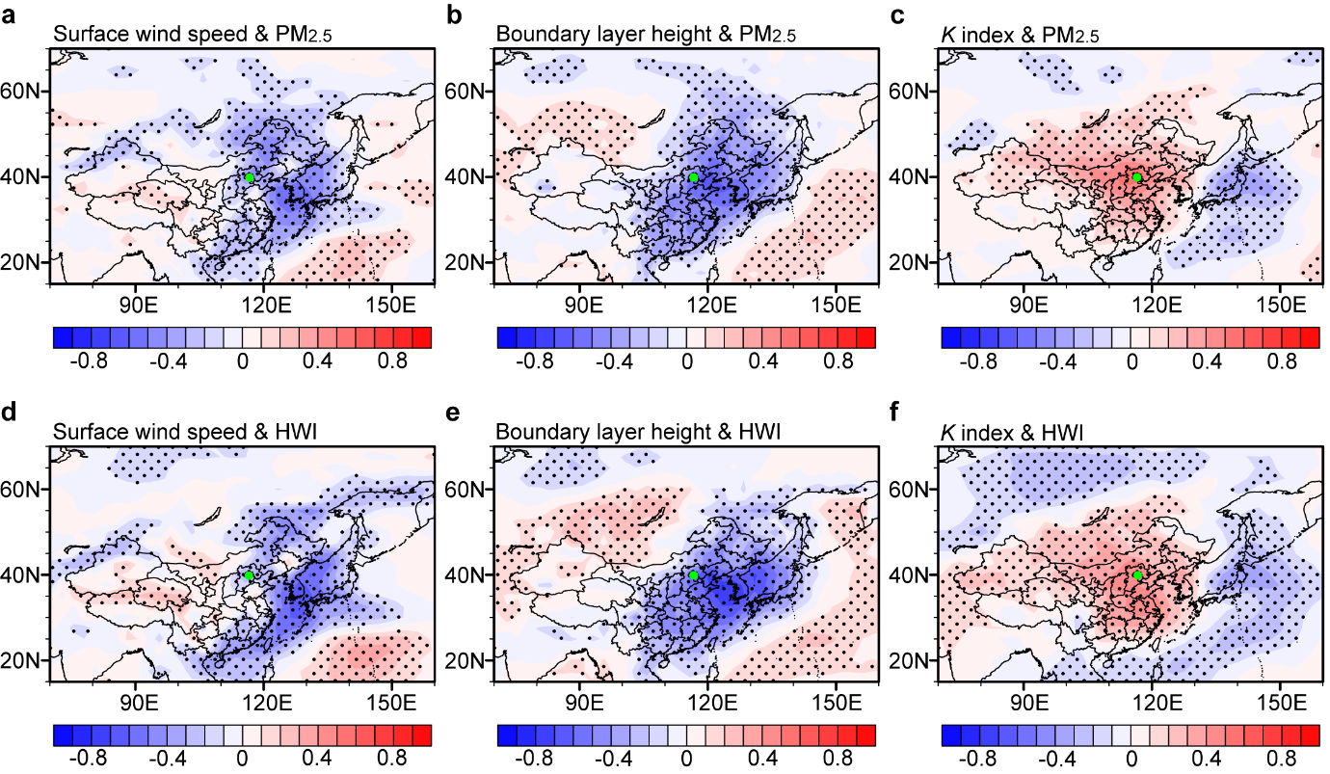

Slide 34
