Slide 1
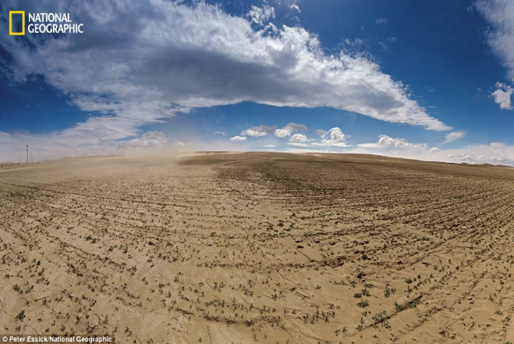
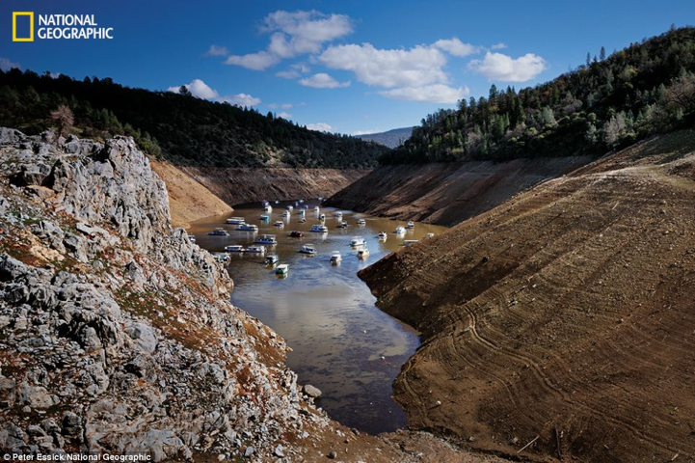
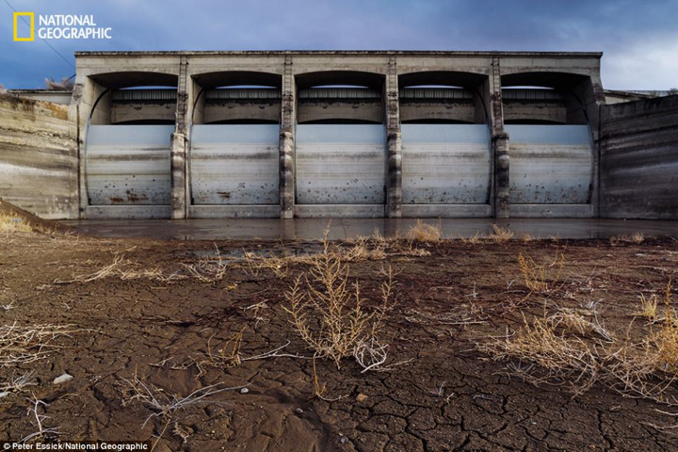
Precipitation Deficit Flash Droughts over the Untied States By Kingtse C. Mo and Dennis P. Lettenmaier
California’s Central Valley
Orville Lake, California
Humboldt River, Nevada
A brief synthesis presented by Josh Walston
ATMS Seminar Spring 2017

Slide 2
Outline
Flash drought…? What the “heck” is flash drought?
Why do we care?
What drives them?
How can this happen?
I must know…Are they predictable?
Is it time to summarize yet?
ATMS Seminar Spring 2017
2 of 22
Notes:
Define 2 types: heat wave and precip deficit.
Discuss motivation.
Determine physical mechanisms.
Explore the evolution.
Discuss trends and predictability.
Summarize, discuss and FINALLY conclude.

Slide 3
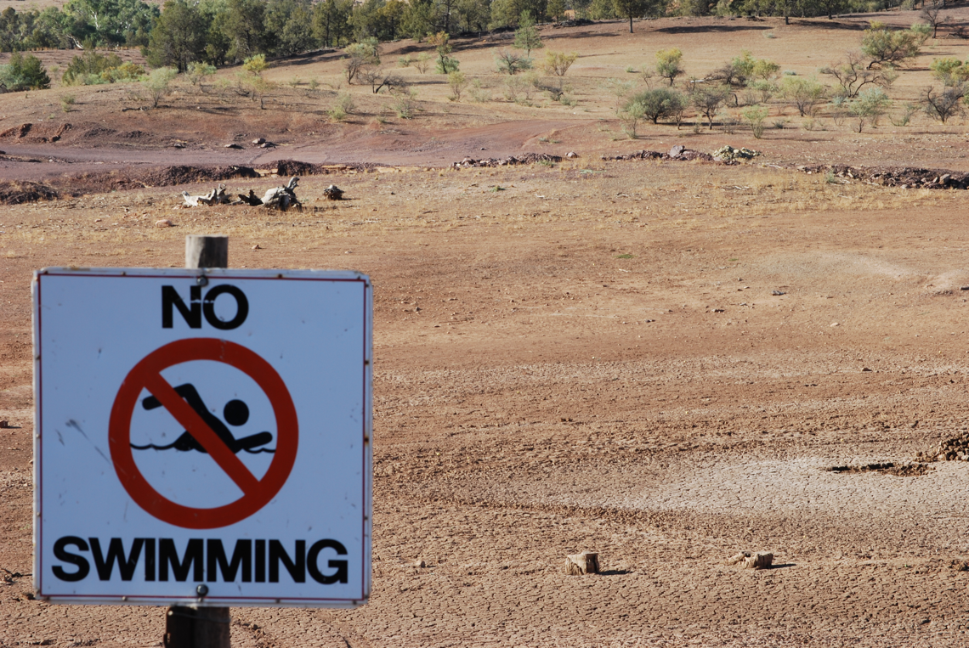
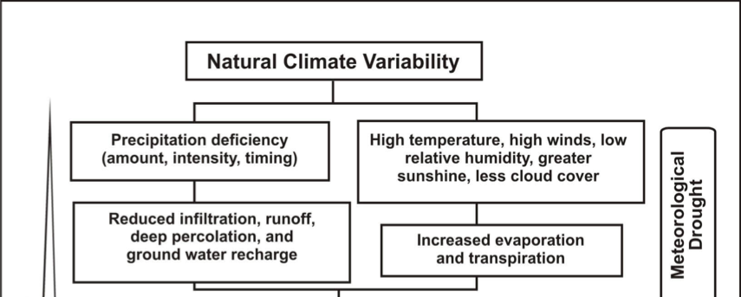
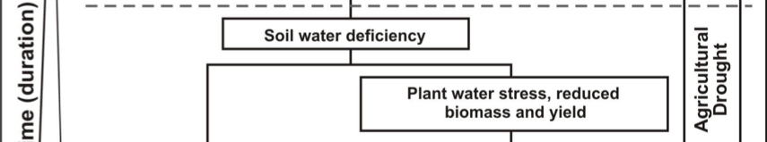
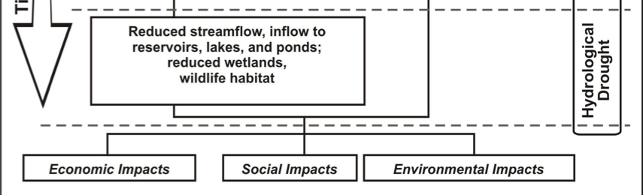
First, What is Drought?
AKA the creeping disaster
“Drought is a persistent and abnormal moisture deficiency having adverse impacts on vegetation, animals, or people.”- National Drought Policy Commission Report, 2000
There are different drought “types”
Sequence of drought occurrence and impacts. Image credit: National Drought Mitigation Center.
ATMS Seminar Spring 2017
3 of 22

Slide 4
Time Scales of Droughts
30
Days
Season
3
Years
10
Years
30
Years
100
Years
or less
- Heat Wave
- Storm Track Variations
- MJO
- ENSO
- Decadal Variability
- Solar Variability
- Meridional Overturning Circulation
- Green House Gasses
Concept credit: UCAR, COMET
ATMS Seminar Spring 2017
4 of 22
Notes:
Droughts occur over a range of timescales…

Slide 5
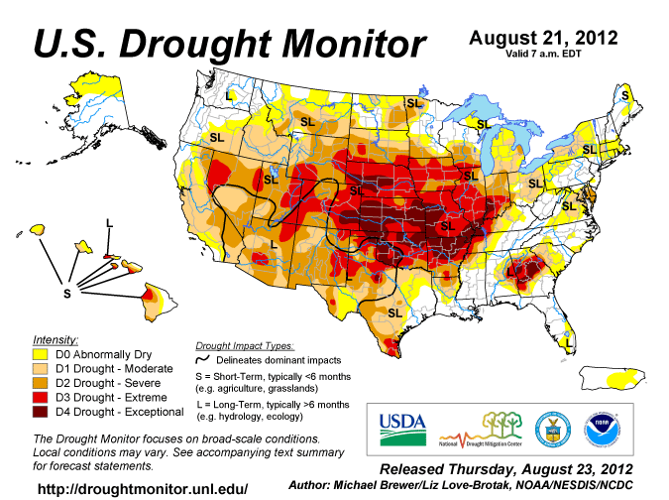
Flash Drought
Not to be confused with Flash Mob!
“…refers to rapid crop deteriation due to the the adverse effects of a severe heat wave and short-term dryness, leading to rapid onset of drought and associated impacts in agriculture, fire potential, live-stock health, and other areas”
- Svoboda et al., 2002; National Drought Mitigation Center
Wasn’t popularized until 2012
1) Anomalous high pressure
2) Declining soil moisture (SM)
Transitioned into a more conventional drought
ATMS Seminar Spring 2017
5 of 22
Notes:
1) Currently no universal definition.
2) Wasn’t popularized until the rapidly evolving droughts in the Central U.S. in 2012
associated with anomalously high pressure → producing heat waves and anomalously low soil moisture.
3) After it was established, the 2012 event continued and transitioned into a more conventional, more slowly evolving drought through the end of summer

Slide 6
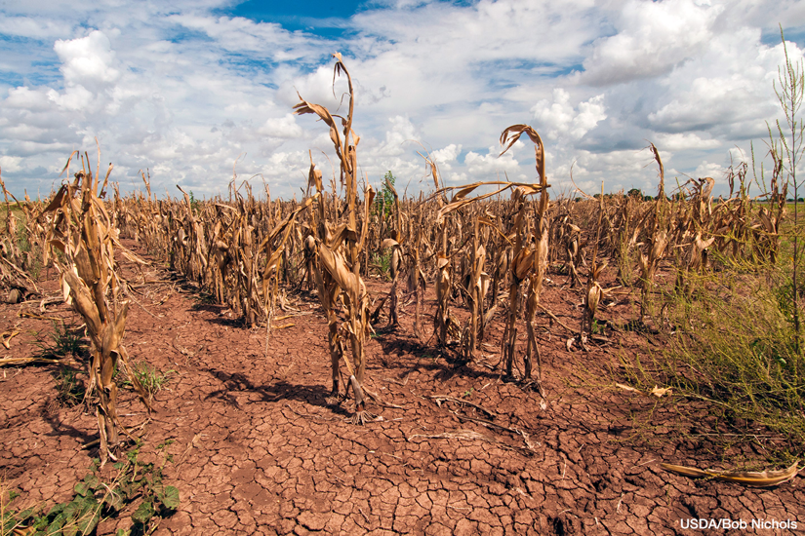
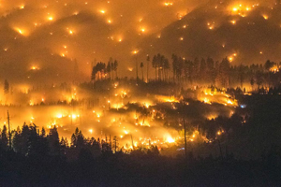
Motivation
Withering corn field Texas drought, August 2013. Image credit: Bob Nichols, USDA
El Portal Fire, Yosemite National Park, July 2014. Image credit: Stuart Palley, EPA
Rapid onset: No early warning for agricultural community
Increased fire potential
Economic losses: Reported in the billions.
ATMS Seminar Spring 2017
6 of 22
Notes:
No early warning to agricultural community →No opportunity to mitigate losses.
Infrastructure damages and billion dollar damages.

Slide 7
Physical Mechanisms
Several years after the first definition Mo and Lettenmaier defined 2 types of Flash Droughts:
Heat Wave Flash Drought
Temperature driven
Precipitation → indirect role
Atmospheric circulation support
Precipitation Deficit Flash Drought
** Similar **
Both characterized by anomalous temperatures and SM deficits
** But Different **
Maintained by different physical mechanisms and have different characteristics.
ATMS Seminar Spring 2017
7 of 22
Notes:
Several years later mo and lettenmaier physicall

Slide 8
Physical Mechanisms
Several years after the first definition Mo and Lettenmaier defined 2 types of Flash Droughts:
Heat Wave Flash Drought
Temperature driven
Precipitation → indirect role
Atmospheric circulation support
Precipitation Deficit Flash Drought
Precipitation driven
Land-atmosphere interaction
Precipitation
Deficit
Precipitation
Deficit
Soil Moisture
Decreases
Evapotranspiration
Decreases
Temperature
Increases
Sensible Heat Increase
Temperature
Increases
Soil Moisture
Decreases
Evapotranspiration
Increases
Vegetation Moisture Extraction
ATMS Seminar Spring 2017
8 of 22
Notes:
Several years later mo and lettenmaier physicall

Slide 9
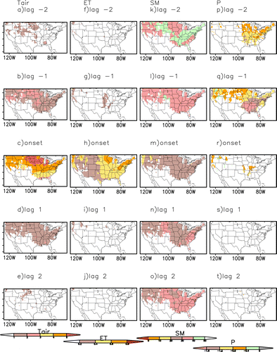
Evolution of a Flash Drought
Heat Wave Flash Drought:
Temperature driven.
ATMS Seminar Spring 2017
9 of 22

Slide 10
Evolution of a Flash Drought
Heat Wave Flash Drought:
Temperature driven.
High temps → increasing ET → decreasing SM
Requires p-deficit.
ATMS Seminar Spring 2017
10 of 22
Notes:
Precipitation deficit → 2 pentads prior to onset.
SM decreases 40% → 1 pentad prior to onset.
T anomalies between 1-2°C → 1 pentad prior to onset.
Rapid increase in T → 3°C or more during event.
Increase T → increases ET
Continued decreased SM (>30%) 2pentands after onset.
Precip deficits only appear prior to onset → indirect role, does not increase T or ET

Slide 11
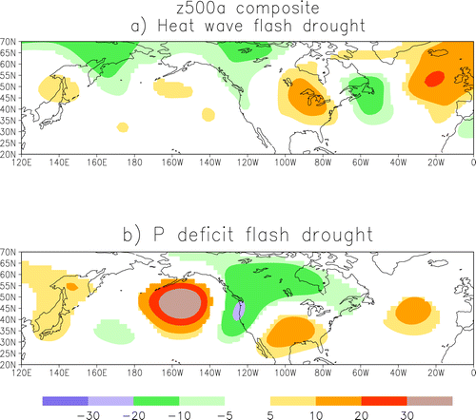
Evolution of a Flash Drought
Heat Wave Flash Drought:
Synoptic setting → strengthening aniticyclone over Great Lake/Midwest.
ATMS Seminar Spring 2017
11 of 22

Slide 12
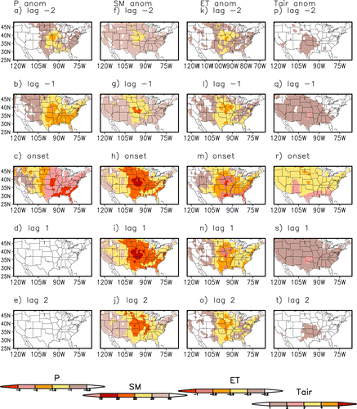
Evolution of a Flash Drought
Precipitation Deficit Flash Drought:
Precipitation driven.
ATMS Seminar Spring 2017
12 of 22

Slide 13
Evolution of a Flash Drought
Precipitation Deficit Flash Drought:
Precipitation driven.
P deficits=> decreasing SM=> decreasing ET => T increases.
ATMS Seminar Spring 2017
13 of 22
Notes:
Precipitation deficits 2 pentads prior to onset and continue to gain strength.
SM decrease in response to precip deficit .
ET decreases in response to decreased SM.
T anomalies between 1-2°C → 1 pentad prior to onset.
T anomalies reach 2-3°C during event

Slide 14
Evolution of a Flash Drought
Precipitation Deficit Flash Drought:
Synoptic setting → Strengthening anticyclone over southern Great Plains.
ATMS Seminar Spring 2017
14 of 22

Slide 15
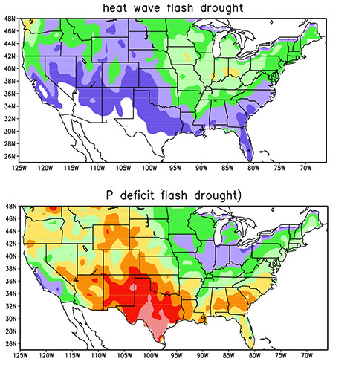
Where are they most likely to occur
Heat Wave Flash Drought
4-5% max
Midwest and Pacific Northwest states.
Vegetation dense regions
ATMS Seminar Spring 2017
15 of 22

Slide 16
Where are they most likely to occur
Precipitation Deficit Flash Drought
8-10% max
Anywhere → Great Plains and Southern states most common.
Regions where land-atmosphere interaction is strong
ATMS Seminar Spring 2017
15 of 22

Slide 17
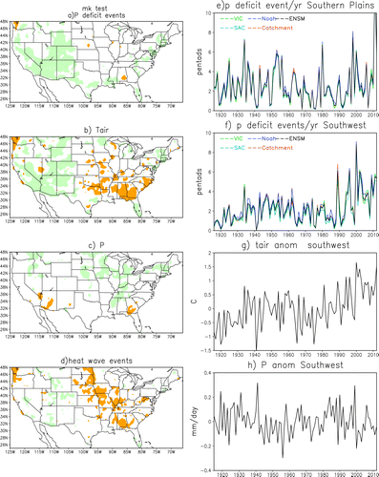
Trends
Probably not trending enough to be on Twitter though.
P-deficit flash droughts Increasing in SW
ATMS Seminar Spring 2017
16 of 22

Slide 18
Trends
Probably not trending enough to be on Twitter though.
Decreasing precipitation
ATMS Seminar Spring 2017
16 of 22

Slide 19
Trends
Probably not trending enough to be on Twitter though.
Warming trend in SW
ATMS Seminar Spring 2017
16 of 22

Slide 20
Trends
Probably not trending enough to be on Twitter though.
Midwest and Central Plains
Heat wave flash droughts decreasing
Precipitation increasing
ATMS Seminar Spring 2017
16 of 22

Slide 21
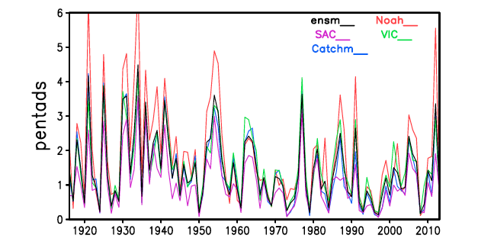
Trends
Probably not trending enough to be on Twitter though.
Heat Wave Flash Droughts on the decline over the Central U.S.
Number of heat wave flash drought per year over (36-40N and 80-100W) from 1916-2013. Mo and Lettenmaier, 2015. “Heat Wave Flash Droughts in Decline”
ATMS Seminar Spring 2017
17 of 22
Notes:
A general decrease
HOWEVER, a spike in 2011-2013…

Slide 22
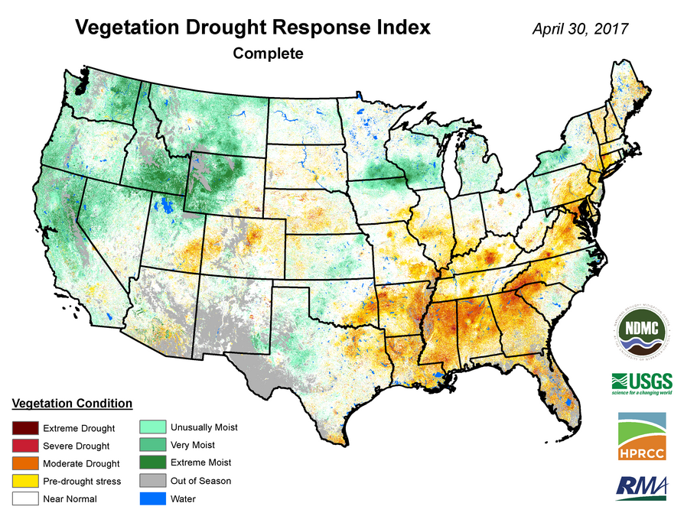
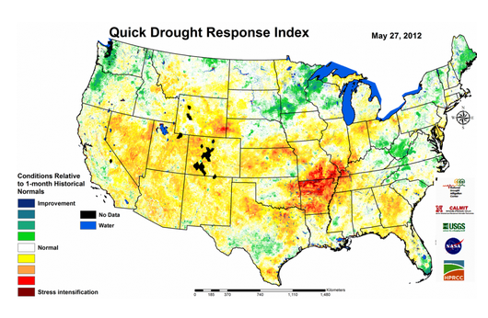
Are they Predictable?
Well, is any complex phenomena?
Credit: National Drought Mitigation Center
Credit: USGS
Vegetation Drought Response Index (VegDRI):
Operational product.
Satellite and climate data to map changes in vegetation.
Seasonal scale
Quick Drought Response Index (QuickDRI):
Complementary to VegDRI
Includes satellite ET estimates
Sub-seasonal scale.
Soon to be operational.
ATMS Seminar Spring 2017
18 of 22
Notes:
Integrates:
Remotely sensed data acquired from Advanced Very High Resolution Radiometer (AVHRR) 1-km NDVI data.
Climate data → Standardized Precipitation Index (SPI) and Palmer Drought Severity Index (PDSI)
And Biophysical components → 1) land use/cover type, 2) soil characteristics, 3) elevation, 4) ecological setting, 5) irrigated ag. Land
QuickDRI:
Complmentary “hybrid” drought index to monitor rapid, short-term changes
Exisiting frame work plus→ Evapotranspiration (ET) estimates from satellite, and Root zone soil moisture (satellite estimated or modeled)

Slide 23
Are they Predictable?
Well, is any complex phenomena?
Credit: National Drought Mitigation Center
Credit: USGS
Vegetation Drought Response Index (VegDRI):
Operational product.
Satellite and climate data to map changes in vegetation.
Seasonal scale
Quick Drought Response Index (QuickDRI):
Complementary to VegDRI
Includes satellite ET estimates
Sub-seasonal scale.
Soon to be operational.
ATMS Seminar Spring 2017
18 of 22
Notes:
Integrates:
Remotely sensed data acquired from Advanced Very High Resolution Radiometer (AVHRR) 1-km NDVI data.
Climate data → Standardized Precipitation Index (SPI) and Palmer Drought Severity Index (PDSI)
And Biophysical components → 1) land use/cover type, 2) soil characteristics, 3) elevation, 4) ecological setting, 5) irrigated ag. Land
QuickDRI:
Complmentary “hybrid” drought index to monitor rapid, short-term changes
Exisiting frame work plus→ Evapotranspiration (ET) estimates from satellite, and Root zone soil moisture (satellite estimated or modeled)

Slide 24
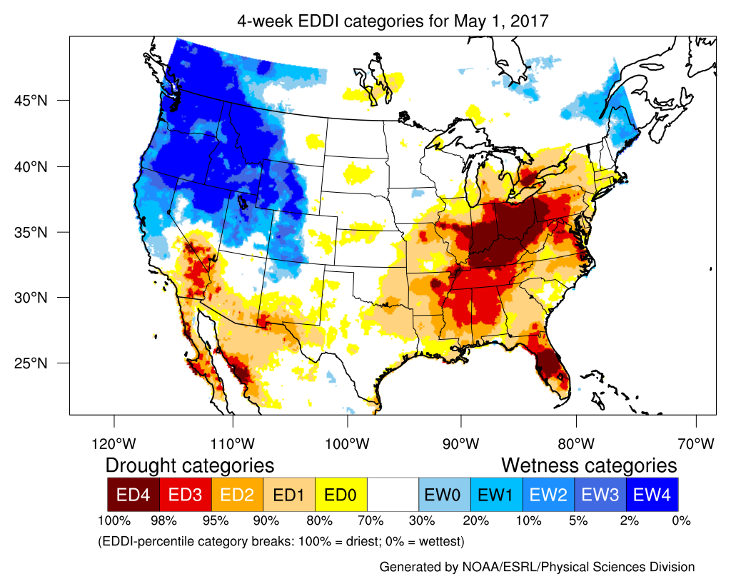
Are they Predictable?
Well, is any complex phenomena?
Evaporative Demand Drought Index (EDDI):
Experimental product.
Does not use precipitation and soil moisture.
Uses air temperature, solar radiation, winds, and humidity.
Not sensitive to land-surface type
Credit: Mike Hobbins CIRES-NOAA and Dan McEvoy DRI.
ATMS Seminar Spring 2017
19 of 22
Notes:
Most drought monitoring tools focus solely on the supply side of moisture imbalance, using climate variables such as precipitation, soil moisture, and air temperature.
it is a valid drought indicator for all regions.
Rather than assessing the landscape itself, or recent rainfall, EDDI looks solely at evaporative demand--the impact of atmospheric temperature, humidity, wind, and solar radiation over a particular time period--and how it compares to climatology. A positive EDDI indicates drier-than-average conditions. In evaluations thus far, EDDI appears to work well in providing advance notice of drought development, often ahead of other commonly used indexes.

Slide 25
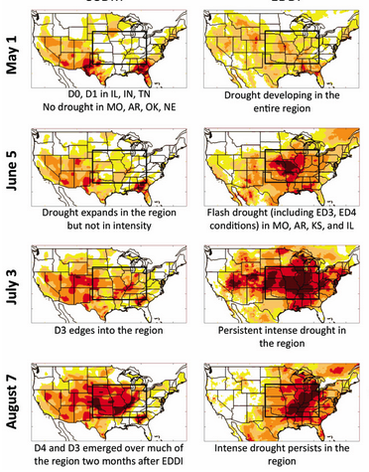
Are they Predictable?
Well, is any complex phenomena?
Example of the EDDI drought monitoring tool:
Flash drought development in the Midwest in 2012.
5-week intervals (left) compared to 2-week (right)
EDDI captures the severe drought condition two months ahead of the USDM.
USDM
EDDI
Development of a flash drought in the Midwest in 2012
Image credit: Mike Hobbins, CIRES–NOAA
ATMS Seminar Spring 2017
20 of 22

Slide 26
Let’s Summarize
A flash drought is:
“A short-term, yet severe event, characterized by moisture deficits and abnormally high temperatures that negatively impact vegetation.” (Salnay et al., 2008)
Take Home Message #1
Heat Wave Flash Drought
Results from the confluence of anomalously warm T_{air} and low SM.
Occur in Midwest and Pacific Northwest during growing season (vegetation dense).
Precipitation Deficit Flash Drought
Results from a lack of precipitation, decreased Et and increased T_{air}.
Occur more than heat wave flash droughts (2x).
Most common in the Southern Great Plains and Southwest U.S.
ATMS Seminar Spring 2017
21 of 22

Slide 27
Let’s Summarize
A flash drought is:
“A short-term, yet severe event, characterized by moisture deficits and abnormally high temperatures that negatively impact vegetation.” (Salnay et al., 2008)
Take Home Message #2
Heat wave flash droughts have been decreasing over the last century but rebounded after 2011. While precipitation flash droughts increasing in the Southwest.
ATMS Seminar Spring 2017
21 of 22

Slide 28
Let’s Summarize
A flash drought is:
“A short-term, yet severe event, characterized by moisture deficits and abnormally high temperatures that negatively impact vegetation.” (Salnay et al., 2008)
Take Home Message #3
Operational and experimental tools are being deployed to monitor flash droughts, with EDDI appearing to provide the most advanced notice of drought development, often ahead of other commonly used indexes.
ATMS Seminar Spring 2017
21 of 22

Slide 29
References
Brown, J. F., 2016: QuickDRI: A New Tool in the Remote Sensing Toolbox for Drought Monitoring. DOI Remote Sensing Activities 2016.
Hobbins, M. T., A. Wood, D. J. McEvoy, J. L. Huntington, C. Morton, and J. Verdin, 2016: The Evaporative Demand Drought Index. Part I: Linking drought evolution to variations in evaporative demand. J. Hydrometeor., 17, 1745–1761, doi:10.1175/JHD-15-0121.1.
McEvoy, D. J., J. L. Huntington, M. T. Hobbins, A. Wood, C. Morton, J. Verdin, M. Anderson, and C. Hain, 2016a: The Evaporative Demand Drought Index. Part II: CONUS-wide assessment against common drought indicators. J. Hydrometeor., 17, 1763–1779, doi:10.1175/JHM-D-15-0122.1.
Mo, K.C., and D. P. Lettenmaier, 2016: Deficit Flash Drought over the the United States. J. Hydrometeor., 17, 1169—1184. DOI: 10.1175/JHM-D-15-0158.1
Mo, K. C., and D. P. Lettenmaier, 2015: Heat Wave Flash Droughts in Decline. Geophys. Res. Lett., 42, 2823–2829, DOI:10.1002/2015GL064018.
Senay, G. B., M. B. Budde, T. F. Brown, and J. P. Verdin, 2008: Mapping drought in the Southern Great Plains. 22nd Conf. on Hydrology, New Orleans, LA, Amer. Meteor. Soc., 6.8
Svoboda, M., and Coauthors, 2002: The Drought Monitor. Bull. Amer.Meteor. Soc., 83, 1181–1190, doi:10.1175/1520-0477(2002)083,1181:TDM.2.3.CO;2.
Understanding Drought. COMET® Website at http://meted.ucar.edu/ of the University Corporation for Atmospheric Research (UCAR), sponsored in part through cooperative agreement(s) with the National Oceanic and Atmospheric Administration (NOAA), U.S. Department of Commerce (DOC) ©1997-2010 University Corporation for Atmospheric Research. All Rights Reserved.
Wardolow, B.D., J.F. Brown, T. Tadesse, K. Callahan, C. Poulsen, D. Howard. 2013: Vegetation Drought Response Index (VegDRI), A Hybrid-Based Agricultural Drought Monitoring Tool for the Continental United States. Symposium of Remote Sensing for the Crop and Pasture Statistics. ASA Sectiion: Climatology and Modeling. Tampa, FL.
Precipitation driven
Land-atmosphere interaction

Slide 30
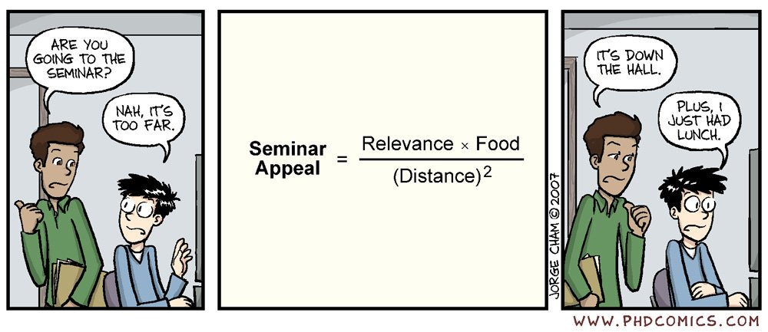
Questions?
ATMS Seminar Spring 2017

