Slide 1


Climate Change and Aeolian Processes
Pramod Adhikari
ATMS 790

Slide 2


Slide 3
Outline
Aeolian Processes
Dust Events
Dune System
Modeling the Response of Aeolian Systems to Climate Change
Aeolian System Response to future climate change

Slide 4
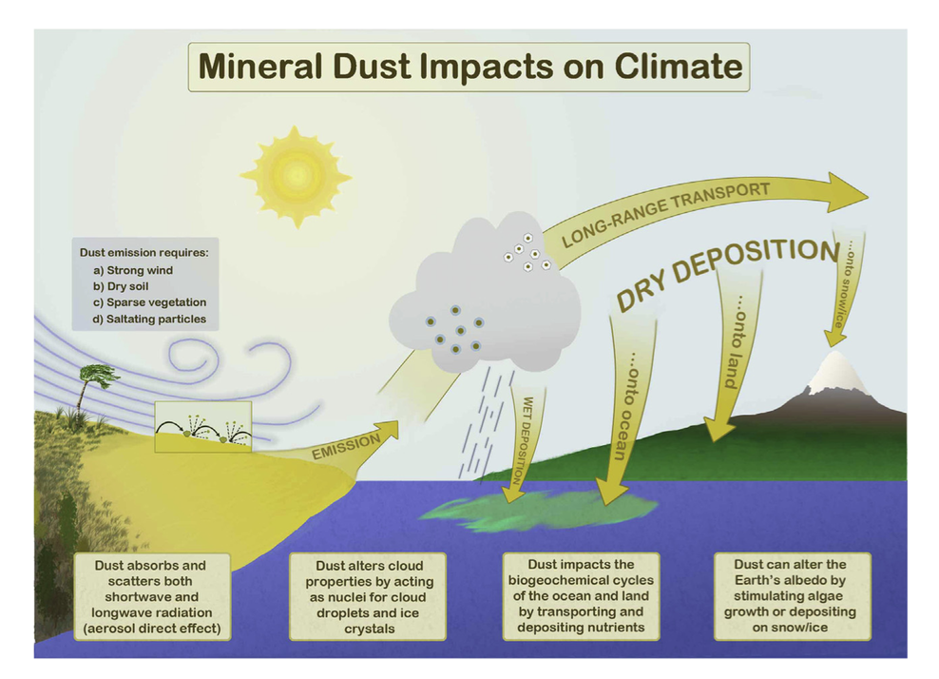
Source: Mahowald, NM, 2013

Slide 5
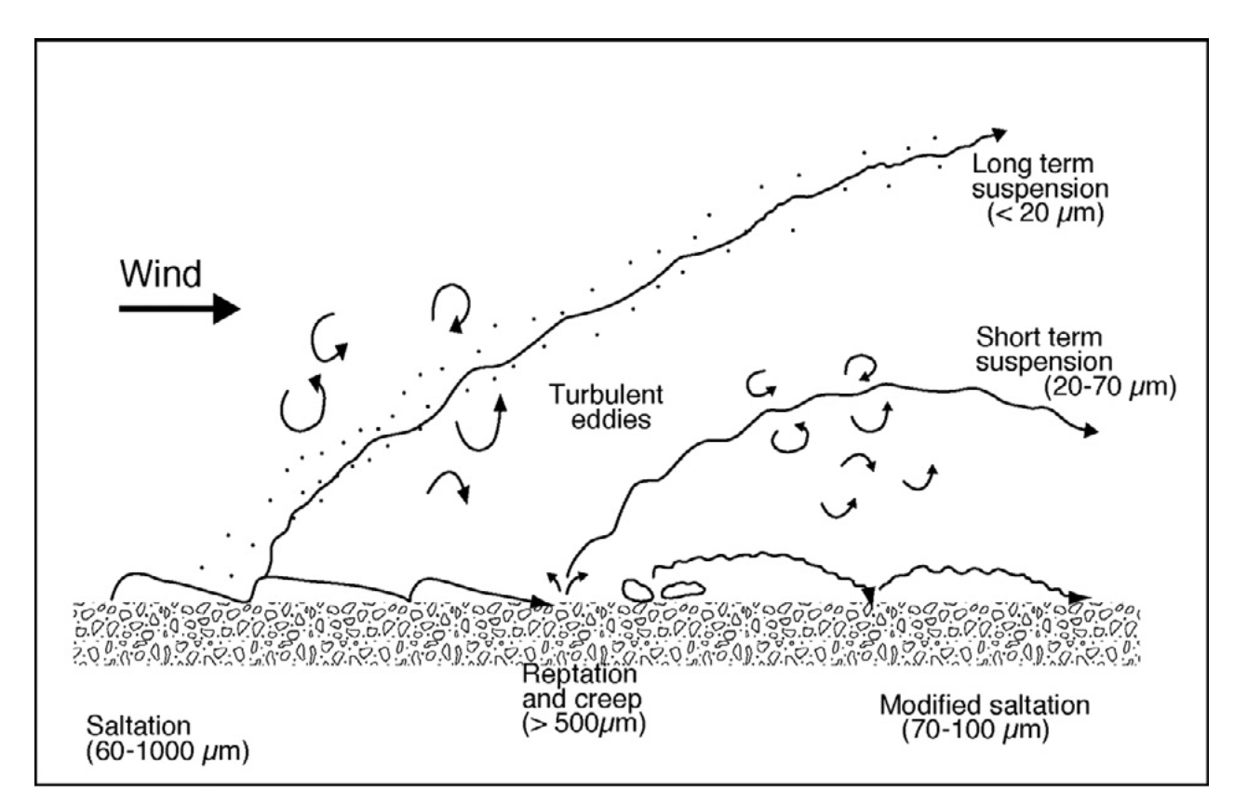
Aeolian Processes
Source: Pye, K. ,1987
Notes:
1. Aeolian processes, involving erosion, transportation, and deposition of sediment by the wind
####### Particle movement is achieved via a combination of direct wind shear stress on the surface and atmospheric turbulence.############
2.Concentrated in Dry land
3.Sand-transpot system covers about 20% of drylands
Concentrated in Dry land mainly in arid ,semi arid and sub humid regions of Earth
2. Eolian processes pertain to the activity of the winds. Winds may erode, transport, and deposit materials, and are effective agents in regions with sparse vegetation and a large supply of unconsolidated sediments. Although water is much more powerful than wind, eolian processes are important in arid environments.
----water Diversion

Slide 6
Aeolian sediment transport systems and landforms responses to climate change :
Supply of sediment
Erosivity or Mobility
Erodibility or Availability
Notes:
Size of a sediment suitable for transport by the wind: Sediment supply may be affected by variations in flood magnitude and frequency, river sediment load, lake and sea levels and rates of bedrock weathering
existence of wind energy to erode and transport the material,:
Susceptibility of a sediment surface to entrainment of material by wind ::::: transport rate of sediment is effected by the change in the magnitude and frequency of winds capable of transporting sediment, vegetation cover and soil moisture
All these factors are determined in large part by regional and local climate and vegetation cover
,

Slide 7
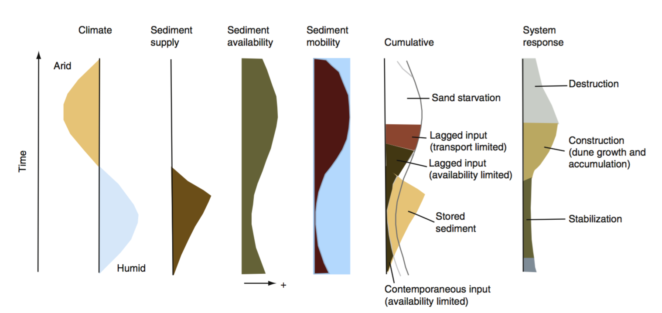
Source: Kocurek, G., 1998

Slide 8
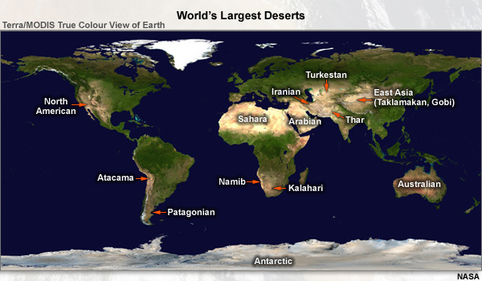
Dust Events and Climate Variability
Characterized by seasonal strong winds and fine grained sediments
Dust sources are sensitive to climate but nature of response depends on the character of the source
http://www.goes-r.gov/users/comet/EUMETSAT/at_dust/navmenu.php_tab_1_page_3.3.0_type_text.htm
Notes:
Dust storms are defined as severe weather conditions in which visibility is reduced to 1 km or less by blowing dust.
major dust source areas
Climate change and climate variability may affect dust storm frequency through changes in surface properties such as soil moisture, crusting and cohesion or vegetation cover that effect the erodibility of the surface and the availability of fine grained materials for erosion and transport. Similarly changes in climate may give rise to changes in the magnitude and frequency of winds capable of eroding and transporting

Slide 9
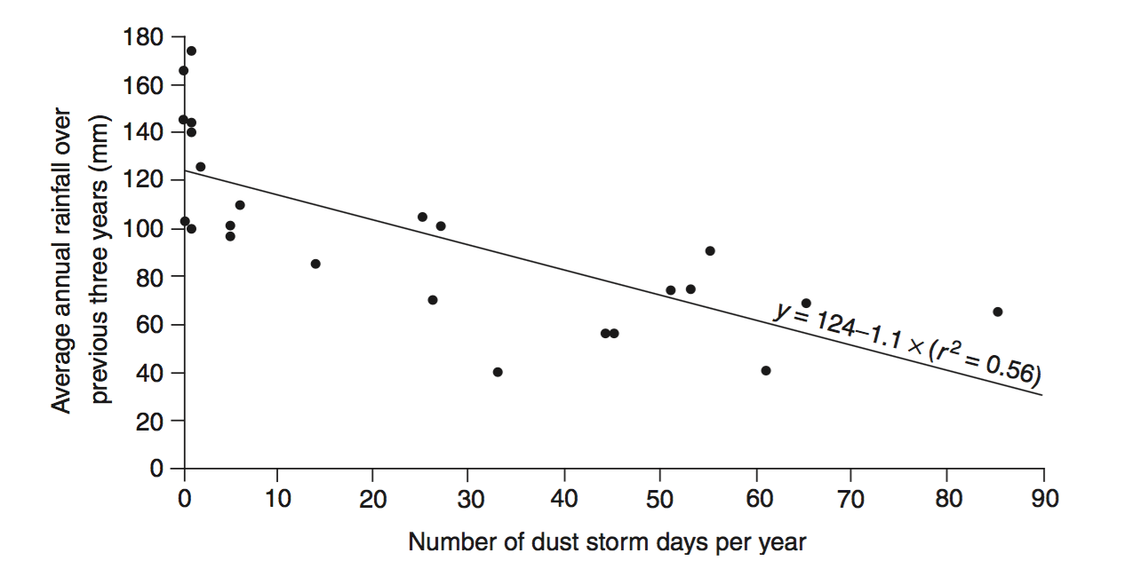
Inverse relation between dust storms and previous rainfall
Source: Middleton, N.J., 1989
Notes:
Inverse relation between Inter-annual dust storm frequency and antecedent precipitation
Ppt changes the soil moisture and vegetation cover
Inverse relation and negative correlation of ppt and dust storm frequency

Slide 10
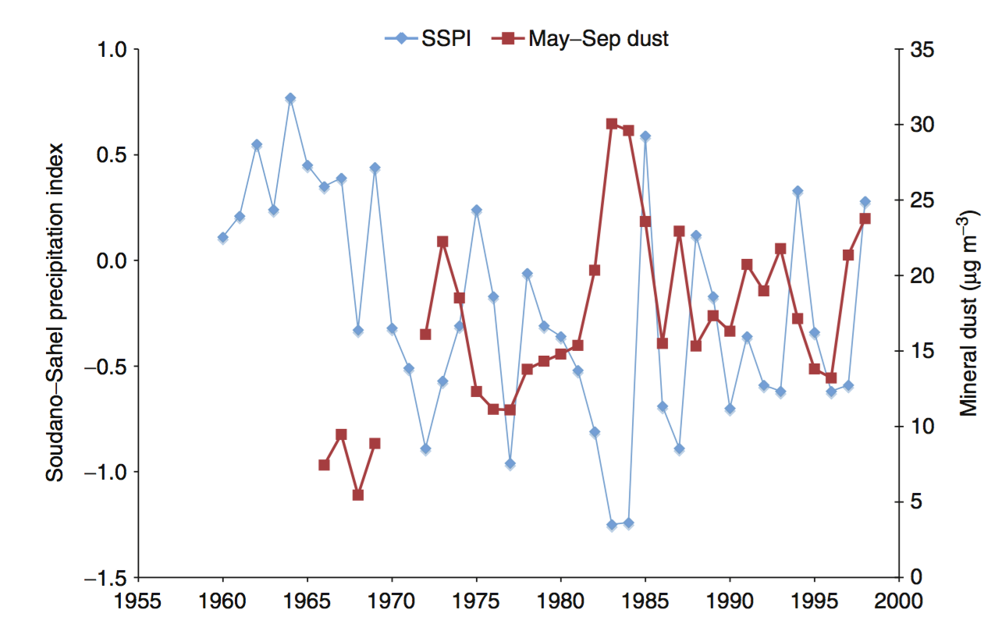
Sahara and Sahel rainfall and dust flux to the Caribbean
Source: Prospero, J.M., 2003
Notes:
- Standardized Precipitation index (SPI) calculation for any location is based on the long term ppt record for desired period.
- The long instrumental record of far-traveled dust from the Sahara and Sahel reaching the Caribbean (Figure 5) shows considerable interannual variability that is highly anticorrelated with source region rainfall in the prior year

Slide 11
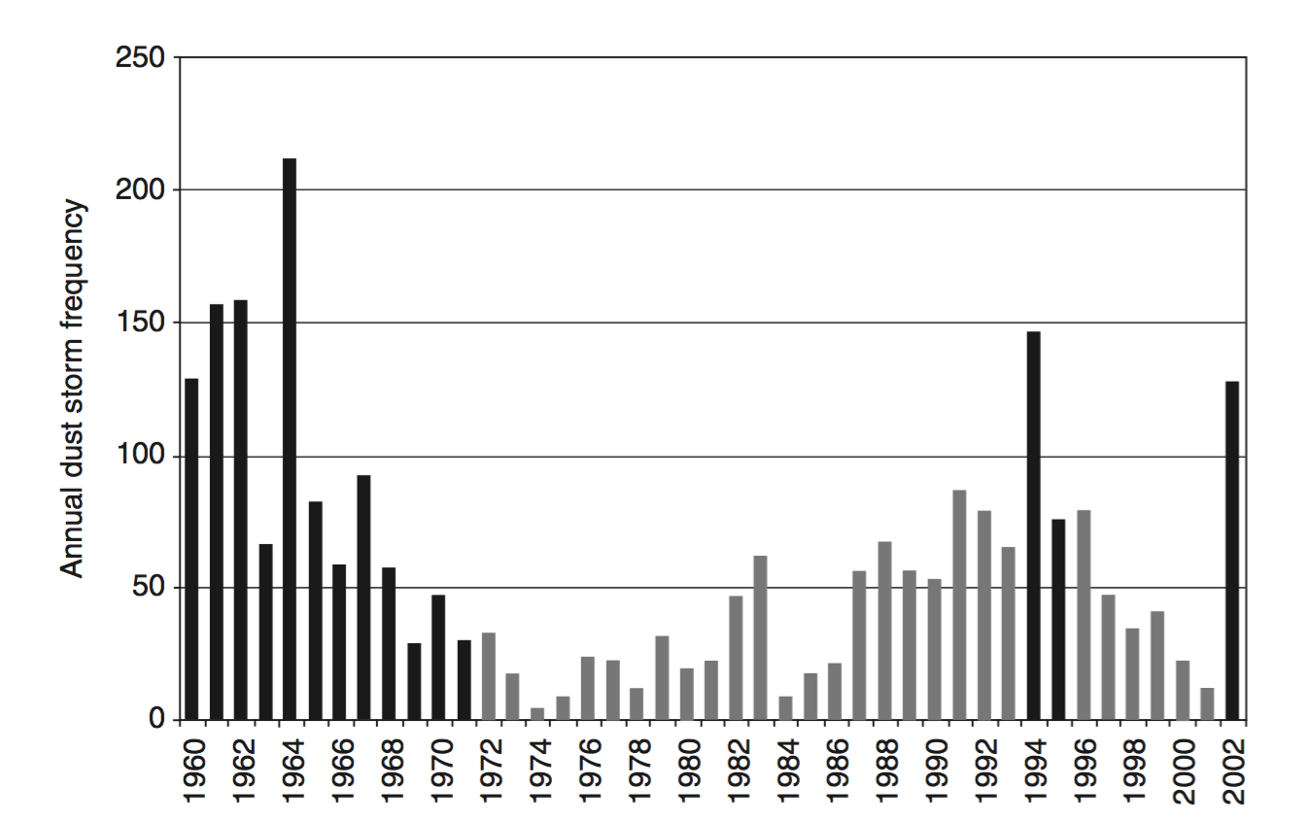
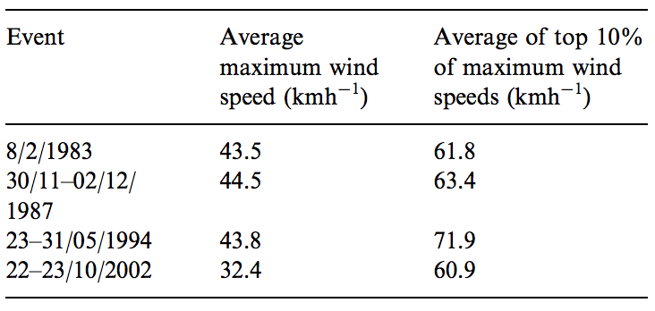
Wind Speed and Drought Condition
Source: G. McTainsh,2005
Notes:
-Dark Bars are drought years
- eg: 2002 was the combination of low mean rainfall , unusually high max temp and large diurnal temp ranges contributed to spike of dust storm

Slide 12
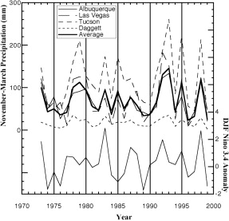
Dust event frequency in Makgadikgadi Pans(Southern Africa) related to the extent of flood events
Dust emissions appear to correlate with ENSO cycles in the southwest of USA
Source: Okin, G. S,2002

Slide 13
Outline
Aeolian Processes
Dust Events
Dune System
Modeling the Response of Aeolian Systems to Climate Change
Aeolian System Response to future climate change

Slide 14

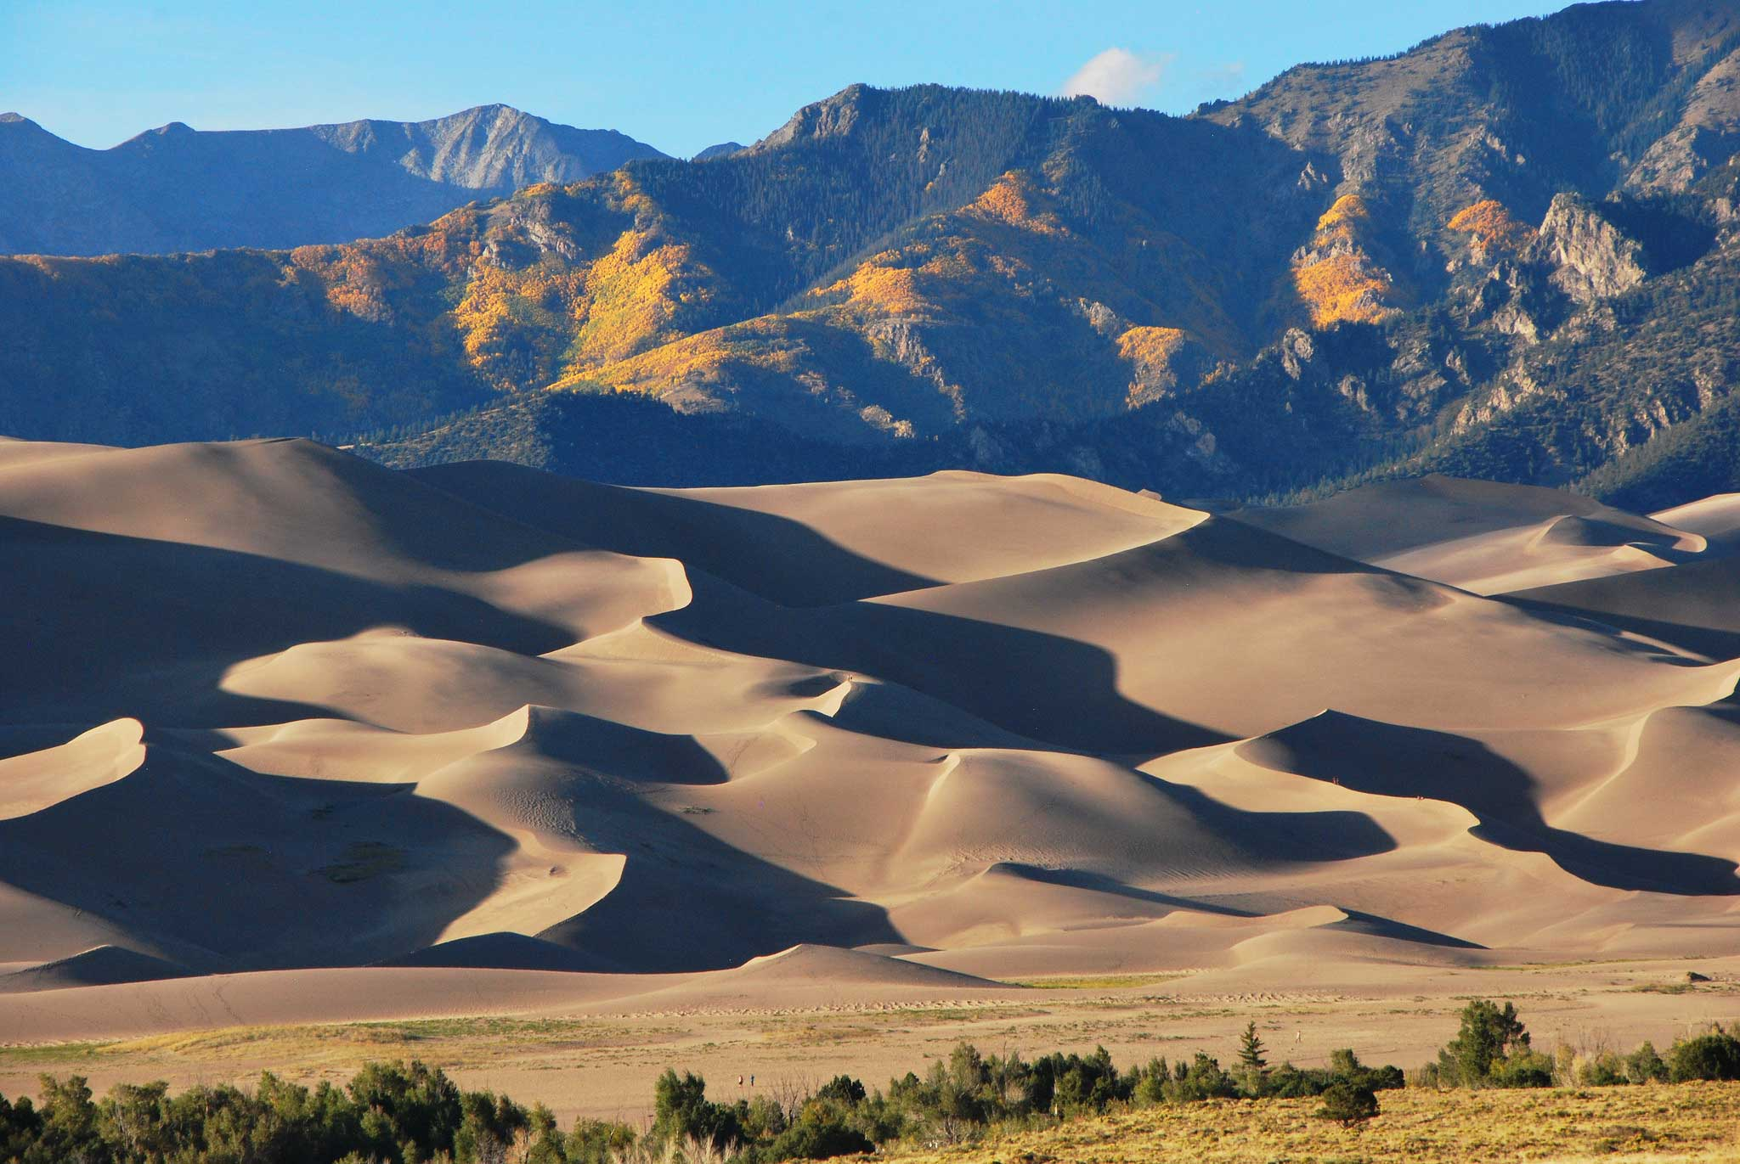
Dune Systems
Mobile, Semi-Anchored and Anchored Dunes
Increase in aridity increases dune activity
Notes:
--Great Sand Dunes,colorado
--Occupies one third of low and mid latitude arid areas and form important landscapes
--a dune is a hill of loose sand built by wind or the flow of water. And has different shape and size
--Conventional view: increases in aridity will result in enhanced sediment availability and/or mobility, leading to increased dune activity (larger areas of mobile sand and increased rates of dune mi- gration or extension

Slide 15
Late Holocene (11700 years ago to present) Dune Movement
Many dunes on the Great Plains were reactivated in the 1930’s droughts and previously in mega‐ droughts (e.g. 1390, 670, 470, 240, 140, and 70 years ago)
10-20% increase in area of active dunes in southern Prairies of Canada, during decade long drought of late 1700s
In Idaho , drought period (1845-56) dropped the high lake level and supplied sediment for the construction of linear and parabolic dunes
Notes:
--The Holocene is the name given to the last 11,700 years* of the Earth's history — the time since the end of the last major glacial epoch, or "ice age.
--Stabilization was accompanied by a change in dune morphology from barchanoid to parabolic over a period of 70 years between 1810 and 1880
--The most significant of these periods of activity were coincident with a widespread and extended drought (mega-drought) that occurred in the sixteenth century
--Elsewhere in this region, a major period of linear dune formation occurred 700–1000 years ago, coincident with a period of widespread drought during the Medieval Warm Period

Slide 16
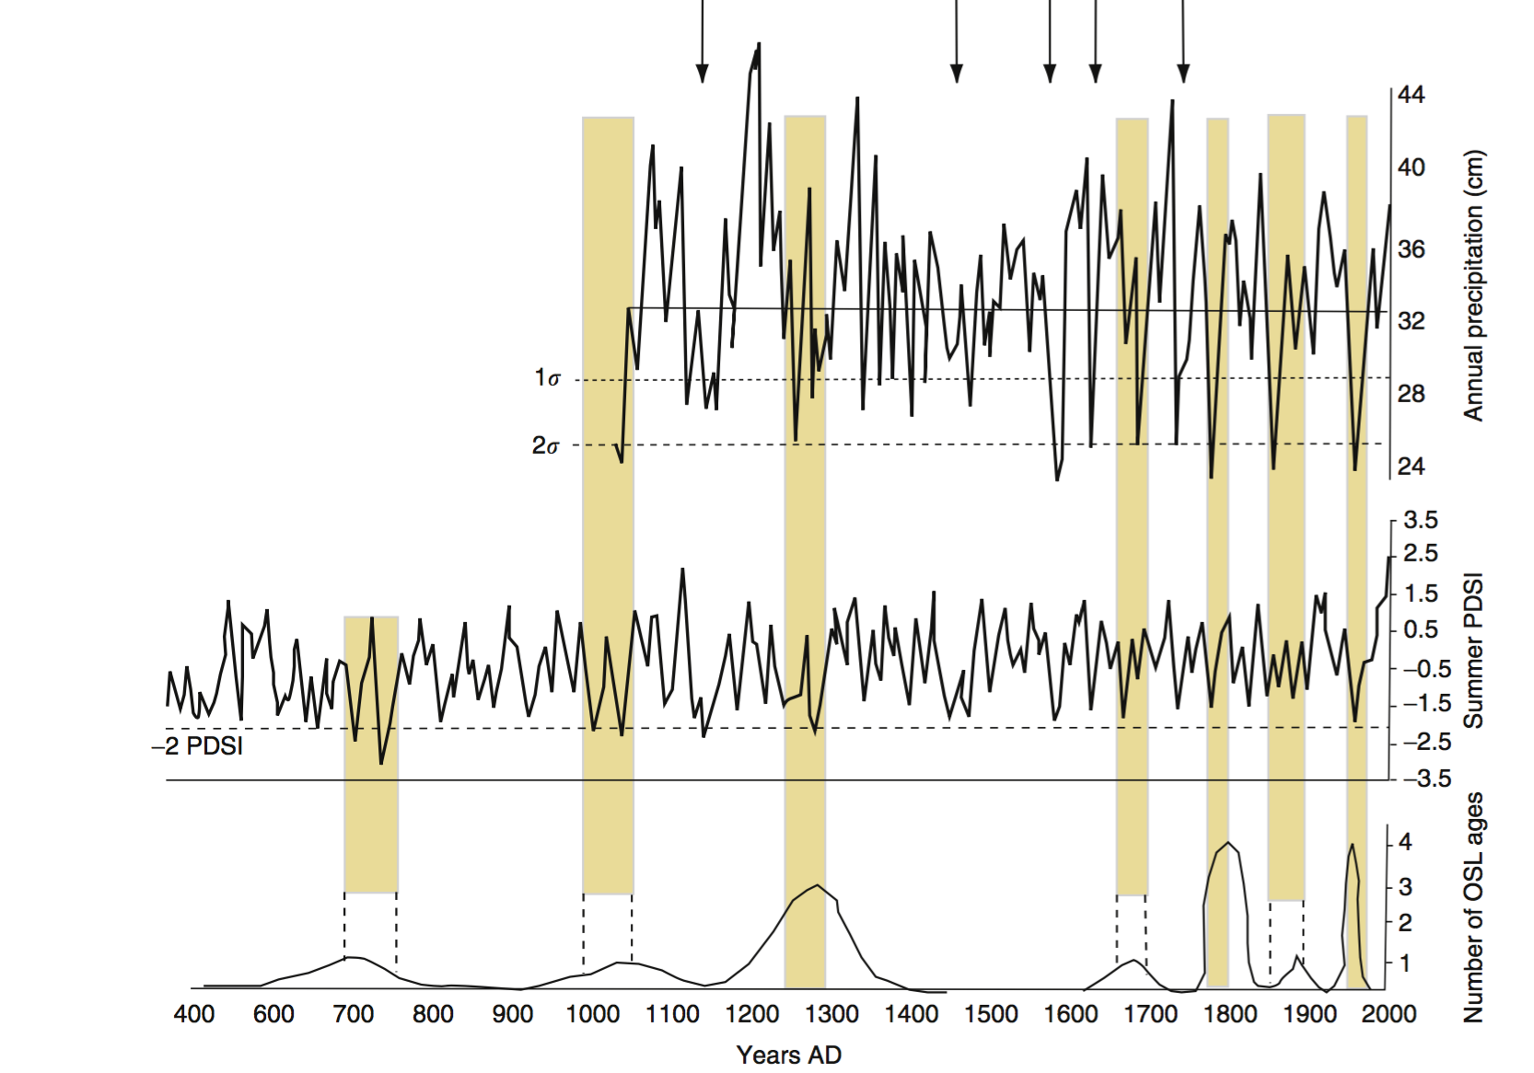
Relationships between records of inferred precipitation and summer Palmer drought severity index (PDSI) from tree ring data, and periods of OSL-dated dune activity at Great Sand Dunes National Park, Colorado
Source:Forman, S.L., 2006

Slide 17
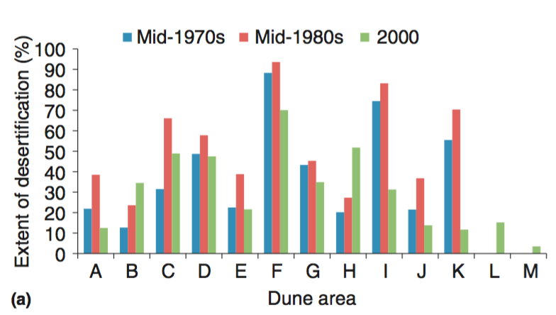
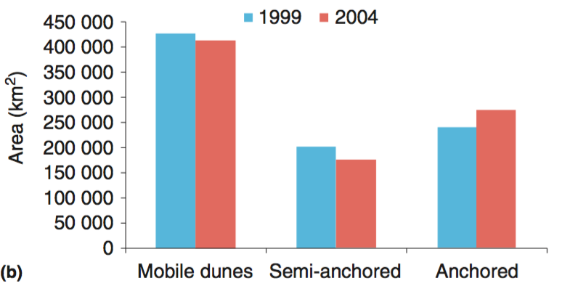
Decadal Scale Changes
3.7%
1950s-80s was characterized by higher wind speed and 2-5 times greater sand drift potential compared to the 1980-present
Wind energy may not be as important to change dune activity but instead human land use in this area may have a more significant role
13.8%
11.4 %
Source: Wang, X. ,2009
Notes:
-- e causes of these changes in dune activity status (described as desertification or rehabilitation) have been much debated, with some authors ascribing them to human activity, including overgrazing or land-use change, and others favoring climatic variability as the main factor influencing changes in the areas of active or stabilized dunes.
-- As a result, vegetation cover in many dune areas doubled so that some areas of active dunes became partially vegetated, whereas in other areas sand transport was restricted to dune crests. Many partially vegetated dunes became completely stabilized by vegetation.

Slide 18
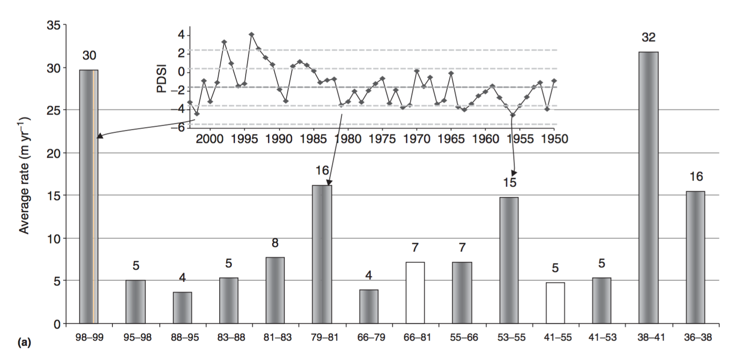
Great Sand Dunes migration rates were up to 6 times higher in drought episodes
Threshold Condition for PDSI = -2 , for Dune Activity
Variations in the rate of dune migration
at Great Sand Dunes Colorado
Dune Migration rates varied by 200% during 1939-92 in Coachella Valley, California
Source: Marin, L., 2005
Notes:
--More than 50% of the movement of parabolic dunes occurred during periods of drought that occurred between 1936 and 1941, 1953 and 1966, and 1998 and 1999.
--Overall rates appear to be inversely related to annual rainfall (Lancaster, 1997), as a result of growth of annual and ephemeral plants following wetter years.

Slide 19
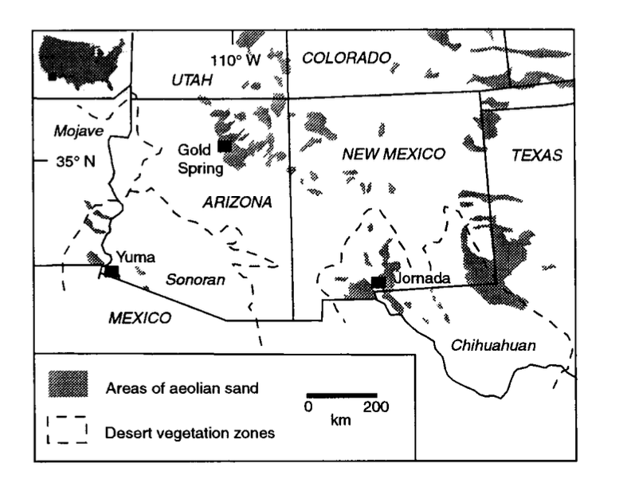
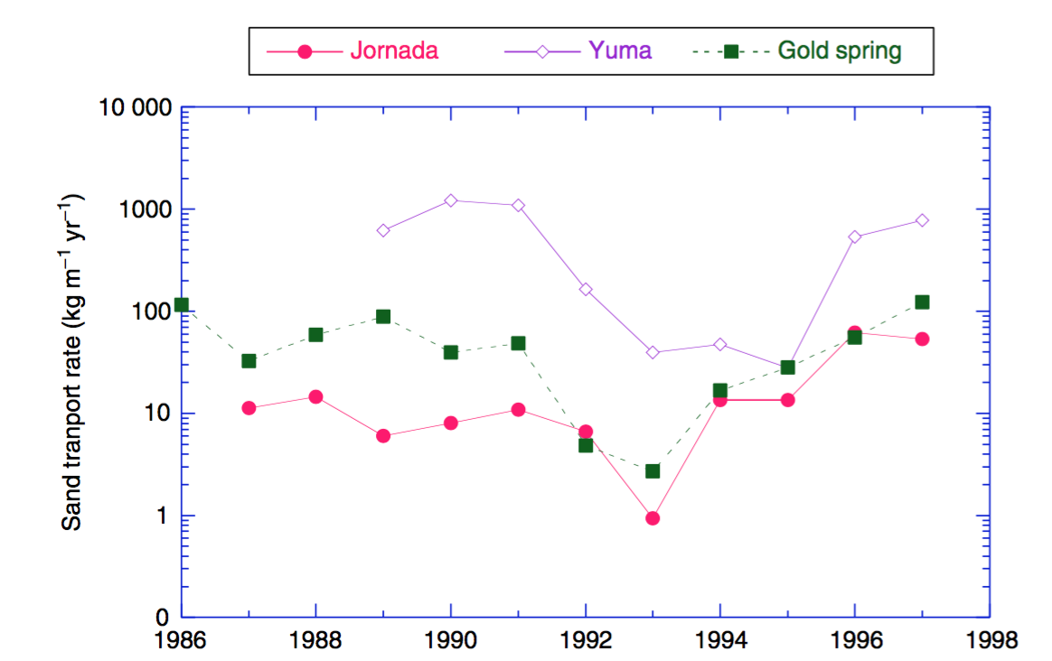
Response to Inter-annual Climate Variability
Sand Transport Rate decreased sharply during El Nino years of 1992-93
Source: Lancaster, N., Helm, P., 2000

Slide 20
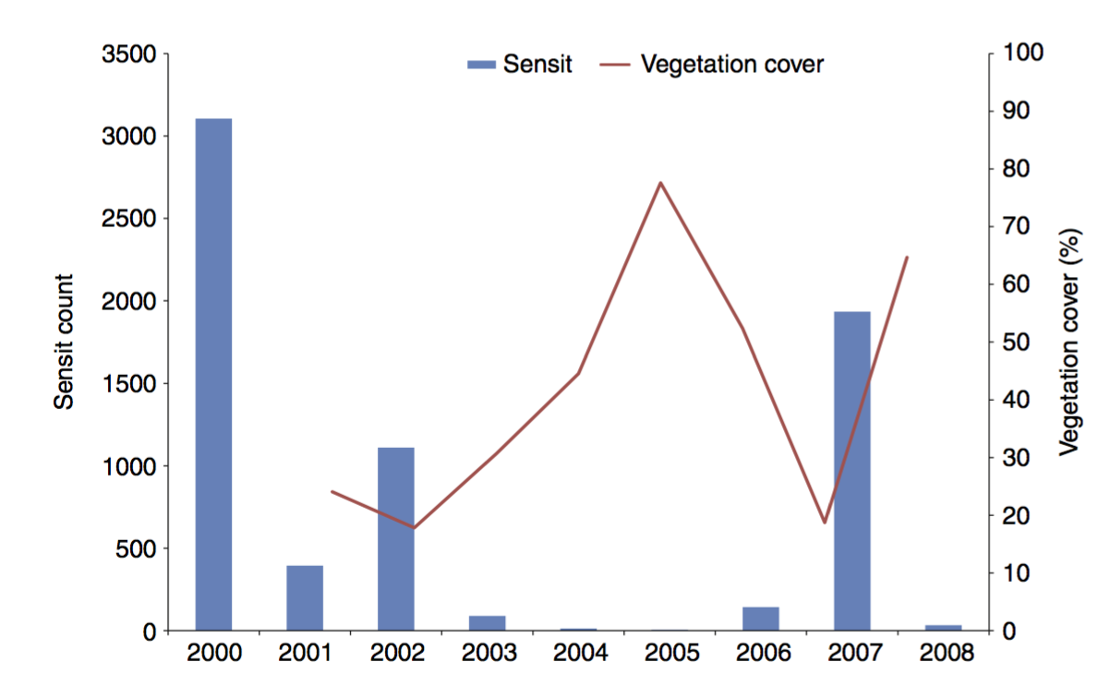
Relationships between sand flux and vegetation cover
Erosion Sensor for particle count
Notes:
-- Dune responds to rainfall through vegetation cover and sediment availability
-=-- USGS CLIM-MET station at Balch, California
Such responses are most notable where the vegetation cover incorporates a significant proportion of annual or ephemeral plants that respond rapidly to changes in rainfall and soil moisture.
-- They noted that remnant annuals may persist for years or months and effectively stabilize the surface by in- creasing roughness even when rainfall is low.

Slide 21
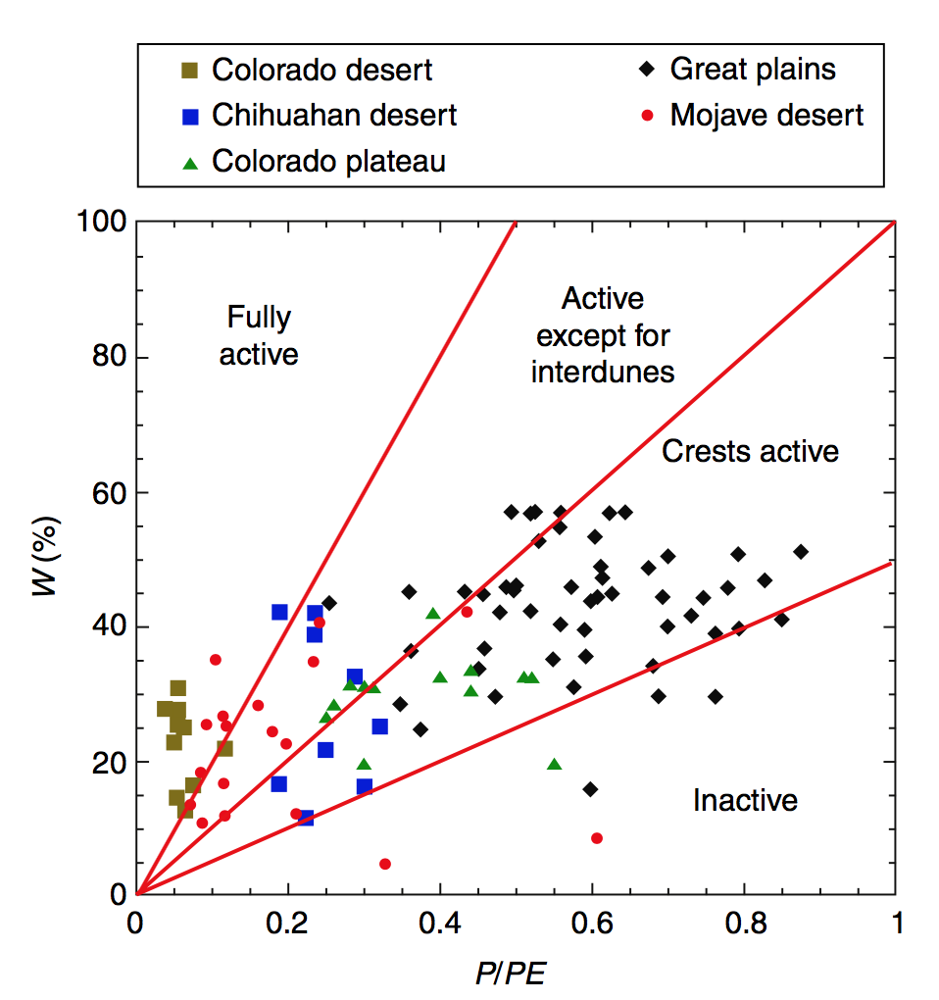
Dune Mobility Index
Dune Mobility Index (M) = W(P/PE)
Critical values of index
< 50 - dunes inactive
50-100 dunecrests active
100 - 200 dunes active, interdunes inactive
>200 fully active dune landscape
Notes:
---Dune mobility is the function of Wind energy and vegetation cover are the On timescales of years to decades, sand transport rates and dune mobility are a function of wind energy and vegetation cover
----Precipitation/Evaporation controls the vegetation cover
----Also consider indirect effects of climate change (e.g. on sediment supply)

Slide 22
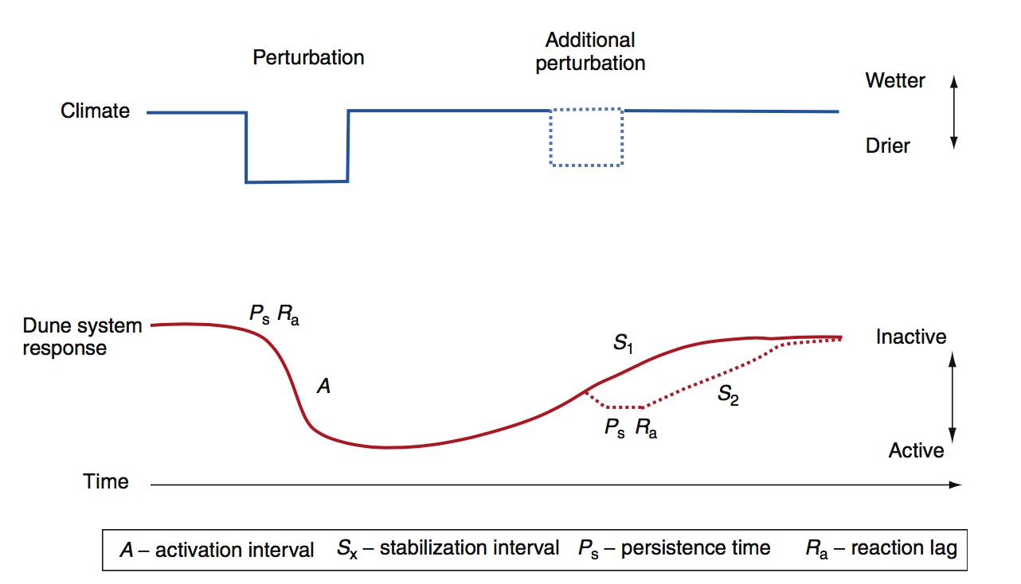
Conceptual Model for the response of dune systems to climate change
Incorporates the lag effects in the form of reaction and response times following perturbation
High intensity perturbations produces more rapid and spatially extensive response
Source: Hugenholtz, C.H., 2005
Notes:
----As vegetation- stabilized dunes respond to a perturbation (e.g., a period of reduced rainfall), the system response is controlled by extrinsic (mainly climatic) and intrinsic (mainly vegetation) thresholds, so that activation occurs after a threshold of vegetation mortality is crossed and vegetation cover decreases, causing sand-transport rates to increase, with attendant feedback effects between sand transport and plant cover.
--In this study, the annual mobility index was found to vary with annual precipitation; sand-transport rates were found to be strongly correlated with the mobility index for the prior year, reflecting the lag effects as a result of growth and persistence of vegetation from year to year
---
----Reversion of an active system as a result of an increase in precipitation follows a path that is determined by the regrowth of the vegetation cover, which may occur in a logistic fashion, and its effects on sand transport

Slide 23
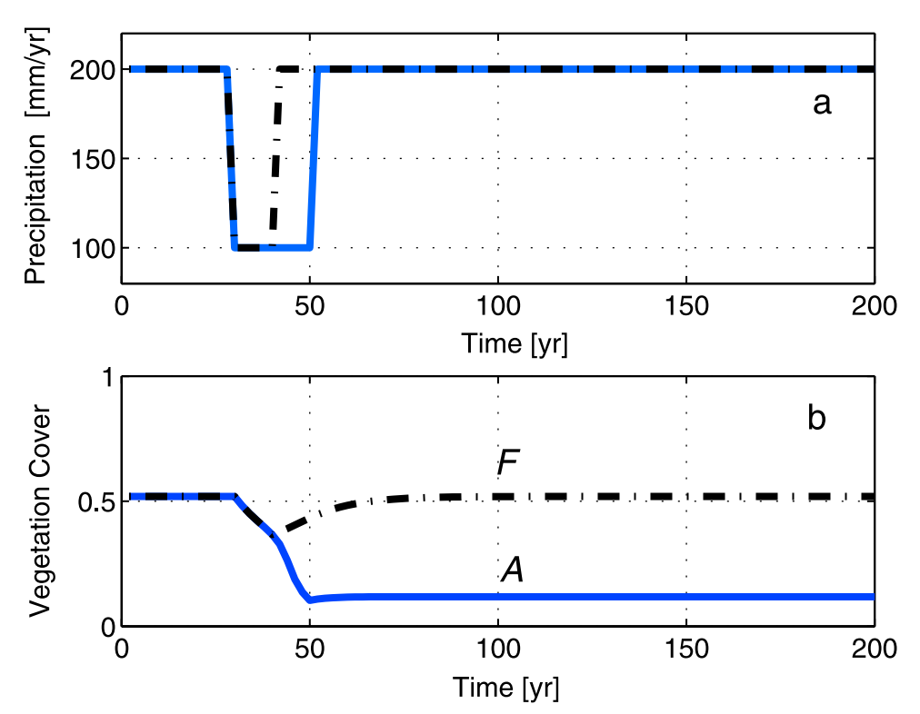
Vegetation response to different droughts period
Fixed Dunes
Active Dunes
Source: Yizhaq.H, 2008
Notes:
-----Two scenarios of precipitation sequences are mapped, one with a reduction of the rainfall from 200 to 100 mm a-1 for a period of 10 years (dash-dotted) and the other for a period of 20 years (solid). (b) For each scenario in Figure 10a, the evolution of vegetation cover is presented. In the case of 10 years of drought (black curve), vegetation recovers and the fixed dune state returns. However, for a prolonged 20 year drought (blue curve), the dunes converge to the active state and remain there despite the return of precipitation to its initial value. Parameters: DP =200
This scenario represents desertification, which is defined as an irreversible decrease in biological productivity induced by an environmental change, and is captured in the model, which demonstrates bistability ranges of active and fixed dune states. Transitions of this kind are often referred to in the ecology literature as "catastrophic regime shifts" [Rietkerk et al., 2004; Sole´, 2007]. In cases where the fixed state is the only stable state, the decline of vegetation cover will be continuous and will not involve sharp transitions
catastrophic regime shifts==gradual change might have little effect until a threshold is reached at which a large shift occurs that might be difficult to reverse

Slide 24
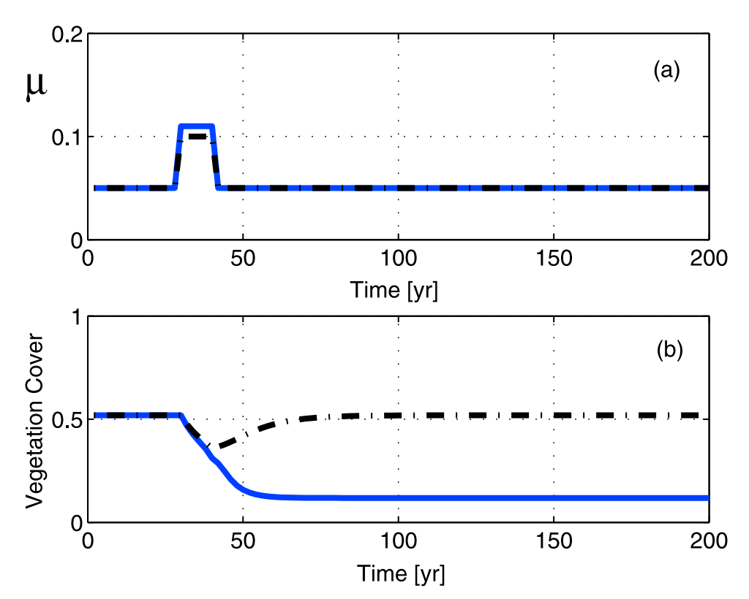
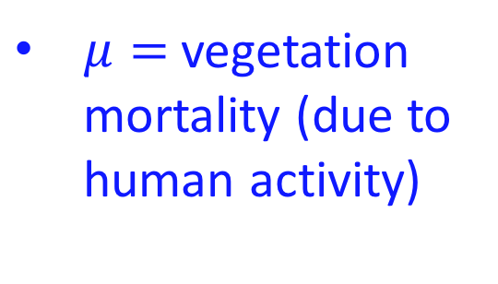
Vegetative response to grazing for the bistable case
$μ=$ vegetation mortality (due to human activity)
Southern limit Kuwait Desert moved 35km in a southeasterly direction during 1977-1989
Fixed Dunes
Active Dunes
Source: Yizhaq.H, 2008
Notes:
Two scenarios of overgrazing are represented with $μ$ going from 0.05 to 0.1 (dash-dotted) or to 0.11 (solid) for 10 years. (b) Vegetation cover time evolution in response to the overgrazing sequences in Figure 12a. After 10 years of grazing at m = 0.1, the vegetation recovered and returned to the fixed state, while for higher-intensity grazing at m = 0.11 it converges to the active state and remains there even when the grazing returns to its initial value of m = 0.05. Parameters: DP = 200
--for the Kuwait Desert,By comparing satellite images from 1977 and 1989, it was clear that the southern limit of the mobile sand sheets had moved 35 km in a southeasterly direction…….. deterioration of the vegetated sand sheet due to human activities, which included overgrazing and woody shrub collecting
even without climatic changes, overgrazing can shift the system from the fixed state to the active one. The opposite scenario is also possible; that is, stopping grazing can stabilize the dunes
Though human perturbation ceases it dunes remain active

Slide 25
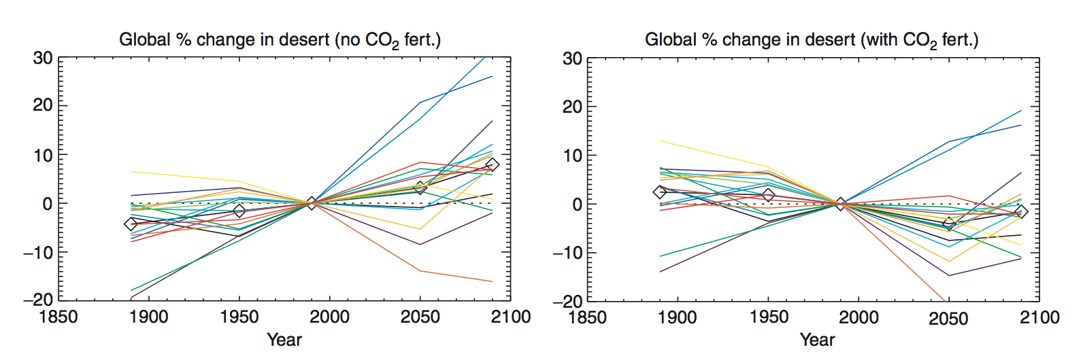
Without CO₂ Fertilization, model predicts to expand desert by 7.9% compared to 1980-2000 period
Aeolian System Response to Future Climates
Source: Mahowald, N.M., 2007
Notes:
--- But there is wide variations of model
---CO₂ Fertilization: the larger amount of carbon dioxide in the atmosphere that has resulted from rising anthropogenic emissions should help the growth of plants, which use carbon dioxide during photosynthesis
----With no CO2 fertilization, most desert regions increase in size in the future, with the exception of the desert extent in the Middle East, which decreases slightly
-----Thus better understanding carbon dioxide fertilization is important for predicting desert response to climate.

Slide 26
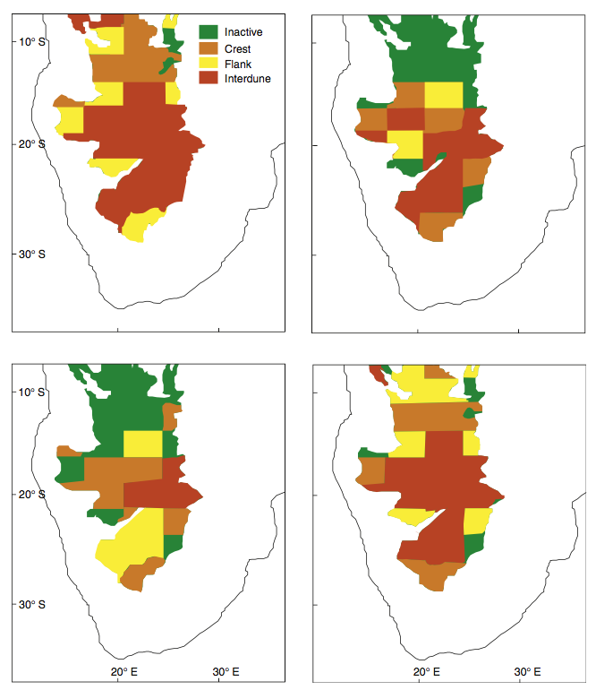
Response of Kalahari dune systems to future climate change
ASO 2070
NDJ 2070
Predicted seasonal dune field activity after 2070
FMA 2070
MJJ 2070
Source:Thomas, D.S.G.,2005

Slide 27
Conclusions
Enhanced dust emissions and dune activity are closely linked to periods of drought
Different climate models predicts variations of results for dry lands
Further research is needed on CO₂ fertilization on desert vegetation
Need to develop, parameterize and verify quantitative models especially for sand-transport systems
An interdisciplinary approach is required to understand dune field response to climate change
Notes:
Plant ecology, geomorphology, climate modeling, numerical simulation modeling

Slide 28
References
Yizhaq, H., Askenazy, Y., Tsoar, H., 2008. Sand dune dynamics and climate change: a modeling approach. Journal of Geophyical Research 114, F01023
Lancaster, N., Helm, P., 2000. A test of a climatic index of dune mobility using measurements from the southwestern United States. Earth Surface Processes and Landforms 25(2), 197–208
Mahowald, NM; Albani, S; Kok, J; Engelstaeder, S; Scanza, RA; Ward, DS; et al.(2013). The size distribution of desert dust aerosols and its impact on the Earth system. Aeolian Research. doi: 10.1016/j.aeolia.2013.09.002. UCLA: 621581. Retrieved from: http://escholarship.org/uc/item/9bm2q8sd
Pye, K. (1987). Aeolian dust and dust deposition. Academic, San Diego, Calif, 92-100.
Okin, G. S., & Reheis, M. C. (2002). An ENSO predictor of dust emission in the southwestern United States. Geophysical Research Letters, 29(9).

Slide 29
THANK YOU

Slide 30
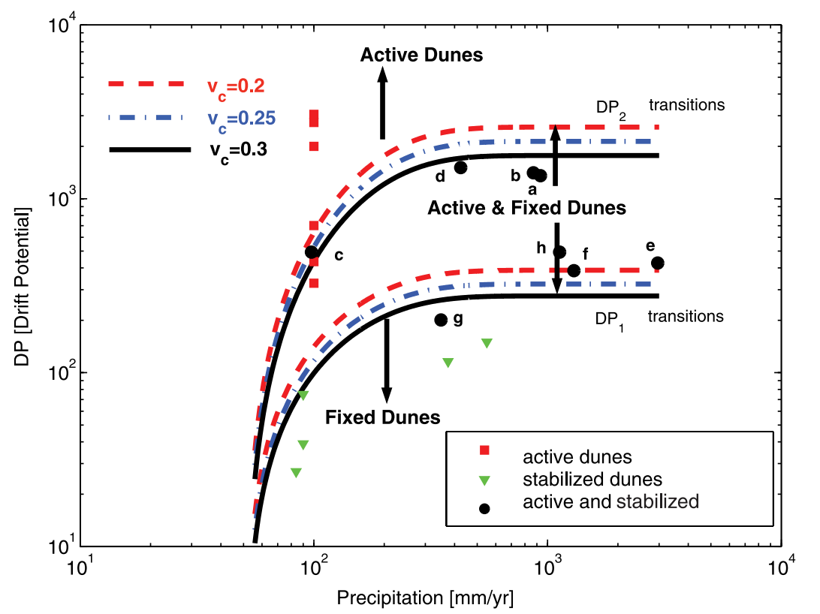
Vc = Critical vegetative response to precipitation
DP ⍺ U²(U-U_{T})t
Source: Yizhaq.H, 2008
Notes:
----Still, the DP is a potential sand drift, as the actual drift further depends on the mean grain diameter, the degree of surface roughness, the amount and type of vegetation or crust cover, the amount of moisture in the sand, and the uniformity of wind direction.
---DP ⍺ U²(U-U_{T})t

Slide 31

Model equation:
v = the dynamical variable representing areal vegetation cover density
dv/dt= vegetation colonization rate
η = a spontaneous growth cover parameter that describes an average cover due to spontaneous growth for even bare dunes because of soil seed banks
v_{max} = maximum vegetation cover
p=annual precipitation
α(p) = areal growth rate and not for biomass production
−ɛDPg(v_{c},v)v= represents the effect of sand transport on vegetative growth, mainly due to root exposure and plant burial
b quantifies the steepness of the curve, the larger the value of b, the steeper is g(v_{c}, v)
γDP^{2/3}v =stands for a reduction in vegetation cover due to direct wind action
−μv=extinction rate due to continuous human activity, as such grazing, clear cutting or burning

Slide 32
Desertification
“Land degradation in arid, semi-arid and dry sub-humid areas resulting from various factors, including climatic variations and human activities”…..... UNCCD
Desertification involves the reactivation of anchored dunes or semi-anchored dunes under conditions leading to sand transport, excerbated by decreases in vegetation cover or increase in sand transport. (X. Wang, 2009)
Notes:
1 Desertification is one of the major impact area of climate change
2. UNCCD: United Nations Convention to Combat Desertification
3. Desertification is a type of land degradation in which relatively dry area of land becomes increasingly arid, typically losing its bodies of water as well as vegetation and wildlife.

Slide 33
