Slide 1
Recent Amazon climate as background for possible ongoing and future changes of Amazon humid forests
M. Gloor, J. Barichivich, G. Ziv, R. Brienen, J. Schongart, P. Peylin, B. Barcante Ladvocat Cintra, T. Feldpausch, O. Phillips, and J. Baker

Slide 2
Outline
Introduction
  AMAZONICA
  Purpose
  Amazon hydrologic cycle
Recent Amazon climate patterns
  Temperatures
  Precipitation and river discharge
  Water vapor transport and atmospheric water vapor content
Implication for Amazon humid forests
Conclusion

Slide 3
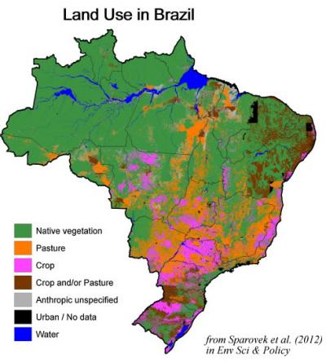
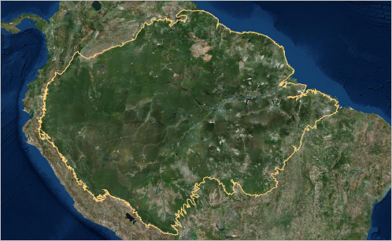
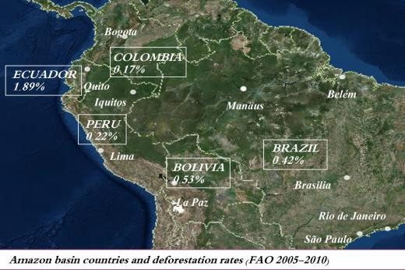
Introduction
Tropical rainforests of Amazonia
Notes:
Amazonian tropical forest- cover the largest forested area globally, constitute the largest reservoir of above-ground organic carbon.
Forests affect the functioning of Earth’s climate due to the exchanges of water, energy and carbon with the atmosphere
They are under strong human pressure because of deforestation for logging, forest to pasture conversion and the use of natural resources
Along with deforestation, forests face threats from climate change and altered fire regimes

Slide 4
AMAZONICA
Amazon integrated Carbon Analysis
  Basin-wide greenhouse gas observations of the lower troposphere
  Basin-wide forest census across a widespread 1 ha plot network
  Comprehensive forest carbon pool measurements
  Remote sensing estimates of land use change
  Fire and vegetation modeling over a period of 4 years
Notes:
Because these forests face continuous pressures from humans through development and global temperature are continuing to rise because of fossil fuel burning, the AMAZONICA consortium or above was formed in 2009. There are 7 Brazilian and 7 UK research institutions that are involved. It combined for the 1st time the above!

Slide 5
Purpose
Discuss recent trends of Amazonian climate
Outlook on effects of recent climate patterns on Amazonian humid forests
Results of study go against perception that the Amazon basin is drying
Notes:
As a background for the AMAZONICA studies.
RAINFOR forest census network 2009-2014, part of AMAZONICA

Slide 6
Large scale effects on Hydrological cycle
ENSO
Sea surface temperatures (SST)
Pacific Decadal Oscillation
Pacific Walker circulation

Slide 7
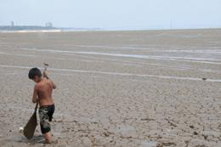
Enso and carbon cycle
El Nino and La Nina
  Affect northern and central parts of basin
  El Nino- negative precipitation anomalies
  La Nina- positive precipitation anomalies
Droughts in 2005 and 2010
  Tree mortality
  Substantial carbon release
E. QUEIROZ/AP/Press Association Images
Notes:
Tightly coupled with Carbon dynamics of Amazonian rainforests
, positive precipitation, negative precipitation

Slide 8
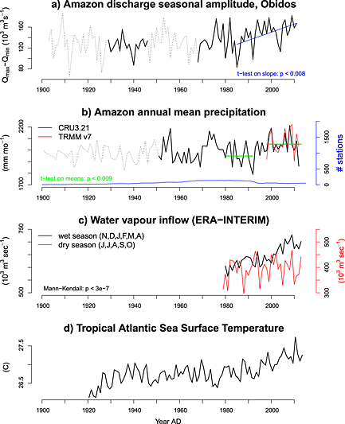
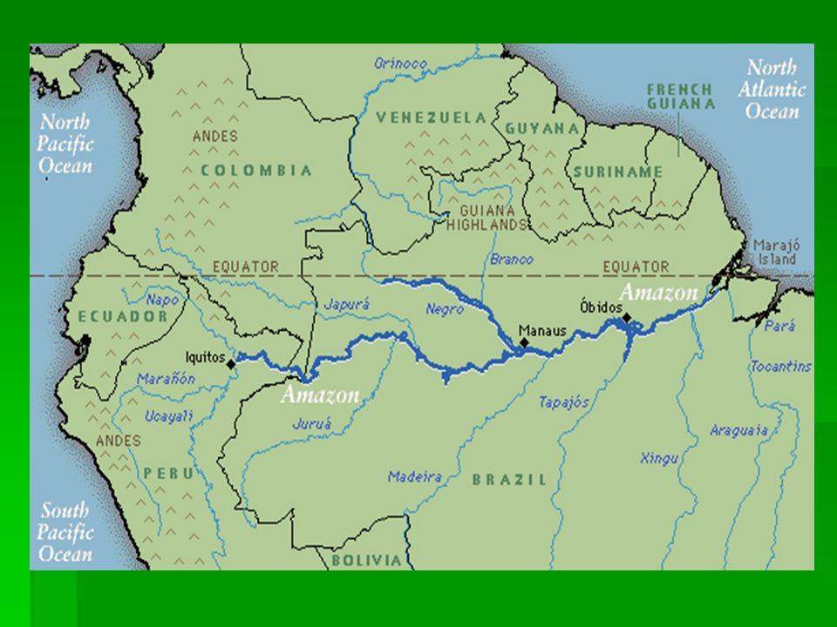
Intensification of Hydrological Cycle
Notes:
More frequent extreme floods (2008/09, 2011/12 and 2013/14)
Strong droughts (2005, 2007 and 2010)
Hydrological cycle is more variable past 3-4 decades
Increase in extreme events is consistent with an upward trend in seasonal amplitude of amazon river discharge measured at Obidos
Precipitation amount increased due to an increase during the wet season in northwestern, northern and central parts of basin
Decrease during the dry season
Intensification of hydrological cycle---

Slide 9

Sea surface temperatures
Tropical North Atlantic sea surface temperatures (SST) anomalies
Intertropical Convergence Zone (ITCZ)

Slide 10
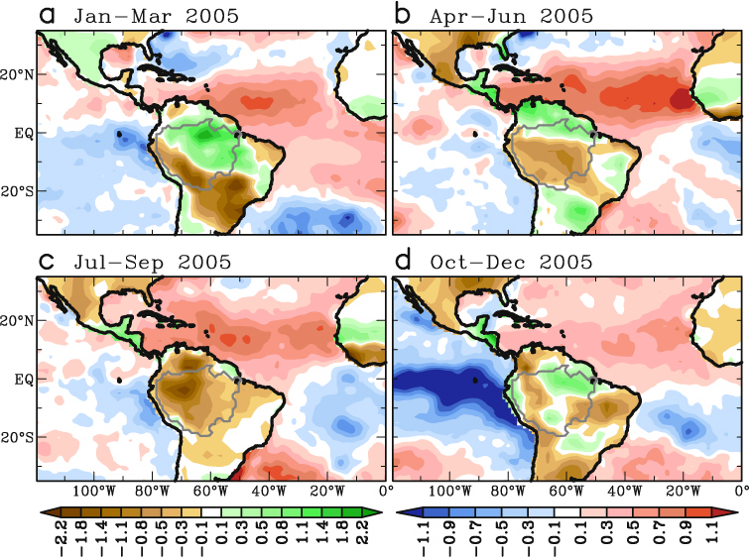
2005 Drought
Rainfall
Sea Surface Temperatures
(OPI, mm d^{–1}) (degree Celsius)
Yoon and Zheng, 2008

Slide 11
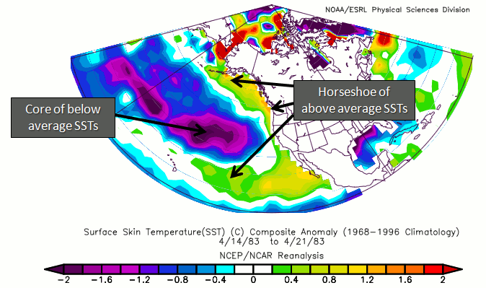
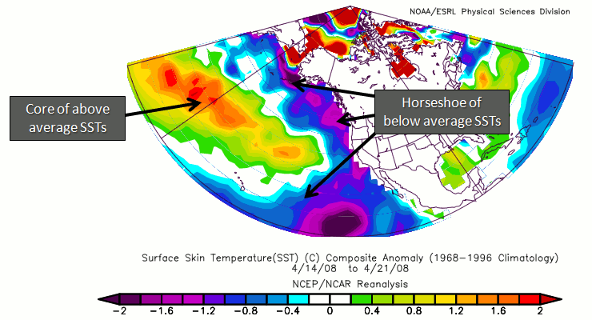
Pacific Decadal Oscillation
Warm PDO
Cold PDO

Slide 12
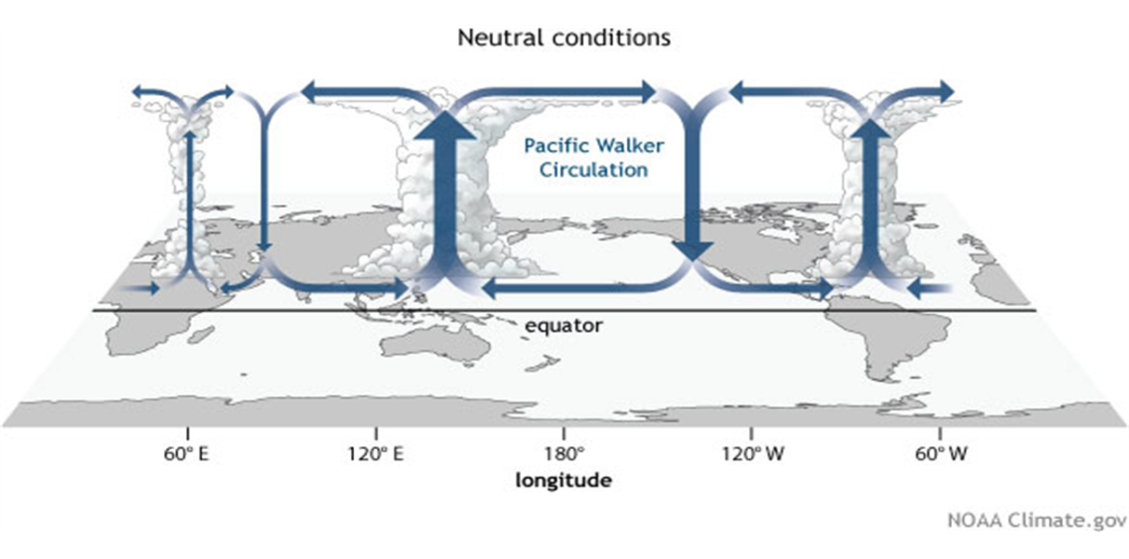
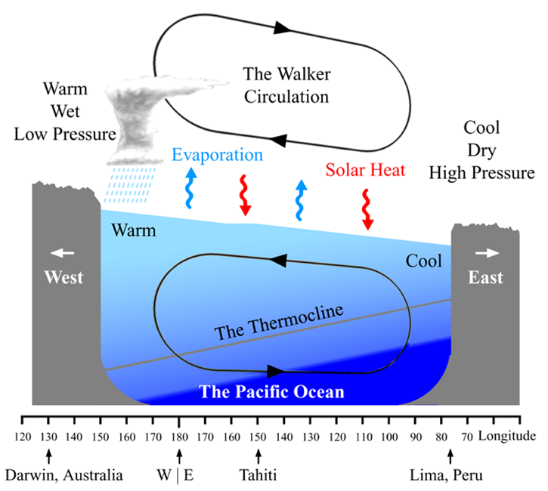
Walker Circulation

Slide 13
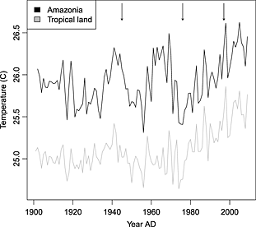
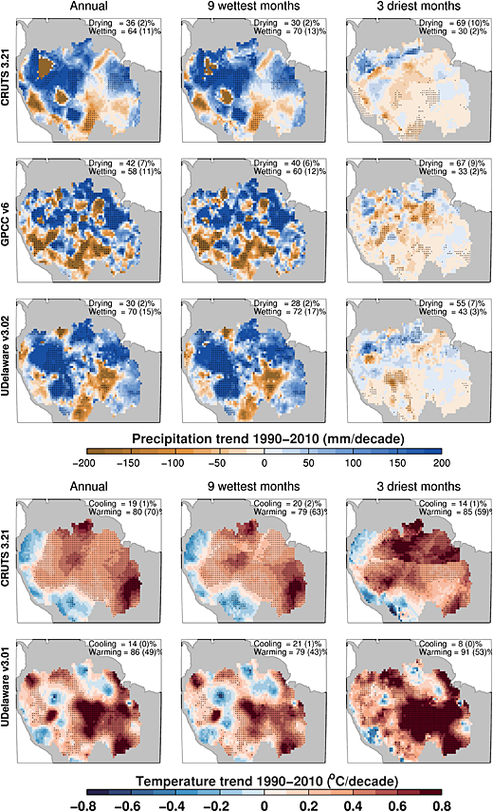
Amazon Temperatures

Slide 14

Precipitation

Slide 15
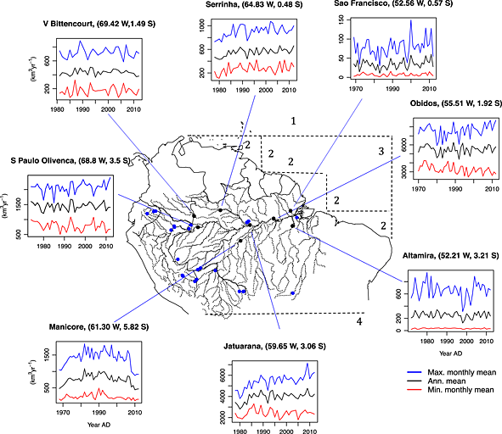
River Discharge

Slide 16
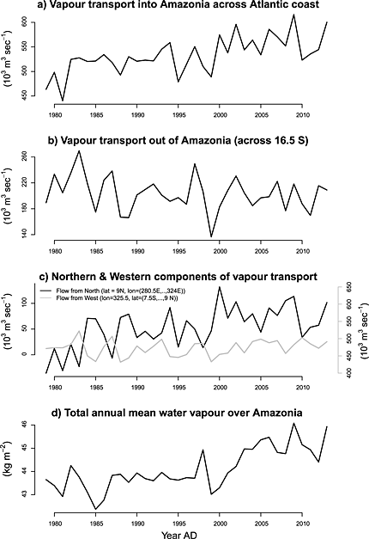
Water vapor budget
Water vapor transport into basin (line 2)
Water vapor outflow (across line 4)
N and W water vapor transport (lines 1 and 3)
Water vapor content over the Amazon Basin (based on ERA-Interim reanalysis)

Slide 17
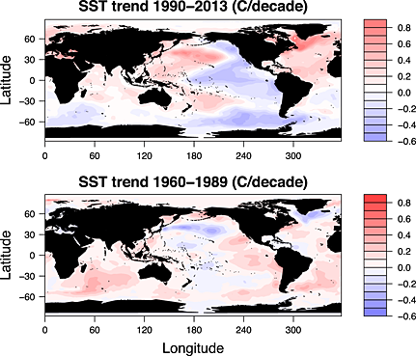
Sea Surface Warming Trends

Slide 18
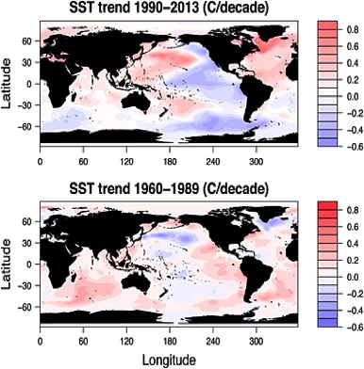
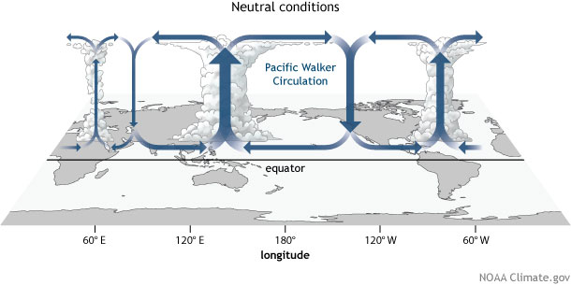

Slide 19
Earth Wind Map
Wet season, SST & Precipitation
https://earth.nullschool.net/#2016/01/01/2100Z/ocean/primary/waves/overlay=sea_surface_temp/patterson
https://earth.nullschool.net/#2016/01/01/2100Z/wind/surface/level/overlay=total_precipitable_water/patterson
Dry season, SST & Precipitation
https://earth.nullschool.net/#2016/08/01/2100Z/ocean/primary/waves/overlay=sea_surface_temp/patterson
https://earth.nullschool.net/#2016/08/01/2100Z/wind/surface/level/overlay=total_precipitable_water/patterson

Slide 20
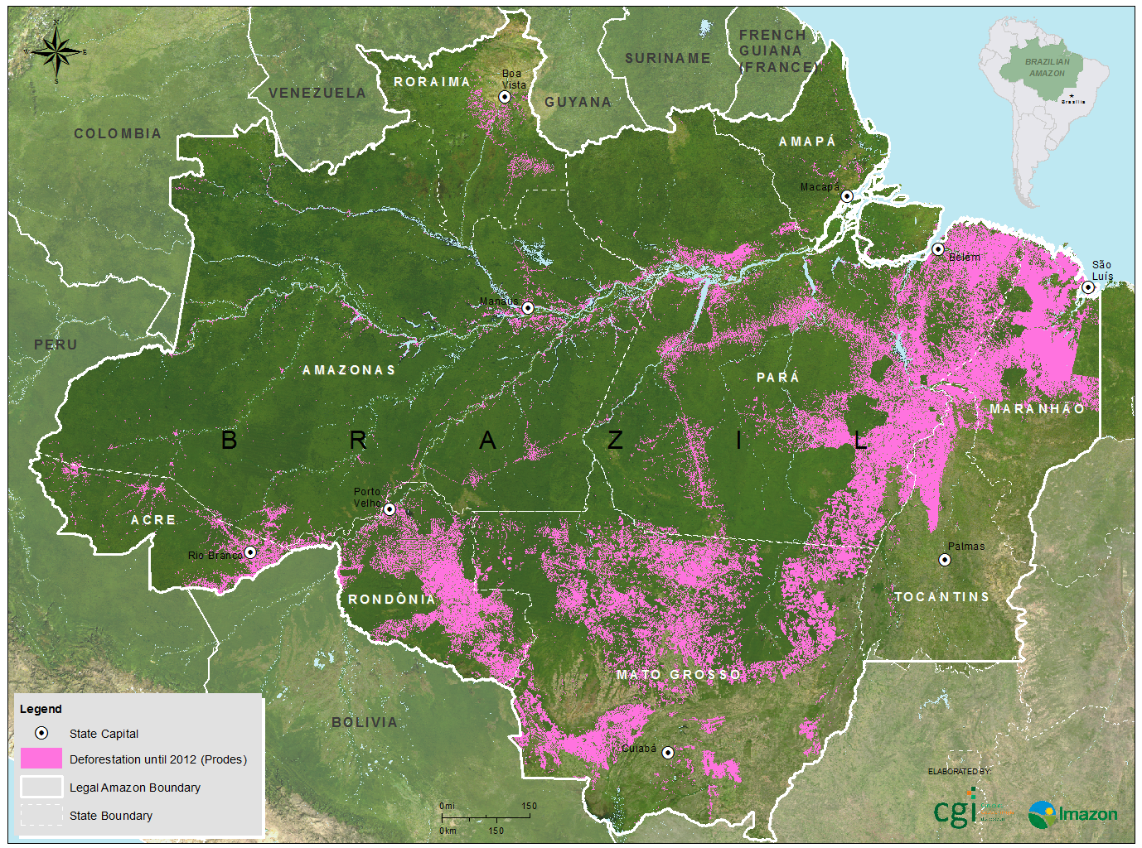
Deforestation
INPE/Prodes.

Slide 21
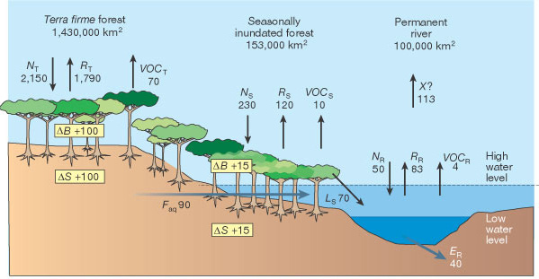
Possible Implications for Amazon Humid Forests
Terra firme forests
Grace & Malhi, 2002

Slide 22
Conclusion
Intensification of hydrological cycle
Riverine records and climatologies exhibit an increase in precipitation
Increase in frequency of extreme floods and drought
Precipitation trends coincide with trends of net water vapor transport into the Amazon basin
Strong warming since 1980 in the basin
Tropical North Atlantic SSTs have warmed over last decades, switch from negative to positive PDO in 1990

Slide 23
Conclusion cont.
Increase in precipitation, neutral effect on forests
Southwest and south basin experience drier conditions, negative effects on forests
Forests will thrive in areas where precipitation is increasing, north and central
Shifts of forested communities in flood plain forests

Slide 24



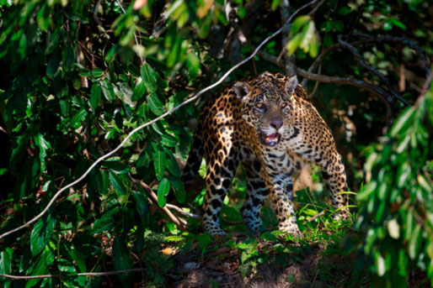
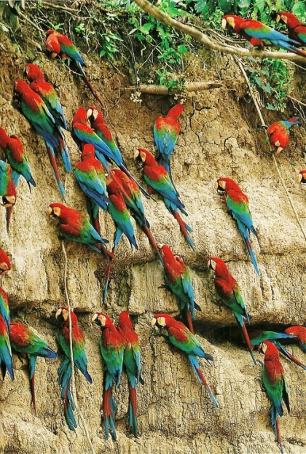

Questions?

Slide 25
Discussion Questions
Why are rising SSTs rarely discussed when talking about climate change?
Increasing risk of Amazonian drought due to decreasing aerosol pollution…?

Slide 26
References
Cox, Peter M., Phil P. Harris, Chris Huntingford, Richard A. Betts, Matthew Collins, Chris D. Jones, Tim E. Jupp, José A. Marengo, and Carlos A. Nobre. "Increasing Risk of Amazonian Drought Due to Decreasing Aerosol Pollution." Nature News. Nature Publishing Group, 08 May 2008. Web. 05 May 2017.
Di Liberto, Tom. "The Walker Circulation: ENSO's Atmospheric Buddy." The Walker Circulation: ENSO's Atmospheric Buddy | NOAA Climate.gov., 01 Aug. 2014. Web. 05 May 2017
Gloor, M., J. Barichivich, G. Ziv, R. Brienen, J. Schöngart, P. Peylin, B. B. Ladvocat Cintra, T. Feldpausch, O. Phillips, and J. Baker (2015), Recent Amazon climate as background for possible ongoing and future changes of Amazon humid forests, Global Biogeochem. Cycles, 29, 1384–1399, doi:10.1002/2014GB005080.
Gloor, M., R. J. W. Brienen, D. Galbraith, T. R. Feldpausch, J. SchÃ¶ngart, J.-L. Guyot, J. C. Espinoza, J. Lloyd, and O. L. Phillips. "Intensification of the Amazon Hydrological Cycle over the Last Two Decades." Geophysical Research Letters 40.9 (2013): 1729-733. Web.
Null, Jan. "El Nio and La Nia Years and Intensities." El Nio and La Nia Years and Intensities. N.p., n.d. Web. 05 May 2017.
Sco, Nc. "Global Patterns - Pacific Decadal Oscillation (PDO)." Pacific Decadal Oscillation (PDO). State Climate Office of North Carolina, n.d. Web. 05 May 2017.
Yoon, Jin-Ho, and Ning Zeng. "An Atlantic Influence on Amazon Rainfall." Climate Dynamics34 (2010): 249-64.

Slide 27

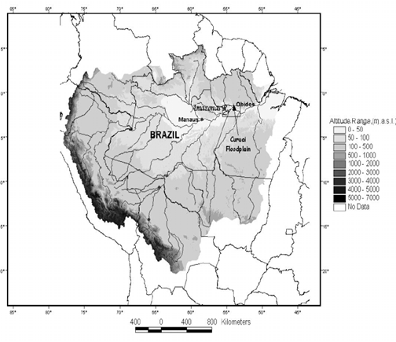

Slide 28
