Slide 1
Agricultural Green and Blue Water Consumption and its Influence on the Global Water System
Presented by Brandi Murphy
Authors: Stefanie Rost, Dieter Gerten, Alberte Bandeau, Wolfgang Lucht, Janine Rohwer, And Sibyl Schaphoff
March 13, 2017
NRES 701C

Slide 2

outline
Introduction
Methods
Results
Discussion
Conclusions And Outlook
Dreamstime.com

Slide 3
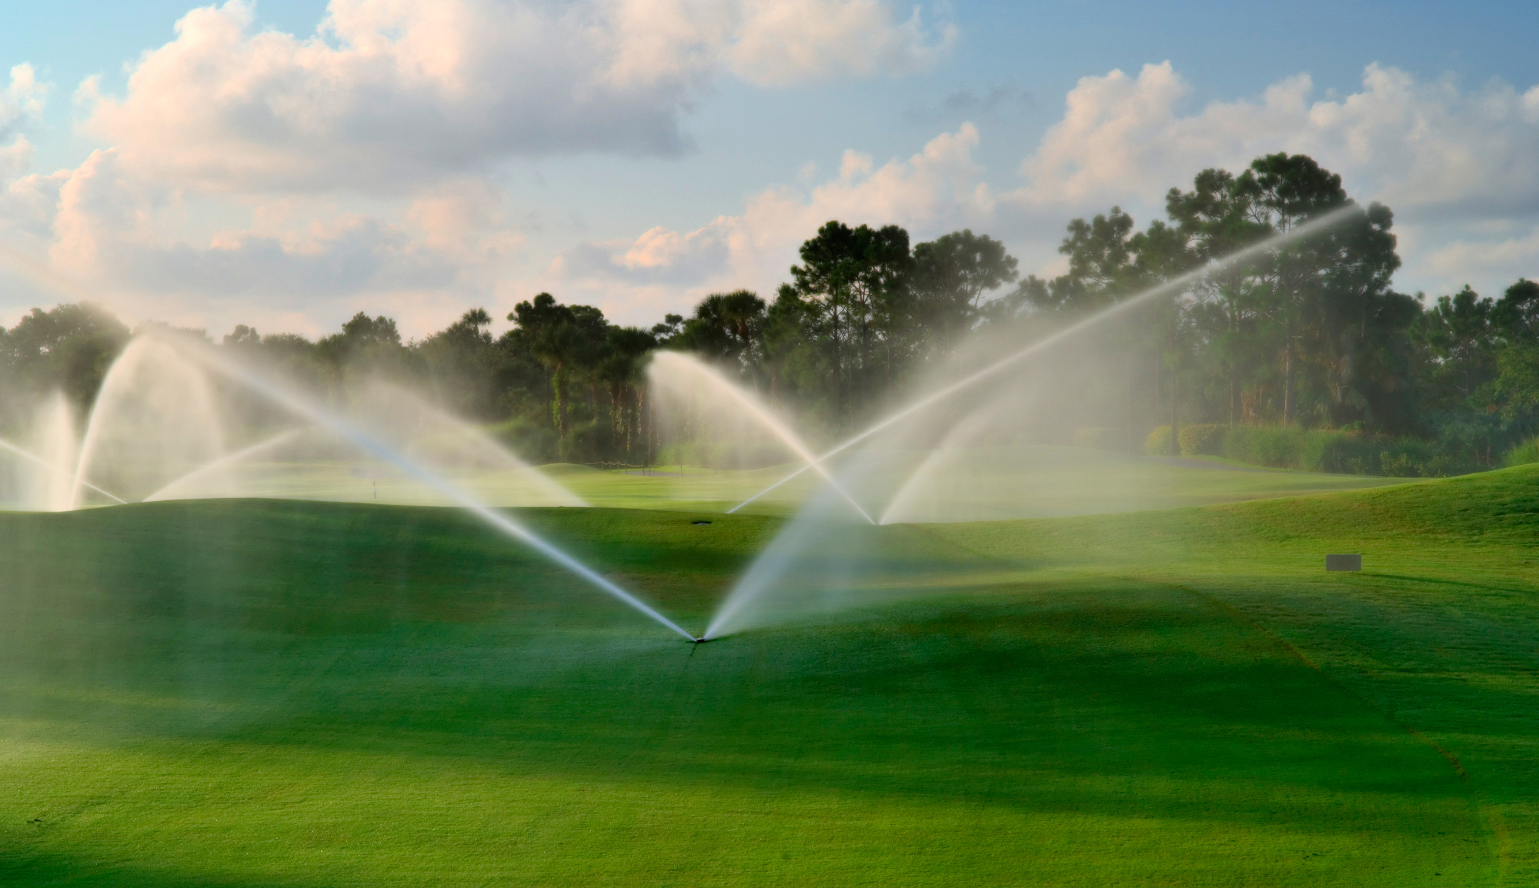
introduction
Human perturbations to the terrestrial water cycle.
Directly: withdrawals for agriculture, industrial and domestic use
70% total human blue water use is irrigation- the largest (2500 km³ year ⁻¹)
Global agricultural blue water consumption
90% of this overall use
However, agricultural water consumption is not primarily dependent on blue water withdrawals
Ars.usda.gov
Indirectly: land cover conversions and anthropogenic climate change
Notes:
Human perturbations to the terrestrial water cycle are increasing with the rise in global population and the water required to produce food.
There are two ways these changes are brought about; directly and indirectly.
We directly effect the water cycle by withdrawing water for agriculture, industrial and domestic use.
Irrigation water is the largest use of blue water globally, estimated at 70%.
Global agricultural blue water consumption is the amount of blue water that transpires productively through plants and evaporates unproductively from soils and bodies of water.
It is, however, a misconception to assume agricultural water consumption relies primarily on blue water withdrawals because 80% of global cropland is rainfed and 60-70% of the world’s food is produced on this cropland.
In some regions such as sub-Saharan Africa, more than 95% of food production depends on green water irrigation.
This places the global rainfed consumption on irrigated lands at 5000 km3/year.
We indirectly effect the water cycle through land cover change and anthropogenic climate change.

Slide 4
Introduction (cont’d)… guiding research questions
How much green water is consumed globally, differentiated between rainfed agriculture, irrigated agriculture, and natural terrestrial ecosystems?
How does this relate to blue water consumption?
How much blue water stems from nonrenewable water and from distant resources?
What is the spatial and temporal variability of these flows?
How large was the effect of human land cover change and irrigation on green and blue water flows?

Slide 5
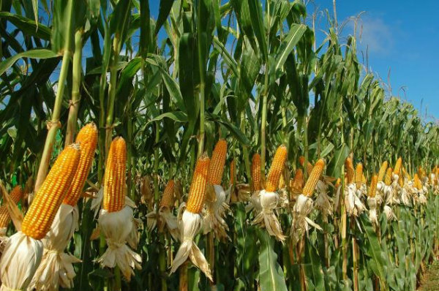
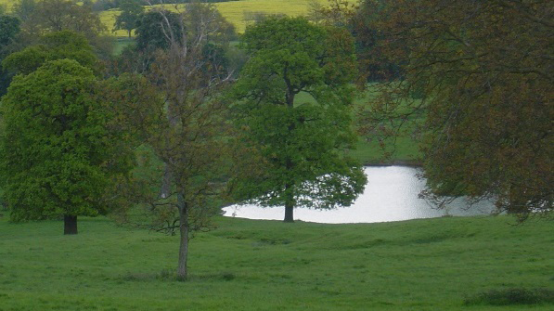
Methods
The Lund-Potsdam-Jena Managed Land (LPJmL) model
Dynamic global vegetation and water balance model.
What does it simulate? Key ecosystem processes
What does it compute?
Vegetation types
CFT
PFT
Model results have been extensively validated
Tutorialspoint.com
Dlf.com
Notes:
Simulates photosynthesis, evapotranspiration, autotrophic and heterotrophic respiration, allocation of assimilated carbon to different above and below-ground pools.
Computes the establishment, growth, and productivity of the major plant types and the associated carbon and water fluxes as well as their spatiotemporal variations in response to climatic conditions and human interference.
There are two categories of vegetation types:
CFT: Crop functional types and there are 12 of them; they are the worlds most important field crops.
PFT: Plant functional types: there are nine types that represent natural vegetation.
The authors have validated their model through biophysical and biogeographical observations such as leaf phenology, carbon dioxide fluxes and crop yields.

Slide 6

Methods (cont’d) simulation protocol
LPJmL model was run for the period 1901-2003
A 990-year spinup was run
Different precipitation data sets were used to estimate uncertainties in results that could have come from uncertainties in precipitation data.
Annual atmospheric CO₂ concentration
Soil information
Irrigated cropland
Data for irrigation efficiencies
Colourbox.com
Notes:
990-year spinup was done to PFT distribution and carbon pools to bring them into equilibrium.
I’ll go over the precipitation data sets momentarily.
Carbon dioxide info used from two previous studies by Keeling and Whorf [2005] and Stitch et al. {2003}.
Soil data derived from the food and agriculture organization.
Derived from a map of areas equipped for irrigation circa 2000.
Irrigation efficiency data prepared by Rohwer et al [2007],

Slide 7

Methods (cont’d) simulation protocol
Four simulations were performed all taking into account PFT’s and CFT’s, each driven by different precipitation data sets:
ILIM, extended and homogenized CRUTS2.1 global climate data set
IPOT, CRUTS2.1 (provided by the Climate Research Unit, University of East Anglia).
INO, data set by Matsuura and Willmott [2007].
PNV, VASClimO v1.1.
The general soil water balance simulated by LPJmL model:
W_{T}= Total water
W_{T-1}= Previous day’s water balance
P= Precipitation
M= Snowmelt
Irr= Irrigation water
E_{I}= Interception Loss
R= Runoff
E_{S}= Soil Evaporation
E_{T}= Plant Transpiration
p= Percolation
(all measurements in mm d⁻¹)
Notes:
ILIM: Irrigation water withdrawal is constrained by local, renewable water
IPOT: assuming sufficient water storage to fulfil Gross Irrigation Requirement
INO: Simulated without irrigation in order to assess the impact of irrigation on the terrestrial water balance.
PNV: simulation to look at potential natural vegetation only to assess the hydrologic impact of human land cover and land use change.

Slide 8
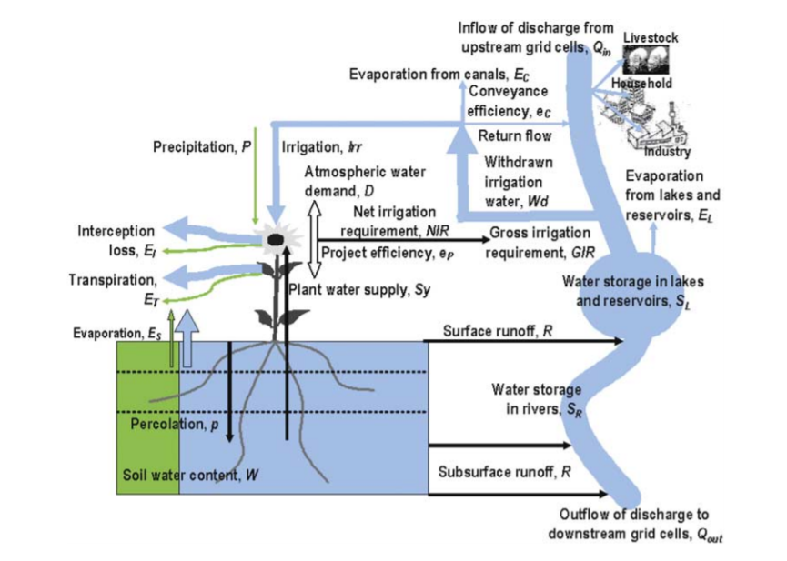
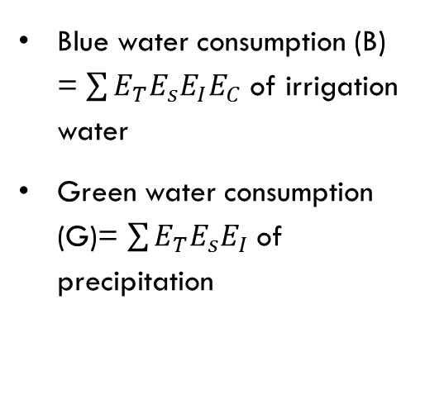
Methods (Cont’d)… LpjMl computes green and blue water flows
Blue water consumption (B) = $\sum{E_{T}E_{s}E_{I}E_{C}}$ of irrigation water
Green water consumption (G)= $\sum{E_{T}E_{s}E_{I}}$ of precipitation
Two alternate approaches for estimating the amount of blue irrigation water that can be withdrawn and brought to the field.
IPOT
ILIM
Water Resources Research, Vol. 44, W09405, doi:10.1029/2007WR006331, 2008
Notes:
This schematic represents the computed green and blue water flows
Blue water consumption is the amount of water consumed productively or unproductively

Slide 9
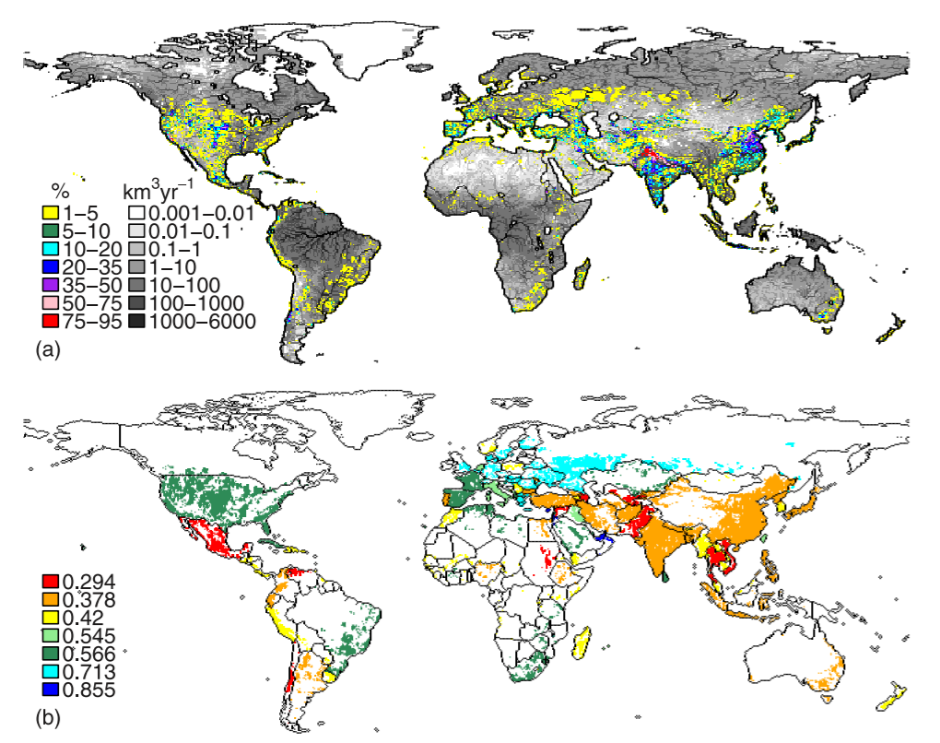
Methods (cont’d) Simulation protocol
(a) Grey= simulated river discharge from 1971-2000
colored = % area equipped for irrigation circa 2000.
(b) Irrigation efficiencies for equipped areas.
Water Resources Research, vol. 44, W09405, doi:10.1029/2007wr006331, 2008
Notes:
Looking at model simulated average river discharge.

Slide 10
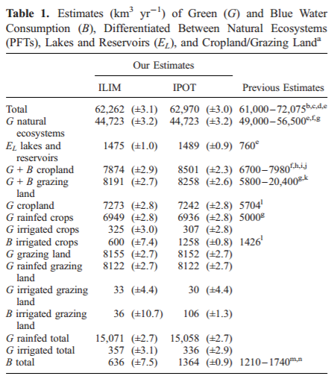
Results contemporary green and blue water consumption
Contemporary green and blue water consumption
Cropland and Grazing land dominated by green water consumption
ILIM and IPOT G contribution are slightly different
Water Resources Research, vol. 44, W09405, doi:10.1029/2007wr006331, 2008
Notes:
There were only a few countries where crop production depended primarily on green water: Egypt, Saudi Arabia, and Pakistan.
ILIM and IPOT green water contributions are different (higher in ILIM) because less blue water was withdrawn.

Slide 11
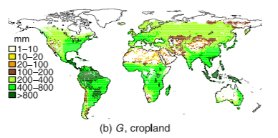
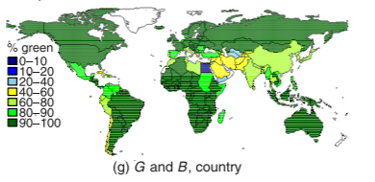
Results (CONT’D) contemporary green and blue water consumption
Water Resources Research, vol. 44, W09405, doi:10.1029/2007wr006331, 2008
1971-2000
(b) G as cropland per unit cropland area, IPOT
Reflects climatic conditions
Highest values in humid tropics
Lower values in cooler drier regions
(g) On a country scale, G water fraction of total water consumption (%)
G is predominant throughout most
Notes:
(g) illustrates beautifully that green water plays a major role for sustaining global food production in most countries of the world.

Slide 12
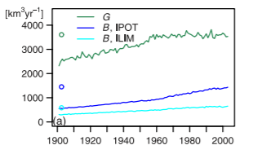
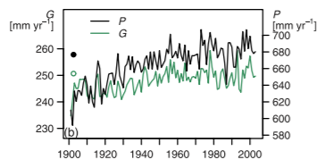
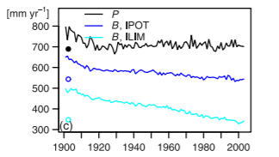
Results (cont’d) temporal variability in green and blue water consumption
Temporal changes related to climatic variability for the entire simulation period (1901-2003)
Water Resources Research, vol. 44, W09405, doi:10.1029/2007wr006331, 2008
(a) Annual G consumption on rainfed cropland and B consumption on irrigated cropland, averaged.
Indicates more G consumed on cropland recently compared to the beginning of the 20th century
Due to increasing area of cropland (B fed and G fed)
Growing difference in B in IPOT and ILIM = more water is being taken from non local and non renewable sources
(b) Shows pronounced interannual variability of rainfed cropland areas
(c ) Shows B consumption on irrigated cropland in relation to precipitation
Notes:
(a) The increase in river discharge has closely followed patterns of agricultural expansion. Highest.
(b) reductions in Q in IPOT were lower than expected because of the assumed extraction of non-renewable sources which increased Q

Slide 13
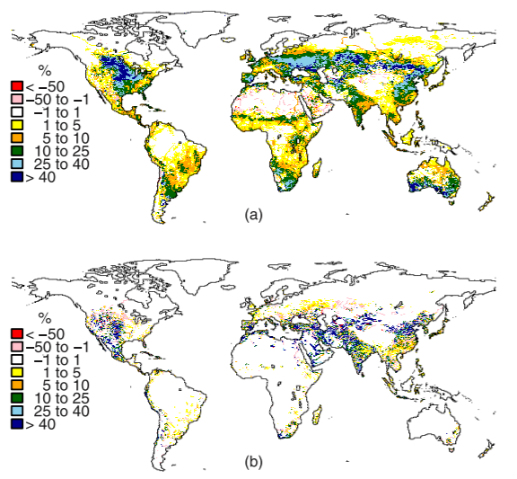
Results (cont’d) global effects of land cover change and irrigation
Assess the impacts of both anthropogenic land cover conversion and irrigation upon the global water balance.
Simulated river discharge, Q
Deriving the isolated land cover change effect: compared PNV and INO results
Deriving the isolated irrigation effect: compared INO, IPOT, and ILIM results
Net effect of both: Reduction in evapotranspiration by 0.9% and an increase in surface water flow by 4.4%
Water Resources Research, vol. 44, W09405, doi:10.1029/2007wr006331, 2008

Slide 14
Discussion
Anthropogenic influences are visible on a global scale through these simulations
The terrestrial water balance is greatly effected in areas of intense irrigation
Approximately half of global B withdrawals were found to come from non-renewable or non-local sources (IPOT) and therefore not sustainable
This figure has dramatically increased over the past century

Slide 15
Conclusions and outlook
Moving forward, development and application of new indicators of water scarcity and stress in both G and B
Enhanced assessments using advanced dynamic vegetation models could distinguish B and G flows, temporal dynamics for natural and agricultural vegetation, as well as rainfed and irrigated agriculture, better than ever before.
Future assessments are crucial with the growing global population and the irrigation effects on the water balance, especially under stress situations in climatic, economic and demographic change

Slide 16
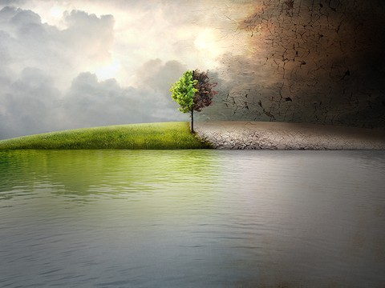
Questions/Comments
thank you!
Tottenhamtrees.com

Slide 17
Definitions/acronyms
Blue water: water withdrawn for irrigation from rivers, lakes and aquifers.
Nonrenewable
Green water: irrigation by precipitation
LPJmL model: Lund-Potsdam-Jena Managed Land model
PFT and CFT
IPOT and ILIM
INO and PNV

