Slide 1
Soil Moisture Evaluation in WRF Model
ATMS 790 Course Presentation
Xia Sun
Atmospheric Science Program, Physics Department
01/30/2017

Slide 2
Outline
Motivation
- Soil moisture-climate interactions
Soil moisture datasets
- Observation networks
- Satellite
- Reanalysis datasets
Evaluation in the WRF model
- Comparison with in situ observations
- Comparison with reanalysis datasets
Conclusion

Slide 3
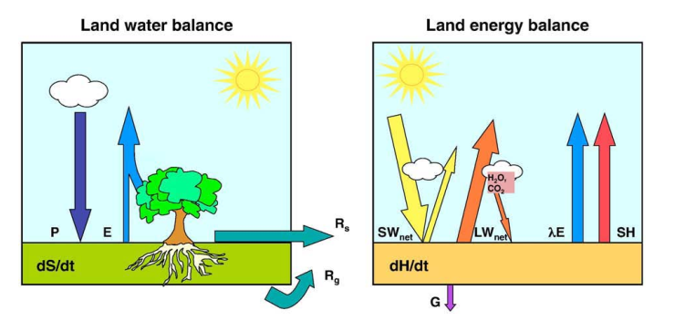


Motivation
dS/dt is the change of water content within the given layer
P is the precipitation
E is the evapotranspiration
Rs is the surface runoff,
Rg is the drainage
dH/dt refers to the change of energy within the same layer
Rn is net radiation
λE is the latent heat flux
SH is sensible heat flux
G is ground heat flux
(Seneviratne et al. 2010)
Notes:
The role of soil moisture in the land energy and water balances
Include latent heat of evaporation of water and call it λ (lambda). Include evapo-transpiration rate and call it Ε

Slide 4
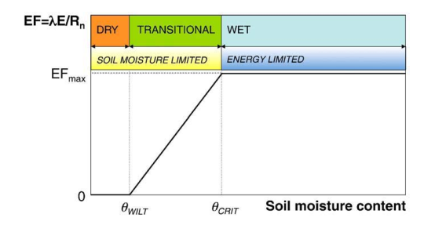
Soil moisture–evapotranspiration coupling
Definition of soil moisture regimes and corresponding evapotranspiration regimes
(Seneviratne et al. 2010)
Notes:
1. Three evapotranspiration regims; 2 this is the basic conceptual model which is use in different land use models. 3 the transitional areas Only in transitional regions between dry and wet climates are both conditions met
for strong soil moisture–climate coupling: a strong dependency of
evapotranspiration on soil moisture and large mean evapotranspiration

Slide 5
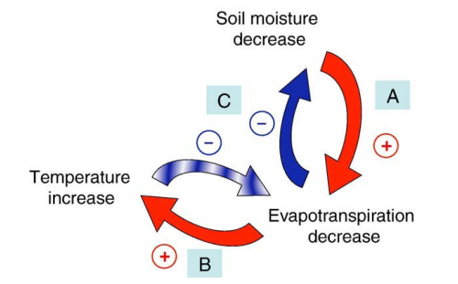
Soil moisture–temperature coupling
Processes contributing to soil moisture–temperature coupling and feedback loop
(Seneviratne et al. 2010)
Notes:
Impacts near-surface temperature, be relevant to extreme hot temperatures and hot waves. Three steps of the feedback loop.
Less soil moisture, less latent heat fluxes, suppressed evapotranspiration,

Slide 6
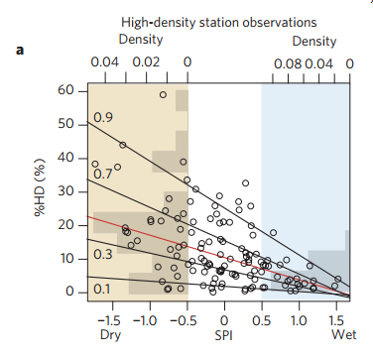
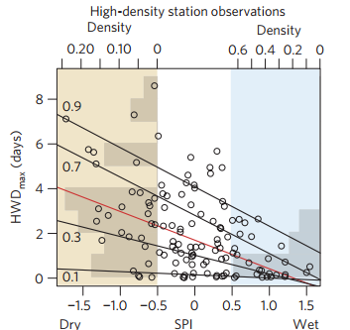
Soil moisture–temperature coupling
Observation Evidence
SPI:
standardized precipitation index
%HD:
the percentage of hot days
HWDmax
the maximum heat-wave duration
Hot extremes versus SPI
(Hirschi et al 2010)
Notes:
standardized precipitation index
(SPI; ref. 13, see Methods), a commonly used drought index23,24,
and two temperature indices from the CECILIA climate and extreme database (see Methods): the percentage of hot days
(%HD) and the maximum heat-wave duration (HWDmax).
Be imporatant to heat wave and extrement temperature forecast

Slide 7
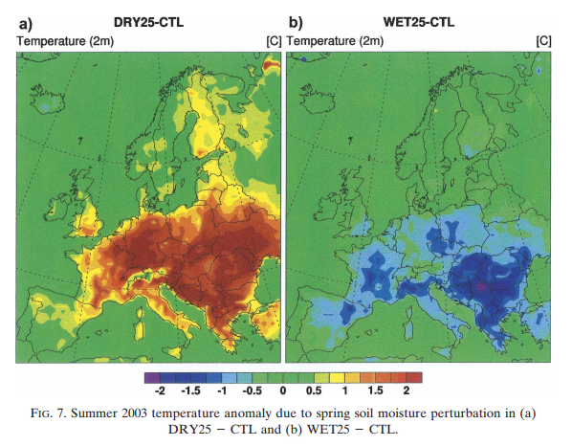
Soil moisture–temperature coupling
Model Evidence
DRY25:
Soil Moisture×(1-25%)
T+2℃
WET25:
Soil Moisture×(1+25%)
T-1.5℃
CTL:
Controlled simulation
The Climate High-Resolution Model (CHRM) version 2.3
(Fischer et al. 2007)
Notes:
The effect of soil moisture on air temperature is commonly referred as soil moisture-temperature coupling.
1.Senstivity experiments
2.spatial temperature anomaly patterns of the
DRY25 and WET25 simulations with respect to the
unperturbed CTL simulation

Slide 8
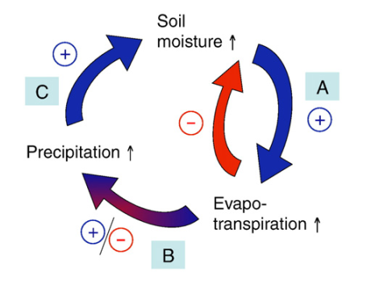
Soil moisture–precipitation coupling
Uncertain Link
Processes contributing to soil moisture–precipitation coupling and feedback loop
(Seneviratne et al. 2010)
Notes:
Three components, C and A are straightforward. B is most uncertain. Model evaluation results: 1. higher evapotraspiration-higher precipitation, 2. under some conditions, convective istability and cloud formation is stronger under dry surface; observation: positive, negative, and no feedbacks

Slide 9
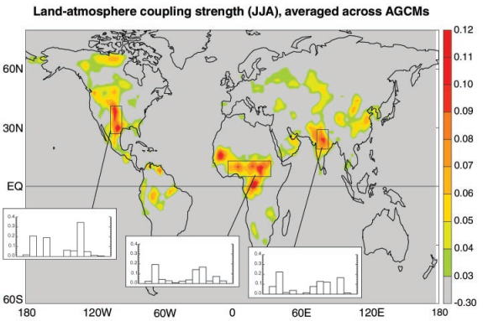
Soil moisture–precipitation coupling
The land-atmosphere coupling strength diagnostic for boreal summer averaged across the 12 models participating in Global Land Atmosphere Coupling Experiment (GLACE).
(Koster et al. 2004)
Notes:
This map Improve seasonal rainfall forecasts, diagnostic parameter，multiple models results, areas lie in the transitions zones between the dry and wet condtions, where evaporazation is large enough and also impacted by soil mositure
the Ω difference, dimensionless, describing the impact of soil moisture on precipitation),

Slide 10

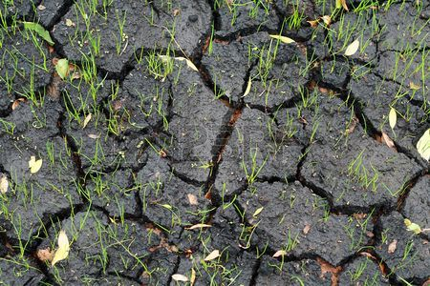

Further Relevant Aspects
Large-scale impacts
Albedo
Biogeochemical cycles
Notes:
1. model, India monsoon, dry conditions induced a stronger monsoon, model suggest impacts also on north American system; 2. bare soil, vegetation, drought impacts on vegetation; 3. plant’s productivity, assimilation of co2 in plants is couple with their water loss through transpiration. Impacts Global carbon cycle

Slide 11
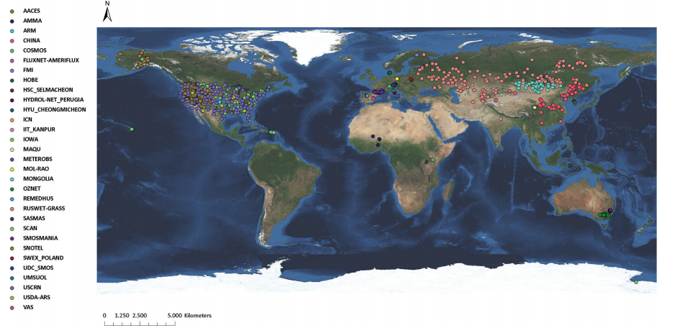
Observation Networks_ISMN
Stations currently contained in the International Soil Moisture Network (ISMN)
(status November 2012)
(Dorigo et al. 2013)
Notes:
1. Meant to provide observations for calibration and validation for satellite and output from LSM models. 2. temporal resolution depend on stations from daily to hourly, no data is omitted, untrustworthy data are flagged. Users need further processing when use this data；3. 55 netwroks ,2200 stations； 4 include stations from Europe asia and also north america

Slide 12
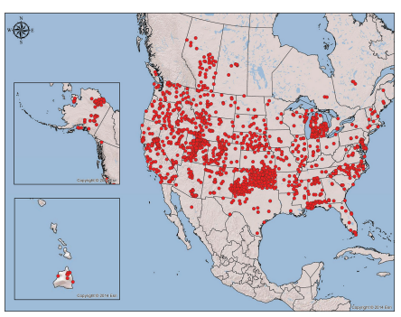
Observation Networks_NASMD
-
Stations currently contained in the North American Soil Moisture Database (NASMD)
(Quiring et al. 2016)
Notes:
motivation for NASMD is to investigate processes by which soil
moisture variability influences climate on seasonal to interannual time scales over NorthAmerica.
Data are processed , daily resolution, this is good for harmonized dataset. But they result in loss of information like diurnal variation.
34 networks
Expected more networks and single stations from Canada and Mexico

Slide 13


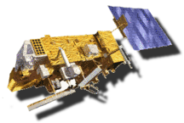
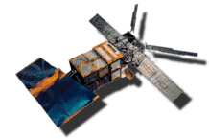


Satellite Observations
SMOS
SMAP
METOP
Operations: launch in 2009
Resolution: 30 km
Operations: launch in 2013
Resolution: 10 /40 km
Operations: 2006-2020
Resolution: 25/50 km
ERS
AQUA
Coriolis
Operations: 1991-2010
Resolution: 25/50 km
Operations: 2002-2011
Resolution: 50 km
Operations: since 2003
Resolution: 50 km
https://ismn.geo.tuwien.ac.at/satellites/
Notes:
Indirect measurements, active and passive remote sensing, different launch time and different resolutions, provide useful datasets of soil moisture products. But needs in situ meansurement validation

Slide 14
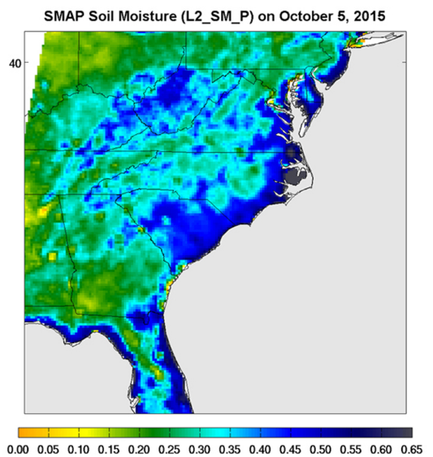
Devastating Carolina Floods Viewed by NASA's SMAP
Surface soil moisture in the Southeastern United States as retrieved from NASA's Soil Moisture Active Passive (SMAP) satellite observatory at around 6 a.m. on Oct. 5, 2015.
(http://smap.jpl.nasa.gov/news/1253/devastating-carolina-floods-viewed-by-nasas-smap/)
Notes:
Large parts of South Carolina appear blue, representing the impact of heavy localized rains and flooding. Regions in blue indicate areas with saturated soil conditions and possible standing water. Devastating Carolina Floods Viewed by NASA‘s SMAP， has a specific soil moisture retrievel goal is 0.04 m3.m-3 rmse

Slide 15
Reanalysis datasets
Reanalysis Dataset | Resolution | Forecast Model | Land Surface Model | Soil layers
NCEP North American Regional Reanalysis (NARR) | 32km 3-hourly | Eta 32km model | Noah | Four layers: 0-10, 10-40, 40-100, 100-200cm
NCEP North American Mesoscale (NAM) | 12km 6-hourly | WRF Non Hydrostatic Mesoscale Model | Noah | Four layers: 0-10, 10-40, 40-100, 100-200cm
ERA-Interim Project (ERA-I) | 1.125 to 0.703 degrees 6-hourly | European Centre for Medium-Range Weather Forecasts (ECMWF) | Tiled ECMWF Scheme for Surface Exchange over Land (TESSEL) | Four layers: 0-7, 7-28, 28-100, 100-255cm
Global Climate Prediction Center (CPC) reanalysis dataset | 0.5 degrees monthly | N/A | One layer bucket water balance model | One layer 0-1.6m
Notes:
The soil moisture calculated by reanalyses depends
on the land surface scheme used, the forcing (particularly
precipitation and solar insolation), and the nudging
employed.

Slide 16

Reanalysis datasets
Noah
Θ: soil moisture
D_{θ}: soil water diffusivity
K_{θ}: hydraulic conductivity
F_{θ} is a source/sink term for precipitation/evapotranspiration
Notes:
Noah: Richard Equation . 2.
Soil moisture volumetic soil concentration The hydraulic conductivity K and diffusivity D depend on soil texture, non linear functions of soil texture and soil moisture, and Fu denotes additional sources and sinks of water.
This land surface model needs forcing datasets, like radition and precipitation , land use datasets, and some parameters to feed in.
Noah is coupled with ncep modelsNorth American Mesoscale
model (NAM; short-range), Global Forecast System (GFS;
medium-range), Climate Forecast System (CFS; seasonal), &
other NCEP modeling systems (i.e. NLDAS & GLDAS)
Coming from 04-Ek-EMC-land-physics

Slide 17


Reanalysis datasets
TESSEL
Superscript a stands for analyzed values
superscript f for forecasted values
subscript i identifies the soil layer
The coefficients α_{i} and β_{i} determine the weight that is given to the increments of temperature (Tª-T^{f}) and relative humidity (RHª - RH^{f} ) with respect to the first guess of soil moisture
(DOUVILLE et al. 1999)
Notes:
TESSEL: The assimilation technique used for soil moisture is the
optimal interpolation and the spatial resolution is about 80 km。 corrections
applied in each soil layer (analysis increments) are linear
combinations of atmospheric increments of 2-m temperature and relative humidity;
1. Add an artificial term
2. Every 6 h, corrections applied in each soil layer (analysis increments) are linear combinations of atmospheric increments of 2-m temperature and relative humidity.
3. Α and β the coefficients are such uf i
that they minimize the variance of resulting analysis error
4. At ECMWF the analysis is done at 6-h intervals
by modifying the 6-h forecast (first-guess) from the previous analysis on the basis of observations.
Source Evaluation of the Optimum Interpolation and Nudging Techniques for

Slide 18
Reanalysis datasets
Bucket
dw/dt = P-E-R-G
W: soil moisture in a single column of depth 1.6 meter, mm;
P: precipitation, mm/month;
E: evaporation, mm/month;
R: runoff, mm/month;
G: loss to groundwater, mm/month
Notes:
CPC, ne?layer ?bucket? water balance model, The model takes observed precipitation and temperature and calculates soil moisture, evaporation and runoff. The potential evaporation is estimated from observed temperature. Monthly averaged

Slide 19
Downscaling in WRF
eg.1-degree NCEP Global Final Analysis (FNL).
eg. a grid spacing at 36 km over the conterminous U.S
Large Scale
/Global
Climate information
Small Scale
/Regional
Statistical downscaling
Model Physics
Downscaling
Dynamic downscaling
Downscaling itself
Notes:
To capture the features of the driving force through the domain, grid nudging is conducted in every grid cell

Slide 20
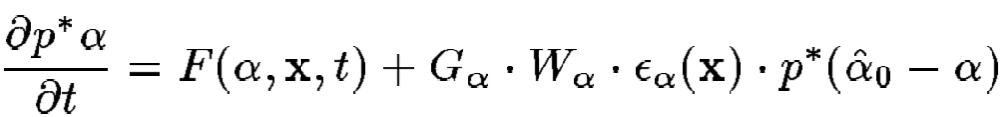

Downscaling in WRF
Downscaling in WRF configurations
Grid-nudging (analysis nudging)
Spectral nudging
grid_fdda=1
if_no_pbl_nudging_uv = 0
guv = 0.0003,
if_zfac_uv = 0,
k_zfac_uv = 10,
grid_fdda=2
xwavenum = 2,
ywavenum = 2,
；DomainSize/wavanum ≈ 1000km
p*: pressure difference of surface and top layer; α is the variable to be nudged; F represents all of the model’s physics terms; G determines the nudging strength; ϵ is the analysis quantity factor; α₀ is estimated for α
Q: prognostic variable to be nudged; L is the model operator, Q₀ is the variable from the driving fields. Q_{mn} and Q_{omn} are the spectral coefficients of Q and
Q_{o} respectively. K_{mn} is the nudging coefficient, which can vary with m and n and also with height; m and n are the wave numbers in the x and y directions
(Stauffer et al. 1991)
(Miguez-Macho et al. 2004)
Notes:
1. Each grid-point is nudged towards a
value that is time-interpolated from
Analyses. Which variable not to nudge in the pbl; model level below which nudging is turned off; guv is nudging coefficient
2. Spectrum ,adding a new term to the tendencies of the variables that relaxes the selected part of the spectrum to the corresponding waves
from reanalysis, nudge features on wavelengths longer than 1000 km
3. spectral nudging can spectral nudging can help eliminate the large-scale precipitation bias, and, at the same time,
maintain the features of small scale.

Slide 21
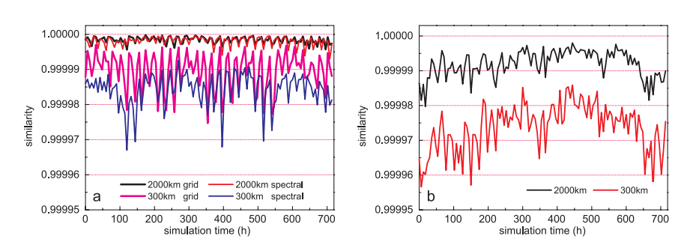
Downscaling in WRF
Grid nudging vs Spectral nudging
NCEP/NCAR data _WRF
NCEP/NCAR data_NARR
Time series plots of similarity for temperature at 850 hpa, 2000 km and 300 km scales for July 2009. (a) similarity between NCEP/NCAR and downscaling results by WRF by grid and spectral nudging; (b) similarity between NCEP/NCAR and NARR data.
(Liu et al. 2012)
Notes:
larger scale 2000km, high similarity better; small scale 300km, low similarity better, need to produce more variance in RCM
Ncep analysis 2.5*2.5, 209km; NARR 32km, NCEP vs NARR provide the ideal decrease of similarity from large scale to small scale
WRF 36 km resolution, regrided
a) both high similarities at large scales, which means at the large scale, both of the nudging techniques are equally capable of capturing the features of the
driving fields.

Slide 22
WRF Evaluation of Soil Moisture
The Soil Moisture Observing System (SMOS) Meteorological Automatic Network Integrated Application
In Situ Observation
5, 10, 20, 30cm
Model
WRF-Noah
0-10, 10-40, 40-100,
100-200cm
0-7, 7-28, 28-100,
100-255cm
ERA-I
CPC
Reanalysis Dataset
1.6m
Notes:
WRF-Noah is evaluated against
ERA-I and CPC.

Slide 23
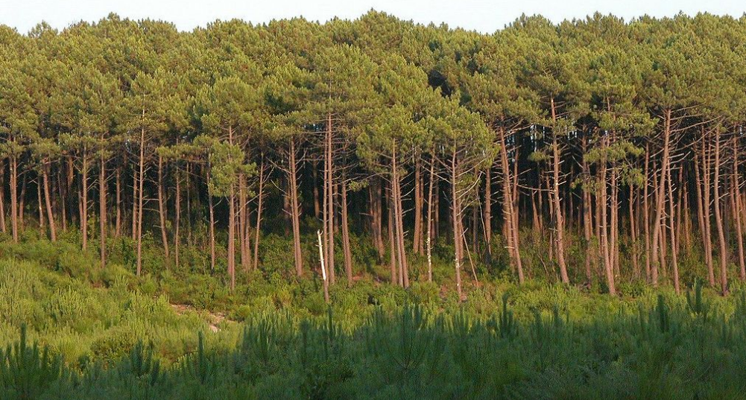
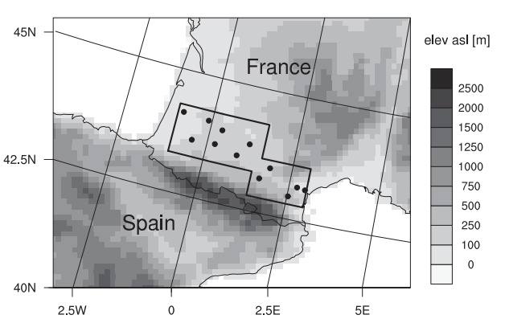
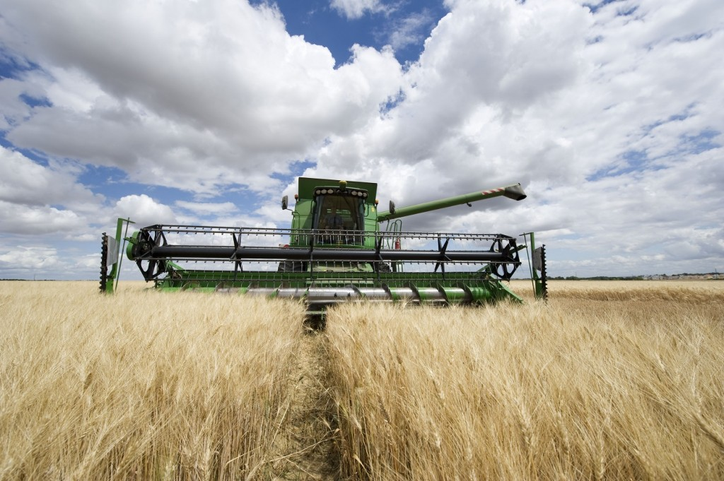
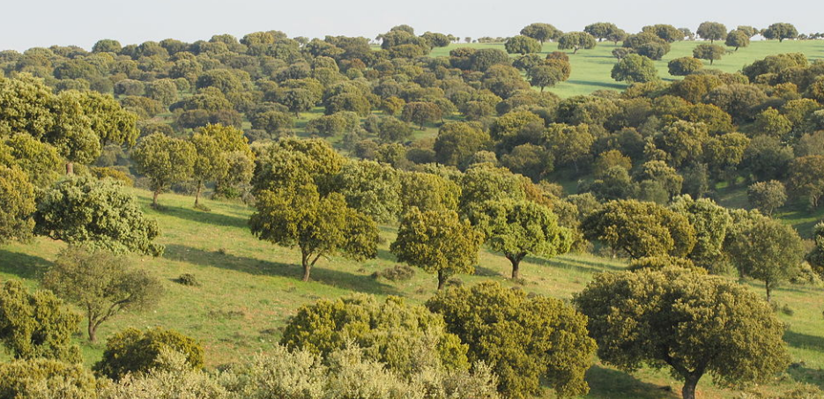
Observation Sites
Twelve measurement stations and the domain used to do the aerial average in WRF and reanalysis datasets
Notes:
three most westward stations are located within the forest
area of the For^ et des Landes, consisting mainly of Aleppo
pines on sandy soils.
The three most eastward stations are
located within forests of Mediterranean type
Six station between is cropland

Slide 24
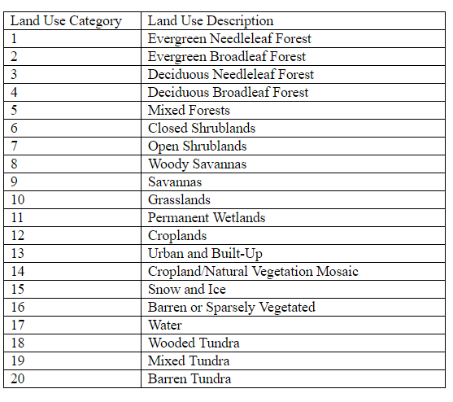
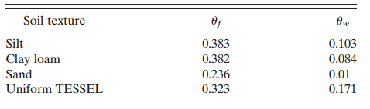
Land Use Classification
Modified version of the Boston University–International Geosphere–Biosphere Program (IGBP) land cover classification based on data from the Moderate Resolution Imaging Spectroradiometer (MODIS)
In situ sites
Forest area of Forêt des Landes
sand
Croplands
silt clay loam
Mediterranean Forest
Table 1. Field capacity and wilting point of the dominant soil categories in the SM domain. ERA-I/TESSEL has a uniform
soil texture everywhere
clay loam
Notes:
1.WRF-Noah applies global datasets for land cover
classes and soil texture
2. Different soil texture have different soil charactersitics. Sand has the lowest soil moisture field capacity

Slide 25
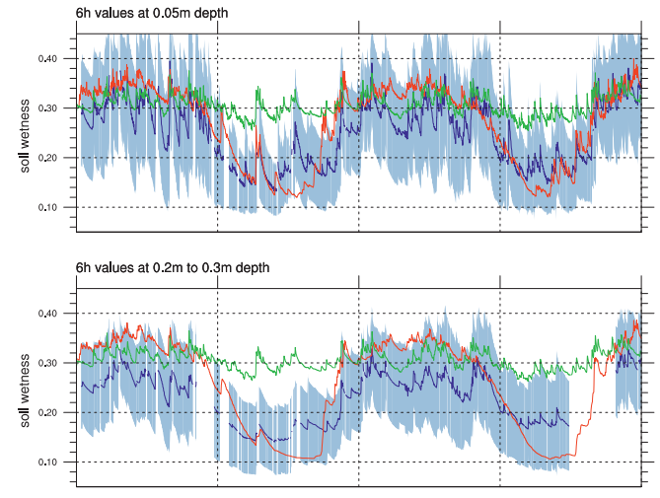
Comparison with in situ observations
In situ Observations
WRF-Noah
ERA-I
Seasonal variation of mean soil wetness comparison among in situ observations (blue), WRF-Noah (red), and ERA-I (green)
Notes:
The largest soil wetness is observed in late winter–spring.
Conditions at 5-cm depth are slightly wetter then at 25-cm depth； the temporal standard deviation under near-surface conditions at 5-cm depth is much larger.
Large SM, around 0.8; rmse deviation between WRF-Noah and SM is much lower than ERA vs SM
WRF-Noah is slightly correlations of WRF-Noah and ERA to wetter in winter–spring and in most cases is slightly drier in summer–autumn at 5-cm
depth. ERA-I is comparable to SM in winter–spring but significantly wetter during summer–autumn, with values comparable to those under wet conditions.
5. ERA-I ranks between WRFNoah and SM in winter–spring and is significantly
(0.15 m3 m23) wetter than SM in summer and autumn

Slide 26
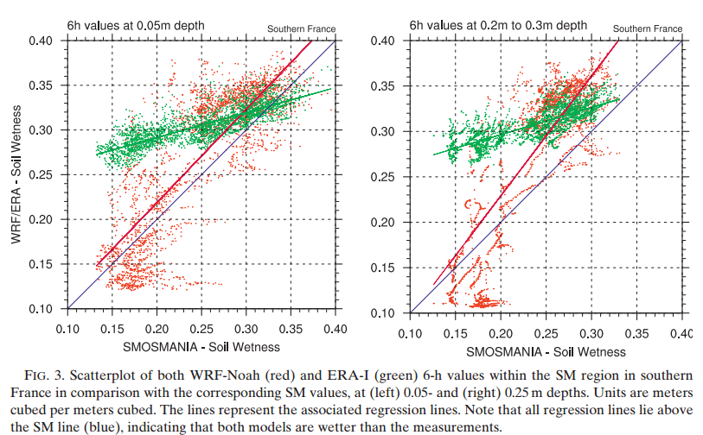
Comparison with in situ observations
In situ Observations
WRF-Noah
ERA-I
Notes:
the regression line of WRFNoah (red line) has nearly the same slope (1.044) as the
reference line of SM (blue line), but it is shifted 0.02 m3m23 toward wetter values
The slope of ERA-I’s regression line is fairly flat, with a smaller spread compared with Noah
At low soil wetness of SM, ERA-I is significantly larger. WRF-Noah is instead particularly drier
then SM under dry conditions
At values above 0.3 m3 m23, the differences get smaller
Two distinct
accumulations appear in the wet and dry values, representing either wet conditions during winter–spring or
dry conditions during summer–autumn.
At 0.25cm, Under dry conditions, most data points from the
WRF-Noah simulation are located below the blue reference line of SM, indicating that WRF-Noah is drier.

Slide 27
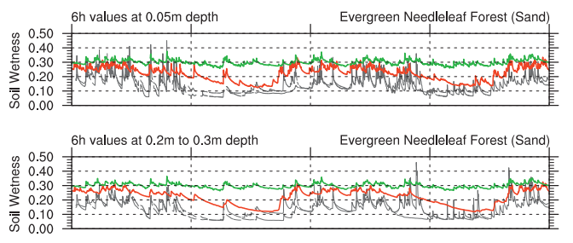
Comparison at different land use types
Evergreen Needleleaf Forest (sand)
In situ Observations
WRF-Noah
ERA-I
The 6-hourly soil wetness of those stations within Forêt des Landes compared with those grid points classified as evergreen needle leaf forest (sand) in WRF-Noah.
Notes:
1. During dry periods in summer, soil wetness
ranks below 0.1 m3 m23 because of low values of uf and
uw (see Table 1)
1. WRF-Noah
soil wetness is nearly twice as large at both depths in
summer–early autumn, especially during 2007.
2. WRF-Noah shows the largest variability on seasonal time scales reflecting the
seasonal cycle, which is also visible in the observations, but
less pronounced. ERA-I shows almost no seasonal variation and those variations corresponding to other time
scales are rather small as well
3. The propagation of rain signals downward into deeper soil layers is
underestimated in WRF-Noah. Lose some variation signals

Slide 28
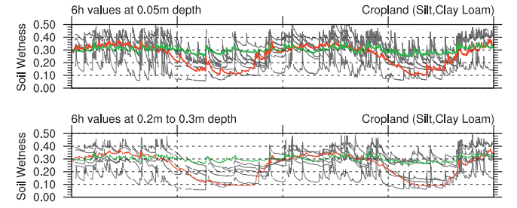
Comparison at different land use types
Cropland (Silt, Clay Loam)
In situ Observations
WRF-Noah
ERA-I
The 6-hourly soil wetness of those stations within cropland compared with those grid points classified as cropland (silt, clay loam) in WRF-Noah.
Notes:
1. In a cropland environment, a seasonal cycle is visible for all stations and for WRF-Noah. For ERA-I this
is not evident.
2. Regarding the mean values, WRF-Noah fitfairly well with
the observations in winter–spring and is drier in summer–
autumn. ERA-I is too wet during summer–autumn s

Slide 29
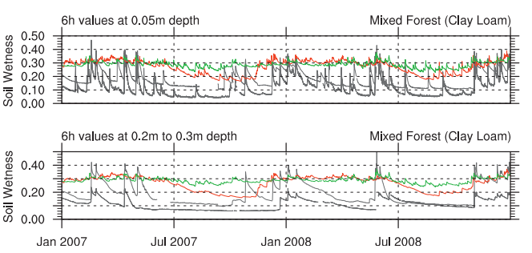
Comparison at different land use types
Mixed Forest (Clay Loam)
In situ Observations
WRF-Noah
ERA-I
The 6-hourly soil wetness of those stations within Mediterranean compared with those grid points classified as mixed forest (clay loam) in WRF-Noah.
Notes:
1. Contrary to sandy soils, only strong rain signals are visible in the deeper soil. Light rain, especially during
summer, only alters the soil wetness at 5-cm depth
2. WRF-Noah once again fails to dry the soil to uw.

Slide 30
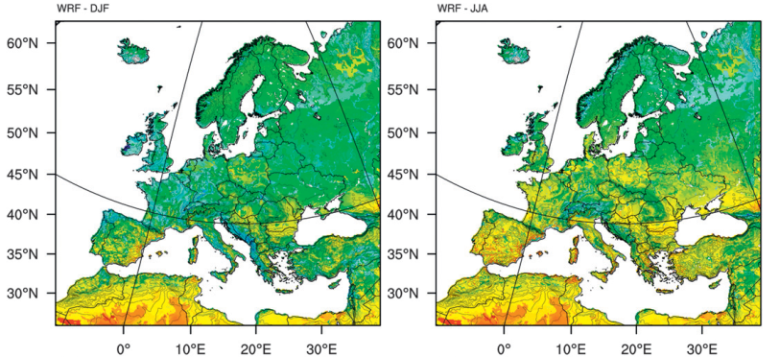
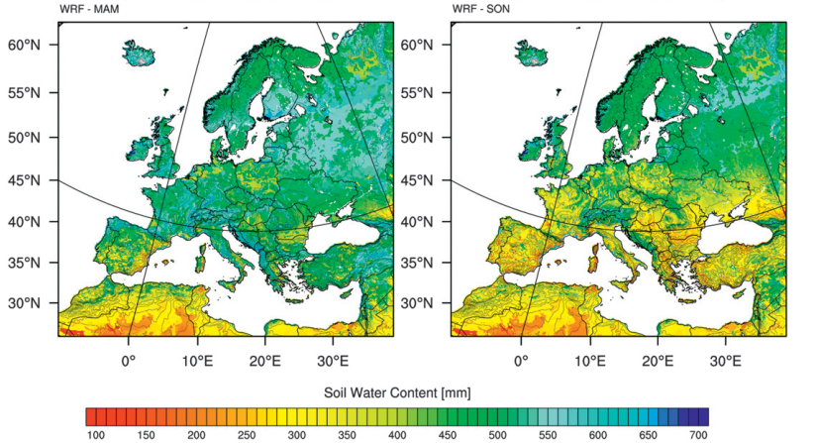
Comparison with reanalysis datasets
Winter
Summer
Spring
Autumn
Seasonal mean SWC of the WRF-Noah Model between 1990 and 2008. The corresponding soil layer depth is 1.6 m (1600 mm).
Notes:
Reverse color bars
SWC is highest during winter–spring and lowest in summer–autumn.
During winter-spring, High swc values are found in regions with large amounts of precipitation. Minimum values are in the desert regions of northern Africa due to very low annual mean precipitation
Minumum swc are found in Mediterranean Sea and in eastern Europe, regions with low precipitation and an high evaporative demand during summer

Slide 31
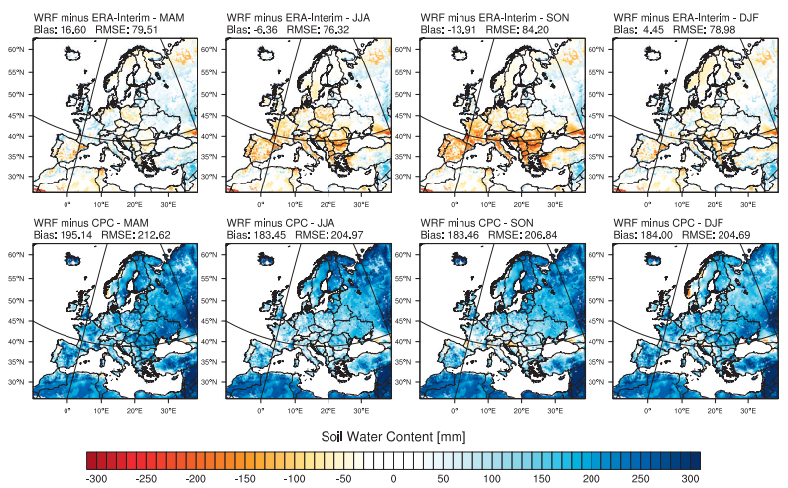
Comparison with reanalysis datasets
Spring
Summer
Autumn
Winter
WRF-ERA
Spring
Summer
Autumn
Winter
WRF-CPC
Difference in seasonal mean SWC (1990–2008) between the WRF-Noah Model and either (top) ERA-I or (bottom) CPC
Notes:
1. reveals the difference when subtracting either ERA-I SWC or CPC SWC from WRF-Noah.
2. According to CPC, WRF-Noah is wetter throughout the year with a mean bias of approximately 184 mm. Differences in central and western Europe range between 100 and 200 mm, which is significantly large
3. Small biases occur when comparing WRF-Noah with
ERA-I over the whole domain. However, on a regional
scale, differences are significantly larger. On the Balkans,
the Iberian Peninsula, and southern Russia, WRF-Noah
is drier during summer. Along the western coastlines and
some parts of Russia, WRF-Noah is wetter.

Slide 32
Conclusion
Soil moisture observations and realistic simulations are important due to the soil moisture-climate couplings
Larger values of soil moisture in winter appear most probably due to a significant overestimation of precipitation from model outputs.
Further detailed classifications of land use could improve soil moisture simulations
Dynamical downscaling clearly improves the representation of the soil hydrology.

Slide 33
THANKS!

Slide 34
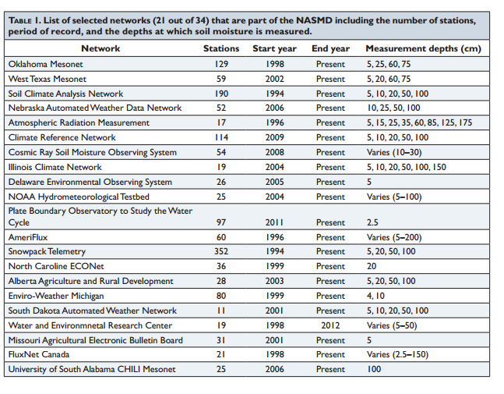
NASMD Network

Slide 35
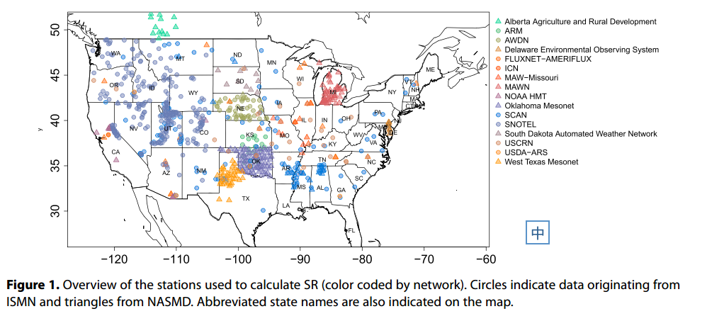
Stations Over North America

Slide 36
Soil moisture–precipitation coupling
where X is soil moisture here; σ²_{<x>} is the intraensemble variance of X; σ_{x} is the corresponding variance of the ensemble of precipitation
The land-atmosphere coupling strength diagnostic for boreal summer (the Ω difference, dimensionless, describing the impact of soil moisture on precipitation), averaged across the 12 models participating in Global Land Atmosphere Coupling Experiment (GLACE).
(Koster et al. 2004)
Notes:
This map Improve seasonal rainfall forecasts, diagnostic parameter，multiple models results, areas lie in the transitions zones between the dry and wet condtions, where evaporazation is large enough and also impacted by soil mositure

Slide 37
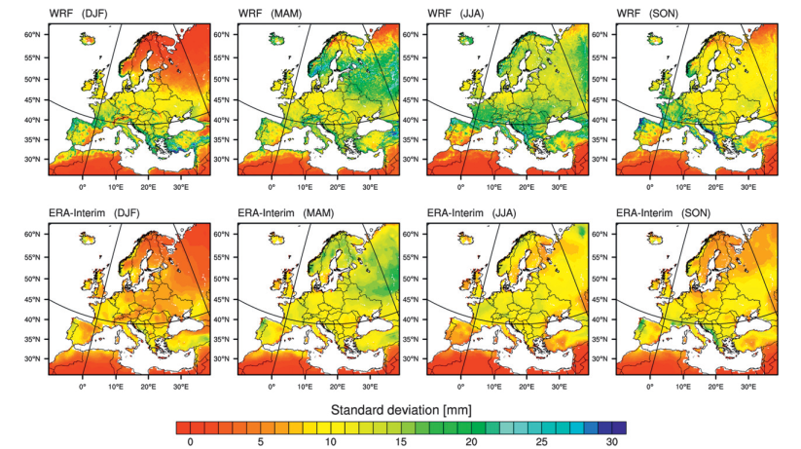
Comparison with reanalysis datasets
Winter
Spring
Summer
Autumn
WRF
Winter
Spring
Summer
Autumn
ERA-I
Mean of 18 seasonal standard deviations (mm) of SWC (from 1990 to 2008) for (top) WRF-Noah and (bottom) ERA-I
Notes:
In winter, areas in northern Europe show nearly no
variation in either of the models. In southern Europe,
values are high, especially along the nortMediterranean Sea. In spring, overall, high standard deviations
are found in most parts of northern-central and eastern
hern Europe. During autumn, the maximum values of variability are located along the eastern Adriatic coast and
in northern Portugal–Spain.

