Slide 1

Black Carbon and Its Climate Effects
Lan Gao
01/23/2017
ATMS 790
Trade cumulus clouds embedded in haze over Northern Indian Ocean, photo taken by Eric Wilcox

Slide 2
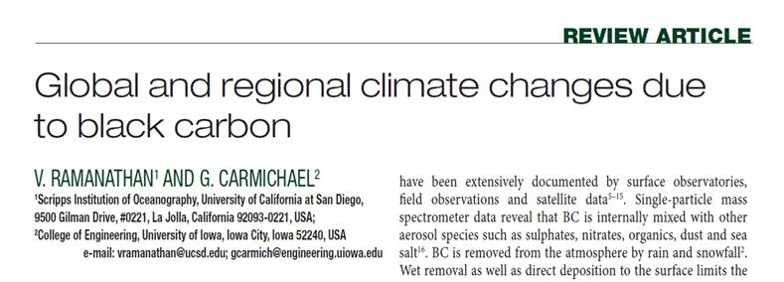
Materials
Two articles:
This review paper summaries the general and broad view of black carbon (BC) effects on the Earth climate.
Notes:
Ramanathan, V., and Carmichael, G.: Global and regional climate changes due to black carbon, Nature Geoscience, 1, 221-227, 1752-0894, 2008.
Wilcox, E. M., Thomas, R. M., Praveen, P. S., Pistone, K., Bender, F. A., and Ramanathan, V.: Black carbon solar absorption suppresses turbulence in the atmospheric boundary layer, Proceedings of the National Academy of Sciences of the United States of America, 10.1073/pnas.1525746113, 2016.

Slide 3
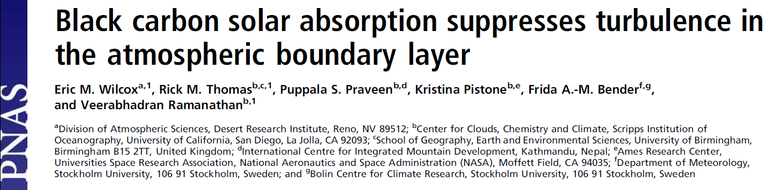
Materials
Two articles:
This paper gives new insights into how BC may affect boundary layer turbulence, which in turn affects climate through cloud processes.

Slide 4
Outline
Background
Definition
Source and sink
Global distribution
Radiative forcing due to BC
Top of atmosphere (TOA) forcing
Atmospheric heating
Surface dimming
Climate change impacts
Global
Regional
New insights
Discussion and summary
Reference

Slide 5
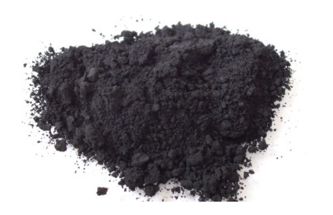
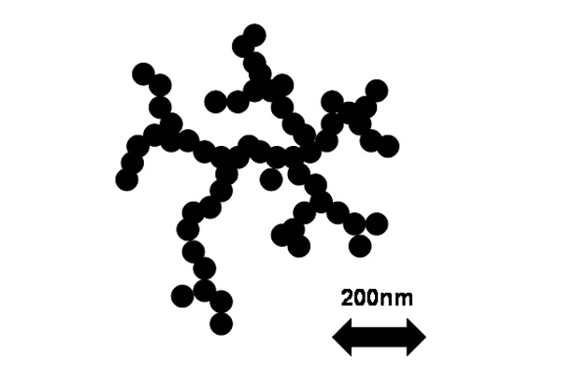
What is black carbon?
“Carbonaceous component of particulate matter that absorbs all wavelengths of solar radiation”--- US EPA (2012).
A product from incomplete combustion.
Source: http://www.cas.manchester.ac.uk/restools/instruments/aerosol/sp2/background/soot_particle/index.html
http://ashvacuumreview.com/is-an-ash-vacuum-a-soot-remover/

Slide 6


Source: http://gemmy.wikia.com/wiki/Funtime
http://www.keyword-suggestions.com/Y2F1dGlvbiBob3Q/

Slide 7

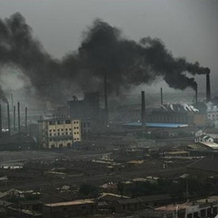
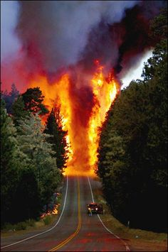
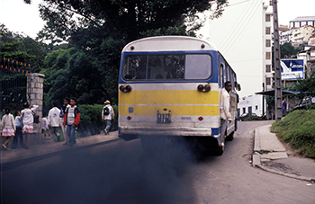
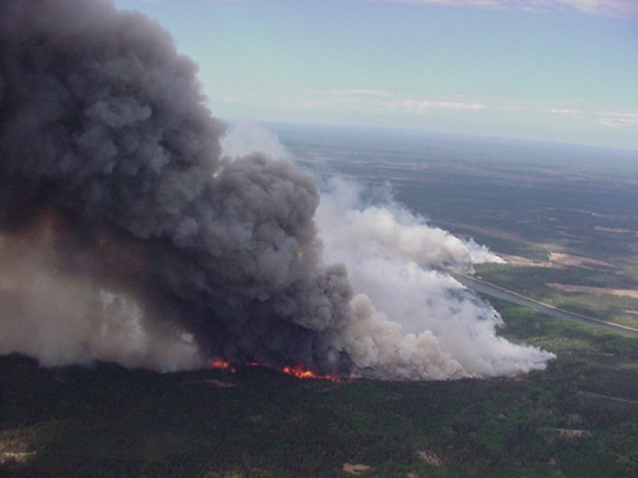
What are the sources for BC?
Source: See page 29.

Slide 8
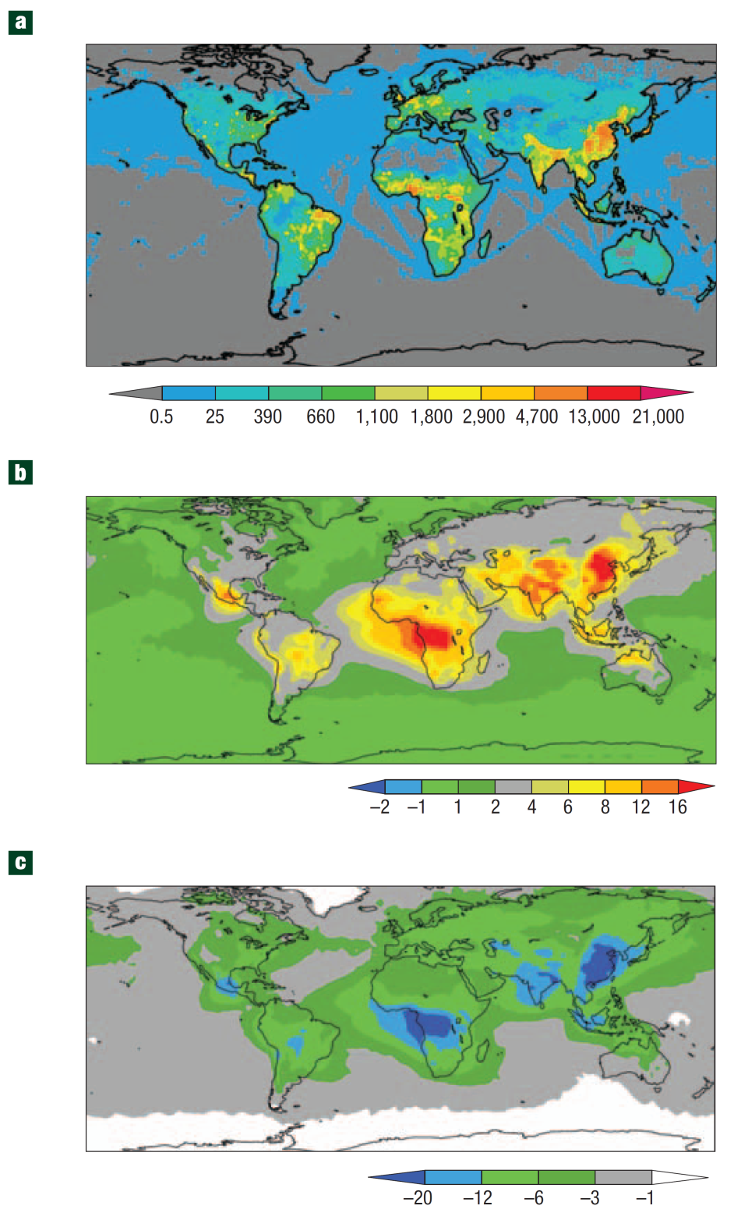
Where is black carbon on Earth?
Source: Global distribution of black carbon emissions (tons/year) for the year 1996 from Bond et al (2004).

Slide 9
What are the sinks for BC?
Typically through dry and wet removal processes.
Rainwater washing is the most important.
Limit the lifetime of BC to about one week, much shorter than GHG.
Q: What is the lifetime of typical GHG, for example, CO₂ ?

Slide 10
Why should we care about black carbon?
Climate:
Second strongest contribution to current global warming
Radiative forcing effects are much more complex than CO₂
Health:
Particulate emissions, especially from diesel exhaust (major source of BC), are linked to lung and heart disease, as well as cancer.
Note: Short lifetime and uneven spatial distribution of BC, we could control BC emission to delay warming trend quickly.

Slide 11
Radiative forcing due to BC
Radiative forcing (W/m²) is defined as the difference of insolation (sunlight) absorbed by the Earth and energy radiated back to space.
Positive forcing | More incoming energy | Warming
Negative forcing | More outgoing energy | Cool ing

Slide 12
Radiative forcing due to BC
Special role in radiative forcing was recognized since 1980s.
A number of field experiments: TARFOE (1996), ACE-II (1997), INDOEX (1999), MAC (2006), CARDEX (2012).
Different from CO₂ radiative forcing.
Radiative forcing | CO₂ | BC
Atmosphere | + | +
Surface | + | -

Slide 13
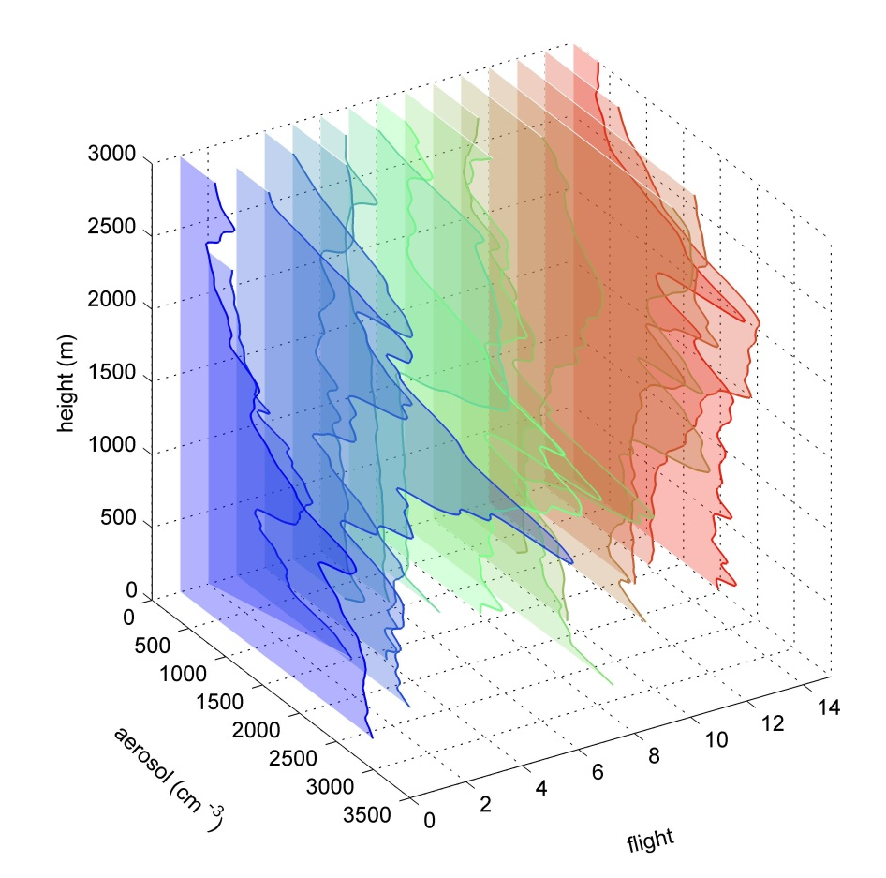
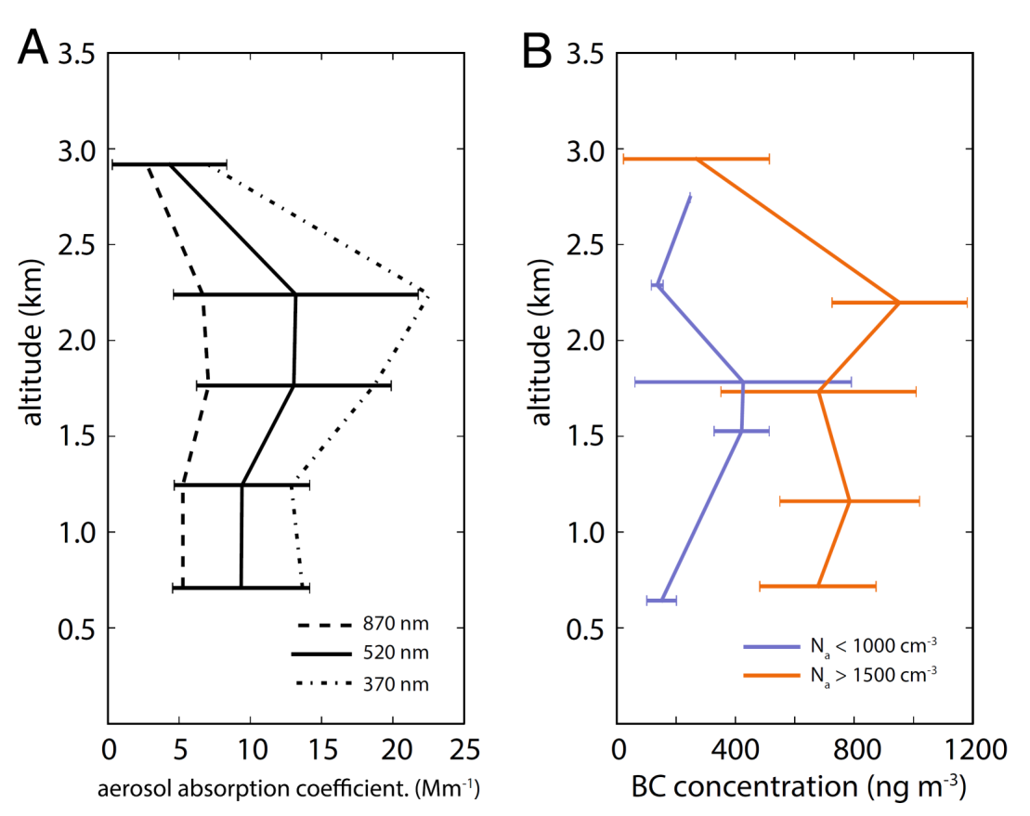
Radiative forcing due to BC
Increase in TOA radiative forcing:
Absorbing the solar radiation reflected by the surface–atmosphere–cloud system.
ABCs
Source: Typical aerosol vertical distribution (Gao, et al. prepare), absorption coefficient and BC concentration (Wilcox, et al, 2016) during CARDEX campaign.

Slide 14
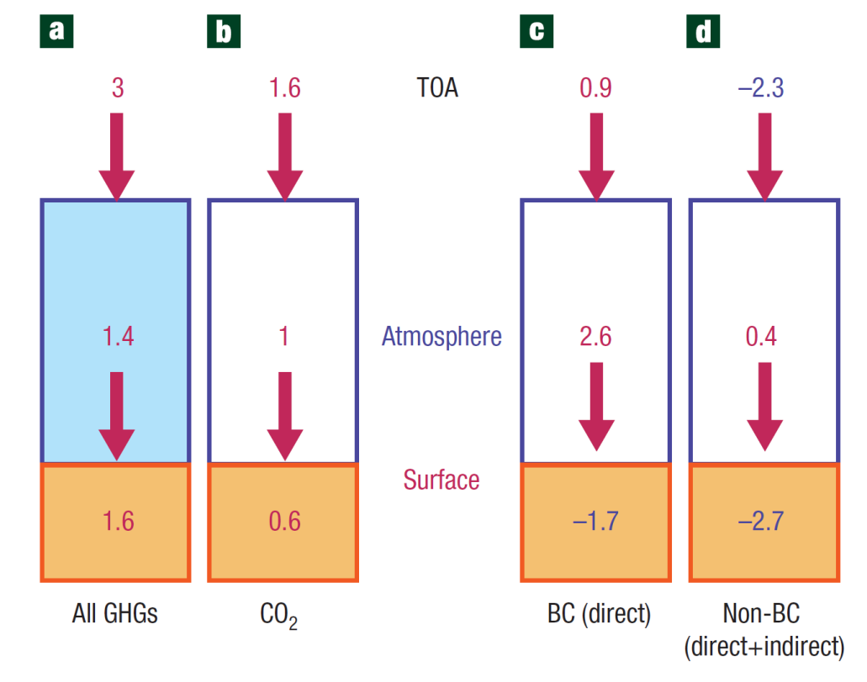
Radiative forcing due to BC
Increase in TOA radiative forcing:
Absorbing the solar radiation reflected by the surface–atmosphere–cloud system.
50% of GHGs
-1.4
55% of CO2
Observation: 0.4-1.2 W/m²
GCMs: 0.2-0.4 W/m²
mixing state
elevated level
biomass burning
Source: Comparison of the global mean radiative forcing due to GHGs with that of ABCs. (Ramanathan, et al, 2008)
14
14

Slide 15
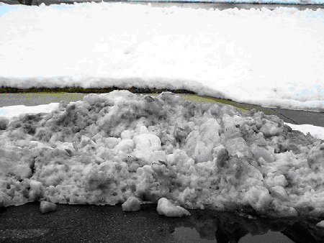
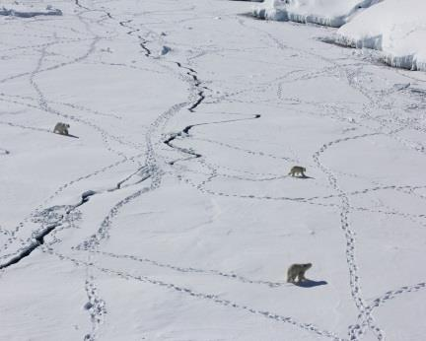
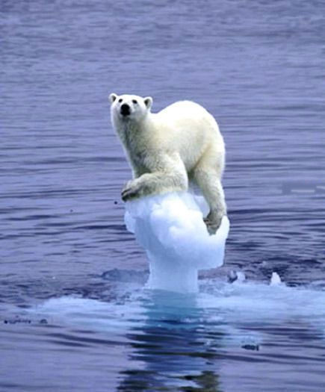
Radiative forcing due to BC
Increase in TOA radiative forcing:
Absorbing the solar radiation reflected by the surface–atmosphere–cloud system.
Deposited over snow and sea ice decreases the surface albedo.
Melting of sea ice
Increase in absorbed sunlight
Lower
albedo
Which snow will melt faster?
White ‘clean’ or dark dirty?
Source: See page 29.

Slide 16
Radiative forcing due to BC
Increase in TOA radiative forcing:
Absorbing the solar radiation reflected by the surface–atmosphere–cloud system.
Deposited over snow and sea ice decreases the surface albedo.
Inside cloud drops and ice crystals can decrease the albedo of clouds by enhancing absorption and evaporation.
Note: Non-BC aerosols have opposite effects which directly reflect more solar radiation and increase cloud albedo.

Slide 17
Radiative forcing due to BC
Atmospheric solar heating: directly absorbs solar radiation
Comparable
Source: Atmospheric solar heating due to BC
from 2001 to 2003 (Chuang, et al, 2005).
Together with absorb reflected solar radiation
Source: Comparison of the global mean radiative forcing due to GHGs with that of ABCs. (Ramanathan, et al, 2008)

Slide 18
Radiative forcing due to BC
Surface dimming
Enhanced by direct and indirect effects of non-BC
Source: Atmospheric solar heating due to BC
from 2001 to 2003 (Chuang, et al, 2005).
Dimming & direct absorption: redistribute energy
Weaken radiative-convective
Decrease evaporation and rainfall
Source: Comparison of the global mean radiative forcing due to GHGs with that of ABCs. (Ramanathan, et al, 2008)

Slide 19

Climate change impacts
Global effects:
Positive surface & atmosphere forcing
Increase humidity & rainfall
GHGs
Net effect on rainfall
Negative surface & TOA forcing
Decrease evaporation & rainfall
ABCs

Slide 20
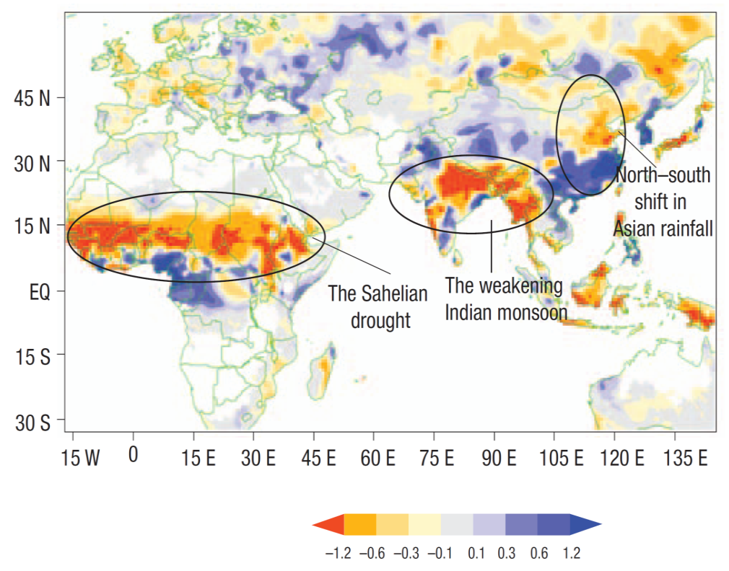
Climate change impacts
Regional effects:
Retreat of Himalayan glaciers
Retreat of Arctic sea ice
Weaken of Indian monsoon
Rainfall shift in China
Drought events
Source: Precipitation trend from 1950–2002 (Chung et al. 2006).

Slide 21
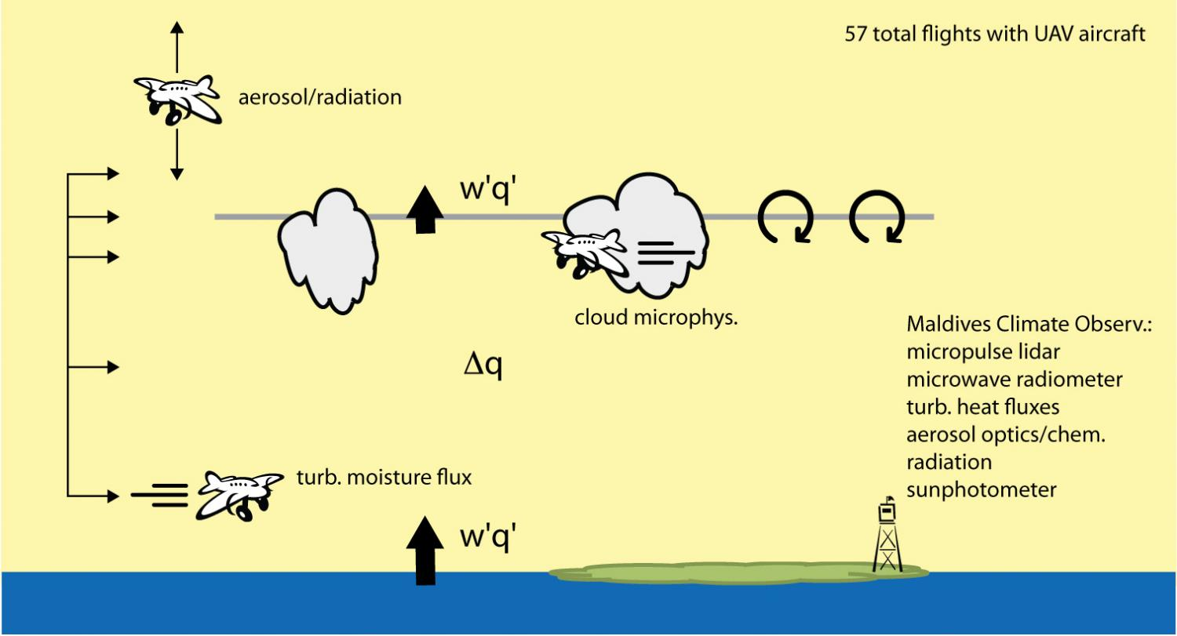
New insights of BC affecting the BL turbulence
Schematic of measurement approach showing all three aircraft during Cloud Aerosol Radiative Forcing and Dynamics Experiment (CARDEX), Feb. and Mar. 2012 over the Northern Indian Ocean. (From https://phys.org/news/2016-10-insights-black-carbon-aerosols-impact.html)

Slide 22
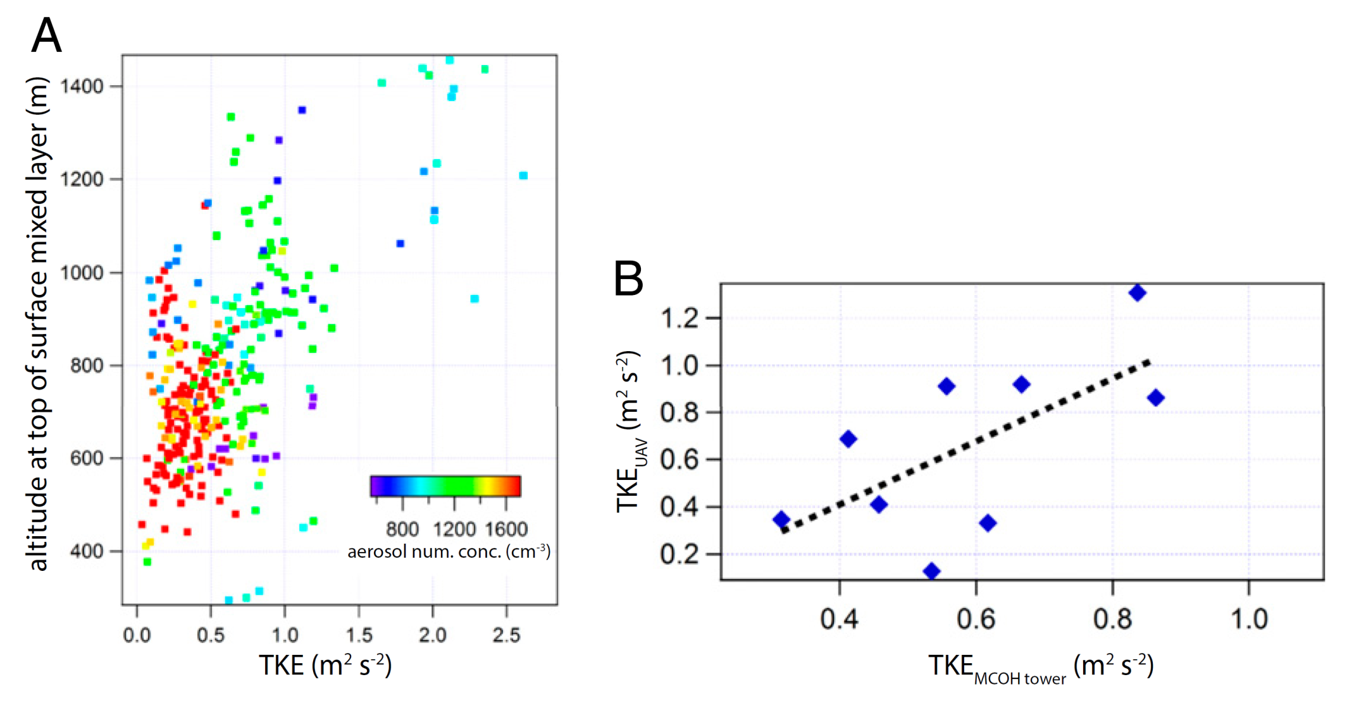
Shallower mixed layer in pollution
Source: Height of mixed layer top against TKE measured at 15m tower top (Wilcox, et al. 2016).

Slide 23
TKE comparison
Source: TKE from UAV against TKE from tower (Wilcox, et al. 2016).

Slide 24
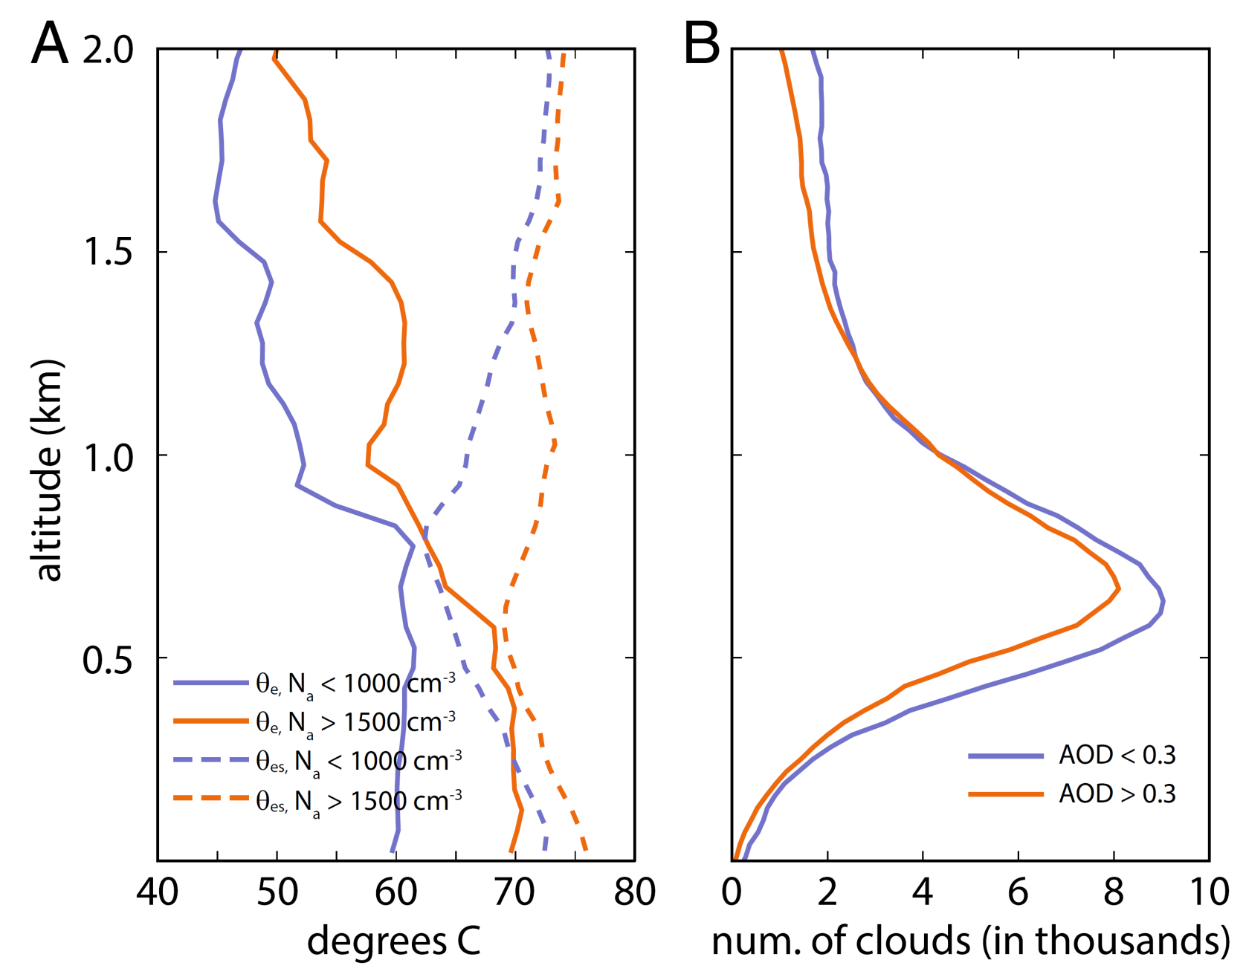
Atmospheric condition: warmer and more humid in pollution
Source: (A) Profiles of equivalent potential T and saturated equivalent potential T under low and high polluted conditions during CARDEX. (B) CALIPSO retrieved cloud top height during February 2007-2013 within 5º of MCOH (Wilcox, et al. 2016).

Slide 25
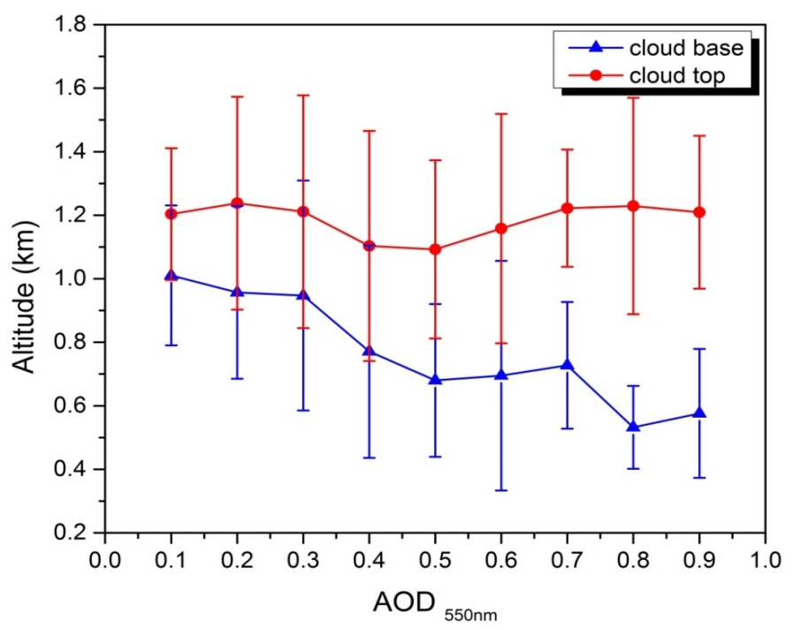
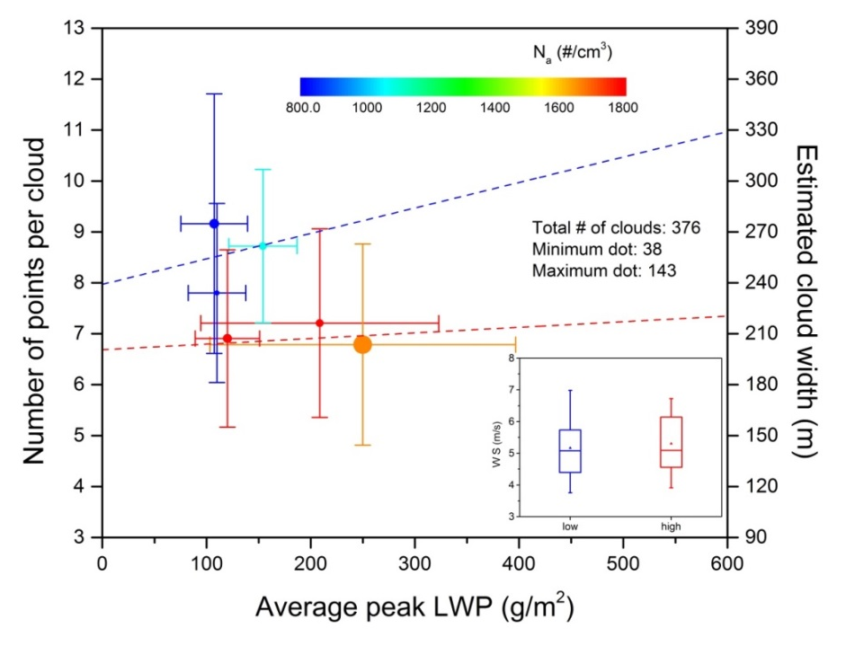
Thicker cloud developed in pollution
Thicker clouds in highly polluted condition
Figure. Cloud top (MODIS) and base (MPL) height as a function of AOD (MODIS) during CARDEX.
Greater cloud LWP in highly polluted condition
Figure. Daily averaged cloud width (UAV) and peak LWP (MPL) during CARDEX.
Figures from Gao et al. (prepare)

Slide 26
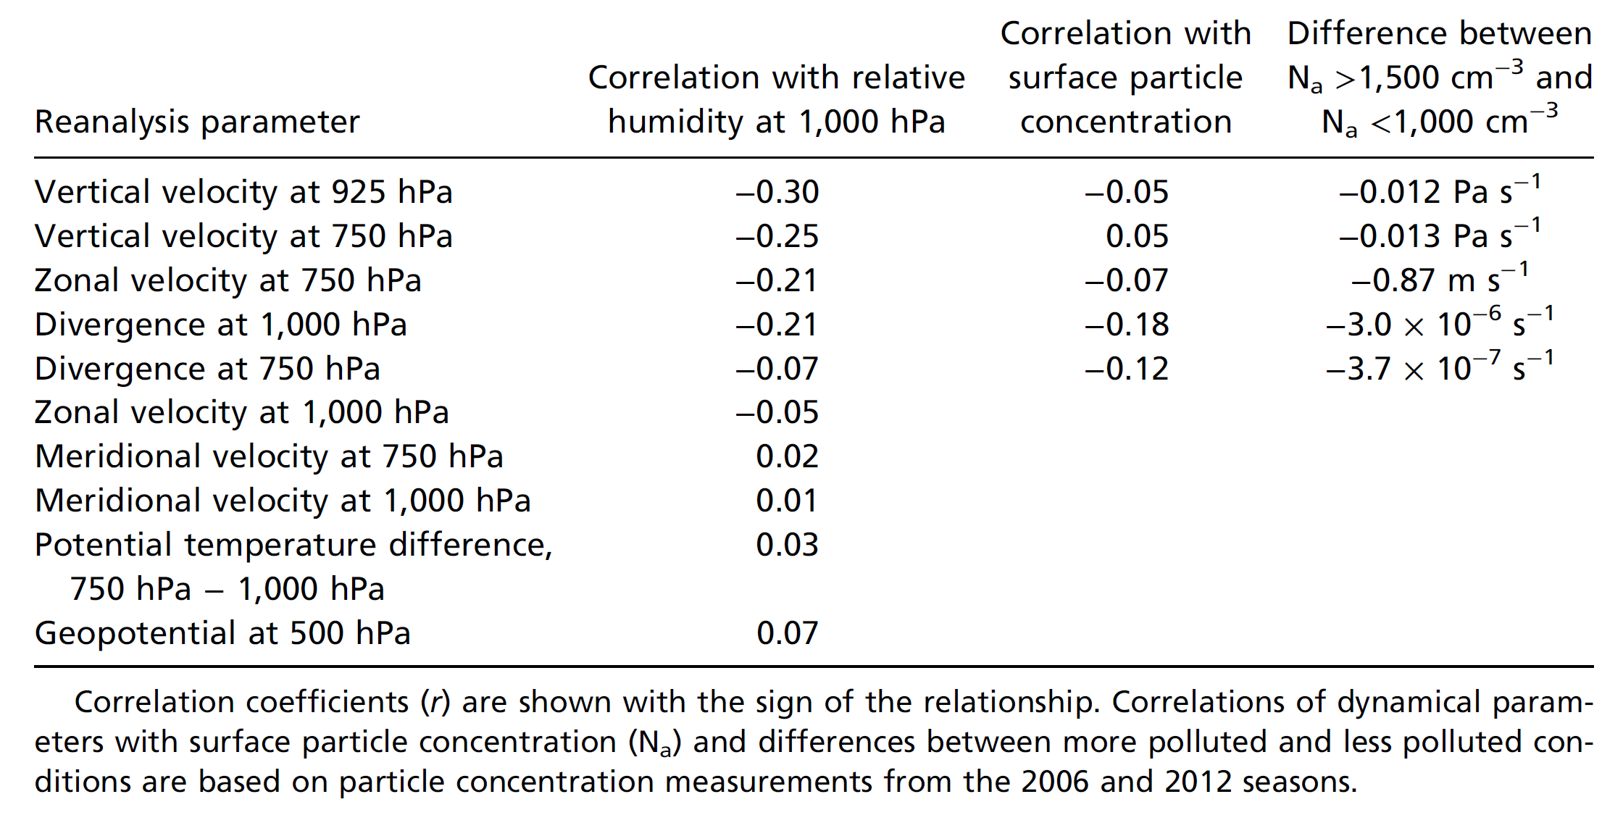
Cause and effects?
Model simulations are needed

Slide 27
Discussion
Uncertainties in BC aerosol research
Observation and model are both needed.
More data are needed (SSA, g, mixing state, etc.).
The parameterization scheme needs to be improved.
The indirect effect of BC aerosols is even more uncertain.

Slide 28
Summary
BC aerosols play a complex and yet important role in the climate change.
Source emission data acquisition and analysis should be improved.
The study of the heterogeneous chemical reactions on BC surfaces and their mixing states with other aerosols should be considered.
The indirect effect of BC aerosols through cloud process on climate should be deeply studied.

Slide 29
Reference:
Chung, C. E., Ramanathan, V., Kim, D., and Podgorny, I. A.: Global anthropogenic aerosol direct forcing derived from satellite and ground-based observations, Journal of Geophysical Research, 110, 10.1029/2005jd006356, 2005.
Gao, L., W., E. M., Shan Y., Praveen, P., Pistone, K., and Bender, F.: Observed Cloud Properties above the Northern Indian Ocean during CARDEX 2012, in preparation.
Gao, L., W., E. M.: Impact of Anthropogenic Aerosol on the Properties of Shallow Maritime Cumulus Clouds, in preparation.
Ramanathan, V., Ramana, M. V., Roberts, G., Kim, D., Corrigan, C., Chung, C., and Winker, D.: Warming trends in Asia amplified by brown cloud solar absorption, Nature, 448, 575-578, 10.1038/nature06019, 2007.
Ramanathan, V., and Carmichael, G.: Global and regional climate changes due to black carbon, Nature Geoscience, 1, 221-227, 1752-0894, 2008.
US Environmental Protection Agency (US EPA), 2012. Report to Congress on Black Carbon. Office of Air Quality Planning and Standards, Office of Atmospheric Programs, Office of Radiation and Indoor Air, Office of Research and Development, Office of Transportation and Air Quality, Washington, DC. EPA-450/R-12-001.
Wilcox, E. M., Thomas, R. M., Praveen, P. S., Pistone, K., Bender, F. A., and Ramanathan, V.: Black carbon solar absorption suppresses turbulence in the atmospheric boundary layer, Proceedings of the National Academy of Sciences of the United States of America, 10.1073/pnas.1525746113, 2016.

Slide 30
Image source:
https://phys.org/news/2016-10-insights-black-carbon-aerosols-impact.html
https://www.google.com/imgres?imgurl=http%3A%2F%2Fwww.postgazette.com%2Fimage%2F2015%2F09%2F24%2F20150923ppAnthracite1POWERSOURCE.jpg&imgrefurl=http%3A%2F%2Fpowersource
https://www.pinterest.com/pin/125678645824434384/
https://www.google.com/search?q=black+carbon&espv=2&biw=1600&bih=721&source=lnms&tbm=isch&sa=X&ved=0ahUKEwj6_579xs3RAhVBT2MKHdWgAlsQ_AUIBigB#tbm=isch&q=China+power+generation+emission+black&imgrc=SUBF6aDpK0eGBM%3A
http://slideplayer.com/slide/9347951/
http://www.gettyimages.com/event/aug-oscar-winning-actor-sir-sean-connery-born-52761304#scottish-actor-sean-connery-with-his-face-covered-in-coal-dust-for-picture-id3163794
https://scied.ucar.edu/sites/default/files/images/longcontentpage/Black%20Carbon%20Power%20Point%20
https://www.nasa.gov/feature/goddard/2016/arctic-sea-ice-annual-minimum-ties-second-lowest-on-record
https://thevendy.wordpress.com/category/uncategorized/page/3/
https://phys.org/news/2016-10-insights-black-carbon-aerosols-impact.html

Slide 31
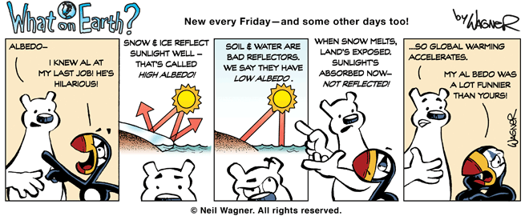
Thank you !
Questions ?

