Slide 1
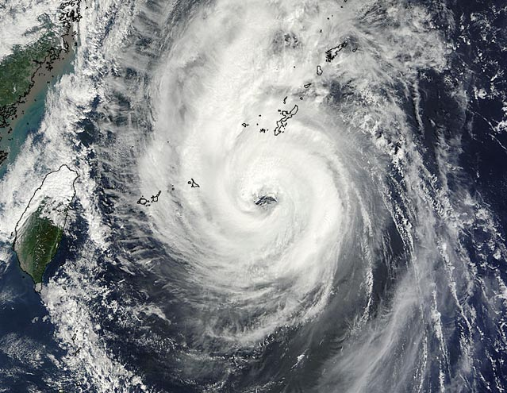
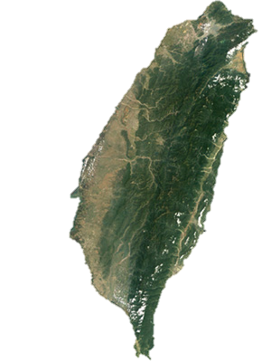
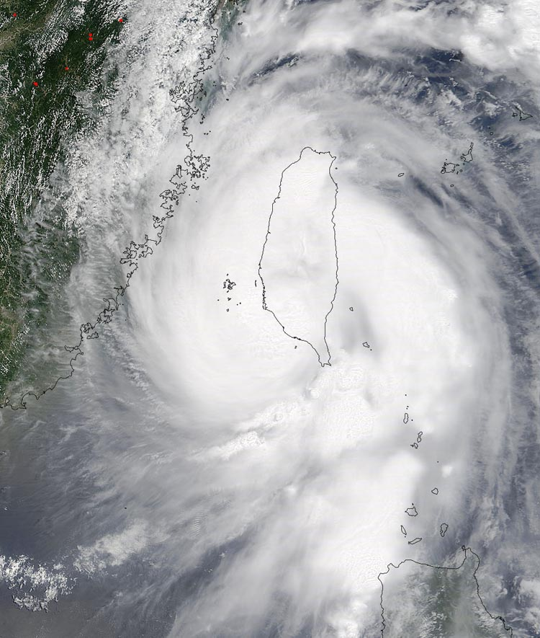

Dynamics of Track Deflection Associated with the passage of tropical cyclones over a Mesoscale Mountain
By Yuh-Lang Lin, Nicholas C. Witcraft and Ying-Hwa Kuo
Presented by Karimar Ledesma-Maldonado
Graduate Student Department of Atmospheric Sciences
Desert Research Institute
University of Nevada Reno
Notes:
Understanding the dynamical processes that control synoptic/mesoscale phenomena will help to improve the forecasts of tropical storms and other phenomena controlled by complex terrain over vast expanses of our planet. An enhancement in storm track prediction will have a major societal impact in coastal regions prone to tropical storms by increasing the lead time available to people for storm preparation including subsequent evacuation.

Slide 2
Outline
Why understand hurricanes track deflection?
Continuous and Discontinuous track
Synopsis of Super typhoon Bilis and typhoon Toraji
Methodology: model description and experiment design
Simulations Results of Bilis and Toraji
Control Parameters and Mechanism responsible for track deflection and discontinuity
Brief comparison between Taiwan and Caribbean islands
Summary/Conclusions

Slide 3
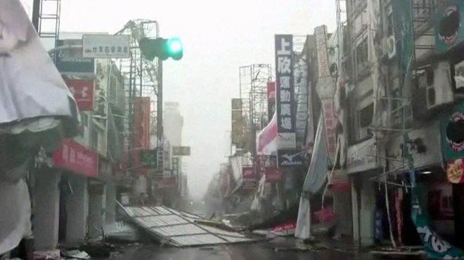
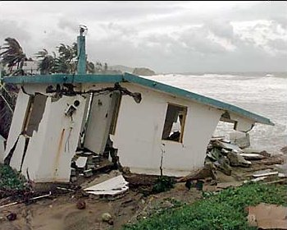
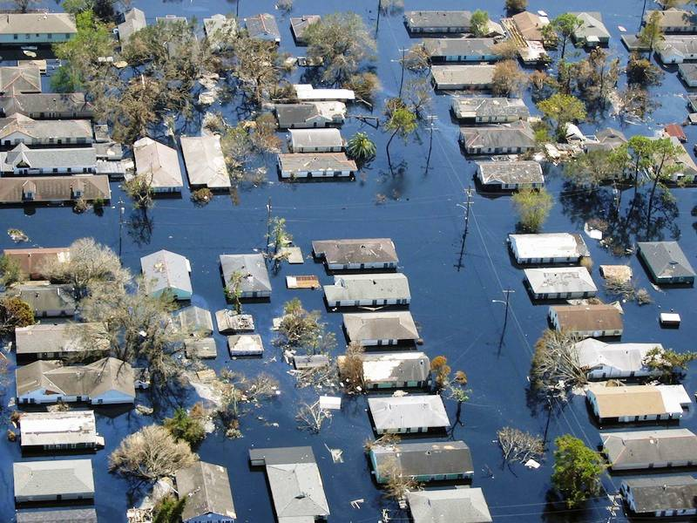
Why understand Hurricanes/Typhoon track deflection?
To improve forecasts of tropical storms and other phenomena controlled by complex terrain over vast expanses of our planet.
An enhancement in storm track prediction will have a major societal impact by increasing the lead time available to people prepare, including subsequent evacuation.
Typhoon Nepartak
Hurricane George
Hurricane Katrina
Notes:
Understanding the dynamical processes that control synoptic/mesoscale phenomena will help to improve the forecasts of tropical storms and other phenomena controlled by complex terrain over vast expanses of our planet. An enhancement in storm track prediction will have a major societal impact in coastal regions prone to tropical storms by increasing the lead time available to people for storm preparation including subsequent evacuation.

Slide 4
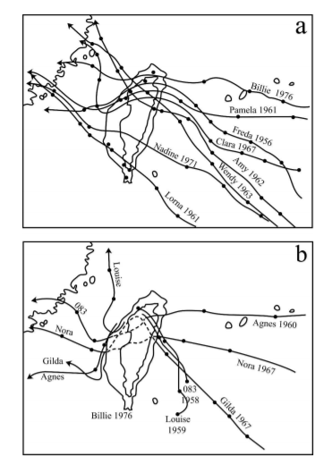
Continuous and Discontinuous Track
Stronger typhoons tend to have a continuous track.
Weaker typhoons tend to have a discontinuous track.
Notes:
Why? Due that to jump over the island by froming a secondary circulation on the lee side, with the original center being blocked by the terrain
It doesn t mean deflection

Slide 5
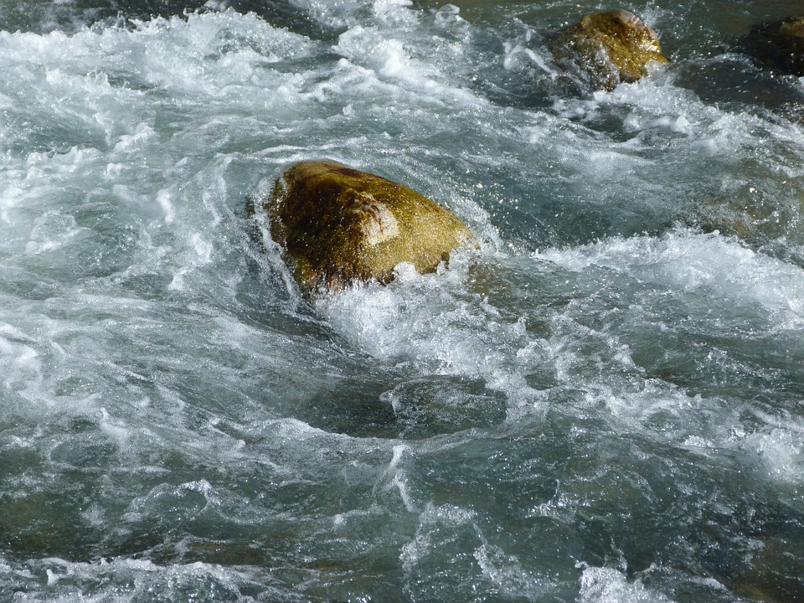

Slide 6
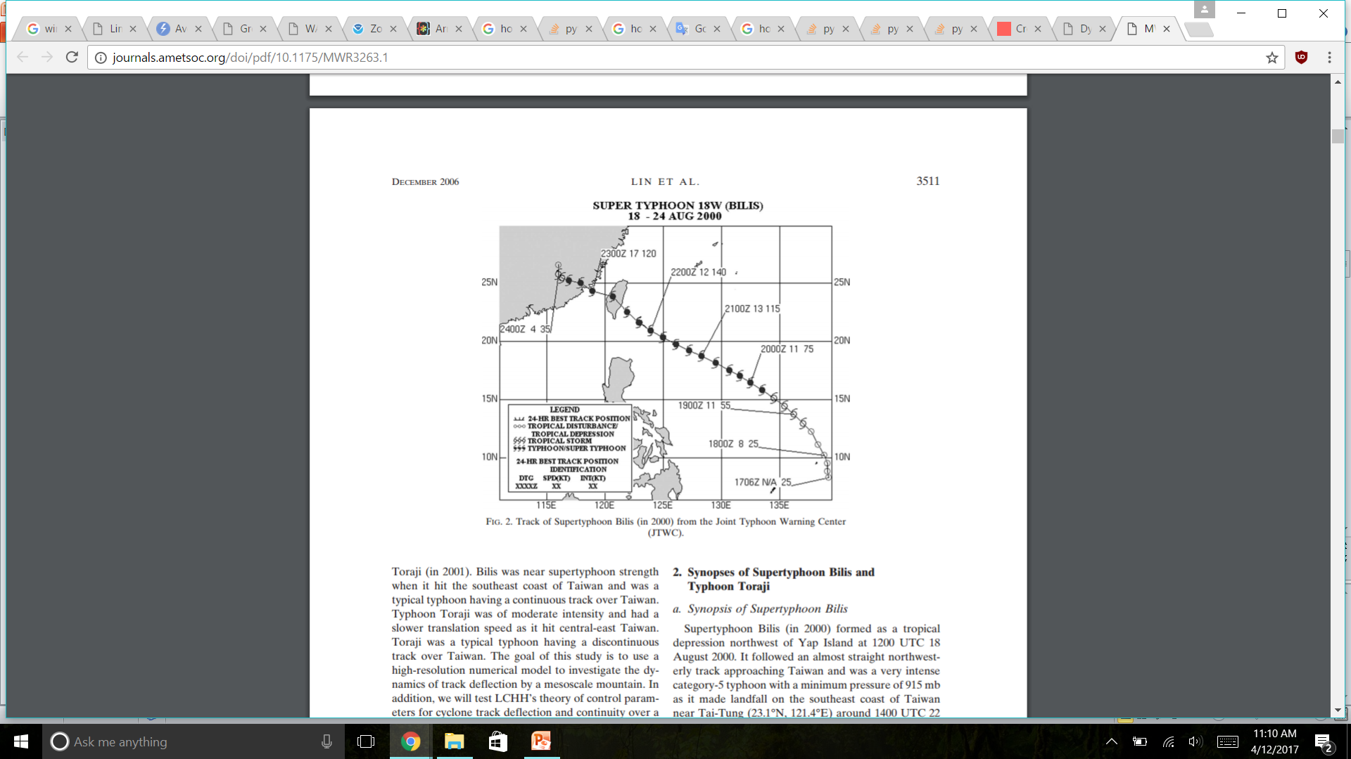
Synopsis of Super Typhoon Bilis
Category 5 typhoon
Minimum pressure of 915mb
Maximum winds 70m/s
Made landfall on the Southeast coast of Taiwan
Notes:
Just before landfall, Bilis turned northward and followed a cyclonic track across the island, afther the landfalll over Taiwan it weakended rapidly, it then conitnued to move westward and made landfall on the southeast coast of China. The high terrain of CMR helped weaken Bilis significantly
Wjen it formed it followed an almost straight northwesterly track aproaching Taiwan

Slide 7
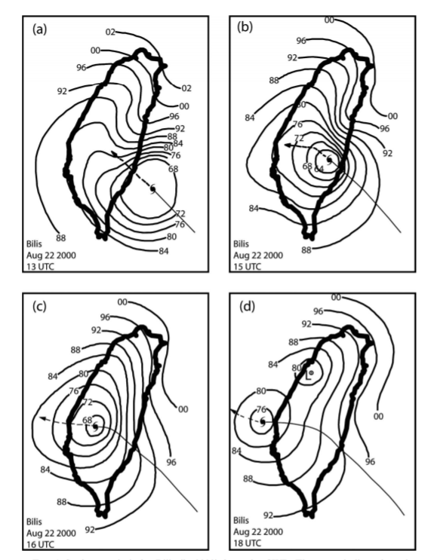
Synopsis of Super Typhoon Bilis
2 An inverted trough was produced to the NE of the CMR before Bilis passed over the CMR due to orographic forcing.
1 In the northern lee of the CMR, latent heat and adiabatic warming created an area of lower pressure.
3 After the center emerges off the western coast was a closed secondary center evident in the lee of Taiwan
Notes:
Bilis was approaching the SE coast of Taiwan
According with the taiwain centtral weather mesoscale analysiss

Slide 8
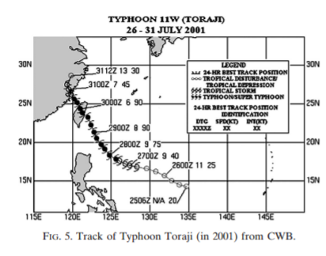
Synopsis of Typhoon Toraji
Category 3 typhoon
Minimum pressure of 960mb
Maximum winds 49m/s
Made landfall on the Southeast coast of Taiwan
Notes:
Wjen it formed it followed westward and then northwesterly track aproaching Taiwan
Again The high terrain of CMR helped weaken Bilis significantly

Slide 9
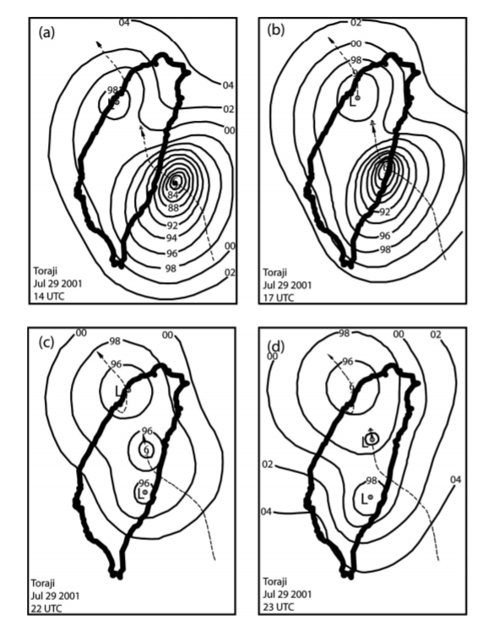
Synopsis of Typhoon Toraji
1A secondary low and vortex have already formed in the lee of CMR before Toraji made landfall.
3 The secondary center has taken over as the main center of Toraji.
2 The primary storm center crosses the CMR and weakens, while the secondary low and vortex center begins to strengthen.
Notes:
Contrary to Bilis Secondary low formed in the lee side before Toraji made landfall

Slide 10
Model Description and Experiment Design
Version 3 of the Mesoscale Model (MM5.v3)
National Centers for Environmental Prediction (NCEP) operational analysis with a resolution of 2.5° x 2.5° lat-lon and 15 standard pressure layers is used for model initialization and for boundary conditions during model integration.
For both typhoons, experiments were integrated for a period of 48hr.
Scheme | Parameterization
Blackadar | To parameterize the planetary boundary layer.
Goddard Lin- Farley- Orville | To parameterize the microphysical processes.
Betts-Miller | To parameterize the sub-grid convection.
Notes:
The PSU/NCAR mesoscale model (known as MM5) is a limited-area, nonhydrostatic, terrain-following sigma-coordinate model designed to simulate or predict mesoscale atmospheric circulation. The model is supported by several pre- and post-processing programs, which are referred to collectively as the MM5 modeling system. The MM5 modeling system software is mostly written in Fortran, and has been developed at Penn State and NCAR as a community mesoscale model with contributions from users worldwide.
They made various assumptions due to the coarse resolution. They remove vortices from the analyssis and implanted bogus vortices

Slide 11
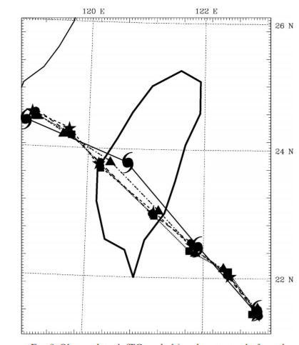

Simulations Results of Bilis
= surface center track
=700mb center track
=500mb center track
=300mb center track
= observed track
The observed and simulated track was very close.
From model simulations
3hr interval
9555
Notes:
The simulated storm, like the observed storm took an almost straight line track over the CMR. The lower- mid and upper level storm center remain vertally stacked during and after the passage over Taiwan.

Slide 12
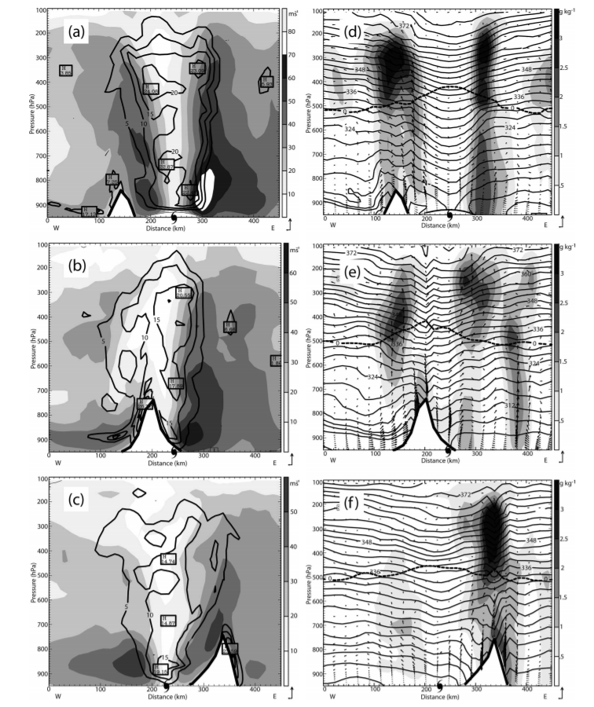
Potential Vorticity
Water mixing ratio, Potential temperature and wind vectors
Vertical coherence structure of the storm via east-west vertical cross sections through the storm center of horizontal wind speed Water mixing ratio, Potential temperature and PV
Notes:
Plotted every 3 hr while Bilis was crossig taiwan, yes moutains are causit that the storm loose its intensity but ir remain vertically stacked in figure b we can see that due to orographic blocking it loose the vertical strucuture but also due that this is a strong typhoon it doesn t form a secodary low in the lee side of the moutain as we are gonna see with typhoon toraji. In figure c PV is once again coupled vertically . But due to the loose of intensity the eye is no longer indetifiable.
From figure d to f….these shaded regions correlate with higher PV regions. Mixing ratio also decrease due the orographic blocking. Also mixing ratio is large due to orographic forcing figure f

Slide 13
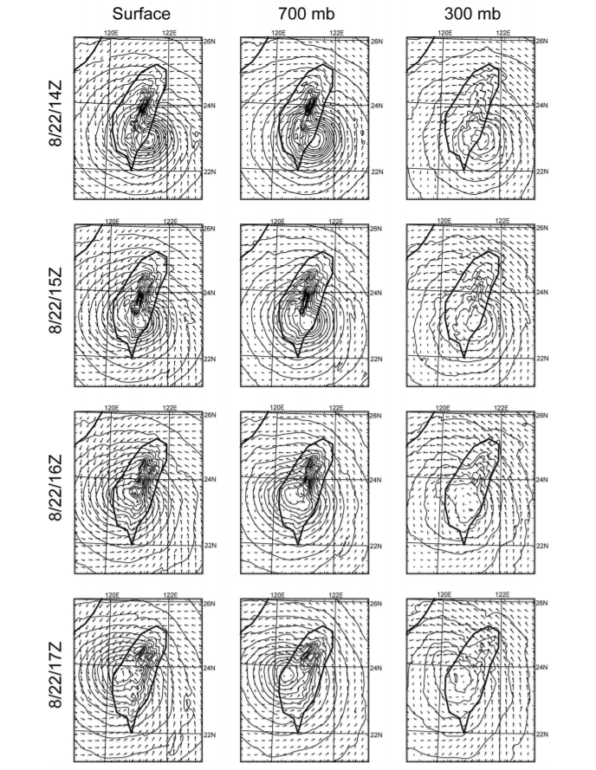
Pressure and vector wind field at the surface, 700mb and 300mb
Notes:
All of the surface pressure center 700- 300 mb geoponteitla center are located at the same location 2 hours later the surface and 700 mb are located on the west side of the moutain but the 300mb is still located over the moutains one hour later the center are vertically stacked. Indicating that the low center crossed the moutains continuiolsy withour much disturbance. And there is no evidence of new circulation center forming in the lee side of the moutains as we agoing to see in thecase of toaji.

Slide 14
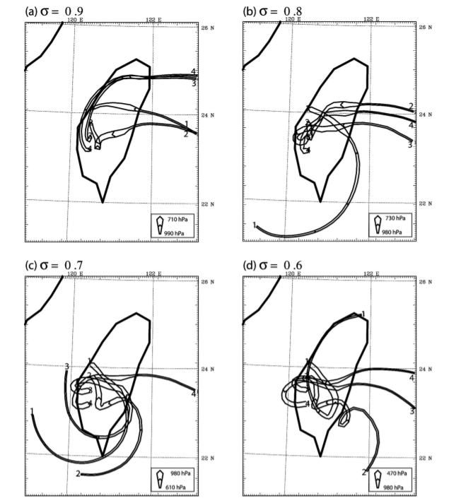




Backward Trajectories
$$σ=0.9$$
$$σ=0.8$$
Parcels tend to go around the north side of the CMR
All Parcels traveled over the central CMR
Parcels tend to go over the CMR
$$σ=0.7$$
$$σ=0.6$$
All Parcels traveled over the central CMR
All Parcels traveled over the central CMR

Slide 15
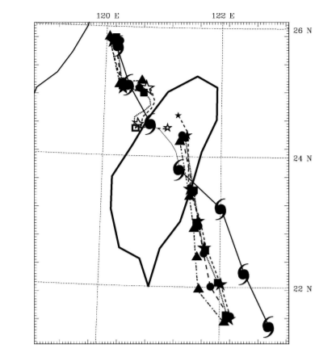
Simulations Results of Toraji
= surface center track
=700mb center track
=500mb center track
=300mb center track
= observed track
The outlined symbols indicate two centers coexisting simultaneously
From model simulations
3hr interval
9555
Notes:
The simulated storm, like the observed storm took an almost straight line track over the CMR. The lower- mid and upper level storm center remain vertally stacked during and after the passage over Taiwan.

Slide 16
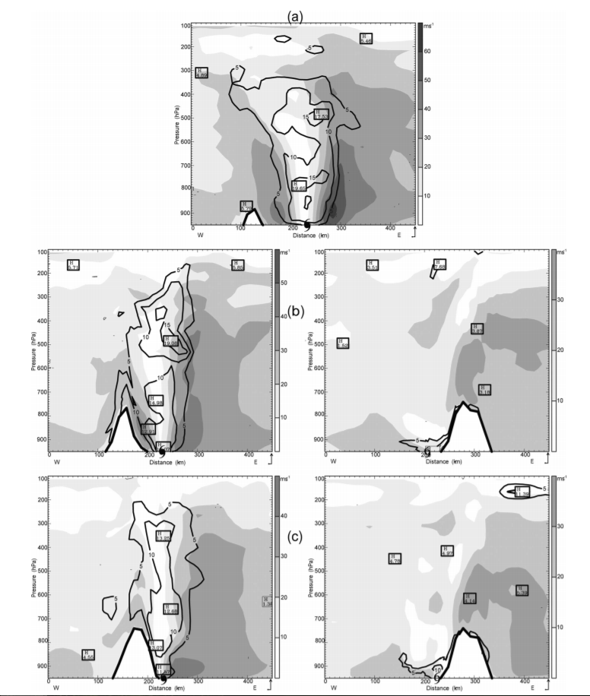
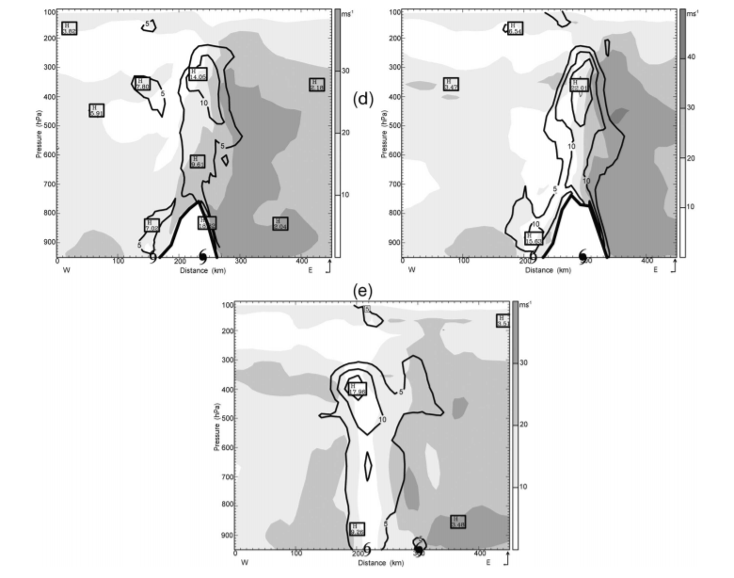
Simulations Results of Toraji
Primary circulation
Secondary
circulation
Vertical coherence structure of the storm via east-west vertical cross sections through the storm center Potential Vorticity
Notes:
For a weaker typhon, the low level PV is destroyed by the interaction with the moutains.when the low level support vanish, the mid and upper level PV weakens. AS the outer circulation impinges on the CMR a new low level PV center forms in the lee side, ultimately takes over as the new center and couples with the remant of the upper leel PV

Slide 17
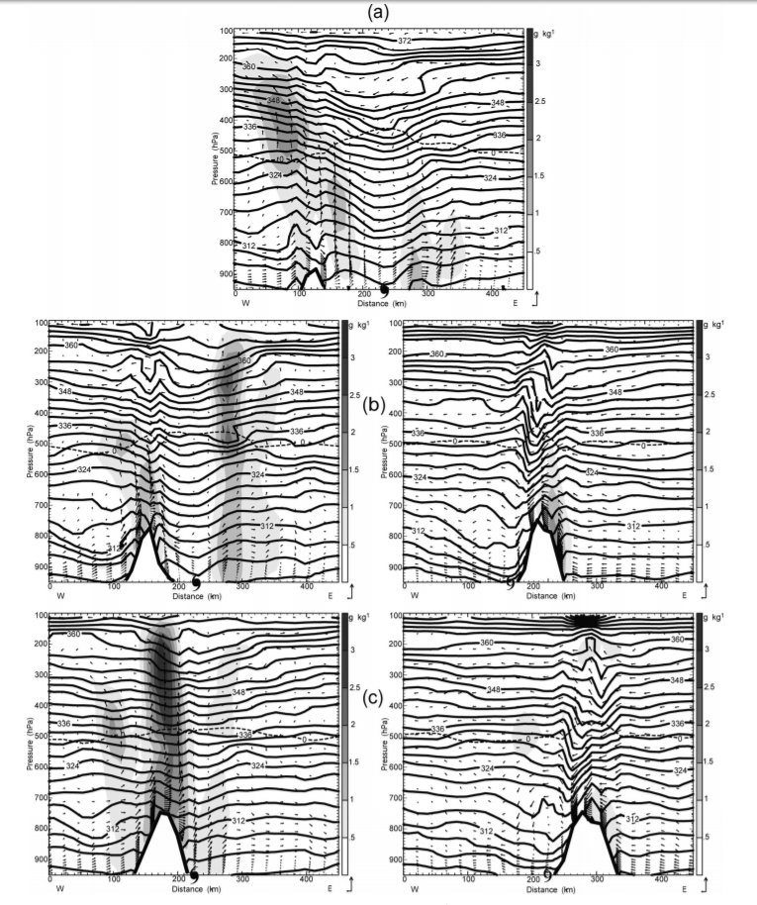
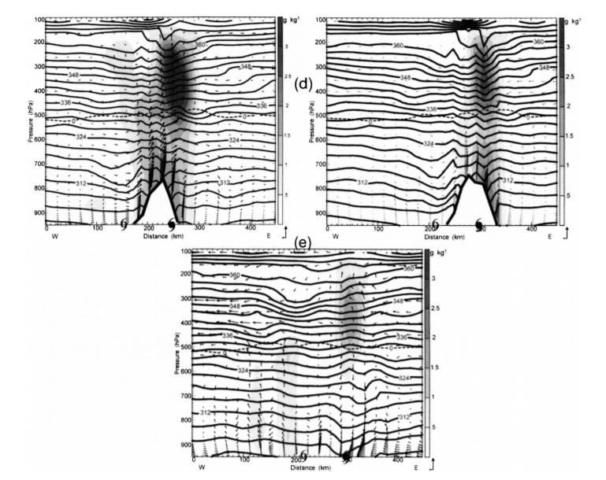
Simulations Results of Toraji
Primary circulation
Secondary
circulation
Vertical coherence structure of the storm via east-west vertical cross sections through the storm center water mixing ratio, potential temperature and wind vectors
Notes:
Lower concentrations mixing ratio are associated with the new lower circulation

Slide 18
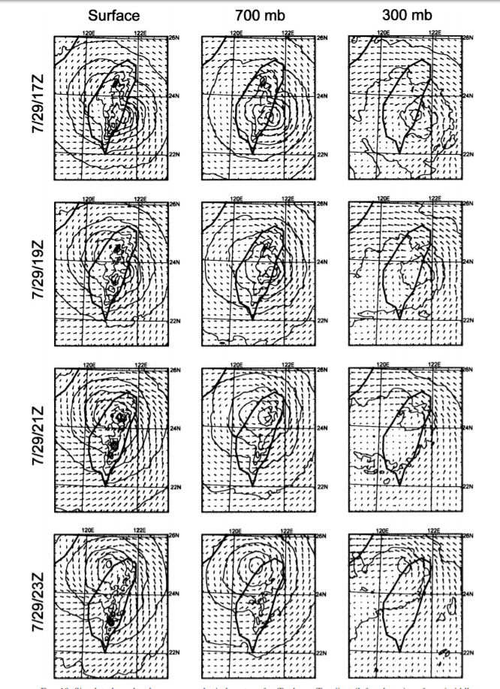
Simulations Results of Toraji
A better look of the formation of the secondary low of Toraji
Notes:
During the first hours the center have a good vertical coherence even over the CMR.the secondary low start to strengthened, having a low circulation at the surface . The upper level low weakended at the same time. This pattern continues ganing stregenthen at surface and extendig at uppr level and finally taken ove rthe original cyclone

Slide 19
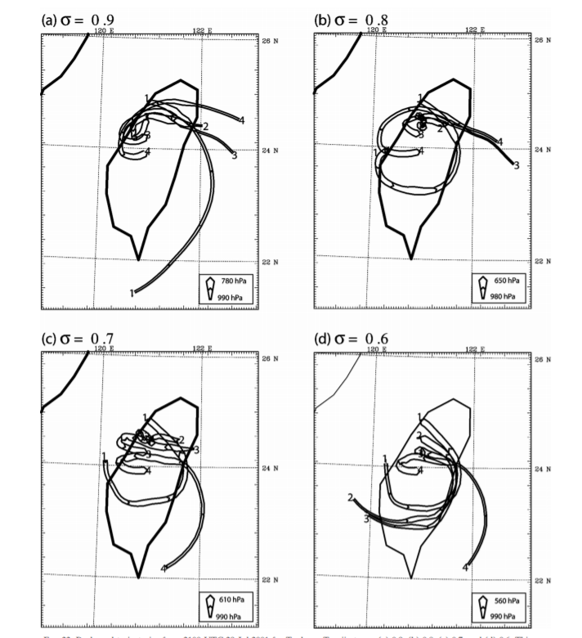




Backward Trajectories
Parcels tend to go around the north side of the CMR
$$σ=0.9$$
$$σ=0.8$$
Parcels tend to go over the CMR
$$σ=0.7$$
$$σ=0.6$$
All Parcels traveled over the central CMR
Parcels tend to go over the CMR

Slide 20
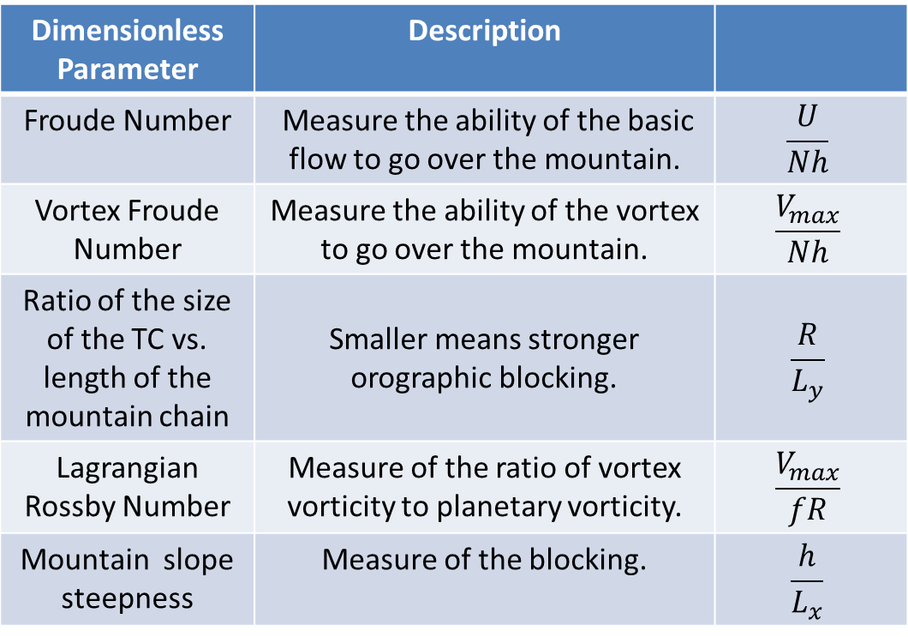
Mechanisms of track continuity and deflection
Dimensionless Parameter | Description
Froude Number | Measure the ability of the basic flow to go over the mountain. | $$\frac{U}{Nh}$$
Vortex Froude Number | Measure the ability of the vortex to go over the mountain. | $$\frac{V_{max}}{Nh}$$
Ratio of the size of the TC vs. length of the mountain chain | Smaller means stronger orographic blocking. | $$\frac{R}{L_{y}}$$
Lagrangian Rossby Number | Measure of the ratio of vortex vorticity to planetary vorticity. | $$\frac{V_{max}}{fR}$$
Mountain slope steepness | Measure of the blocking. | $$\frac{h}{L_{x}}$$
Degree of deflection is mostly controlled by Froude Number
Track continuity is mostly controlled by Froude Number
Notes:
For U/(Nh) >> 1, the flow ascends over the obstacle with no upstream deceleration. For U/(Nh) << 1, a region of upstream flow deceleration forms that may propagate continuously upstream with time.

Slide 21
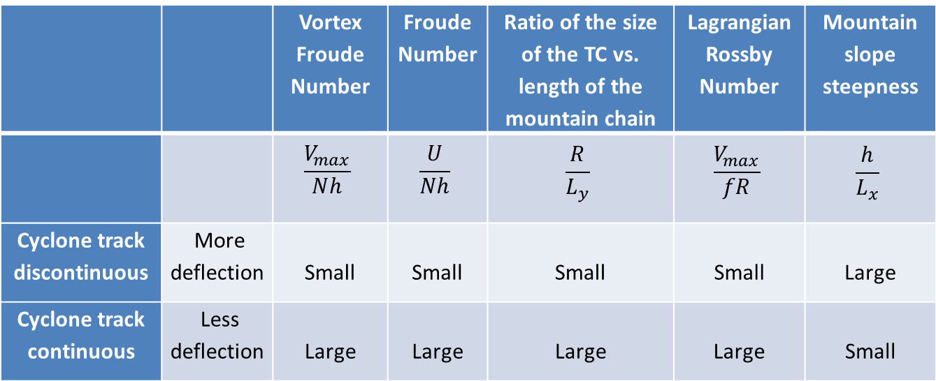
Mechanism of track continuity and deflection
 |  | Vortex Froude Number | Froude Number | Ratio of the size of the TC vs. length of the mountain chain | Lagrangian Rossby Number | Mountain slope steepness
 |  | $$\frac{V_{max}}{Nh}$$ | $$\frac{U}{Nh}$$ | $$\frac{R}{L_{y}}$$ | $$\frac{V_{max}}{fR}$$ | $$\frac{h}{L_{x}}$$
Cyclone track discontinuous | More deflection | Small | Small | Small | Small | Large
Cyclone track continuous | Less deflection | Large | Large | Large | Large | Small
Table 1. Non-dimensional parameters, where Vmax is the maximum tangential wind, N is the Brunt–Väisälä frequency, h is the mountain height, U is the basic wind speed, R is the radius of Vmax, f is the Coriolis parameter, and Lx and Ly are the horizontal scales of the mountain in x and y directions, respectively (Lin 2006).
Notes:
Those arameters are base on cyclones moving westward over a north south oriented mesoscale mountain ranges
Vortex frounde number-meausre the ability to go over the moutain
ratioTC/MTN leng= smaller means that stronger orographic bloking
Track conitnuity controlled by Vortex Froude number and ratio ..
Degree of delfection is controlled by Froude Number.

Slide 22
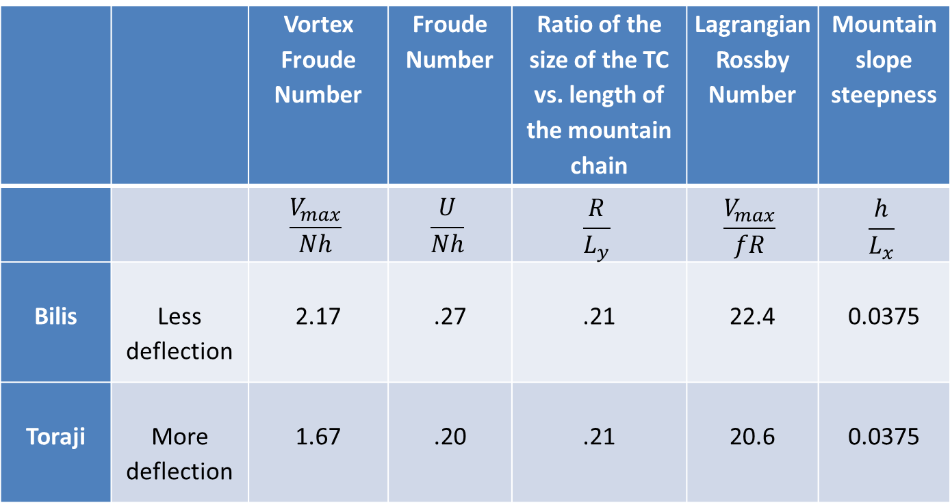
Application of control parameters for track continuity and deflection to Bilis and Toraji
 |  | Vortex Froude Number | Froude Number | Ratio of the size of the TC vs. length of the mountain chain | Lagrangian Rossby Number | Mountain slope steepness
 |  | $$\frac{V_{max}}{Nh}$$ | $$\frac{U}{Nh}$$ | $$\frac{R}{L_{y}}$$ | $$\frac{V_{max}}{fR}$$ | $$\frac{h}{L_{x}}$$
Bilis | Less deflection | 2.17 | .27 | .21 | 22.4 | 0.0375
Toraji | More deflection | 1.67 | .20 | .21 | 20.6 | 0.0375

Slide 23
Comparison between Taiwan and Caribbean Island
Pacific Ocean | Caribbean
North-South Central Mountain Range (CMR) in Taiwan | East-West island mountain ranges in the Caribbean
Mountain height 3000m | Mountain height 3000m ( Dominican Republic)
Isolated island of Taiwan | Island Range
Notes:
Applying those parameters to tropical storms in the Atlantic Ocean and the Caribbean may imply different results based on the unique geometry, topography, and sea surface temperature as well as larger scale wind and temperature conditions in the Caribbean compared to Taiwan. For example, there are some massive differences that are important to point out between Taiwan and Puerto Rico: the east-west island mountain ranges in the Caribbean (Bender M., 1987) are radically different than the mountain range in Taiwan and the mountain height in the Caribbean Islands in general are lower than the CMR in Taiwan.

Slide 24
Track deflection in the Caribbean
Previous studies of tropical storm track deflection were focused mostly on the topographic effects of Hispaniola and Cuba due to the fact that they have very high mountains. (Bender, 1987).
Topography employed in previous simulation studies was very coarse and often underestimated terrain forcing due to low numerical model topographic resolution.
Notes:
Since I’m originally from Puerto Rico, this topic always had caught my attention when every year we are in a constant state of concern as to whether a hurricane will make or not a landfall over Puerto Rico. I have always noticed that most of the tropical cyclones deviate to the north or south when they approach Puerto Rico. Thus, I have a particular interest in understanding in a depth manner the dynamical processes responsible for this deviation.
Previous studies of tropical storm track deflection were focused mostly on the topographic effects of Hispaniola and Cuba due to the fact that they have very high mountains. (Bender, 1987). It is important to point out that the topography employed in previous simulation studies was very coarse and often underestimated terrain forcing due to low numerical model topographic resolution. Properly incorporating the effect of high resolution terrain may enhance track predictions of tropical cyclones and have large societal impacts downstream in the Caribbean and even the U.S.
Since in the Caribbean the highest mountains are lower compared to the CMR in Taiwan, track deflection may be caused by other parameters that are not taken into consideration in the previous studies. These have not been studied in depth in the Caribbean and as mentioned above real data simulations have suffered from poor topographic resolution and inadequate initial data. Those parameters include orientation, scale, nearby sea surface temperatures, sensible and latent heat from nearby dry and moist convection as well as background wind/temperature stratification fields.

Slide 25
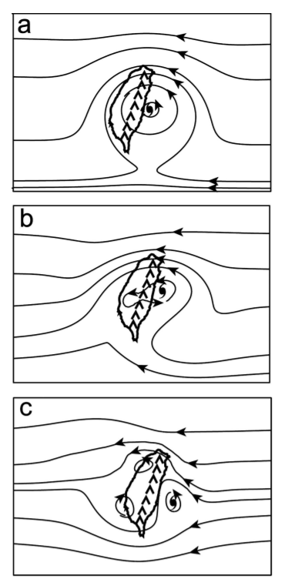

Conclusions
Continuous track- Strong TC
The MM5 predicted the track of each storm reasonably well.
Bilis had a continuous track and Toraji had discontinuous track due to differences in strength.
Weak Cyclone produce a secondary low center in the lee side.
Dynamically, strong(weak) orographic blocking will lead the cyclone track to be discontinuous( continuous)
Orographic blocking will result in greater deflection of the moving cyclone to the left or right.
Discontinuous track
Moderate TC
Discontinuous track
Weak TC

Slide 26
Future work
To understand the dynamics of TC the following should be investigated:
1. The effects of planetary boundary layer
2. Latent heating
3. Impinging angles
4. Land falling locations

Slide 27
Summary
Any Questions? & Thank you for your attention!

Slide 28
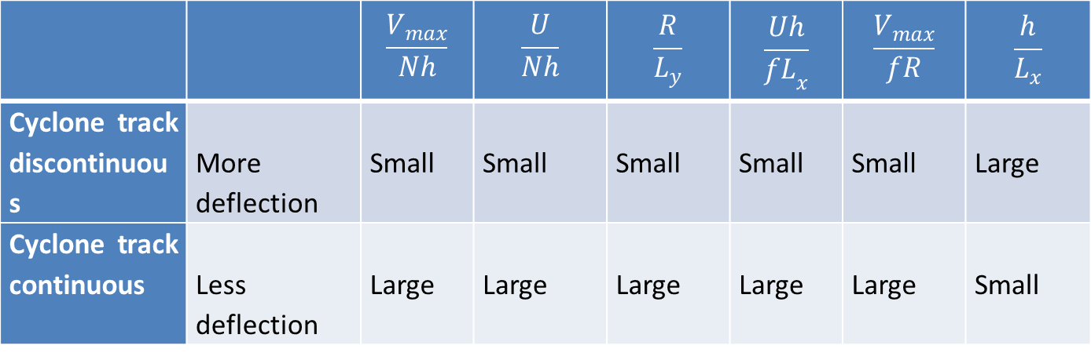
6 non-dimensional Parameters: Pacific Ocean
 |  | $$\frac{V_{max}}{Nh}$$ | $$\frac{U}{Nh}$$ | $$\frac{R}{L_{y}}$$ | $$\frac{Uh}{{fL}_{x}}$$ | $$\frac{V_{max}}{fR}$$ | $$\frac{h}{L_{x}}$$
Cyclone track discontinuous | More deflection | Small | Small | Small | Small | Small | Large
Cyclone track continuous | Less deflection | Large | Large | Large | Large | Large | Small
Table 1. Non-dimensional parameters, where Vmax is the maximum tangential wind, N is the Brunt–Väisälä frequency, h is the mountain height, U is the basic wind speed, R is the radius of Vmax, f is the Coriolis parameter, and Lx and Ly are the horizontal scales of the mountain in x and y directions, respectively (Lin 2006).
Notes:
From those numerical simulations, six non-dimensional parameters have been established (see Table 1) which help to determine the deflection of TC tracks (Lin, 2006).

Slide 29
 |  | Time Step
Domain 1 | 200 x 200 grid 21km resoution | 30s
Domain 2 | 199 x 199 grid 7km resoution | 10s
Domain 3 | 265 x 244 grid 2.3km resution | 3.3

Slide 30
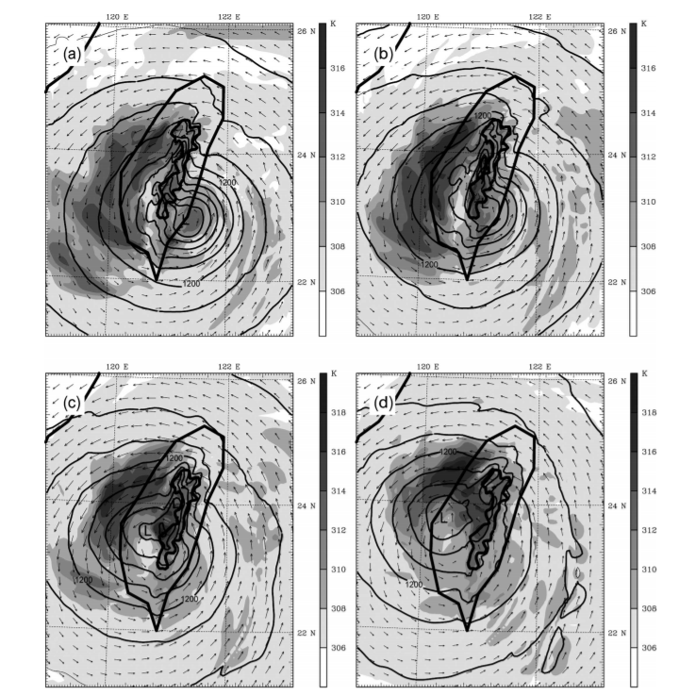
Simulations Results of Bilis

Slide 31
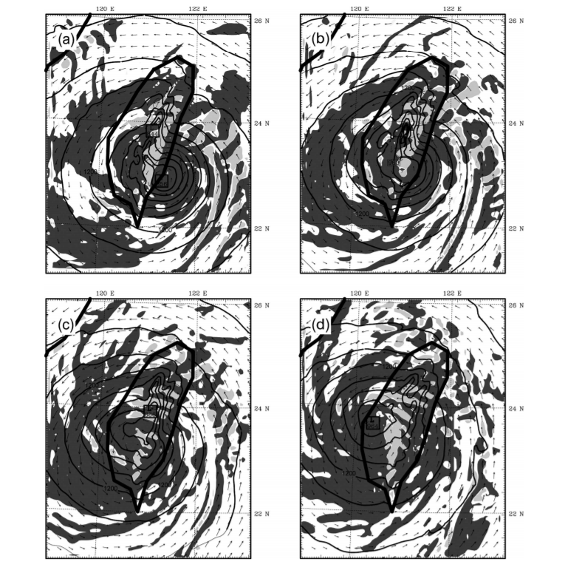
Simulations Results of Bilis

Slide 32
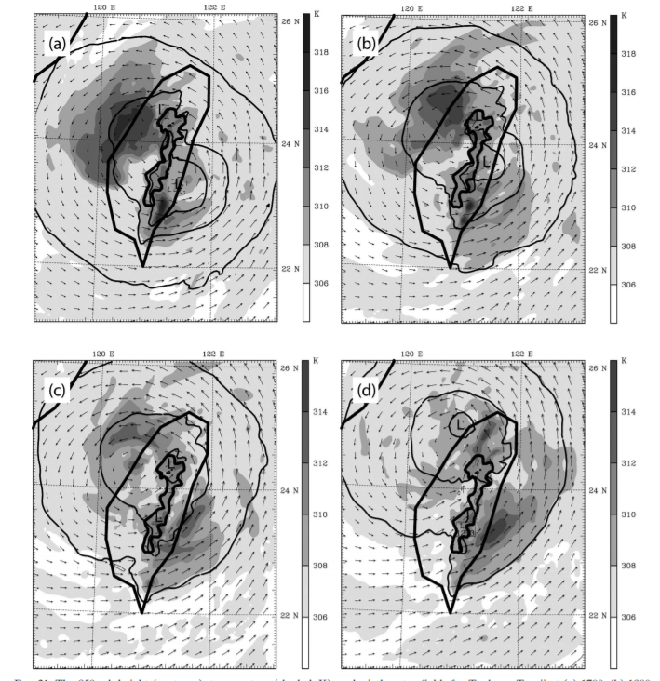
Simulations Results of Toraji

Slide 33
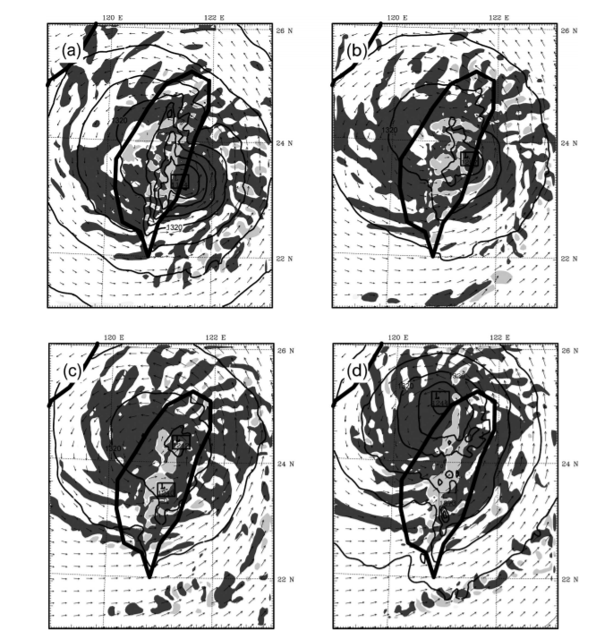
Simulations Results of Toraji

Slide 34
Important concepts to keep in mind
Potential Vorticity- is the absolute circulation of an air parcel that is enclosed between two isentropic surfaces.
Mixing Ratio- is the amount of water vapor that is in the air.

