Slide 1

Tropospheric Ozone Change from 1980 to 2010 Dominated by Equatorward Redistribution of Emissions Zhang et. al.(2016), Nature Geoscience, Vol 9(875-879)
Presented By : Dhurba Neupane
NRES 701C
March 27,2017

Slide 2
Outline
Terms: Troposphere, Ozone
Background
Methods
Results and Discussions
Implications of results
Conclusions
Future works
References

Slide 3
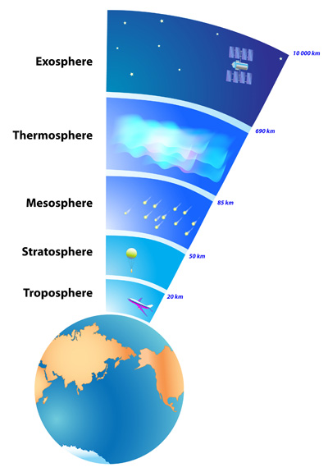
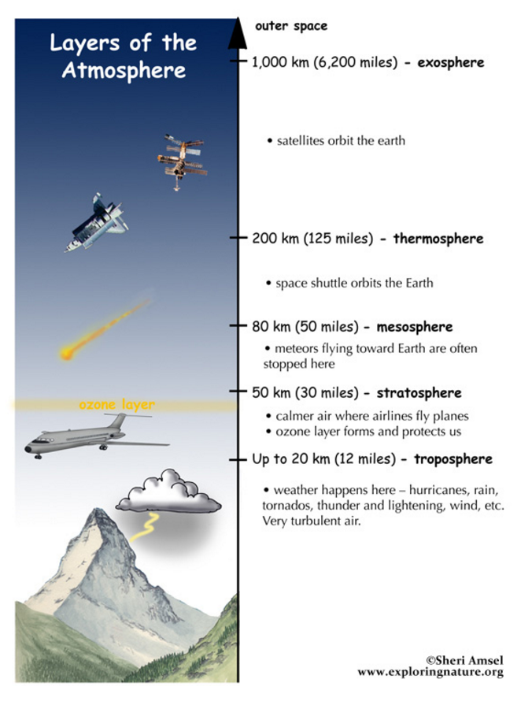
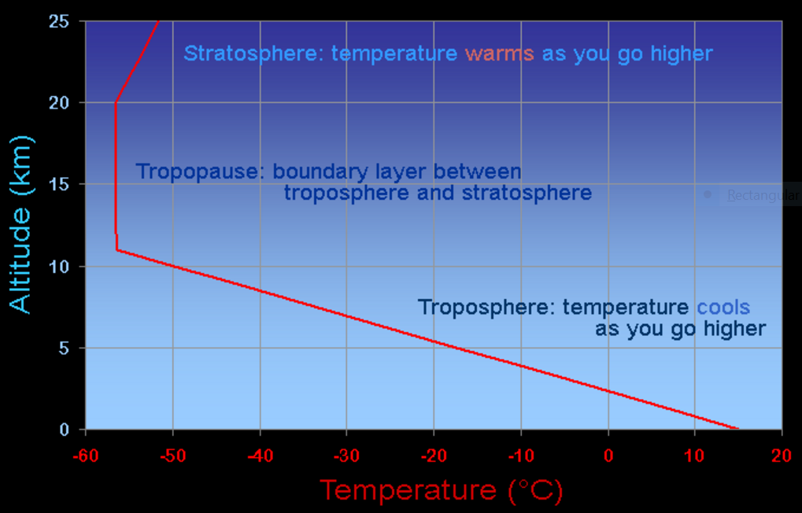
Troposphere
Lowest layer of atmosphere, where we live
Source: http://ete.cet.edu/gcc/?/volcanoes_layers/
Notes:
The production of ozone causes the temperature to rise with increasing altitude in the stratosphere
mesopause—the boundary between the mesosphere and the thermosphere; the coldest place on Earth.
mesosphere—the layer in which most meteors burn up after entering Earth’s atmosphere and before reaching Earth’s surface.
stratopause—the boundary between the mesophere and the stratosphere.
stratosphere—contains the ozone layer; the layer where volcanic gases can affect the climate.
tropopause—the boundary between the stratosphere and troposphere.
troposphere—the layer closest to Earth’s surface in which all weather occurs.

Slide 4
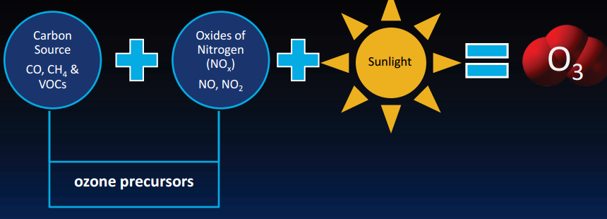
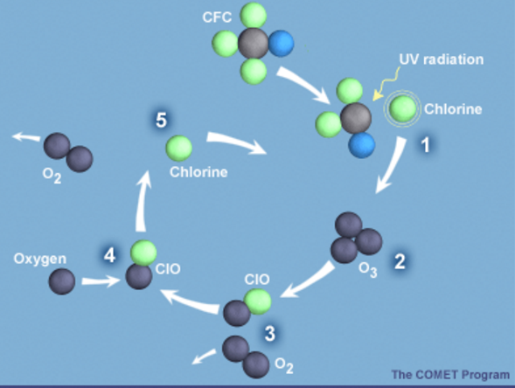
Ozone
Gas in the atmosphere, compose of 3 oxygen atoms
Formation and Destruction of Ozone
Source: http://webcache.googleusercontent.com/search?q=cache:https://www.ucar.edu/learn/1_6_1.htm
Source: http://www.go3project.com/network2/curriculum/Lesson2.pdf

Slide 5
Background
Air pollutant, 3rd most imp GHGs, lifetime ῀ 22 days global averaged
Observations and Models: Emissions increases in Asia
Tropospheric ozone burden important quantity related to RF
1940-1980: O₃ precursors emissions increased, but Spatial distribution unchanged
1980: emissions shifted equatorward
1980-2010, emission increased of CO: 6.4%, NO_{x}: 21.2% ,NMVOCs: 6.0%, Global CH₄ mixing ratio: 14.7%
CO, NMVOCs: increased south of 30⁰ N and decreased N of this latitudes
NO_{x} increased south of 40⁰N and decreased to N.
Notes:
⁰

Slide 6
Objectives
To investigate the influences of global emission changes from 1980 to 2010 on tropospheric ozone burden(BO₃) and Surface O₃
How these changes influences in
Spatial distribution of anthropogenic short lived emissions
The global magnitude of emissions
Global CH₄ mixing ratio

Slide 7
Methods
Global emissions spatial pattern change :
To analyze emission trends and drive the global model, use anthropogenic emissions including biomass burning from:
Atmospheric Chemistry and Climate Model Intercomparison Project(ACCMIP) in 1980 and representative concentration pathway 8.5(RCP8.5) in 2010
RCP8.5 emissions are self consistent with the ACCMIP,most reasonable scenario
Global emissions estimates for short lived species are uncertain, and uncertain in developing regions
Rapid increased of emissions in tropics and subtropics and also in regional scales.
Supported by observations from satellites and from surface and airborne observations, NO₂ decreased in Europe and North America and increased in China and India
Notes:
RCP8.5 are self consistent with the ACCMIP historical emissions and are considered to be the most reasonable scenario to extend ACCMIP beyond 2000(ref 6) they track the GAINS current legislation Scenario for several decades.
2010 global emission of CO, Nox and NMVOCs are 1030 Tg, 82 Tg and 180 respectively
Global emission estimates for short lived species are uncertain and uncertain in developing regions.
However, rapid growth of emission is seen in tropics and subtropics as well as regional ones. The inventories are supported by observations from satellites
surface and airbone observations, NO2 emissions are shown to be diminished since 1980 in developed regions , Europe and North America.
Increased in developing countries , especially China and India, shifting global emissions equatorward.

Slide 8
Chemistry climate (CAM-Chem)model configuration
Based on Community Atmospheric Model (CAM ) version 4
Horizontal Resolution : 1.9⁰ latitude and 2.5⁰ longitude, 56 vertical levels between surface and 4hPa(40 km) with a time step of 1800 s.
Run 5 consecutive year, 1st year-spin up, results as 4 year average
Use NASA global modeling and assimilation office GEOS-5 meteorology to drive the model as a chemical transport model
Result of single model differ with other models: different reaction mechanisms
Notes:
CAM –Chem based on the global community atmospheric model(CAM) version 4
Model: horizontal resolution of 1.90 latitude and 2.50 longitude and 56 vertical levels between surface and 4hPa(40 km) with a time step of 1800 s.

Slide 9
Chemistry climate model(CAM-Chem) configuration
Run three sensitivity simulation for 1980 and 2010 for spatial distribution(S_Distribution), magnitude(S_Magnitude), and CH₄ mixing ratio(S_CH₄ )
Different between S_1980 and S_2010 reflects total emission changes.
Notes:
CAM –Chem based on the global community atmospheric model(CAM) version 4
Model: horizontal resolution of 1.90 latitude and 2.50 longitude and 56 vertical levels between surface and 4hPa(40 km) with a time step of 1800 s.

Slide 10
CAM-Chem evaluation
Evaluated S_2010 using present day O₃ data from multi year observations ( ozonesondes, satellites, aircraft campaign and ground based observations)
Compared with 4 year average of CAM-Chem output: model capture well
Seasonal cycle of O₃ at specific pressure captures well
Also model performs better in NH than SH.

Slide 11
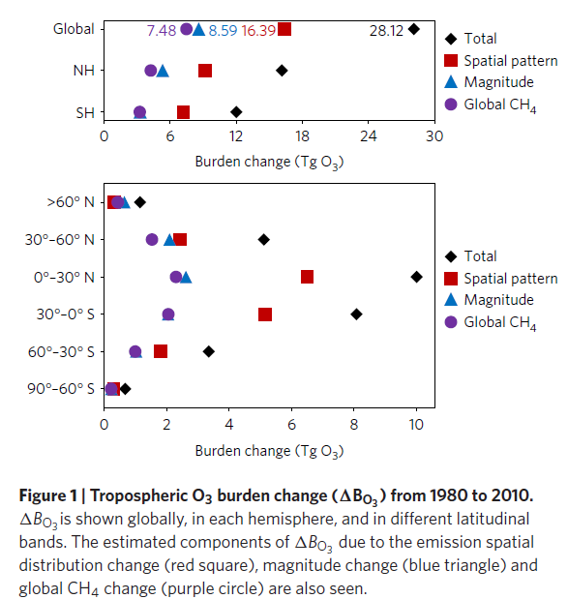
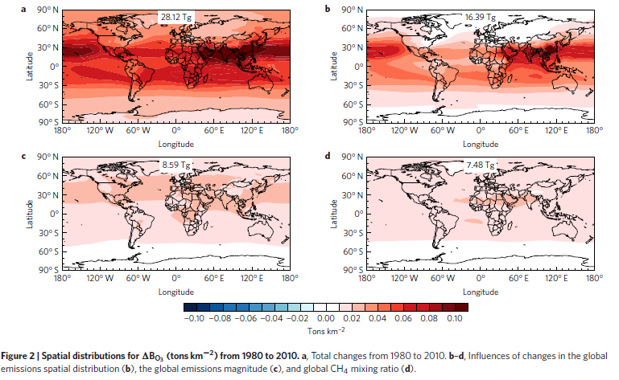
Results and Discussions
Source: Main paper
Notes:
North of 60⁰ N, the change in BO₃ due to emission spatial distribution change is lowest becoz lower amounts of O₃ and its precursors are transported from North America and Europe.

Slide 12
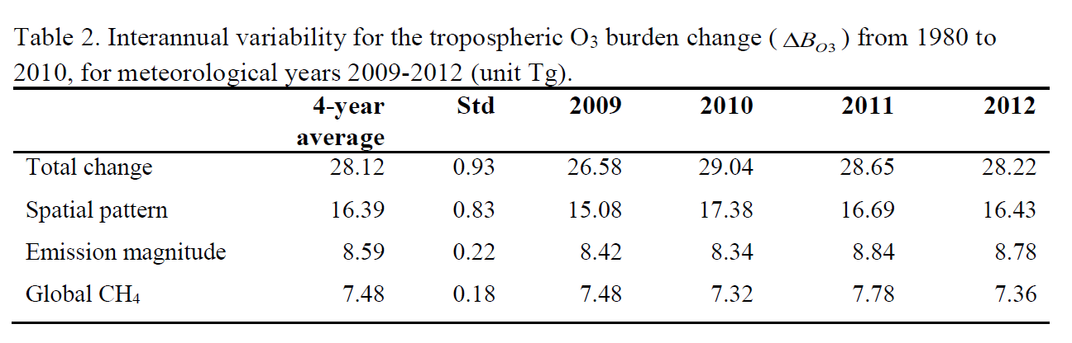
Results and Discussions
Influence of change in spatial distribution> sum of two other influences in 3 of 4 years modelled.
Total BO₃ change from sensitivity simulations(32.46 Tg) > the difference between S_2010 and S_1980(28.12Tg)
15.90 15.66 16.62 16.14
Source: supplementary information at http://www.nature.com/ngeo/journal/v9/n12/extref/ngeo2827-s1.pdf
Notes:
The influence of the change in spatial distribution is greater than the sum of the other two influences in three of four years modelled, with the interannual variability in BO3 being much smaller than the overall change.
Global anthropogenic emissions refer to all short lived species, including ozone precursors and other species, aerosols.
Each of other three simulations are subtracted from S_2010 to isolate individual influences

Slide 13
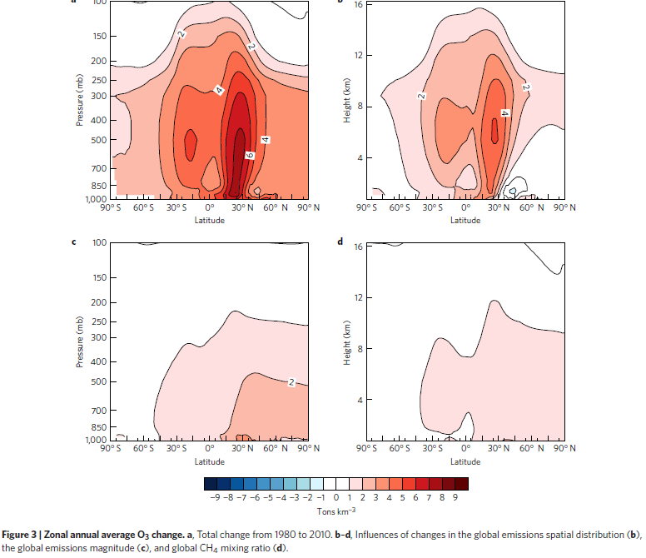
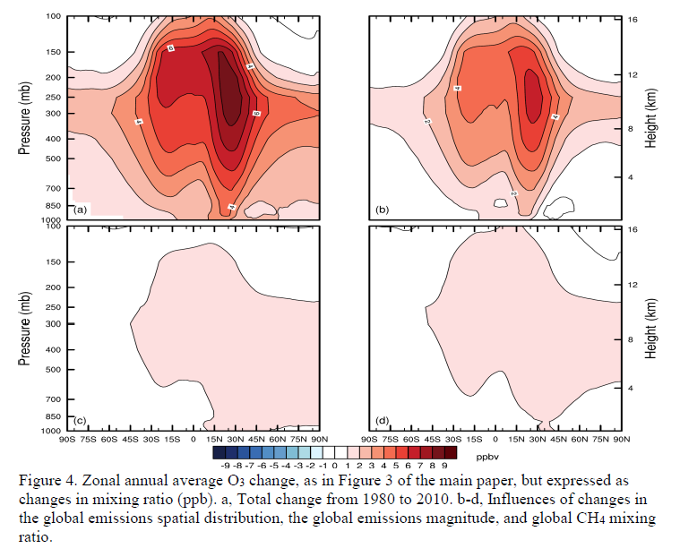
Results and Discussions
Over 30⁰S-30⁰N, the change BO₃ from Spatial distribution is much greater than other influences
In extratropical regions, the change is only slightly greater
North of 60⁰N, BO₃ change due to emission spatial distribution is lowest
From 1980-2010, global emission magnitude change and CH₄ change both increase O₃ over 30⁰ S-30⁰ N, but spatial distribution best explains overall O₃ change at regions with greatest ozone increase.
68% BO₃ is below 500 hPa
Source: figure 3(main paper) and figure (supplementary information at http://www.nature.com/ngeo/journal/v9/n12/extref/ngeo2827-s1.pdf)
Notes:
Between 1980-2010,greatest modelled increases in O3 burden over 10-35⁰ N from the surface to the upper troposphere
68% Change in BO3 is below 500 hPa
Over 35-60⁰N, O₃ increases at all altitudes, even though the anthropogenic emissions from North America and Europe decreased between 1980 to 2010.

Slide 14
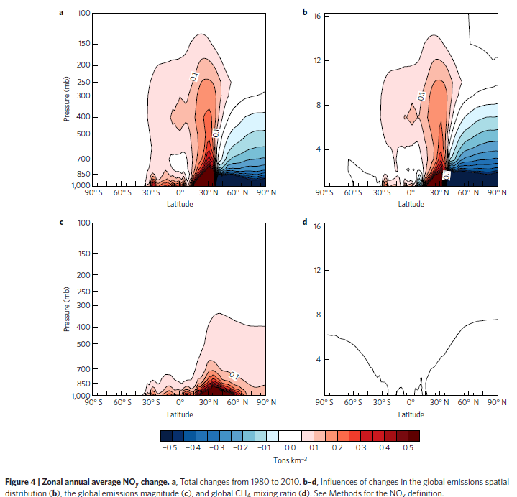
Results and Discussions
Increase of O₃ precursor emission south of 35⁰ N: Hadley cell
Decrease of north of 35⁰ N : Ferrell cell circulation
Equatorward shift emission: strong convective mixing lift O₃ and its precursor NO_{Y} , favors O₃ accumulation
NH mid altitudes, less NO_{Y} is lifted to high altitude
O₃ increases are affected by:
transport of pollutant.
Also faster chemical reaction at tropics/subtropics (strong sunlight and warm temperature)
Spatial distribution change increases global ozone production efficiency
Strong NOx sensitivity over sub/tropics.
O₃ lifetime is lower at tropics due to destruction from water vapor and dry deposition to vegetated surfaces.
Source: Main paper
Notes:
The influences of the global emission magnitude change and global CH₄ change both increases O₃ over 30⁰S-30⁰N but the emission spatial distribution change best explains the overall O₃ change particularly the regions with greatest ozone increases.
Increase of O3 precursor emissions South of 35 deg N are transported efficiently to the middle and upper troposphere, from strong convection in the Hadley cell, where as emission decrease North of 35 deg N stay at high latitudes and low elevation in Ferrell cell circulation.
When global emission shift equatorward, strong convective mixing over the tropics and subtropics lifts O3 and its precursor Noy to the higher altitudes, where O3 lifetime is longer, favoring O3 accumulation.
When emission increases in NH mid altitude, less Noy is lofted to high altitudes. O3 increased at high altitudes over middle and high latitudes are affected by transport of pollutant from sub/tropics.

Slide 15
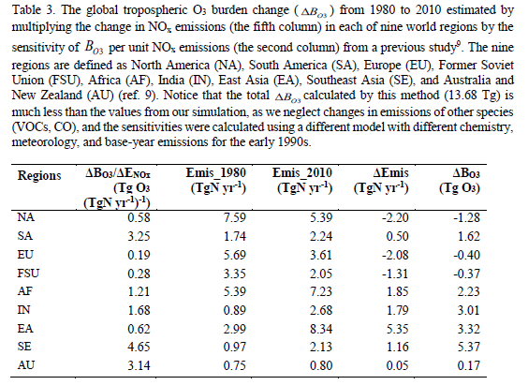
Results and Discussions
Largest modelled change Bo₃ over South and Southeast Asia, strong influences of emission in these regions
ΔB_{O3} =(ΔB_{O3} /Δ E_{NOx})*Δ Emis
Emission SE>EA>South Asia
SE: very large sensitivity of B_{O3} to NO_{X}
strong convection
Convection in Himalayas in NH summer, when intertropical convergence zone is farthest north
Source: Supplementary information at http://www.nature.com/ngeo/journal/v9/n12/extref/ngeo2827-s1.pdf

Slide 16
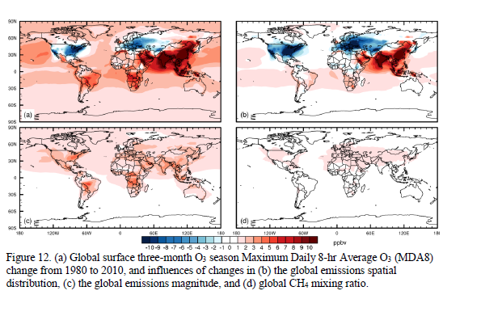
Results and Discussions
Using MDA8 dominated by regional emission trends
Europe and North America, over EA and SE, consistent with observations
Similar regional variations MDA8 from influence of global emission spatial pattern change
Smaller contribution from global emission magnitude and CH₄ changes.
Surface O₃ change
Source: supplementary information at http://www.nature.com/ngeo/journal/v9/n12/extref/ngeo2827-s1.pdf
Notes:
These modelled ozone changes are broadly consistent with observed changes over recent decades, suggesting strong increase in South, East and Southeast Asia(Supplementary information)

Slide 17
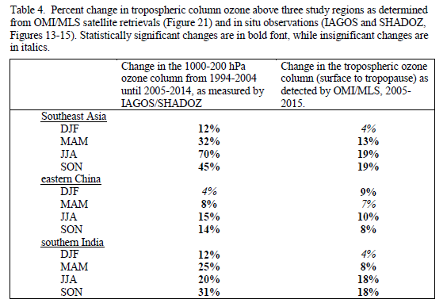
Results and Discussions
Analysis of ozone observations from IAGOS and SHADOZ good agreement with the model
Changes from 1994-2005 to 2005 -2014 are similar to the modelled 1980-2010
Over SE and SI,significant O₃ at all most elevation
Whereas in Northeastern China, positive trend continue from earlier.
DJF, MAM, JJA, SON are months of year, from December to November
Ozone monitoring instrument (OMI),Microwave Limb Sounder(MLS), In-service Aircraft for a Global Observing System (IAGOS), Southern Hemisphere Additional Ozonesondes(SHADOZ)
Source:Supplementary information at http://www.nature.com/ngeo/journal/v9/n12/extref/ngeo2827-s1.pdf

Slide 18
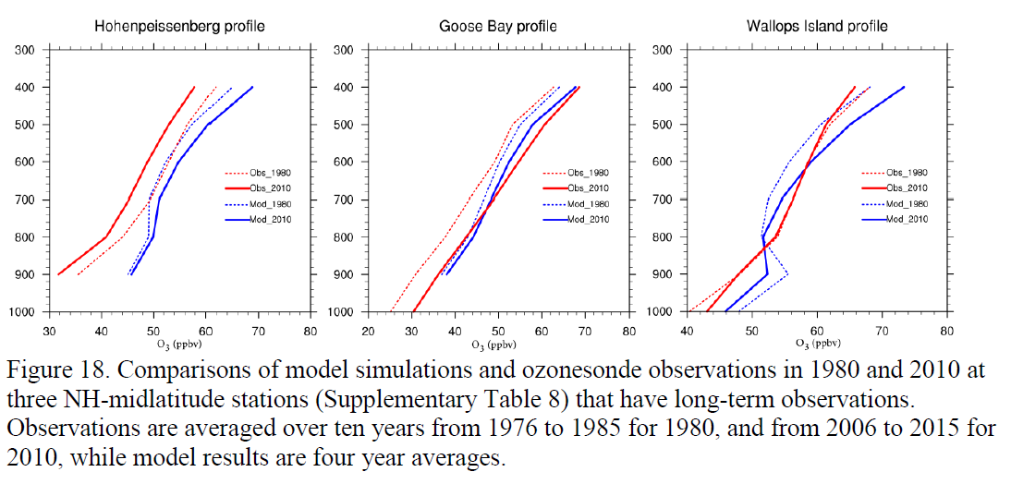
Results and Discussions
S_1980 compares well with global ozonesondes observations from study between 1966-1996 ( Logan et al,1999), are in between 1980-1993 at most sites, and S_2010 compares well with that from Tilmes et al 2012 range 1995-2011, with some sites covering a smaller range of years.
Biased high at 200 mb(milli bar) in S_1980 between 30⁰S and equator, and biased increased in S_2010 between 30⁰S and 30⁰N but ΔB_{O3} modelled is below 500 mb, bias is not very important
Comparing 1980-2010 trends at long term observation sites
Model overestimates change at 2 of 3 NH midlatitude long term ozonesonde sites
Source:Supplementary information at http://www.nature.com/ngeo/journal/v9/n12/extref/ngeo2827-s1.pdf
Notes:
Logan et al: Range between 1966-1996, but are between 1980-1994 at most sites
Tilmes et al: 1995-2011, with some sites covering a smaller range of years

Slide 19
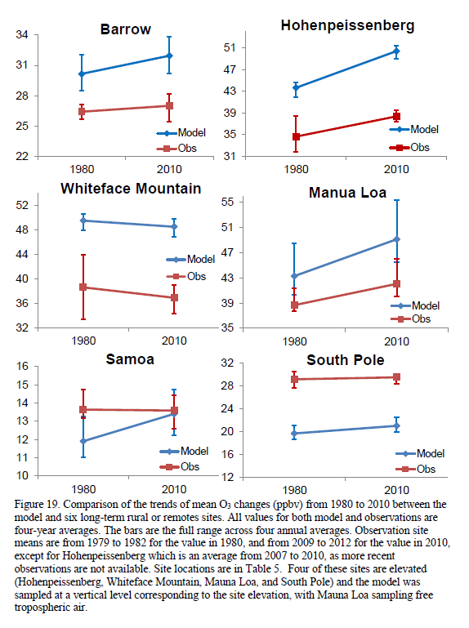
Results and Discussions
Comparing 1980-2010 trends at long term observation sites
Model captures well 1980-2010 O₃ trend at 5 of 6 rural or remote surface sites
Source: Supplementary information at http://www.nature.com/ngeo/journal/v9/n12/extref/ngeo2827-s1.pdf

Slide 20
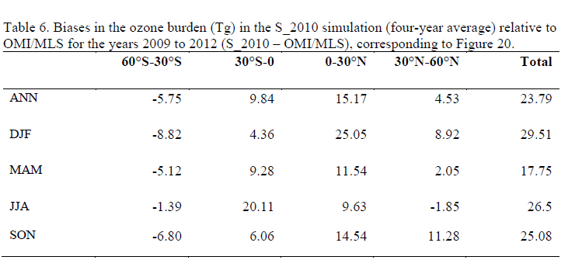
Results and Discussions
Comparing with OMI/MLS, S_2010 : high bias for B_{O3} over tropics/subtropics, including Africa
However, OMI/MLS trends from 2004-2015 highest growth over South and Southeast Asia, consistent with model
Source: Supplementary information at http://www.nature.com/ngeo/journal/v9/n12/extref/ngeo2827-s1.pdf
Source: Supplementary information at http://www.nature.com/ngeo/journal/v9/n12/extref/ngeo2827-s1.pdf
Notes:
S_2010 was compared with simulated 1980-2010 burden change and thus model overstate the magnitude of the tropical and subtropical ozone changes
Despite model biases, these observations provide strong evidence for ozone increases where the model predicts the greatest increases.
Observations have shown the ozone peak has shifted at rural NH sites, and emissions moving equatorward has been hypothesized as an explanation.

Slide 21
Implication of results
Implication for RF of O₃, but NO_{X} cause negative RF( due to decrease of CH₄), regions with high sensitivity of BO₃ to NO_{X} has high sensitivity of CH4 to NO_{X}, RF cancels each other
CO long lived, sensitivity of CO does not vary strongly with the location of CO emissions
Increase in isoprene emissions reflects the O₃ change determined by background NO_{X} levels, doubling soil Nox emissions increases tropospheric ozone upto 5 ppbv in source regions( Zeng et al, 2008)
Tropospheric ozone contributed to the greater 20th century warming in the NH extra tropics than tropics than SH. Rapid warming at later half of century, strongly agreed with claim made in this paper as tropospheric ozone increased as developing nations become industrialized, contributing accelerated rapid warming (Shindell et all, 2006).
Outgoing longwave radiation is strongly reduced over high water vapor regions due to significant absorption of water vapor over a wide spectral range, thus TOA flux sensitivity to troposphere ozone changes is low.

Slide 22
Conclusions
The change in spatial distribution of the global anthropogenic emissions from 1980 to 2010 dominates the BO₃ change, > combined effect of global emission magnitude and CH₄ mixing ratio.
Increased of O₃ precursors in the sub/tropics significantly influences the global BO₃
Emissions increased from Southeast, East and South Asia as BO₃ increases.
Reasons
Strong photochemical reaction rates, convection and NO_{x} sensitivity in the sub/tropics.
As a result, emissions might continue to increase due to equatorward shift of emissions, even if global anthropogenic emissions remains same or decrease.

Slide 23
Future work
Model for contribution of emissions changes from each regions individually
It did not account for possible effects of climate change or climate variability on change in BO₃
Parameters evaluated , simulating 1980 conditions, relative to 2010 simulation and change in BO₃, might have smaller emissions if done relative to 1980.
The effect of the equatorward emission shift on RF should be investigated.
Notes:
Future emissions :
Uncertainty exists
depends upon the occurrence of the required meteorological conditions( assuming no change in the emissions of ozone precursors)
Local to regional scenarios based on conc of pollutant at global scale

Slide 24
References
Lamarque, J. F. et al. Historical (1850–2000) gridded anthropogenic and biomass burning emissions of reactive gases and aerosols: methodology and application. Atmos. Chem. Phys. 10, 7017–7039 (2010).
Naik, V. et al. Net radiative forcing due to changes in regional emissions of tropospheric ozone precursors. J. Geophys. Res. 110, D24306 (2005).
Young, P. J. et al. Pre-industrial to end 21st century projections of tropospheric ozone from the Atmospheric Chemistry and Climate Model Intercomparison Project (ACCMIP). Atmos. Chem. Phys. 13, 2063–2090 (2013).
Logan, J. A. An analysis of ozonesonde data for the troposphere: recommendations for testing 3-D models and development of a gridded climatology for tropospheric ozone. J. Geophys. Res. 104, 16115–16149 (1999).
Tilmes, S. et al. Technical note: ozonesonde climatology between 1995 and 2011: description, evaluation and applications. Atmos. Chem. Phys. 12, 7475–7497 (2012).
Supplementary Information available at: http://www.nature.com/ngeo/journal/v9/n12/extref/ngeo2827-s1.pdf
General Circulation of the Atmosphere. Available at: http://climate.ncsu.edu/edu/k12/.atmosphere_circulation
Ferrel Cell meteorology from Encyclopedia Britannica. Available at: https://www.britannica.com/science/Ferrel-cell

Slide 25
Thank you
Notes:
Mist, fog and clouds move over the Sierra Nevada mountains (time-lapse)

Slide 26
Appendices
Code availability.
The CAM-chem model code used to perform all the simulations is available at: https://www2.cesm.ucar.edu/models.
The diagnostic package used to perform the model evaluation is developed and maintained by the NCAR AMWG, and code can be found at: https://www2.cesm.ucar.edu/working-groups/amwg/amwg-diagnostics-package/find-code.
Data availability.
Hourly O₃ observations for the remote sites of Barrow, Mauna Loa, Samoa and South Pole are maintained by the NOAA Global Monitoring Division (GMD) and can be found at: ftp://aftp.cmdl.noaa.gov/data/ozwv/SurfaceOzone.
Hourly ozone data from Hohenpeissenberg for the years 1971–2010 were downloaded from the Global Atmosphere Watch (GAW) World Data Centre for Greenhouse Gases: http://ds.data.jma.go.jp/gmd/wdcgg. The Meteorological Observatory Hohenpeissenberg is operated and financed by the German Meteorological Service (DWD).
The Whiteface Mountain Summit ozone data were collected by the University at Albany-SUNY with instrumentation provided by the New York State Department of Environmental Conservation. The data set was provided by J. J. Schwab, Atmospheric Sciences Research Center, University at Albany-SUNY, and is archived by the United States Environmental Protection Agency: http://www.epa.gov/ttn/airs/aqsdatamart.
Ozone profiles from commercial aircraft were collected and made freely available by the Measurement of Ozone and water vapour on Airbus In-service airCraft – In-service Aircraft for a Global Observing System (MOZAIC-IAGOS) programme (www.iagos.org). The data were made possible by: the European Commission’s support for the MOZAIC project (1994–2003) and the preparatory phase of IAGOS (2005–2012); the partner institutions of the IAGOS Research Infrastructure (FZJ, DLR, MPI, KIT in Germany, CNRS, CNES, Météo-France in France and the University of Manchester in the UK); ETHER (CNES-CNRS/INSU) for hosting the database; and the participating airlines (Lufthansa, Air France, Austrian, China Airlines, Iberia, Cathay Pacific) for the transport free of charge of the instrumentation.
The Hanoi, Vietnam ozonesondes were made freely available by the NASA Southern Hemisphere ADditional OZonesondes (SHADOZ) project²³. The processed ozonesonde climatology of ref. 25 was shared by P. Young of Lancaster University.
Monthly OMI/MLS tropospheric column ozone data²⁷ were provided by J. Ziemke, Morgan State University, Baltimore, and downloaded from: http://acd-ext.gsfc.nasa.gov/Data_services/cloud_slice. The OMI/MLS tropospheric column ozone product is derived from the Ozone Monitoring Instrument (OMI) and Microwave Limb Sounder (MLS) remote sensors onboard NASA’s polar orbiting Aura satellite. MLS retrievals are the latest available, version 4.2.

Slide 27
Acronyms
GHGs: Green House Gases
CO: Carbon monoxide
O₃ : Ozone
CH₄: Methane
NMVOCs: None methane volatile organic compounds
NO_{X}: Nitrogen oxides
NO_{Y}: Total reactive nitrogen
RF: Radiative forcing
TOA: Top of atmosphere
MDA8: three month O₃-season maximum daily 8-h average O₃

