Slide 1
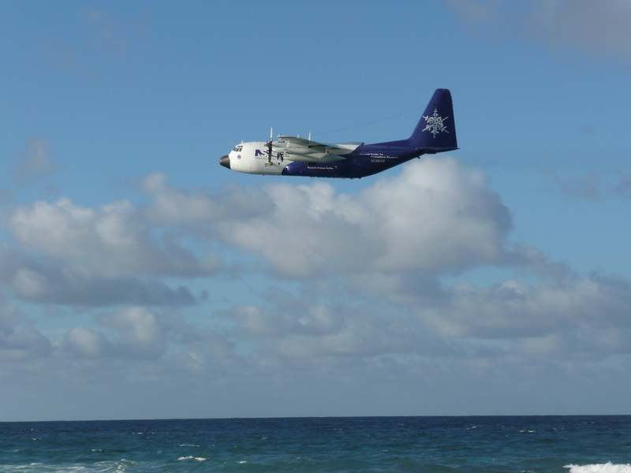
Free troposphere as a major source of CCN for the equatorial pacific boundary layer: long-range transport and teleconnections
Presented by:
Stephen Noble
Clarke, A. D., Freitag, S., Simpson, R. M. C., Hudson, J. G., Howell, S. G., Brekhovskikh, V. L., Campos, T., Kapustin, V. N., and Zhou, J.
Clarke, A. D., Freitag, S., Simpson, R. M. C., Hudson, J. G., Howell, S. G., Brekhovskikh, V. L., Campos, T., Kapustin, V. N., and Zhou, J. (2013): Free troposphere as a major source of CCN for the equatorial pacific boundary layer: long-range transport and teleconnections, Atmos. Chem. Phys., 13, 7511-7529.

Slide 2
Outline
Project background
Explanations
CO (carbon monoxide)
Volatility
Hoppel minimum
Clean and polluted case descriptions
Aqueous oxidation and convective outflow
Combustion and long range transport
Project study: sources for boundary layer aerosols
Sea salt
Growth
Mixing
Conclusions
Criticisms

Slide 3
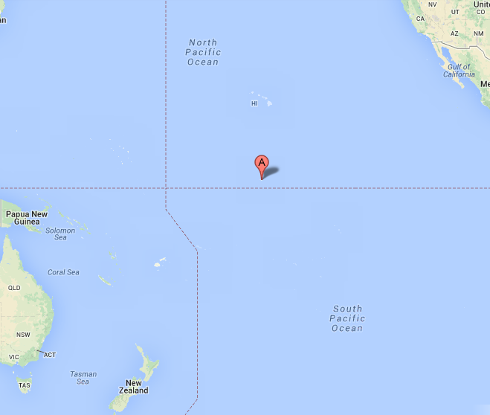
Background
CLAW hypothesis (Charlson et al. 1987)
Pacific Atmospheric Sulfur Experiment (PASE) August-September 2007
Remote (Kiribati)
DMS (dimethyl sulfide) nucleation of sulfate aerosol

Slide 4
Failure
Figure 1a&b, Hudson and Noble 2009, cloud droplets with CCN at 1% supersaturation
More CCN than in a less remote location in the Caribbean
Woodhouse et al. 2010 and 2013 – More DMS does not lead to formation of many new particles
Condenses on pre-existing particles
Processed in cloud by aqueous oxidation

Slide 5
Definitions
CN = condensation nuclei (aerosols>0.01µm)
CNhot = CN concentrations heated to 360°C
CNcold = CN not heated
CNvol = difference of CNcold and CNhot
CCN.2 = CCN concentration at 0.2% S
DMA = differential mobility analyzer
ITCZ = Intertropical convergence zone

Slide 6
Aerosol instruments
Two CN counters (TSI 3010), one hot and one cold >0.01µm
Ultra fine CN (TSI 3025A) >0.003µm
Aerodynamic particle sizer (APS-TSI 3321) 0.7-7.0µm
Long DMA (TSI 3081) 0.1-0.5µm
Radial DMA 0.01-0.2µm
Time of flight AMS
DRI CCN spectrometer 0.04-1.5% S

Slide 7
CO concentrations as proxy aerosol
Low CO concentrations indicate aged clean air masses
High CO concentrations indicate recent combustion process in polluted air masses
FT = free troposphere

Slide 8
Histograms of CO measurements
CO can be separated into high (>63ppbv) and low (<63ppbv) cases in boundary layer (BL), buffer layer (BuL), and free troposphere (FT) (upper and lower)
This helps to define which are more likely to have pollution from combustion

Slide 9
Volatility of aerosols
Heating to 360°C vaporizes some aerosol (CNvol)
Internally mixed aerosol shrink
Not volatile remain such as BC and sea salt, among others (CNhot)
polluted
clean

Slide 10
CNhot as proxy for CCN@0.2%
Much of the CNhot and CCN.2 fall on the 1:1 line
This allows use of the CNhot data as proxy for times when CCN.2 was not available

Slide 11
The Hoppel minimum
Minimum in the size distribution related to cloud processing of aerosols at 0.2% supersaturation usually corresponding to 80nm size
Chemical processing from aqueous oxidation of gases
Physical processing from scavenging and droplet combination

Slide 12
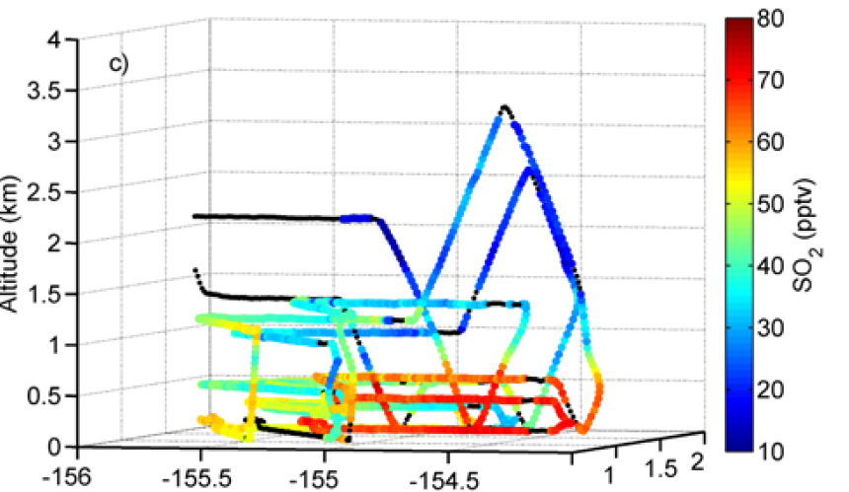
Low CO (clean), 13 Aug
CNhot shows higher concentrations near the surface which follows CO
SO₂ shows high concentrations at the surface

Slide 13
Clean case, convective outflow, 15 Aug
Sea salt dominates in the CNhot in the MBL while CNvol has high concentrations in the outflow

Slide 14
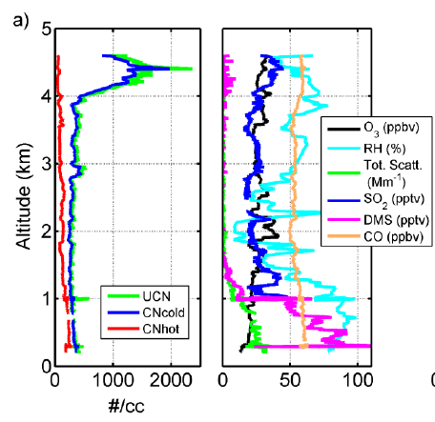
Convective outflow (CNvol)
DMS and SO₂ decrease in cloud indicating aqueous oxidation
CO and O₃ mostly constant
15 Aug, clean
High concentrations and small sizes near the convective out flow
Larger sizes at low altitudes

Slide 15
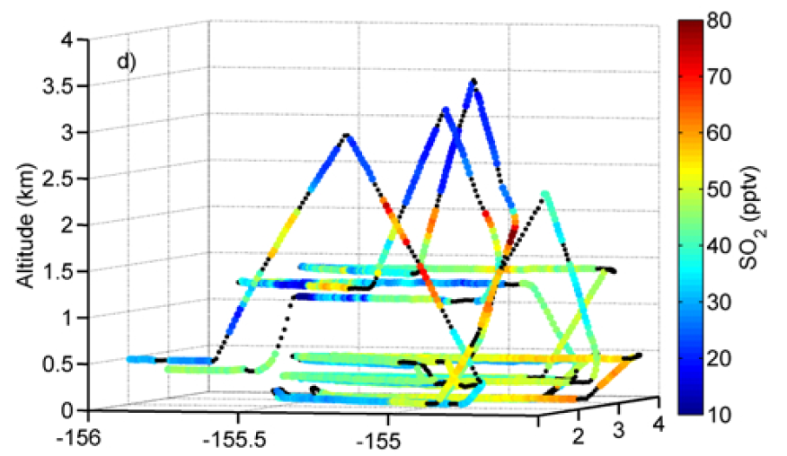
High CO (polluted), 25 Aug
Much higher CO concentrations as well as CNhot concentrations in the FT
SO₂ concentrations are lower at the surface than for the clean case

Slide 16
High CO (polluted) case, 6 Sept
High CNhot concentrations of in the FT with high CO
Where is the combustion occurring as indicated by high CO?

Slide 17
High CO back trajectories for 6 Sept (polluted)
Higher altitude came from the surface into the ITCZ and then subsided (low CO)
Lower altitude subsided from aloft at higher altitudes (high CO)

Slide 18
High CO originates over the Amazon Basin
Low CO over the Pacific
For 6 Sept trajectories with high CO are over Amazon basin near 8/27

Slide 19
CALIPSO data
Smoke
Cloud
Surface
Blocked beam
Amazon Basin
SW
NE
NE
SW
Amazon Basin
Pacific

Slide 20
So far…
Back trajectories show CO and aerosol likely originated from combustion in the Amazon basin
During a 10 days the air subsided while being transported to the central Pacific
CNvol are produced locally as shown by the convective outflow and decrease of SO₂

Slide 21
Which aerosols make up the CCN.2 in the marine boundary layer?

Slide 22

Sea salt and DMS
Profiles similar but just reduced after removal of sea salt
Nucleation of DMS doesn’t appear to have much effect

Slide 23
Sea salt
Sea salt in the boundary layer increases the CCN@0.2%S
Removing CCN@0.04%S (most likely sea salt) leaves concentrations in the BL more similar to those in the FT
Sea salt

Slide 24
Stacked distributions
clean
polluted
Larger sizes dominate the surface area distribution
Hoppel minima in both polluted and clean at 80nm
Higher concentrations at slightly larger sizes in polluted FT

Slide 25
Growth of aerosol
polluted
clean
Hoppel min. in both cases is evidence of aerosol growth by cloud processing
Polluted case has a larger processed mode
Sizes in the FT polluted are much closer to the min so grow more readily

Slide 26
Localized mixing
CO level below inversion near constant but higher above
6.5 hours later CO and CCN.2 concentrations had increased below

Slide 27
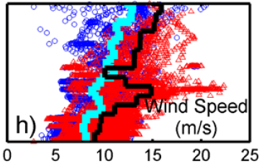
My take on mixing
Overall there is a strong wind speed with high CO cases at the inversion layer
This layer also has consistently higher concentrations of CNhot, CCN.2, CO, etc…
Strong wind speed in the entrainment interface layer of an inversion can effectively entrain dry polluted air from the FT to the BL

Slide 28
Sea salt

Slide 29
The overall results
Total = 192 cm⁻³
FT = 125 cm⁻³ – 65.10%
SSA = 15 cm⁻³ – 7.81%
Growth = 50 cm⁻³ – 26.04%
Missing = 2 cm⁻³ – 1.04%
25%
65%
10%
99.99%

Slide 30
Conclusion
“This work confirms that most of the MBL population is typically resupplied through entrainment from the FT rather than nucleation and growth in the MBL and that the CLAW hypothesis, as proposed, was not operational within the PASE MBL.”
Biomass burning “combustion” in the Amazon basin can be a source for aerosol in the central pacific by long range transport
Transport occurs in the free troposphere and then mixes to the MBL to act a CCN

Slide 31
Criticisms
No cloud droplet concentration data: 139 ± 39 cm⁻³ (Hudson and Noble 2009)
Do I believe that the sea salt contribution was only 15 cm⁻³ when CCN.04 difference from BL to FT was 39 cm⁻³?
Lack of discussion of mixing over the whole project where increased wind speed in the inversion layer in polluted cases creates a mechanism to mix the aerosol from the FT to the BL

Slide 32
References
Charlson, R. J., Lovelock, J. E., Andreae, M. O. and Warren, S. G. (1987). Oceanic phytoplankton, atmospheric sulphur, cloud albedo and climate. Nature 326 (6114): 655–661.
Clarke, A. D., Freitag, S., Simpson, R. M. C., Hudson, J. G., Howell, S. G., Brekhovskikh, V. L., Campos, T., Kapustin, V. N., and Zhou, J.: Free troposphere as a major source of CCN for the equatorial pacific boundary layer: long-range transport and teleconnections, Atmos. Chem. Phys., 13, 7511-7529, doi:10.5194/acp-13-7511-2013, 2013.
Hoppel, W. A., Frick, G. M., Fitzgerald, J. W., and Larson, R. E.: Marine boundary layer measurements of new particle formation and the effects nonprecipitating clouds have on aerosol size distribution, J. Geophys. Res., 99, 14443–14459, doi:10.1029/94JD00797, 1994.
Hudson, J. G., and S. Noble (2009), CCN and cloud droplet concentrations at a remote ocean site, Geophys. Res. Lett., 36, L13812, doi:10.1029/2009GL038465.
Woodhouse, M. T., Mann, G. W., Carslaw, K. S., and Boucher, O.: Sensitivity of cloud condensation nuclei to regional changes in dimethyl-sulphide emissions, Atmos. Chem. Phys., 13, 2723-2733, doi:10.5194/acp-13-2723-2013, 2013.
Woodhouse, M. T., Carslaw, K. S., Mann, G. W., Vallina, S. M., Vogt, M., Halloran, P. R., and Boucher, O.: Low sensitivity of cloud condensation nuclei to changes in the sea-air flux of dimethyl-sulphide, Atmos. Chem. Phys., 10, 7545-7559, doi:10.5194/acp-10-7545-2010, 2010.

