Slide 1
Technical Note: Evaluation of the WRF-Chem “Aerosol Chemicals to Aerosol Optical Properties” Module using data from the MILAGRO campaign
J. C. Barnard, J. D. Fast, G. Paredes-Miranda, W. P. Arnott, and A. Laskin
Atmos. Chem. Phys., 10, 7325-7340, 2010
Presented by: Dan McEvoy
ATMS 790 Graduate Seminar
03/10/2014

Slide 2
Topics to covered:
What is WRF?
What is WRF-Chem?
WRF-Chem “aerosol chemical to aerosol optical properties” module
Overview of the MILAGRO campaign and measurements
Paper overview and experiment set up
Results: WRF-Chem vs. observation
Uncertainties
Key findings

Slide 3
What is WRF?
Weather Research and Forecasting model (WRF)
Used for research and operational forecasting (i.e. National Weather Service)
It is a supported “community model”, i.e. a free and shared resource with distributed development and centralized support
Integrates atmospheric flow equations (i.e. Navier-Stokes) through time using a Eulerian framework, or fixed point in space
  Visualize sitting on river bank watching water flow by
Advantages over global models: user chooses domain
  Greatly reduces computation time
  Allows for high resolution modeling (sub kilometer, where global models are typically 100 km or more)
Notes:
In contrast to a Langrangian framework, sitting in a boat floating down a river

Slide 4
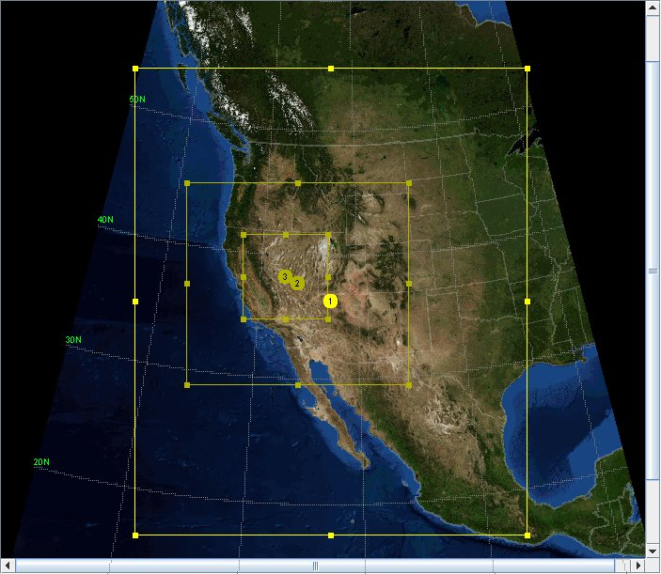
WRF example: dynamic downscaling
Global Forecast System (GFS) model data used as initial and boundary conditions (~100 km spatial resolution)
Domain 1: 36 km spatial resolution
Domain 2: 12 km spatial resolution
Domain 3: 4 km spatial resolution
Resolve meteorological features associated with topography such as rain shadows, temperature inversions, and meso-scale wind features
Notes:
Coarse resolution of global models does not always resolve features associated with terrain (rain shadows, temperature inversions) or mesoscale meteorological features (Washoe Zephyr, convection)

Slide 5
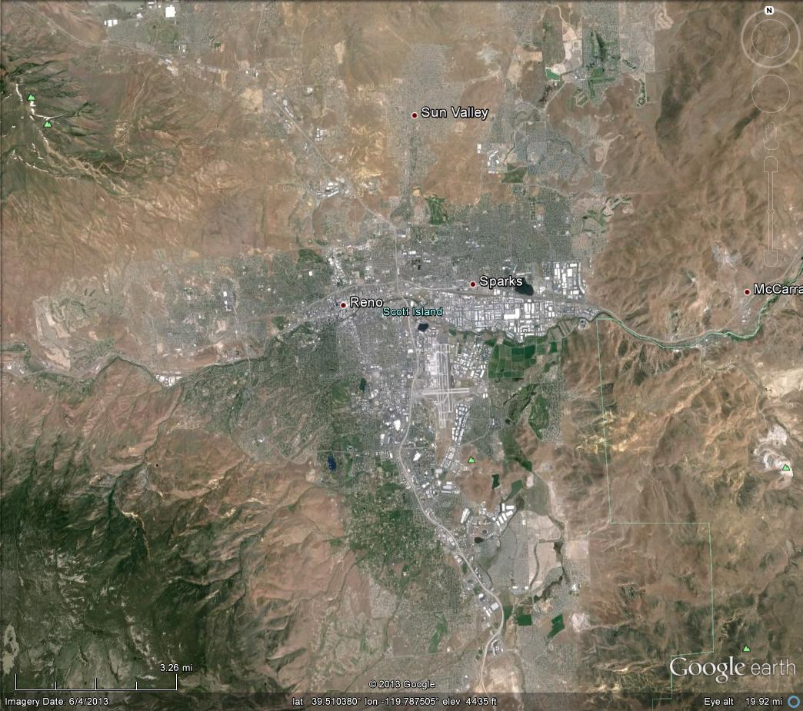
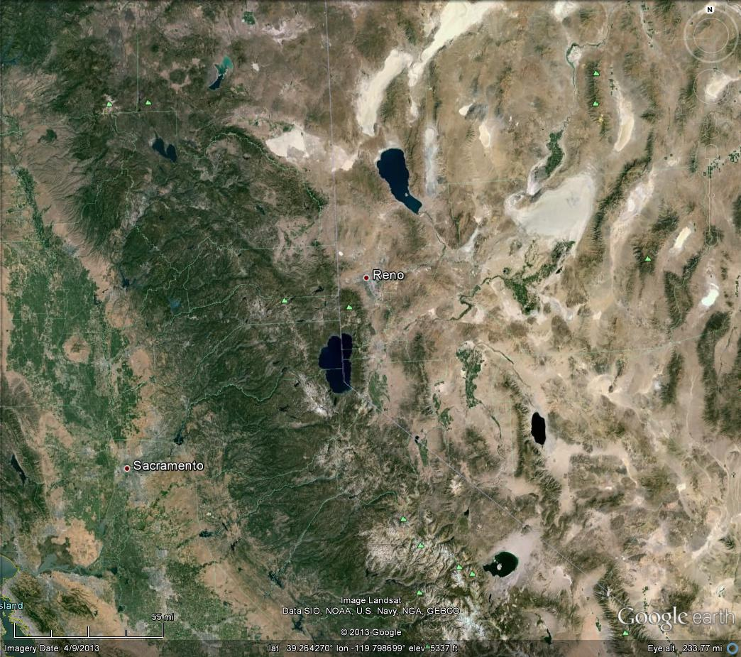
North Reno to South Reno, ~10 km
~10 km
~175 km
Reno to Sacramento, ~175 km

Slide 6
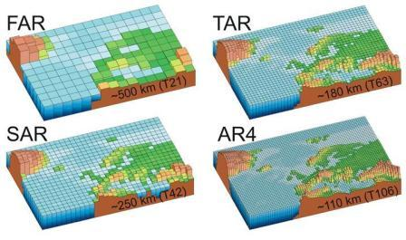
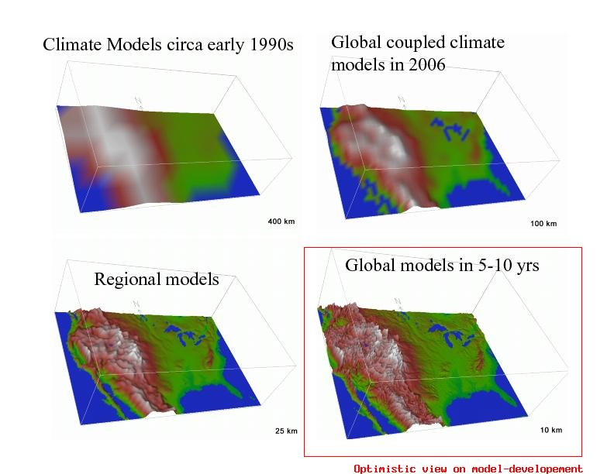
Evolution of global climate model spatial resolution
(www.wmo.int)
Global climate models vs. regional models
(www.realclimate.org)

Slide 7
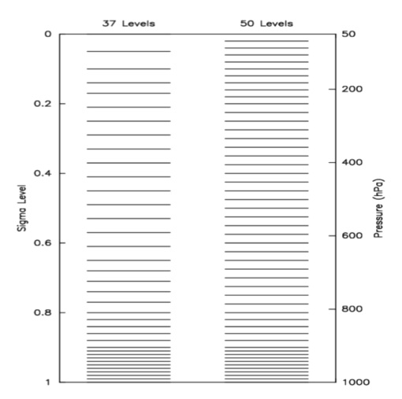
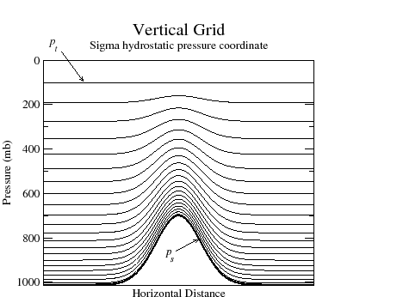
Hybrid-sigma level vertical coordinate system
Based on normalized atmospheric pressure, not geometric distance
Layers near the surface thinner than upper air layers

Slide 8
Matlab
Image courtesy of NCAR

Slide 9
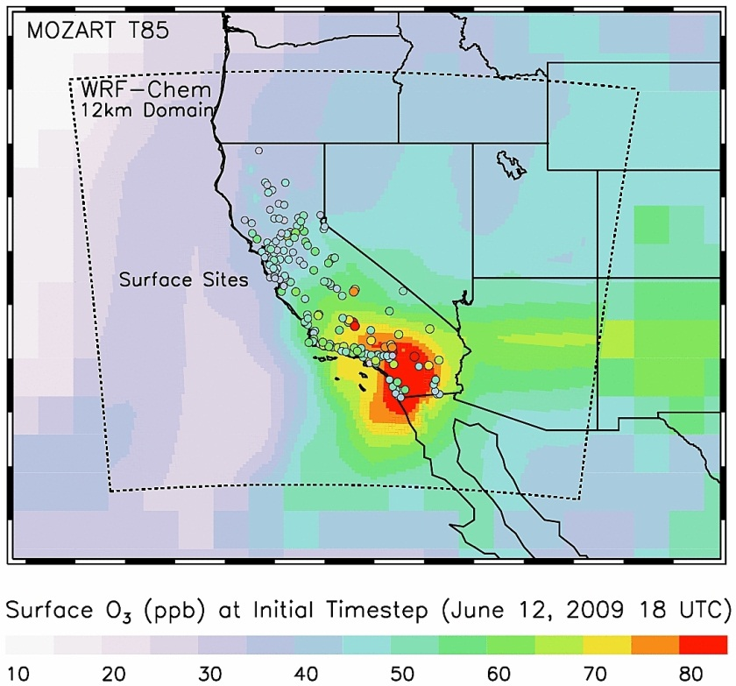
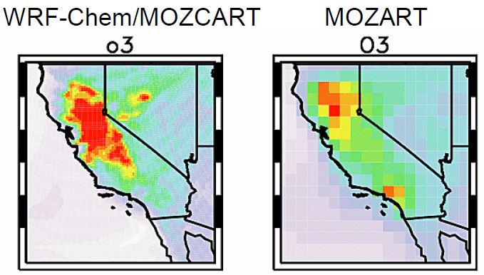
What is WRF-Chem?
WRF coupled with chemistry modules
Simulate emissions, transport, mixing, and chemical transformation of trace gases and aerosols simultaneously with meteorology
Instead of using idealized profiles for chemical species and aerosols, use results from Model for OZone And Related chemical Tracers (MOZART) chemical transport model
Popular uses: regional air quality forecasting, cloud scale interactions between clouds and chemistry
(images courtesy of: www.acd.ucar.edu/wrf-chem)

Slide 10
WRF-Chem “aerosol chemical to aerosol optical properties” module:
Start with chemical masses (M _{i, j}) and particle # (N_{i}), where i = bin number and j = chemical species
Convert masses to volumes, V _{i, j}, by dividing by the density of each chemical species
Physical diameter, D_{p, i}, assigned to each bin, assuming spherical particles:
Calculate bulk refractive index of particles in each bin, m _{s, i}:
where m_{j} is the refractive index of each chemical
constituent
“Use a spherical shell/core configuration, where all species except BC are uniformly distributed within a shell that surrounds a core consisting only of BC”
Notes:
Make sure to add notes on why black carbon is excluded

Slide 11
WRF-Chem “aerosol chemical to aerosol optical properties” module:
Find absorption efficiency (Q_{a, i}), scattering efficiency (Q_{s, i}), and asymmetry parameter (g_{i}) using Shell/core Mie theory
Find optical properties (scattering coefficient, absorption coefficient, and single scattering albedo) at 870 nm by summing over the size distributions:
Notes:
This is what is going on inside of the WRF-chem module code

Slide 12
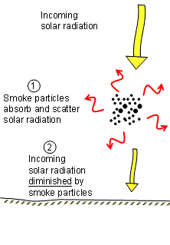

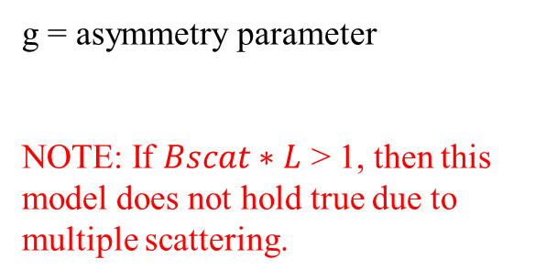
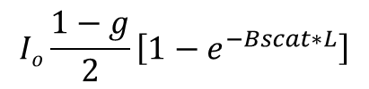
TOA
I_{back} = backscattering radiation =
I_{o} =
$$Io\frac{1−g}{2}\left[1−e^{−Bscat∗L}\right]$$
B_{scat} and B_{abs}
probability for backscatter
probability for all scattering
Aerosol layer thickness (L)
g = asymmetry parameter
NOTE: If $Bscat∗L$ > 1, then this model does not hold true due to multiple scattering.
I_{L}
I_{L} = radiation reaching surface or instrument =
$$Ioe^{−Bext∗L}$$
B_{scat} + B_{abs} = B_{ext}
optical depth
single scattering albedo (ω₀) = B_{scat}/B_{ext}
(image courtesy: www.esrl.noaa.gov/research/themes/aersols)

Slide 13
MILAGRO campaign
Megacity Initiative: Local And Global Research Observations (MILAGRO, Spanish for “miracle”)
Mexico City, March 2006
Overreaching goal: characterize sources and processes of emissions from the urban center and to evaluate the regional and global impacts of Mexico City emissions
Massive undertaking: over 150 institutions and worked together to gather field measurements from an extensive list of instruments…

Slide 14
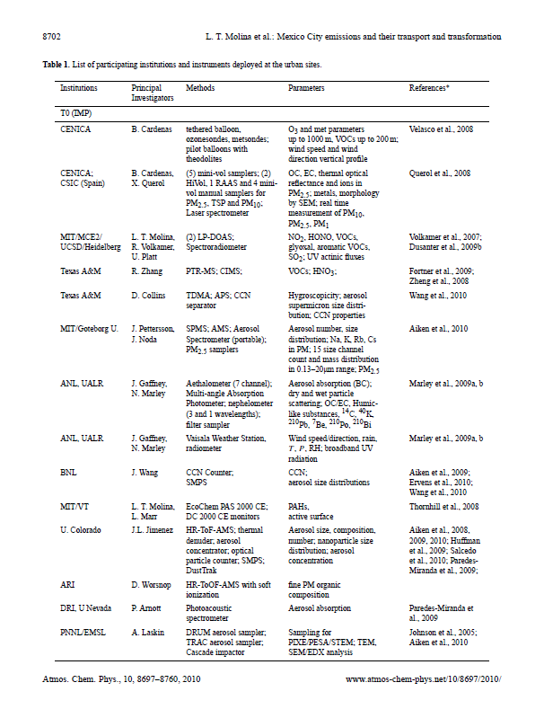
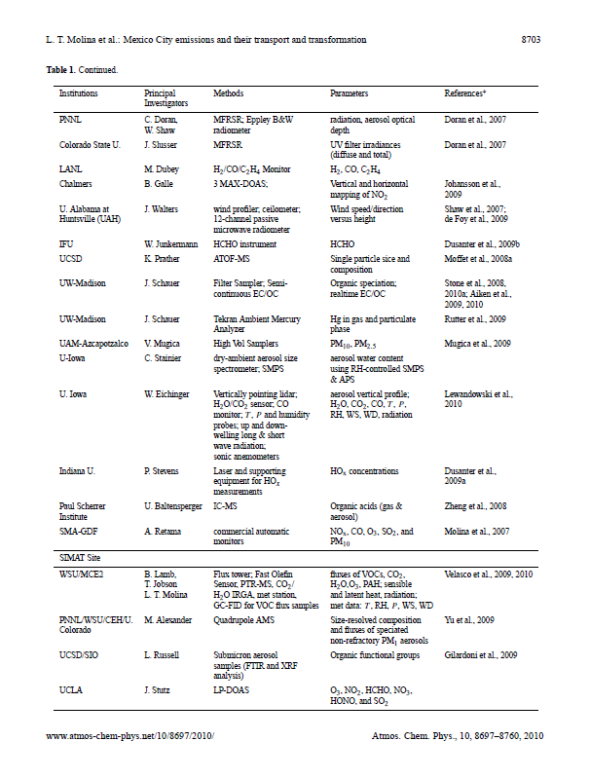
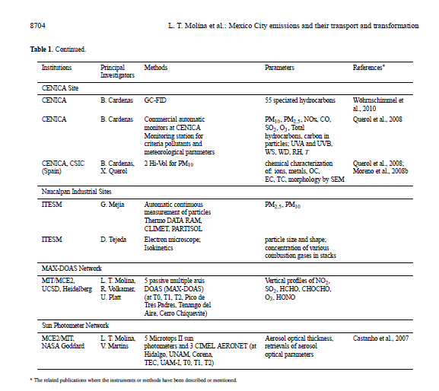
An overview of the MILAGRO 2006 Campaign: Mexico City emissions and their transport
Molina et al. 2010
Atmos. Chem. Phys., 10, 8697-8760, 2010
Notes:
This just from the urban site, there are two other main sites with lists just about as long as this one

Slide 15
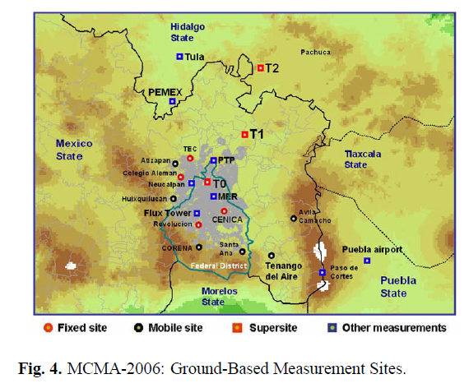
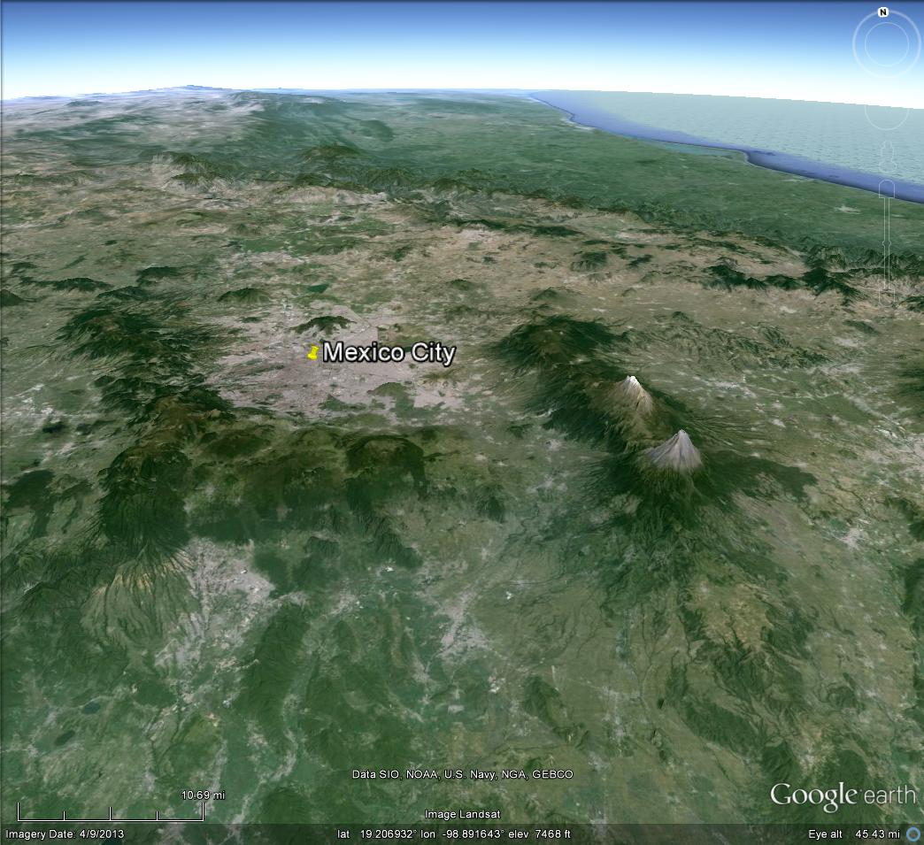
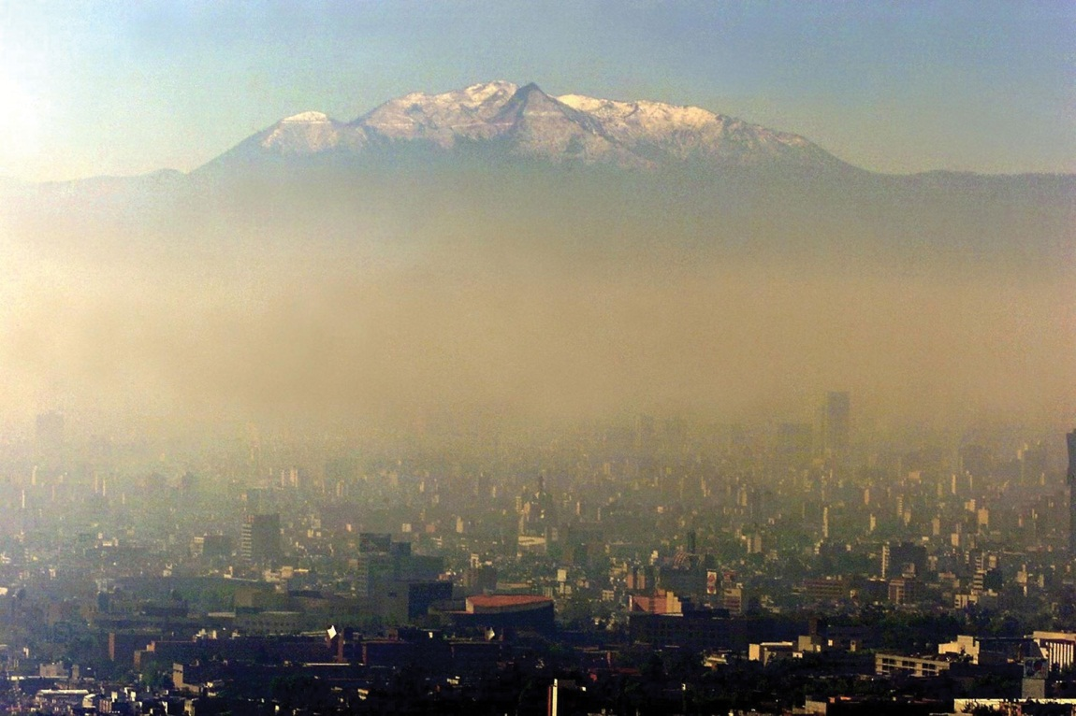
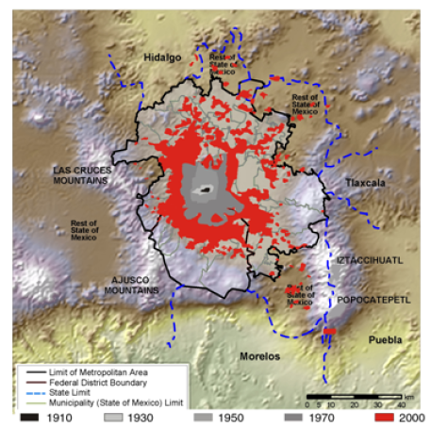

Slide 16
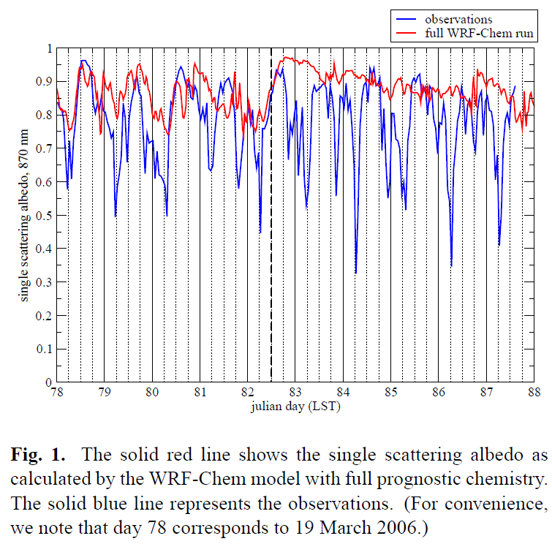
Paper Overview, Barnard et al. 2010:
Observed aerosol optical properties from MILAGRO campaign compared to full WRF-Chem run revealed major differences
“aerosol chemical to aerosol optical properties” WRF-chem module predicts B_{scat}, B_{abs}, and ω₀
Use MILAGRO measurements to drive WRF-chem module instead of modeled values to asses and understand errors found in Figure 1 (M _{i, j} and N_{i} from WRF-chem code)

Slide 17
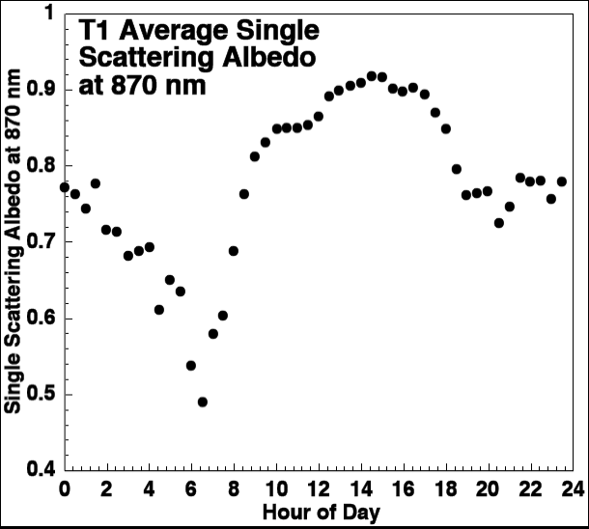
(slide courtesy of the MILAGRO working group)
Cooling effect
Warming effect
Afternoon.
Well mixed atmosphere.
Regional SOA,
dust and local
emissions mix.
Morning rush hour.
Large amounts of black carbon aerosol.

Slide 18
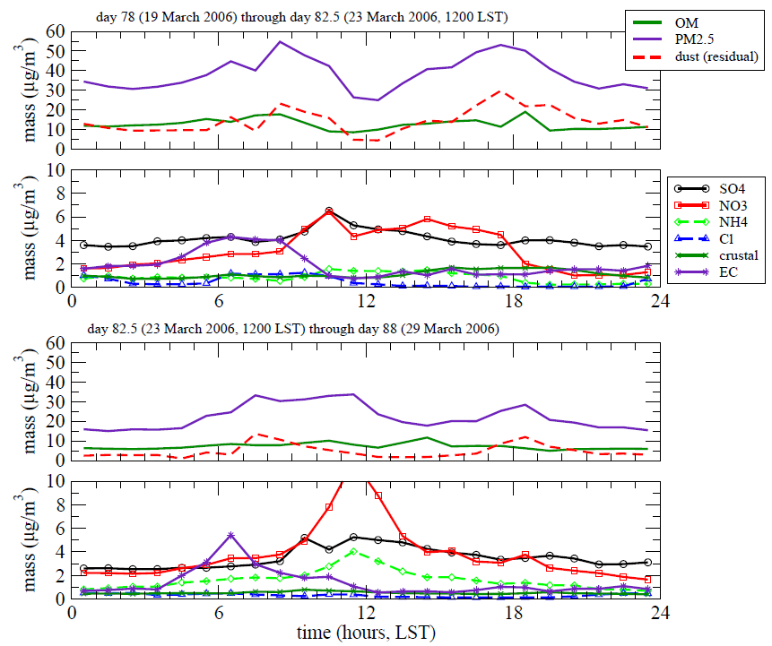
MILAGRO observed aerosol chemical measurements:
Figure 2: diurnally averaged time series
Two meteorological categories:
  Mostly clear sky (day 78-82.5; top two panels)
  Showery (day 82.5-88; bottom two panels)
Larger masses during clear period, precipitation scavenging
09:00 PM 2.5 peak: trapped pollutants in stable boundary layer
18:00 PM2.5 peak: wind blown dust
Notes:
These are the measurements needed as input to the WRF-Chem module. Could not identify reason for peaks in NO3 and NH4. EC is equal to BC, black carbon

Slide 19
MILAGRO optical measurements:
Optical measurements (B_{scat}, B_{abs}, and ω₀): photoacoustic spectrometer (PAS; Arnott et al. 1999)
Laser light is power modulated by the chopper.
Light absorbing aerosols convert light to heat - a sound wave is produced.
Microphone signal is a measure of the light absorption.
Light scattering aerosols don't generate heat.
Acoustical Resonator
(courtesy of the MILAGRO working group)

Slide 20
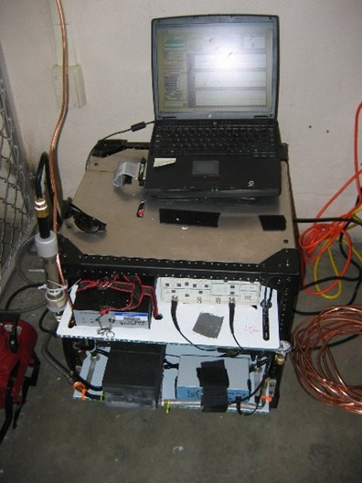
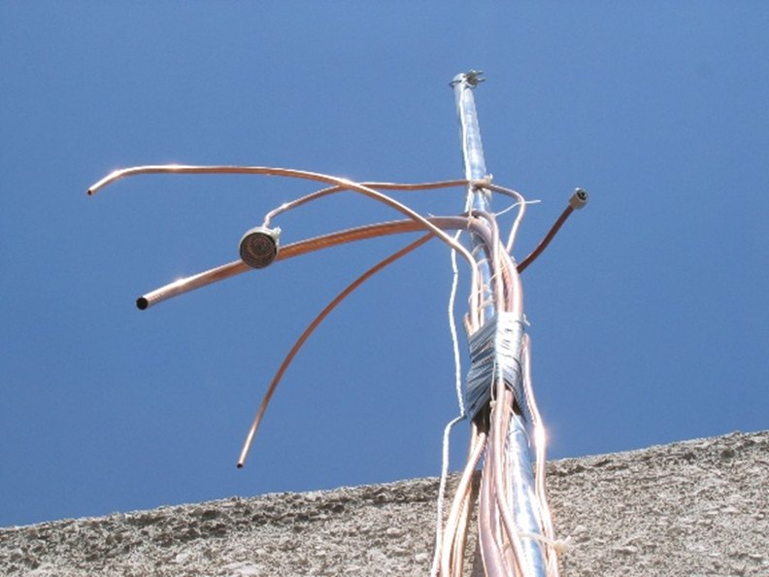
PAS instrumentation
Inlet system at T0
(images courtesy of the MILAGRO working group)

Slide 21
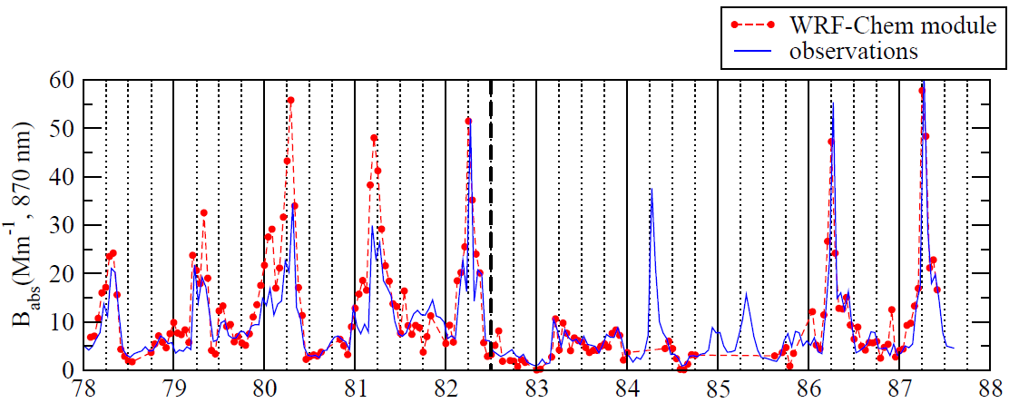
Results, WRF-chem module vs. observations:
Figure 5, B_{abs}
  Similar diurnal patterns, peak between 06:00 and 08:00
  Correlates well with BC peaks seen in Figure 2
  Suggests BC controls most of the absorption at 870 nm
  WRF-Chem module performed reasonably well (r² = 0.82), with tendency to over predict

Slide 22
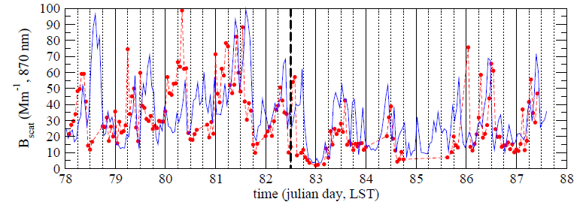
Results, WRF-chem module vs. observations:
Figure 5, B_{scat}
  Poor agreement between WRF-Chem and observations compared to B_{abs} (r² = 0.16)
  module magnitudes are decent, but the timing of the peaks are consistently off by a few hours

Slide 23
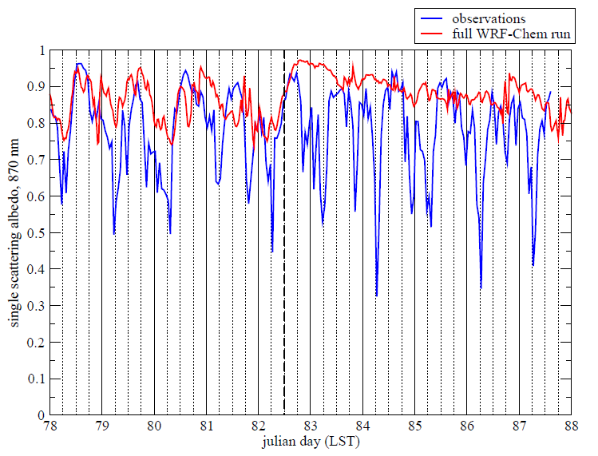
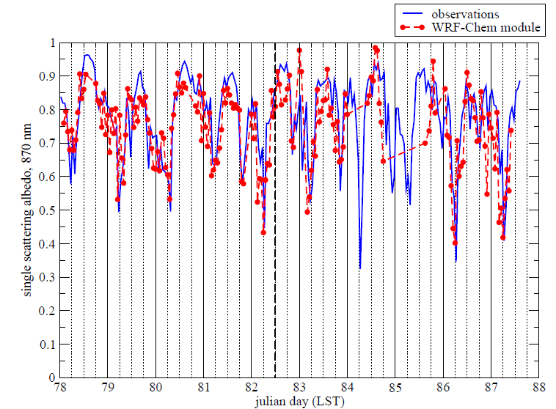
Full WRF-Chem
WRF-Chem module with obs.
  Significant improvements found running WRF-Chem module with observations
  ω₀ ~3 times more sensitive to changes in B_{abs} than to changes in B_{scat}
  Large daily swings in B_{abs} govern diurnal behavior of ω₀

Slide 24
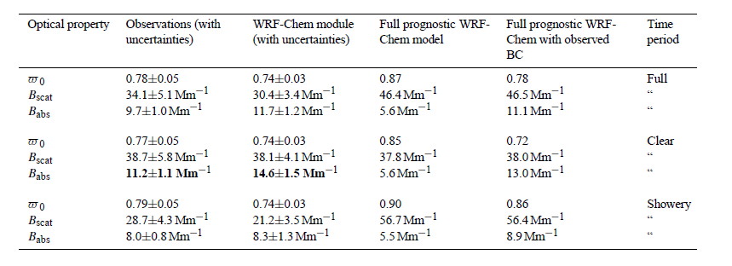
Mean values of optical properties
Full WRF-Chem: over predicts albedo and scattering, under predicts absorption

Slide 25
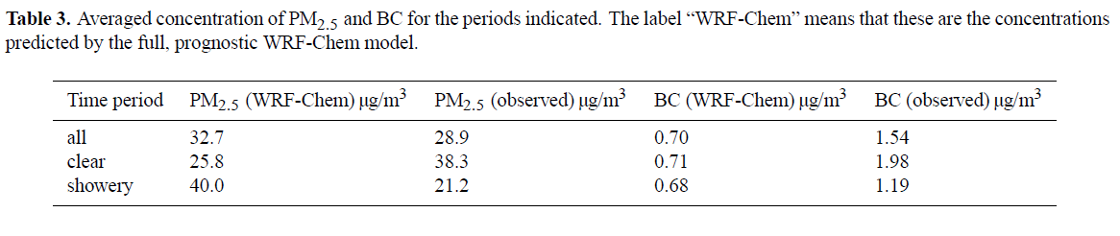
“Why is B_{abs} so grossly under predicted?”
WRF-Chem greatly under predicts BC
Attribute this to emissions inventory not containing enough BC
For “all” time period, PM_{2.5} reasonably predicted
However, PM_{2.5} is under predicted for “clear” period and over predicted for “showery” period
Cannot yet explain this behavior
A doubling of PM_{2.5} leads to a doubling in B_{scat}, which significantly influences ω₀

Slide 26



Bigger picture: aerosol direct radiative forcing
Estimate forcing using method described by McComiskey et al. (2008):
F = top of atmosphere (TOA) aerosol broadband forcing
= net instantaneous downwelling shortwave broadband flux at TOA in presence of aerosols
= net instantaneous downwelling shortwave broadband flux at TOA without aerosols
Find average solar forcings from observations and WRF-Chem…

Slide 27
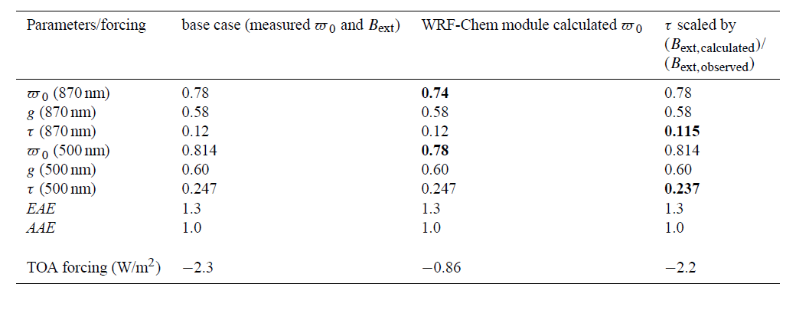
~1.4 W/m² TOA forcing difference from WRF-Chem module compared to using measured ω₀ and B_{ext}
Lower albedo, so greater warming effect

Slide 28
Uncertainties:
WRF-Chem module:
Aerosol shape and morphology: All particles treated as spherical, although aerosols are much more complex shapes. Author states that a detailed treatment of aerosols is not possible with todays models. (Possible error: ±15% to B_{scat} and B_{abs})
Assumptions regarding chemical species density: single value used instead of range of densities. (Possible error: ±5%)
Assumptions regarding refractive index: single value used instead of range of values
Conversion of organic carbon mass to organic matter mass: suggested values range from 1.4 to 2.3 for conversion factor. Used 1.7 for this study based on previous study (Aieken et al. 2008), with uncertainty of ±0.2.

Slide 29
Uncertainties:
Measurements:
Errors in the PAS measurements: ±15% for B_{scat} and ±10% for B_{abs}
Sampling efficiency of the PAS: Assumed that particles with aerodynamic diameter > 2 to 3 µm were not sampled. However, this was not quantified.
Errors in measurements of PM_{2.5} chemical masses used as input data: PILS instrument for inorganic species, ±10% (Weber et al. 2001), OC/EC instrument, ±0.2 µg/m³, and PM2.5 mass measurements from TEOM instrument, ±5%.
Size distribution measurement errors: Errors in number concentration are ±10% for each size channel. Additional error due to extrapolation to extend size distribution from 0.735 µm to larger sizes.

Slide 30
Key findings and conclusions:
WRF-Chem “aerosol chemical to aerosol optical properties” module unlikely to be a factor in poor performance of WRF-Chem full run single scattering albedo
Poor specifications of emissions is more likely the problem, especially BC
For climate simulations at longer temporal scales, “aerosol chemical to aerosol optical properties” module may be quite useful
Study confined to local, unsure if similar results would be found elsewhere

Slide 31
QUESTIONS?

Slide 32
References:
Arnott, W. P., H. Moosmuller, and C. F. Rogers, 1999: Photoacustic spectrometer for measuring light absorption by aerosols: Instrument description. Atmos. Env., 33, 2845-2852.
Barnard, J. C., J. D. Fast, G. Paredes-Miranda, W. P. Arnott, and A. Laskin, 2010: Technical Note: Evaluation of the WRF-Chem “Aerosol Chemicals to Aerosol Optical Properties” Module using data from the MILAGRO campaign, Atmos. Chem. Phys., 10, 7325-7340, 2010.
Molina, L. T. et al., 2010: An overview of the MILAGRO 2006 Campaign: Mexico City emissions and their transport, Atmos. Chem. Phys., 10, 8697-8760.

Slide 33
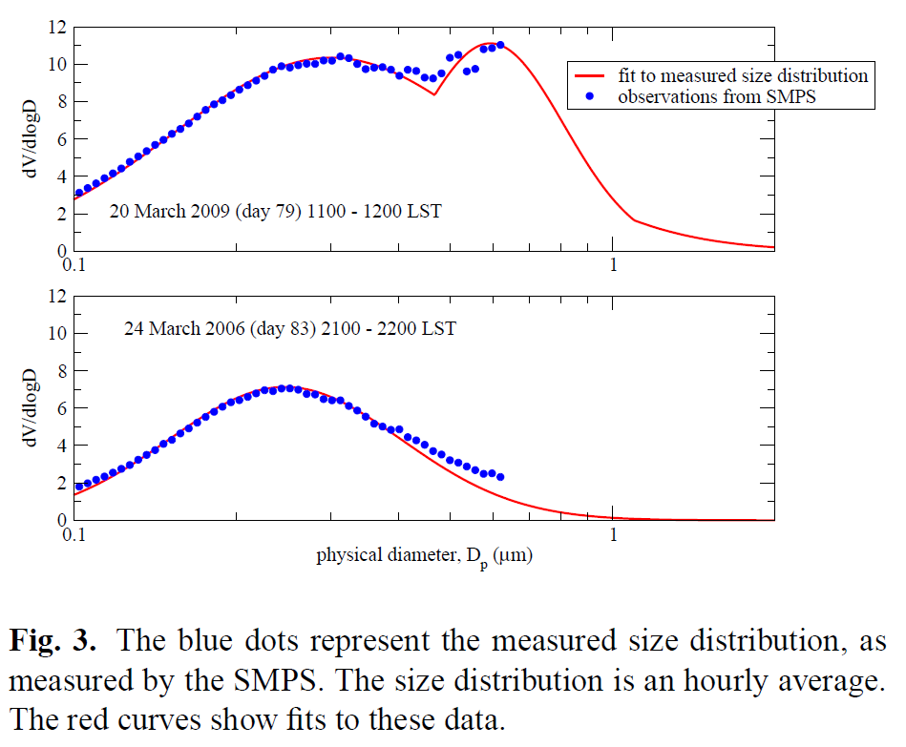
clear period
showery period
  Distributions begin to differ around particles > 0.5 µm
  Larger particles during clear periods may be due to wind blown dust

Slide 34
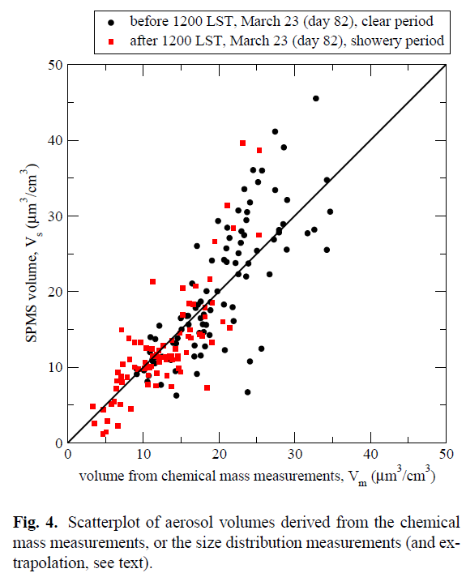
  Compare volumes obtained from SPMS to volumes obtained from chemical mass measurements
Not much to say about this figure other than: “Given the approximations involved, the correlation is satisfactory.”

