Slide 1
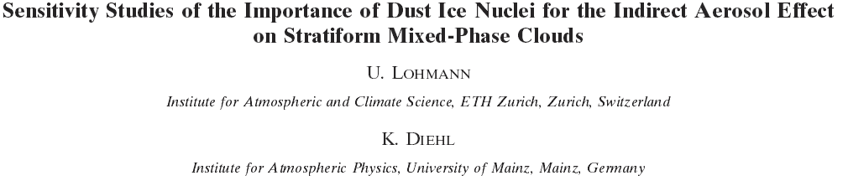
By : Kerwyn Texeira

Slide 2
Outline
Definitions
Introduction
Model Description
Model Evaluation
The effect of dust nuclei on cloud coverage
Conclusion
Questions

Slide 3
Definitions
Aerosol - tiny particles or droplets suspended in air or another gas.
Aerosol indirect effect –cloud microphysical properties.
Accumulation mode – 0.1 and 2.5µm.
Cloud Condensation Nuclei (CCN)
Ice Nuclei (IN)

Slide 4
Definitions Cont’d
Liquid Water Content (LWC) – mass of water in a cloud in a specified dry air (g/m³)
Liquid Water Path (LWP) – the total amount of water present in the atmosphere between two points [g/m²].
Short Wave forcing – difference in the TOA shortwave radiation between all –sky and clear-sky conditions obtain from the Earth Radiation Budget Experiment.

Slide 5
Introduction
Aerosol particles affect the climate system
Two types of freezing :- Contact and Immersion Freezing
Immersion freezing will serve as a surrogate in this study
Black carbon is a good absorber of solar radiation
Black carbon is a effective ice nuclei

Slide 6
Introduction Cont’d
Both kaolinite and montmorillonite are frequent surrogates for atmospheric dust particles.
Kaolinite is a less efficient ice nucleus by itself than montmorillonite.
The main theme of the paper is to establish the effectiveness of immersion freezing between kaolinite, montmorillonite and black carbon in a mixed phase cloud.

Slide 7
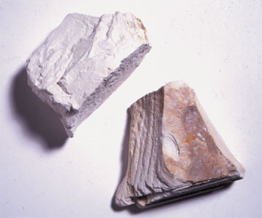
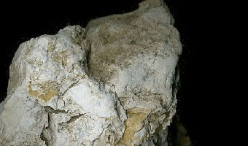
Examples of Kaol. And Mont.
Kaolinite Clay
Montmorillonite Clay

Slide 8


Model Description
An ECHAM4 general circulation model was used.
Contact parameterization:
Immersion parameterization:

Slide 9
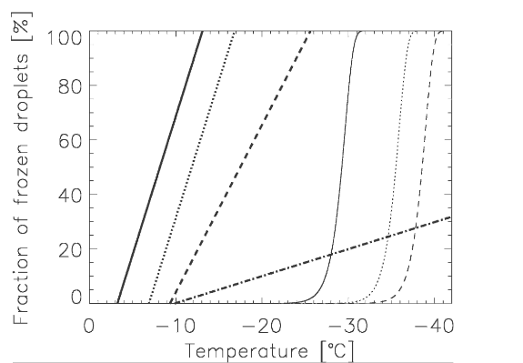
% of frozen cloud droplet as a function of ice nuclei composition
Fraction of frozen droplets versus temperature

Slide 10
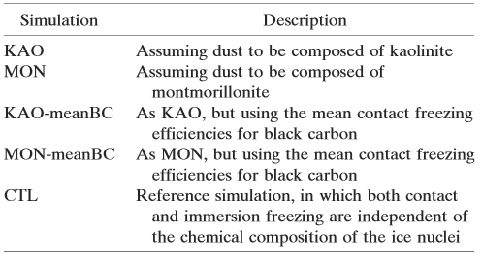
Sensitive Simulations
Table shows different simulations

Slide 11
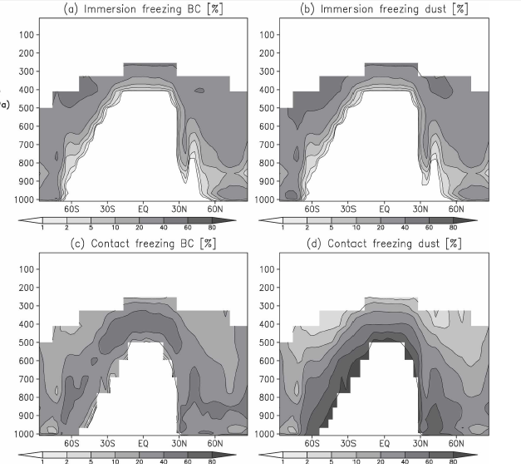
Model Evaluation- Annual latitude-pressure cross sections
A comparison over view

Slide 12
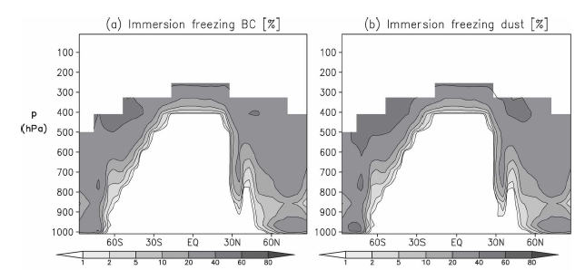
Immersion Freezing Comparison
Simulation KAO

Slide 13
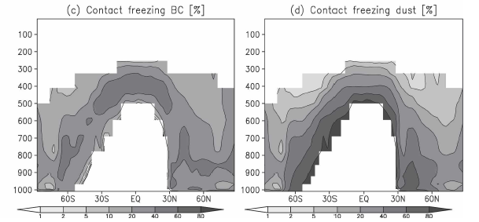
Contact Freezing Comparison
Simulation KAO

Slide 14
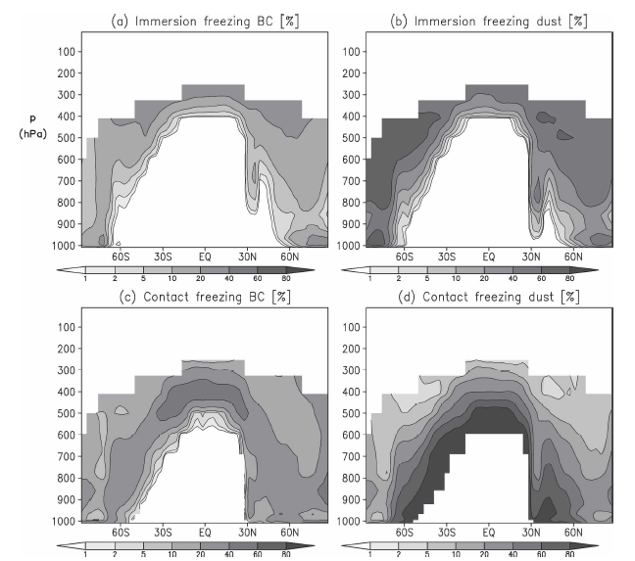
Immersion Freezing
A comparison overview

Slide 15
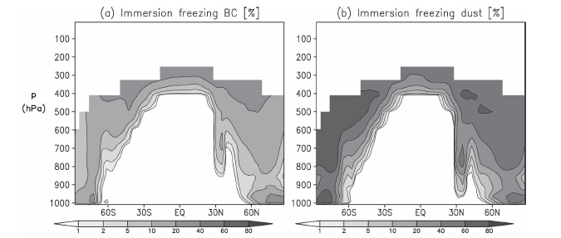
Immersion Freezing
Simulation MON

Slide 16
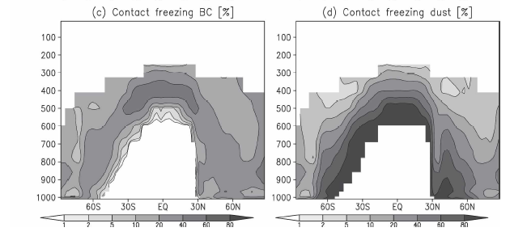
Contact Freezing
Simulation MON

Slide 17
Summary
Contact freezing in both simulation is most important especially at higher temperatures.
If you consider dust composed of montmorillonite in the MON simulation then then immersion freezing of dust is second in line.

Slide 18
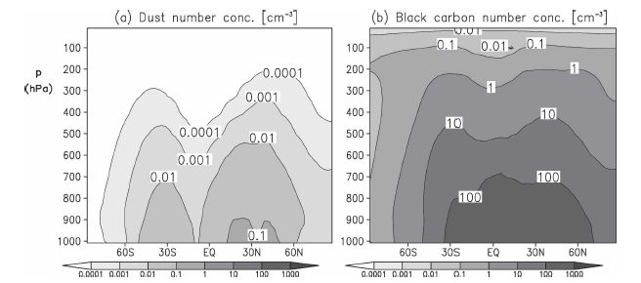
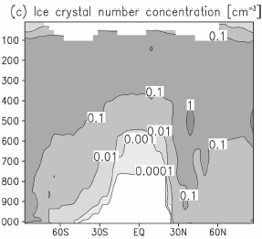
Model Evaluation Cont’d
Ten year annual zonal mean latitude vs. pressure cross section

Slide 19
Explanation
Black carbon exceeds 20% at the coldest temperature.
The freezing of black carbon in the simulation is more important because the freezing of kaolinite is less efficient than montmorillonite.
Immersion freezing is most important at coldest temperatures.

Slide 20
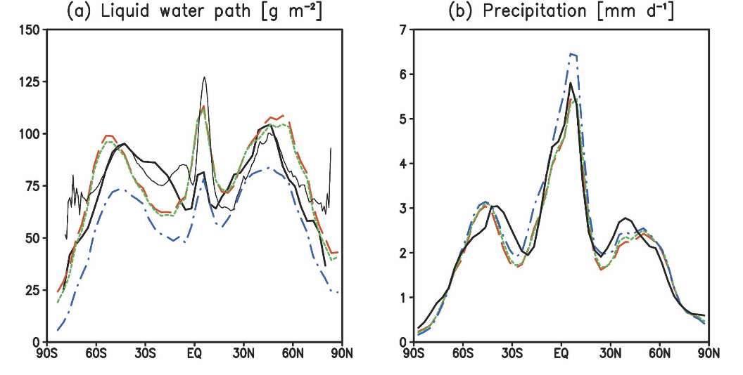
Annual Zonal Mean
LWP and Precipitation from simulations KAO, CTL and MON compared to observations

Slide 21
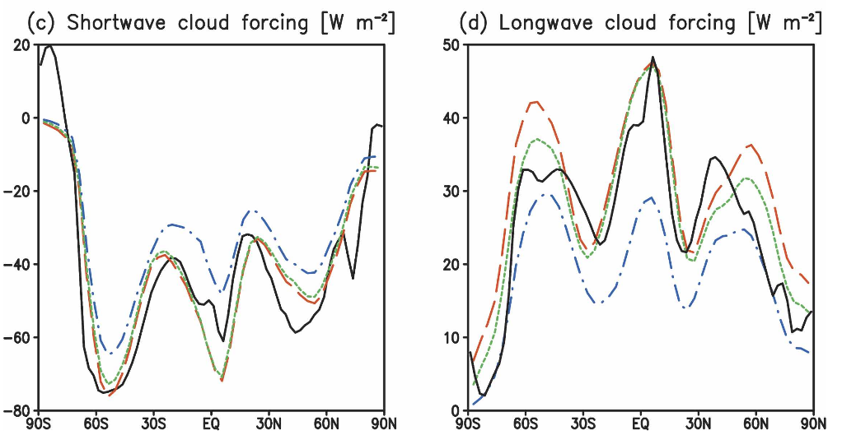
Annual Zonal Mean Cont’d
Short Wave Forcing and Longwave Forcing from simulations KAO, CTL and MON compared to observations

Slide 22
Comparison With field Data
The comparison between the size and number concentration of cloud droplets and ice crystal as d function of temperature between 0 and 35°C.
Data collected across Canada in the winter, spring and fall.
Two Forward Scattering Spectrometer Probes were used to count ice particles smaller than 32 and 95µm.

Slide 23
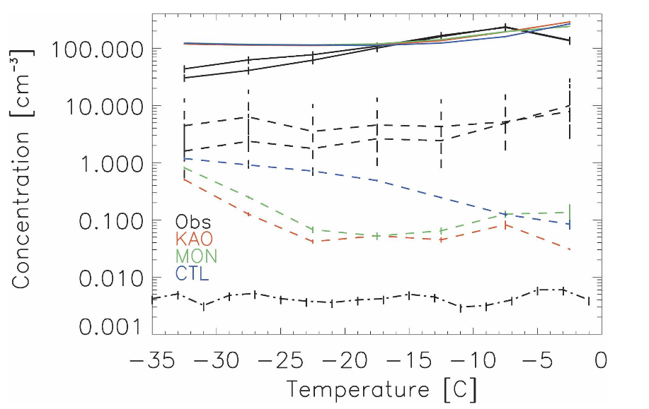
Field Data Comparison
Fig shows cloud droplets and ice crystals number
number concentration with two FSSP

Slide 24
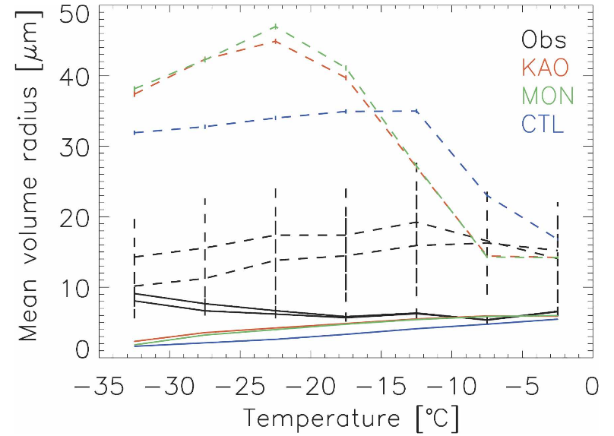
Field Data Comparison
Fig shows average mean volume cloud droplets and ice crystals with two FSSP

Slide 25
Question Time
Do you believe that the observation using the FSSP is a good validation for the results?
Should we give it a go?

Slide 26
The effect of dust nuclei on cloud coverage
To determine whether the total anthropogenic indirect aerosol effect on the net radiation at TOA depends on nature of the dust aerosols and the effectiveness as freezing nuclei.
There was rerun of a 10 year simulation without any anthropogenic emissions.

Slide 27
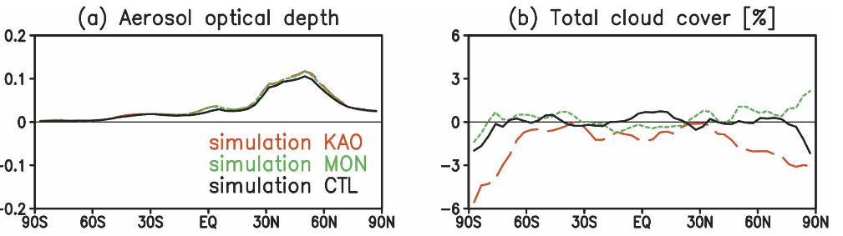
Zonal annual mean changes in aerosol optical depth and total cloud cover.

Slide 28
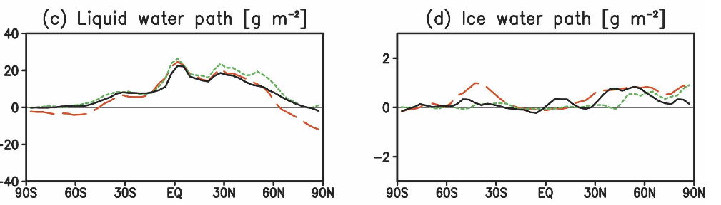
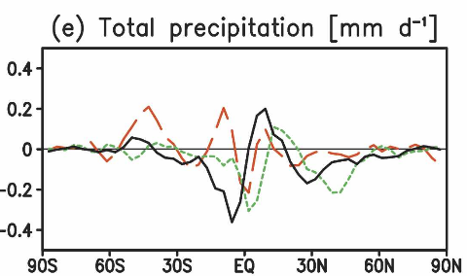
Zonal annual mean changes in LWP, IWP and total precipitation

Slide 29
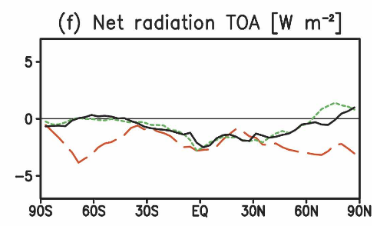
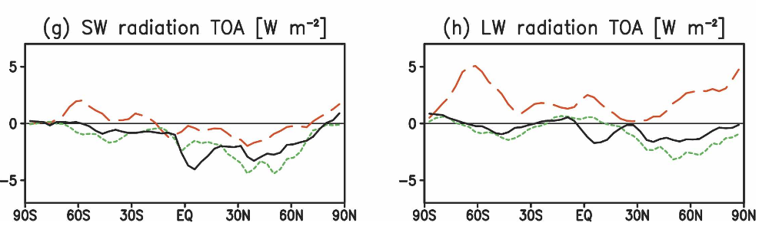
Zonal annual mean changes in net radiation, sw radiation and lw radiation at the TOA

Slide 30
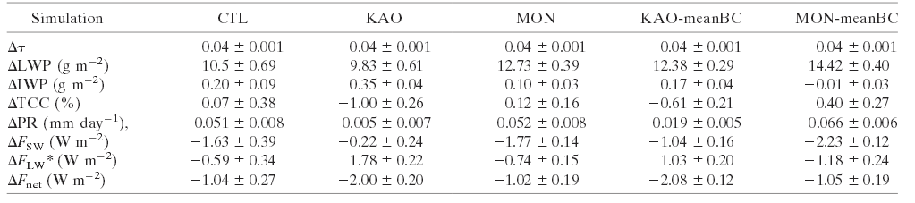
Report
Table shows different simulation s and how they affect energy budget.

Slide 31
Conclusion
A new parameterization of immersion freezing for black carbon and mineral dust were introduced in the ECMAM4 general circulation model.
In the simulation where dust assumed to be kaolinite, black carbon has a higher relevancy as ice nuclei, because kaolinite is not freezing as effectively as montmorillonite.
In simulation KAO, the addition of black carbon results in a larger ice water path and a slightly higher precipitation rate and thus a total reduction in cloud cover.

Slide 32
Conclusion Cont’d
In the case of the simulation MON, the increase in the ice water path is much smaller and globally the change in precipitation is dominated by the reduction in warm-phase precipitation due to indirect cloud lifetime effect.

Slide 33
Questions?

