Slide 1
Large Contribution of Natural Aerosols to Uncertainty in Indirect Forcing
K.S Carslaw, L. A. Lee, C. L. Reddington, K. J. Pringle, A. Rap, P. M. Forster, G.W. Mann, D. V. Spracklen, M. T. Woodhouse, L. A. Regayre and J. R. Pierce
Presented by Samantha Tabor
March 31st, 2014

Slide 2
Outline
Background Information
The Problem
The Methods
Radiative Forcing Uncertainty
Alternative Reference Years
Importance of Natural Aerosols
Implications and Conclusions
Summary
Questions

Slide 3
Basic Definitions
Pre-Industrial (PI) : defined as the year 1750
Present-Day (PD) : defined as the year 2000
DMS: Dimethyl Sulphide
Anthropogenic: originated from man or man-made sources
Natural: sources originated from nature

Slide 4
Basic Definitions
Supersaturation: When the ratio of saturation vapor pressure of the air to the saturation vapor pressure over a flat surface is greater than 100%
Cloud Condensation Nuclei: Particles that water vapor condenses upon in order to form droplets
Cloud Droplet Number Concentration: The amount of droplets in a cloud per unit area.

Slide 5
Albedo and Aerosol First Indirect Forcing
What is albedo?
  Albedo describes the fraction of incident radiation reflected back by a surface or object
What is the Aerosol First Indirect Forcing?
  The impact of aerosol changes on cloud albedo and the resulting radiative forcing on the climate
90%
100%
20%
High albedo
Low albedo

Slide 6
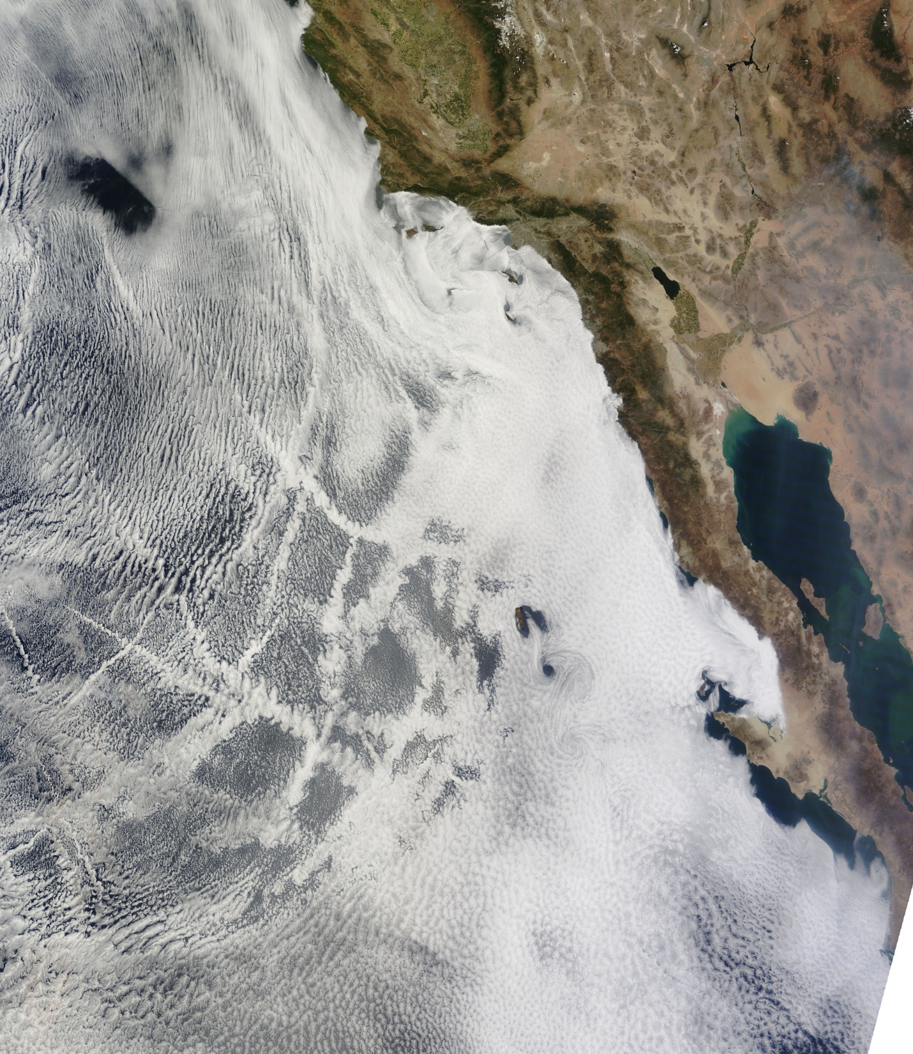
From NASA MODIS instrument on the Terra satellite

Slide 7
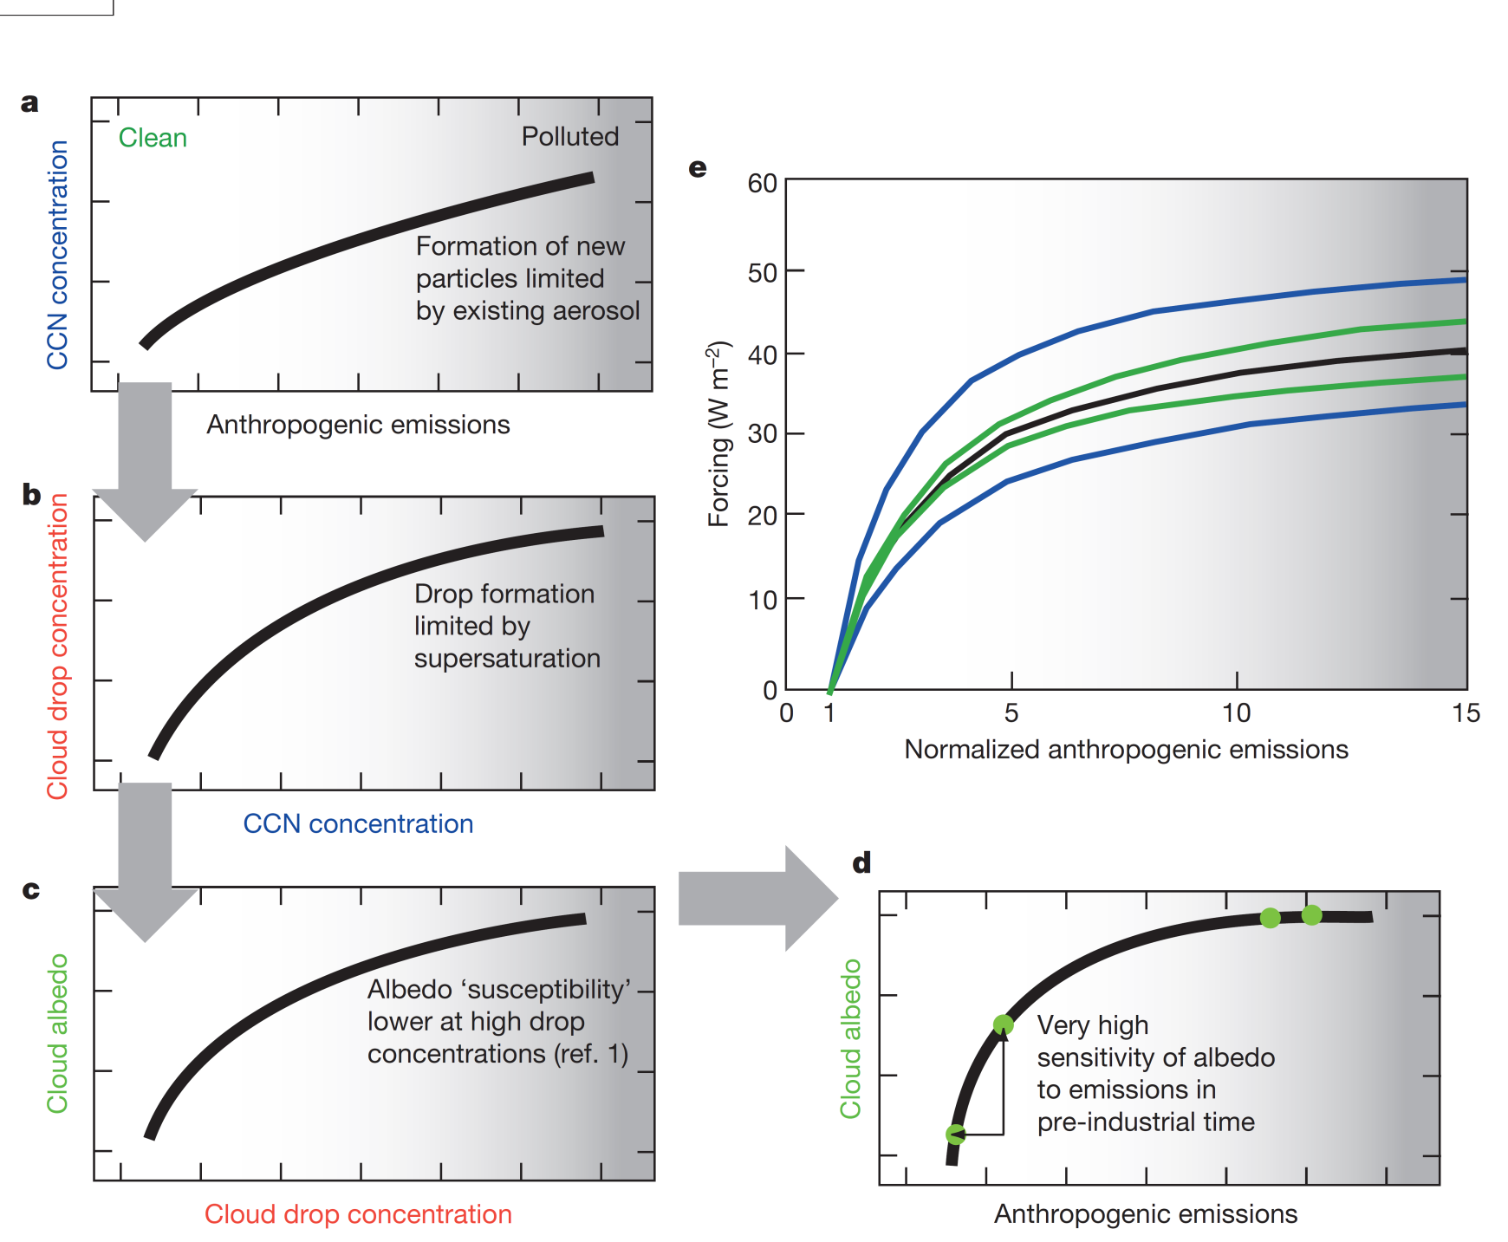

Why does that happen?
  $$\frac{dA}{dN}=\frac{A(1−A)}{3N}$$

Slide 8
The Problem
The aerosol first indirect forcing has significant impact on the climate
  Radiative forcing global mean of -0.4 wm⁻² to -1.8wm⁻²
The uncertainty for aerosol forcing is much larger than that of Carbon Dioxide (1.7±0.2 wm⁻²)
This leads to uncertainty of how aerosols will affect the climate
To understand this we need to understand the changes from the PI to PD

Slide 9
Methods: The Model
Global Model of Aerosol Processes (GLOMAP)
Three-dimensional global aerosol microphysics model
Transport of aerosols and chemical species is calculated by three-dimensional meteorological fields from the European Centre for Medium-Range Weather Forecasts (ECMWF)
Resolves six different processes: new particle formation; coagulation; gas-to-particle transfer; cloud processing; dry and wet deposition

Slide 10
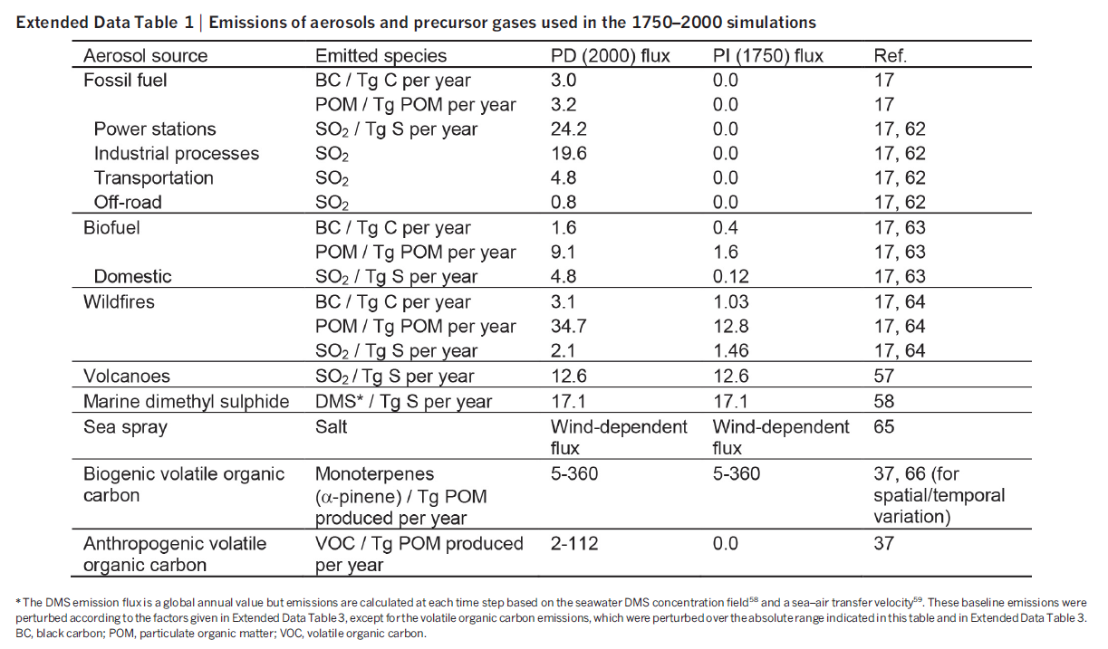
Methods: Emissions

Slide 11
Methods: Cloud Droplet Number Concentrations
Calculated using an activation parameterization and the monthly mean aerosol size distribution and composition determined from the model for each parameter run
Updraft speed of 0.15 ms⁻¹ over marine areas and 0.3 ms⁻¹ over land
Increasing updraft speeds has a negligible impact on the global mean forcing

Slide 12
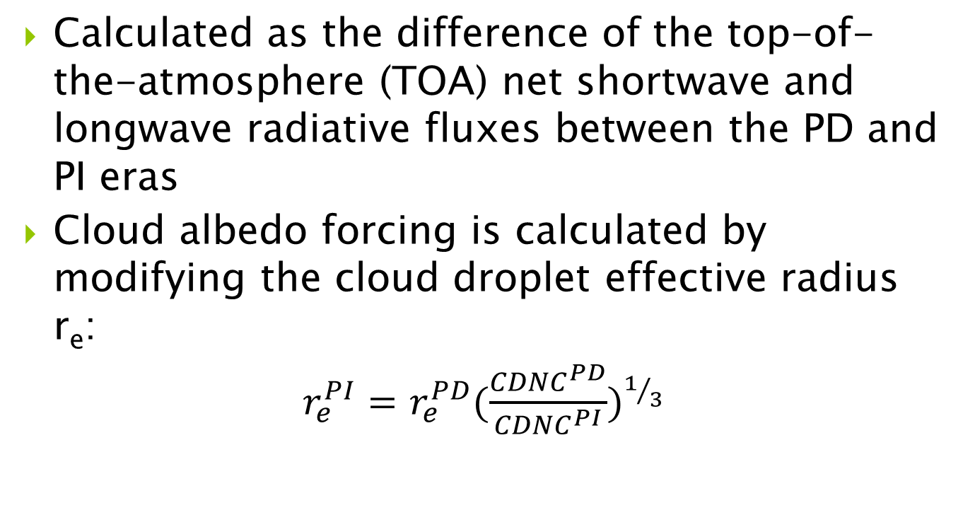
Methods: Radiative Forcing
Calculated as the difference of the top-of-the-atmosphere (TOA) net shortwave and longwave radiative fluxes between the PD and PI eras
Cloud albedo forcing is calculated by modifying the cloud droplet effective radius r_{e}:
$r_{e}^{PI}=$ $r_{e}^{PD}(\frac{{CDNC}^{PD}}{{CDNC}^{PI}})^{1/3}$
Notes:
(

Slide 13
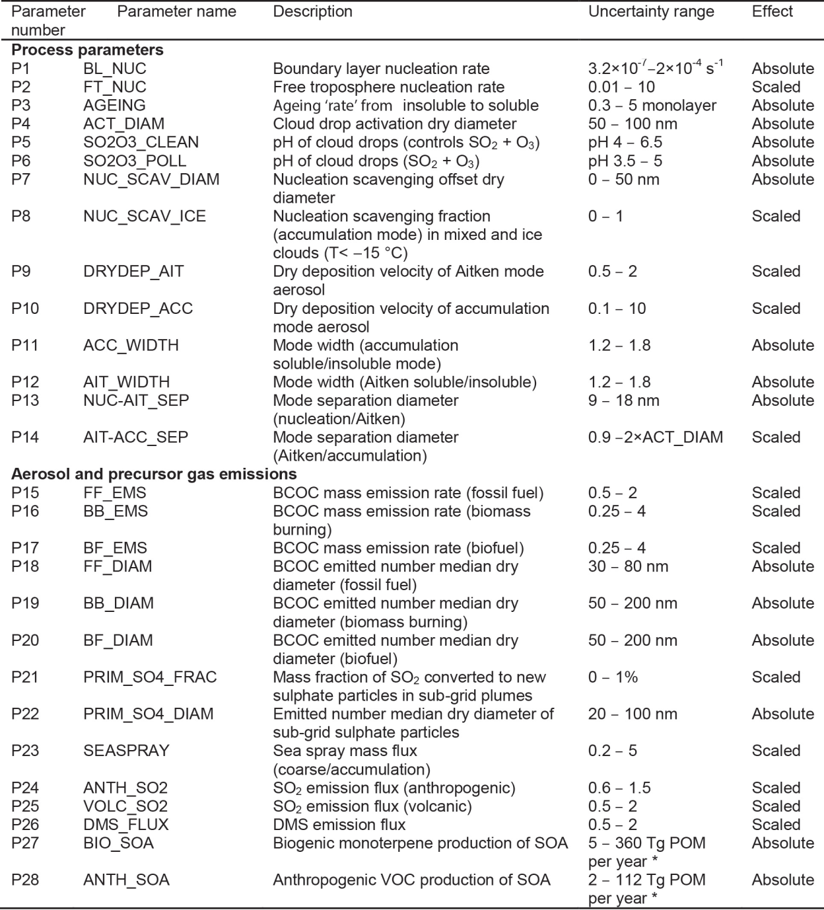

Slide 14
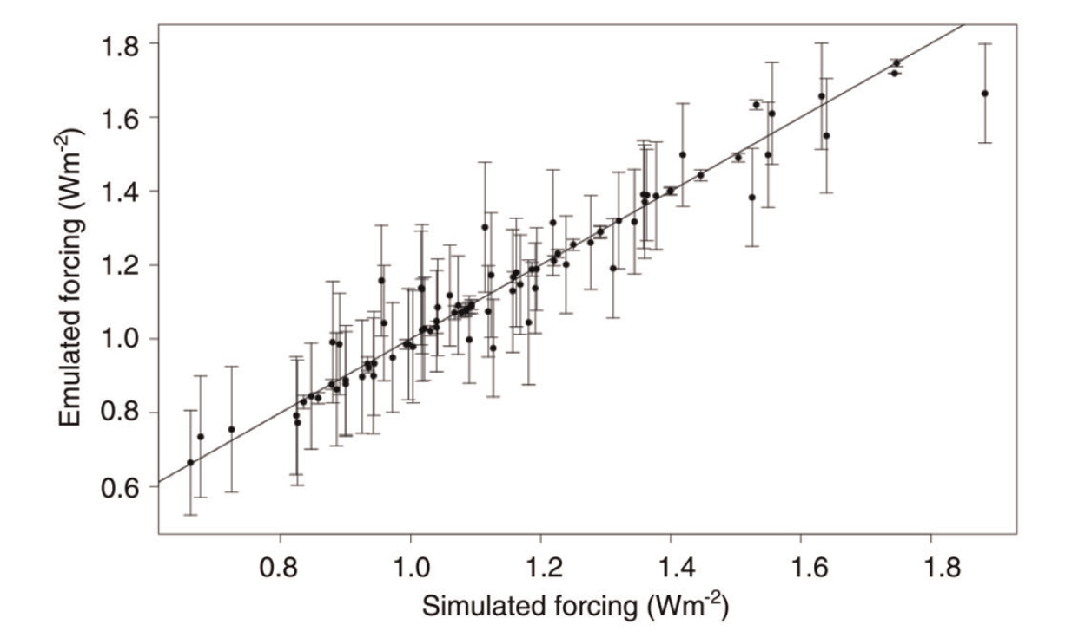
Methods: Model Emulation
Coefficient of determination r² is 0.94

Slide 15
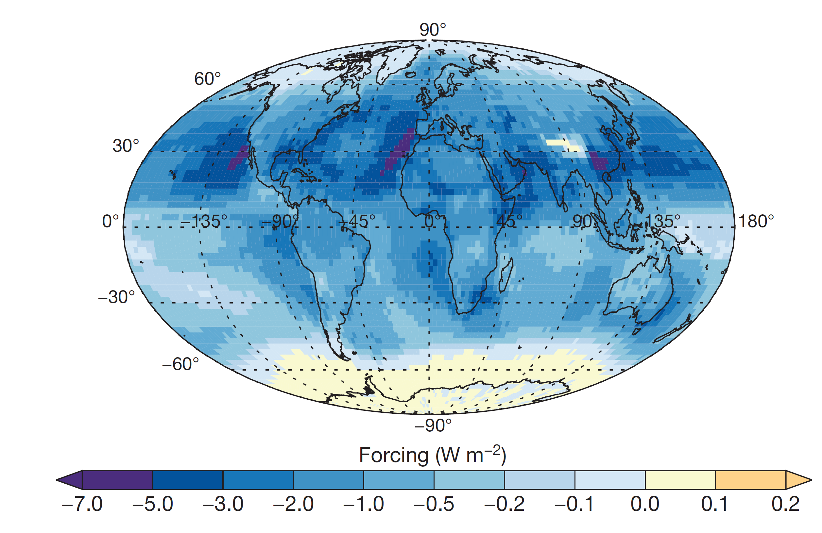
Annual mean

Slide 16
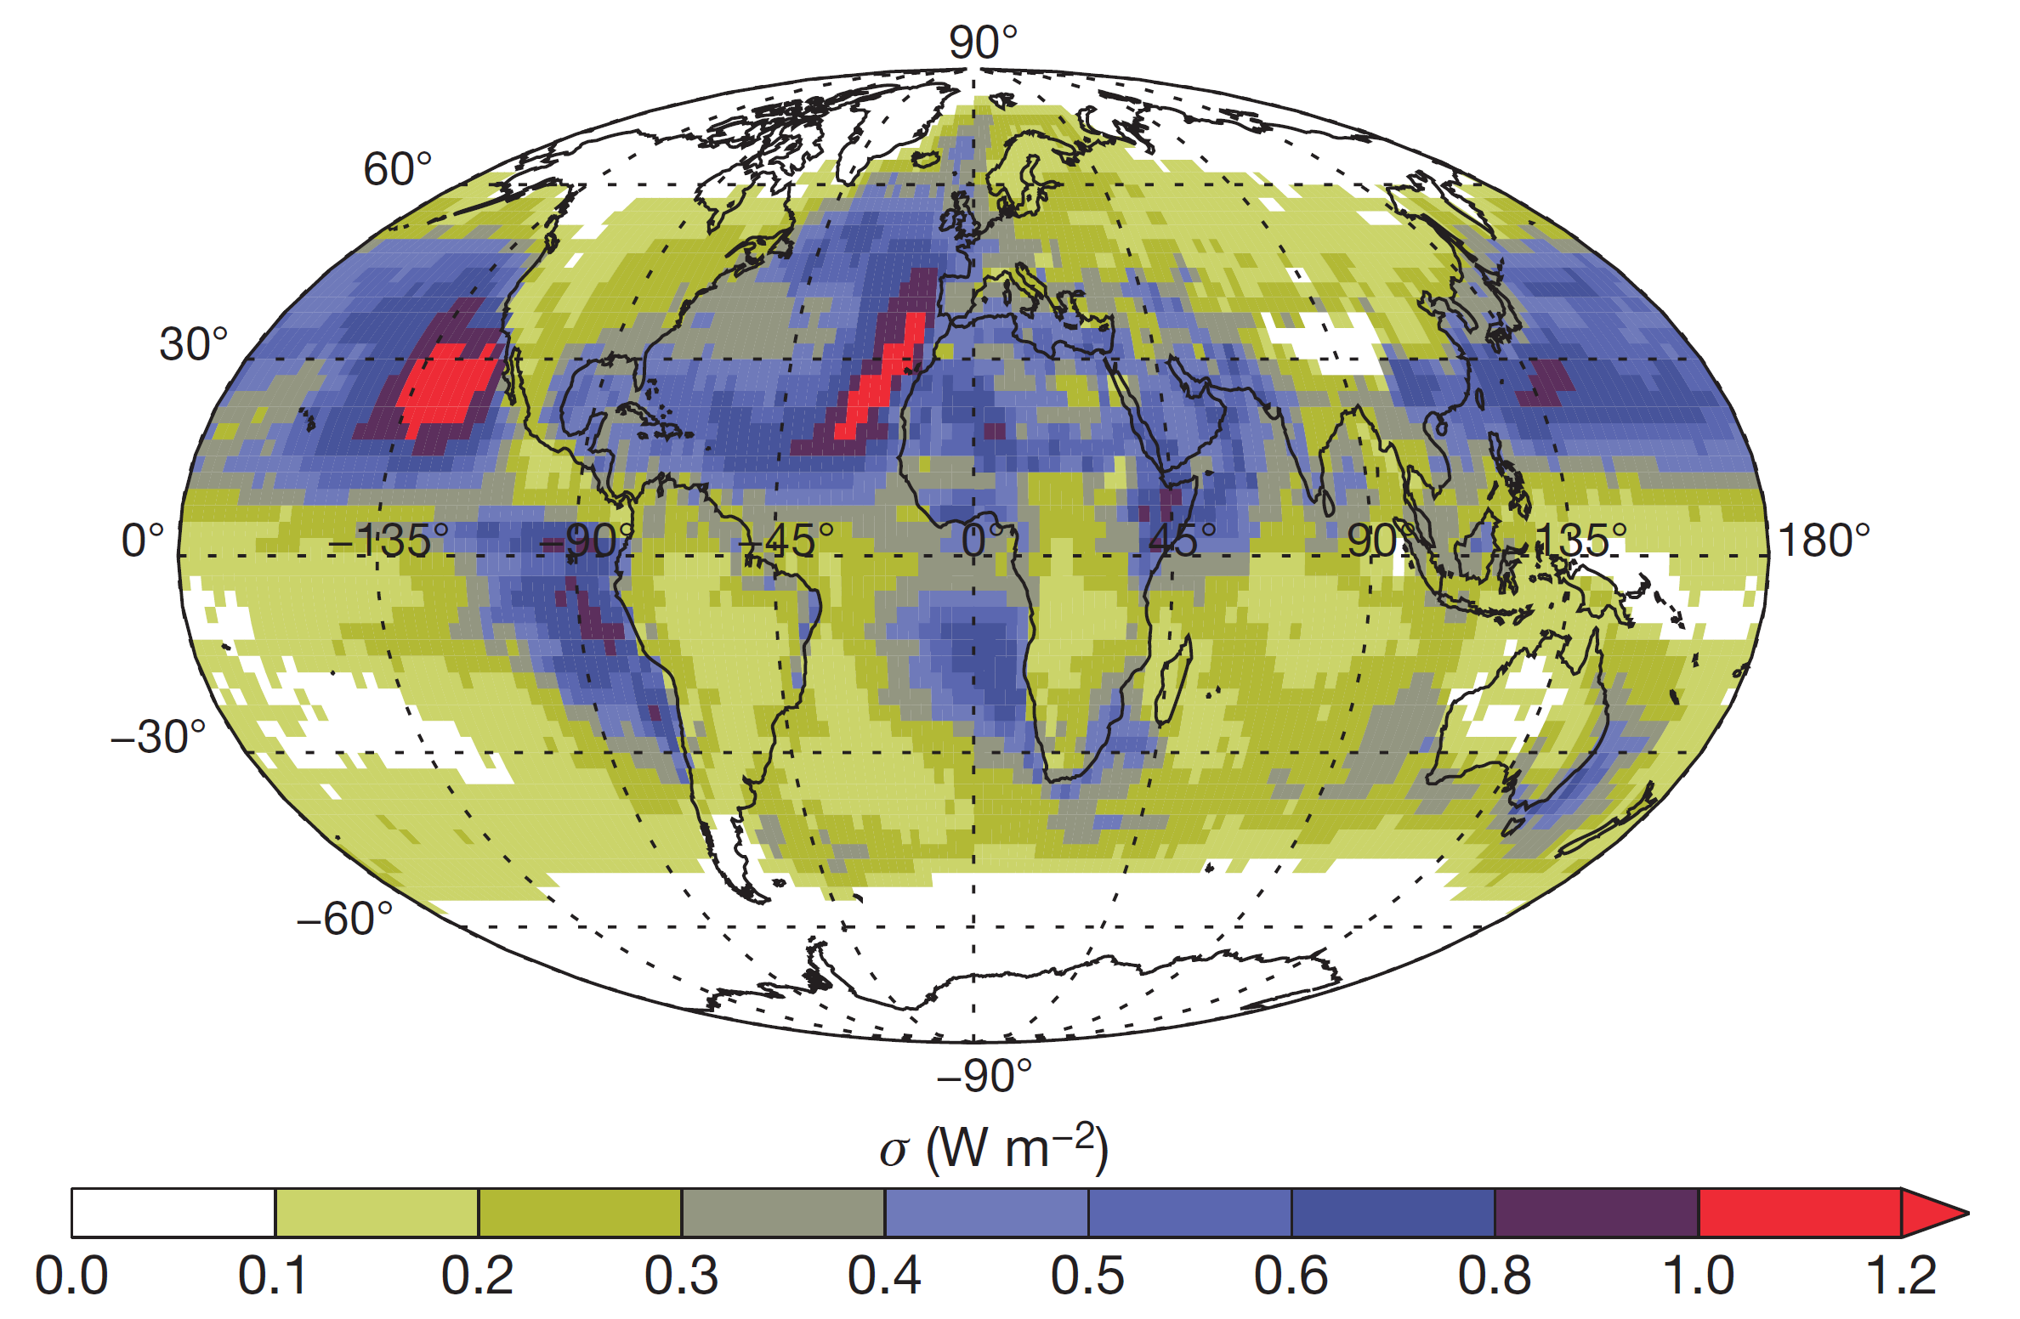
Annual standard deviation (σ)

Slide 17
Radiative Forcing Uncertainty
Global annual mean indirect forcing is -1.16 Wm⁻² with σ = 0.22 Wm⁻²
Eight parameters account for 92% of the forcing variance
  Volcanic SO₂
  Anthropogenic SO₂
  Dimethyl Sulphide (DMS) from marine biota
  Width of accumulation mode
  Dry deposition of accumulation mode aerosols
  Sub-grid sulphate particle formation
  Width of Aitken mode
  Diameter of emitted fossil fuel combustion particles

Slide 18
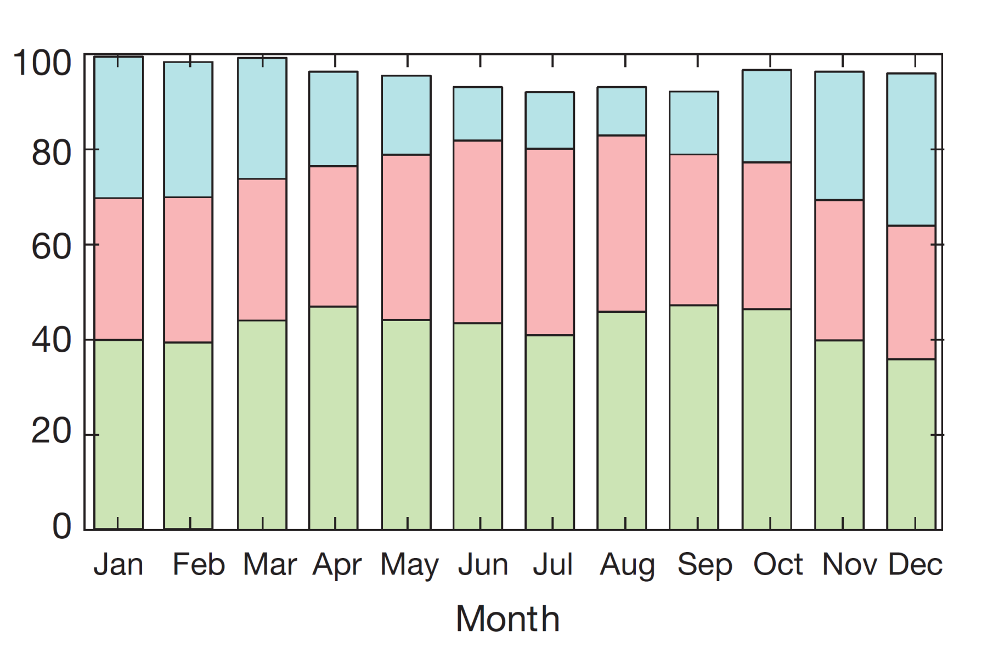
Blue: Aerosol Processes
Red: Anthropogenic Emissions
Green: Natural Emissions

Slide 19
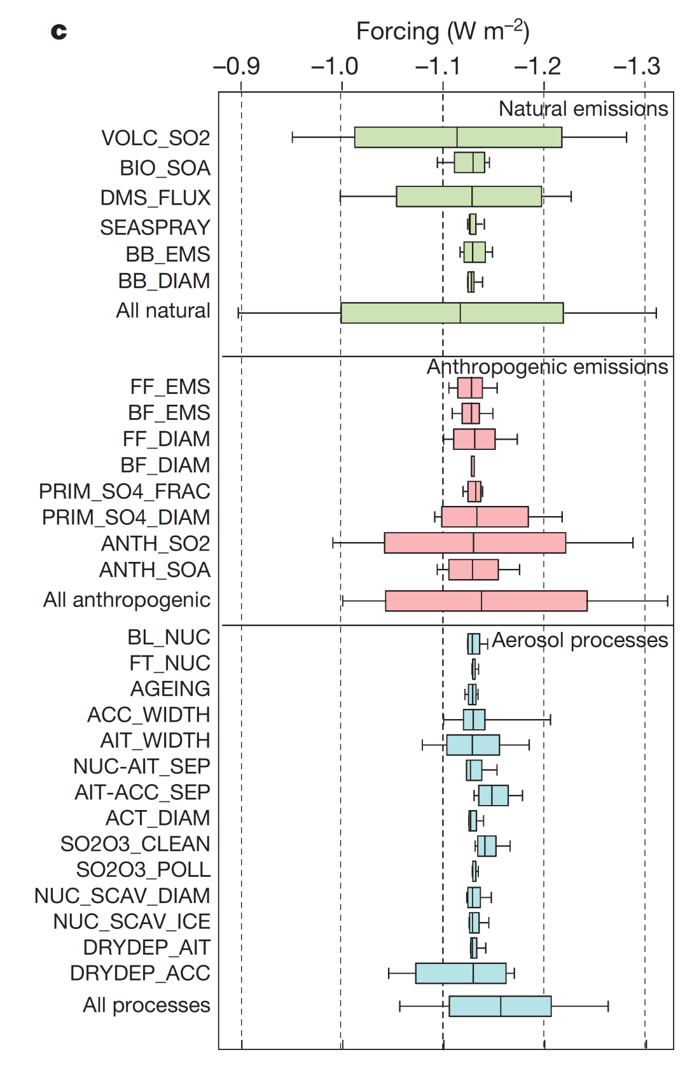

Slide 20
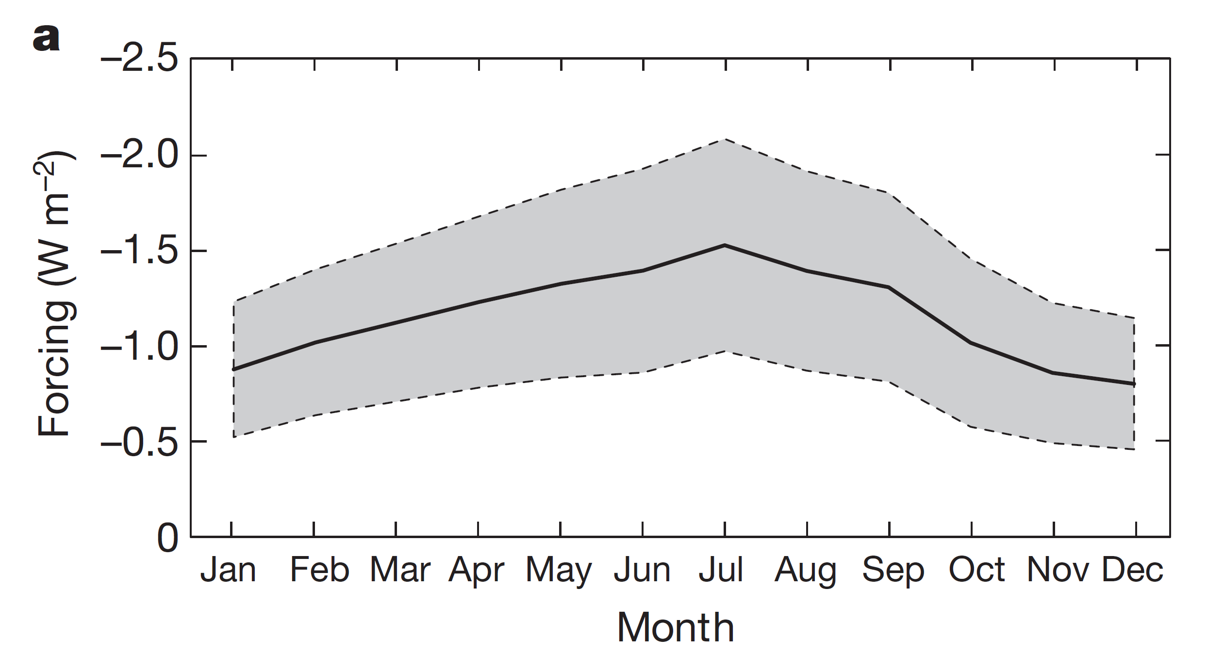
Seasonal variation of global mean forcing

Slide 21
Alternative Reference Years
Contributions from natural emissions depend on the reference year used to represent a PI state
Calculations were repeated for 1850-2000; 1850-1980; and 1900-2000
  Natural emissions remained the same as 1750
Even when polluted reference years were used, natural emissions remained a significant contributor to the forcing uncertainty
  The uncertainty is also sensitive to assumed PI conditions

Slide 22
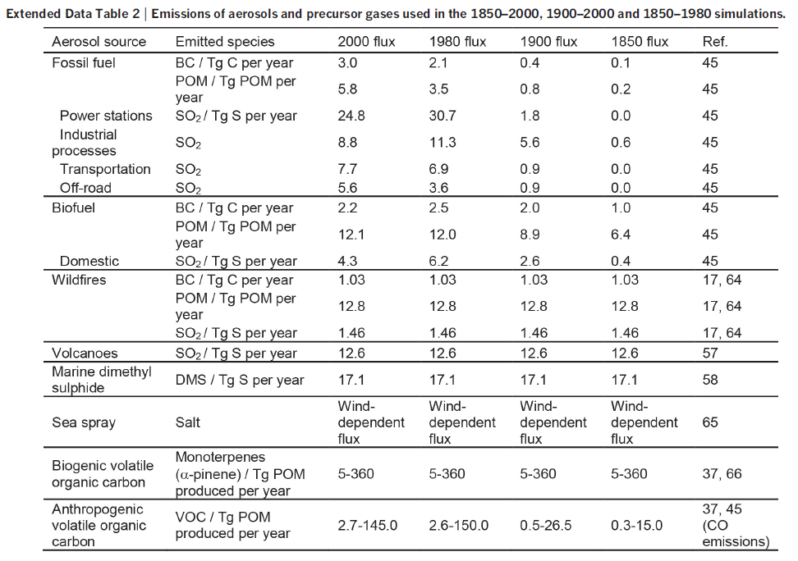
Alternative Reference Years

Slide 23
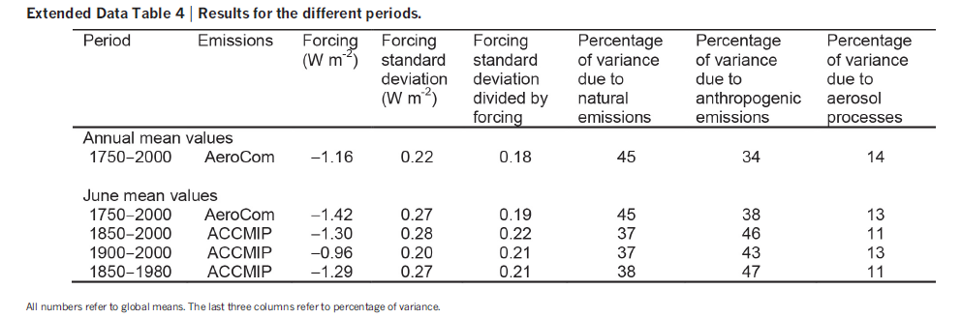
Alternative Reference Years

Slide 24

Importance of Natural Aerosols

Slide 25
Implications
Constraining the sources of forcing uncertainty by making observations in the PD atmosphere will be difficult
Empirical estimations of PI-to-PD forcing based on observations under PD conditions may not be accurate
Because we can’t constrain the natural aerosol state, efforts to constrain the magnitude of climate sensitivity will be hampered
Accurate simulations of past forcing may not guarantee future estimates

Slide 26
Summary
Uncertainty will always exist due to:
  Low sensitivity of PD clouds to the emissions studied are unrepresentative of the PI atmosphere
  Lack of understanding on the effects of natural emissions on PI-like aerosols
45% of the variance of aerosol forcing arises from natural aerosol emissions
As aerosol levels rise, cloud albedos become more resistant to changes
An understanding of how natural aerosols behaved in the PI era and the changes from PI to PD is necessary

Slide 27
Questions

