Slide 1
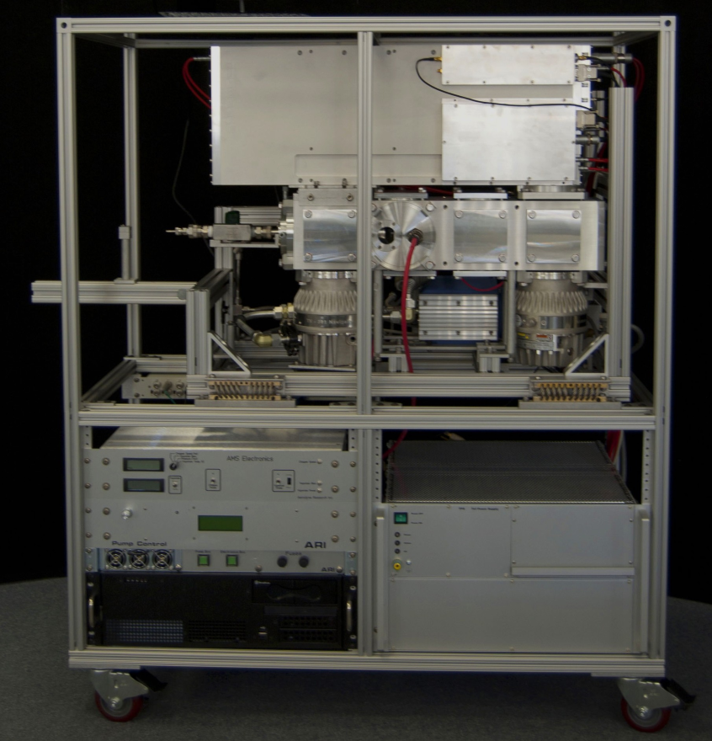
Soot Particle Aerosol Mass Spectrometer: Development, Validation, and Initial Application
T. B. Onasch,A. Trimborn,E. C. Fortner,J. T. Jayne,G. L. Kok,L. R. Williams,P. Davidovits, and D. R. Worsnop
By Gustavo M. Riggio
05/12/2014

Slide 2
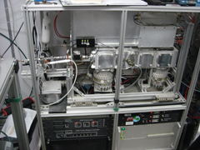
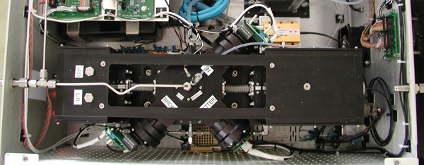
Introduction
Single Particle Soot Photometer (SP2)
Aerosol Mass Spectrometer (AMS)
+
Developed to measure the chemical and physical properties of particles containing
black carbon (rBC)

Slide 3
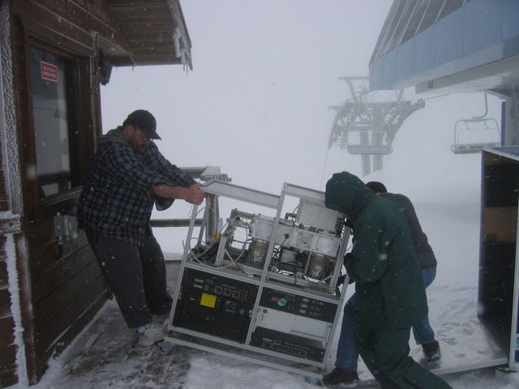
Introduction
Portable
Real time
Highly sensitive
Expensive

Slide 4

Refractory Black Carbon (rBC)
Black Carbon (BC)
Generated by incomplete combustion of fossil fuels, biomass, and biofuels.
Affect air quality, human health, and direct and indirect radiative forcing.
Detailed effects of BC highly uncertain.

Slide 5
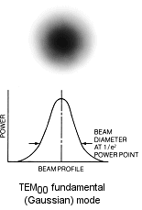
Instrument Utility/Development
Single Particle Soot Photometer
Quantify rBC by detecting incandescent signals.
Non-incandescing materials will scatter light (i.e. organic coatings)
Notes:
Provides rBC mass loadings, particle number concentration , and size distribution
Explain laser beam, incandescence, scattering. (overview from Ben’s presentation)
CHEMICAL INFO MISSING

Slide 6
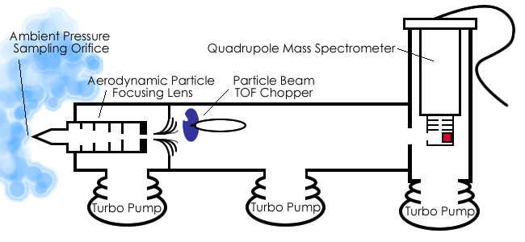
Instrument Utility/Development
Aerosol Mass Spectrometer
Measures composition of nonrefractory aerosol particle ensembles.
TOF Mass Spectrometer
Animation of the Aerodyne AMS. Credit: Matt Thyson (Lexington, Massachusetts)
Notes:
Explain entrance region and TOF MS
Lack of sensitivity to refractory particles.
Particles vaporized at 600 C using resistively heated tungsten vaporizer.
Vapor is ionized with an electron beam via electron impact ionization and ions detected in a high resolution mass spectrometer.
Provides average mass spectrometric measurements on a particle by particle basis.

Slide 7
Instrument Design SP-AMS
Laser ON/OFF
SP-AMS mode
Chopper OPEN/CLOSED
MS mode

Slide 8
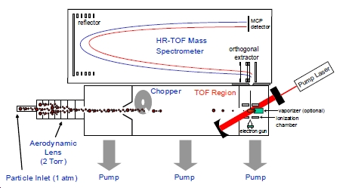
Instrument Capabilities
Quantitative detection of black carbon
Information on coatings on black carbon cores
Real time analysis

Slide 9
Particles Across Laser Beam
Coating evaporates first.
Low temp. (<600 ºC)
Core evaporates last.
High temp. (> 1000 ºC)

Slide 10
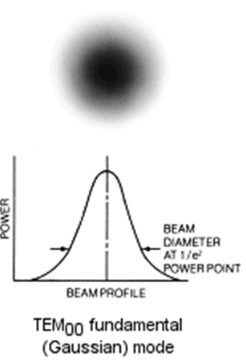
Laser Vaporizer
Ionization efficiency depends on laser alignment
(CCD camera), and power.
Intensity must be sufficient to vaporize particles.
Dispersion of particles may
cause particles to miss the laser.

Slide 11
Vaporization Overview
Non refractory material vaporizes first.
rBC heats to thousands of degrees.
Gives rise to visible incandescent signal
Simultaneously, rBC vaporize into carbon clusters.
Ionized and detected by mass spectrometry.
AMS not able to vaporize rBC (Filament temp. = 600 ºC)
What happens if we turn the laser on and off while the tungsten vaporizer is on? What do we measure?

Slide 12
SP-AMS Parameters

Slide 13
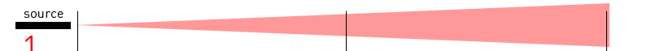

Efficiency
Collection efficiency depends on:
Fraction of particles diverted from laser beam (E_{S}).

Slide 14
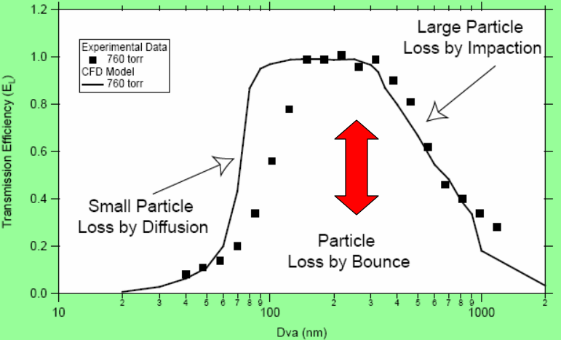
Efficiency
Collection efficiency depends on:
Fraction of particles lost during transit through inlet and aerodynamic lens (E_{L}).
Fraction of particles lost due to bounce effects (E_{B}).
CE = E_{L} x E_{B} x E_{S}
AMS Collection Efficiency Issues. http://cires.colorado.edu/jimenez-group/UsrMtgs/UsersMtg9/08_Onash_CE.pdf

Slide 15
Calibration
Dependent on the measurement of 2 out of 3 variables.
Relative ionization efficiency
Mass specific ionization efficiency of a species
Mass ionization efficiency of nitrate ions

Slide 16
Calibration…
Ionization Efficiency:
Ions detected per particulate mass sampled
Relative Ionization Efficiency:
Ratio of the mass specific ionization efficiencies
10⁻¹² = units conversion
Na = Avogadro’s number

Slide 17
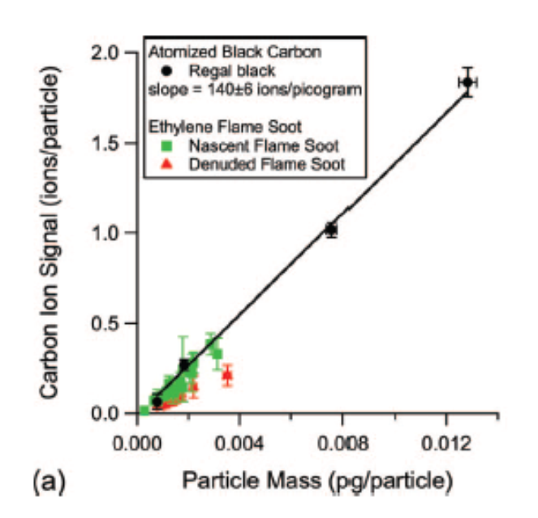
rBC Calibration
Calibration appears to be dependent on particle type.
Used Couette Centrifugal Particle Mass Analyzer
Shape independent measure of particle mass.
Incomplete overlap between particle and laser beam.

Slide 18
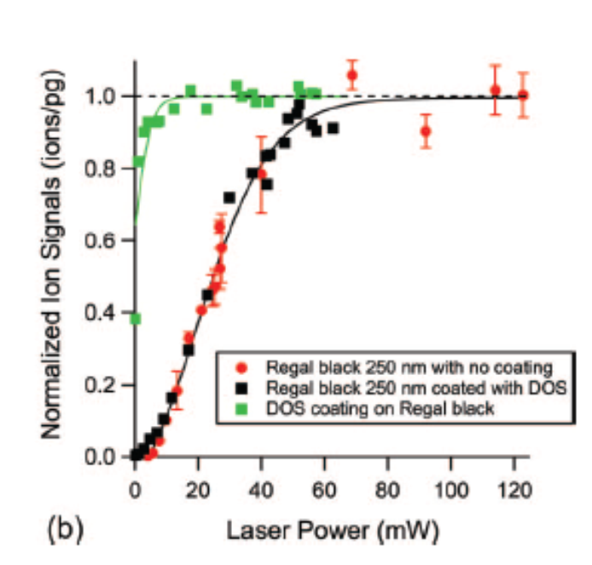
Sensitivity Curve for SP-AMS
Relative rBC ion signal as function of vaporizing laser power.
rBC reaches a plateau at higher laser power.
Detection limit not limited by laser power.
Important to operate with sufficient light intensity.

Slide 19

Sensitivity
See figure S3

Slide 20
Measure Particulate Species for 3 vaporizer combinations

Slide 21
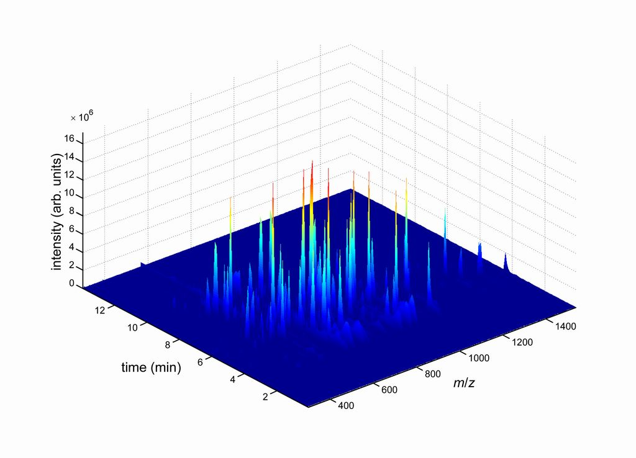
Chemical and Physical Information

Slide 22
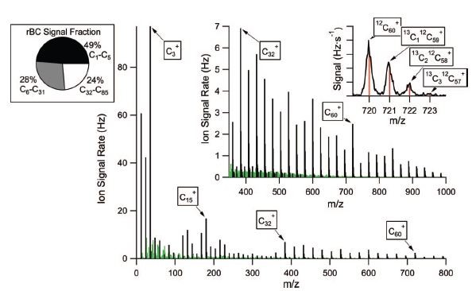
Instrument Characterization
Peaks in black are carbon ions.
Not observed using standard AMS
Provide “finger print” for different combustion sources.
Mass spectrum of denuded ethylene flame soot.
Notes:
Change in carbon clusters: below C30 is m/z 12, above C30 is m/z 24 (2 carbon atoms),
Represent changes in structures (i.e linear chains, monocyclic rings and polyciclic, to fullerenes.

Slide 23
Laser ON/OFF Mass Spectra
Lab generated soot particles
Laser ON vs OFF
CO₂ = largest difference
Same signals may be
present with laser ON and
OFF.
Notes:
The CO2+ signal that disappears in the laser-off experiment is not observed in 2 other different types of rBC particles (i.e., the denuded soot shown in Figure 3 or in the mass spectrum of glassy carbon spheres, not shown). Therefore, we conclude that this signal observed in the Figure 4 mass spectrum originates from the particle composition rather than from products of laser induced oxidation of carbon.

Slide 24
Laser ON/OFF Differences
Sum of the ion signals
Laser ON vs. OFF
Laser ON – all signals
present
Laser OFF – only organic signals
Decrease of 20%
CO₂ originates from particle composition.

Slide 25
Coating Effects and CO₂
Measures of ion signal
distribution as function of
particle size.
rBC integrated signal
remains the same.
Organic signal increases.
Uneven coating.
Notes:
225 mm size selected – 50mm glassy carbon spheres
Coated via gas to particle deposition of DOS (dyoctil sebacate)

Slide 26
Ambient Measurements
Spectra dominated
by nonrefractory BC
and inorganics.
Higher C₁ – C₅ for
ambient than lab.
samples.

Slide 27
MAAP vs SP-AMS
Good agreement
Organic vs BC
dominated plumes
differentiated
Similar to diesel
exhaust and lubrication
oil spectra.

Slide 28
Plume Types
Diameter rBC ∼ 120 nm
Similar in size to diesel exhaust particulate emissions (fresh)
Diameter organics ~ 170 nm
Consistent with coating effects
Sulfates indicator of the accumulation mode
Particles least affected by atmosphere (persistent)
rBC from local sources

Slide 29
Conclusion
Portable, high resolution, real time
Two configurations
Laser vaporizer (SP-AMS)
Tungsten vaporizer (AMS)
Provides BC measurements (chemistry, size distribution, and mass loading)
Coating measurements possible

