Slide 1
THE Single Particle Soot Photometer (SP2): METHODS, APPLICATIONS
BENJAMIN SUMLIN
GRADUATE SEMINAR IN ATMOSPHERIC SCIENCES
24 MARCH, 2014

Slide 2
Single Particle Soot Photometer
INTRODUCTION
Black Carbon
Why measure?
Radiative Forcings
Climate Models
Visibility and Air Quality standards/regulations
Optical properties
THE INSTRUMENT
How it works
Testing, calibration, and validation
Model vs. Measurements
CASE STUDIES
Houston, TX flight study (Schwarz, et. al.)
Mt. Everest Ice Cores (Kaspari et. al.)
Greenland Ice Cores (McConnel et. al. - DRI group)

Slide 3
Black Carbon Aerosol
What is Black Carbon?
BC, EC, OC, BCA – too many acronyms!
Optical Properties
Scattering and absorption are important mechanisms in radiative forcings.
Climate models use this data in order to predict long-term effects of Black Carbon Aerosol.
Absorbing aerosols such as black carbon exert a warming on the atmosphere.
Air Quality, Visibility, and Health
Government agencies need data on black carbon in order to recommend policies to mitigate or eliminate negative effects on human health, property, landmarks, protected areas, and cultural artefacts.

Slide 4
Black Carbon Aerosol
How does BCA form?
Black carbon (BC, EC) aerosol is formed by high-temperature combustion reactions. The energetic environment liberates more hydrogen from the compound being burnt and the remaining carbon can easily form rings.
Brown carbon aerosol (BRC, OC) is formed in lower-temperature smoldering reactions. More hydrogen-carbon bonds remain which can possibly carry additional functional groups.
BCA as defined by Schwarz et. al. as “the stuff the SP2 measures”. More specifically, BCA is the portion of “soot” that incandesces, while everything else scatters radiation.

Slide 5
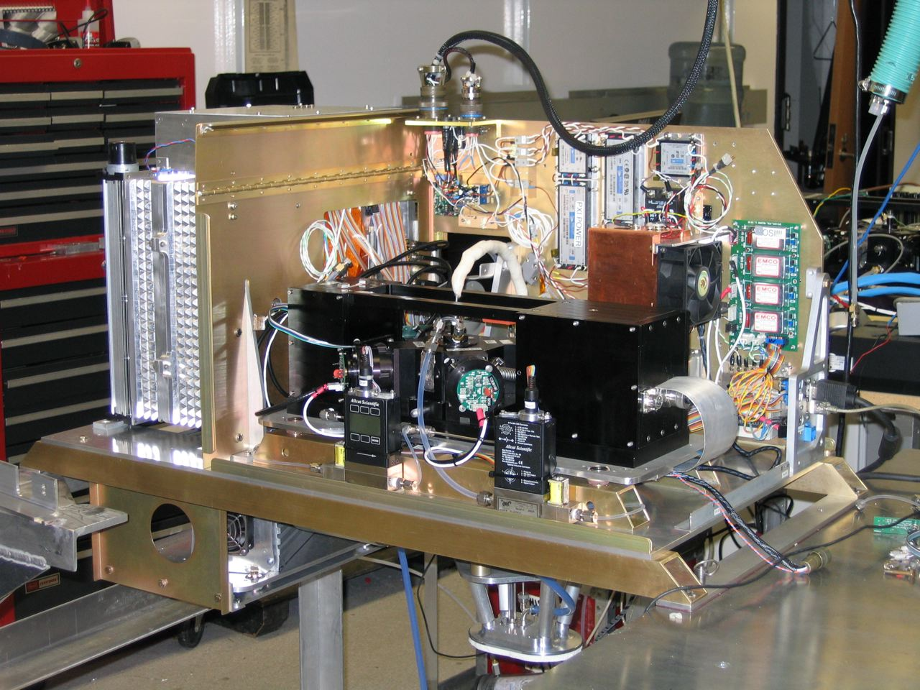
Single Particle Soot Photometer

Slide 6
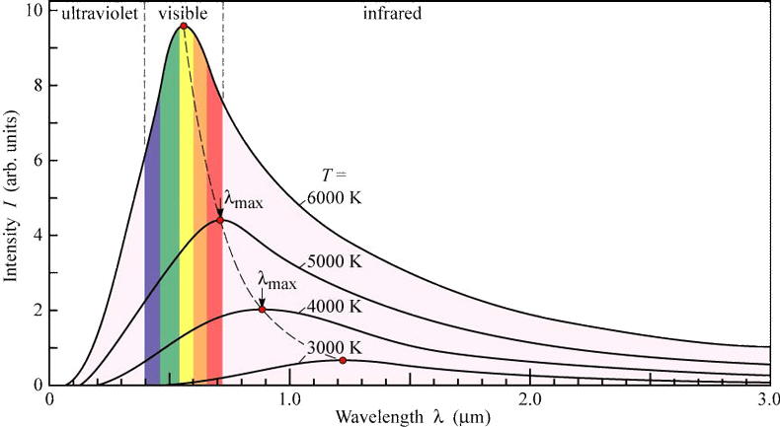
Single Particle Soot Photometer
How it Works
PAS raises temperature of aerosol by a few mK in order to detect the energy released upon relaxation, whereas the SP2 heats it to its boiling point to detect incandescence.

Slide 7
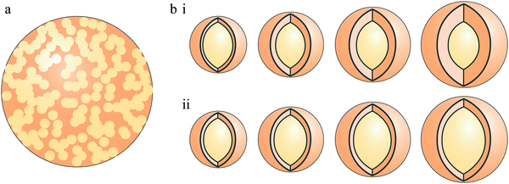
Single Particle Soot Photometer
Specifically, the SP2 looks for both incandescence and scattering.
Non-incandescing material will instead prefer to scatter light
Organic coatings, etc.
These coatings scatter light as they vaporize until only the core BC is left
[Lang-Yona et. al.]

Slide 8
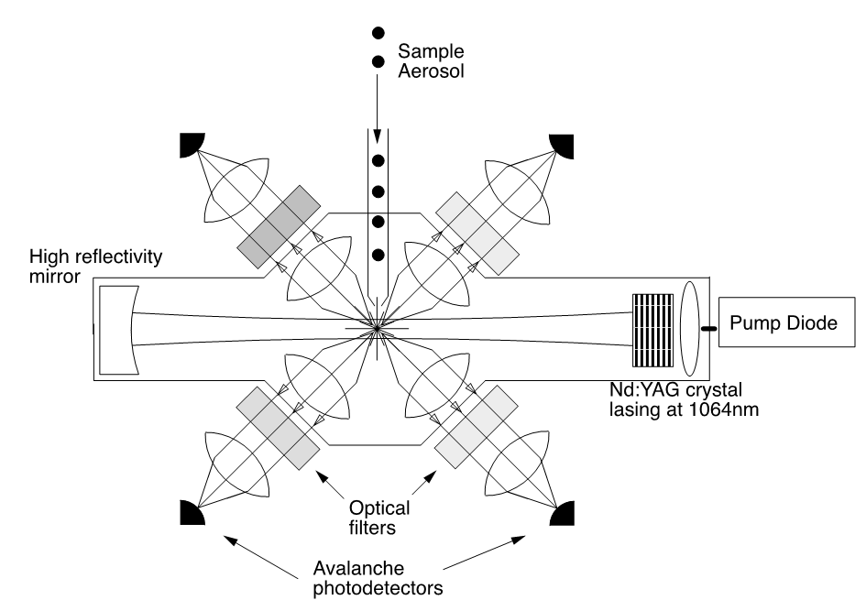
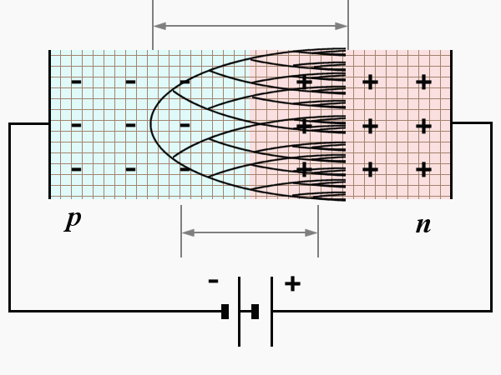
Single Particle Soot Photometer
Scattering signal detectors:
850-1200 nm at two gain
settings
Incandescence signal
detectors: broadband
(350-800 nm) and
narrowband
(630-800 nm)

Slide 9
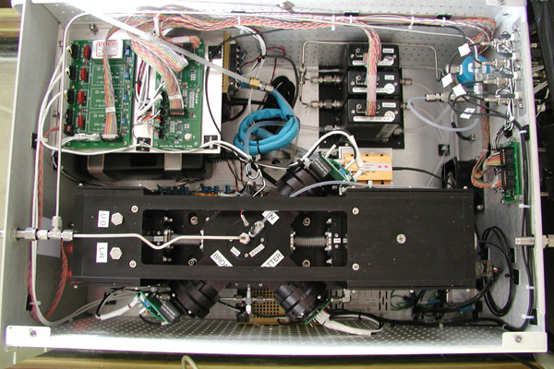
Single Particle Soot Photometer
Optical Detectors

Slide 10
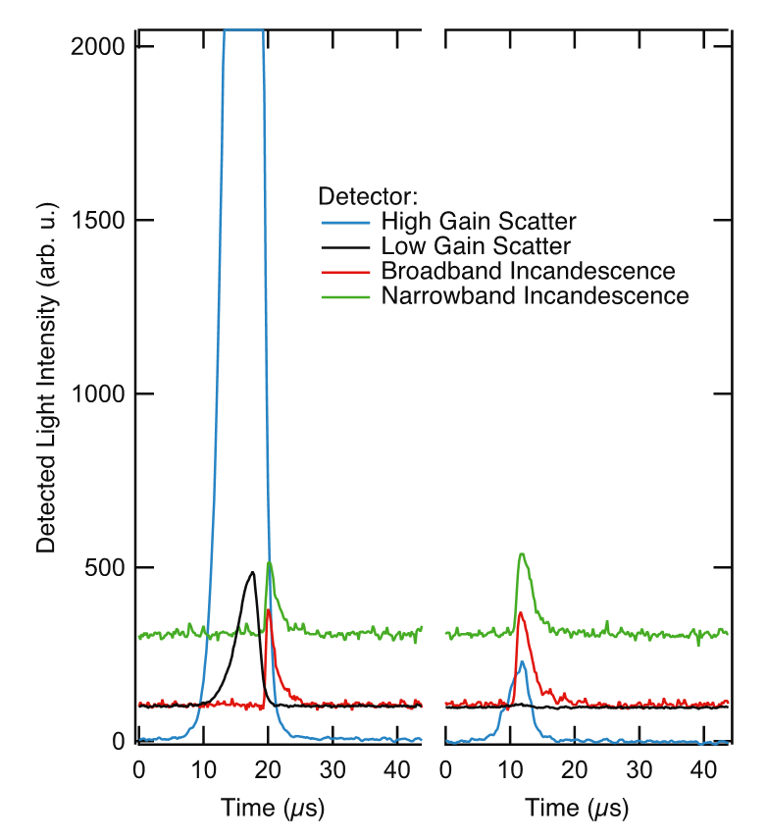
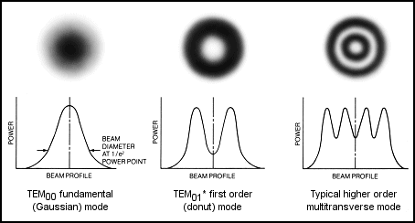
Single Particle Soot Photometer
Responses of the detectors
Gaussian vs. non-Gaussian
Gaussian
scattering
signal
Non-gaussian
incandescence
signal

Slide 11

Case Study I: Aircraft Campaign
NASA WB-57F high-altitude aircraft

Slide 12
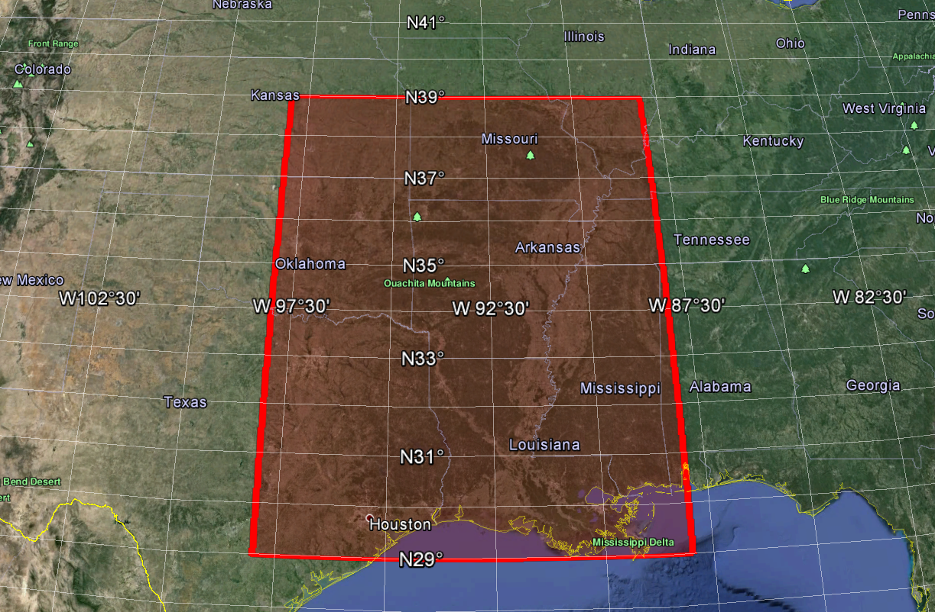
Case Study I: Aircraft Campaign
Flights on 10 and 12 November 2004 were within a 10°x10° square and went as high as 18.7 km.

Slide 13
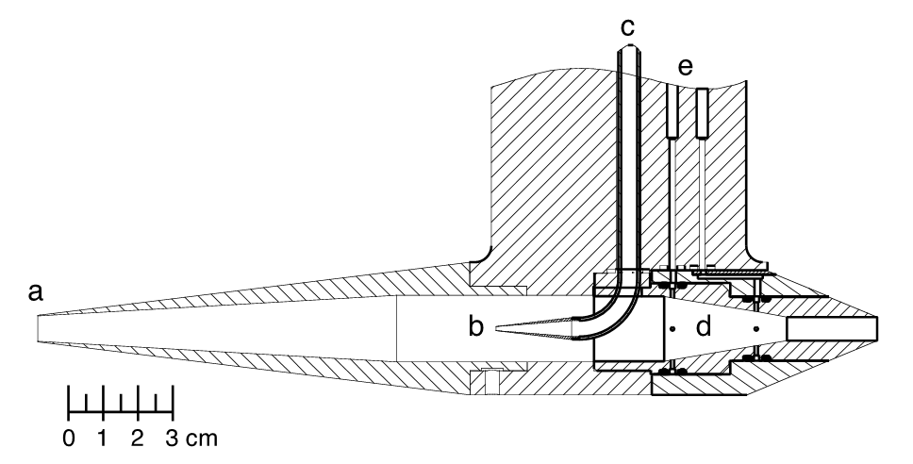
Case Study I: Aircraft Campaign
Instrument Considerations
Unpressurized
Unheated
Aircraft Speed vs. sampling rate

Slide 14
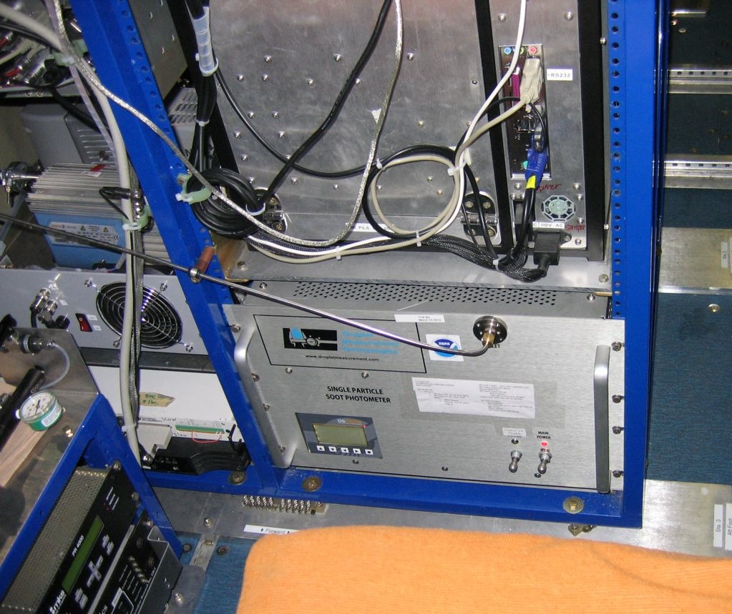
Case Study I: Aircraft Campaign

Slide 15
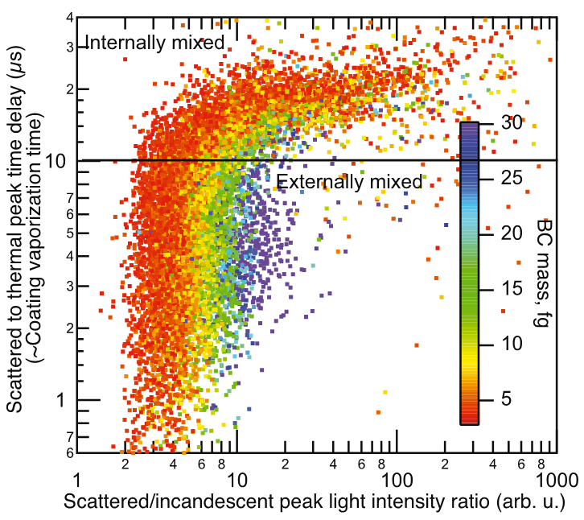
Case Study I: Aircraft Campaign

Slide 16
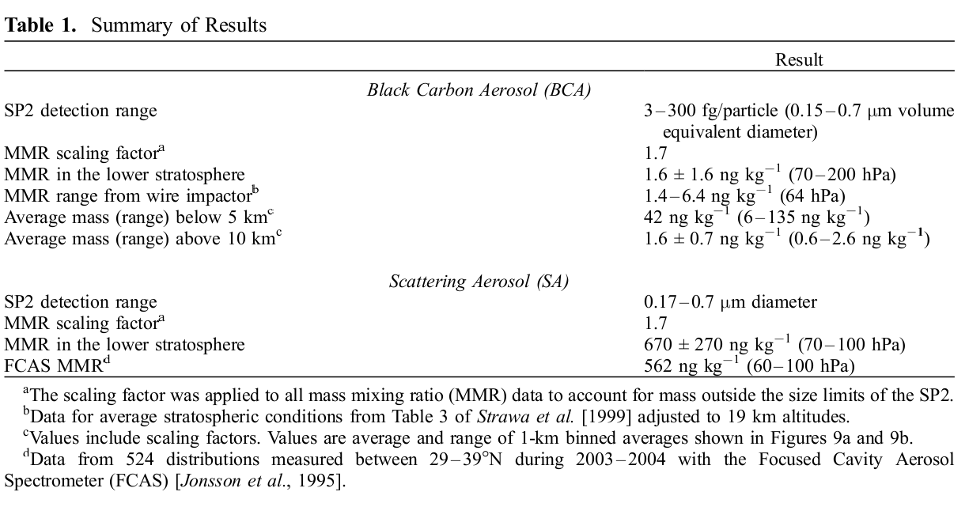
Case Study I: Aircraft Campaign

Slide 17
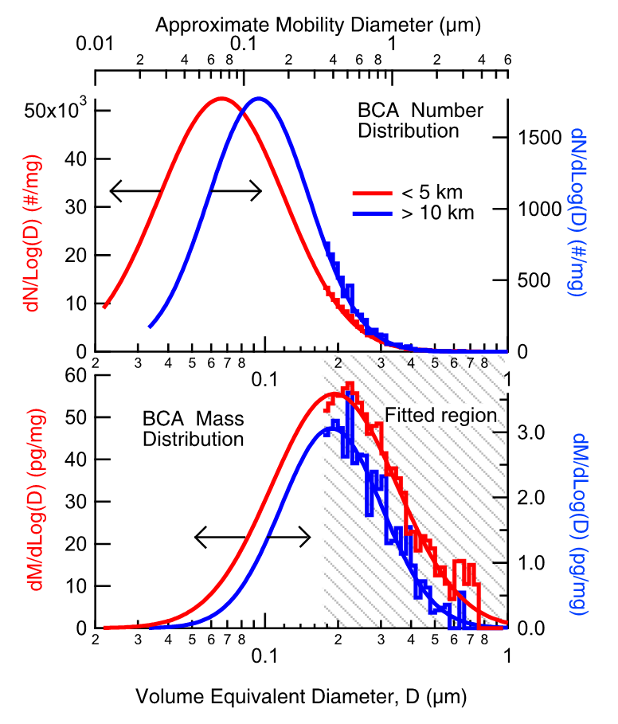
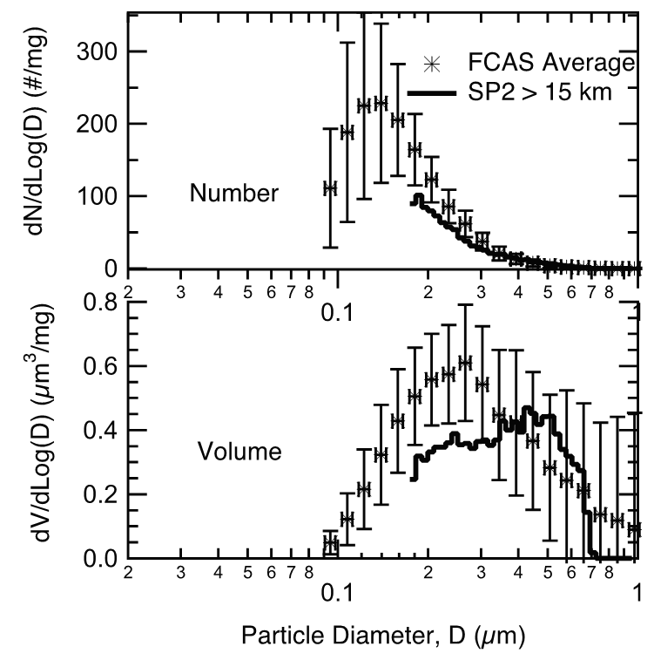
Case Study I: Aircraft Campaign

Slide 18
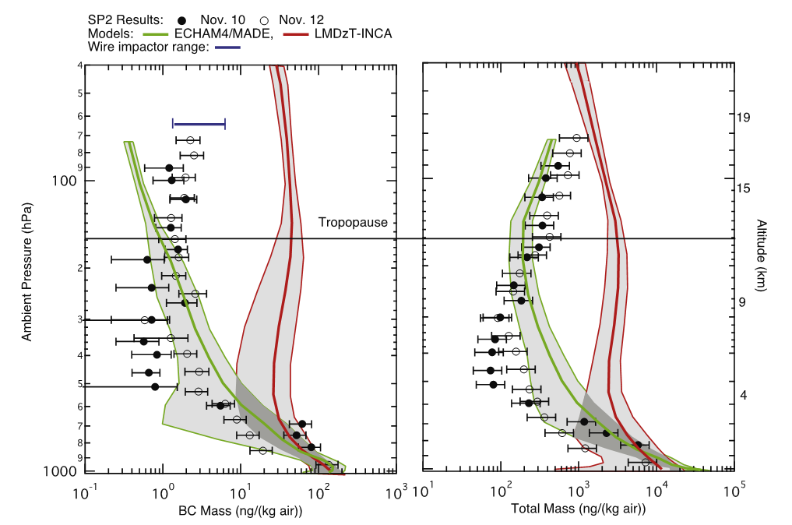
Case Study I: Aircraft Campaign
LMDzT-INCA tends to overestimate at nearly all levels while ECHAM4/MADE overestimates slightly at mid-levels (4-9 km)

Slide 19
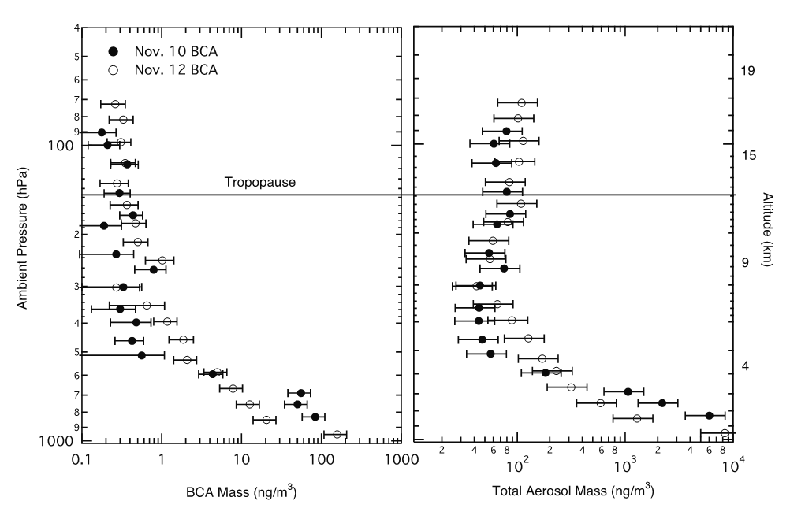
Case Study I: Aircraft Campaign

Slide 20

Case Study I: Aircraft Campaign
QUESTION: What mechanisms are responsible for pushing aerosol above the tropopause?
Tropical convection: upwelling motion to move BC through tropopause
Violent events such as volcanoes and forest fires
Controvesrial: BC absorption “self-heats” its own parcel, making it convective.
Is The Sharper Image responsible for
cross-tropopause black carbon transport?
probably not.

Slide 21
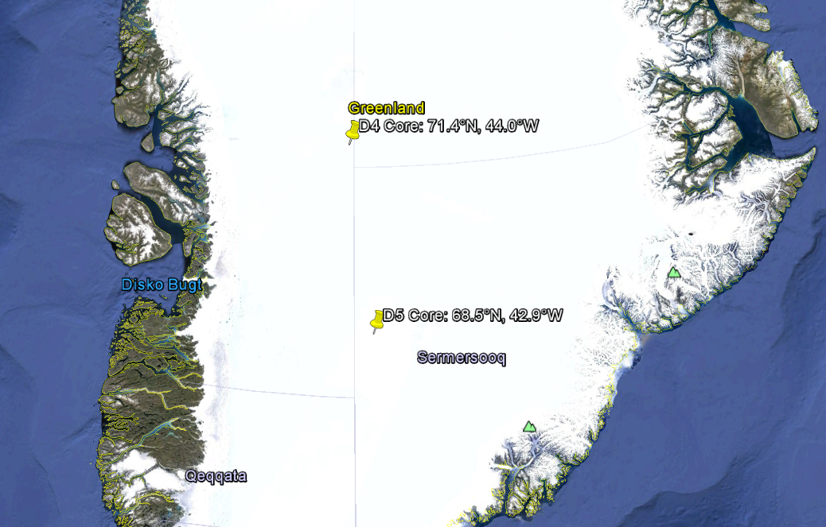
Case Study II: Greenland Ice Core
McConnell et. al. from DRI

Slide 22
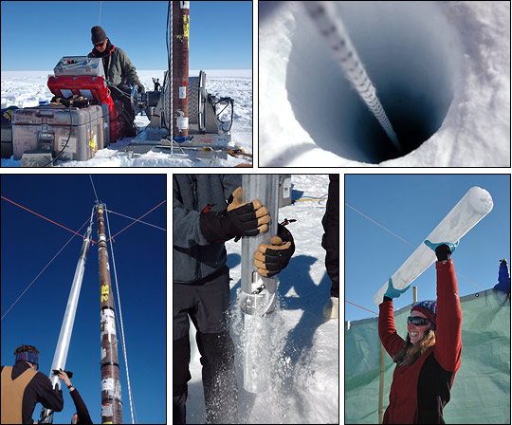
Case Study II: Greenland Ice Core

Slide 23
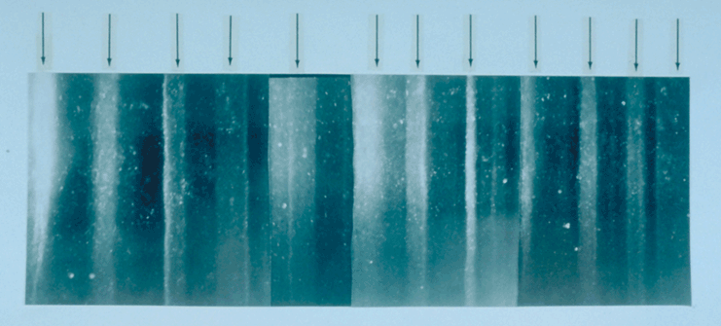
Case Study II: Greenland Ice Core

Slide 24
Case Study II: Greenland Ice Core
Ice Cores were sampled from two sites (D4, D5) in Greenland.
Cores were melted and nebulized, then dried before going through the SP2.
Groups experimented with different nebulizer setups, each with pros and cons.
For example, Schwarz et. al. experimented with both a DMT and a homebrew nebulizer.
DMT’s was faster and required less of the ice core sample.
The in-house nebulizer was much slower but didn’t damage larger BC particles.

Slide 25
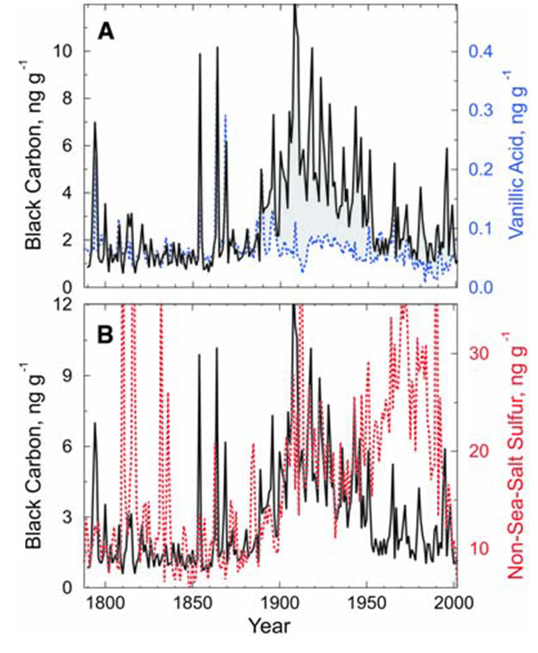
Case Study II: Greenland Ice Core
The Greenland Ice Cores showed a record of the onset of the Industrial Revolution.
Vanillic Acid is produced in forest fires, and is used to differentiate between non-industrial and industrial pollution, which correlates to non-SSA Sulfur.
At the height of BC concentrations in 1906-1910, surface forcing was 3 W m⁻², an eightfold increase over pre-industrial times.

Slide 26
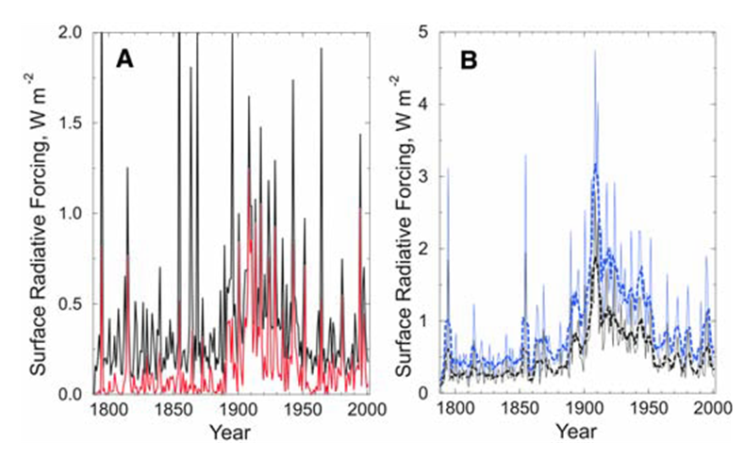
Case Study II: Greenland Ice Core
Summer (June-July)
Winter and early summer

Slide 27
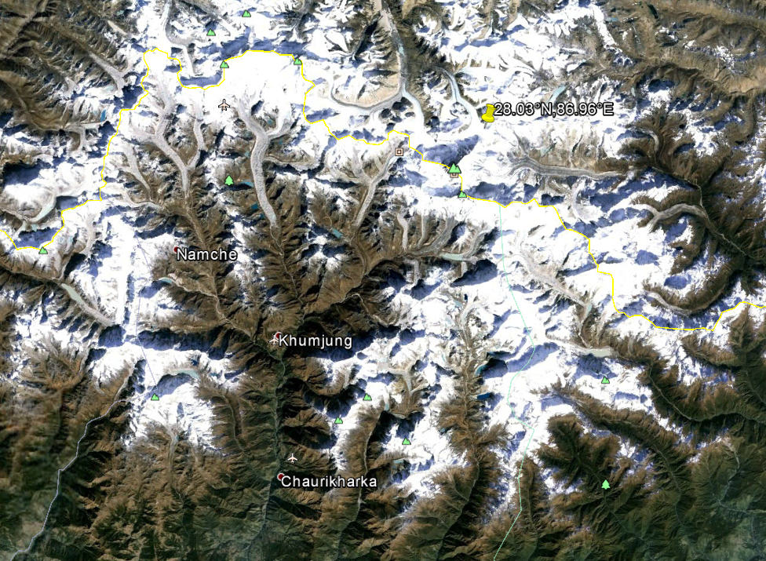
Case Study III: Mt. Everest Ice Core
Kaspari et. al.
1860-2000 AD
1975-2000 vs. 1860-1975

Slide 28
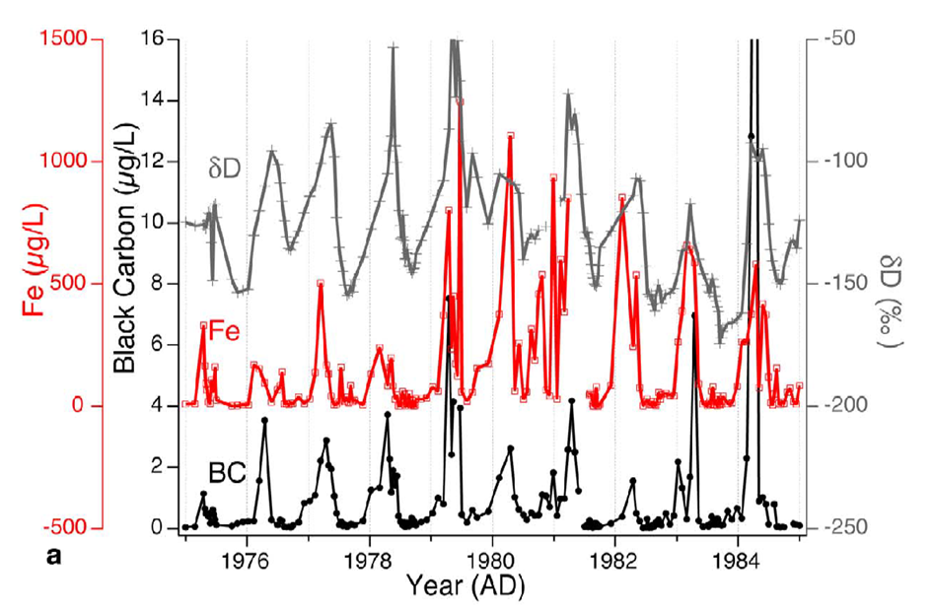
Case Study III: Mt. Everest Ice Core

Slide 29
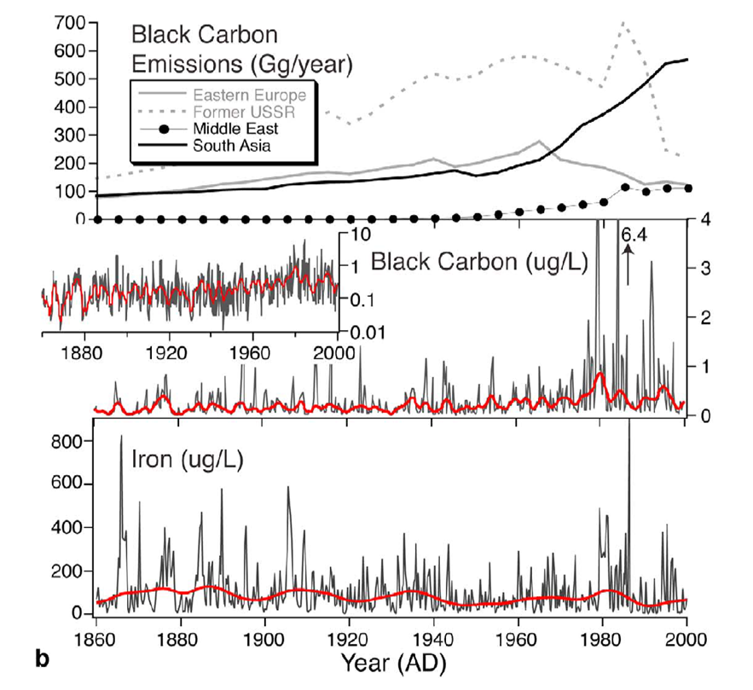
Case Study III: Mt. Everest Ice Core

Slide 30
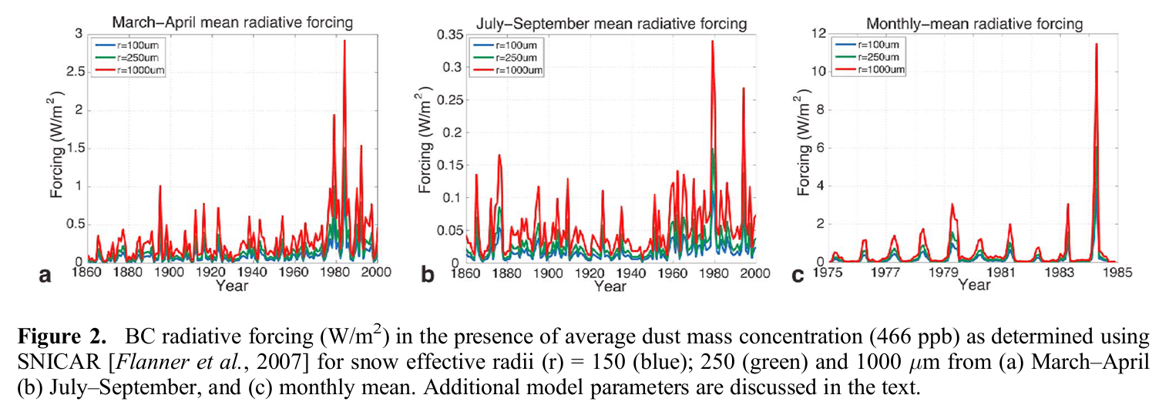
Case Study III: Mt. Everest Ice Core

Slide 31
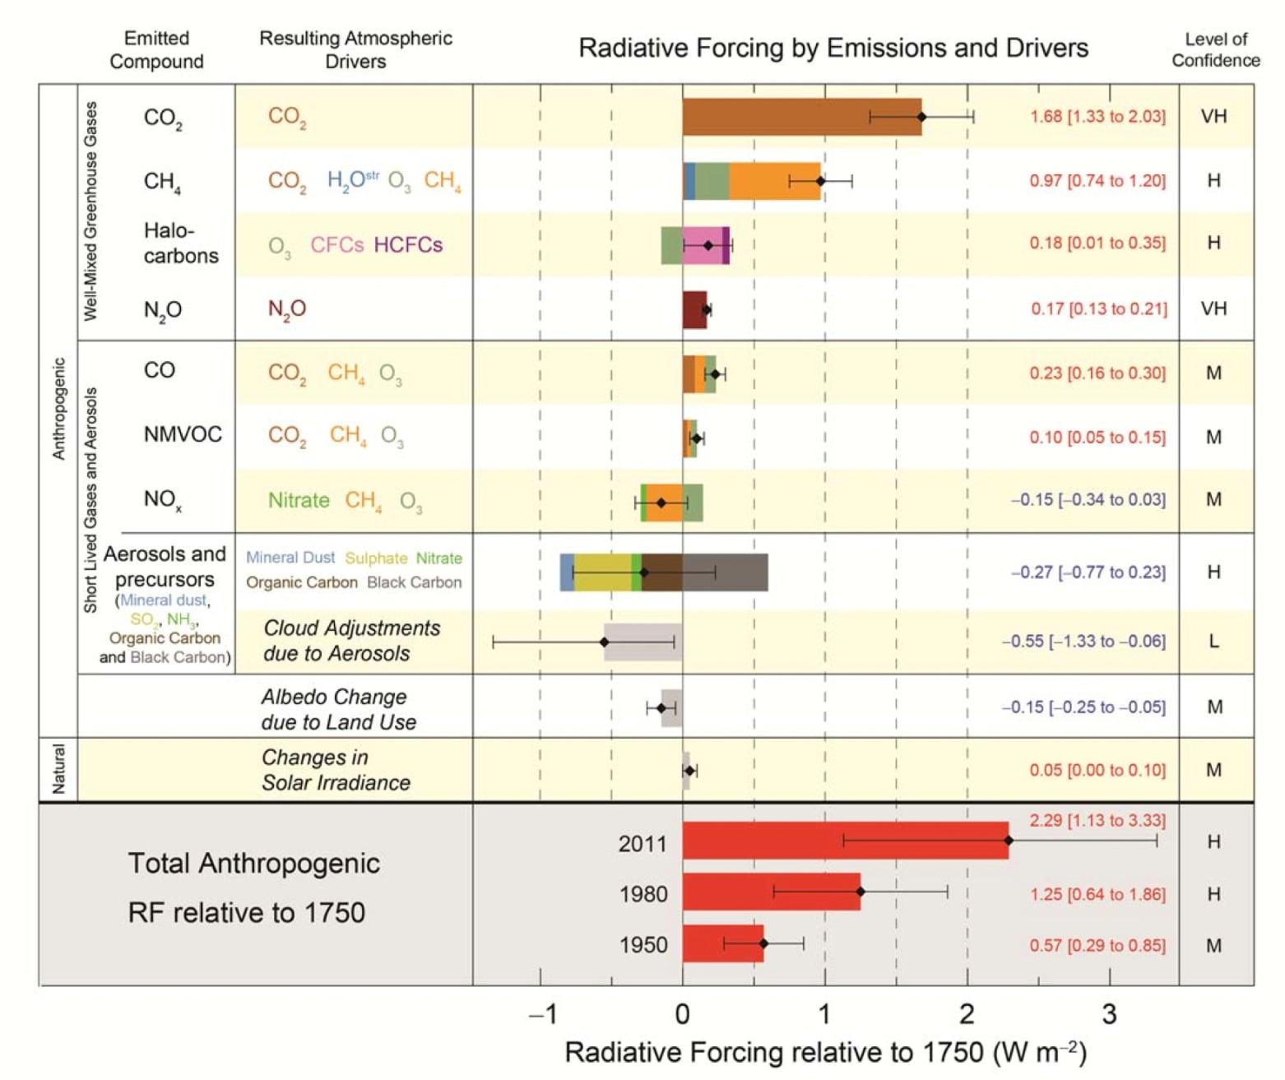
Case Study III: Mt. Everest Ice Core
[IPCC]

Slide 32
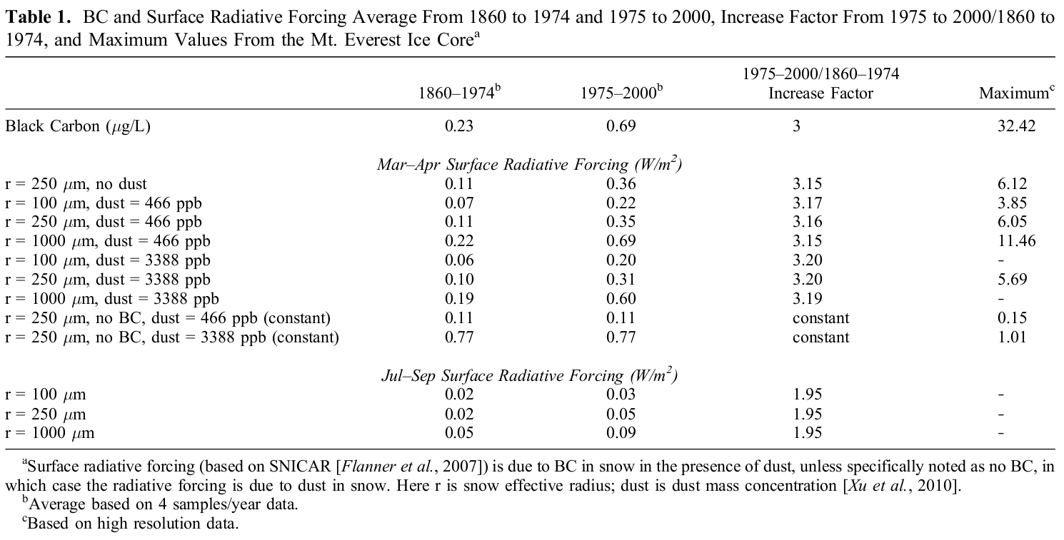
Case Study III: Mt. Everest Ice Core

Slide 33
Open Questions
How does BC deposition change glacier dynamics? How does it alter the energy budget of the glacier?
What happens when BC gets entrained within the glacier by melting in?
Does BC cause more of the surface of the glacier to evaporate off?
Does BC cause the surface to melt and run off?

Slide 34
References
Schwarz et. al. (2006). “Single-particle measurements of midlatitude black carbon and light-scattering aerosols from the boundary layer to the lower stratosphere”. Journal of Geophysical Research 3.
McConnell et. al. (2007). “20th-Century Industrial Black Carbon Emissions Altered Arctic Climate Forcing”. Science 317: 1381-1384.
Kaspari et. al. (2011). “Recent increase in black carbon concentrations from a Mt. Everest ice core spanning 1860-2000 AD”. Geophysical Research Letters 38.
[Lang-Yona] Lang-Yona et. al. (2010). “Interaction of internally mixed aerosols with light”. Physical Chemistry Chemical Physics 12: 21-31.
[IPCC] Intergovernmental Panel on Climate Change. “Climate Change 2013: The Physical Science Basis”.

