Slide 1

Lan Gao Apr.21
Aircraft Measurements of the Impacts of Pollution Aerosols on Clouds and Precipitation Over the Sierra Nevada
Daniel Rosenfeld, William L. Woodley, Duncan Axisa, Eyal Freud, James G. Hudson,
and Amir Givati
JOURNAL OF GEOPHYSICAL RESEARCH, VOL. 113, D15203, doi:10.1029/2007JD009544, 2008
Presented by Lan Gao
April 21st, 2014

Slide 2
Outline
Background
Purpose
Methods
Results
Conclusion
Reference
Questions

Slide 3
Background-Basic Concepts
Cloud Condensation Nuclei (CCN): Particles that water vapor condenses upon in order to form droplets
Cloud Droplet Number Concentration: The number of droplets in a cloud per unit volume (#/cm³)
Liquid Water Content (LWC): The mass of the water in a cloud per unit volume of air (g/m³)

Slide 4
Background-Basic Concepts (continue)
Supersaturation: When the ratio of saturation vapor pressure of the air to the saturation vapor pressure over a flat surface is greater than 100%
Cloud Drop Effective Radius (r_{e}): A weighted mean of the size distribution of cloud droplets
Orographic Cloud: Clouds that develop in response to the forced lifting of air by the Earth's topography

Slide 5
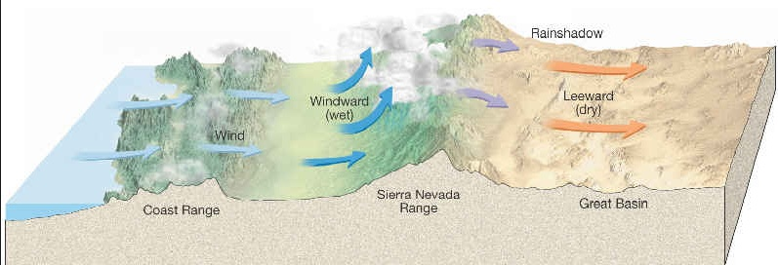
Orographic Cloud
Pristine Maritime Air
Graph come from: http://www.geography.hunter.cuny.edu/~tbw/wc.notes/15.climates.veg/climate/B/rain.shadow.deserts.diagram.jpg

Slide 6
What will happen to orographic cloud?
●
●
●
●
●
●
●
Anthropogenic Aerosol

Slide 7
Previous research
Satellite measurements in onshore-flowing clouds showed that they become more microphysically continental downwind of areas of major emissions of anthropogenic aerosols.
Rain gauge analyses of orographic precipitation showed that the upslope precipitation in mountain ranges downwind of area of major emission of anthropogenic aerosol was decreased with respect to the coastal precipitation during the 20th century.
Rosenfeld D., 2000: Suppression of Rain and Snow by Urban and Industrial Air Pollution. Science, 287 (5459), 1793-1796.
Givati A. and D. Rosenfeld, 2004: Quantifying precipitation suppression due to air Pollution. Journal of Applied meteorology 43, 1038-1056.

Slide 8
Hypothesis from previous research
The results mentioned above are consistent with the hypothesis that air pollution aerosols that are incorporated in orographic clouds slow down cloud-drop coalescence and riming on ice precipitation, hence delaying the conversion of cloud water into precipitation.

Slide 9
Purpose
In order to validate the above hypothesis, a research effort called Suppression of Precipitation (SUPRECIP) was conducted to make in situ aircraft measurements of the polluting aerosols, the composition of the clouds ingesting them, and the way the precipitation forming processes are affected.

Slide 10
Methods
Time:
SUPRECIP 1: February and March of 2005
SUPRECIP 2: February and March of 2006
Place: California-Sierra-Nevada region
Instruments:
SUPRECIP 1: Cloud aircraft

Slide 11
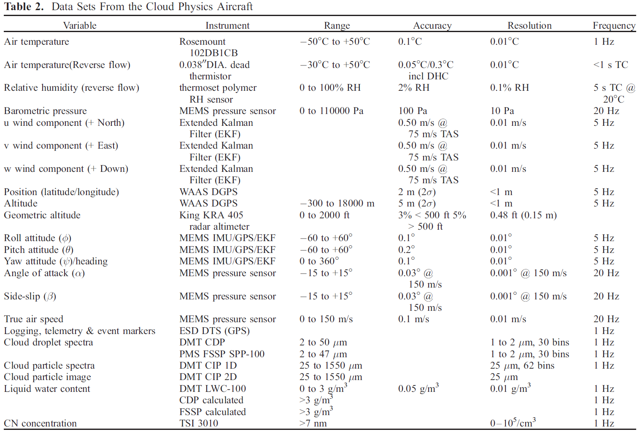

The SOAR Cheyenne Ⅱ cloud physics aircraft Fly through the cloud to document the microphysics of cloud droplets

Slide 12
Methods
Time:
SUPRECIP 1: February and March of 2005
SUPRECIP 2: February and March of 2006
Place: California-Sierra-Nevada region
Instruments:
SUPRECIP 1: Cloud aircraft
SUPRECIP 2: Cloud aircraft + Aerosol aircraft

Slide 13

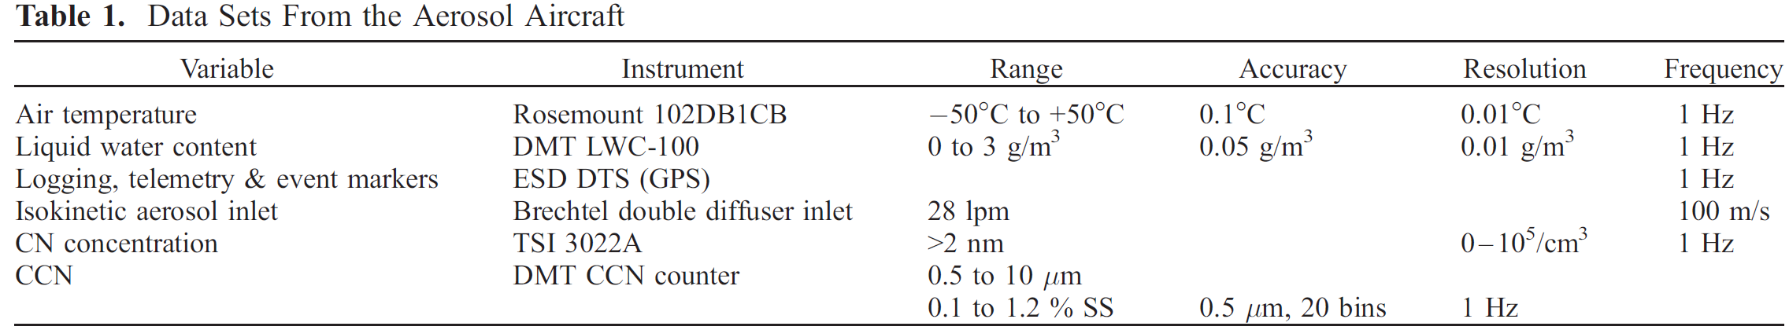
SOAR Cessna 340 aerosol aircraft
Fly below the base of cloud that the cloud aircraft monitored

Slide 14
Results from SUPRECIP 1
Anomalous weather
A high-pressure blocking pattern at the surface and aloft
The desired orographic clouds produced by the usual westerly winds into the Sierra were a rarity during SUPRECIP 1.
Instrument Flight Rules
It’s hard to obtain clearance to conduct flights under instrument flight rules in the boundary layer in the San Francisco/Oakland/Sacramento heavily populated urban and industrial areas.

Slide 15
Results from SUPRECIP 1
Main results:
Validated the satellite retrievals of r_{e} and microphysical phase.
Ample supercooled drizzle drops were found in the pristine orographic clouds.
The pristine clouds occurred in air masses that were apparently decoupled from the boundary layer in the early morning, whereas the more microphysically continental clouds occurred during the afternoon.

Slide 16
Results from SUPRECIP 2
Relationship between the subcloud aerosols and cloud microphysical structure
a) a case study (Feb.28 2006)
b) ensemble results
Diurnal variability of the aerosols
Spatial distribution of the aerosols

Slide 17
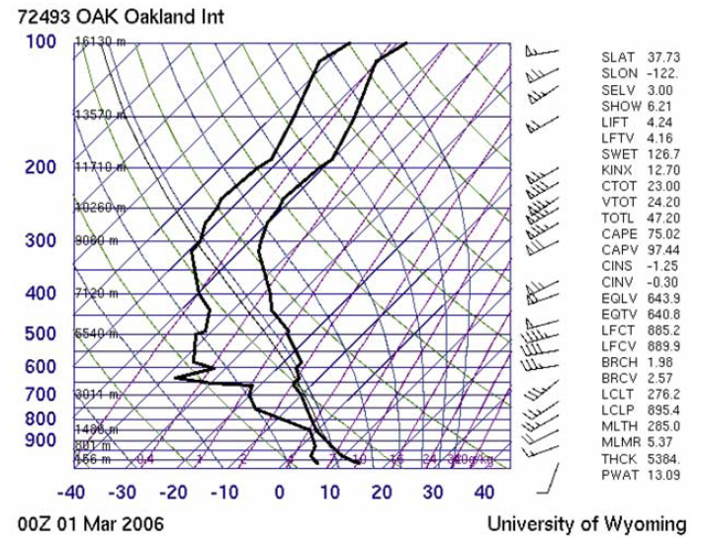
Case study: on the afternoon of Feb.28
Oakland radiosonde of Mar.1 2006 at 00Z
Notes:
A cold front had passed through the area on Feb.27 and a postfrontal cold air mass moved from the west southwest over all of Central California by the following afternoon. Postfrontal instability caused convective clouds over the ocean, and triggered convective clouds over the coastal hills and over the Sierra Nevada.

Slide 18
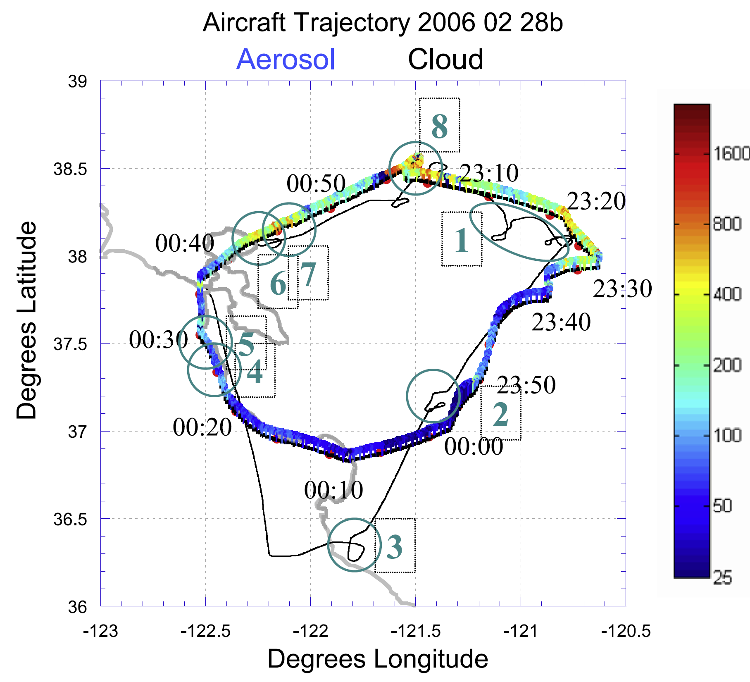
Sacramento
San Francisco
CCN concentration at Supersaturation of 0.9%

Slide 19
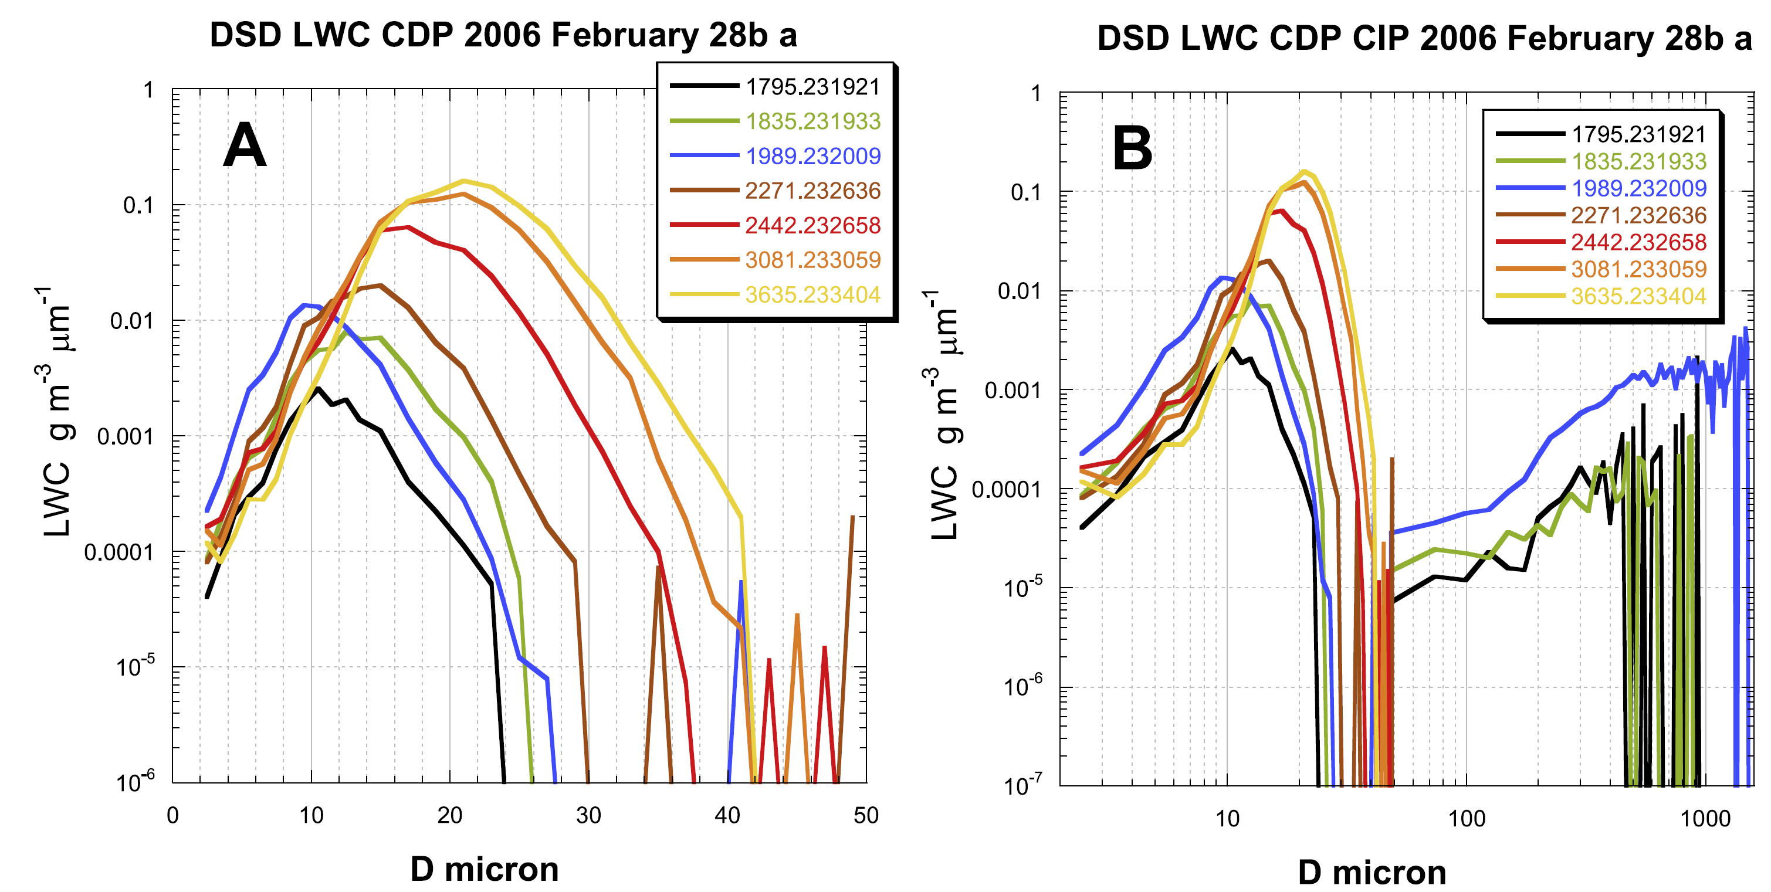
CDP
CIP
The cloud and precipitation particle size distribution for cloud 1
Modal liquid water drop diameter (DL): the drop diameter having the greatest LWC. The threshold of DL for warm rain is 24 μm.

Slide 20
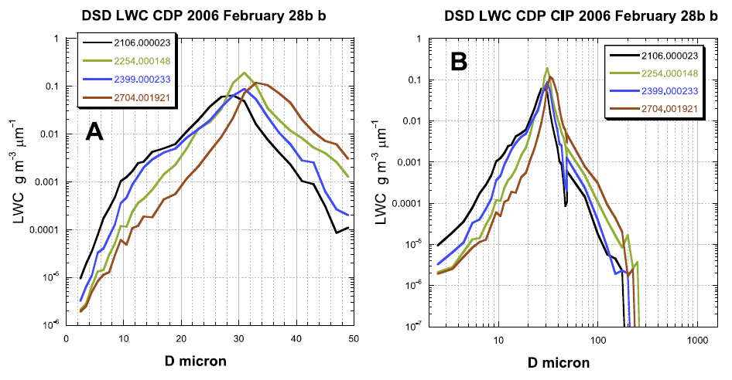
Cloud 2

Slide 21
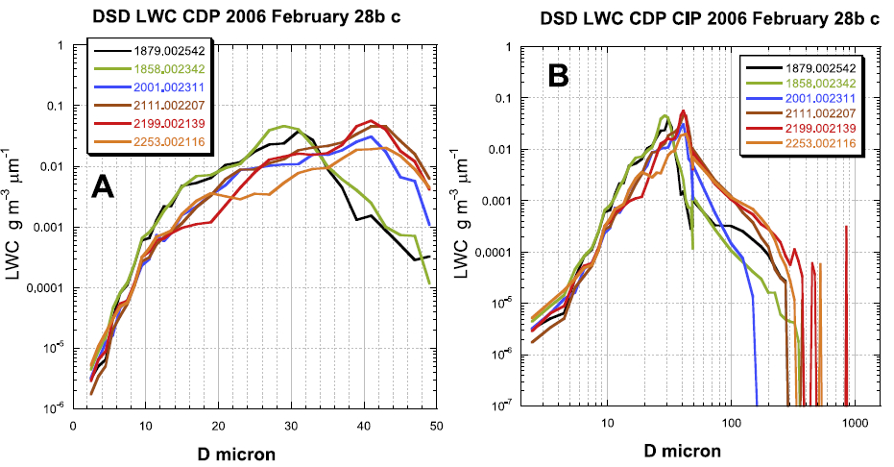
Cloud 3

Slide 22
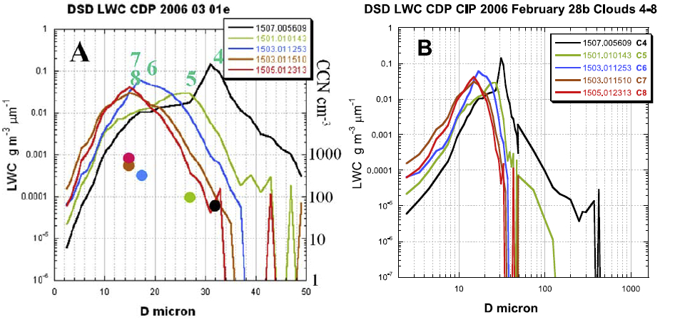
Cloud 4-8

Slide 23
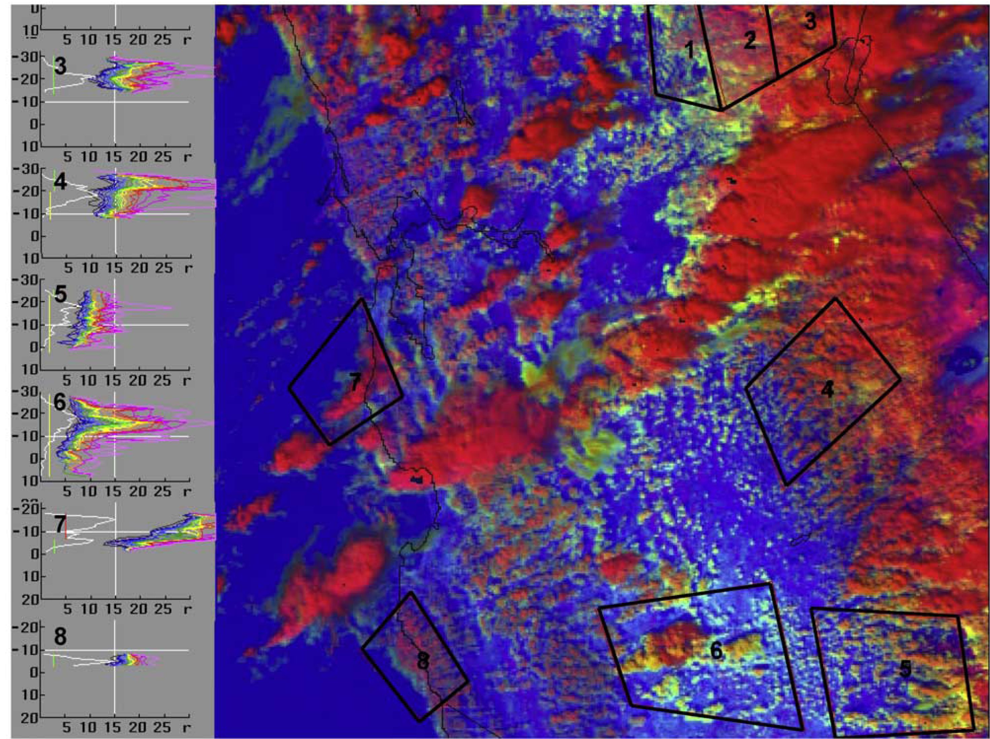
Aqua MODIS image of the clouds in central California on 2006 02 28 at 21:00Z

Slide 24
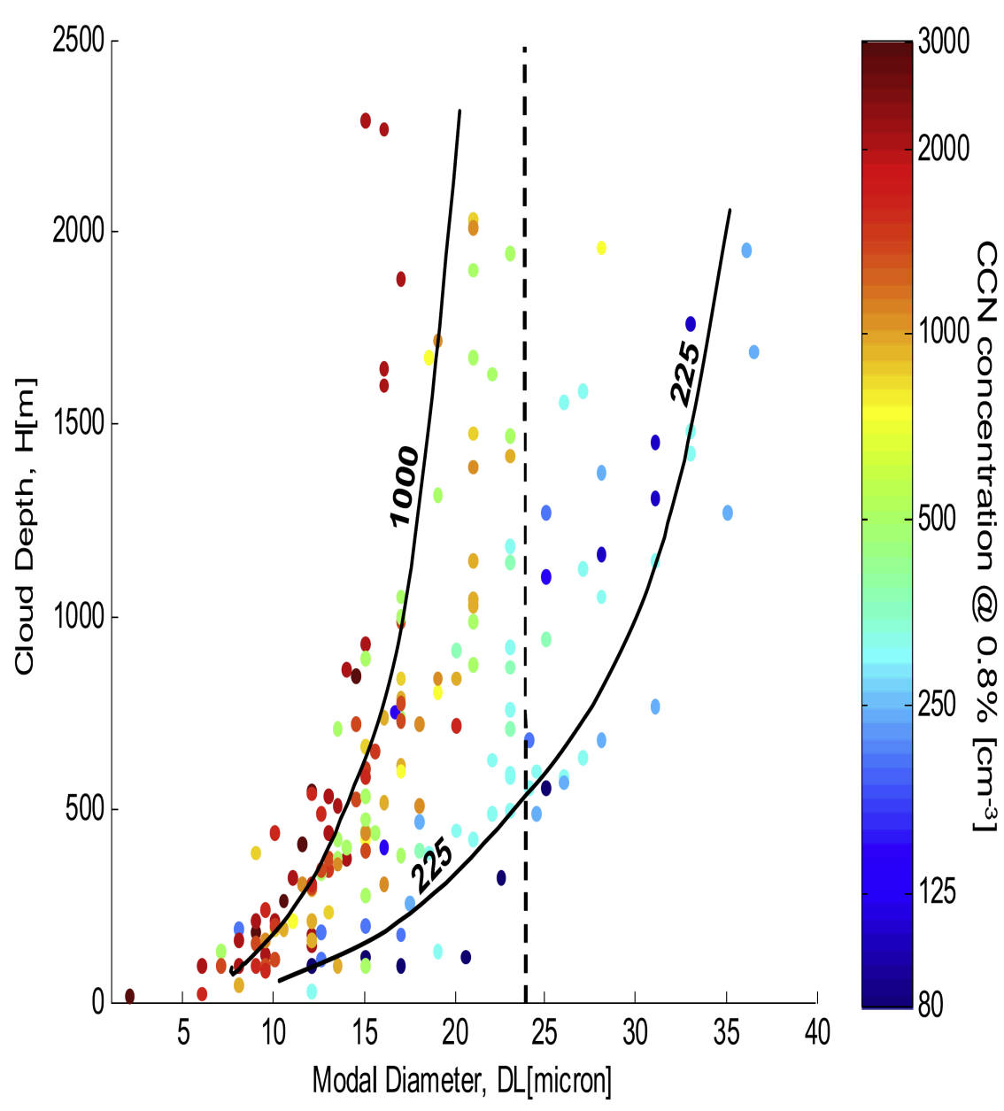
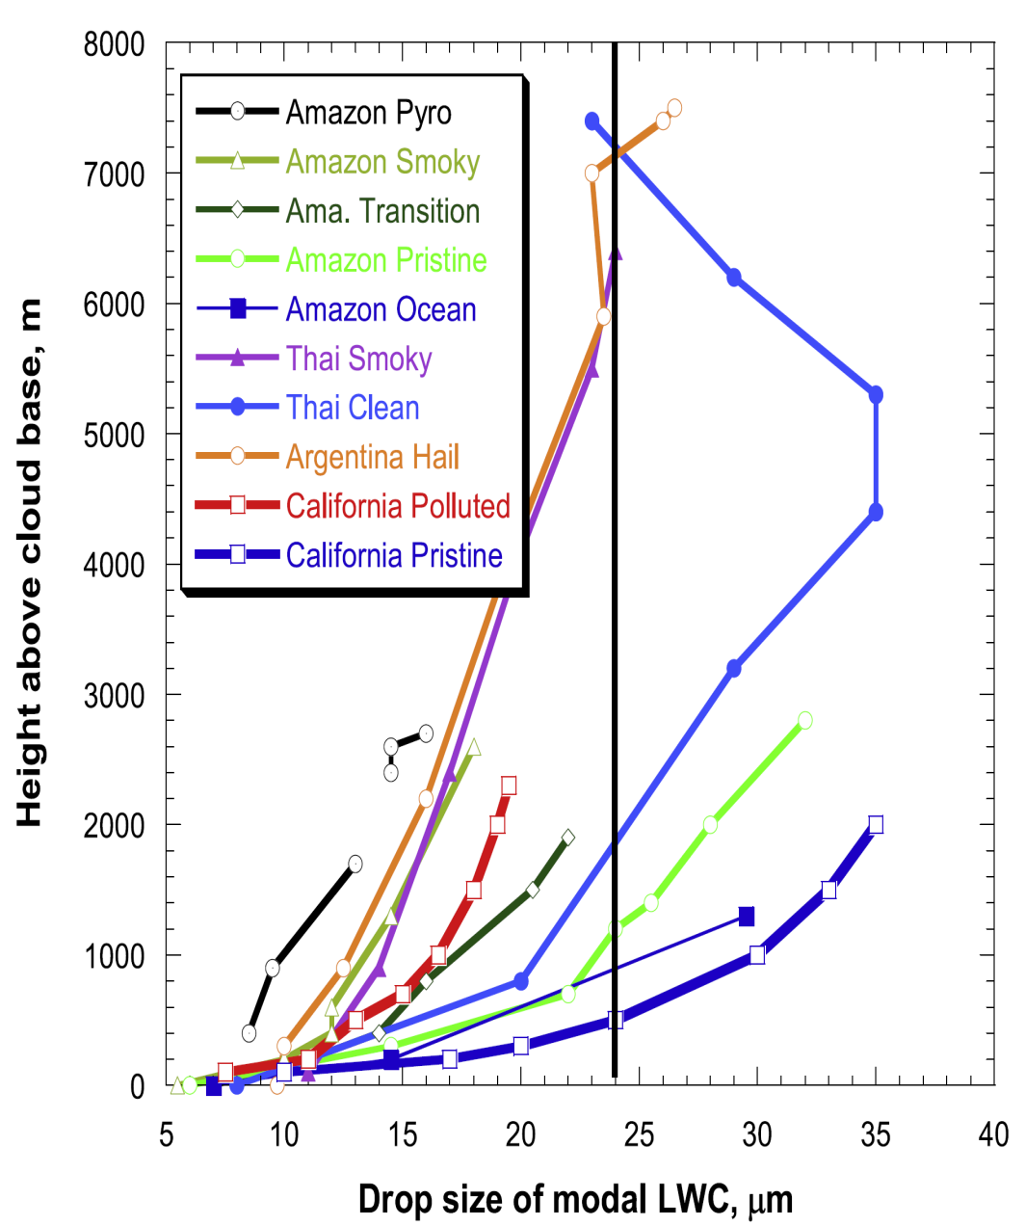
Ensemble Results
The aerosols can influence the precipitation amounts from these clouds.
Notes:
Analysis of all of the cloud passes on all the flights of SUPRECIP 2 to determine the cloud depth necessary for each cloud to develop particles of precipitation size as a function of the measured subcloud CCN concentrations.

Slide 25
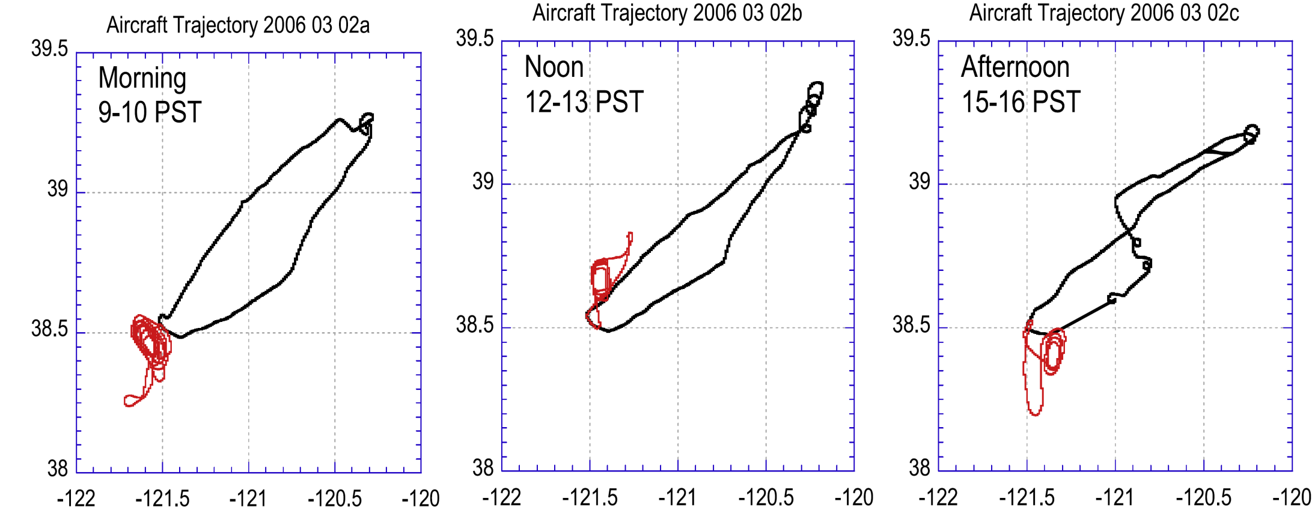
Diurnal variability of the aerosols
Chose three flights on Mar.2, 2006 to study the diurnal variability
Blodgett Forest Research Station
Sacramento
The red star in the graph represents the Blodgett Forest Research Station

Slide 26
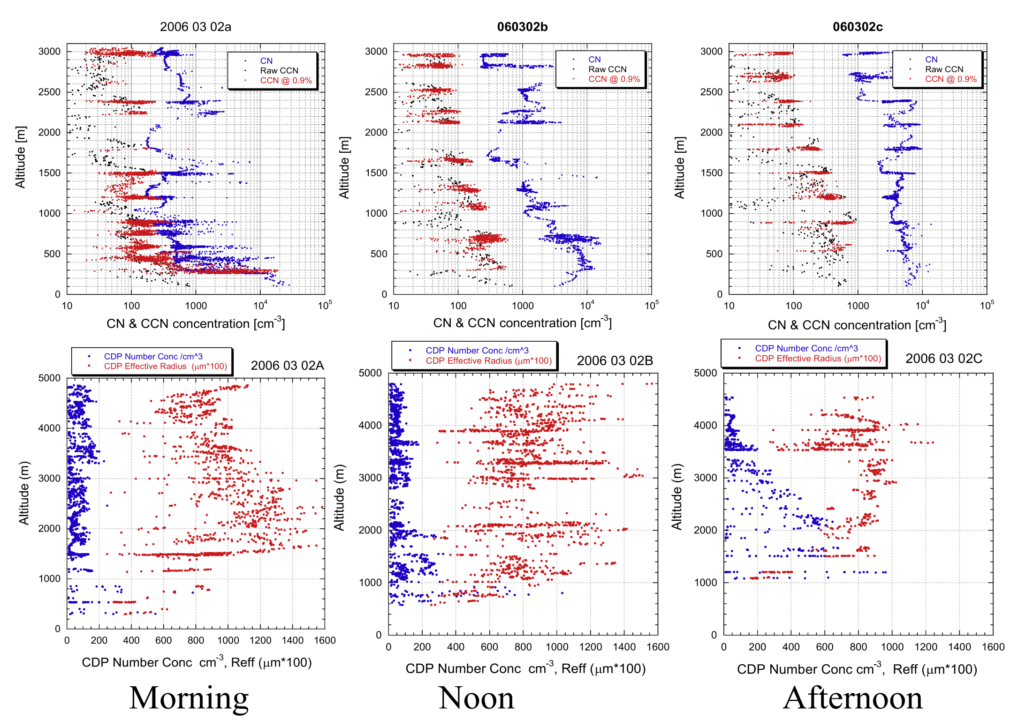
Cloud and aerosol properties during the three flights on Mar.2, 2006

Slide 27
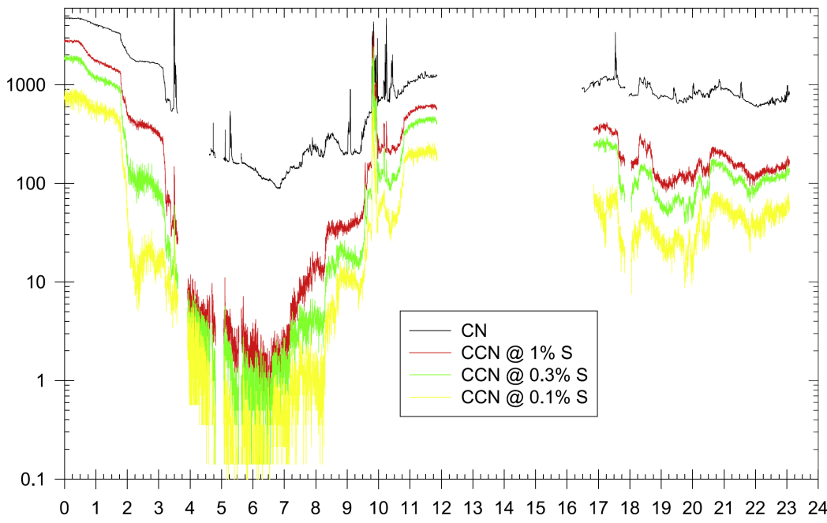
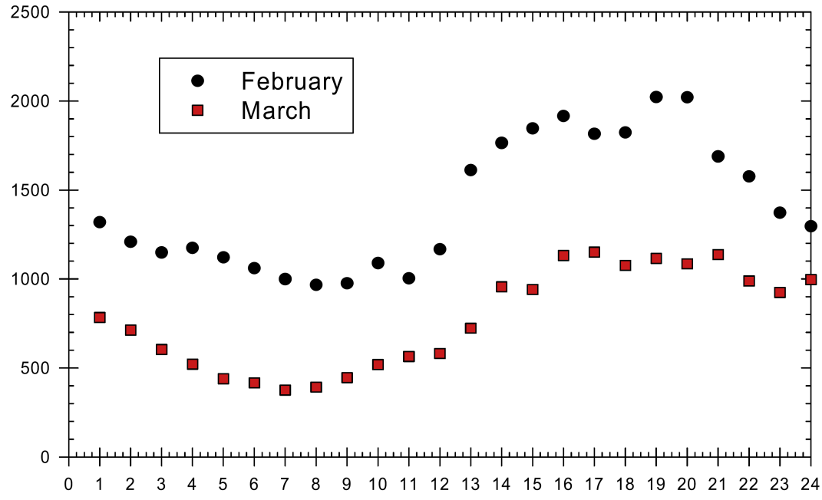
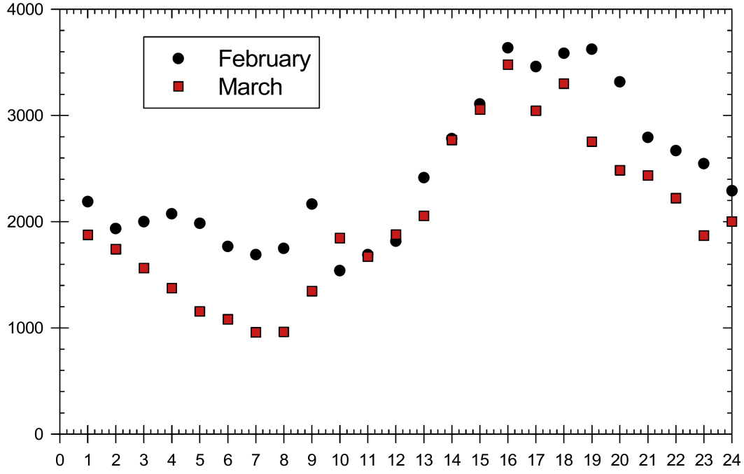
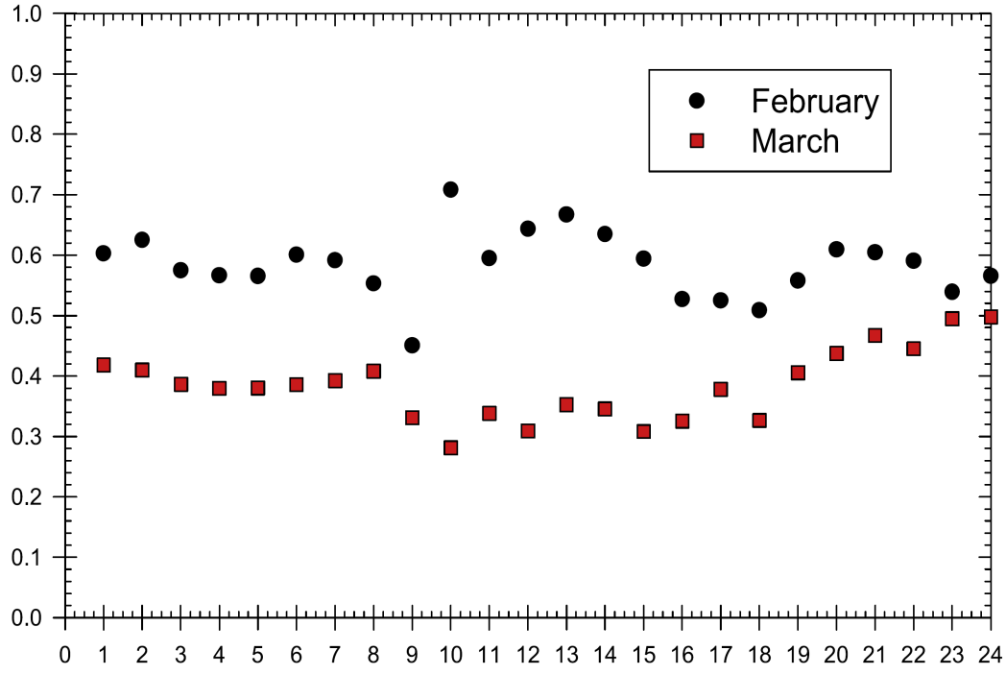
Concentration (cm⁻³)
CCN Concentration (cm⁻³)
Mar.2 2006
CN Concentration (cm⁻³)
CCN/CN ratio
Time (PST)
The diurnal variable of CN and CCN concentration observed in the Blodgett Forest Research Station.
Notes:
The CCN and CN aerosols observed at the Blodgett Forest Research Station by the DRI instrument

Slide 28
Plots above consistent with:
These aerosol originate at the Earth’s surface
Transported upward by convective currents in the day
Indicate the greatest suppressive effect on precipitation of aerosols on clouds will take place late in the day
Assumption:
The maximum suppressive effect on precipitation of aerosols should be most noticeable in spring storms when the sun is stronger, the heating is greater, the resulting convective currents are stronger, and the photochemical processes leading to the formation of aerosols are most active.

Slide 29
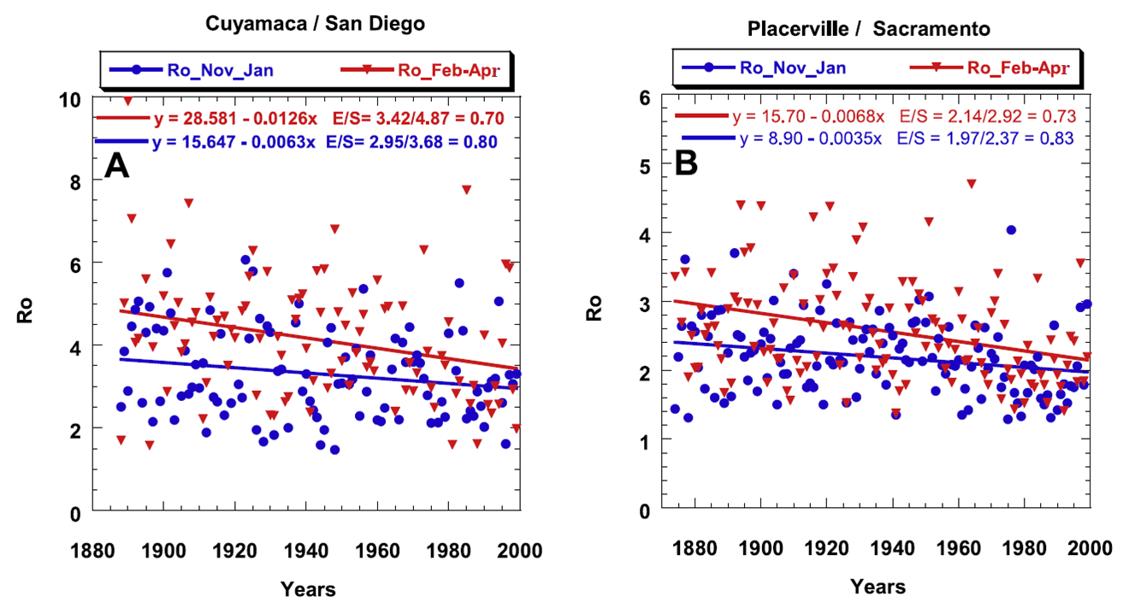
Why?
Scatter plot of the orographic precipitation enhancement factor (Ro)
Ro is defined as the ratio of the precipitation at the mountain station to the precipitation at the upwind lowland plains or coastal station.

Slide 30
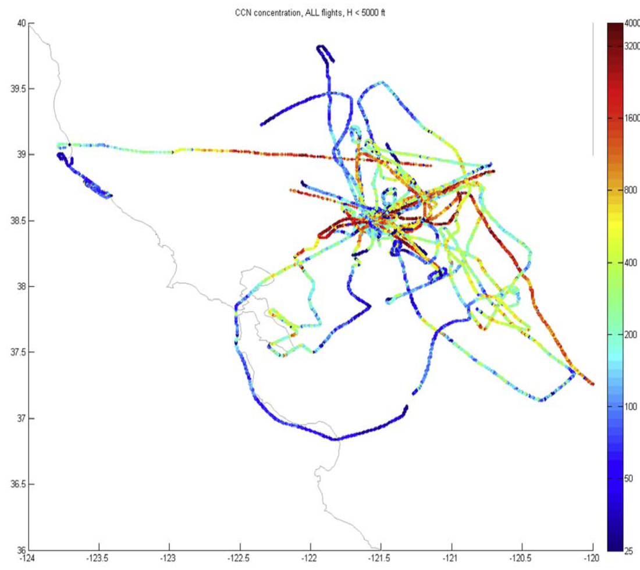
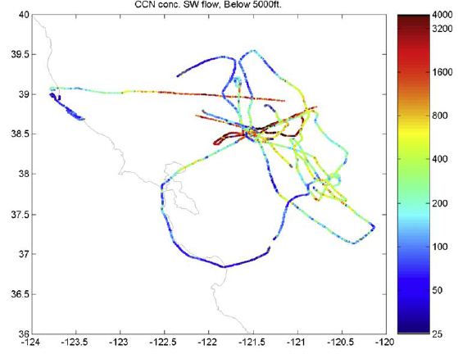
Spatial distribution of the aerosols
CCN concentration, All flights, H<5000ft
CCN concentration, SW flow, H<5000ft
Central valley
CCN concentration without wind
CCN concentration with southwest wind
similar
Surprise: the highest CCN concentrations appeared in the Central Valley
Notes:
Surprise: the highest CCN concentrations appeared in the Central Valley, mostly to the east and south of Sacramento and not so much in the coastal urban areas as had been expected.

Slide 31
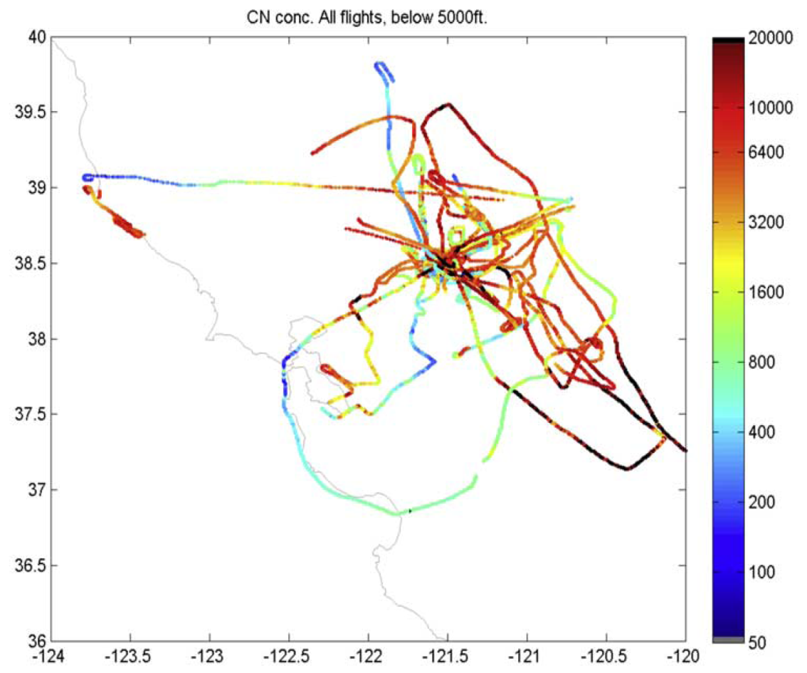
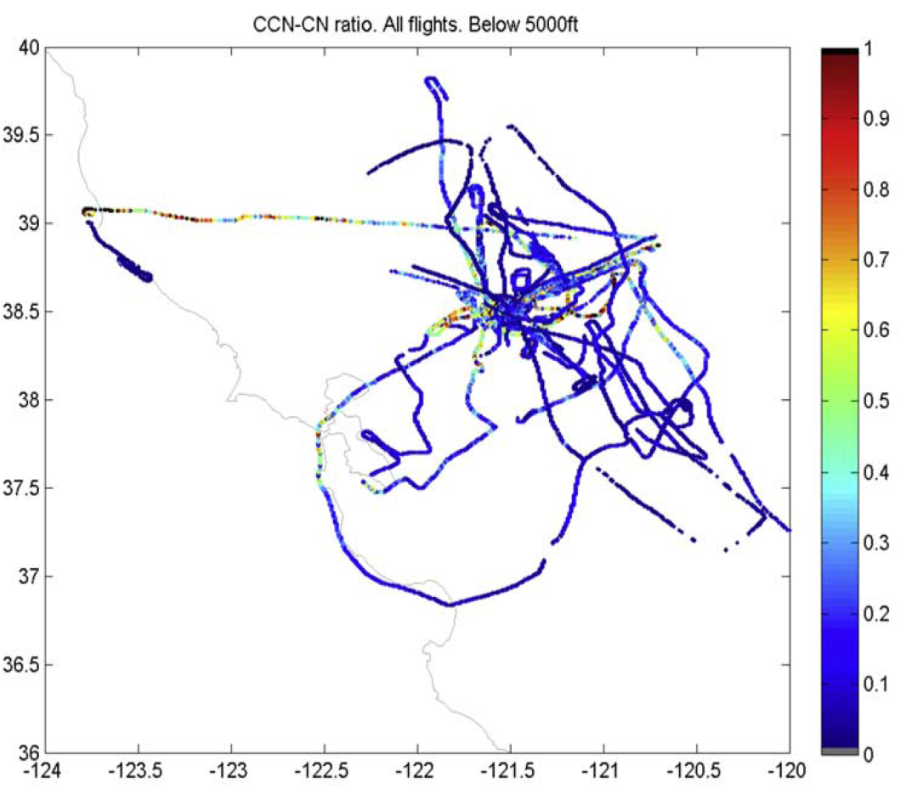
CN concentration, All flights, H<5000ft
CCN-CN ratio, All flights, H<5000ft
CN concentration without wind
CCN/CN ratio
CCN/CN ratio (most range from 0.1-0.2) is much smaller than the results from Blodgett Forest Research station (0.6).
Why ?

Slide 32
Conclusion
The aircraft measurements of cloud properties validated the satellite inferences of cloud microphysics.
A linkage between aerosols and the regions in the central and southern Sierra Nevada that have suffered losses of orographic precipitation was estimated.
The pollution aerosols show a strong diurnal trend.
The local generation of the pollution aerosols in the Central Valley is greater than the transport of pollution from the urbanized/industrialized coastal regions, so the study of the sources and chemical constituency of the aerosols in the Central Valley is needed.

Slide 33
References:
1. Rosenfeld D., 2000: Suppression of Rain and Snow by Urban and Industrial Air Pollution. Science, 287 (5459), 1793-1796.
2. Givati A. and D. Rosenfeld, 2004: Quantifying precipitation suppression due to air Pollution. Journal of Applied meteorology 43, 1038-1056.
3. Hudson, J. G., and S. Mishra (2007), Relationships between CCN and cloud microphysics variations in clean maritime air, Geophys. Res. Lett., 34, L16804, doi:10.1029/2007GL030044.
4. Andreae, M. O., D. Rosenfeld, P. Artaxo, A. A. Costa, G. P. Frank, K. M. Longo, and M. A. F. Silva-Dias (2004), Smoking rain clouds over the Amazon, Science, 303, 1337–1342. Retrieving microphysical properties near the tops of potential rain clouds by multispectral analysis of AVHRR data. Atmos. Res., 34, 259– 283.

Slide 34
Thank you !
Questions ?

