Slide 1

Radiative Absorption Enhancements Due to the Mixing State of
Atmospheric Black Carbon
Christopher D. Cappa et al, Science, 31 August 2012
31 AUGUST 2012 VOL 337 SCIENCE
Presented by: Madhu Gyawali
Department of Physics, University of Nevada, Reno

Slide 2
Outline
Findings from Two field Campaigns: The California Research at the Nexus of Air Quality and Climate Change (CalNex) and Carbonaceous Aerosols and Radiative Effects Study (CARES)
-- C. D. Cappa et al., Science, 31 August 2012
Technical Comment
-- M. Z. Jacobson, Science, 11 December 2012
Response to Comment
-- C. D. Cappa et al., Science, 25 January 2013

Slide 3
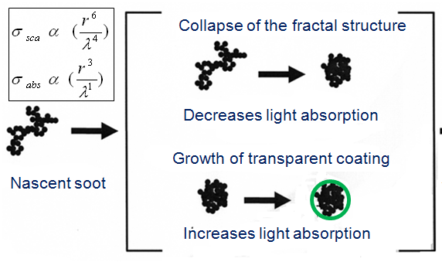
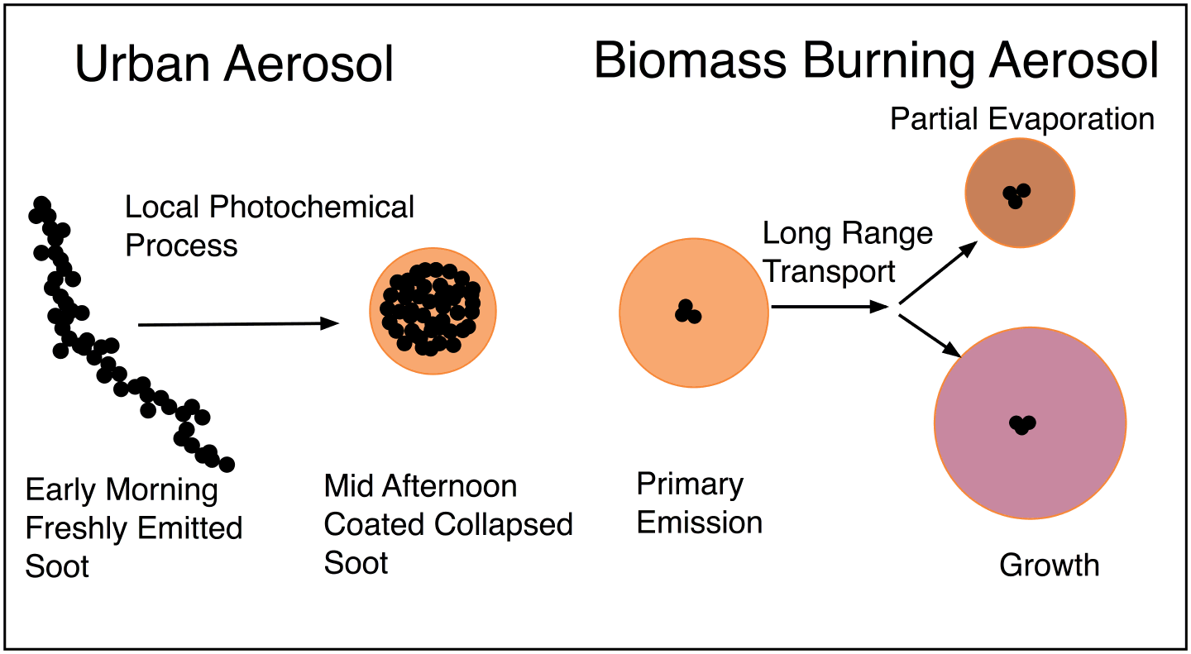
Black Carbon (BC)
BC is released from the burning of fossil fuel, biomass, and, natural fires
Aging of BC
Absorption enhancement (E_{abs}): Ratio between ambient particle absorption and the absorption after particle heating in a thermo denuder to evaporate and remove NR-PM (non-refractory particulate matter: organics, nitrates, sulfates etc). The observed E_{abs} include effects of both lensing and of BrC (brown carbon) absorption.

Slide 4
Black Carbon BC
Radiative forcing:
Change in net (down minus up) irradiance at the top of the atmosphere (TOP)
BC global direct forcing :
0.27 (externally mix BC)- 0.54 (Core-sell BC) Wm⁻²
(Jacobson, 2001, Nature)
Present-day global warming due to BC: 0.2–0.4 ⁰C
(climate sensitivity 0.75 ⁰C per W/m⁻², Hansen et al., 2005, Science)

Slide 5
Photochemical Age (PCA)
−Log₁₀ (NO_{x}/NO_{y})
A value of 0 for fresh emissions (NO_{Y}=NO_{X})
A value of 1 when 90% of NO_{x} has been converted into oxidation products
NO_{X}=NO+NO₂
NO_{Y}=NO_{X}+ Oxidation product of NO_{X}

Slide 6
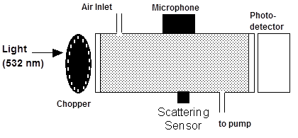
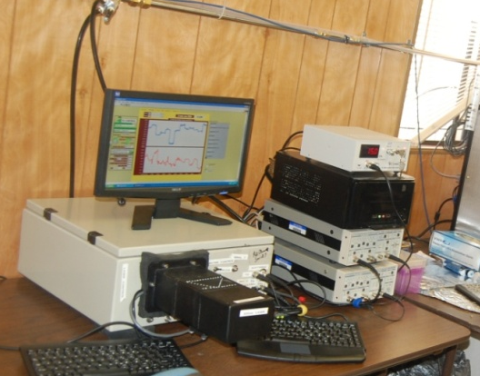
Photoacoustic (PA) Aerosol Optics Instrument
The photoacoustic effect is based on the conversion of light energy into sound energy
Schematic of Photoacoustic Instrument
PA at 355 nm (new )

Slide 7
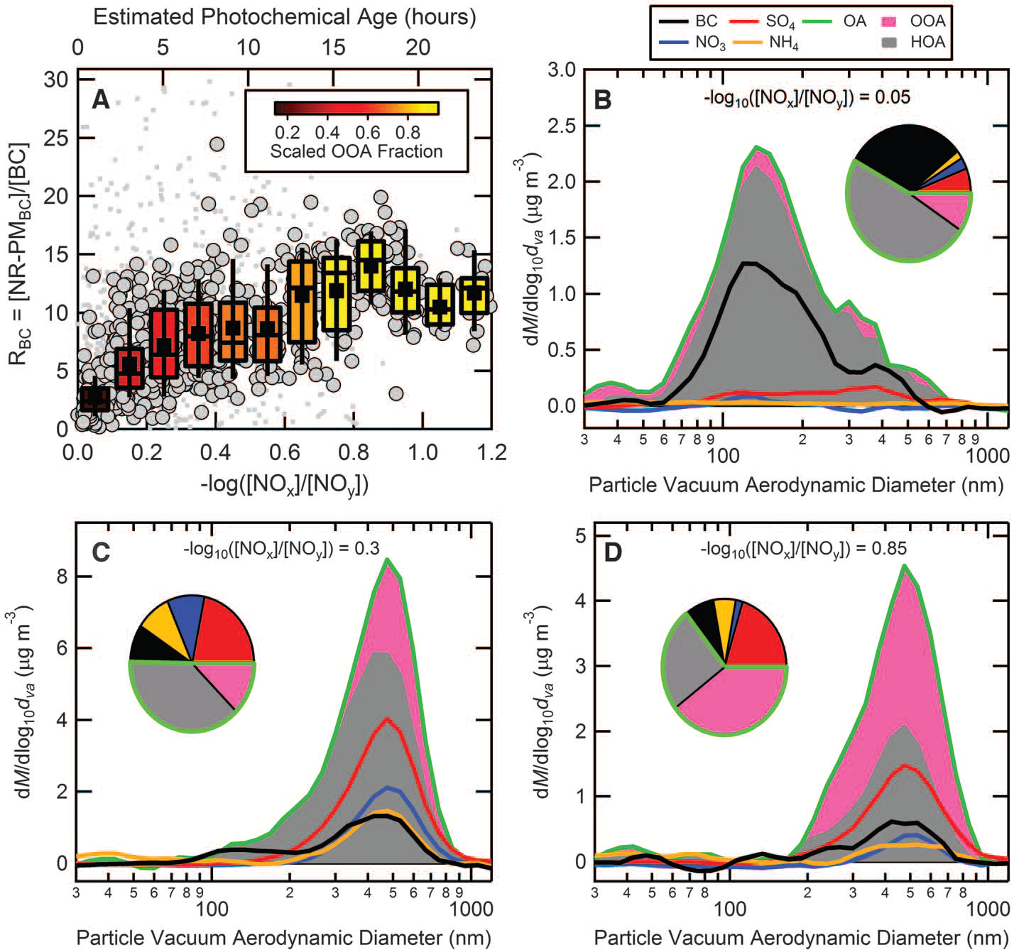
Black Carbon Coating with Photochemical Aging (PCA)
Cappa et al, Science, 31 August 2012
The R_{BC} (=[NR-PM_{BC}]/[BC]) ratio as a function of PCA (–log([NO_{x}]/[NO_{y}]) for total NR-PM_{BC} during CalNex. The box and whisker plots show the mean (■), median (–), lower and upper quartile (boxes), and 9th and 91st percentile (whisker). The corresponding PCA (assuming [OH] = 4 × 10⁶ molecules cm⁻³) is shown on the top axis.

Slide 8
Particle Vacuum Aerodynamic Diameter Size
Distributions with Photochemical Aging (PCA)
Cappa et al, Science, 31 August 2012
Particle Vacuum Aerodynamic Diameter (nm) from SP-AMS
Vacuum aerodynamic diameter (d_{va}) size distributions, for periods where –log([NOx]/[NOy]) was (B) 0.05 (fresh; R_{BC} = 3.1), (C) 0.3(intermediate; R_{BC} = 10.3), and (D) 0.85 (aged; R_{BC} = 15.8).. The pie charts show the fractional contributions of the various species to the total mass of BC-containing particles.

Slide 9
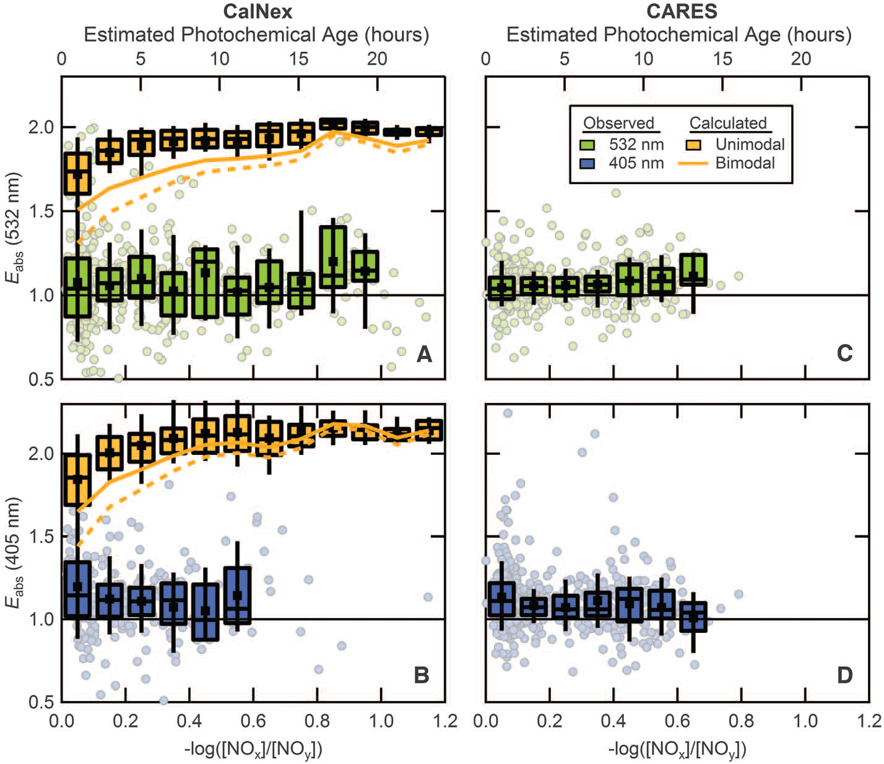
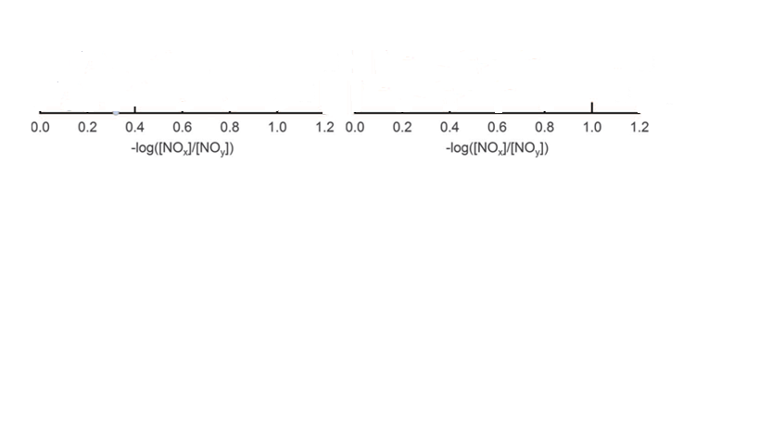
Measured and Calculated BC Absorption
Enhancement , E_{abs}
Cappa et al, Science, 31 August 2012
E_{abs} at 532 nm
Measured E_{abs} at 532 nm as a function of PCA. Calculated E_{abs} values for CalNex are shown, assuming that the distribution of NR-PM_{BC} material on the BC-containing particles was either bimodal (orange lines) or unimodal (orange box and whisker). For the bimodal case, one mode was assumed to be “thickly” coated (R_{BC}=1 (solid) , whereas the other was “thinly” coated (R_{BC}=0.1 (dashed).

Slide 10
Measured and Calculated BC Absorption
Enhancement , Eabs
Cappa et al, Science, 31 August 2012
Measured E_{abs} at 405 nm as a function of PCA

Slide 11
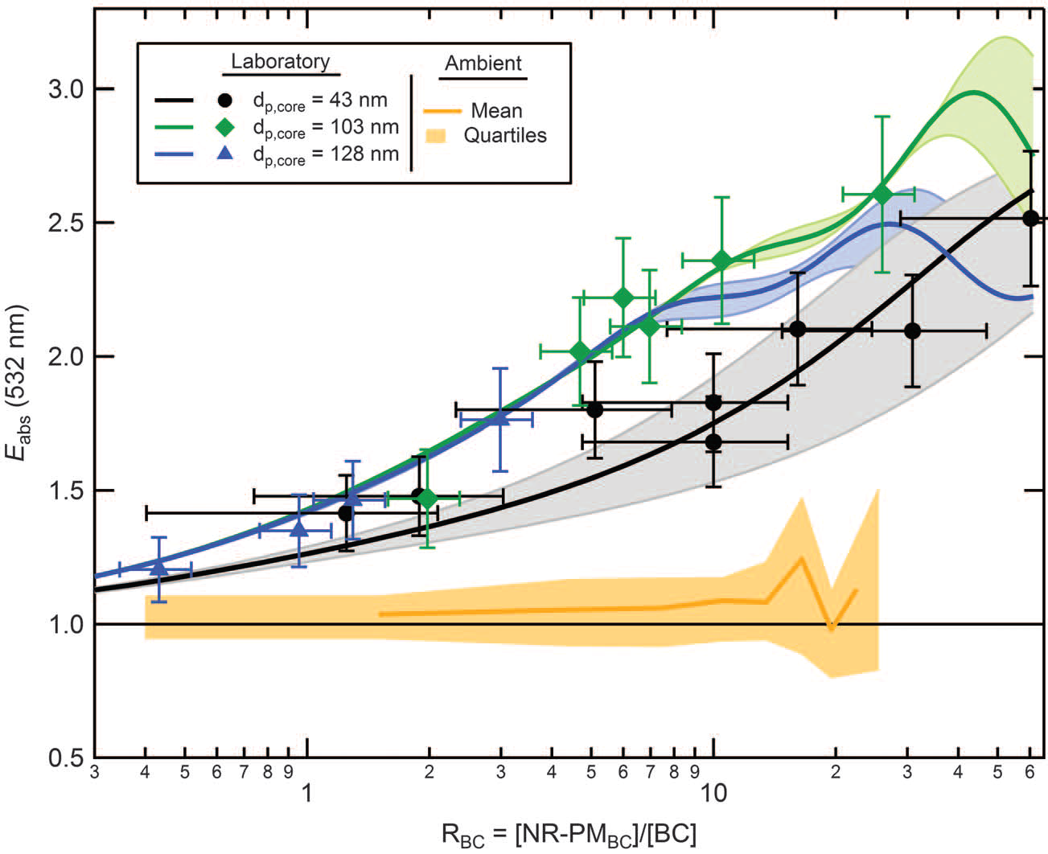
Comparison with Lab Measurements
Cappa et al, Science, 31 August 2012
Observed E_{abs} at 532 nm as a function of R_{BC} for laboratory experiments in which BC particles of various size, produced from ethylene flame, were coated with dioctyl sebacate (symbols). The d_{p,core} values are the volume-equivalent diameter of the uncoated BC particles. The observed mean ambient particle E_{abs} versus RBC during CalNex is shown for comparison(orange line).

Slide 12
Conclusion
There is no evidence of strong lensing induced absorption enhancements at 532 nm from the field measurements.
The E_{abs} is less than predicted from observationally constrained theoretical calculations, suggesting that many climate models may overestimate warming by BC.

Slide 13
Comment on “Radiative Absorption Enhancements Due to the Mixing State of Atmospheric Black Carbon”
--Mark Z. Jacobson (A well renowned modeler from Standard ford University), Science, 11 December 2012
Main Criticisms
The authors misinterpret at least some model results and omit optical focusing at high RH and of involatile components. Thus, their conclusion about model error is not demonstrated.

Slide 14
Criticisms ……
Comments…
The conclusions about “model error” are invalid
Observations were made over short atmospheric times (up to 20 hours of aging) and thereby were “not completely aged”.
Measurements were experimentally controlled under low RH conditions and thus do not include high RH observations.
Thermally denuding particles to ~200°C does not remove involatile material.
Measurements only took place in two locations and thus are not statistically significant to global climate.

Slide 15
Response to Comment on "Radiative Absorption Enhancements Due to the Mixing State of Atmospheric
Black Carbon
Christopher D. Cappa et al Science 339, 393 (2013)
Christopher D. Cappa et al.
Response
We explicitly compared observations of ambient black carbon (BC) particle absorption enhancements (E_{abs}) and average mixing states with observationally constrained Mie theory predictions to establish whether core-shell (CS) Mie theory accurately reproduces the observed E_{abs}.

Slide 16
Detail response
Conclusion: Christopher D. Cappa et al. Reply
Jacobson was correct in noting that denuding BC-containing particles at temperature 200°C may not remove all non-BC particulates; reanalysis indicates a minor contribution due to sea salt.
The inclusion of this residual material decreases the calculated maximum Eabs from the no-residual calculation.
If CS Mie theory is not appropriate for ambient particles—whether only at low RH or at both low and high RH—then climate models that use CS Mie theory may overestimate warming by BC.
We acknowledge that it is important that future measurements are expanded to higher RH, the effects of residual components after thermal, and to make measurements at more locations and over time.

Slide 17
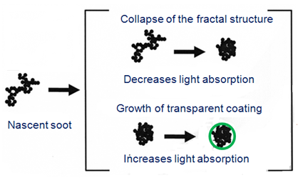
Our Comment
Neither the authors nor the commenter
consider the BC morphology

Slide 18
THANK YOU

