Slide 1
Increased Arctic cloud longwave emissivity associated with pollution from mid-latitudes by: Garrett & Zhao (2006)
Aerosol Effects on Cloud Emissivity and Surface Longwave Heating in the Arctic by: Garrett, Radke, and Hobbs (2002)
Presentation by: Mackenzie Kilpatrick
Date: 3/3/2014

Slide 2
Outline of this talk
Definitions
Background
Objectives
Covering two papers, which compliment each other well.
Frist, I’ll be introducing the 2002 study.
  Garrett, Radke & Hobbs
Then I’ll discuss the 2006 study, which builds off the 2002 paper.
  Garrett & Zhou

Slide 3
KEY ACRONYMS, DEFINITIONS
CCN: Cloud Condensation Nuclei, particles on which water vapor condenses to undergo transformation from gas to liquid. Sulfate aerosol is a common CCN, others are dust and black carbon.
LWC: Liquid Water Content, the amount of water in a cloud, usually measured in g/m³.
LWP: Liquid Water Path, measures the amount of water present in a 1m² column of atmosphere, measured in g m⁻².
R_{e}: Effective radius (µm), the weighted mean radius of a size distribution of cloud droplets.
ε: Emissivity, is the ability to emit energy via radiation. It is expressed as the ratio of energy radiated relative to a blackbody at the same temperature, and so it has values from 0 to 1.

Slide 4
AeroSOLS and Climate
Aerosols are fine solid particles or liquid droplets in air or other gases.
  They can serve as condensation nuclei for water.
  Aerosols such as black carbon are hydrophobic and are not efficient cloud condensation nuclei.
  Sulfate aerosols are excellent condensation nuclei for water.
Aerosols are currently presumed to produce a net negative radiative forcing globally.
  This negative forcing from aerosols is because the amount of shortwave reflected is greater than the longwave emitted.
Aerosol effects are much more local than Greenhouse gases, and so global means may have little influence on local forcings.

Slide 5
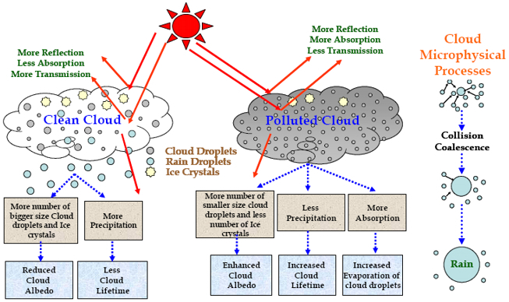
Aerosols Effects on Clouds
Cloud droplet spectra can be altered by aerosols.
  Smaller droplet radii
  Higher droplet concentrations
Aerosols increase solar (shortwave) albedo via the Cloud Albedo Effect (Twomey 1977).
Aerosols also increase the emissivity of longwave radiation by thin clouds, which has a warming effect.

Slide 6
Aerosol Pollution in the Arctic:
ARCTIC HAZE
Arctic Haze
  Produced by migration of pollutants from mid-latitudes by east-west pressure gradients causing episodic intrusions of polluted air into the Arctic.
  Prevalent in winter and early spring.
  Arctic Haze only disperses when moist air intrudes in the spring.
Aerosols have long lifespans because of low precipitation.
Thin Arctic clouds are susceptible to changes in emissivity from aerosol modifications.

Slide 7
AEROSOLS in the ARCTIC:
Objectives of this talk
Examine how Arctic Haze affects Arctic clouds clouds.
Look at the resulting effects on longwave emission and ultimately, surface heating.
2002 paper identifies pollutant effects on cloud microstructure
2006 paper examines in more detail how the changes in cloud microstructure affect longwave flux and surface heating.
CONTEXT
Last week Ashley reviewed a paper focusing on the global effects of Aerosols on Direct Radiative Effects (DRE) and Direct Radiative Forcing (DRF).
This week we have a more local view of aerosol effects.
The papers I present to you focus on aerosol effects on cloud microstructure, specific to the Arctic.

Slide 8
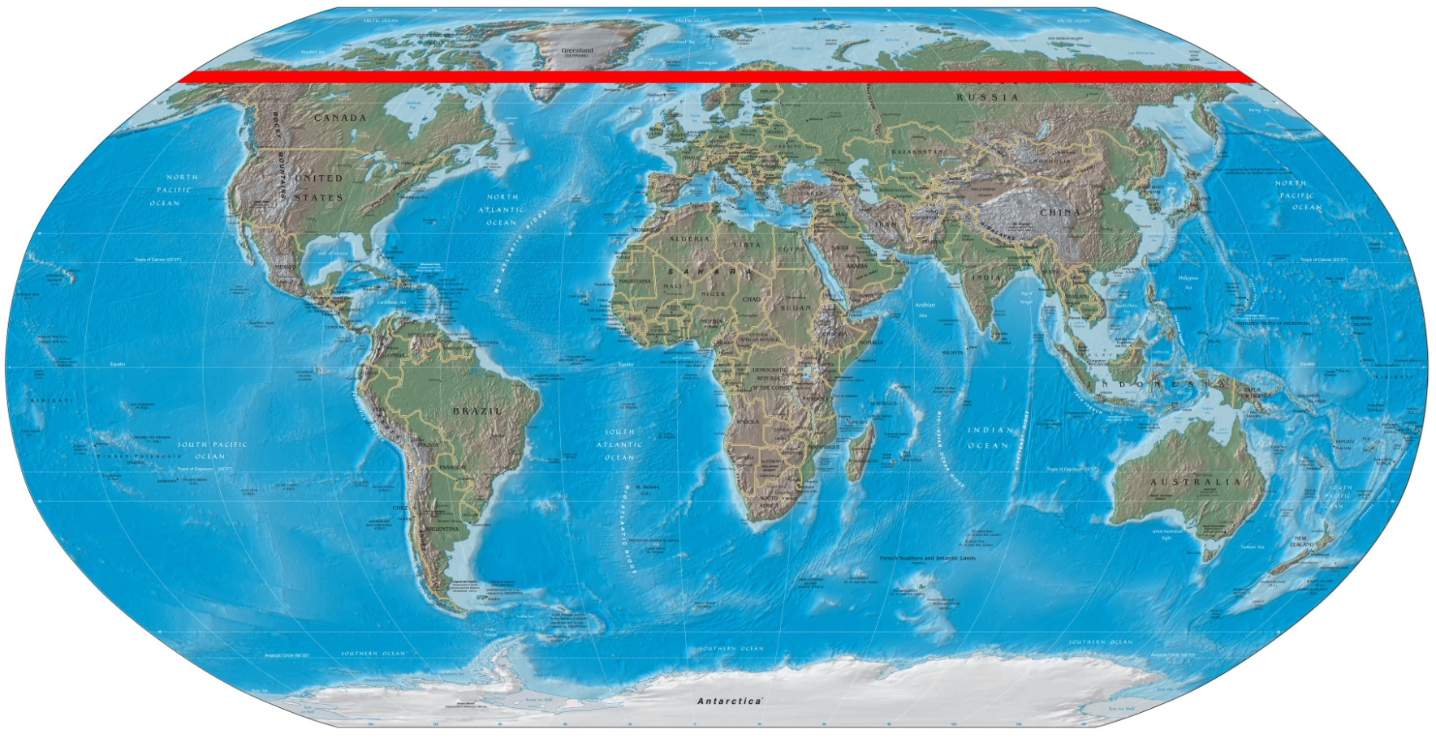
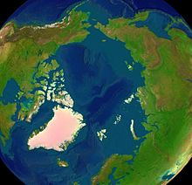
Area of interest, the arctic regions
Image source: commons.wikipedia.org

Slide 9
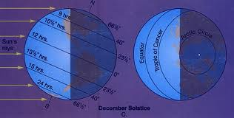
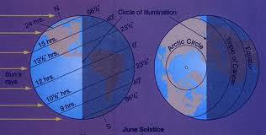
Aerosol Effects at high latitudes
Because of Earth’s 23.5º axial tilt Arctic regions (> 66.5º N) don’t get direct solar radiation during the winter months.
Only the longwave effects of aerosols on cloud emissivity will be present during the winter.
During summer months the effects of aerosols on both shortwave and longwave radiation are present in Arctic regions.

Slide 10
MONTHLY RADIATIVE EFFECTS
Figure shows monthly net longwave surface flux, and absorbed solar surface flux, from Vowinckel & Orvig 1964.
Solid line shows sulfate aerosol concentrations from Sirois & Barrie 1999.
From Oct. to Feb. there is zero absorbed solar flux (Arctic Winter).
Longwave (IR) flux still persists during winter months.
Figure 5, on page 776

Slide 11
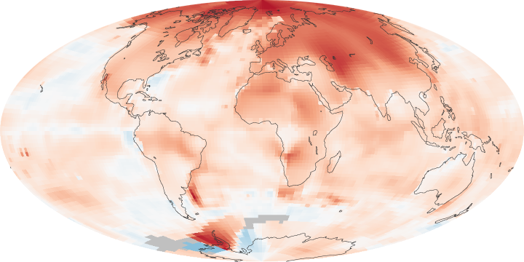
Summary of the Arctic Implications of Aerosols
At high latitudes, the longwave effect may be especially important because during much of the year, there is near ZERO incoming shortwave, while the longwave effects are still in place when clouds are present.
Arctic amplification is an area of concern with regards to climate change.
Figure to the right shows that Arctic temperatures are increasing faster than most of the Earth.
In the Arctic clouds produce a net warming effect, an effect which aerosols may further enhance.
Image downloaded from earthobservatory.nasa.gov/IOTD

Slide 12
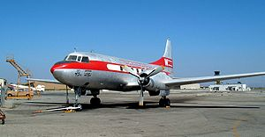
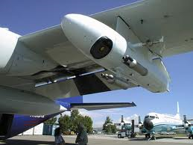
2002 Study Background:
Aircraft base study
From 6 June to 14 June 1998.
Six flights in the Arctic (Chukchi Sea)
University of Washington Convair-580 research aircraft.
Instruments used: FSSP-100 (Forward Scattering Spectrometer Probe) and OAP-200X probes. These measure droplet size distributions.
Basically, they use the data from the aircraft to measure how anthropogenic aerosols alter cloud microstructure and how this affects emissivity.
Convair 580
FSSP-100: photo from Earth Observing Lab.

Slide 13
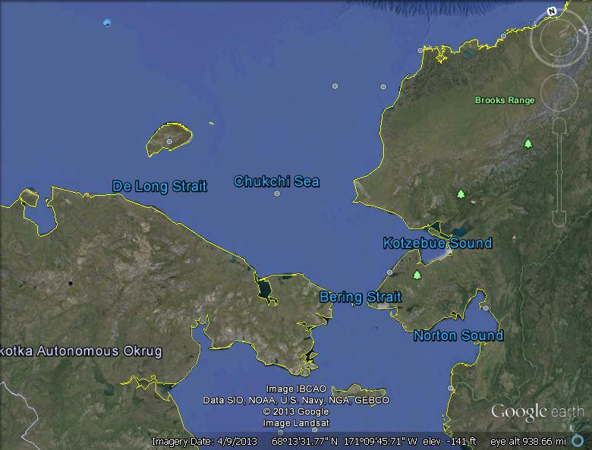
Area of
STUDY
Exact areas studied were not identified.
Flights paths were stated to be in the Chukchi Sea.

Slide 14
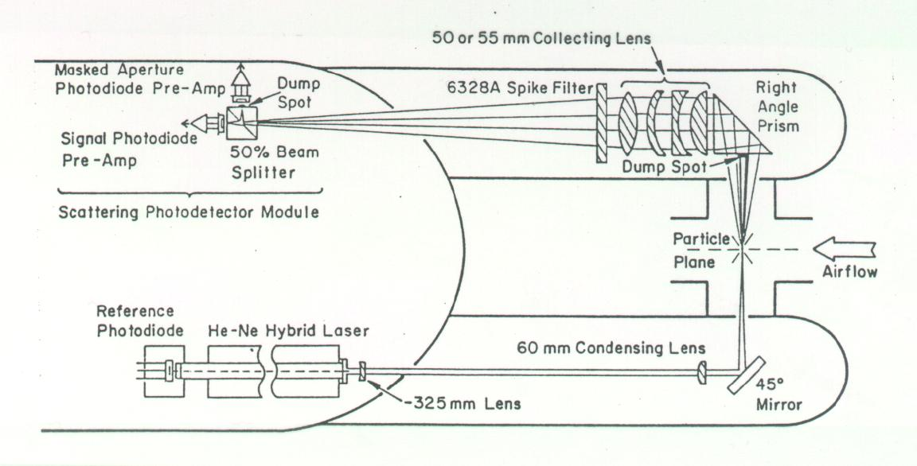
FSSP: Forward Scattering Spectrometer Probe (Cloud DROPLET MEASUREMENTs)
Helium neon laser 0.2mm diameter.
Measures light scattering intensity to determine particle size.
Measures the size distribution of particles, from which optical/IR parameters are calculated.
Assumes light is scattered by spherical particles.
Works best in water clouds, which most Arctic clouds are.
Direction of Flight
Image from: eol.ucar.edu

Slide 15
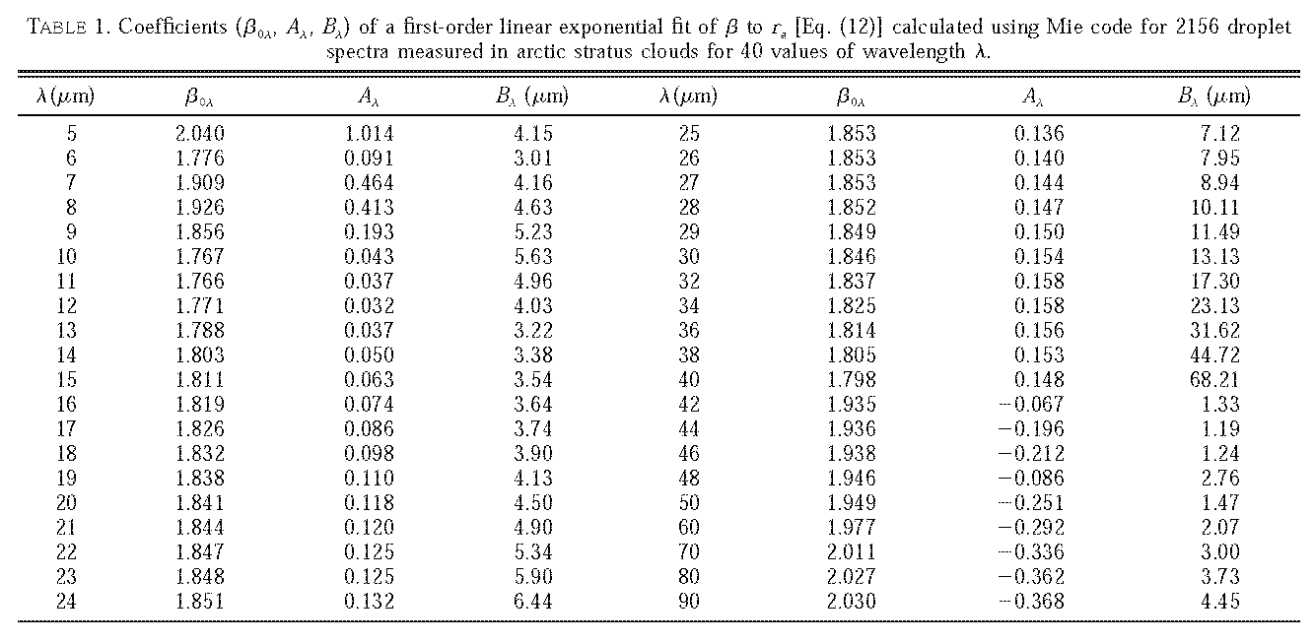
Results: Droplet Measurements
2156 droplet spectra measurements
Optical parameters for each droplet spectrum were calculated using Mie code, and for 40 wavelengths
  These wavelengths range from 5 to 90 µM, shown in the table below.

Slide 16
Results
Figure 2 shows sensitivities of β to the droplet effective radius R_{e.}
As the effective radius decreases the absorption efficiency increases.
Values derived using Mie theory for wavelength of 11µm from the 2156 measurements of cloud droplet size distributions.
Figure 2, on page 771

Slide 17
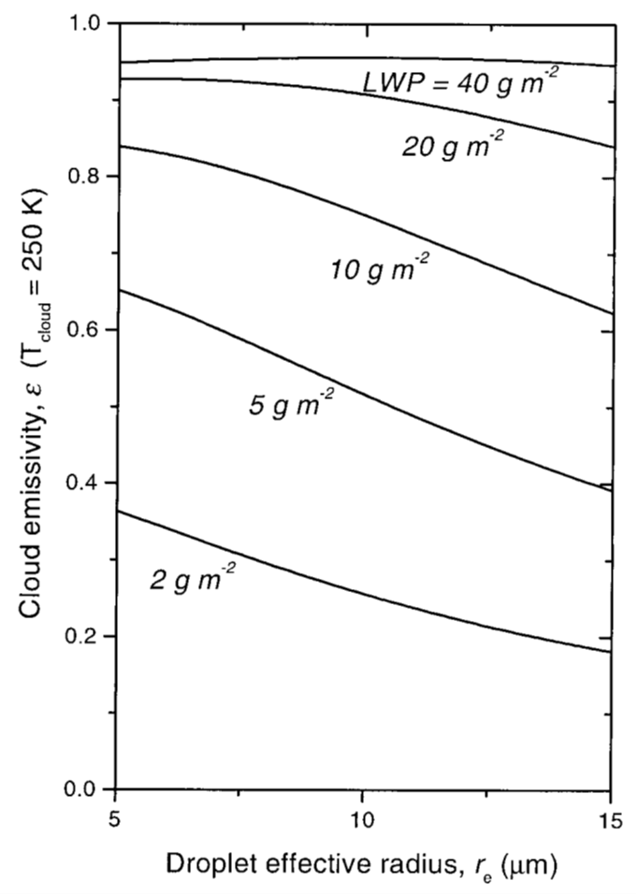
How emissivity relates to cloud
microstructure
Figure shows how R_{e} affects cloud ε at a given LWP.
Notice at higher LWP the clouds are essentially blackbodies, and so changes in droplet radius are unimportant.
At lower LWP (between 2 and 10 g m⁻²) decreasing droplet effective radius causes higher cloud emissivity.
Figure 3, page 773

Slide 18

Cloud thermal emission follows the relationship:
F_{LW} = εσT⁴
  ε = emissivity
  σ = Stefan-Boltzmann constant (5.67x10⁻⁸ w m⁻²)
Emissivity related to cloud properties via:
ε = 1 – exp(-K LWP),
where LWP = 4/3π R_{e}³ ρ N h
  ρ = bulk density of water
  R_{e} = mean droplet effective radius
  K = imaginary component of the refractive index and the wavelength
  N = droplet concentrations
  h = cloud thickness
Figure 3, page 773

Slide 19
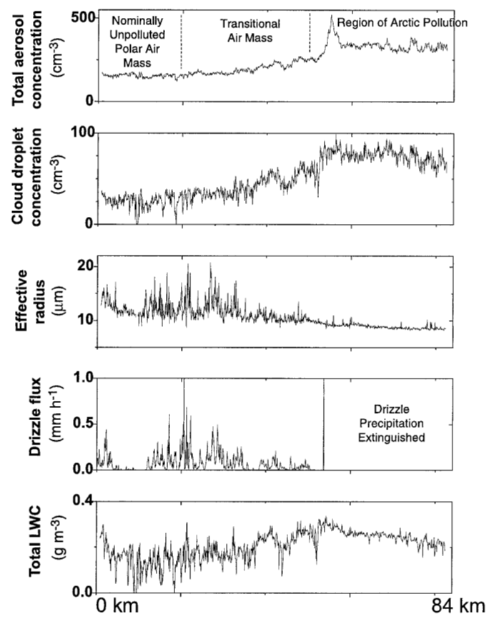
June 14th Flight: Polluted Versus Unpolluted Cloud Characteristics
Encountered transition from pristine air to aerosol polluted air.
Detected droplet concentration increase from 29 to 77 cm⁻³.
Droplet effective radius decreased 12.5 to 8.8 µm.
Drizzle flux decreased to effectively zero in the polluted cloud.
LWC increased by ~66%, from .15 ± 0.05 to .25 ± 0.01 g m⁻³.
Figure 4, on page 775

Slide 20
Critical Findings From Garrett et al. 2002
Figure 3 shows relationship of effective radius to cloud emissivity.
  When R_{e} goes does down, emissivity increases.
  This assumes the LWP stays constant.
Figure 4 shows the changes in cloud microstructure measurements from Arctic Haze.
  Droplet R_{e} decreased, CCN increases, and drizzle precipitation is extinguished, while liquid water content increases.
Combining these two findings shows that Arctic Haze makes for more emissive clouds.

Slide 21
Caveats
The authors acknowledge that this study does not examine any potential feedbacks caused by aerosols induced warming.
  The authors only examine the immediate effects on cloud microstructure an emissivity.
Climate is very complex, and so the implications are unclear in the longterm.
Focus is primarily on sulfate aerosols because those are most important to clouds, but the paper doesn’t try to account for the effects of other types of aerosols.

Slide 22
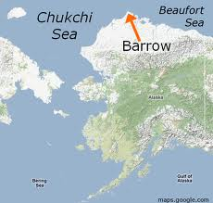
2006 Study Background:
GROUND Based STudy
Builds off the 2002 study by Garrity et al.
Uses ground based aerosol measurements from Barrow Alaska.
Aerosols affect cloud ε, this paper seeks to quantify these effects, and how they affect temperatures at Arctic latitudes.
Attempts to identify the potential for mid-latitude industrial aerosols to cause warming in the Arctic.
Image source: maps.google.com

Slide 23
Measurements
From two programs with operations near Barrow, AK, USA.
  DOE Atmospheric Radiation Measurement (ARM) program.
  NOAA Climate Monitoring Diagnostics Laboratory (CMDL).
Measurements include only particles smaller than 1µm to exclude Asian dust, and are restricted to single-layer clouds with tops below 1.5 km altitude.
The following parameters were measured;
  ε, LWP, R_{e}, and N
Measurements sources and instruments used;
  FTIR (Fourier transform infrared spectrometer)
  Lidar (Light detection and ranging) for cloud top determination.
  Radar (Radio detection and ranging) for cloud base determination.
  Temperature and humidity soundings (via ARM)
  Ozone profiles via Global Ozone Monitoring Experiment (GOME) aboard European Remote Sensing Satellite (ERS-2)

Slide 24
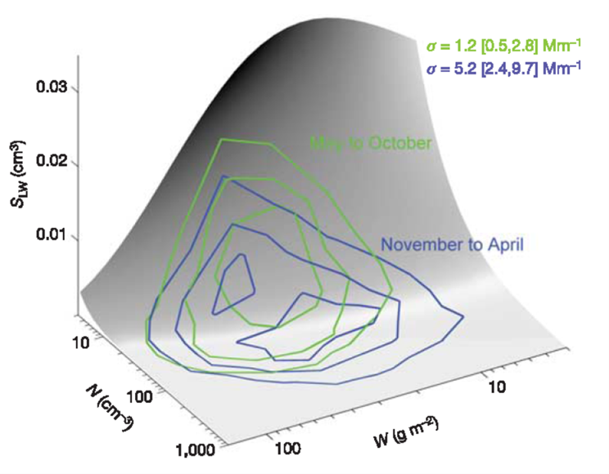
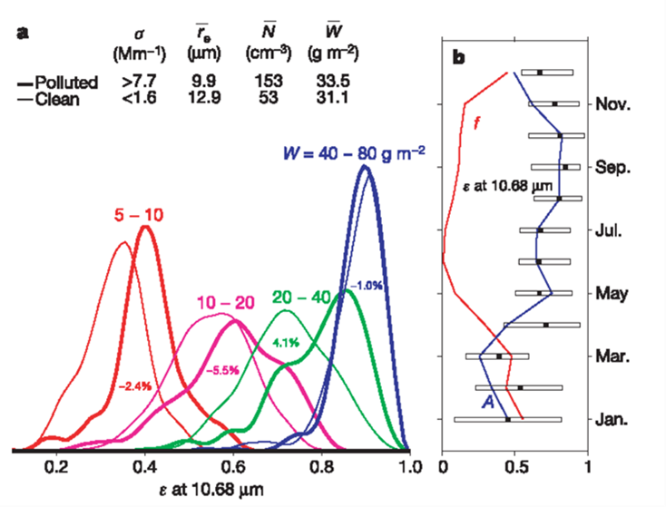
Figure 1.
Figure 2.
S = Sensitivity
N = cloud number concentration
W = liquid water path
σ = 550nm light scattering cross-section density
Figure 2b
A = average cloud cover
f = fraction that σ is in upper quartile

Slide 25

Sensitivity to pollution
Figure 1 shows that N was higher between Nov-April than May-Oct
Authors estimate sensitivity of clean Arctic stratus to be S_{LW} = _{0.002} cm
Assuming a 4 km ceiling to important Arctic LW clouds…
  To raise concentrations (N) by 1 cm⁻³ requires ~ 1 kt material
  To raise concentrations (N) by 5 cm⁻³ requires ~10-100 kt material via long range transport.
    This is only 1% of anthropogenic SO₂ produced north of 60°, excluding mid-latitudes.
Thus pollution via mid-latitudes should be sufficient to cause to alter Arctic cloud properties.
S = Sensitivity
N = cloud number concentration
W = liquid water path
σ = 550nm light scattering cross-section density
Figure 1, on page 787

Slide 26
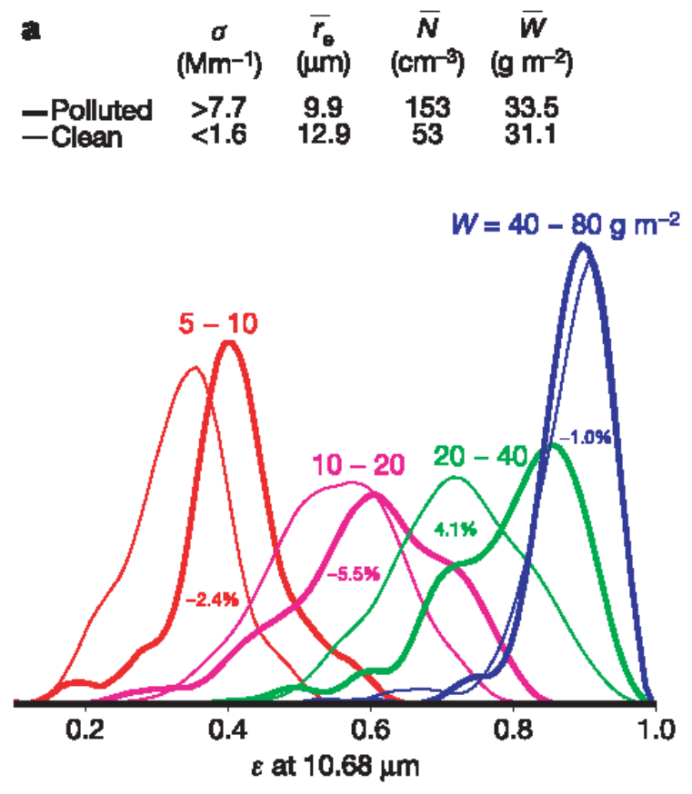
Effects of Pollution on
Cloud MiCrostructure
Clouds where W > 40 g m⁻² are insensitive to changes in ε as a result of pollution.
  Because those clouds function similarly to blackbodies already.
On average polluted clouds have higher ε than clean clouds, per one-sided Student’s T-test results.
Causes of higher greybody ε in polluted clouds than in clean clouds was:
  R_{e} was 3 µm smaller
  3x greater droplet concentration.
Figure 2A, on page 788

Slide 27
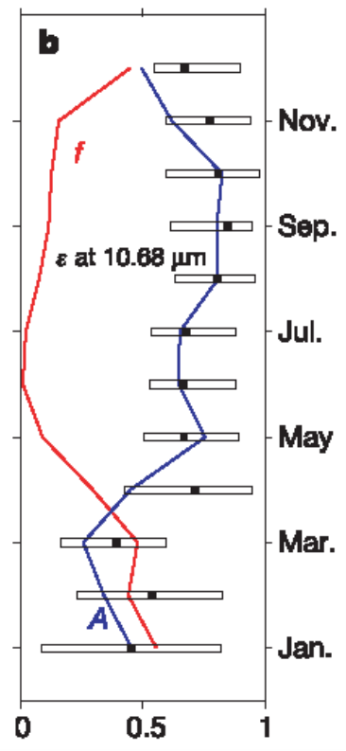
Cloud Cover & Emissivity through the year
The quartile plot shows the monthly averages for cloud ε.
  Winter clouds have more potential to increase ε than summer.
The blue line A shows the cloud coverage
Figure 2B on page 788

Slide 28
Implications for Surface Warming
Drifting ice stations show Nov-Mar cloudy sky CF_{LW} between 20 and 30 W m⁻²
At these stations transitions from clear to cloudy skies during winter result in temperature increases of 6 to 9 K over the next 2 days.
Temperature differences of 1 to 1.6 K by clouds when comparing the upper and lower quartiles of σ (from Figure 2B).
Mid-latitude aerosol production and transport to the Arctic is more than sufficient to cause changes in cloud microstructure.
These cloud microstructure changes increase the longwave flux during winter months and cause surface warming.
These measurements essentially confirm the effects of Arctic Haze on wintertime cloud cover and climate in the Arctic.

Slide 29
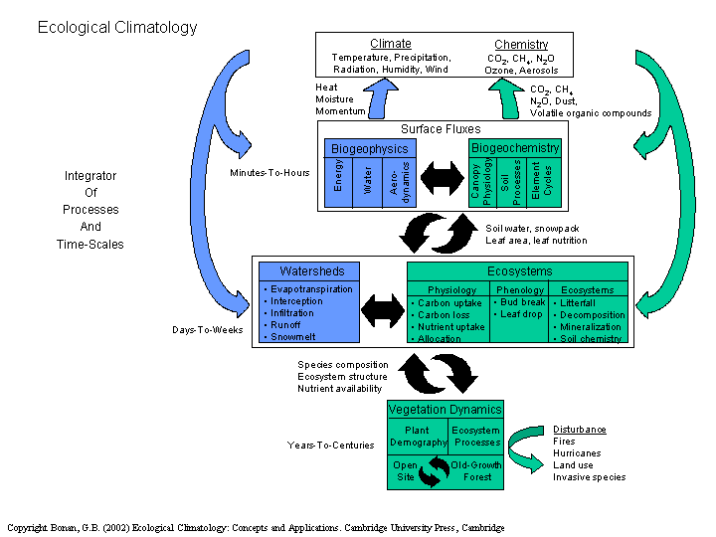
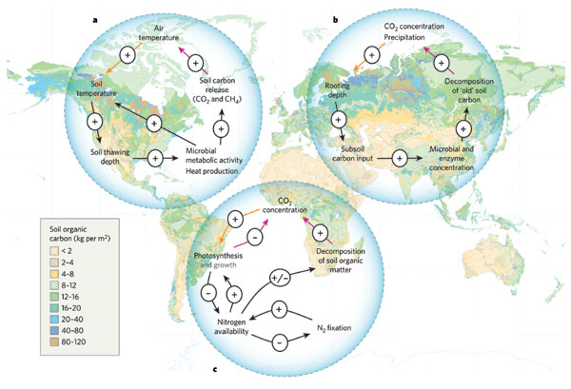
FUTURE CONCERNS
Potential effects on icepack, permafrost, and ocean circulation.
Feedback processes beyond short term heating during the winter months.
  Climate feedbacks are very complex.
Some feedback schematics, some including biological components. Not simple.
Image Source: Bonan, 2002.
Image source: Heimann & Reichstein, Nature, 2008.

Slide 30
Questions?

Slide 31
References
Garrett, T.J., Radke, L.F., and Hobbs, P.V. 2002. Aerosol Effects on Cloud Emissivity and Surface
Longwave Heating in the Arctic. Journal of the American Meteorological Society, 59: 769-778.
Garrett, T.J., and Zhao, C. 2006. Increased Arctic cloud longwave emissivity associated with pollution
from mid-latitudes. Nature, 440: 787-789.
Sirios, A., and Barrie, L.A. 1999. Arctic lower tropospheric aerosol trends and composition at Alert, Canada:
1980-1995. J. Geophys. Res., 104: 11599-11618.
Twomey, S. 1977. Influence of pollution on shortwave albedo of clouds. Journal of Atmospheric Science,
34: 1149-1152.
Vowinckel, E., and Orvig, S. 1964. Energy Balance of the Arctic. Part II: Longwave radiation and total
radiation balance at the surface in the Arctic. Arch. Meteor. Geophys. Bioklimatol., 13: 451-479.

