Slide 1
The Effect of Aerosols on Long Wave Radiation and Global Warming
Y. Zhou and H. Savijärvi
University of Helsinki, Finland
Atmospheric Research 135-136 (2014)
Presented by Anna Ya-Chun Tai

Slide 2
Warm-Up
Aerosols: Liquid droplets or solid particles suspended in a gaseous medium.
Long wave radiation: electromagnetic radiation at wavelengths > 4 um.
Light extinction coefficient, β_{ae} : The fraction of light attenuated by aerosols.
Transmissivity (T) & Absorptivity (A)
T= 1 - A
Notes:
Emitted Radiation = Emissivity(λ)*BB(T, λ)
Since we are focusing on LW spectrum, where scattering isn’t important, we can simply use absorption approximation.

Slide 3

I₀
TOA
I
Transmissivity = I/I₀ = e^{(-βae*dz)}
Aerosol optical depth (AOD; τ)

Slide 4
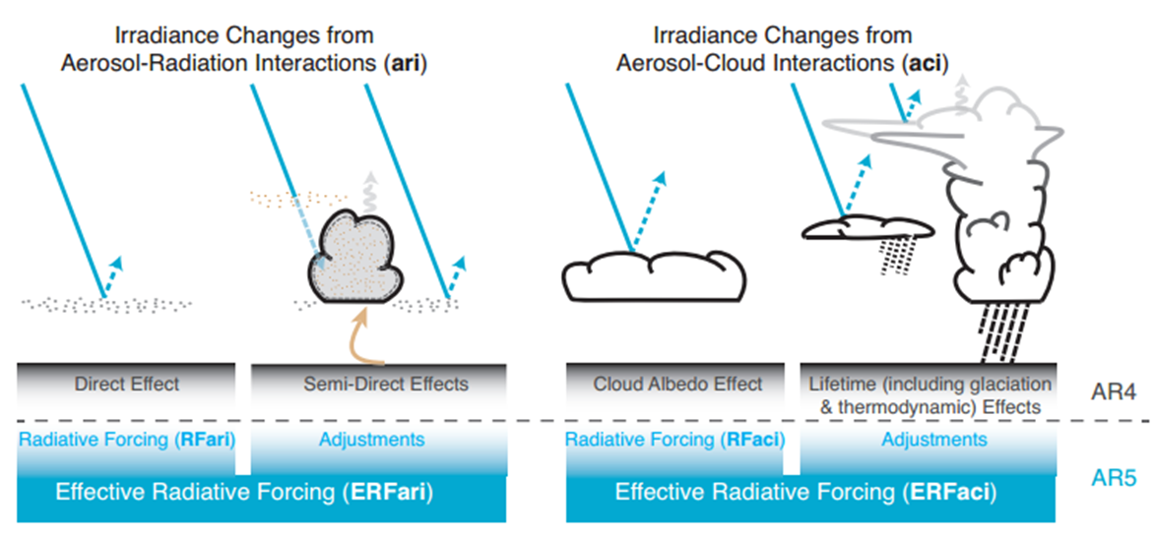
Motivation
But how do aerosols affect terrestrial radiation?
IPCC AR5: limited knowledge of LW ERF_ari (7.3.4.1).
This paper addresses the effects of aerosols on long wave thermal radiation.
Notes:
SO2⁻⁴: sulfate, NO3⁻: nitrate
Ashley (DR Forcing and Radiative Effect); Makenzie (Increasing LW emissivity of Arctic clouds); Sam (effect of anthr aerosols on cloud albedo effect)

Slide 5
Key long wave radiation properties
Down-welling LW Radiation (DLR) [Wm⁻²]
Outgoing LW Radiation (OLR) [Wm⁻²]
LW Heating rate (LH) [Kday⁻¹] ( (-) most of time)
TOA
Notes:
Emitted radiation depends on 1) emissivity/absorption and 2) temperature of the aerosol layer

Slide 6

LW Heating/Cooling Rate
Q = ρCpΔT | LH(z) = -dF/dz | Set -dF/dz = dQ/dt
It provides insights of the strength of these effects at each level.
Positive – the layer warms
Negative – the layer cools
Notes:
local & synoptic scale circulation , further enhance or suppress clouds/ precip

Slide 7
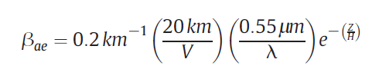


Fundamental Equations
Light extinction coefficient by aerosols:
Assuming no scattering, then transmissivity of aerosol is:
Total transmissivity:
Notes:
Third page of article
Empirical values over European inland areas and NW China
At surface (e^0) at ref λ= 0.55μm and visibiliity V = 20 km β_{ae} will be 0.2 km⁻¹.
(think when t_{a}= 0 -1)

Slide 8
Paper Outline
1. Reference case (MLS)
- Fixed 300ppm CO₂
- Liquid Water Path (LWP)
- Doubling CO₂
- Aerosol in stratosphere
2. Extreme case
- Constant β_{ae}
- Exponentially decreasing β_{ae}
→ Fixed H (1km), varying V
→ Fixed V(20km), varying H

Slide 9
Paper Outline
1. Reference case (MLS)
- Fixed 300ppm CO₂
- Liquid Water Path (LWP)
- Doubling CO₂
- Aerosol in stratosphere
2. Extreme case
- Constant β_{ae}
- Exponentially decreasing β_{ae}
→ Fixed H (1km), varying V
→ Fixed V(20km), varying H

Slide 10
Model Setting
Narrow-Band Model (NBM) for LW Radiation
LW Radiation scheme by Savijärvi (2006)
Absorption approximation
Spectral fluxes at each narrow band (dk) were calculated with NBM for t_{gas}.
67 bands in the LW range (0-2500 cm⁻¹)
Band model adoption for
water vapour: Goody random band model
CO₂ and O₃: Malkmus model
Notes:
k = wave number = 1/λ

Slide 11
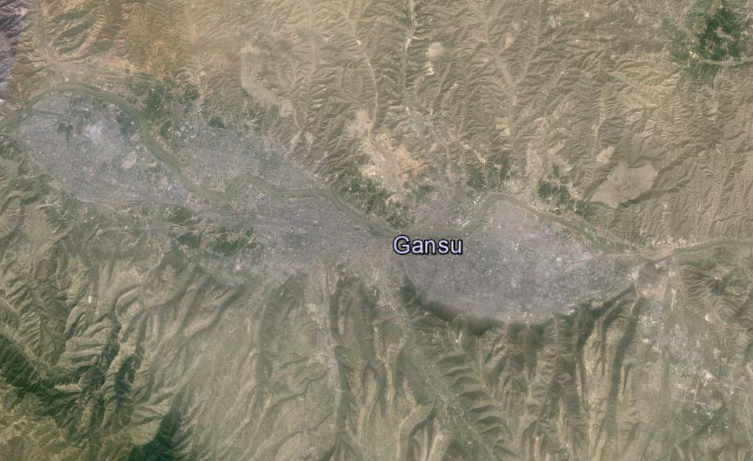
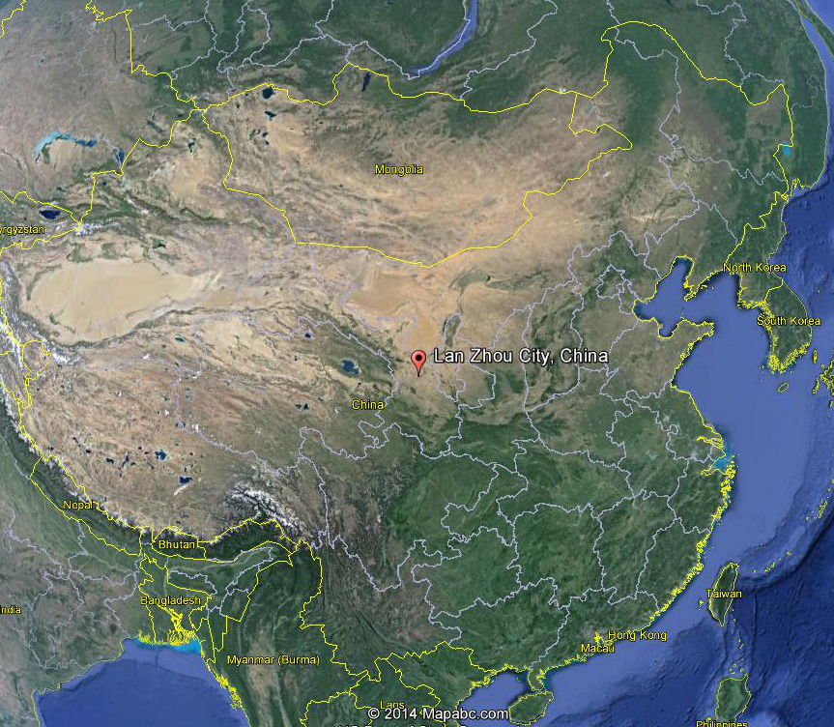
Location Choice: Lan Zhou City, Gansu, China
36°02’N, 103°48E
At the basin
“Smog Trap”
Notes:
Includes both anthropogenic aerosols and dusts from the vast desert area (fine+coarse)

Slide 12
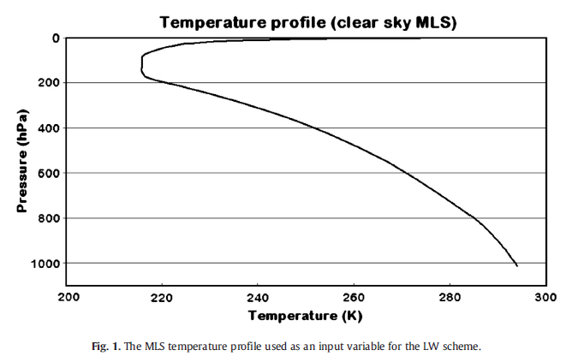
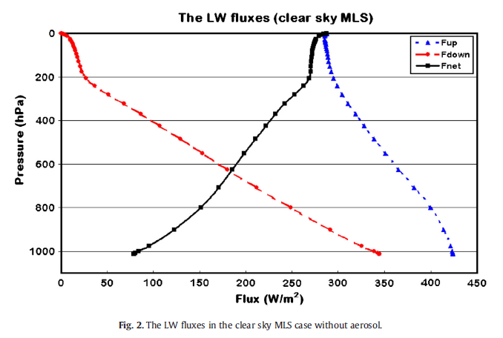
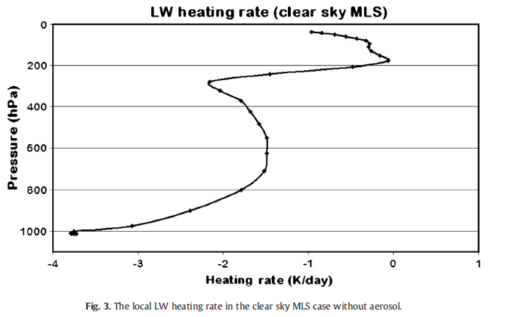
Reference Case (cloud-free)
F_{net}_sfc = 78 W/m²
LH_sfc = -3.8 K/day
LH_ut = -2 K/day
? Great decrease near the surface ?

Slide 13
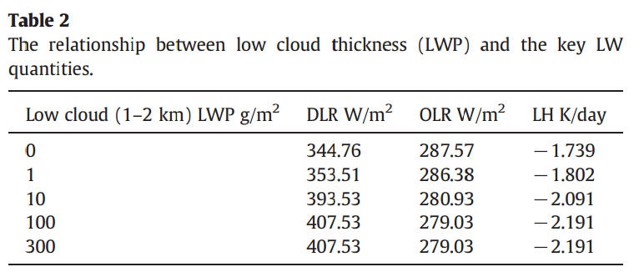
Effect of LWP on LW

Slide 14
Paper Outline
1. Reference case (MLS)
- Fixed 300ppm CO₂
- Liquid Water Path (LWP)
- Doubling CO₂
- Aerosol in stratosphere (14-24km)
2. Extreme case
- Constant β_{ae}
- Exponentially decreasing β_{ae}
→ Fixed H (1km), varying V
→ Fixed V(20km), varying H

Slide 15
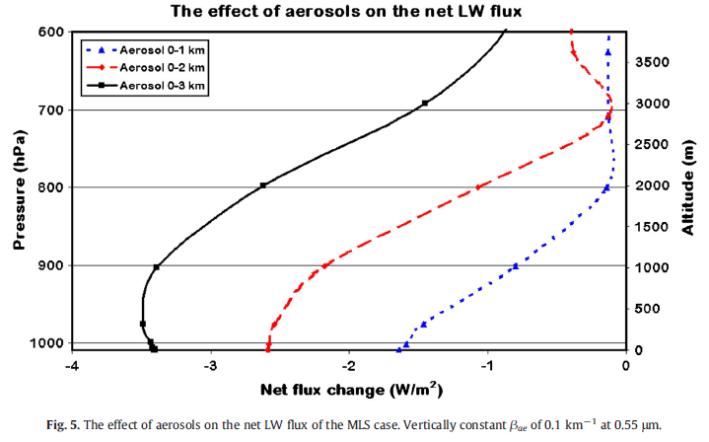
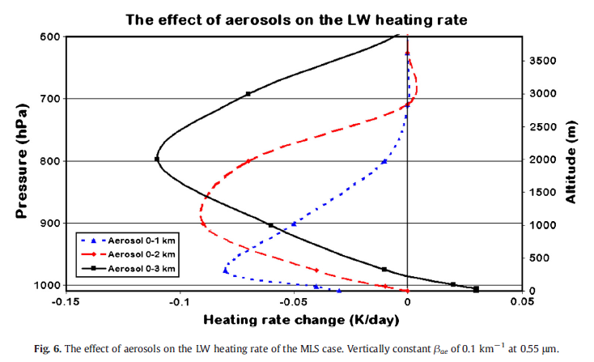

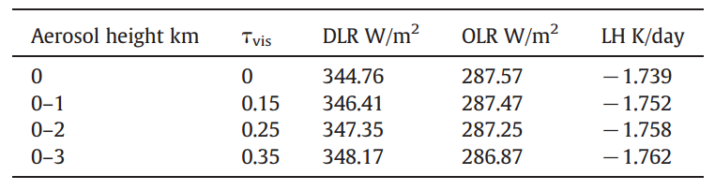
Extreme case (const. β_{ae} )
Notes:
Mention “Net flux Change” (Actual case - Ref case)

Slide 16
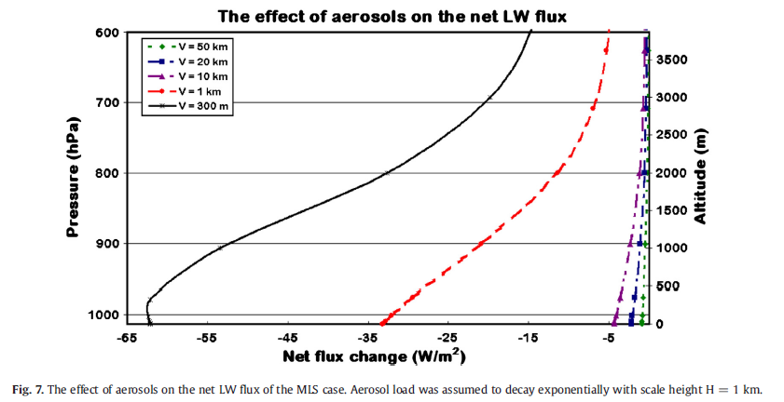
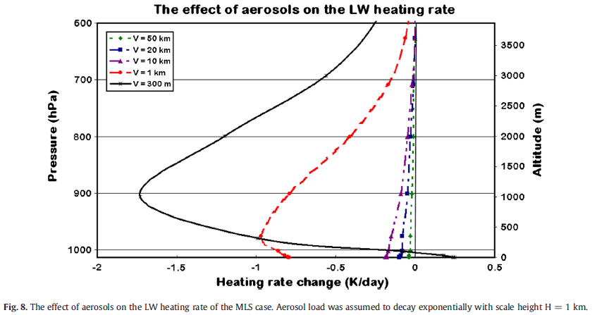
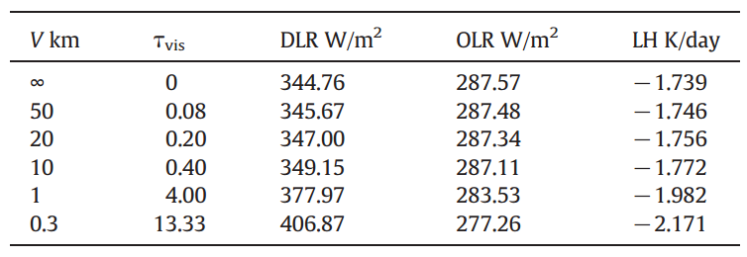
Extreme case (exp. decaying β_{ae} )

Slide 17
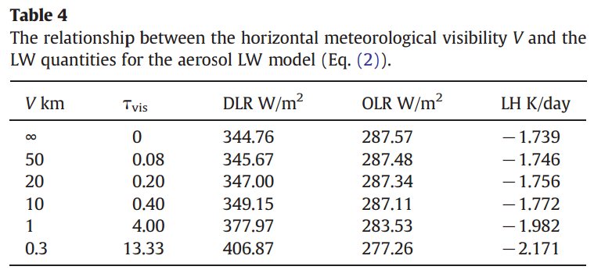
Table 2 (LWP) and Table 4 (dust)
inc 62.77
dec 8.54
inc 62.21
dec 10.31

Slide 18
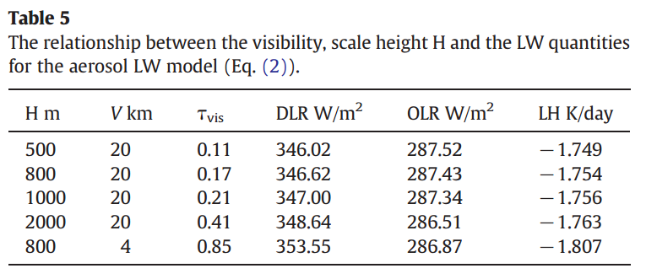
Table 2 (LWP) and Table 5 (fine aerosol)

Slide 19
Conclusion (TAKE-HOME messages)
The effect of aerosol layer on LW quantities is similar to a thin low-level cloud.
The cooling rate of the layer results from increase of DLR and slight decrease of OLR.
Tropospheric aerosols can lead to an increasing LW cooling effect w/ higher concentration .
LW cooling effect is stronger near the surface. During heavy pollution events, a warming effect near the surface is likely to happen.

Slide 20
A Broader Picture of Energy Transfer and Aerosols…
I₀
OLR
TOA
I
DLR
Notes:
Effect of aerosols on radiation depends on aerosol type, concentration, aerosol height, and time(diurnal/seasonal) and location(trop/mid/poles)

Slide 21
Comments on the paper
No specification of aerosol kinds. Only use β_{ae} and τ in the NBM.
Not enough discussion about life assessment of aerosols and GHGs, but conclusion mentioned it.
‘Global warming’ in the title; only a light touch on changing CO₂ concentration
More comprehensive research is needed.
Modification of the climate model

Slide 22
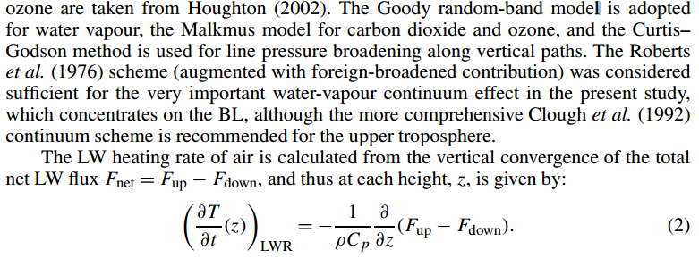
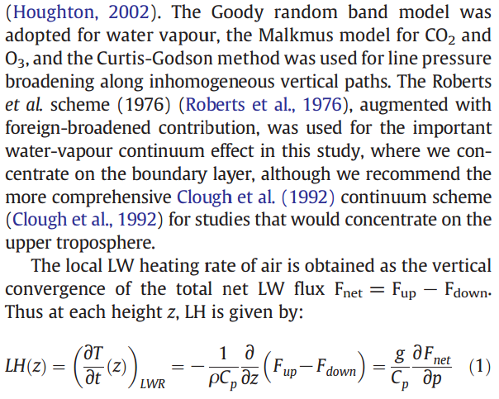
from Savijärvi (2006)
Avoid plagiarism!!

Slide 23
Questions?

