Slide 1
Beyond direct radiative forcing
Heald et al. 2013 ACPD
Ashley Pierce
Aerosol seminar, February 24th

Slide 2
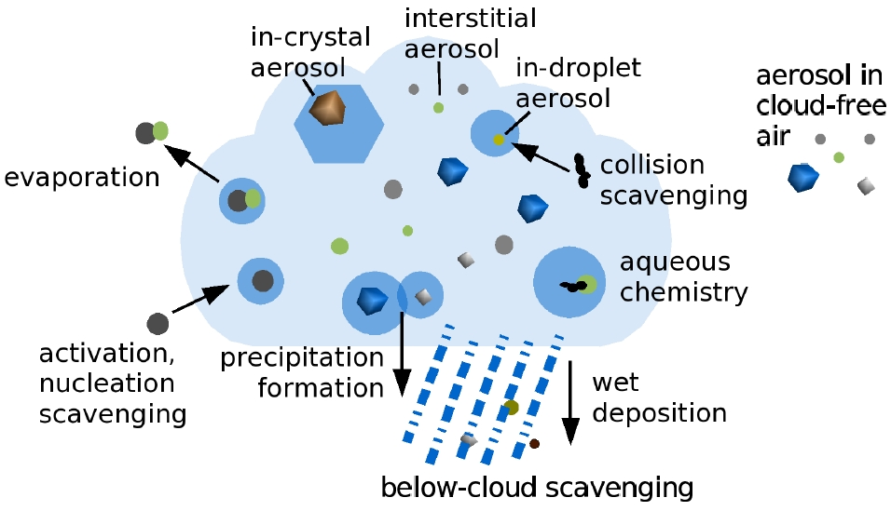
outline
Aerosols and climate change
IPCC on aerosols
Direct Radiative Effect vs. Direct Radiative Forcing
Model: assumptions & simulations
Results
Uncertainties and feedbacks
Larger picture
http://www.c2sm.ethz.ch/research/hoose.jpg?hires

Slide 3
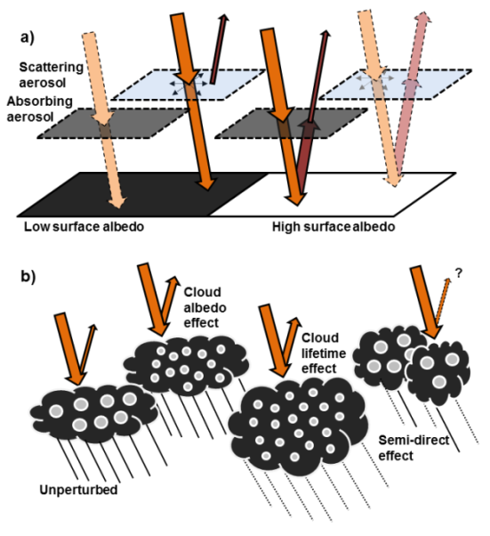
aerosols and climate change
Direct cooling:
Scatter radiation
Indirect cooling:
Cloud condensation nuclei (increase albedo)
Direct warming:
Absorb radiation
Indirect warming:
Cloud-aerosol interactions
http://www.nature.com/scitable/knowledge/library/aerosols-and-their-relation-to-global-climate-102215345

Slide 4
IPCC (AR5) on aerosols
Relative forcing of total aerosol effect -0.9 (-1.9 − -0.1) Wm⁻²
medium confidence
negative forcing from most aerosols
positive forcing from black carbon absorption
Aerosol/cloud interactions have offset a substantial amount of mean global forcing from GHGs
High confidence
Contribute largest uncertainty to total relative forcing estimate
Aerosols not as well mixed as greenhouse gases (GHGs)
more localized
amount in atmosphere varies, day to day, place to place
Notes:
Overall cooling
Climate change will impact natural aerosol sources and removal by precipitation but no confidence level on overall impact on PM2.5 distributions

Slide 5
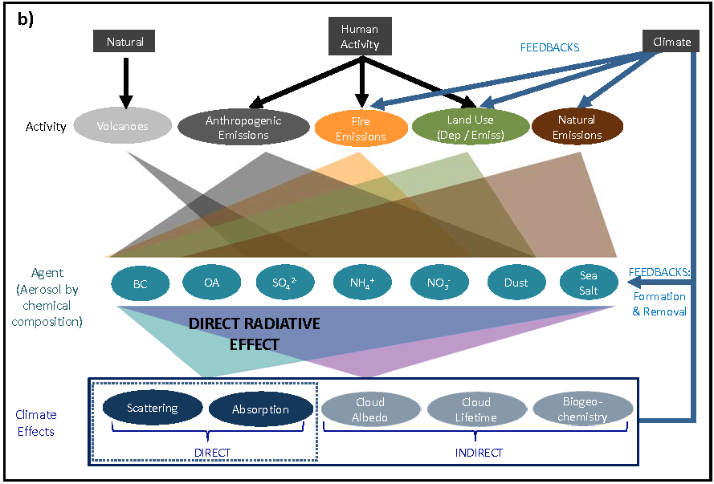
Direct radiative effect (DRE)
Instantaneous radiative impact of all atmospheric particles on Earth’s energy balance (incoming net solar radiation vs. outgoing infrared radiation)

Slide 6
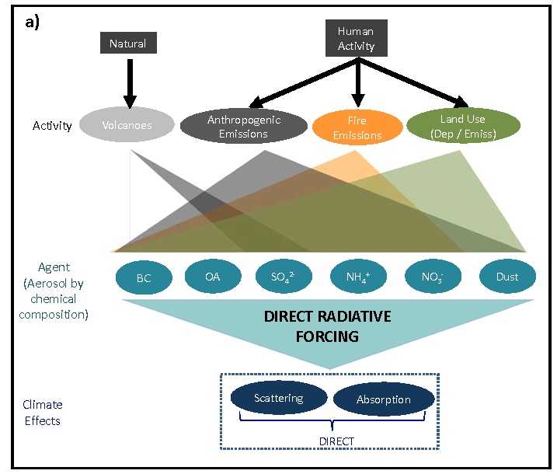
Direct Radiative Forcing (DRF)
Change in DRE from pre-industrial to present-day (excluding feedbacks)

Slide 7
DRF
Direct radiative forcing (DRF):
“Radiative forcing is a measure of the influence a factor has in altering the balance of incoming and outgoing energy in the Earth-atmosphere system and is an index of the importance of the factor as a potential climate change mechanism. In this report radiative forcing values are for changes relative to preindustrial conditions defined at 1750 and are expressed in Watts per square meter (W/m²)”
Anthropogenic: rise in human emissions, land-use change
Natural: changes in solar flux, volcanic emissions
Does NOT include feedbacks resulting from changing climate
In this model, neglects ALL feedbacks
Change in primary aerosol emissions from anthropogenic activity
Impacts of changing chemical environment (due to anthropogenic emissions) on secondary aerosol formation
Notes:
Changes in the chemical formation of biogenic secondary organic aerosol due to changes in anthropogenic nitrogen oxide emissions qualify as a DRF but similar changes induced by changes in lighting NOx sources (due to climate feedback) do not

Slide 8
DRE vs. DRF
DRF quantifies the change in DRE over time which will induce a change in global temperatures
Radiative impacts of natural aerosols are typically reflected in DRE and not DRF
Treatment of secondary aerosol formation complicated:
Ex. Changes in the chemical formation of biogenic secondary organic aerosol due to changes in anthropogenic nitrogen oxide emissions qualify as a DRF
similar changes induced by changes in lighting NO_{x} sources (due to climate feedback) do not

Slide 9
simulations
Baseline 2010
Identical simulation with zero anthropogenic emissions
The difference between the two simulations provides an estimate of the anthropogenic burden, AOD and DRF
Projected out to 2100

Slide 10
Model
Chemical transport model (CTM):
driven by assimilated meteorology
Integrated online with the global GEOS-Chem (v9-01-03) chemical transport model (GCRT) driven by GEOS-5
Year 2010
2° x 2.5°
47 vertical levels
Rapid Radiative Transfer Model for GCMs (RRTMG):
correlated-k method to calculate longwave (LW) and shortwave (SW) atmospheric fluxes
Shown to be highly accurate in tests against reference radiative transfer calculations as part of the Continual Intercomparison of Radiations Codes (CIRC) project
AOD at a specific wavelength is calculated within GEOS-Chem as a function of local relative humidity from the mass concentration and mass extinction efficiency (MEE)
Uses aerosol optical depth (AOD), single scattering albedo (SSA), and asymmetry parameter (g) for each aerosol type to calculate aerosol impacts on rediative fluxes in both the shortwave and longwave

Slide 11
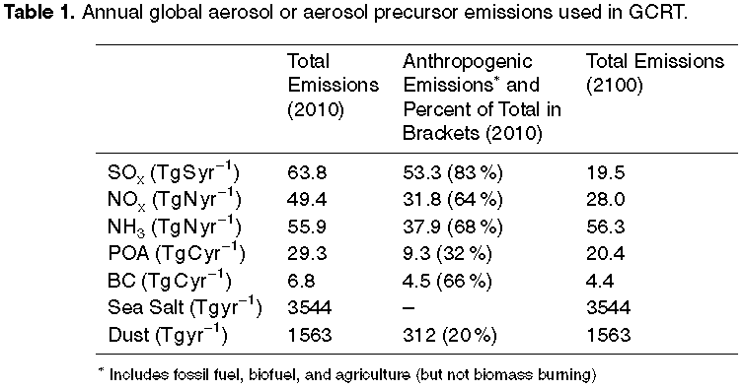
Model

Slide 12
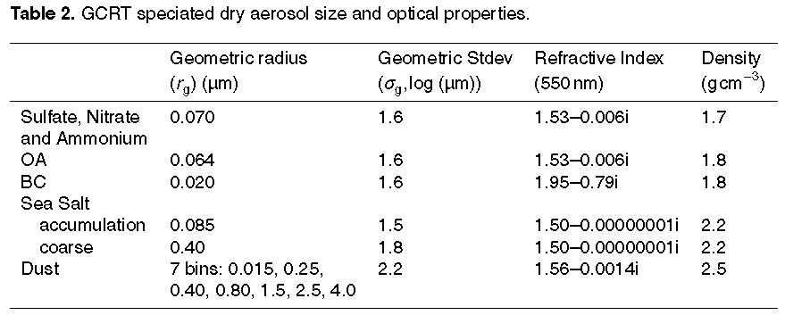
Model
Scattering
Absorption
Aerosols treated as externally mixed with log-normal size distributions and optical properties (including refractive indices and growth factors) defined by the Global Aerosol Data Set (GADS) database

Slide 13
assumptions
Log-normal distribution
Refractive indices and growth factors defined by the Global Aerosol Data Set (GADS) database
Fixed effective radii: 14.2 μm water droplets, 24.8 μm ice particles
20% of all dust is of anthropogenic origin
Biomass burning not included in anthropogenic emissions
Observations characterize total DRE of present-day aerosols
to estimate DRF the anthropogenic fraction is assumed
2100: anthropogenic emissions of ozone and aerosol precursors follow RCP 4.5
All other natural, fire emissions, methane concentrations are identical in 2010 and 2100

Slide 14
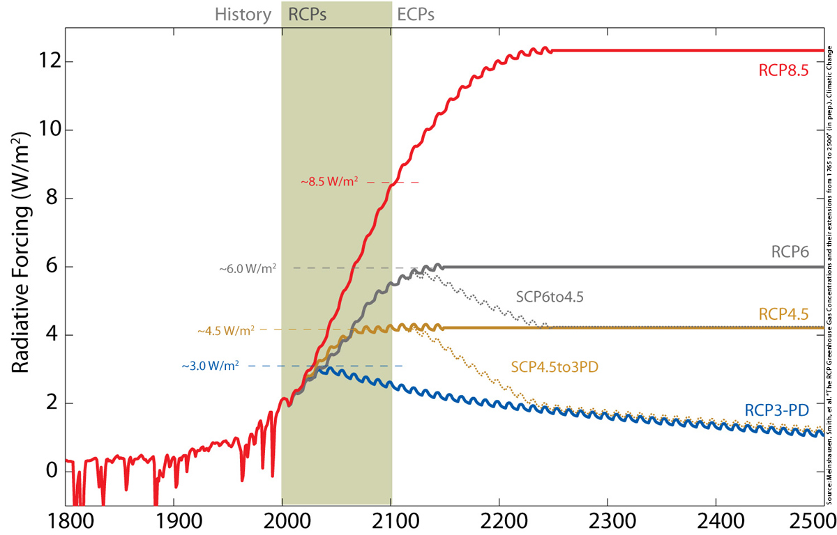
Representative concentration pathways (RCP)
Emissions of aerosols and precursors decline sharply in 21st century for all RCPs
Global Anthropogenic Radiative Forcing for the high RCP8.5, the medium-high RCP6, the medium-low RCP4.5 and the low RCP3-PD
two supplementary extensions:
connecting RCP6.0 levels to RCP4.5 levels by 2250 (SCP6TO45)
RCP45 levels to RCP3PD concentrations and forcings (SCP45to3PD)

Slide 15
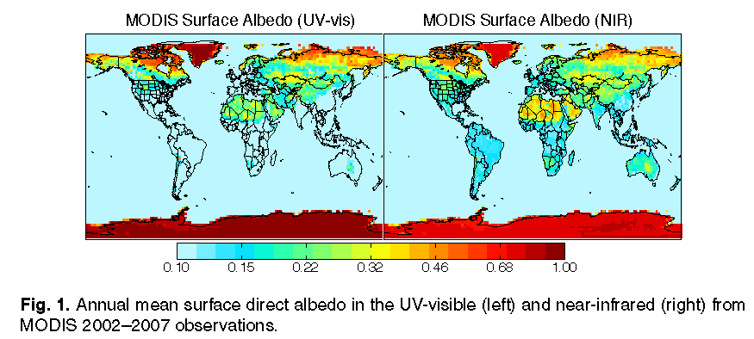
Aerosols produce a warming over the highly reflective hot spots over North America, the Middle East, and Greenland
In other regions aerosols are typically more scattering than the surface albedo resulting in cooling
Notes:
MODIS: Moderate Resolution Imaging Spectroradiometer
On board Terra satellite

Slide 16
Refresher
What is DRE?
Direct radiative effect:
Radiative impact of all atmospheric particles (natural and anthropogenic) on the Earth’s energy balance
What is DRF?
Direct radiative forcing:
Change in DRE from pre-industrial to present-day (not including climate feedbacks)
The difference?
Radiative impacts of natural aerosols are typically reflected in DRE and not DRF

Slide 17
results
Global radiative impact of natural aerosol is more than 4 times that of anthropogenic aerosol perturbation
total aerosol DRE: -1.83 Wm⁻²
total aerosol DRF: -0.36 Wm⁻²
Tropospheric aerosols exert a large influence on the global energy balance

Slide 18
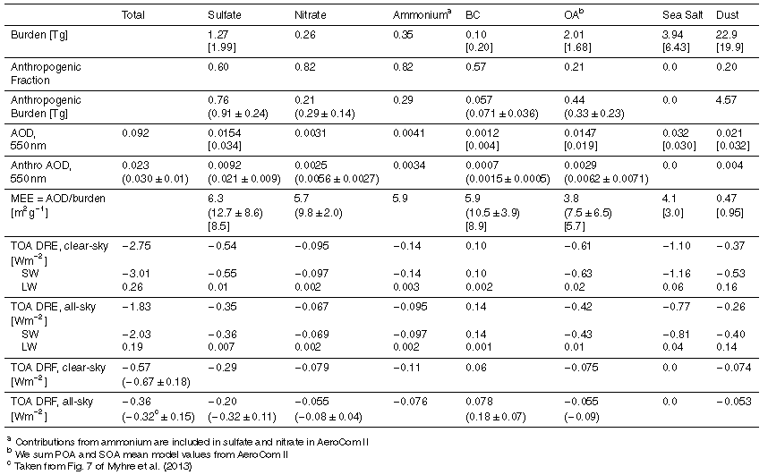
Table 3: Global annual mean aerosol budget and impacts simulated for 2010 using GCRT
(comparisons with AEROCOM II means from Myhre et al., 2013
[comparisons with AERCOM I medians from Kinne et al., 2006]
Note anthropogenic here does not include biomass burning
Biomass burning not included
DRE for all biomass burning particles: -0.19 Wm⁻²
Notes:
OA (20%) dust (15%) similar to aerocom
BC about half aerocom
Sulfate 32% lower than aerocom
Sum of inorganic aerosols (sulfate, nitrate, ammonium) within 5%
Sea salt ~40% lower
MEE lower (AOD)

Slide 19
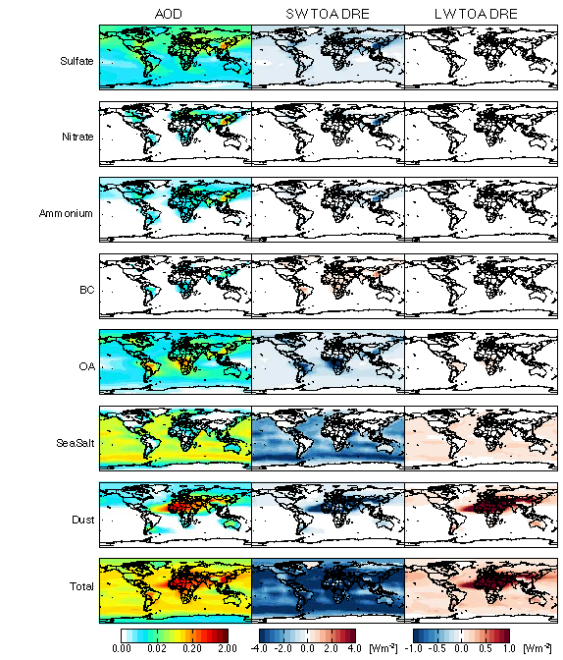
Figure 2: Annual mean AOD (left), shortwave TOA clear-sky direct radiative effect (center) and longwave TOA clear-sky direct radiative effect (right) simulated by GCRT for 2010. Color bars are saturated at respective values.

Slide 20
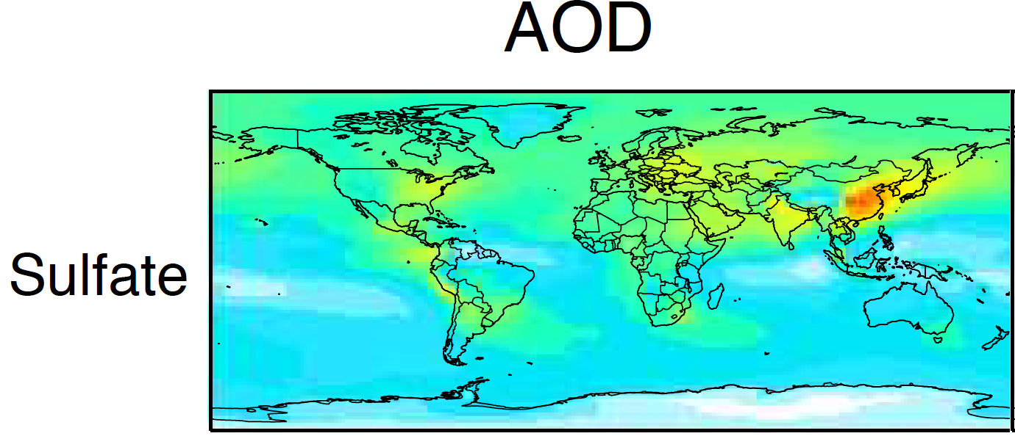
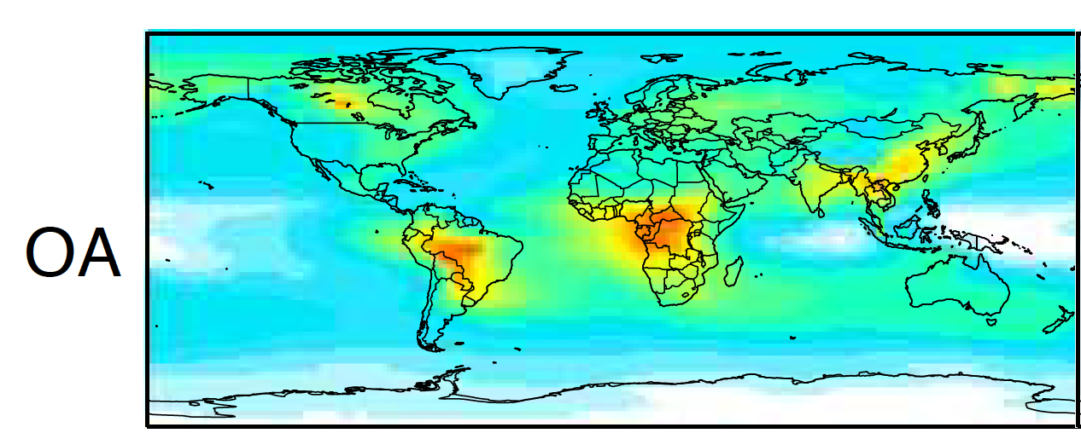


Slide 21
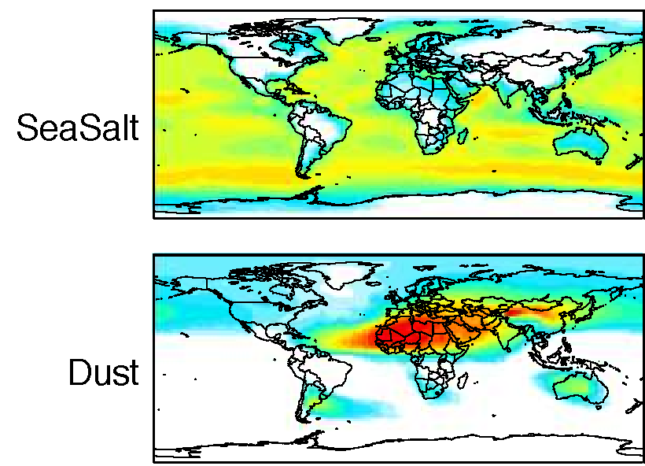
AOD

Slide 22
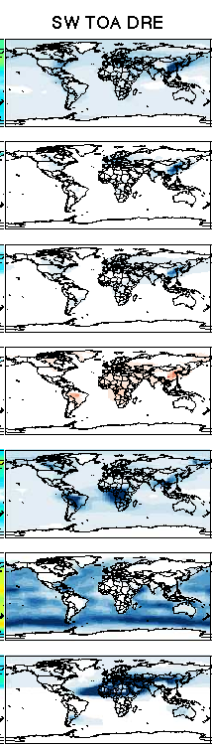

OA
SW TOA DRE
Sulfate
Sea salt
BC
Dust

Slide 23
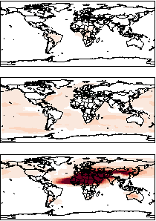

LW TOA DRE
OA
Sea salt
Dust

Slide 24
Figure 2: Annual mean AOD (left), shortwave TOA clear-sky direct radiative effect (center) and longwave TOA clear-sky direct radiative effect (right) simulated by GCRT for 2010. Color bars are saturated at respective values.

Slide 25
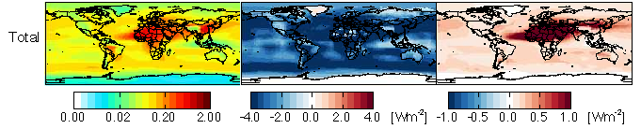
Total
AOD
SW TOA DRE
LW TOA DRE
Figure 2: Annual mean AOD (left), shortwave TOA clear-sky direct radiative effect (center) and longwave TOA clear-sky direct radiative effect (right) simulated by GCRT for 2010. Color bars are saturated at respective values.

Slide 26
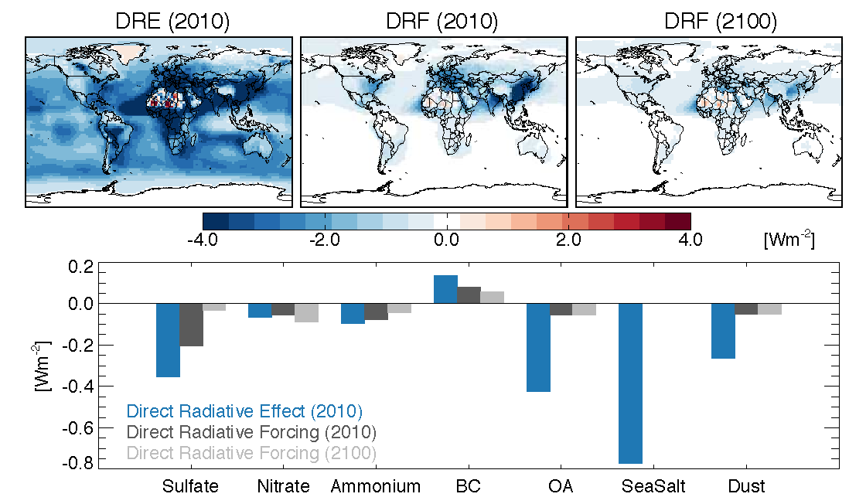
Aerosols that are dominated by anthropogenic sources (e.g. nitrate) show a similar DRE and DRF whereas natural aerosols (e.g. sea salt) have a large DRE but zero DRF
Figure 3.
Top left: Global annual mean all-sky speciated aerosol TOA Direct Radiative Effect in 2010 (graph: blue)
Top center: Direct Radiative Forcing for 2010 (Graph: dark grey)
Top right: Direct Radiative Forcing for 2100 (graph: light grey)

Slide 27
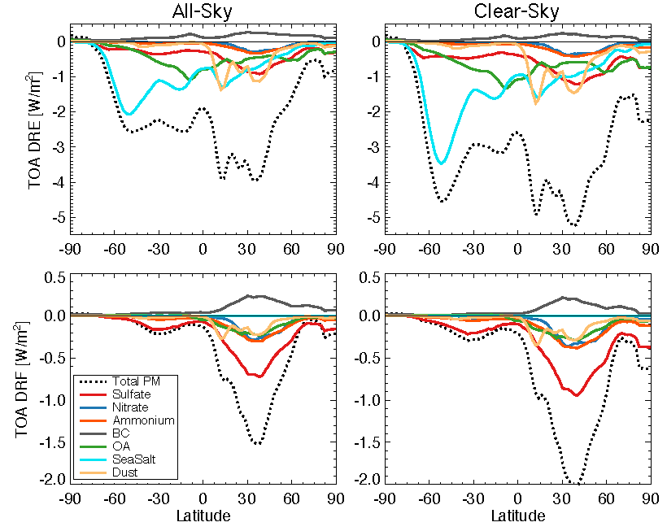
Figure 4. simulated by GCRT (2010)
Notes:
Zonal radiative impacts
Forcing concentrated in N latitudes (anthro. emissions N. Am, Europe, Asia)
Modest impacts in the arctic – spring/summer Eurasia sulfate pollution
Sea salt in S ocean
Biomass burning in the tropics and artic
Dust from Africa and Asia

Slide 28
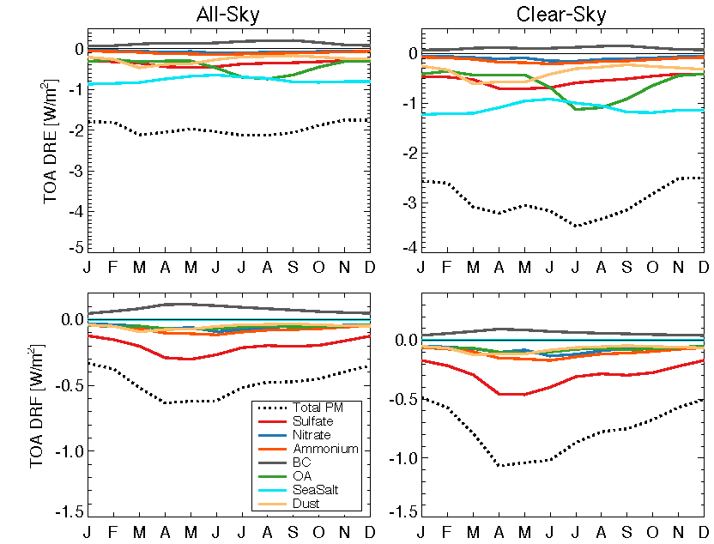
Figure 5. Global seasonal mean speciated aerosol TOA (GCRT for 2010)

Slide 29
Average monthly aerosol aOD from MODIS
http://upload.wikimedia.org/wikipedia/commons/7/72/MODAL2_M_AER_OD.ogv
AOD of 0.1 (pale yellow) indicates clear sky with little to no aerosols
AOD of 1 (brown) indicates hazy conditions

Slide 30
Uncertainties
Uncertainty in MEE dominates uncertainties in DRF
assumptions in size, water uptake and absorption efficiency
Used to calculate AOD
BC coating not addressed
DRE and DRF values may underestimate absorption
Uncertainty in aerosol optics
Anthropogenically caused SOA likely underestimated
Anthropogenic dust
Poor understanding of natural particle emissions from ecosystems
Marine OA and methane sulfonate not included
Lack of measurements in remote areas
Indirect effects of aerosols (aerosol-cloud interaction)
Feedbacks difficult to attribute

Slide 31
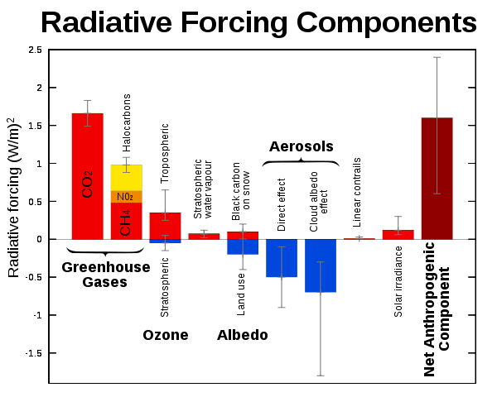
feedbacks
Anthropogenic land use change and changes in the chemical environment affect natural aerosols (forcing)
Changes in natural aerosols are typically associated with climate feedbacks
Changes brought on by changing temperatures or precipitation
Ex. Dust emissions associated with changes in soil moisture or wind speed
changes induced by changes in lighting NO_{x} sources (climate feedback)
Increased smoke from fire activity
Changes in aerosols driven by climate feedbacks may result in radiative perturbations up to ±1 Wm⁻²

Slide 32
Larger picture
Anthropogenic emissions of aerosols and their precursors are expected to continue to decline globally
DRF will also decrease
At the same time feedbacks from climate change on aerosols are likely to grow
DRF may not give full picture
Issues:
Anthropogenic land-use change and biomass burning not included
Climatic Feedbacks
Areas such as China and India are going to be increasing aerosols
Thoughts or questions?

Slide 33
References
Chao, N. et al., 2014. Vehicular emissions in China in 2006 and 2010. Atmos. Chem. Phys. Discuss., 14(4): 4905-4956.
Heald, C.L. et al., 2013. Beyond direct radiative forcing: the case for characterizing the direct radiative effect of aerosols. Atmos. Chem. Phys. Discuss., 13(12): 32925-32961.
IPCC, 2013: Summary for Policymakers. In: Climate Change 2013: The Physical Science Basis. Contribution of Working Group I to the Fifth Assessment Report of the Intergovernmental Panel on Climate Change [Stocker, T.F., D. Qin, G.-K. Plattner, M. Tignor, S.K. Allen, J. Boschung, A. Nauels, Y. Xia, V. Bex and P.M. Midgley (eds.)]. Cambridge University Press, Cambridge, United Kingdom and New York, NY, USA.
Rotstayn, L.D., Collier, M.A., Chrastansky, A., Jeffrey, S.J., Luo, J.J., 2013. Projected effects of declining aerosols in RCP4.5: unmasking global warming? Atmos. Chem. Phys., 13(21): 10883-10905.
Smith, S.J., Bond, T.C., 2013. Two hundred fifty years of aerosols and climate: the end of the age of aerosols. Atmos. Chem. Phys. Discuss., 13(3): 6419-6453.

