Slide 1
Chapter 2: (read Ch 2 of Petty and Thomas/Stamnes)
Basic ideas
Absorption, scattering, and emission cross sections, coefficients, and optical depths.
Use Beer’s law to describe the direct beam of radiation.
Define radiance and irradiance.
Develop the idea of electromagnetic penetration depth.
Define and appreciate the real and imaginary parts of the refractive index.
Review Snell’s law.
Example applications.

Slide 2
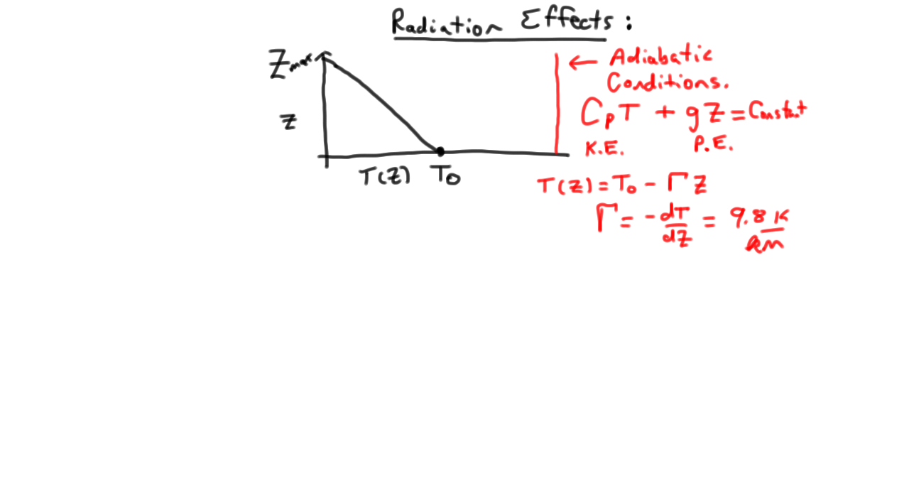
Radiation Impacts on the Temperature Structure: ‘Pure” adiabatic atmosphere (no diabatic processes).

Slide 3
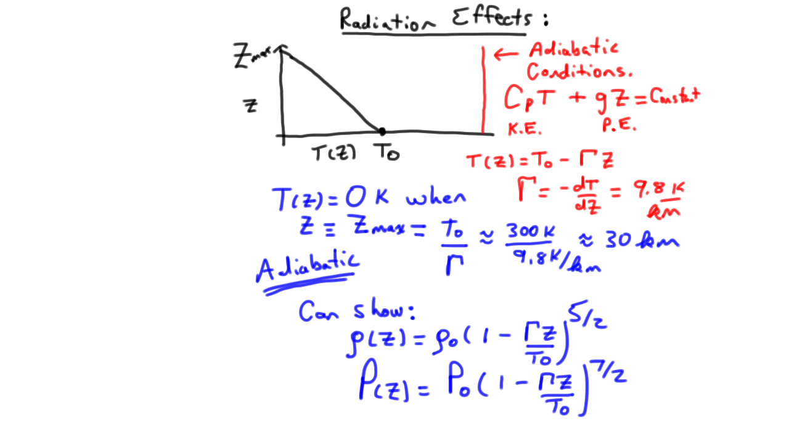
Description of the Adiabatic Atmosphere: Goes up to height z_{max} ≈ 30 km.

Slide 4
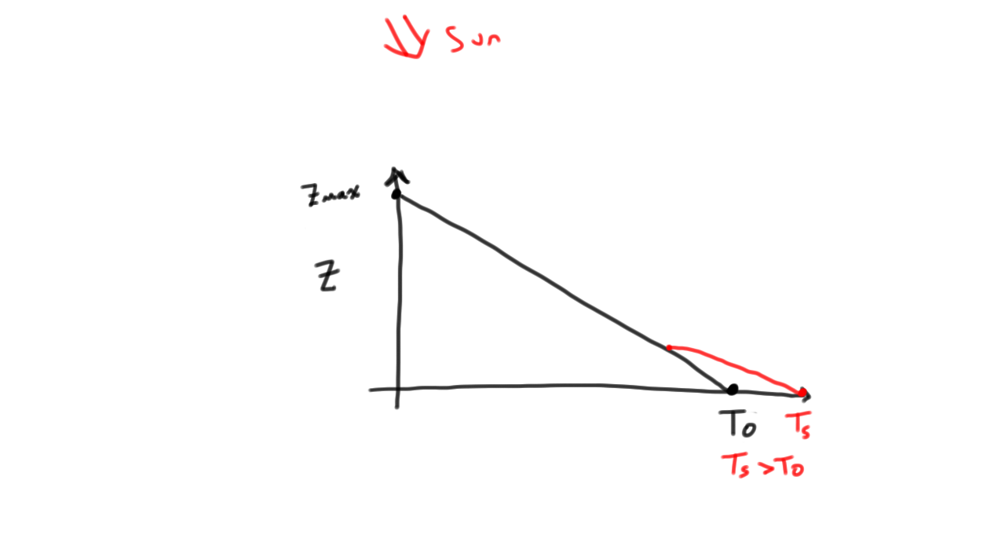
Add sunlight: First effect – heating at the surface.

Slide 5
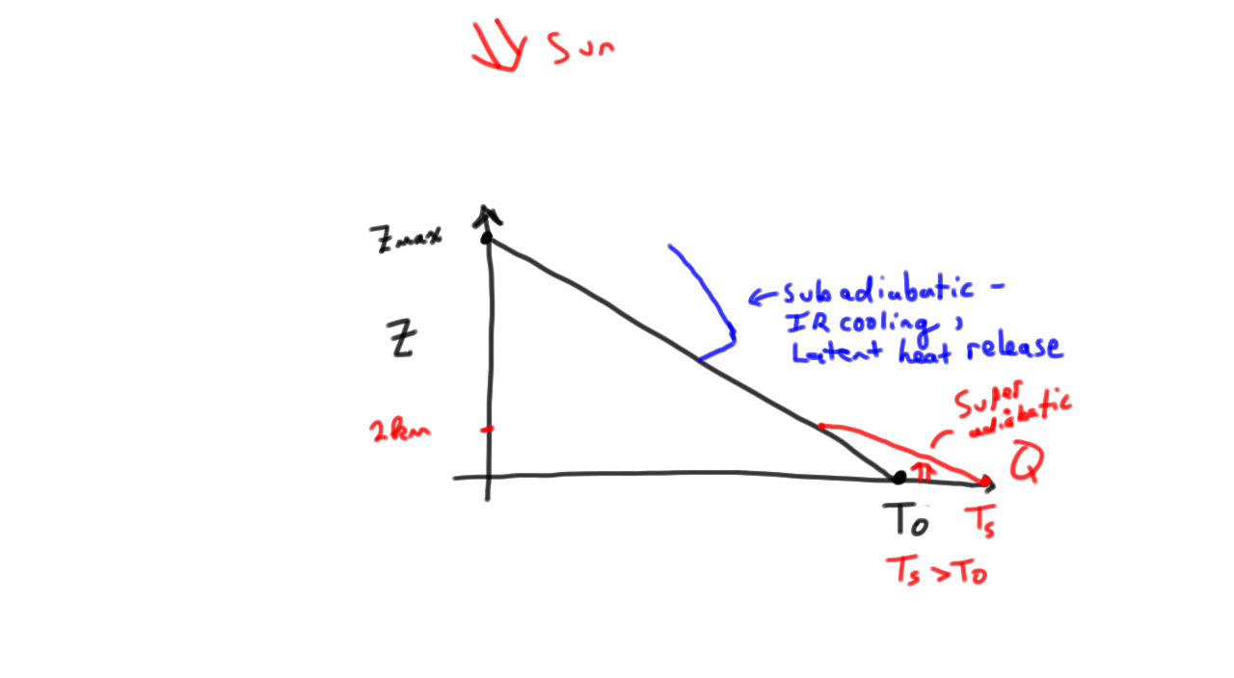
Add effects of latent heat, balanced by net SW and LW heating by absorption and emission of radiation.

Slide 6
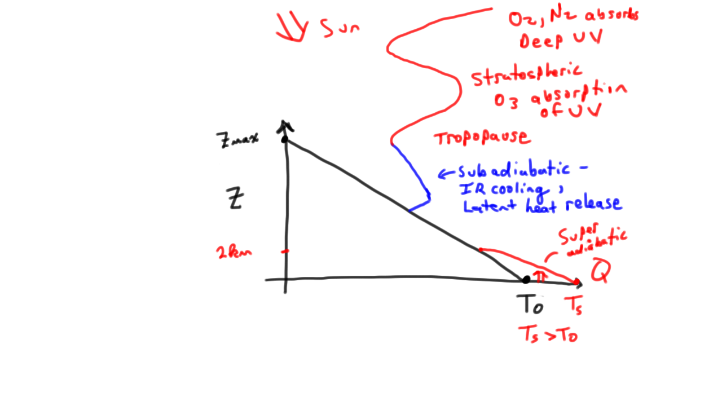
Strong Diabatic Processes in the Stratosphere and Above: UV and deep UV absorption.

Slide 7
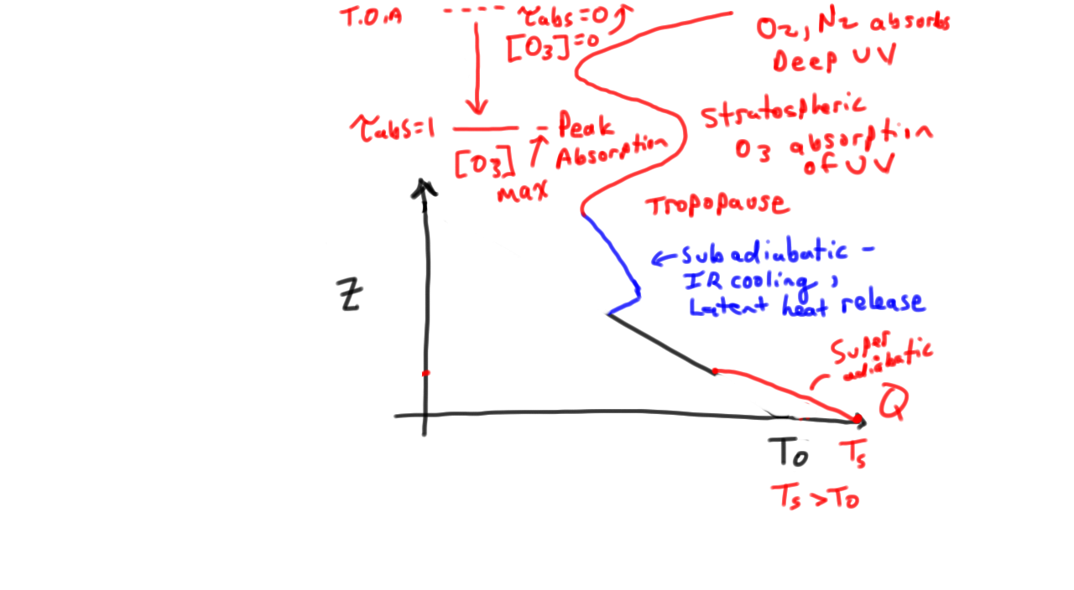
Atmosphere is now vastly different… Peak UV absorption for given wavelength happens where τ_{abs} ≈ 1.
Adiabatic model describes the daytime atmosphere above
the surface.

Slide 8
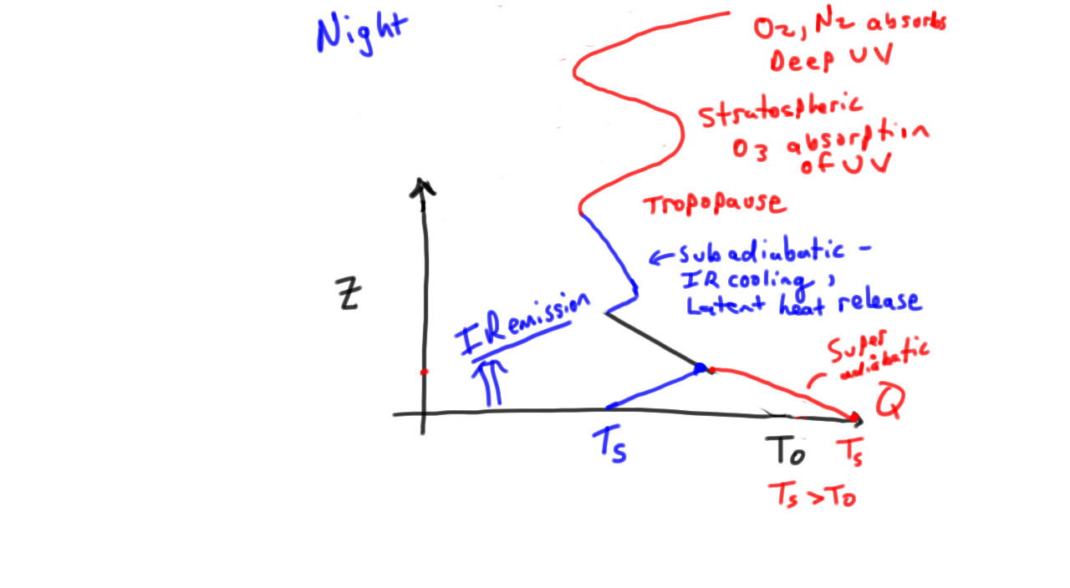
After Sunset … Strong changes near the surface.

Slide 9
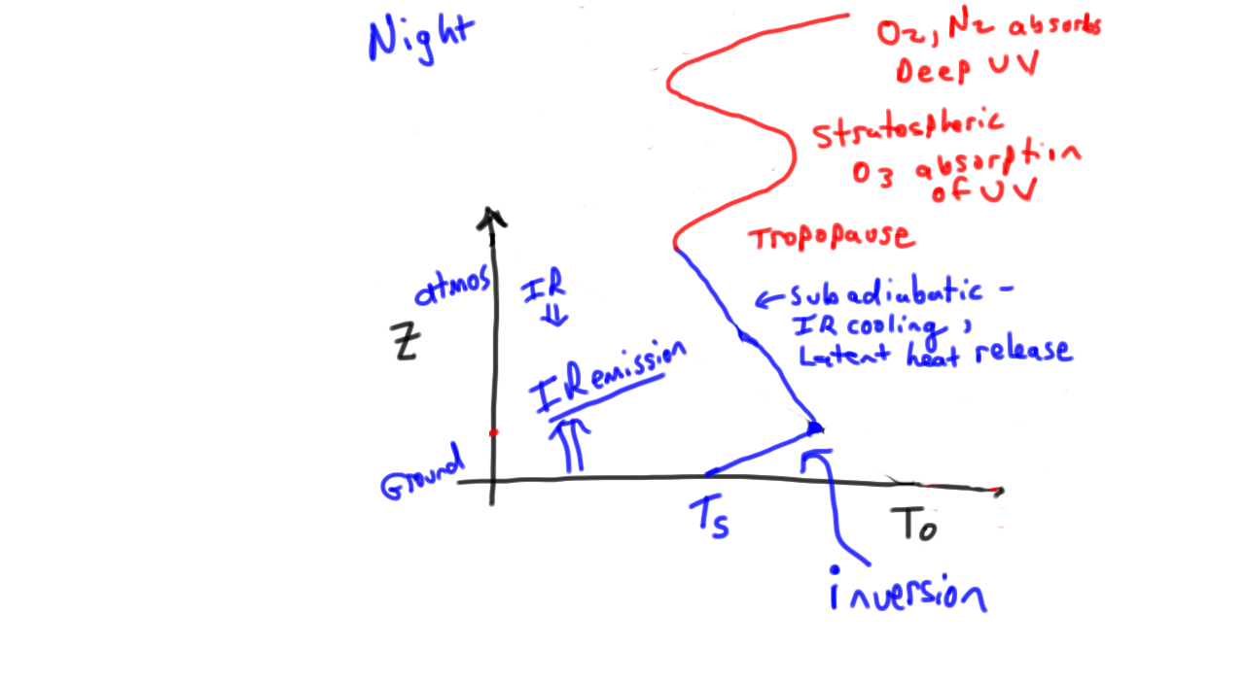
Nighttime temperature profile: Again vastly different from the adiabatic model.

Slide 10
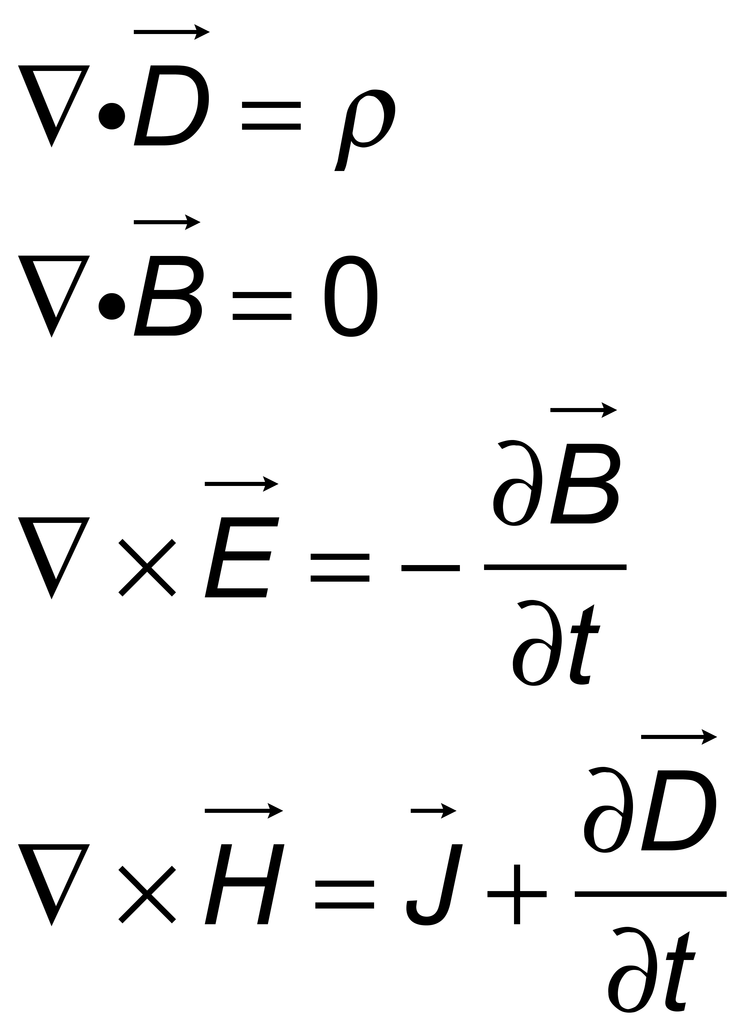
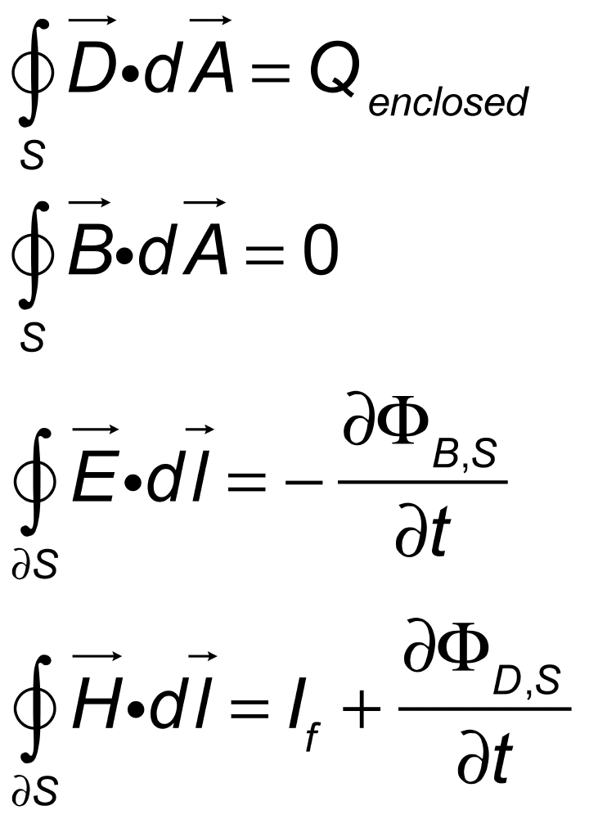


Chapter 2: Electromagnetic Theory, Refractive Index, and Definitions of Radiance, Irradiance.
Gauss’ law
Gauss’ law for B
Faraday’s law induction
Ampere’s law
D=electric displacement
B=magnetic induction
E=electric field
H=magnetic field
ρ = free charge density
Q_{enclosed} = free charge enclosed by Gaussian surface S
dS=closed boundary on S
Gauss’s law to get the E field of a charge in vacuum?

Slide 11
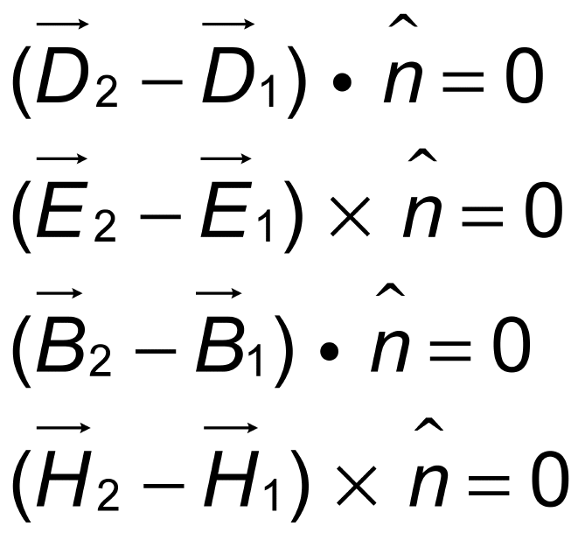
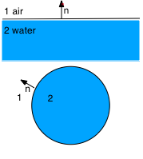
Boundary Conditions at Interfaces
Used along with boundary conditions to calculate the single scattering properties of aerosols and hydrometeors (cloud droplets, rain drops, ice crystals, snow flakes, etc), from first principles if possible. {Mie theory for homogeneous spheres, coupled dipole theory for general particles, T-Matrix method, etc}
Are not used to calculate the radiation field arriving at the surface from the complex atmosphere. Multiple scattering theory is used.
Which case is Mie Theory?
Which refer to normal and tangential components of the fields?

Slide 12
Constitutive Relationships: Material Properties σ, χ, ε, and μ.
Homogeneous Media
J=σE σ=electric conductivity
(like Ohm’s Law, V=IR)
B=μH μ=magnetic permeability
D= ε₀(1+ χ) E
ε₀ =permittivity of free space
χ =electric susceptibilty (to polarization)
ω=2πf, f=frequency of time harmonic wave (next slides).
ε= ε₀(1+ χ) + iσ/ω = complex permittivity

Slide 13
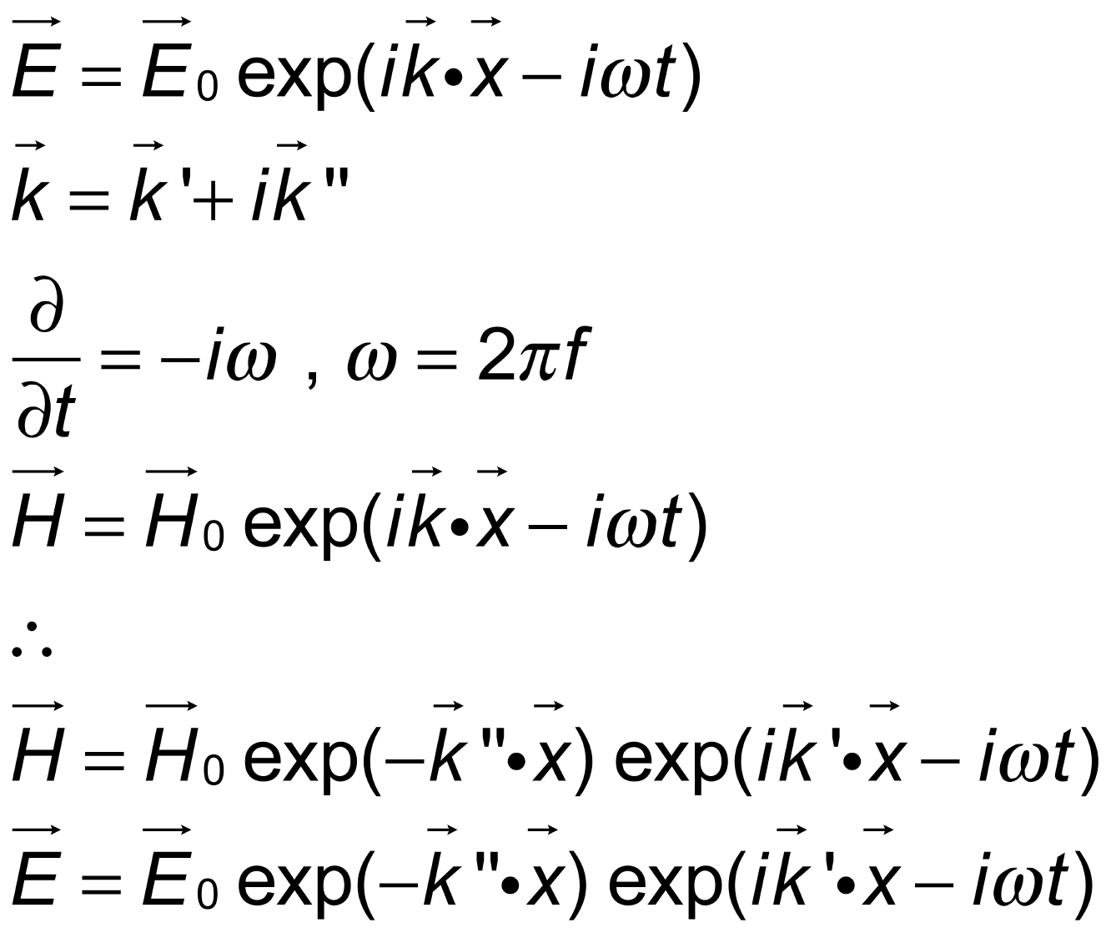
Seek Plane Wave Solutions to Maxwell’s Equations
E₀ and H₀ are complex constants.
What is f for wall current, radio stations?

Slide 14
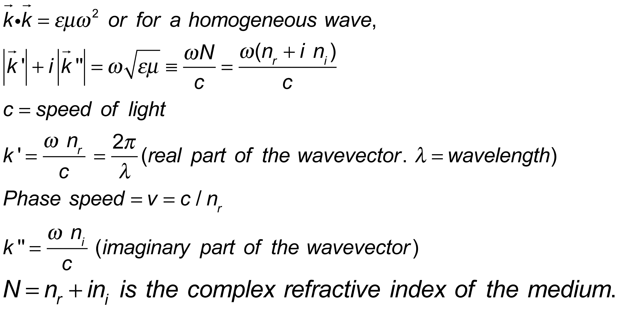
Dispersion Relationship: Relationship between ω and k.
Comes from putting the assumed solutions into Maxwell’s equations.
At 550 nm, what is n_{r} for water? For glass?
What is n_{r} for ice at 2.85 um?
What is n_{i} for ice at 2.85 um?

Slide 15
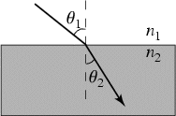
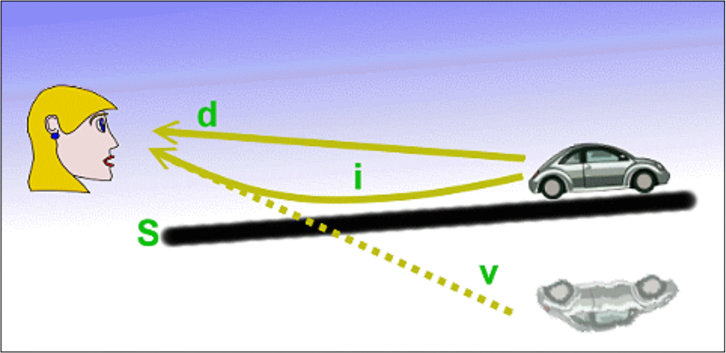
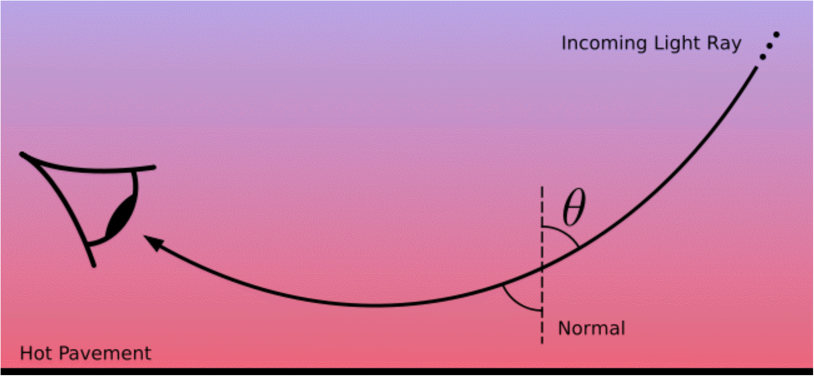
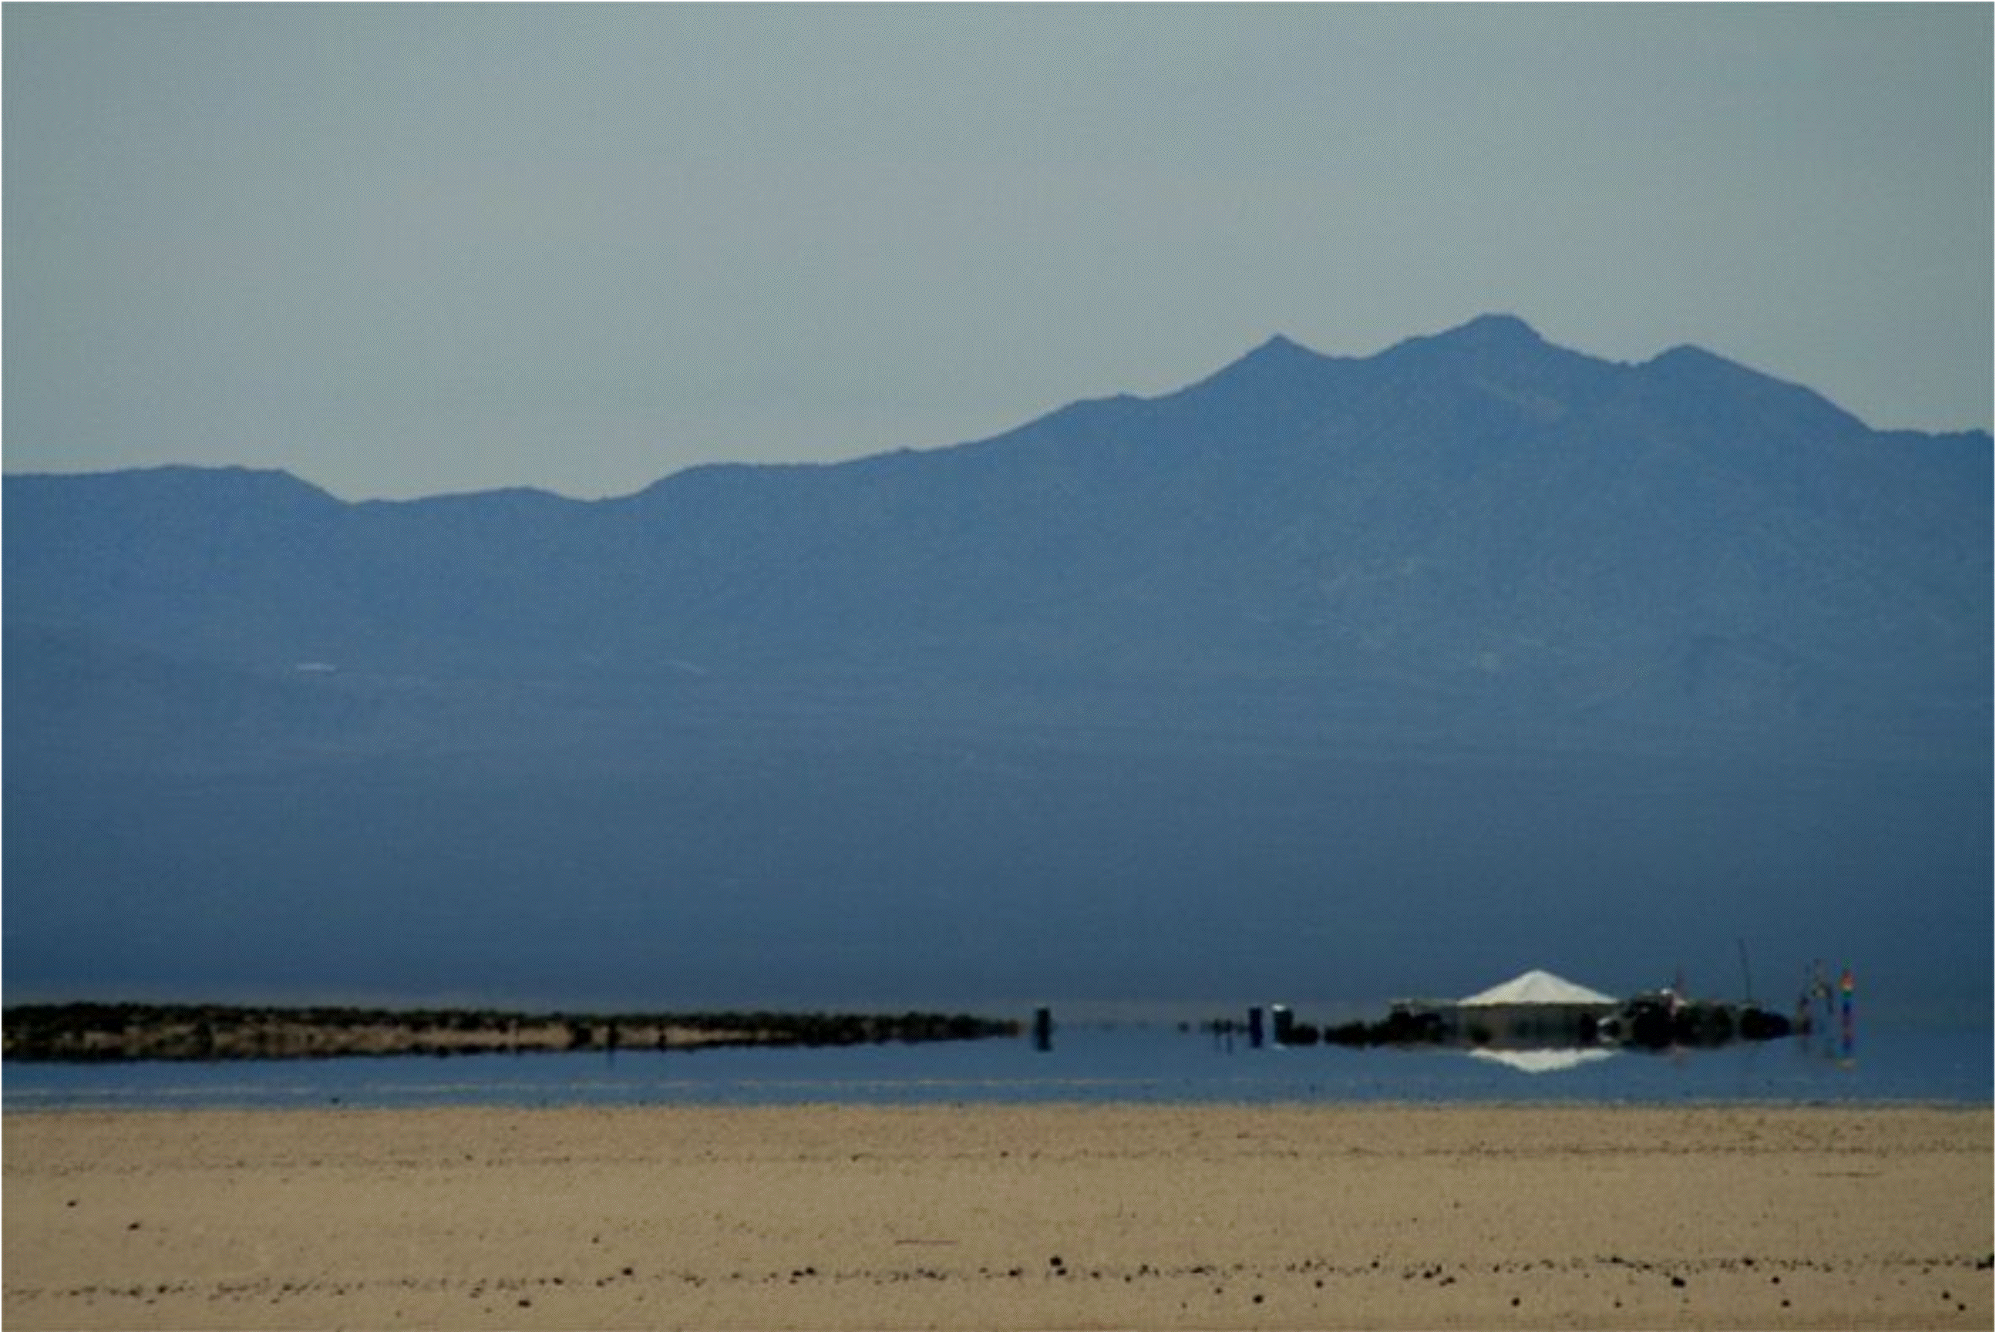
Trace velocity matching principle: Snell’s law (continuity of the wavefront at a boundary)
“slow is more normal”
Here assume
n₁=n_{1r}, n_{1i}=0,
n₂=n_{2r}, n_{2i}=0.
Why do we sometimes see lightning but not hear thunder?
In which medium is the speed of light less?
n₁sin(θ₁)= n₂sin(θ₂)
MIRAGES
z
For a gas, (n_{r}-1) ≈ ρ
ρ=gas density.
dρ/dz > 0 for this type or mirage.
What does this say about the likelihood of convection?

Slide 16
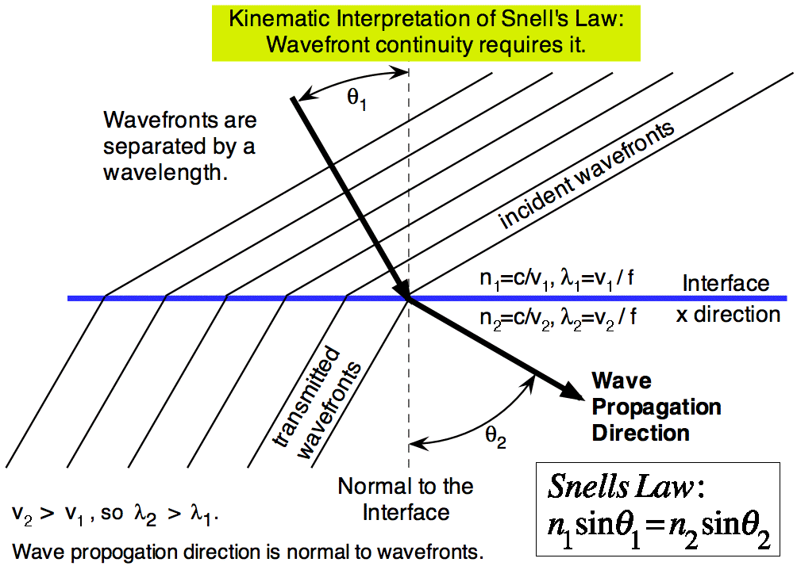
Snell’s Law: Kinematics

Slide 17
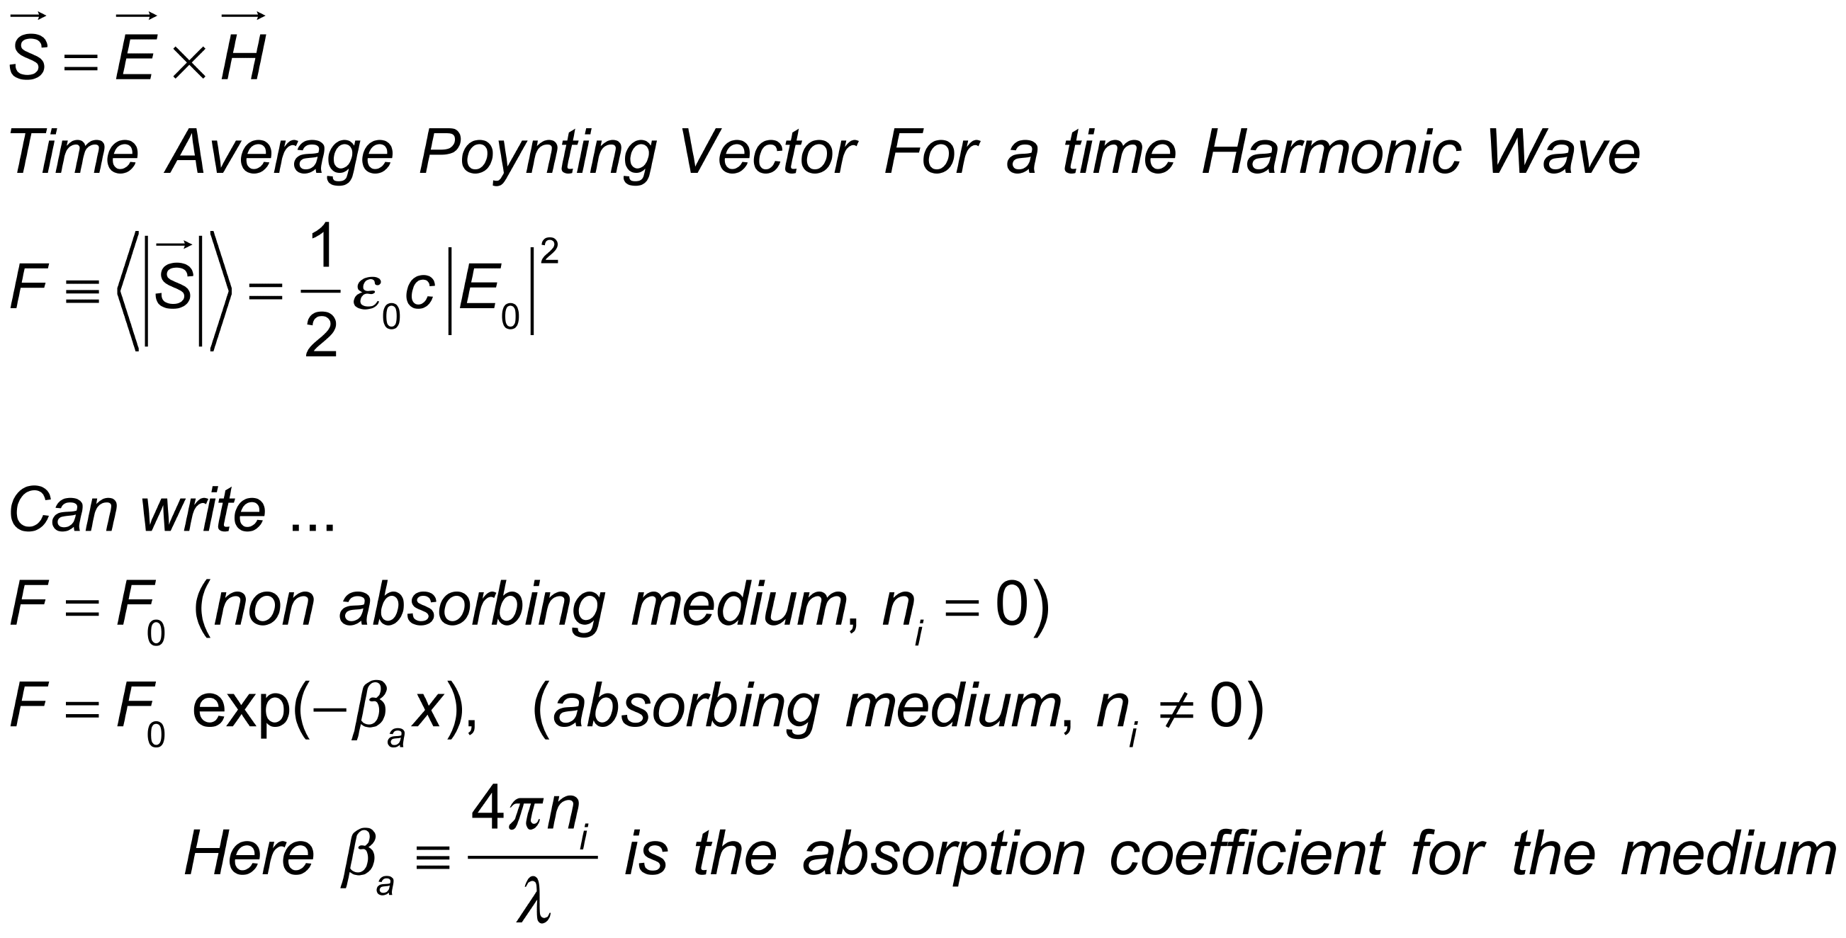
Poynting Vector: Direction and magnitude of electromagnetic irradiance (power / area or energy/second / area).
Consider a time harmonic wave traveling in the x direction.
Why does the navy typically use acoustic methods under water instead of radar to find submarines from other countries and other things?

Slide 18
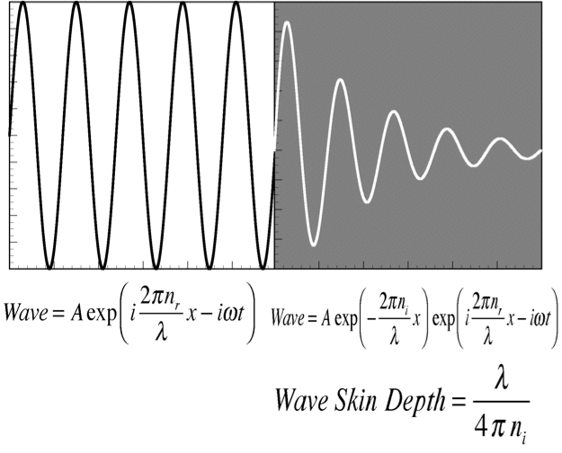
Some Basics, Electromagnetic Skin Depth

Slide 19
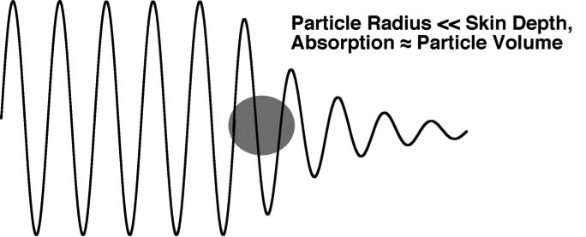
Particle Diameter << Wave Skin Depth

Slide 20
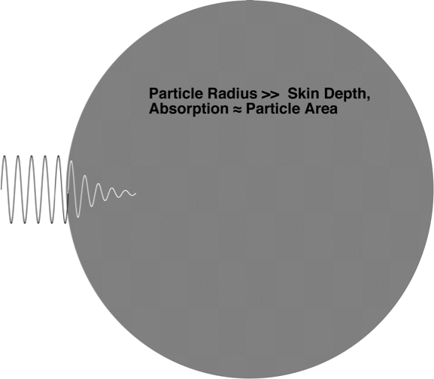
Particle Diameter >> Electromagnetic Skin Depth

Slide 21
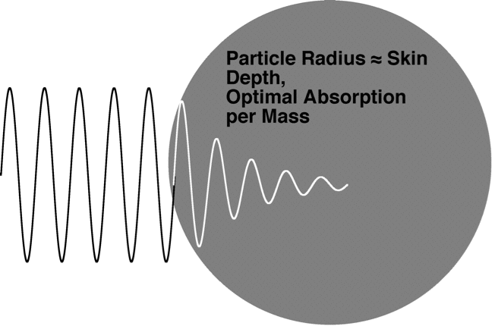
Particle Radius Equal to the Skin Depth
(Rigor needed in the electromagnetic theory to get the right answer).

Slide 22
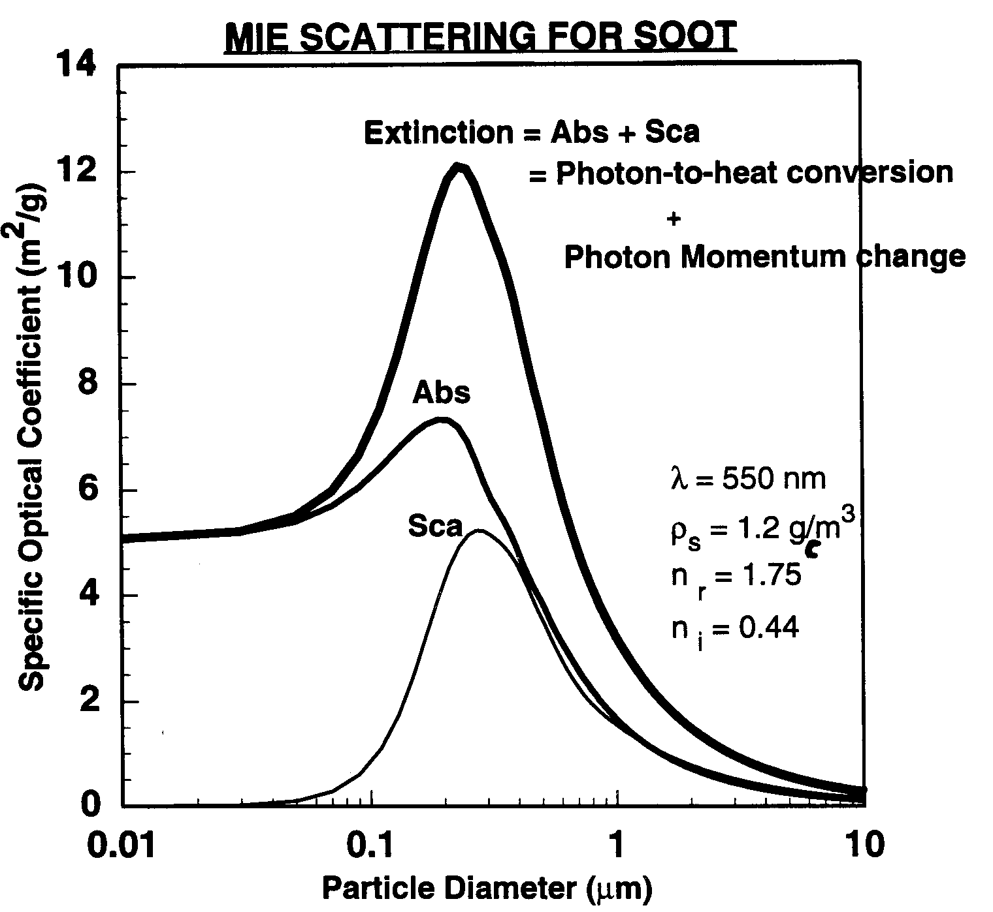
Aerosol Optical Properties: Absorbing particles.
Optical power removed by ext=abs+sca.
F₀ (W/m²)
P_{ext} (W) = F₀ σ_{ext}
P_{abs} (W) = F₀ σ_{abs}
P_{sca} (W) = F₀ σ_{sca}
For small optical depths,
and D < 0.1 µm:
I(L)/I(0) = e^{(-Λ L)},
Λ(1/m) ≈ S.O.C (m²/g) x ρ (g/m³),
L = path length,
ρ = aerosol concentration by mass.
Absorption dominates for D < 0.1 µm (Rayleigh scattering).
Aside: For non-absorbing aerosols, Extinction=Scattering. Note the strong dependence of the scattering coefficient on diameter!
σ
particle
mass

Slide 23
Simple Collapsed Sphere Absorption Analysis

Slide 24
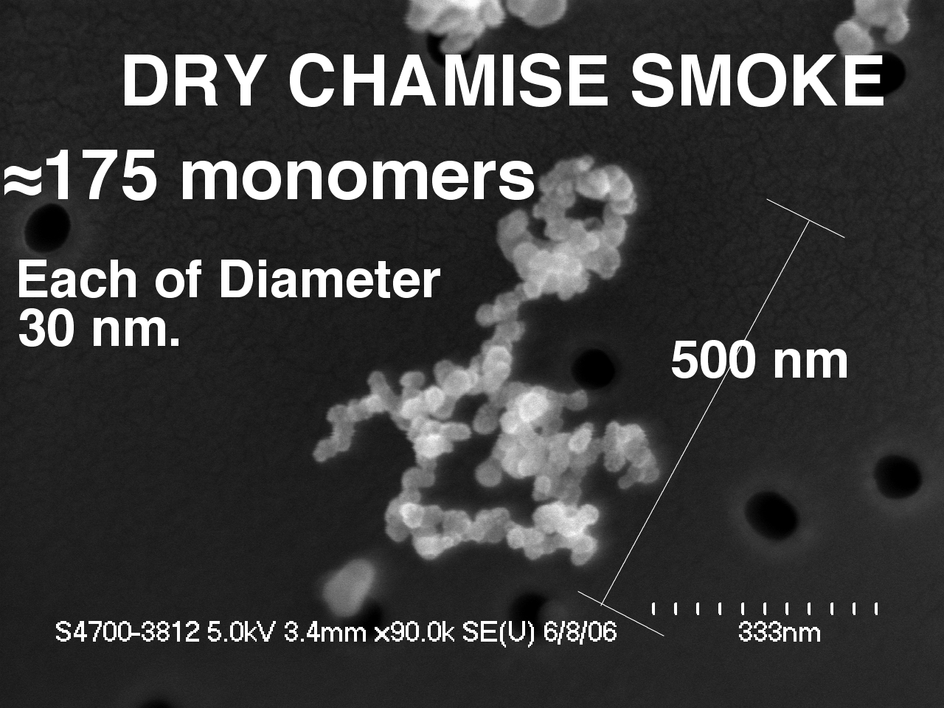
Example of Dry Chamise Particle SEM Image
`

Slide 25
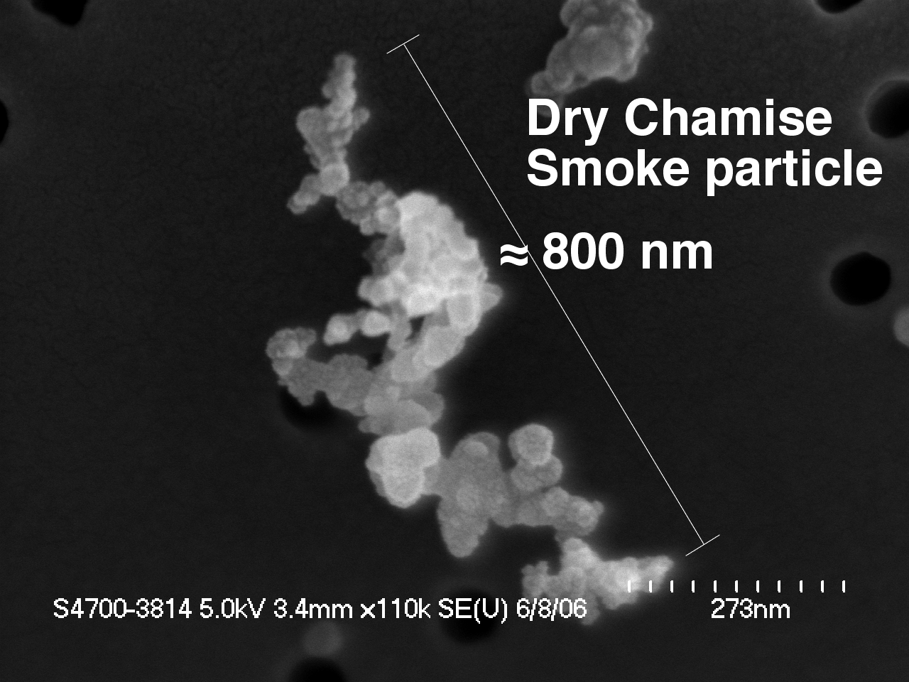
Another Example of Dry Chamise Particle SEM Image
`

Slide 26
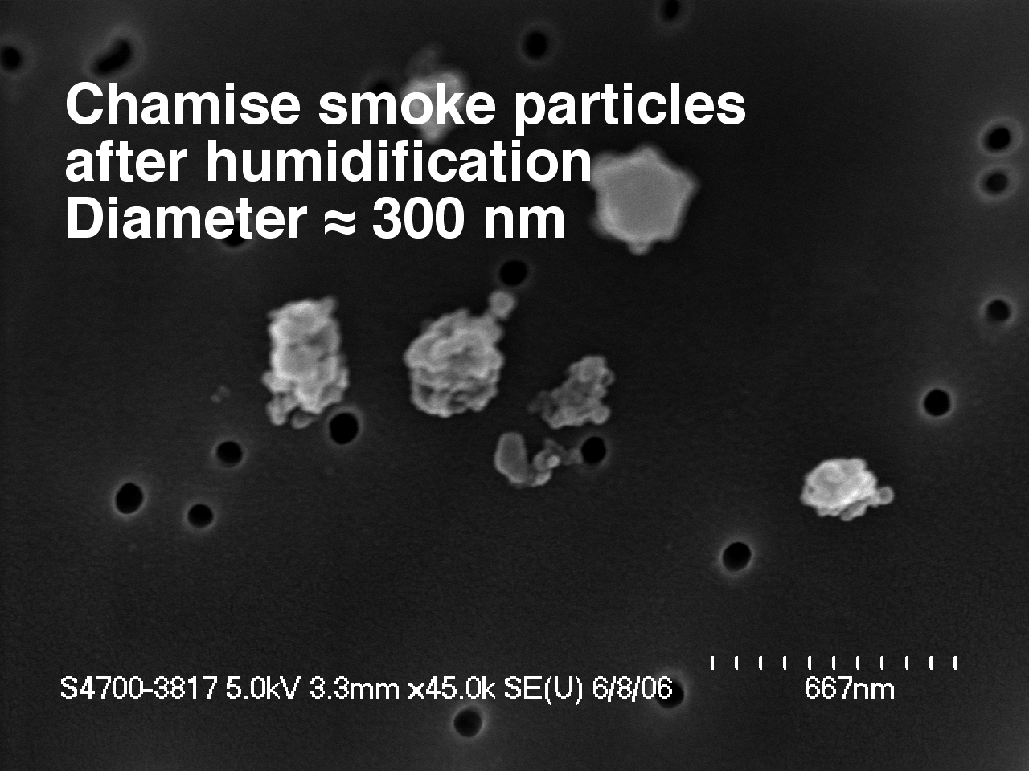
Example of Chamise Particle SEM Image After H20 Vapor Applied at 85%
`

Slide 27
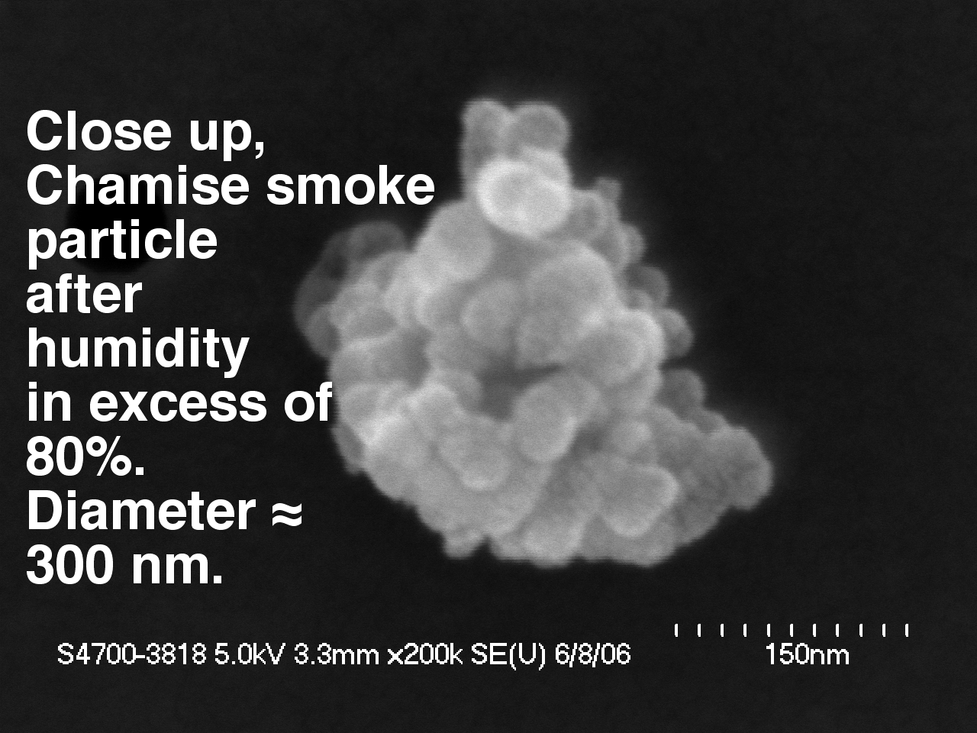
Another Example of Chamise Particle SEM Image After H20 Vapor Applied at 85%
`

Slide 28
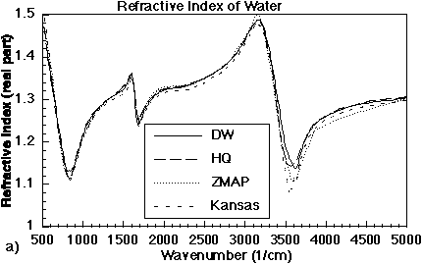
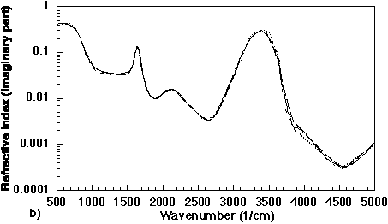
Complex Refractive Index of Water in the IR
500 1/cm = 20 microns
5000 1/cm = 2 microns
Minima in n_{r} are associated with minima in scattering by water droplets.
Peaks in n_{i} are associated with strong absorption phenomena in water, intermolecular vibration, rotation, etc.

Slide 29
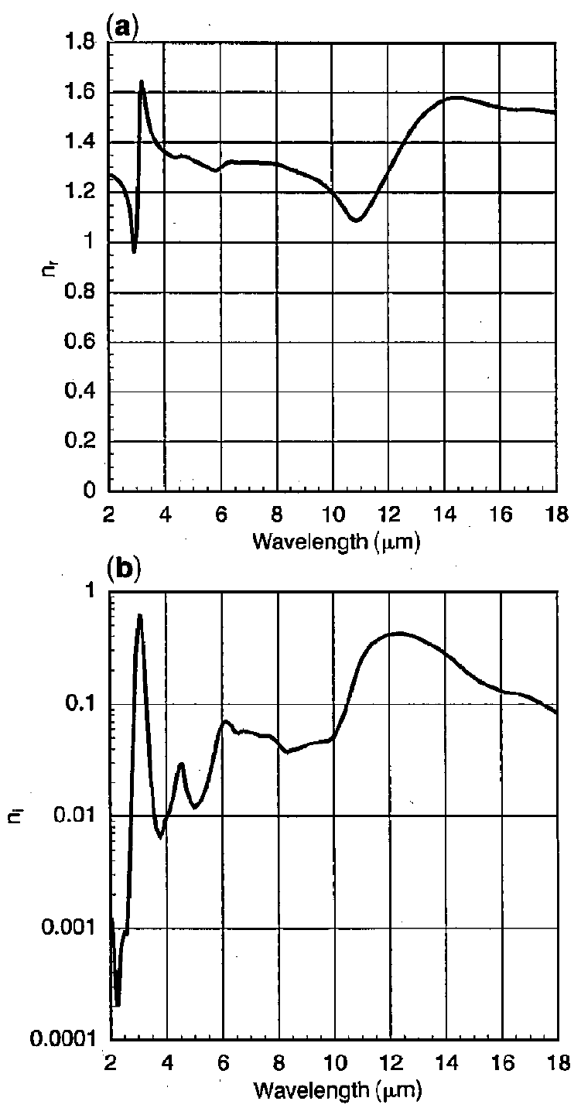
Complex Refractive Index of Ice in the IR
500 1/cm = 20 microns
5000 1/cm = 2 microns
Minima in n_{r} are associated with minima in scattering by ice crystals.
Peaks in n_{i} are associated with strong absorption phenomena in ice, intermolecular vibration, rotation, etc.
Arnott, W. P., Y. Y. Dong, and J. Hallett, 1995: Extinction efficiency in the IR (2 µm to 18 µm) of laboratory ice clouds: Observations of scattering minima in the Christiansen bands of ice. Applied Optics 34 , 541-551.

Slide 30
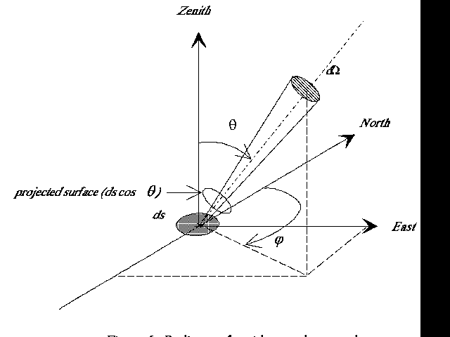
Radiant Intensity or Radiance: Watts / (m² Sr)

Slide 31
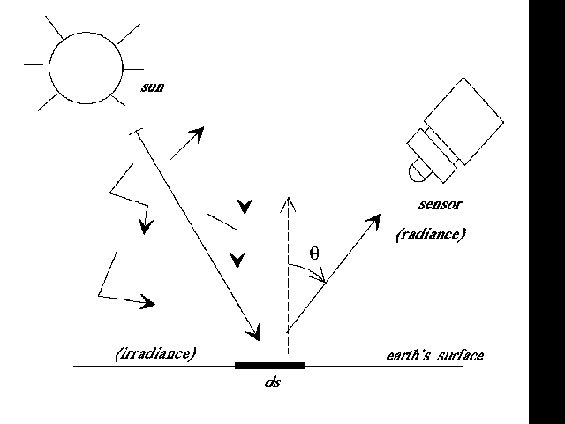
Flux (also Irradiance) and Radiant Intensity (Radiance)

Slide 32
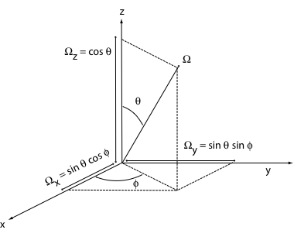
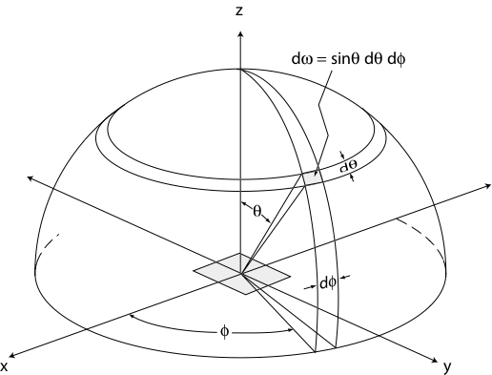
Spherical Coordinate System: z axis is the vertical component in the atmosphere.
SOLID ANGLE
What angle is latitude?

Slide 33
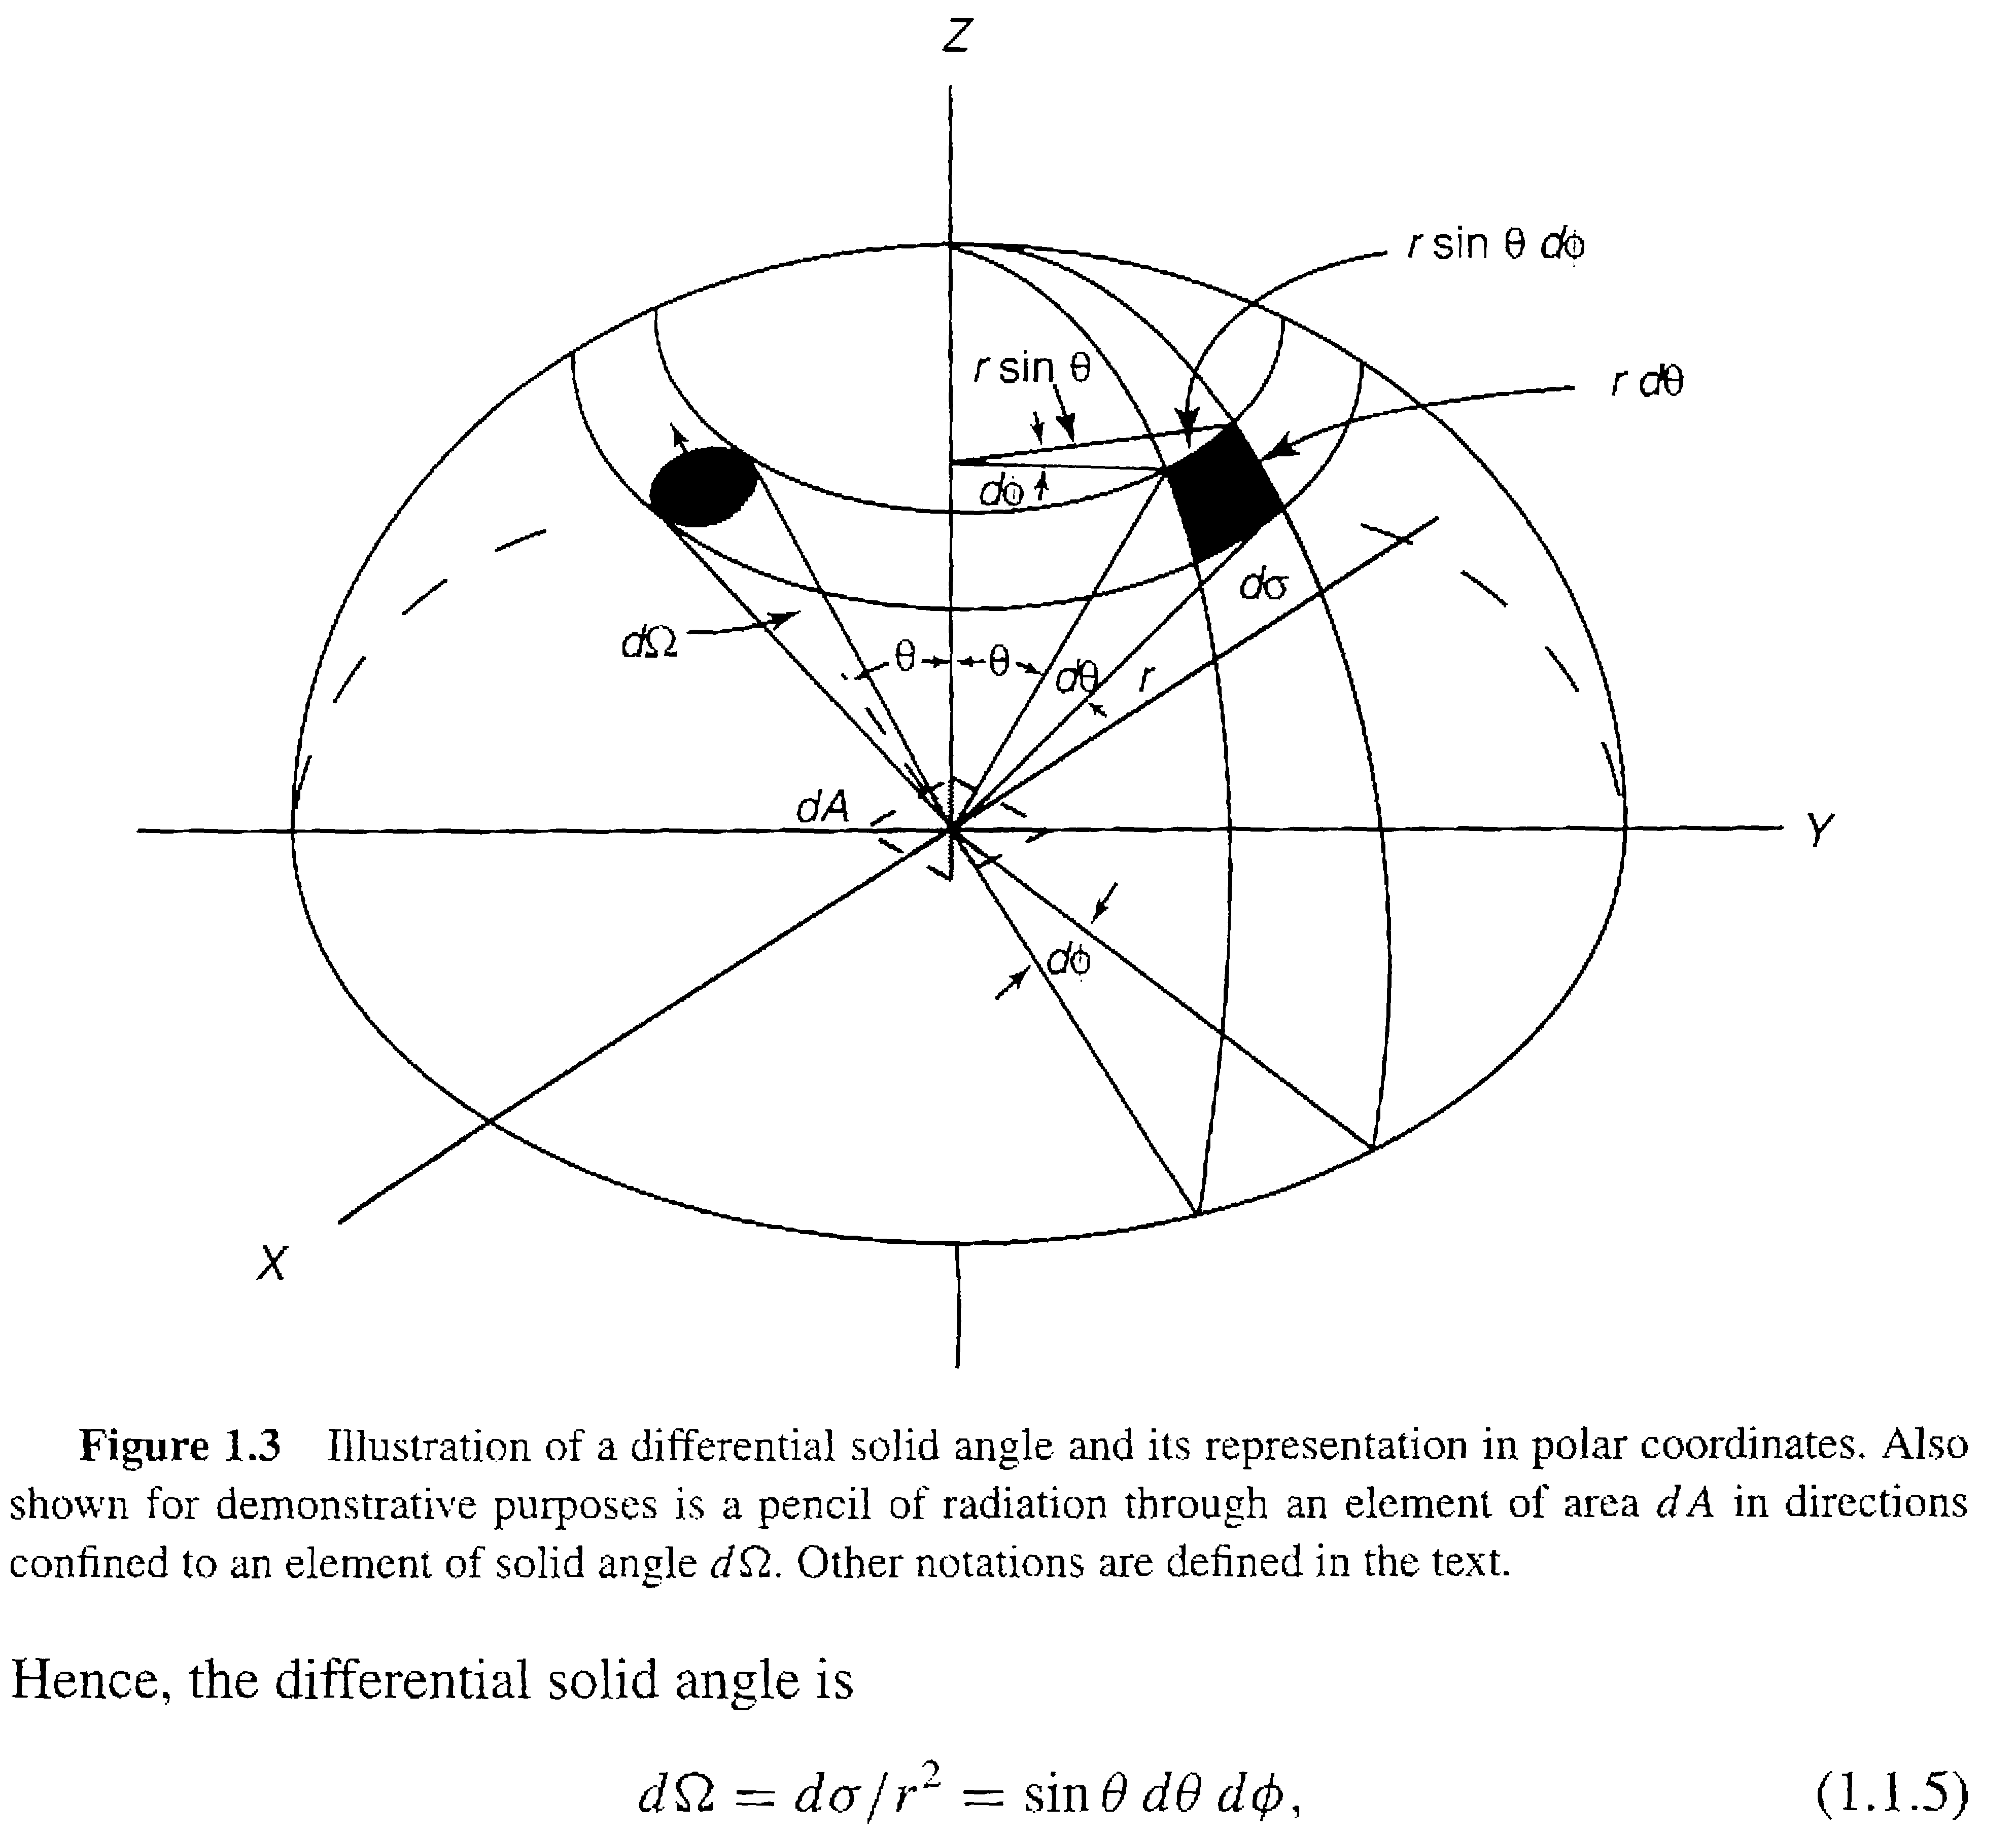
Spherical Coordinate System: z axis is the vertical component in the atmosphere: Another view.

Slide 34
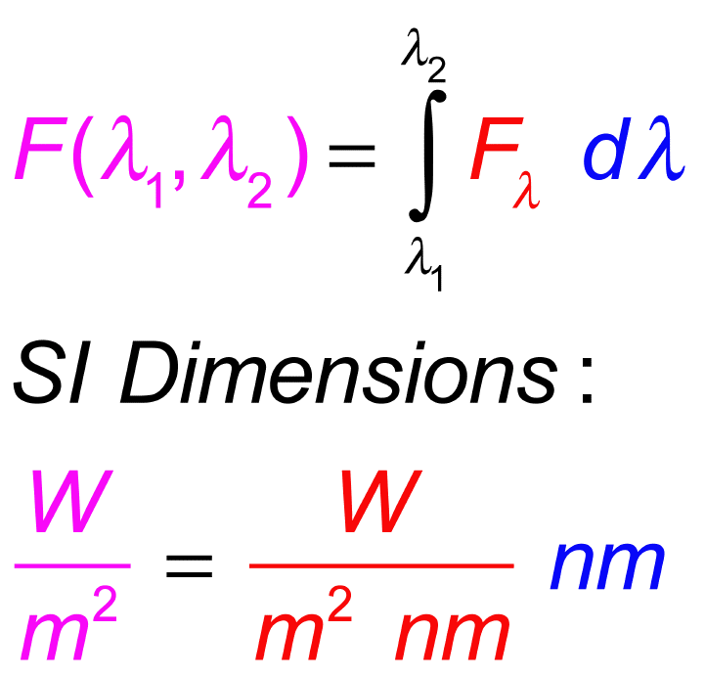
Flux (irradiance) as a distribution function and broadband quantity. Purpose: Describe radiation in particular direction such as net downward, net upward, etc.

Slide 35
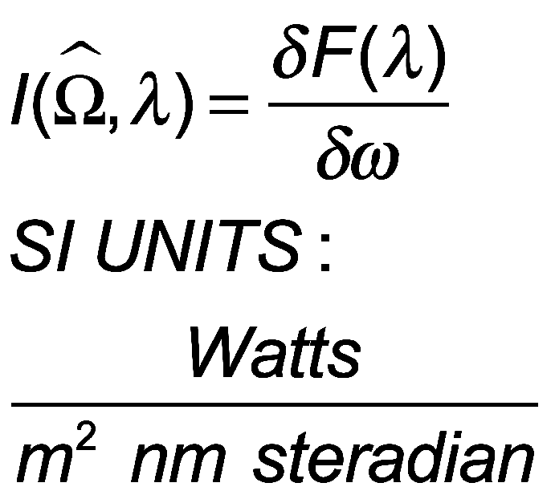
Radiant Intensity Definition (also known as Radiance)
Purpose: Describe radiation from all and any direction.
It is also a distribution function with respect to wavelength (or frequency, or wavenumber, depending on the orientation).

Slide 36
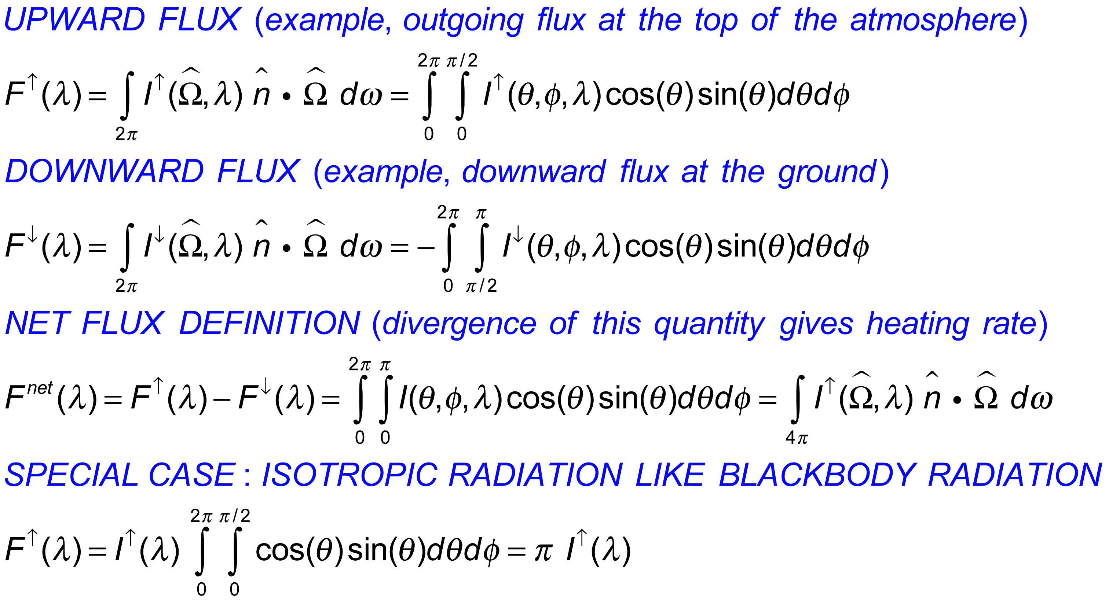
Flux and Radiant Intensity Relationships
Prove this relation…

Slide 37
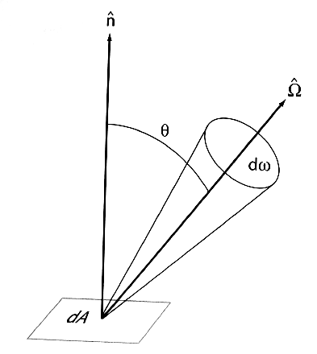

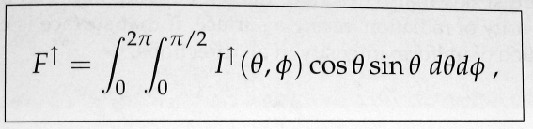
Irradiance - Radiance Relations
Special case: I isotropic, same in all directions, like black body radiation from a surface.

Slide 38
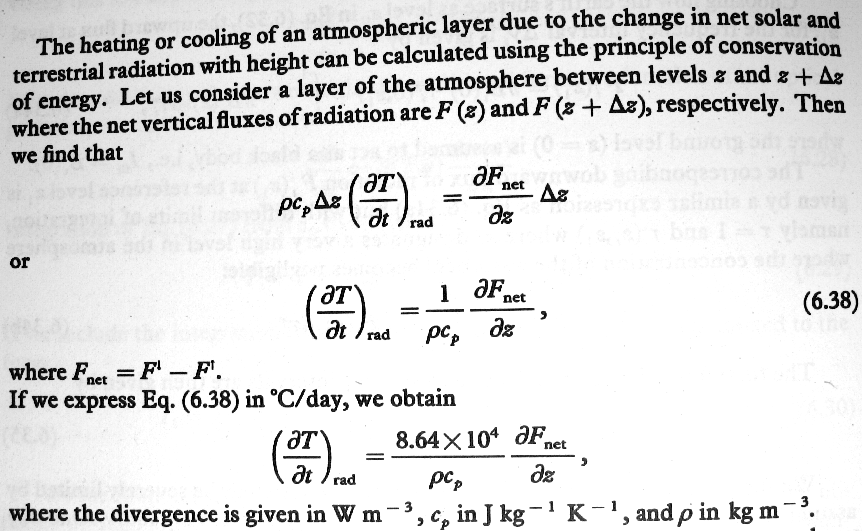
THE BIG PICTURE: Radiation Heating of the Atmosphere
From Oort and Peixoto

Slide 39
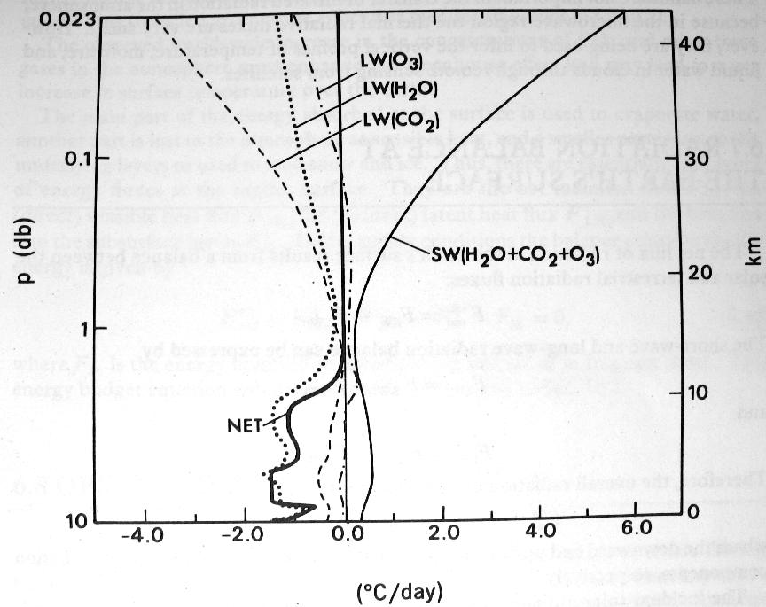
ATMOSPHERE HEATING BY RADIATION: The heating rate is the divergence of the net irradiance (or net flux if you prefer).
From Oort and Peixoto

Slide 40
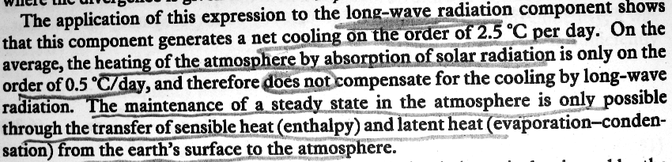
ATMOSPHERE HEATING BY RADIATION: The heating rate is the divergence of the net irradiance (or net flux if you prefer).
From Oort and Peixoto

Slide 41
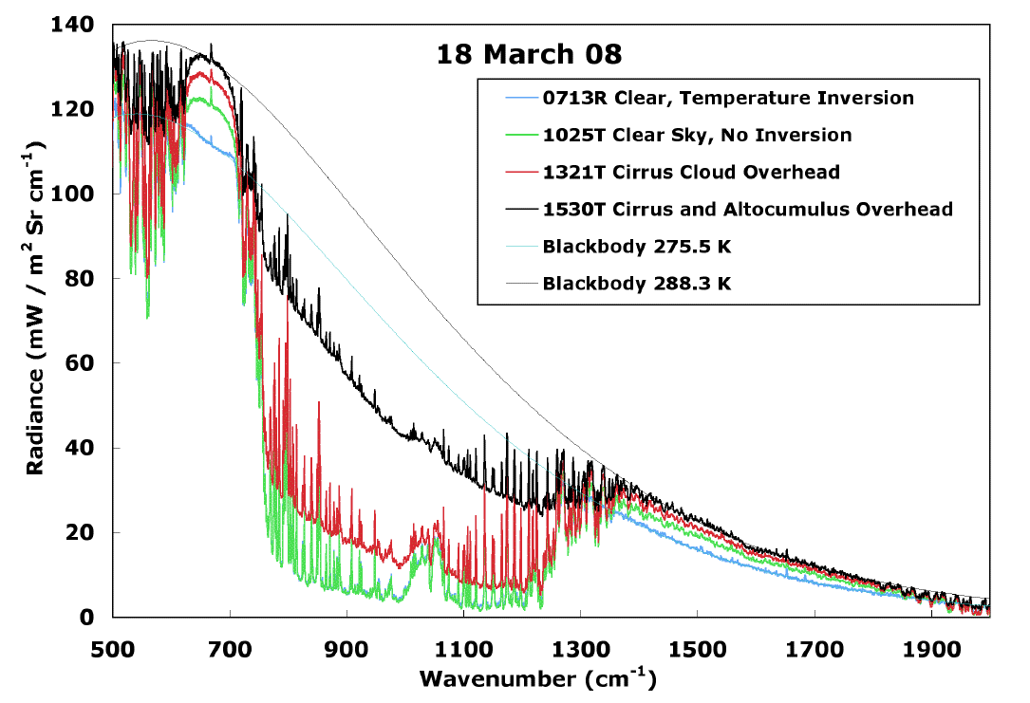
FTIR Radiance: Atmospheric IR Window
13 microns
8 microns

Slide 42
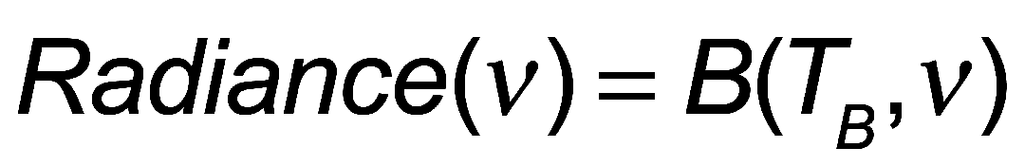
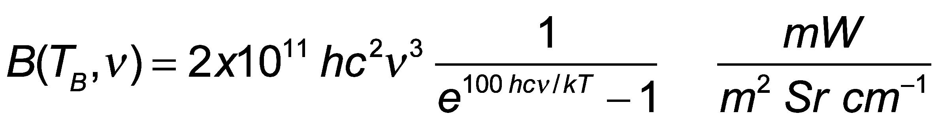
DEFINITION OF THE BRIGHTNESS TEMPERATURE
T_{B}
Measured Radiance at wavenumber v
=
Theoretical Radiance of a Black Body at temperature T_{B}

Slide 43
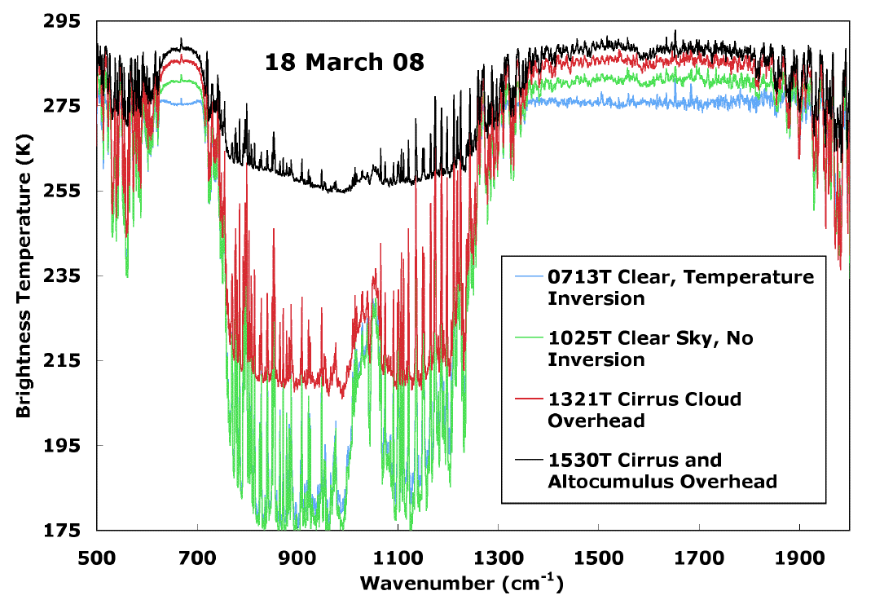
FTIR Brightness Temperatures

Slide 44
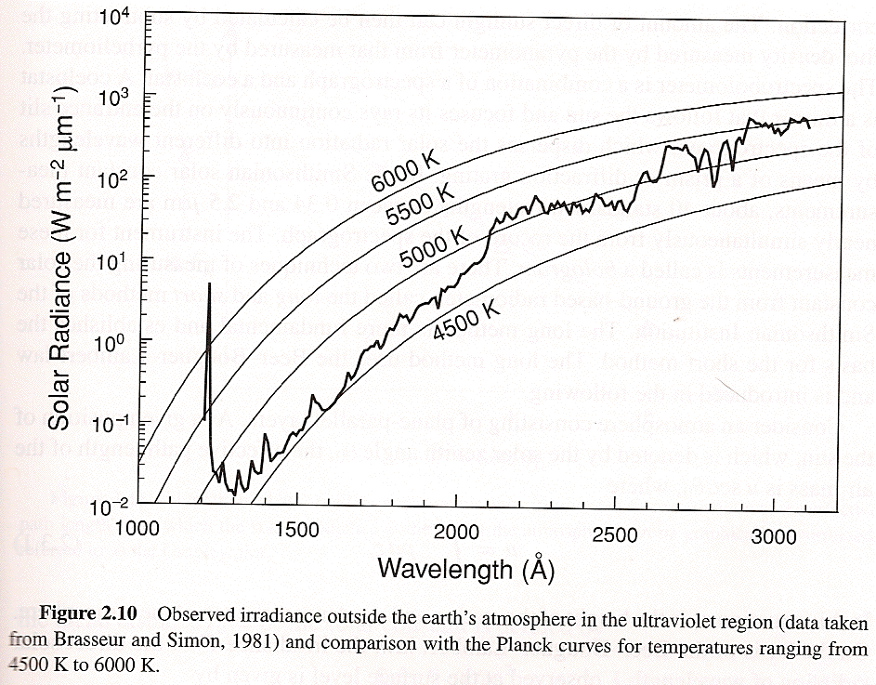
Solar Radiance at the Top of the Atmosphere

Slide 45


Solar Flux S₀
SUN
Earth

Slide 46


Regional and Seasonal Insolation at the TOA
Normal Flux:
What is the range in Reno?
In Mexico City?
In Barrow Alaska?
Where is the peak? Why?

Slide 47

Insolation at the Two Solstices and the Annual Average
What is the average insolation over all latitudes?

Slide 48




Sun Cross Section, Sunspots, and Nuclear Fusion
A sunspot is a region on the Sun's surface (photosphere) that is marked by a lower temperature than its surroundings and has intense magnetic activity, which inhibits convection, forming areas of reduced surface temperature. They can be visible from Earth without the aid of a telescope. Although they are at temperatures of roughly 4000-4500 K, the contrast with the surrounding material at about 5800 K leaves them clearly visible as dark spots, as the intensity of a heated black body (closely approximated by the photosphere) is a function of T (temperature) to the fourth power. If a sunspot was isolated from the surrounding photosphere it would be brighter than an electric arc. Source: Wikipedia.
4 ¹H + 2 e --> ⁴He + 2 neutrinos + 6 photons

Slide 49

Sun’s Atmosphere:
Region above the photosphere.
Chromosphere,
Corona.

Slide 50

Solar Corona

Slide 51

Number of Sun Spots Observed as a function of Year …

Slide 52

Geometry of Earth and Sun

Slide 53

Sun and Satellite Perspective: How do the properties of the surface affect what we see?

Slide 54

Radiance and Irradiance: How do we define radiation?
Types of reflection: Can also think of the reflected light as emitted light from different types of surfaces.

Slide 55

Geometry for the BDRF (bidirectional reflection function)
S is solar irradiance coming in.
I is the reflected radiance.

