Slide 1
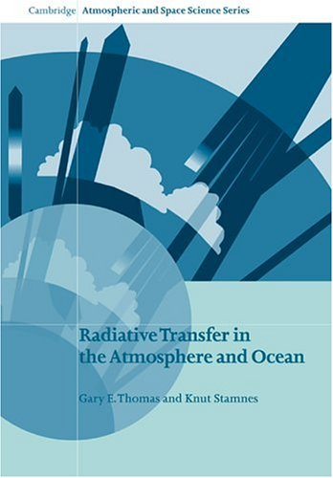
Chapter 1
Goals:
Introduction, scope of course.
Large scale issues, radiative forcing and climate.
See homework for suggested take home conceptual messages from this chapter.

Slide 2
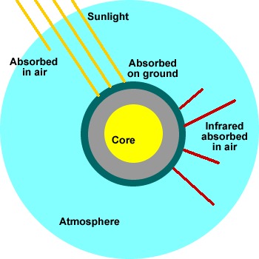
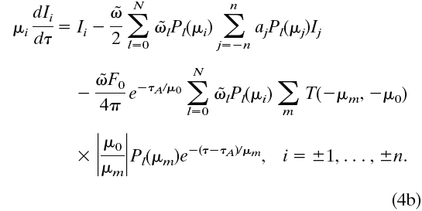
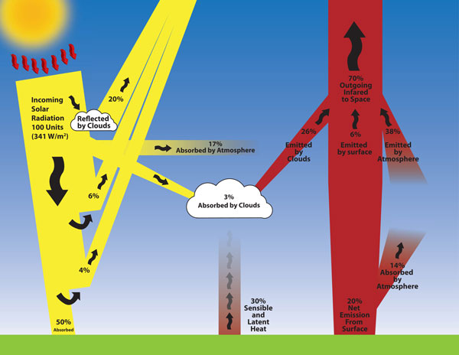
Chapter 1

Slide 3
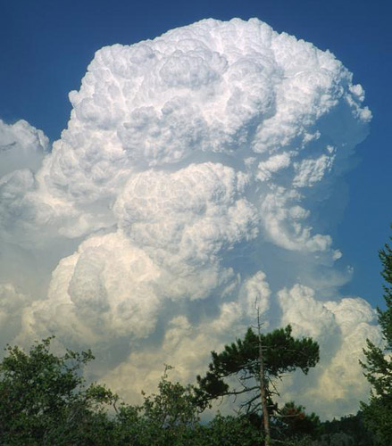
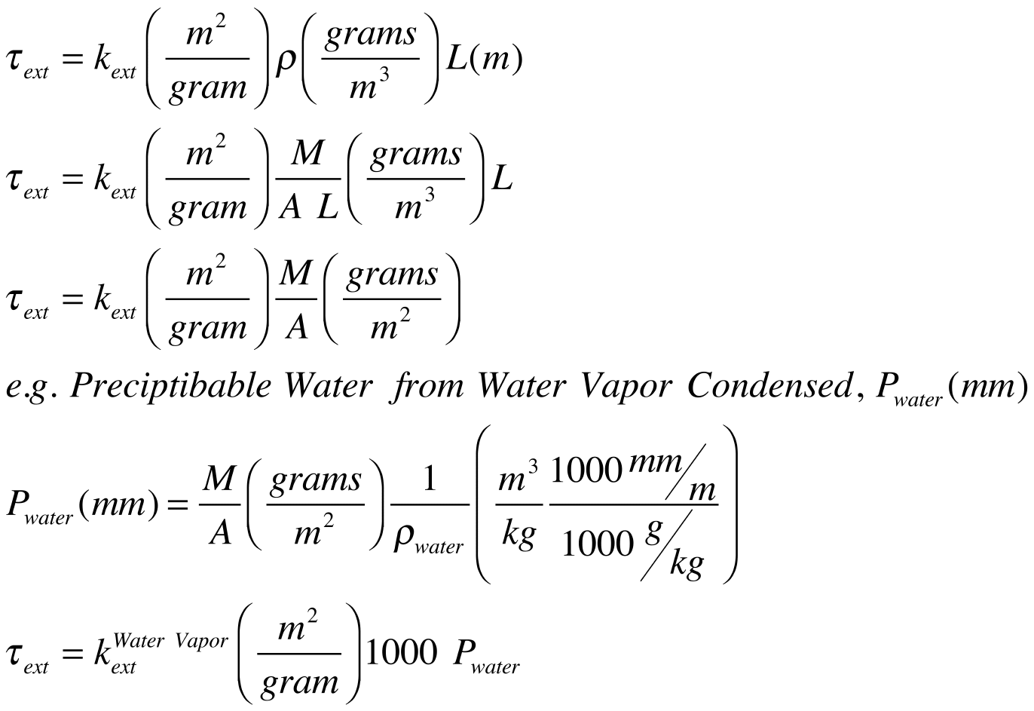
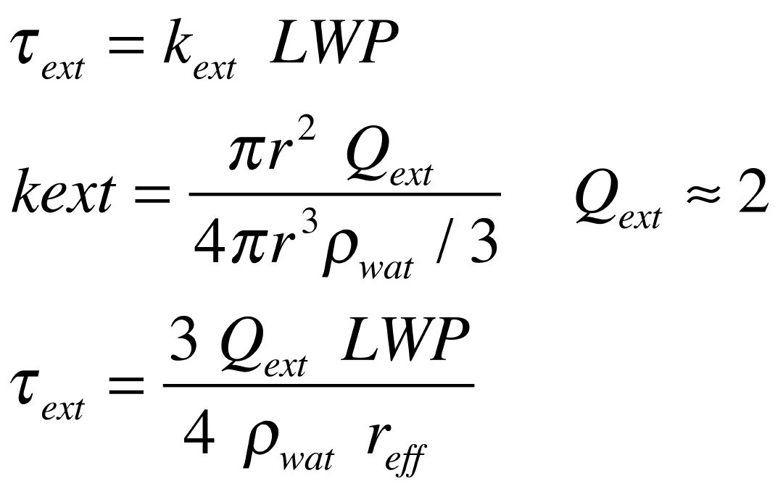
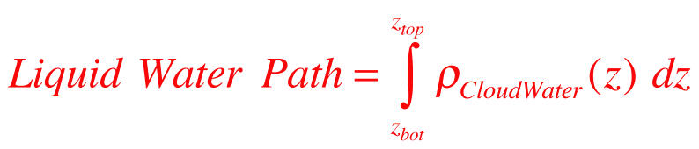
Optical Depth from k_{ext}: Liquid Water Path
z_{top}
Liquid Water Path
z_{bot}
Somewhere there has to be an integral over z!

Slide 4
Aerosol Indirect Effect
The impact of aerosols on cloud radiative properties

Slide 5
What is the Aerosol Indirect Effect?
The climatic impact of aerosols on cloud properties is called the aerosol indirect effect
A high concentration of aerosols overseed cloud droplets to generate highly concentrated, narrowly distributed cloud droplet spectra
This can increase the cloud albedo up to 30% reducing the amount of radiation reaching the surface
Narrowly distributed cloud droplet spectra prevent the formulation of precipitation and could increase cloud lifetime that further cools the Earth’s surface (Matsui et al., 2004)

Slide 6
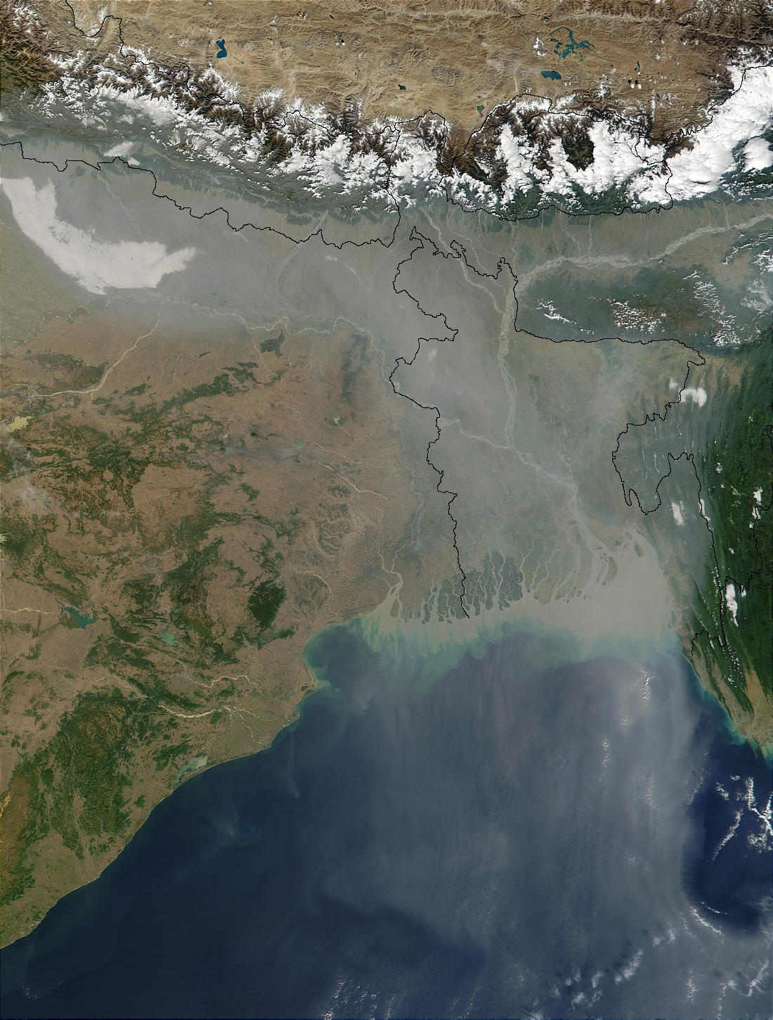

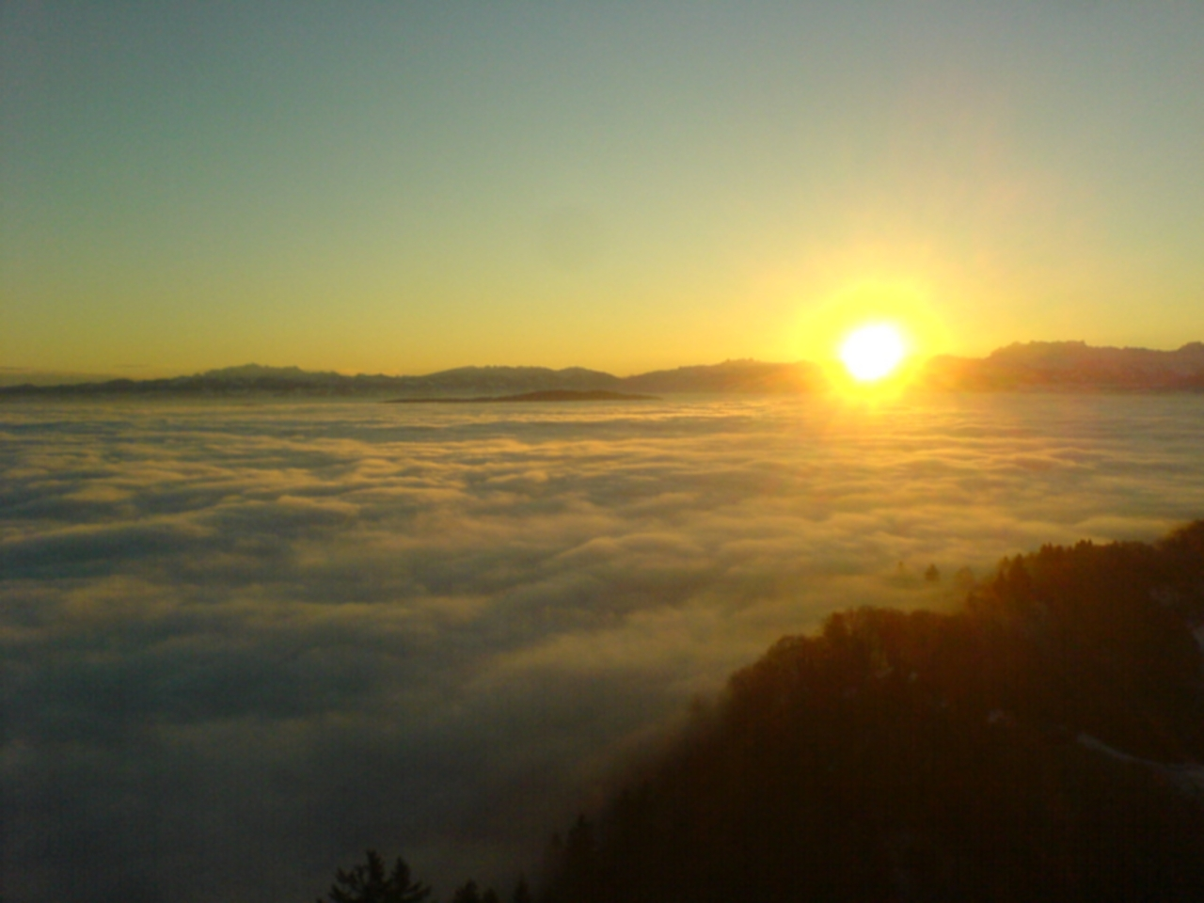
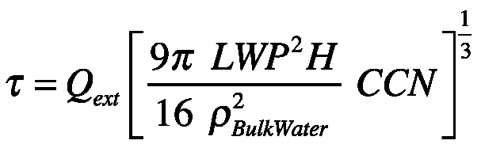
Cloud Optical Depth and Cloud Condensation Nuclei Particles
CCN ≈ 200 nm diameter
CCN: (dust, soot, smoke),
(sea salt, sulfate, phytoplankton)
Water Vapor
&
Cloud Droplet
Water Vapor
& CCN
cloud
I₀
I_{r}
H
I_{t}
Cloud optical depth
LWP = Cloud Water Mass / Area
Q_{ext} = Cloud droplet extinction efficiency
CCN = # cloud condensation nuclei
source: http://en.wikipedia.org/wiki/Cloud_condensation_nuclei

Slide 7
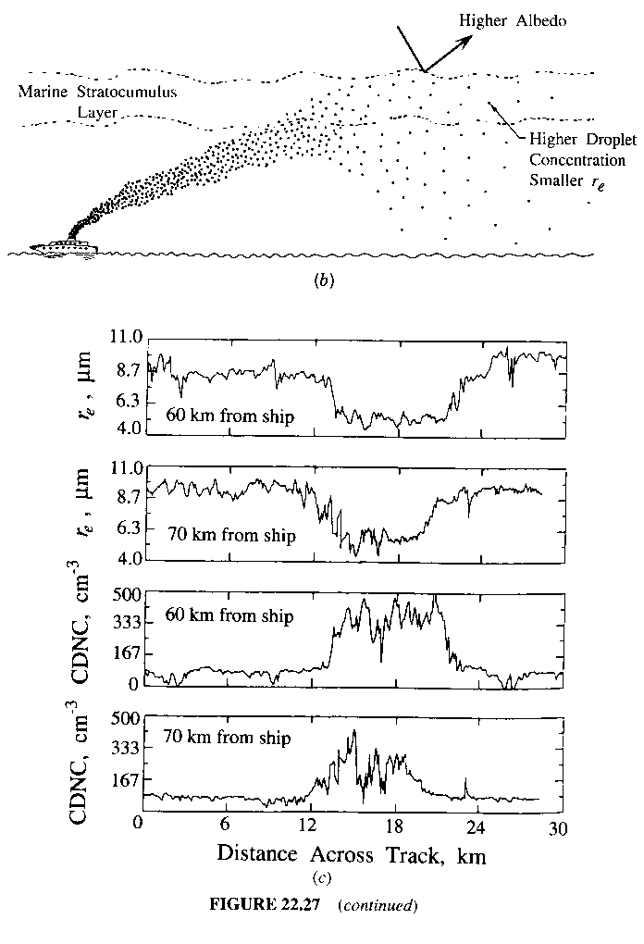
Ship Tracks
Ship
Ship Exhaust
CDNC = CCN
(# cloud condensation nuclei)

Slide 8
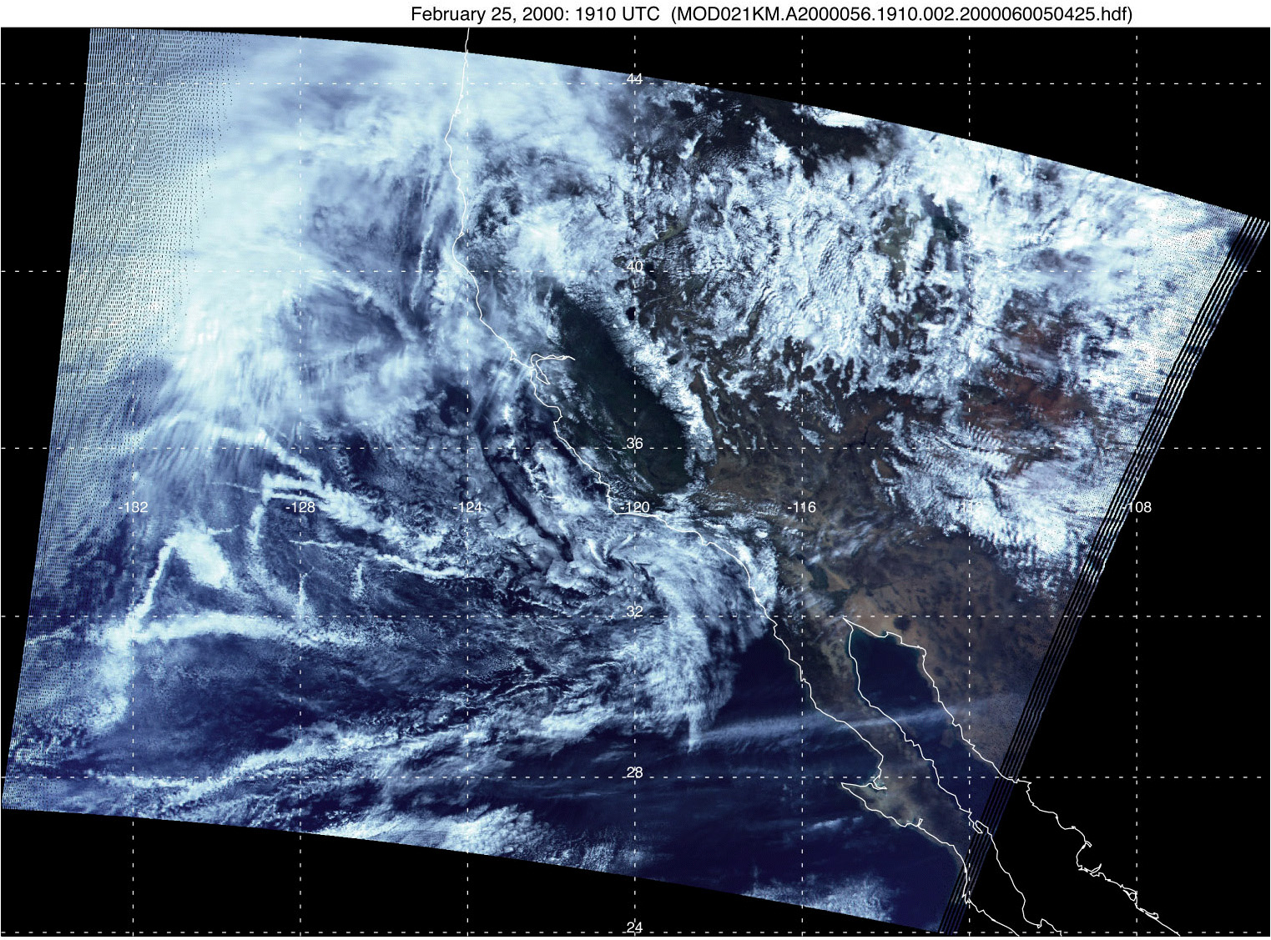
Indirect Effect in Nature (from MODIS satellite instrument)

Slide 9
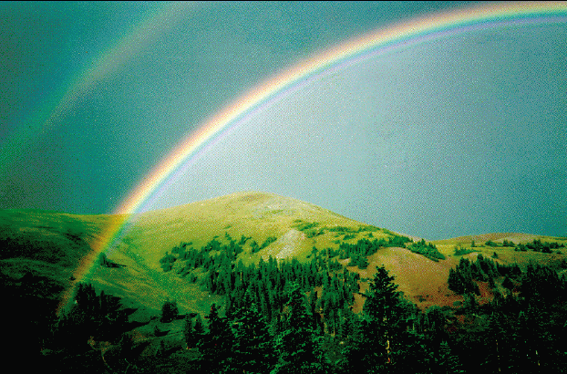
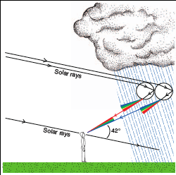
Geometrical Optics: Interpret Most Atmospheric Optics from Raindrops and lawn sprinklers (from Wallace and Hobbs CH4)
Rainbow from raindrops
Primary Rainbow Angle: Angle of Minimum Deviation (turning point) for rays incident with 2 chords in raindrops.
Secondary Rainbow Angle: Angle of Minimum Deviation (turning point) for rays incident with 3 chords in raindrops.

Slide 10
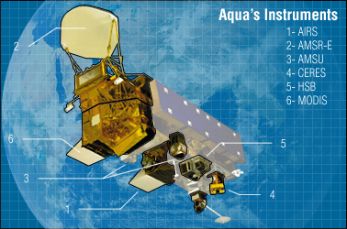
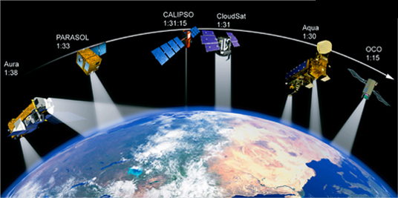
AMSR Sensor: http://wwwghcc.msfc.nasa.gov/AMSR/
NASA A-Train
In support of the Earth Science Enterprise's goals, NASA's Earth Observing System (EOS) Aqua Satellite was launched from Vandenberg AFB, California on May 4, 2002 at 02:54:58 a.m. Pacific Daylight Time. The primary goal of Aqua, as the name implies, is to gather information about water in the Earth's system. Equipped with six state-of-the-art instruments, Aqua will collect data on global precipitation, evaporation, and the cycling of water. This information will help scientists all over the world to better understand the Earth's water cycle and determine if the water cycle is accelerating as a result of climate change.
The Advanced Microwave Scanning Radiometer - EOS (AMSR-E) is a one of the six sensors aboard Aqua. AMSR-E is passive microwave radiometer, modified from the Advanced Earth Observing Satellite-II (ADEOS-II) AMSR, designed and provided by JAXA (contractor: Mitsubishi Electric Corporation). It observes atmospheric, land, oceanic, and cryospheric parameters, including precipitation, sea surface temperatures, ice concentrations, snow water equivalent, surface wetness, wind speed, atmospheric cloud water, and water vapor.

Slide 11
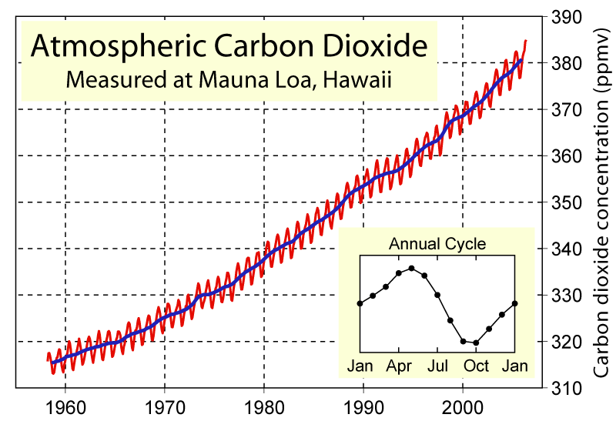
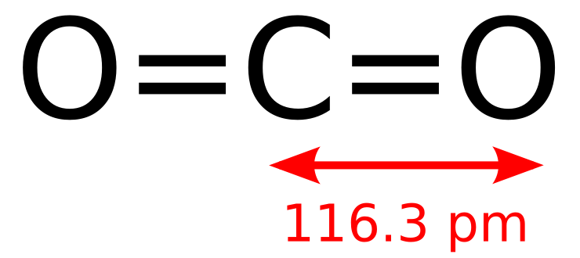
CO₂ Concentration: Annual Cycle (green=plants grow and take up CO₂, brown=leaves and plants decay and release CO₂)
Notes:
Seasonal trends in atmospheric CO2
The "wiggles" in the Mauna Loa curve reflect seasonal differences in carbon flows between the atmosphere and the biota. Two flows connect the atmosphere and biota. Photosynthesis moves carbon from the atmosphere to the biota. Respiration moves carbon from the biota to the atmosphere. To generate an annual cycle, photosynthesis must vary relative to respiration in a regular pattern. For some portion of the year, photosynthesis must be greater than respiration. During this period, there is a net flow of carbon from the atmosphere to the biota and the atmospheric concentration of carbon dioxide declines. At other times of the year, respiration must be greater than photosynthesis. During this period, there is a net flow of carbon from the biota to the atmosphere and the atmospheric concentration of carbon dioxide increases. What causes these regular changes in photosynthesis and respiration?
Many plants in temperate latitudes are either annuals or deciduous. Deciduous trees drop their leaves in the fall or during the dry season. Similarly, annual plants die during the fall and winter. The dead leaves and plants decay. As they decay, their carbon is returned back to the atmosphere. The flow of carbon to the atmosphere via respiration is larger than photosynthesis, and as a result, the atmospheric concentration of carbon dioxide increases through the fall, winter and into early spring.
In late spring and summer, this process is reversed. The seeds of annuals grow, deciduous trees regenerate their leaves, and photosynthetic rates in evergreens increase. Under these conditions, photosynthesis increases relative to respiration, and there is a net flow of carbon from the atmosphere to the biota. As a result, the atmospheric concentration of carbon dioxide decreases during the late spring and summer.
But this still does not explain the cycle. The seasons in the northern and southern hemisphere are out of phase. That is, when it is spring in the northern hemisphere it is fall in the southern hemisphere and vice-versa. Because there is some exchange of atmospheric CO2 between hemispheres, why doesn’t the spring-summer increase in photosynthesis in one hemisphere cancel the fall-winter increase in respiration in the other hemisphere? Equally important, does the peak in the annual cycle of atmospheric concentration of carbon dioxide occur in the early spring of the northern hemisphere or in the early spring of the southern hemisphere?
To answer these questions, one needs to remember the Mauna Loa is in the northern hemisphere and hence largely reflects conditions in the northern hemisphere. In addition, there are important differences between hemispheres regarding the ratio of land to water. The ratio of land to water is much greater in the northern hemisphere, which implies that the northern hemisphere has more land than the southern hemisphere. This difference is even greater in the temperate latitudes—most of the land in the southern hemisphere is in the tropics.
The difference in land area implies that the trough (the low point) in the annual cycle of atmospheric CO2 is determined by the growing season in the northern hemisphere. Because of the differences in land area, the rate of net primary production during the northern hemisphere growing season is greater than the amount of carbon returned to the atmosphere via the decay of biota in the southern hemisphere. Even if there were a complete exchange of CO2 between hemispheres (but there isn’t), the trough in the annual cycle of atmospheric carbon dioxide occurs during September.
Scientists use the annual cycle in an attempt to measure changes in biota in temperate latitudes. Scientists cannot balance the carbon cycle. Some scientists postulate that the increased concentration of carbon dioxide and/or higher temperatures stimulates photosynthesis, and this increase accounts for some of the “missing carbon.” If increased concentrations of atmospheric CO2 increase the biota in the temperate latitudes, the amplitude (the change from peak to trough) of the cycle may also increase. That is, there may be more biota regrowing each spring and decaying each fall. Several scientists have looked for a change in the amplitude of the cycle, but these analyses do not provide conclusive evidence for an increase in northern hemisphere biota.

Slide 12
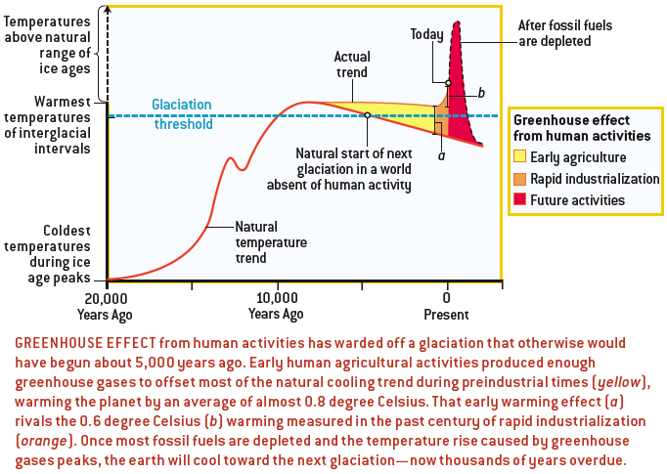
Hot!
William F. Ruddiman Feb 2005, Sci. Am: How Did Humans First Alter Global Climate? Hypothesis that our ancestors' farming practices kicked off global warming thousands of years before we started burning coal and driving cars

Slide 13
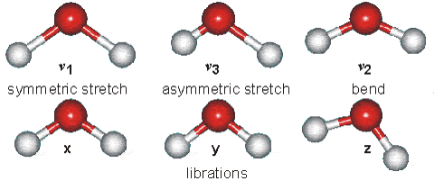
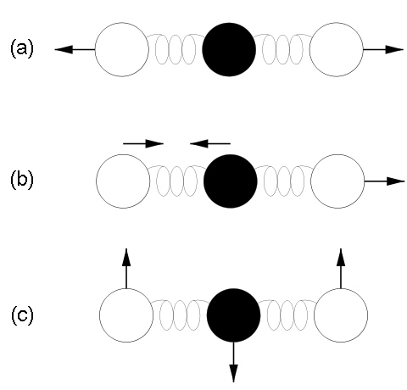



Some Energy States of Water Molecules
http://www.lsbu.ac.uk/water/vibrat.html
... of Carbon Dioxide Molecules
Vibration modes of carbon dioxide. Mode (a) is symmetric and results in no net displacement of the molecule's "center of charge", and is therefore not associated with the absorption of IR radiation. Modes (b) and (c) do displace the "center of charge", creating a "dipole moment", and therefore are modes that result from EM radiation absorption, and are thus responsible for making CO2 a greenhouse gas.
“15 um motion”

Slide 14
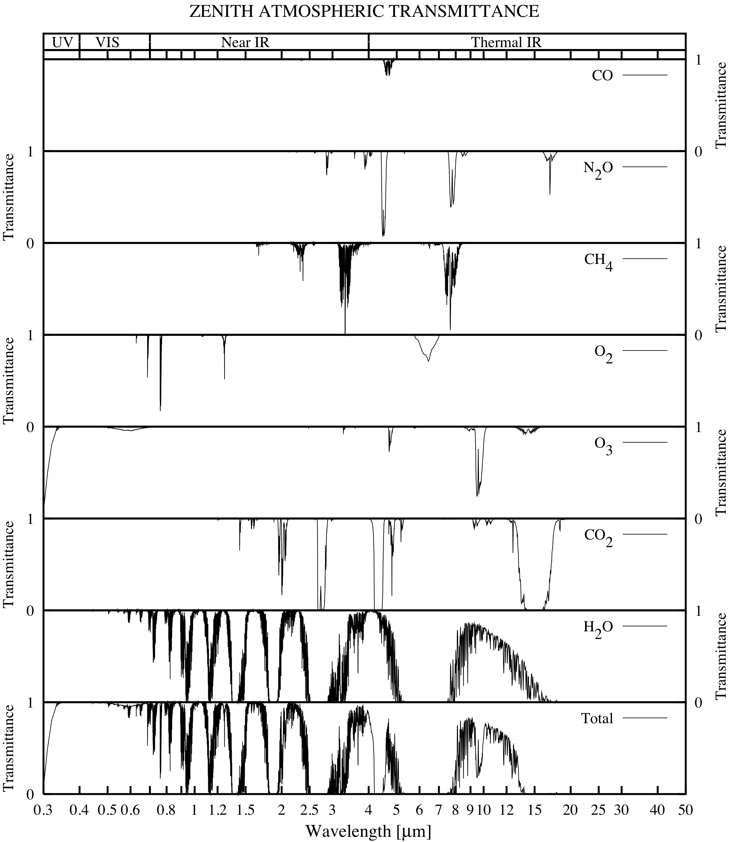
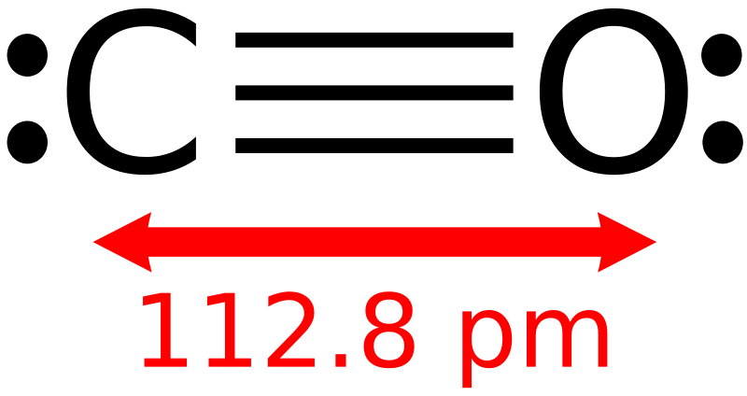
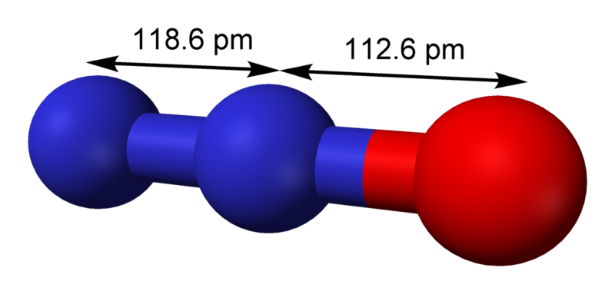
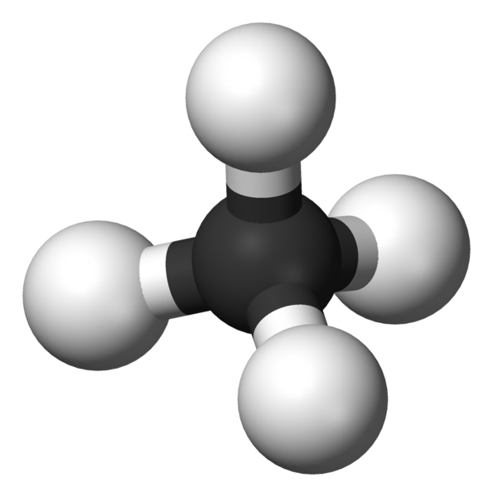
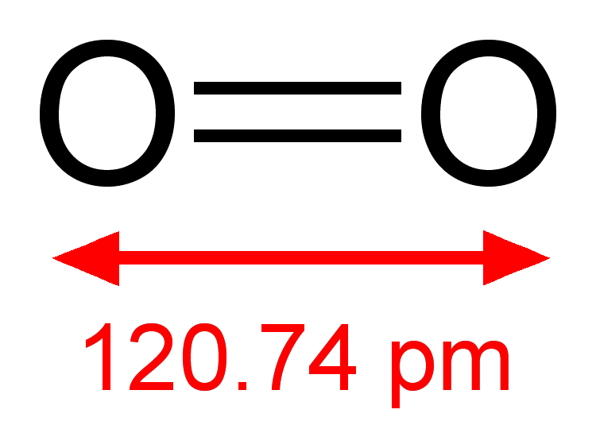
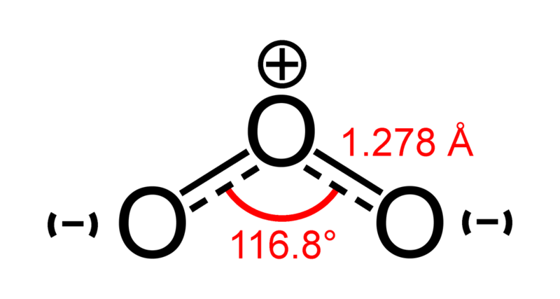
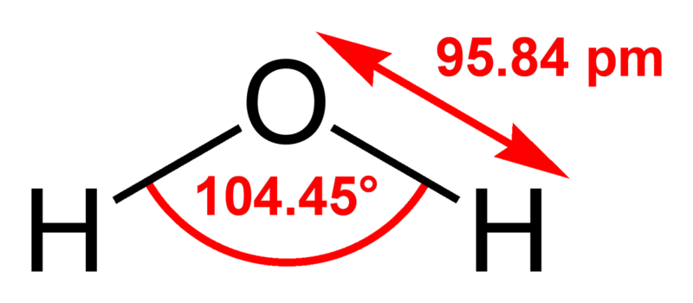
Atmospheric Transmission: Beer’s Law: I(x)=I₀e^{(-βabs x)}
What are the main sources for each gas?
Which gases are infrared active and contribute to greenhouse warming?
Which gases significantly absorb solar radiation?
Gas concentrations from ‘typical’ midlatitude summer atmosphere.
Nitrous oxide is emitted by bacteria in soils and oceans, and thus has been a part of Earth's atmosphere for eons. Agriculture is the main source of human-produced nitrous oxide: cultivating soil, the use of nitrogen fertilizers, and animal waste handling can all stimulate naturally occurring bacteria to produce more nitrous oxide. The livestock sector (primarily cows, chickens, and pigs) produces 65% of human-related nitrous oxide. [1] Industrial sources make up only about 20% of all anthropogenic sources, and include the production of nylon and nitric acid, and the burning of fossil fuel in internal combustion engines. Human activity is thought to account for somewhat less than 2 teragrams of nitrogen oxides per year, nature for over 15 teragrams.

Slide 15
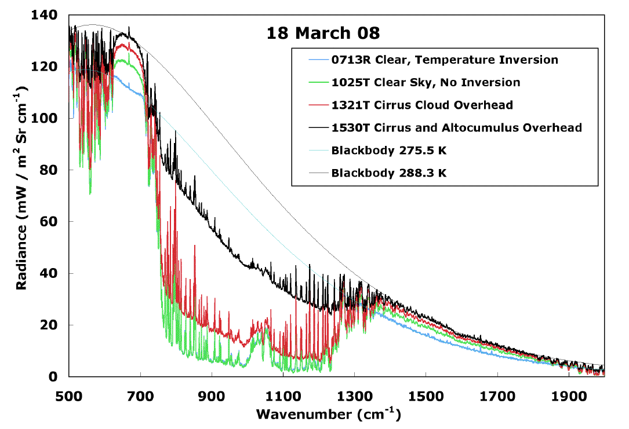
FTIR Radiance: Atmospheric IR Window
13 microns
8 microns

Slide 16

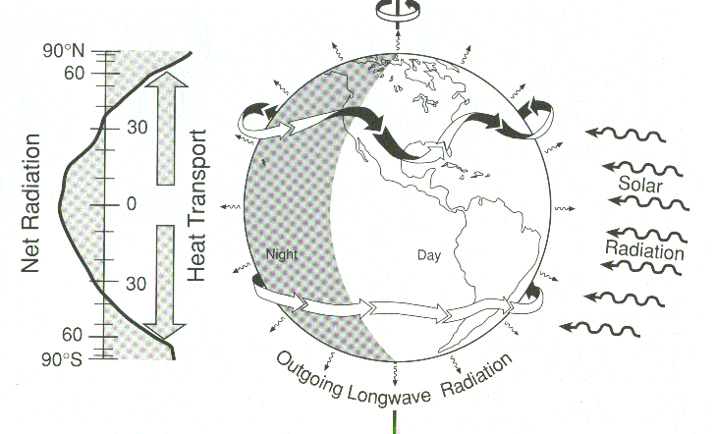
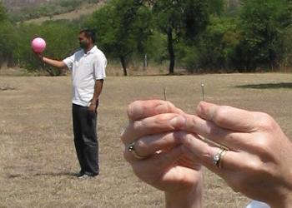
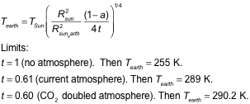
Earth’s Surface Temperature
T_{e} Earth’s radiative temperature
T_{s} Sun’s radiative temperature
R_{s} Sun’s radius
R_{se} Sun to Earth distance
a Earth’s surface solar reflectance
t IR transmittance of Earth’s atmosphere.

Slide 17
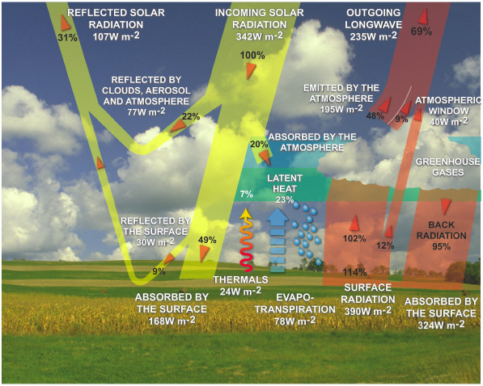
Radiation Balance

Slide 18
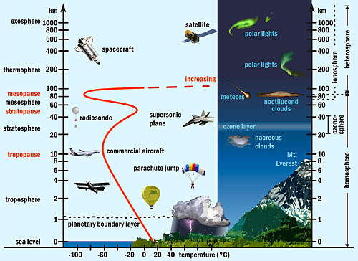
Earth’s Atmosphere: Vertical Distribution

Slide 19
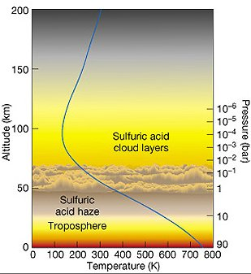
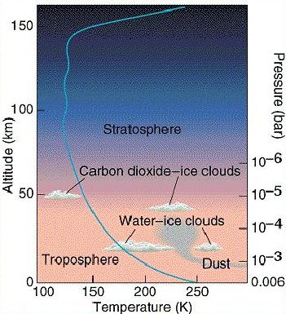
Terrestrial Planets: Properties of the Atmospheres
Properties all in Earth Units | EARTH | VENUS | MARS
Scale Heights of Atmospheric Distribution | 1 | 2 | 1.4
Surface Pressure | 1 | 92 | 0.006
Surface Number Density | 1 | 36 | 0.008
Column Number Density | 1 | 68 | 0.01
Total Atmospheric Mass | 1 | 92 | 0.004
VENUS
MARS

Slide 20
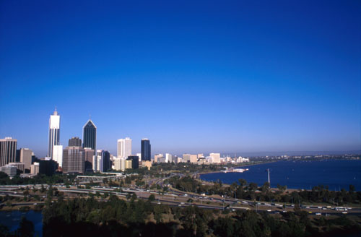
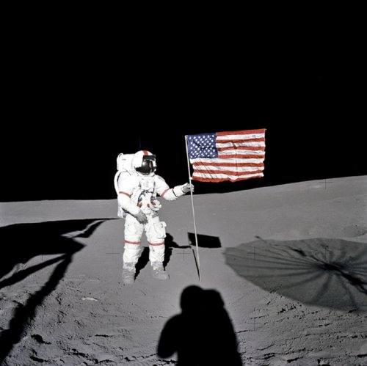
Terrestrial Planets: Global Average Surface Temperatures
 | Mercury (Lacks atmosphere, long day, close to sun) | Venus (Insulating atmosphere and runaway greenhouse effect) | Earth (Water filled oceans helps buffer its temperature) | Earth’s Moon (Like Mercury, lacks atmosphere) | Mars (similar to some of the coldest places on Earth)
Daytime | 400 C (750 F) | same as night | 20 C (75 F) | 110 C (230 F) | -5 C (20 F)
Night | -200 C (-330 F) | 464 C (864 F) | 10 C (40 F) | -150 C (-240 F) | -85 C (-120 F)
EARTH
MOON

Slide 21
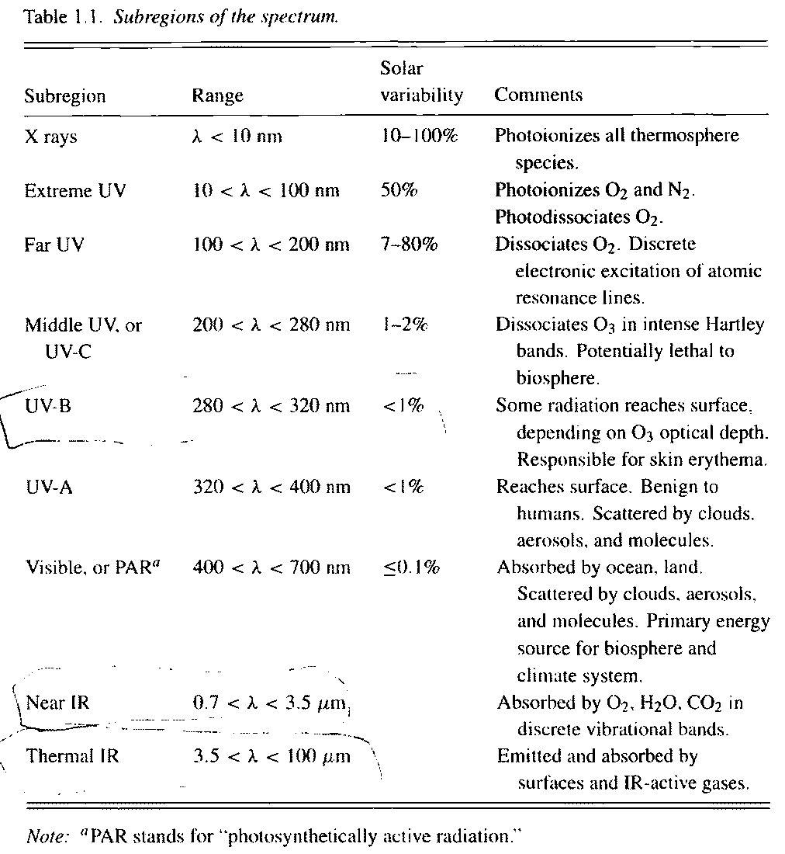
Spectral Regions

Slide 22
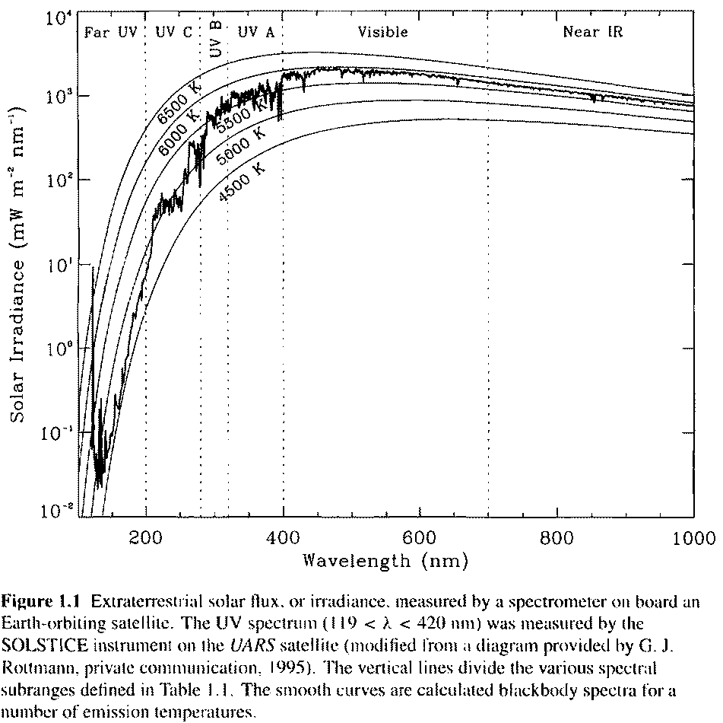
Top of Atmosphere Solar Spectrum

Slide 23
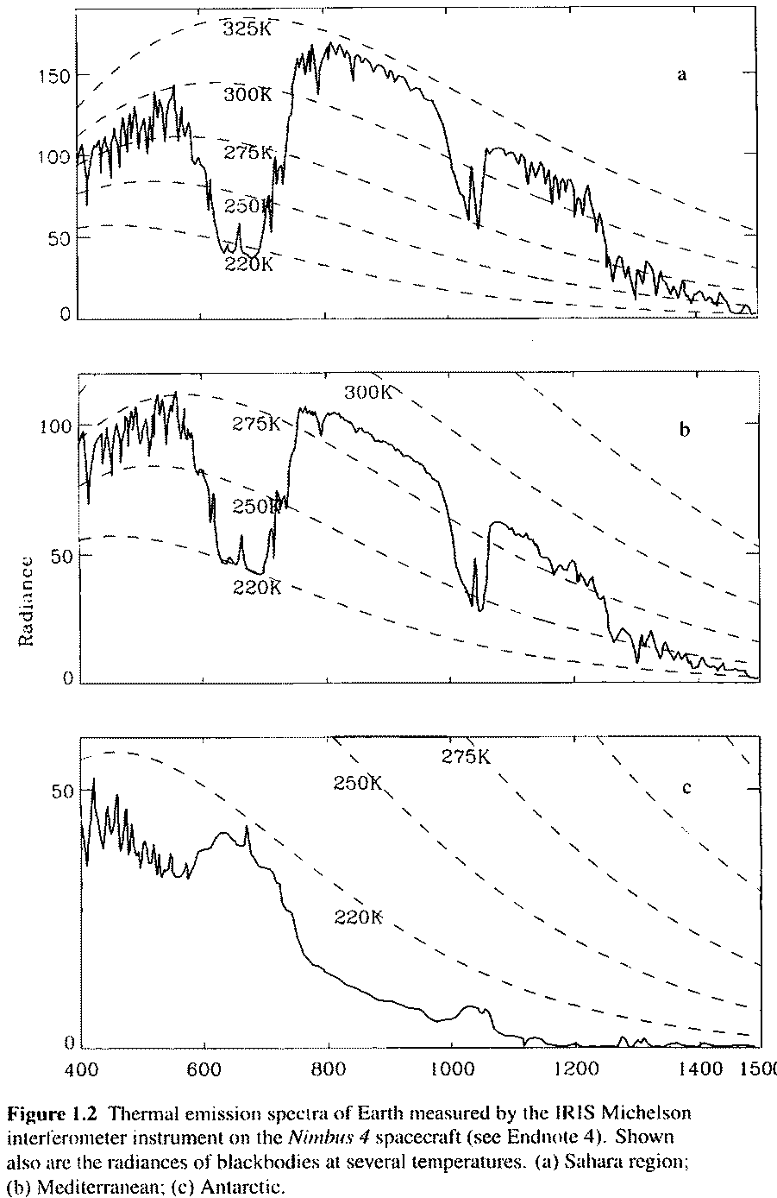
Infrared Spectra from Satellite Looking to Earth

Slide 24
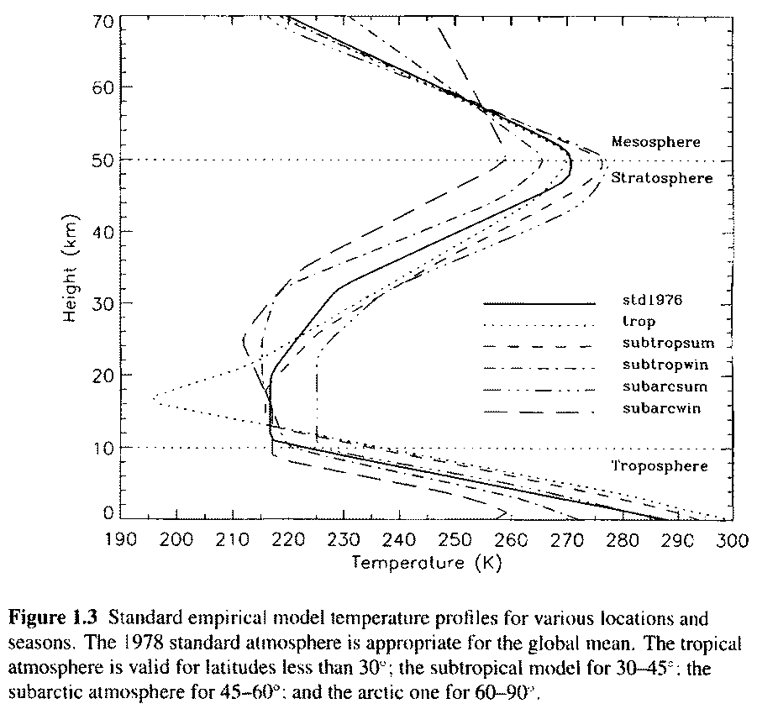
Standard Atmosphere Temperature Profiles

Slide 25
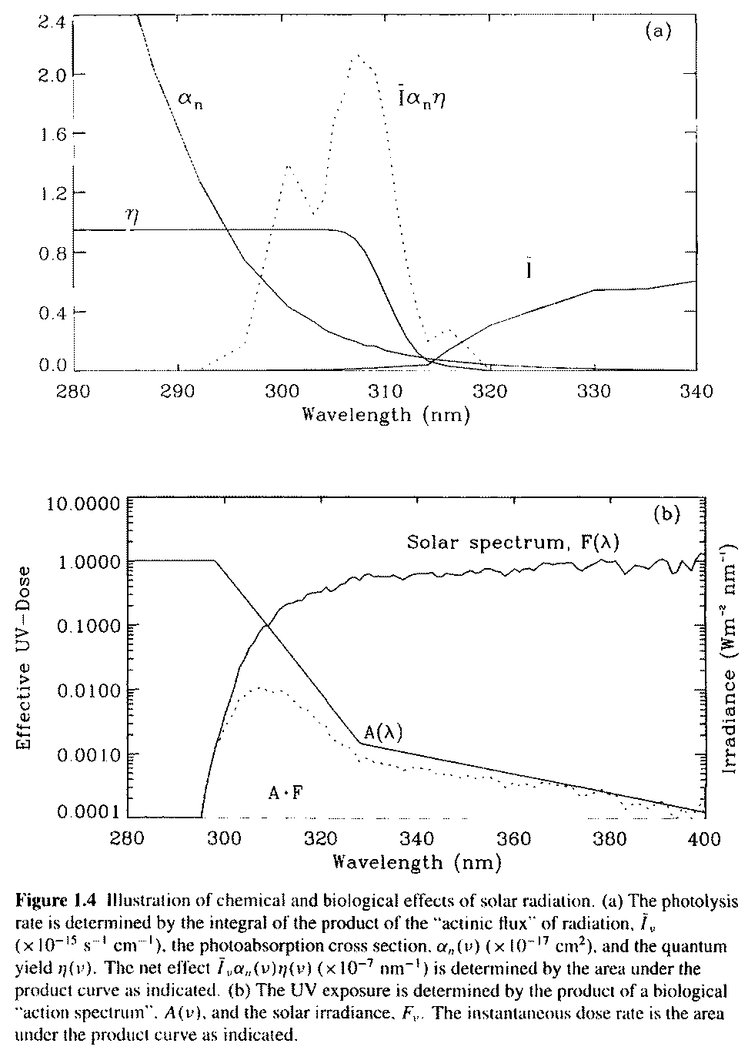
Actinic flux and UV Dose

Slide 26
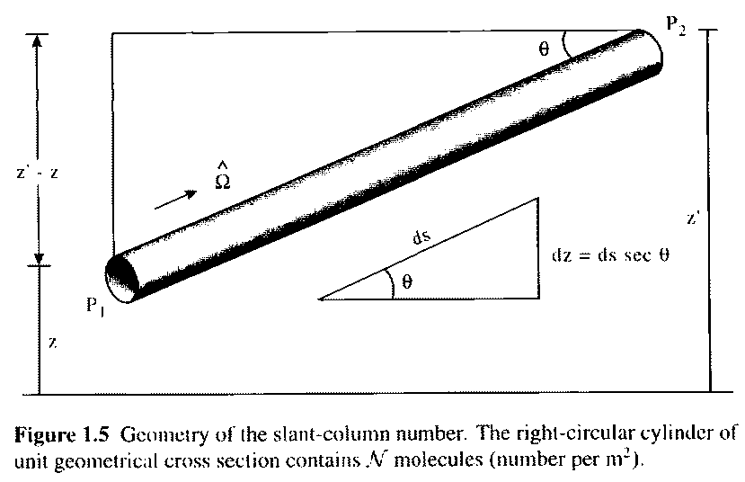

Column Content Calculation Geometry: e.g. how much water vapor mass is in this column?

Slide 27
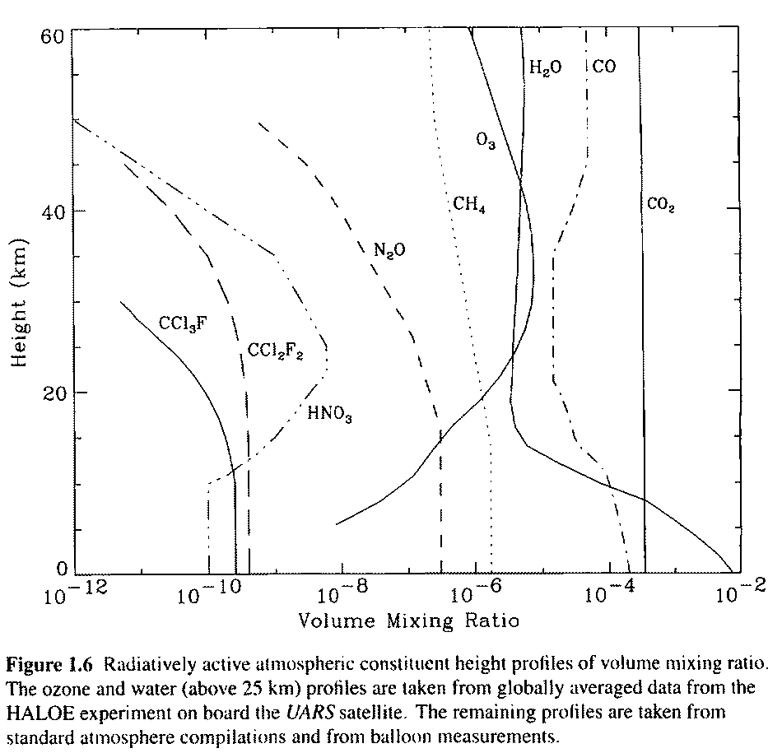
Gas Distribution

Slide 28
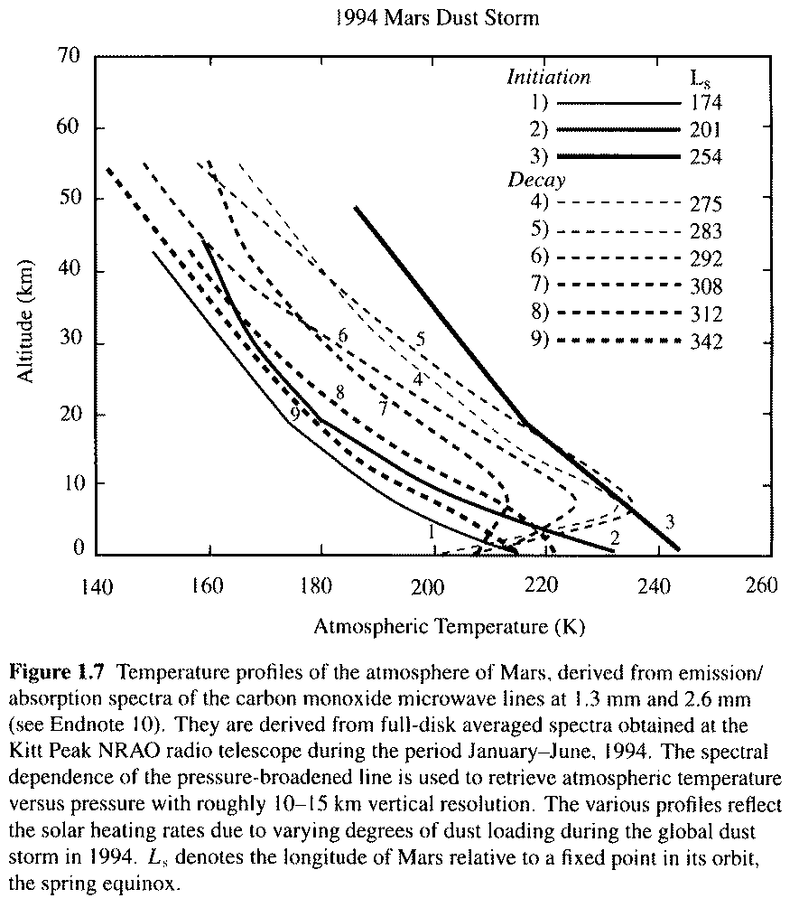
Dust Blocks Solar Radiation on Mars: Causes Temperature Inversions

Slide 29
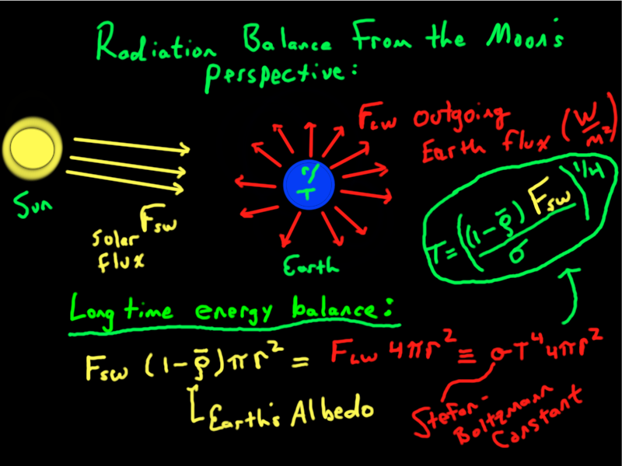
Expand and Explore Radiative Forcing: Start Simple…

Slide 30
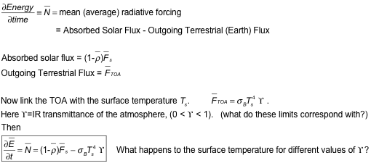
Conservation of Energy (1st ‘law’ of Thermo)
Basic idea of the ‘greenhouse’ or infrared effect…

Slide 31
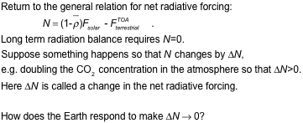
Change in the Net Radiation Balance: Radiative Forcing

Slide 32

Like this…

Slide 33

Interpretation of the Surface Temperature Change

Slide 34

Example: Double CO₂ and calculate T_{surface}.

Slide 35

Forcings and Feedbacks to Surface Temperature

Slide 36



Radiative Forcing Estimates

Slide 37

Temperature Distribution in the Ocean

Slide 38

Seasonal and Latitudinal Clear Sky Solar Radiation at the Surface

Slide 39

Seasonal Variation of Ocean Temperature at one Location

Slide 40

Typical Absorption Coefficient for Ocean Water

Slide 41

Radiation Penetration Depth Idea

Slide 42

Radiation Penetration Depth for Ocean Water

