Slide 1
Fast Response (< 1 sec) Thermistor Temperature Sensor
By Pat Arnott
Atmospheric Science Program
University of Nevada Reno
3D printing by Jayne Boehmler, Atmospheric Science Grad Student
Circuit board machining Wade Cline, Physics Dept Machinist
All design files and modeling files included in project outcome.

Slide 2
Motivation for the Temperature Sensor: The Perlan Project – Go for the World’s Record Altitude Glider Flight.
The Perlan 2 glider aircraft will ride atmospheric gravity waves, made stronger by interaction with the Antarctic vortex, to a record height for a glider ≈ 30 km altitude. Temperature measurements allow for mapping of the wave structure to characterize it, and help navigate.
http://www.perlanproject.org/aircraft
From http://pubs.rsc.org/en/content/chapterhtml/2015/bk9781782620761-00001?isbn=978-1-78262-076-1

Slide 3
Based on the Amphenol Thermistor BR11KA152M (available through Mouser)

Slide 4
Based on the Amphenol Thermistor BR11KA152M (available through Mouser)
Guides Circuit for Measuring Thermistor Resistance

Slide 5
Nominal Temperature Table and Stein Hart Equation: Note R(T=25 C) = 1.5 kOhm
where for that table, T is in Celcius, R is in Ohms, and
A= 1.051740553e-3,
B= 3.042515034e-4,
C= 1.974195817e-7.
Stein Hart Coefficients were calculated from the website below, using the table values for resistance at -80 C, -40 C, and 25 C.
The website for the Stein Hart calculator is http://www.thinksrs.com/downloads/programs/Therm%20Calc/NTCCalibrator/NTCcalculator.htm

Slide 6
Design Using a Voltage Divider Circuit, Thermistor Resistance, and Fixed Resistance = 1 Mohm.
Fixed resistance = 1 MegOhm chosen to keep thermistor power dissipation below 0.007 mW.

Slide 7
Design Using a Voltage Divider Circuit, Thermistor Resistance, and Fixed Resistance = 1 Mohm.
Maximum thermistor voltage is about 1 volt. The AD623 instrument amplifier provides gain of 4.834.
The ADS1115 analog to digital convertor was chosen because it provides programmable gain of
1, 2, 4, 8, and 16, so that it can help provide good measurements at warmer temperatures where the voltage is about 8 mv.

Slide 8
Sensor Head Schematic: Note the thermistor is sandwiched between 500 kOhm resistors

Slide 9
Sensor Head Board Layout Dots are 0.1” apart
Top side
(ground plane)
Bottom side
(5v plane)
Yellow is from top side
stencil

Slide 10
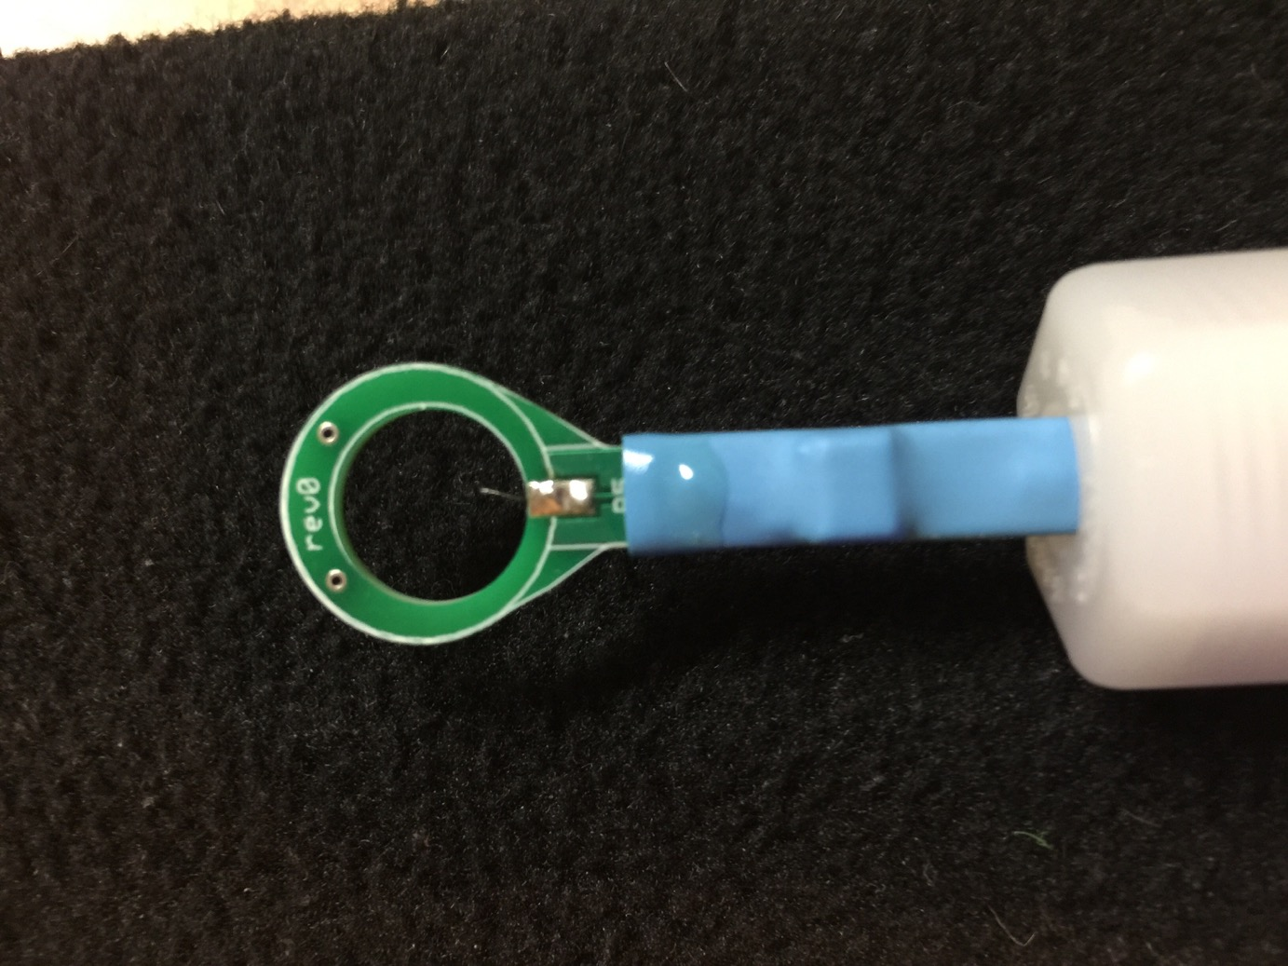
Actual Board

Slide 11
Receiving Board Layout Sensors: Digital and analog pressure, GPS, Digital temperature and RH, Thermistor, 5 analog inputs for Teensy Teensy 3.6 microcontroller with real time clock and microSD card data storage. Nokia 5110 display screen Power from 12 volts in, converted to 5 volts. Battery backup for the real time clock

Slide 12
Transceiver on Receiving Board Purpose: Convert TTL serial output to RS232 standard for old style serial port on computer

Slide 13
Control Board Layout: Front Side

Slide 14
Control Board Layout: Back Side (note capacitors C1 through C5)
Yellow stencil is from the front side

Slide 15
3D print box for circuit board

Slide 16
3D print box top: Slot is for wires from thermistor and digital T and RH sensors

Slide 17
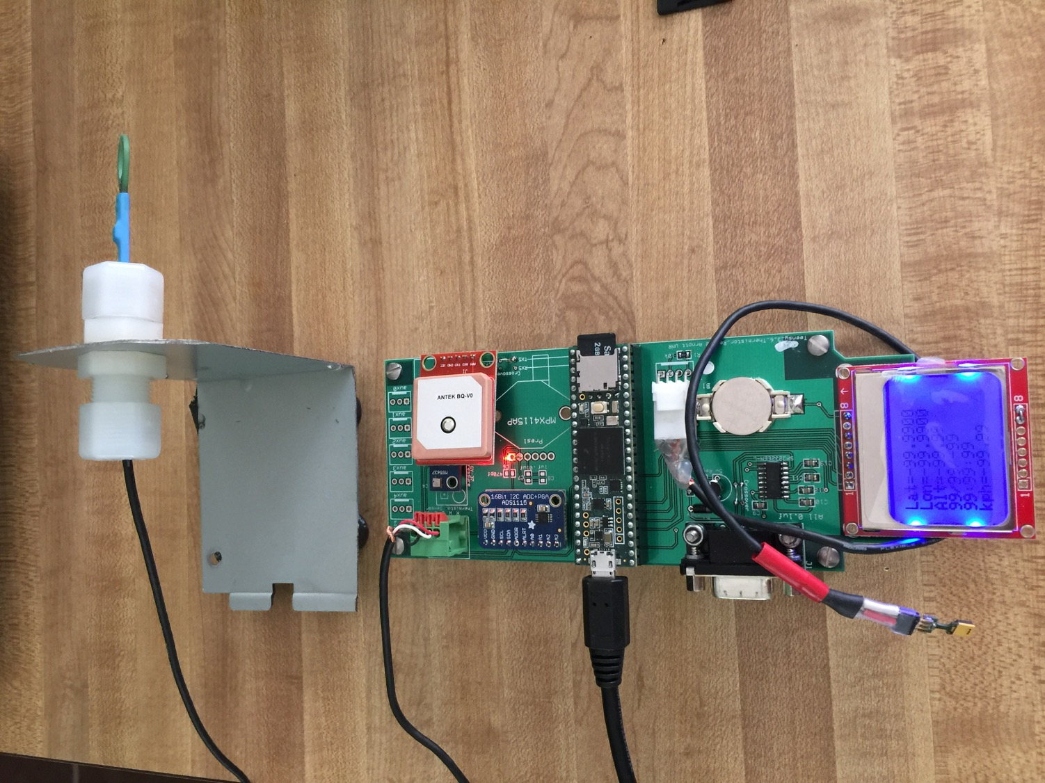
Board and Sensor

Slide 18
Theoretical Time Response:
Based on the paper: N. K. Wagner, “Theoretical Time Constant and Radiation Error of a Rocketsonde Thermistor” Journal of Meteorology, vol. 18, 1961, pgs. 606-614.
Figure 1 of the paper is shown here. We will use the theory to an altitude of 25-30 km.
The thermistor in this paper is ventilated as a sensor attached to a falling parachute released when the rocket reaches peak altitude. Note that parachute fall speed increases with height, while time constant increases as well, making the measurement all the more difficult.

Slide 19
Theoretical Time Response:
Based on the paper: N. K. Wagner, “Theoretical Time Constant and Radiation Error of a Rocketsonde Thermistor” Journal of Meteorology, vol. 18, 1961, pgs. 606-614.
Figure 2 of the paper is shown here. We will use the theory to an altitude of 25-30 km.
The thermistor in this paper is ventilated as a sensor attached to a falling parachute released when the rocket reaches peak altitude. Note that parachute fall speed increases with height, while time constant increases as well, making the measurement all the more difficult.
The Perlan aircraft moves much faster (horizontally) than the parachute falls, so time response calculations are upper estimates.

Slide 20
Theory
Implemented in Fortran, with subroutines I wrote years ago for the thermal physical properties of air.
Atmospheric temperature and pressure vs height taken from this simple description:
https://www.grc.nasa.gov/www/k-12/airplane/atmosmet.html

Slide 21
Model Atmosphere

Slide 22
Our Thermistor Calculated Time Response as if it were falling with a parachute
Unrealistic above
25 km.
Convective heat transfer coefficient needs change. (See fig. 1 of paper for more correct shape).
Notes: Reasonably matches product claim of 0.8 seconds in still air at the ground. Since aircraft speed is probably an order of magnitude larger than parachute (at least), theory is providing an upper limit for the time response.

Slide 23
Our Thermistor Calculated Time Response as if it moving at 10x fall speed of parachute.
Notes: Time response calculation for speed a factor of 10 faster than a falling parachute.

Slide 24
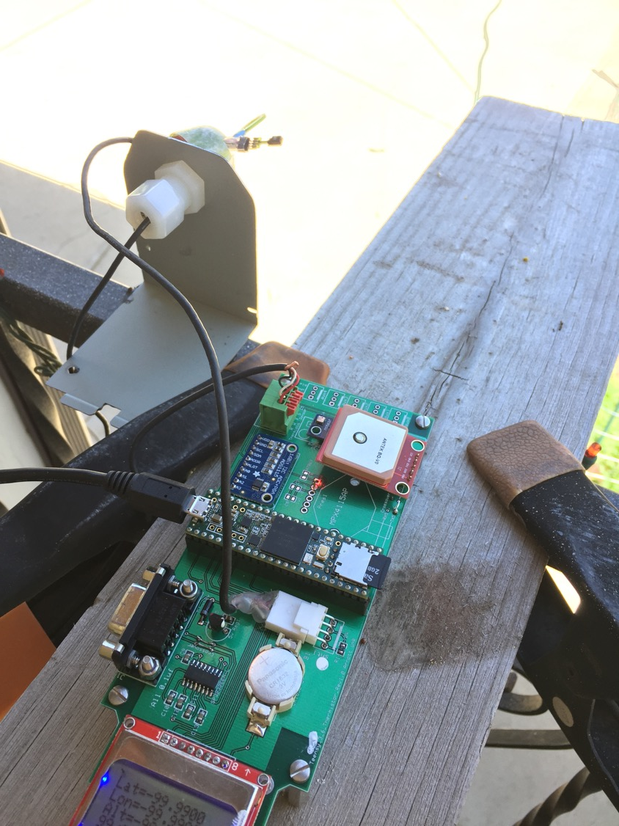
Overnight Testing Set Up

Slide 25
Testing in Ambient Conditions: Overnight

Slide 26
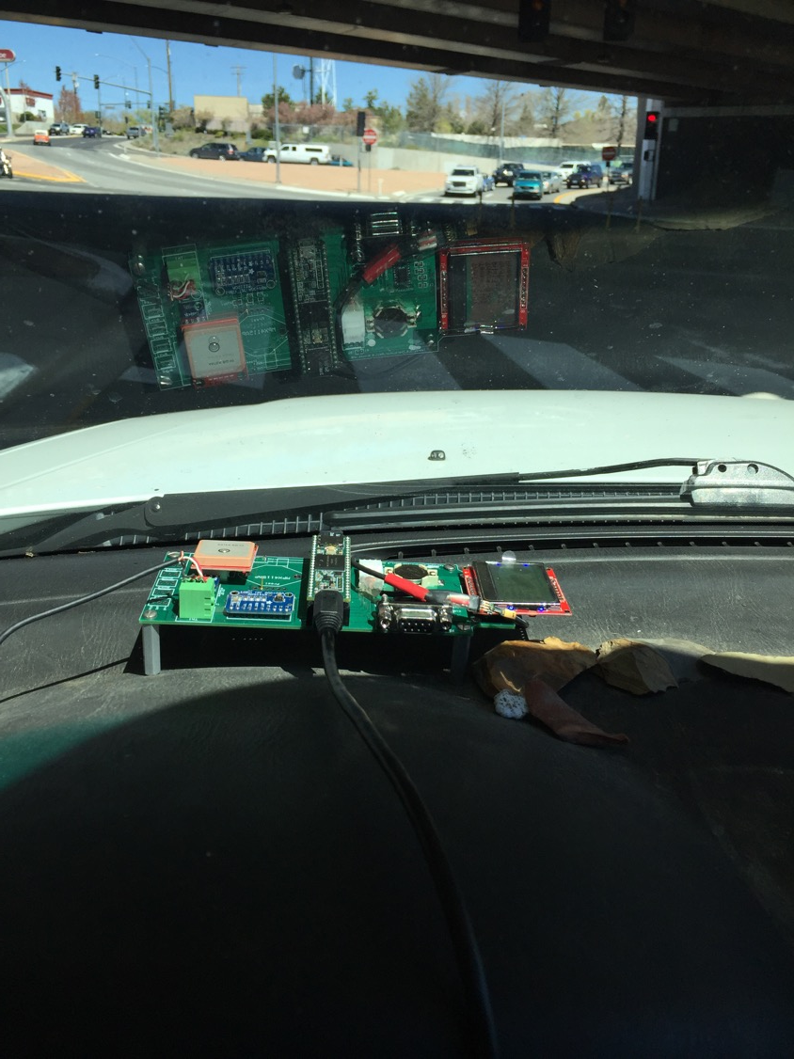
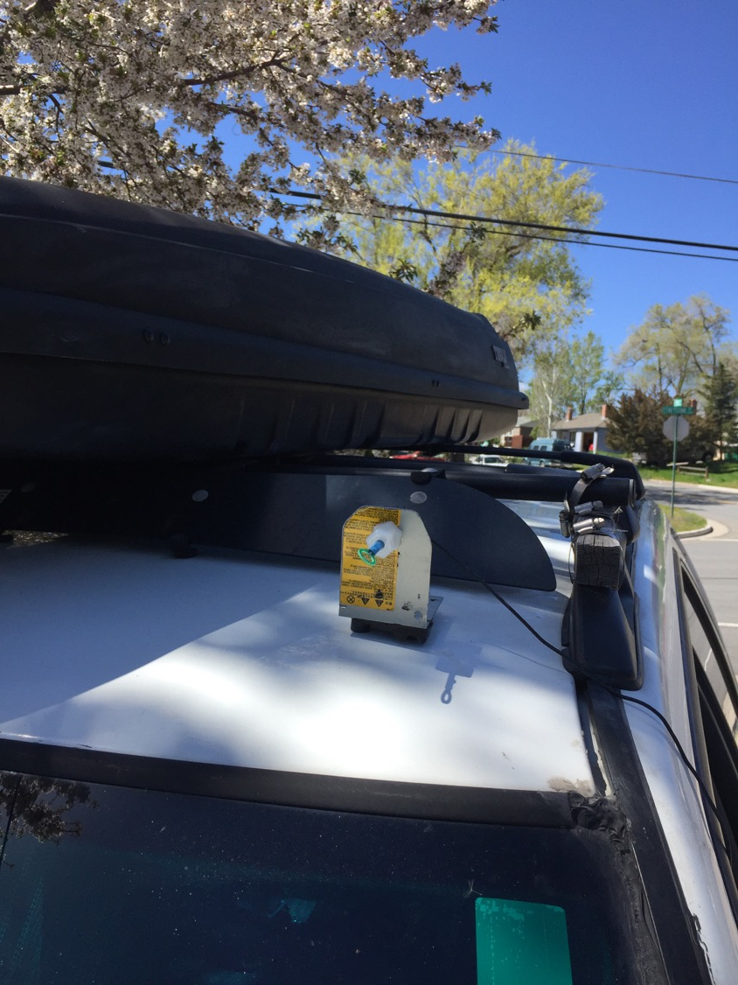
On Road Set Up

Slide 27
Testing Driving in Car along I80 in Reno using GPS on control board for speed sensor

Slide 28
Freezer Test: Suddenly put Thermistor in Upright Freezer.

