Slide 1
The use of the Arduino Mega Prototype Shield in making fully automated Sonic Anemometer
ATMS 748
Class - project
Group members:
Jehren Boehm
Karimar Ledesma
Saroj Dhital

Slide 2
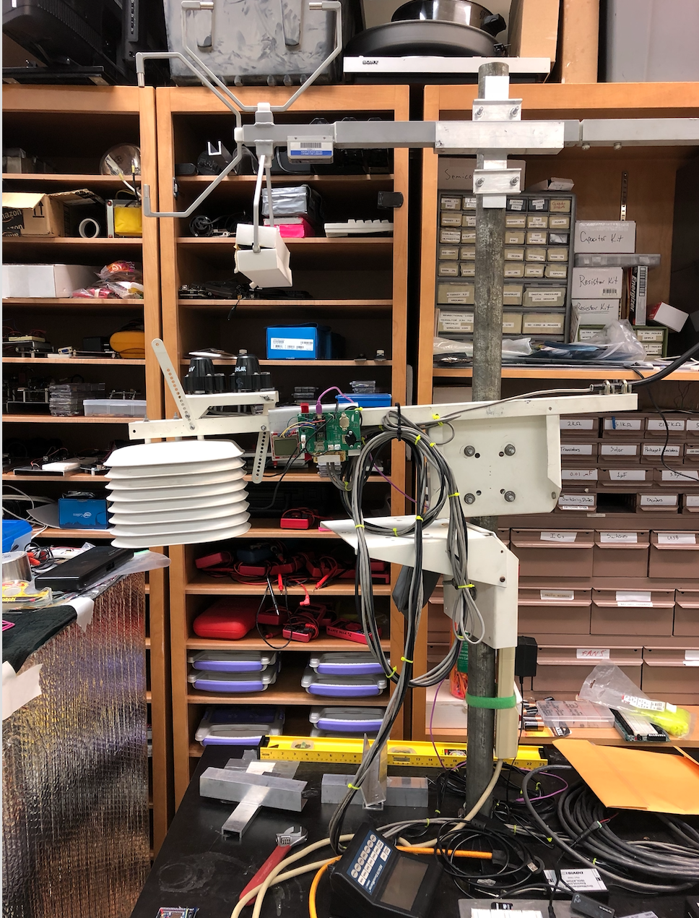
Motivation
Sonic anemometer was used to operate with electric power, which might be one of the problem if needs to runs this device in rural places.
Computer setup is required to run the system.
More power is required

Slide 3
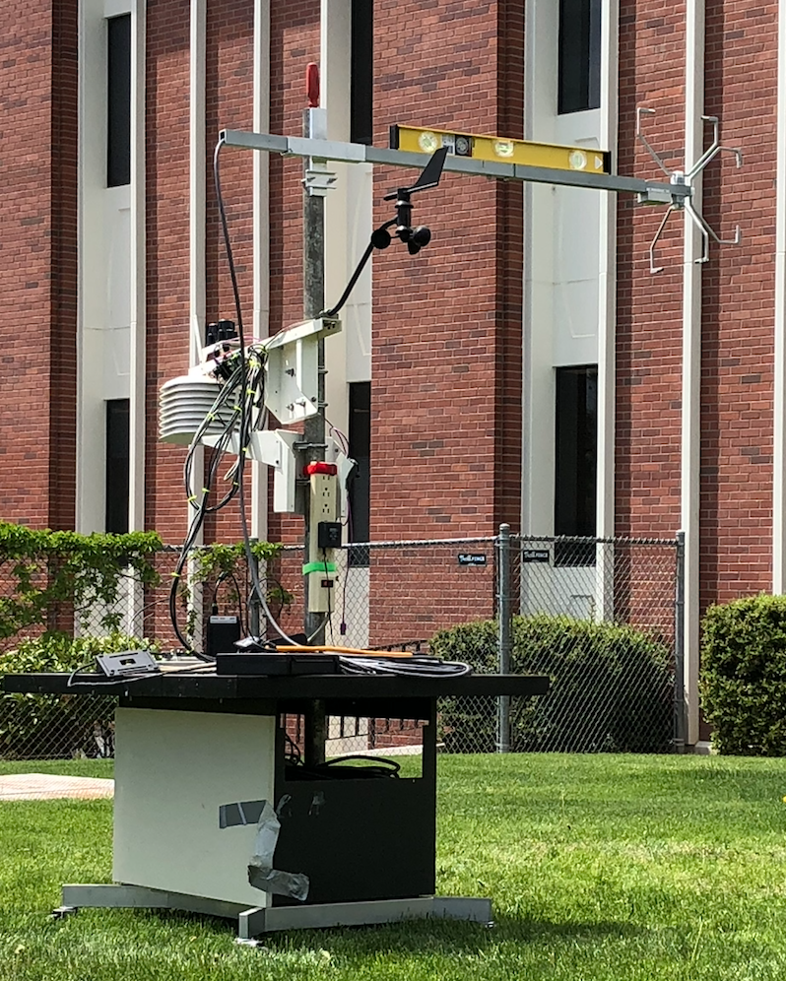
Objective
To make the Anemometer fully automated :
Device can run through solar power.
Store the data in memory card and transfer through radio signal.
To gain a better understanding about micro-meteorology (e.g., turbulent kinetic energy).

Slide 4
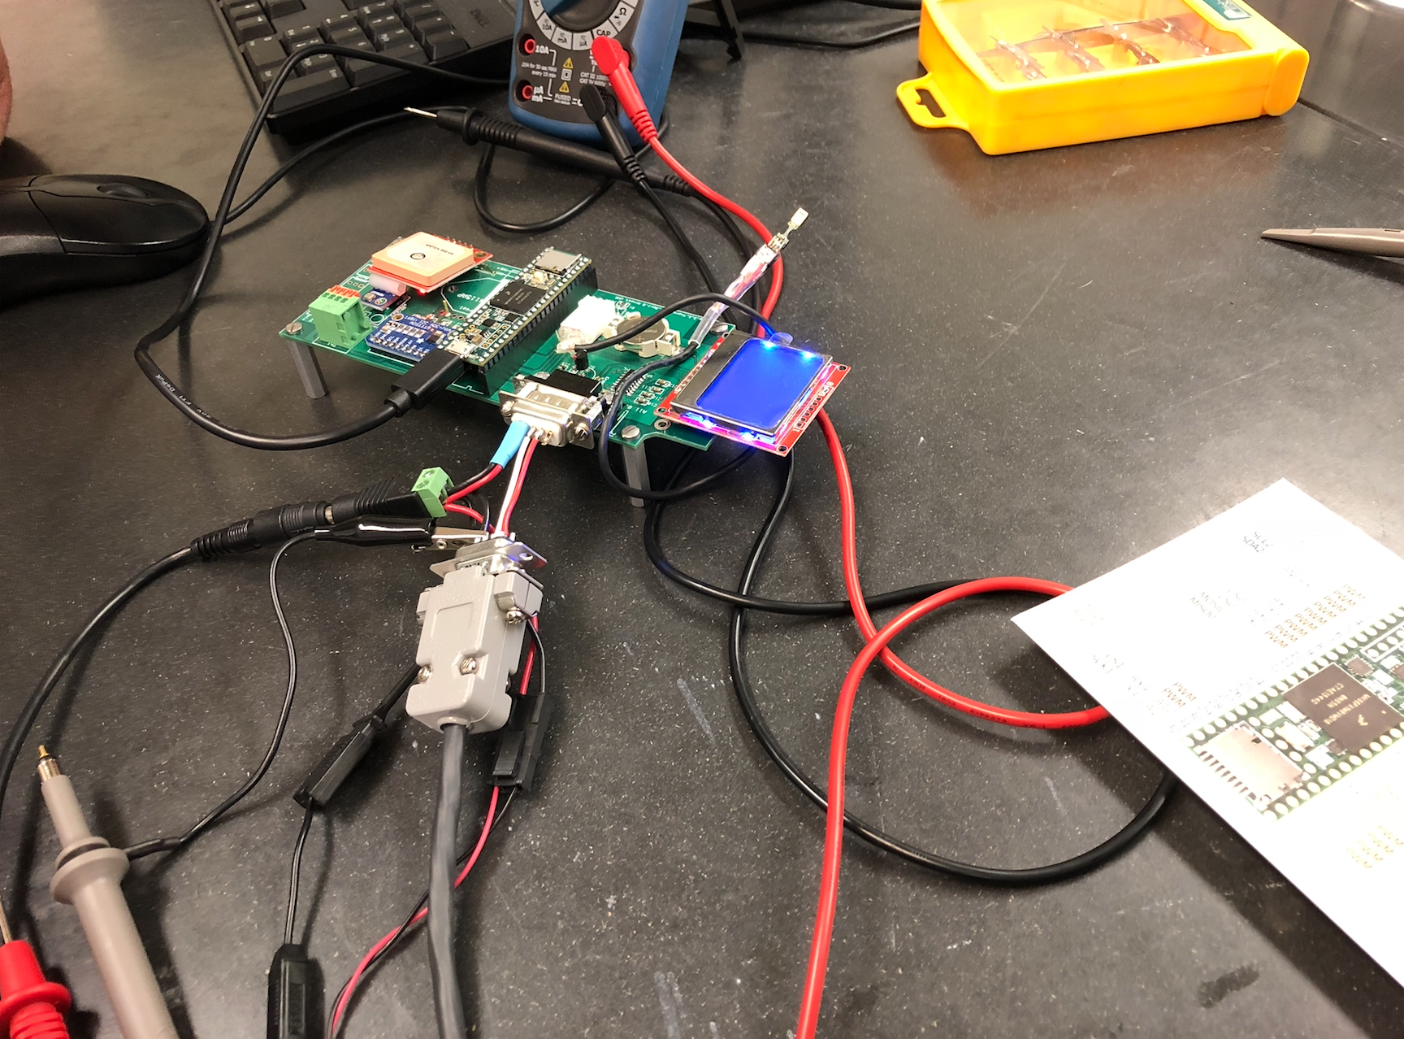
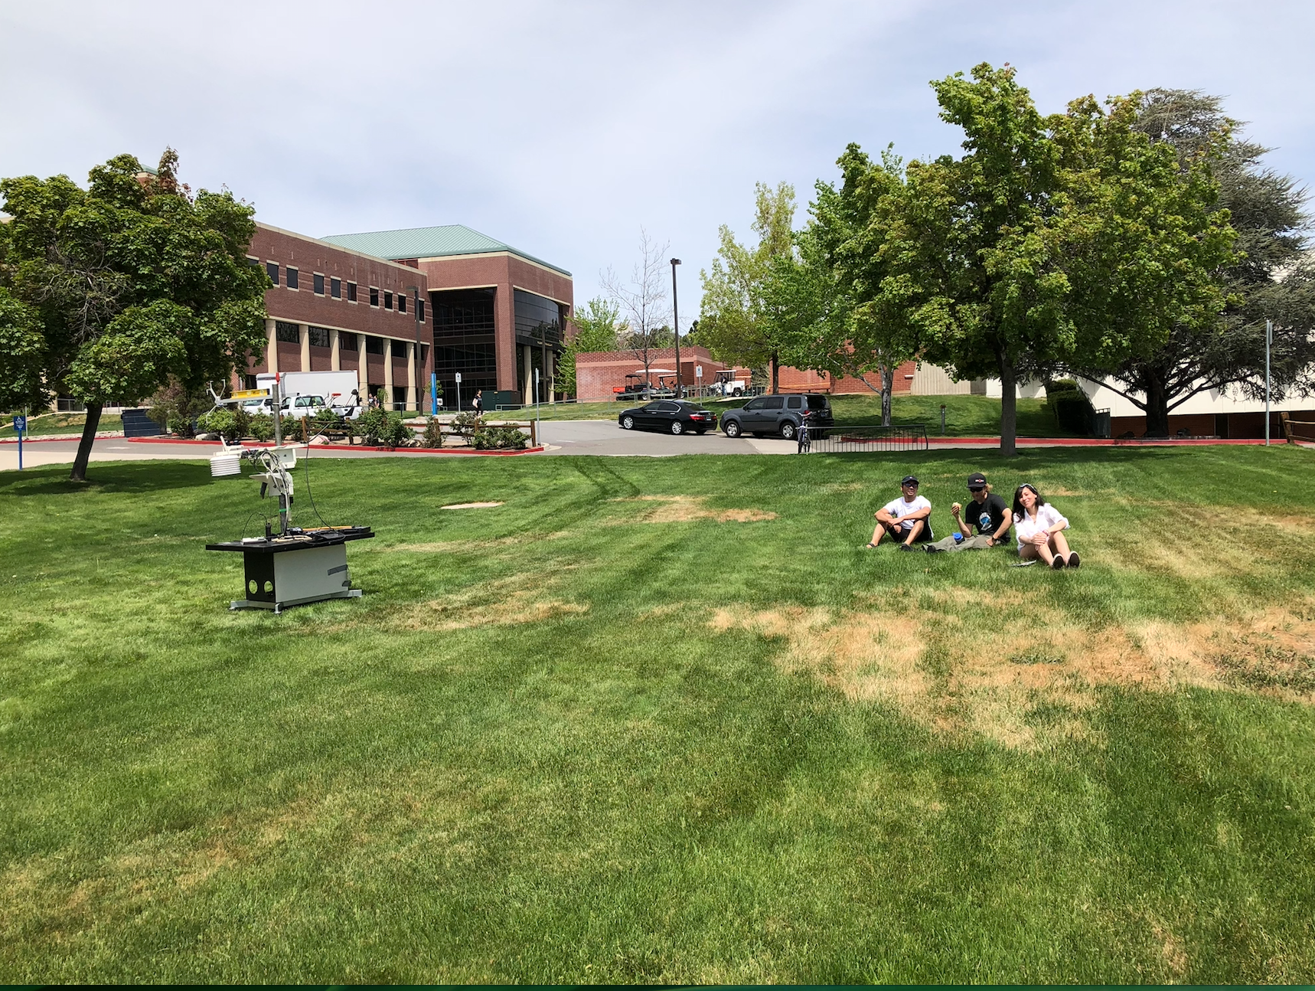
Working pathway

Slide 5
Sonic Anemometer/Thermometer
Model SATR/3K
Serial #050802
The Sonic Anemometer/Thermometer is a wind sensor. It is able to measure the wind velocity in three different direction(x,y,z) with reliable accuracy.
The instrument measure the wind velocity by transmitting and receiving sonic signals along the fixed orthogonal directions. After processes these signal in the microcomputer it then calculates the wind velocity in the three directions.
It is free from contamination from other velocity components, pressure, temperature, and relative humidity.
It provides wind velocity data with higher frequency (10Hz).
(Applied Technologies, Inc.,19--)

Slide 6
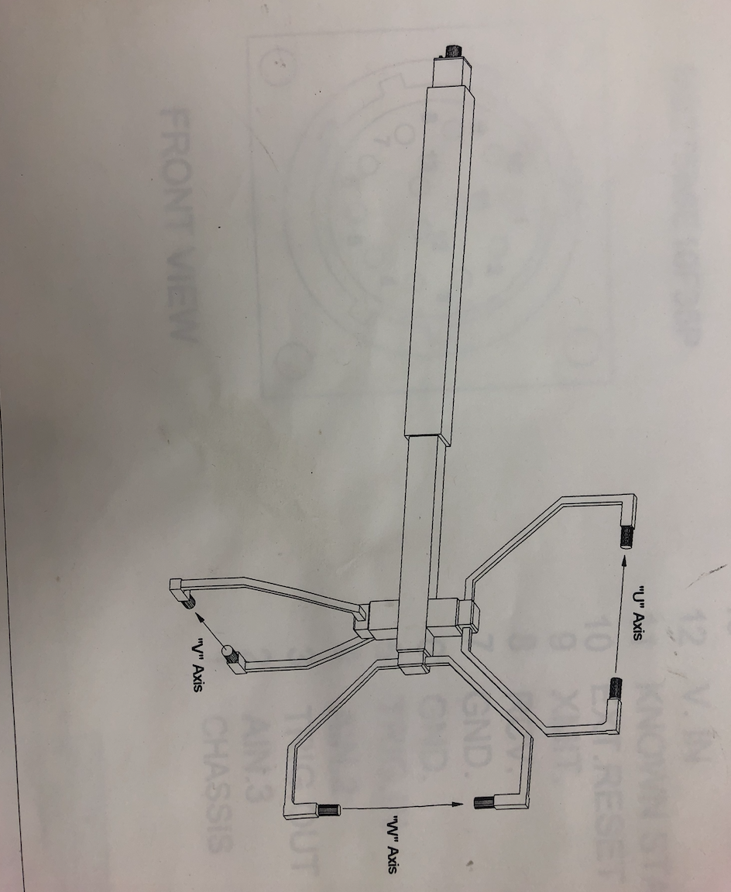
Probes in sonic anemometer
Transducers
Direction of probes are similar to right hand rule

Slide 7

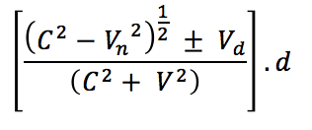
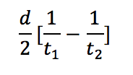

Working equations of sonic anemometer
Speed of sound (C) =
Transient time from one probe to another (t) =
Velocity parallel to the sound path (Vd) =
Sonic/Virtual temperature (Tv) =

Slide 8
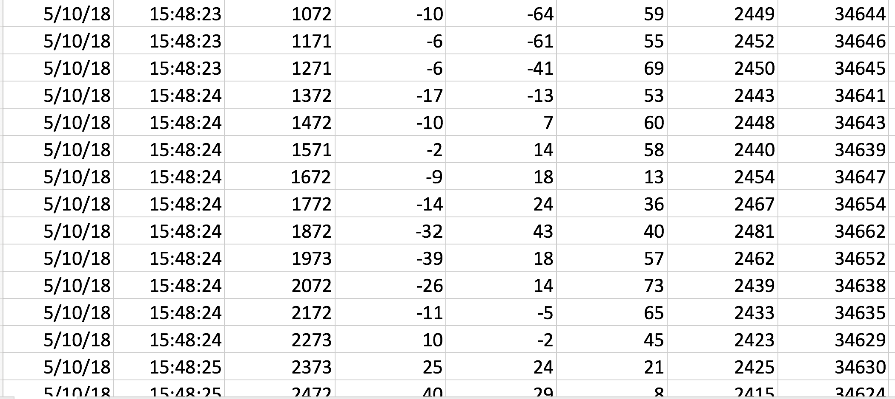
Sample data

Slide 9
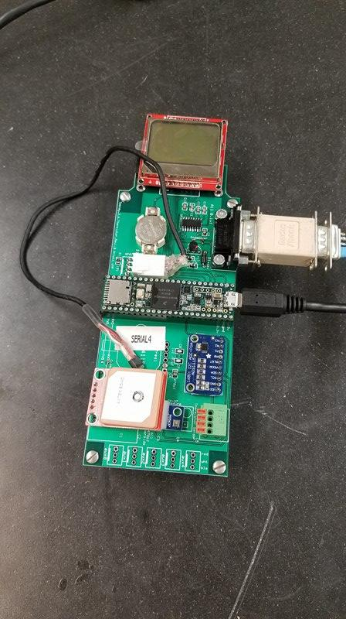
Setting up the Sonic Anemometer
First trial using Teensy 3.6 (32 bit Arduino-compatible microcontroller):
Try the serial event on backwards through usb out send:
Computer to computer through Teensy (= all bit levels)
Serial to USB transceiver
2. Try binary 8 bit no parity with hex conversion
-Should work compactly with serial monitor
Conclusion: Teensy is not compatible with 7E1 Serial Communication

Slide 10
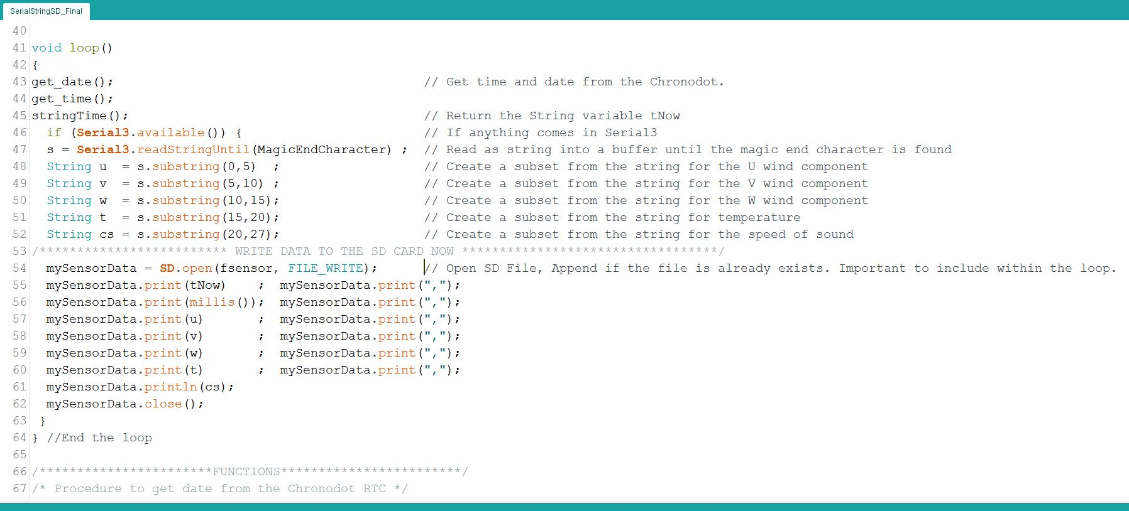
The Code:

Slide 11
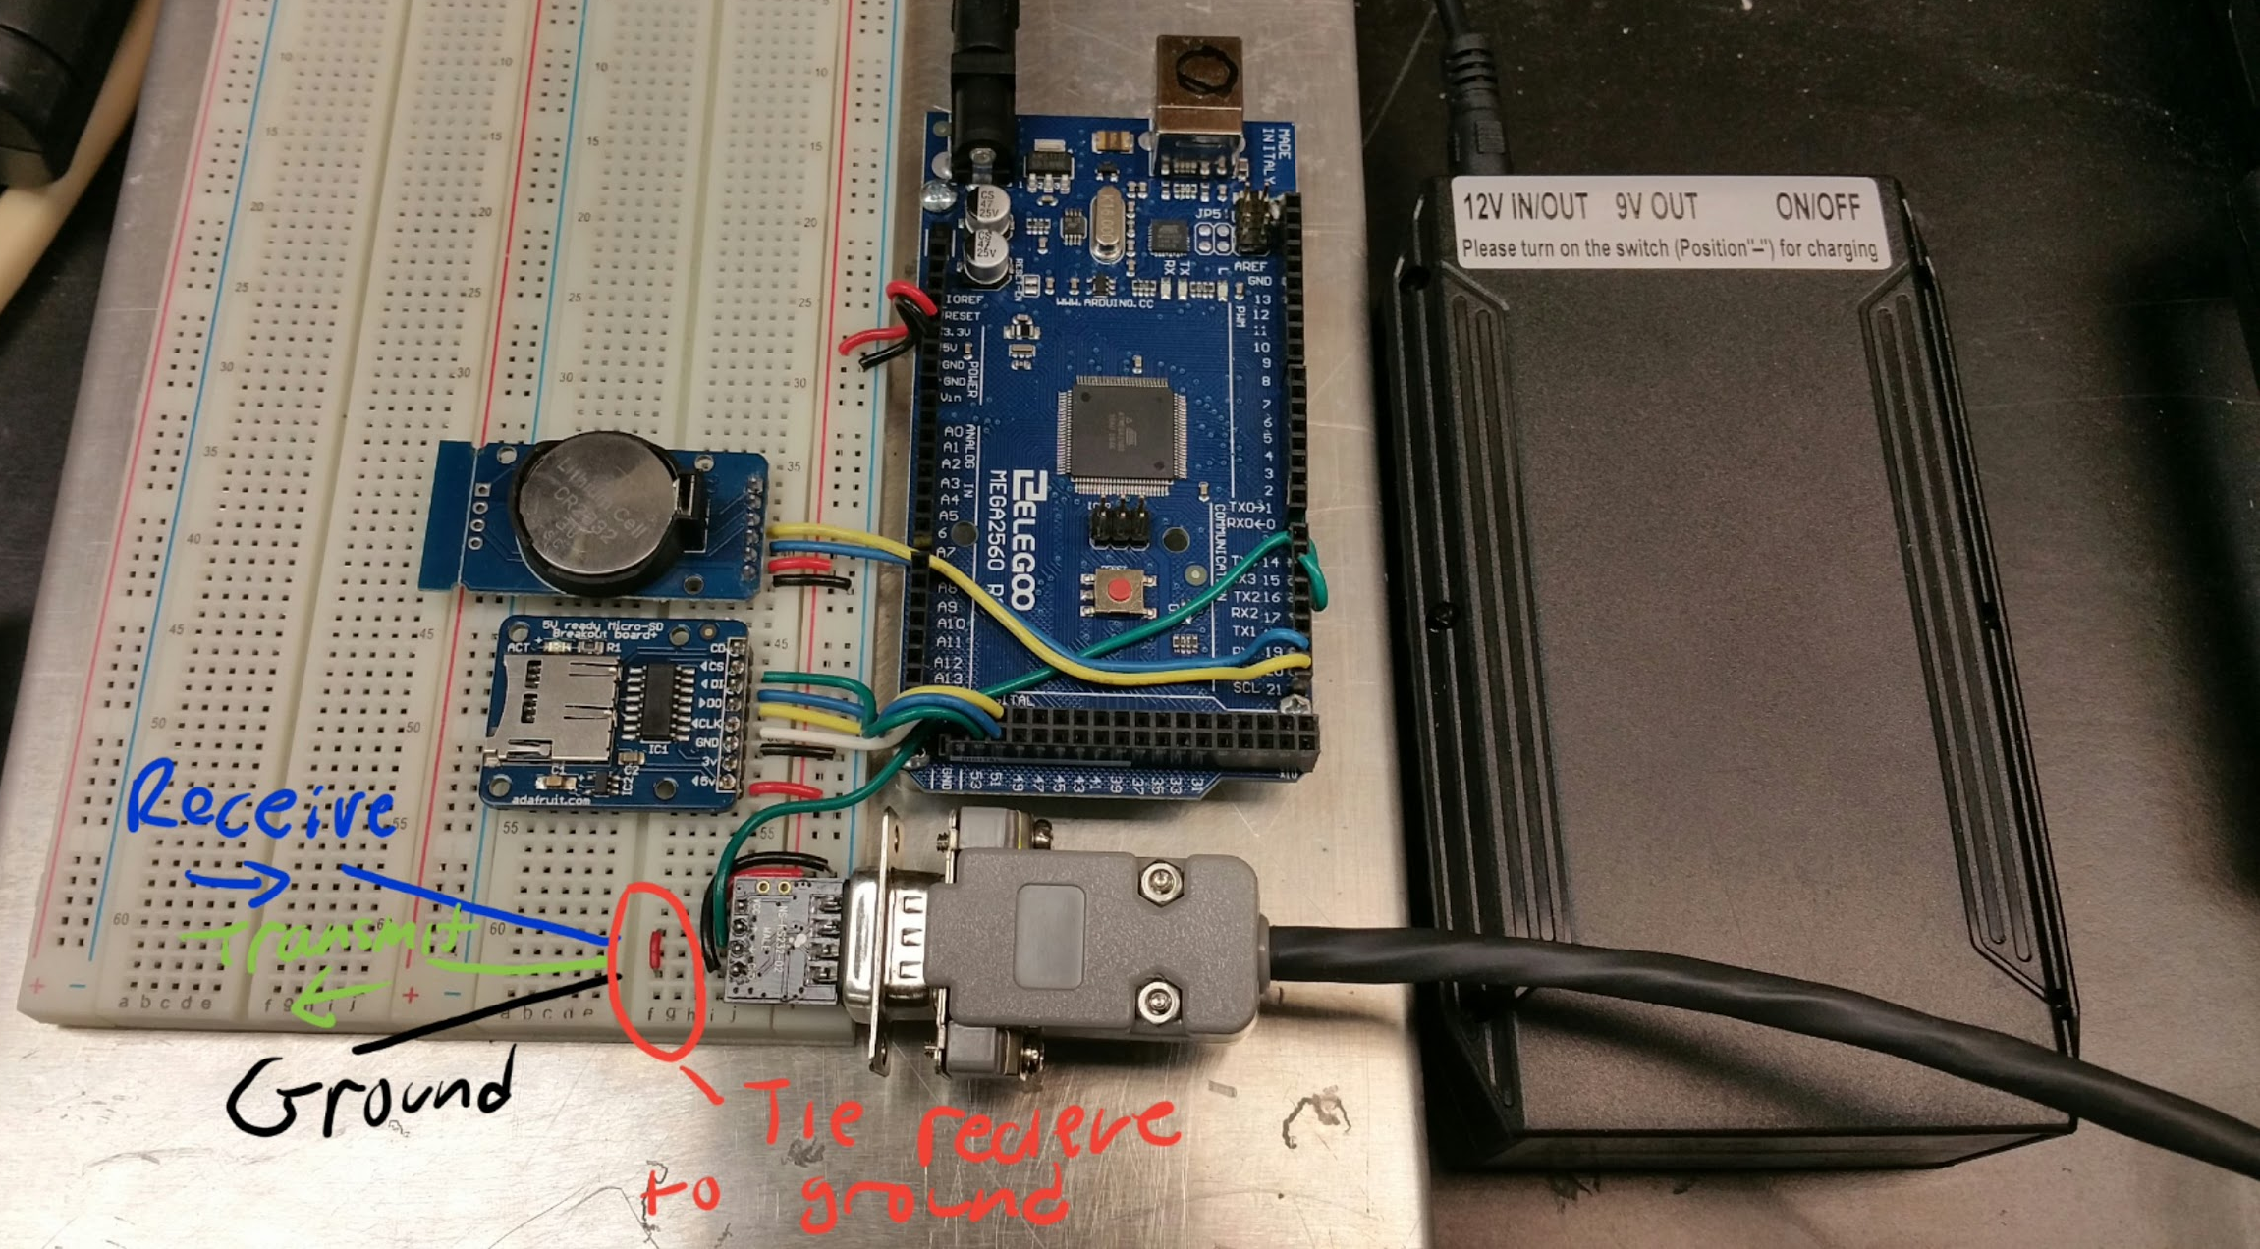
The magic wire to end erratic Esc commands

Slide 12
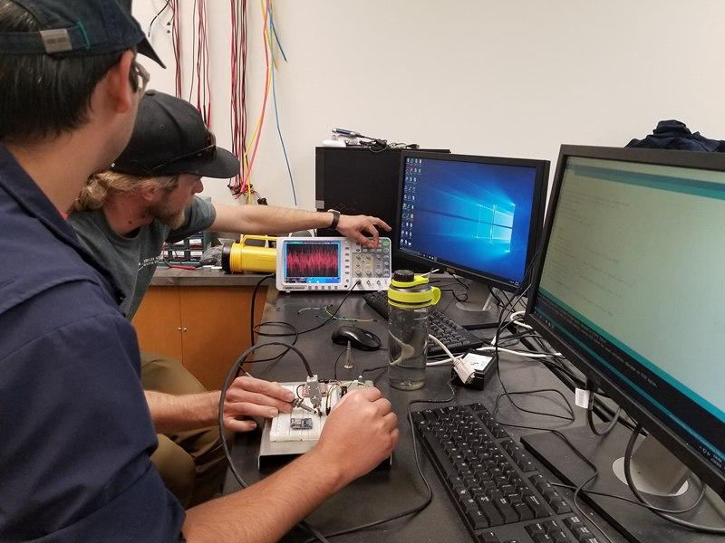
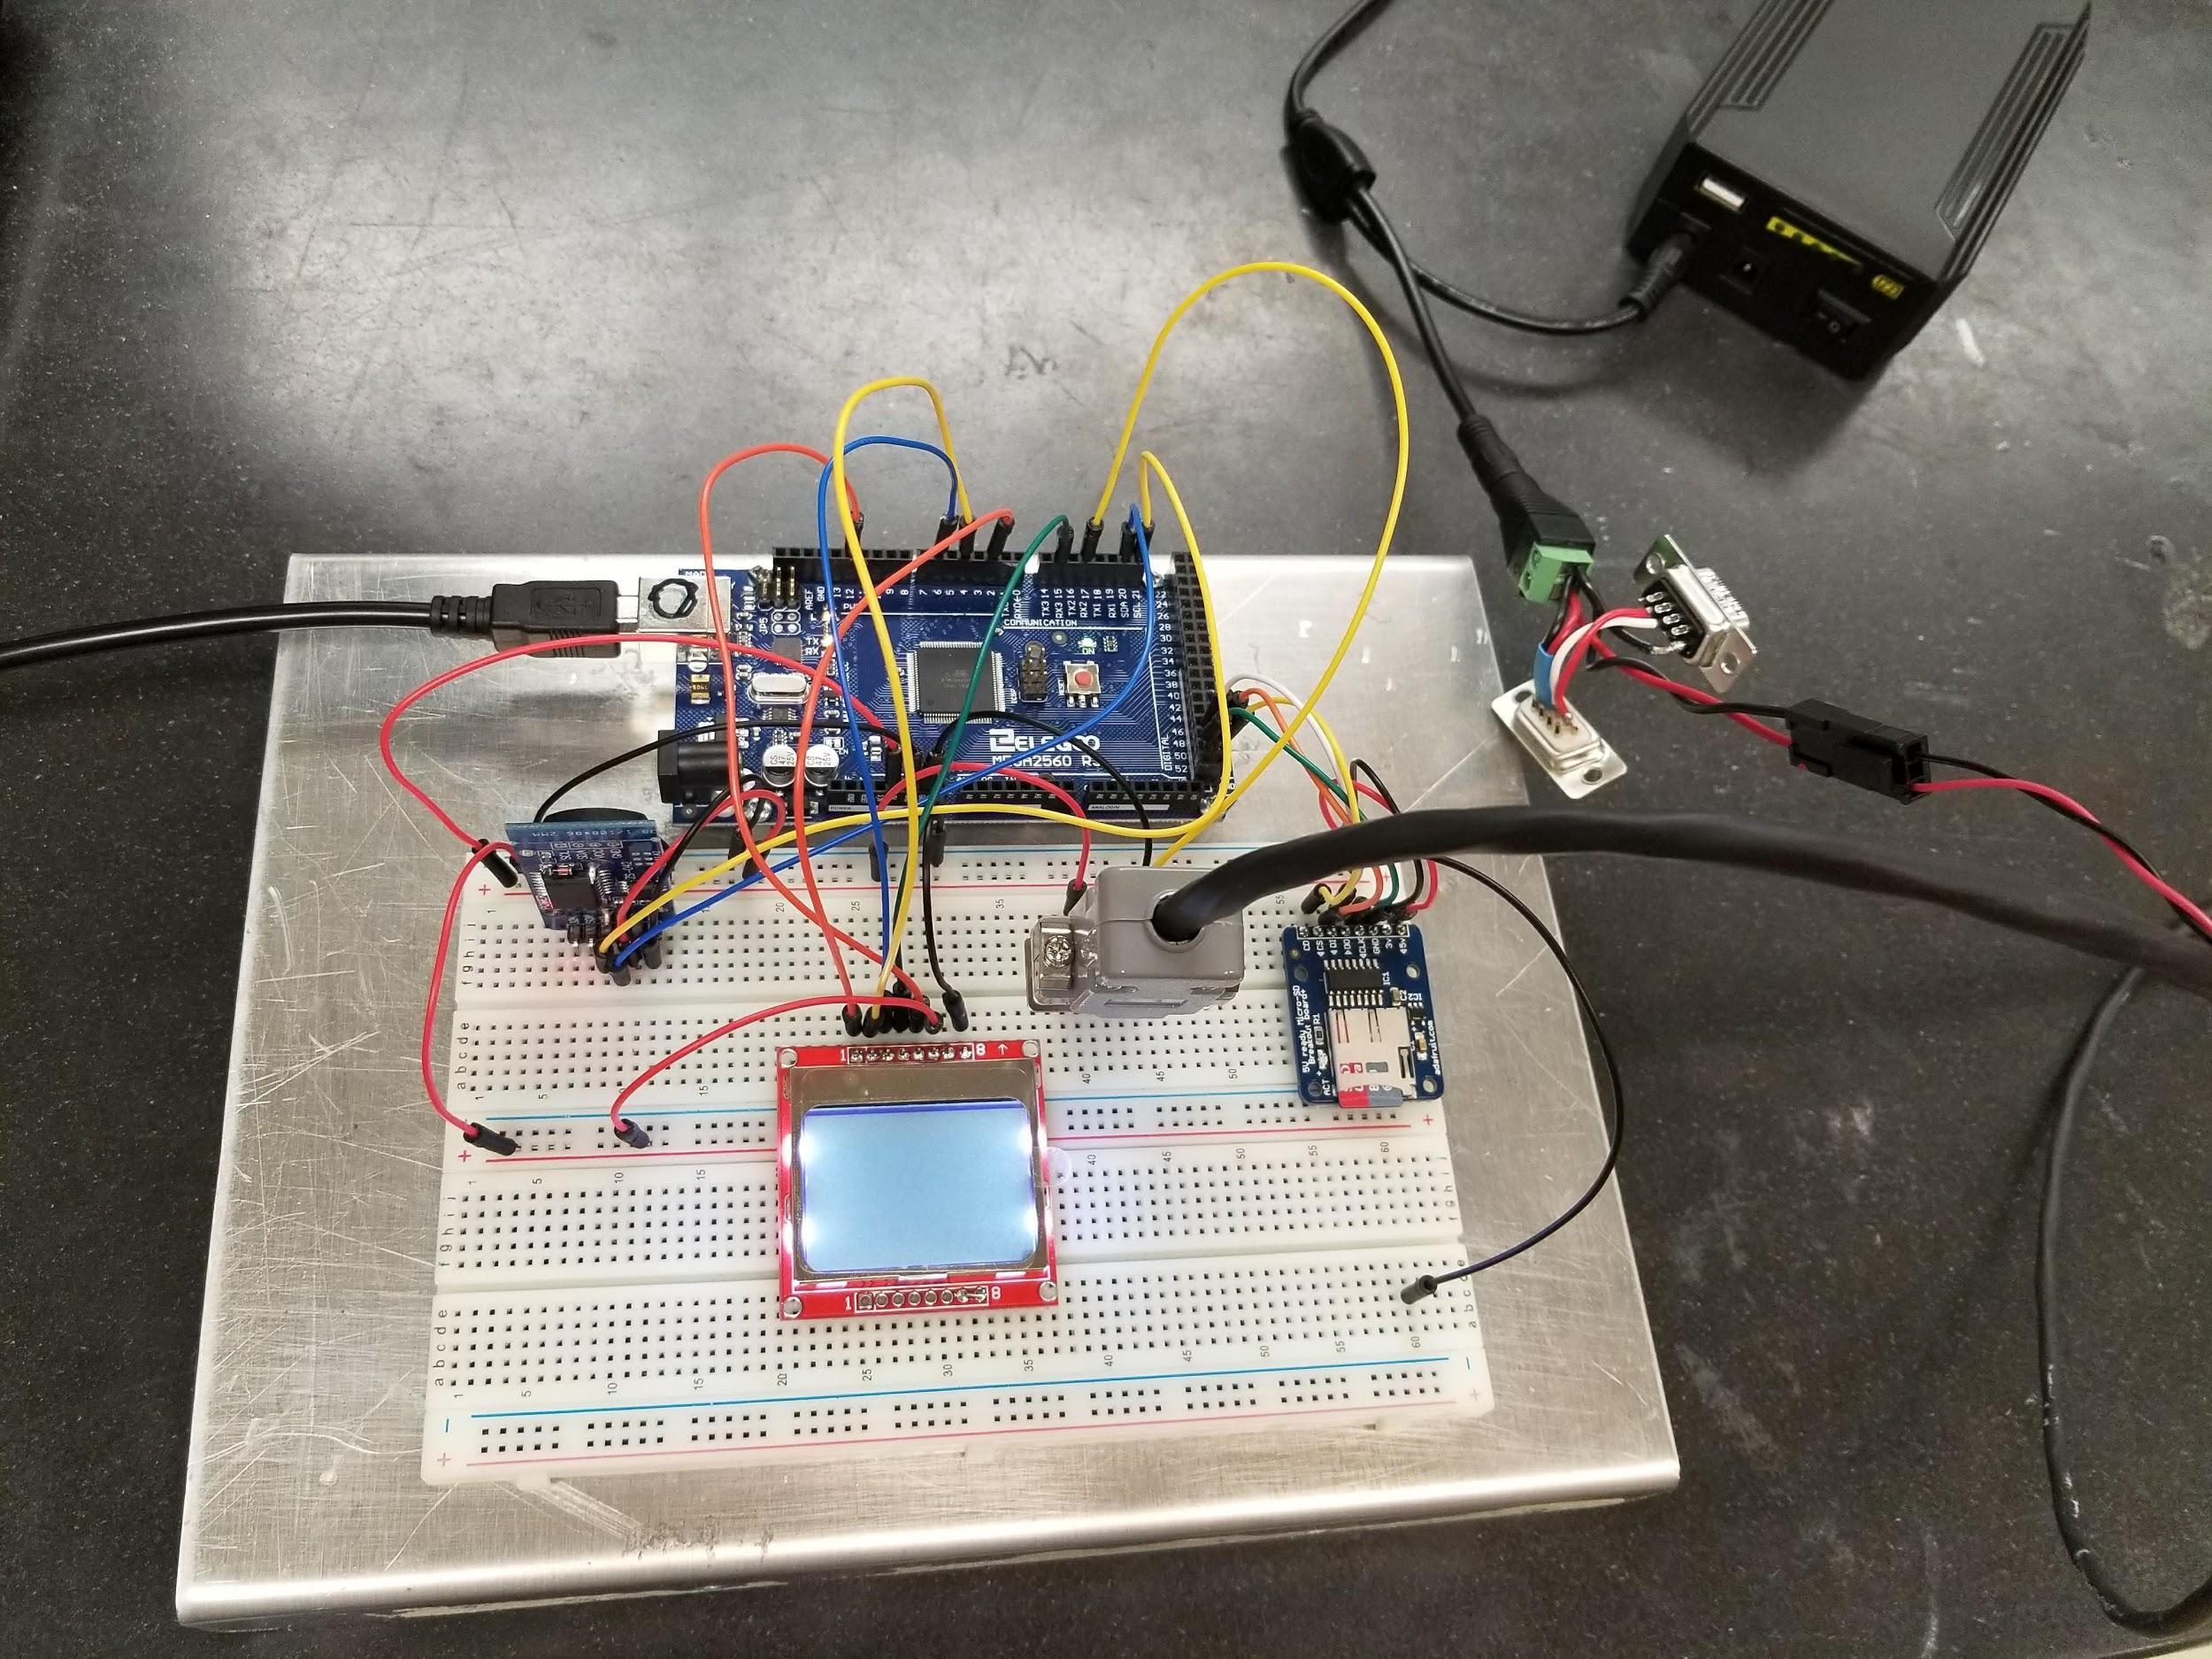
Setting up the Sonic Anemometer
Second trial using Arduino Mega Prototype shield:
The output from the Anemometer/Thermometer is connected to an Arduino Mega Prototype shield, and data is transmitted to a digital recording device in this case SD card.
The chronodot is a real time clock. At the moment the SD card is receiving data is reading the time from the chronodot.

Slide 13
Method
Data were taken from SATR 3K Three Dimensional Sonic Anemometer at three differents sites in UNR for May 10, 2018 from 3:40 pm to 4:20pm (10 min each sites). The instrument takes measurements with a sampling frequency of 10Hz.
To understand the daily variations time series wind speed (𝑢,𝑣,𝑤), sonic temperature (𝑇𝑠,) , friction velocity (𝑢∗), sensible heat flux (𝐻𝑠 ), Monin-Obukocv Length (𝐿) and turbulent kinetic energy (𝑇𝐾𝐸) analyzed.

Slide 14
Site Description and Synopsis of Weather Conditions
The measurements were taken at three different sites.
Site Description | Weather Conditions | Time Period
Over the grass | High Clouds-Cirrus N, NW | 10 minutes
Under the tree | High Clouds-Cirrus N, NW | 10 minutes
Parking lot | High Clouds-Cirrus N, NW | 10 minutes

Slide 15
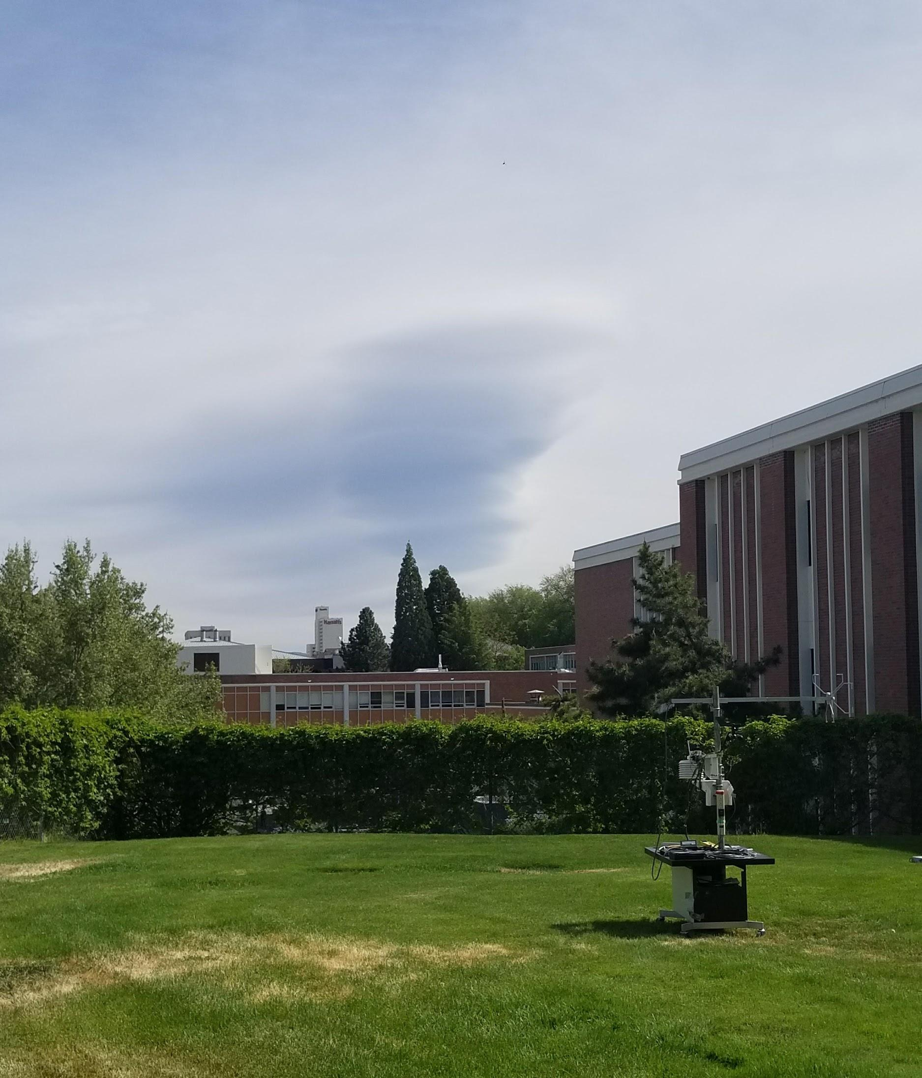
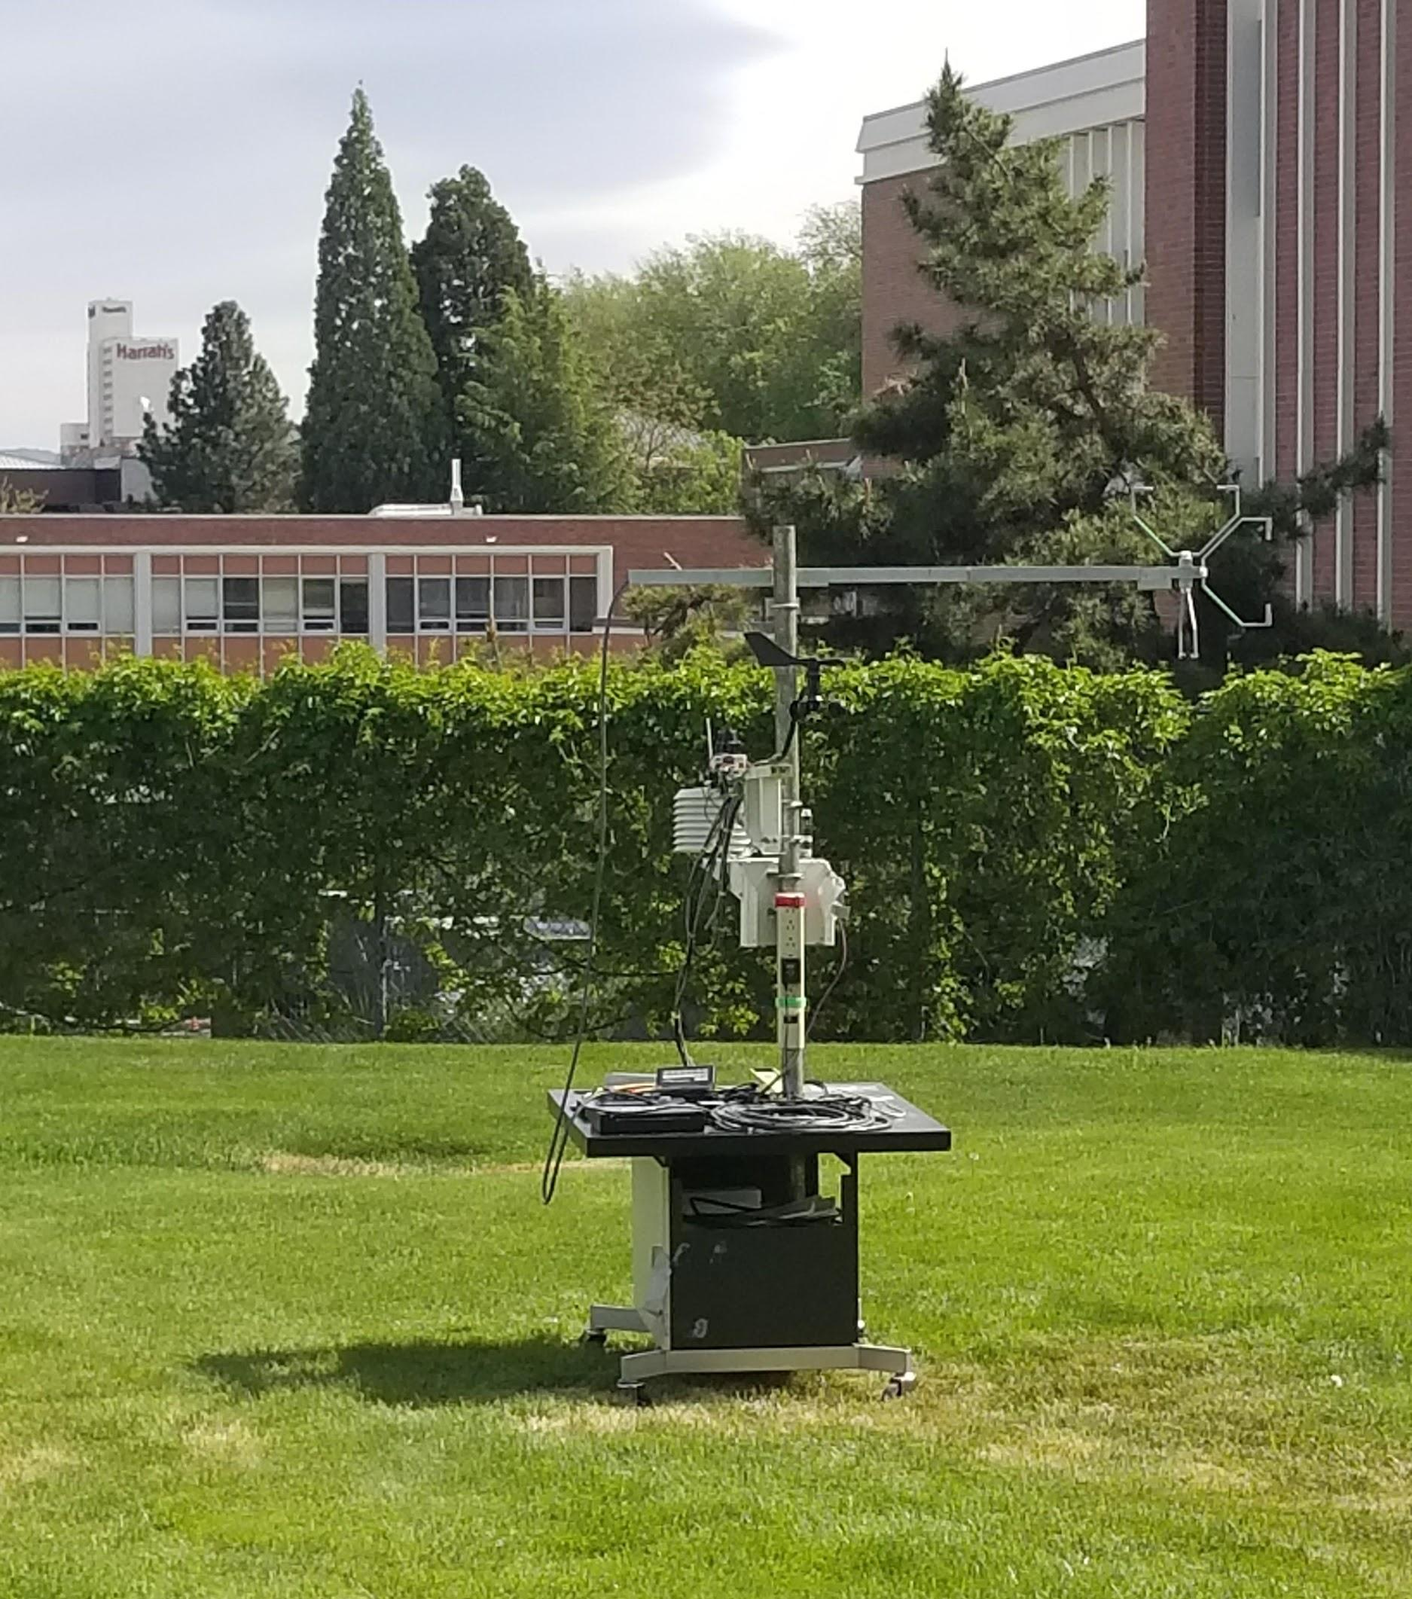

1st Spot

Slide 16
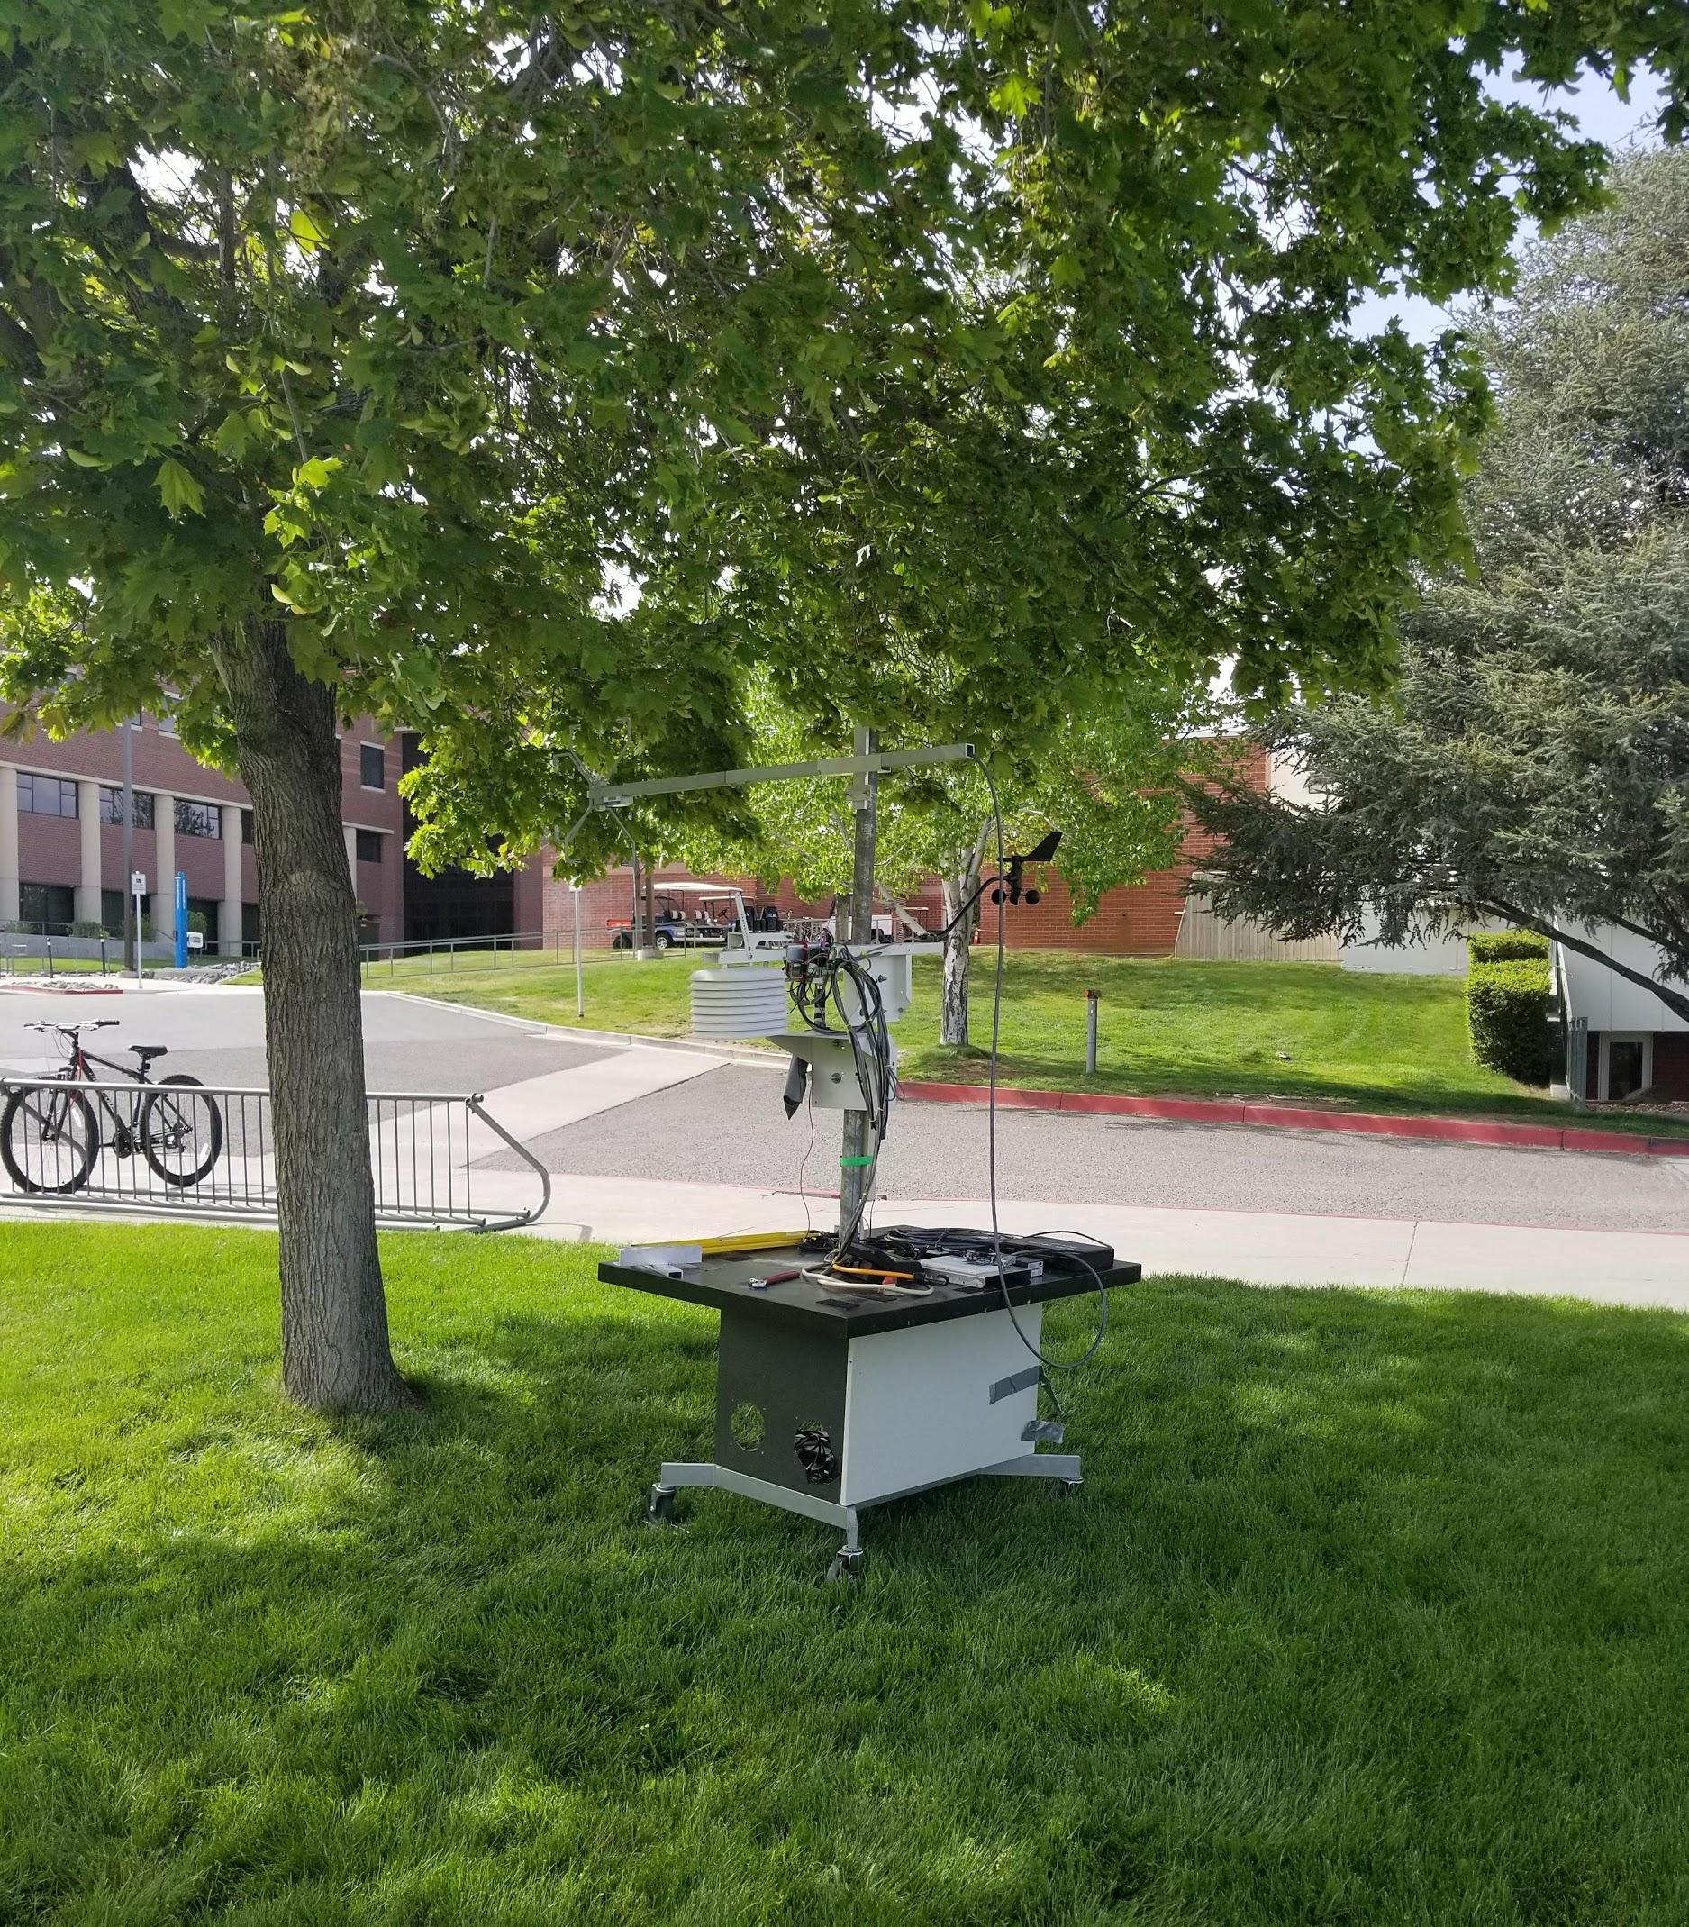
2nd Spot

Slide 17
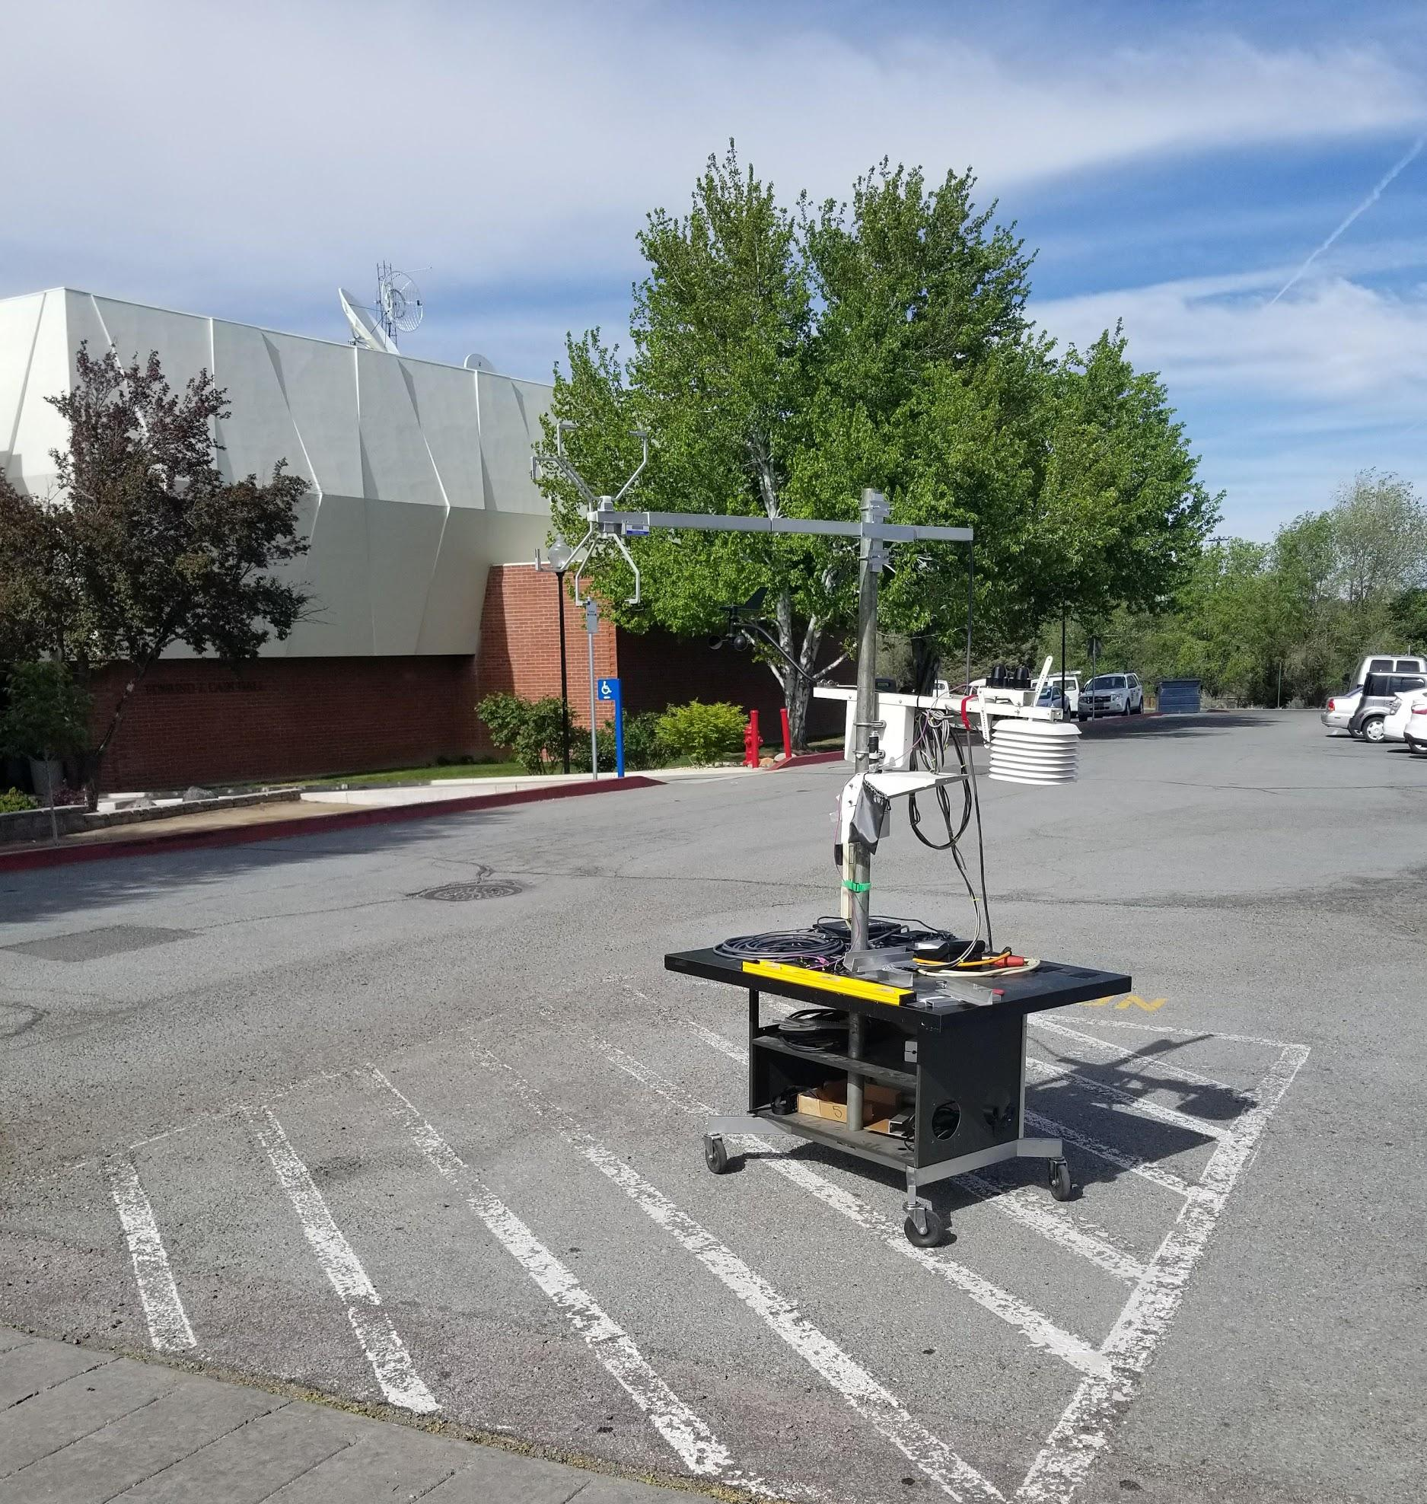
3rd Spot

Slide 18
Atmospheric Turbulence
Atmospheric turbulence is an irregular small-scale motion, characterized by winds that vary in speed and direction.
Turbulence is important especially in air pollution studies because it mixes the air in the atmosphere vertically and horizontally(Holmes H. et. al ,2015).
Turbulence behavior is still not fully understood, as consequence predicting turbulence is one of the most intriguing problems for physicist and engineers.
Understanding the daily variations and mean in u, v, w and T will help to improve the forecasts.

Slide 19
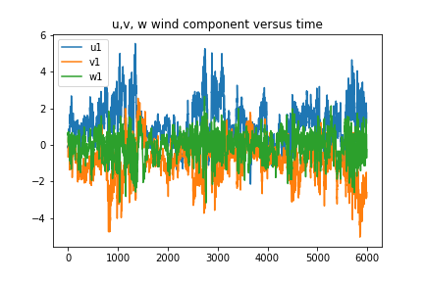
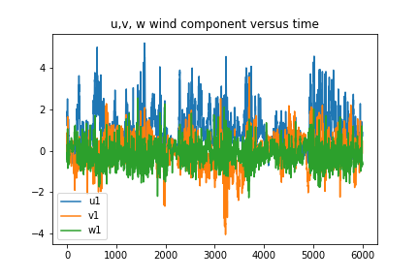
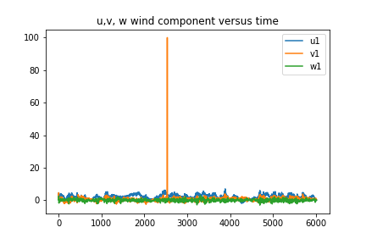
Data Analysis - Time Series
Time series of measurements of wind speed (𝑢,𝑣,𝑤), and sonic temperature (𝑇𝑠,).
Spot 1
Spot 2
Spot 3
Notes:
10 min variations

Slide 20
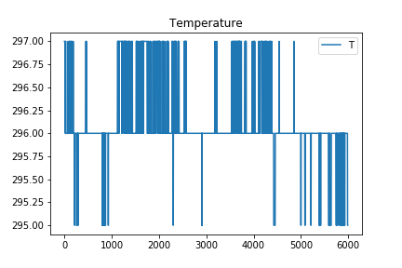
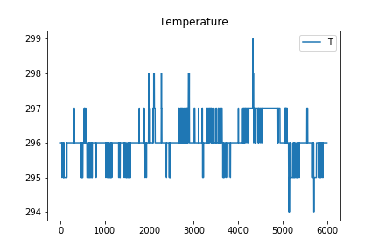
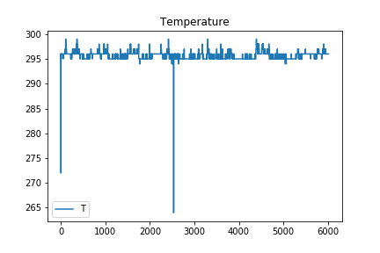
Data Analysis - Time Series
Time series of measurements of wind speed (𝑢,𝑣,𝑤), and sonic temperature (𝑇𝑠,).
Spot 1
Spot 2
Spot 3
Notes:
10 min variations

Slide 21
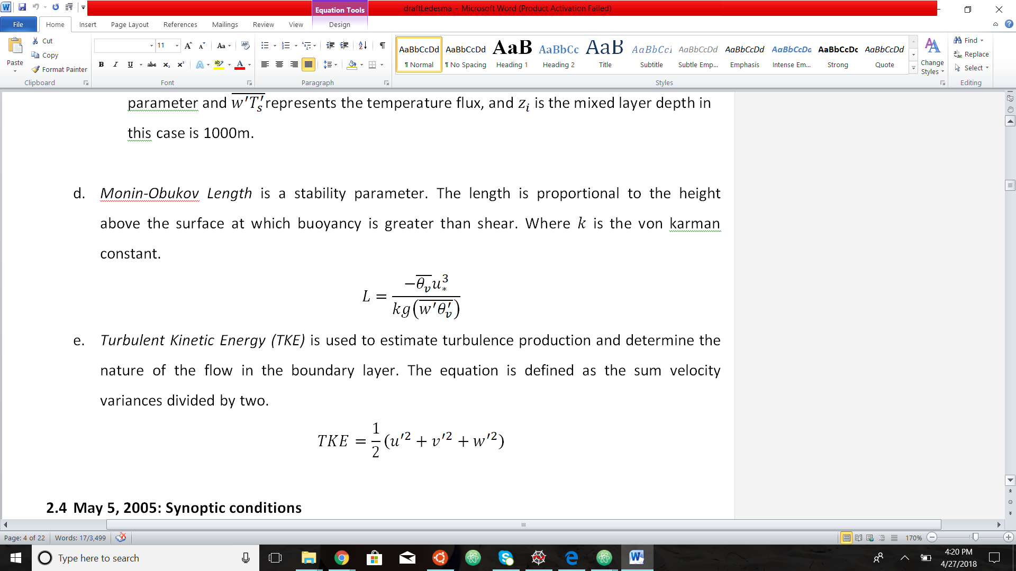
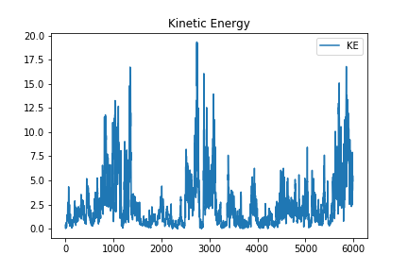
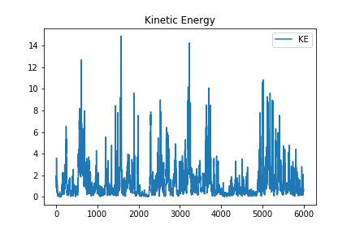
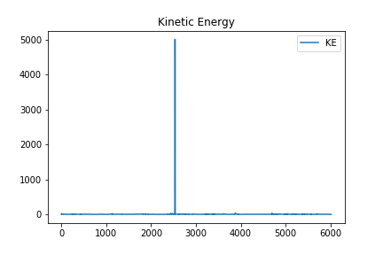
Data Analysis - Kinetic Energy
Spot 1
Spot 2
Spot 3
Notes:
Turbulent first sport

Slide 22
Data Analysis - Turbulent Kinetic Energy
Turbulent Kinetic Energy (TKE) is used to estimate turbulence production and determine the nature of the flow in the boundary layer. The equation is defined as the sum velocity variances divided by two.

Slide 23
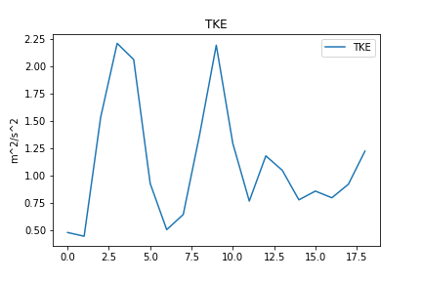
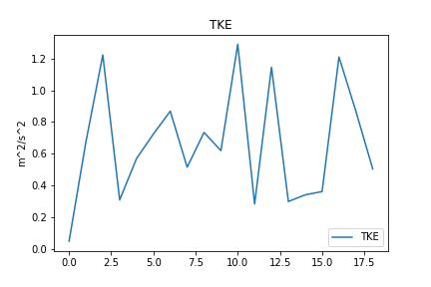
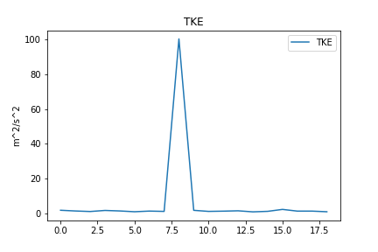
Data Analysis - Turbulent Kinetic Energy
Spot 1
Spot 2
Spot 3
Notes:
Turbulent first sport

Slide 24
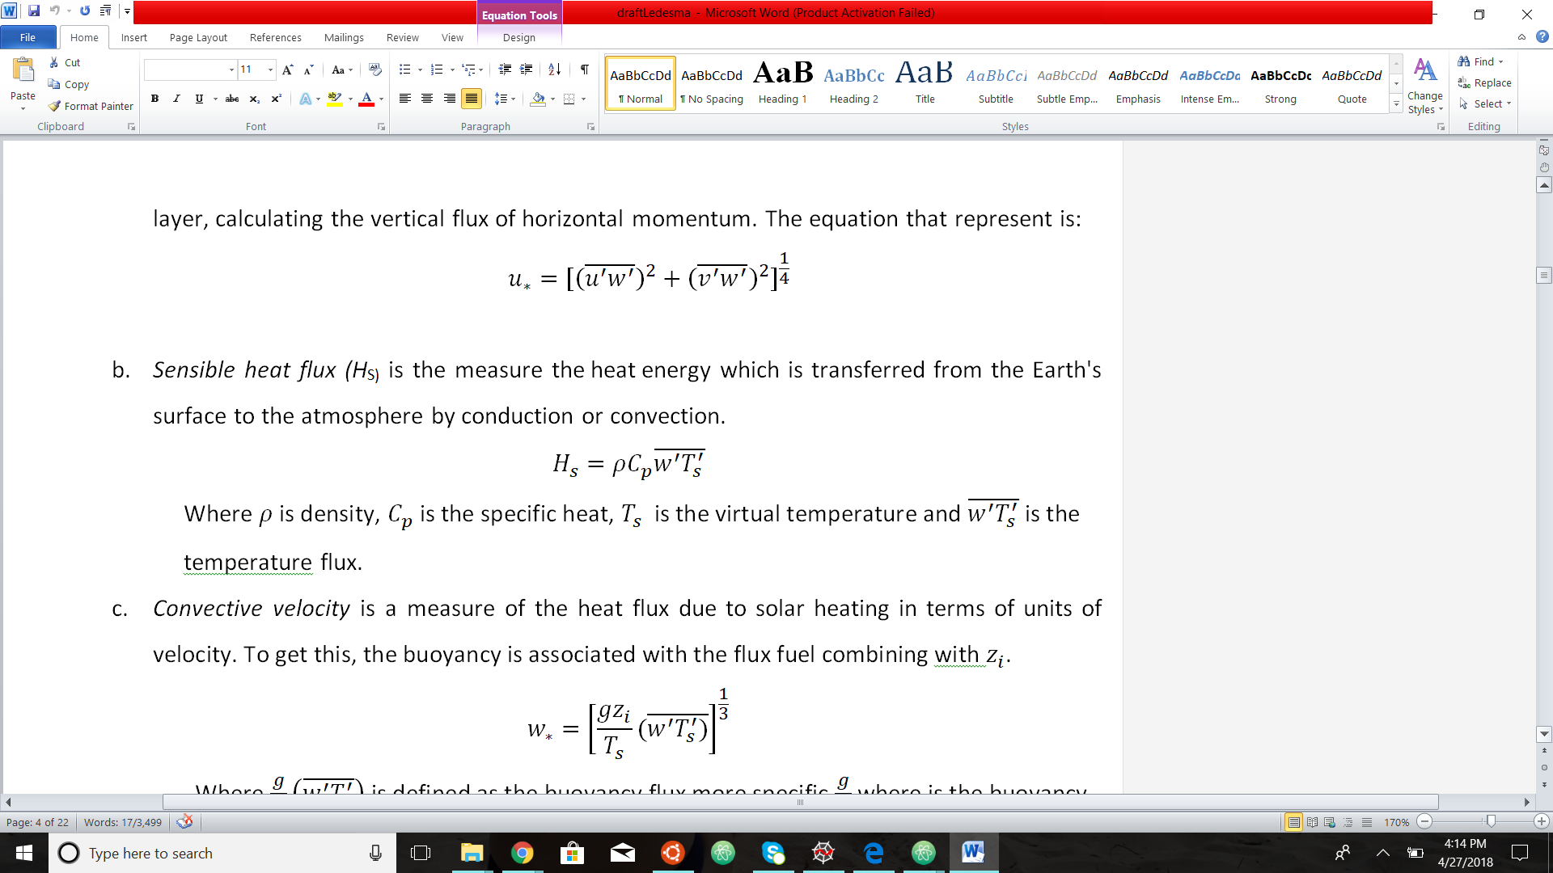
Data Analysis - Friction Velocity
Friction velocity (𝑢∗) is a surface velocity scale, it represent the shear strength at the boundary layer, calculating the vertical flux of horizontal momentum. The equation that represent is:

Slide 25
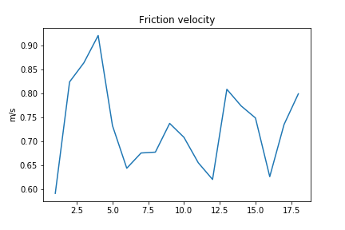
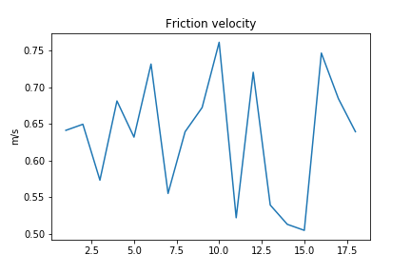
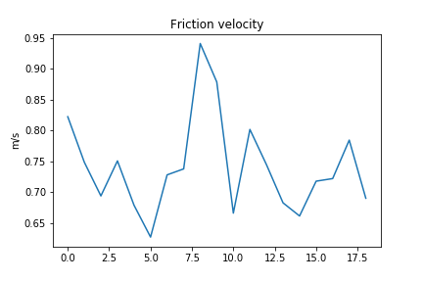
Data Analysis - Friction Velocity
Spot 1
Spot 2
Spot 3

Slide 26
Data Analysis - Monin-Obukov
Monin-Obukov (𝐿) is a stability parameter. The length is proportional to the height above the surface at which buoyancy is greater than shear. Where k is the von karman constant.

Slide 27
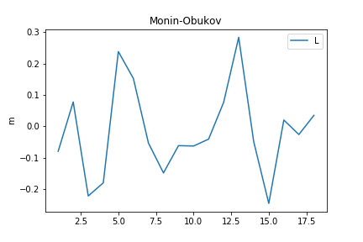
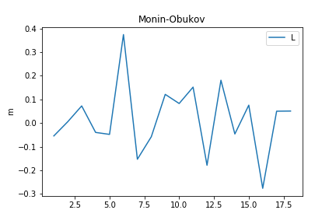
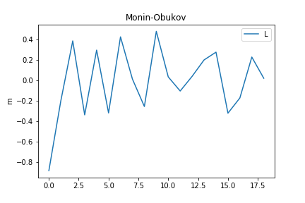
Data Analysis - Monin-Obukov
Spot 1
Spot 2
Spot 3

Slide 28
Data Analysis - Sensible Heat
Sensible heat flux (H_{S}) is the measure the heat energy which is transferred from the Earth's surface to the atmosphere by conduction or convection
Notes:
Where is density, is the specific heat, is the virtual temperature and is the
temperature flux.

Slide 29
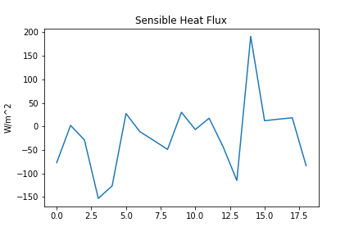
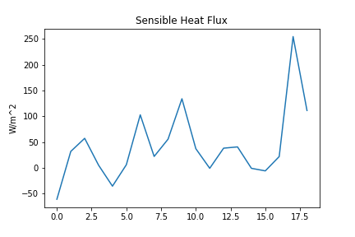
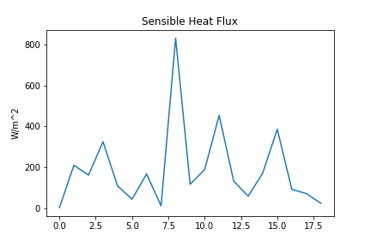
Data Analysis - Sensible Heat
Spot 1
Spot 2
Spot 3

Slide 30
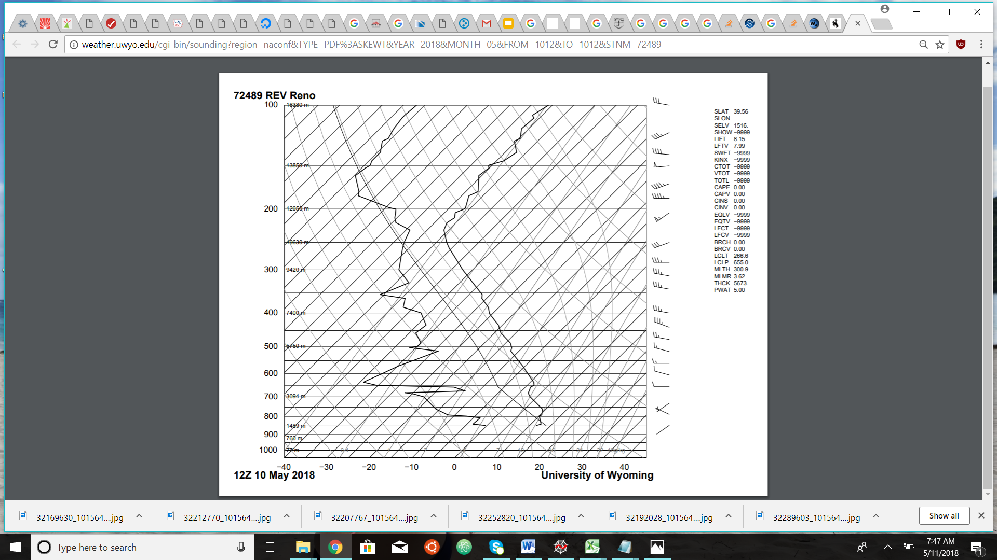
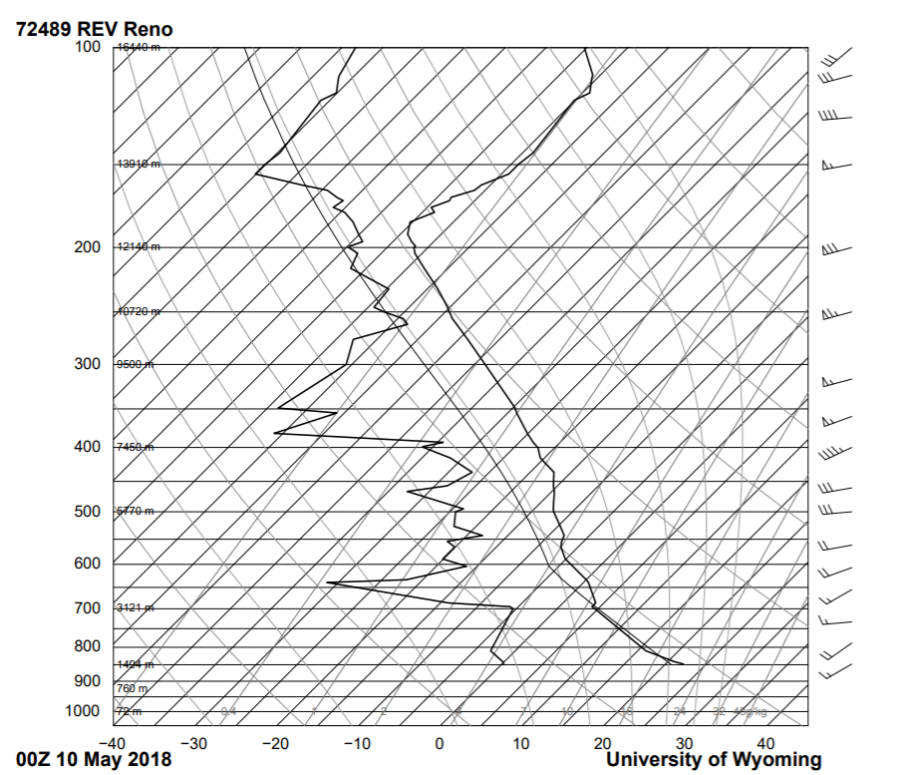
Analysis Summary
Higher values of friction velocity, sensible heat convective velocity and negative value of Monin-Obukov length indicates that the boundary layer becomes more turbulent.
The radiosonde data indicate a neutral atmosphere indicating that the magnitude of turbulence was
suppressed.

Slide 31
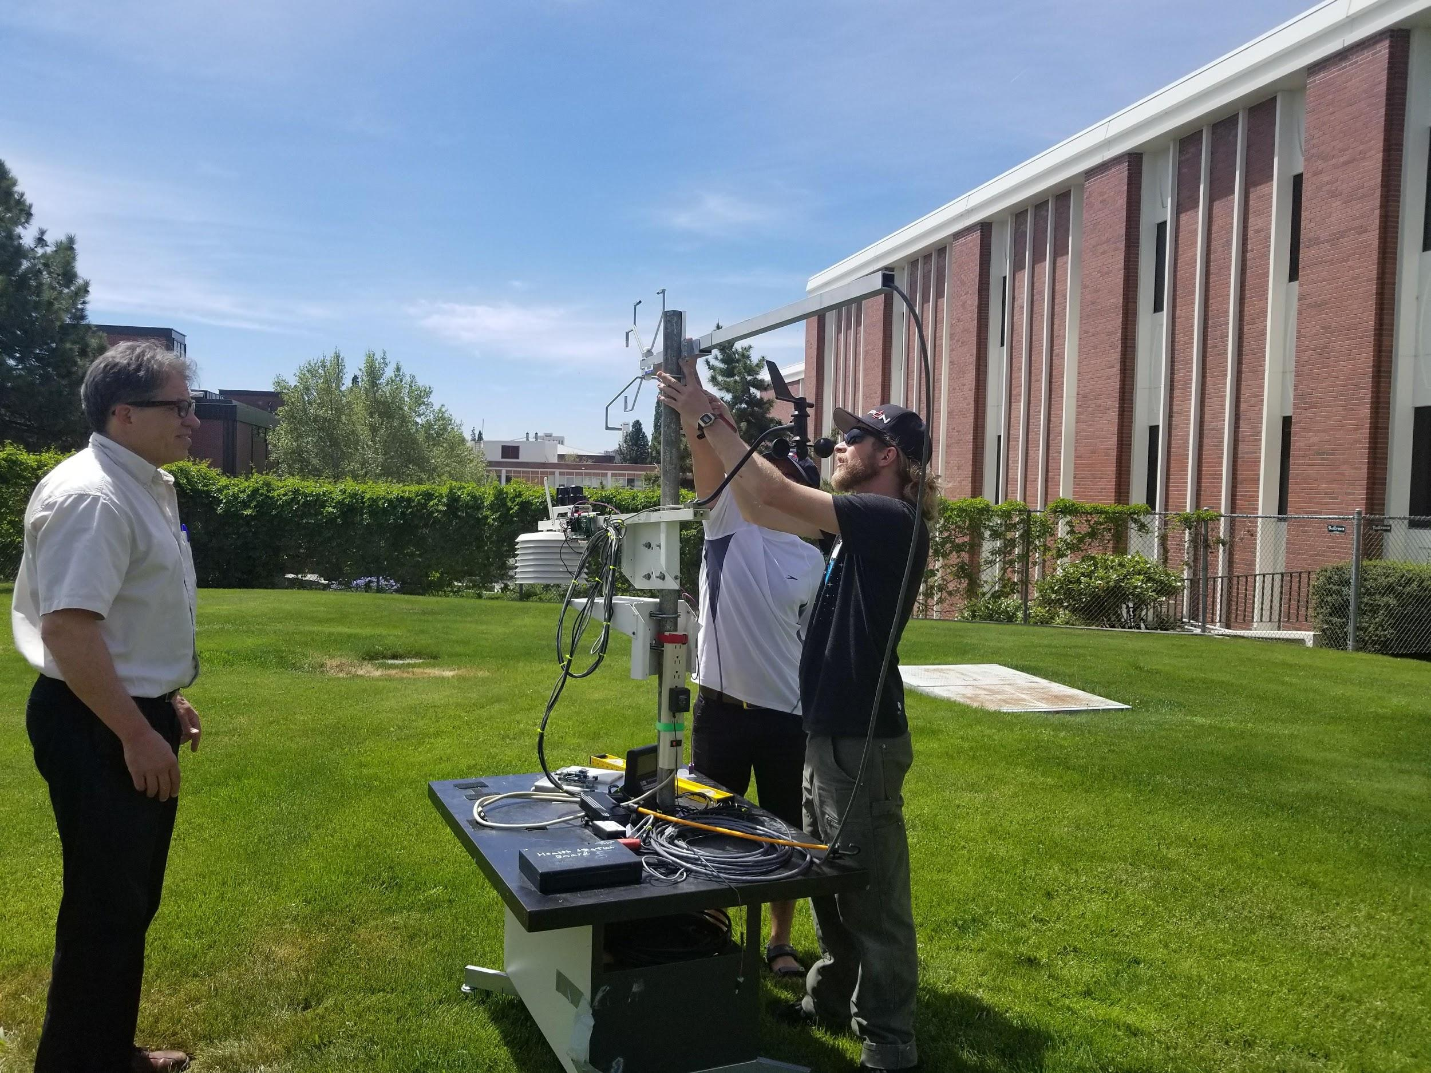
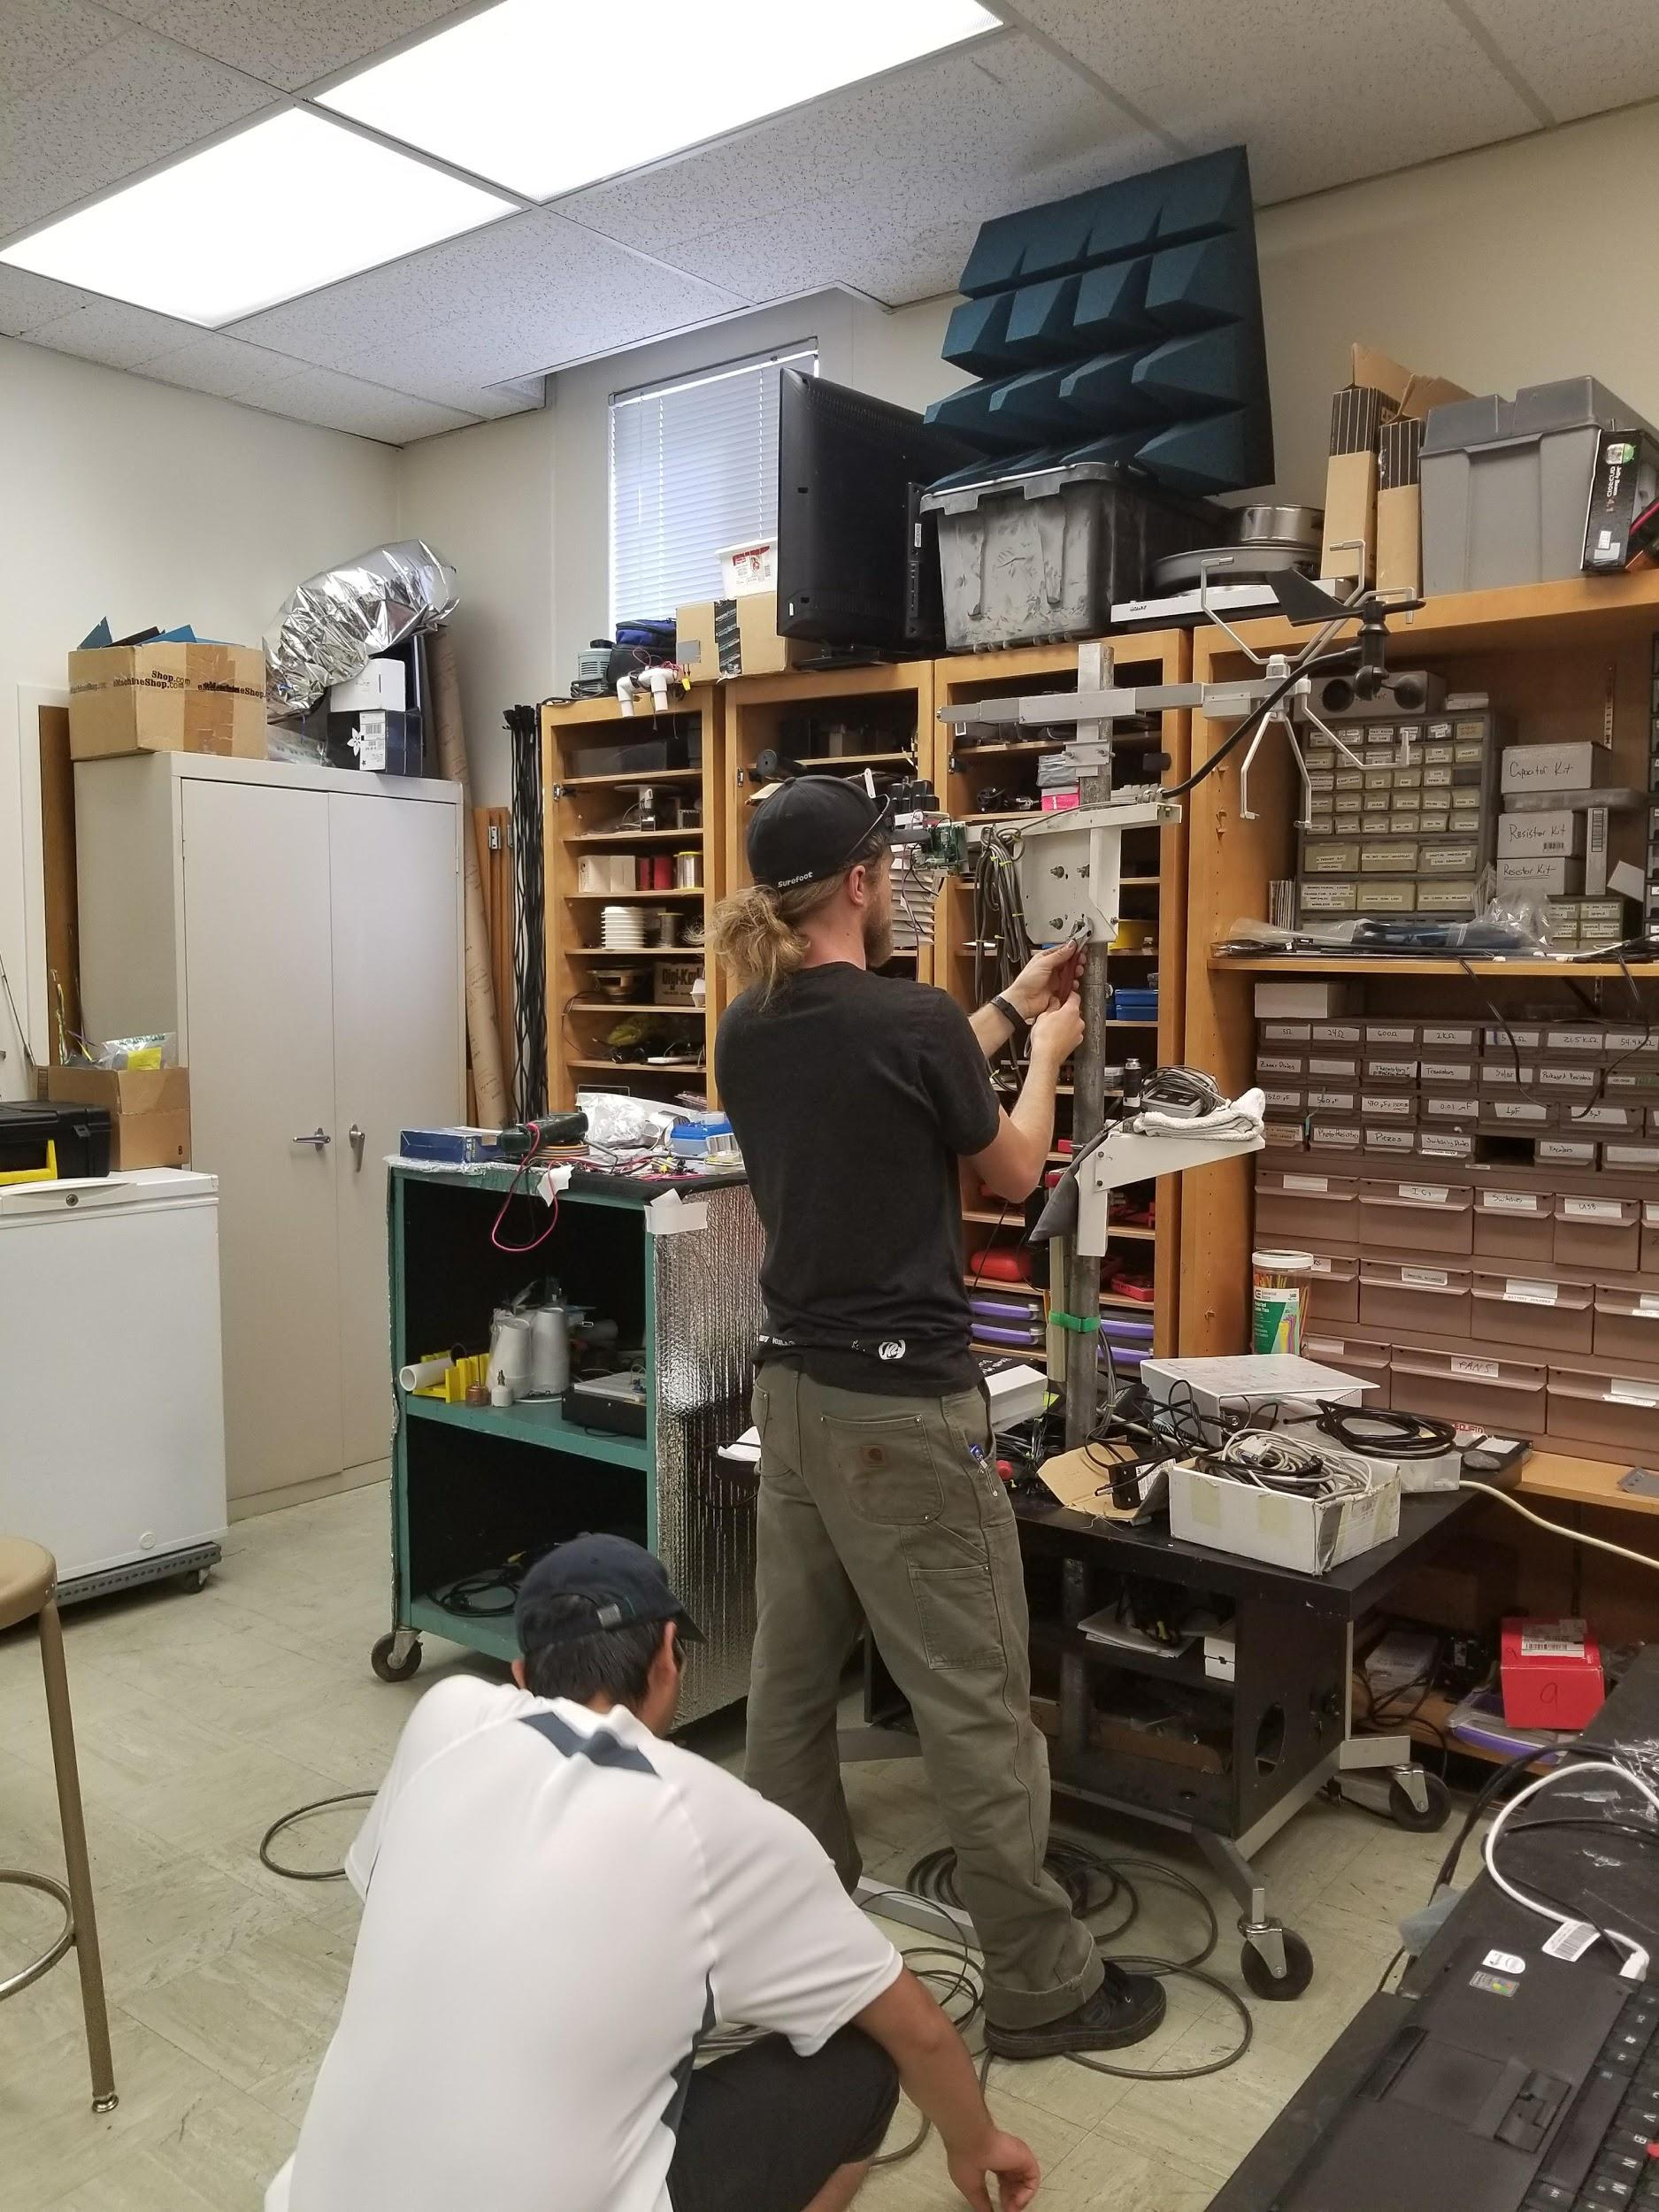
Any Questions? Thank You for your attention!

Slide 32
