Slide 1
Development and testing of a UVA/UVB detector for integration onto a high altitude aircraft
ATMS 748, Spring 2018
LIZARD LAMP GROUP

Slide 2
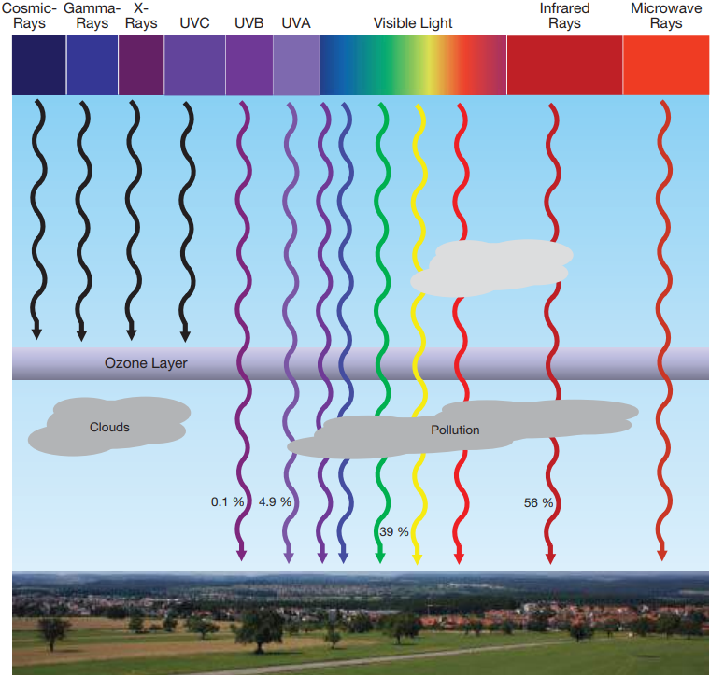
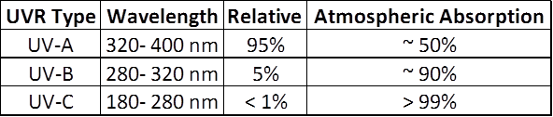
Ultraviolet Radiation (UVR)
~10% of total solar irradiance [W/m²]
Leading sources of variation
-Ozone absorption
-Aerosols, air pollution, cloud coverage
-Elevation
-Solar zenith angle (latitude, season, time of day)
Notes:
https://www.epa.gov/ozone-layer-protection/frequently-asked-questions-about-ozone-layer
Irradiance [ W*m⁻² ]: Radiant flux (power) received per unit area (radiation flux density)

Slide 3
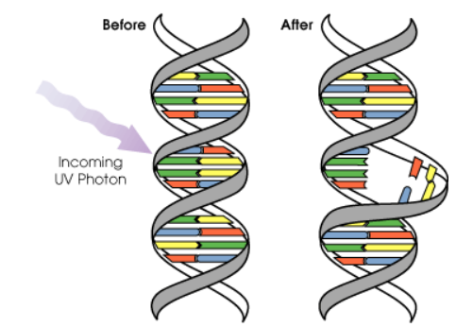
Importance
UVA
Formation of Vitamin D by the skin
Harmful to skin if overexposed
UVB
Can cause damage at molecular level including damaging DNA
Needed to maintain Vitamin D3 and calcium levels in reptiles

Slide 4

The Perlan 2 will fly to 90,000 feet at the edge of space to explore the science of giant mountain waves that help create the ozone hole and change global climate models. This will require the engineering of a spacecraft with glider wings that can fly in less than 3% of normal air density and at temperatures of minus 70 degrees C, conditions approximating the surface of Mars. These missions will provide education and inspiration for young people seeking careers of exploration and adventure in engineering and science.
Mission Statement:
“The Perlan 2 will fly to 90,000 feet at the edge of space to explore the science of giant mountain waves that help create the ozone hole and change global climate models. This will require the engineering of a spacecraft with glider wings that can fly in less than 3% of normal air density and at temperatures of minus 70 degrees C, conditions approximating the surface of Mars.”

Slide 5
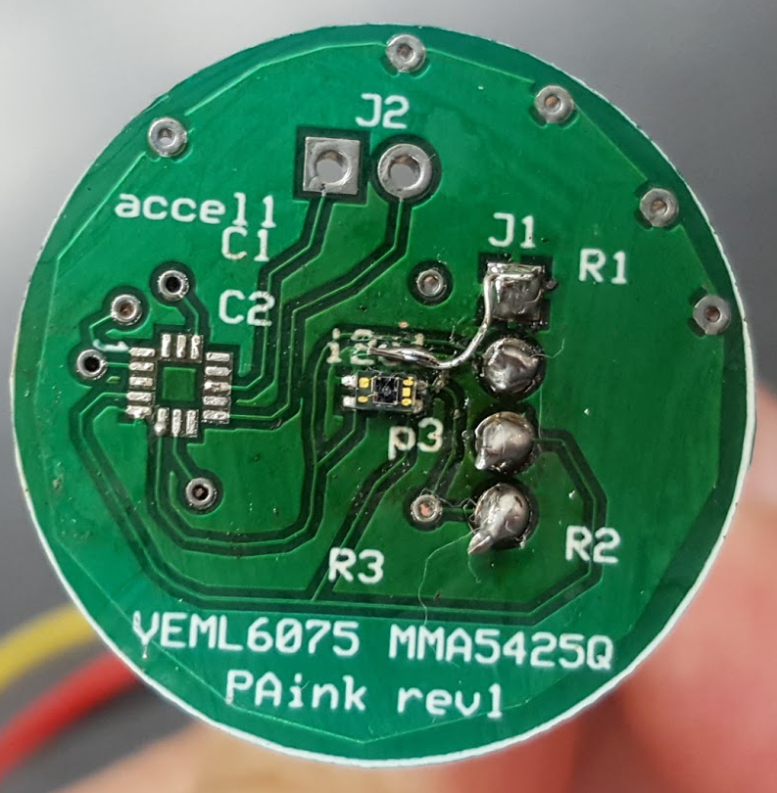
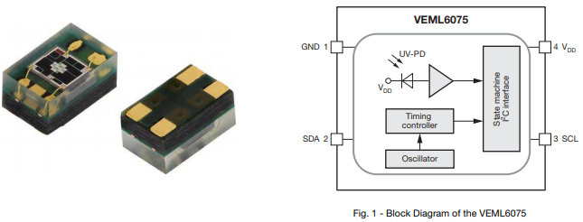
VEML6075
Silicon Photodiode Detector
UVA, UVB, Visible, IR

Slide 6
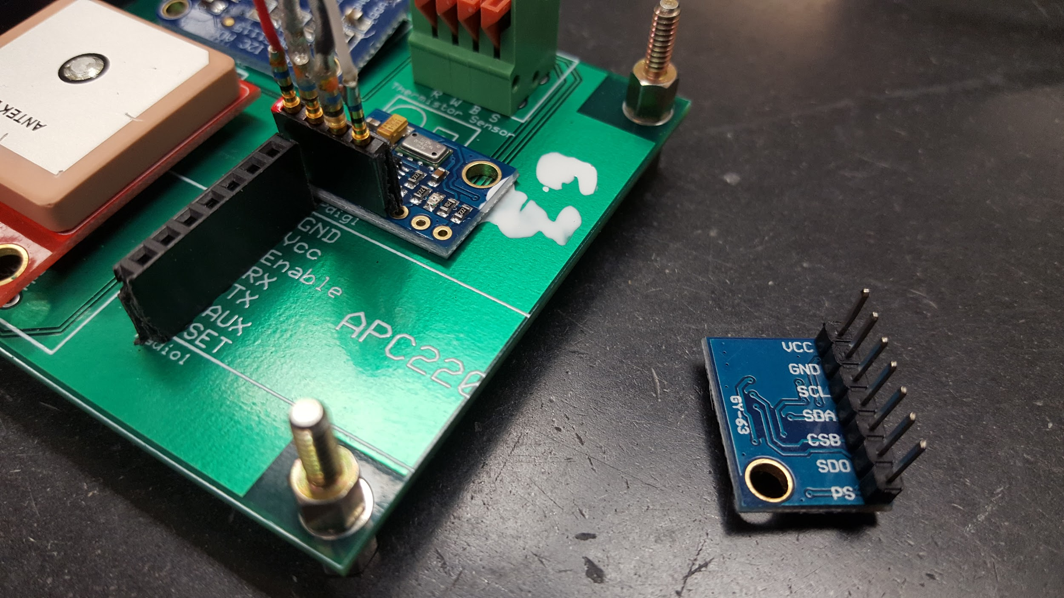
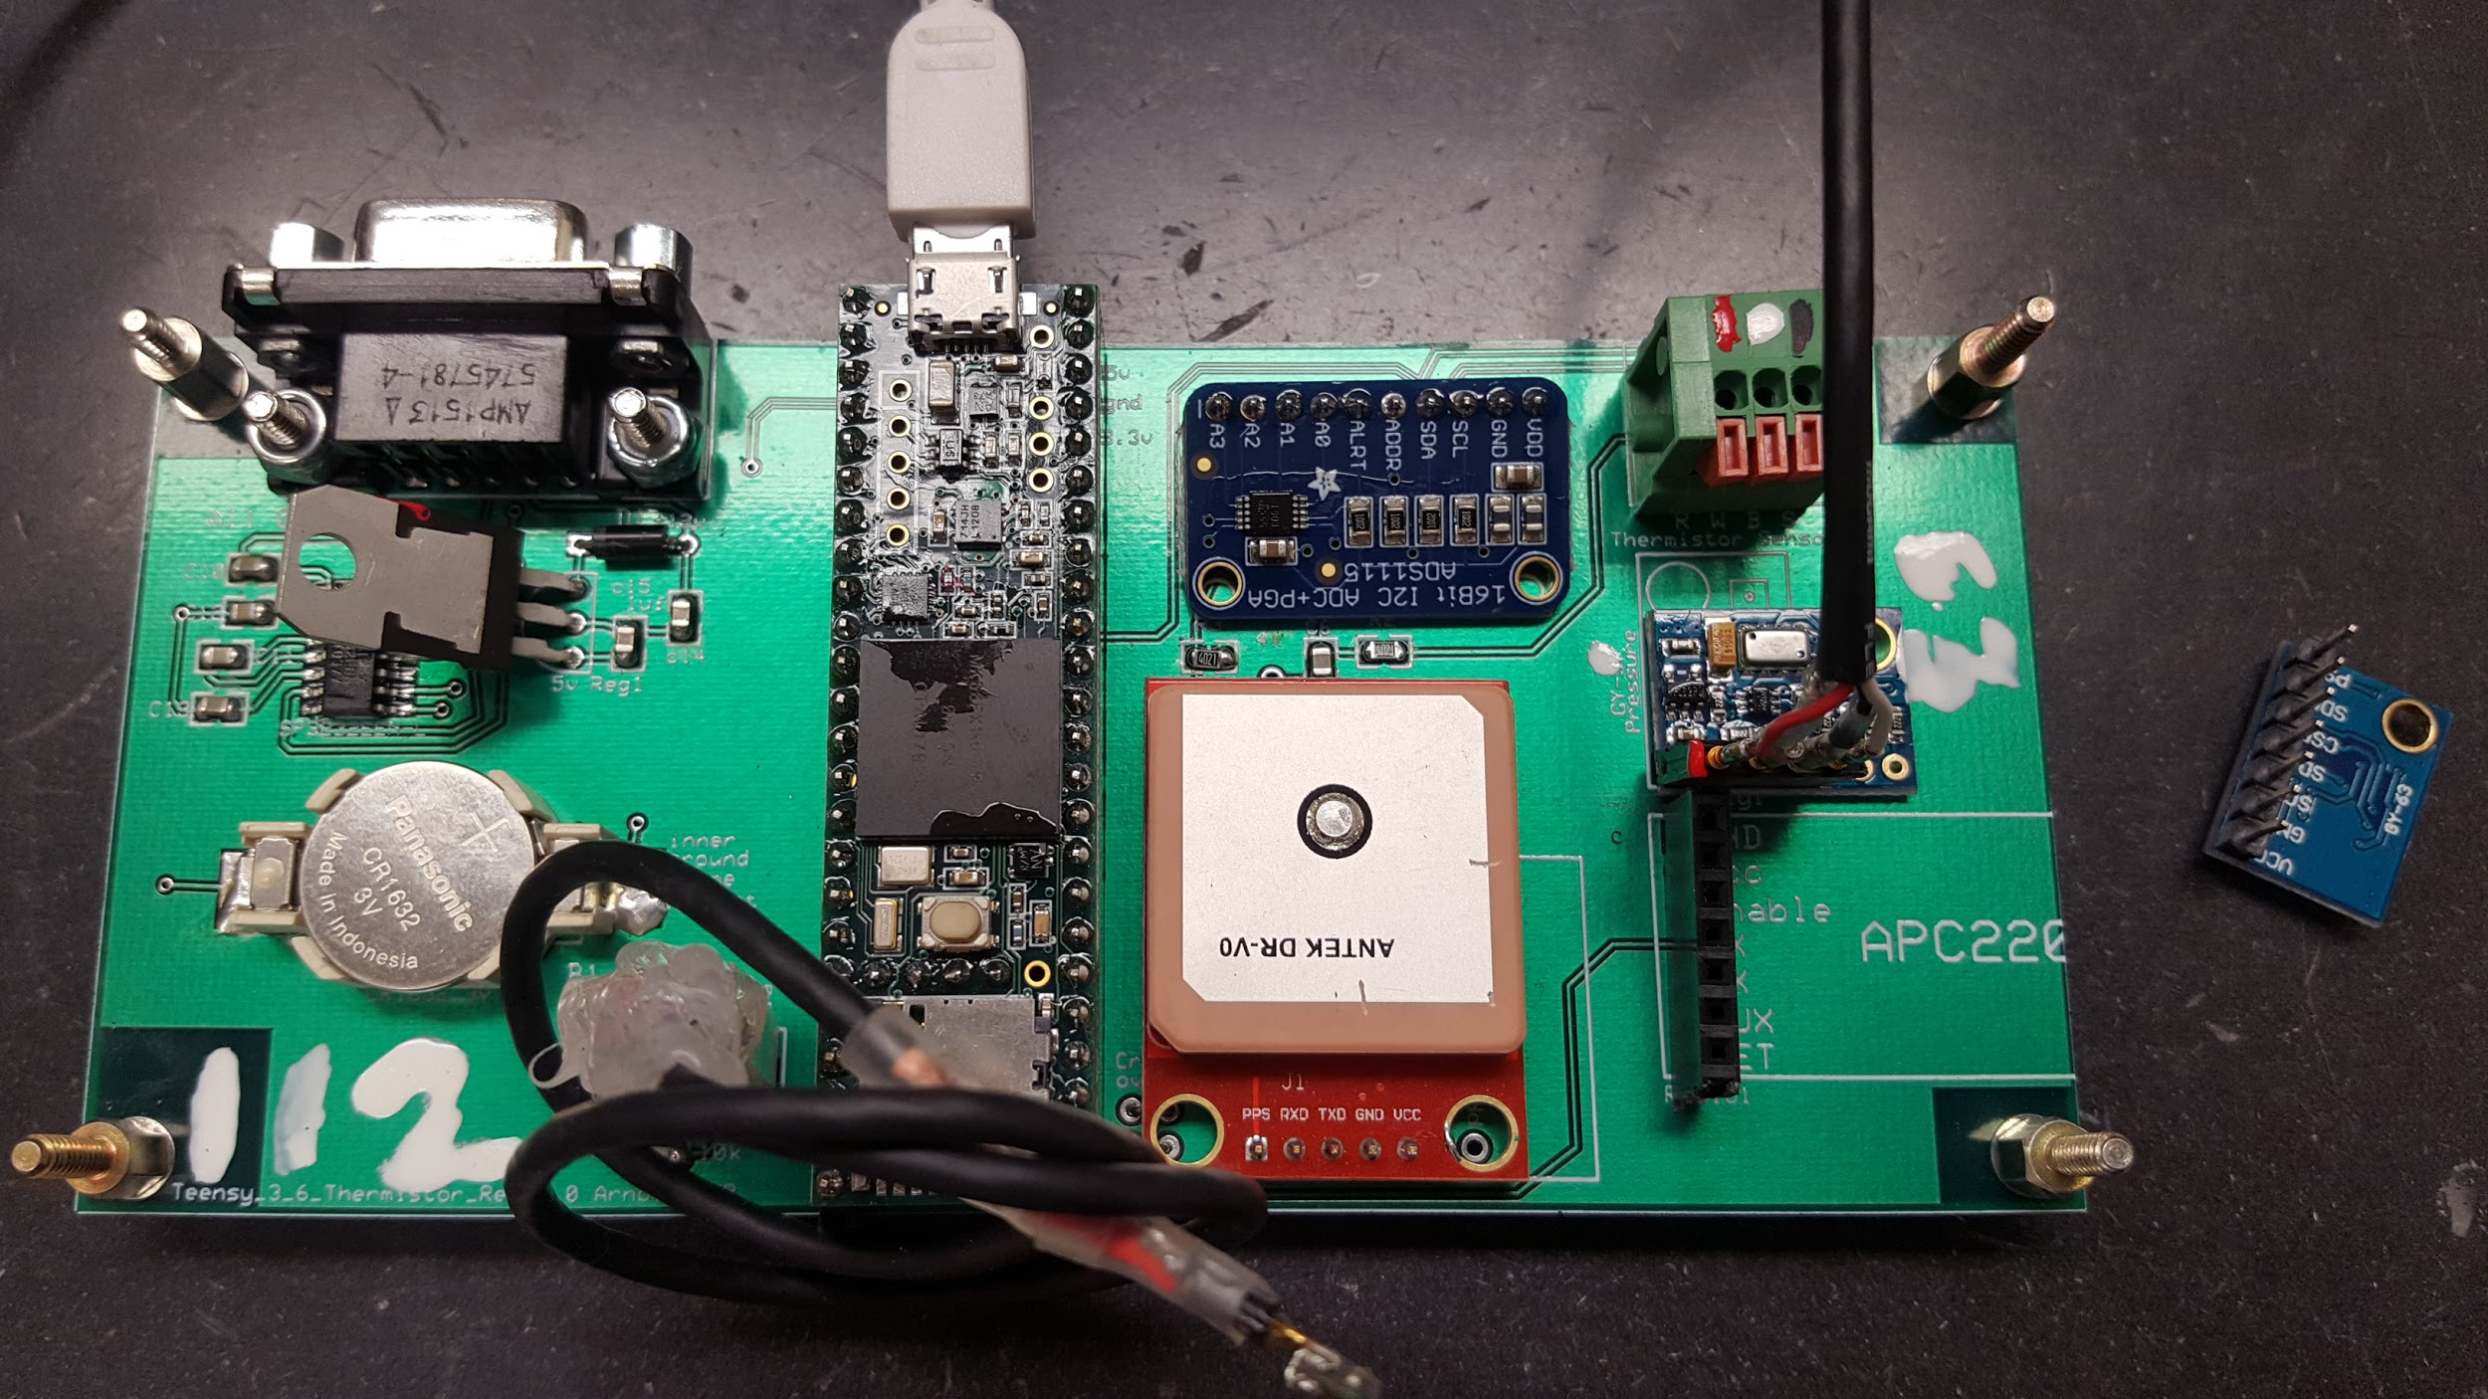
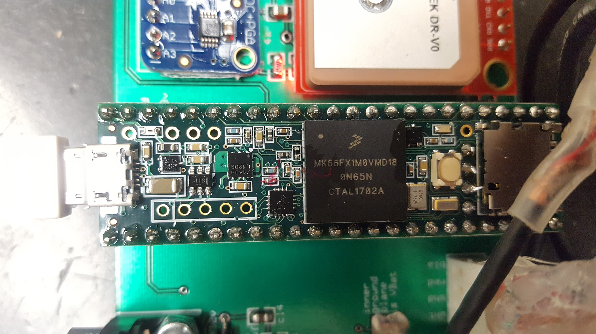
Integration into Perlan aircraft

Slide 7
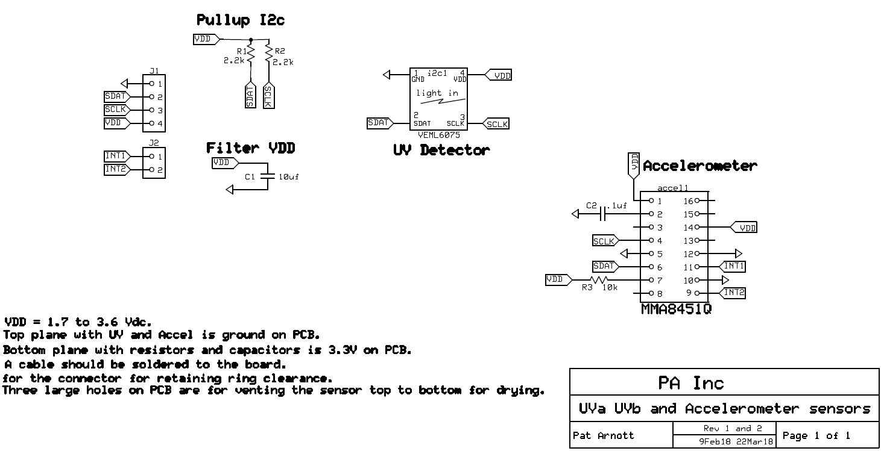
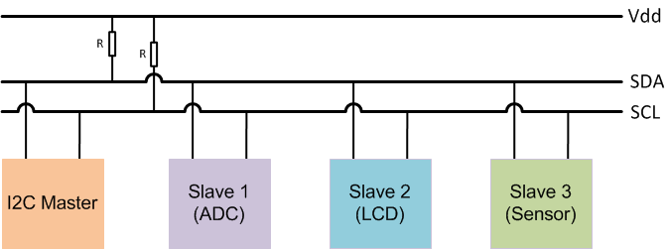
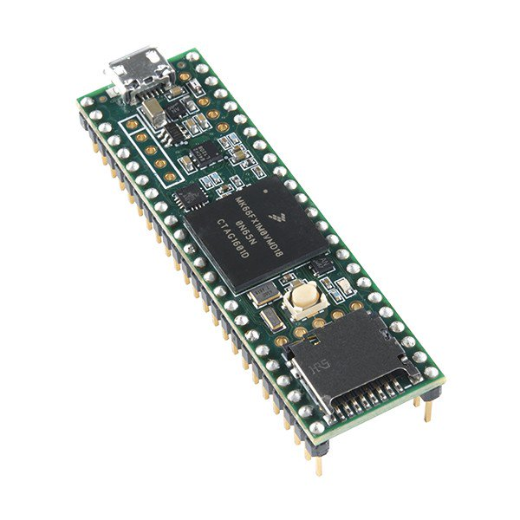
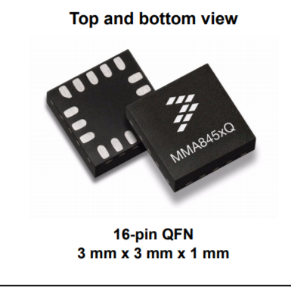
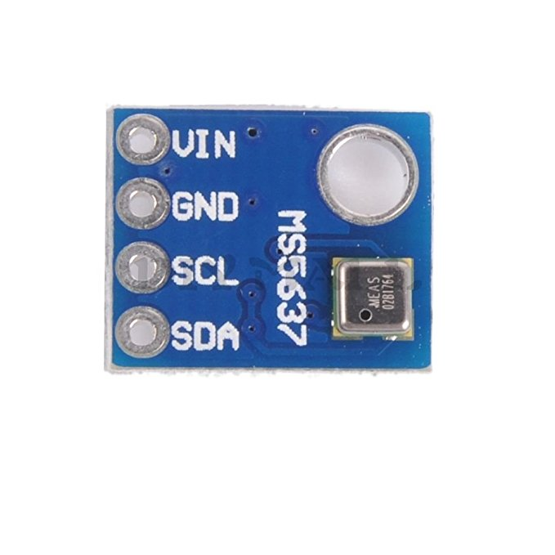
Circuit Schematic
2.2kΩ
2.2kΩ

Slide 8
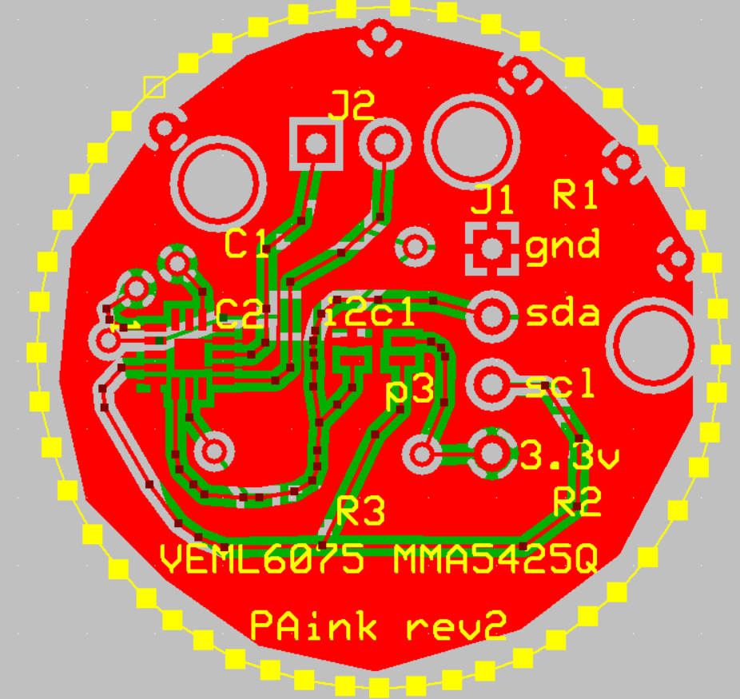
Printed Circuit Board

Slide 9
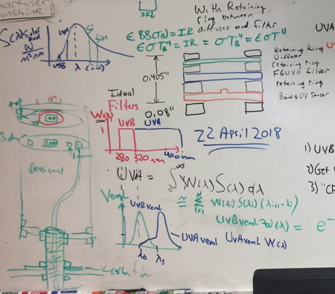
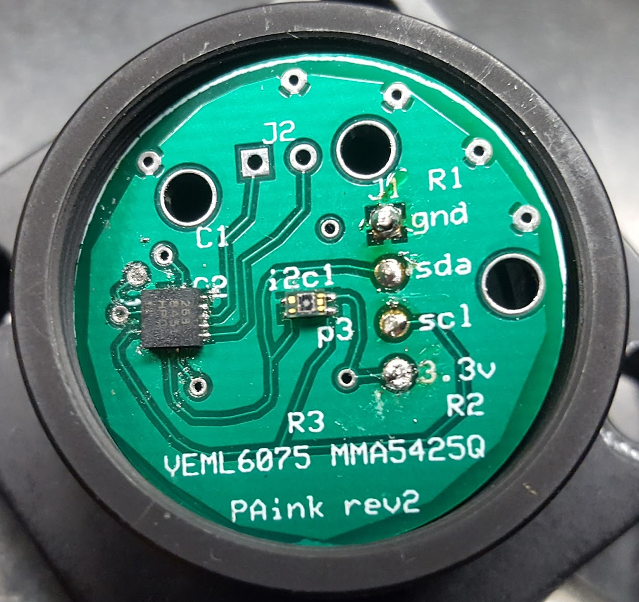
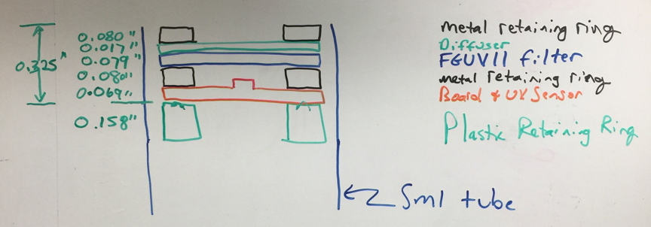
UV Sensor Head Design Stack
Retaining ring (metal)-0.080”
Diffuser (um)-0.017”
FGUV11 Filter-0.079”
Retaining ring (metal)-0.080”
Board + UV Sensor-0.069”
Total Height = 0.325”
Retaining ring (Plastic w/ O-ring)-0.158” long, set at 0.205 below top
SM Tube - 0.530”

Slide 10
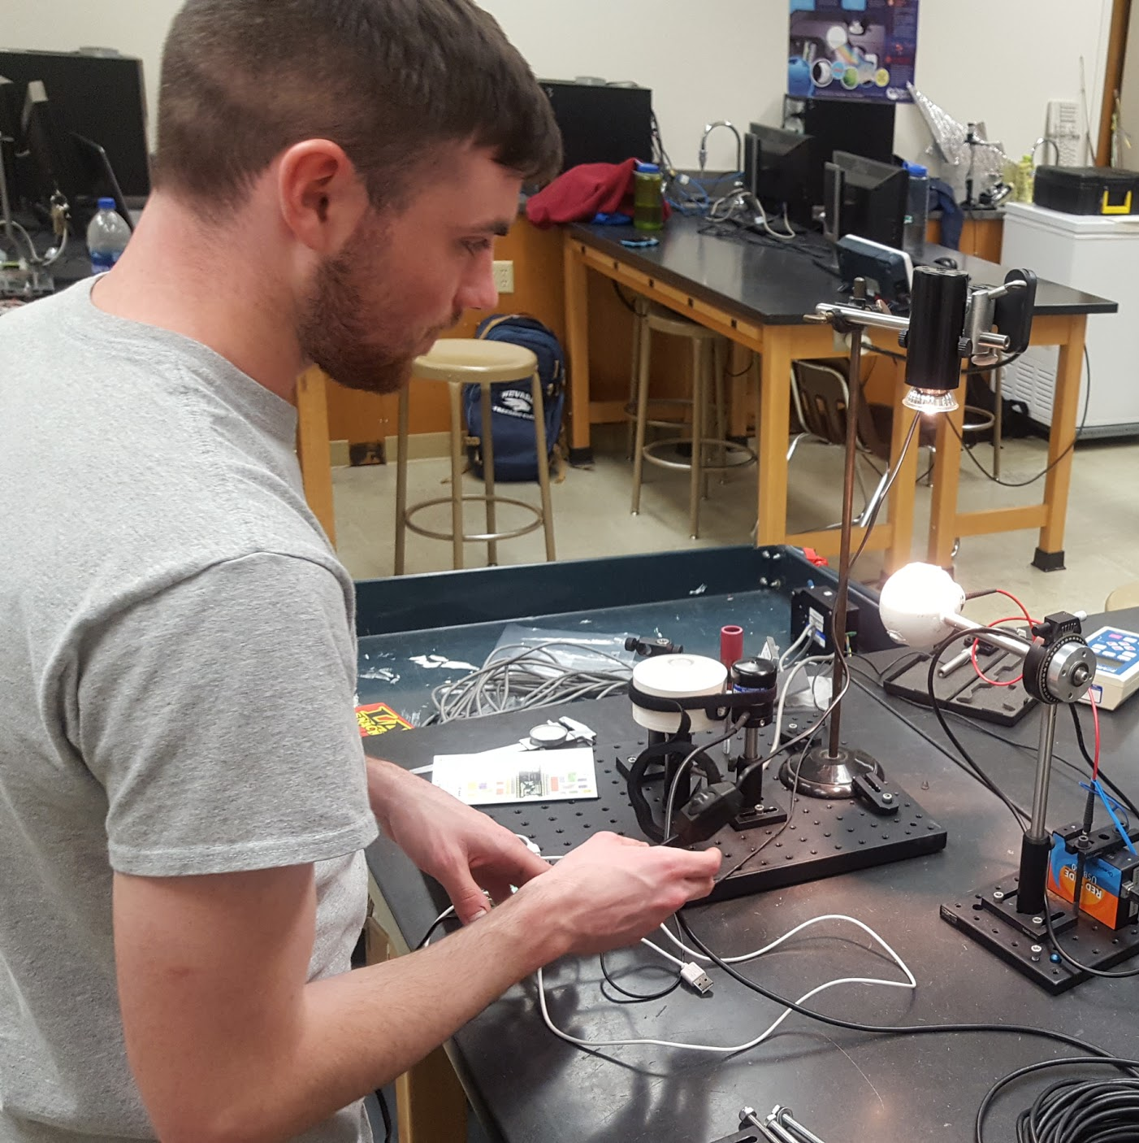
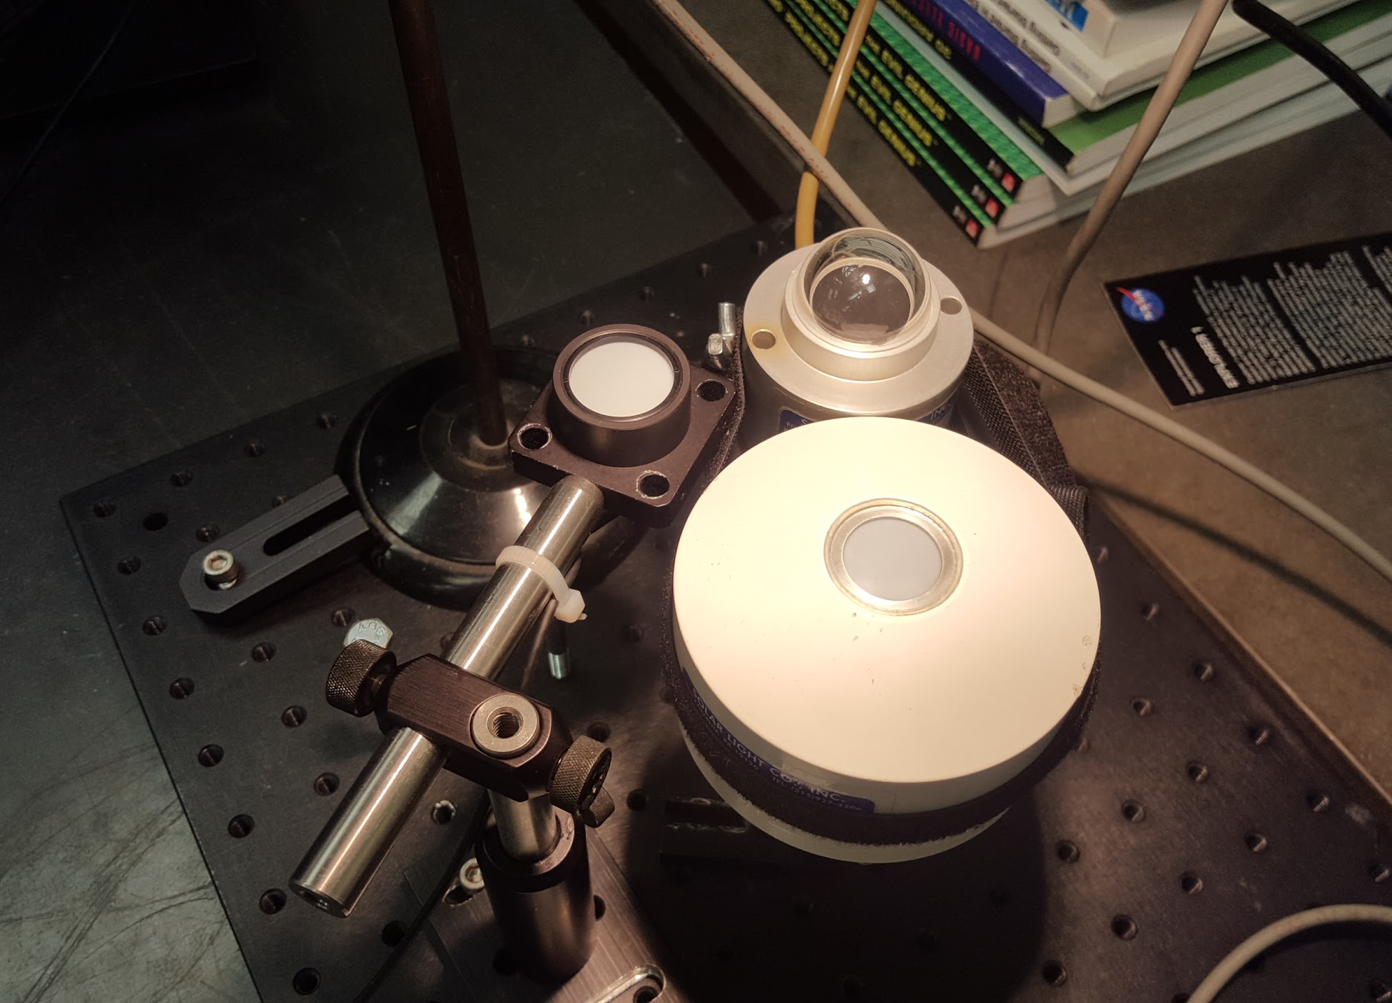
Testing and Calibration

Slide 11
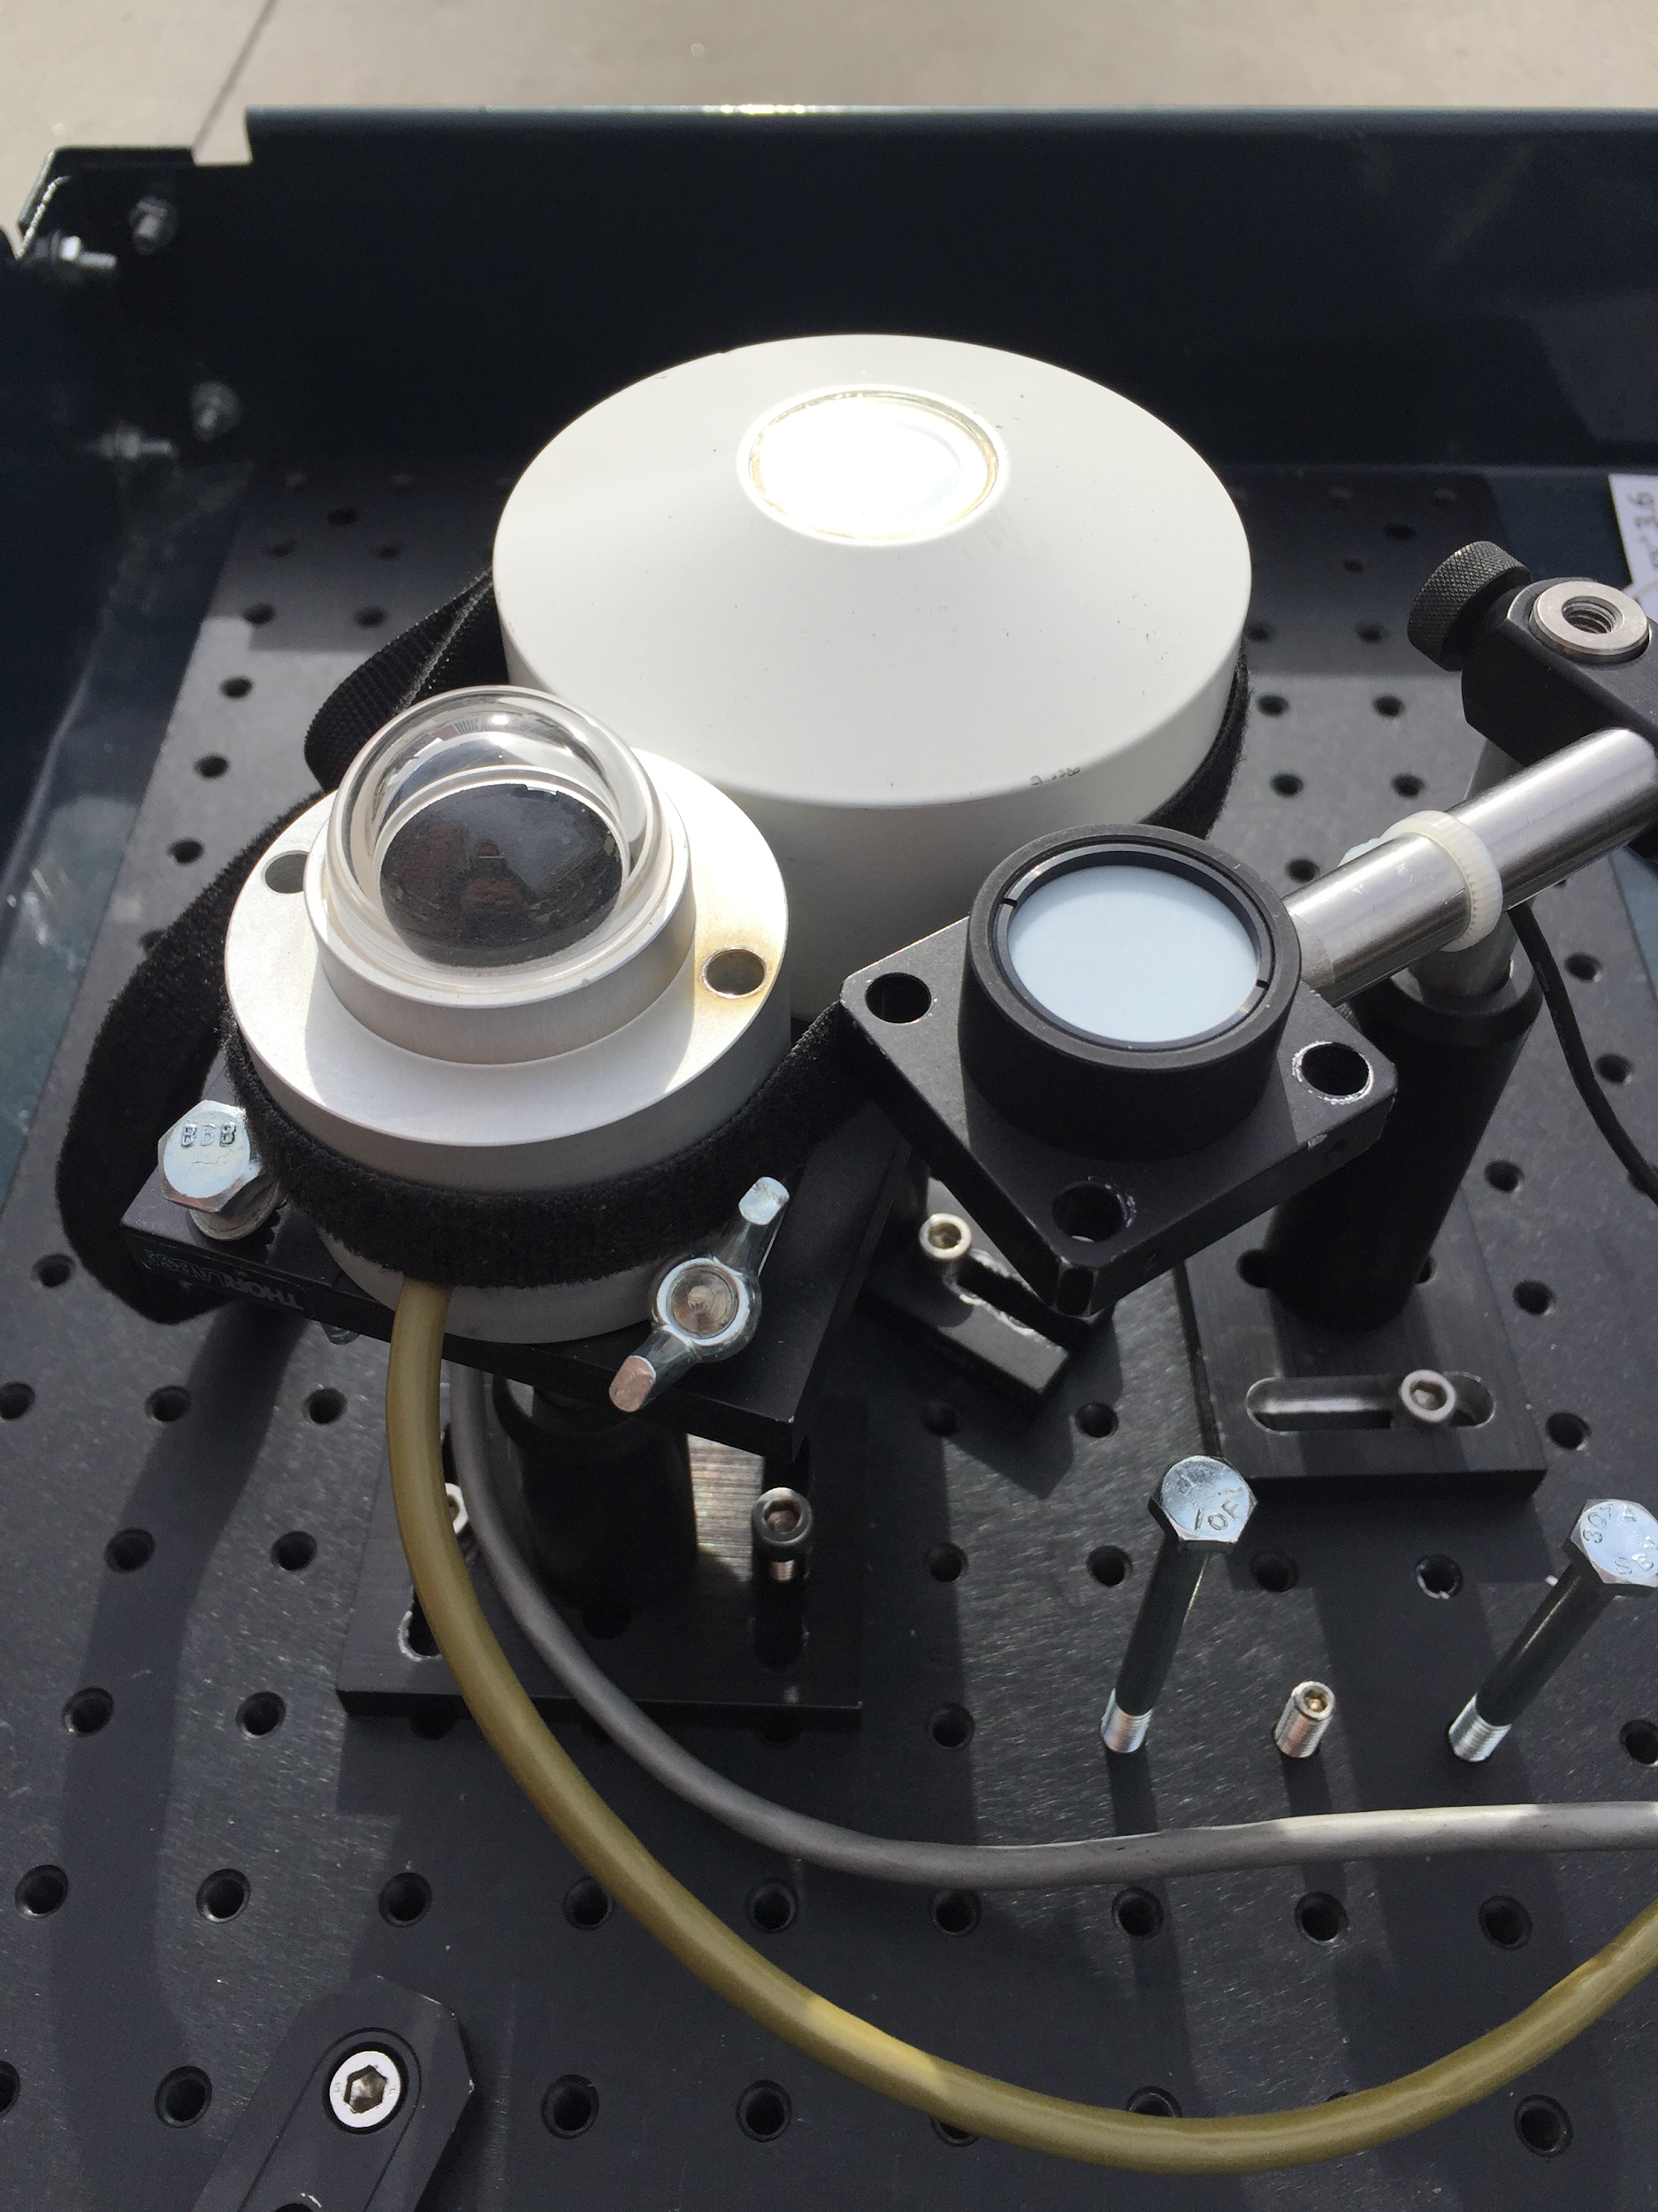
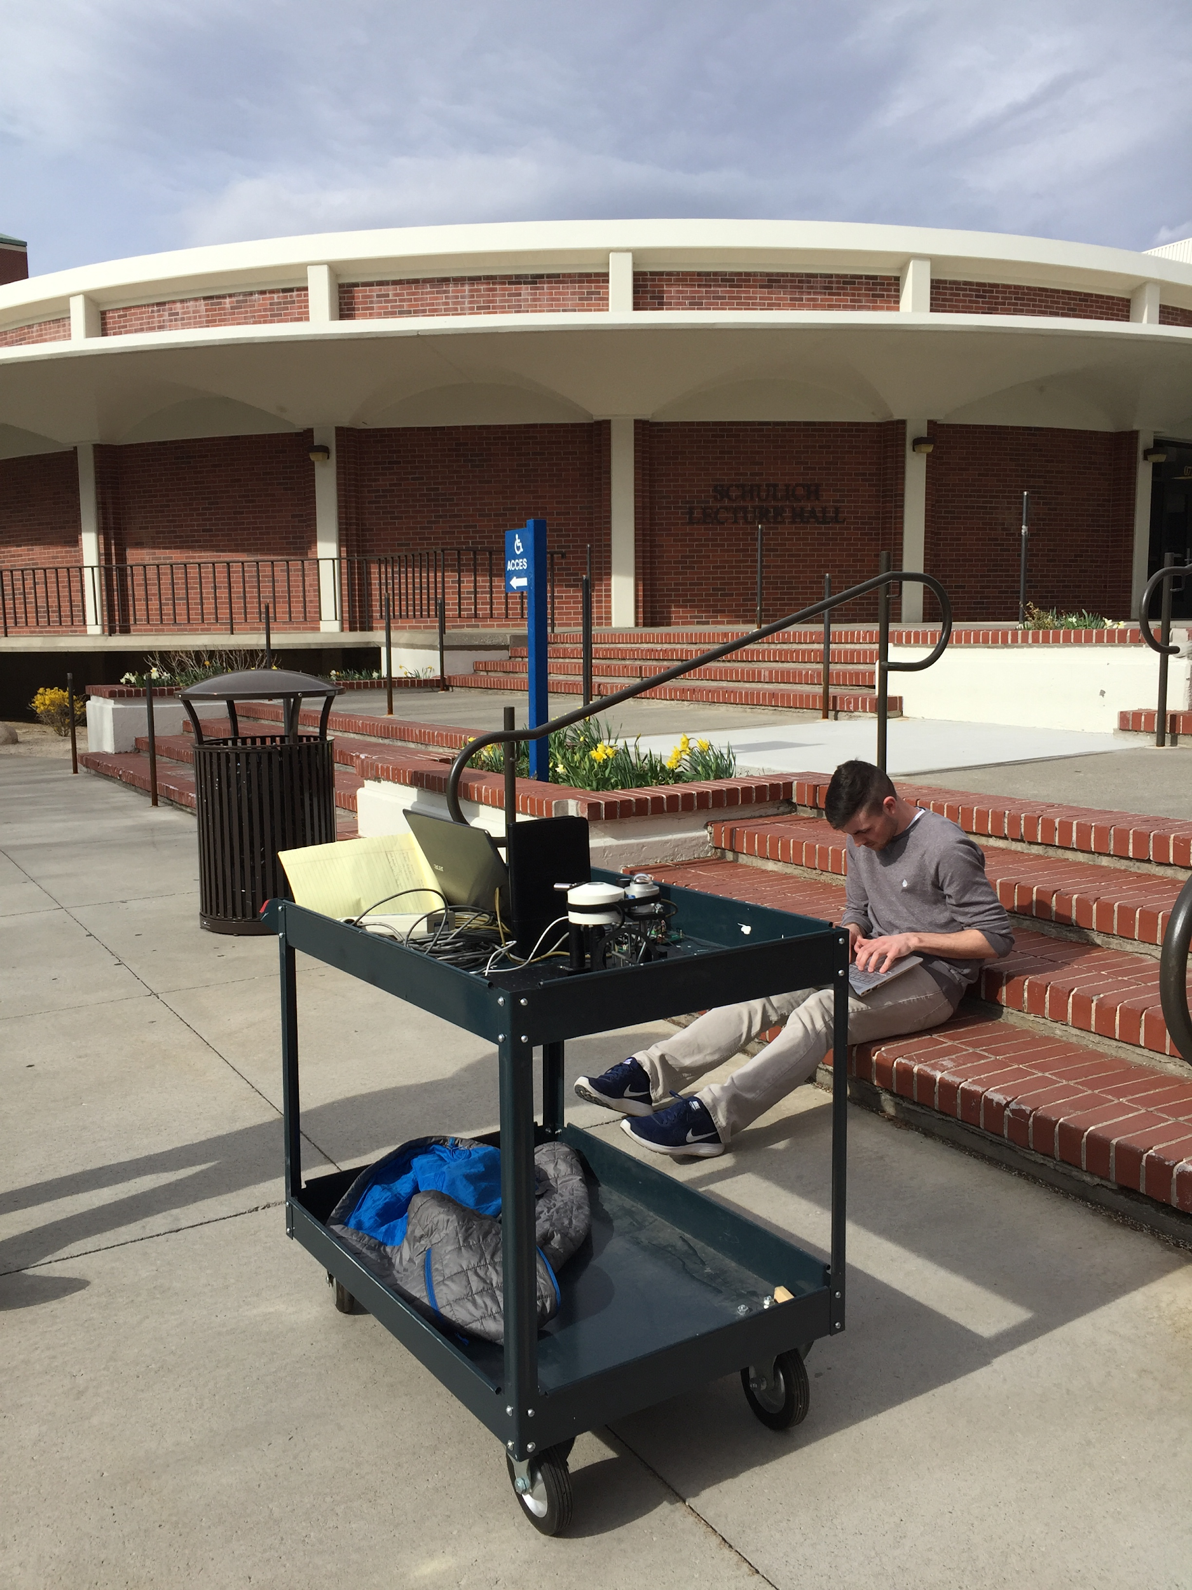
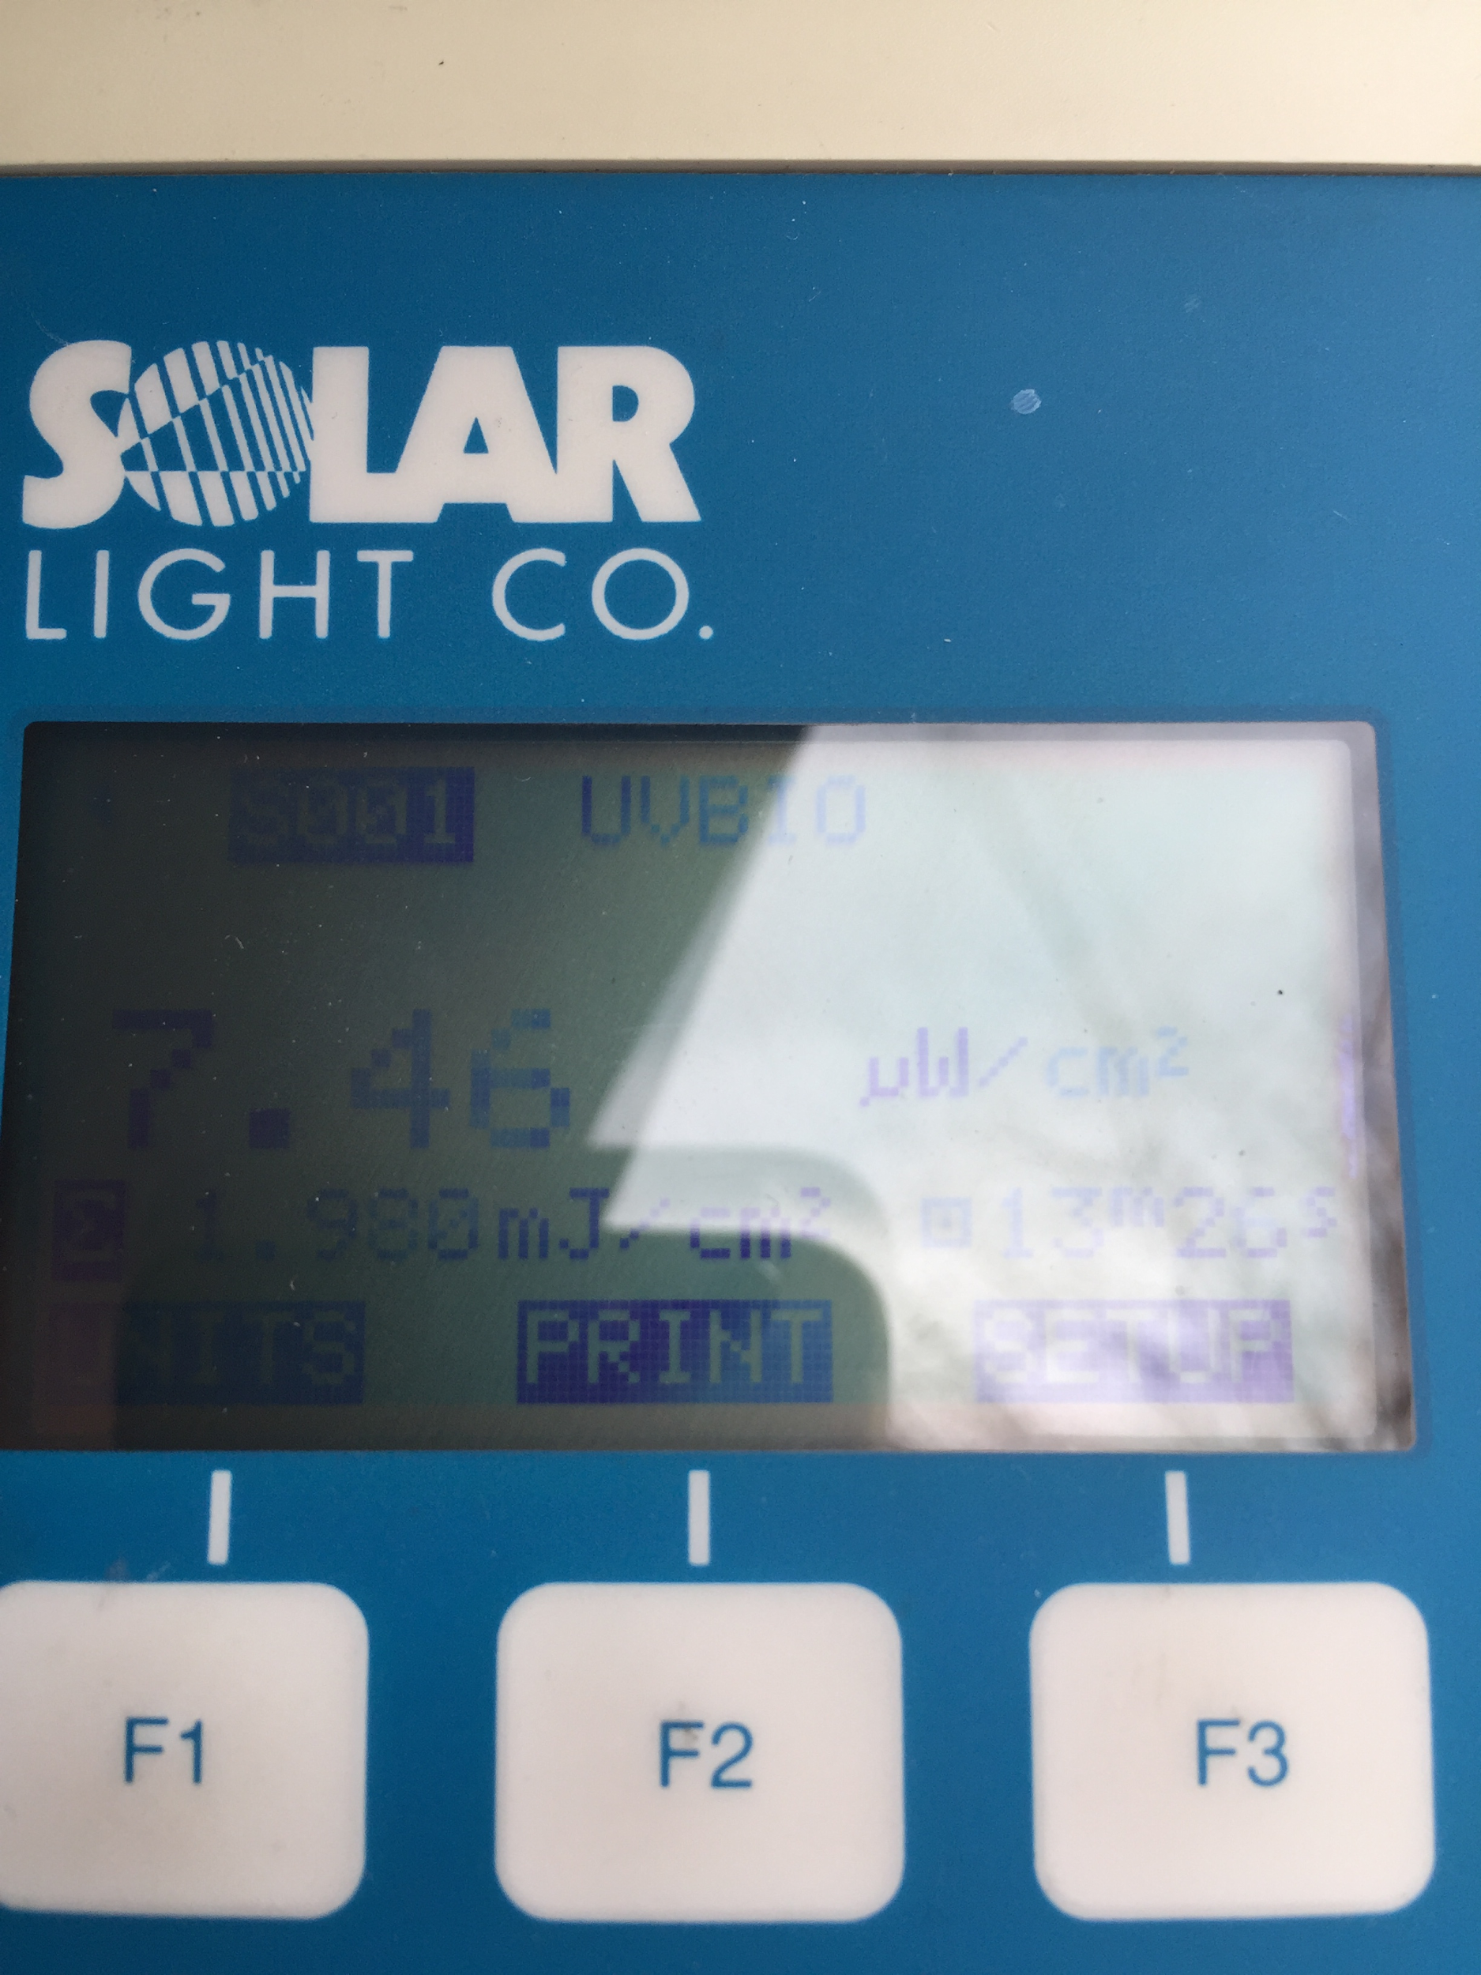
Outdoor testing

Slide 12
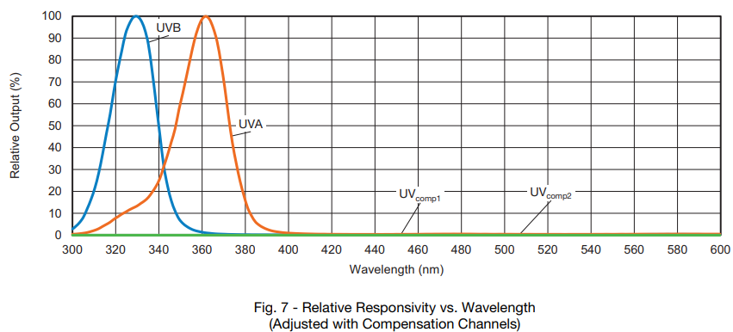
VEML Spectral Response
UVA (320-400 nm)- Standard
VEML-A Bandwidth: 350-375, 365 nm peak
UVB (280-320 nm)- Standard
VEML-B Bandwidth: 315-340, 330 nm peak

Slide 13
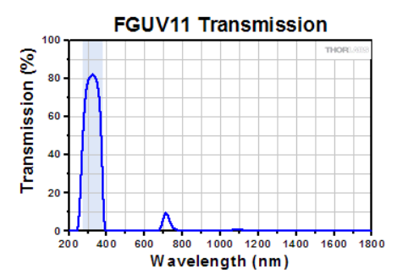
FGUV11 (275nm-375nm)

Slide 14
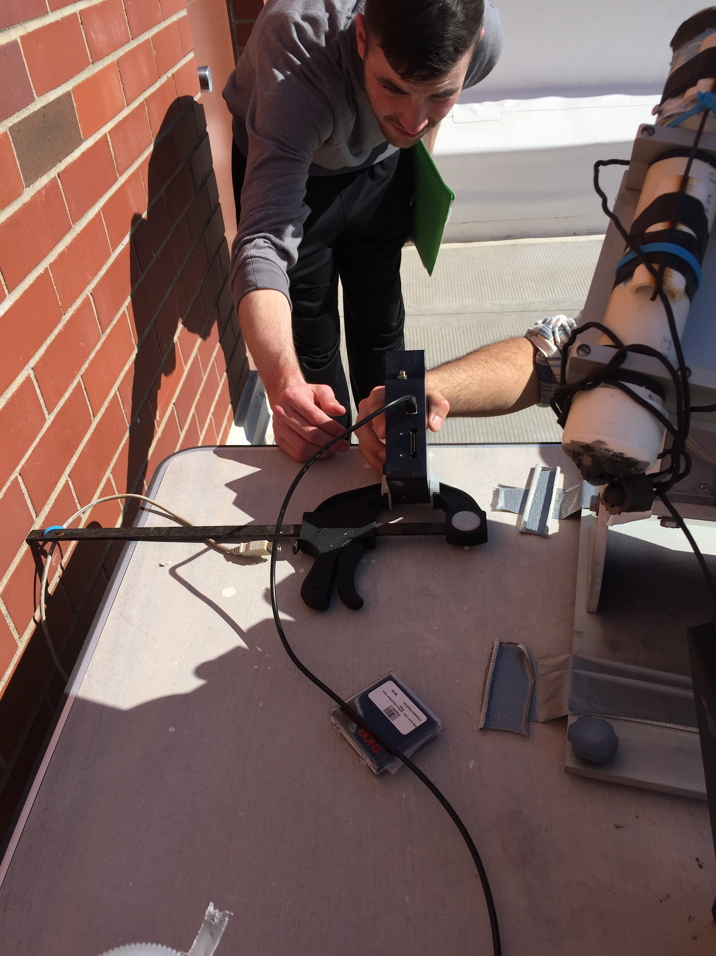
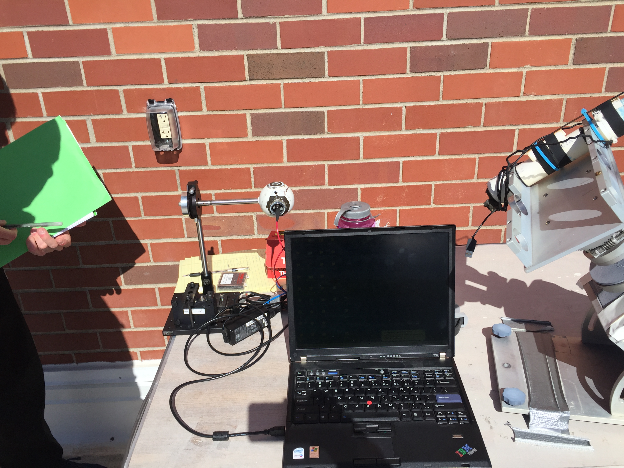
April 17th, 2018

Slide 15
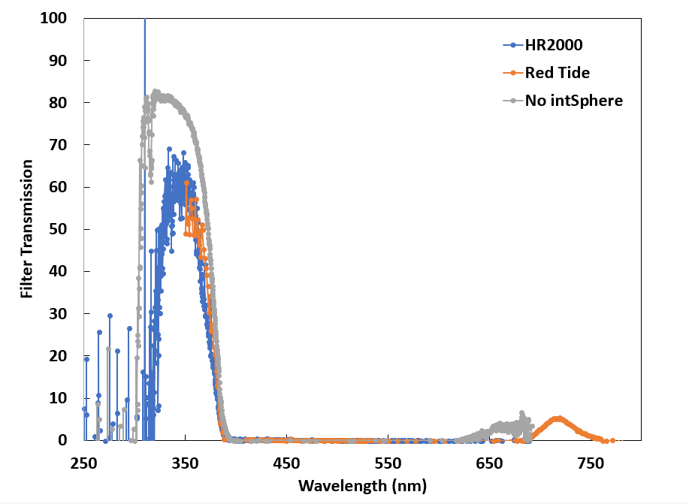
Filter Transmission
Red Tide: Integration time: 170 ms (350-1000 nm)
HR2000: Integration time: 160 ms (190-1100 nm)
Used the HR2000 spectrometer without the integrating sphere and without the optical fiber cable.
Set the filter on top of the opening and stood a distance away after finding that our bodies greatly changed the radiation field.
Integration time: 35 ms

Slide 16
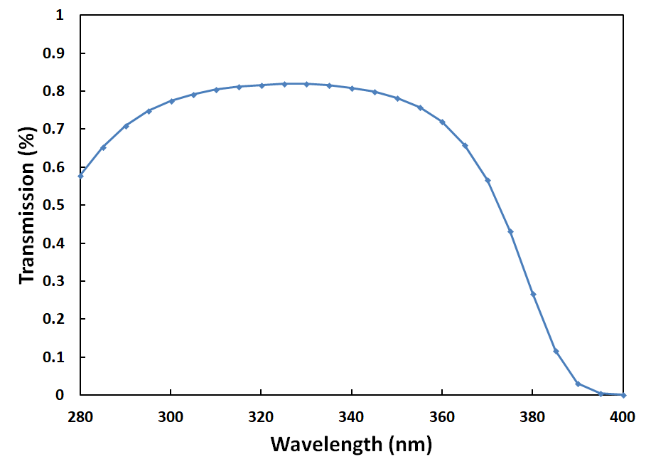
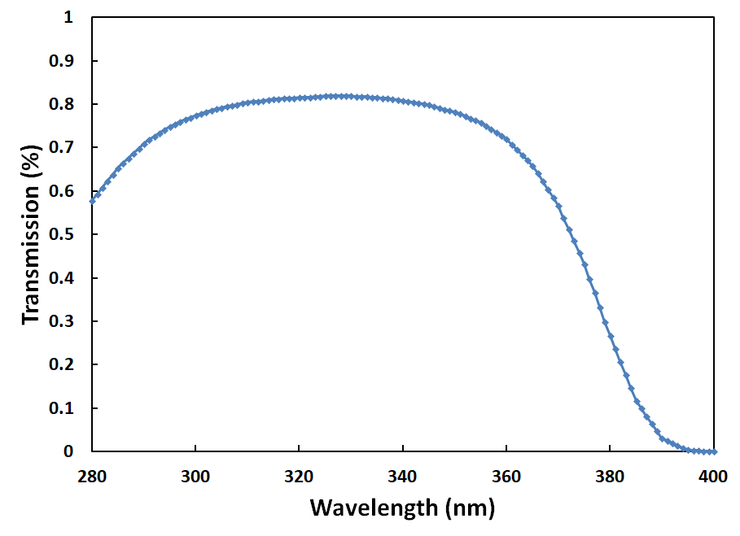
FGUV11 Interpolation

Slide 17
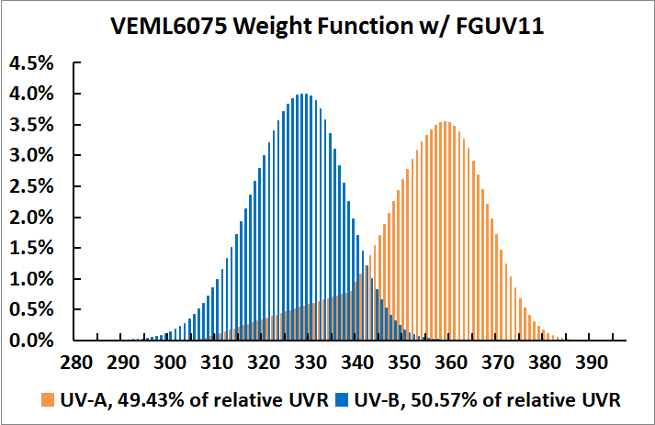
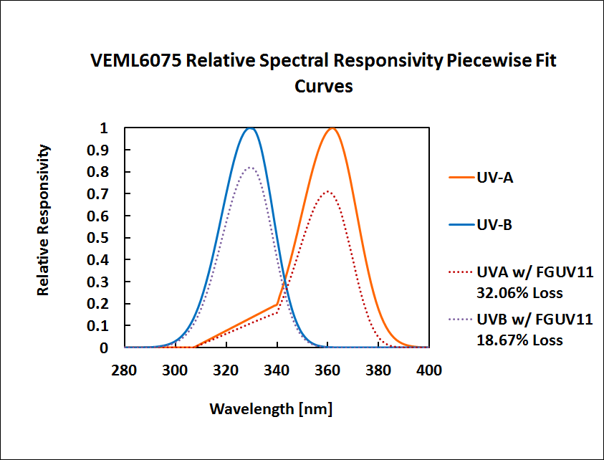
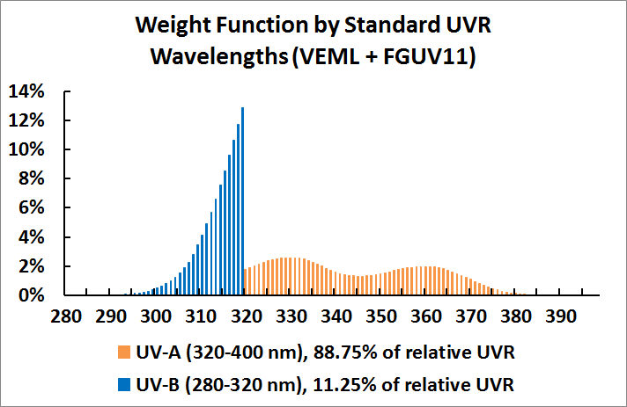
Notes:
From “VEML6075ResponsivityGaussianFit.xlsx” file

Slide 18
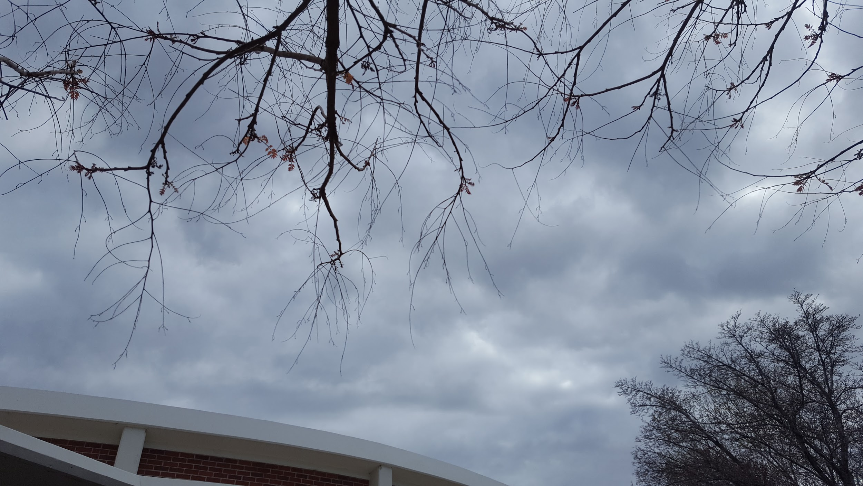
April 19th, 2018 Cloud Coverage

Slide 19
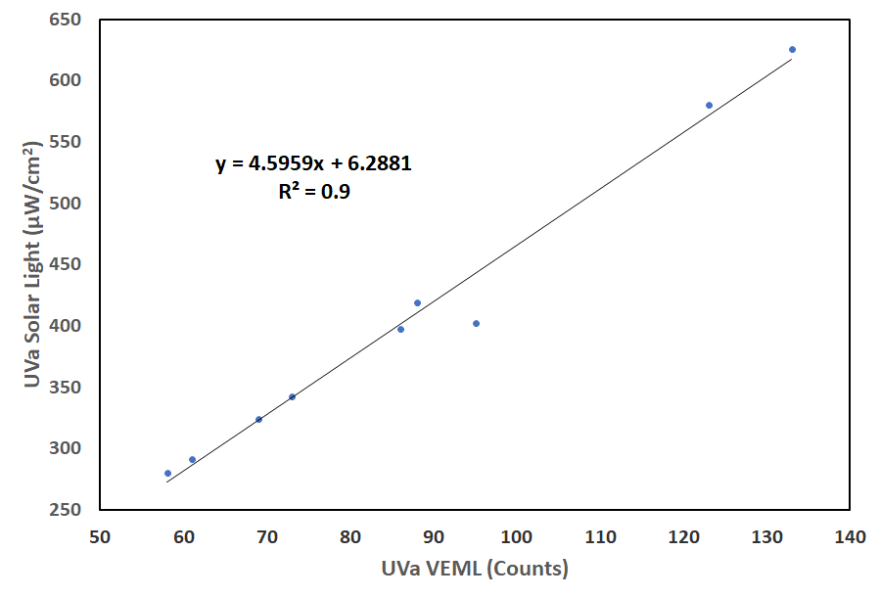
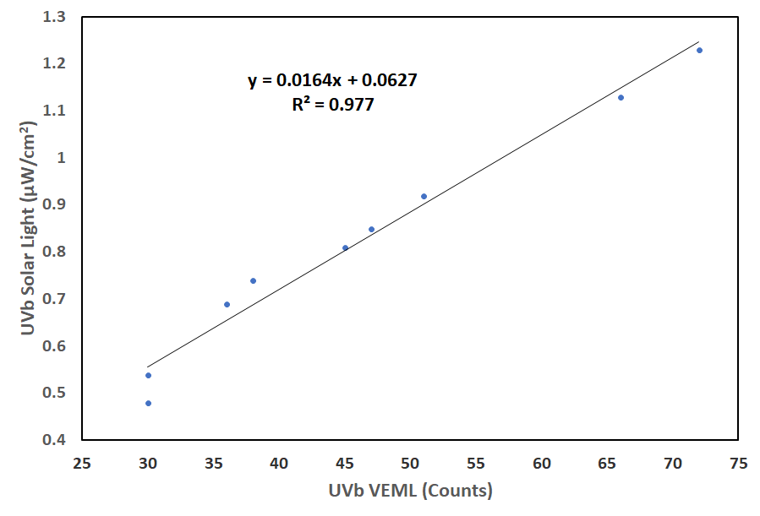
VEML vs Solar Light (UVA and UVB)

Slide 20
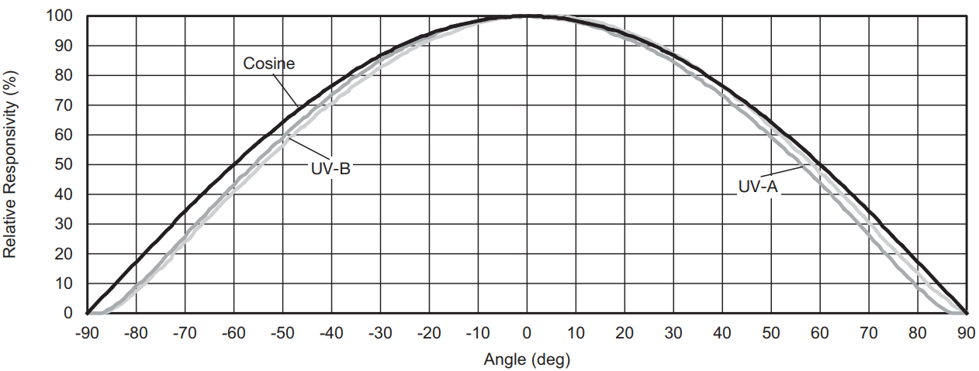
VEML 6075 Cosine Response

Slide 21
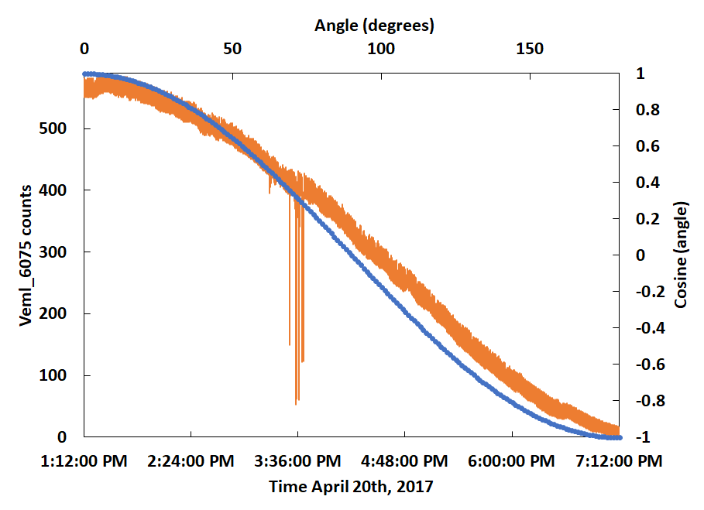
Cosine Response

Slide 22
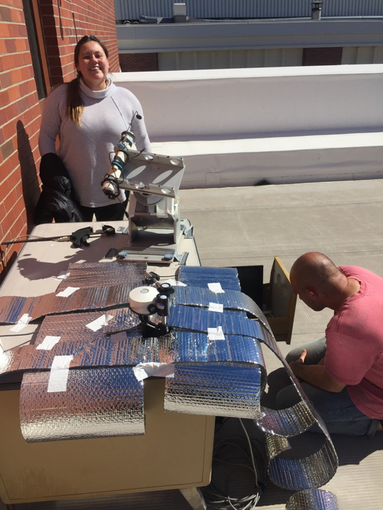
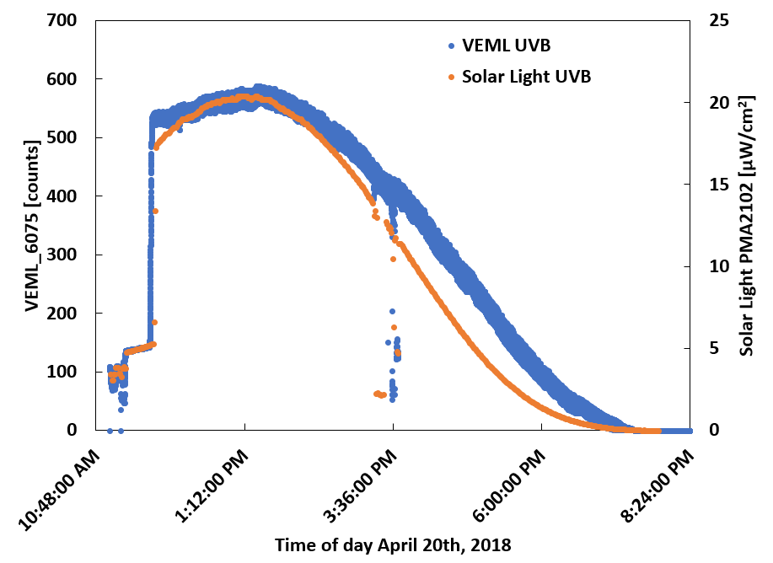
April 20th, 2018 (clear skies)
Solar Light Detectors:
UV-A PMA2111 (300-400 nm)
UV-B PMA2102 (320-400 nm)

Slide 23
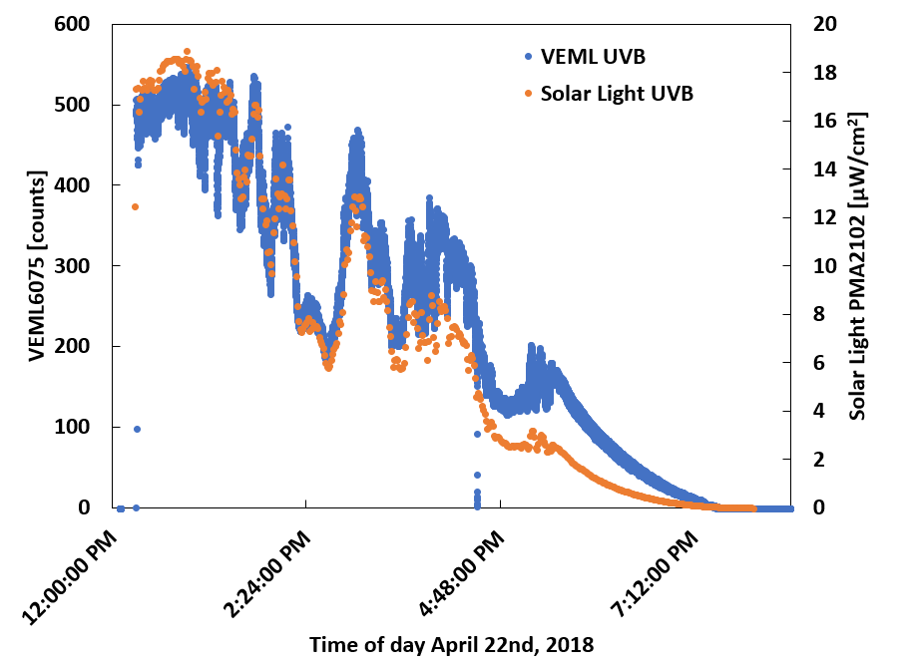
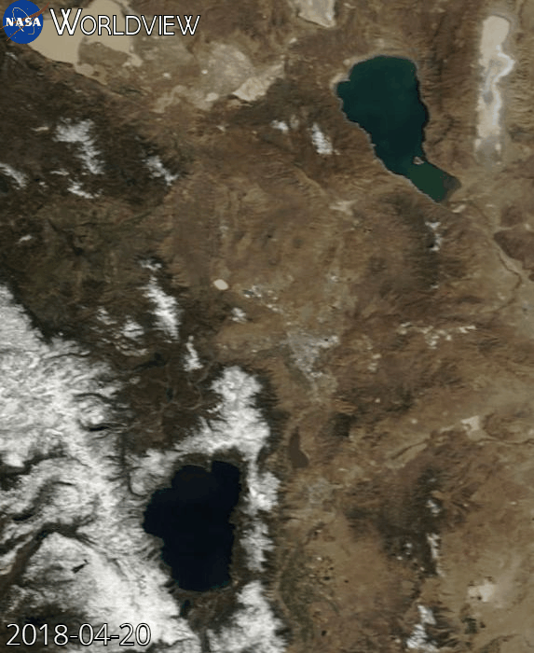
April 22nd, 2018 (cloudy skies)

Slide 24
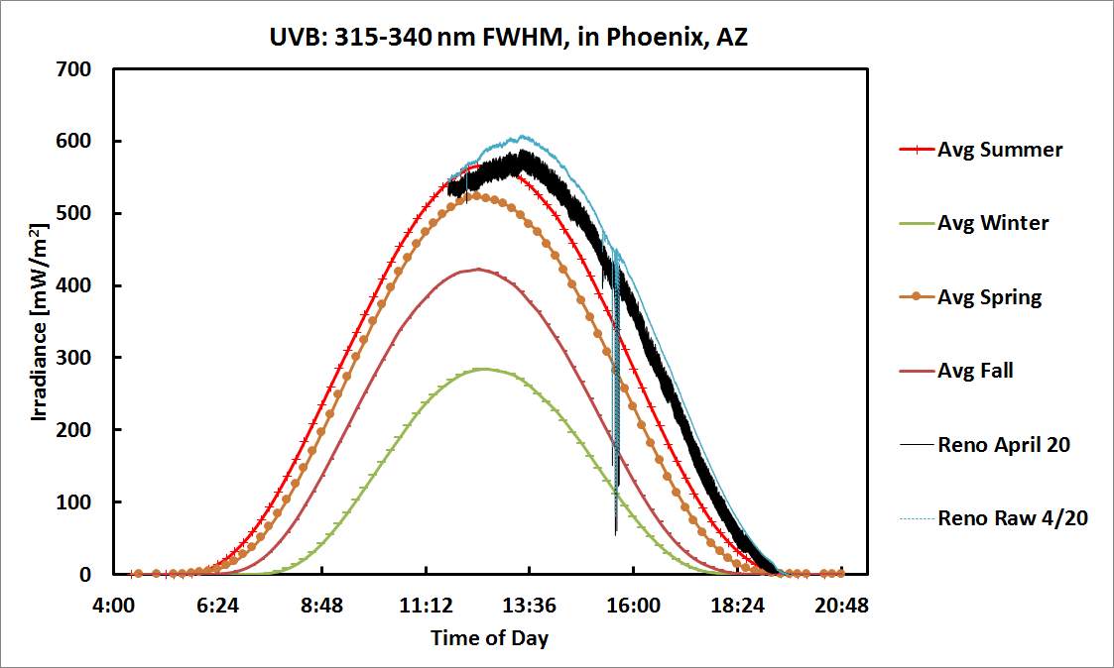

Slide 25
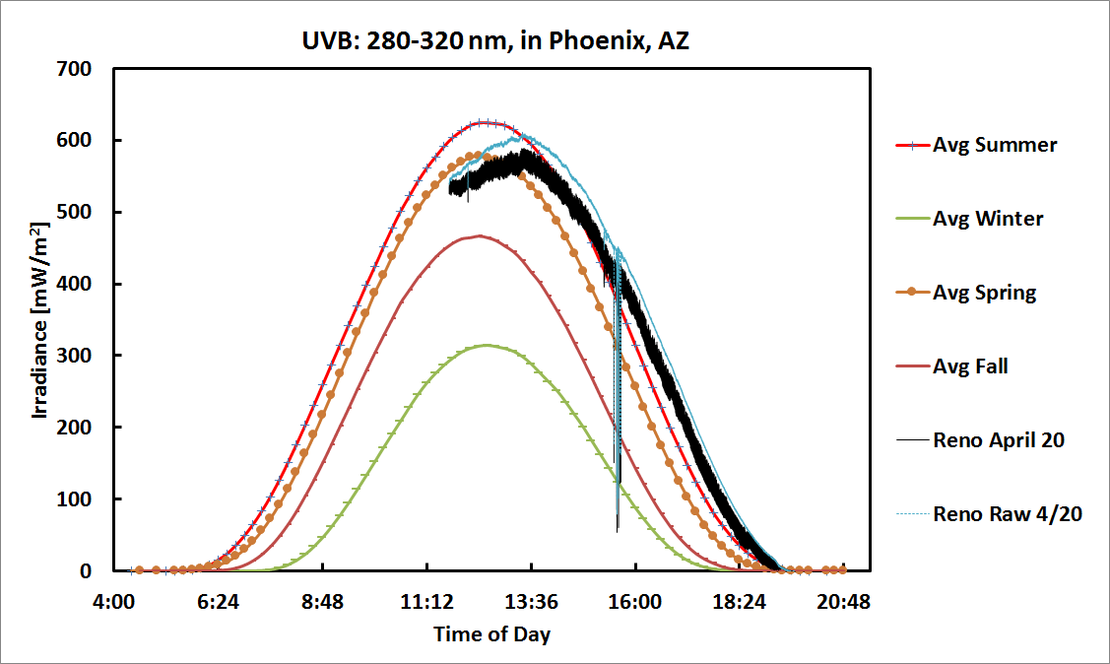

Slide 26
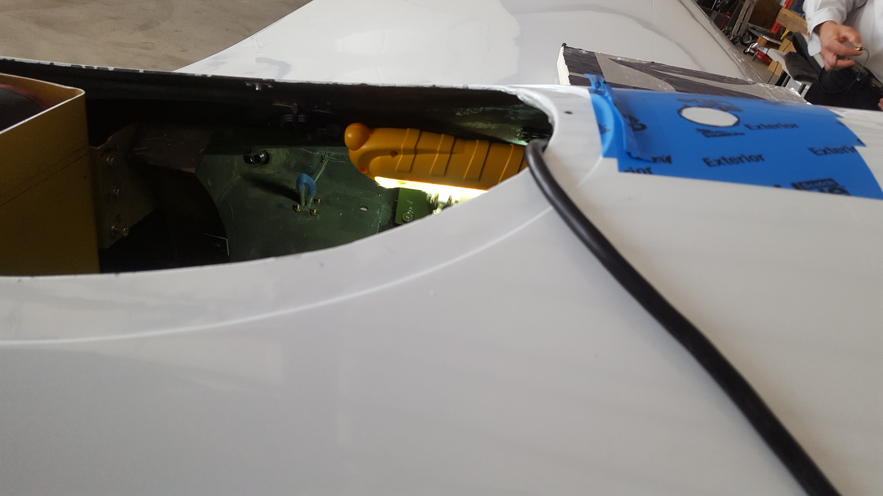
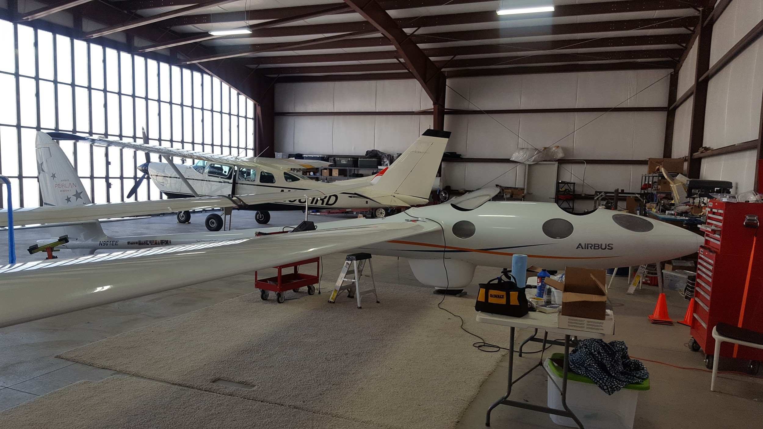
Perlan Trip to Minden

Slide 27
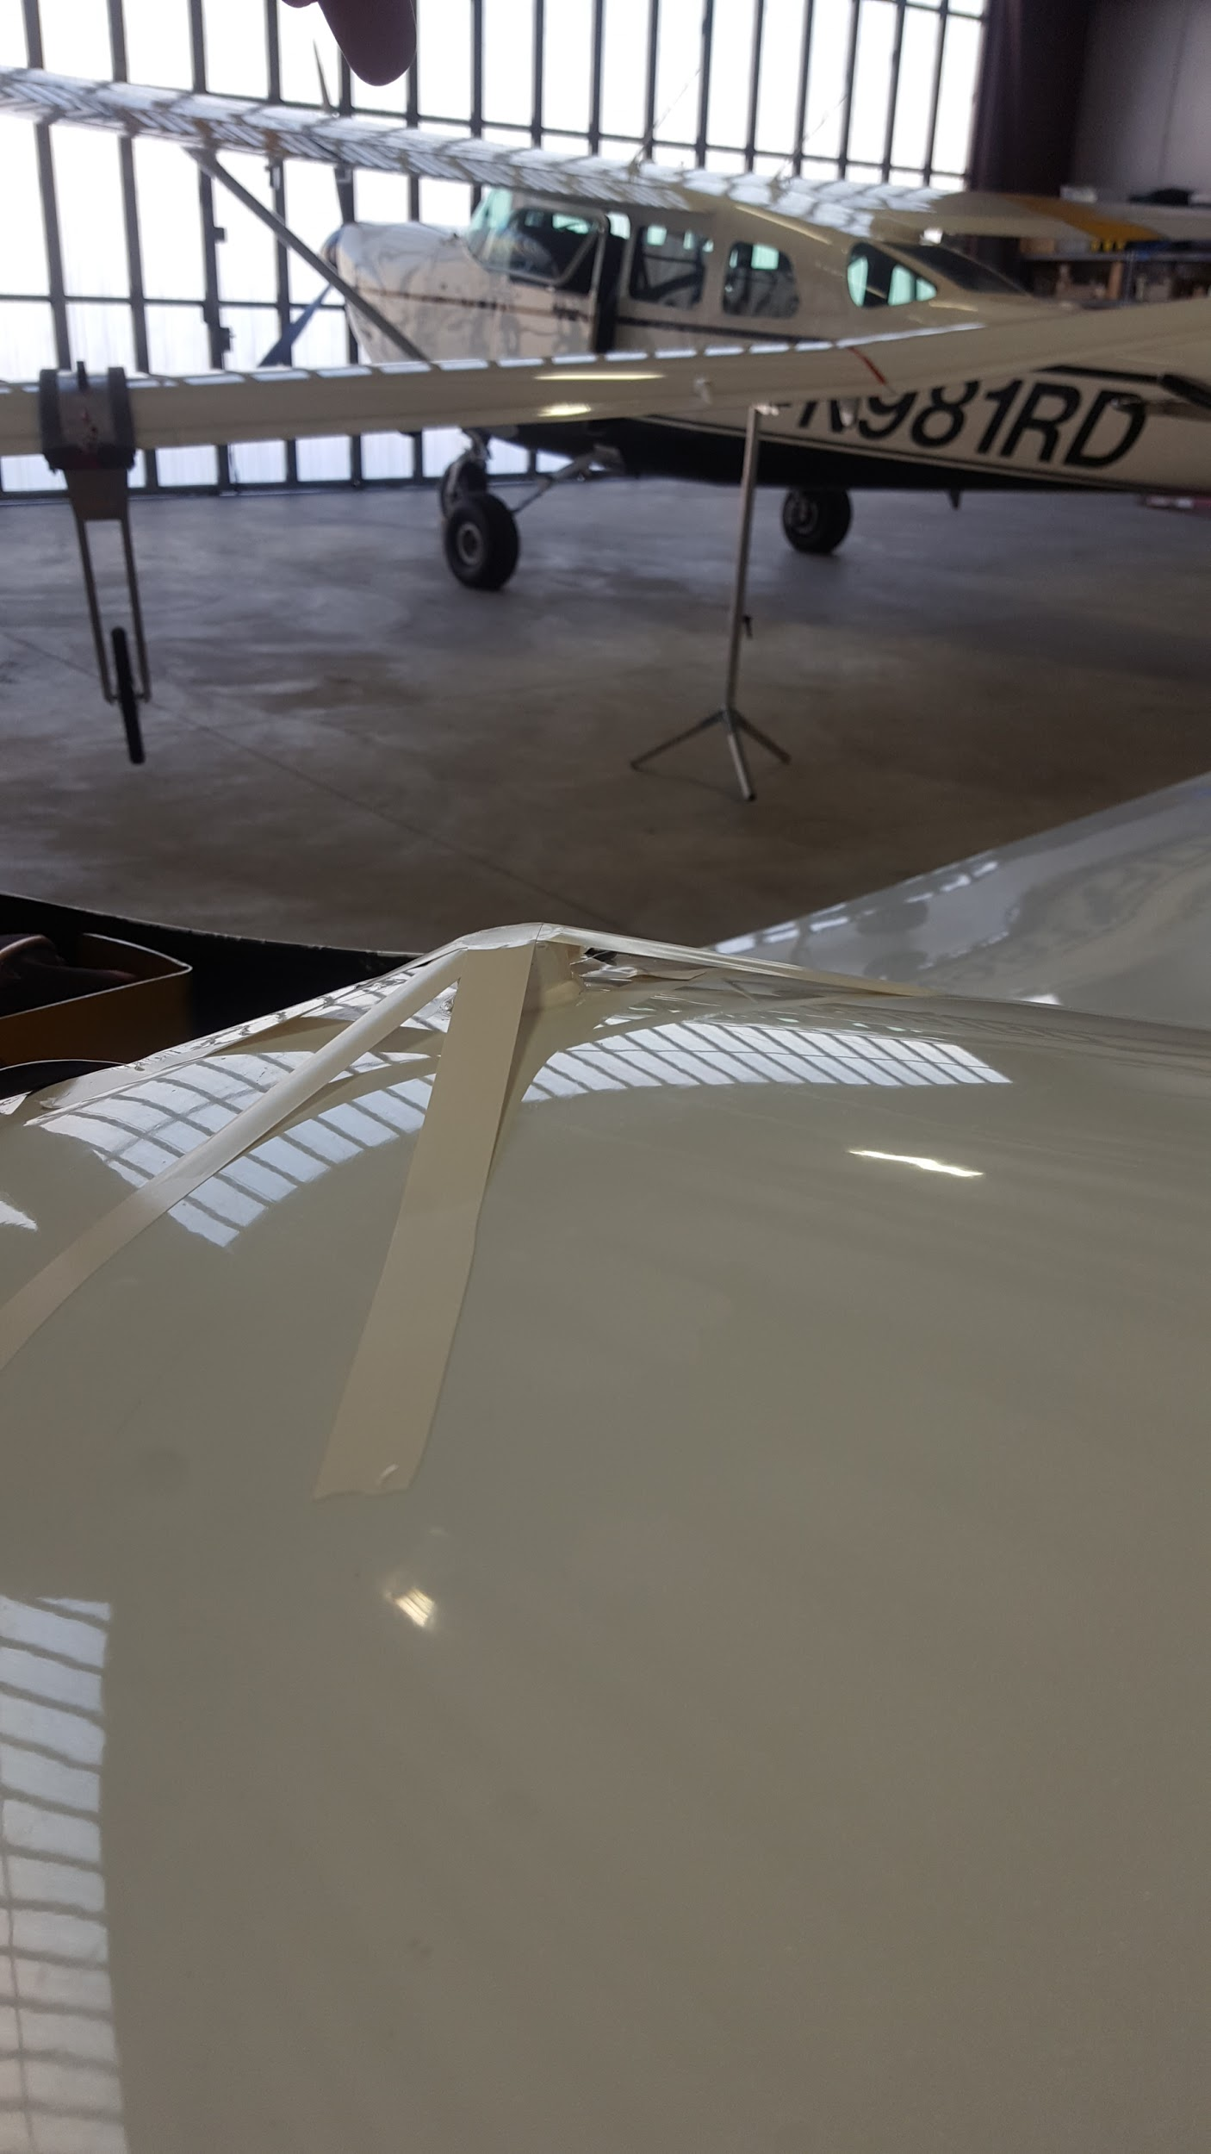
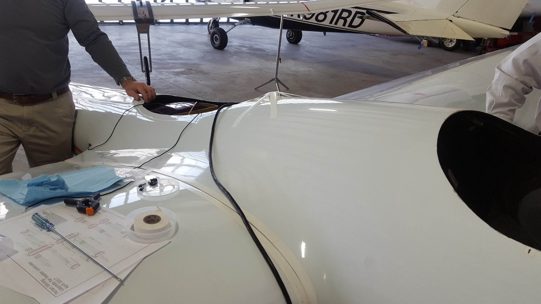

Slide 28
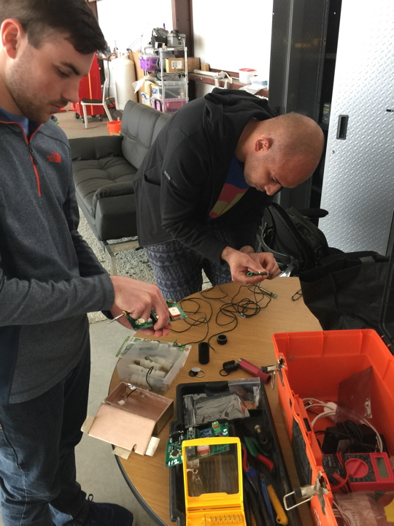
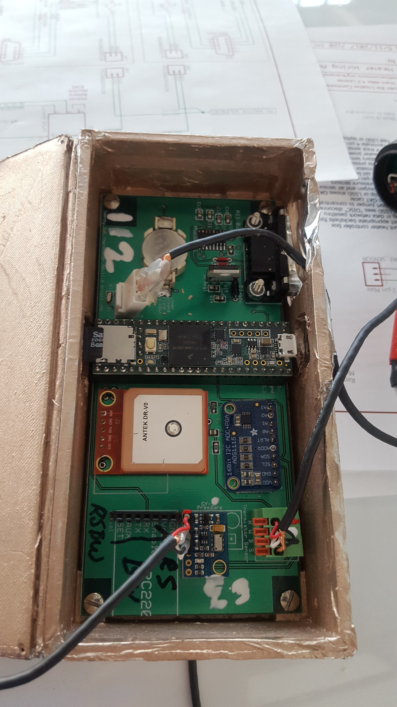

Slide 29
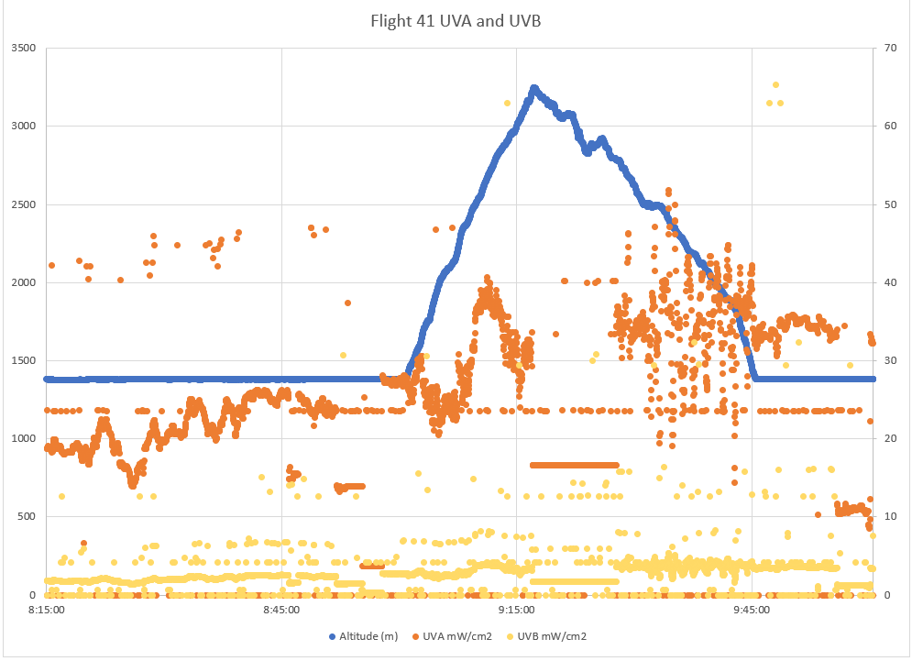


Perlan UV Flight Data
-Telemetry induced RF noise
-Ferrite core
-Excitation by nearby RF signals
-Induce current
-Ferrite magnifies self-induction, thus
reducing noise by opposing emf
Notes:
-RF absorbed, no longer irradiated, converted to heat
-Prevents contamination and interference of signal
-Ferrite(Iron oxide mix): Non-conducting material composed for specific range of permeability

Slide 30
Appendix

Slide 31
Light Detection Glossary
Luminous Flux [lumen]: Weighted sum of radiant power in visible band only
Radiant Flux [W]: Integrated irradiance; Power emitted, reflected, transmitted or received for all frequencies
Spectral Flux [W/Hz or W/nm]
Luminous Intensity [ I_{v} ] = [candela]
Illuminance [E_{v} ] = [ lux ] = [ lumen*m⁻² ] = [ cd*sr*m⁻² ]
Luminance [ L_{v} ] = [ cd*m⁻² ]: Luminous intensity from a surface per unit area
-Brightness
Radiance [ W*sr⁻¹*m⁻² ] Radiant flux per unit solid angle per unit area (directional quantity), the intensity per unit solid angle
-Brightness
Irradiance [ W*m⁻² ]: Radiant flux (power) received per unit area (radiation flux density)
Intensity

Slide 32
Solar Light Company Inc.
Data Logging Radiometer PMA2100, Dual-Input
-Radiometer (radiant flux = radiant power [Watts])

Slide 33
Detector Technology
Silicon-based linear image sensor arrays, Sony SILX511B (Ocean Optics Spectro)
Complementary metal-oxide semiconductor, CMOS, (veml6075)
Notes:
Reminders:
Charge-coupled devices (CCDs) convert incoming photons into electron charges
Transistors are made of silicon for the semiconductor qualities (Metal-oxide, controlled oxidation of silicon gate, applied voltage at gate changes the conductivity of the device)
Pixels are represented by p-doped MOS capacitors,
Quantum efficiency (spectral response) 100% means one count = one photon, 90% is 9 counts for every 10 photons

Slide 34

April 17th, 2018 Cloud Coverage

Slide 35

Diffuser Spectra
April 17th, 2018
Used the HR2000 spectrometer without the integrating sphere and without the optical fiber cable.
Integration time: 40 ms.
Repeated the same measurement due to changing cloud coverage

Slide 36

Teensy Microcontroller

Slide 37

Data
Solar Light Gauge (Dual channel...or is it?)

Slide 38




