Slide 1
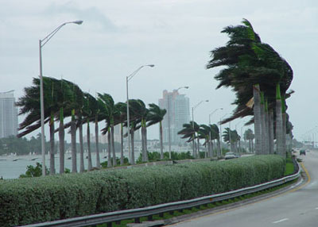
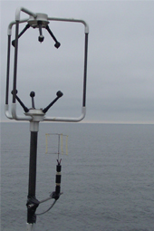
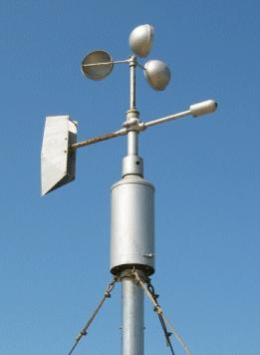
ANEMOMETRY
Stephen Bone
April 21, 2009

Slide 2
The Anemometer
Instrument designed to measure wind speed/velocity, or other components of the wind vector.
Classified according to the transducer employed (device for converting energy from one form to another).
Cup, propeller, pilot-tube, hot-wire, and sonic anemometers.

Slide 3
The Sonic Anemometer
Developed in the 1970’s.
Uses ultrasonic sound waves to measure wind speed and direction.
Extremely short time constant.
No moving mechanical equipment required for taking measurements (Unlike cup or propeller anemometers).

Slide 4
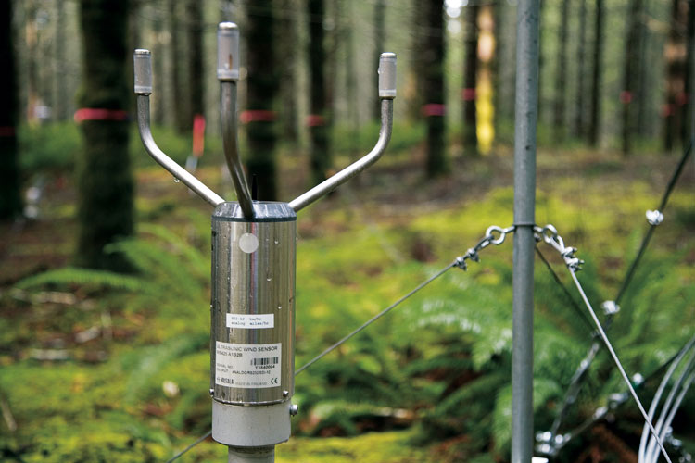
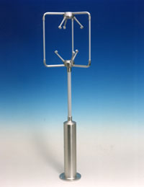
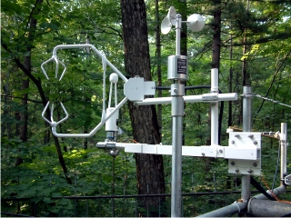
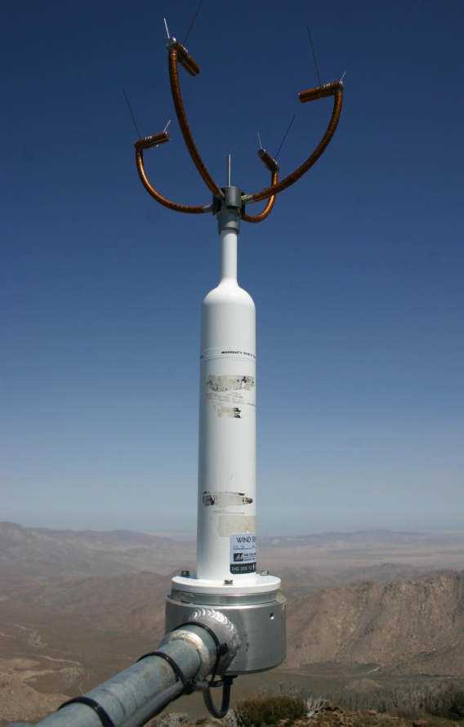
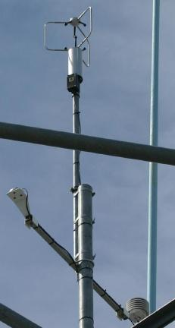

http://www.weatherhut.com/site/1298901/LearningCenter/Images/Ultrasonic_animated.gif

Slide 5
Measurements
Measurements based on time of flight of sonic pulses between pairs of transducers.
The wind acts as a “medium”.
The speed of sound through the medium added to the speed of the medium itself yields the speed of sound.
This basic relationship is manipulated and used to make measurements with the Sonic Anemometer.
Measurements can be done in three dimensions due to the design.

Slide 6
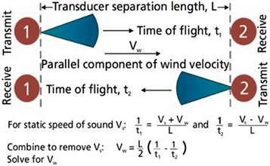

Slide 7
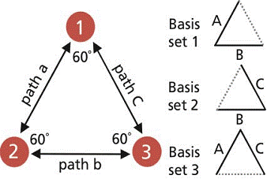
The equilateral triangle configuration of the three transducers provides three possible sets of basis vectors.
The combinations yield bi-directional measurements on the paths labeled A, B and C.
These measurements are used to determine the wind velocity components parallel to each of the three paths.
(Stolen from Pat)

Slide 8
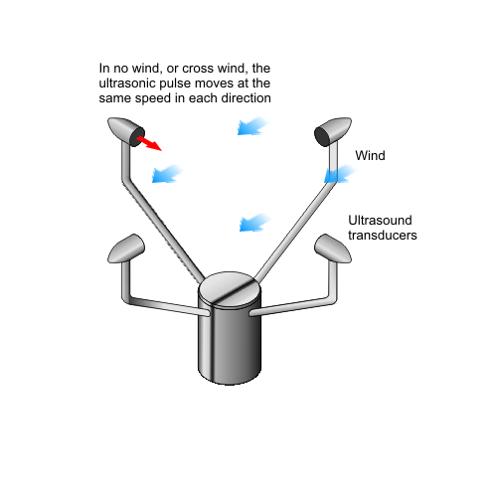
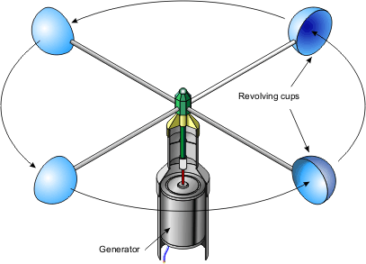
Information located at…
http://www.vaisala.com/files/A_Sonic_Anemometer_for_General_Meteorology.pdf

