Slide 1
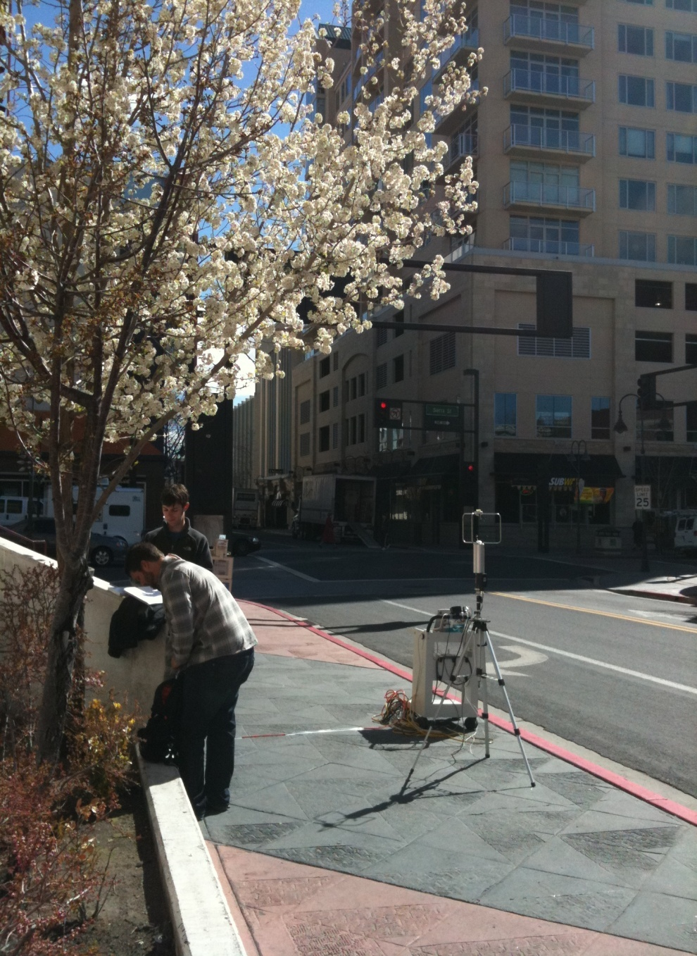
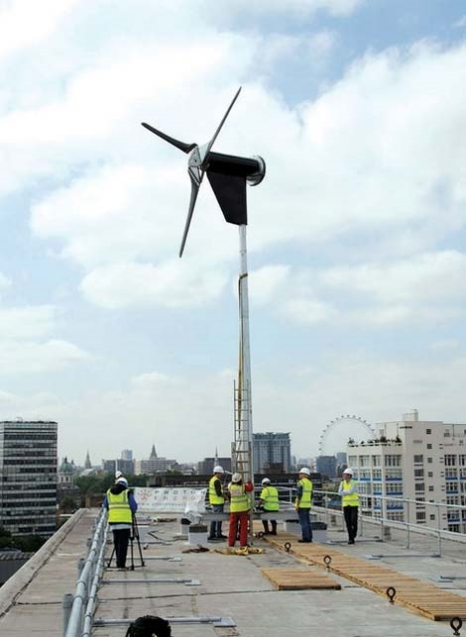
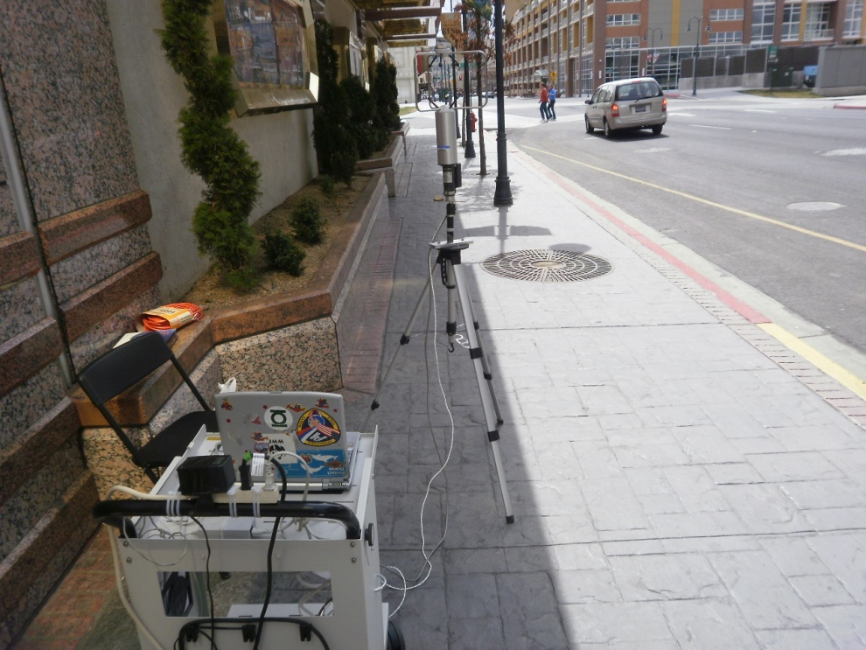



An Examination of Urban Wind Canyons in Reno, Nevada
TRUNK HIT HARD LIKE KIMBO SLICE
Ben Hatchett, Andrew Joros, Bryan Rae, Erich Uher, and Josh Walston
ATMS 360

Slide 2
Outline
Statement of Purpose
Measurement Technique and Challenges
Site Overviews
Data: Comparison of Measurements to Synoptic Environment
Data: Evaluation of TKE
Analysis and Discussion
Concluding Remarks and Suggestions for Future Work

Slide 3
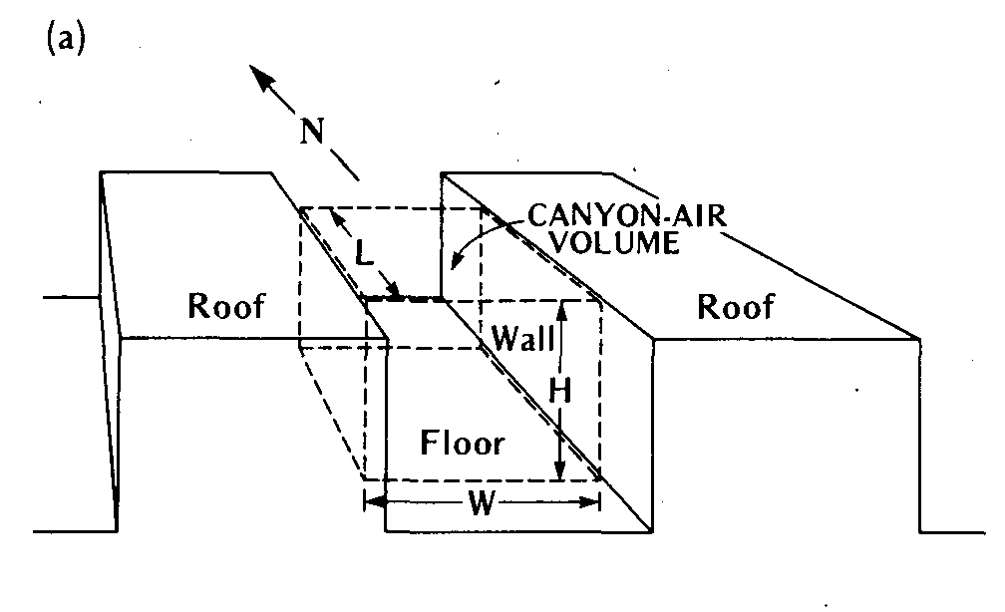
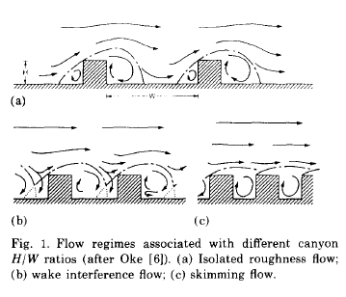
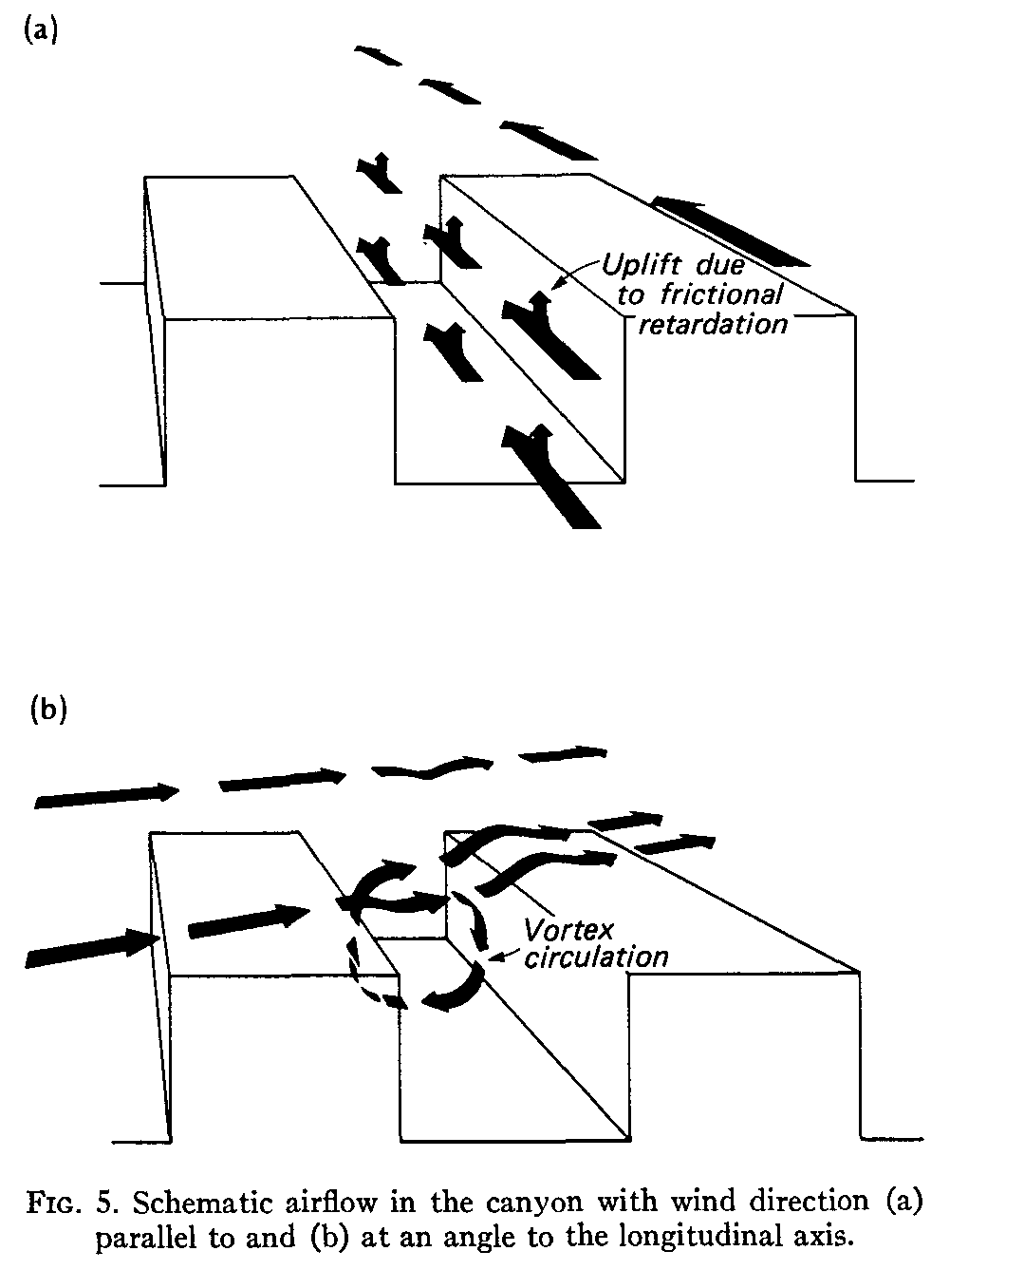
The Question:
The Theory:
The “Urban Canyon” and the associated airflow processes (Nunez and Oke 1977, J.Apl. Met. and Oke 1988, Boundary Layer Climates)
Bernoulli’s Principle: Energy is conserved, higher velocities→lower pressure
THUS: If wind is channeled into canyons created by buildings, velocity must increase. BUT! Turbulent dissipation of KE may dominate…
Can urban canyons be used to funnel wind kinetic energy to allow for smaller, high output urban wind power generators?

Slide 4
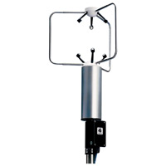
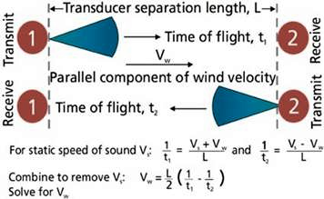
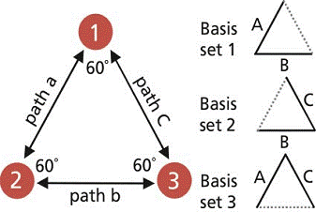
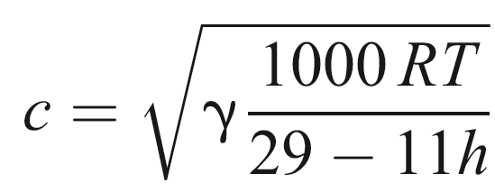
Measurement Technique: Sonic Anemometry
Wind velocity (U,V,W) measured based on transit time of ultrasonic signals sent between sensors.
Orientation and magnitude of flow alters signal transit time.
Speed of sound allows sonic temperature to be derived.

Slide 5
Challenges with Measurement
Proximity to power source (power draw too extreme with unit, need lots of batteries)
Private property (Can we measure here?)
Busy streets (Would be nice to measure in center of urban canyon, not along wall)
Unit falling over

Slide 6
Measurement Analysis
Labview Package to record 3-D Winds (U,V,W, direction) and total wind vector (magnitude and direction) from 20Hz incoming data
MATLAB Package used for data analysis and calculation of turbulent fluxes and plotting
Unisys Weather Server provided historical synoptic weather data

Slide 7
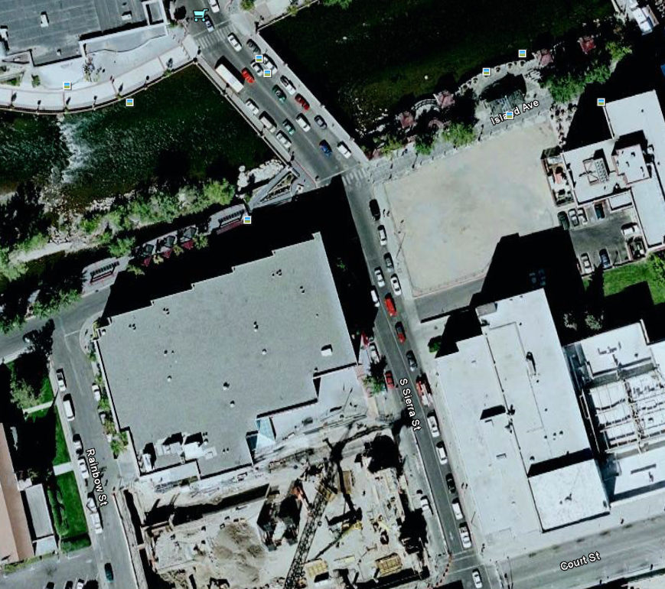
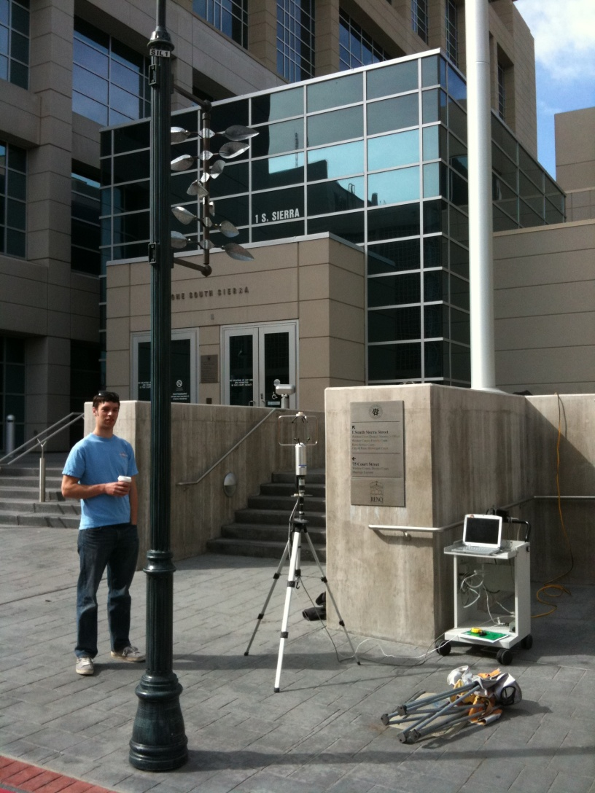
Site Overviews: Sierra Street
GOTTA HOUSE BY THE BAYSIDE
Construction complete
Street Oriented NNW-SSE

Slide 8
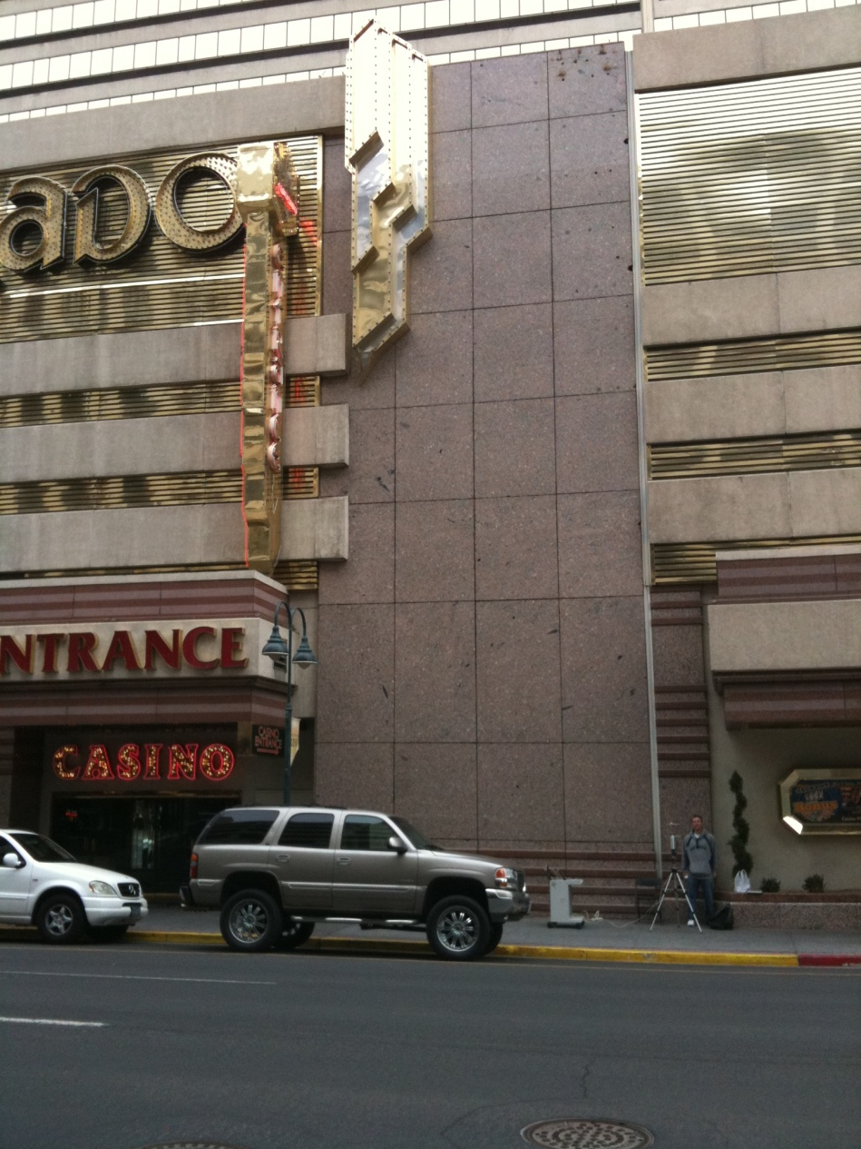
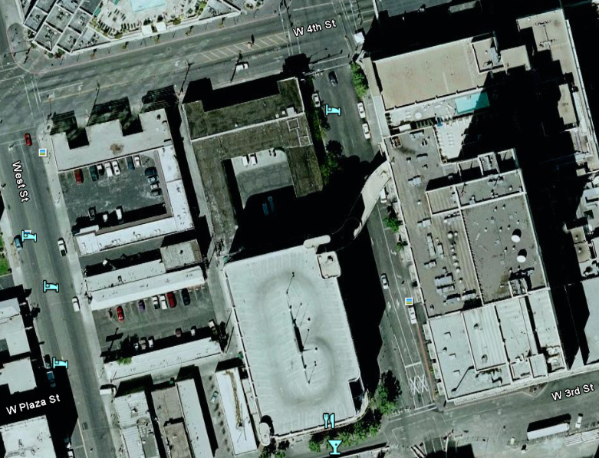
Site Overviews: El Dorado @Sierra
Street Oriented NNW-SSE
Deep Canyon

Slide 9
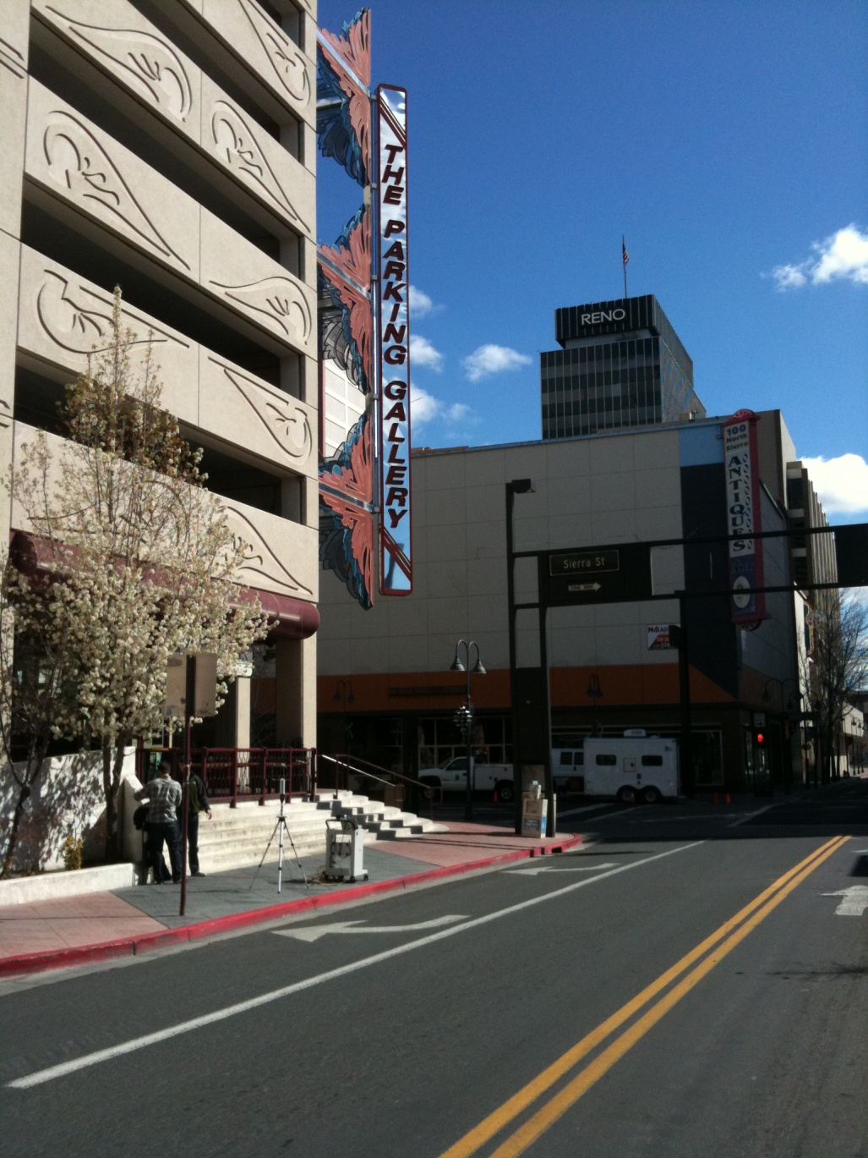
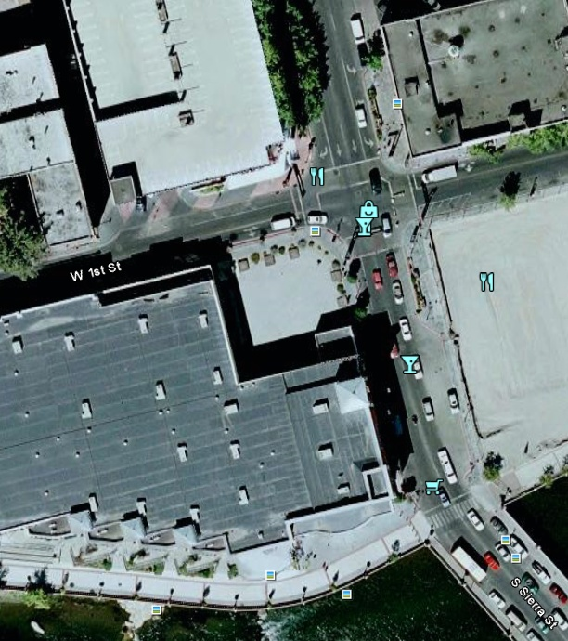
Site Overviews: Silver Peak
Street Oriented WSW-ENE

Slide 10
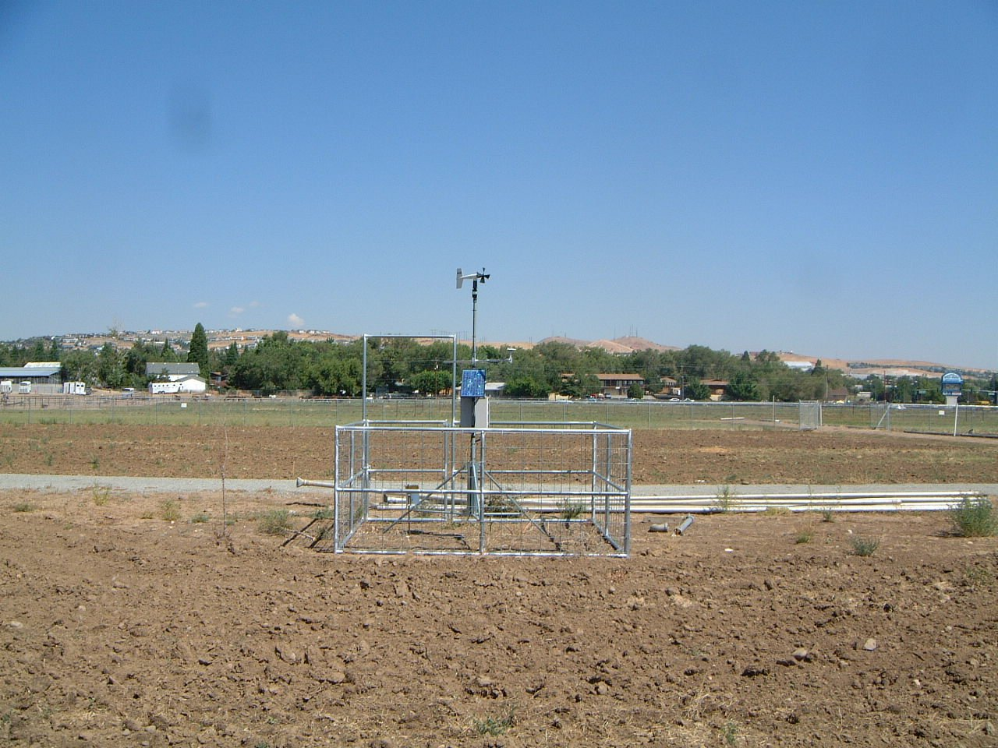
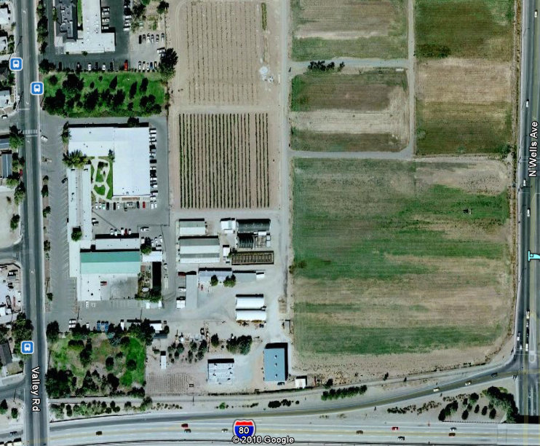
Site Overviews: UNR Ag Field (Calibration)

Slide 11
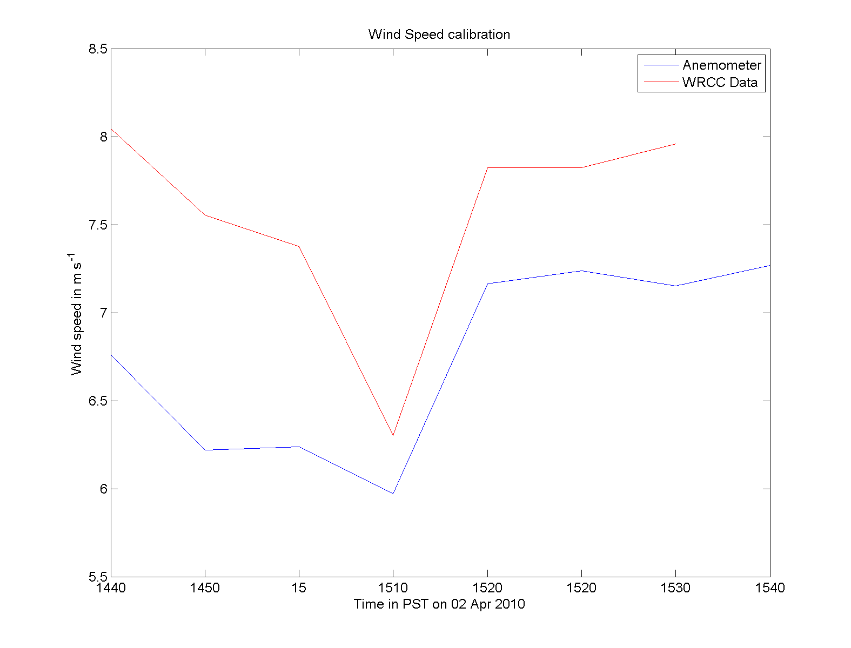
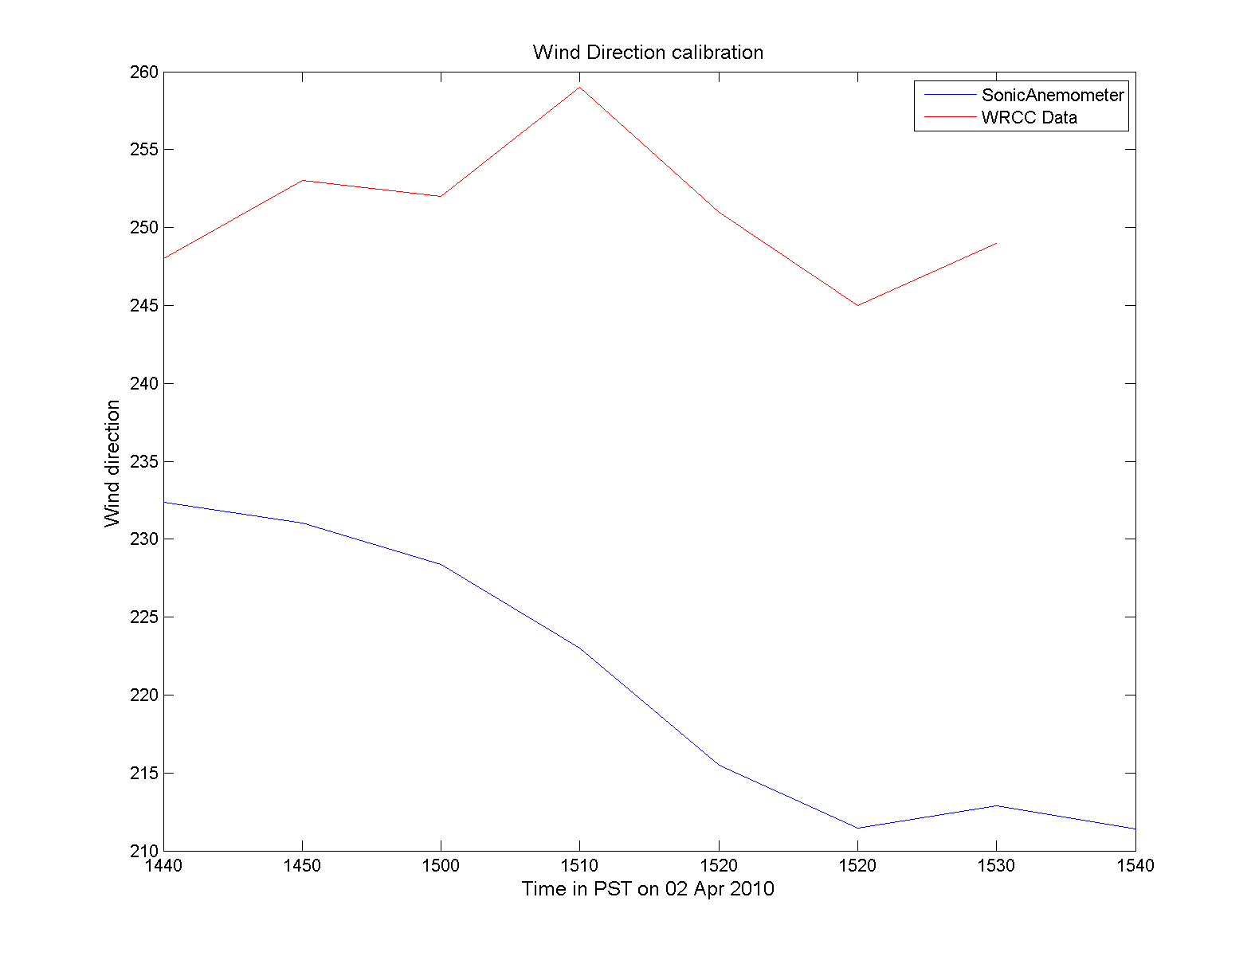
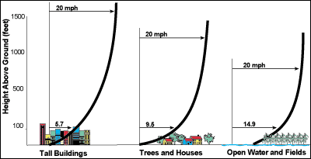
Calibration Procedure: Via UNR Ag Field
Reduced V_{anem} possibly due to reduced height vs. V_{unr} (1.2m vs. 3m) and increased Fr?
Same reasoning for direction change? Increased Fr?

Slide 12
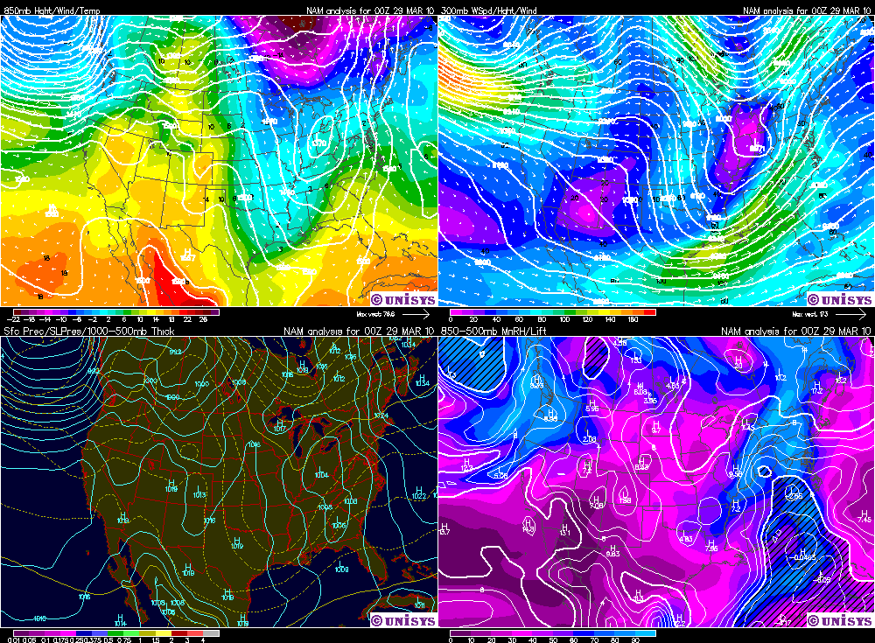
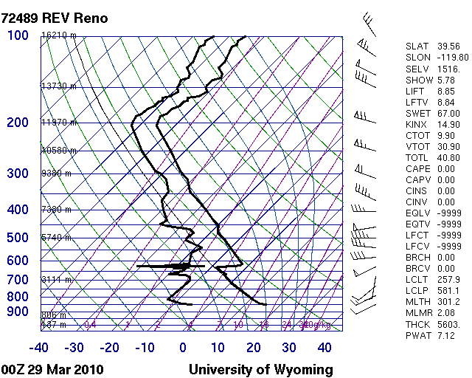
Data Part 1: Site Measurements Versus Synoptic Setting (Sierra St.)
Zonal Flow at 300mb ahead of NW jet max
Weak Ridge at 850mb with SW’erly flow
Weak regional sfc pressure gradient
Dry Adiabatic lapse rate from sfc to 650mb, strong shearing at 650mb with associated inversion

Slide 13
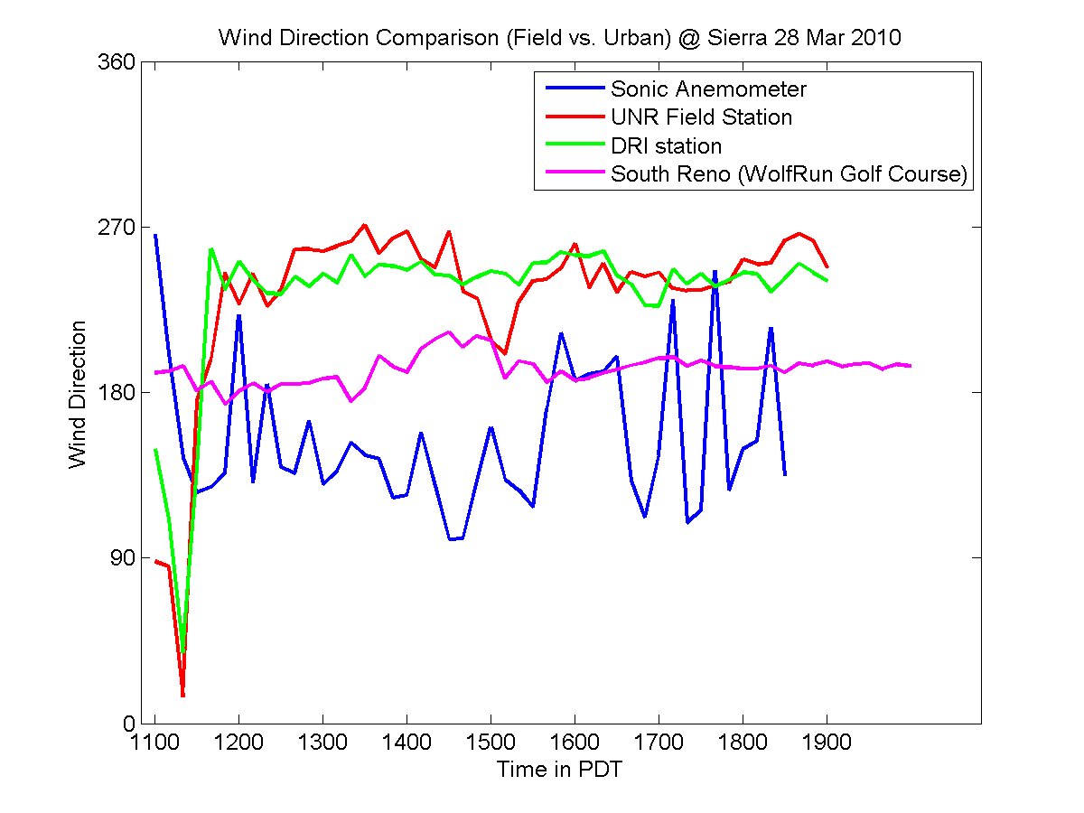
Comparison of Reno SFC Stations to S.A. at Sierra St.
Flow is parallel to canyon
NNW-SSE (~160° -190°)
SFC flow adjusts to canyon

Slide 14
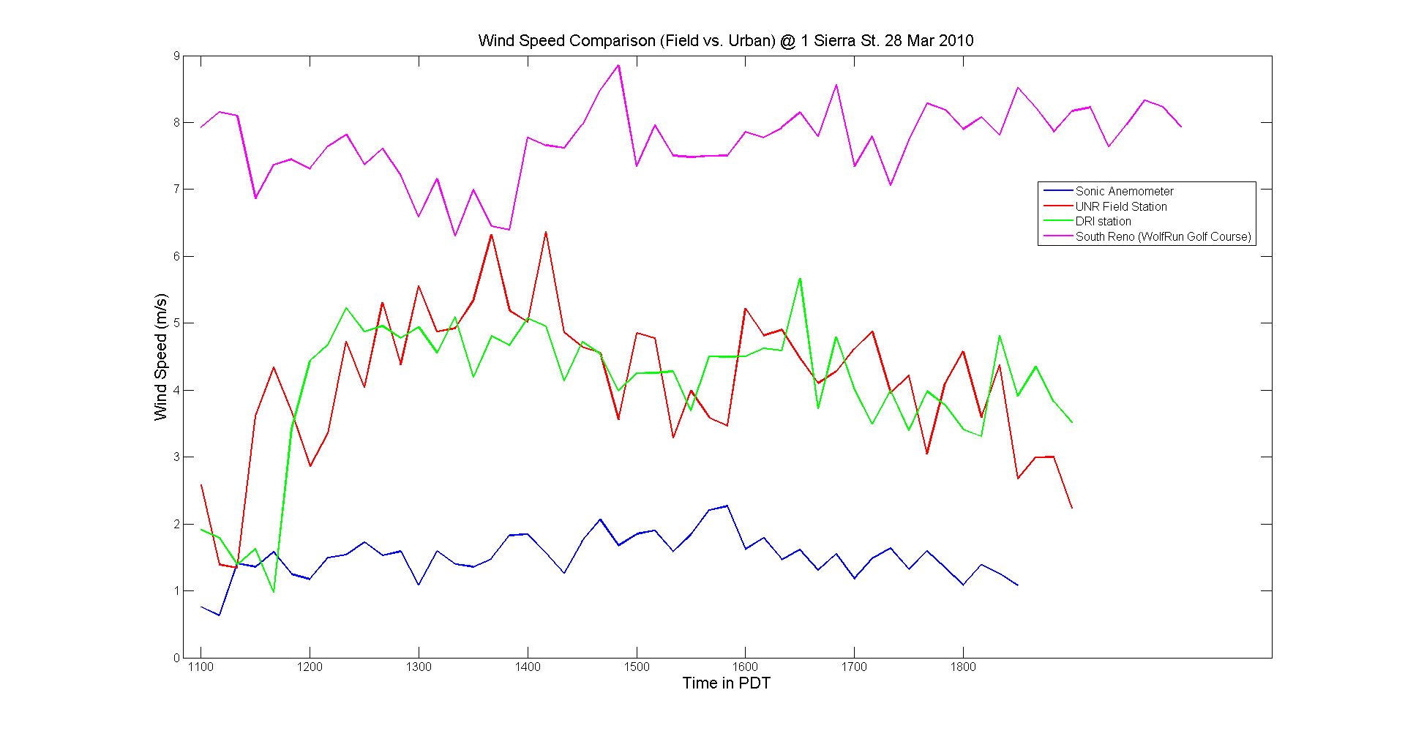
Comparison of Reno SFC Stations to S.A. at Sierra St.
Velocity at Sierra was decreased by factor of 2 compared to nearby sites
Friction and uneven surfaces, canyon is too small to force enhancement of velocity?

Slide 15
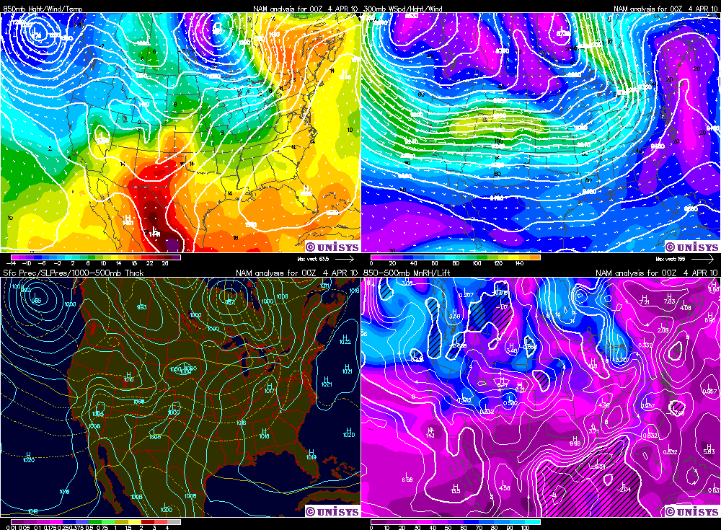
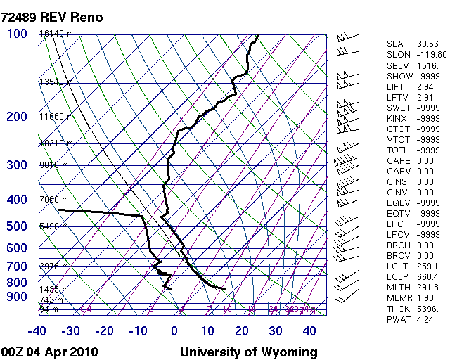
Data Part 1: Site Measurements Versus Synoptic Setting (El Dorado)
Weak zonal flow, jet max east of Reno
Shortwave trough approaching, indicated by SW flow regime
Moderate southwesterly flow at surface
Deep unstable boundary layer, nearly dry adiabatic to 450mb
Dry atmosphere

Slide 16
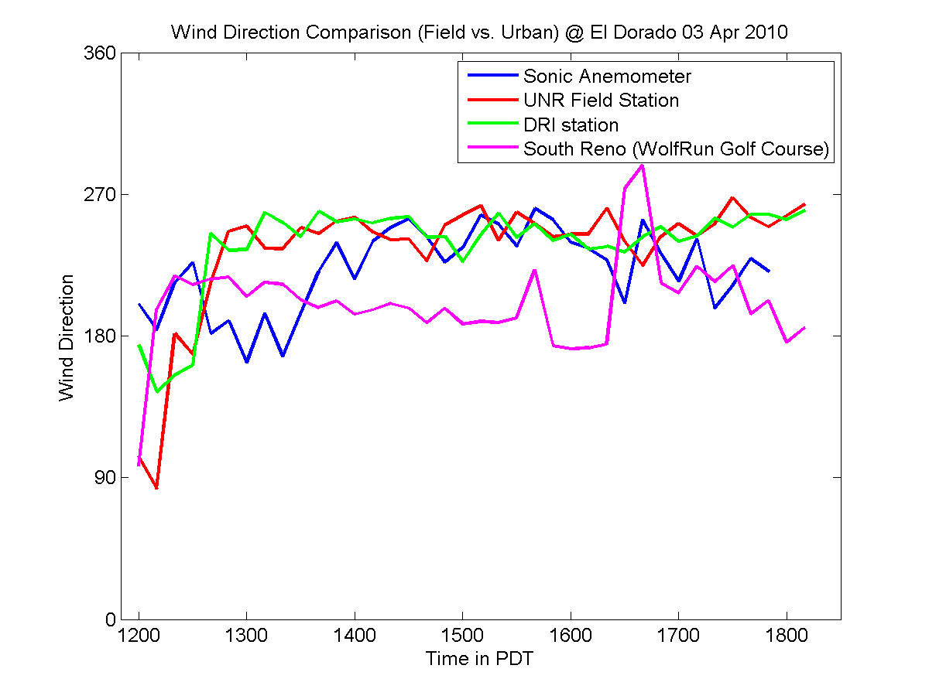
Comparison of Reno SFC Stations to S.A. at El Dorado
Flow direction perpendicular to canyon and consistent with synoptic scale flow
Proximity to intersection and wide streets (small H/W ratio) reduces canyon effect?
Not enough canyon to channel flow?

Slide 17
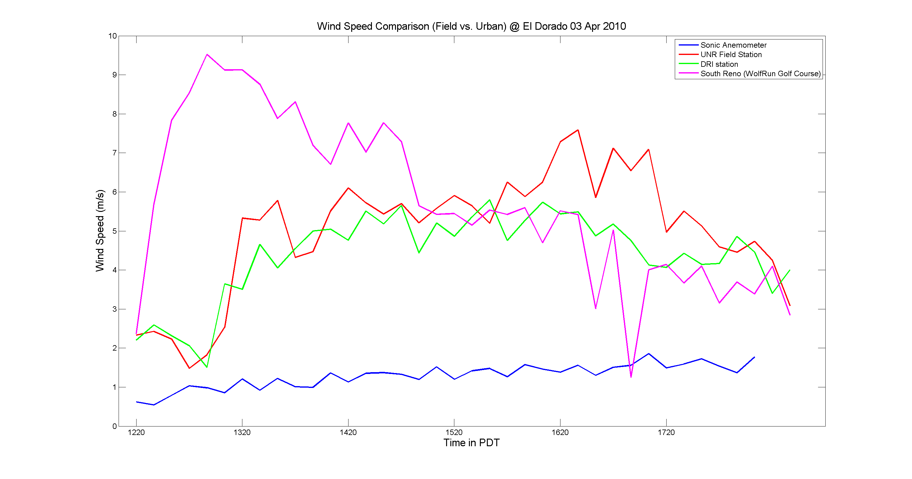
Comparison of Reno SFC Stations to S.A. at El Dorado
Roughness of downtown decreases velocity by factor of 4!

Slide 18
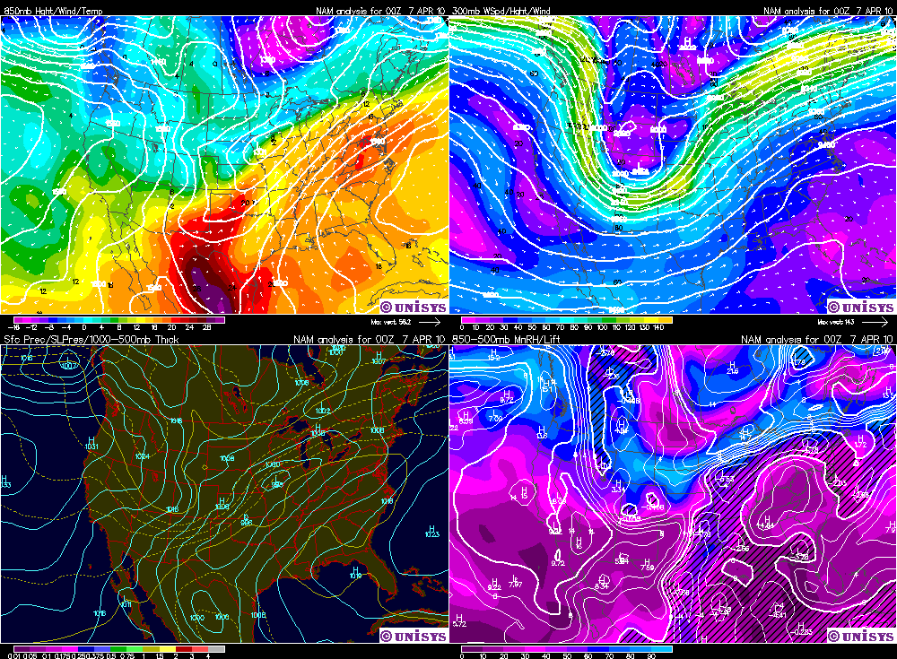
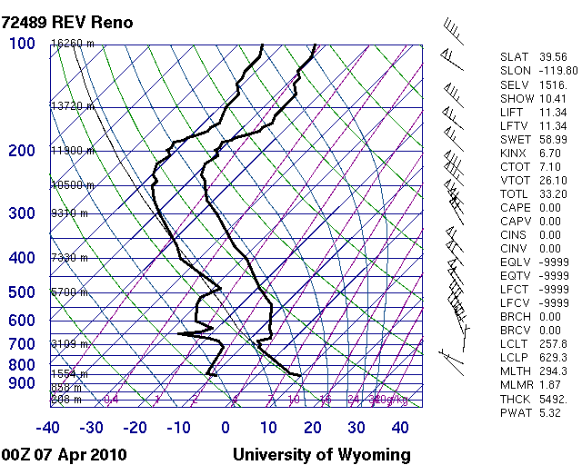
Data Part 1: Site Measurements Versus Synoptic Setting (Silver Peak)
Upper level trough located East of Reno
Light northerly flow at surface
Unstable at surface, indicated by dry adiabatic lapse rate to 700mb

Slide 19
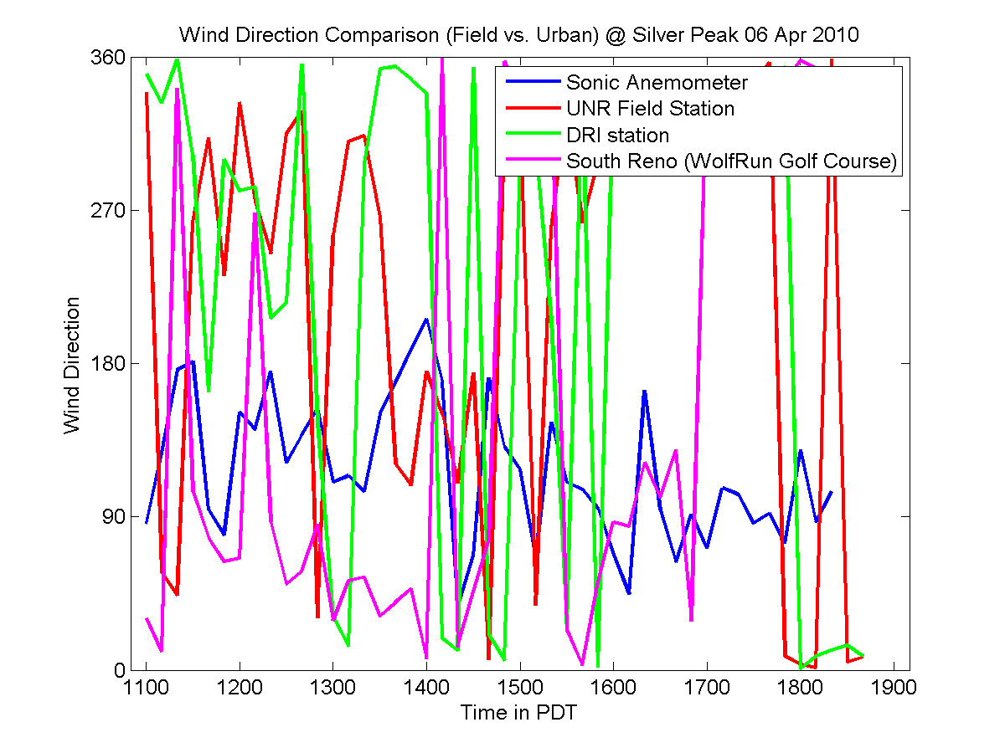
Comparison of Reno SFC Stations to S.A. at Silver Peak
Flow at SP was 180° to larger scale flow
Intersection overturning caused by large buildings upwind and downwind intersection open space?

Slide 20
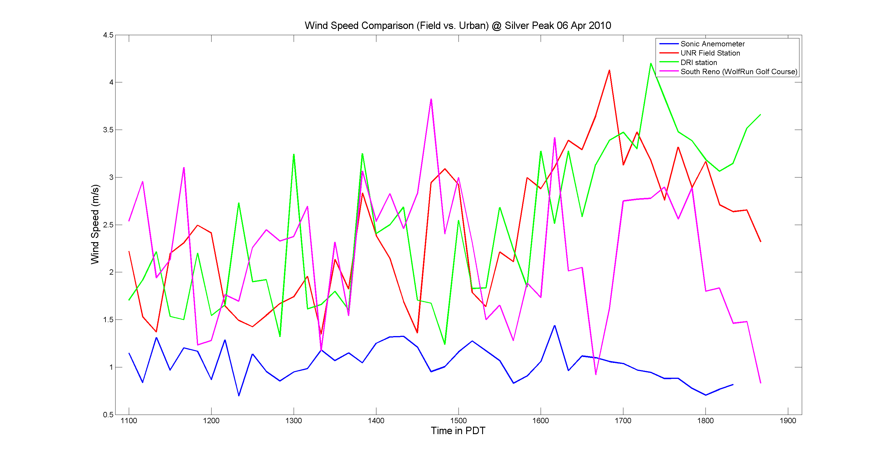
Comparison of Reno SFC Stations to S.A. at Silver Peak
Once again, roughness decreases site velocity by factor of 2 (Lower velocities overall→less roughness effect)

Slide 21
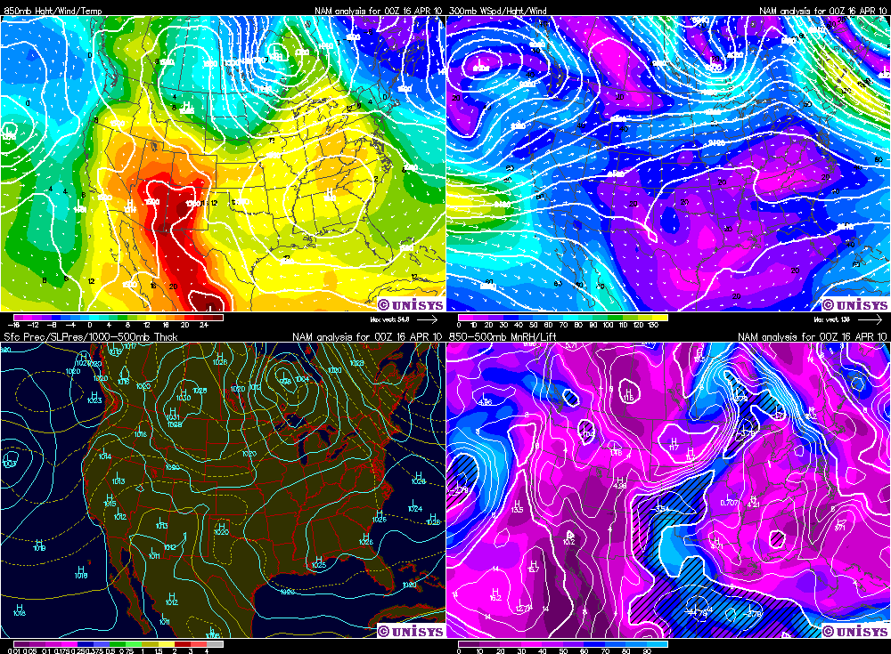
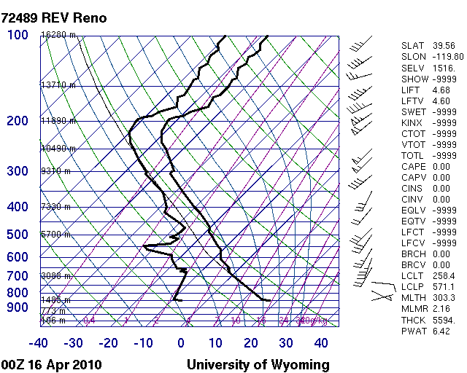
Data Part 1: Site Measurements Versus Synoptic Setting (UNR AB)
Reno under influence of longwave ridge
Shortwave trough approaching, indicated by SW flow regime, jet max offshore and to the south
Weak easterly flow at surface
Speed and direction shear at 650mb
Dry, unstable atmosphere.

Slide 22
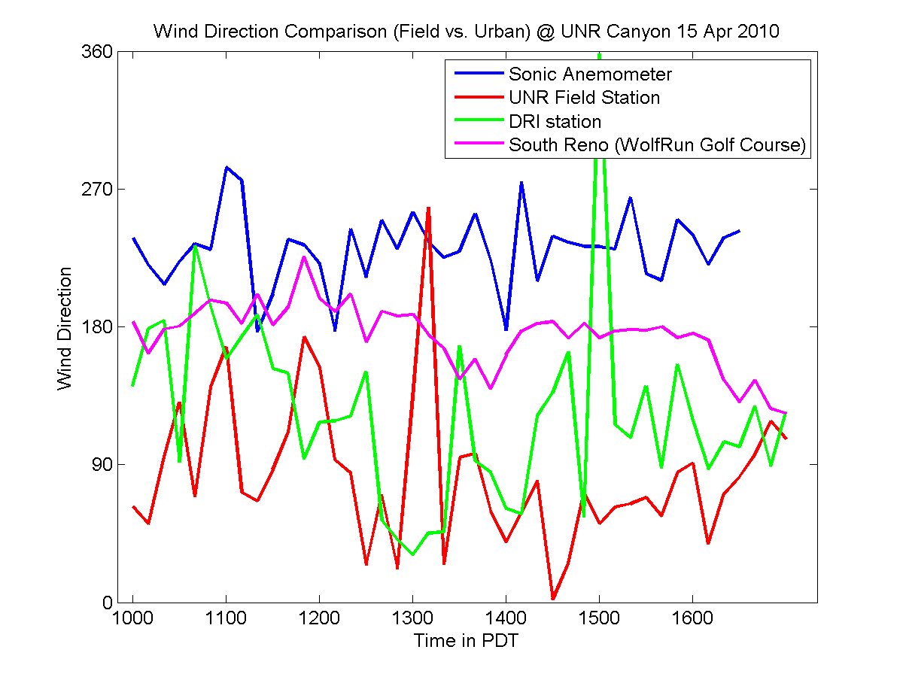
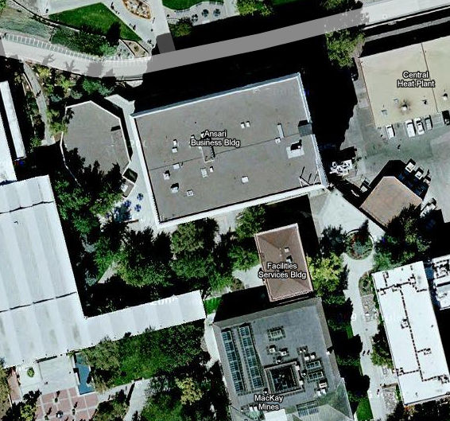
Comparison of Reno SFC Stations to S.A. at UNR Business Bldg
Flow around building
90° to synoptic scale flow

Slide 23
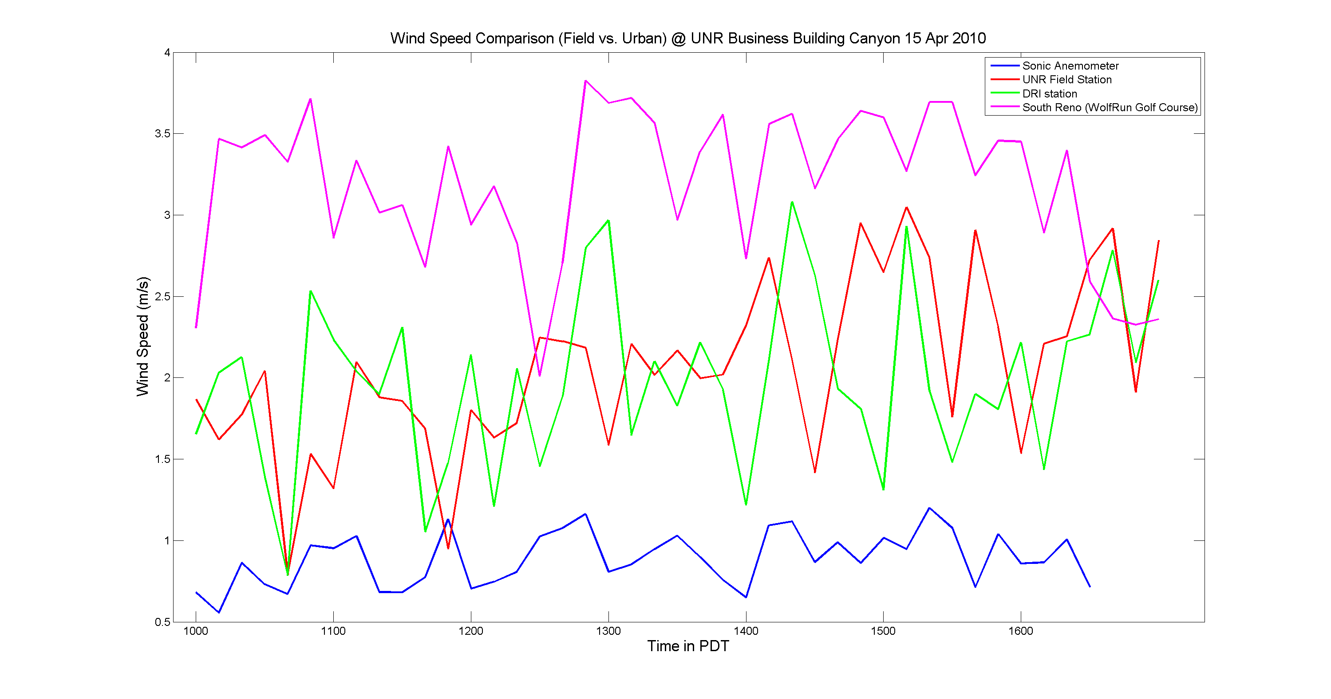
Comparison of Reno SFC Stations to S.A. at UNR Business Bldg
Roughness decreased flow velocity by factor of 4

Slide 24
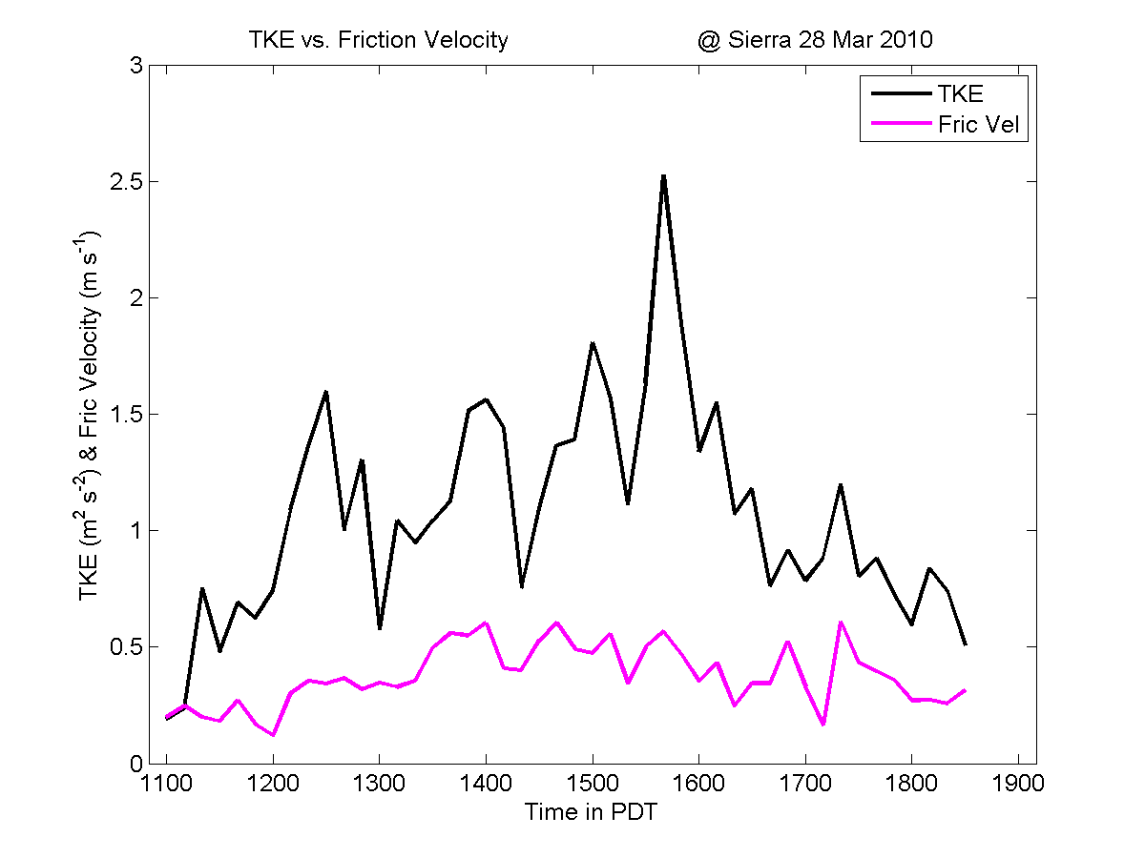
Data Part 2: Turbulent Fluxes (Sierra St.)
Typical diurnal pattern of increasing TKE until afternoon (sun behind building), then decreasing as insolation decreases
Fric Vel indicates shearing at surface, governed by roughness, convection, and stability (Stull 2000)
Results seem consistent with observed diurnal pattern and roughness

Slide 25
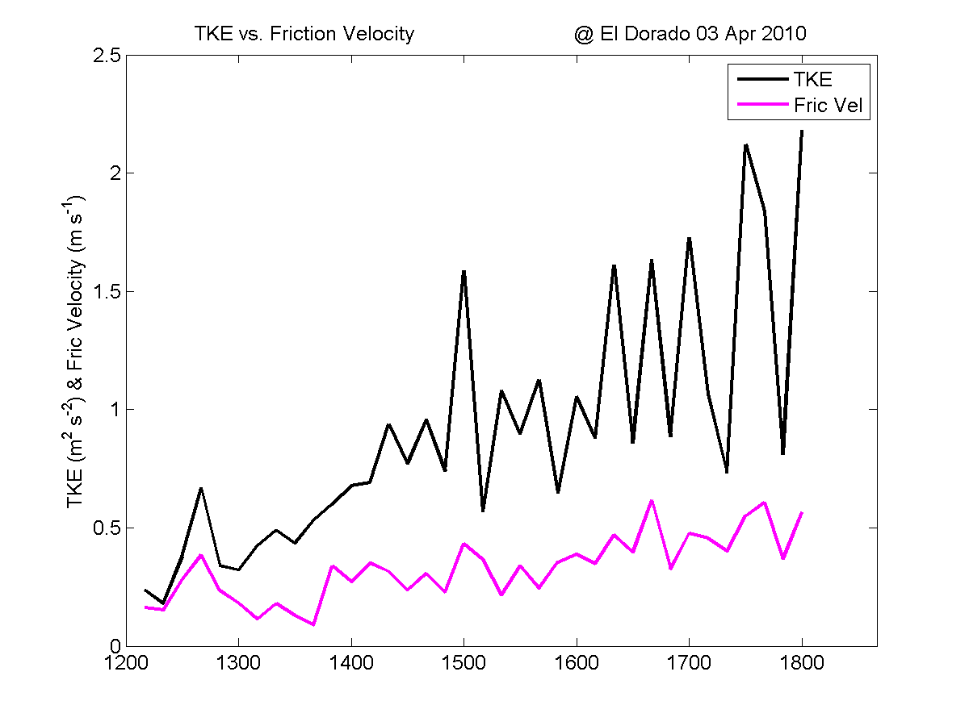
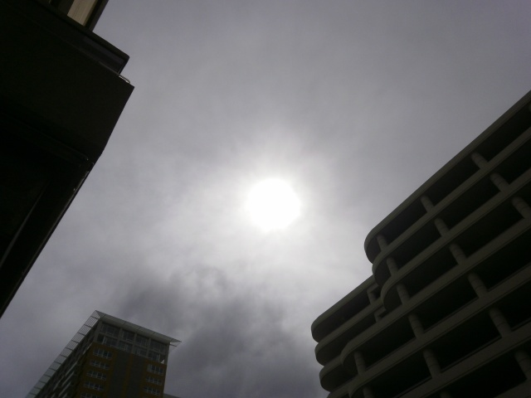
Data Part 2: Turbulent Fluxes (El Dorado)
TKE trend indicates presence of sun and decreasing stability increased convection
Fric Vel consistent with TKE trend and insolation

Slide 26
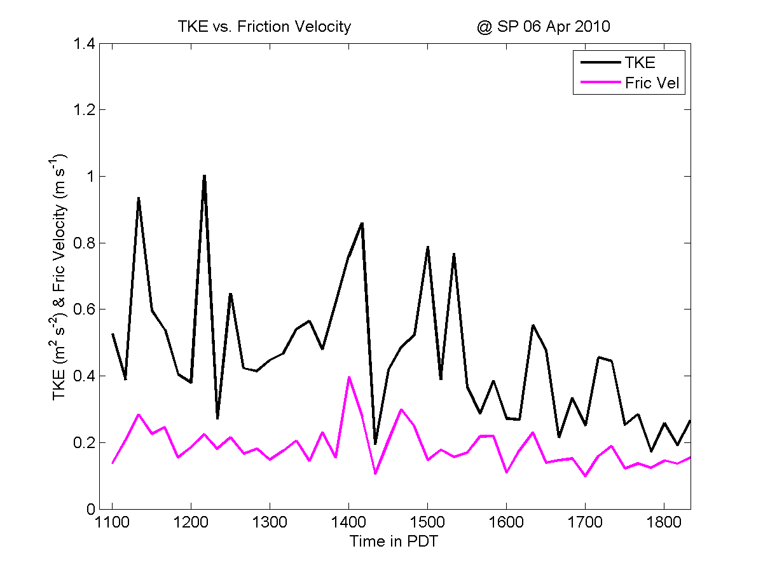
Data Part 2: Turbulent Fluxes (Silver Peak)
Buildings influenced insolation, after 1530, sun behind buildings, decreased boundary layer convection

Slide 27
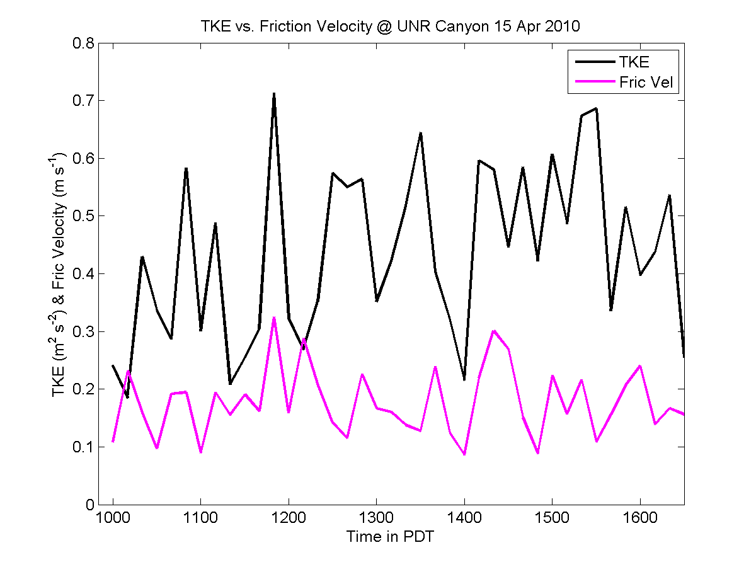
Data Part 2: Turbulent Fluxes (UNR AB)
Slight diurnal trend
Post-crash data may be skewed
Low TKE/FV values but highly variable

Slide 28
Analysis and Discussion
Original hypothesis cannot be rejected, too many variables (sites, synoptic conditions)
Sierra canyon channeled flow to parallel (urban canyon!)
Silver Peak upwind buildings overturned flow
El Dorado showed consistent TKE trend with relation to diurnal insolation, wind direction not consistent with channeling into canyon
Location of anemometer should be in middle of street to decrease building frictional effects on velocity and direction

Slide 29
Concluding Remarks
Wake interference flow regimes (figure B below) observed at Silver Peak
Sierra St. only true urban canyon (by definition of channelling)
Surface roughness decreases mean flow in all cases, probably not sufficient to power wind turbines unless above building height
Downtown landscape often too
complex to channel flow

Slide 30
Suggestions For Future Work
Multiple anemometers setup at fixed locations for long duration field experiment (days-weeks)
Must attempt to capture multiple synoptic conditions at same location
Identify more well-defined urban canyons
Rooftop measurements for comparison to ground level measurements
Partition sources of TKE to detect effects of various source terms (advection, buoyancy, shear) to identify dominant terms (sources/sinks) and relate to canyon influence
3-D CFD modeling of location for comparison to data

