Slide 1
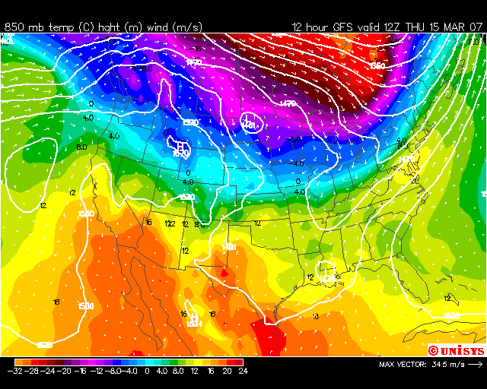

Air Motions at 850 mb
http://weather.unisys.com/gfsx/loop/gfsx_pres_loop.html

Slide 2
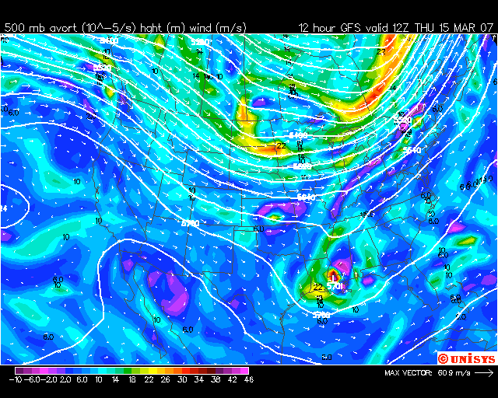
Air Motions at 500 mb

Slide 3
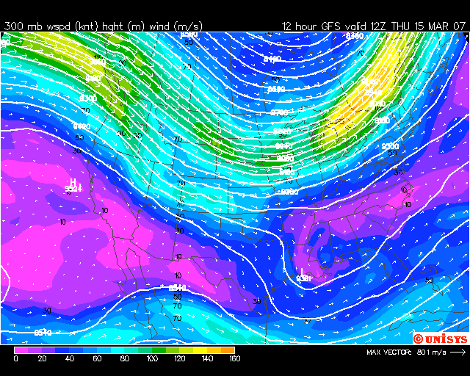
Air Motions at 300 mb

Slide 4
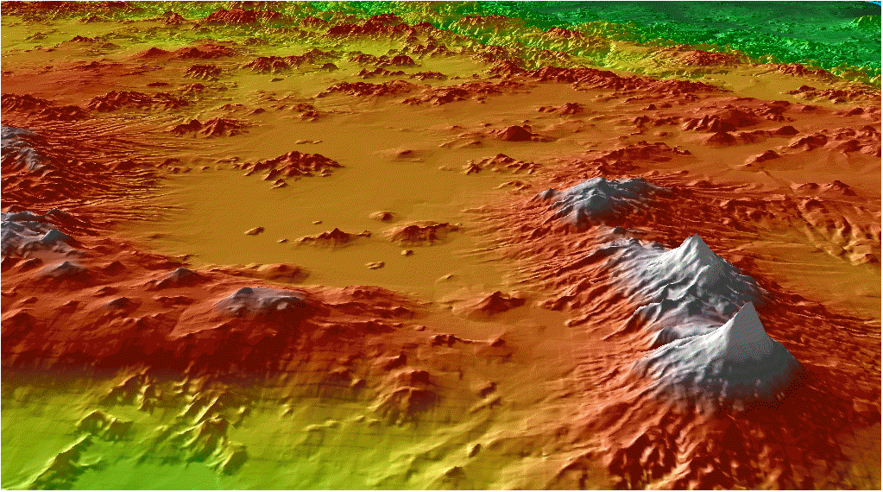
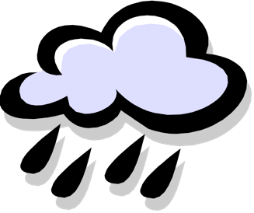
Local Meteorology
IMADA 1997 radar wind profiler and sounding sites
Cuautitlan
Teotihuacan
2200 m
3700 m
3500 m
Chalco
UNAM
4700 m
1300 m
1) slope flows
[Jauregui, Atmosfera, 1988]
2) gap wind
[Doran and Zhong, JAM, 2000]
3) density current
[Bossert, JAM,1997]

Slide 6
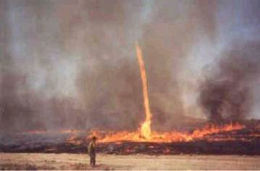
Fire Whirls: Tornado like effects. Fire is a tracer for flow.

Slide 7
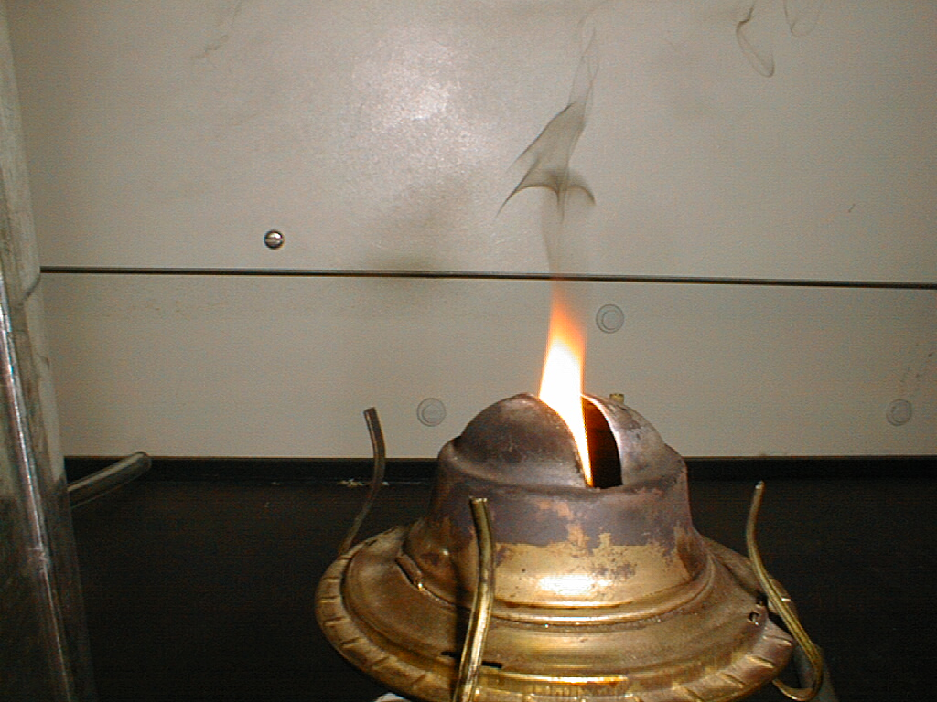
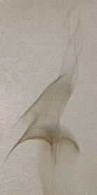
FIRE!! Smoke is a tracer for flow.

Slide 8
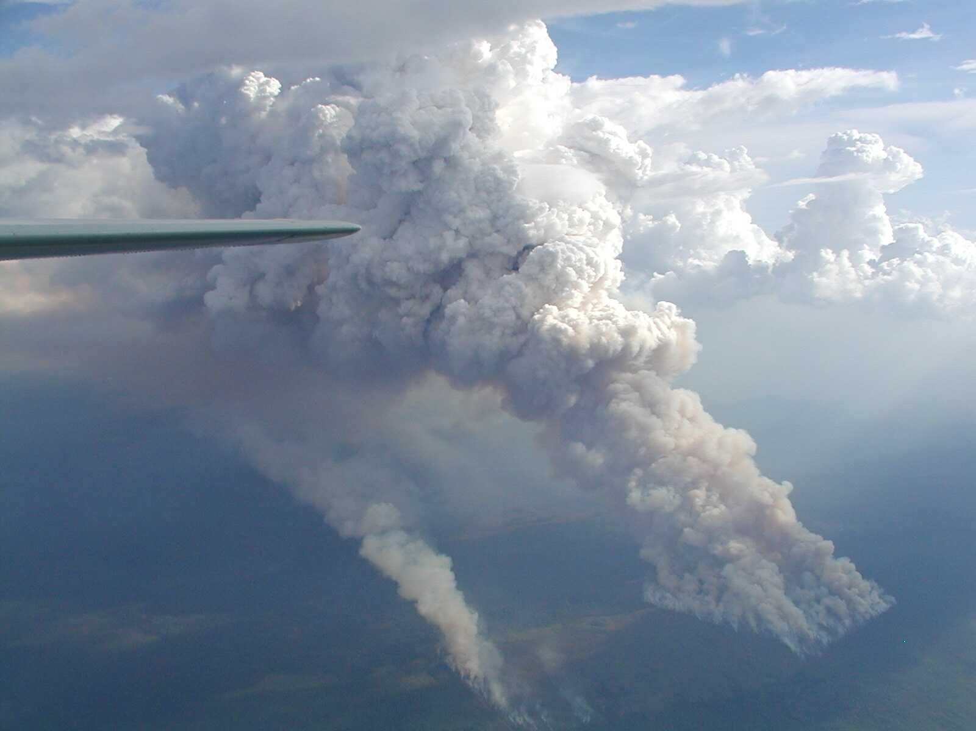
Burning Brazilian Forest near Ji Parana: Pyrocumulus. Smoke is a tracer for flow.
Courtesy Michael Welling, SMOCC 2002, Sept 25

Slide 9
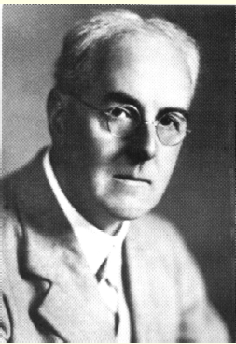
Lewis Fry Richardson, Pacifist, Air Motions Expert, Physicist, Mathematician, Psychologist, Quaker 1881-1953.
Big whirls have little whirls that feed on their velocity,
and little whirls have lesser whirls and so on to viscosity.
(from Jonathan Swift’s "Great fleas have little fleas upon their backs to bite 'em, And little fleas have lesser fleas, and so ad infinitum." (1733))
Source: http://en.wikipedia.org/wiki/Lewis_Fry_Richardson

Slide 10
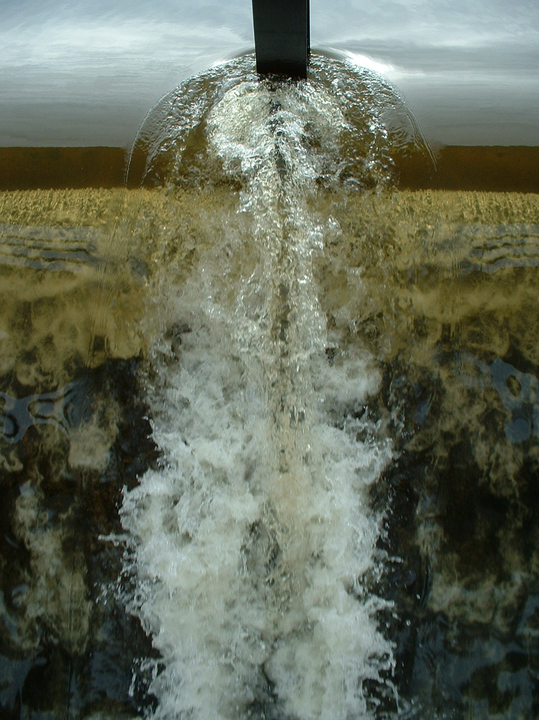
Laminar to turbulent flow… Air bubbles show flow.
Source: http://en.wikipedia.org/wiki/Image:Turbulence.jpg

Slide 11
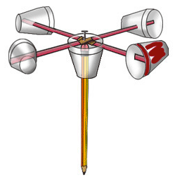
How does an anemometer work?
Count the number of times you see your favorite cup go around…

Slide 12
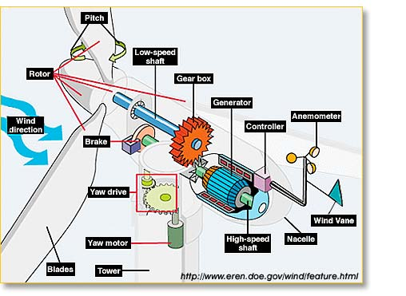
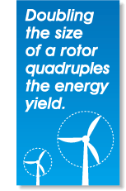
Put the wind to work for you…

Slide 13
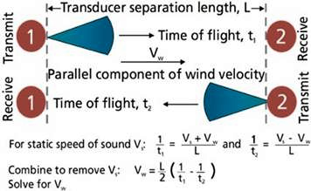
Use Sound to Measure Wind Speed…
great video on the ultrasonic anemometer…
http://www.gill.co.uk/products/anemometer/principleofoperation.htm

Slide 14
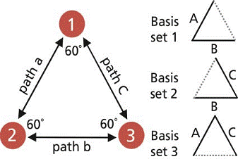
Use Sound to Measure Wind Speed…
The equilateral triangle configuration of the three transducers provides three possible sets of basis vectors. The combinations yield bi-directional measurements on the paths labeled A, B and C. These measurements are used to determine the wind velocity components parallel to each of the three paths.
http://www.vaisala.com/businessareas/instruments/products/wind/ultrasonic%20wind%20measurement%20technology.html

Slide 15
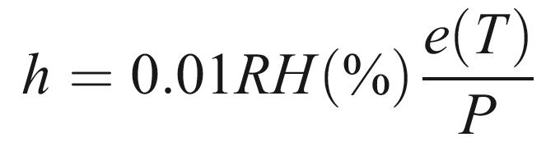
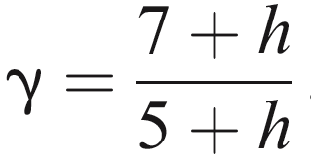
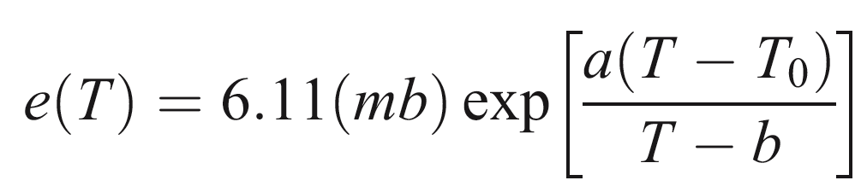
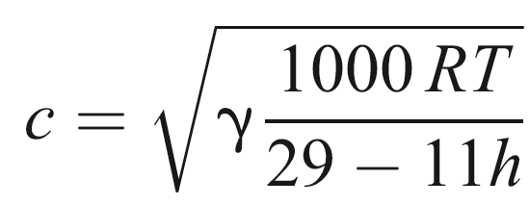
Speed of Sound in Moist Air.
Fraction of water vapor molecules in air of pressure P.
Saturation vapor pressure at temperature T.
Speed of sound, about 345 meters/second at T = 300 K. Note that water vapor increases the speed of sound (like the effect of breathing helium on your voice.)

Slide 16
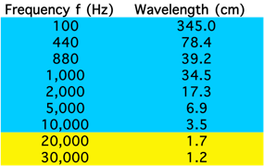
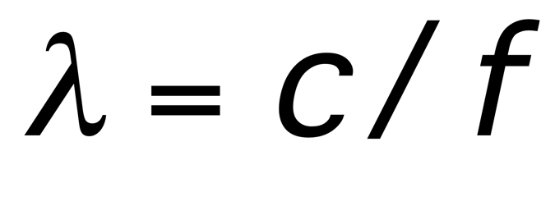
Sound Wavelengths
Audible sound in blue, ultrasound in yellow.
Higher frequency ‘resolves’ finer details, more precise measurements over shorter ranges, more compact instruments. Trade off, eventually absorption of sound in air.

