Slide 1
PhotoAcoustic Analysis of Black Carbon Combustion Aerosol
By Pat Arnott pat@dri.edu, Desert Research Institute, Reno NV
Collaborators: Hans Moosmüller, Fred Rogers, John Walker, Barbara Zielinska, John Sagebiel, Eric Fujita, Dave Campbell, Rick Purcell, Dan Wermers, Sebastian Upallalli (DRI), Rich Raspet, Willie Slaton (Univ. Miss.), James Mehl, Rob Abbott, Mike Ossosfsky, Khadeejeh Hamasha, Ali Rahmah, Kristin Lewis, Lupita Paredes (Students), Adel Sarofim, Kerry Kelly, Dave Wagner, Joanne Lighty (Univ. Utah CFE), Otmar Schmid, Meinrat Andreae (Max Planck Institute for Chemistry), John Ogren and Pat Sheridan (NOAA CMDL), John Seinfeld, Rick Flagan, Haf Jonsson (CAL TECH), Anthony Strawa, Beat Schmid, Rich Ferrare (NASA)
Funding over the years: EPA, NPS, ONR, NSF, DOE, DOD-SERDP, DRI, UNR, NIOSH

Slide 2
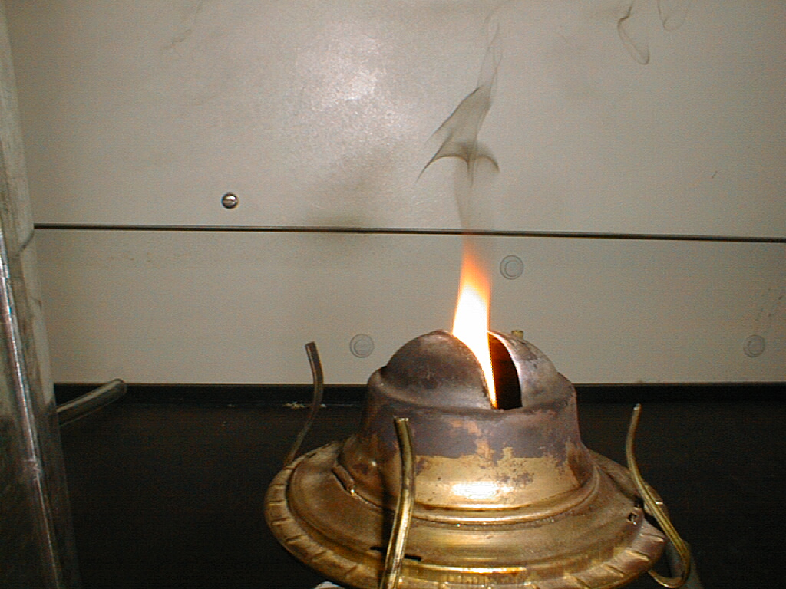
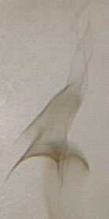
FIRE!!

Slide 3
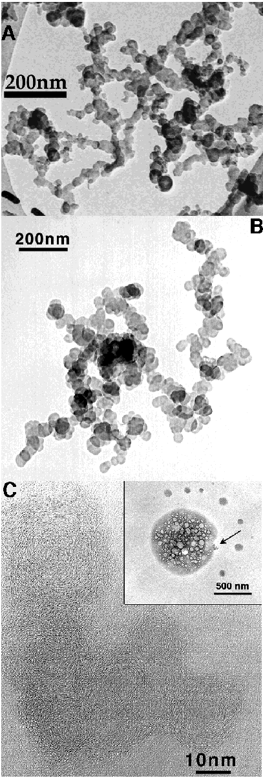
Soot: 10 - 50 nm monomers chained together to form larger aggregates. ‘Onion Shell’ structure of the monomers.
IMAGE CREDIT:
http://7starm.asu.edu/Buseck2000%20/figure_10.htm
TEM images of soot.
A, B. Chain-like soot aggregates. (A--Phoenix, after Katrinak et al., 1993; B--Sagres, Portugal, ACE-2).
C. High-resolution TEM image of the arrowed soot aggregate showing the onion-like structure of soot spheres. (Southern Ocean, ACE-1; after Pósfai et al, 1999).

Slide 4
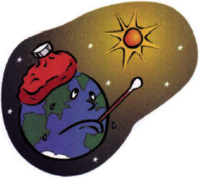
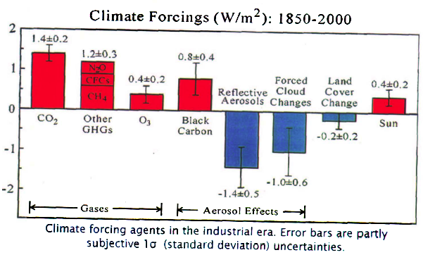
James Hansen, NASA Climatologist Man’s Climate Forcings Above and Beyond those of ‘Nature’
http://www.nrel.gov/vehiclesandfuels/nfti/pdfs/bc2_jhansen.pdf

Slide 5
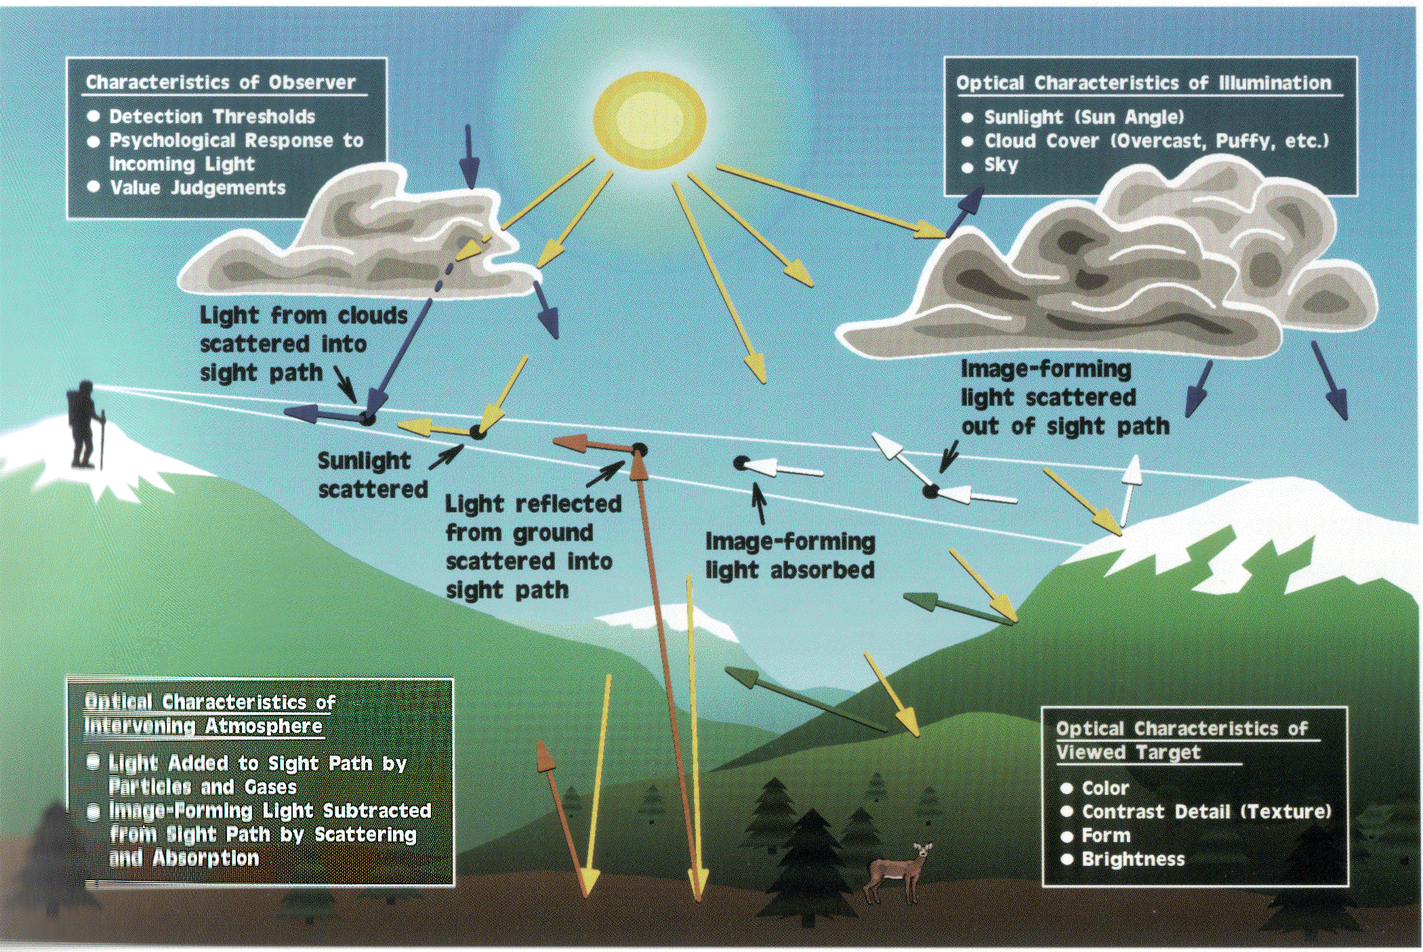
Visibility Overview: From Bill Malm, NPS Fort Collins
Notes:
Important factors involvede in seeing a scenic vista. Image forming information from an object is reduced (scattered and absorbed) as it passes through the atmosphere to the human observor. Sunlight, light from clouds and the grounds are scattered from particles in the sight path. Some scattered light remains in the sight path and can be so bright that the image essentially disappears.

Slide 6
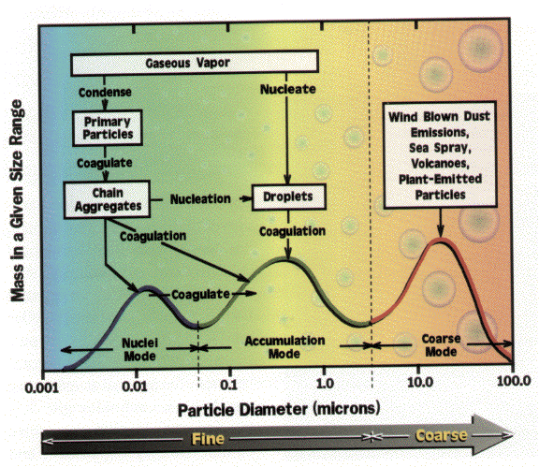
Atmospheric Aerosol: From small to large particles
Source:
Malm, NPS
Notes:
Mass size distribution. Coarse particles tend to have natural origins and typically deposit out close to the source. Fine particles are usually man-made, can transport great distances, and cause the greatest visibility impairment.

Slide 7
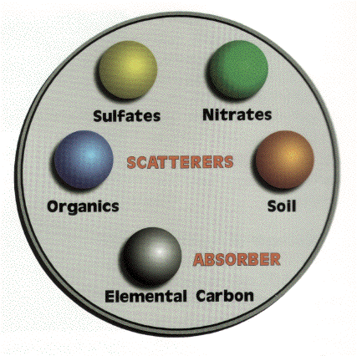
Typical types of fine particle mass
Elemental Carbon (EC) is loosely similar to Black Carbon (BC)
Source:
Malm, NPS

Slide 8
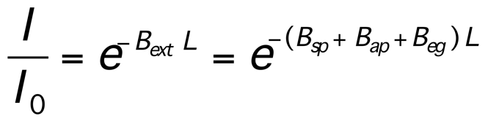
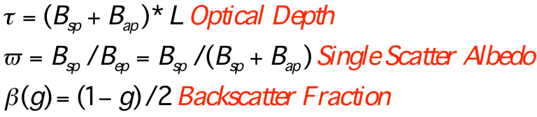
Scattering and Absorption of Light by Aerosols: Adapted from Jin Xu, DRI.
Treatment of the direct beam.
(The diffuse radiation comes from scattering.)
I=Light
Detector (W/m²)
Io=Light Source (W/m²)
L=Path Length

Slide 9
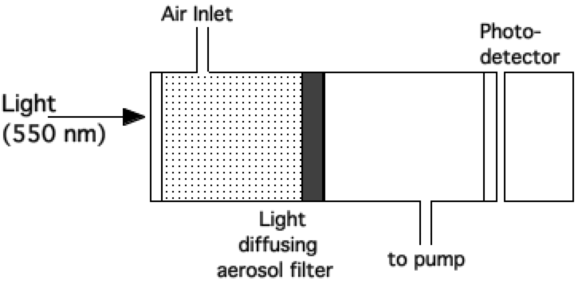
Simplified description of filter methods for light absorption. PSAP and AETHALOMETER
Aerosol are deposited on the light-diffusing filter, multiple scattering substrate.
Light absorbing aerosol reduce the light power at the photodetector.
Light scattering aerosol don't reduce power in principle.
Calibration and effects of aerosol loading (blocking)??
We have noted Giant RH induced artifacts (PSAP).

Slide 10
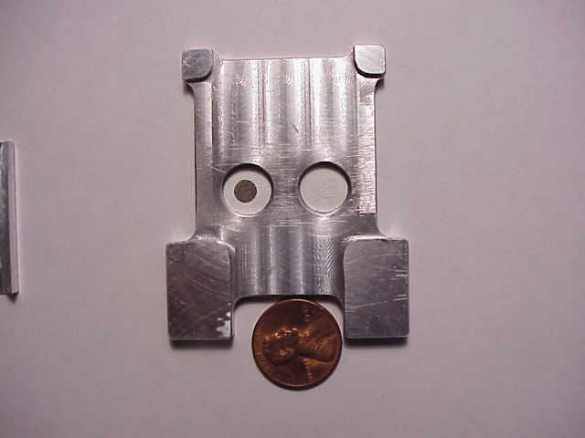
PSAP: Particle Soot Absorption Photometer A filter-based measure of light absorption.
Reference filter on the right. Aerosol-loaded filter on the left. Compare light transmission through these filters as a measure of light absorption.

Slide 11
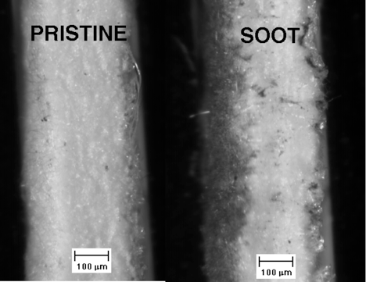
Aethalometer Filter Details: Side view.

Slide 12
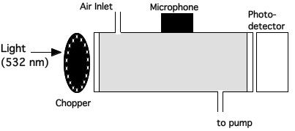
Photoacoustic Instruments For Light Absorption Measurements
Basic principles:
Laser light is power modulated by the chopper.
Light absorbing aerosols convert light to heat - a sound wave is produced.
Microphone signal is a measure of the light absorption.
Light scattering aerosols don't generate heat.

Slide 13
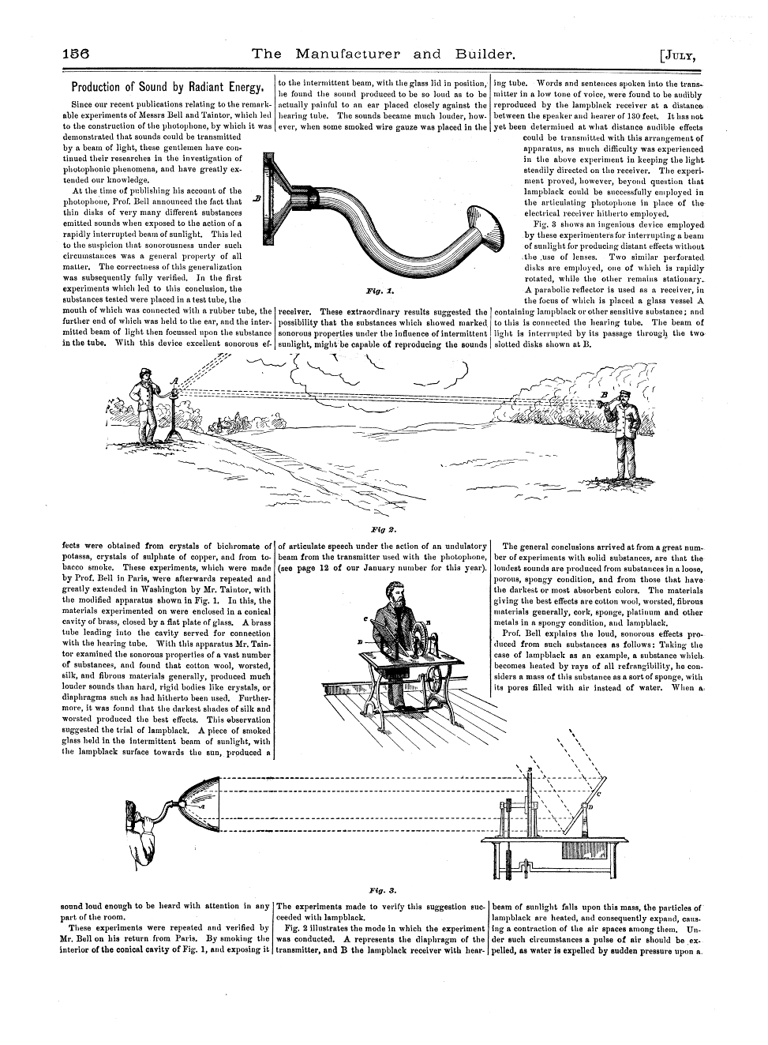
Photoacoustics and Alexander Graham Bell

Slide 14
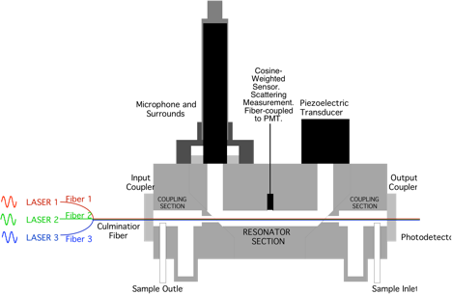
Schematic of 3 wavelength Photoacoustic instrument with scattering sensor

Slide 15
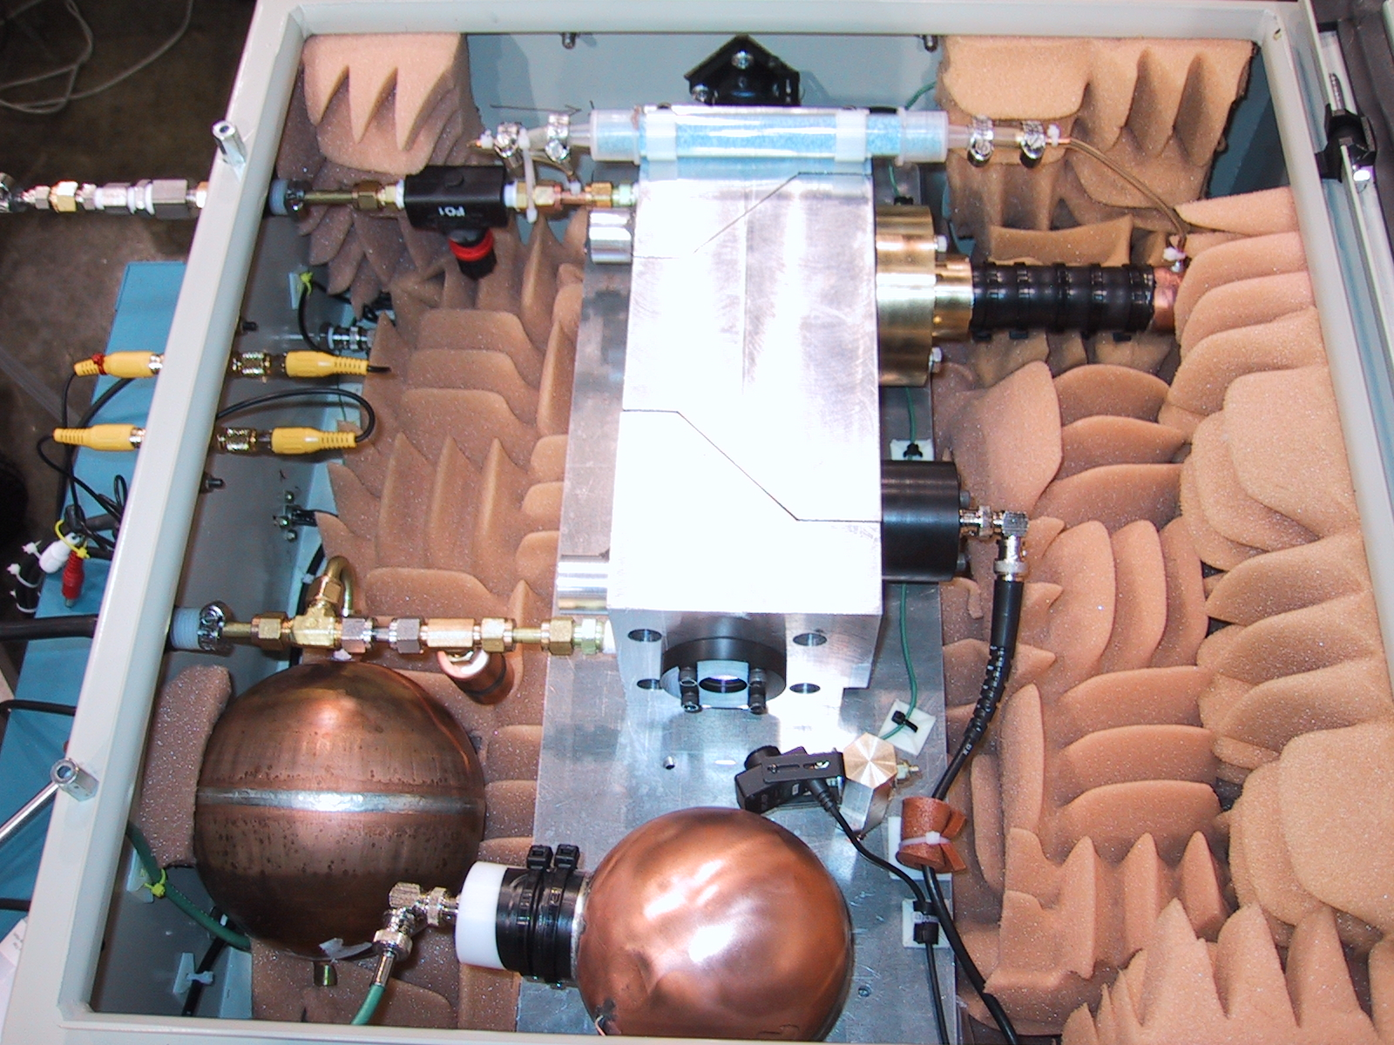
PA serial # 1...

Slide 16
Photoacoustic Instrument Details: Equation to Obtain Light Absorption Coefficient.

Slide 17
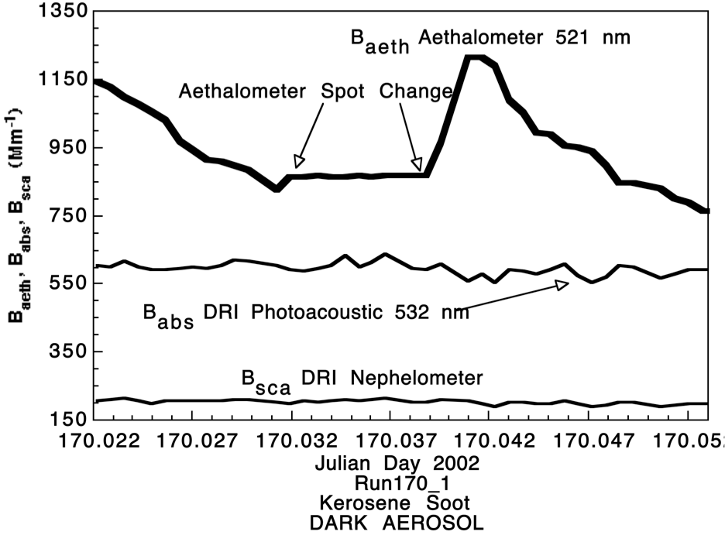
Strongly Absorbing Aerosol Response

Slide 18
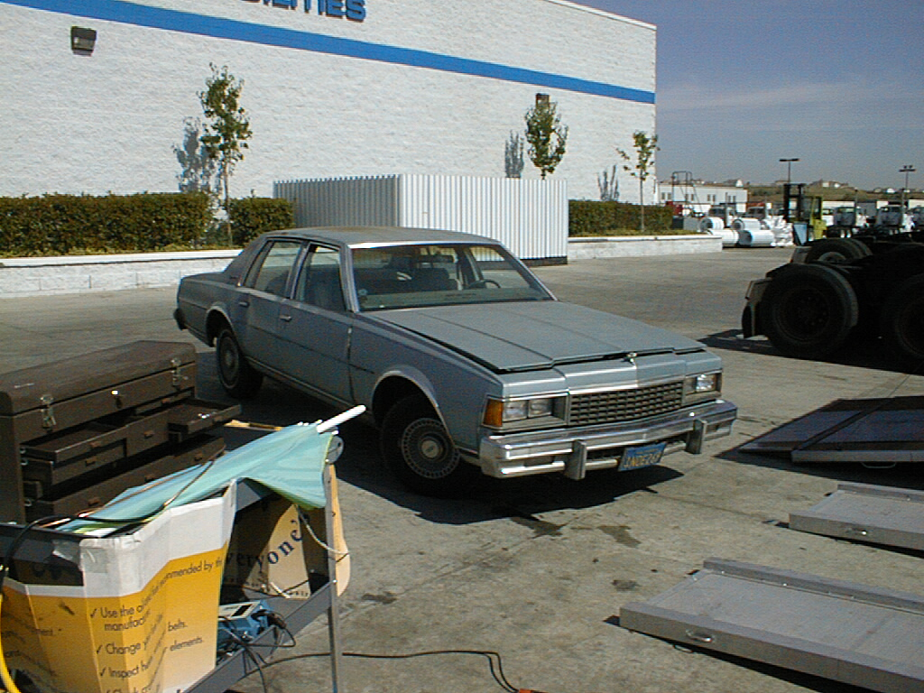
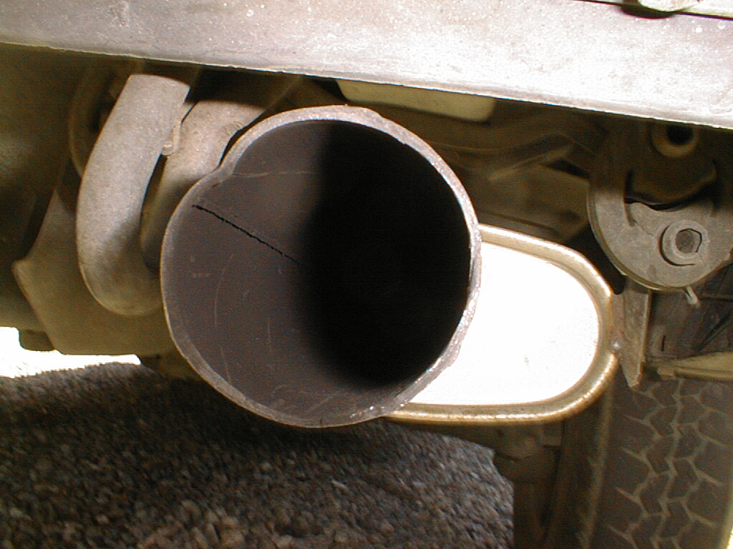
Images of Black Carbon Particles from Spark Ignition Vehicles?

Slide 19
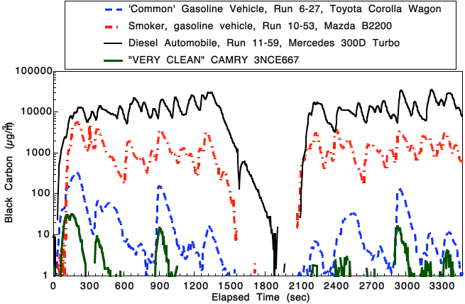
BC During the Modified UC Test

Slide 20
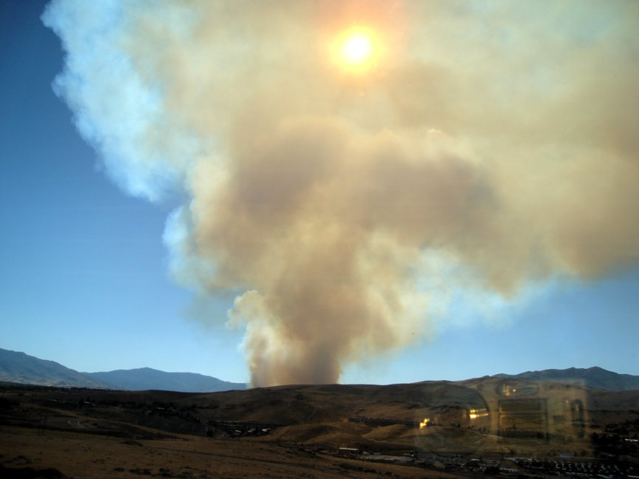
Smoke, Reno Fire, August 2006 photo by Lupita Paredes

Slide 21
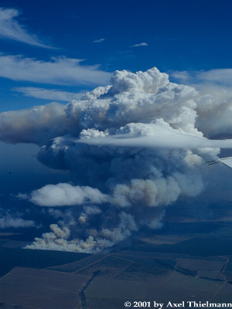
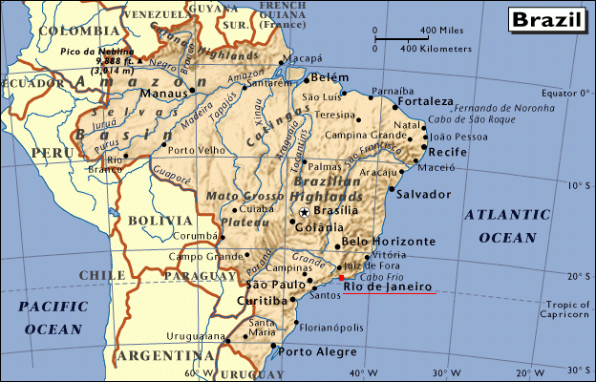
SMOCC
Smoke Aerosols, Clouds, Rainfall and Climate:
Aerosols from Biomass Burning Perturb Regional
and Global Climate
S M O C C
http://dionysos.mpch-mainz.mpg.de/smocc/
Notes:
S M O C C
Objectives
The overall goal of SMOCC is to investigate the connection between the composition and abundance of biomass burning aerosol, the lowering of the size of cloud droplets formed on this aerosol, and the climatic consequences of the resulting perturbation of cloud physics. To achieve this goal, we will:
(1) Make field measurements of aerosol and supporting parameters in the Amazon Basin;
(2) chemically characterise the aerosols produced by biomass burning, with particular attention to the organic fraction;
(3) determine the link between the aerosol chemical/physical properties and the aerosol hygroscopic and cloud-nucleating properties;
(4) model the effect of biomass burning aerosol on cloud microphysics at the cloud and regional level; (5) investigate the effect of smoke aerosols on climate dynamics and the resulting large-scale climate effects;
(6) use satellite data to detect, validate and quantify the effect of smoke aerosol on cloud properties and precipitation processes.

Slide 22
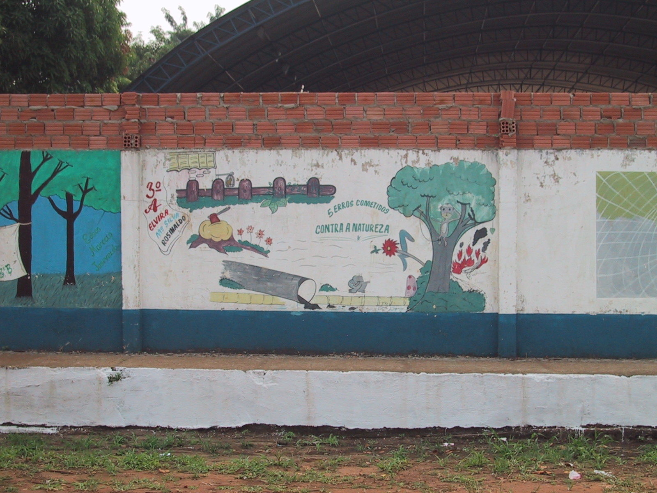
Ecology in Porto Velho, Brazil

Slide 23
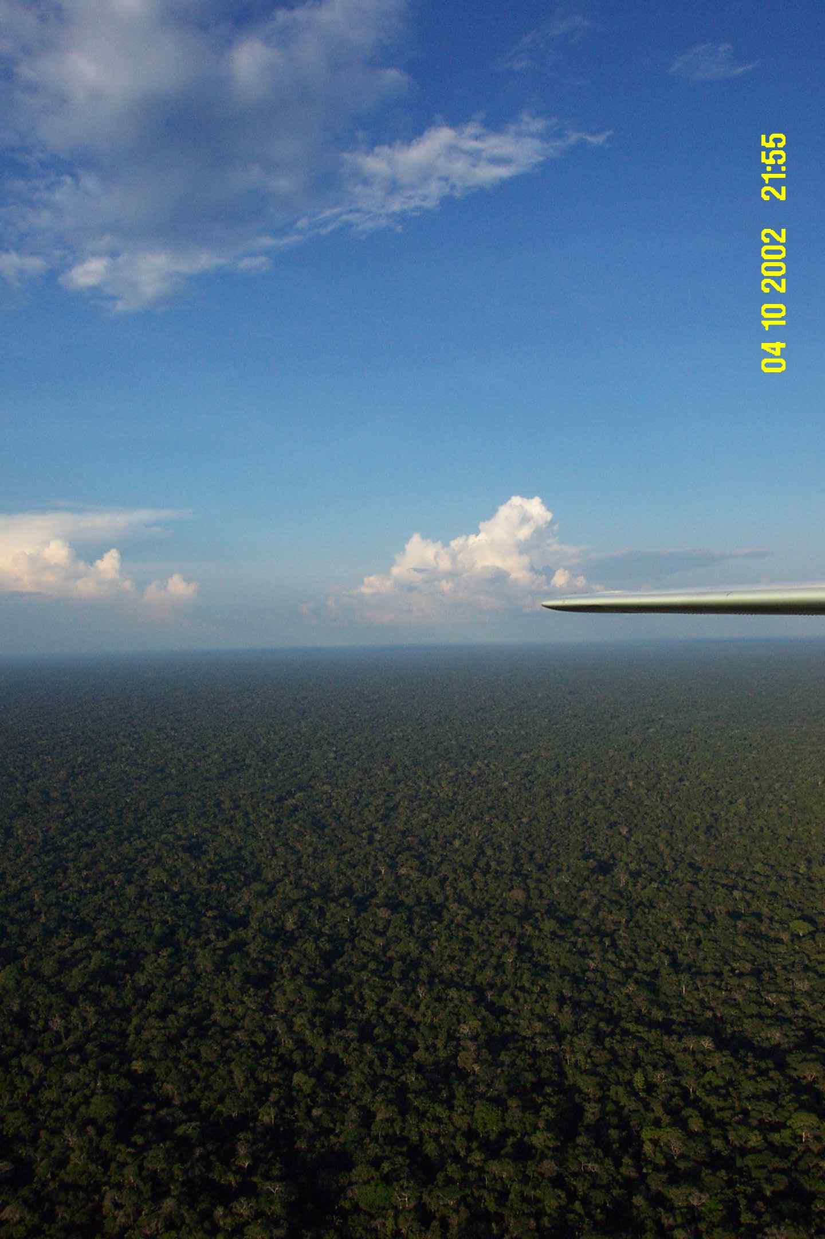
Green Ocean, Horizon to Horizon

Slide 24
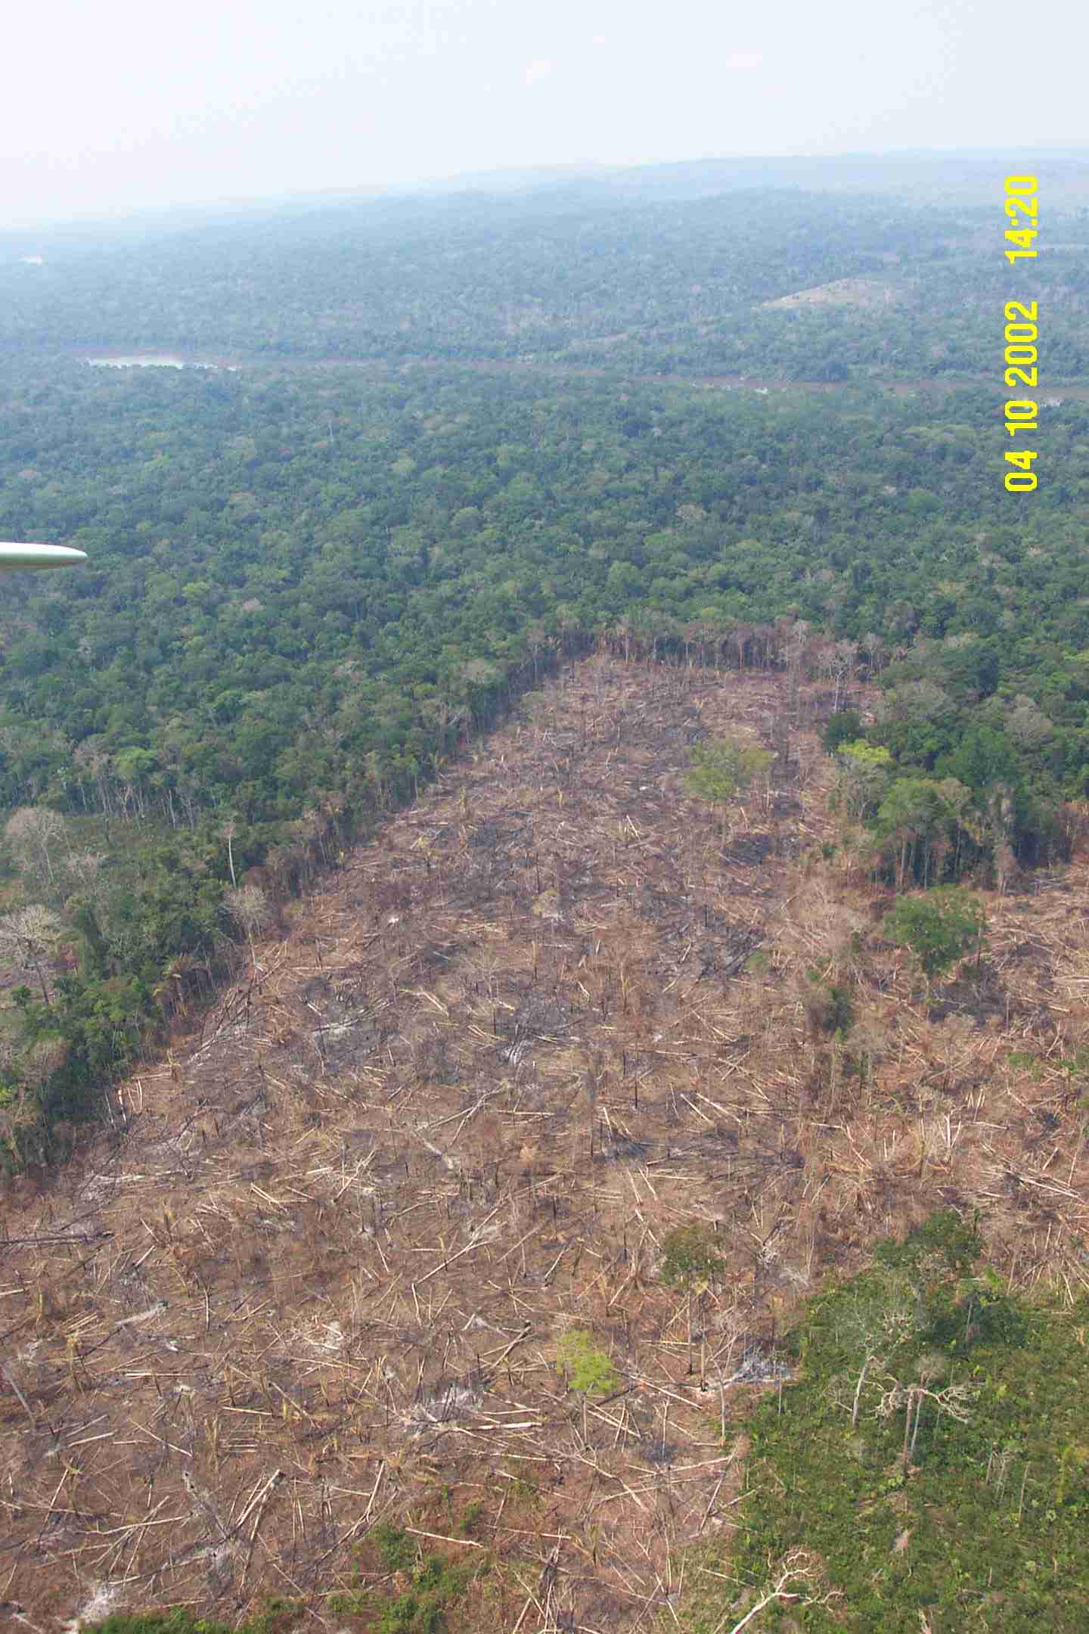
Deforestation

Slide 25
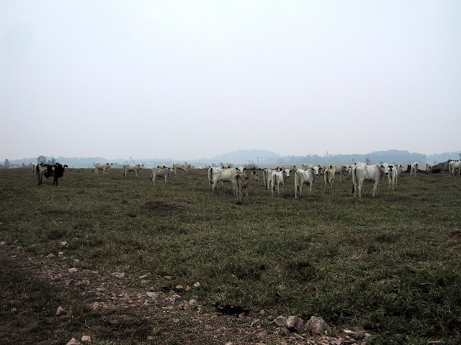
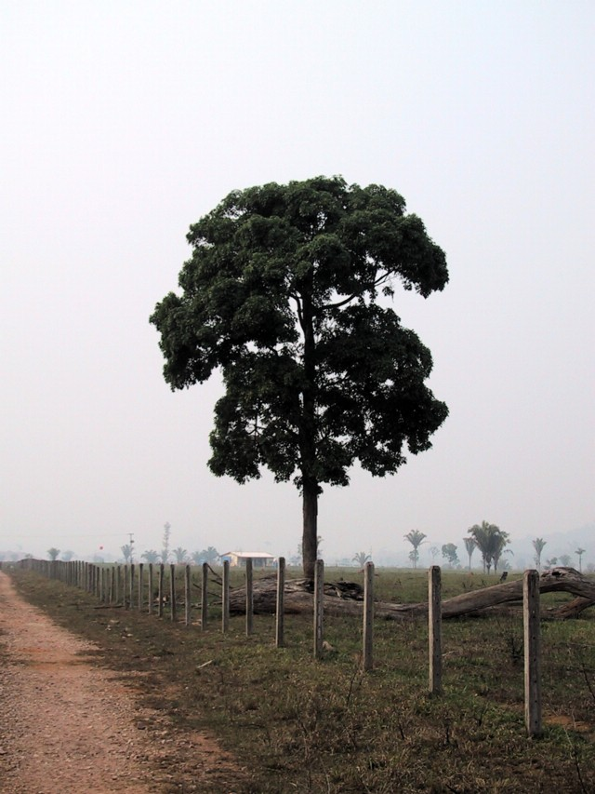
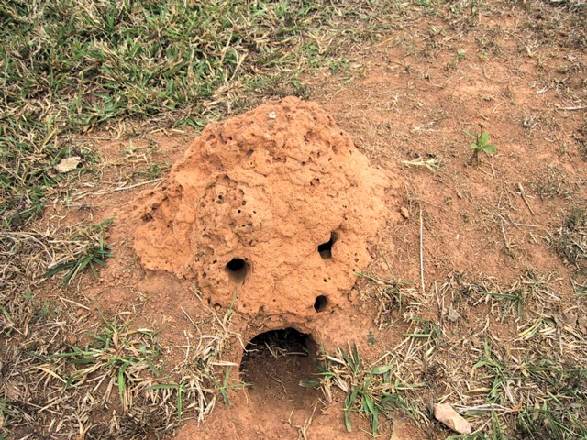
Images near Ouro Preto: One Study Site

Slide 26
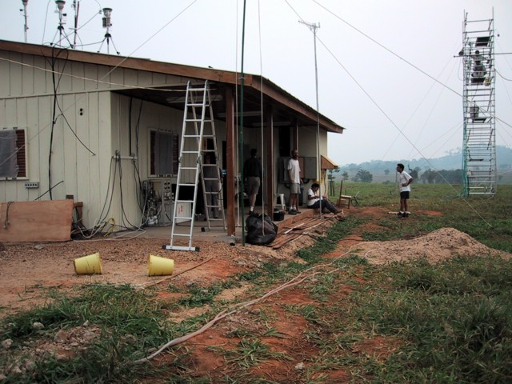
Amazonian house for science built by the Brazilians for this project

Slide 27
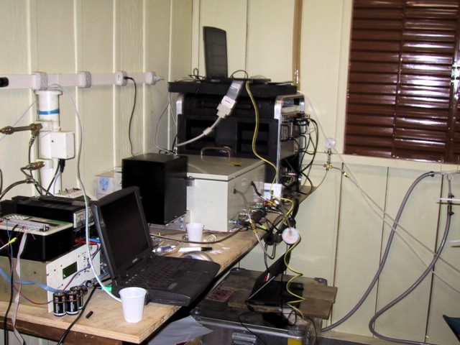
Site Details

Slide 28
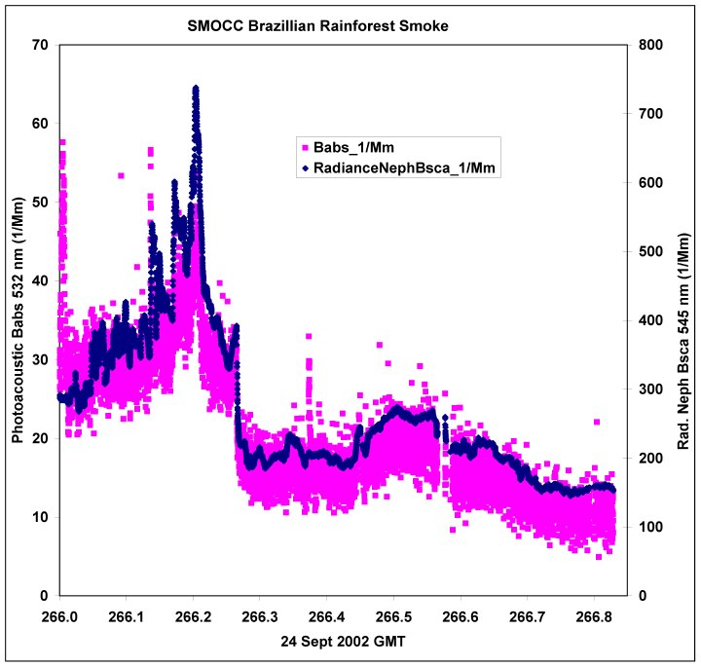
Aerosol Optics Measurements at the Pasture

Slide 29
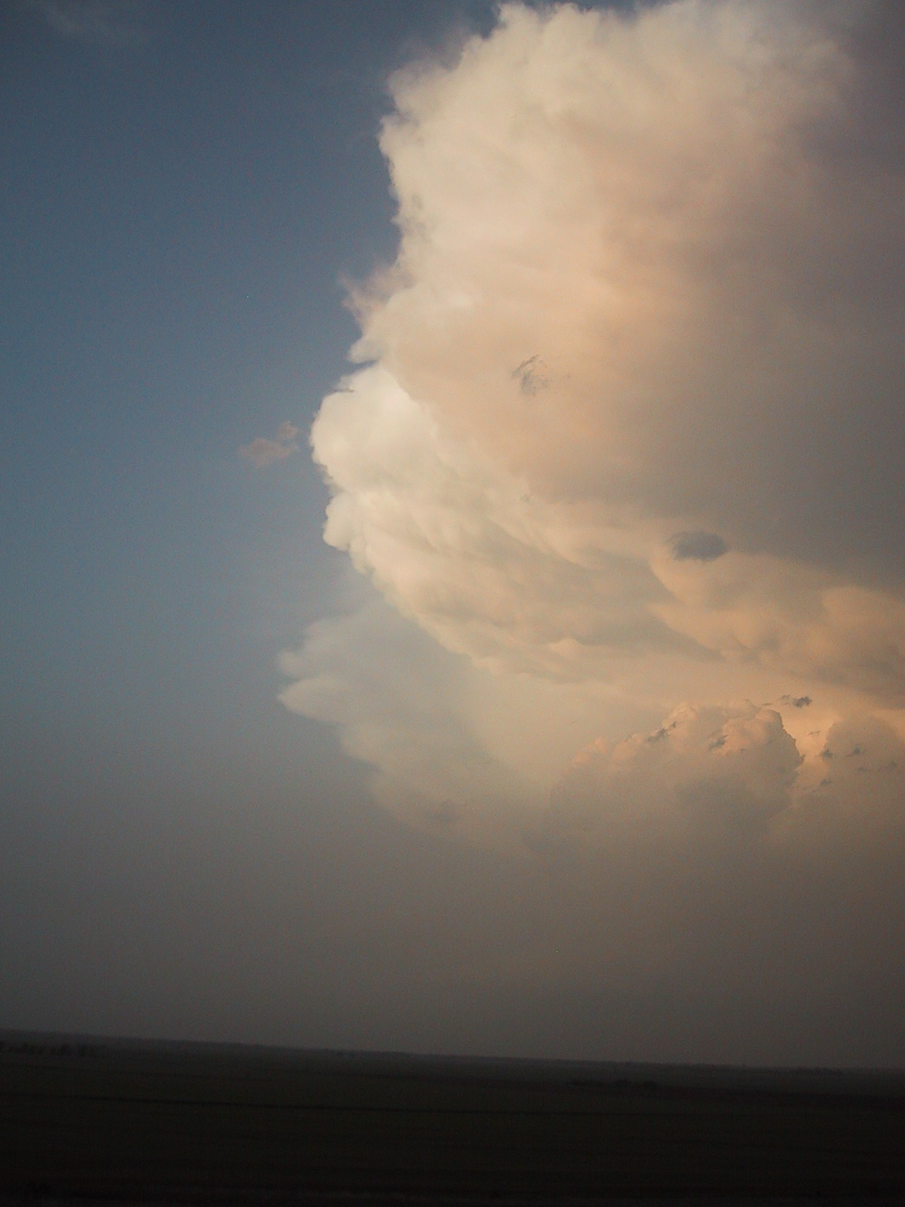
Sky at the SGP, May 2003.

Slide 30
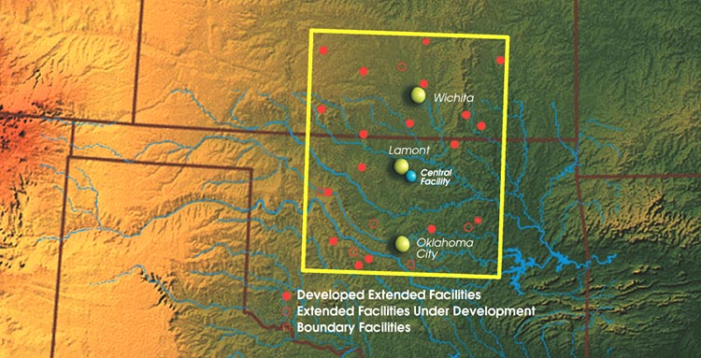
Where does the Aerosol Come From During the ‘Main Event’?
Maybe a city-plume was responsible for the aerosol? Wichita? Oklahoma City?

Slide 31
Otter over GIF Trailer, Photo courtesy Yin-Nan Lee, BNL

Slide 32
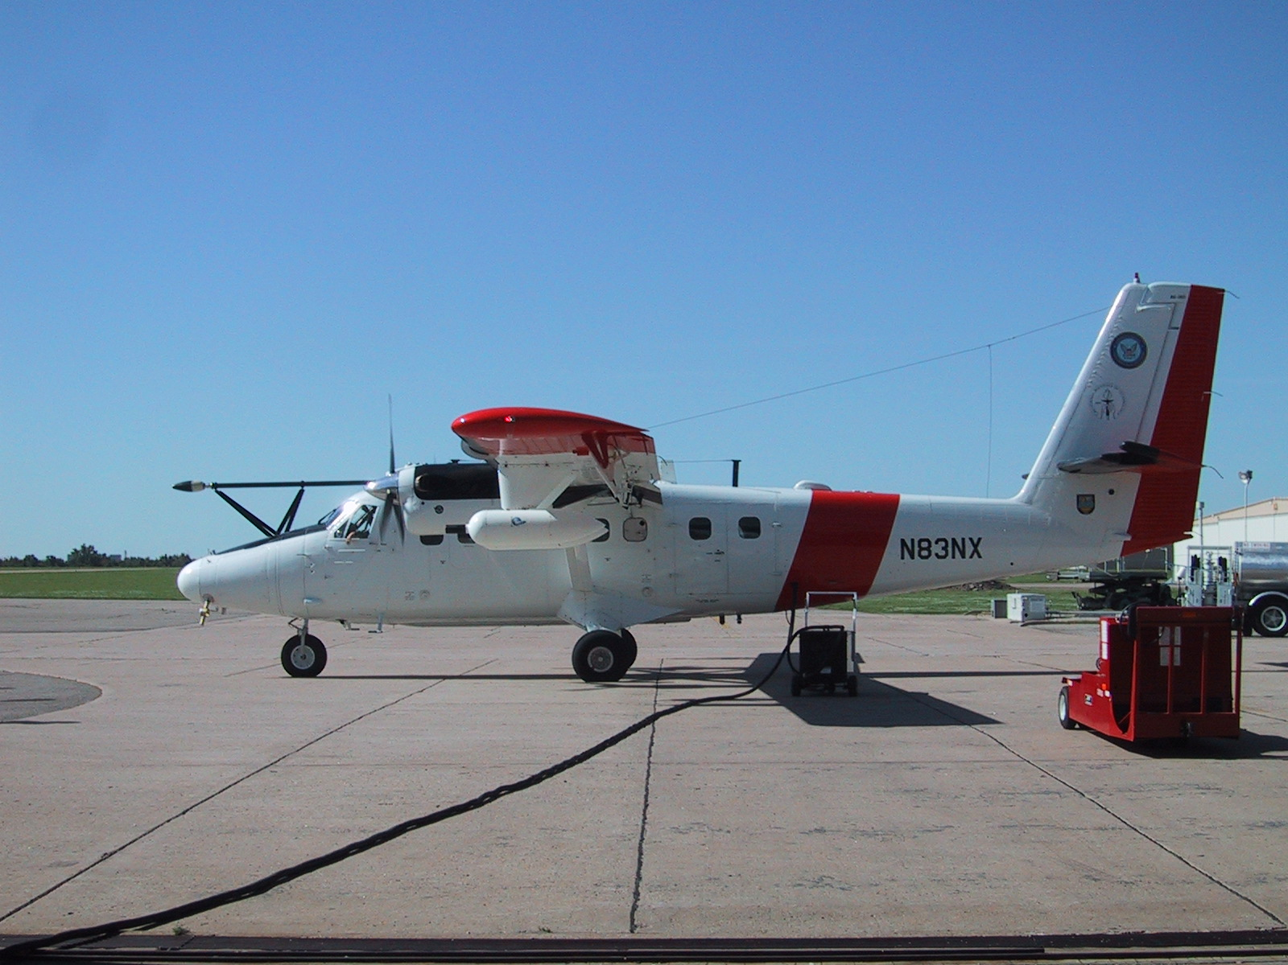
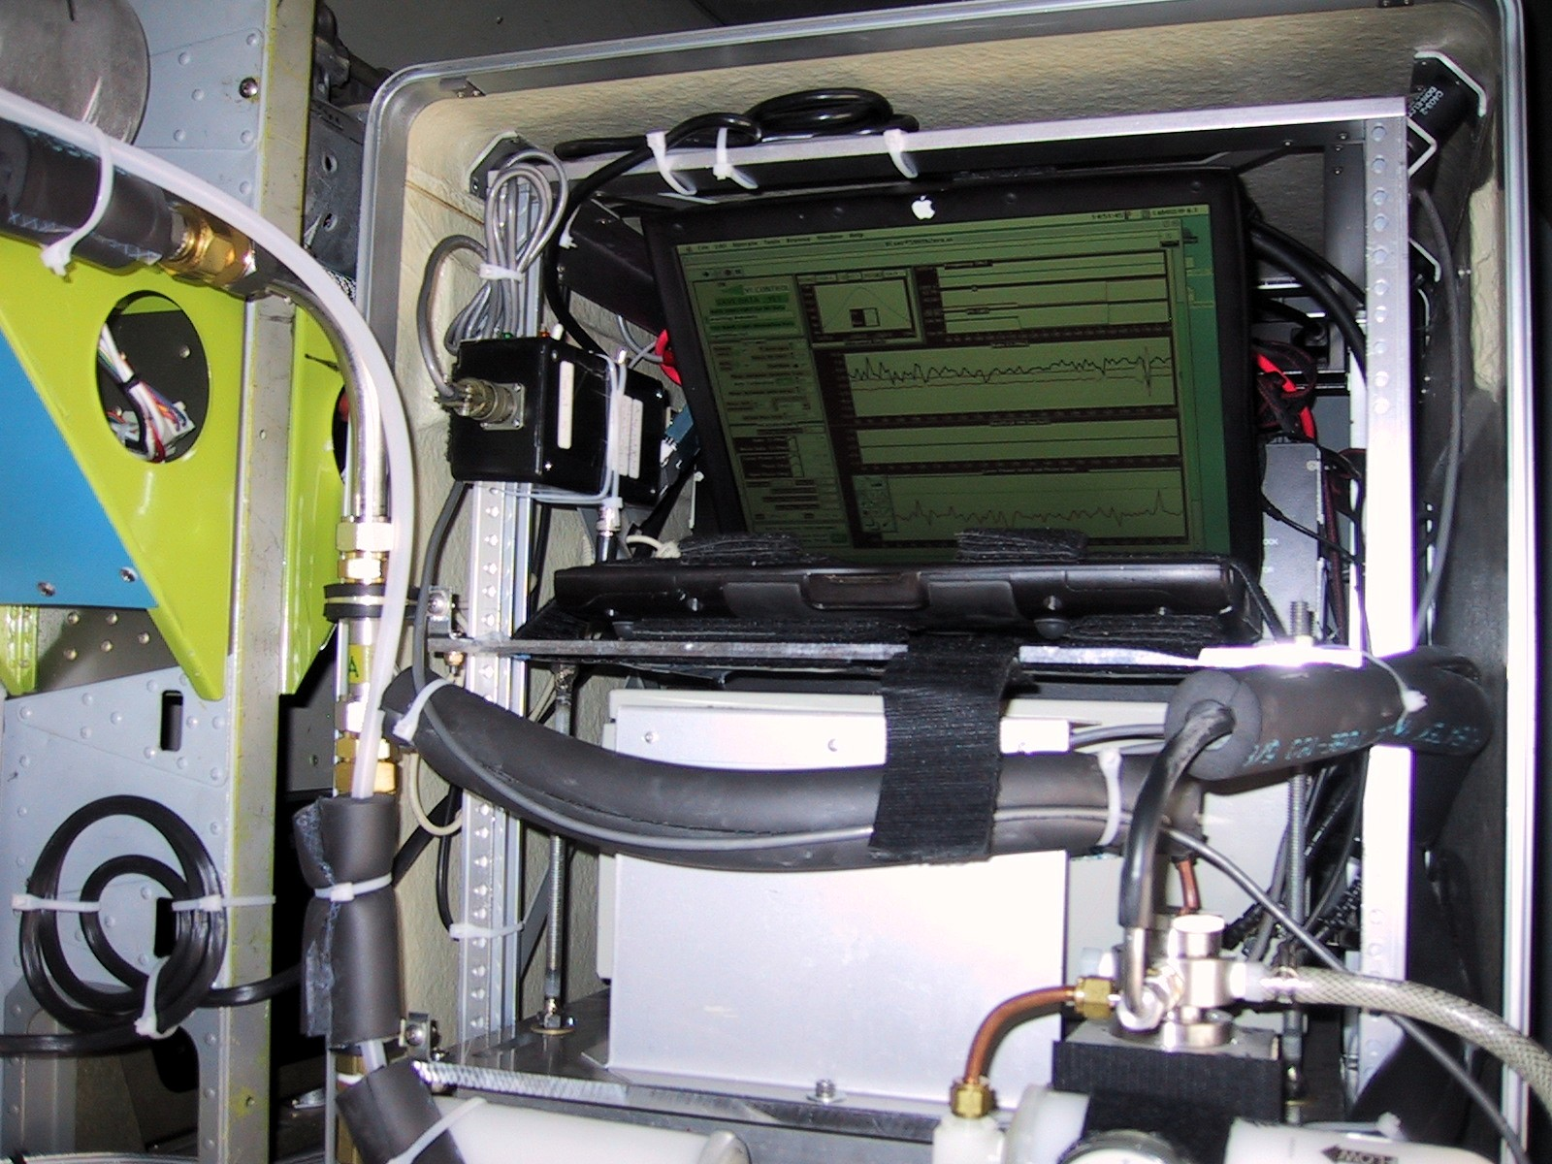
Photoacoustic Measurements from the Twin Otter

Slide 33
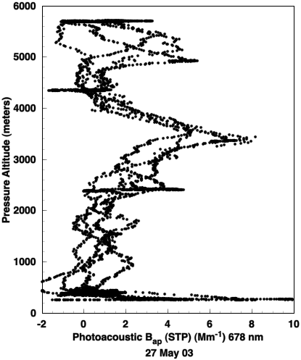

Vertical Profile 27 May 2003: Pancaked Layers of Russian Forest Fire Smoke
PHOTOACOUSTIC LIGHT ABS.
Significant layers of light absorbing aerosol near 650 mb and 550 mb, with a clean layer in between at 600 mb.

Slide 34
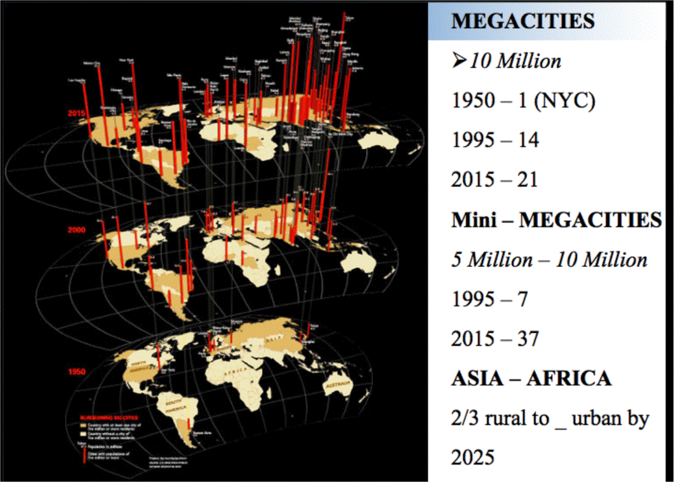
Megacities
2015
2000
1950

Slide 35
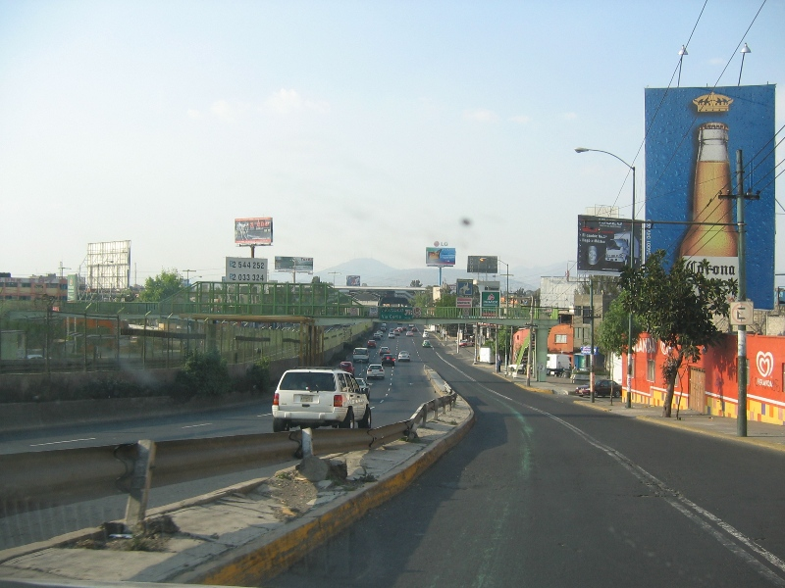
Photoacoustic Measurements of Aerosol light absorption and scattering at four sites in and near Mexico City
Guadalupe Paredes-Miranda and William P. Arnott
Department of Physics, University of Nevada Reno, and Desert Research Institute.
Jeffrey S. Gaffney and Nancy Marley
Department of Chemistry, University of Arkansas
Presented in July 2006, Second International Conference on Global Warming and the Next Ice Age. Aerosol Workshop on Climate Prediction Uncertainties

Slide 36

The MILAGRO field campaign was carried out in
March 1-30, 2006
in Mexico City.
MEGACITY AEROSOL EXPERIMENT IN MEXICO CITY (MAX-MEX)
Understand the local and global radiative and cloud microphysical impacts of aerosol from a large city, Mexico City.

Slide 37
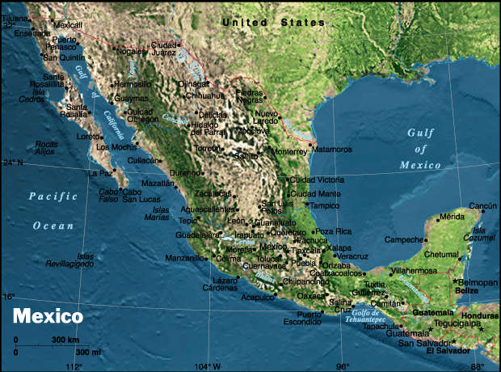
LAT N 19 00
LONG W 99
Altitude 2240 m to 3700 m North to South
Area: 1 964 375 Km²

Slide 38
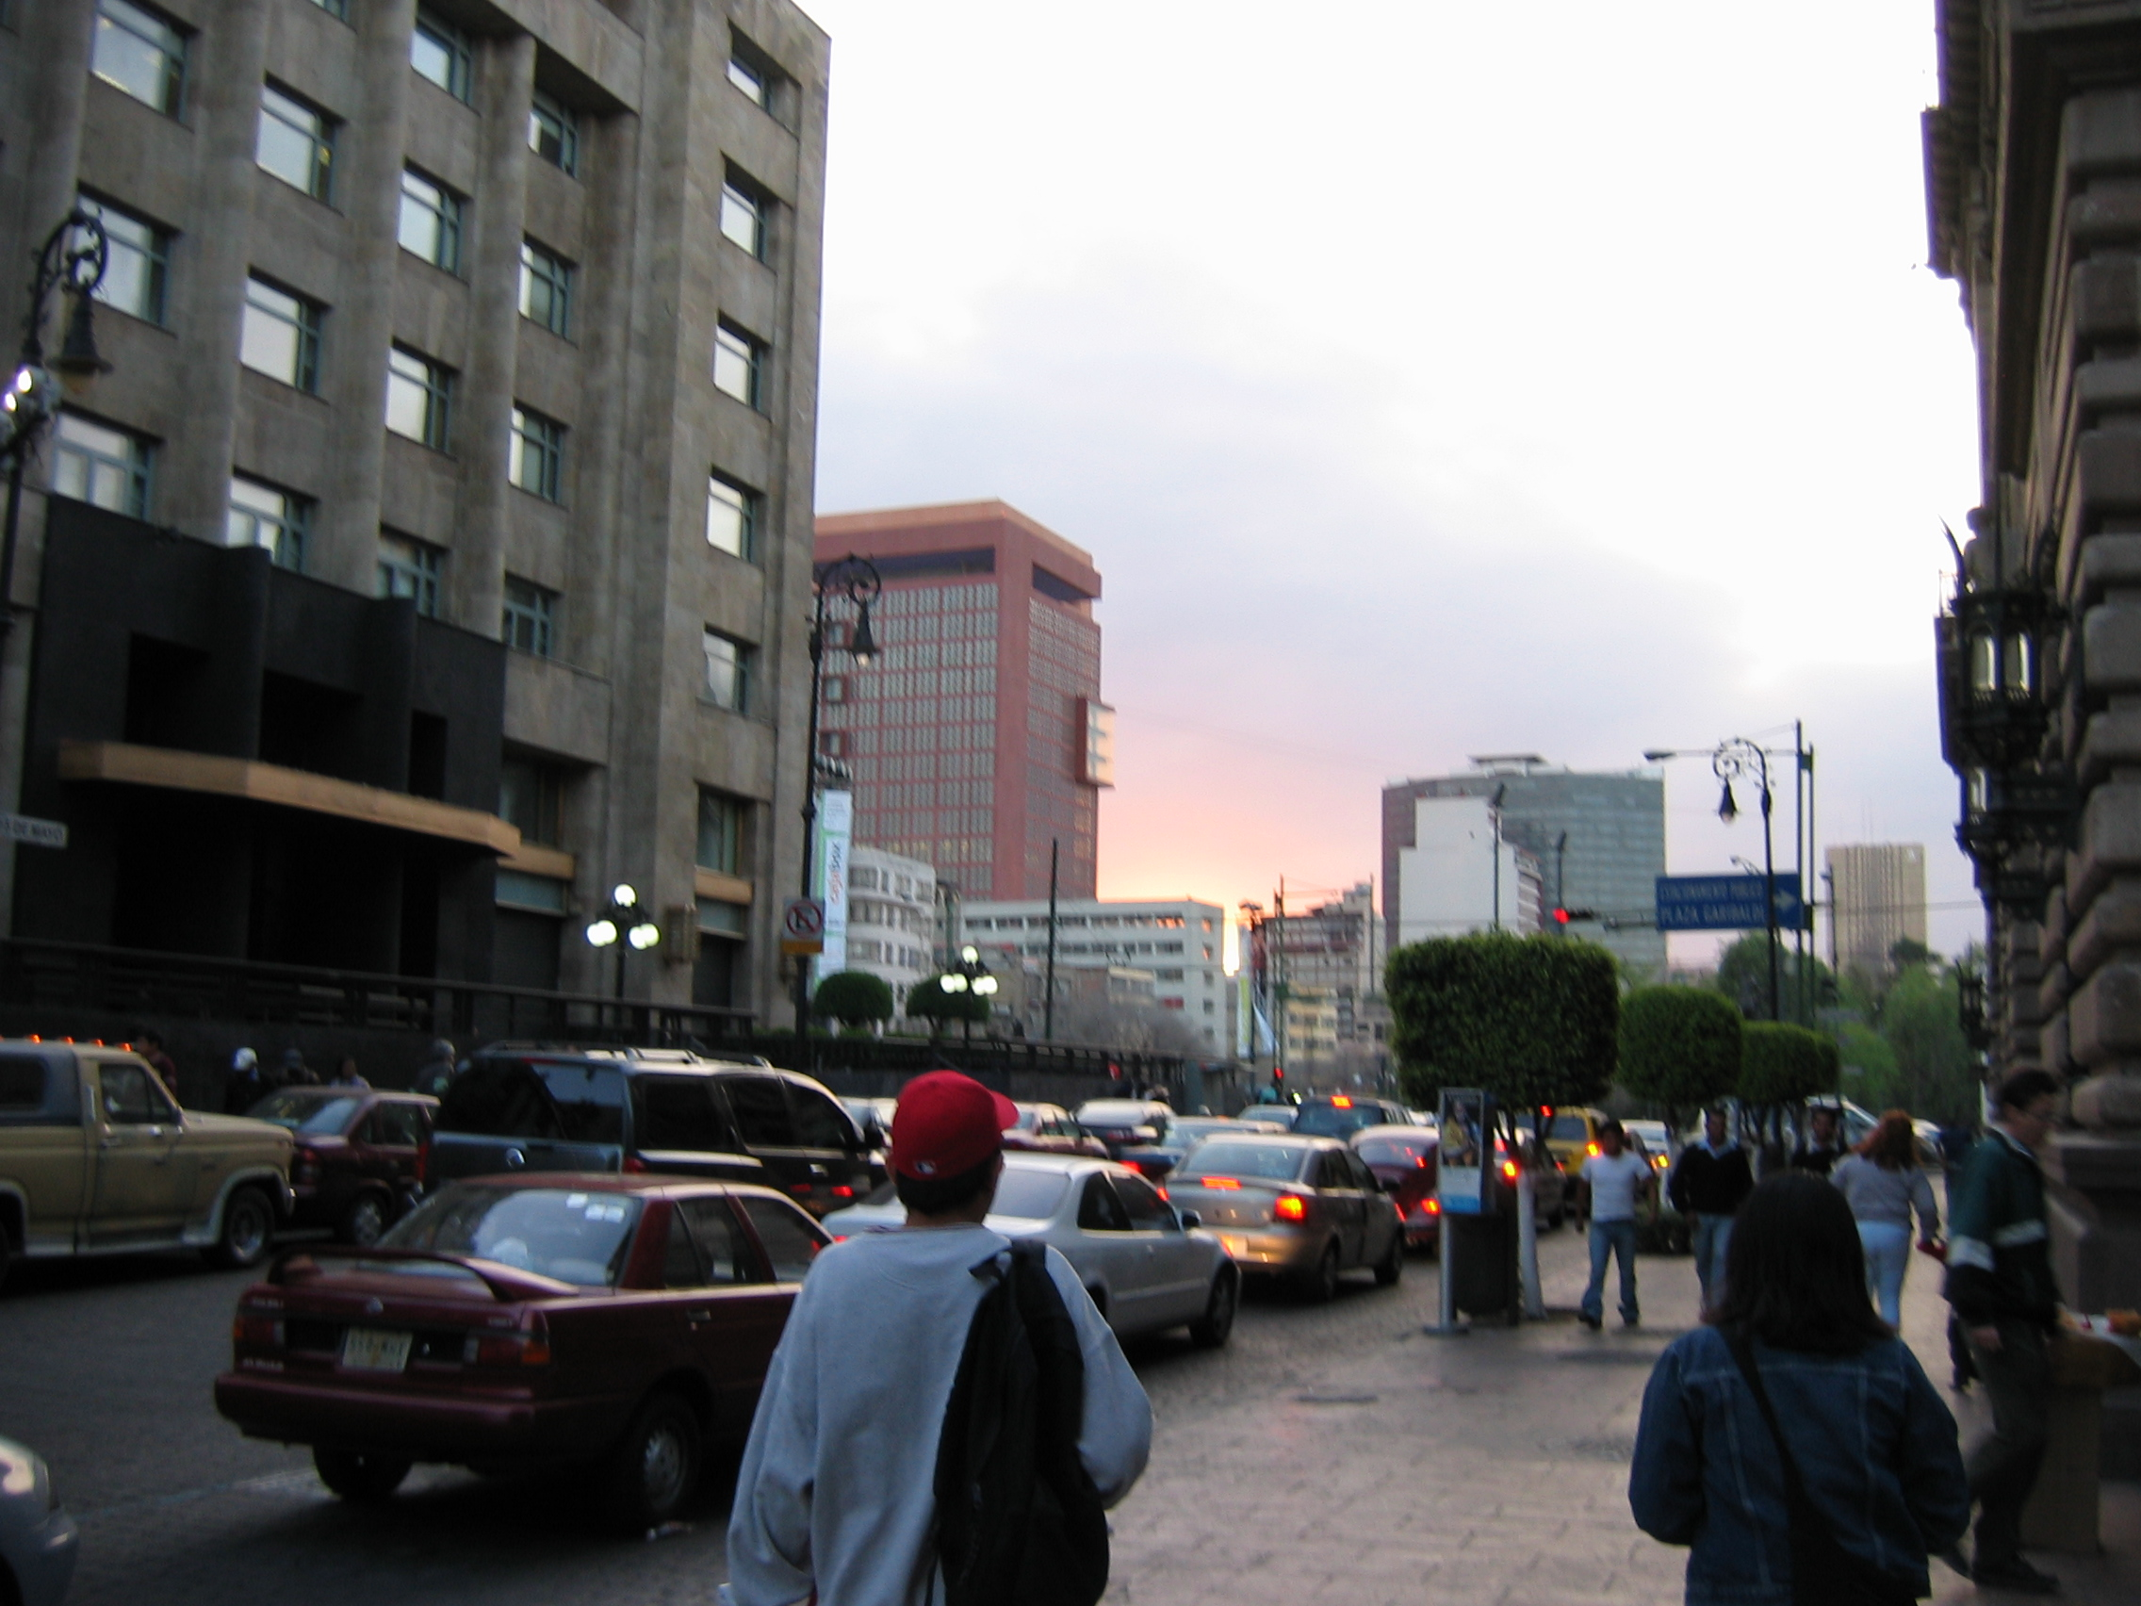
About Mexico City…
~23,000,000 people in 2005
>4,000,000 Motor vehicles

Slide 39
MEASUREMENT SITES
T0: Instituto Mexicano del Petroleo, Distrito Federal, Northeast Mexico City.
T1: University of Tecamac, Tecamac, north of Mexico City.
T2: Rancho La Biznaga, Road to Pachuca Hidalgo, north of Mexico City.
T3: Paseo De Cortes, Amecameca
(All sites inside Mexico City)

Slide 40
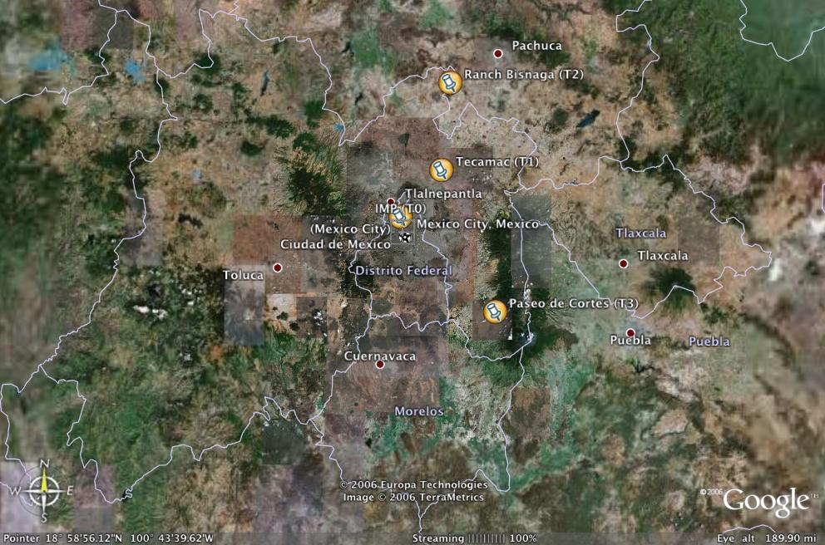
Scale 25 miles between
IMP and U of Tecamac
Scale 65 miles between IMP and La Biznaga

Slide 41
Air Pollution in Mexico City
~ 85% coming from fuel combustion
~ 15% dust
~ 44 x10⁶ liters of burned fuel as follows:
25% industry, 11% housing, 9% power companies, and 55% in transportation
(^{REFERENCE}Secretaria del Medio Ambiente SMP:
Government Department for the study of the Environment) THIS TALK CONSIDERS…
Gaseous (NO₂) and aerosol light absorption and scattering at sites T0, T1, and T2.

Slide 42
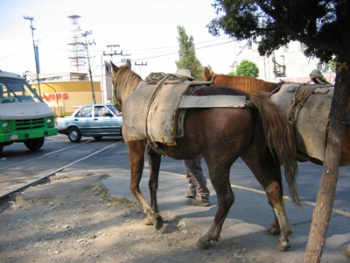
Sometimes transportation may pollute in a different way! Methane Makers…

Slide 43
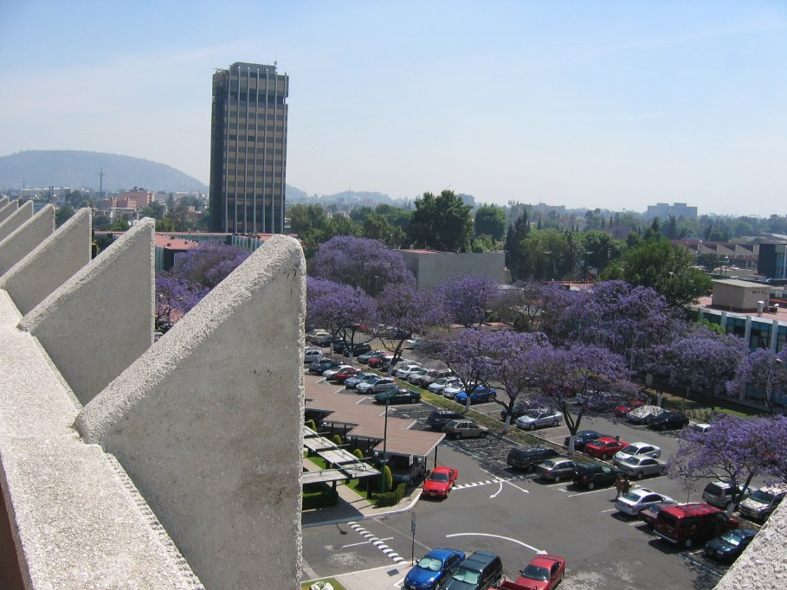
Relatively clean day at IMP in the Northeast.

Slide 44
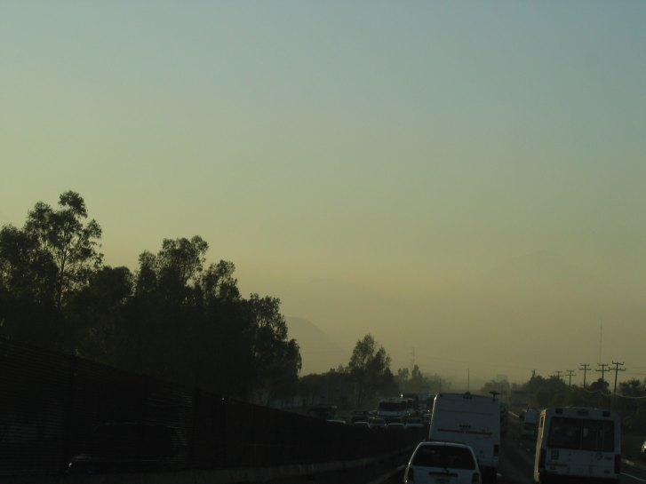
Example of a day when the Mexico City Plume Goes South to Popocatepetl 17k’ volcano.

Slide 45
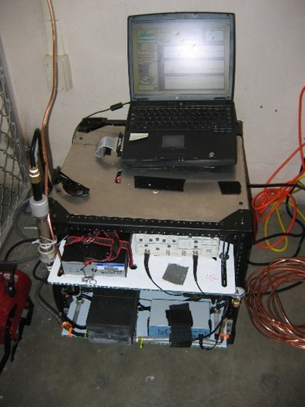
Photoacoustic instrumentation at the sites
T0: IMP Mexico City
Absorption and Scattering by particles and gaseous compounds: 532 nm
T1: TECAMAC
Absorption and Scattering by particles: 870 nm .
T2: LA BIZNAGA
Absorption by particles: 870 nm
T3: AMECAMECA Mountains
Absorption and Scattering by particles, 780nm

Slide 46
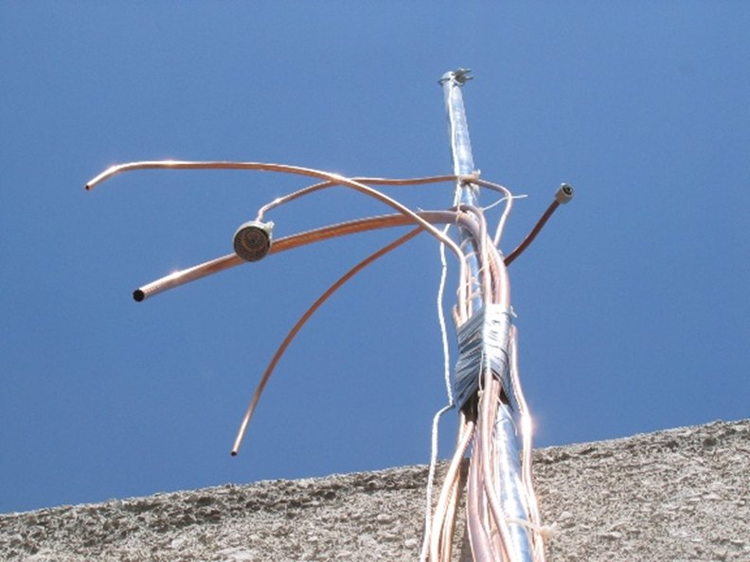
Inlet System at T0

Slide 47
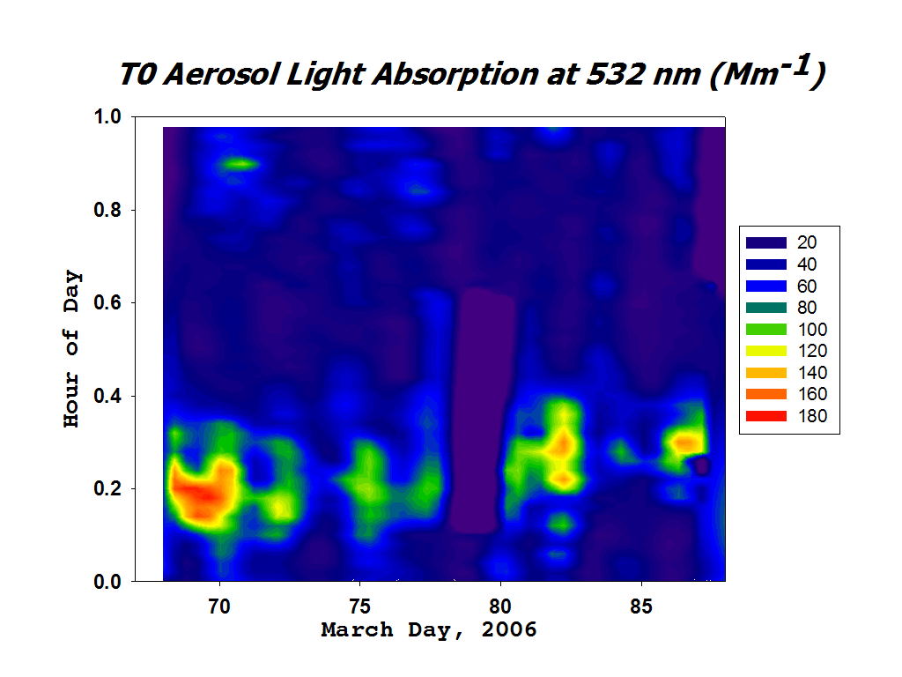
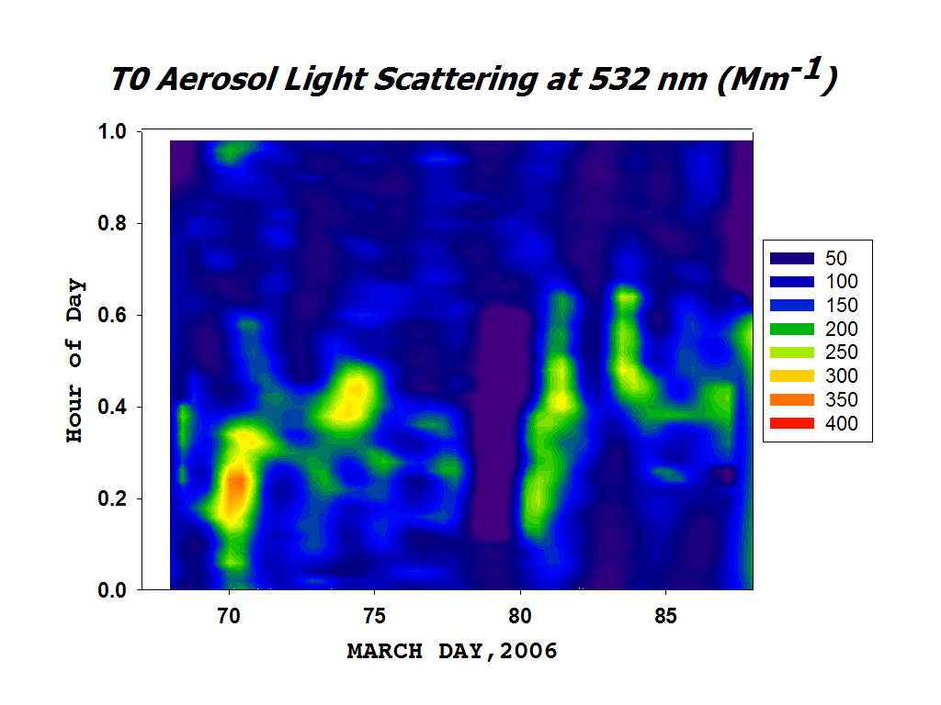
TO Site Mexico City Aerosol Optics for 532 nm
Aerosol Absorption
Note the day to day variability in the peak absorption, probably due to meteorology.
Aerosol Scattering
Aerosol Scattering peaks later in the day than absorption, probably due to dust, OC, and inorganics.
Missing data given by the color white.

Slide 48


GASEOUS AND PARTICULATE ABSORPTION
Gaseous Absorption, 532 nm, mostly NO_{2,}
(1/3 Mm⁻¹ / ppb efficiency for absorption by NO₂)
Note that gaseous absorption peaks 2 hours later in the day than particulate absorption. Peak particle absorption is 6x gaseous absorption peak.
Particulate Absorption, 532 nm

Slide 49

Average Single Scattering Albedo: Scattering/Extinction
Cooling effect
Warming effect
Afternoon.
Well mixed atmosphere.
Regional dust and local emissions mix.
Morning rush hour.
Large amounts of black carbon aerosol.

Slide 50


Aerosol Optics for 870 nm @ T1 30 minute average data
Aerosol Absorption
T1 Tecamac University typically has large amounts of windblown dust in the afternoon.
Aerosol Scattering

Slide 51

Cooling effect
Warming effect
Afternoon.
Well mixed atmosphere.
Regional dust and local emissions mix.
Morning rush hour.
Large amounts of black carbon aerosol.

Slide 52

Rural Site: Absorption only, Long range plume transport from the south when level are higher.

Slide 53


Rural Mountain Site:, Long range plume transport from the north when level are higher.

Slide 54

Rural Mountain Site:, Long range plume transport from the north when level are higher. Back trajectories and temperature.

Slide 55

A tale of 2 Cities…
Vegas: Jan thru Feb
Daily variations small
Mexico City: March
Daily variations large

Slide 56
Summary
Significant day to day variations of BC are observed due to meteorology in the Mexico City basin.
Peak gaseous absorption is approx. 2 hr later in the day than peak particle absorption. Peak 30-minute-average aerosol absorption in Mexico City was 180 Mm⁻¹.
Daily single scattering albedos vary between 0.4 and 0.85 at 532 nm at the T0 site. Transportation dominates aerosol optics in the morning and windborne dust is important in the afternoon, especially at the T1 site.

Slide 57

Field Work At T1
SITES ALONG THE WAY….

Slide 58

Future Car: Maime Eisenhouser Family Hot Rod (Ponca City U-Haul South)

Slide 59

Under the hood

Slide 60

Washing Machine used in Mexico City

Slide 61

Drip System in Mexico City

Slide 62

Guanajuato: Miguel Hidalgo & the birth of Mexico’s Independence

Slide 63


Guanajuato: City of Music and Art (Jorge Negrete and Fan Club)

Slide 64




Perros and Perro Callejeros

Slide 65

Best Job on the Planet: El Torno and Chess Judge

Slide 66

Graffiti With a Purpose…

Slide 67

Sanborns Restaurant originally a hacienda built in 1597, Revolutionaries ate there…

Slide 68

Calle de Tacuba Downtown Mexico City

Slide 69


Art on display at Palacio de Bellas Artes: Diego Rivera

Slide 70

Concert at Zocalo Downtown Mexico City

Slide 71

Working on an instrument at Gloria’s house in Mexico City. Thanks for the help, “ayuda”. Thanks for your attention.

