Slide 1
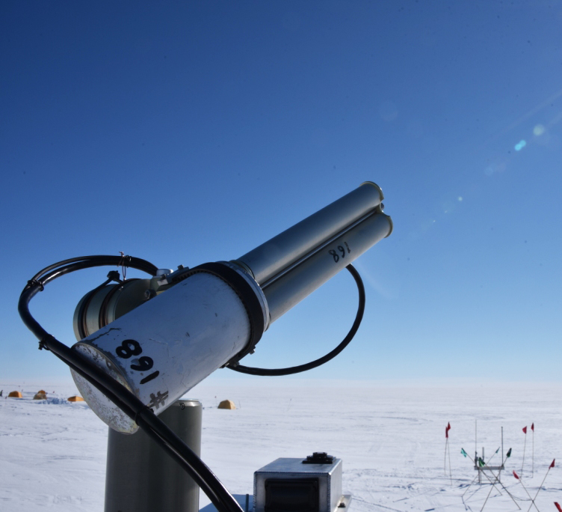
ARM CSPOT. Cimel Sunphotometer and the AERONET network
Christopher Atkinson
Notes:
ARM West Antarctic Radiation Experiment

Slide 2
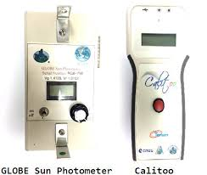
Why am I interested?
Summer 2014
  Aerosol optical depth (AOD) has a variety of applications
  Multiple handheld sun photometers were evaluated for use in classrooms
  Global Learning and Observations to Benefit the Environment (GLOBE) Program
  Every 15 minutes, weather permitting, measurements were taken at NASA Langley Research
  Sun photometers measurements within the range of (+/-) 7 minutes of AERONET (Statistically compared by linear regression)
Notes:
Three raw voltagereadings on each channel (505 nm and 625 nm) were recorded andaveraged to give one distinct data point for each wavelength. Exact timeand GPS location for each measurement was provided by the ExifWizardphone application. Data was reported from 12:00 to 15:00 UTC asGLOBE Aerosols protocol indicates measurements are best prior to solarnoon. A spreadsheet provided by Dr. David Brooks was modified in orderto convert the raw voltage into AOD.

Slide 3
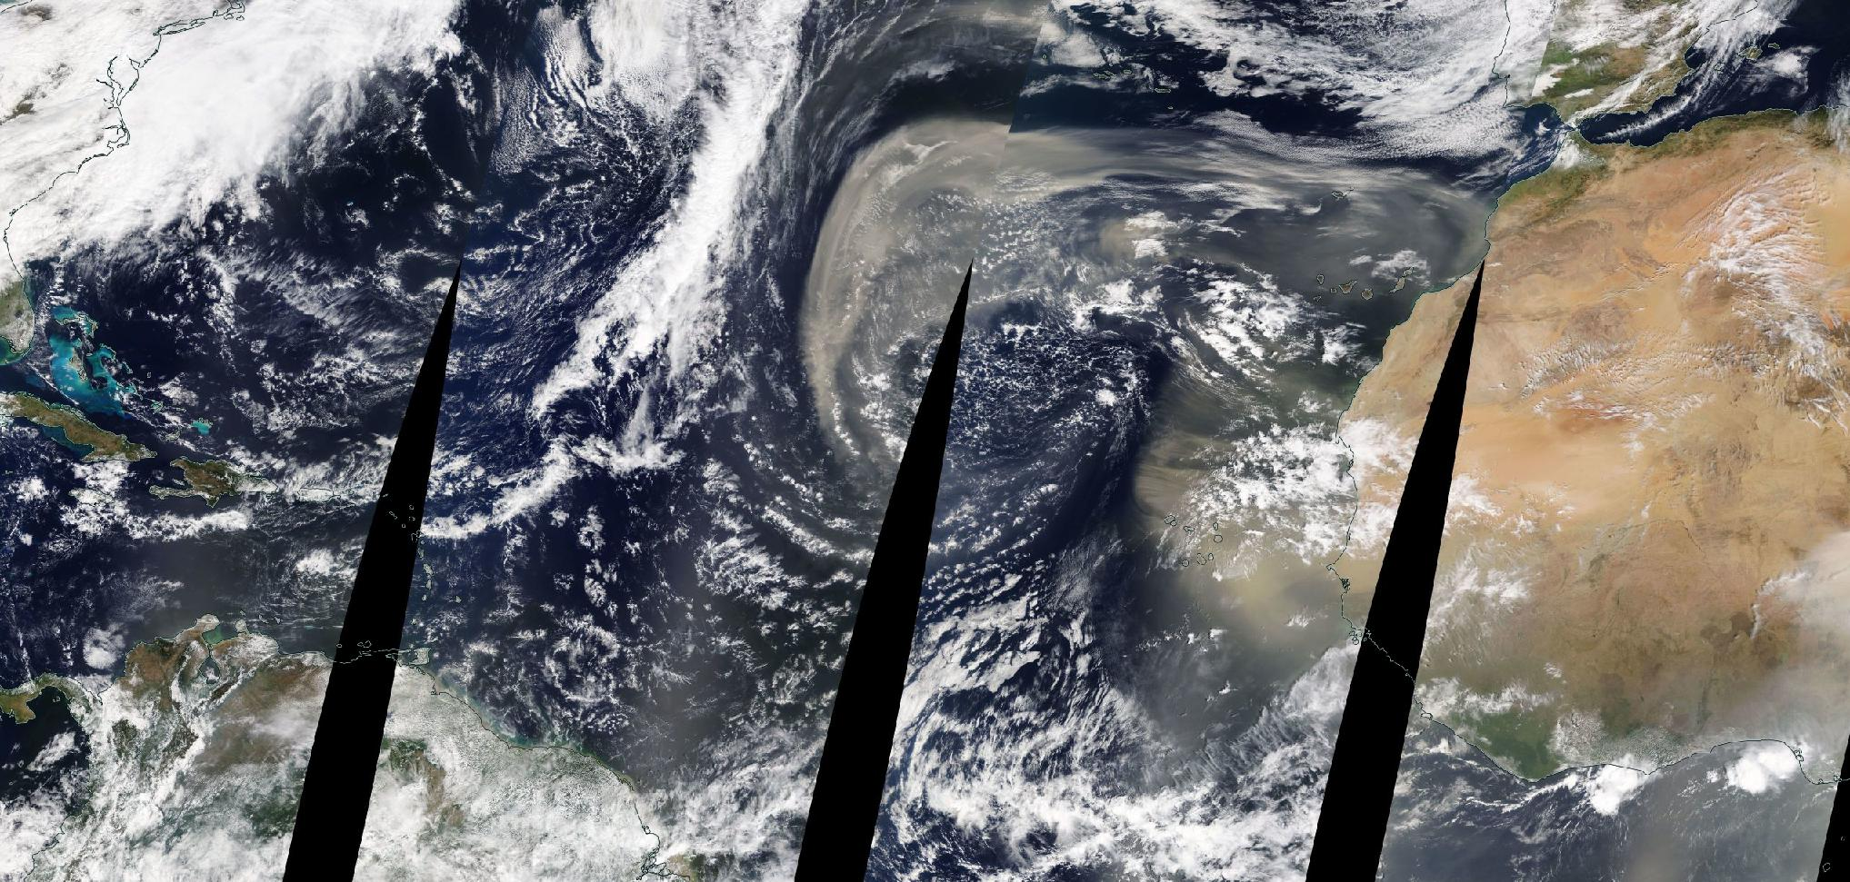
Motivation
NASA World View Feb. 25, 2020
Notes:
14 million metric tons of transcontinental dust travels across the Atlantic Ocean
NASA research scientists estimate it would take 53,022 semi-trucks to move enough desert sand to equal the amount of dust transported from Northern Africa to the Greater Caribbean annually.

Slide 4
Applications
Aerosol quantification (AOD)
Satellite calibration & data validation
Climate research
Atmospheric analysis
Site validation of solar power plants
Air quality

Slide 5
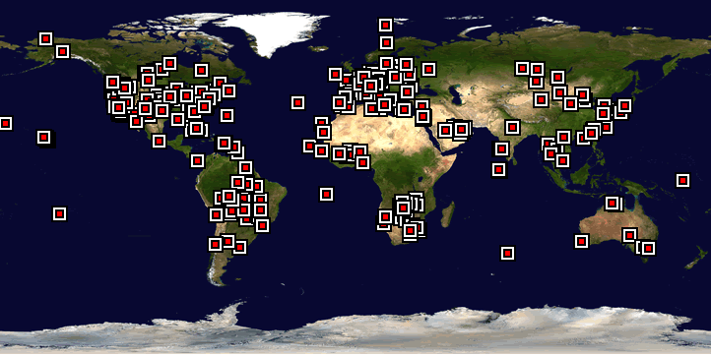
NASA’s AERONET
Aerosol Robotic Network
Worldwide federation of ground-based remote sensing aerosol networks
Near real-time acquisition; long term measurements
Homepage access http://aeronet.gsfc.nasa.gov
Notes:
AERONET provides global observations of spectral aerosol optical depth (AOD), inversion products, and precipitable water.
The worldwide federation of networks dedicated to the measurement of atmospheric aerosols and federated by the NASA. Other independent networks like SKYNET, CARSNET, and SONET also operate CE318 photometers.

Slide 6
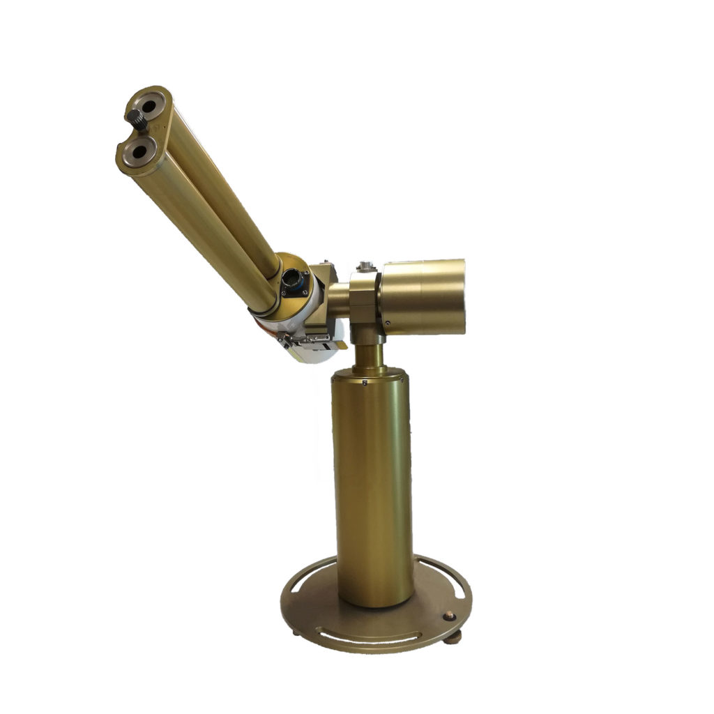
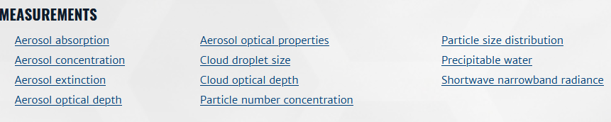
Instrument Description
“The Cimel sunphotometer (CSPHOT) is a multi-channel, automatic sun-and-sky scanning radiometer that measures the direct solar irradiance and sky radiance at the Earth’s surface.”
Deployed to ARM sites starting in 1998 (SGP)
Including other independent networks like SKYNET, CARSNET, and SONET
Latest version only accepted photometer for AERONET
CE318-T
Notes:
Measurements are taken at pre-determined discrete wavelengths in the visible and near-IR parts of the spectrum to determine atmospheric transmission and scattering properties. This instrument is weather-proof and requires little maintenance during periods of adverse weather conditions. It takes measurements only during daylight hours (sun above horizon).

Slide 7
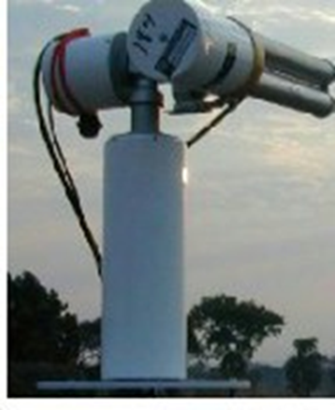

Operating Principle
Full autonomy with low power consumption
A sensor head pointing at the sun according to a preprogrammed routine
Day-time (SUN/SKY) & night-time (MOON: from 1st to last quarter) measurements:
    Aerosol Optical Depth (AOD), Volume Size Distribution (VSD), complex refractive index (n), and water vapor content
    Lev. 1.0, unscreened, 1.5 cloud screened, 2.0 cloud screened and quality assured.
The Cimel controller, batteries, and Vitel satellite transmission equipment are usually deployed in a weatherproof plastic case.
Notes:
W Solar panel
The photometer follows a daily schedule of automatic actions
. Some actions are
triggered
by the time of the day and some by the air mass which is relate
d to the
thickness of atmosphere the sun light has been t
hrough to get to the photometer
(Langley times). The Langley times
depend on
both
the site where
the
pho
tometer is
located and the date. T
hey are automatically calculated and set in the photometer
se
quence list each day at 1AM.

Slide 8
Sensor Head Options
Main differences include
  The wavelengths mounted in the head sensor
  Presence of an addition wheel filter
  Scenario sequence established.
5 Different sensor head options:
  Standard: It uses 340, 380, 440, 500, 675, 870, 937, 1020 and 1640 nm filters
  Polarized: A filter wheel containing 3 sets of 3 polarizers operating in infrared (POL1), Ultraviolet (POL2), and visible (POL3) and which are orientated with a 120° angles is added on top of the wheel containing the Standard filters.
  Seaprism: It is designed for Ocean Color application. It uses only silicon detectors. It uses 412, 440, 500, 531, 550, 675, 870, 937, 1020 nm filters.
  BRDF: it uses 380, 440, 550, 675, 720, 870, 937, 1020 and 1640 nm filters
  BRDF 12 filters: It is designed for satellite calibration. It uses 412, 440, 500, 555, 675, 702, 740, 782, 870, 937, 1020, 1640 nm filters.
Notes:
A polarizer or polariser is an optical filter that lets light waves of a specific polarization pass through while blocking light waves of other polarizations.
The SeaPRISM, which stands for “Photometer Revision for Incident Surface Measurements,”
The Bidirectional Reflectance Distribution Function (BRDF)

Slide 9
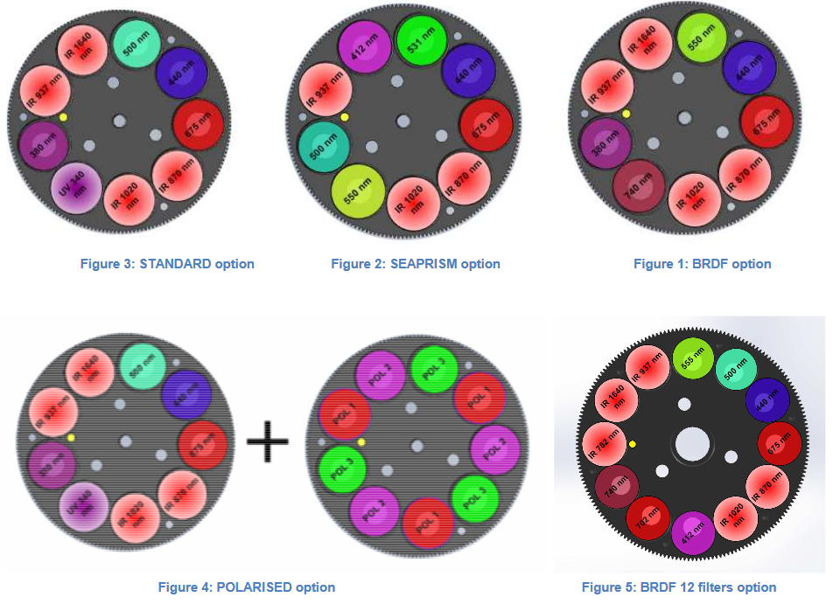
Sensor Head Options (cont.)

Slide 10
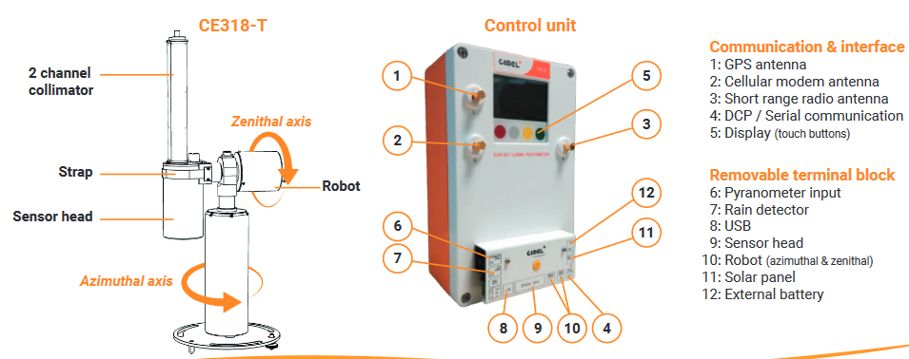
Configuration

Slide 11
Measurement Range
Sensor head spectral range
  Si detector: from 340 to 1020 nm
  InGaAs detector: from 1020 to 1640 nm
Robot
  Azimuth range: 0°-360°
  Zenith range: 0°-180°
Power
  110 – 240 V
Environmental conditions
  Temperature range:
    Without cold weather option: -20°C to 50°C (in non-icing conditions)
    With cold weather option: -30°C to 50°C
  Humidity range
    0 to 100% RH (in non-icing conditions)
Notes:
Silicon, Indium Gallium Arsenide

Slide 12
Measurement Range (cont.)
The radiometer makes two basic measurements-either direct sun or sky-both within several programmed sequences.
The direct sun measurements are made in eight spectral bands requiring approximately 10 seconds.
  at wavelengths of 340, 380, 440, 500, 670, 870, 940 and 1020 nm
  the 940 nm channel is used for column water abundance determination
A preprogrammed sequence of measurements is taken by these instruments from sunrise to sunset daily.

Slide 13
Measurement Accuracy
Direct Sun Calibration
  Aerosol optical depth (AOD), precipitable water (cm), and radiance (W/m2/sr/um)
  Generally returned to GSFC approximately every 6 to 12 months
  GSFC reference Cimels are calibrated at Mauna Loa Observatory frequently (Langley Plot)
Radiance Calibration
  Performed at NASA Goddard Calibration Facility (+/- 5% accuracy)
  Calibration coefficients accuracy decrease 1 to 10% per year
  Optical interference filters are changed when needed
Interpolation and Uncertainty
  Intercalibrated against MLO calibrated AERONET reference instruments
  Suggests uncertainty of approximately 0.01-0.02 In AOD
Notes:
The photometer should go through the calibration proces
s
every 12 to 24 months
.
Depending on
t
he quality of the measurements, the season
, and the meteorological
phenomenon that occurs, the calibration process can be
forwarded or
postponed
up
to 3 months.
The cal
ibration consists in
a sky calibration
by inter
-
comparison with an integrating
sphere
and
a sun calibration by inter
-
comparison
with
master photometers.

Slide 14
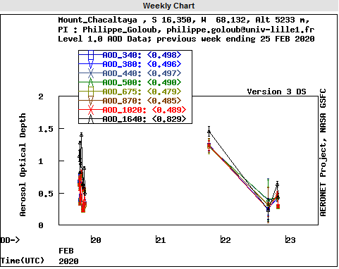
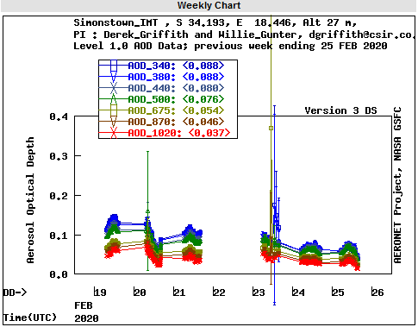
Troubleshooting
Communication and data transfer is down
  Using serial port transfer protocol
  Using Satellite transmitter
Bad sun tracking
InGaAs / silicon and A / K discrepancy
High dark current
Constant humidity
Robot errors
Dissymmetric Almucantar
Battery Low

Slide 15
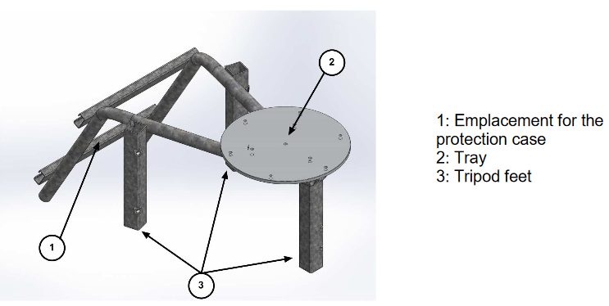
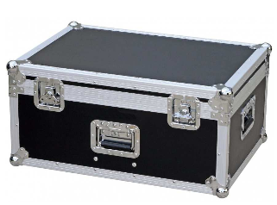
Specifications of Instrument
Infrastructure
  Tripod, with protection enclosure
Packaging
  Flycase for transportation
Dimensions (H x W x D)
  Flycase box: 66 x 52 x 47 cm
  Tripod box: 101 x 54 x 54 cm
Gross Weight
  Flycase box: 29 kg
  Tripod box: 20 kg

Slide 16
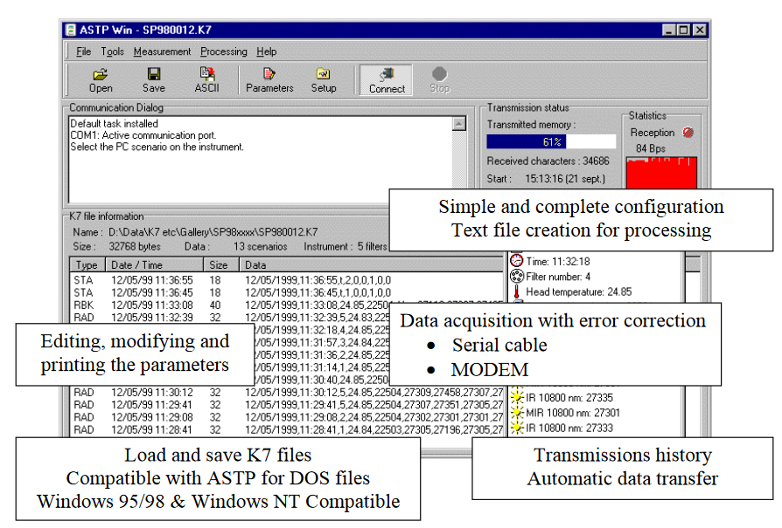
Data transmission
The photometer can use 2 different communication protocols
  PC Data Transfer (RS232 link)
  Data can be previewed and bad measurements are deleted.
  ASCII Text files are created for computations
  AERONET members will install the automatic protocol for data transfer

Slide 17
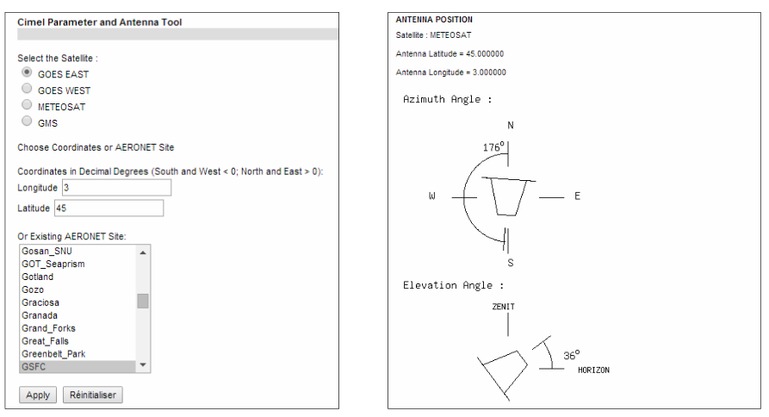
Data Transmission (cont.)
Satellite data transfer using DCP transmitter module.

Slide 18
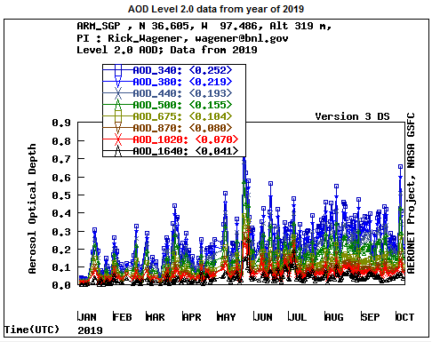
Measurement Example 1

Slide 19
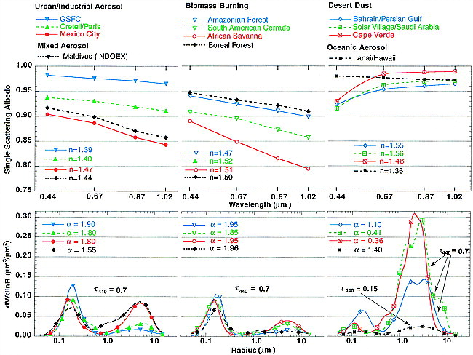
Measurement Example 2
Variability of Absorption and Optical Properties of Key Aerosol Types Observed in Worldwide Locations
Notes:
Variability of Absorption and Optical Properties of Key Aerosol Types Observed in
Worldwide Locations

Slide 20
References
Ma, L., & Wagener, R. (2014). Cimel Sunphotometer (CSPHOTAODFILTQAV3). Atmospheric Radiation Measurement (ARM) user facility.
Dubovik, O., B. Holben, T. F. Eck, A. Smirnov, Y. J. Kaufman, M. D. King, D. Tanré, and I. Slutsker, 2002: Variability of absorption and optical properties of key aerosol types observed in worldwide locations. J. Atmos. Sci., 59, 590–608
Photometer CE318 - T User Manual. (2014). Retrieved 25 February 2020, from http://support.cimel.fr/photo/pdf/man_ce318_t_us.pdf
Dunmore, R., Hopkins, J., Lidster, R., Lee, J., Evans, M., Rickard, A., Lewis, A. & Hamilton, J. (2015). Diesel-related hydrocarbons can dominate gas phase reactive carbon in megacities. Atmospheric Chemistry and Physics Discussions, 15(6), pp.9541-9571. DOI: 10.5194/acp-15-9983-2015.

Slide 21
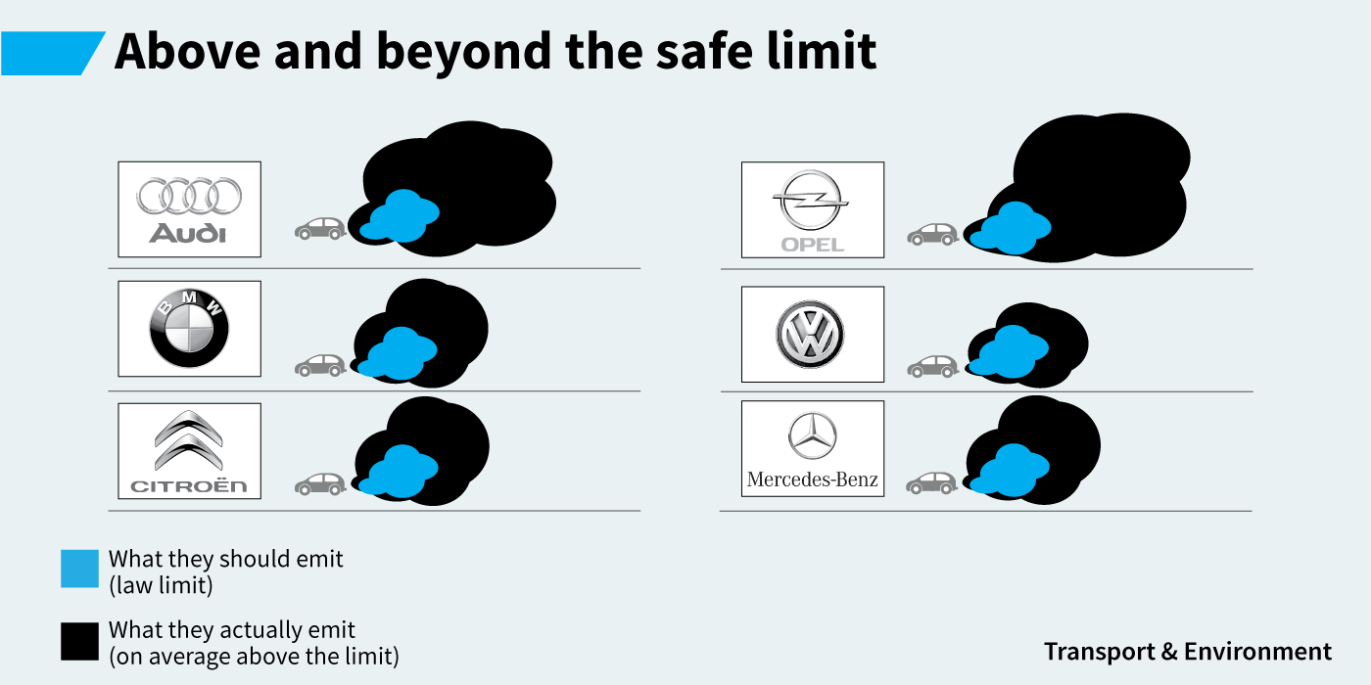
Questions?

Slide 22
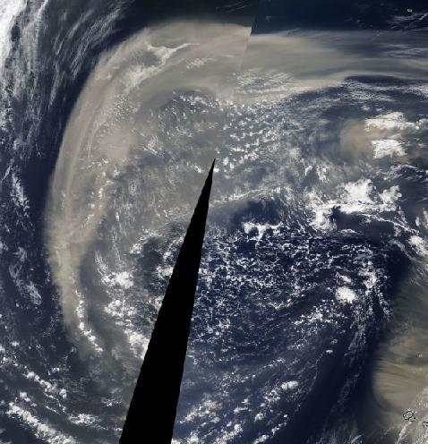
Motivation

Slide 23
Summary
Remote sensing with sun photometers is a powerful tool for monitoring AOD and other aerosol properties.
Provides real-time diverse data
AERONET provides a world-wide network.
Necessary maintenance every year
Should be fine for satellite “validation”

Slide 24
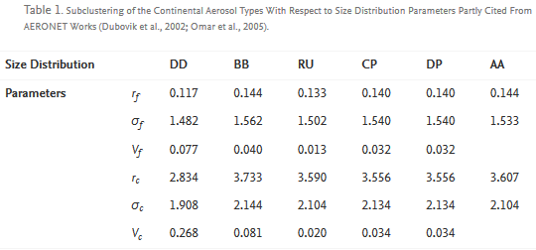
Data Distribution/Aerosol Model
α = – ln (AOT(λ2)/AOT(λ1))/ ln (λ2/λ1)

