Slide 1
UNR Quad turbulence experiment on March-15, 2018 Set number : 5
Saroj Dhital
Date : March-29, 2018

Slide 2
Experimental set up : set number 5
S
Serial 11 (NS) Serial 4 Serial 11 (OS)
Serial 12 Serial 13 Serial 10
E
W
N

Slide 3
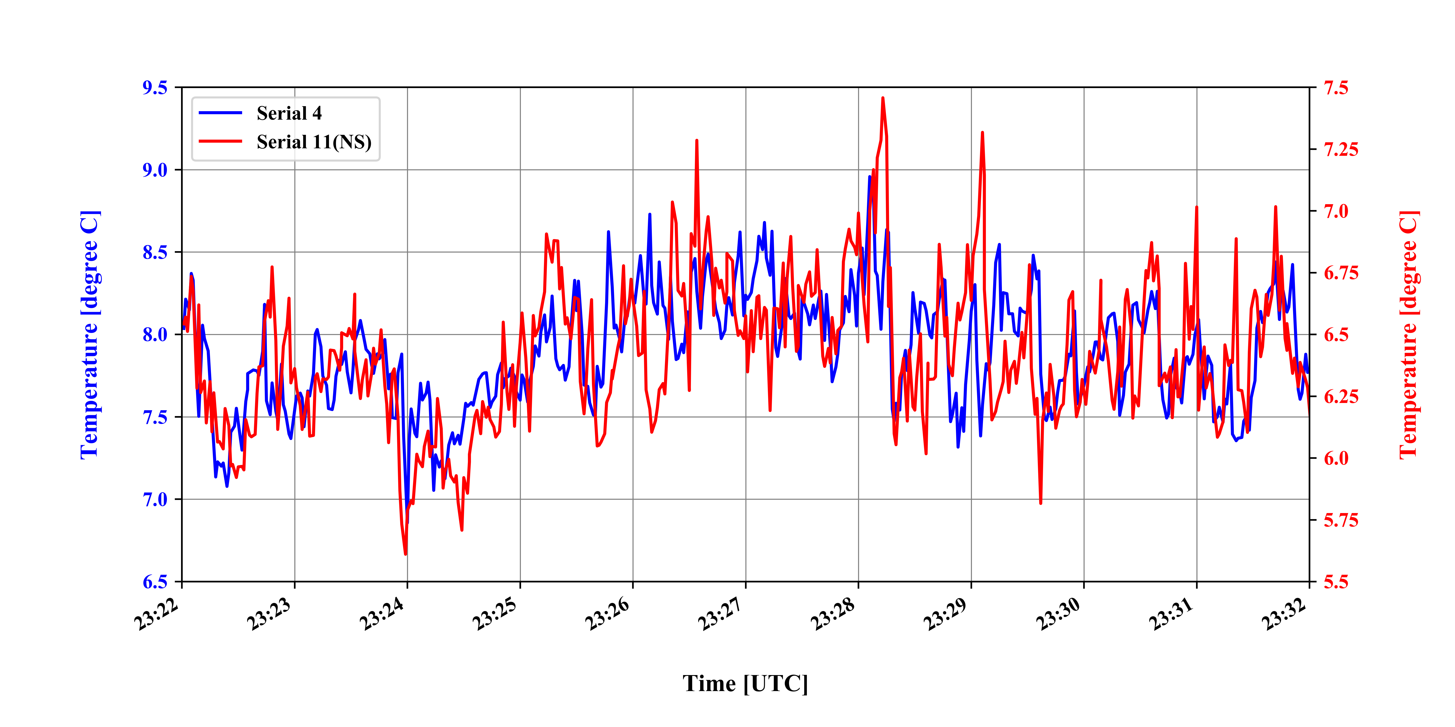
Comparison of thermistor temperature between sensors 4 and 11 (NS)

Slide 4
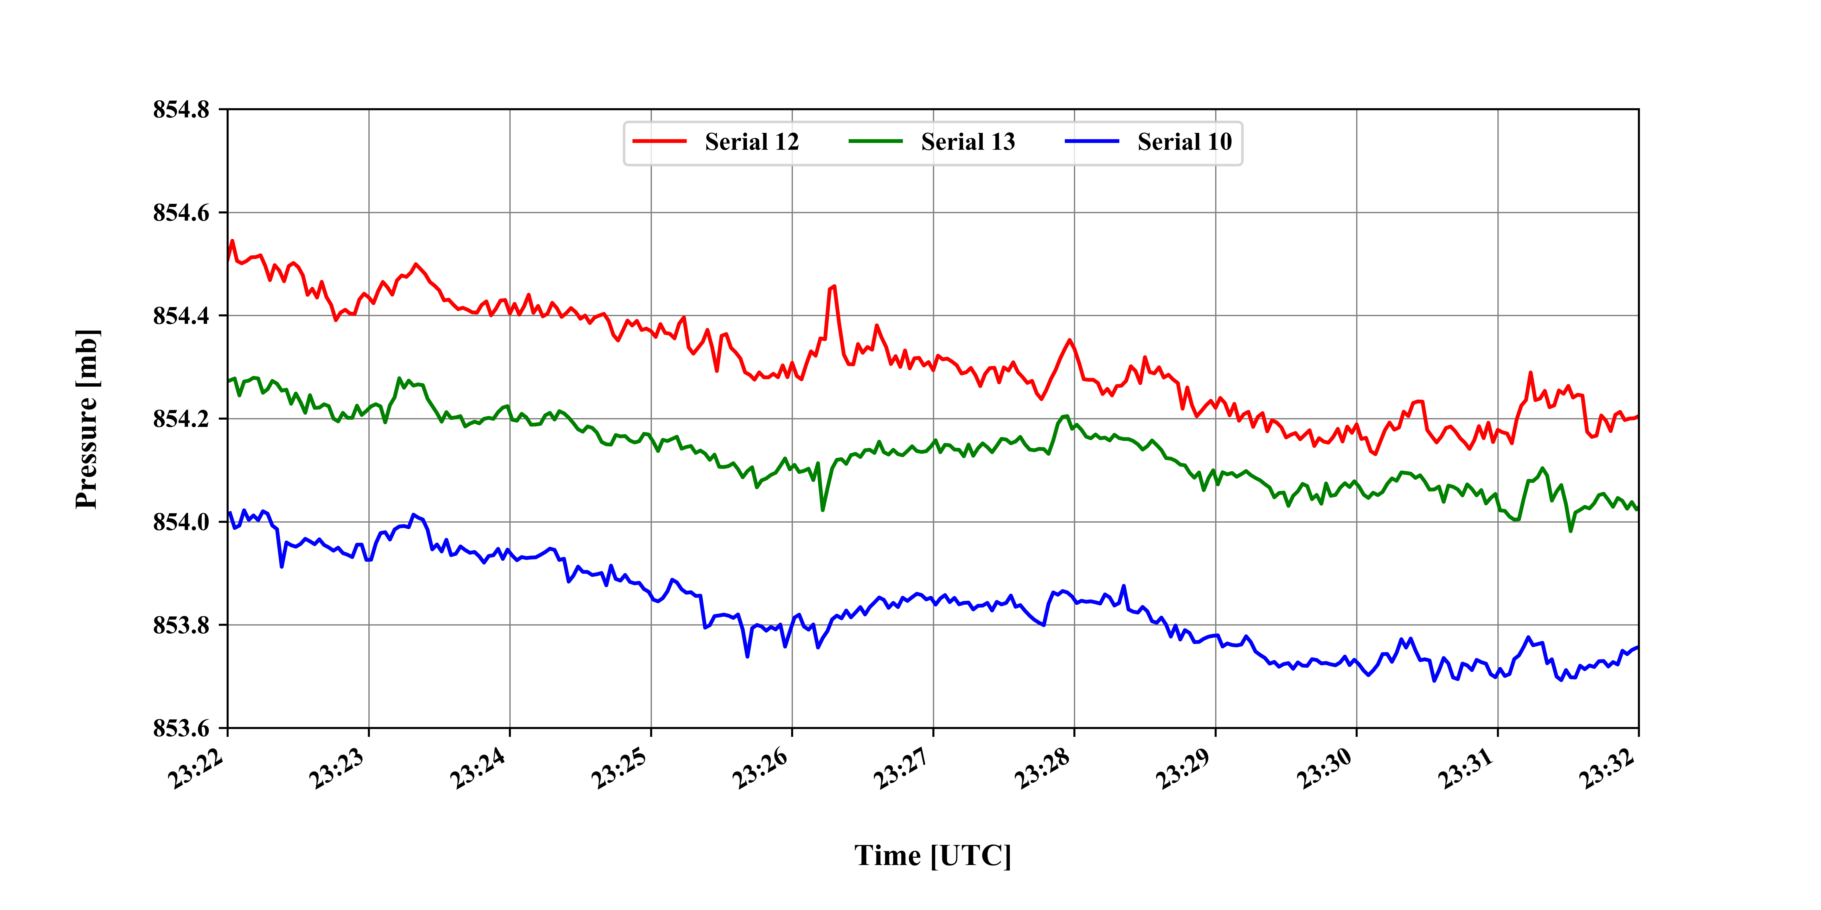
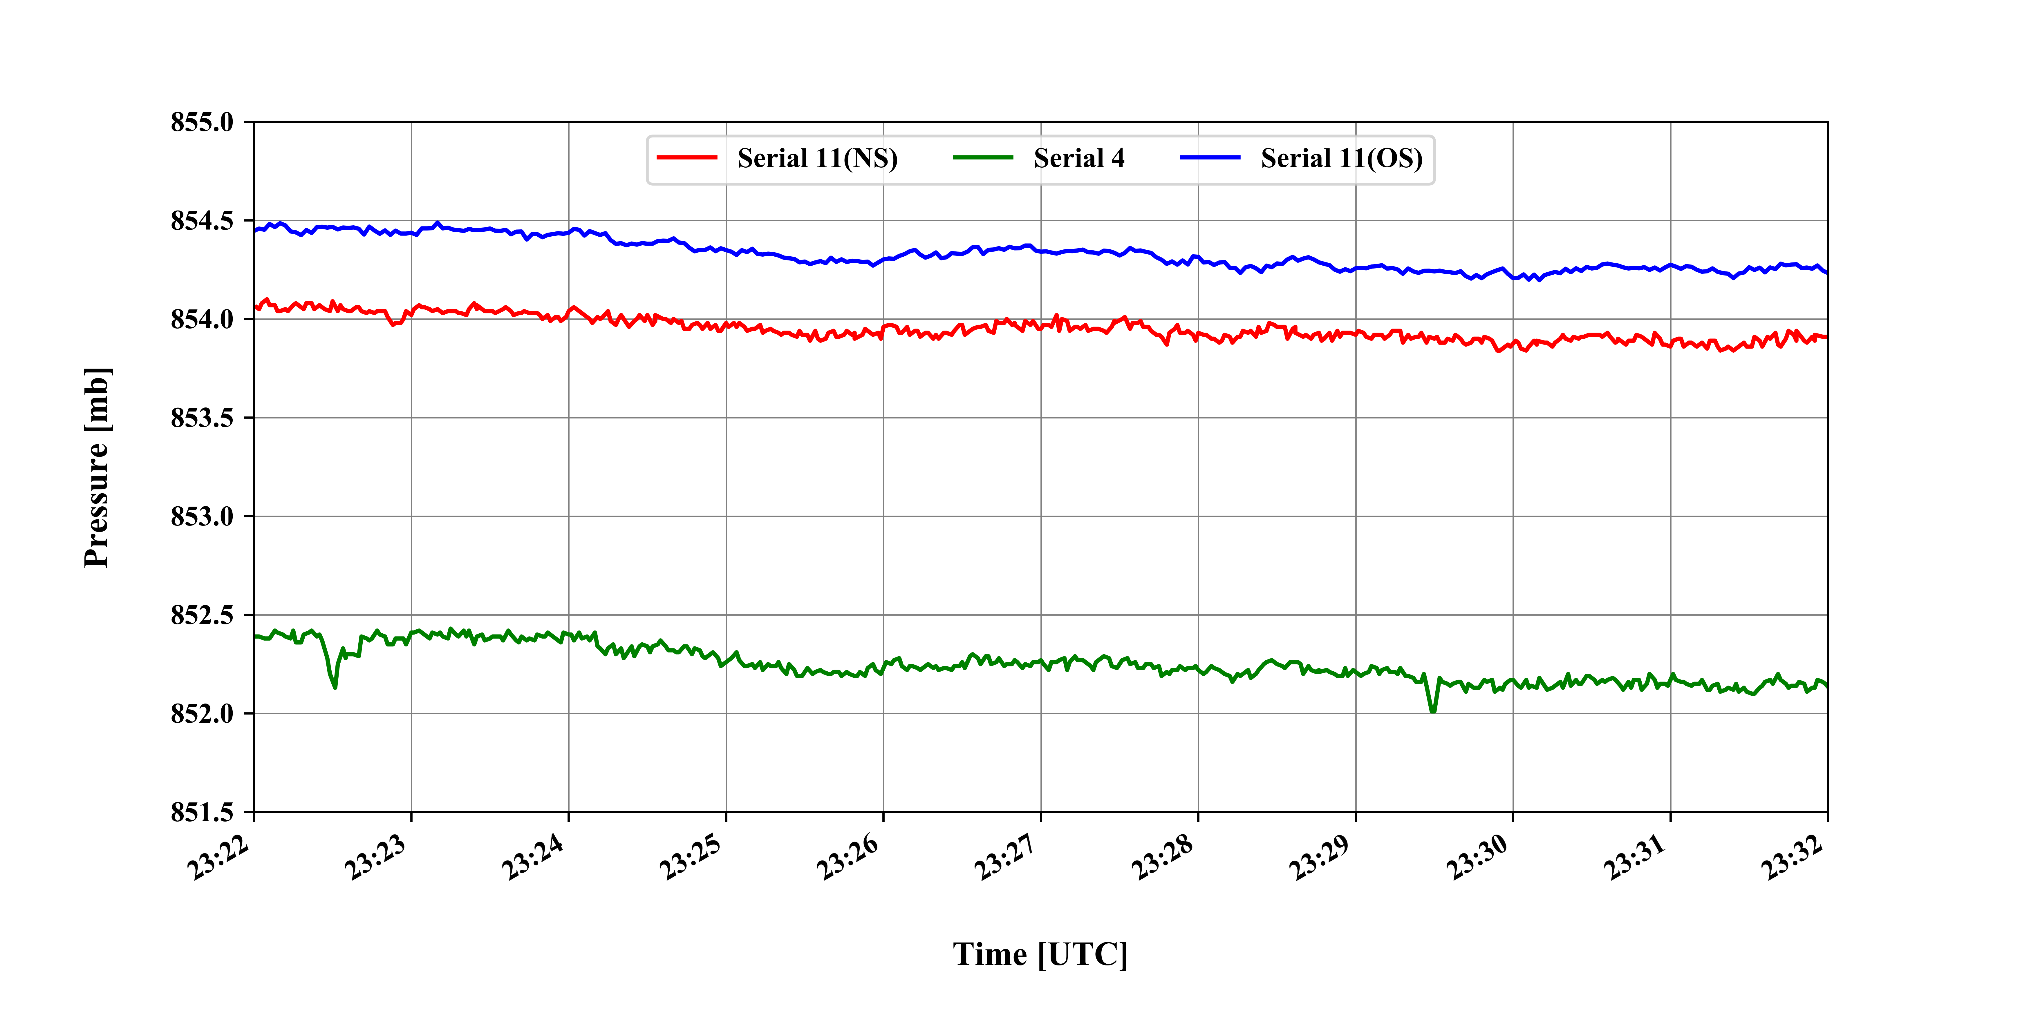
Comparison of atmospheric pressure between two sets of sensors

Slide 5
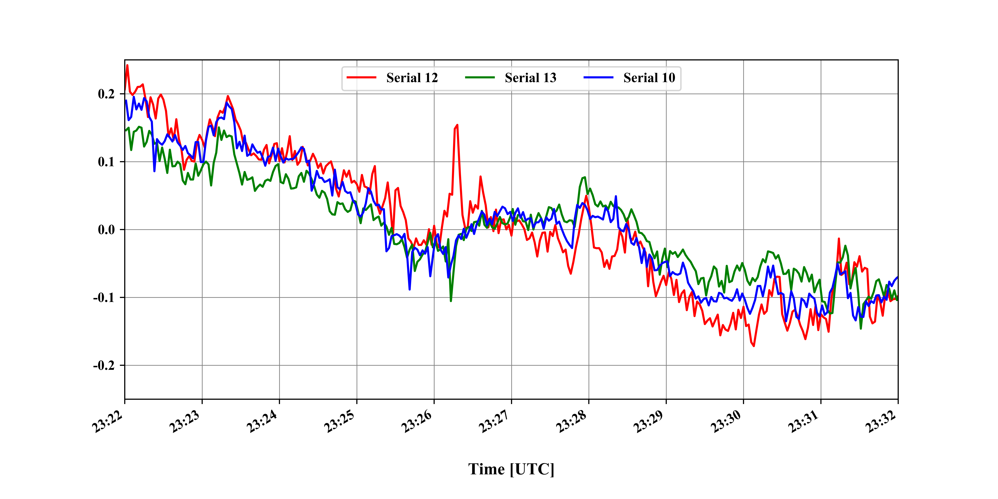
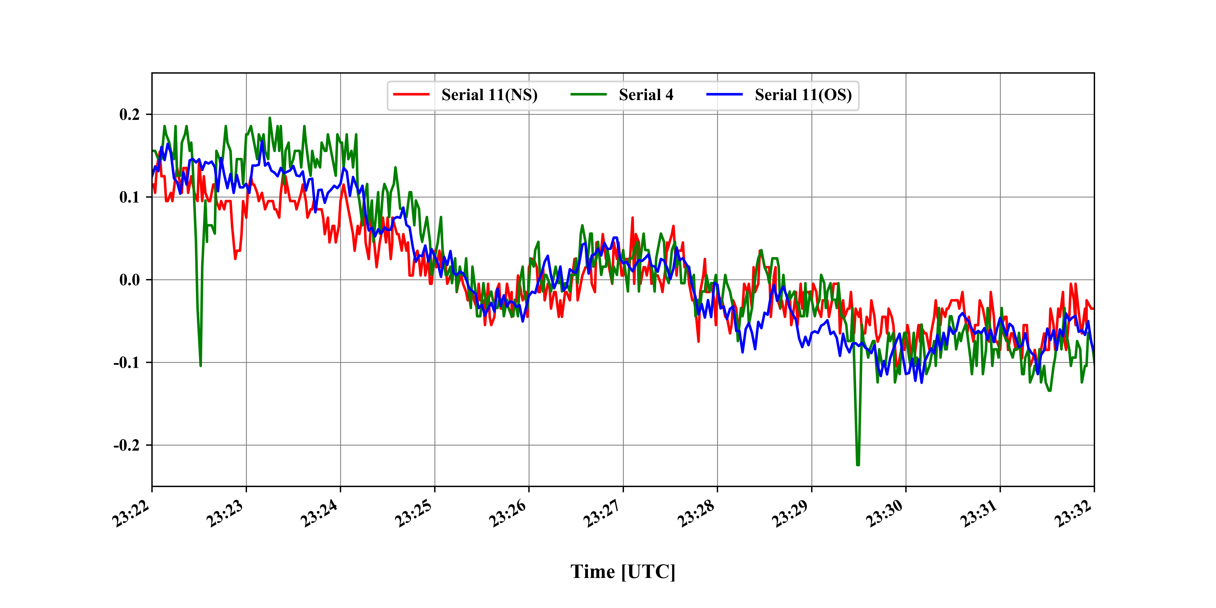
Comparison of atmospheric pressure anomalies between two sets of sensors

Slide 6
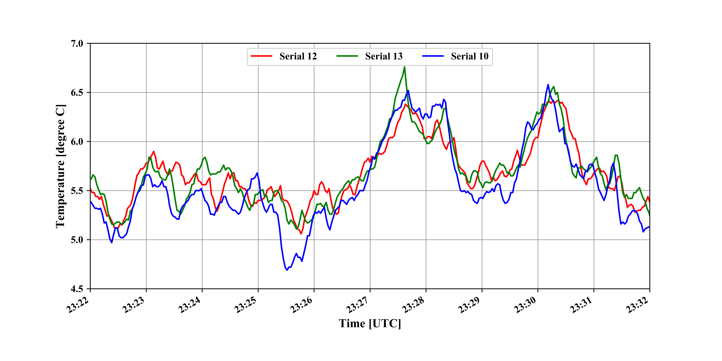
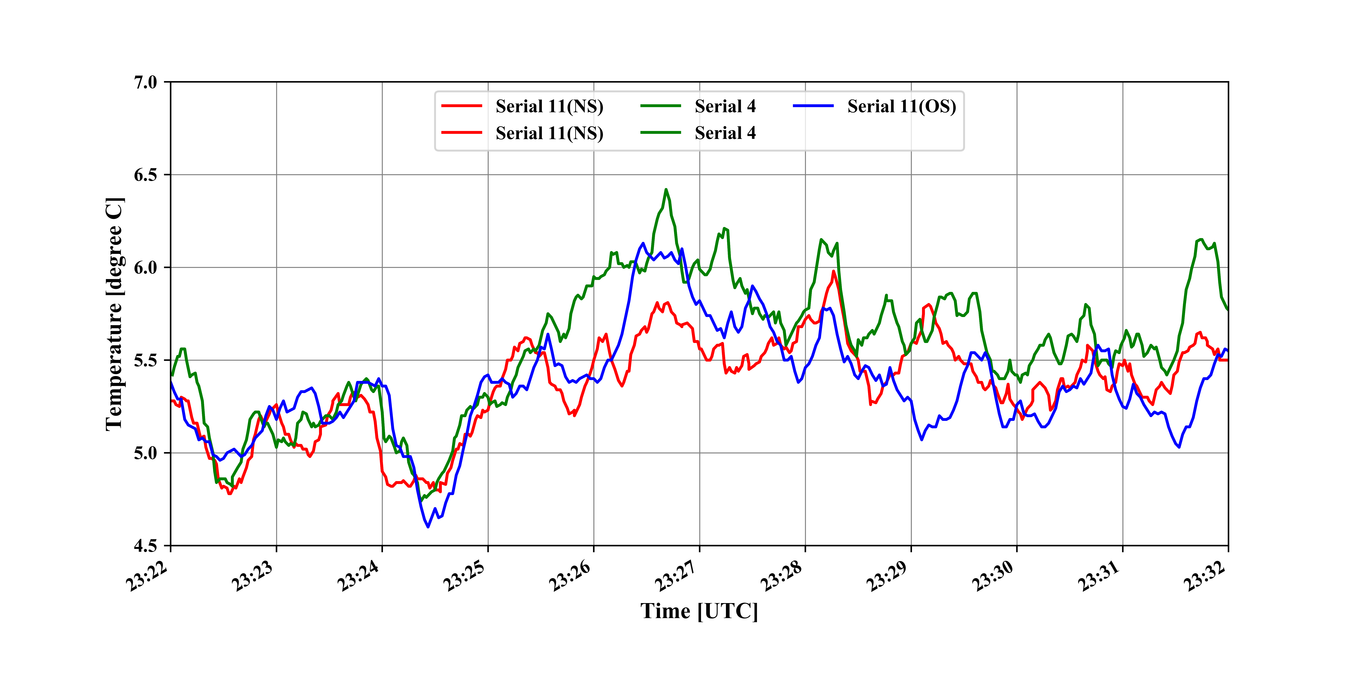
Comparison of atmospheric pressure between two sets of sensors

Slide 7
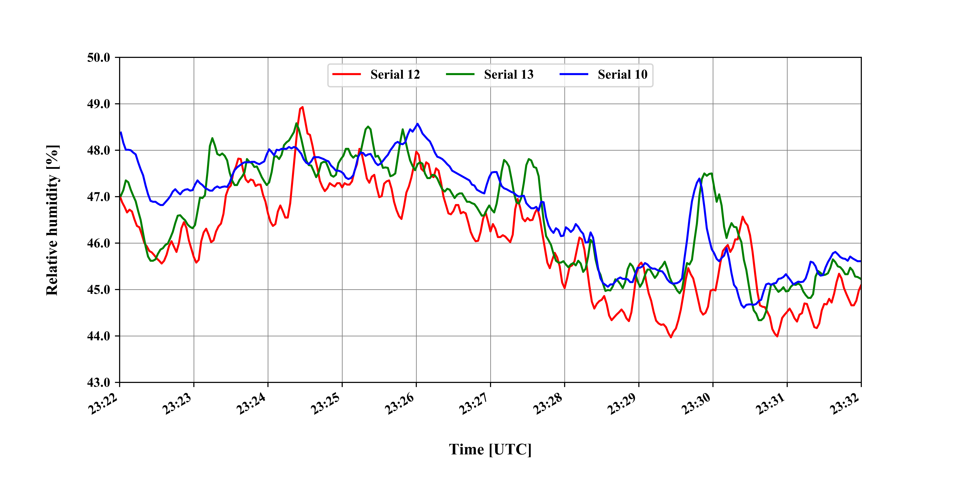
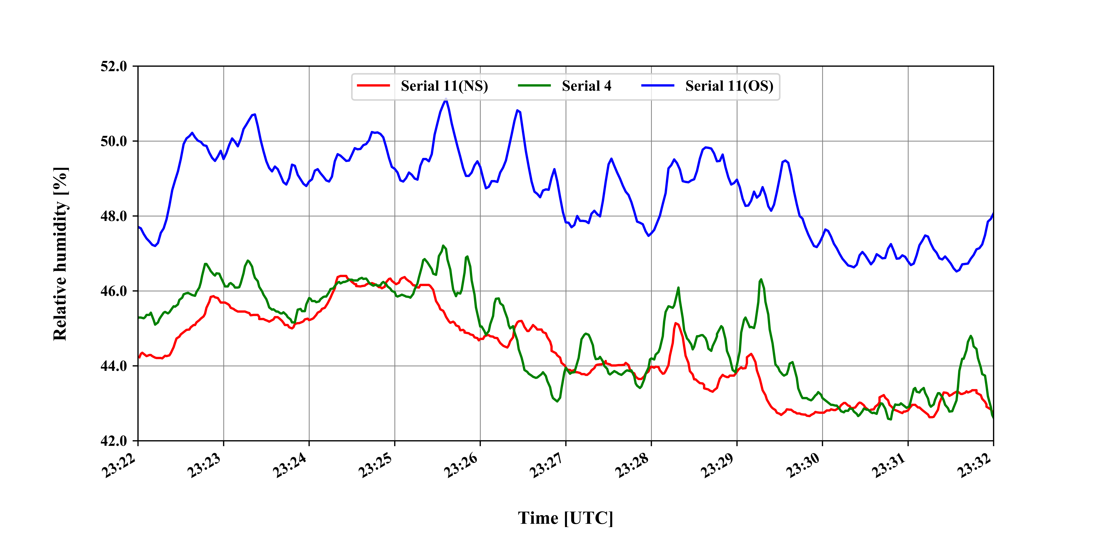
Comparison of atmospheric pressure between two sets of sensors

