Slide 1
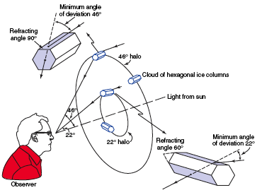

Quantify Photograph Of Glory, Corona Rings, Halo, or Rainbow
film or ccd detector
Hydrometeor scatters some color strongly at angle θ at point A
camera lens
The Observers eye or camera is at point B
A
θ
origin
θ
f
f focal length
B
y
A
For a simple lens,
$$tan⁡(θ)=\frac{y}{f}$$
B
eye lens
eye retina

Slide 2
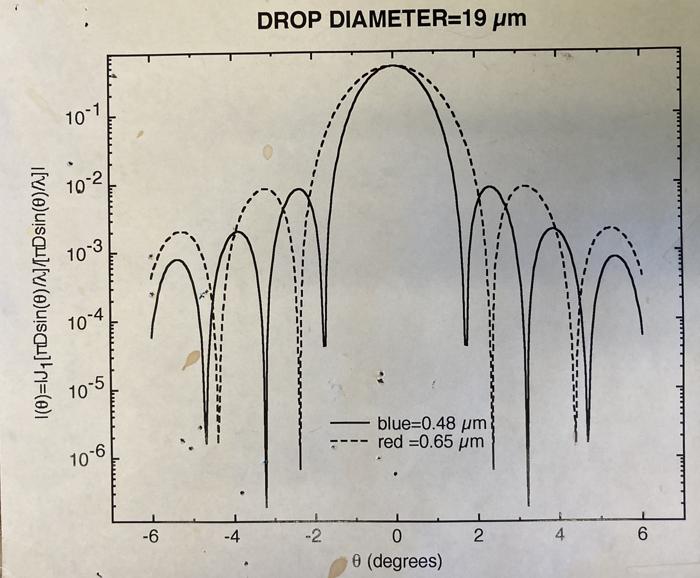
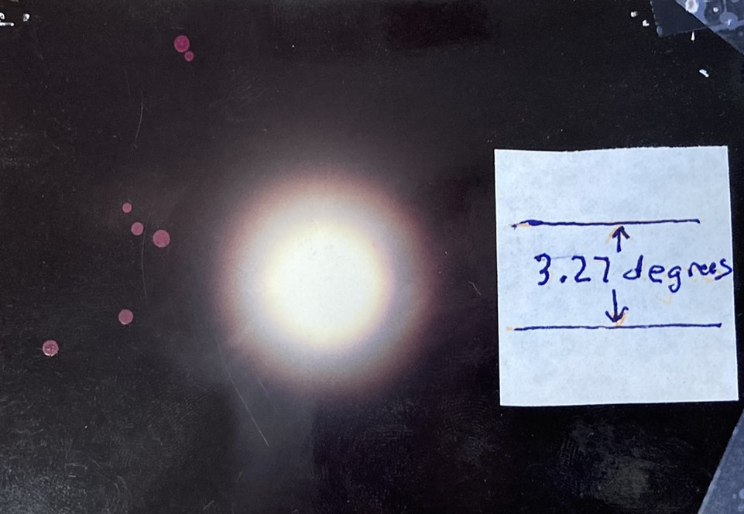
Example From a Lunar Corona Observation (film camera with known focal length f, and measured y on the negative.)

Slide 3
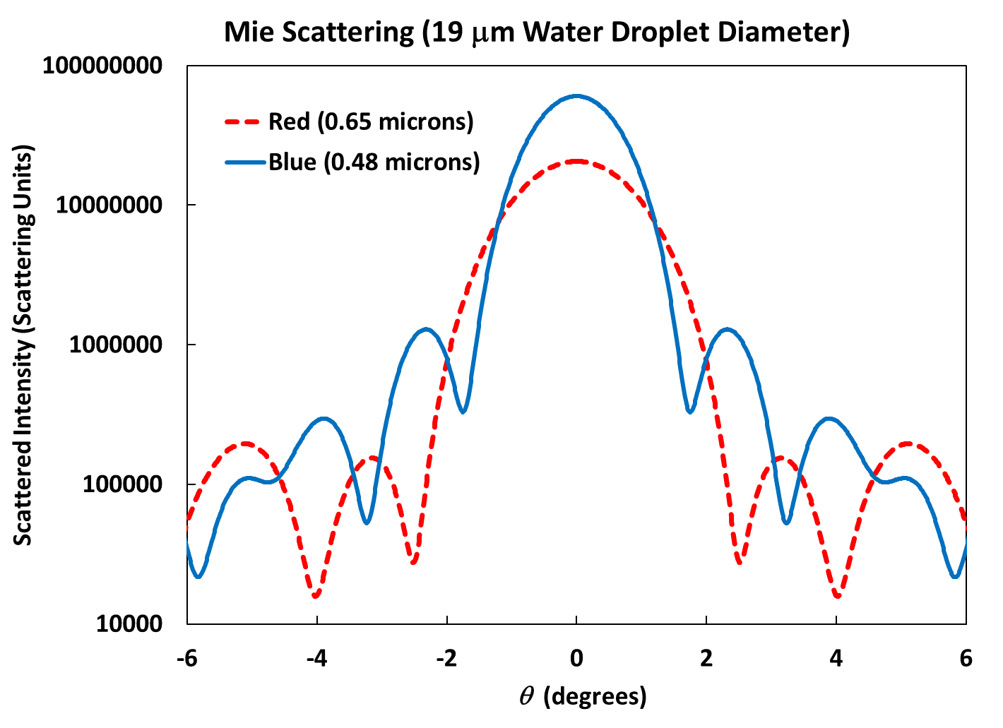
Example From a Lunar Corona Observation (film camera with known focal length f, and measured y on the negative.) Philip Laven Mie Code Calculation.

