Slide 1
Labor Day Weekend Storm CA and Northern NV
2023
September 1-3

Slide 2
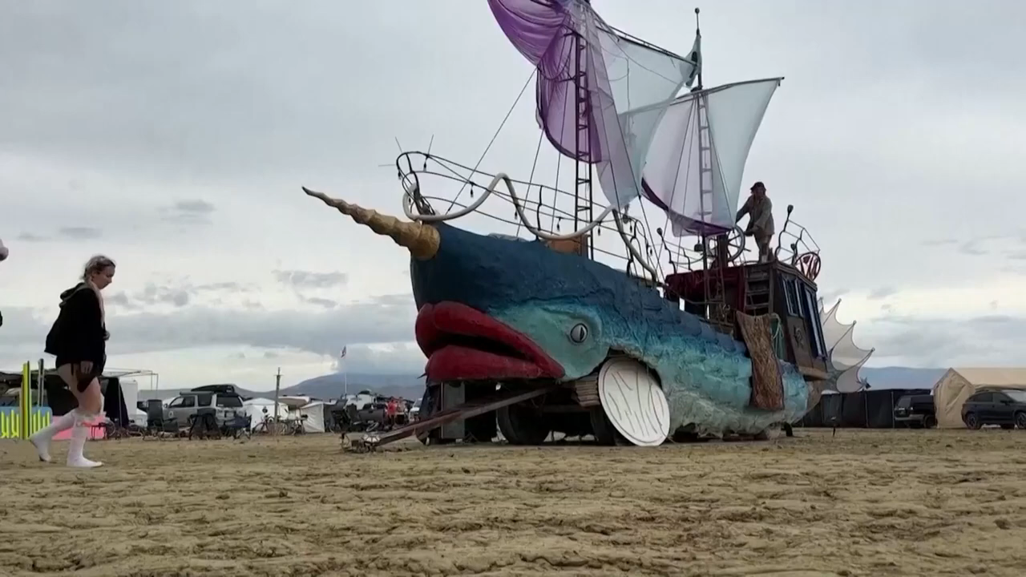
News Outlet Video

Slide 3
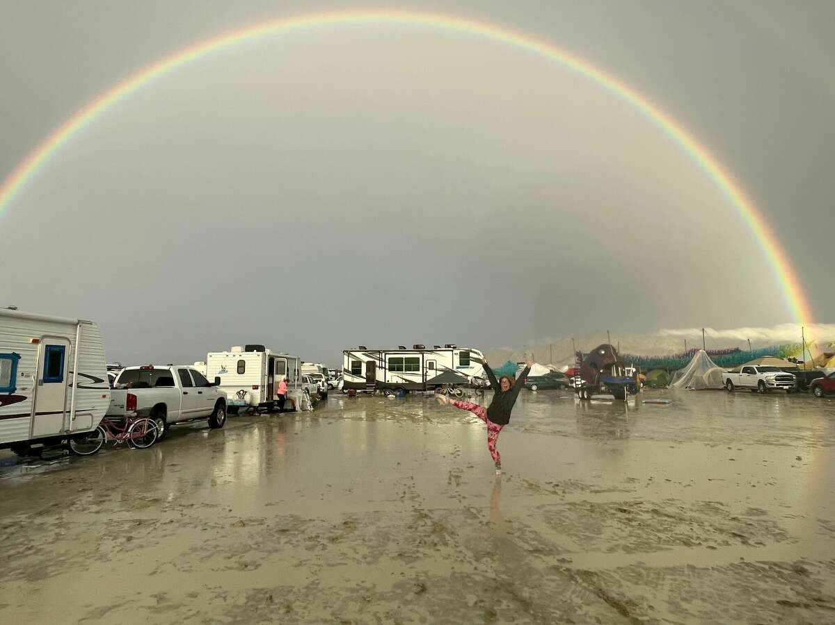
Rainbow at Burning Man 2023 from the San Francisco Chronicle

Slide 4
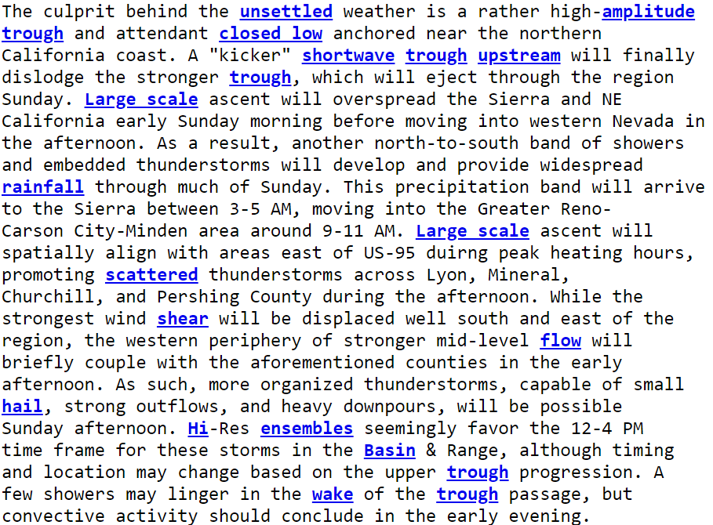

Discussion from the Reno NWS Office

Slide 5
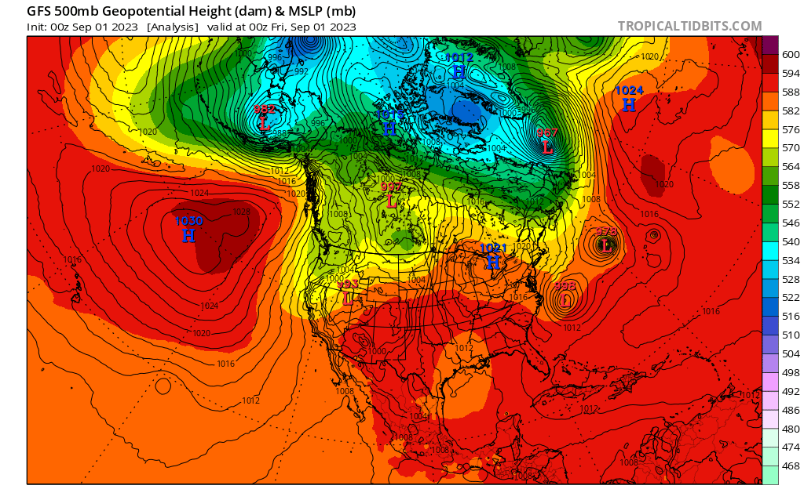
Global Forecast System Analysis. Look for the low to close.

Slide 6
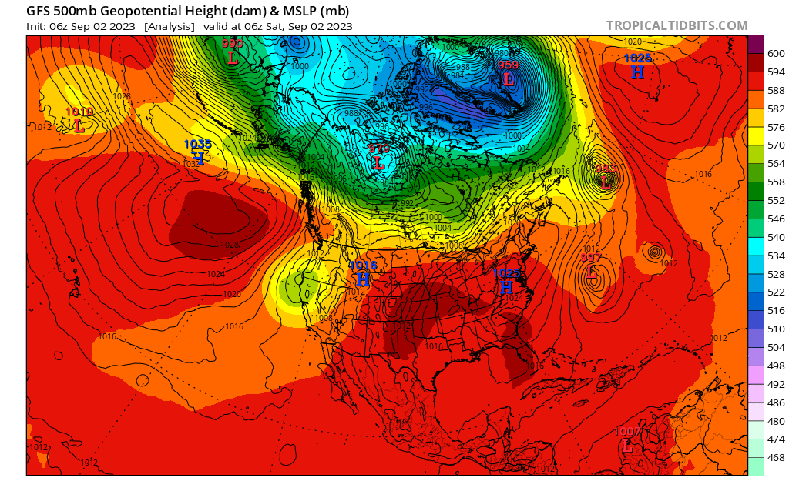
Global Forecast System Analysis

Slide 7
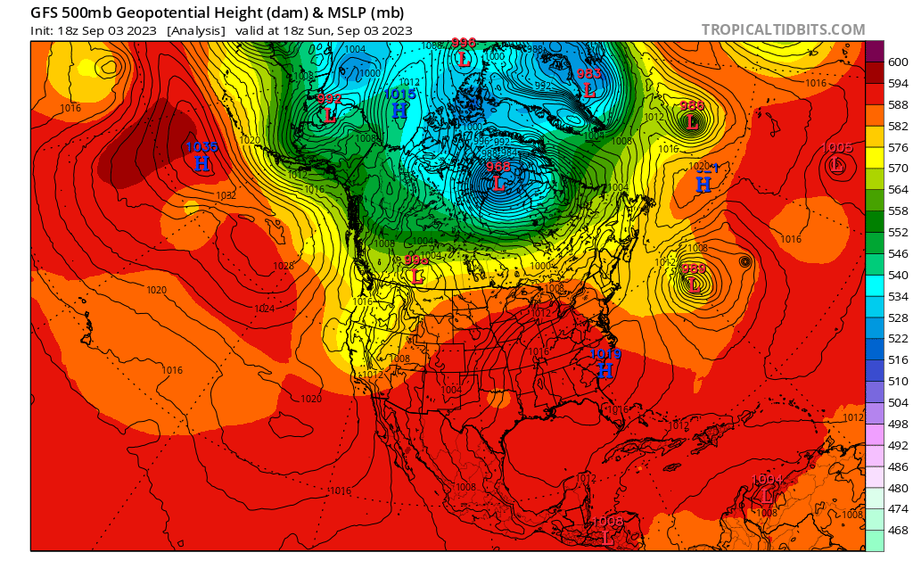
Global Forecast System Analysis

Slide 8
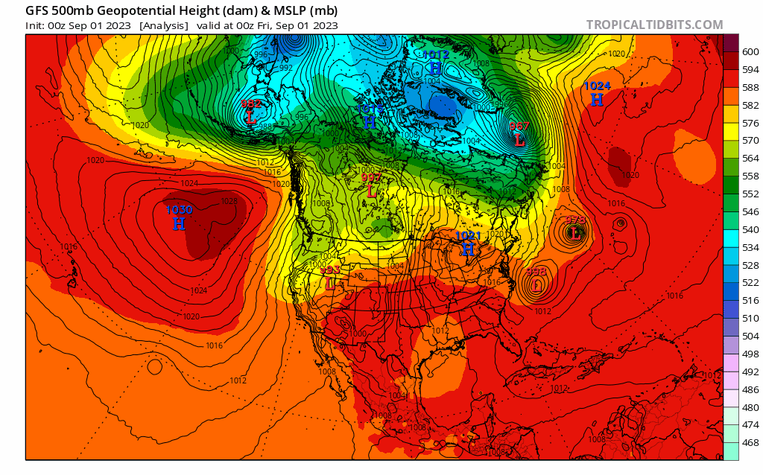
Global Forecast System Analysis. Watch the low cut off from the main flow

Slide 9
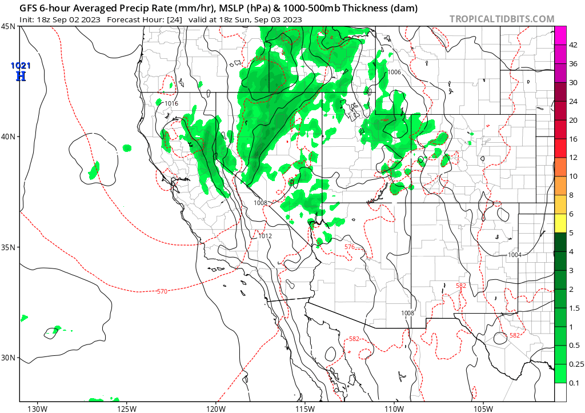
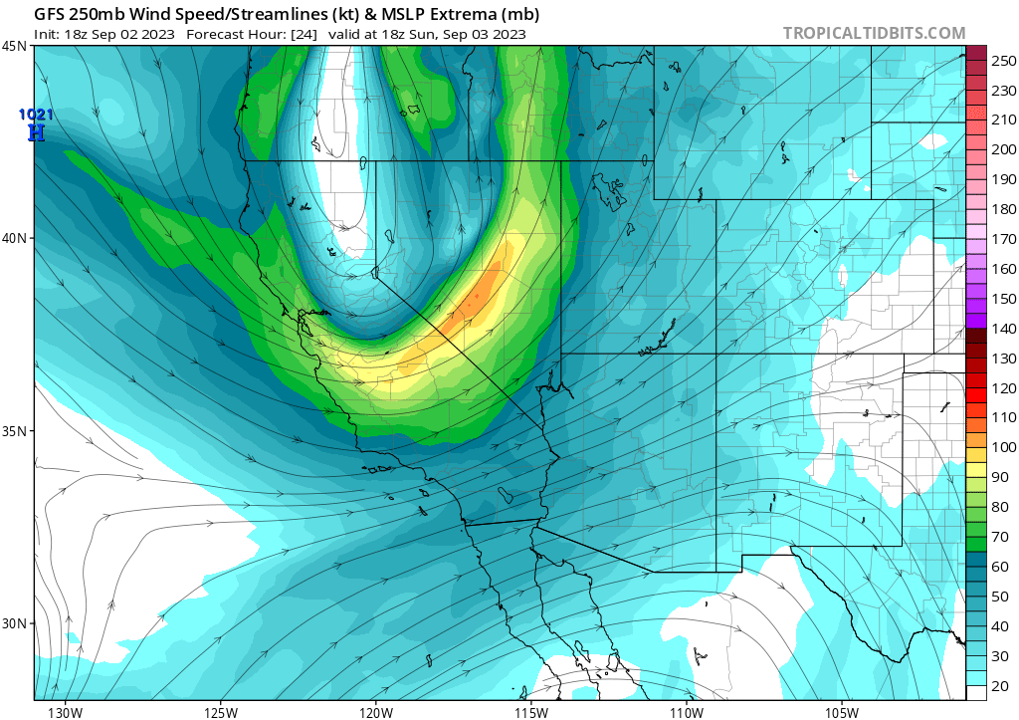
GFS ANALYSIS

Slide 10
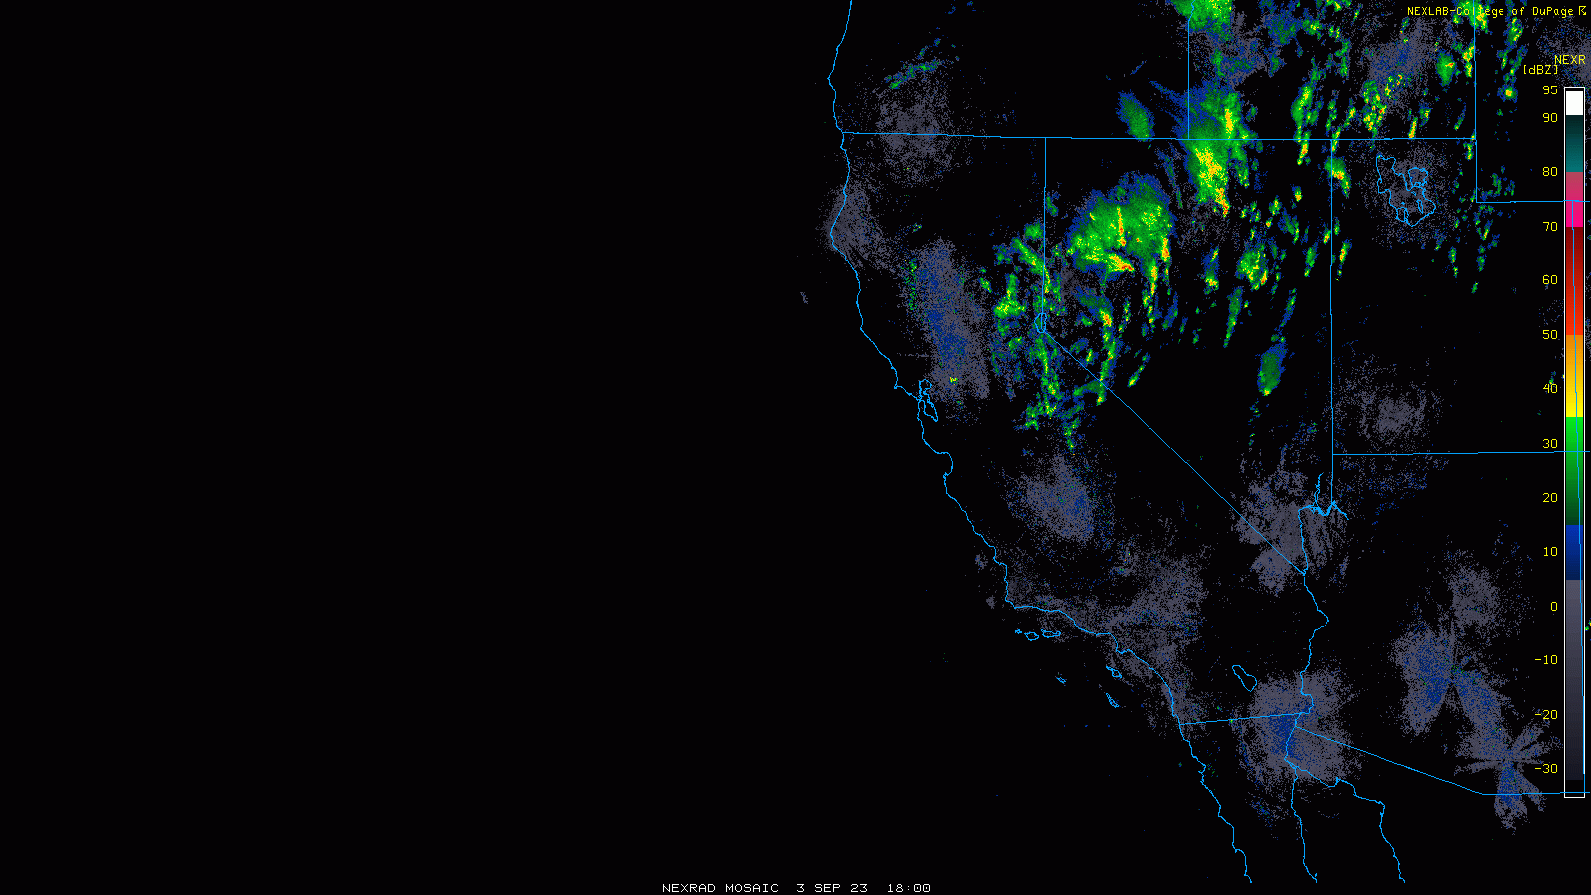
Radar Observations of Precipitation

Slide 11
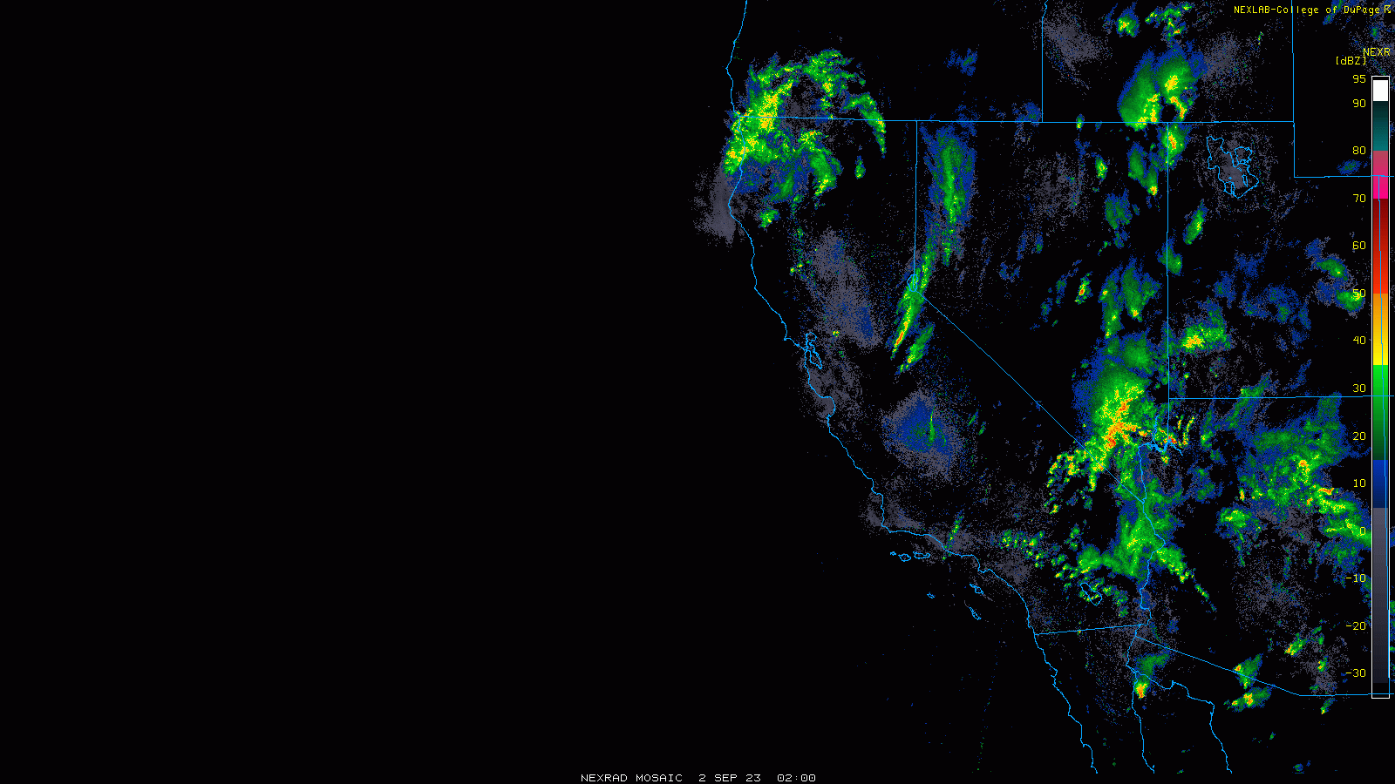
Radar Observations of Precipitation

Slide 12
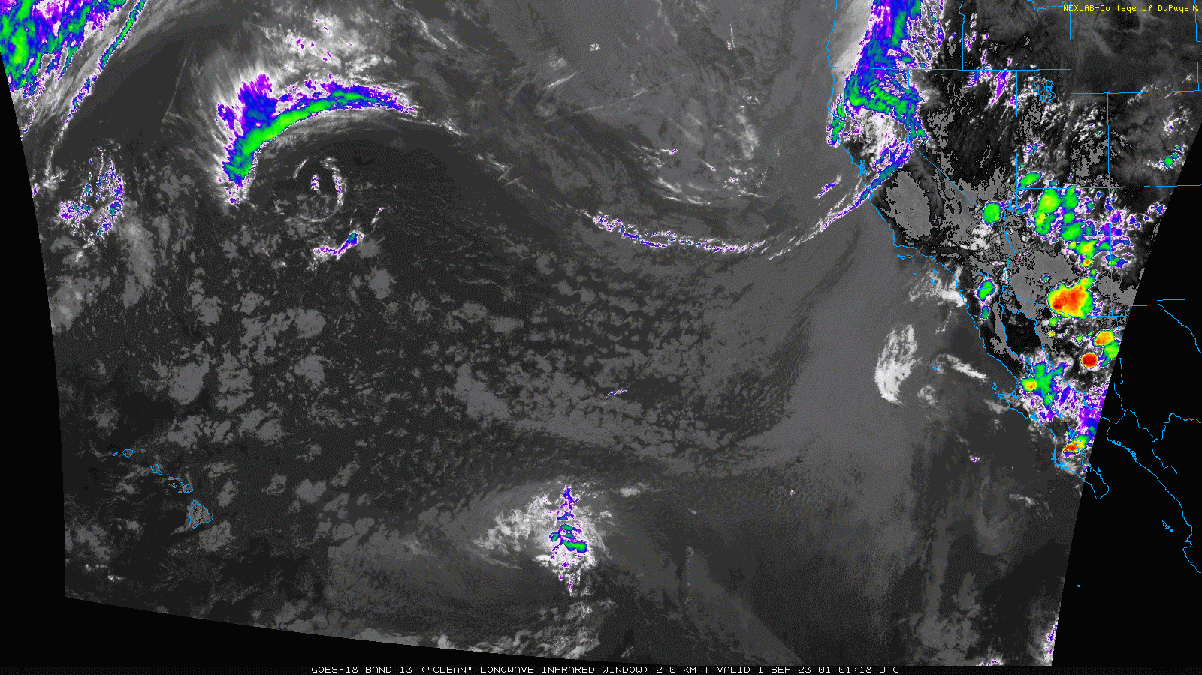
Geostationary Operatational Environmental Satellite (GOES18)

