Slide 1
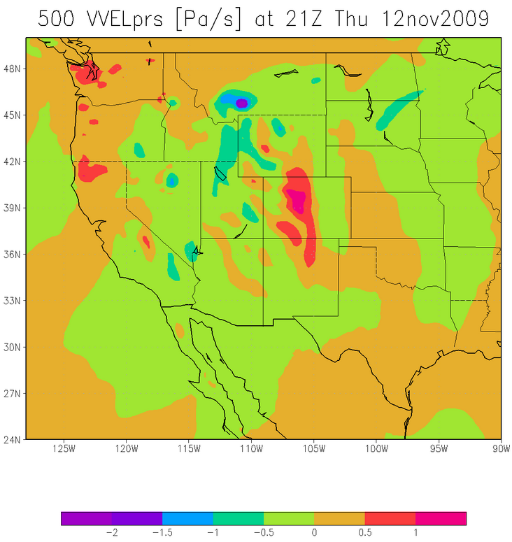
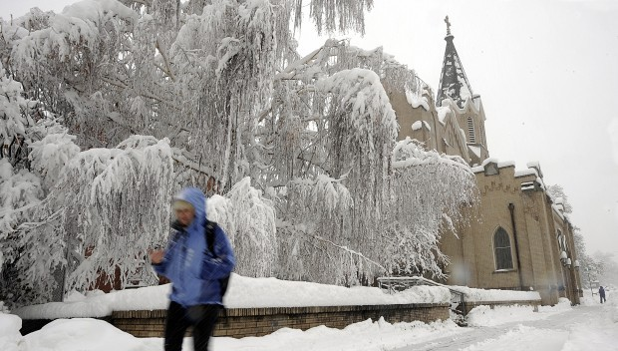



Playing CSI: A Case Study of the November 12th, 2009 Snow Event in Bozeman, Montana
Benjamin J. Hatchett
Michael Kaplan, Darko Koracin
and John Mejia
Division of Atmospheric Sciences
Desert Research Institute, Reno, NV

Slide 2
Overview
Why?
Relevance to Avalanche Forecasting
Atmospheric Dynamics 101
Conditions Preceding Event
Conditions During Event
Conceptual Model of Extreme Convective Snowfall
Take Home Techniques
Conclusions and Future Work

Slide 3
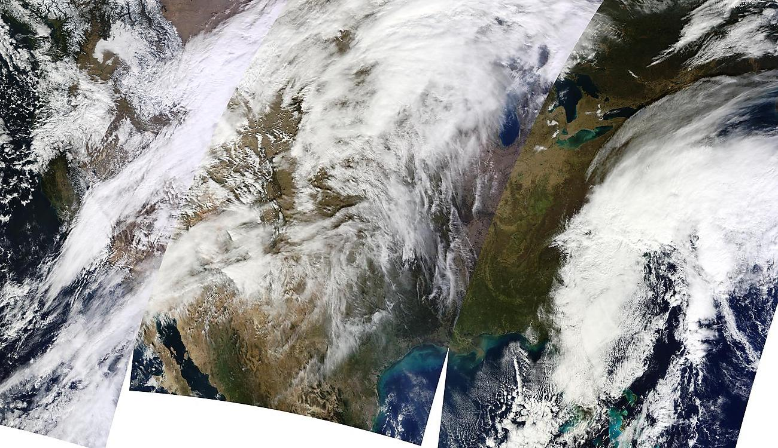
Why Play CSI?
Snowfall severely underforecasted by NWS.
10cm predicted versus 50cm actual
Events common in western NA during cold season
Avalanches and burials were reported post-event
Convective snow VERY hard to diagnose
Significant role in mountain precipitation events (e.g. Keyser and Johnson 1984, Ralph et al. 2004, Underwood et al. 2009)
Area of Explosive Convection!
MODIS Terra Image
12 November 2009. U.Wisc. CIMMS

Slide 4
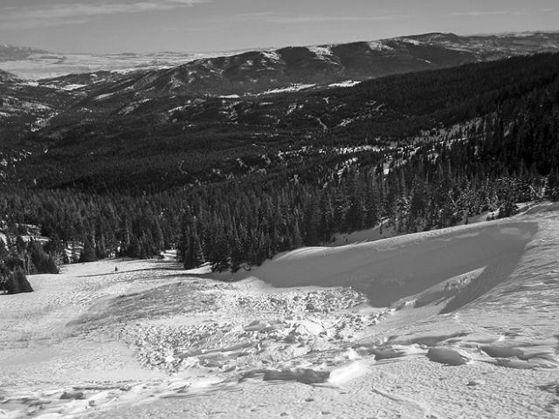
Relevance to Avalanche Forecasting
Avalanche Generation Factors:
Rapid Loading: >7.5cm/hr (typical duration 2-8hrs)
Large Total Accumulations: >20cm (Johnson and Petrescu 2005)
Spatially Variable Accumulation (Hoenisch 2008)
Independent of Terrain (Novak et al. 2004)
Cloud microphysics→Crystal growth, riming (LaChapelle 1969, Wallace and Hobbs 2006)
Avalanche Persistence Factors:
Establishment of thin snowpack due
to terrain independence→ depth hoar
Post cold frontal conditions of clear and
cold→surface hoar
Ross Pass windslab. Courtesy GNFAC

Slide 5
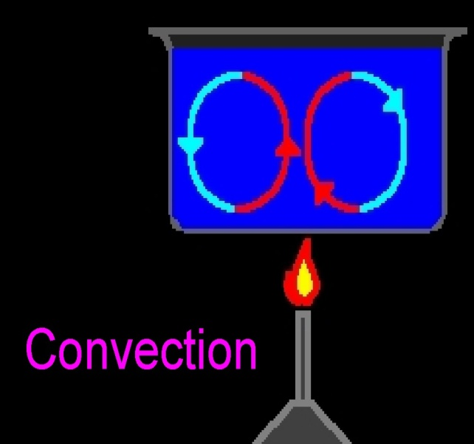
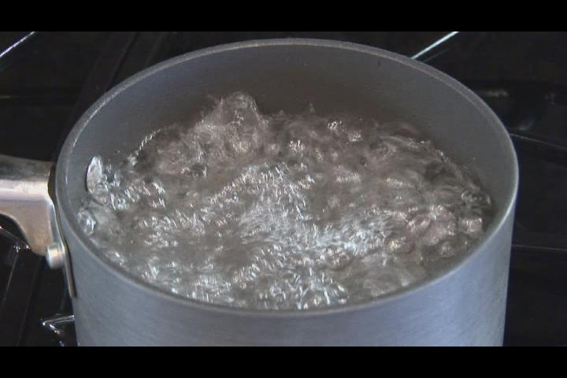
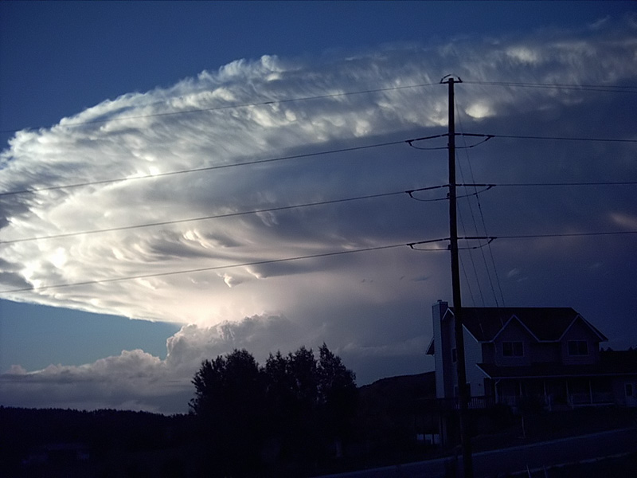
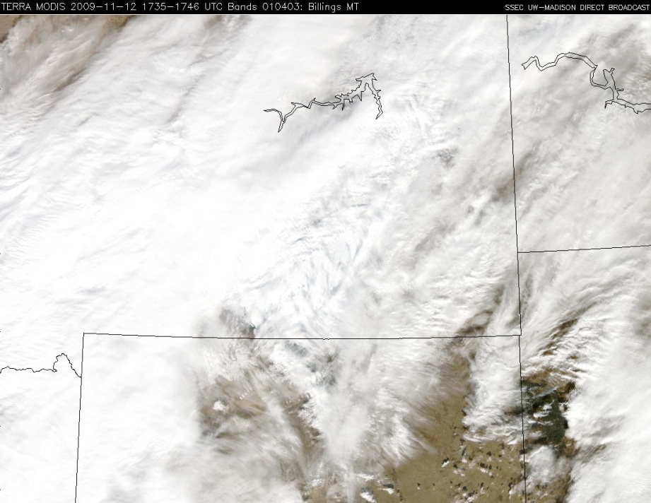
Convection
Convection is the flow of heat from warm region to cooler region
Tendency: atmospheric convection = supercells (mesoscale <200km).
Reality: convection plays important role in many synoptic scale (>200km) events.
‘Classic’ Supercell
Synoptic Scale Roll Clouds from Event (MODIS)

Slide 6
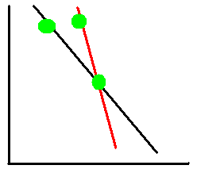
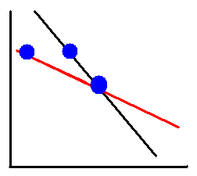
Atmospheric Dynamics Part I: Stability
Stability of air refers to where an air parcel goes if displaced (Up, unstable; Down, stable)
Convection requires unstable air!
Stability of airmass defined by lapse rate Γ=-dT/dz where T is temperature and z is height
Parcel
Stable Conditions
UNstable Conditions
A
B
→
→
A
B
O
O
Z
Z
Lift from O to height of A and B along Γd. T(A)<T(B), returns to O.
Γenv
Repeat lift along Γd. T(A)>T(B), parcel goes UP!
Γenv
Γd
Γd
T(A)
T(B)
T →
T(A)
T(B)
T →

Slide 7
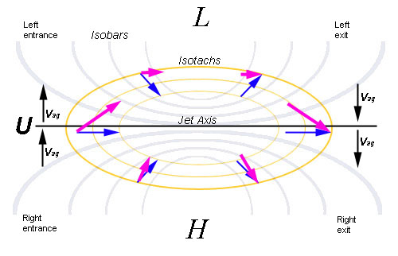
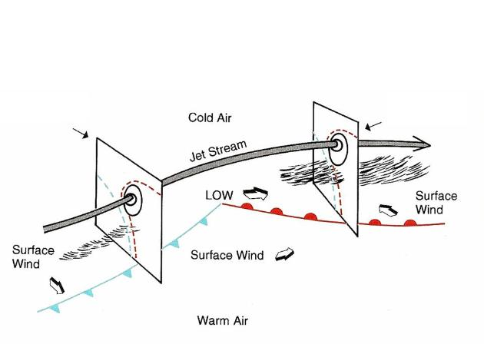
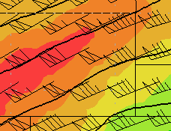
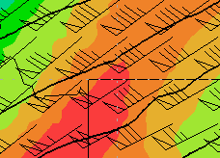
Atmospheric Dynamics Part II: Balanced and Unbalanced Jets
Balanced Jet Streak, 3D
Balanced Jet Streak, X-Y space
V_{tot}=V_{g}+V_{ag}
V_{ag}=Isallobaric + Inertial Advective
UPPER LEVEL JET
Inertial Advective
Balanced Unbalanced
Isallobaric
Balanced Streak: Energy conversions decelerate flow.
Unbalanced: Exiting parcels accelerate!

Slide 8
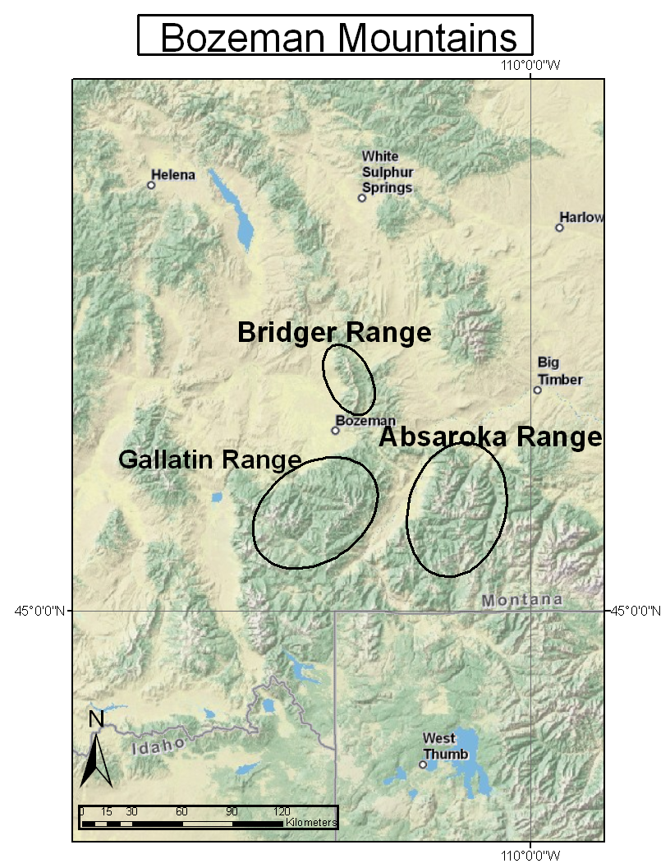
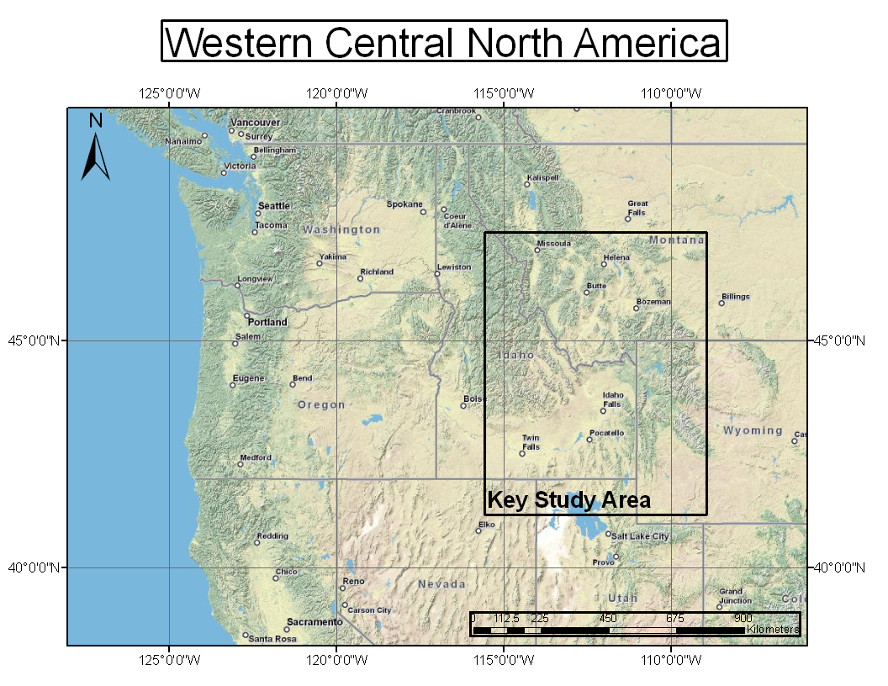
Study Area: Bozeman, Montana
Valley Elevation +/- 1500m
Mountain Elevations +/- 3000m
Complex Terrain!

Slide 9
Analysis Dataset
North American Regional Reanalysis (Mesinger et al. 2006)
NOAA National Operational Model Archive and Distribution System (NOMADS).
36km grid, 27 pressure levels
Period: 00Z 12 November to 12Z 13 November 2009 3hr intervals.
All relevant dynamic and thermodynamic fields
850mb to 150mb

Slide 10
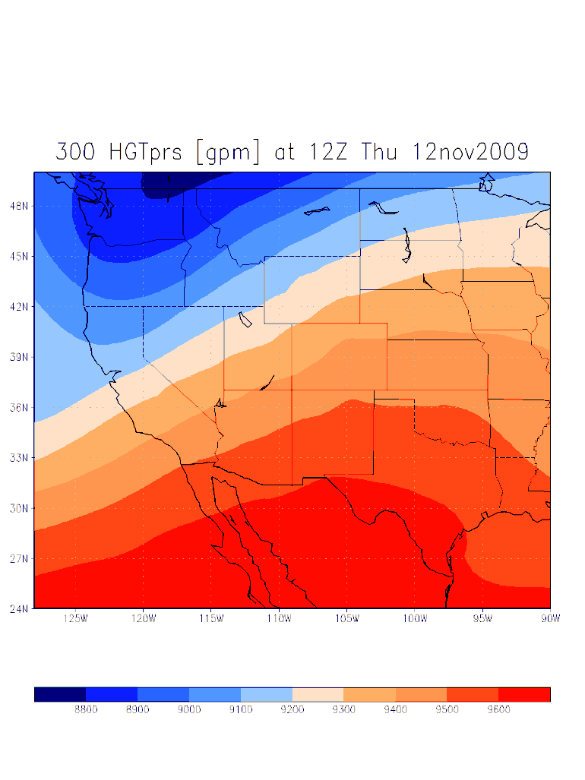
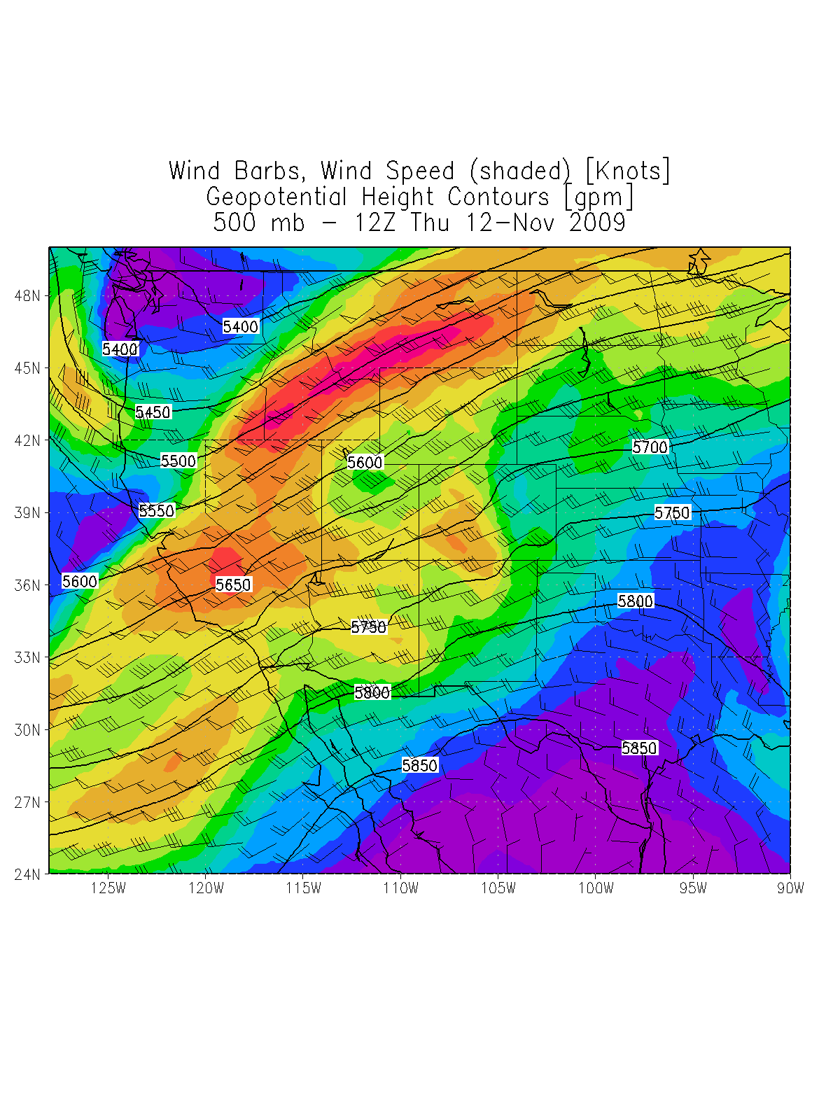
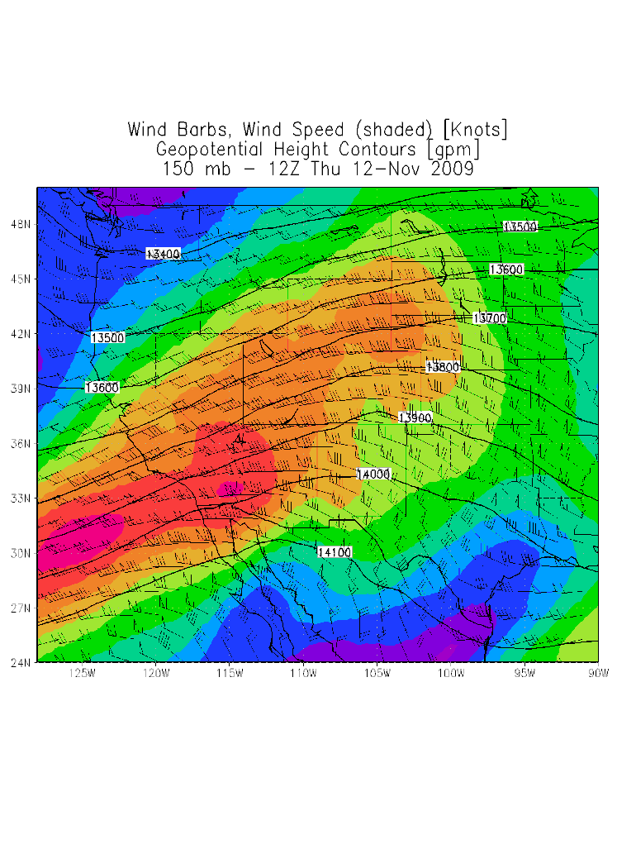
Conditions Preceeding Event: 12Z 12 November 2009
Cold, positively tilted trough in PacNW
Right Exit Region (sinking) of 35m/s Polar Jet (PJ)
Roaring 60m/s Subtropical Jet (STJ) approaches
300mb Heights 500mb Winds/Heights 150mb Winds/Heights

Slide 11
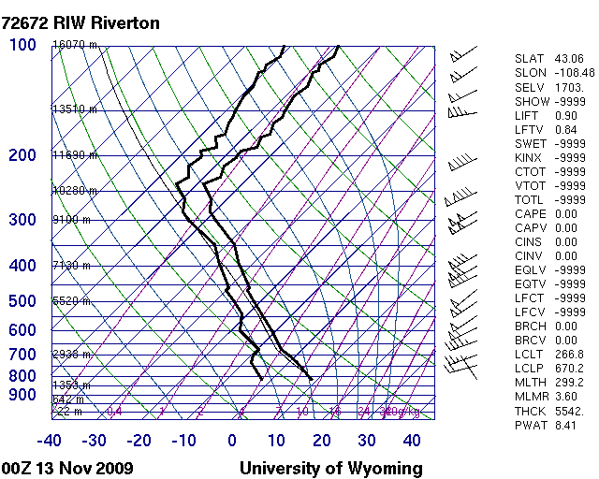
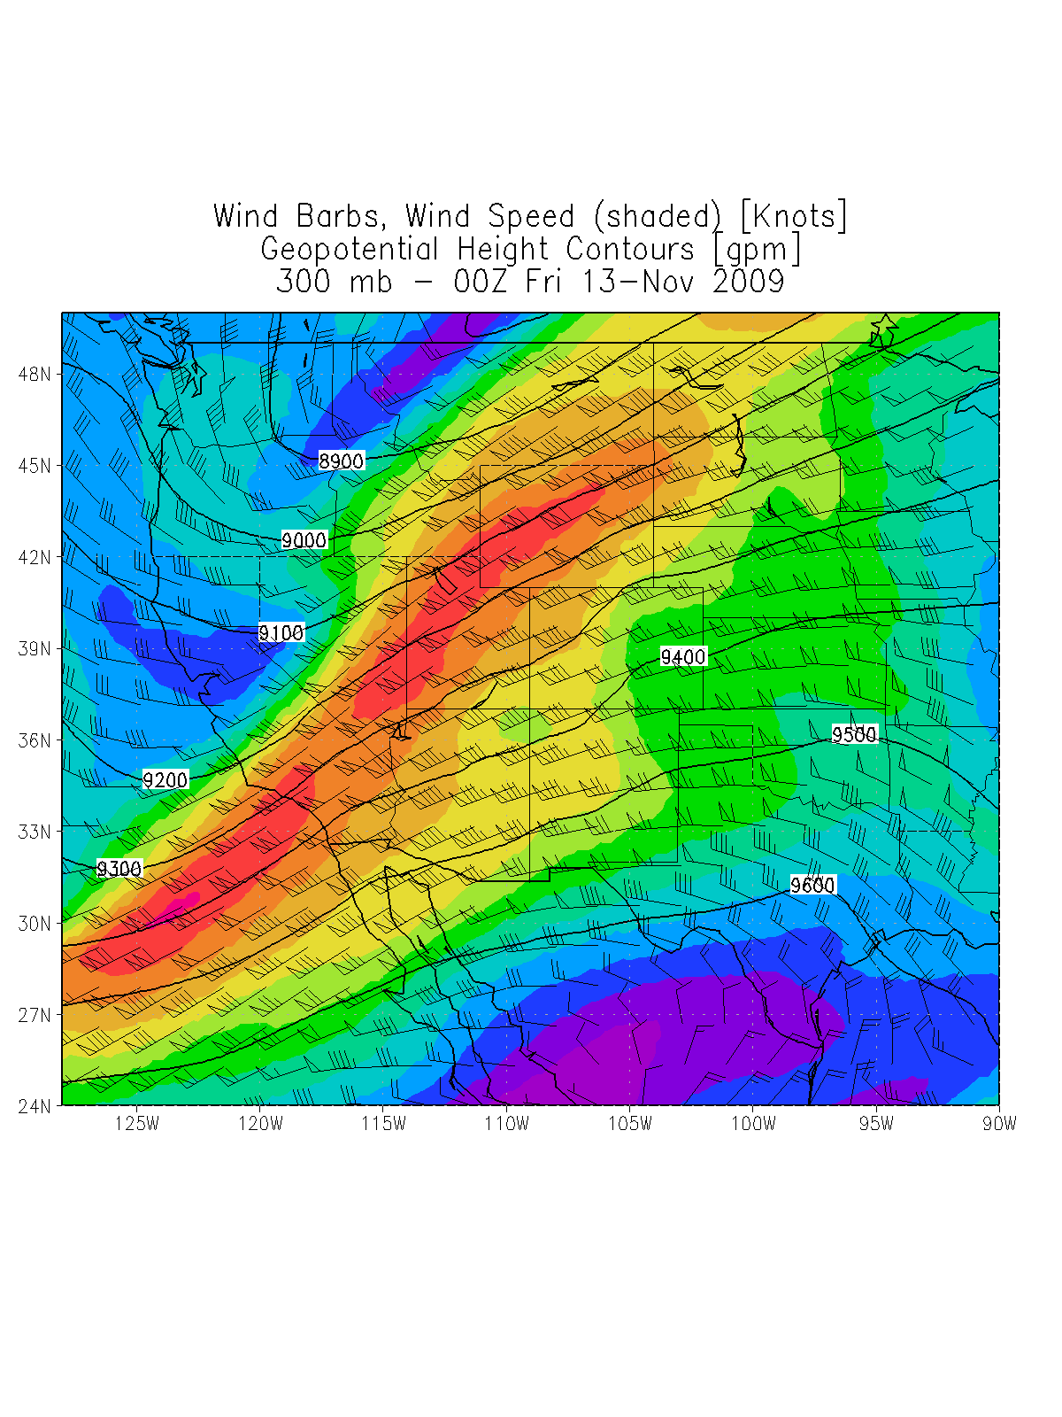
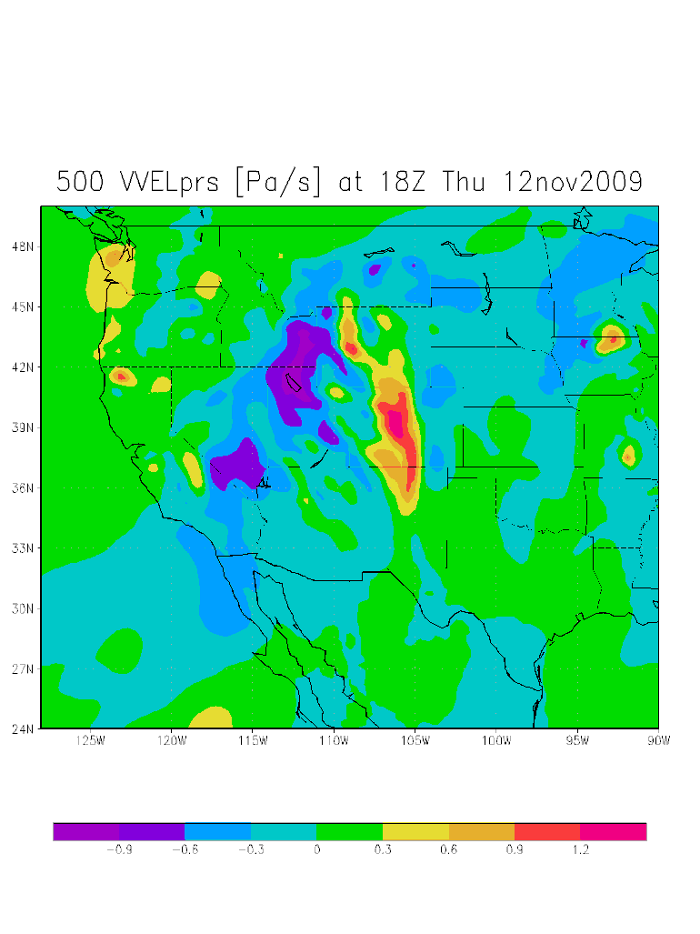
The Event: 18Z 12 November 2009
Moist, unstable layer (red)
Thermal Wind Imbalance, weak backing despite cold air advection (blue)
Strong momentum from PJ/STJ coupling (green)
SW Montana in Left Exit Region of coupled, unbalanced jet
Upward Vertical Motion in presence of cold air!

Slide 12
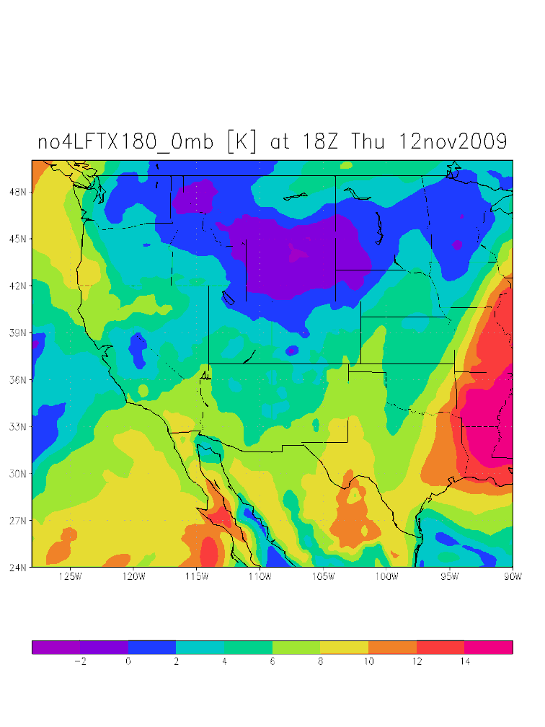
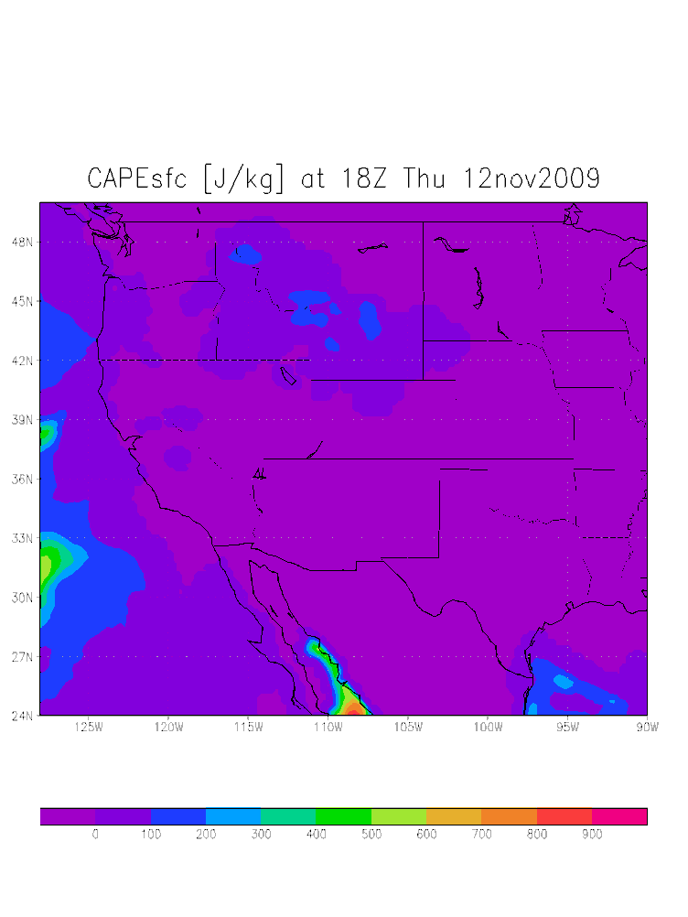
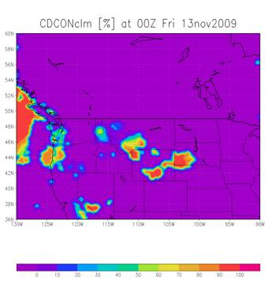
Convective Indicators During Event
Negative Lifted Index →
Unstable air
Large % Convective Clouds
Convective Available Potential Energy (CAPE) present

Slide 13
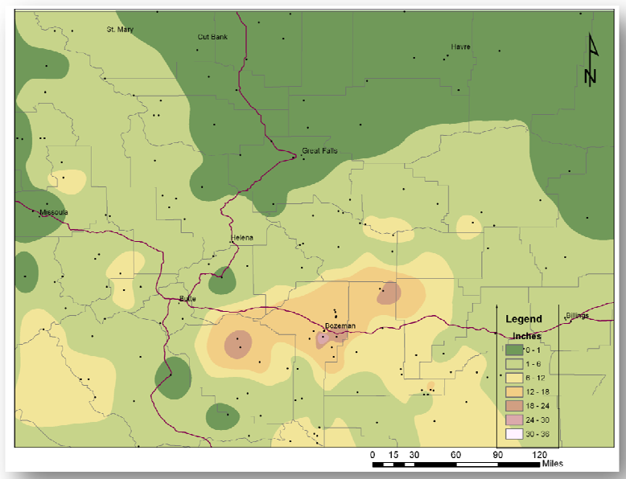
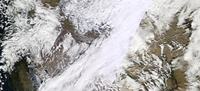
Spatial Variability of Snowfall
Scales of accumulation
Banded nature of storm
Patchy nature of accumulation along band
Role of Terrain << Synoptic Dynamics
Event provided 1/3 total snowfall to date
Persistent valley inversion set up after event. Depth hoar observed in following weeks.
Image courtesy of NWS Billings

Slide 14
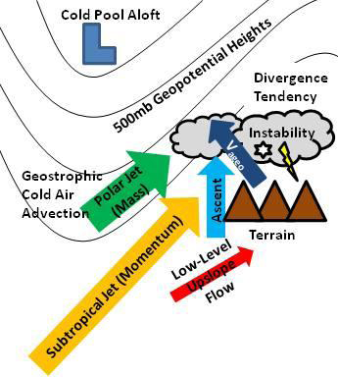
Extreme Convective Snowfall: A Recipe
Primary Ingredients:
Instability: Cold, unstable air brought in by Polar Jet
Lift: Momentum-rich Subtropical Jet (STJ), Left Exit Region
Secondary Ingredients:
Upslope Flow: Terrain
Convective Heating
Moisture: 70-90% RH
Preparation: Overlay STJ with PJ. Advect cold air to divergent region. Force cold air to rise. Release instability with violent convective precipitation!

Slide 15
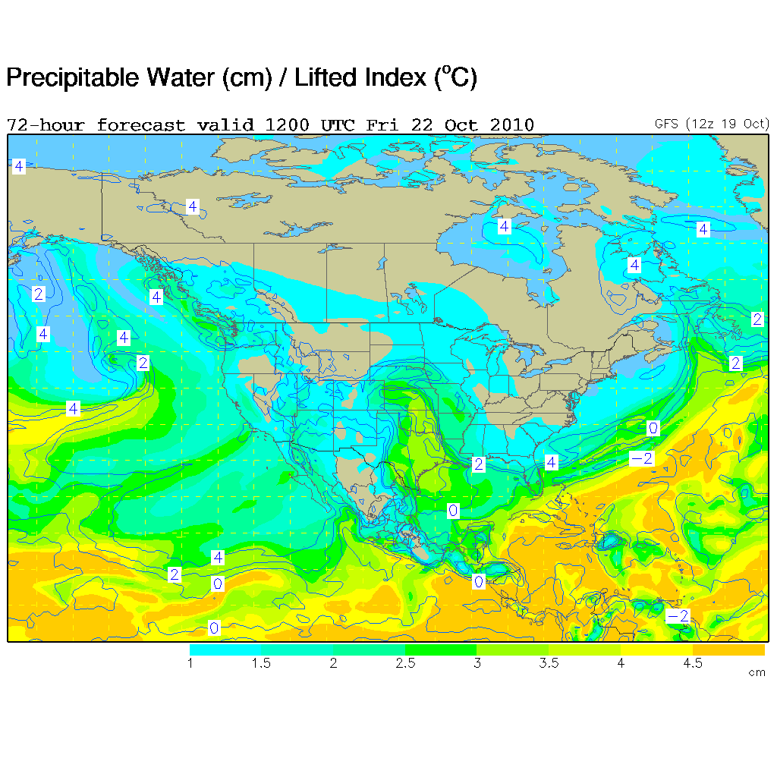
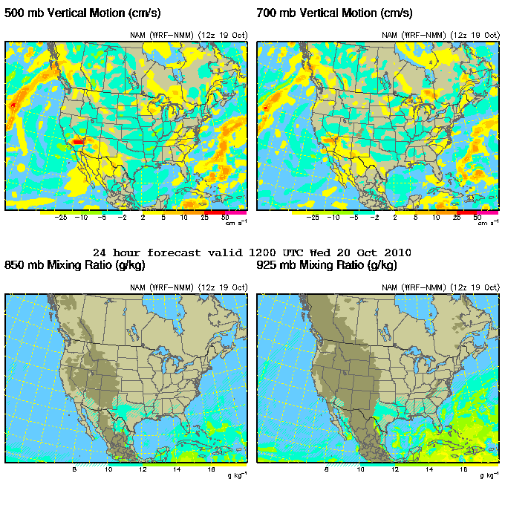
Take Home Messages and Techniques For the Avalanche Community
Satellite imagery→Banding
Jet interactions
Never underestimate Subtropical Jet (look at 175-250mb)!
Soundings can provide insights (Advection, Instability, Momentum)
Re: Spatial Variability
Persistent weak layer establishment
Distribution of accumulation
Utilize forecast fields: Lifted Index, CAPE, PW
http://www.rap.ucar.edu/weather/
Satellite, Upper Air, Forecasts, Surface Data

Slide 16
Conclusions and Future Work
Forecasting events a challenge!
Phasing of synoptic features (STJ, GPJ, CP) crucial!
Unbalanced and unstable ascent
Insights into mountain precipitation regimes
High resolution mesoscale modeling
4 domains: 54km, 18km, 6km, 2km
Weather Research and Forecasting Model (WRF) V3.2.
Derive radar, unbalanced flow parameters, verify jet interactions
Case studies of avalanche events postceding convective snowfall events

Slide 17
References and Acknowledgements
Support comes from National Science Foundation Cooperative Agreement EPS-0814372.
References:
Hoenisch (2008) NWS Tech. Attach. 0808
Johnson and Petrescu (2005) West. Reg. Tech. Att. No.5-14
Keyser and Johnson (1984) Mon. Wea. Rev., 112, 1709-1724
LaChapelle (1969) Field Guide to Snow Crystals, 101pp.
Mesinger et al. (2006) Bull. Am. Met. Soc. 87, 343-360.
Novak et al. (2004) Wea. Forecast. 19, 993-1010
Ralph et al. (2004): Mon. Wea. Rev. 132, 1721-1745
Underwood et al. (2009): J. Hydromet. 10, 1309-1326
Wallace and Hobbs (2006) Atmospheric Science, 483pp.

